Slide 1
Add slide title here
Spotted Lanternfly
(Lycorma delicatula)

Slide 2
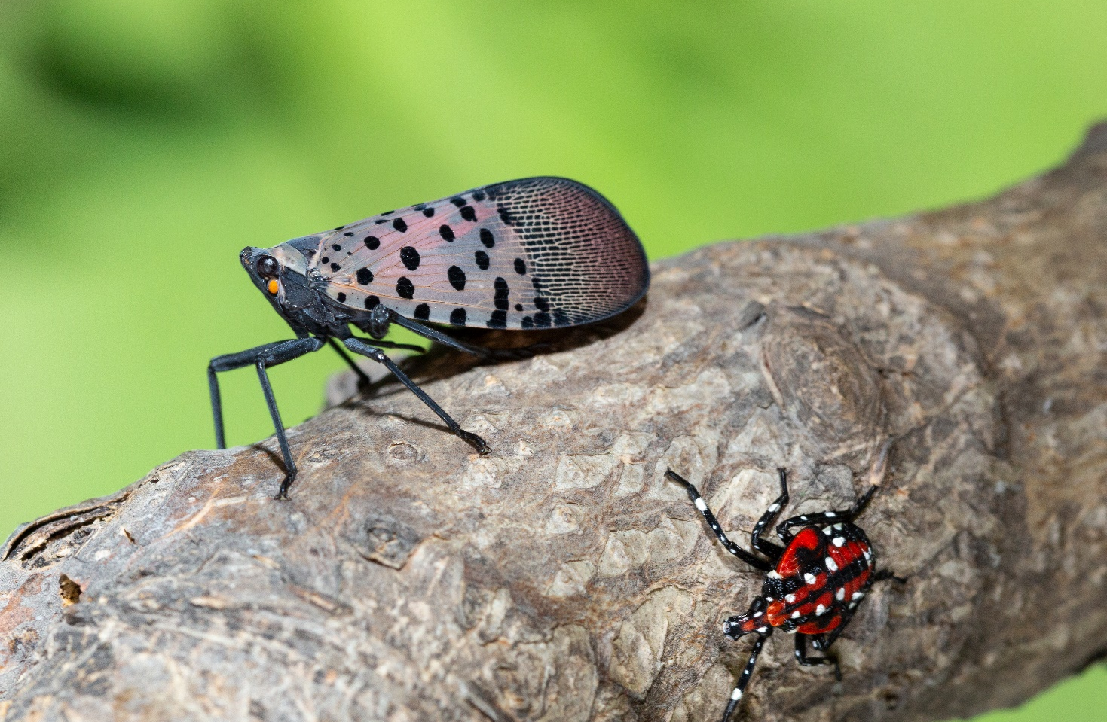
Spotted Lanternfly
Native to China, India, and Vietnam
Order Hemiptera: true bug, not a moth
First U.S. detection was in Pennsylvania in 2014
  Berks County
Invasive species
Pest of hardwood and fruit trees (Sap feeder)
Spotted Lanternfly – adult and 4th instar nymph
Photo: U.S. Department of Agriculture, Stephen Ausmus, Flickr.com, Flickr 20180720-ARS-SRA-d4020-09
Notes:
The spotted lanternfly is a planthopper that is native to China, India, and Vietnam. It was first detected in Berks County, PA, in 2014.
This species is an economic pest to hardwood and fruit trees. Florida growers are concerned about the potential for this pest to become established here in the state because it is showen to be detrimental impact upon plant growth and fruit production

Slide 3
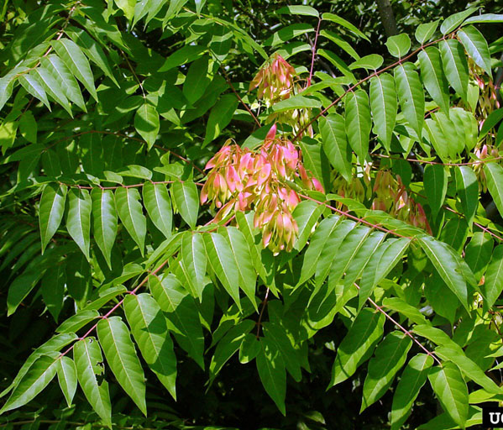
Host Plants
Common Hosts:
  More than 70 host plant species
    Tree of heaven (Ailanthus altissima) – invasive tree
      Adult spotted lanternfly accumulates cytotoxins from the tree of heaven. It is used as chemical defense against predators.
      Can grow 70-100 feet tall
Tree of heaven (Ailanthus altissima)
Photo: University of Georgia, Chuck Bargeron, Bugwood.org #1150026
Notes:
Tree of heaven is the preferred host. The insect attains cytotoxins as they feed on the tree of heaven to use as a chemical defense. This chemical defense is indicated to predators by the bright hindwings. SLF will feed on over 70 other host plants to get energy as they move to find their preferred food source. It has been reported that they have fed on soybean, corn, basil, cucumber, rose, and many others. The nymphs have a wider host range than the adults. The beaks on SLF are stronger in the 4th instar and adult stages which allows them to penetrate thicker and older plant tissue. The strong preference developed during the 4th instar to adult stages.
While SLF does not directly feed on the fruit the honeydew produces allows for sooty mold to grow on the skin of the fruit and it is not sellable.

Slide 4
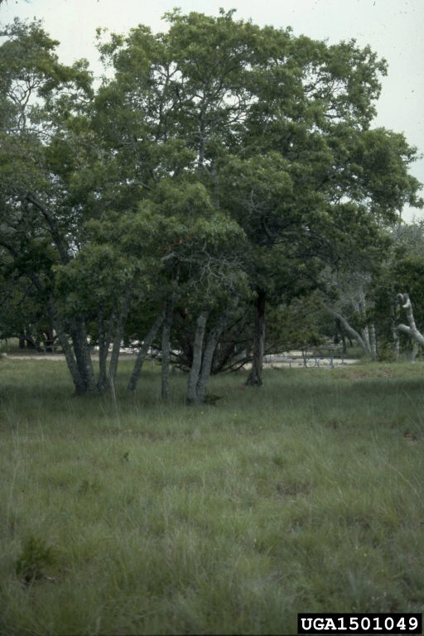
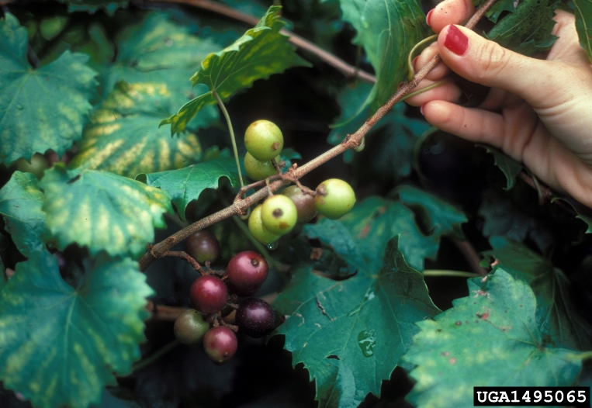
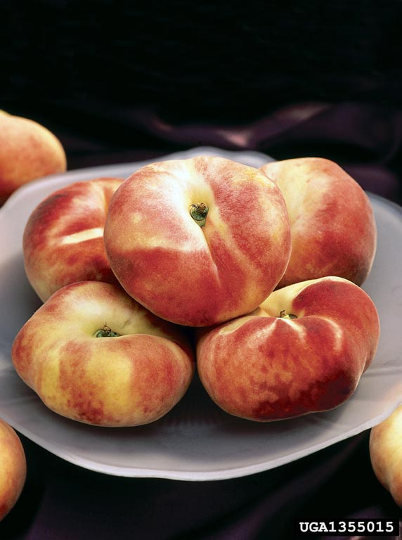
Host Plants: Florida
Florida hosts can include:
  Ornamentals:
    maple, oak, pine, poplar, and sycamore trees
  Agricultural:
    blueberries, grapes, peaches (and other stone fruits)
Grapes, Genus Vitis
Peach, Prunus persica
Live Oak, Quercus virginiana
Photo:University of Georgia Plant Pathology , University of Georgia, Bugwood.org, #1495065; Peggy Greb, USDA Agricultural Research Service, Bugwood.org, #UGA1355015; Paul A. Mistretta, USDA Forest Service, Bugwood.org, #UGA1501049
Notes:
The host plants that are present within Florida under ornamentals are maple, oak, pine, polar, and sycamore trees
Agricultural crop that could be affected by feeding of the spotted lanternfly are blueberries, grapes, peaches (and other stone fruits).
On grapes up to 400 spotted lanternfly adults can be found feeding per grape vine (New York State Integrated Pest Management, no date). The sooty mold feeding on the grapes and other fruit will make them unmarketable.
References
New York State Integrated Pest Management. No date. Spotted Lanternfly Damage. Cornell College of Agriculture and Life Sciences. https://cals.cornell.edu/new-york-state-integrated-pest-management/outreach-education/whats-bugging-you/spotted-lanternfly/spotted-lanternfly-damage.

Slide 5
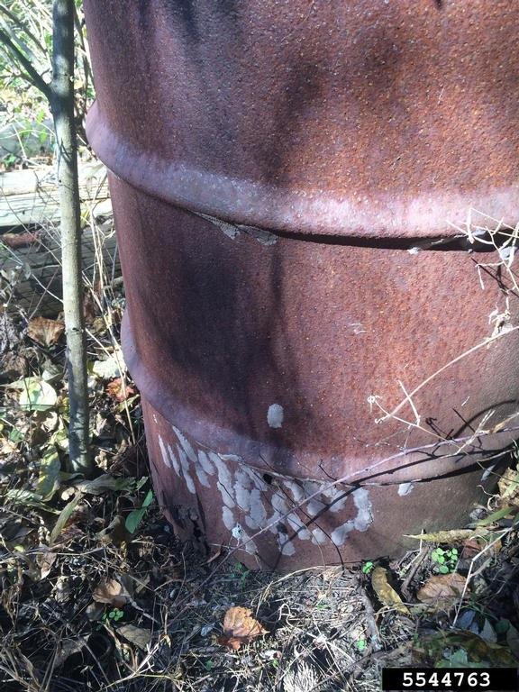
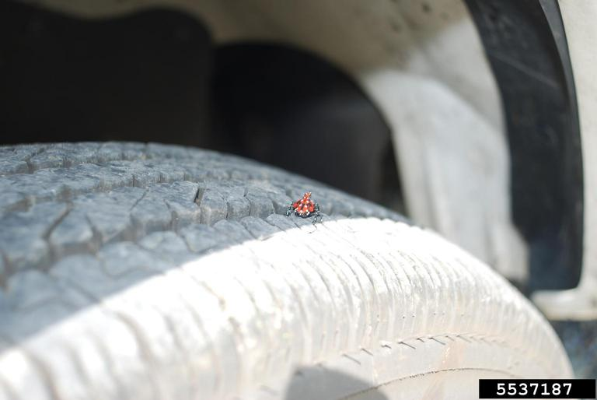
Dispersal
Spotted Lanternfly can be accidentally spread through many routes: eggs, nymphs, and adults
  Vehicles, backs of trucks, outdoor surfaces, metal bins, kiddie pools, homes (mobile homes), building materials, tars, gardening tools, tractors, sandboxes
  Human transporting and activity can unknowingly spread these insects; wind can transport nymphs
  When traveling to other states, be sure to check equipment of hitchhiking insects like the spotted lanternfly
Rusted barrel with spotted lanternfly egg masses
Spotted lanternfly 4th instar nymph on tire - Pennsylvania
Photo: Lawrence Barringer, Pennsylvania Department of Agriculture, Bugwood.org, #5537187; Lawrence Barringer, Pennsylvania Department of Agriculture, Bugwood.org, #5544763

Slide 6
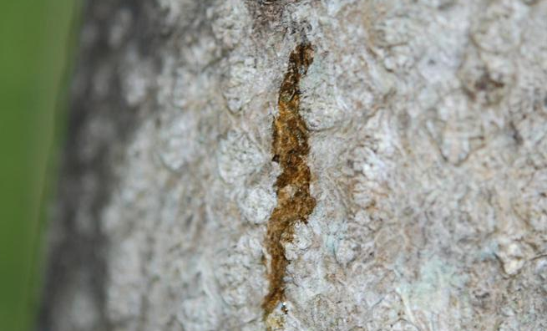
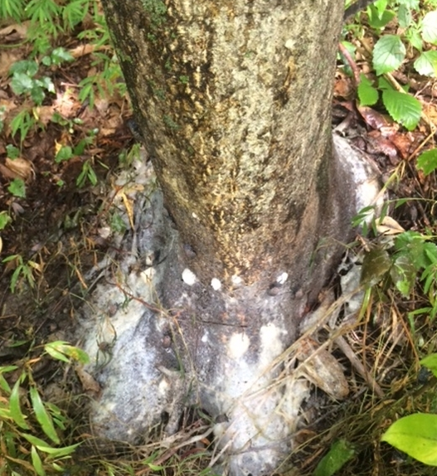
Signs, Symptoms and Damage
Sap that oozes or weeps
Honeydew builds up:
  On plants
  On the ground (underneath infested plants)
Sooty mold on infested plants
Wilting
Defoliation and dieback
Photos: Pennsylvania Department of Agriculture, Lawrence Barringer, Bugwood.org #5522645; #5385954
Notes:
Some signs and symptoms of damage by the spotted lanternfly is the sap oozing or weeping from the tree. This sap can have a fermented, rotten odor. They feed on the tree’s foliage and stems through the phloem. This feeding with affect photosynthesis of the plant, causing it to have stunted growth or even mortality. Sooty mold (fungal) growth from honeydew build up on tree as well, further causing decrease in photosynthesis.
References:
Animal and Plant Health Inspection Service. 2024. Spotted Lanternfly. United States Department of Agriculture. https://www.aphis.usda.gov/plant-pests-diseases/slf#:~:text=Spotted%20lanternfly%20populations%20are%20in,%2C%20Virginia%2C%20and%20West%20Virginia.

Slide 7
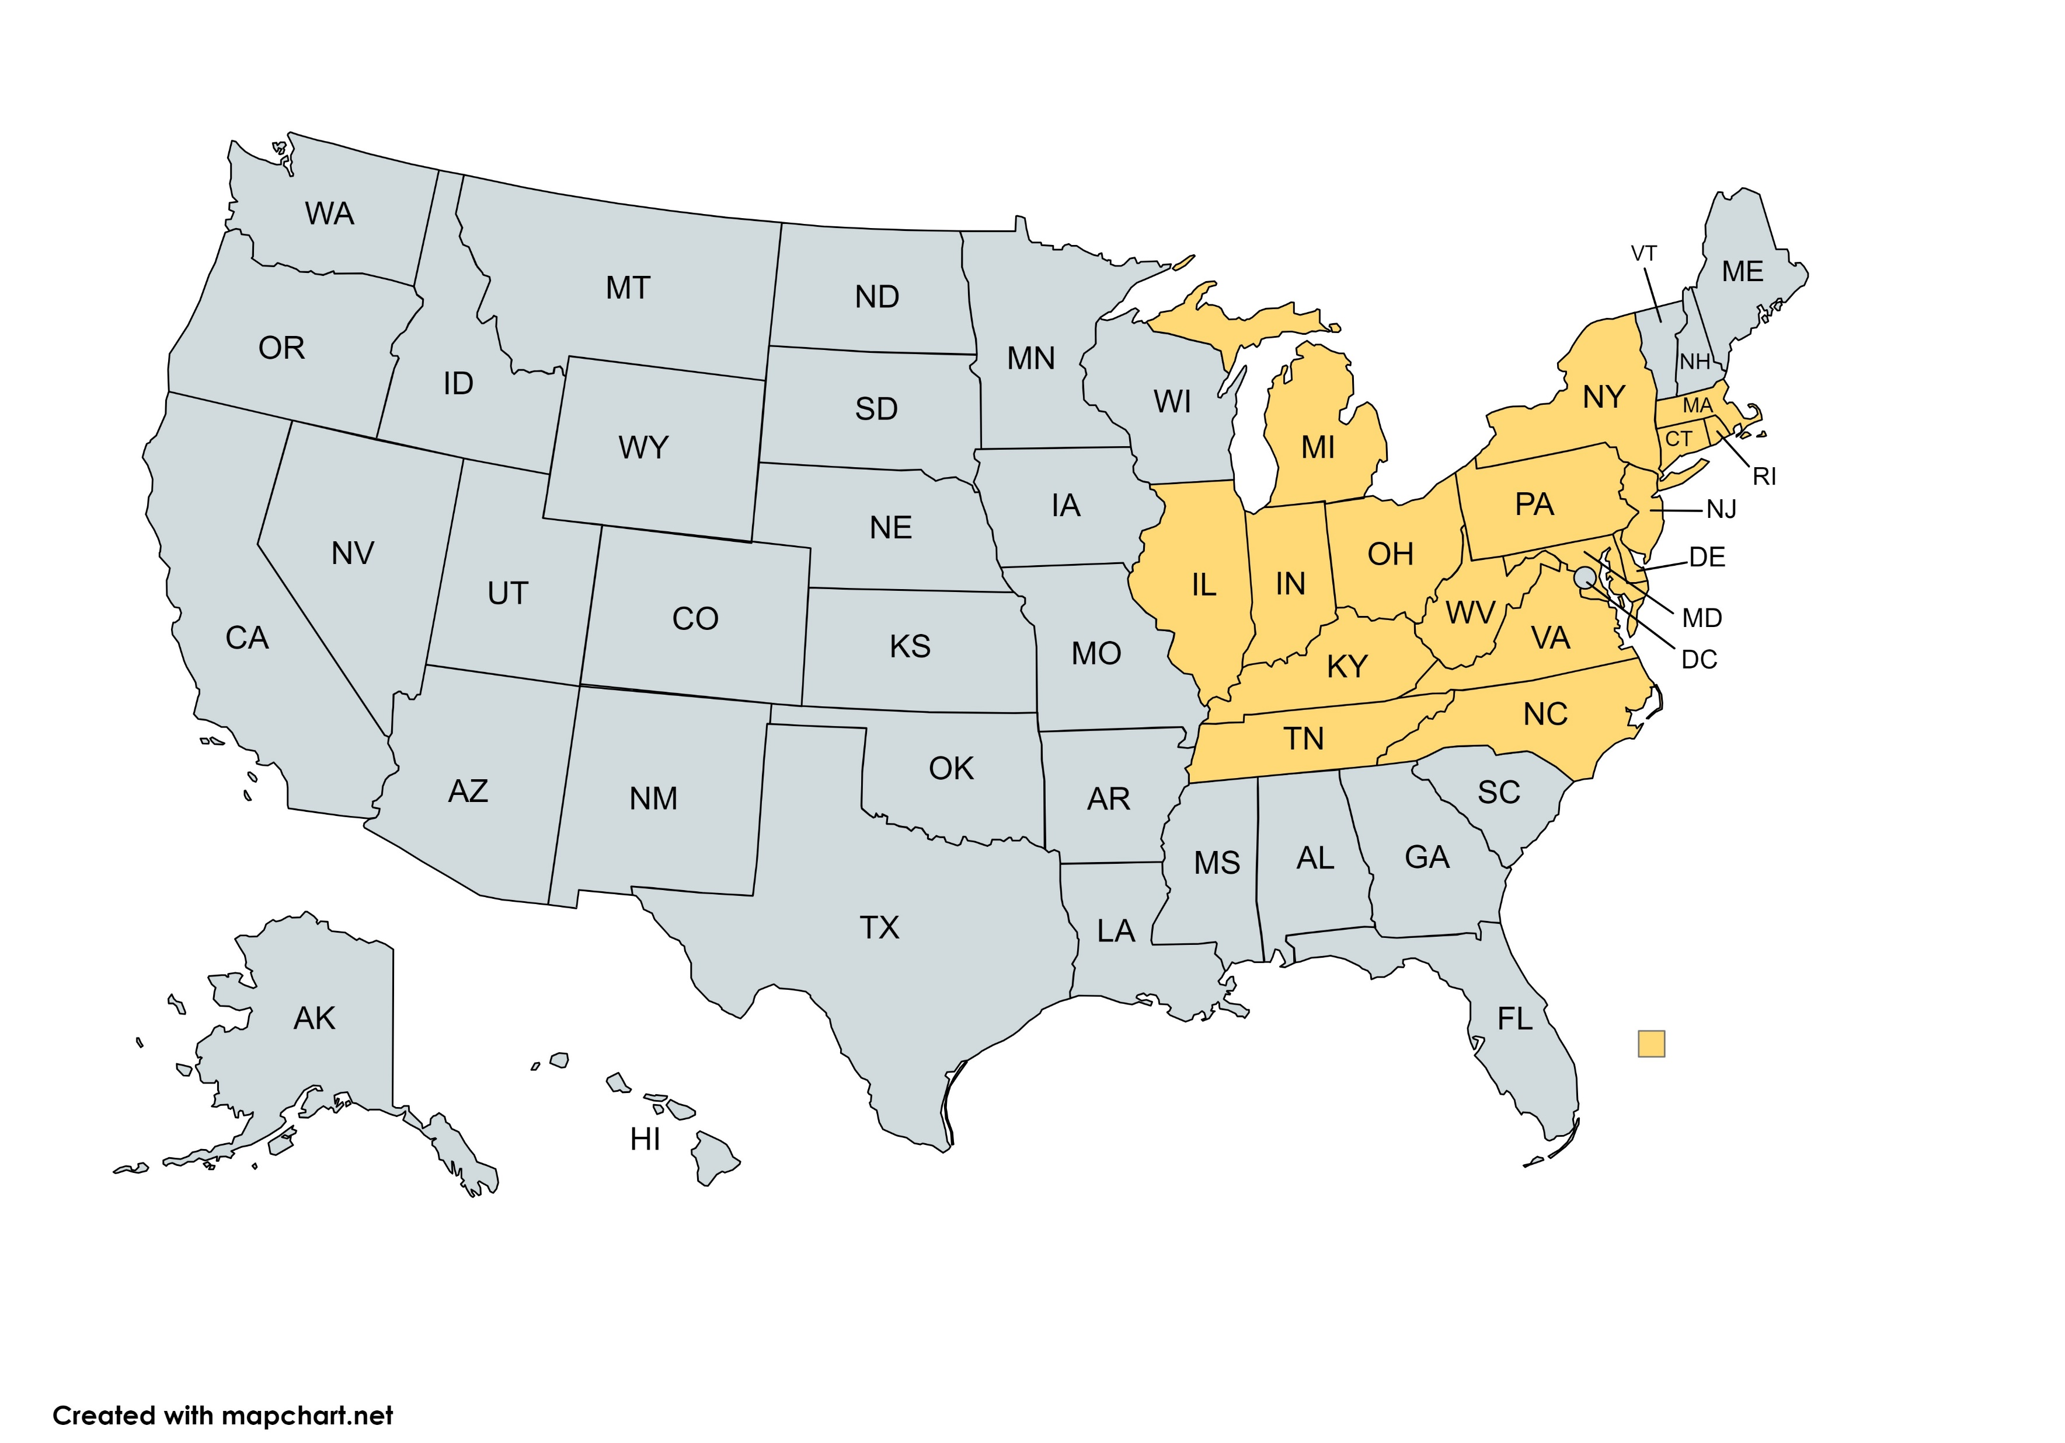
Distribution
Not established in Florida, however our state is home to the invasive plant host, the tree of heaven.
Not reported
Reported populations by USDA APHIS in parts of the state
Notes:
Currently found in 17 states including: Connecticut, Delaware, Illinois, Indiana, Kentucky, Maryland, Massachusetts, Michigan, New Jersey, New York, North Carolina, Ohio, Pennsylvania, Rhode Island, Tennessee, Virginia, and West Virginia.
Since SLF can only fly short distances, long distance travel is through human activity. By laying their eggs on vehicles wood, and stone they can be inadvertently move to new areas.
References:
Animal and Plant Health Inspection Service. 2024. Spotted Lanternfly. United States Department of Agriculture. https://www.aphis.usda.gov/plant-pests-diseases/slf#:~:text=Spotted%20lanternfly%20populations%20are%20in,%2C%20Virginia%2C%20and%20West%20Virginia.

Slide 8
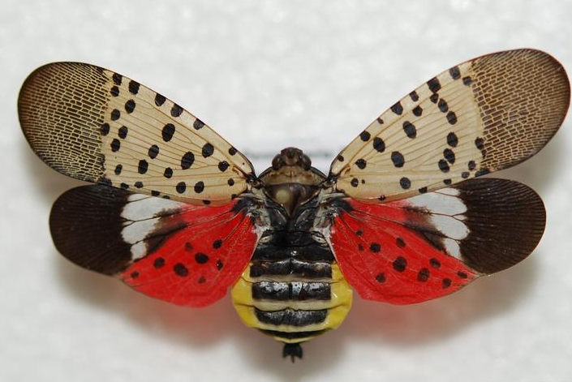
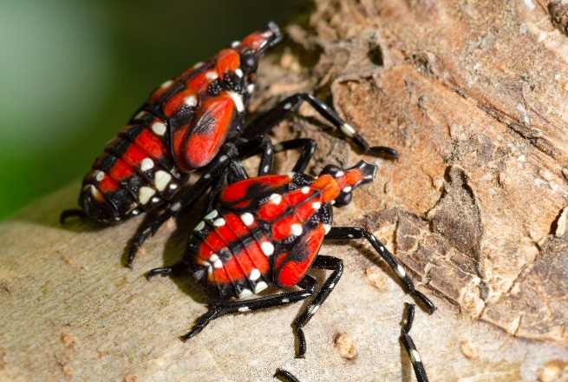
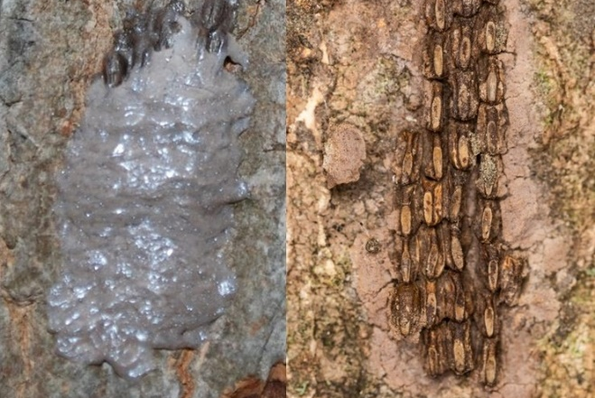
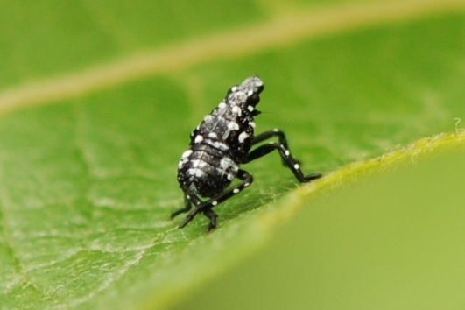
Life cycle
Adults begin to appear in July
Red nymphs seen from July to September
Eggs laid in the fall
Black nymphs seen between April and July
Photos: Pennsylvania department of Agriculture,, Bugwood.org #552451 (adult); #5522647 (eggs left); #5535776 (immature black); U.S. Department of Agriculture, Stephen Ausmus, flickr.com 20180716-ARS-SRA-d4021-02 (immature black); 20180716-ARS-SRA-d4021-02 (eggs right)
Notes:
The eggs are usually laid in fall to overwintering until the spring time. Each mass can contain 30-50 eggs. These eggs are often laid on smoother surfaces of the tree. Freshly laid eggs in an ootheca, or egg casing, and then covered by a mud-like wax covering on the eggs (left eggs). Multiple masses of eggs are laid during this one time per year. The covering dries can have a cracked appearance. When the eggs hatch the covering falls off and the individual eggs can be seen, and they look like seeds. Usually eggs hatch in early spring to summer. There is only one generation per year.
There are 4 nymphal instars. The first three are black with white spots and the fourth and final instar is red with black stripes and white dots. These are shown on the next slide to compare the nymphal stages.
The adults have gray colored forewings with black spots. This color of the forewings allows the adults to blend in with their background on the branches of trees. The hind wings are red with black spots, and on the ends of these wings there is a white band separating the red area from the black tips. The head is black and has a yellow abdomen with black bands.

Slide 9
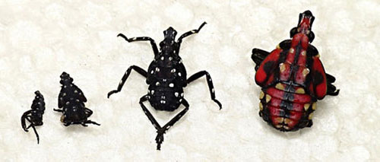
Nymphs: Four Instars (Growth Stages)
Notice: No wings present
4
1
2
3
Photo: Tea-Kesting-Handly, Pennsylvania Department of Agrilculture
Notes:
This is another example of the four nymphal stages of the spotted lanternfly. Hemimetabolous lifecycle, where there are some differences in nymphs based off color in comparison to the adult form. The eating habits are similar when comparing the nymphs to the adults. These nymphal stages will not have wings, and just mainly depend on legs for crawling. They can be dispersed by the wind

Slide 10
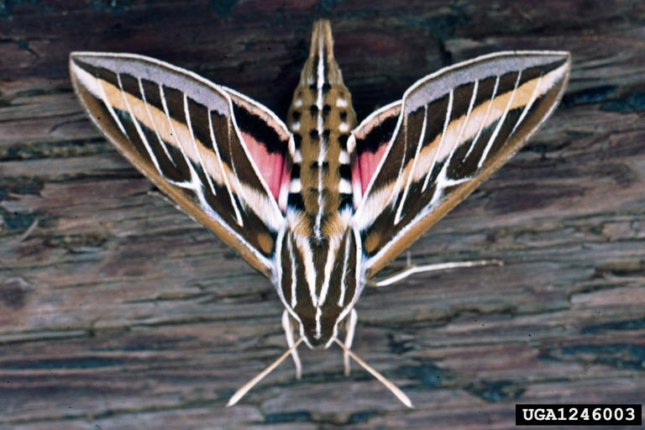
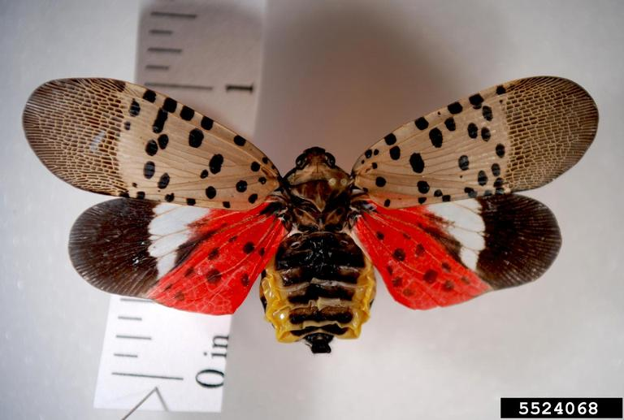
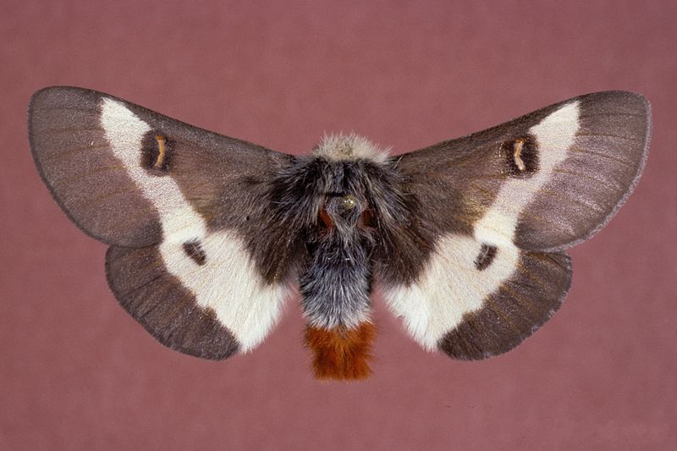
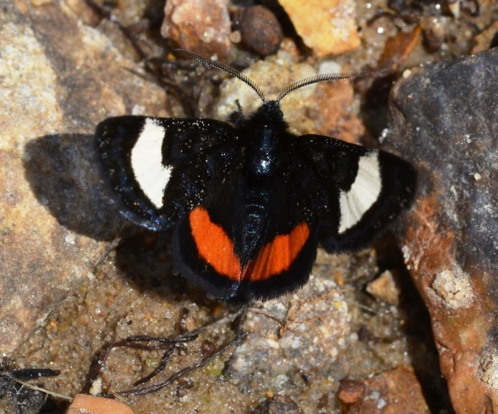
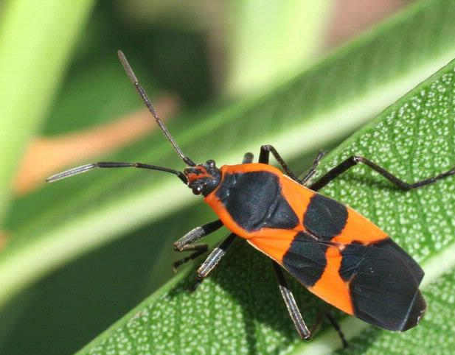
Look a Like Species
Abdomen tapers to a cone-shape
Cryptic forewings and hindwings
Cryptic forewings
Aposematic hindwings
Tip of abdomen is red
Spotted Lanternfly
Lycorma delicatula
White-lined Sphinx (Hyles lineata)
Buck Moth (Hemileuca maia)
White line on forewing
Orange coloring dispersed on head and wings
Orange line on hindwing
Grapevine Epimenis (Psychomorpha epimenis)
Milkweed bug (Oncopeltus fasciatus)
Photos: Auburn University, Lacey Hyche, Bugwood.org #1540291 (top left); Louisiana State University, Gerald Lenhard, Bugwood.org #UGA0014195 (top middle); Pennsylvania Department of Agriculture , Bugwood.org, #5524068; Andy Reago & Chrissy McClarren, flickr.com # 9309; University of Georgia, Russ Ottens, Bugwood.org :5367955
Notes:
White-lined Sphinx moth is an adult form of the caterpillar hornworm within the Sphingidae family, where a horn at the top of their abdomen is a distinctive feature to this family. The adult female moth will lay eggs, where the larvae will become phytophagous of many garden plants. The hindwings are colored with red and pinkish with a blackend . . The forewings are cryptic and able to hide the adult when needed.
Buck moth is within the family of Saturniidae, the giant silkworm family. The caterpillars in this subfamily have multi-branched spines on their body that can sting the skin when touched (Scott et al., 2022). This pain from the venom can last up to tend days, sometimes leaving the sclerotized spikes in the skin. They are known to be a problem to livestock when pastures are infested. The adult females will also have stinging hairs on their abdomen as well to be used in defense to protect the eggs. Considered endangered.
The Grapevine Epimenis moth is shown The adult here in this picture also has wings that look different from each other. The forewing has white line in the center. The hindwings have an orange line in the center.
Milkweed bug is an orange insect with black bands present on the body. Similarly to the monarch caterpillar the sequester cardiac glycosides and keep them within the adult bodies making them poisonous to most predators.
References:
Scott, C., Kaufman, P.E. 2022. Buck Moth Hemileuca Maia (Drury). Publciation #EENY464. EDIS. University of Florida/IFAS Extension. https://edis.ifas.ufl.edu/publication/IN834.

Slide 11
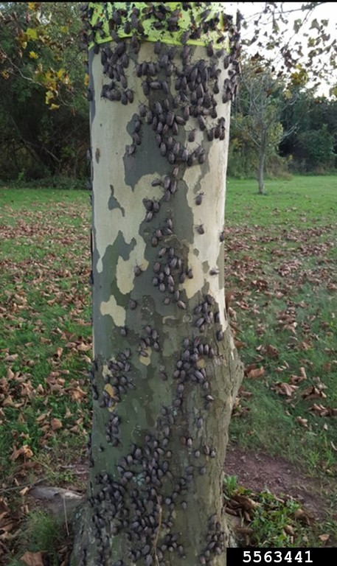
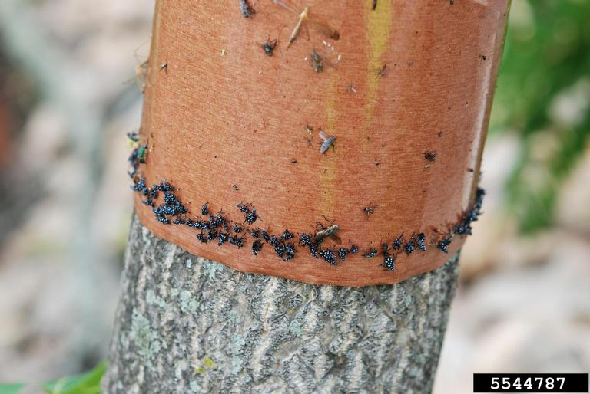

Monitoring and Management
Scouting
  Nymphs may feed on herbaceous plants
  Check on adult preferred plants
  Individuals tend to move around frequently
Management
  Remove preferred host plants: Tree of heaven
  Find and destroy eggs
  Sticky wraps for trees
    Not needed in FL because species is not established in our state.
Infestation of spotted lanternfly on sycamore tree (Pennsylvania)
Nymphs trapped on brown adhesive band on tree
Photo: Lawrence Barringer, Pennsylvania Department of Agriculture, Bugwood.org, #5563441; Lawrence Barringer, Pennsylvania Department of Agriculture, Bugwood.org, #5544787; Pennsylvania Department of Agriculture - Commonwealth of Pennsylvania
Notes:
Scouting: Look for sap oozing from trees can be an indication of feeding. Infestation of nymphs or adults on trunk of trees.
Removing egg masses by scraping them off trees can be used to manage population. Using sticky traps wrapped around the trees and coating with adhesive can catch many mobile adults and nymphs. This will be less likely to affect beneficial insects like the use of insecticides could have done. Once a sticky trap is full, it needs to replaced. There is a risk of capturing beneficial or non-target insects, so using a narrower band and encasing the trap with chicken wire can help keep the unwanted animals from being stuck to the traps. If using this trap check at least once per week.
Being observant of what plants the adults prefer is critical to know when to look for increase in population sizes.
This insect is very mobile and will frequently relocate to different trees in other areas. Being observant of this type of movement is important.
Management: Removing preferred host plants like the tree of heaven is a good preventative measure. The tree of heaven is common in FL, so removing this invasive plant species will help with reducing the favorite host plant of the spotted lanternfly.
References:
Dara, S.K. 2018. An update on the invasive spotted lanternfly, Lycorma delicatula: Current distribution, pest detection efforts, and management strategies. Pest News eJournal about endemic and invasive pests in California. University of California, Agriculture and Natural Resources. https://ucanr.edu/blogs/pestnews/index.cfm?tagname=tree-of-heaven.
Pennsylvania Department of Agriculture. 2024. Spotted Lanternfly: Look Before you leave!. Commonwealth of Pennsylvania. https://www.agriculture.pa.gov/Plants_Land_Water/PlantIndustry/Entomology/spotted_lanternfly/Pages/Look-Before-You-Leave.aspx

Slide 12
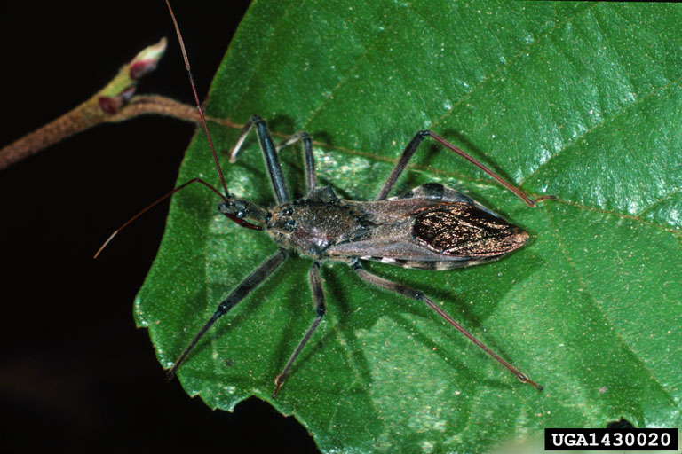
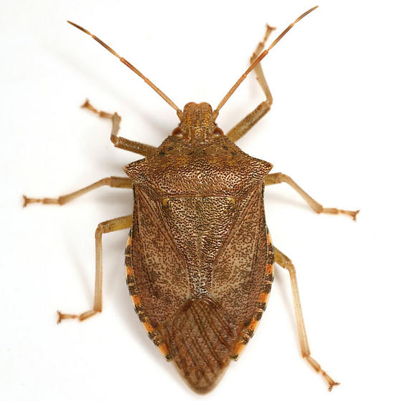
Biological Control: Predators
Wheel bug, Arilus cristatus
Predatory stinkbug nymph, Apoecilus cynicus
2015 – first observation of predation of spotted lanternfly by wheel bug
Common generalist predator (beneficial – assassin true bug)
Widely distributed in U.S. (in FL)
Toxic, paralytic substance in saliva kills prey
First observed predation on spotted lanternfly in Berks County, PA
Common generalist predator
Can be commonly found on maple trees like Florida Maple or Red Maple
Photo: Lacy L. Hyche, Auburn University, Bugwood.org, #UGA1430020; Mike Quinn – BugGuide, Iowa State University Department of Plant Pathology, Entomology and Microbiology
Notes:
The wheelbug predator is present within the state of Florida and many other locations within the U.S. It is not sold commercially to buy, so having habitats that promote hiding places such as wood perennials that support places to hide as they are hunting for prey due to being good at feeding on well-protected hairy caterpillars that defoliate forest and shade trees (Griffith et al. 2019). This is a generalist predator, meaning they feed on multiple insects such as moths, beetles, aphids, and the brown marmorated stink bug. The way that prey is killed is that the wheel bug has a toxic, paralytic substance in saliva that immobilizes and kills the insect in 15-30 seconds of the time of injection (Griffith et. al. 2019). For humans, it is important to be careful to not disturb the wheel bug, due to its bite hurting worse than wasp, hornet, and bee stings. Numbness is followed for several days to the affected area. The area will be red, swollen and hot when touched. The area of the bite may later turn white and harden. Overtime it may take up to 2 weeks to heal, however other effects from the bite may be due to secondary infection or hypersensitivity to the insect by an individual.
Predatory stinkbugs can be often found in wooded areas, trees, shrubs, and woodland areas. Having a habitat that has wooded perennials and taller grasses and shrubs will promote a habitat for the predatory stinkbug to hide and be likely to hunt for prey. The way this predatory stinkbug kills its prey is through the use their piercing, sucking mouthparts to suck the body fluids form their prey.
Both of these predators attack the egg life stage.
References:
Griffith, T.B., Gillett-kaufman, J.L., 2018. Revised 2019. Spotted Lanternfly, Lycorma delicatula. Featured Creatures. Department of Entomology and Nematology. EDIS. Publication Number EENY-714. University of Florida/IFAS Extension, Florida Department of Agriculture and Consumer Services. https://entnemdept.ufl.edu/creatures/ORN/TREES/spotted_lanternfly.html.

Slide 13
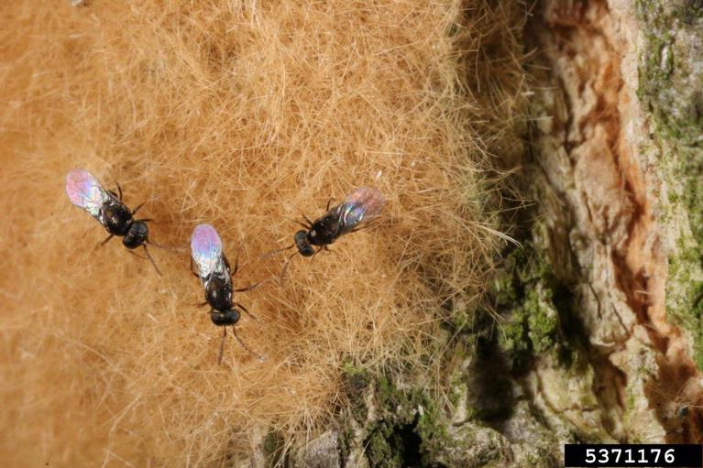
Biological Control: Parasitoid
This parasitoid wasp was introduced to the United States in 1908.
  Was often used to control the spongy moth population through the egg life stage of spongy moths.
  It has also been found parasitizing the spotted lanternfly, but not a high rate.
    This occurred in Pennsylvania in 2016
Encyrtid parasitoid wasp
Ooencyrtus kuvanae
Photo: Gyorgy Csoka, Hungary Forest Research Institute, Bugwood.org, #5371176
Notes:
References
Dara, S.K. 2018. An Update on the invasive spotted lanternfly, Lycorma delicatula: current distribution, pest detection efforts, and management strategies. Pest News. eJournal about endemic and invasive pests in California. University of California, Agriculture and Natural Resources. https://ucanr.edu/blogs/pestnews/index.cfm?tagname=tree-of-heaven

Slide 14
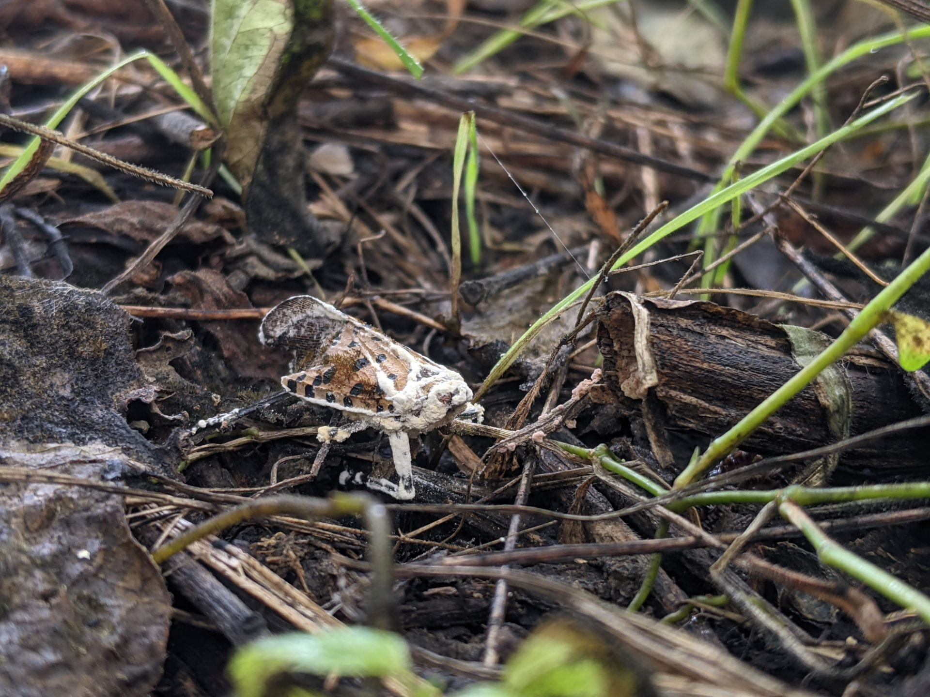
Biological Control: Entomopathogenic Fungi
Entomopathogenic fungal pathogens are being researched for their ability to control population of spotted lanternfly.
  Beauveria bassiana
    First evidence of fungus found to kill adult of spotted lanternfly in 2017 in Berks County, Pennsylvania.
    Known to infect many sap-sucking pests like aphids, mealybugs, and scales in the Hempiteran order.
    Still research to see how non-target insects may be affected and how to minimize infection of those non-target insects.
Spotted lanternfly killed by entomopathogenic fungus, Beauveria bassiana
Photo: Eric Clifton, 2021 –Dr. Ann Hajek Lab, Cornell University
Notes:
Reference:
Clifton, E.H., Castillo, L.A., Jaronski, S.T., Hajek, A.E. 2023. Cryptic diversity and virulence of Beauveria bassiana recovered from Lycorma delicatula (Spotted lanternfly) in eastern Pennsylvania. Front. Insect Sci., Sec. Invasive Insect Species. Volume 3. https://doi.org/10.3389/finsc.2023.1127682
Hajek, A. 2022. Hajek Lab. Insect Pathology and Epizootiology of Enomopathogens. Cornell University. https://blogs.cornell.edu/hajek/spotted-lanternfly/

Slide 15
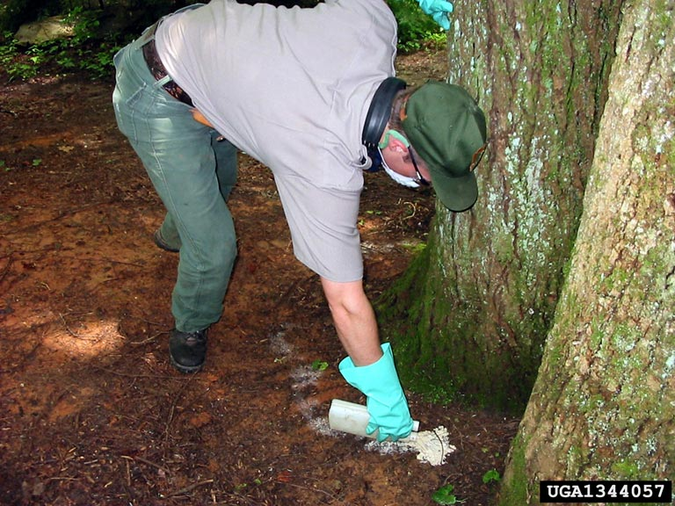
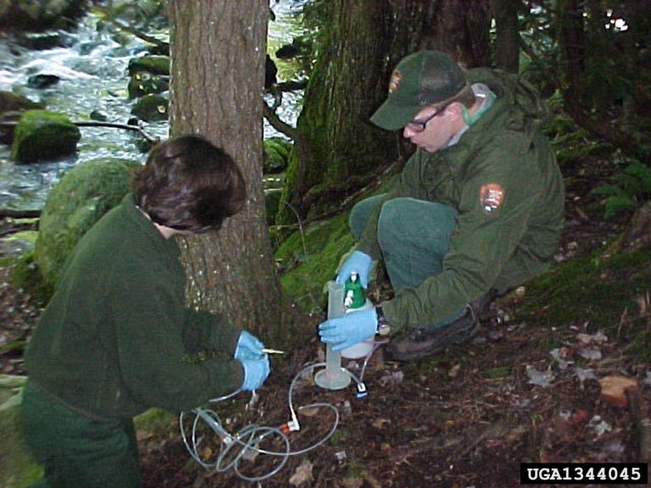
Chemical Control
Label is the law
  Be mindful of beneficial insects and non-target insects.
Neem oil, insecticidal soap, horticultural spray oil
  Target egg life stages
Natural pyrethrins
Systemic insecticides: Professionals apply
  Dinotefuran
    Soil drench
    Trunk spray
    Trunk injection – last resort
  Imidacloprid
    Soil drench
    Trunk injection
Soil drenching - imidacloprid
Stem injection – systemic insecticide
Photo: Great Smoky Mountains National Park Resource Management , USDI National Park Service, Bugwood.org, #UGA1344057; Great Smoky Mountains National Park Resource Management, USDI National Park Service, Bugwood.org, #UGA1344045
Notes:
System insecticides absorbed through the root, bark, leaves and whole vascular system of plant. When an insect feeds on plant/tree, the systemic insecticide kills the insect. Routes to apply insecticide could be through trunk injection, trunk spray, soil drench or injection, and foliar sprays. Usually need to be applied to actively growing trees, so not in fall or winter. Most target populations and life stages are nymphs and mainly adults. Don’t apply to blooming/flowering plants to protect beneficial insects and pollinators.
Neem oil, insecticidal soap, and horticultural spray oil – purchase at retail store
- These are often used on egg masses during winter or early spring
Dinotefuran – systemic neonicotinoid insecticide that is taken up by foliage, bark, or root system. The central nervous system of the insect will be disrupted.
Imidacloprid - systemic neonicotinoid insecticide that is taken up by foliage, bark, or root system. The central nervous system of the insect will be disrupted.
Trained pesticide applicators and handlers will have to apply the treatment. These systemic insecticides cannot just be purchased from the store.

Slide 16
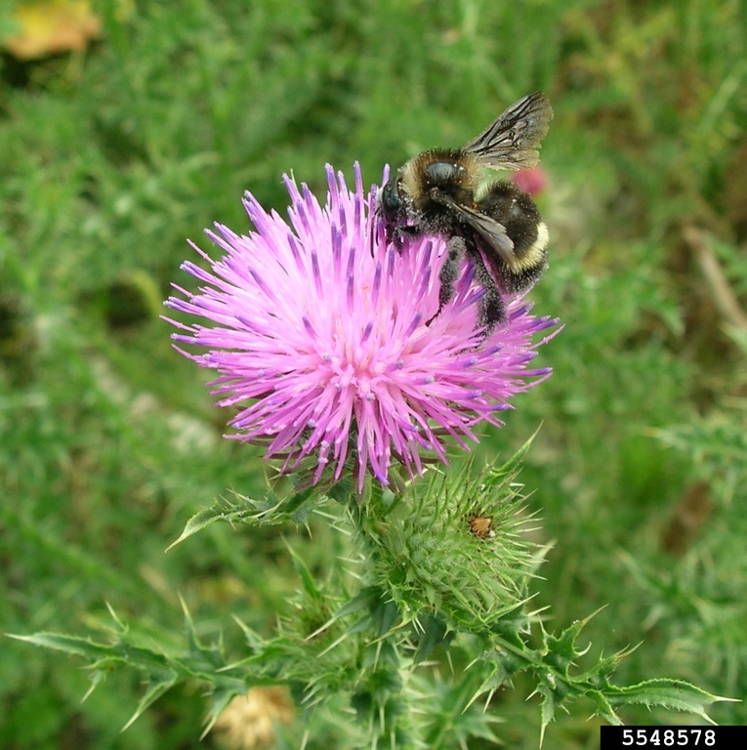
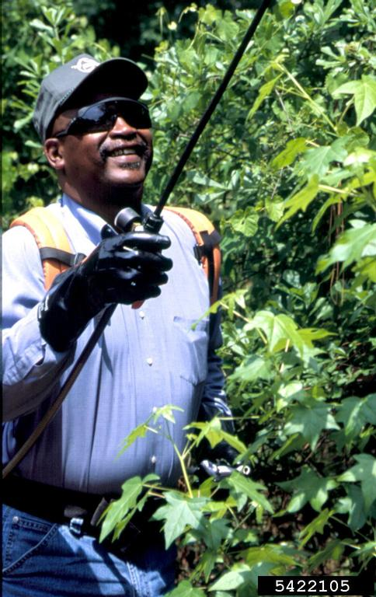
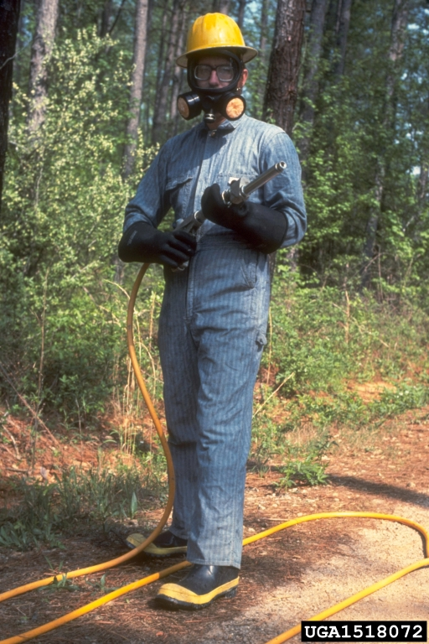
Factors to Consider in Chemical Control
Risk of hurting beneficial and pollinating insects
  Do not apply during time of blooming/flowering
Chemical drift in air of insecticides to unintended areas
Water contamination
Use the right amount according to label
Use a combination of insecticides and not the same one to reduce resistance by insects
Use least toxic insecticide
Wearing proper personal protective equipment
  Contact extension office to ask about recommendations for certain chemicals to apply
Photo:Juan Campá, MGAP, Bugwood.org, #5548578; James H. Miller, USDA Forest Service, Bugwood.org, #5422105; USDA Forest Service - Region 8 - Southern , USDA Forest Service, Bugwood.org, #UGA1518072

Slide 17
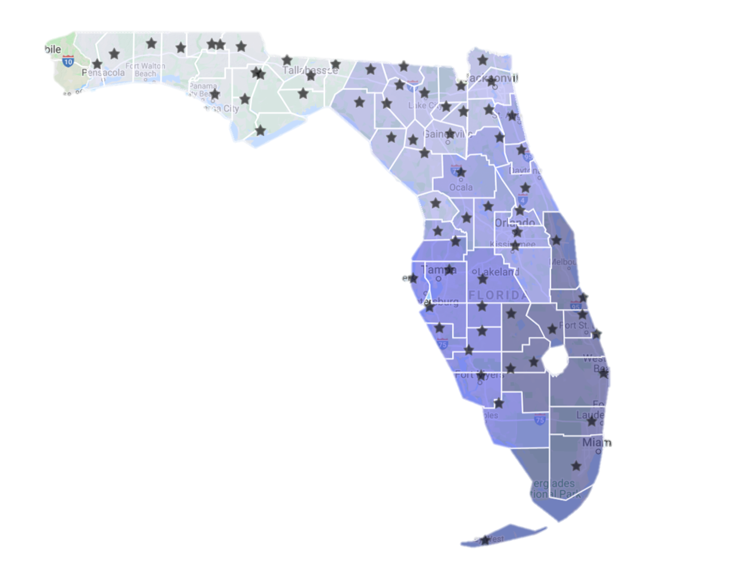
Reporting to UF/IFAS Faculty in Florida
Local county extension office
https://sfyl.ifas.ufl.edu/find-your-local-office/
Insect ID Lab - Dr. Lyle Buss
http://entnemdept.ufl.edu/insectid/
Nematode Diagnostic Lab - Dr. Billy Crow
http://nematology.ifas.ufl.edu/assaylab/index.html
Plant Diagnostic Center - Dr. Carrie Harmon
https://plantpath.ifas.ufl.edu/extension/plant-diagnostic-center/
Notes:
The UF/IFAS faculty is responsible for reporting diseases, insects, weeds, nematodes, or any other invasive species to the Florida Department Agriculture and Consumer Services, Division of Plant Industry (FDACS, DPI). Reporting this information is essential to protect Florida agriculture, communities and natural areas.
Local county extension agents can assist in identifying plant pest or assist in submitting a pest sample to the correct department or agency for identification. Attached is a link to find the closest extension agent near you.
If you need a insect identified, Dr. Lyle Buss at is the director of the Insect ID Lab at the University of Florida. The link attached will direct you to the insect ID Lab for further instructions for contact, questions, and submission forms.
If a diseased plant needs identification, the link to the UF/IFAS Plant Diagnostic Center run by Dr. Carrie Harmon is attached to assist in reporting and identifying the correct pest.
The diagnosticians and identifiers in each area will also provide management strategies for the pest identified to help eliminate the damage caused on the plants. If an invasive pest is found, they will send it FDACS, DPI for further testing.

Slide 18
Reporting to FDACS-DPI in Florida
Florida Department of Agriculture and Consumer Services (FDACS) - Division of Plant Industry (DPI)
FDACS, DPI Responsibility
  Announcing detection or establishment of new invasive species.
  Reporting is a legal obligation under Florida Statute 581.091.
Submission Form
  http://forms.freshfromflorida.com/08400.pdf
  https://www.fdacs.gov/Agriculture-Industry/Pests-and-Diseases/How-to-Submit-a-Sample-for-Identification
Notes:
Florida Department of Agriculture and Consumer Services: Division of Plant Industry is a regulatory agency that detects, intercepts, and controls Florida’s native and commercially grown plants. Announcing the establishment of new invasive species can affect Florida’s agricultural producers and trade of agricultural products.
FDACS, DPI provides online submission forms to fill out and send into the agency for proper identification. Additionally, DPI provides useful videos of how to properly handle the specimens before shipping them for identification

Slide 19
FDACS, DPI Contact
Dr. Leroy Whilby, Bureau Chief-Entomology, Nematology and Plant Pathology
  352-395-4661
  Leroy.whilby@freshfromflorida.com
Dr. Paul Skelley, Assistant Chief-Entomology, Nematology and Plant Pathology
  352-395-4678
  Paul.skelley@freshfromflorida.com
Division of Plant Industry Hotline
  1-888-397-1517
  DPIHelpline@FDACS.gov
Notes:
The DPI contacts provided will assist in determining the next steps if the pest found is of regulatory concern. Additionally, FDACS, DPI has a hotline with both a phone number and email for questions and concerns.

Slide 20
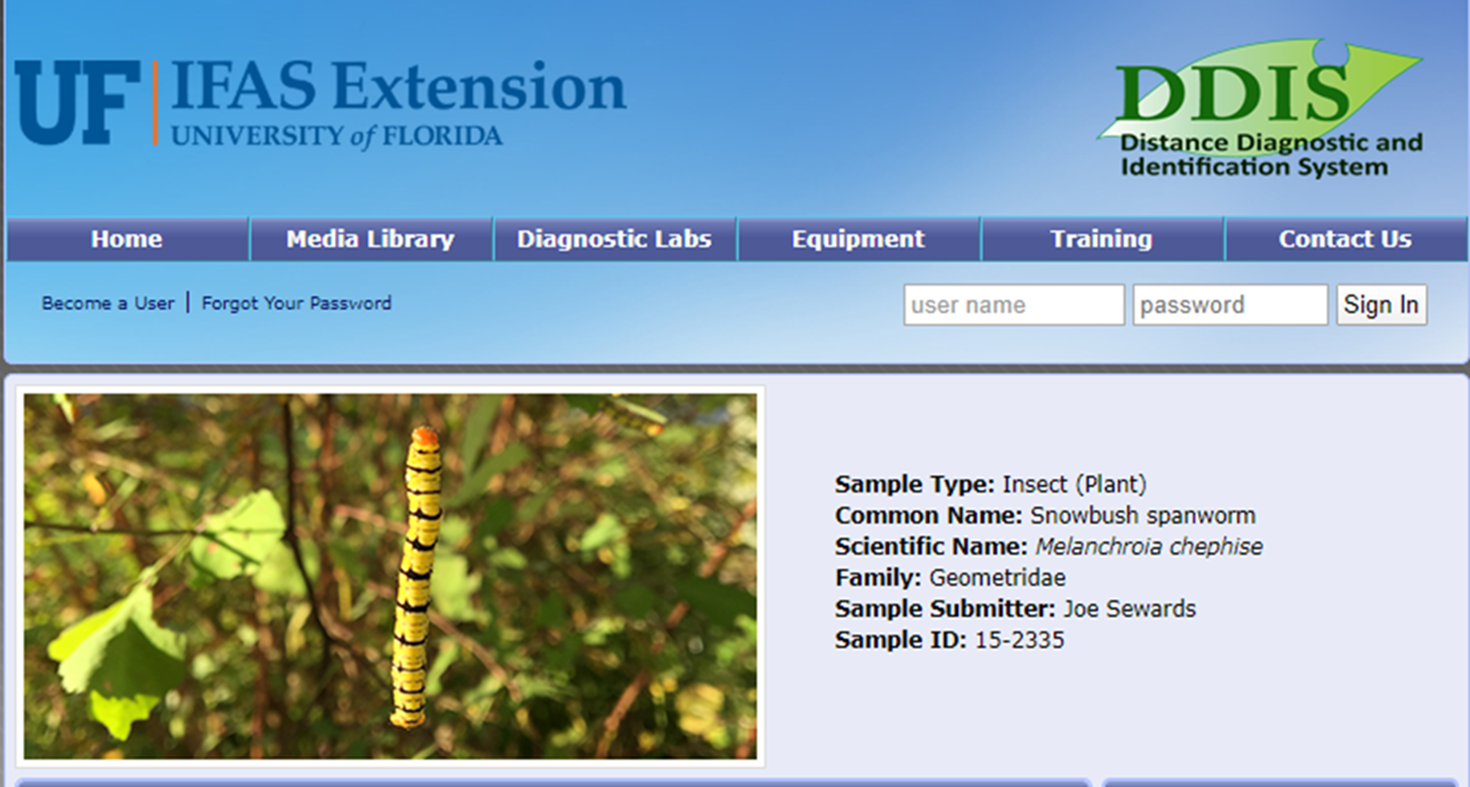
Reporting using DDIS in Florida
Digital Diagnostic and Identification System (DDIS)
Digital Diagnostic Collaboration
  Extension agents
  Laboratories
  Clinics
  Specialists
https://ddis.ifas.ufl.edu/
Notes:
The DDIS system connects the UF/IFAS faculty mentioned before to provide quick and accurate identification throughout Florida. This reporting collaboration tool enhances screening, early detection, monitoring, pest mapping, and rapid communication to protect agriculture. The site provides training, media of pest, equipment, and diagnostic labs in Florida.

Slide 21

Find More Information At:
https://entnemdept.ufl.edu/ffd/

Slide 22
Lab Team
Authors & Editors
Julia Rycyna, M.S.
Department of Entomology and Nematology, University of Florida
Ariana Rollins, B.S. – Graduate Student, Doctor of Plant Medicine Program, University of Florida
Daniela Perez Lugones, M.S. – Graduate Student, Doctor of Plant Medicine Program, University of Florida
Lyuyi Chen, M.S. – Graduate Student, Doctor of Plant Medicine Program, University of Florida
Sarah Tafel, B.S. – Graduate Student, Doctor of Plant Medicine Program, University of Florida
Lab Director
Amanda Hodges, Ph.D. - Extension Scientist and DPM Director, Department of Entomology and Nematology, University of Florida

Slide 23
Collaborating Agencies
U.S. Department of Agriculture Animal and Plant Health Inspection Service (USDA-APHIS)
Cooperative Agricultural Pest Survey Program (CAPS)
Florida Department of Agriculture and Consumer Services (FDACS)
National Plant Diagnostic Network (NPDN)
Sentinel Plant Network (SPN)
University of Florida Institute of Food and Agricultural Sciences (UF-IFAS)
Protect U.S.

Slide 24
Educational Disclaimer and Citation
This presentation can be used for educational purposes for NON-PROFIT workshops, trainings, etc.
Citation:
  University of Florida, Entomology and Nematology Department, Biosecurity Research and Education Lab. May 2024, Spotted Lanternfly, Day Accessed

Slide 25
References
Animal and Plant Health Inspection Service. 2024. Spotted Lanternfly. United States Department of Agriculture. https://www.aphis.usda.gov/plant-pests-diseases/slf#:~:text=Spotted%20lanternfly%20populations%20are%20in,%2C%20Virginia%2C%20and%20West%20Virginia.
Clifton, E.H., Castillo, L.A., Jaronski, S.T., Hajek, A.E. 2023. Cryptic diversity and virulence of Beauveria bassiana recovered from Lycorma delicatula (Spotted lanternfly) in eastern Pennsylvania. Front. Insect Sci., Sec. Invasive Insect Species. Volume 3. https://doi.org/10.3389/finsc.2023.1127682
Cornell College of Agriculture and Life Sciences. Spotted lanternfly damage. Accessed November 2, 2022.https://nysipm.cornell.edu/environment/invasive-species-exotic-pests/spotted-lanternfly/spotted-lanternfly-ipm/damage/
Cornell College of Agriculture and Life Sciences. Tree of heaven (TOH), Ailanthus altissima. Accessed November 2, 2022.https://nysipm.cornell.edu/environment/invasive-species-exotic-pests/spotted-lanternfly/spotted-lanternfly-ipm/hosts/
Dara, S.K. 2018. An update on the invasive spotted lanternfly, Lycorma delicatula: Current distribution, pest detection efforts, and management strategies. Pest News eJournal about endemic and invasive pests in California. University of California, Agriculture and Natural Resources. https://ucanr.edu/blogs/pestnews/index.cfm?tagname=tree-of-heaven.
Hajek, A. 2022. Hajek Lab. Insect Pathology and Epizootiology of Enomopathogens. Cornell University. https://blogs.cornell.edu/hajek/spotted-lanternfly/
New Jersey Department of Agriculture. About the spotted lanternfly. Accessed November 1, 2022.https://www.nj.gov/agriculture/divisions/pi/prog/pests-diseases/spotted-lanternfly/about/
New York State Integrated Pest Management. No date. Spotted Lanternfly Damage. Cornell College of Agriculture and Life Sciences. https://cals.cornell.edu/new-york-state-integrated-pest-management/outreach-education/whats-bugging-you/spotted-lanternfly/spotted-lanternfly-damage.
New York State Department of Environmental Conservation. Spotted lanternfly. Accessed November 1, 2022.https://www.dec.ny.gov/animals/113303.html
Otto, E. 2021. Spotted Lanternfly Control Program in the Mid-Atlantic Region, North Carolina, Ohio, and Kentucky. Animal and Plant Health Inspection Services. United States Department of Agriculture. https://www.aphis.usda.gov/sites/default/files/supplemental-slf-mid-atlantic-october-2021.pdf
Scott, C., Kaufman, P.E. 2022. Buck Moth Hemileuca Maia (Drury). Publciation #EENY464. EDIS. University of Florida/IFAS Extension. https://edis.ifas.ufl.edu/publication/IN834.
PennState Extension. 2021. Spotted lanternfly management guide. Accessed November 2, 2022.https://extension.psu.edu/spotted-lanternfly-management-guide
USDA APHIS. Spotted lanternfly. Accessed November 1, 2022. https://www.aphis.usda.gov/aphis/resources/pests-diseases/hungry-pests/the-threat/spotted-lanternfly/spotted-lanternfly

Slide 26
UPDATE INFORMATION FOR AUTHORS
*Keep slide hidden*
Presentation Topic: Spotted Lanternfly
Updated by: Ariana Rollins
Update began (dd/mm/yy): 5/20/24
Update complete (dd/mm/yy): 1/1/25
Uploaded to site (dd/mm/yy):

