Slide 1
Distant Diagnostic and Identification System
(DDIS)

Slide 2
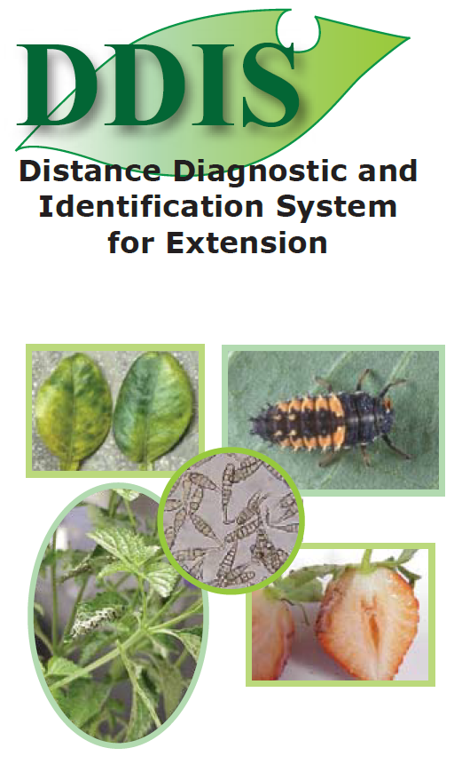

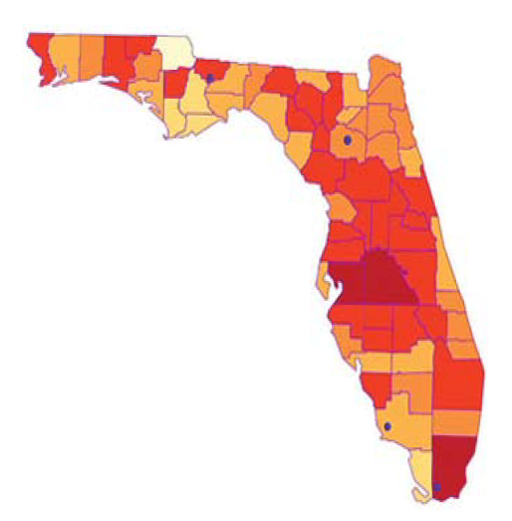
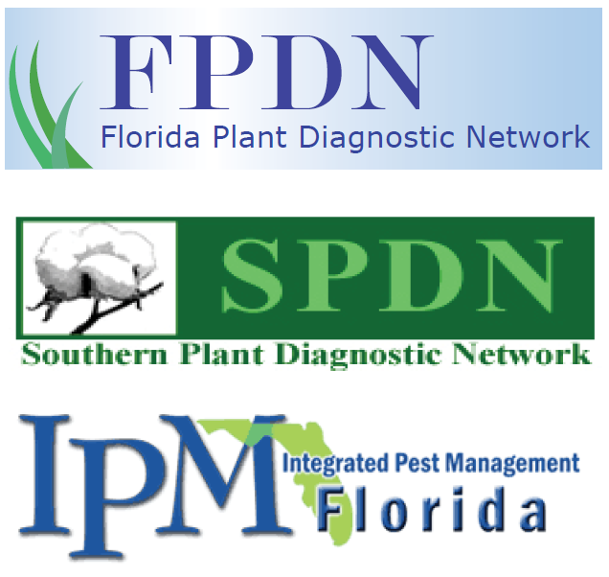

Slide 3
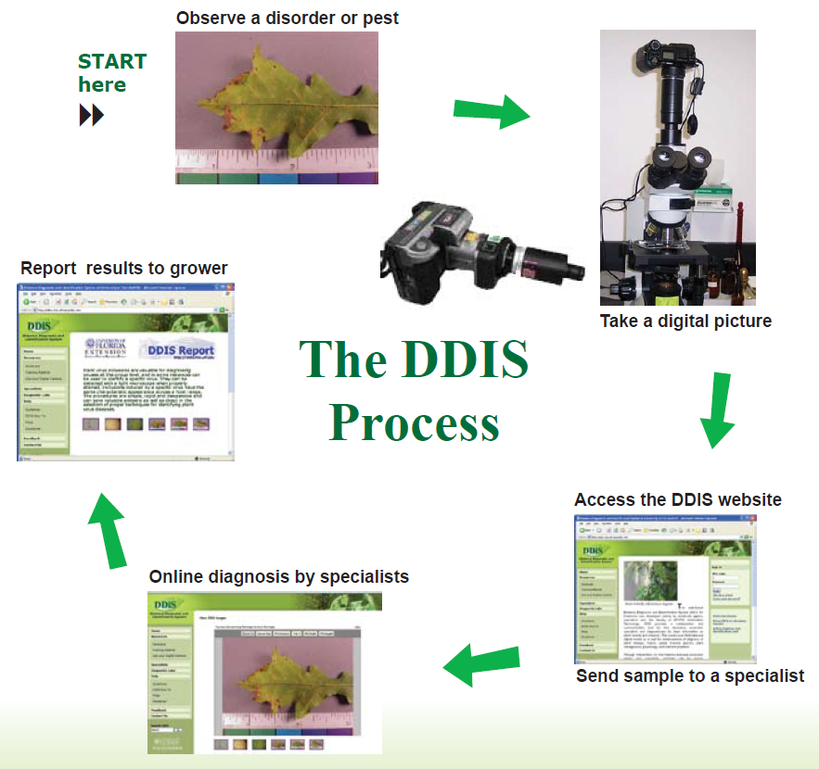
(http://ddis.ifas.ufl.edu/ddisx/home.jsp)
DDIS Website
Notes:
DDIS Process
Start here:
Observe a disorder or pest
Take a digital picture
Access the DDIS website and send sample to a specialist
Online diagnosis by specialists
Report results to grower

Slide 4
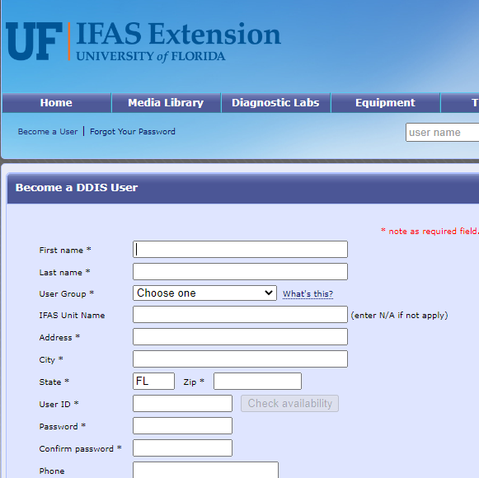

How to Use DDIS
Reach out to local county extension agent
Navigate to: https://ddis.ifas.ufl.edu/
Scroll down to the bottom of the page and select:
In “User Group” select Extension Clientele
Input N/A for “IFAS Unit Name”
Extension agent must approve user

Slide 5
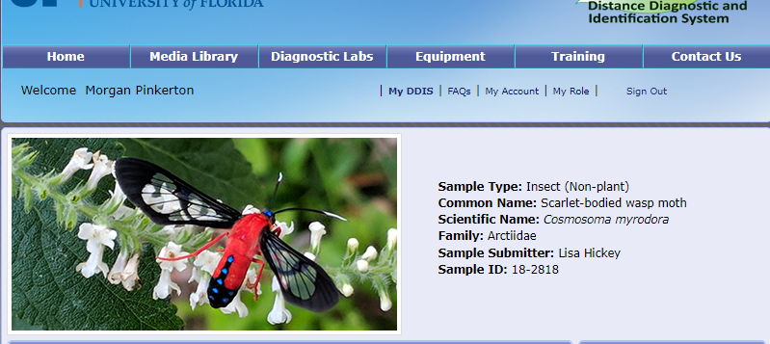
How to Use DDIS
From the home page, Click “My DDIS” to begin the sample submission

Slide 6
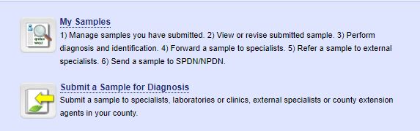
How to Use DDIS
Click “Submit a Sample for Diagnosis”
Notes:
To start a new sample submission, click on the “Submit a Sample for Diagnosis” button with the green leaf and yellow arrow.
To look at the samples that have been submitted and see the reports generated once the sample has been identified, select “My Samples” button with the magnifying glass. The first option at the top of the “My DDIS” page.

Slide 7
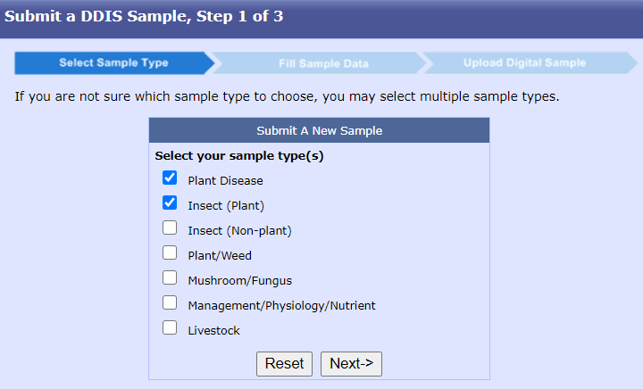
How to Use DDIS:
Select Sample Type (step 1 of 3)
Select the sample type for submission
Select multiple categories if not sure about the problem with the plant
Notes:
There are three steps:
Select Sample type
Fill Sample data
Upload digital sample

Slide 8
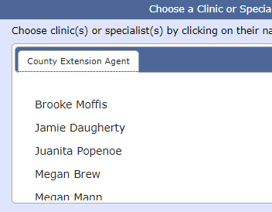
How to Use DDIS:
Fill Sample Data (step 2 of 3)
Fill with Information based on sample type
Name, address, locality
GPS coordinates
Extension agent
Any additional information

Slide 9
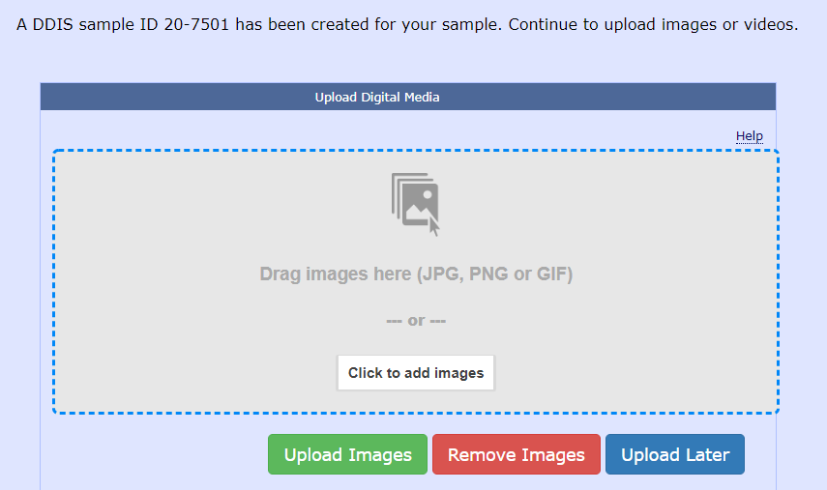
How to Use DDIS:
Upload Digital Sample (step 3 of 3)
The last step:
Add CLEAR images of the sample
Can submit up to seven images

Slide 10
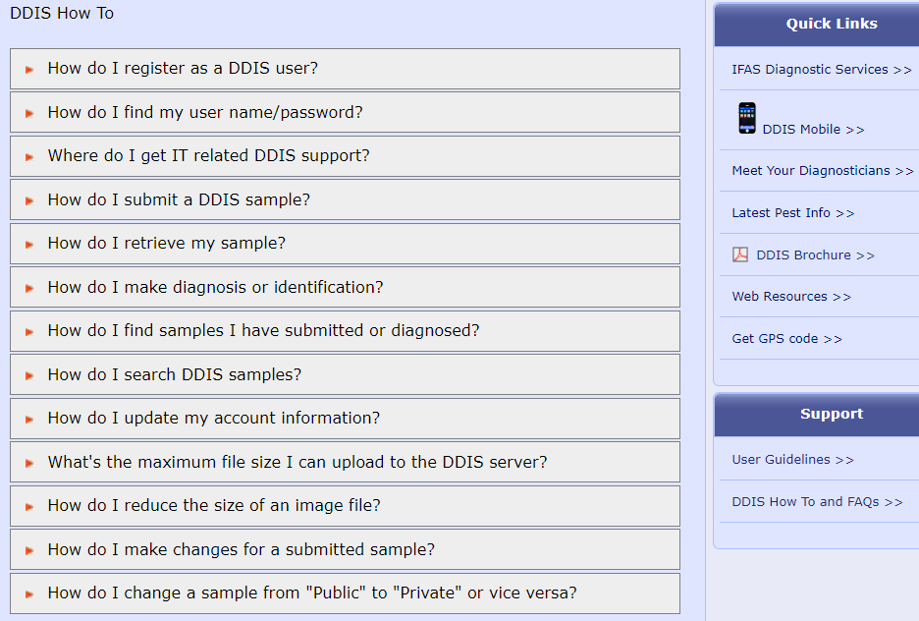

Slide 11
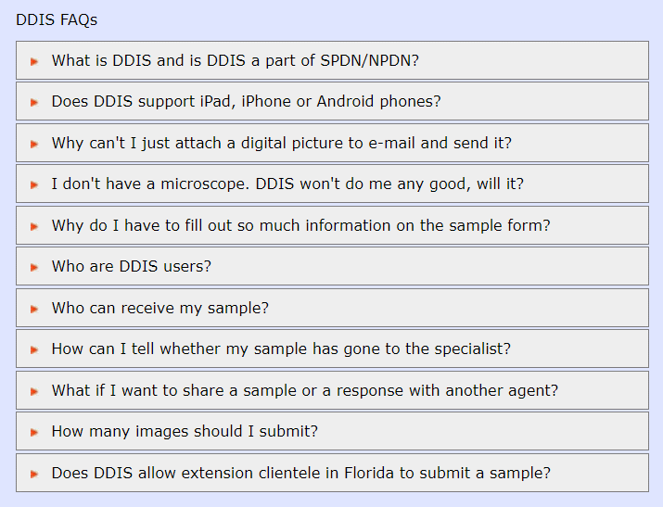

Slide 12
ID Resources
IFAS EDIS and Featured Creature fact sheets
  http://edis.ifas.ufl.edu; https://entnemdept.ifas.ufl.edu/creatures/
IFAS Entomology Insect I.D. Lab – Lyle Buss
  http://entnemdept.ufl.edu/insectid/ ; ljbuss@ufl.edu; (352) 273-3933
IFAS Nematode Diagnostic Lab – Dr. Billy Crow
  http://nematology.ifas.ufl.edu/assaylab/index.html ; NEMALAB@ifas.ufl.edu; (352) 392-1994
IFAS UF/IFAS Plant Diagnostic Center - Dr. Carrie Harmon
  https://plantpath.ifas.ufl.edu/extension/plant-diagnostic-center/; pdc@ifas.ufl.edu; (352) 392-1795
Commodity-specific specialists around the state
  http://entomology.ifas.ufl.edu/extension/; http://entomology.ifas.ufl.edu/people-directory/
Notes:
IFAS Extension Bookstore I.D. books / decks <-- unavailable currently (removed from slide)
http://ifasbooks.ifas.ufl.edu/p-153-helpful-harmful-harmless.aspx

Slide 13
UF/IFAS Resources
EDIS – Online Publications on Vegetable Production & Diseases
UF/IFAS Faculty – Gainesville campus
  Plant Pathology Department
  Horticultural Sciences Department
  Entomology and Nematology Department
  Center for Organic Agriculture
UF/IFAS Extension & Research Faculty – County & REC vegetable specialists

Slide 14
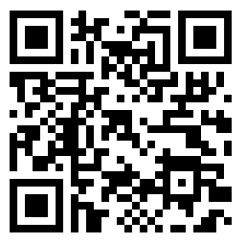
Find More Information At:
https://entnemdept.ufl.edu/ffd/

Slide 15
Lab Team
Authors & Editors
Ariana Rollins, B.S. – Graduate Student, Doctor of Plant Medicine Program, University of Florida
Daniela Perez Lugones, M.S. – Graduate Student, Doctor of Plant Medicine Program, University of Florida
Jhonson Leonard, M.S. – Graduate Student, Doctor of Plant Medicine Program, University of Florida
Lyuyi Chen, M.S. – Graduate Student, Doctor of Plant Medicine Program, University of Florida
Sarah Tafel, B.S. – Graduate Student, Doctor of Plant Medicine Program, University of Florida
Lab Director
Amanda Hodges, Ph.D. - Extension Scientist and DPM Director, Department of Entomology and Nematology, University of Florida

Slide 16
Collaborating Agencies
U.S. Department of Agriculture Animal and Plant Health Inspection Service (USDA-APHIS)
Cooperative Agricultural Pest Survey Program (CAPS)
Florida Department of Agriculture and Consumer Services (FDACS)
National Plant Diagnostic Network (NPDN)
Sentinel Plant Network (SPN)
University of Florida Institute of Food and Agricultural Sciences (UF-IFAS)
Protect U.S.

Slide 17
Educational Disclaimer and Citation
This presentation can be used for educational purposes for NON-PROFIT workshops, trainings, etc.
Citation:
    –University of Florida, Entomology and Nematology Department, Biosecurity Research and Education Lab. May 2024. Collaborative and Enhanced First Detector Training: DDIS, *Day Accessed*

Slide 18
UPDATE INFORMATION FOR AUTHORS
*Keep slide hidden*
Presentation Topic: Distant Diagnostic and Identification System
Updated by: Sarah Tafel
Update began (dd/mm/yy): 5/6/2024
Update complete (dd/mm/yy): 5/23/2024
Uploaded to site (dd/mm/yy):

