Slide 1
Biological Controls

Slide 2
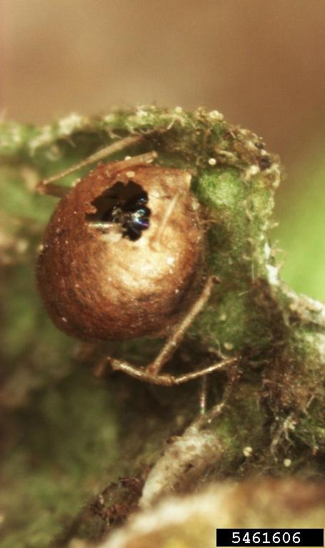
Introduction
Biological control – populations of beneficial organisms are intentionally used and manipulated, under the role of natural enemy, to manage and limit insect pest populations.
Natural enemy - a predator, parasite, or pathogen that is used to target and limit specific insect pest populations.
Three types of biocontrol
  Classical Biocontrol
  Conservation
  Augmentation
Parasitoid ready to emerge from mummified aphid.
Photo: Sandra Jensen, Cornell University, Bugwood.org, #5461606
Notes:
Biological control is used in entomology and nematology research quite often to use beneficial organism populations as a natural enemy to manage and limit insect pest populations. A natural enemy can be a predator, a parasite or parasitoid, or a pathogen. It is often used in conjunction with other management/control strategies withing integrated pest management (IPM).
The three types of biological control are classical, conservation, and augmentation. They can be used in different settings such as a greenhouse, a farm, or within a backyard. Years of extensive research would need to be put into the process of deciding on if a selected organism to use as a biological control agent is the proper and safe choice for the target pest.
Biological control can be used for weeds, plant diseases in addition to insects.
References:
Stoner, K. 2024. Approaches to the Biological Control of Insect Pests. Connecticut State: The Connecticut Agricultural Experiment Station. Connecticut’s Official State Website. https://portal.ct.gov/caes/fact-sheets/entomology/approaches-to-the-biological-control-of-insect-pests#:~:text=There%20are%20three%20primary%20methods,a%20seasonal%20basis%20or%20inundatively.

Slide 3
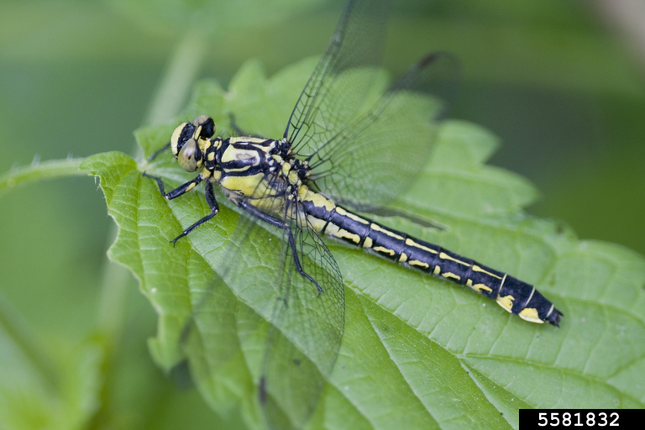
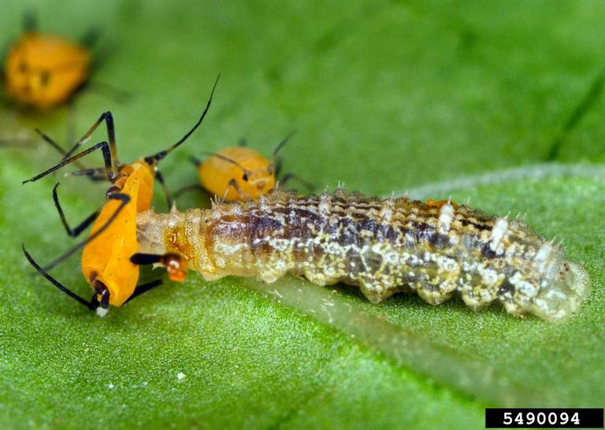
Biocontrol Agents/ Natural Enemy: Predators
Predators: Arthropods
  Order Aranea: Spiders
  Order Odonata: dragonflies
  Order Neuroptera: Lacewings
  Order Coleoptera: beetles
  Order Diptera: Flies
  Order: True bugs
  Order Hymenoptera: ants
  Order Thysanoptera: some thrips
  Order Mantodea: generalist mantids
Clubtail dragonfly, Gomphus vulgatissimus
Syrphid fly larvae, Family Syrphidae
Photo: Mary C Legg, Mary C Legg, Bugwood.org, #5581832; David Cappaert, Bugwood.org, #5490094
Notes:
Predators are natural enemies or biocontrol agents that eat the target pests. Predatory insects kill their target pests quickly. They can often have morphological characteristics of mandibles and chewing mouthparts. Some of these orders have larvae, or immatures, that are predatory and will eat the target pests as well. This is often seen in the Order Diptera, with the fly larvae having mandibles that can tear and eat the pest.
The top image is an example of the Club tail dragonfly, which is in the Order Odonata. It is a predator to smaller insect pests such as flies and mosquitoes.
The Syrphid fly larvae (hoverfly larvae) in the order of Diptera, will attack aphids feeding on plants. Making areas more suitable for hoverfly adults to stay in the area and reproduce will allow for more of their larvae to become natural enemies in crop or garden areas, so that they can manage pest populations. They also can eat mites, mealybugs, leafhoppers, and thrips.
References:
Komondy, L. 2022. Hover Fly. New York State Integrated Pest Management. Department of Entomology, College of Agriculture and Life Sciences. Cornell University. https://cals.cornell.edu/new-york-state-integrated-pest-management/outreach-education/fact-sheets/hover-fly-biocontrol-fact-sheet#:~:text=Because%20many%20syrphid%20larvae%20are,2008).

Slide 4
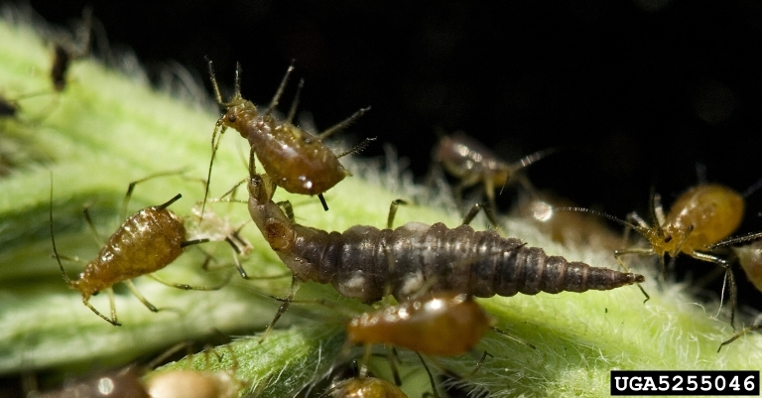
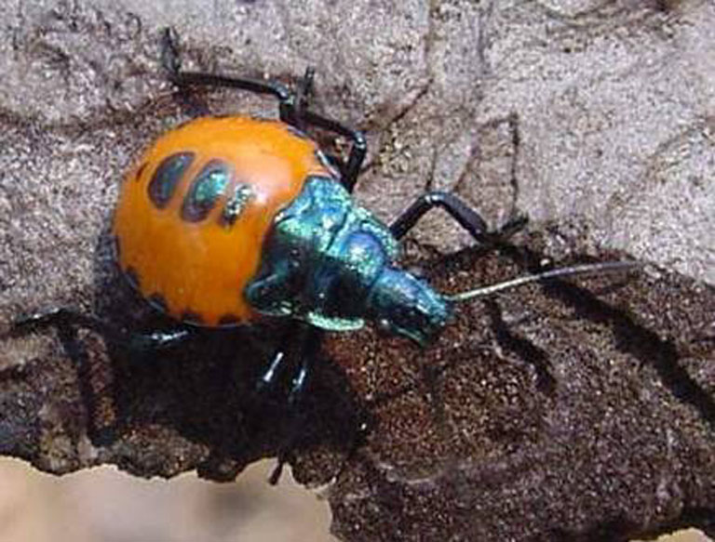
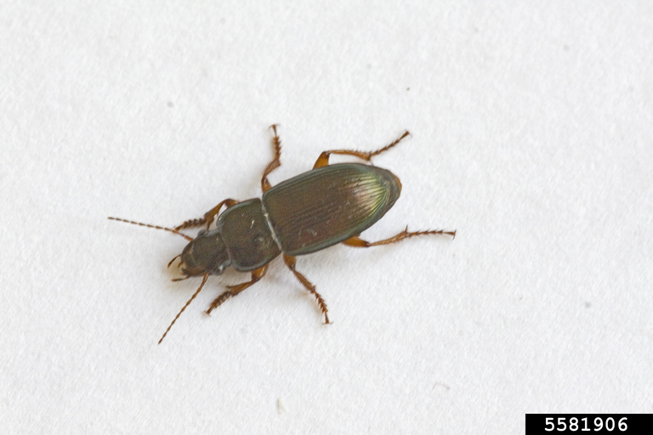
Biocontrol Agents/ Natural Enemy: Predators
Predatory stink bug Euthyrhynchus floridanus
Ground beetle
Harplaus affinis
Lacewings larvae eating aphids
Photo: David Cappaert, Bugwood.org, #5255046; Herbert A. 'Joe' Pase III, Texas A&M Forest Service, Bugwood.org, #9009073; Mary C Legg, Mary C Legg, Bugwood.org, #5581906
Notes:
These are some more examples of predatory insects.
The first example is from the order of Neuroptera. This lacewing larvae is a predator to aphids. Therefore, they provide control of the aphid colony through eating the aphids feeding on the plant host.
The second example is a predatory stink bug. It often preys on plant-damaging bugs, caterpillars, as well as beetles.
The third example is a ground beetle that feeds on crop pests like cutworms and lawn pests like smaller mole crickets.

Slide 5
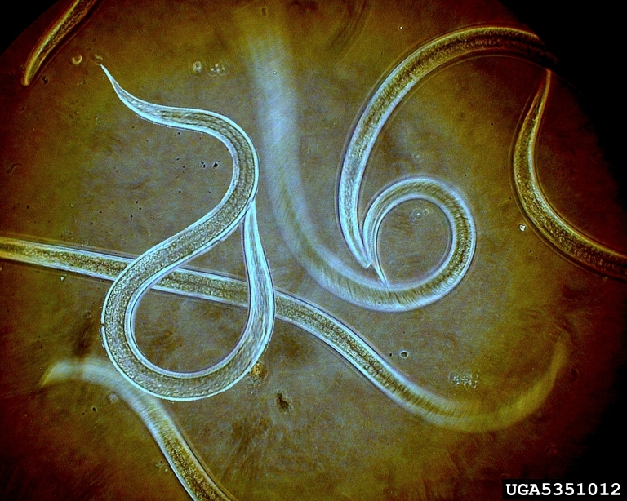
Biocontrol Agents/ Natural Enemy: Parasitoids
Parasitoids:
  Roundworms
    Nematodes (phylum Nematoda): entomopathogenic nematodes
  Arthropods:
    Order Diptera: flies
    Order Hymenoptera: wasps
Entomopathogenic nematodes
Steinernema scapterisci
Photo: David Cappaert, Bugwood.org, #5351012;
Notes:
Parasitoids are natural enemies that feed on pest slowly. They eventually die over time as the parasitoid feeds.
An example shown in the picture are entomopathogenic nematodes. This species have been used within biological control of mole crickets, a common turf grass pest here in Florida.
Some other orders that have parasitoids are within Diptera and Hymenoptera.

Slide 6
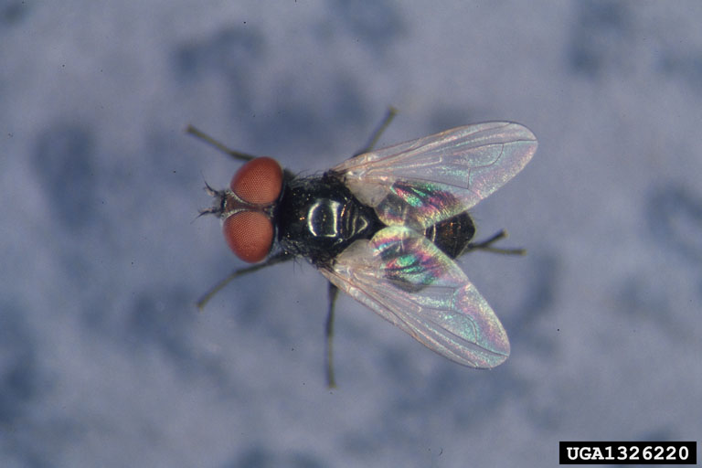
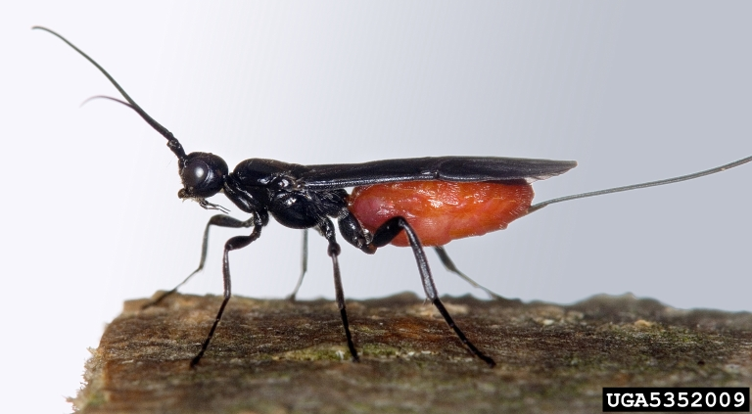
Biocontrol Agents/ Natural Enemy: Parasitoids
Tachinid flies
Phasia occidentis
Braconid wasp
Atanycolus cappaerti
Photo: Whitney Cranshaw, Colorado State University, Bugwood.org, #1326220; David Cappaert, Bugwood.org, #5352009
Notes:
The tachinid fly is within the order of Diptera. This fly is a parasitoid of most of the immature life stages (nymphs, caterpillars or larvae, eggs, pupae) of insects such as grasshoppers, moths butterflies, beetles, and some other insects.
The Braconid wasps often parasitize the larvae life stages of their target host insect. An example insect host Braconid wasp would target is the hornworm larvae. The wasp would lay eggs in the hornworm, and the immature life stages of the wasp offspring will emerge to pupate on the outside of the hornworm.
Reference:
Raupp, M. Traunfeld, J., Sargent, C. 2023. Tachinid Flies. University of Maryland Extension. University of Maryland. https://extension.umd.edu/resource/tachinid-fly/

Slide 7
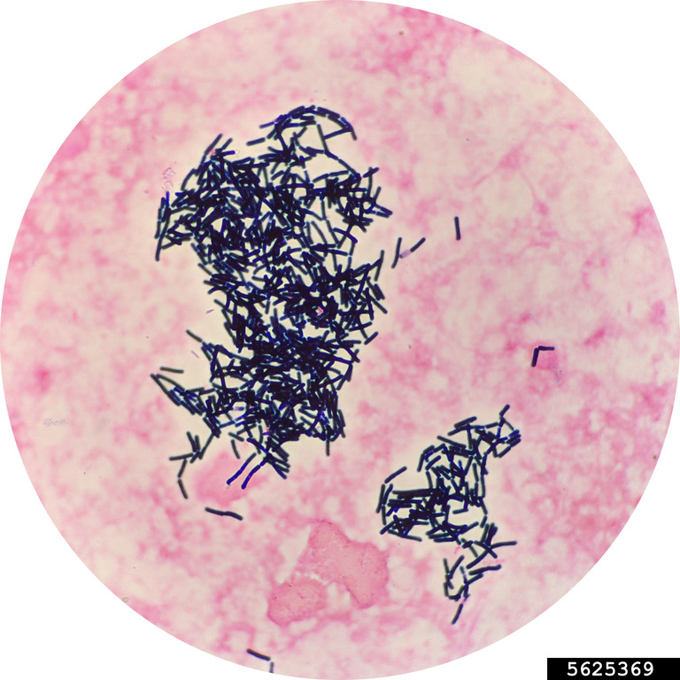
Biocontrol Agents: Pathogens
Pathogens:
  Fungi – entomopathogenic fungus
  Bacteria
  Viruses – entomopathogenic viruses
    EX: Nuclear or Cytoplasmic Polyhedrosis virus
Bacterial biological control
Bacillus thuringiensis (Bt)
Photo: Ansel Oommen, Bugwood.org, #5625369
Notes:
Another type of biocontrol agent is the use of pathogens. The types of pathogens that can be used are fungi, bacteria, viruses, and protozoans.
Entomopathogenic fungi can attack some insect pests. An example is Aschersonia aleyrodis which is found to attack immature whiteflies.
Some viruses can be used to attack insects as well. An example is the polyhedrosis virus, that is often known to attack the caterpillar’s cell structure. It is usually available commercially for greenhouses. Some pests this type of biocontrol agent has been used on are gypsy moth, beet armyworm, and cotton bollworm (Hoffmann, et al. 1993)
In this picture to the right, the bacterial biocontrol agent Bacillus thuringiensis (Bt) is shown. Insects will ingest the bacterial toxin that will later form pores in the gut lining of the insect. This will lead to the insect starving or infection from gut bacteria leaking through these pores, further killing the insect. Bt can be sprayed onto plants and is often used in organic farming for managing insect pests.
Reference:
Hoffmann, M.P., Frodsham, A.C. 1993. Natural Enemies of Vegetable Insect Pests. Cooperative Extension, Cornell University, Ithaca, NY. 63 pp. https://biocontrol.entomology.cornell.edu/pathogens/viruses.php
Fasulo, T.R., University of Florida, Weems, H.V., Florida Department of Agriculture and Consumer Services, Division of Plant Industry. 1999. Revised June 2020. Citrus whitefly, Dialeurodes citri (Ashmead) (Insecta: Hemiptera: Aleyrodidae). Featured Creatures. Publication Number EENY-84. University of Florida/IFAS Extension. https://entnemdept.ufl.edu/creatures/citrus/citrus_whitefly.htm#:~:text=citri%20(Ashmead).-,Photograph%20by%20University%20of%20Florida.,with%20a%20system%20of%20ridges.

Slide 8
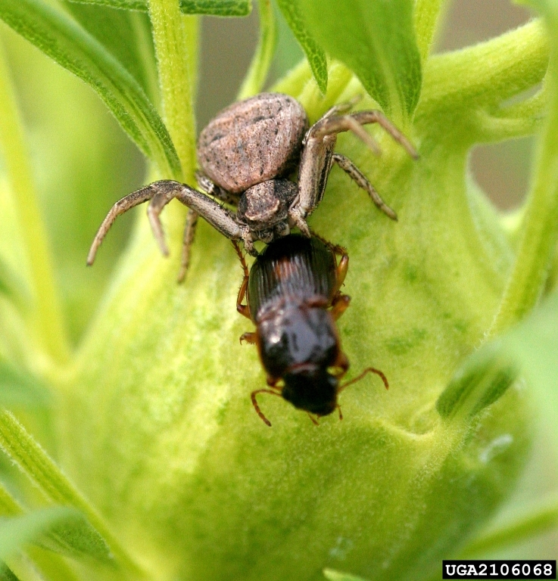
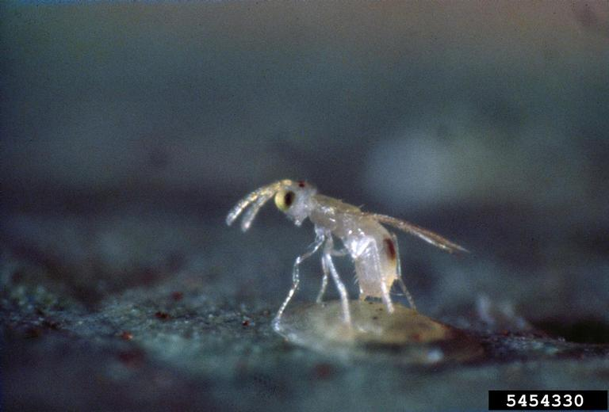
Generalist vs. Specialist
Generalist
  Biocontrol agent that has a wide range of hosts that it will eat, parasitize, or infect (biocontrol pathogen).
Specialist
  Biocontrol agent that is specific for usually one type or host, or narrow range of hosts that it can eat, parasitize, or infect (biocontrol pathogen).
Crab Spider, family Thomisidae
Parasitoid wasp, Encarsia lahorensis
Photo: David Cappaert, Bugwood.org, #2106068; Jeffrey W. Lotz, Florida Department of Agriculture and Consumer Services, Bugwood.org, #5454330
Notes:
Biocontrol agents or natural enemies can be generalists or specialists. This is based off how many hosts they can feed on, parasitize, or infect if it is a biocontrol pathogen.
Generalists are biocontrol agents that attack a wide range of hosts. An example would be a predatory spider. This spider can eat multiple pests or other animals that comes within its vicinity, such as aphids, whiteflies, stink bugs, flies, and so many more insects. For a biocontrol plant, a generalist would not be a good choice to use, due to host switching and not focusing on the target pest that is supposed to be managed properly.
Specialists are biocontrol agents that attack usually one host, or very narrow range of hosts. An example would be the Encarsia lahorensis parasitoid wasp that specializes in parasitizing citrus whitefly immatures. Specialists are usually a good choice to use for biocontrol agents because they do not conduct host switching and feeding on other non-target pests.

Slide 9
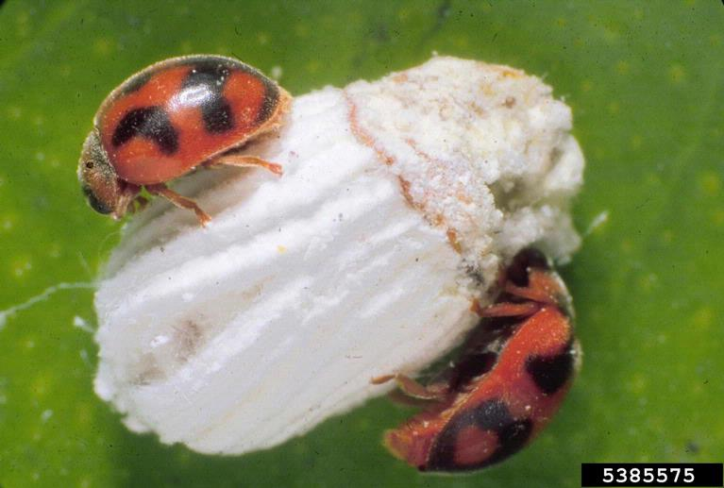
Classical Biocontrol
Import and release of non-native organism for the permanent establishment of this natural enemy to control target pest population.
Factors to consider:
  Origin of pest and biocontrol agent
  Biological life stage of biocontrol agent
  Time to study their interactions
  Permits to bring non-native biocontrol agent for research.
  Host specificity
Vedalia beetle (Rodolua cardinalis) feeding on pest cottony cushion scale (Icerya purchasi)
Photo: Florida Division of Plant Industry , Florida Department of Agriculture and Consumer Services, Bugwood.org, #5385575
Notes:
Classical Biological control is an approach for importing and releasing non-native organism to establish permanent populations to control target pest population. For researchers to properly plan and prepare for this type of control, there are many factors to consider. The origin country, habitat and climate are important to know when planning to introduce the natural enemy into the new environment. You would want the natural enemy to survive to be able to control the pest populations, as well as not interfere with the native flora and fauna that is in the new environment. Next step, would be monitoring its biological life cycle to learn about the stages of immature to an adult it goes through. Then monitoring which life stages of the pest’s life cycle does the natural enemy parasitize to be able to control the pest population sizes. This is critical for biocontrol plan to know what time of growing season to target the pest. This also allows for monitoring their interactions and to notice if the natural enemy is host specific or has the tendency to swap its appetite towards another pest or non-target insect to feed on. To be able to bring non-native insect to the USA, a permit would need to be received to conduct the research.
In the image is an example of a classical biological control released to manage the pest cottony-cushion scale that was found in 1868. The Vedalia beetle was found in the same habitat of where the scale was from. This was in Australia. Scientists studied how the beetle fed on the scale and decided to use this within the California climate to manage the cottony-cushion scales. The pest was devastating the citrus industry during this time and treatment was needed. 514 beetles were released into citrus groves of California and the scale was less of an important pest in 1890 due to biological control efforts.
Reference:
Shelton, A., Eccleston, J. No date. Success in Biological Control. College of Agriculture and Life Sciences. Cornell University. https://biocontrol.entomology.cornell.edu/success.php.

Slide 10
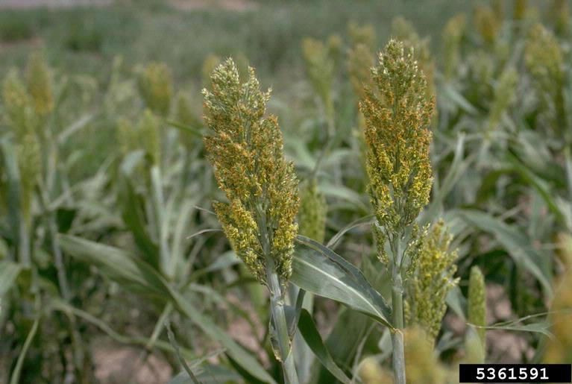
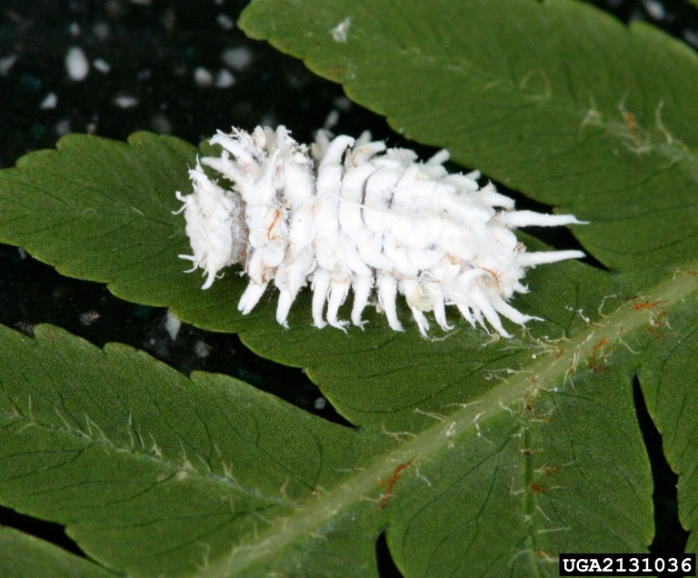
Conservation Biocontrol
Providing a habitat or environment that promotes and supports natural enemies that are present in the environment.
Benefits:
  Providing flowering plants– nectar or pollen
  Trees for natural enemies to overwinter or use for shelter
  Trap plants for pests
  Intercropping
Trap crop: Sorghum attracts aphids
Mealybug destroyer, Cryptolaemus montrouzieri
Photo: Howard F. Schwartz, Colorado State University, Bugwood.org, #5361591
Notes:
Conservation Biocontrol involved providing a habitat or environment that will support natural enemies that are currently present in the environment. Some benefits that could be incorporated into a garden or farm is by providing flowering plants to parasitoid wasps, as well as pollinators. They are attracted to the flowering plants because they are a source for nectar or pollen. Trees are another addition that can provide shelter or place to overwinter when temperatures become colder. Planting other trap plants for pests to be attracted to is also a great way to make it more accessible for the natural enemy to find the pests in a higher concentration on these trap plants. For farmers, intercropping may not always be something each farm can do due to expenses, however, this technique of growing crops can provide multiple types of plants so that more natural enemies can be attracted. Monoculture crop land makes it easier for pest populations to grow because they have a high source of the host plant they are feeding on in one location. This can cause devastating losses to farmers and gardeners.
In the picture example, the trap crop sorghum, can be used to attract aphids. Aphids are a common pest that feeds on many host crops. The mealybug destroyer can detect the congregation of the aphids on the trap plant and eat them. The trap plants promotes the presence of biological control agents/natural enemies like the mealybug destroyer to eat the pests, further managing and limiting their population. Mealybug destroyer feeds on aphids, mealybugs, and immature scales.

Slide 11
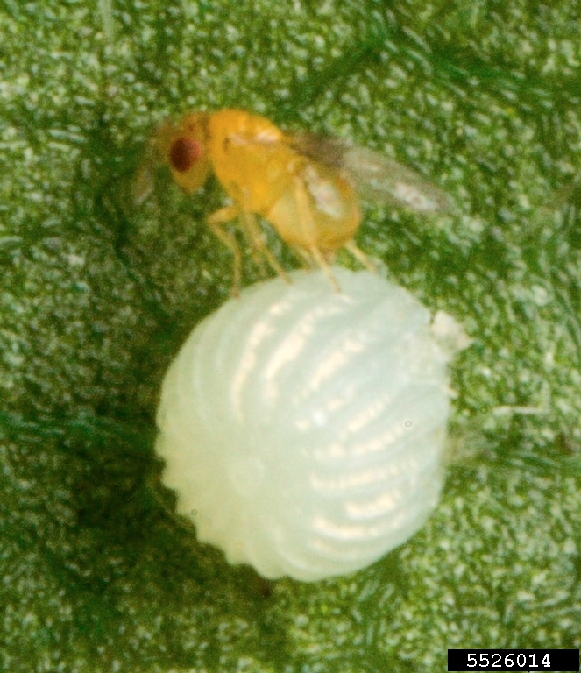
Augmentation Biocontrol
Release of natural enemies in multiple applications as an additional source, but the goal is not to have them to become established within the environment.
Pests are targeted with the release of higher numbers of natural enemies.
There are 2 approaches to augmentation biocontrol:
  Inundative
  Inoculative
Trichogramma wasp, Trichogramma ostriniae
Photo: Peggy Greb, USDA Agricultural Research Service, Bugwood.org, #5526014
Notes:
Augmentation biocontrol is the release of natural enemies in multiple applications. It is often used as an additional source of providing more natural enemies in an area, however the goal is not for them to become established. High numbers of natural enemies are usually released. There are two approaches of augmentation biocontrol, one being inundative and the other is inoculative.
An example of a parasitoid wasp that is often released as an augmentation biocontrol agent is the species Trichogramma ostriniae. In this picture, the female is laying her eggs inside the egg of a pest.

Slide 12
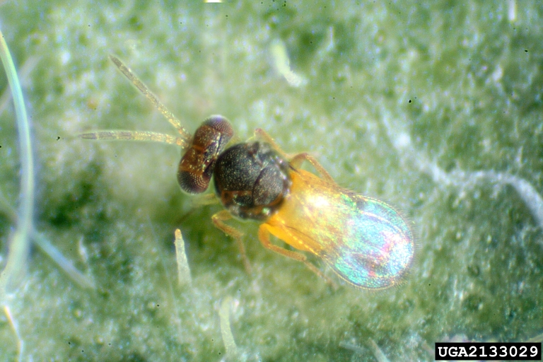
Inoculative
Used for a long-term (growing season) control to manage pest populations from reaching intolerable numbers.
Release small numbers of natural enemies early in pest life cycle.
Whitefly parasitoid, Encarsia formosa
Photo: David Cappaert, Bugwood.org, #2133029
Notes:
Inoculative approach is one of the two approaches used un augmentation biological control. This approach is used for long-term control, usually throughout the specific growing season for a particular host plant, to mage pest populations. These natural enemies are introduced to environment of the pests in small numbers at an early part of the pest’s life cycle. It is expected for the natural enemy to grow and reproduce beside the pest populations, while providing control throughout the growing season.
The picture shows an example of a species of parasitoid wasp that eats greenhouse whiteflies. This wasp is often used in inoculative control in a greenhouse environment. They are expected to limit the greenhouse whitefly pest population during the duration of the growing season. Periodic releases of the parasitoid wasp are often used.
References:
Toscano, K. 2017. Augmentation Biological Control Practices for the Home Landscape. HLA-6446. Oklahoma Cooperative Extension Service. Oklahoma State University.
https://extension.okstate.edu/fact-sheets/print-publications/hla/augmentation-biological-control-practices-for-the-home-landscape-hla-6446.pdf.

Slide 13
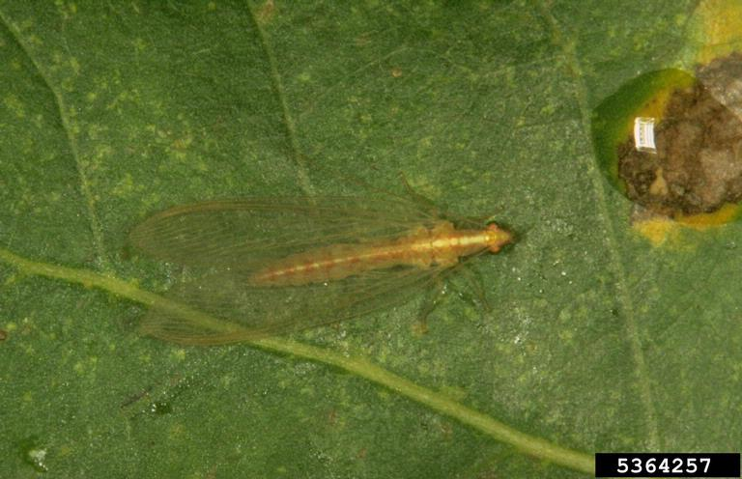
Inundative
During pest outbreaks, natural enemies can be released in large numbers to overwhelm pest numbers.
This provides a quick reduction in pest population.
Similar to the release of chemicals to reduce pest populations.
Green lacewings, Genus Chrysoperla
Photo: Frank Peairs, Colorado State University, Bugwood.org, #5364257
Notes:
Inundative approach is the second approach used in augmentation biological control. During pest outbreaks, natural enemies can be released in large numbers that will overwhelm pest populations. This approach will provide quick reduction in pest population in that area. This release can often be compared to the release of chemicals to reduce pest populations a lot quicker than classical biological control that would take a longer period to wait for reproductive stages of the biocontrol agents. It is expected that only the released individuals of the biocontrol agents in the inundative approach to manage pest populations, not their offspring.
Green lacewings are an example shown in the picture on the right. They are often used in inundative biological control. They can be released in numbers of 5,000 to 200,000 per acre per week based off pest infestation levels (Shelton, no date). The goal with the high numbers of individuals during the release is to get a quicker reduction of the pest population during period of infestation.
References:
Shelton, A. No date. What is biological Control. College of Agriculture and Life Sciences. Cornell University. https://biocontrol.entomology.cornell.edu/what.php.
Toscano, K. 2017. Augmentation Biological Control Practices for the Home Landscape. HLA-6446. Oklahoma Cooperative Extension Service. Oklahoma State University.
https://extension.okstate.edu/fact-sheets/print-publications/hla/augmentation-biological-control-practices-for-the-home-landscape-hla-6446.pdf.

Slide 14
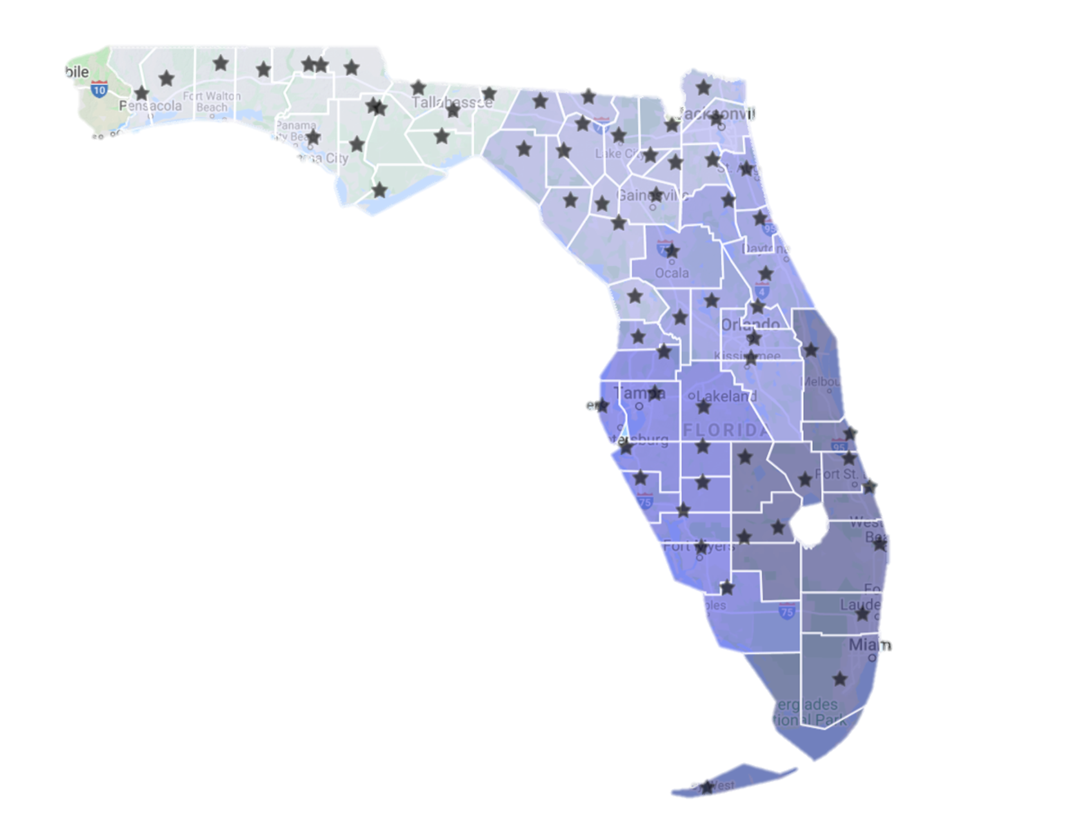
Reporting to UF/IFAS Faculty in Florida
Local county extension office
https://sfyl.ifas.ufl.edu/find-your-local-office/
Insect ID Lab - Dr. Lyle Buss
http://entnemdept.ufl.edu/insectid/
Nematode Diagnostic Lab - Dr. Billy Crow
http://nematology.ifas.ufl.edu/assaylab/index.html
Plant Diagnostic Center - Dr. Carrie Harmon
https://plantpath.ifas.ufl.edu/extension/plant-diagnostic-center/
Notes:
The UF/IFAS faculty is responsible for reporting diseases, insects, weeds, nematodes, or any other invasive species to the Florida Department Agriculture and Consumer Services, Division of Plant Industry (FDACS, DPI). Reporting this information is essential to protect Florida agriculture, communities and natural areas.
Local county extension agents can assist in identifying plant pest or assist in submitting a pest sample to the correct department or agency for identification. Attached is a link to find the closest extension agent near you.
If you need a insect identified, Dr. Lyle Buss at is the director of the Insect ID Lab at the University of Florida. The link attached will direct you to the insect ID Lab for further instructions for contact, questions, and submission forms.
If a diseased plant needs identification, the link to the UF/IFAS Plant Diagnostic Center run by Dr. Carrie Harmon is attached to assist in reporting and identifying the correct pest.
The diagnosticians and identifiers in each area will also provide management strategies for the pest identified to help eliminate the damage caused on the plants. If an invasive pest is found, they will send it FDACS, DPI for further testing.

Slide 15
Reporting to FDACS-DPI in Florida
Florida Department of Agriculture and Consumer Services (FDACS) - Division of Plant Industry (DPI)
FDACS, DPI Responsibility
  Announcing detection or establishment of new invasive species.
  Reporting is a legal obligation under Florida Statute 581.091.
Submission Form
  http://forms.freshfromflorida.com/08400.pdf
  https://www.fdacs.gov/Agriculture-Industry/Pests-and-Diseases/How-to-Submit-a-Sample-for-Identification
Notes:
Florida Department of Agriculture and Consumer Services: Division of Plant Industry is a regulatory agency that detects, intercepts, and controls Florida’s native and commercially grown plants. Announcing the establishment of new invasive species can affect Florida’s agricultural producers and trade of agricultural products.
FDACS, DPI provides online submission forms to fill out and send into the agency for proper identification. Additionally, DPI provides useful videos of how to properly handle the specimens before shipping them for identification

Slide 16
FDACS, DPI Contact
Dr. Leroy Whilby, Bureau Chief-Entomology, Nematology and Plant Pathology
  352-395-4661
  Leroy.whilby@freshfromflorida.com
Dr. Paul Skelley, Assistant Chief-Entomology, Nematology and Plant Pathology
  352-395-4678
  Paul.skelley@freshfromflorida.com
Division of Plant Industry Hotline
  1-888-397-1517
  DPIHelpline@FDACS.gov
Notes:
The DPI contacts provided will assist in determining the next steps if the pest found is of regulatory concern. Additionally, FDACS, DPI has a hotline with both a phone number and email for questions and concerns.

Slide 17
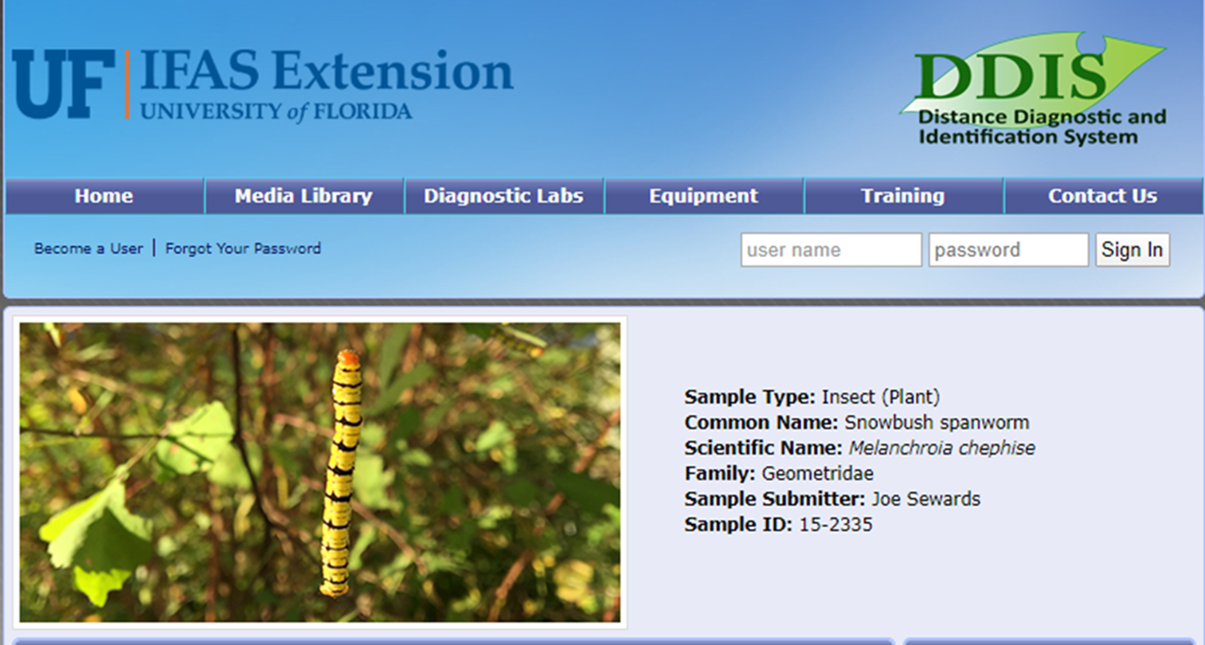
Reporting using DDIS in Florida
Digital Diagnostic and Identification System (DDIS)
Digital Diagnostic Collaboration
  Extension agents
  Laboratories
  Clinics
  Specialists
https://ddis.ifas.ufl.edu/
Notes:
The DDIS system connects the UF/IFAS faculty mentioned before to provide quick and accurate identification throughout Florida. This reporting collaboration tool enhances screening, early detection, monitoring, pest mapping, and rapid communication to protect agriculture. The site provides training, media of pest, equipment, and diagnostic labs in Florida.

Slide 18

Find More Information At:
https://entnemdept.ufl.edu/ffd/

Slide 19
Lab Team
Authors & Editors
Ariana Rollins, B.S. – Graduate Student, Doctor of Plant Medicine Program, Entomology and Nematology Department, University of Florida
Daniela Perez Lugones, M.S. – Graduate Student, Doctor of Plant Medicine Program, Entomology and Nematology Department, University of Florida
Gideon Alake, PhD – Research Assistant Scientist, Entomology and Nematology Department, University of Florida
Jhonson Leonard, M.S. – Graduate Student, Doctor of Plant Medicine Program, Entomology and Nematology Department, University of Florida
Lyuyi Chen, M.S. – Graduate Student, Doctor of Plant Medicine Program, Entomology and Nematology Department, University of Florida
Sarah Tafel, B.S. – Graduate Student, Doctor of Plant Medicine Program, Entomology and Nematology Department, University of Florida
Lab and DPM Program Director
Amanda Hodges, Ph.D. - Extension Scientist and DPM Director, Entomology & Nematology Department, University of Florida

Slide 20
Collaborating Agencies
U.S. Department of Agriculture Animal and Plant Health Inspection Service (USDA-APHIS)
Cooperative Agricultural Pest Survey Program (CAPS)
Florida Department of Agriculture and Consumer Services (FDACS)
National Plant Diagnostic Network (NPDN)
Sentinel Plant Network (SPN)
University of Florida Institute of Food and Agricultural Sciences (UF-IFAS)
Protect U.S.

Slide 21
Educational Disclaimer and Citation
This presentation can be used for educational purposes for NON-PROFIT workshops, trainings, etc.
Citation:
  University of Florida, Entomology and Nematology Department, Biosecurity Research and Education Lab. May 2024. Biological Controls, Day Accessed

Slide 22
UPDATE INFORMATION FOR AUTHORS
*Keep slide hidden*
Presentation Topic: Biological Controls
Updated by: Ariana Rollins
Update began (dd/mm/yy): 5/1/2024
Update complete (dd/mm/yy): 5/9/2024
Uploaded to site (dd/mm/yy):

