Slide 1
Invasive Species and
Population Growth
Notes:
National Science Education Life Science Standards:
Grades 5-8:
The number of organisms an ecosystem can support depends on the resources available and abiotic factors, such as quantity of light and water, range of temperatures, and soil composition. Given adequate biotic and abiotic resources and no disease or predators, populations (including humans) increase at rapid rates. Lack of resources and other factors, such as predation and climate, limit the growth of populations in specific niches in the ecosystem.
Sunshine state standards covered:
SC.7.L.17.3 - Describe and investigate various limiting factors in the local ecosystem and their impact on native populations, including food, shelter, water, space, disease, parasitism, predation, and nesting sites.
The focus of this presentation is how invasive species can affect the population growth of native species through disease (or disease transmission), competition, and predation.
The text provided at the bottom of the slide is meant to aid the presenter. It is not meant to be read verbatim. Please feel free to go into more detail or less detail as needed.

Slide 2
Questions
What is population growth?
What factors affect population growth?
What is an invasive species?
How can invasive species affect population growth of native species in a local ecosystem?

Slide 3
Vocabulary
Population
Population growth
Exponential growth
Logistic growth
Limiting factors
Abiotic factors
Biotic factors
Carrying capacity
Native species
Invasive species
Competition
Predation
Notes:
Population - a group of individuals of the same species living in a particular geographic area at a particular time. It is calculated by adding the number of births plus immigration (the number of individuals coming into an area) and subtracting the number of deaths and emigration (the number of individuals leaving an area).
Population growth – is the change in the number of individuals that make up a particular population over time. Population growth can be positive or negative. For example, if a population was 60 one year and 70 the next year, then we would say that the population growth is positive (it has increased). If, however, a population was 60 one year and 45 the next, then we would say that the population growth is negative (it has decreased). Population growth is usually expressed for a specified amount of time (i.e. population growth between 1999 and 2009).
Exponential growth – is unregulated growth. It assumes that growth continues with no limits. It is represented in graph form as a J-shaped growth curve.
Logistic growth – is limited growth. It assumes that population growth is limited by several factors such as space, food, and water availability, nesting sites, weather, predators, competition, etc. It is represented in graph form as an S-shaped growth curve.
Limiting factors – food, water, space, etc. are all factors that limit a population’s ability to grow. These are finite or scarce resources meaning that there may not be enough of this resource available for all the organisms found in a particular habitat to use.
Abiotic factors – any contribution to the environment that is of a non-living nature. For example, temperature, humidity, and pH are all non-living factors that affect the environment and the organisms living in it.
Biotic factors – influences on the environment that are caused by living organisms.
Carrying capacity – the number of organisms a particular habitat can normally support. This number is influenced by the limiting factors and things like predation and competition and is represented on the logistic growth graph as the point where the population levels out (the growth rate is zero).
Native species are organisms including a plants or animals whose presence in a given ecosystem is the result of only natural processes with no human intervention. Native species normally live and thrive in a particular ecosystem. Examples of species native to the U.S. include crabapple, wild turkey, and pumpkin.
Invasive species – are defined by the National Invasive Species Council as any species that is not native to that area (i.e. an introduced species) and whose introduction does or is likely to cause economic harm (such as to the environment or to food crops) or harm to human health. The definition of invasive species also includes any parts from which the species can reproduce. For example, some amphibians and insects hatch from eggs, plants may grow from seeds, and bacteria and fungi may reproduce from spores. Some species can also reproduce from parts of their body. For example, some plants can develop from roots, leaves, or stem cuttings. Invasive species are usually accidentally introduced through shipping of goods from country to country or the movement of people from country to country, but sometimes they can be intentionally introduced. You have probably seen some invasive species, but may not have known they were considered invasive.
Competition – the interaction between organisms that are trying to acquire the same resource. For example, there may be competition between organisms for food, water, nesting sites, etc. Competition can occur between individuals of the same species or individuals of different species.
Predation – an animal that lives by eating other organisms is a predator.
Information sources:
Allaby, M., editor. Concise Oxford Dictionary of Ecology. 1998. Oxford University Press, USA
Campbell, N.A. 1990. Biology, 2nd Edition. Benjamin/Cummins Publishing Company, New York.
Hale, W. G. and J.P. Margham. 1991. The Harper Collins Dictionary of Biology. Harper Perennial, New York.
National Invasive Species Council
accessed June 4, 2012 –
http://www.invasivespecies.gov/
Stiling, P.D. 1992. Ecology: Theories and Applications, 2nd Edition. Prentice Hall, New Jersey.

Slide 4
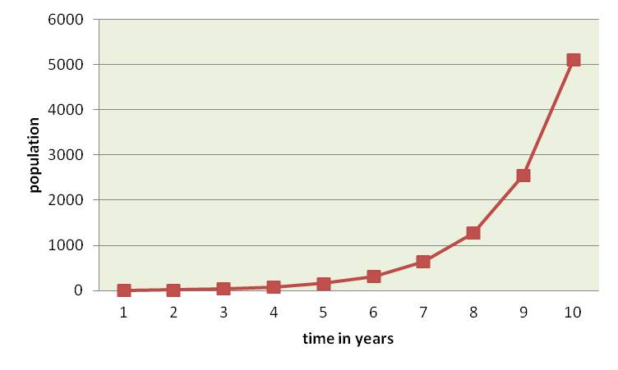
Exponential Growth
J-shaped exponential growth curve
Notes:
Population growth can be displayed in graphic representation.
Here we see exponential growth. It is represented in graph form as a J-shaped growth curve. The y-axis shows the number of individuals in the population while the x-axis shows time in years. This graph shows the number of individuals in a population over a certain amount of time.
This type of growth assumes that there is unlimited food, water, space, nesting sites, etc. available and that the population will continue to increase (with more births and immigration than deaths and emigration) until the end of time. When an organism colonizes a new area, you may see exponential growth in the beginning stages. For example, if you inoculated a petri dish with a single bacterial cell, within 100 minutes, you would have 32 cells; in 4 hours, you would have 4096 cells; and in 8 hours, you would have 16,777,216 cells.
However, exponential growth cannot go on indefinitely, can it?
Discussion Questions:
Can you think of an example of exponential growth?
What would allow exponential growth to occur? (HINT: are the basic needs met?)
Is exponential growth realistic? Why or why not?
Information citation:
Campbell, N.A. 1990. Biology, 2nd Edition. Benjamin/Cummins Publishing Company, New York.
Hale, W. G. and J.P. Margham. 1991. The Harper Collins Dictionary of Biology. Harper Perennial, New York.
Stiling, P.D. 1992. Ecology: Theories and Applications, 2nd Edition. Prentice Hall, New Jersey.

Slide 5
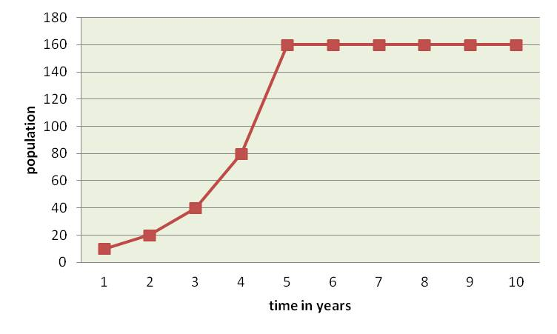
Logistic Growth
S-shaped logistic growth curve
Notes:
There are several factors which limit the growth of organisms because they are scarce in their availability. These limiting factors include space, food, water, nesting sites, etc. In the case of the bacteria, the resources are limited to the space in the petri dish and the amount of food in the petri dish. Therefore, the initial exponential population growth of bacteria will actually begin to slow down and level out (remaining fairly constant in population numbers – no increase or decrease).
As a population slows in its growth due to limiting factors, the graph forms an S-shape. This called a logistic growth curve. The point where the line levels out is considered the carrying capacity (indicated by the blue line, click the mouse to see it appear). This number takes into account food, water, space, nesting sites, etc. that are available in this particular habitat and shows you the number of individuals that this habitat can support given the limiting factors found in that environment.
Discussion Questions:
What other limiting factors can you suggest?
Can population growth be a negative number? If so, how?
Information citation:
Campbell, N.A. 1990. Biology, 2nd Edition. Benjamin/Cummins Publishing Company, New York.
Hale, W. G. and J.P. Margham. 1991. The Harper Collins Dictionary of Biology. Harper Perennial, New York.
Stiling, P.D. 1992. Ecology: Theories and Applications, 2nd Edition. Prentice Hall, New Jersey.

Slide 6
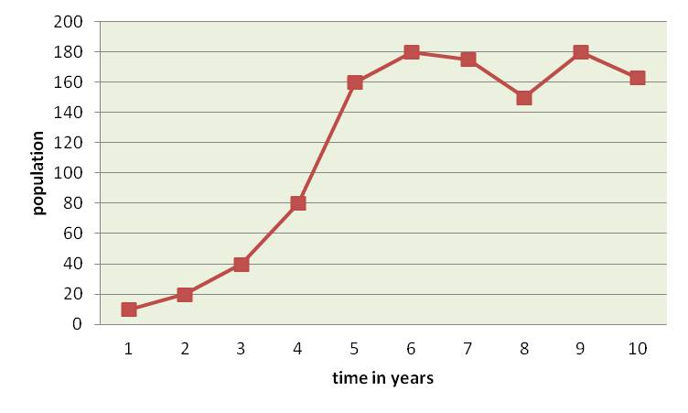
Factors that cause the population to fluctuate around the carrying capacity
Notes:
The carrying capacity is not a set number. Populations do not reach the carrying capacity and just stop. In fact, it is natural for populations to fluctuate over time, increasing some times and decreasing at other times. A population that is increasing has a positive population growth, while a population that is decreasing has a negative population growth. The carrying capacity is an estimated number that lies somewhere in the middle of these population fluctuations (the blue line represents the carrying capacity). The carrying capacity represents a growth rate of zero.
There are many factors (besides limiting factors) that can cause population fluctuations. These include things like droughts, hurricanes, wildfires, mild winters, wet summers, etc. In some cases (such as droughts, hurricanes, and wildfires), you would expect the populations to drop. In other cases (such as mild winters or wet summers), you might expect an increase in the population. Having access to extra water during the summer or having mild winters might increase the chances of offspring surviving to become sexually mature.
Over the long term, many populations remain fairly stable in size and hover around their carrying capacity based limiting factors, but short term fluctuations may occur due to other events.
Discussion Questions:
What other factors can you suggest that might cause a population to fluctuate?
Are these factors biotic or abiotic?
Which would cause the population to decrease?
Which would cause the population to increase?
Information citation:
Campbell, N.A. 1990. Biology, 2nd Edition. Benjamin/Cummins Publishing Company, New York.
Hale, W. G. and J.P. Margham. 1991. The Harper Collins Dictionary of Biology. Harper Perennial, New York.
Stiling, P.D. 1992. Ecology: Theories and Applications, 2nd Edition. Prentice Hall, New Jersey.

Slide 7
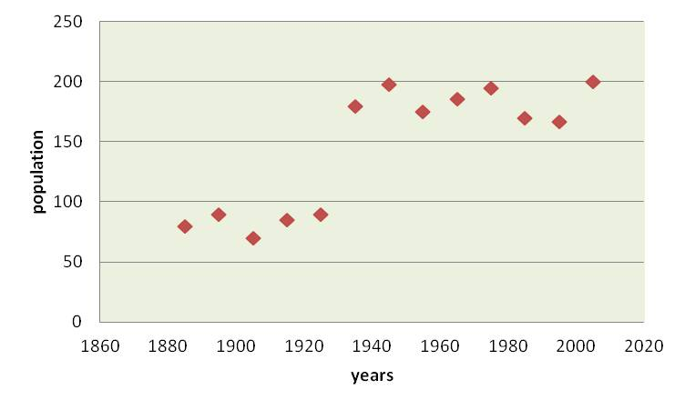
Adjusting the carrying capacity
Notes:
The carrying capacity can be kept artificially low or boosted to be artificially high.
For example, hunting can keep the carrying capacity low. Should hunting be removed as a factor, the population may increase until it reaches its true carrying capacity of the environment. This was seen on Saint Paul’s Island when it came to fur seals. Fur seals were hunted for their fur which kept the carrying capacity artificially low (black line). In 1925, when hunting was banned, the population increased until it reached the true carrying capacity of the environment (blue line).
You can keep populations artificially high as well by providing food or water or nesting sites that normally would not occur. For example, if you feed the birds, provide them with nesting boxes, and give them water, you can keep the carrying capacity artificially high.
Discussion Questions:
How would providing food, water, and nesting sites artificially inflate the carrying capacity?
Information sources:
Pearson Education, Inc.
Accessed June 14, 2012 –
http://wps.pearsoncustom.com/wps/media/objects/5697/5834441/ebook/htm/chp36_4.htm

Slide 8
Other factors that affect the population size
Disease
  Impact depends on lethality and ability to spread
Competition
  Occurs between individuals of the same species and individuals of different species
  Can be over resources
  Has three outcomes
Predation
  animals that eat other animals or animals that eat plants
  Predators can come in all shapes and sizes
Notes:
Disease, competition, and predation have large impacts on population size (and thus the carrying capacity).
The impact of disease largely depends on its lethality and its ability to spread. If a disease is lethal, but members of a population do not come into contact with each other much, then the impact of the disease on the overall population is greatly diminished. If, however, a disease is lethal and the population lives in close quarters, then the impact of the disease on the overall population will be greater.
Competition can occur between individuals of the same species and individuals of different species. This competition can be over resources such as water, food, nesting sites, space, etc. In the case of individuals of the same species, it can even be over mates. When it comes to competition, there can only be 3 outcomes.
In the first scenario, species 1 (or individual 1) outcompetes species 2 (or individual 2) for a resource, and species 2 (or individual 2) either leaves the area, dies, or has a reduction in its population and the resulting adjustment to its carrying capacity.
In the second scenario, species 2 (or individual 2) outcompetes species 1 (or individual 1) for a resource, and species 1 (or individual 1) either leaves the area, dies, or has a reduction in its population and the resulting adjustment to its carrying capacity.
In the third scenario, species 1 (or individual 1) and species 2 (or individual 2) end up sharing a resource, and therefore both species (or both individuals) coexist. For example, two species of fish live in the same pond. Species one lives in the shallow area while species 2 lives in the deeper area. Another example would be lions and elephants that need access to the same watering hole. The lions may visit in the morning, while the elephants may visit in the evening.
It is important to remember that competition for resources occurs for all species – plants, animals, fungi, etc. In addition, the more individuals you have, the more impact competition will have on the population. For example, if you have a pond that is 2 acres in area and there are only 2 turtles in it, there is not much competition. However, if you have 2000 turtles, all competing for space and food, the impact that competition will have on the population is greater.
Predation can also occur between individuals of the same species and individuals of different species. The term applies to animals that eat other animals or animals that eat plants. It is important to remember that predators come in all different sizes.
The impact of predation depends on the population number. For example, if you have 1 fox and 1000 rabbits, the fox can only eat so many rabbits, so predation will not have much of an impact on the rabbit population. However, if you have 100 foxes and 1000 rabbits, predation will have a larger impact on the rabbit population. In areas where predators and prey have coexisted for thousands of years, each develop certain strategies to either help it eat well (predator) or to avoid being eaten (prey). This is an important concept to remember as we discuss yet one more factor that affects the population size.
Discussion Questions:
Can you think of a disease that could affect an organism’s population size? You can use a human example if you wish.
Can you think of an example of competition that could affect an organism’s population size?
Can you think of an example of predation that could affect an organism’s population size?
Information sources:
Campbell, N.A. 1990. Biology, 2nd Edition. Benjamin/Cummins Publishing Company, New York.
Stiling, P.D. 1992. Ecology: Theories and Applications, 2nd Edition. Prentice Hall, New Jersey.

Slide 9
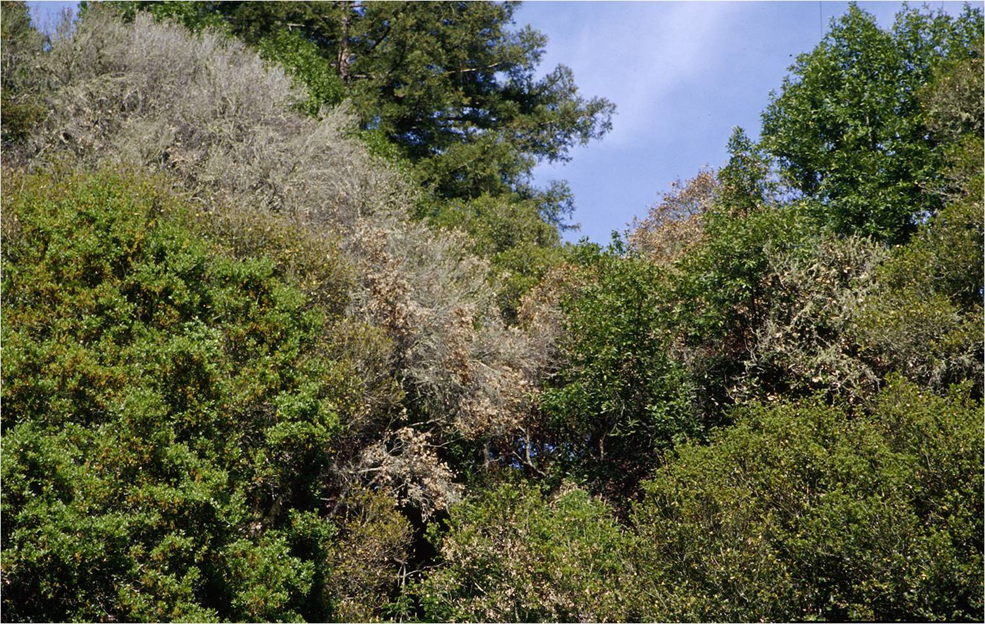
Invasive species as diseases
Sudden oak death
Photo Credit: Joseph O’Brien, USDA Forest Service
http://www.invasive.org/ Image No. 1427112
Notes:
An invasive species is one that has been introduced from another area and causes economic harm (such as to the environment or to food crops) or harm to human health. Invasive species can cause disease (or vector a disease), outcompete native organisms for resources, or even prey on native organisms. We have already discussed the impact each of these can have on the population. Now, we will take a look at several examples of invasive species that fall in these categories.
Sudden oak death (also known as ramorum leaf blight or ramorum dieback) is an invasive disease that is caused by a water mold called Phytopthora ramorum. Water molds look like fungi, but are actually more closely related to algae. Though researchers are still determining the native distribution of this disease, evidence suggests that it is not native to either North America or Europe (where it has recently been found).
Over 135 plants have been recorded as hosts for sudden oak death including many that are found in native forests, in the nursery trade, and in people’s yards. Though many plants, such as rhododendron, camellia, and viburnum can have the disease, but do not die from it, many others have no defense for this newly introduced disease and thus succumb to it.
This disease can kill a tree in one to two seasons and causes leaf death or cankers (large, weeping wounds).
Discussion Questions:
How does sudden oak death affect the populations of those organisms that depend on these plants for food and shelter?
What are some examples of the types of organisms that could be affected?
Information from:
California Oak Mortality Task Force. 2012.
accessed 6/14/2012 –
http://www.suddenoakdeath.org/diagnosis-and-management/hosts-and-associated-plants/
Garbelotto, M. 2004. “Sudden oak Death: A Tale of Two Continents”. Outlooks on Pest Management, Volume 15, Number 2, pp. 85-89.
USDA – APHIS. 2012.
accessed 6/14/2012 -
http://www.aphis.usda.gov/plant_health/plant_pest_info/pram/downloads/pdf_files/nationalpestalert_.pdf

Slide 10
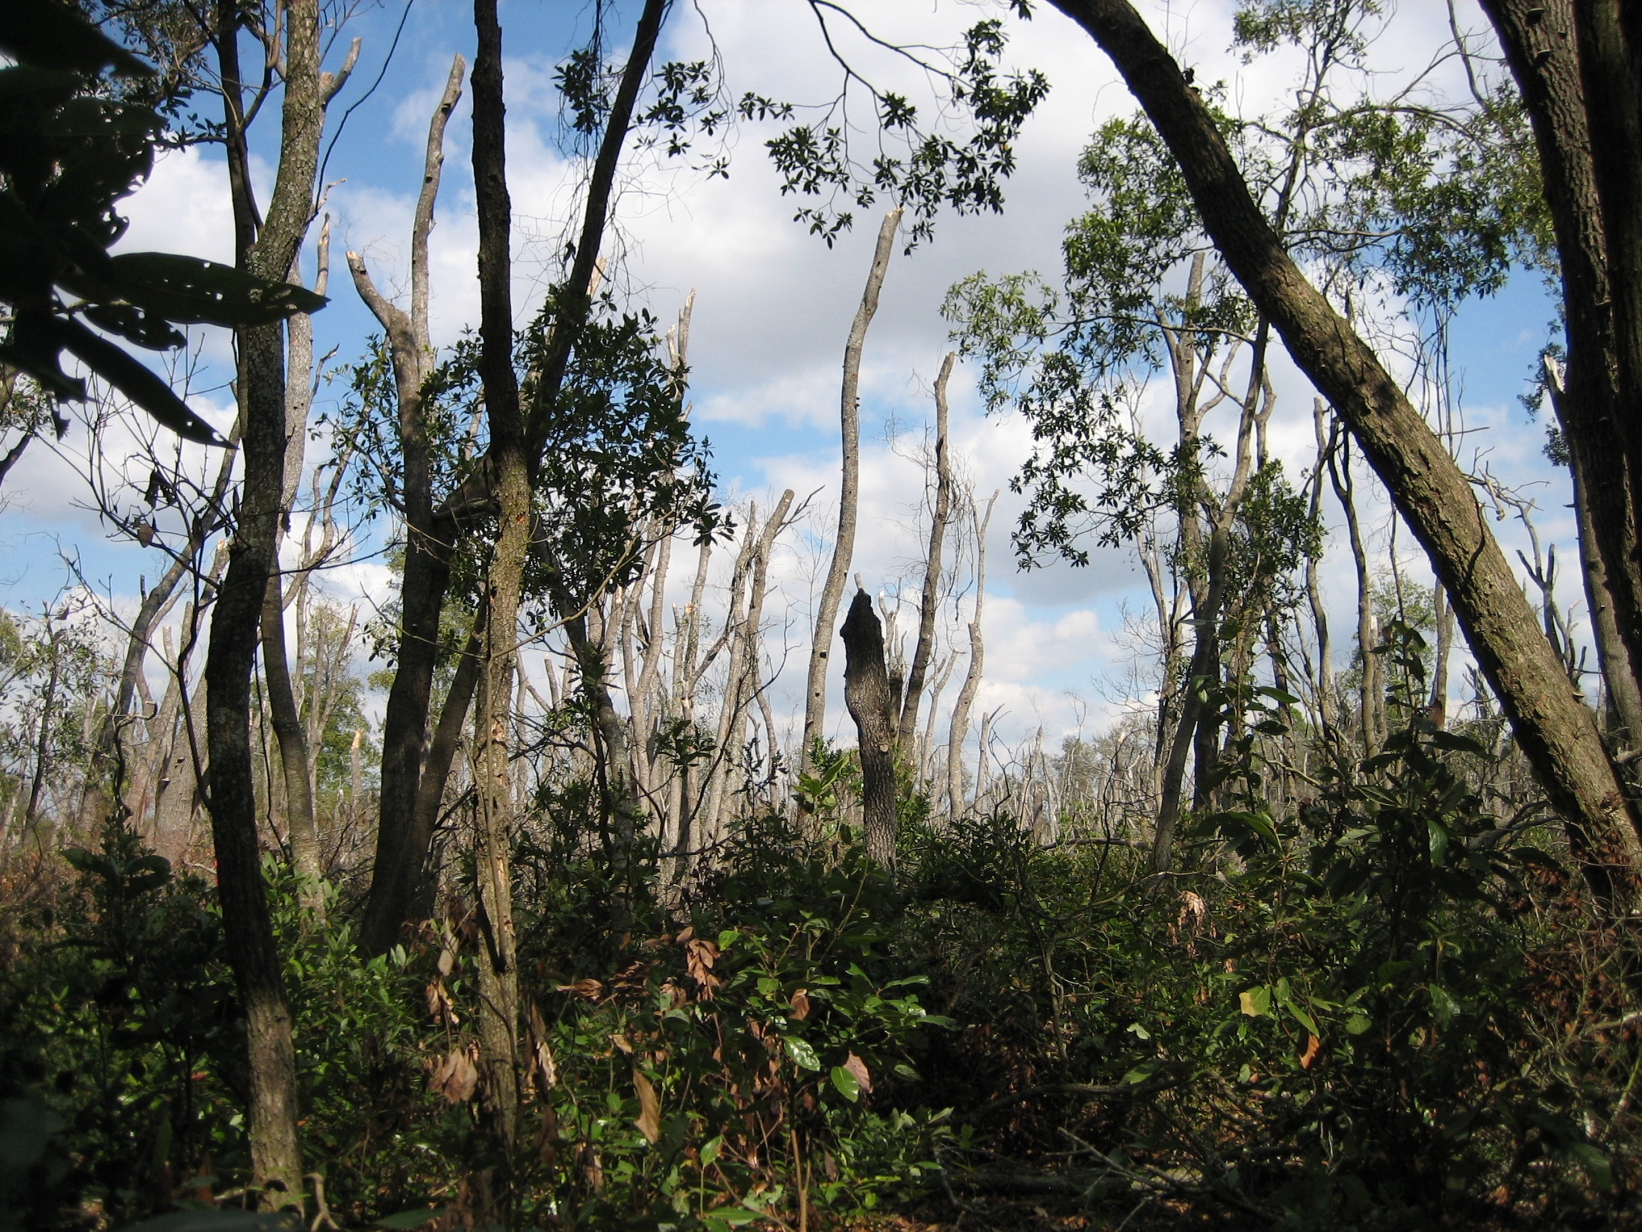
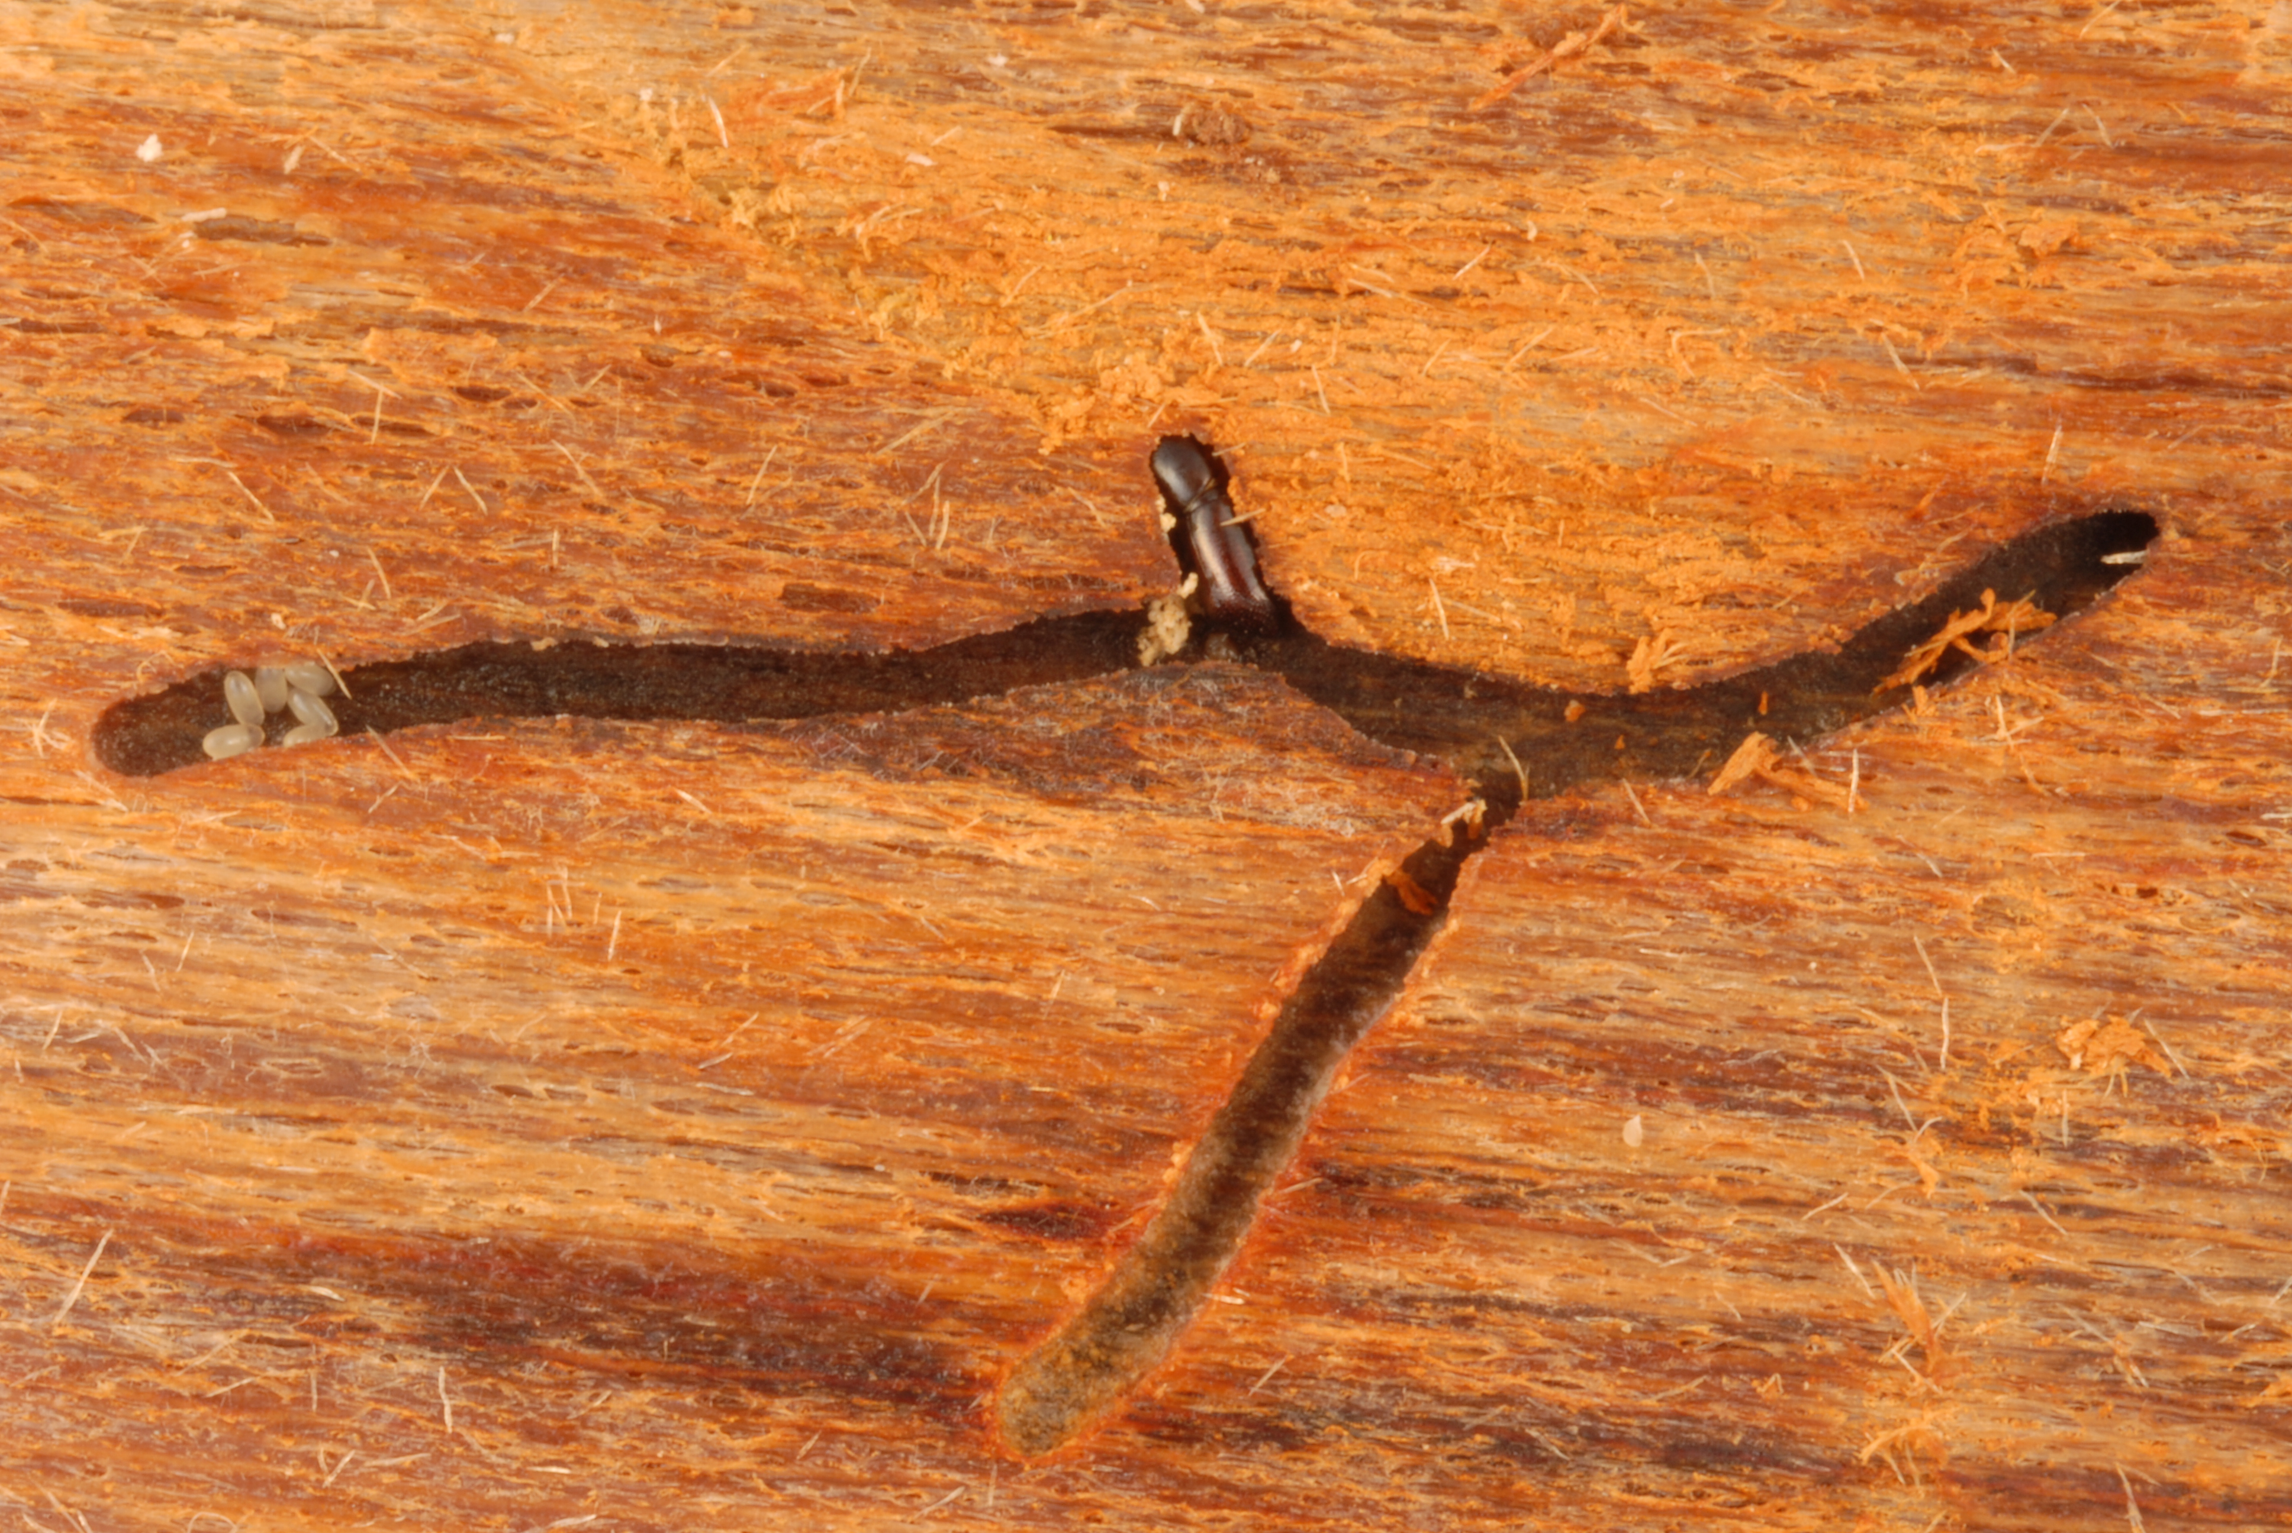
Invasive species as diseases
Laurel wilt
Photo credits:
Damage: CL Harmon, University of Florida
Adult and tunneling: Lyle Buss, University of Florida
Notes:
Another invasive disease is laurel wilt which that is caused by a fungus (Raffaelea lauricola). It is spread by an invasive beetle from Asia called the redbay ambrosia beetle (Xyleborus glabratus). The beetle (and therefore the fungus that causes the disease) came into the U.S. most likely on wood packing material.
The adult of this beetle is tiny (averaging just 1/32inch or 2mm in length) and brown. You will probably never see this beetle, just the damage that it causes.
This disease attacks mostly redbay trees found in the southeastern United States. These trees produce fruit that is a very important source of food for wildlife in the winter. This disease also kills sassafras, swamp bay, pondspice, pondberry, camphor, and avocado.
The adults tunnel into the tree, bringing with it the fungus which it grows in the tree for food. This fungus then spreads throughout the tree and kills it. It was first detected in Georgia and has since spread to North Carolina, South Carolina, Florida, Alabama, and Mississippi. Once infected, a stand of mature redbays can be completely killed in 3 to 5 years.
There is currently no cure for the disease.
Discussion Questions:
How does laurel wilt affect the populations of those organisms that depend on these plants for food and shelter?
What are some examples of the types of organisms that could be affected?
Information from:
Alabama Forestry Commission. “Laurel Wilt Disease”.
accessed 6/14/2012 –
http://www.forestry.alabama.gov/LaurelWilt.aspx?bv=3
Florida Department of Agriculture and Consumer Services – Florida Forest Service. 2008.
accessed 6/14/2012 –
http://www.floridaforestservice.com/publications/fh_pdfs/Laurel_Wilt.pdf
Jeff Eickwort, Forest Biologist, Florida Department of Agriculture and Consumer Services, Division of Forestry.
Fraedrich, S.W., T.C. Harrington, R.J. Rabaglia, M.D. Ulyshen, A.E. Mayfield, III, J.L. Hanula, J.M. Eickwort, and D. R. Miller. 2008. “A Fungal Symbiont of the Redbay Ambrosia Beetle Causes a Lethal Wilt in Redbay and Other Lauraceae in the Southeastern United States”. Plant Disease, Volume 92, No. 2.

Slide 11
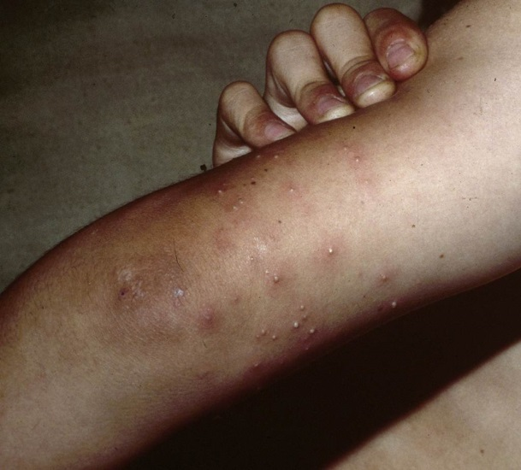
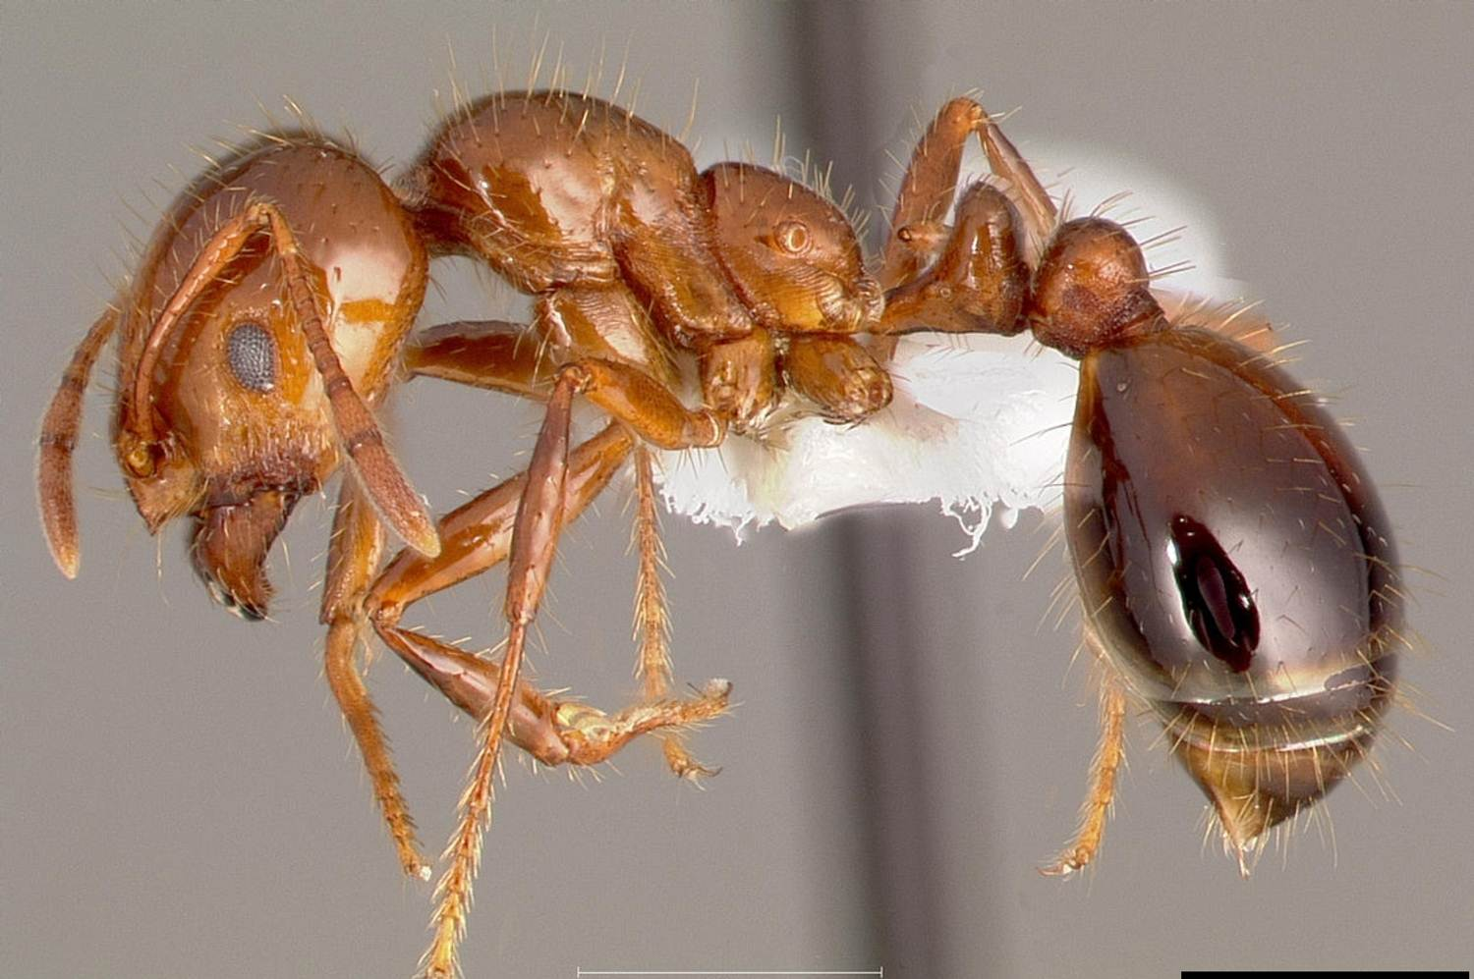
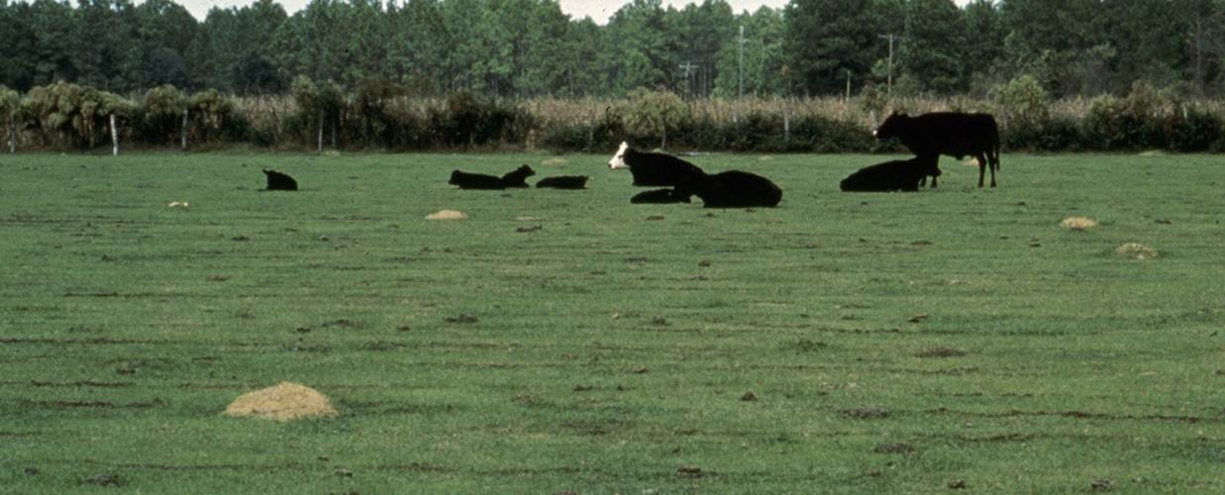
Invasive species as competitors
Red Imported Fire Ant
Photo credits:
Fire ant – April Noble, Antweb.org, www.bugwood.org, #2121038
Mounds – USDA APHIS PPQ Archive, USDA APHIS PPQ, www.bugwood.org, #1148038
Bites – USDA APHIS PPQ Archive, USDA APHIS PPQ, www.bugwood.org, #1148032
Notes:
The red imported fire ant (Solenopsis invicta) is a native of South America, but was introduced in North America (Mobile, Alabama) in the 1930’s probably through soil that was used for ship’s ballasts. Ballasts are weights that are added to a ship to make it more stable when crossing the ocean. In the past, things like bricks and boxes of soil were used as ballast. As a result, this invasive species has also been introduced to Australia, New Zealand, and some of the Caribbean Islands.
The insects vary in size from 1/16 inch to almost 1/4 inch and are mostly red with black in color. The mounds that these ants make can also vary in size, but rarely exceed 18 inches in diameter.
This invasive insect has had a profound effect on both the invertebrate and vertebrate populations where it has been introduced. Because they are so aggressive towards other species within their territory, fire ants outcompete many native ant species for resources. Several of these native ant species that the fire ant outcompetes aid in seed dispersal and pollination of certain native plant species.
In addition, they are aggressive generalist predators that feed on birds (particularly the nestlings and eggs), lizards, small mammals, and frogs. They can also consume the beneficial insects you would like to keep in your garden. Furthermore, they have been documented to cause crop damage and damage to mechanical harvesting systems.
Because they can live in your yard or where you like to play, they can be a nuisance. In addition, their sting can be particularly painful. Many times you can receive multiple stings due to their swarming behavior and their ability to sting simultaneously leaving pustules behind.
Discussion Questions:
How does the red imported fire ant affect the populations of those organisms with which it competes?
What are some examples of the types of organisms that could be affected?
Information sources:
Global Invasive Species Database. “Solenopsis invicta”.
accessed June 29, 2012 –
http://www.issg.org/database/species/impact_info.asp?si=77&fr=1&sts=&lang=EN
Texas AgriLife Extension. “Frequently Asked Questions on Fireants”.
accessed June 29, 2012 –
http://fireant.tamu.edu/about/faq.php

Slide 12
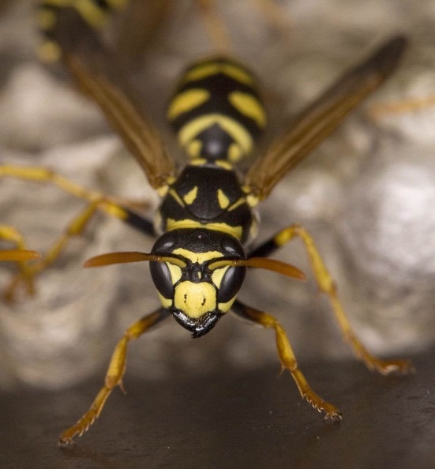
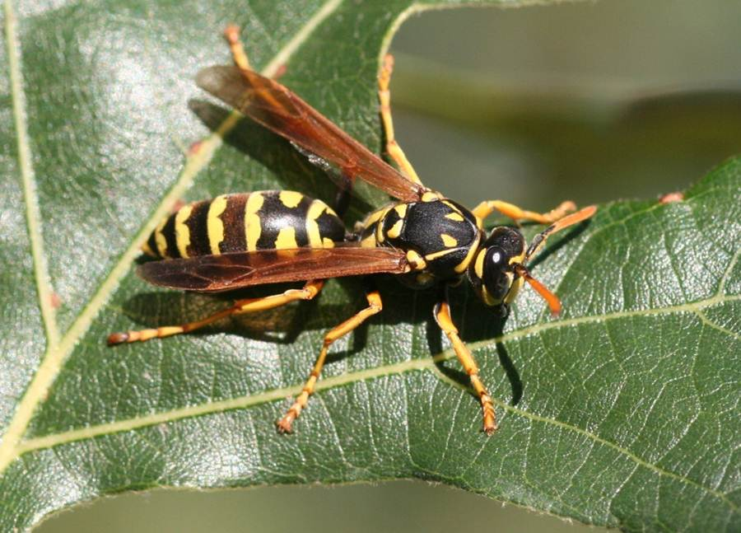
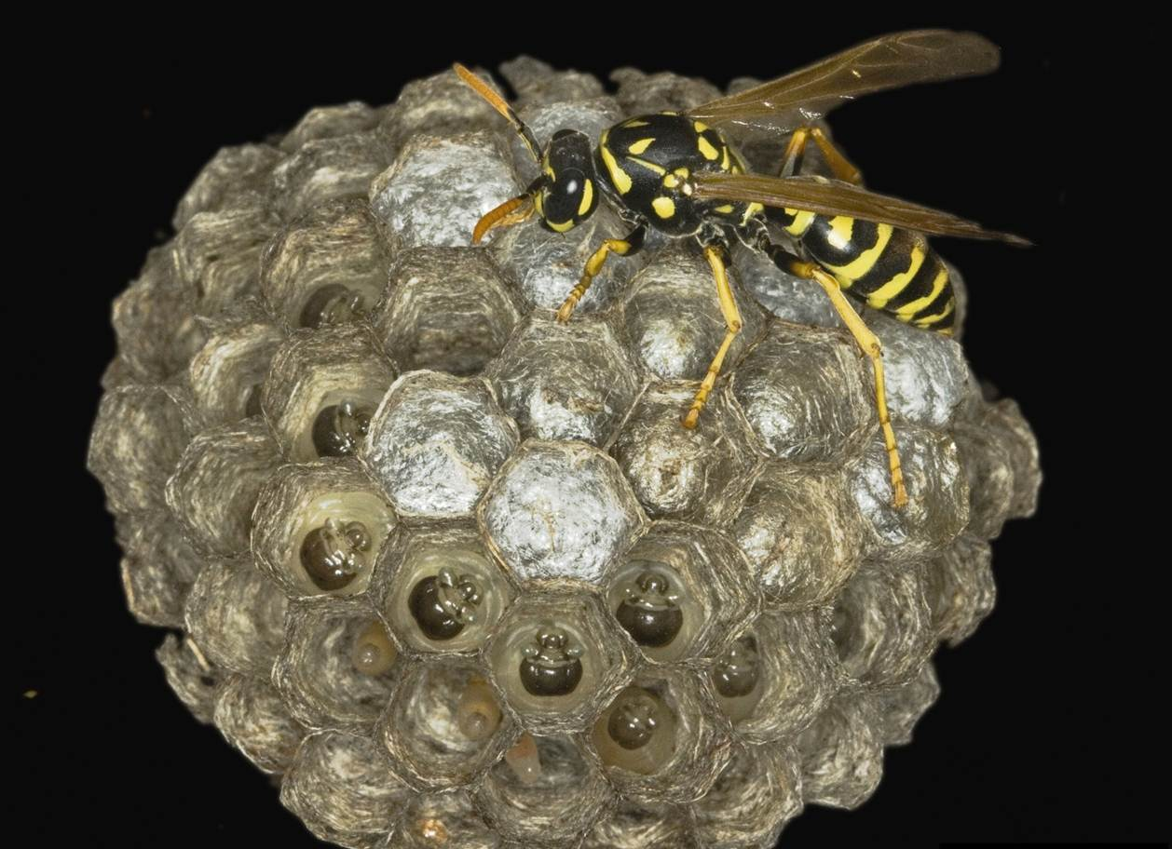
Invasive species as competitors
European paper wasp
Photo credits:
Adult – Whitney Cranshaw, Colorado State University, www.bugwood.org, #5024086
Close-up – David Cappaert, Michigan State University, www.bugwood.org, #5381057
Nest - David Cappaert, Michigan State University, www.bugwood.org, #5255019
Notes:
There is also an invasive species of paper wasp (Polistes dominulus) that was introduced into the United States (Boston) in the late 1970s and has since spread west.
This wasp is black in color, marked with yellow. It has a slender body with a distinct constriction at the waist. It does resemble the native yellow jacket in size and pattern and are commonly mistaken for them. This invasive wasp has bright orange antennae which distinguishes it from all other native wasps.
This wasp is outcompeting a native wasp species (Polistes fuscatus) mainly due to its shorter developmental time and its ability to survive the winters during hibernation. In some areas, the invasive paper wasp has outcompeted the native paperwasp to the point that the native species can no longer be found there.
While we may think of paper wasps as something “bad” that can sting you, they play a vital role in our ecosystem. The native wasp that has been replaced by this invasive species is important in its role as a predator on caterpillar pests (such as those that eat food crops or those that can impact the health of forest trees). In addition, the invasive wasp has a tendency to nest close to human habitation thus increasing the chance of getting stung by them.
Discussion Questions:
How does the European paper wasp affect the populations of those organisms with which it competes?
What are some examples of the types of organisms that could be affected?
Information sources:
Gamboa, G.J., E.I. Greig, and M.C. Thom. 2001. “The comparative biology of two sympatric paper wasps, the native Polistes fuscatus and the invasive Polistes dominulus (Hymenoptera,Vespidae)”. Insectes Sociaux, Vol. 2002, pages 45-49.
Libert, A.E., G.J. Gamboa, N.E. Stamp, T.R. Curtis, K.M. Monnet, S. Turillazzi, and P.T. Starks. 2006. “Genetics, behavior, and ecology of a paper wasp invasion: Polistes dominulus in North America”. Annales Zoologici Fennici, volume 43, pages 595-624.’
accessed June 29, 2012 –
http://www.sekj.org/PDF/anzf43/anzf43-595.pdf
Institute for the Study of Invasive Species. “Polistes dominulus”.
accessed June 29, 2012 –
http://www.tsusinvasives.org/database/european-paper-wasp.html

Slide 13
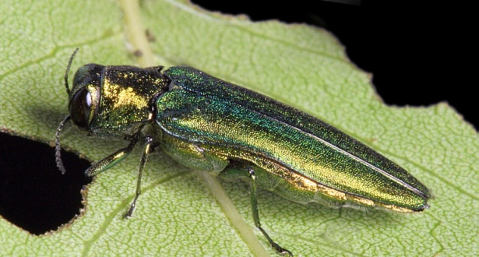
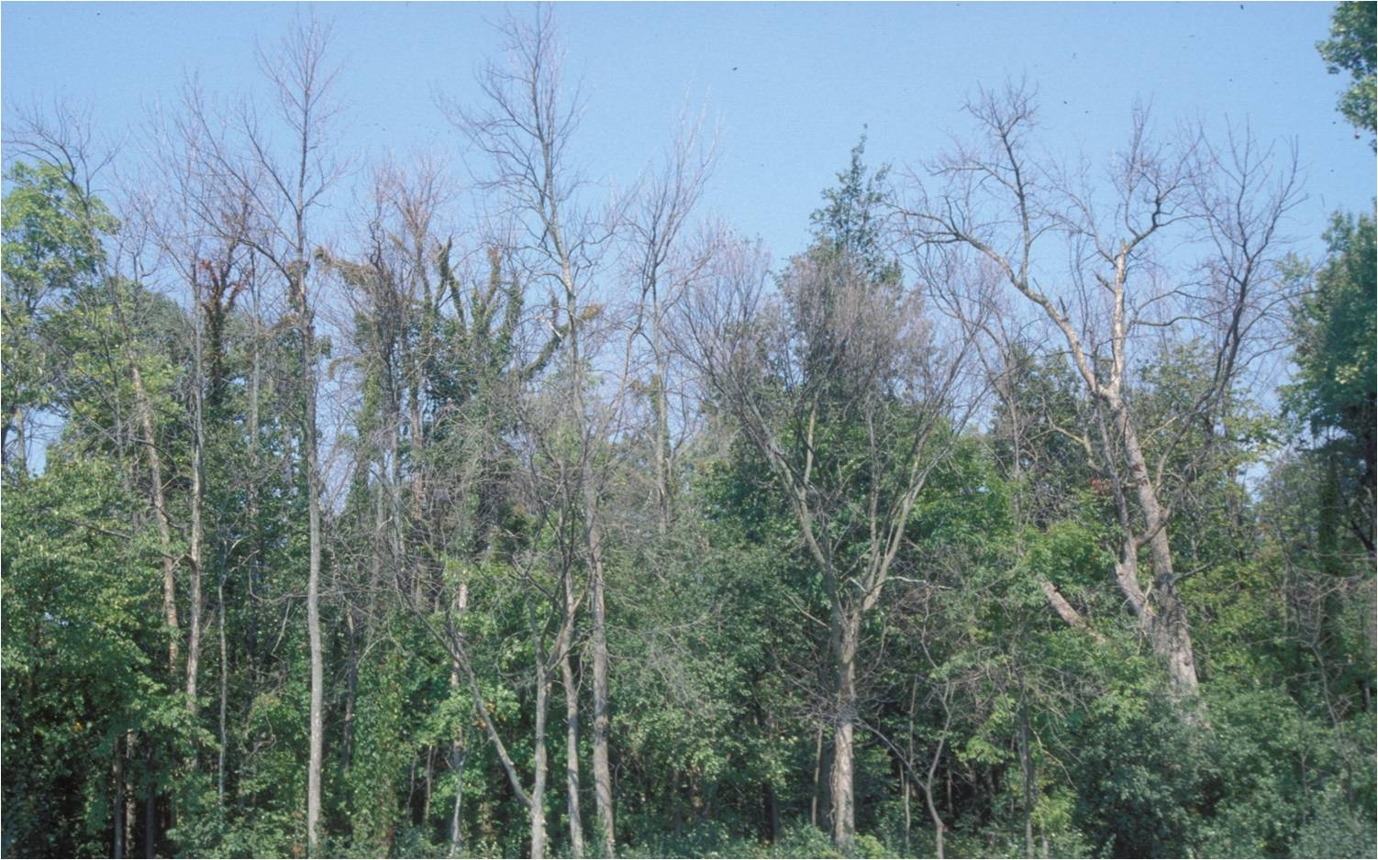
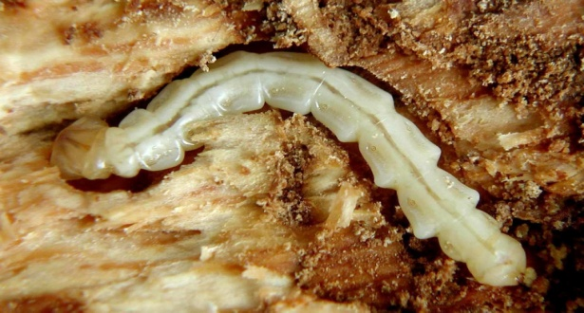
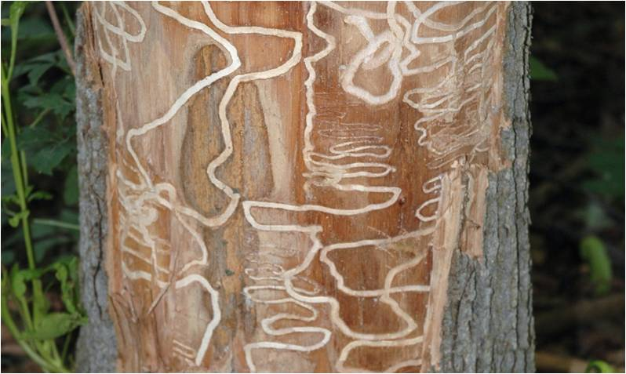
Invasive species as predators
Emerald Ash Borer
Photo Credit:
Damaged ash trees: Daniel Herms, The Ohio State University, www.bugwood.org, #5171038
Beetle: David Cappaert, Michigan State University, www.bugwood.org, #2106098
Larvae: David Cappaert, Michigan State University, www.bugwood.org, # 1460071
Tunnels: Art Wagner, USDA APHIS PPQ, www.bugwood.org, #5147090
Notes:
While many people think of the Burmese python (a large snake) as an invasive predator on mammals in the Everglades or the nutria (a large member of the rodent family) as an invasive predator on aquatic plants, there are many more out there. Remember, predators don’t always have to be big animals to have a big impact. The following examples are of small invasive predators with a big impact.
The emerald ash borer (Agrilus planipennis) is a beetle that is native to Asia. It was first detected in Michigan in the summer of 2002 and has since spread to at least 19 other states (Connecticut, Illinois, Indiana, Iowa, Kansas, Kentucky, Massachusetts, Maryland, Minnesota, Missouri, New Hampshire, New York, North Carolina, Ohio, Pennsylvania, Tennessee, Virginia, West Virginia, and Wisconsin). It is thought that they came in by accident on wood packing material made from ash trees in its native range.
The adults average 0.5 inches (1.25cm) long and are metallic green in color. The larvae reach about 1.5 inches (4cm) long, are creamy white, and are somewhat flattened. Their segments look like a series of nested bells.
The adults feed on the leaves of the ash trees (Fraxinus spp.) that grow here with very little damage to the tree itself. However, its larvae burrow into the vascular tissues of the tree essentially starving the tree to death within a few years (vascular tissue carries food and water to all parts of the plant). The image above shows typical damage seen after an emerald ash borer infestation. Millions of ash trees have already been killed and millions more will die because of this invasive insect.
Discussion Questions:
How does the emerald ash borer affect the populations of those organisms that depend on these plants for food and shelter?
What are some examples of the types of organisms that could be affected?
Information sources:
Emerald ash borer website.
accessed June 5, 2012 –
http://www.emeraldashborer.info/
Florida Department of Agriculture and Consumer Service, Division of Forestry. 1999. Forest Trees of Florida. Published in house.
NPDN First Detector Modules - Introduction to the Emerald Ash Borer and Identification and Hosts
accessed June 5, 2012 –
http://www.firstdetector.org
USDA Natural Resources Conservation Service – Plant Database. “Fraxinus”.
accessed June 6, 2012 –
http://plants.usda.gov/
USDA Pest Alert. “Emerald Ash Borer”.
accessed June 5, 2012 –
http://www.na.fs.fed.us/spfo/pubs/pest_al/eab/eab04.htm

Slide 14
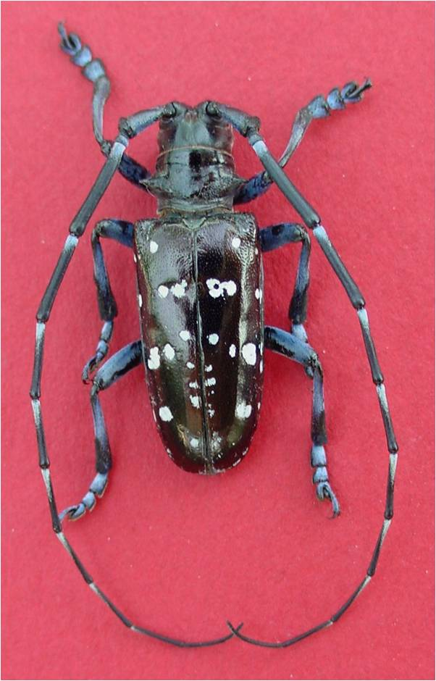
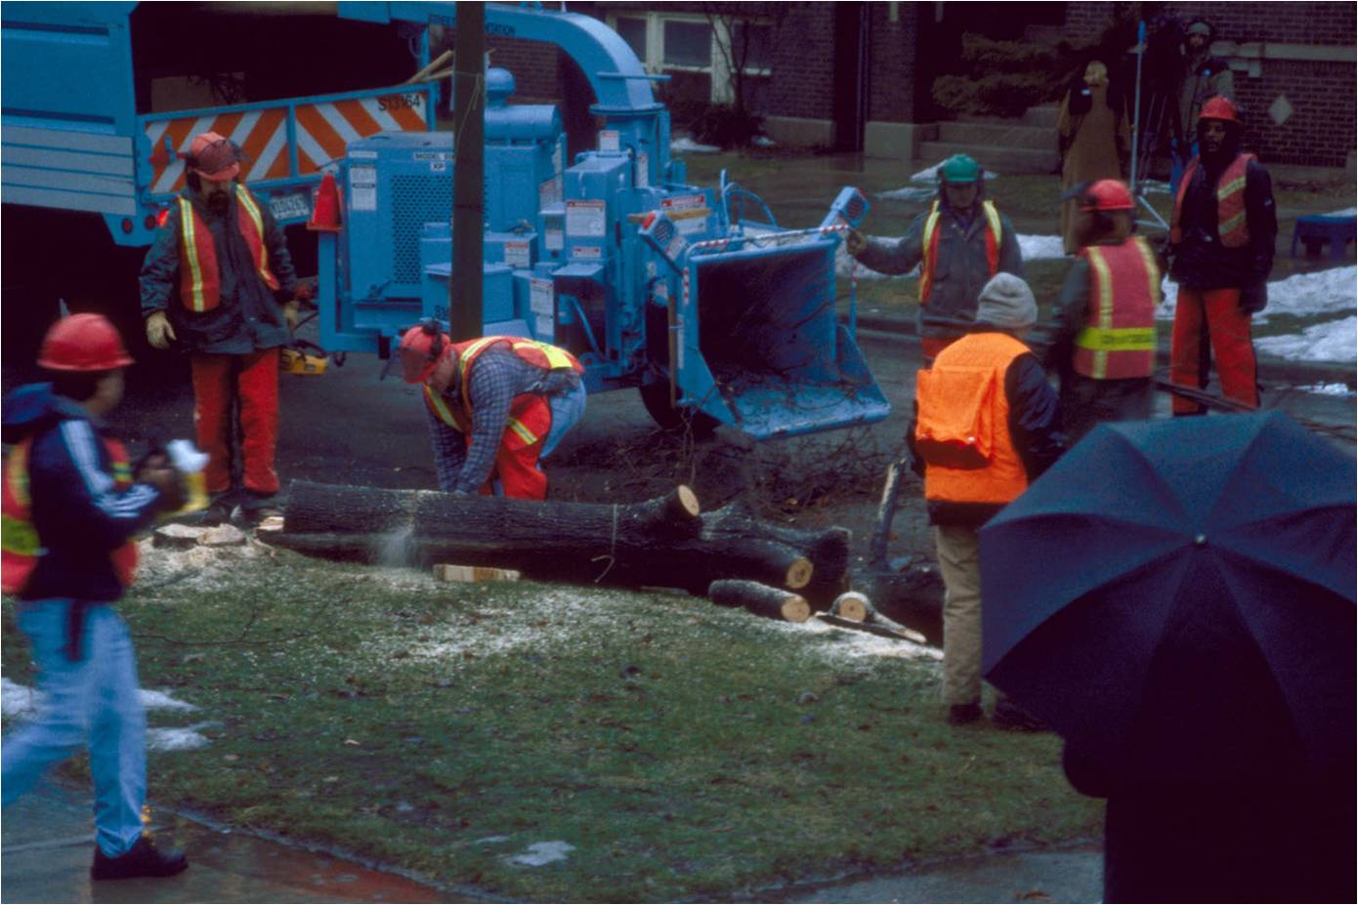
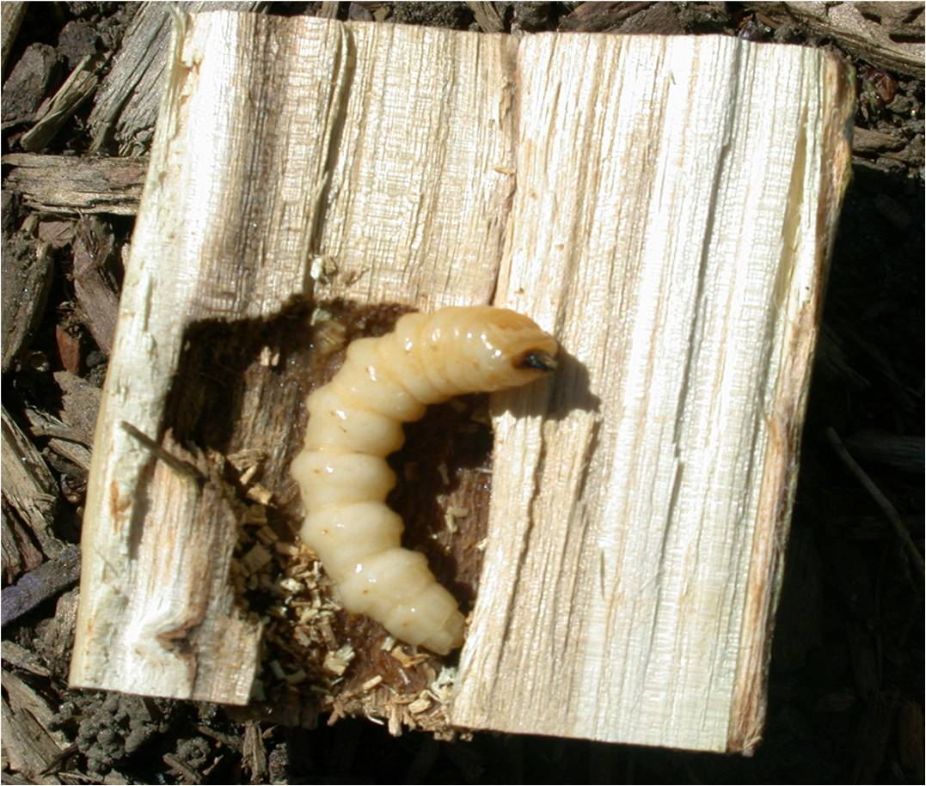
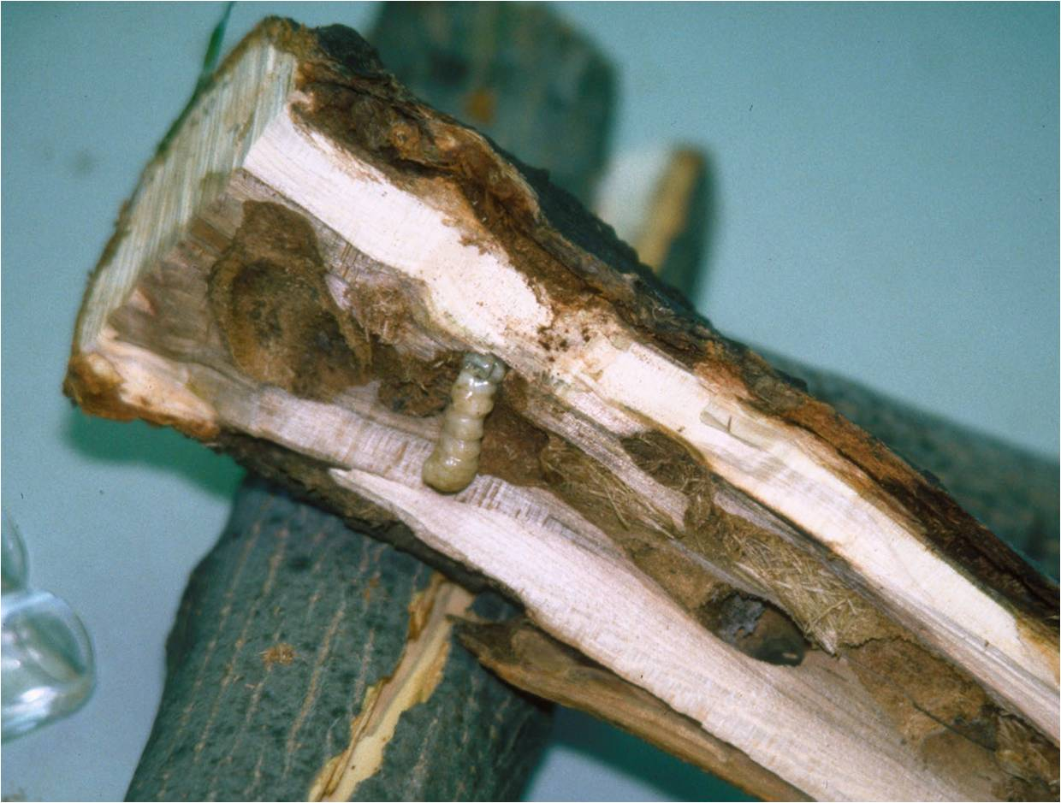
Invasive species as predators
Asian long horned beetle
Photo Credit:
Chipping trees: Larry R. Barber, USDA Forest Service, www.bugwood.org, #3047034
Beetle: Michael Bohne, www.bugwood.org, #1262001
Larvae: Thomas B. Denholm, New Jersey Department of Agriculture, www.bugwood.org, #1253027
Tunnels: Steven Katovich, USDA Forest Service, www.bugwood.org, #1398111
Notes:
Another example of an invasive species that is a predator on native species is the Asian long horned beetle (Anoplophora glabripennis). This species is also a native of China and was first detected in New York in 1996. It then spread to areas in Illinois, New Jersey, Massachusetts, and Ohio. It also probably came in accidently on wood packing material. Because there are isolated detections of this pest, an eradication effort is underway. As of September 1, 2013, this pest has been eradicated from Illinois and New Jersey, but populations remain in Ohio, New York, and Massachusetts (NAPPO September 2013).
The adults range between 1 to 1.5 inches (25 and 35mm) in length with long antennae that is 2.5 times the length of the body in males, and 1.3 times the length of the body in females. They are black with white spots. The larvae average 2 inches (50mm) long, are creamy white in color, and quite round in profile.
The larvae of this beetle tunnel into the tree where they feed in the vascular tissues of the tree causing the tree to die. They prefer maple (Acer spp.), but will also attack birches (Betula spp.), buckeye (Aesculus spp.), elms (Ulmus spp.), and willows (Salix spp.).
Currently, authorities are working on eradicating this insect where it is found by removing all trees that are infested. So far, thousands of trees have been cut down and either chipped or burned.
Discussion Questions:
How does the Asian long horned beetle affect the populations of those organisms that depend on these plants for food and shelter?
What are some examples of the types of organisms that could be affected?
Information sources:
Asian Longhorned Beetle website –
accessed June 5, 2012 –
http://www.uvm.edu/albeetle/management/treeremoval.html
EPPO Data Sheets on Quarantine Pests. “Anoplophora glabripennis”.
accessed June 6, 2012 –
http://www.eppo.int/QUARANTINE/insects/Anoplophora_glabripennis/ANOLGL_ds.pdf
USDA Natural Resources Conservation Service – Plant Database. “Acer”, “Betula”, “Aesculus”, “Ulmus”, “Salix “.
accessed June 6, 2012 –
http://plants.usda.gov/
USDA Pest Alert. “Asian Longhorned beetle”.
accessed June 5, 2012 –
http://www.na.fs.fed.us/pubs/palerts/alb/alb_pa.pdf

Slide 15
Summary
Population growth can be positive or negative.
Over time, populations remain fairly constant, though there will be population fluctuations that will occur over the course of a year or years.
There are many factors that affect population growth. These factors include food, space, water, nesting sites, diseases, competition, and predation.
Invasive species are introduced in an area and cause economic harm or harm to human health.
Invasive species affect population growth of a native species in a given community through the introduction (or transmission) of a disease, competition with native species, or predation on native species.

Slide 16
Activity #1: Manipulating the Carrying Capacity
Questions:
  What is the carrying capacity of duckweed in a given “environment”?
  Can the carrying capacity of duckweed be manipulated by changing the limiting factors available in its “environment”?

Slide 17
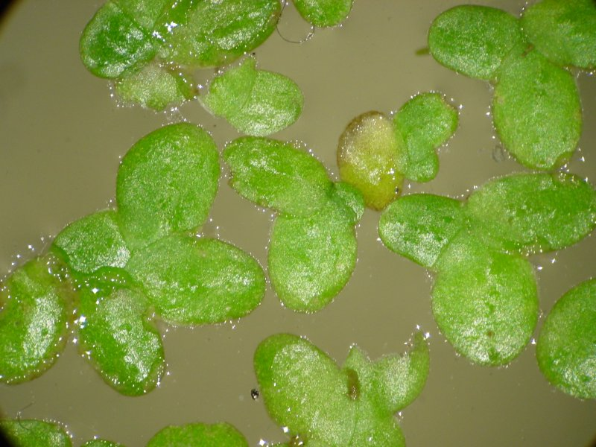
How can you manipulate the carrying capacity?
Follow along in your handout
Duckweed is a freshwater aquatic plant that can reproduce asexually.
Each plant consists of a single leaf and a root.
  If there are two leaves, count them as two separate plants.
  Use a magnifying glass to count the plants.
Photo Credit:
WikiMedia Commons.
Notes:
For the purposes of this experiment, we will refer to the green discs as leaves though they are actually a thallus.
Though there are many species of duckweed out there, Lemna minor is best to use for this experiment.
Information sources:
Washington State Department of Ecology. “Free Floating Plants”.
accessed July 2, 2012 –
http://www.ecy.wa.gov/programs/wq/plants/plantid2/descriptions/lemmin.html

Slide 18
For this assignment…
Work in groups to monitor the population growth of duckweed (Lemna minor) for 4 weeks
  Control – spring water in a cup
  Test group 2 – spring water with fertilizer in a cup
  Test Group 3 – spring water in a sandwich container
  Test group 4 – spring water with fertilizer in a sandwich container
  Test group 5 – spring water in a cup with less light
Take data twice a week and chart growth
  Estimate the carrying capacity of each group to see if it is the same

Slide 19
Activity #2: Estimating the
Carrying Capacity
Follow along in your handout
Use “rabbits” and an “environment” to estimate the carrying capacity
  Start with 25 rabbits and dump them into the “environment”
  5 or more “rabbits” in a square are removed from the population
  2, 3, or 4 “rabbits” reproduce and are added to the population
  1 “rabbit” does not reproduce but remains part of the population
  Count all “rabbits” and record that number
  Continue this for 8 rounds
  Graph your results and estimate the carrying capacity

Slide 20
Activity #3: Computer Lab
Go to the computer lab and complete the online e-learning module

Slide 21
References
Allaby, M., editor. Concise Oxford Dictionary of Ecology. 1998. Oxford University Press, USA
Alabama Forestry Commission. “Laurel Wilt Disease”. accessed 6/14/2012.
  http://www.forestry.alabama.gov/LaurelWilt.aspx?bv=3
Asian Longhorned Beetle website . accessed June 5, 2012 –
  http://www.uvm.edu/albeetle/management/treeremoval.html
California Oak Mortality Task Force. 2012. accessed 6/14/2012 –
  http://www.suddenoakdeath.org/diagnosis-and-management/hosts-and-associated-plants/
Campbell, N.A. 1990. Biology, 2nd Edition. Benjamin/Cummins Publishing Company, New York.
Emerald ash borer website. accessed June 5, 2012 –
  http://www.emeraldashborer.info/

Slide 22
References
EPPO Data Sheets on Quarantine Pests. “Anoplophora glabripennis”. accessed June 6, 2012 –
  http://www.eppo.int/QUARANTINE/insects/Anoplophora_glabripennis/ANOLGL_ds.pdf
Florida Department of Agriculture and Consumer Services – Division of Forestry. 2008. accessed 6/14/2012 –
  http://www.floridaforestservice.com/publications/fh_pdfs/Laurel_Wilt.pdf
Florida Department of Agriculture and Consumer Service, Division of Forestry. 1999. Forest Trees of Florida. Published in house.
Fraedrich, S.W., T.C. Harrington, R.J. Rabaglia, M.D. Ulyshen, A.E. Mayfield, III, J.L. Hanula, J.M. Eickwort, and D. R. Miller. 2008. “A Fungal Symbiont of the Redbay Ambrosia Beetle Causes a Lethal Wilt in Redbay and Other Lauraceae in the Southeastern United States”. Plant Disease, Volume 92, No. 2.

Slide 23
References
Gamboa, G.J., E.I. Greig, and M.C. Thom. 2001. “The comparative biology of two sympatric paper wasps, the native Polistes fuscatus and the invasive Polistes dominulus (Hymenoptera,Vespidae)”. Insectes Sociaux, Vol. 2002, pages 45-49.
Global Invasive Species Database. “Solenopsis invicta”. accessed June 29, 2012 –
  http://www.issg.org/database/species/impact_info.asp?si=77&fr=1&sts=&lang=EN
Hale, W. G. and J.P. Margham. 1991. The Harper Collins Dictionary of Biology. Harper Perennial, New York.
Institute for the Study of Invasive Species. “Polistes dominulus”. accessed June 29, 2012 –
  http://www.tsusinvasives.org/database/european-paper-wasp.html

Slide 24
References
Libert, A.E., G.J. Gamboa, N.E. Stamp, T.R. Curtis, K.M. Monnet, S. Turillazzi, and P.T. Starks. 2006. “Genetics, behavior, and ecology of a paper wasp invasion: Polistes dominulus in North America”. Annales Zoologici Fennici, volume 43, pages 595-624. accessed June 29, 2012 –
  http://www.sekj.org/PDF/anzf43/anzf43-595.pdf
National Invasive Species Council. accessed June 4, 2012 –
  http://www.invasivespecies.gov/
NPDN First Detector Modules - Introduction to the Emerald Ash Borer and Identification and Hosts. accessed June 5, 2012 –
  http://www.firstdetector.org
Pearson Education, Inc. accessed June 14, 2012 –
  http://wps.pearsoncustom.com/wps/media/objects/5697/5834441/ebook/htm/chp36_4.htm
Stiling, P.D. 1992. Ecology: Theories and Applications, 2nd Edition. Prentice Hall, New Jersey.

Slide 25
References
Texas AgriLife Extension. “Frequently Asked Questions on Fireants”. accessed June 29, 2012 –
  http://fireant.tamu.edu/about/faq.php
USDA – APHIS. 2012. accessed 6/14/2012 –
  http://www.aphis.usda.gov/plant_health/plant_pest_info/pram/downloads/pdf_files/nationalpestalert_.pdf
USDA Natural Resources Conservation Service – Plant Database. “Acer”, “Betula”, “Aesculus”, “Ulmus”, “Salix “. accessed June 6, 2012 –
  http://plants.usda.gov/
USDA Natural Resources Conservation Service – Plant Database. “Fraxinus”. accessed June 6, 2012 –
  http://plants.usda.gov/
USDA Pest Alert. “Asian Longhorned beetle”. accessed June 5, 2012 –
  http://www.na.fs.fed.us/pubs/palerts/alb/alb_pa.pdf

Slide 26
References
USDA Pest Alert. “Emerald Ash Borer”. accessed June 5, 2012 –
  http://www.na.fs.fed.us/spfo/pubs/pest_al/eab/eab04.htm
Washington State Department of Ecology. “Free Floating Plants”. accessed July 2, 2012 –
  http://www.ecy.wa.gov/programs/wq/plants/plantid2/descriptions/lemmin.html

Slide 27
Author Credits and Date of Publication
Stephanie D. Stocks, Protect U.S. Coordinator, University of Florida
June 2012

Slide 28
Reviewers Credits
Amanda Hodges, PhD, Department of Entomology and Nematology, University of Florida
Jennifer Weeks, PhD, Department of Entomology and Nematology, University of Florida

