Slide 1
Wheat Stem Rust Ug99: Recognition, Risk, and Response.

Slide 2
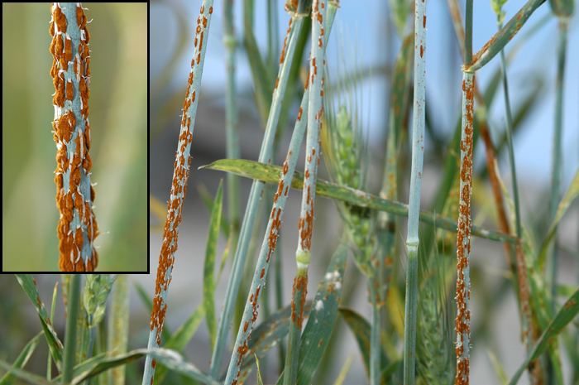
Outline
Recognition
  biology and characteristics
Risk
  Historical significance
  New challenges: Ug99
  Current status
Response
  How to look for stem rust
  How to report stem rust
Notes:
In this presentation, you will learn about wheat stem rust. First, we will explain the complex biology and historical significance of this pathogen in agriculture. Then, we will discuss the challenges presented by the emergence of new, virulent strains of wheat stem rust, the current status of control efforts. By the end of the presentation, we hope you recognize the potential importance of this pathogen, how to identify it, and who to contact with that information.

Slide 3
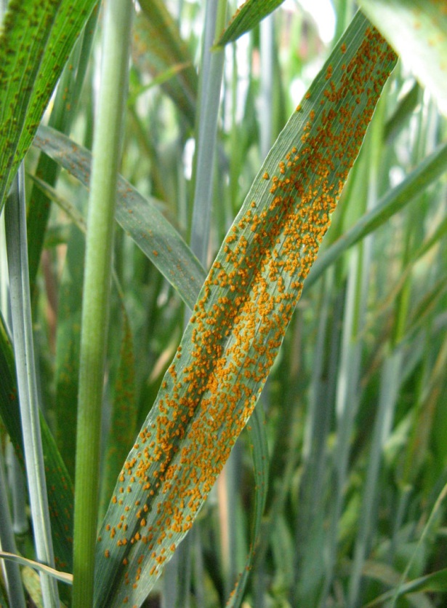
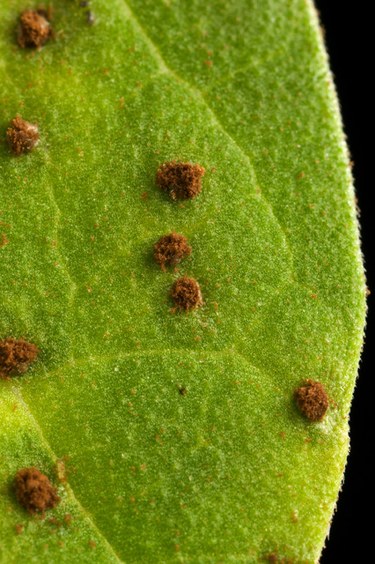
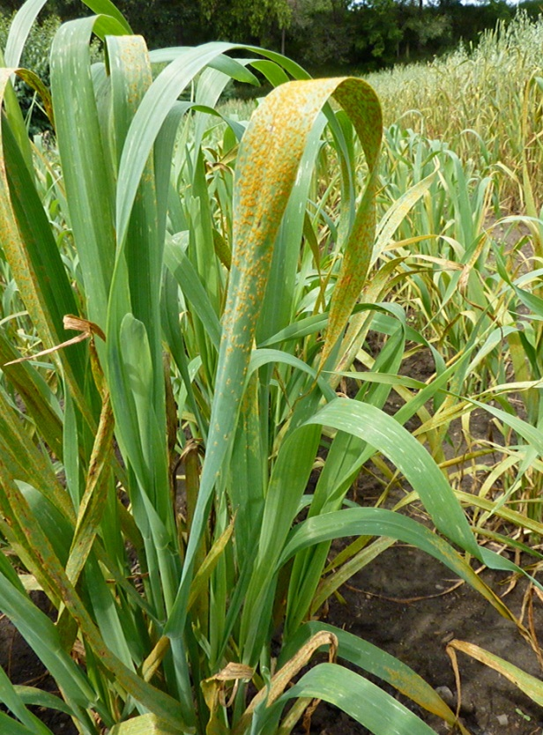
Recognizing Rusts
Wheat leaf rust
Bean leaf rust
Oat crown rust
Image Citations: United States Department of Agriculture, Agricultural Research Service
Notes:
Rusts are a diverse group of plant pathogens with over 120 genera and 6,000 species. These fungi are obligate parasites on plants. As an obligate parasite, they require a host plant to complete their life cycle.
As a group, rust fungi attack a wide variety of plants and can infect stems, leaves, fruits, and seeds. However, rust fungi are normally only able to attack specific groups of plants. For example, the rust fungi that infect corn are different than those that attack wheat.
Rusts are one of the most problematic group of pathogens in horticulture and agriculture. They get their name from the color of the spore masses seen on an infected plant which is similar to the color or rust on metal. Most notably, rusts that infect cereal crops like wheat, oats, barley, and rye can result in dramatic economic losses that we discuss in more detail later.
References:
Manitoba Agriculture, Food, and Rural Initiatives. 2011. Stem rust in wheat, barley, and oats.
Accessed 2/26/2012-
http://www.gov.mb.ca/agriculture/crops/diseases/fac15s00.html
USDA/ARS. 2008. Cereal rusts and their hosts. Cereal Disease Laboratory.
Accessed 2/26/2012-
http://www.ars.usda.gov/Main/docs.htm?docid=9855

Slide 4
What is wheat stem rust?
Fungus, Puccini graminis f. sp. tritici
Common names:
  stem rust
  black rust
Infects:
  wheat
  barley
  barberry
Occurs worldwide
Image Citation: United States Department of Agriculture, Agricultural
Research Service
Notes:
Wheat stem rust, also referred to as stem rust or black rust, is caused by the fungus, Puccinia graminis f. sp. tritici which occurs worldwide. This particular rust infects stems, leaf sheaths, leaf blades, and the head of wheat plants. Wind-blown spores of the fungus that land on green wheat plants cause the initial infection. Infections are very evident on the stems where they produce reddish-brown, oval-shaped, elongated lesions.
The f. sp. In the scientific name stands for forma specialis, a term applied to parasites that have a very specific host range. The important hosts infected by Puccinia graminis f. sp. tritici are wheat (Triticum spp.) and barley (Hordeum vulgare). Barberry (Berberis spp.) or related species of Mahonia and Mahoberberis in the family Berberidaceae are alternate hosts.
Note: Oats (Avena sativa), Italian ryegrass (Lolium multiflorum), rye (Secale cereale), wild barley (Hordeum leporinum), goatgrass (Aegilops spp.), timothy (Phleum pratense), fescue (Festuca spp.), bluegrass (Poa pratensis), orchardgrass (Dactylis glomerata) , and turfgrasses have also been reported as minor hosts.
References:
Anikster Y, 1984. The formae speciales In: Bushnell WR, Roelfs AP, eds. The Cereal Rusts Vol. I. Orlando, USA: Academic Press, 115-130.
CABI Invasive Species Compendium. 2013. Pucinia graminis.
accessed 9/6/2013-
http://www.cabi.org/isc/?compid=5&dsid=45797&loadmodule=datasheet&page=481&site=144
Manitoba Agriculture, Food, and Rural Initiatives. 2011. Stem rust in wheat, barley, and oats.
Accessed 2/26/2012-
http://www.gov.mb.ca/agriculture/crops/diseases/fac15s00.html
USDA/APHIS/PPQ. 2011. Plant pest information program: barberry.
Accessed 2/26/2012-
http://www.aphis.usda.gov/plant_health/plant_pest_info/barberry/index.shtml.

Slide 5
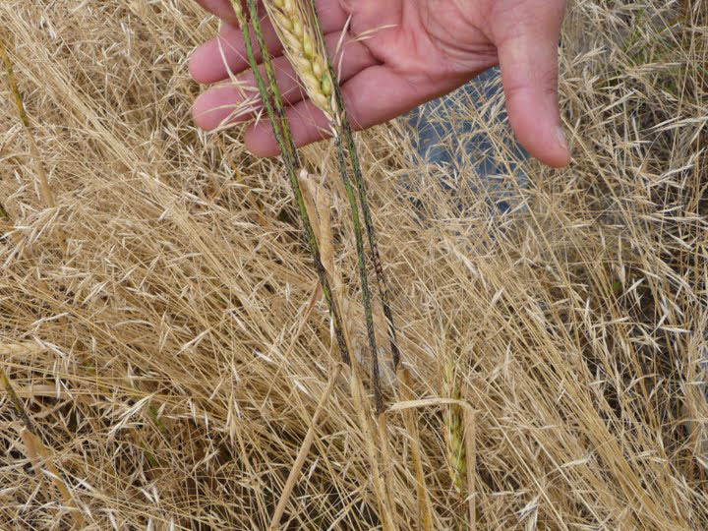
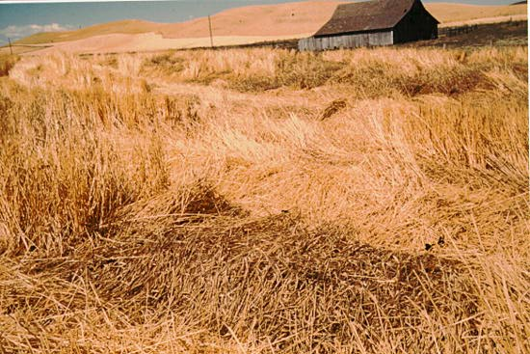
What does stem rust do?
Most important disease of wheat, globally!
Drastically reduces growth and yield, up to 70 %!
Brittle stems can fall over or “lodge” hampering mechanical harvest.
Lodging as a result of rust infection.
Image Citations: Top − United States Department of Agriculture, Animal and Plant Health Inspection Service, Bottom − United States Department of Agriculture, Agricultural Research Service
Notes:
Stem rust is one of the most important disease associated with wheat around the world. Rust infection results in a drastic reduction in plant growth and crop yield (up to 70%) because it can infect the leaves, stems, and heads of a developing plant (see top photo). The plant loses nutrients to the rust fungus and damage to the tissues compromises photosynthesis and metabolism. The plant also loses water through the wounds. The result of infection is stunted and desiccated wheat plants producing only small, withered grain. The fungus can also weaken stems to the point that stalks fall over (lodge) which makes mechanical harvest impossible (see bottom photo). These weakened plants are also more susceptible to other secondary pathogens (fungi and/or diseases).
References:
Biello, D. 2009. Global Wheat Crop Threatened by Fungus: A Q&A with Han Joachim Braun. Scientific American.
Accessed 2/26/12-
http://www.scientificamerican.com/article.cfm?id=global-wheat-crop-threatened-by-fungus
De Wolf, E., T. Murray, P. Paul, L. Osborne, and A. Tenuta. 2011. Identification and Management of Stem Rust on Wheat and Barley. USDA-CREES Extension IPM 2009-41533-05331.
Accessed 2/26/2011 at-
http://plantpath.wsu.edu/people/faculty/murray/Stem%20Rust%20Man%20WA.pdf
Schumann, G.L. and K.J. Leonard. 2000. Stem rust of wheat (black rust). The Plant Health Instructor. DOI: 10.1094/PHI-I-2000-0721-01.
Accessed 2/26/2012-
http://www.apsnet.org/edcenter/intropp/lessons/fungi/Basidiomycetes/Pages/StemRust.aspx

Slide 6
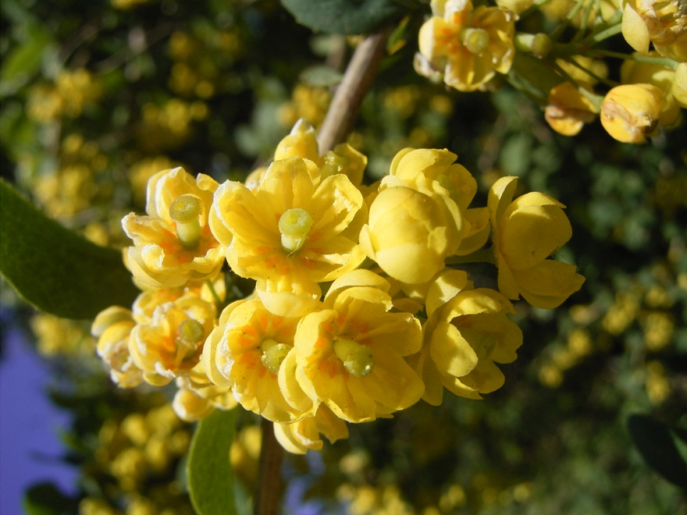
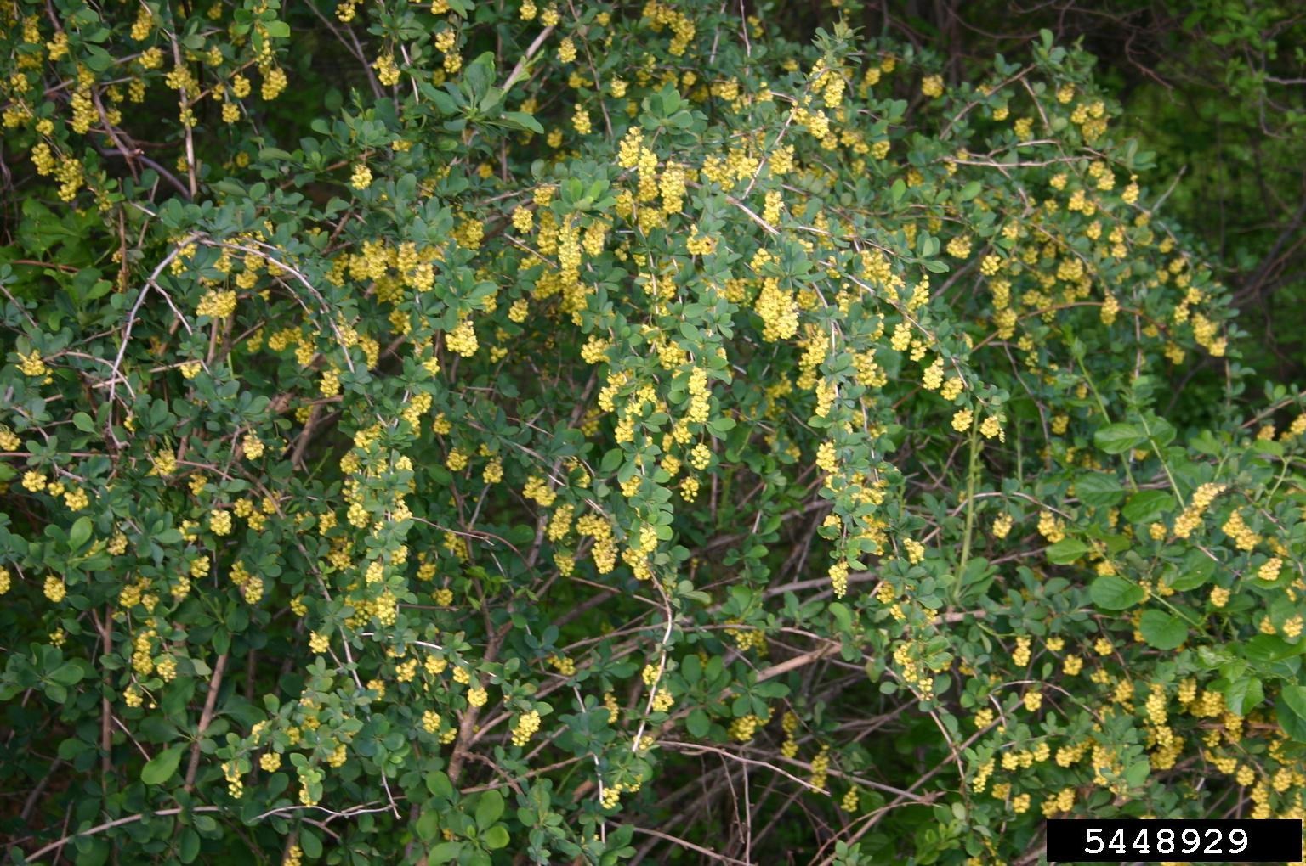
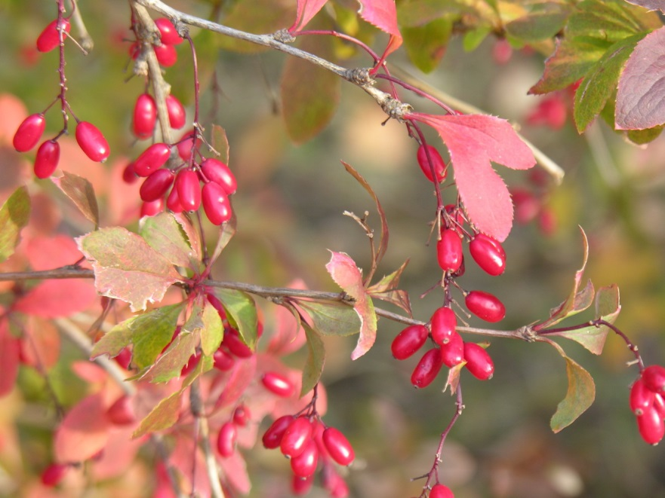
Hosts
Image Citations: Leslie J. Mehrhoff, University of Connecticut, Bugwood.org, #5448929 and Wikimedia Commons.
Notes:
Wheat stem rust also infects barberry, Berberis spp., and related species of Mahonia and Mahoberberis in the family Berberidaceae. These plants represent alternate hosts in the lifecycle of wheat stem rust. The most important alternate host in the United States is common barberry, Berberis vulgaris (pictured here). Common barberry is not native to the United States. It was introduced by early European settlers and was once present across much of the United States, but is rare now thanks to eradication programs. (see distribution map on next slide).
Wheat, and to a much lesser extent, barley are key hosts due to their importance as economic crops. Barberry was an important alternate host because it was prevalent in areas where wheat is grown.
Barberry is a hardy plant and the fruit of the common barberry was prized by early Americans and used in a variety of foods such as pies, jellies, and jams. Thus, it was frequently planted by farmers and often found in close proximity to wheat fields. Barberry was further spread across the landscape and naturalized because the seeds of barberry are dispersed by birds. Barberry was once found along fencerows, woodlots and other areas where birds might frequent.
A list of stem rust-susceptible barberry, mahonia, and mahoberberis can be found at:
http://www.ars.usda.gov/Main/docs.htm?docid=9751
References:
USDA/APHIS/PPQ. 2011. Plants profile: Berberis vulgaris.
Accessed 2/26/2012-
http://plants.usda.gov/java/profile?symbol=BEVU&mapType=nativity&photoID=bevu_002_ahp.tif
USDA/ARS. 2005. Barberry situation- past, present, and future. Cereal Disease Laboratory.
Accessed 2/26/2012-
http://www.ars.usda.gov/Main/docs.htm?docid=9749
Whetstone, R. D., T. A. Atkinson, and D. D. Spaulding. 2011. Berberidaceae. Flora of North America, Volume 3.
Accessed 2/26/2012 -
http://www.efloras.org/florataxon.aspx?flora_id=1&taxon_id=10100

Slide 7
Distribution of Common Barberry and Wheat in the United States
Dark green indicates states that have both barberry and wheat.
Light green indicates those states that have barberry but no wheat.
Yellow indicates those states that do not have barberry, but grow wheat.

Slide 8
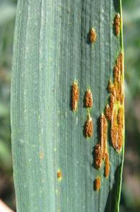
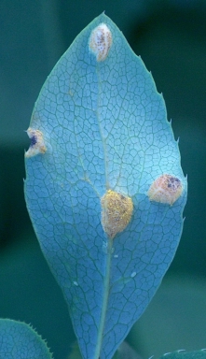
Life Cycle of Wheat Stem Rust in Northern Climates
Fall Year 1
Winter Year 1
Spring Year 2
Urediniospore
Teliospore
Basidiospore
Summer Year 2
Wheat
Aeciospore
Spermatia
Wheat
Still on Barberry
Barberry
Image Citations:
Wheat - Mary Burrows, Montana State University, www.bugwood.org, #5418725; Barberry - Haruta Ovidiu, University of Oradea, www.bugwood.org, #2168056
Notes:
Fall year 1:
We begin this diagram when wheat is infected by wheat stem rust and you can see the reddish-brown, oval-shaped, elongated lesions on stems, leaf sheaths, leaf blades, and head of wheat plants during the growing season(s). In these lesions, we find fungal spores called urediniospores which are produced on uredinia (fruiting structures formed in the wheat tissues).
Urediniospores are dikayotic spores which have a pair of un-fused haploid nucleus. These spores can re-infect not only the already infected wheat but can also infect healthy wheat by entering the plant through the stomata. These spores can easily be transmitted long distance by wind, sometimes up to hundreds of kilometers. This ability makes it possible for this disease to spread from a localized infestation to a worldwide epidemic in a short period of time.
Winter year 1:
Because rust fungi are obligate parasites, if their hosts are dead (such as what happens the end of the wheat harvest), the fungi cannot survive to infect a subsequent crop. When the temperature changes during the fall, this rust fungus starts producing a different type of spores which can survive the winter months and the cold temperatures. These spores are called teliospores. They are black resting spores which have thick cell walls and two fused diploid nuclei which are produced on telia in the same lesions where the urediniospores appeared. These types of spores can survive on wheat debris or volunteer wheat plants during winter season.
Spring year 2:
When weather conditions are favorable for the fungus once again, the teliospores that were produced to survive the winter germinate. A germinated teliospore usually produces another form of spore called basiodiospores. The teliospores produce four of these basidiospores (which are haploid spores) on basidium. These spores are also easily blown away by wind. Basidiospores cannot infect wheat but can infect alternate hosts such as common barberry.
Once they are inoculated on the young barberry leaves, they germinate and directly penetrate the epidermal cells, growing intercellularly. Mycelium colonized in the barberry leaf tissues forming spermagonia which are fruiting structures (usually produced on upper leaf surface). These spermagonia, also known as pycnia, produce another type of spore called spermatia (a.k.a. pycniospores) which are haploid spores and receptive hyphae. Spermatia are produced in a sticky and sweet liquid which attracts insects and the insects carry then them to other spermagonia on other barberry. Rain splashing can also transmit the spermagonia.
During this cooperation, sexual reproduction with fertilization occurs when spermatia contact receptive hyphae of different mating types. Spermatia are not able to infect plants, their only function is in the process of sexual reproduction.
Summer year 2:
Once this happens, dikaryotic hyphae develop and produce aceia which are also fruiting structures on lower side of barberry leaf surface. These structure produce yet another type of spore called aceiaspore. This spore can then infect wheat that has been planted in the spring by entering the plant through the stomata.
Dikaryotic aeciospores have two different mating types of nuclei that are released and thus infect wheat plants in the late spring. Infected aeciospores germinate and colonize the wheat tissues producing mycelial mats under the epidermis. These mats produce uredinia, breaking out of the epidermis and producing urediniospores which begins the cycle again in fall of year 2.
The life cycle of wheat stem rust repeats complex events such as infection to wheat plants with asexual reproduction on wheat plants, overwintering with genetic recombination including karyogamy and meiosis, infection to alternate hosts, common barberry, and sexual reproduction including plasmogamy with two different mating types.
References:
Agrios, George N. 1997. Plant Pathology, fourth edition. Academic Press, San Diego.
Roelfs, A.P. 1984. The Cereal Rusts. Vol2, Chapter 1. Academic Press, San Diego.
Schumann, G.L.; Leonard, K. J. (2000 (updated 2011)). "Stem rust of wheat (black rust)". The Plant Health Instructor. doi:10.1094/PHI-I-2000-0721-01.
Accessed 8/30/2013-
http://www.apsnet.org/edcenter/intropp/lessons/fungi/Basidiomycetes/Pages/StemRust.aspx

Slide 9
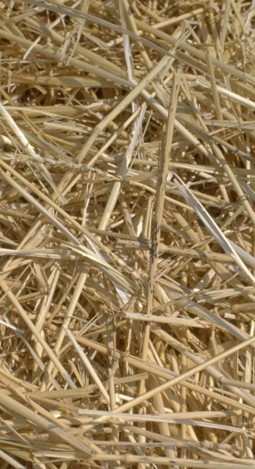
Life Cycle of Wheat Stem Rust in Southern Climates
Fall Year 1
Winter Year 1
Spring Year 2
Urediniospore
Urediniospore
Wheat residue or volunteer plants
Wheat
Wheat
Image Citations:
Wheat - Mary Burrows, Montana State University, www.bugwood.org, #5418725; fallen wheat - William M. Brown Jr., www.bugwood.org, #5357107
Notes:
The urediniospores produced in infected wheat can survive mild winters in wheat residue or volunteer plants (plants that germinate from seeds that fall to the ground when wheat is harvested). If winters are mild, no teliospores are produced which means that the urediniospores can then infect the next season’s wheat crop.
This also means that barberry is not needed as an alternate host.
References:
Agrios, George N. 1997. Plant Pathology, fourth edition. Academic Press, San Diego.
Roelfs, A.P. 1984. The Cereal Rusts. Vol2, Chapter 1. Academic Press, San Diego.
Schumann, G.L.; Leonard, K. J. (2000 (updated 2011)). "Stem rust of wheat (black rust)". The Plant Health Instructor. doi:10.1094/PHI-I-2000-0721-01.
Accessed 8/30/2013-
http://www.apsnet.org/edcenter/intropp/lessons/fungi/Basidiomycetes/Pages/StemRust.aspx

Slide 10
Summary
Northern climates
  Resting structure for overwintering and genetic recombination and sexual reproduction on alternate host are needed to continue the life cycle
Southern climates
  Asexual reproduction to complete life cycle
  Overwintering occurs in urediniospore stage
  No resting structure or alternate host needed
Global warming will cause a change management strategies
Notes:
The life cycle of wheat stem rust repeats complex events such as infection to wheat plants, overwintering with genetic recombination, infection in alternate hosts (common barberry), and plasmogamy with two different mating types.
Under harsh weather conditions, wheat stem rust fungi tend to sexually reproduce with special structures such as teliospores (where genetic recombination occurs on wheat) and spermatia and receptive hyphae on barberry. This sexual reproduction enables the fungi to be more diverse so various pathogen races can appear.
Sometimes, asexual reproduction of this disease is enough to continue the life cycle in southern areas. They do not need to produce the resting spore stage and can survive during the winter season as urediniospores. This means these rust fungi do not have to have their alternate hosts (common barberry). They can survive on residues or volunteers of wheat plant during the winter and can infect wheat planted the next spring (or season).
Global warming could cause a change in management strategies in certain areas where the temperature in winter is not cold enough. For example, one of the most valuable management strategies in stopping the wheat stem rust life cycle is that the alternate hosts are eliminated. In warmer areas, barberry is not needed as an alternate hosts because the rust fungus does not have to produce any teliospores and basidiospores that need that alternate host to continue the life cycle. It will be important to remove wheat residue and volunteer wheat plants between harvests to stop the life cycle in warmer climates.
The good news is that although new pathogen races will emerge by mutations and selections under asexual reproductions, they will be less severe than those pathogen races that can occur under sexual reproduction.
References:
Agrios, George N. 1997. Plant Pathology, fourth edition. Academic Press, San Diego.
Roelfs, A.P. 1984. The Cereal Rusts. Vol2, Chapter 1. Academic Press, San Diego.
Schumann, G.L.; Leonard, K. J. (2000 (updated 2011)). "Stem rust of wheat (black rust)". The Plant Health Instructor. doi:10.1094/PHI-I-2000-0721-01.
Accessed 8/30/2013-
http://www.apsnet.org/edcenter/intropp/lessons/fungi/Basidiomycetes/Pages/StemRust.aspx

Slide 11
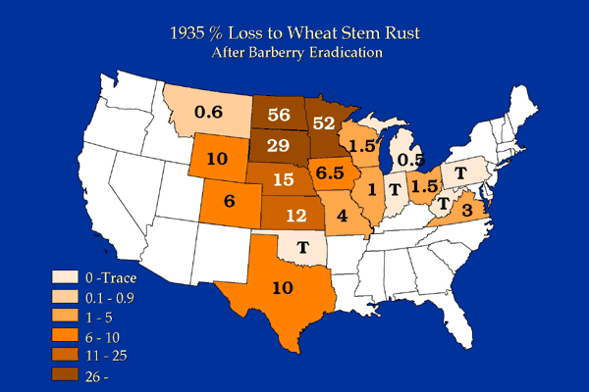
Historical significance - problem
  1900 – 1960: severe outbreaks in the U.S. and Canada
Image Citation: United States Department of Agriculture, Agricultural Research Service
Notes:
Wheat stem rust has been problematic in agriculture since the time of Ancient Greece where it was noted by philosophers like Aristotle.
By the 1600’s, the connection between the failure of wheat crops and the presence of barberry led to laws in France banning the planting of barberry. Despite this knowledge, both wheat and barberry were brought to the U.S. by early settlers and the problems with rust continued in the U.S.
Between 1900 and 1960, there were several severe outbreaks of stem rust in the U.S. and Canada. Losses were greatest in the northern plains where spring wheat is grown, maturing later than the winter wheat grown in the southern and central U.S. This map shows the percentage of the 1935 crop that was lost to wheat stem rust despite efforts to eradicate barberry. In the northern plains, you can see that some states lost 50% of their wheat crop.
References:
Dubin, H. J. and J. P. Brennan. 2009. Combating stem and leaf rust of wheat- historical perspective, impacts, and lessons learned. International Food Policy Research Institute (IFPRI) Discussion Paper 00910.
accessed 8/31/2013 –
http://www.ifpri.org/sites/default/files/publications/ifpridp00910.pdf
Duplessis, S., et. al. 2011. Obligate biotrophy features unraveled by the genomic analysis of rust fungi. PNAS 108 (22) 9166-9171.
accessed 8/31/2013-
www.pnas.org/cgi/doi/10.1073/pnas.1019315108
Schumann, G.L. and K.J. Leonard. 2000. Stem rust of wheat (black rust). The Plant Health Instructor. DOI: 10.1094/PHI-I-2000-0721-01.
Accessed 2/26/2012-
http://www.apsnet.org/edcenter/intropp/lessons/fungi/Basidiomycetes/Pages/StemRust.aspx
USDA-ARS. 2005. Barberry situation- past, present, and future. Cereal Disease Laboratory.
Accessed 2/26/2012-
http://www.ars.usda.gov/Main/docs.htm?docid=9749

Slide 12
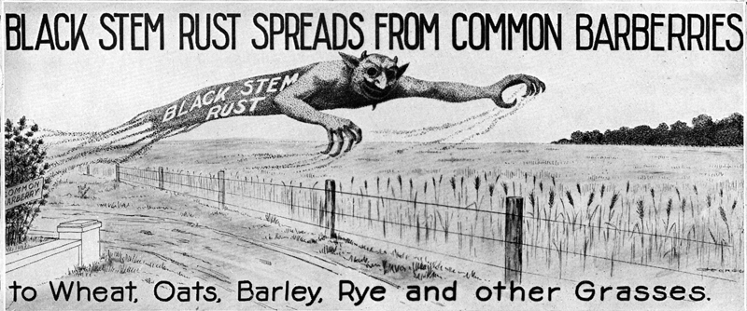
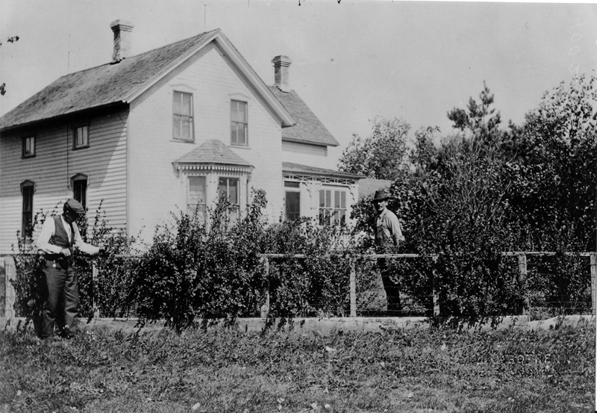
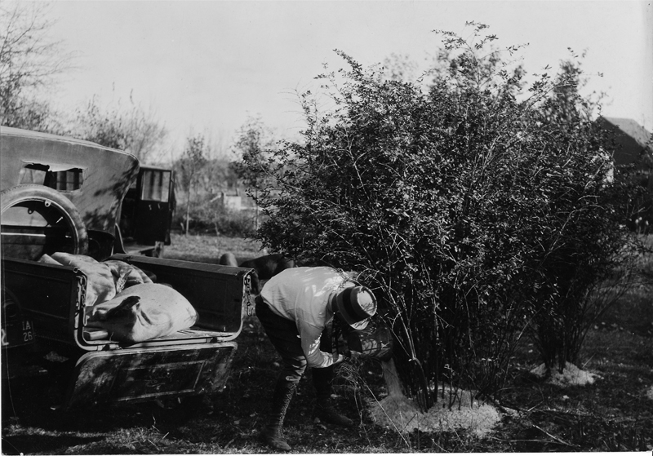
Historical significance - solution
Image Citation: United States Department of Agriculture, Agricultural Research Service
Notes:
Historically, barberry was extremely prevalent in and around agricultural fields. The photo on the lower left illustrates common barberry in the yard of a farmer. As alluded to in the previous slide, the main efforts to control wheat stem rust in the U.S. in the early 1900’s focused on eradicating barberry from the agricultural landscape. The U.S. Department of Agriculture led a massive effort to educate the public about the role of barberry in spreading wheat stem rust (Upper photo is part of a leaflet handed out to farmers). The photo on the lower right illustrates a farmer applying salt to the base of a barberry bush to kill it.
This campaign was effective at minimizing reservoirs of wheat stem rust, but did not eliminate rust altogether. Although some states still ban the sale of common barberry, the eradication campaign was eliminated in the early 1980’s. Today, although a few scattered populations of barberry plants remain, there are very few known areas where stem rust spreads from barberry to commercially-grown wheat.
References:
Roelfs, A. P. 1982. Effects of barberry eradication on stem rust in the United States. Plant Disease 66: 177-81.
Schumann, G.L. and K.J. Leonard. 2000. Stem rust of wheat (black rust). The Plant Health Instructor. DOI: 10.1094/PHI-I-2000-0721-01.
Accessed 2/26/2012-
http://www.apsnet.org/edcenter/intropp/lessons/fungi/Basidiomycetes/Pages/StemRust.aspx
USDA-ARS. 2005. Barberry situation- past, present, and future. Cereal Disease Laboratory. Accessed 2/26/2012-
http://www.ars.usda.gov/Main/docs.htm?docid=9749

Slide 13
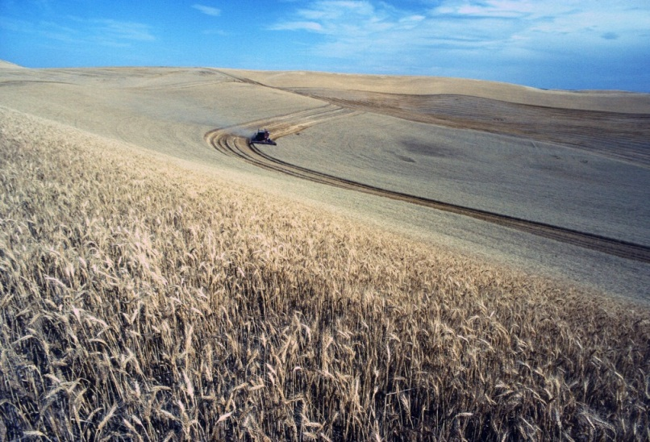
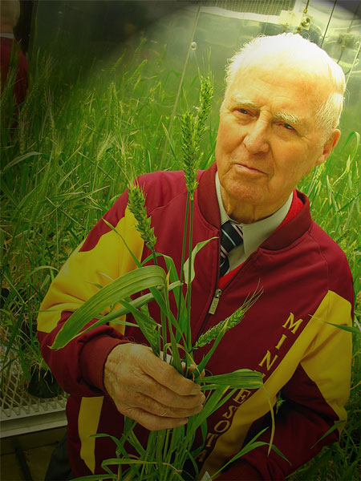
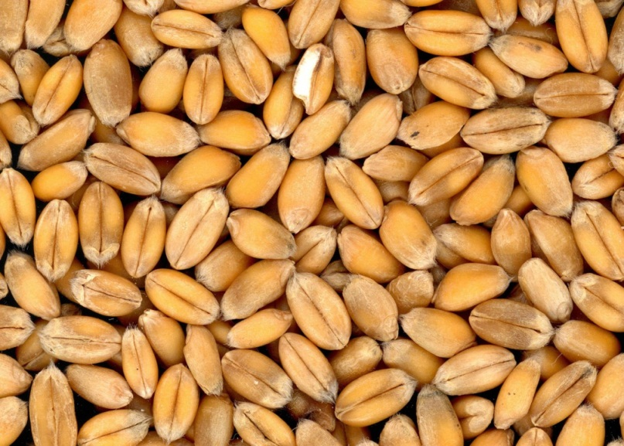
Historical significance - solutions
Norman Borlaug, father of the “green revolution.”
Image Citations: Clockwise from top left: pulic-domain-image.net, usaid.gov, publicdomainimage.net
Notes:
Continued progress in the fight against wheat stem rust came with the “green revolution” of the 1940’s and 1950’s. The work of Norman Borlaug resulted in the development of stem rust-resistant, high-yield varieties of wheat and other cereal grains through selective breeding. More specifically, Borlaug was able to select for a gene (called Sr31 – the Sr stands for Stem rust and the capital ‘S’ designates a resistance gene, named number 31 in this case) that conveyed resistance to wheat stem rust. Thus, he was able to produce cultivars that were resistant to wheat stem rust infection. These agricultural advancements in research and development, combined with improvements in irrigation and fertilizer, were instrumental in making developing countries self-sufficient in terms of food production and averting global famine. For example, wheat production in India went from 12 million metric tons in 1965 to over 20 million in 1970. That technology changed India form a net importer of wheat to an exporter and made them a food secure nation – which can assure the nations people can eat and stabilize the region politically.
Norman Borlaug was awarded the 1970 Nobel Peace Prize and the Congressional Medal of Honor for his contributions to the green revolution. His life’s work breeding new, high-yield wheat cultivars that were resistant to disease dramatically increased the world food supply and, in helping to avoid famine in developing nations, altered the course of history.
References:
Schumann, G.L. and K.J. Leonard. 2000. Stem rust of wheat (black rust). The Plant Health Instructor. DOI: 10.1094/PHI-I-2000-0721-01.
Accessed 2/26/2012-
http://www.apsnet.org/edcenter/intropp/lessons/fungi/Basidiomycetes/Pages/StemRust.aspx

Slide 14
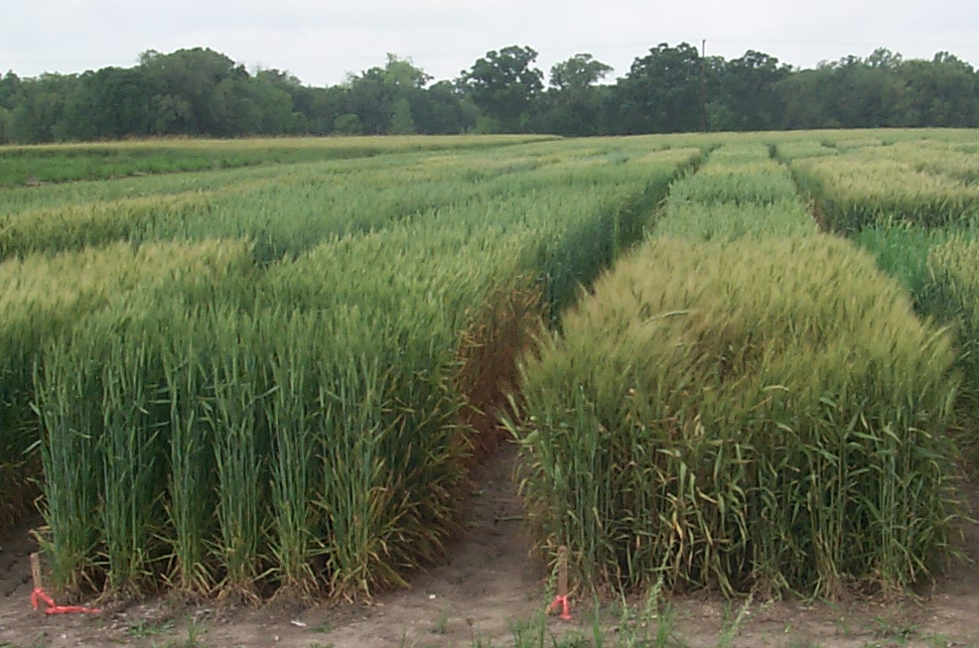
Historical significance - solutions
  Effective management by utilizing wheat cultivars that are resistant to stem rust fungus.
Image Citation: Boyd Padgett, Louisiana State University
Notes:
On the heels of the “green revolution,” global markets including Mexico, India, and Africa expanded their wheat production by growing the new, high-yield, disease resistant cultivars that were made available. Other genes associated with resistance to rust were identified and bred into current cultivars.
For the past 3 - 4 decades, we have enjoyed a respite from the agricultural and economic devastation that is often associated with large outbreaks of wheat stem rust.
References:
Dubin, H. J. and J. P. Brennan. 2009. Combating stem and leaf rust of wheat- historical perspective, impacts, and lessons learned. International Food Policy Research Institute (IFPRI) Discussion Paper 00910.
accessed 8/31/2013-
http://www.ifpri.org/sites/default/files/publications/ifpridp00910.pdf
Schumann, G.L. and K.J. Leonard. 2000. Stem rust of wheat (black rust). The Plant Health Instructor. DOI: 10.1094/PHI-I-2000-0721-01.
Accessed 2/26/2012-
http://www.apsnet.org/edcenter/intropp/lessons/fungi/Basidiomycetes/Pages/StemRust.aspx

Slide 15
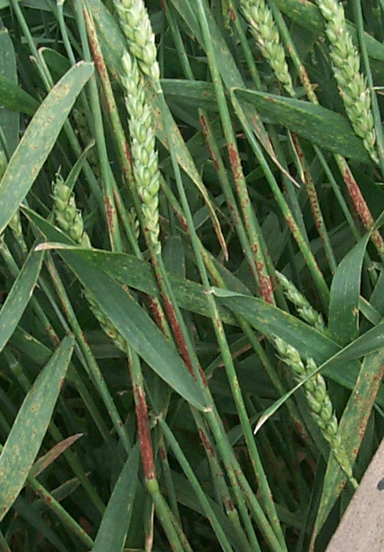
New challenges - U.S. outbreaks
  Stem rust is changing to overcome plant resistance.
  In 1985-1986, localized outbreaks
  affected wheat production the
  southern Great Plains.
  Localized outbreaks on barley
  with recent epidemics occurring
  in the northern Great Plains in
  1989 and early 1990’s.
Image Citation: Boyd Padgett, Louisiana State University
Notes:
Wheat stem rust never completely disappeared, but developed much more slowly and at much lower levels, effectively removing the threat to the wheat crop. Over time, populations of stem rust have changed due to genetic variability and mutations that occur naturally. As a result, some populations of stem rust have been able to overcome the resistance that was bred into the cultivars we are currently growing worldwide.
This was seen in the mid 80’s when small, localized outbreaks of stem rust were documented in the Southern Great Plains of the United States. There have also been localized outbreaks on barley in the northern Great Plains in 1989 and the early 1990’s.
References:
De Wolf, E., T. Murray, P. Paul, L. Osborne, and A. Tenuta. 2011. Identification and Management of Stem Rust on Wheat and Barley. USDA-CREES Extension IPM 2009-41533-05331.
Accessed 2/26/2011 at-
http://plantpath.wsu.edu/people/faculty/murray/Stem%20Rust%20Man%20WA.pdf

Slide 16
New challenges: Ug99
New genetic variant discovered in Uganda in 1999.
Overcomes the resistance provided by Sr31 gene.
Spread to Kenya, Ethiopia, Iran, Yemen.
New variants continue to evolve and overcome resistance provided by other genes (Sr24, Sr36).
Notes:
The most problematic and potentially globally devastating genetic variant of wheat stem rust that has emerged is called Ug99. The name reflects its origin and date of discovery in Uganda in 1999. Wheat stem rust variant Ug99 is unique in that it was the first strain that has been able to overcome the resistance provided by the Sr31 gene. Ug99 is of particular concern because it has rapidly spread across northern Africa and into the Middle East. As it spreads, new variants of Ug99 continue to develop virulence and overcome the resistance provided by other genes, like Sr24 and Sr36.
References:
De Wolf, E., T. Murray, P. Paul, L. Osborne, and A. Tenuta. 2011. Identification and Management of Stem Rust on Wheat and Barley. USDA- CREES Extension IPM 2009-41533-05331.
Accessed 2/26/2011 at-
http://plantpath.wsu.edu/people/faculty/murray/Stem%20Rust%20Man%20WA.pdf
FAO. 2011. Rust spore- a global wheat rust monitoring system.
Accessed 2/26/2012-
http://www.fao.org/agriculture/crops/rust/stem/rust-report/stem-ug99racettksk/en/
Singh,R. P., D. P. Hodson, J. Huerta-Espino, Y. Jin, P. Njau, R. Wanyera, S. A. Herrera-Foessel, and R. W. Ward. 2008. Will Stem Rust Destroy the World’s Wheat Crop? Advances in Agronomy, Volume 98, pp. 271-308.

Slide 17
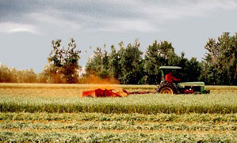
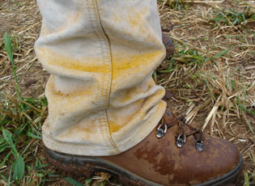
New challenges: Ug99 continued
Previous rust epidemics suggest a continued spread through Africa, the Middle East, and Asia…and North America in the next decade.
Rust spores blown into the air during harvest.
Image Citations: United States Department of Agriculture, Agricultural Research Service
Notes:
If we use previous rust epidemics to predict what the future may hold, it is likely that Ug99 will continue to spread through Africa, the Middle East, and Asia in the next decade. Because the majority of cultivars being grown utilize resistance genes (like Sr31) that Ug99 has overcome, the spread of this variant would be disastrous. And like previous rust epidemics, it is also possible that it will come to North America via intentional or unintentional human-aided movement. The picture at the bottom of the slide shows rust spores being thrown into the air column by harvest machinery. The spores can be carried by the wind for hundreds to thousands of miles. Spores could easily spread across the plains of the U.S. and have been implicated in travel from Africa to Australia! Rust is also easily spread by humans (see picture with spores on a farm worker’s boot).
References:
De Wolf, E., T. Murray, P. Paul, L. Osborne, and A. Tenuta. 2011. Identification and Management of Stem Rust on Wheat and Barley. USDA-CREES Extension IPM 2009-41533-05331.
Accessed 2/26/2011 at-
http://plantpath.wsu.edu/people/faculty/murray/Stem%20Rust%20Man%20WA.pdf
FAO. 2011. Rust spore- a global wheat rust monitoring system.
Accessed 2/26/2012-
http://www.fao.org/agriculture/crops/rust/stem/rust-report/stem-ug99racettksk/en/
R. P. Singh, R. P., D. P. Hodson, J. Huerta-Espino, Y. Jin, P. Njau, R. Wanyera, S. A. Herrera-Foessel, and R. W. Ward. 2008. Will Stem Rust Destroy the World’s Wheat Crop? Advances in Agronomy, Volume 98, pp. 271-308.

Slide 18
Why an issue? Global wheat picture
More wheat is grown than any other crop.
Most important food grain source.
675 million tons or 11,266,667 bushels in 2011.
108 million tons or 1.8 million bushels were
imported into developing countries.
Few of the current cultivars grown are resistant to Ug99!
Image Citation: Food and Agricultural Organization of the United Nations
Notes:
To emphasize how devastating the spread of Ug99 could be if it continues to spread, consider that more wheat is grown than any other crop. It is the most important food grain source for the world’s population. In 2011, 675 million tons of wheat (over 11 million bushels) were harvested and 108 million tons (1.8 million bushels) were imported into developing countries. Few of the current cultivars grown are resistant to Ug99.
References:
Curtis, B. C. 2002. Wheat in the world. In B. C. Curtis, S. Rajaram, and H. Gomez Macpherson (eds.), Bread Wheat: Improvement and Production. Food and Agriculture Organization of the United Nations, Rome, Italy.
Accessed 2/26/2012
http://www.fao.org/docrep/006/y4011e/y4011e04.htm
FAO (Food and Agriculture Organization of the United Nations). 2011. Global wheat production to increase in 2011.
Accessed 2/26/2011 –
http://www.fao.org/news/story/en/item/53813/icode/
FAO. 2011. Rust spore- a global wheat rust monitoring system.
Accessed 2/26/2012-
http://www.fao.org/agriculture/crops/rust/stem/rust-report/stem-ug99racettksk/en/
USDA/ERS (Economic Research Service). 2011. Briefing Room: wheat overview.
Accessed 2/26/2012 –
http://www.ers.usda.gov/Briefing/Wheat/
USDA/ERS. 2011. Wheat yearbook.
Accessed 2/26/2012 -
http://www.ers.usda.gov/Data/Wheat/Yearbook/WheatYearbookTable04.htm

Slide 19
Why an issue- U.S. wheat picture
Important producer of wheat- fourth largest in the world.
Third largest food crop in U.S. in acreage and gross farm receipts.
45 million acres harvested = 2 billion bushels each year.
Over half of U.S. wheat crop is exported.
240,000 farms = $14 billion industry.
Notes:
We should also consider the importance of wheat to the United States.
The United States is an important producer of wheat, exceeded only by China, the European Union, and India. Wheat is third in U.S. food crops in terms of both planted acreage and gross farm receipts behind only corn and soy. Each year over 45 million acres of wheat are harvested in the U.S., that equates to 2 billion bushels each year. Over half of the United States’ wheat crop is exported. There are approximately 240,000 farms producing wheat that contribute to a $14 billion industry. Thus, it is an important component to our economy.
References:
USDA/ERS (Economic Research Service). 2011. Briefing Room: wheat overview.
Accessed 2/26/2012 –
http://www.ers.usda.gov/Briefing/Wheat/
USDA/ERS. 2011. Wheat yearbook.
Accessed 2/26/2012 -
http://www.ers.usda.gov/Data/Wheat/Yearbook/WheatYearbookTable04.htm
USDA/NASS (National Agricultural Statistical Service). 2011. Wheat: data and statistics.
Accessed 2/26/2012 –
http://www.nass.usda.gov/Data_and_Statistics/index.asp

Slide 20
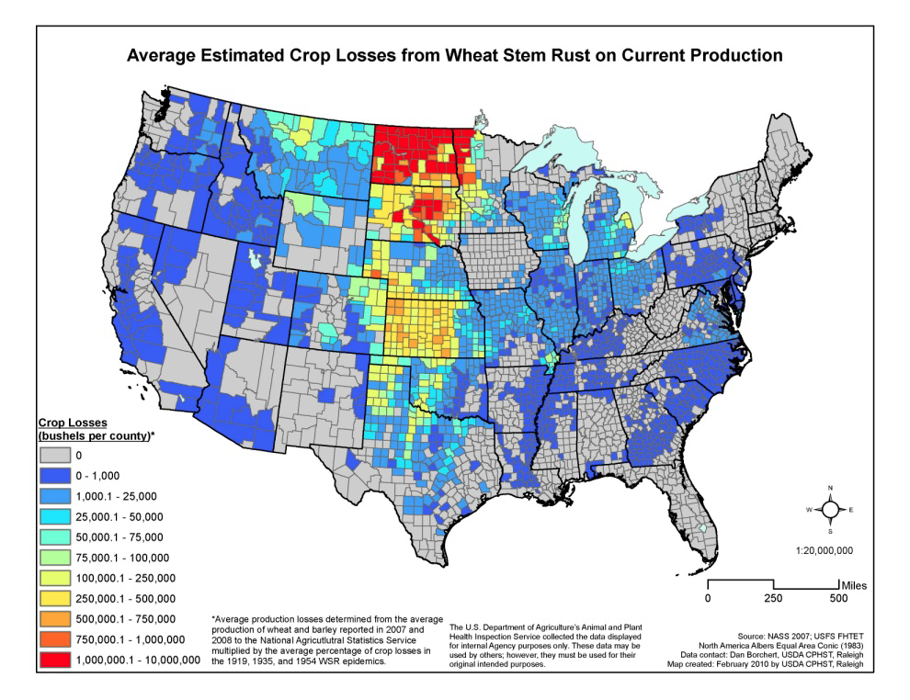
Current Estimate of Disease Risk
Largest wheat production = greatest risk.
The fungus will survive in the south and blow north.
Stem rust is important everywhere!
Red indicates the greatest possible loss. Blue areas have the lowest risk. No risk in gray.
Notes:
If new, virulent strains of stem rust like Ug99 were to make it to the United States, the greatest threat would be to areas with the largest wheat production. Places like Kansas, Nebraska, South Dakota, North Dakota, and Minnesota. Areas shown in yellow, red, and orange on the map pictured. However, it is important to consider that stem rust will survive on minor wheat operations in the south were the climate is favorable and blow North. Much of the spread across Africa and into the Middle East is a direct result of rust spores carried by the wind. So, it is important to be vigilant everywhere.
References:
De Wolf, E., T. Murray, P. Paul, L. Osborne, and A. Tenuta. 2011. Identification and Management of Stem Rust on Wheat and Barley. USDA-CREES Extension IPM 2009-41533-05331.
Accessed 2/26/2011 at-
http://plantpath.wsu.edu/people/faculty/murray/Stem%20Rust%20Man%20WA.pdf

Slide 21
What scientists are doing
Monitoring stem rust disease around the world with the Global Cereal Rust Monitoring System.
Screening varieties for resistance to Ug99 and other races of stem rust.
Enhancing efforts to breed new resistance into high-yield cultivars.
Notes:
The Global Cereal Rust Monitoring System (GCRMS) is an international coalition that is collecting and disseminating information on stem rust incidence and severity.
The GCRMS integrates and disseminates up-to-date information. Currently 15 leading, wheat-producing countries and countries at risk from stem rust Ug99 are reporting standardized survey information in multiple languages via Rust SPORE (http://www.fao.org/agriculture/crops/rust/en/).
Scientists are screening wheat varieties, germplasm collections, and advanced breeding materials for resistance to Ug99. Currently 85-95% of the varieties that have been screened are susceptible to Ug99.
Scientists are also increasing their efforts to breed new resistance into high-yield cultivars.
References:
Singh, R. P., D. P. Hodson, J. Huerta-Espino, Y. Jin, P. Njau, R. Wanyera, S. A. Herrera-Foessel, and R. W. Ward. 2008. Will Stem Rust Destroy the World’s Wheat Crop? Advances in Agronomy, Volume 98, pp. 271-308.

Slide 22
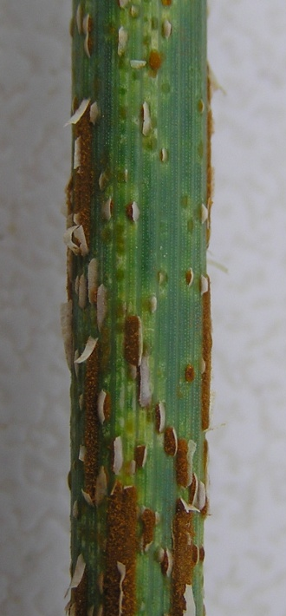

Identifying and reporting rust
Early detection is important!
Recognize the threat, know the symptoms.
- No symptoms until 7-15 days post-infection.
- Early on, oval or elongate lesions that
are reddish-brown in color.
- Progresses to pustules that produce
numerous black sooty spores.
- Can result in lodging.
Report all instances of suspected rust to your local extension agent!
Image Citations: Top – Boyd Padgett, Louisiana State University, Bottom - United States Department of Agriculture, Agricultural Research Service
Notes:
Early detection of stem rust is critical to the response in North America therefore it is importance that you can recognize the threat of stem rust and be watchful for plants that have the symptoms.
Plants do not usually show obvious disease symptoms until 7 to 15 days after infection. Early symptoms include oval to elongate lesions that are generally reddish-brown in color (see picture on far right with inset). The lesions (also referred to as pustules) may be abundant and produced on both leaf surfaces and stems of wheat. In the later stages of the disease, pustules produce numerous black sooty spores. Severe infestations with many stem lesions may weaken plant stems and result in lodging.
References:
De Wolf, E., T. Murray, P. Paul, L. Osborne, and A. Tenuta. 2011. Identification and Management of Stem Rust on Wheat and Barley. USDA-CREES Extension IPM 2009-41533-05331.
Accessed 2/26/2011 at-
http://plantpath.wsu.edu/people/faculty/murray/Stem%20Rust%20Man%20WA.pdf
Marsalis, M. A. and N. P. Goldberg. 2011. Leaf, stem and stripe rust diseases of wheat. Guide A-415. Cooperative Extension Service, College of Agriculture and Home Economics, New Mexico State University.

Slide 23
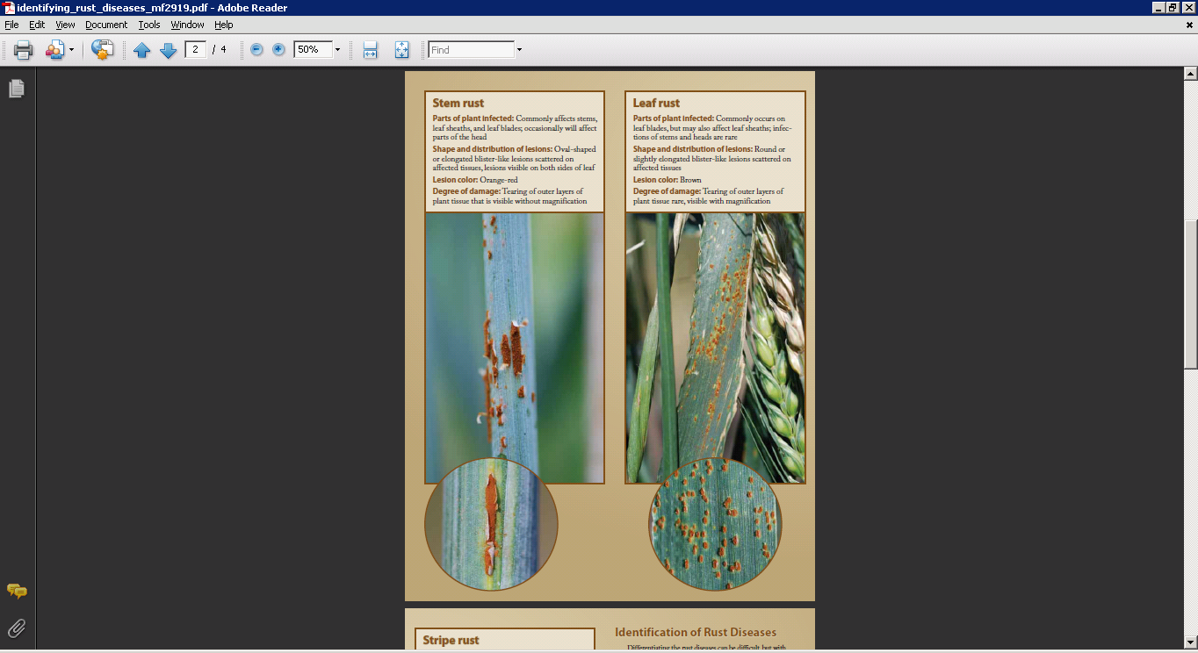
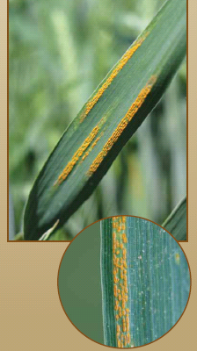
Recognize the threat:
Identification of Rust Diseases
There are three cereal rusts of concern:
A. Leaf Rust
B. Stripe Rust
C. Stem Rust
Leaf blades, leaf sheaths. Stem and heads, only rarely.
Stems, leaf sheaths, leaf blades, and head
Stems, leaf sheaths, leaf blades, and head.
Image Citation: ??
Notes:
Diagnostic features and images for leaf rust (A), stripe rust (B), and stem rust (C) of wheat and barley. Insets show close-up images of lesions.
Differentiating the rust diseases can be difficult, but with practice they can be reliably identified. Begin by considering broad characteristics such as which plant parts are affected (see diagram of plant parts at top right) or the arrangement of the blister-like lesions on plants. These characteristics will often separate one or more of these diseases quickly. Continue by examining less obvious characteristics including lesion size, shape, and color to either confirm the diagnosis or separate the more similar diseases.
For example, stripe rust is the only one of these diseases to have the blister-like lesions organized into stripes on the leaves (Photo B). If the lesions are scattered on the affected plant parts, both stem rust and leaf rust are a possibility and additional characteristics must be considered. Leaf rust typically causes small, round lesions on the leaf blades and leaf sheaths (Photo A). In comparison, stem rust causes oval or elongated lesions and is capable of infecting nearly all above-ground parts of the plant, most notably the true stems (Photo C). Stem rust also causes visible tearing of the outer layers of plant tissue (Photo C).
All three diseases have unique interactions with common varieties of wheat and barley. These interactions can modify the disease symptoms resulting in things like reduced lesion size and varying amounts of yellow or tan tissue surrounding the lesions. Thus, it is important to notify your local extension agent if you encounter these rusts so the identification can be verified by trained professionals.
References:
De Wolf, E., T. Murray, P. Paul, L. Osborne, and A. Tenuta. 2011. Identification and Management of Stem Rust on Wheat and Barley. USDA-CREES Extension IPM 2009-41533-05331.
Accessed 2/26/2011 at-
http://plantpath.wsu.edu/people/faculty/murray/Stem%20Rust%20Man%20WA.pdf

Slide 24
Response to Suspected Wheat Stem Rust Infestation
For additional assistance identifying diseases of wheat or barley, contact your local NPDN lab or your local county extension office.
  Contact your state’s NPDN lab:
    http://www.npdn.org
  Contact your local count extension office:
    http://nifa.usda.gov/Extension/index.html
They will instruct you on collecting samples for disease confirmation.
Notes:
Early recognition and reporting of suspicious samples will allow appropriate grower responses to minimize spread and crop loss!

Slide 25
Additional information resources
To see how much wheat and barley is grown in your state:
  USDA- National Agricultural Statistics Service, Quick Stats http://www.nass.usda.gov/QuickStats/Create_Federal_All.jsp
Other sources of cereal rust information:
  USDA Cereal Disease Lab, St. Paul, MN
  http://www.ars.usda.gov/main/site_main.htm?modecode=36-40-05-00
  Borlaug Global Rust Initiative
  http://www.globalrust.org/traction

Slide 26
Questions?
For more information, check out www.protectingusnow.org
You can also contact:
  Amanda Hodges, Ph.D., Associate Extension Scientist, Department of Entomology and Nematology, University of Florida, achodges@ufl.edu
  Stephanie D. Stocks, M.S., Assistant-In Extension Scientist, Department of Entomology and Nematology, University of Florida, sstocks@ufl.edu

Slide 27
Author and Publication Dates
Erick De Wolf, Ph.D., Department of Plant Pathology, Kansas State University
Jennifer Weeks, Ph.D., Department of Entomology and Nematology, University of Florida
Marty Draper, Ph.D., USDA, National Institute of Food and Agriculture
Keumchul Shin, M.S., DPM student, University of Florida
Published June 2012
Updated August 2013

Slide 28
Editors
Stephanie Stocks, M.S., Department of Entomology and Nematology, University of Florida
Amanda Hodges, Ph.D., Department of Entomology and Nematology, University of Florida

Slide 29
Educational Disclaimer and Citation
This presentation can be used for educational purposes for NON-PROFIT workshops, trainings, etc.
Citation:
  De Wolf, E., J. A. Weeks, M. Draper, and K. Shin. 2012. Wheat stem rust. Accessed (add the date) – www.protectingusnow.org.

Slide 30

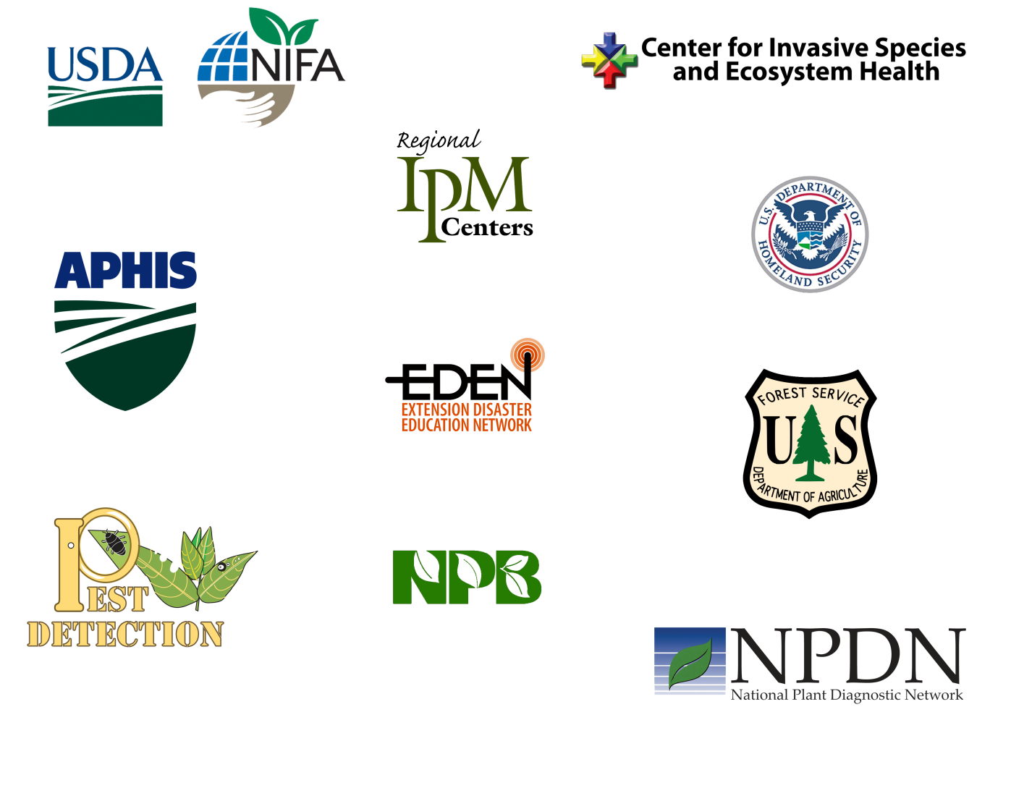
Our Partners
Much of the authorship of e-learning content has occurred through partnerships.
Some of our partnering organizations have included:
Center for Invasive Species and Ecosystem Health
(i.e. the Bugwood Network)
National Institute of Food and Agriculture (NIFA)
Local and Regional Integrated
Pest Management programs (IPM)
U.S. Department of Homeland Security (DHS)
USDA-APHIS
Extension Disaster Education Network (EDEN)
U.S. Forest Service
National Plant Board (NPB) and
State Departments of Agriculture
Cooperative Agriculture Pest Survey Program (CAPS)
National Plant Diagnostic Network (NPDN)

Slide 31
References
Agrios, George N. 1997. Plant Pathology, fourth edition. Academic Press, San Diego.
Anikster Y, 1984. The formae speciales In: Bushnell WR, Roelfs AP, eds. The Cereal Rusts Vol. I. Orlando, USA: Academic Press, 115-130.Biello, D. 2009. Global Wheat Crop Threatened by Fungus: A Q&A with Han Joachim Braun. Scientific American. Accessed 2/26/12-
  http://www.scientificamerican.com/article.cfm?id=global-wheat-crop-threatened-by-fungus
CABI Invasive Species Compendium. 2013. Pucinia graminis. accessed 9/6/2013-
  http://www.cabi.org/isc/?compid=5&dsid=45797&loadmodule=datasheet&page=481&site=144
Curtis, B. C. 2002. Wheat in the world. In B. C. Curtis, S. Rajaram, and H. Gomez Macpherson (eds.), Bread Wheat: Improvement and Production. Food and Agriculture Organization of the United Nations, Rome, Italy. Accessed 2/26/2012 –
  http://www.fao.org/docrep/006/y4011e/y4011e04.htm
De Wolf, E., T. Murray, P. Paul, L. Osborne, A. Tenuta, and M. Stadtlander. 2010. Identifying Rust Diseases of Wheat and Barley. USDA-CREES Extension IPM 2009-41533-05331.
De Wolf, E., T. Murray, P. Paul, L. Osborne, and A. Tenuta. 2011. Identification and Management of Stem Rust on Wheat and Barley. USDA-CREES Extension IPM 2009-41533-05331. Accessed 2/26/2011 –
  http://plantpath.wsu.edu/people/faculty/murray/Stem%20Rust%20Man%20WA.pdf
Dubin, H. J. and J. P. Brennan. 2009. Combating stem and leaf rust of wheat- historical perspective, impacts, and lessons learned. International Food Policy Research Institute (IFPRI) Discussion Paper 00910. Accessed 2/26/2012 –
  http://www.ifpri.org/sites/default/files/publications/ifpridp00910.pdf

Slide 32
References
Duplessis, S., et. al. 2011. Obligate biotrophy features unraveled by the genomic analysis of rust fungi. PNAS 108 (22) 9166-9171. Accessed 2/26/2012 -
  www.pnas.org/cgi/doi/10.1073/pnas.1019315108
FAO (Food and Agriculture Organization of the United Nations). 2011. Global wheat production to increase in 2011. Accessed 2/26/2011 –
  http://www.fao.org/news/story/en/item/53813/icode/
FAO. 2011. Rust spore- a global wheat rust monitoring system. Accessed 2/26/2012-
  http://www.fao.org/agriculture/crops/rust/stem/rust-report/stem-ug99racettksk/en/
Manitoba Agriculture, Food, and Rural Initiatives. 2011. Stem rust in wheat, barley, and oats. Accessed 2/26/2012-
  http://www.gov.mb.ca/agriculture/crops/diseases/fac15s00.html
Marsalis, M. A. and N. P. Goldberg. 2011. Leaf, stem and stripe rust diseases of wheat. Guide A-415. Cooperative Extension Service, College of Agriculture and Home Economics, New Mexico State University. Accessed 2/26/2012 -
  http://aces.nmsu.edu/pubs/_a/A-415.pdf

Slide 33
References
Murray, T., Milus, G., DeWolf, E., Dill-Macky, R., Steffenson, B., Wegulo, S., Bergstrom, G., Sorrells, M., McMullen, M., Paul, P., Hunger, R., Mundt, C., Isard, S., Stein, J., Baker, H., Bulluck, R., Divan, C., Engle, J., Hebbar, P., Bowden, B., Carson, M., Chen, X., Jin, Y., Marshall, D., Smith, K., and Szabo, L. 2010. Recovery plan for stem rust of wheat caused by Puccinia graminis f. sp. tritici Ug99. National Plant Disease Recovery System, a cooperative project of The APS (American Phytopathological Society)/USDA. Accessed 2/26/2012 –
  http://www.ars.usda.gov/research/npdrs.
Roelfs, A. P. 1982. Effects of barberry eradication on stem rust in the United States. Plant Disease 66: 177-81.
Roelfs, A.P. 1984. The Cereal Rusts. Vol2, Chapter 1. Academic Press, San Diego.
Singh,R. P., D. P. Hodson, J. Huerta-Espino, Y. Jin, P. Njau, R. Wanyera, S. A. Herrera-Foessel, and R. W. Ward. 2008. Will Stem Rust Destroy the World’s Wheat Crop? Advances in Agronomy, Volume 98, pp. 271-308.
Schumann, G.L. and K.J. Leonard. 2000. Stem rust of wheat (black rust). The Plant Health Instructor. DOI: 10.1094/PHI-I-2000-0721-01. Accessed 2/26/2012-
  http://www.apsnet.org/edcenter/intropp/lessons/fungi/Basidiomycetes/Pages/StemRust.aspx
USDA/ARS. 2005. Barberry situation- past, present, and future. Cereal Disease Laboratory. Accessed 2/26/2012-
  http://www.ars.usda.gov/Main/docs.htm?docid=9749

Slide 34
References
USDA/ARS. 2008. Cereal rusts and their hosts. Cereal Disease Laboratory. Accessed 2/26/2012-
  http://www.ars.usda.gov/Main/docs.htm?docid=9855
USDA/ARS. 2011. Cereal rusts and their hosts. Cereal Disease Laboratory. Accessed 2/26/2012-
  http://www.ars.usda.gov/Main/docs.htm?docid=9910
USDA/ERS (Economic Research Service). 2011. Briefing Room: wheat overview. Accessed 2/26/2012 -
  http://www.ers.usda.gov/Briefing/Wheat/
USDA/APHIS/PPQ. 2011. Plant pest information program: barberry. Accessed 2/26/2012-
  http://www.aphis.usda.gov/plant_health/plant_pest_info/barberry/index.shtml.
USDA/ERS. 2011. Wheat yearbook. Accessed 2/26/2012 -
  http://www.ers.usda.gov/Data/Wheat/Yearbook/WheatYearbookTable04.htm
USDA/NASS (National Agricultural Statistical Service). 2011. Wheat: data and statistics. Accessed 2/26/2012 –
  http://www.nass.usda.gov/Data_and_Statistics/index.asp
Whetstone, R. D., T. A. Atkinson, and D. D. Spaulding. 2011. Berberidaceae. Flora of North America, Volume 3. Accessed 2/26/2012 –
  http://www.efloras.org/florataxon.aspx?flora_id=1&taxon_id=10100

