Slide 1
Oak Splendour Beetle Agrilus biguttatus

Slide 2
Oak Splendour Beetle
Other common names: oak buprestid beetle, two spotted oak borer, metallic beetle, oak jewel beetle
Closely related to the emerald ash borer
Pest of Europe, northern Africa, Siberia and the Middle East
Causes damages to oak forests, ornamental trees, and nursery trade
Notes:
The oak splendour beetle (Agrilus bigittatus) is also commonly known as the oak buprestid beetle, the two spotted oak borer, the metallic beetle, or the oak jewel beetle. It is closely related to the emerald ash borer which is a pest that causes severe problems in the United States annually. Currently, the oak splendour beetle is isolated to areas in Europe, northern Africa, Siberia and the Middle East where they cause damage to oak forest, ornamental trees and nursery trade. There is a risk that they will eventually spread to more areas of the globe.
Information sources: 4, 6

Slide 3
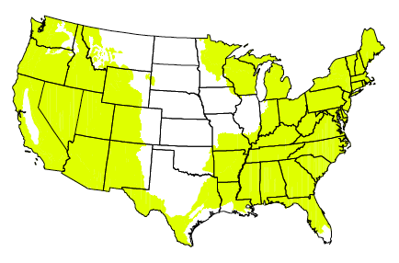
Oak Splendour Beetle suitable climate in the U.S.
Potential areas in the U.S. for the oak splendour beetle to invade.
Image credits: Figure 2 - Davis, E.E., S. French, and R. C. Venette. - https://www.researchgate.net/publication/268001382_Mini_Risk_Assessment_Metallic_Beetle_Agrilus_biguttatus_Fabricius_Coleoptera_Buprestidae_A_B_C
Notes:
The oak splendour beetle is a pest in Europe, Russian Asia, northern Africa, and the Middle East. Although it has yet to invade the United States, there is risk that it will in the future due to suitable climate and vegetation. This pest could seriously threaten forest ecosystems. The pest could potentially enter the United States through wood products and wood packing materials such as dunnage and crating.
Information sources: 4, 6

Slide 4
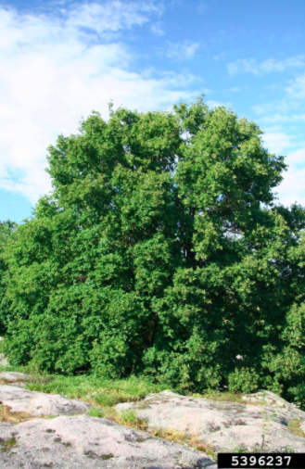
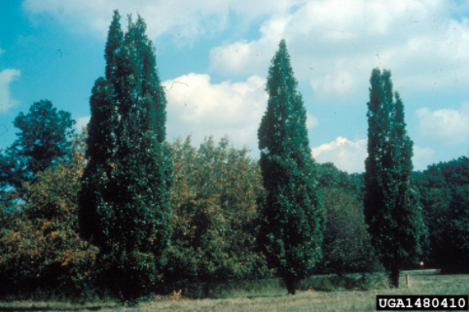
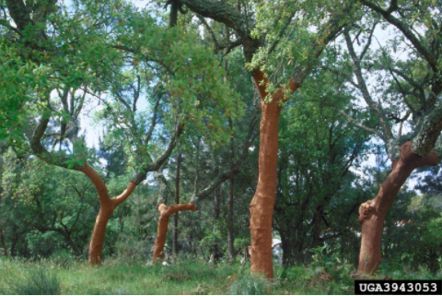
Pest of Oak Trees (Quercus)
Image credits: English oak (Quercus robur) L. - Richard Webb - Bugwood.org, #1480410; downy oak (Quercus pubescens) Willd. - Robert Vidéki, Doronicum Kft. - Bugwood.org, #5396237; cork oak (Quercus suber) L. - William M. Ciesla, Forest Health Management International - Bugwood.org, #3943053
Notes:
The Oak Splendour beetle is a pest of mainly Oak (Quercus). Other susceptible trees are Chestnut (Castanea) and beech (Fagus).
Primary hosts:
Quercus spp. (Oak),
Quercus cerris (European turkey oak),
Quercus ilex (Holly oak),
Quercus petraea (Durmast oak),
Quercus pubescens (Downy oak),
Quercus robur (English oak),
Quercus suber (Cork oak)
Other hosts:
Castanea sativa (European chestnut),
Cytisus scoparius (Scotchbroom),
Fagus spp. (Beech)
Fagus sylvatica (European beech),
Quercus pyrenaica (Pyrenean oak),
Quercus rubra (Northern red oak)
Information sources: 1

Slide 5
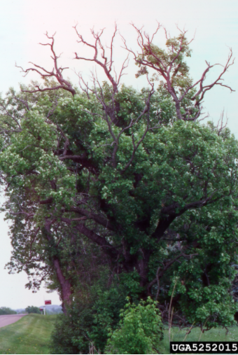
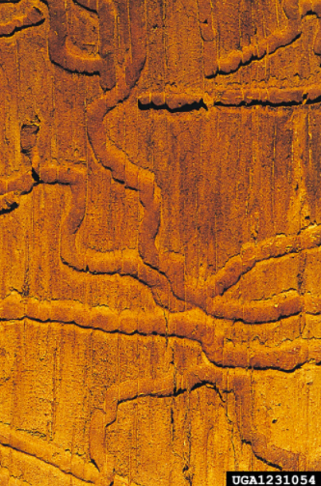
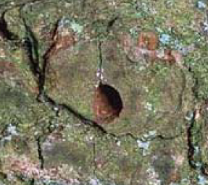
Damage
D-shaped exit holes
Dieback
Zig-zag larval galleries
Image credits: D-shaped exit holes from A. biguttatus - C. Bystrowski; oak splendour beetle (Agrilus biguttatus) (Fabricius, 1776) - Gyorgy Csoka, Hungary Forest Research Institute - Bugwood.org, #1231054; dieback - Joseph OBrien, USDA Forest Service - Bugwood.org, #5252015
Notes:
The oak splendour beetle will slowly damage hosts until they eventually die after several generations of invasion. Some common initial signs are yellowing or dry leaves along with girdling. The host tree can experience dieback and thinning at the crown. Other key damage includes D-shaped exit holes 3 to 4mm where adults emerged from the host. If these signs are present, it is recommended that bark be removed and check the tree for zig-zag galleries created by feeding larvae. Often, woodpecker damage increases along with the presence of this pest as a result of the larvae in host tissues. Furthermore, any signs of tree death should be examined.
Information Sources: 1

Slide 6
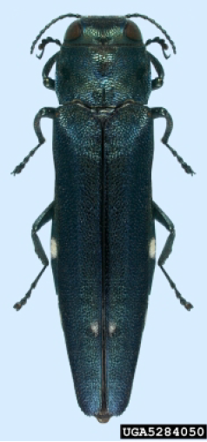
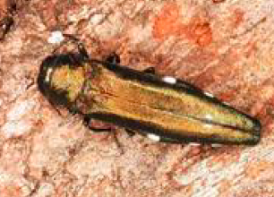
Identification
Adults
8-13mm long
Green and metallic
Two white spots on elytra
Short antennae
Image credits: Agrilus biguttatus adult - Natasha Wright, Florida Department of Agriculture and Consumer Services -Bugwood.org, #5284050; Agrilus biguttatus adult - Gyorgy Csoka, Hungary Forest Research Institute,- Bugwood.org, #5371055
Notes:
The adults are a greenish color with a shiny metallic appearance. Their bodies are 8-13mm long with short antennae on the head. Also commonly referred to as the two spotted oak borer, this pest has white spots located on the lower elytra. The elytra are the hard wing covers found on beetles. In late Spring, they will emerge from the host and create a distinct D-shaped hole in the bark before mating and laying eggs.
Information sources: 7

Slide 7
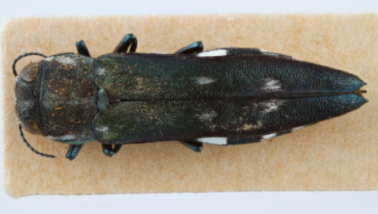
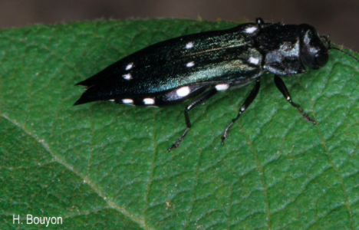
Lookalikes - Adults
Agrilus ater
Agrilus guerini
Image credits: Metallic wood-boring beetle (Agrilus ater) Linneaus - Hanna Royals, Museum Collections: Coleoptera, USDA APHIS ITP, - Bugwood.org , #5544512; Agrilus guerini – H. Bouyon - inpn.mnhn.fr
Notes:
The oak splendour beetle is commonly mistaken for other beetles in the same genus. Both Agrilus ater and Agrilus guerini look very similar and are the more commonly misidentified because of the white spots present on their elytra. In the United States, the oak splendour beetle may also be mistake for other pests including Agrilus planipennis (Emerald ash borer), Agrilus cuprescens, Agrilus cyanescens, Agrilus derasofasciatus, Agrilus hypericici, Agrilus obsoletoguttatus, Agrilus pilosovittatus, and Agrilus sinuatus. These can usually be ruled out due to the lack of white spots on the wing covers.
The emerald ash borer is an invasive pest of limited distribution in the United States. It is reportable in some areas. The emerald ash borer is a common pest of ash trees. This pest is a green metallic color but lacks spots on the wing covers.
Agrilus ater has short and sharp ends on their elytra whereas the oak splendour beetle has more rounded tips on their elytra. Furthermore, the oak splendour beetle only has two spots of white further down on the wing covers while Agrilus ater often has three white spots.
Similar to Agrilus ater, Agrilus guerini has three white spots. Moreover, the tips of the elytra are long, sharp and pointed which is very distinct from the oak splendour beetle.
Information sources: 1

Slide 8
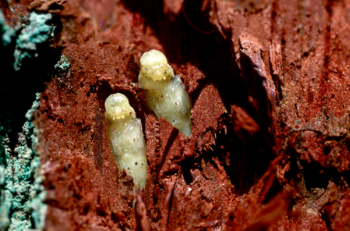
Identification
Pupae
White
Pupate in Spring
Found chambers in host tissues
Image credit: Agrilus biguttatus pupae. Louis-Michel Nageleisen, Département de la Santé des Forêts, Bugwood.org, #2515037
Notes:
Pupation will occur in the Spring of the second year of a single generation. Pupae are generally white and found within the chambers formed in plant tissues by the larvae.
Information sources: 6

Slide 9
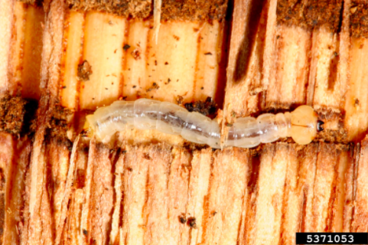
Identification
Larvae
White
Legless
10-40mm
Two horn-like protrusions on abdomen
Image credits: oak splendour beetle (Agrilus biguttatus) (Fabricius, 1776) - Gyorgy Csoka, Hungary Forest Research Institute - Bugwood.org, #5371053
Notes:
Oak splendour beetle larvae are white, legless creatures up to 40mm in length. They have two darker horn like protrusions from the end of their abdomens called urogomphi, and the first body segment directly behind the head is wider than the other segments. Larvae will complete 5 instars as they eat through the plant tissues creating larval galleries. As they eat, they produce frass which can be an early warning sign of host infection.
Information sources: 4, 6

Slide 10
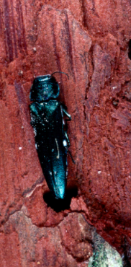
Identification
Eggs
Clusters of 5-6 eggs
7-14 days
Adult female laying eggs into a crevice in the bark of a tree
Image credits: oak splendour beetle (Agrilus biguttatus) (Fabricius, 1776) - Louis-Michel Nageleisen, Département de la Santé des Forêts, - Bugwood.org, #2515033
Notes:
The adult oak splendour beetle will lay clusters of 5-6 eggs at a time into bark crevices. They take about 7-14 days to hatch.
Information sources: 8

Slide 11
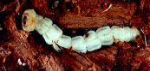
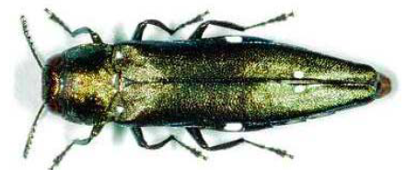
Life cycle
Eggs
7-14 days
Adult
Larvae
Pupae
Image credit: invasive.org (2005); Agrilus biguttatus pupae. Louis-Michel Nageleisen, Département de la Santé des Forêts, Bugwood.org
Notes:
In Europe, it has been reported that oak splendour beetle the completes one generate in a two year period. Between May and June of the first year, adults emerge from the host tree. Around early August, females deposit eggs in crevices of trees which take 7-14 days to hatch. The larvae feed on cambial tissues in the tree and create larval galleries until around November when they overwinter. In March of the following year, larvae continue feeding and go through 5 instars. In early September, the larvae again overwinter and pupate in the following April. Completing one generation, the adults emerge around May to mate and deposit eggs.
Information sources: 5

Slide 12
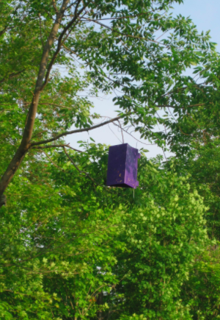
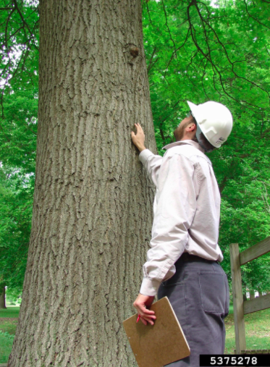
Monitoring
Visual surveying for:
D-shaped exit holes
Larval galleries
Tree dieback
Purple prism traps
Cerceris wasps
Image credits: visual tree inspection - Andrew Koeser, International Society of Arboriculture - Bugwood.org, #5375278, emerald ash borer (Agrilus planipennis) Fairmaire, 1888 - Dawn Dailey O'Brien, Cornell University, - Bugwood.org, #5458354
Notes:
The best time of the year to survey is May through August when the larvae and adults are most active. Agrilus biguttatus is difficult to monitor because it does not have any known trapping methods that work extremely well. The best way of monitoring is with visual surveying by looking for tree damage and the presence of the pest in any of its four life stages. Common warning signs of infestation are larval galleries beneath the bark, D-shaped exit holes, bark splitting and tree dieback. If an infestation is suspected, sweeping of foliage is recommended in sunny areas. If the D-shaped exit holes are present, it is advised to remove some of the tree bark to inspect for larval galleries or pupae.
Some resources suggest trying a purple prism trap without a lure in high risk areas like forests and nurseries. Traps should not be used as a main focus of monitoring because they have very limited success for the oak splendour beetle.
Another method is to look for Cerceris wasps. These are ground-nesting wasps that collect the beetles and store them in the nest. The wasps are known to collect Agrilus biguttatus and the nests of Cerceris wasps can provide a collection of beetles to confirm infestation of nearby hosts.
Information Sources: 1

Slide 13
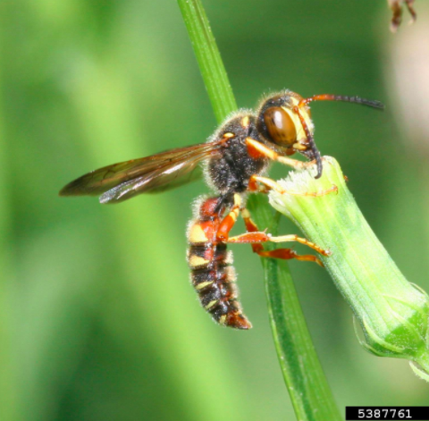
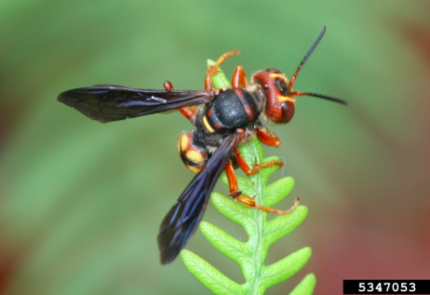
Natural Control
Cerceris wasps
Image credits: Sphecid wasp (Cerceris bicornuta) Guerin-Meneville, 1844 - Johnny N. Dell - Bugwood.org, #5387761; Sphecid wasp (Cerceris bicornuta) Guerin-Meneville, 1844 - Johnny N. Dell - Bugwood.org, #5347053
Notes:
Cerceris wasps are a natural control of the oak splendour beetle. Cerceris wasps are a natural predator of the oak splendour beetle and will collect the pest in their nests. It is not known if a species of this wasp is preferential to the oak splendour beetle. Additionally, these wasps can aid in monitoring for the oak pest. Cerceris fumipennis is a species that is known in the United States and has been utilized in the monitoring of the emerald ash borer.
Information Sources: 1, 9

Slide 14
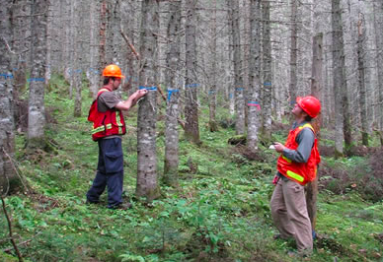
Cultural Control
General Sanitation
Removal of infested hosts
Silviculture
Pruning
Cleaning
Image credits: Silvicultural research - http://www.nrcan.gc.ca/forests/industry/tools-research/13341
Notes:
The oak splendour beetle is very cryptic and chemical control can be extremely difficult and unsuccessful. As a result, cultural control is the best method for dealing with the pest. Cultural controls include general sanitation and silviculture. General sanitation includes removal of extremely infested hosts and host materials. This can be done by burning or chipping infested hosts to destroy all life stages of Agrilus biguttatus. Also, silviculture is highly recommended in areas of susceptible hosts. These practices can include pruning or thinning out trees to prevent infestation as well as cleaning. Inspection of trees should be fairly frequent and vehicles used for host transportation should be kept clean to prevent dispersal of the pest.
Information Sources: 8

Slide 15
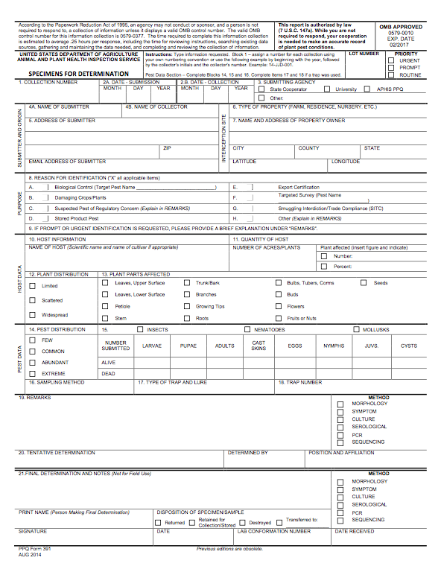
Suspect Sample Submissions
Contact your State Department of Agriculture or University Cooperative Extension laboratory
http://www.npdn.org/home
PPQ form 391, Specimens for Determination
https://www.aphis.usda.gov/library/forms/pdf/PPQ_Form_391.pdf
An example of a PPQ form for sample submissions
Image credits: https://www.aphis.usda.gov/library/forms/pdf/PPQ_Form_391.pdf
Notes:
If a suspect pest has been located in the United States, a sample should be submitted for proper identification. Contact your local diagnostic lab to ship in a sample for identification. Information regarding your local diagnostic lab is available at National Plant Diagnostic Network (NPDN) website. The diagnostic lab information and available contacts are divided by state.
http://www.npdn.org/home
The sample specimen should be submitted along with accompanying documentation using the PPQ form 391.
https://www.aphis.usda.gov/library/forms/pdf/PPQ_Form_391.pdf
Your local diagnostic lab is part of your local cooperative extension service or your state department of agriculture. Your local lab will also have a specific form. All local labs may not be a member of NPDN. However, all labs should report new pest and pathogen detections to local regulatory officials.

Slide 16
Communications
Contact your State Plant Health Director
https://www.aphis.usda.gov/aphis/ourfocus/planthealth/ppq-program-overview/ct_sphd
Contact your State Plant Regulatory Official
http://nationalplantboard.org/membership/
Image credits: http://www.usda.gov/wps/portal/usda/usdahome; http://nationalplantboard.org/
Notes:
Remember that new pest and pathogen records must be reported to your State Plant Health Director (SPHD) and your State Plant Regulatory Official (SPRO). The SPRO is a State Department of Agriculture Employee and the SPHD is a USDA-APHIS-PPQ employee.
The link to your SPRO is on the National Plant Board (NPB) website. It has an interactive map and when you click on your state it will take you to another page with contact information. The NPB is a cooperative organization that includes membership from all State Departments of Agriculture.

Slide 17
Author and Publication Dates
Morgan Pinkerton
Lab Technician, Department of Entomology and Nematology, University of Florida
Amanda Hodges, Ph.D.
Associate Extension Scientist, Department of Entomology and Nematology, University of Florida
Publication date: October 2016

Slide 18
Reviewers
Catherine A. Marzolf
Assistant State Plant Health Director, USDA APHIS PPQ

Slide 19
Educational Disclaimer and Citation
This presentation can be used for educational purposes for NON-PROFIT workshops, trainings, etc.
Citation: Pinkerton, Morgan and Amanda Hodges. 2016. Oak splendour beetle – Agrilus biguttatus.
Accessed (add the date)
www.protectingusnow.org

Slide 20
Our Partners
United States Department of Agriculture, National Institute of Food and Agriculture (USDA NIFA)
United States Department of Agriculture, Animal and Plant Health Inspection Service, Plant Protection and Quarantine (USDA APHIS PPQ)
Cooperative Agriculture Pest Survey (CAPS) Program
National Plant Board (NPB)
States Department of Agriculture
Extension Disaster Education Network (EDEN)
Center for Invasive Species and Ecosystem Health (Bugwood)
National Plant Diagnostic Network (NPDN)
U.S. Department of Homeland Security (DHS)
U.S. Forest Service (USFS)

Slide 21
References
Anonymous. Exotic Wood Borer/Bark Beetle. Purdue University. Accessed 3/10/2016.
download.ceris.purdue.edu/file/1975
Anonymous. Oak Splendor Beetle-Agrilus biguttatus (Fabricus). United States Department of Agriculture. Accessed 3/10/2016.
http://www.fs.fed.us/foresthealth/technology/invasives_agrilusbiguttatus_riskmaps.shtml
Barclay, H.J. and L. Humble. 2009. Probability models to facilitate a declaration that an exotic insect species has not yet invaded an area. Biological Invasions 11: 1267-1280. Accessed 3/10/2016.
caps.ceris.purdue.edu/dmm/1175
Davis, E.E., S. French, and R. C. Venette. 2005. Mini Risk Assessment Metallic Beetle: Agrilus biguttatus Fabricius [Coleoptera: Buprestidae]. Accessed 3/10/2016.
https://www.researchgate.net/publication/268001382_Mini_Risk_Assessment_Metallic_Beetle_Agrilus_biguttatus_Fabricius_Coleoptera_Buprestidae_A_B_C

Slide 22
References
Denman, S. and N. Brown. 2011. Schematic diagram of the life cycle of Agrilus biguttatus on native oak trees in Britain - from egg to adult. Forest Research. Accessed 3/10/2016.
http://www.forestry.gov.uk/pdf/AOD_poster_Agrilus_biguttatus.pdf/$FILE/AOD_poster_Agrilus_biguttatus.pdf
Noma, T., et al. 2010. Oak splendor beetle Agrilus biguttatus. Michigan State University’s. Accessed 3/10/2016.
http://www.ipm.msu.edu/uploads/files/forecasting_invasion_risks/oaksplendorbeetle.pdf
Silagyi, A.J. 2011. Survey guideline for Agrilus biguttatus (Coleoptera: Buprestidae), the oak splendor beetle. Accessed 3/10/2015.
caps.ceris.purdue.edu/dmm/1175
USDA–APHIS. 2011. New Pest Response Guidelines: Exotic Wood-Boring and Bark Beetles. USDA–APHIS–PPQ–EDP-Emergency Management, Riverdale, Maryland. Accessed 3/10/2016.
https://www.aphis.usda.gov/import_export/plants/manuals/emergency/downloads/nprg-wood_boring_bark_beetles.pdf

Slide 23
References
USDA. 2014. Questions and Answers: USDA’s Emerald Ash Borer Biocontrol Program. USDA: Animal and Plant Health Inspection Service, Plant Protection and Quarantine. Accessed 6/22/2016.
https://www.aphis.usda.gov/publications/plant_health/2014/faq_eab_biocontrol.pdf

