Slide 1
Egyptian cotton worm
Spodoptera littoralis

Slide 2
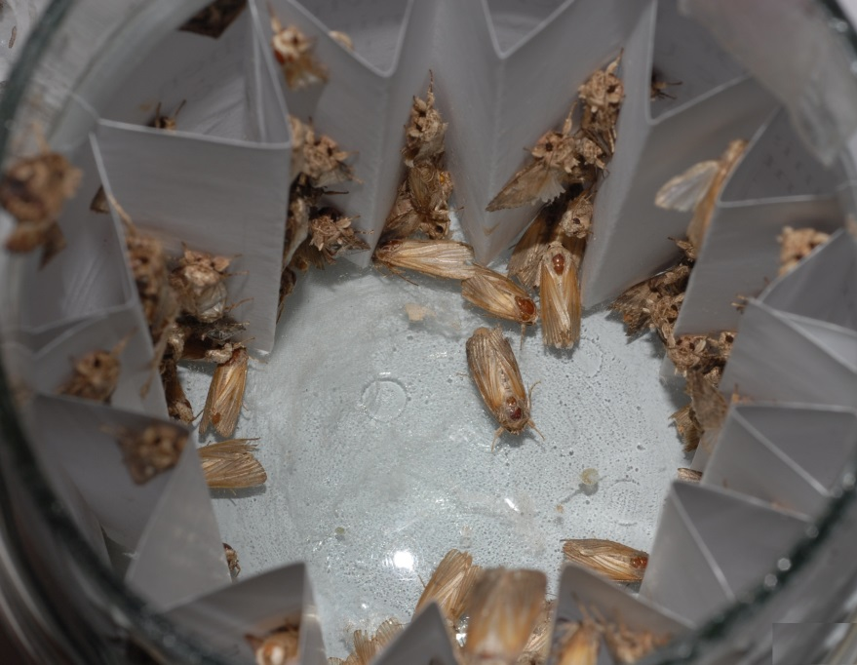
Egyptian cottonworm
Native to Africa, the Middle East and the Mediterranean countries of Europe.
Greenhouse pest of tomato, pepper, and melon in Spain, Italy and Greece.
Image citation: Esmat M. Hegazi, University of Alexandria, Bugwood.org
Notes:
There are two species of cotton leaf worm that are geographically isolated; S. litura and S. littoralis. S. litura is found in Asia while S. littoralis is primarily in Africa. Some literature cites the two as the same species.
As far as S. littoralis is concerned, the distribution includes most parts of Africa, southern or mediterranean Europe and the middle east. Some of the locations include Greece, Italy, Malta, Portugal, Spain, Israel, Syria, and Turkey.
Spodoptera littoralis is native to Africa, the Middle East and the Mediterranean countries of Europe. This pest can be found in greenhouse crops including tomato, pepper and melon in Spain, Italy, and Greece. S. littoralis has not yet established in northern Europe due to the colder climate, but there is still a risk that it could eventually. Furthermore, there is a risk of introduction to other locations through shipments of plants.
box
Information sources: 3, 8, 16

Slide 3
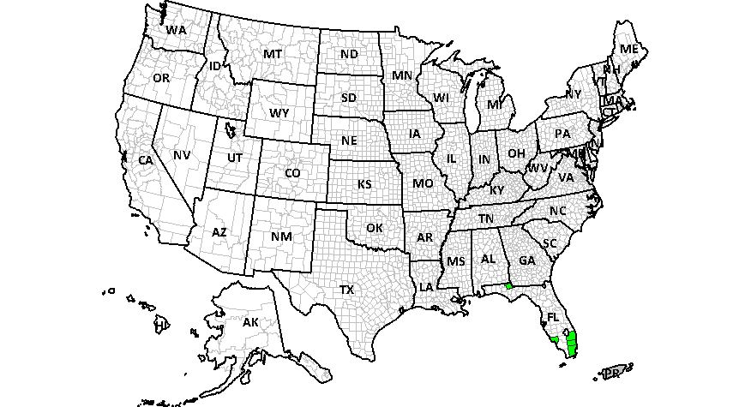
Egyptian Cottonworm
Distribution in the U.S.
No survey
Surveyed but not found
Map citation: Center for Environmental and Research Information Systems (CERIS). Purdue University. "Survey Status of
Egyptian cottonworm – Spodoptera littoralis (2016)." Published: 06/21/2016.
http://pest.ceris.purdue.edu/map.php?code=ITBCFPA&year=2016. Accessed: 06/27/2016.
Notes:
In the U.S., this species has been intercepted over 170 times. Even so, it has yet to establish in North America. Nonetheless, S. littoralis is on the CAPS Priority Pest List for 2017 Commodity and Taxonomic Surveys for Oaks.
Information sources: 10, 15, 16

Slide 4
Potential Distribution in the U.S.
Map citation: USDA-APHIS-PPQ-CPHST.
Notes:
Higher values (red) indicate a higher risk for the establishment of this pest while lower (blue) values suggest a much lower risk.
This risk map developed by USDA-APHIS-PPQ-CPHST in 2011 shows that many parts of the United States have a high risk for the establishment of this pest based on host availability and climate. According to the USDA (1982) the potential range for this species may be limited to the west coast and the lower southwestern and southeastern United States. However, seasonal migrations could occur to other parts of the country.
Information sources: 16, 18
Map citation: USDA-APHIS-PPQ-CPHST.

Slide 5
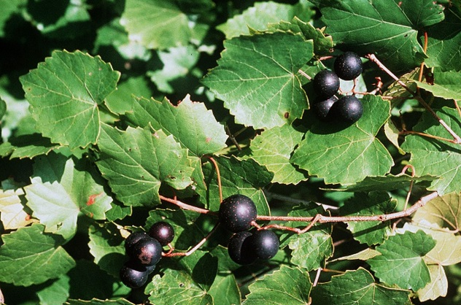
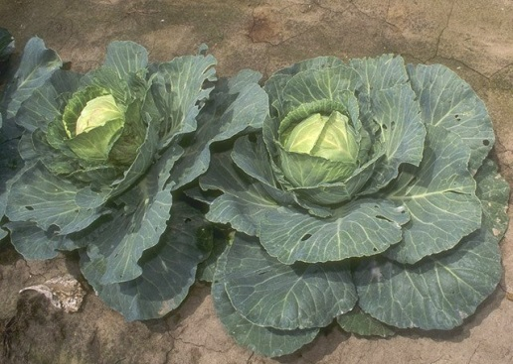
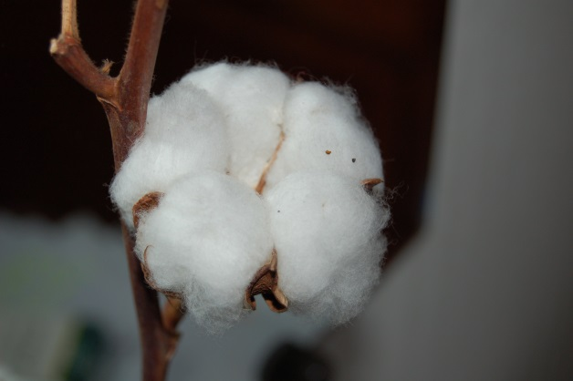
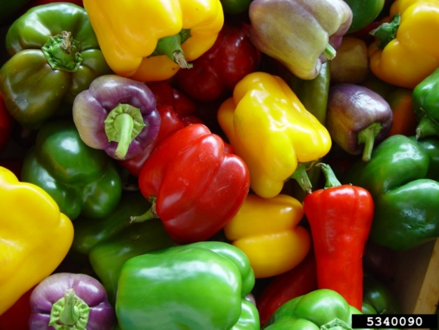
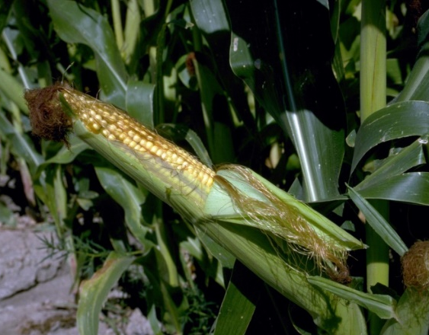
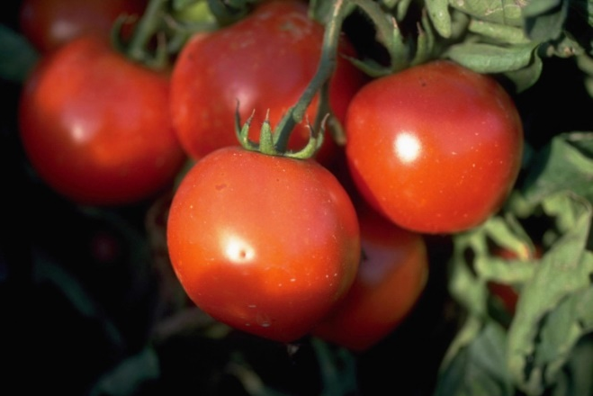
Pest of many herbaceous ornamentals and field crops
Image credits: peppers – Grapes: public domain, wikimedia.com, Cabbage: public domain, wikimedia.com, Cotton: public domain, wikimedia.com Gerald Holmes, Valent USA Corporation, www.bugwood.org, #5340090; corn - Howard F. Schwartz, Colorado State University, www.bugwood.org, #5361595; tomatoes - Howard F. Schwartz, Colorado State University, www.bugwood.org, #5365838.
Notes:
The pest has a wide host range and will feed on oaks as a secondary host (Salama et al., 1970).
Major Hosts
Abelmoschus esculentus (okra), Allium spp. (onion), Amaranthus spp. (pigweed, amaranthus), Apios spp. (groundnut), Arachis hypogaea (peanut), Beta vulgaris (beet), Brassica oleracea (cabbage, broccoli), Brassica rapa (turnip), Brassica spp. (mustards), Camellia sinensis (tea), Capsicum annuum (pepper), Chrysanthemum spp., Citrullus lanatus (watermelon), Citrus spp., Coffea arabica (coffee), Colocasia esculenta (taro), Corchorus spp. (jute), Cucumis spp. (squash, pumpkin), Cynara cardunculus (artichoke), Daucus carota (carrot), Dianthus caryophyllus (carnation), Ficus spp. (fig), Glycine max (soybean), Gossypium spp. (cotton), Helianthus annuus (sunflower), Ipomoea batatas (sweet potato), Lactuca sativa (lettuce), Linum spp. (flax), Medicago sativa (alfalfa), Morus spp. (mulberry), Musa spp. (banana, plantain), Nicotiana tabacum (tobacco), Oryza sativa (rice), Pennisetum glaucum (pearl millet), Persea americana (avocado), Phaseolus spp. (bean), Pisum sativum (pea), Prunus domestica (plum), Psidium guajava (guava), Punica granatum (pomegranate), Raphanus sativus (radish), Rosa spp. (rose), Saccharum officinarum (sugarcane), Solanum lycopersicum (tomato), Solanum melongena (eggplant), Solanum tuberosum (potato), Sorghum bicolor (sorghum), Spinacia spp. (spinach), Theobroma cacao (cacao), Trifolium spp. (clover), Triticum aestivum (wheat), Vicia faba (broad bean), Vigna spp. (cowpea, black-eyed pea), Vitis vinifera (grape), and Zea mays (corn).
Minor hosts include but not limited to:
Casuarina equisetifolia (she-oak) Quercus petraea (durmast oak), and Pinus spp. (pine)
Information sources: 13, 16

Slide 6
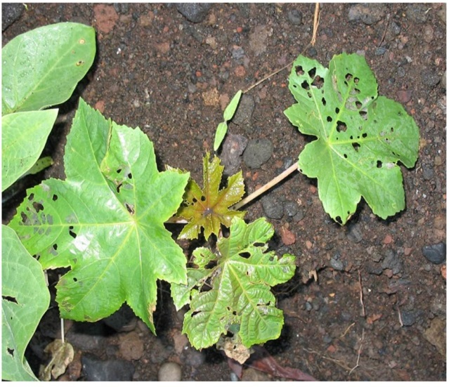
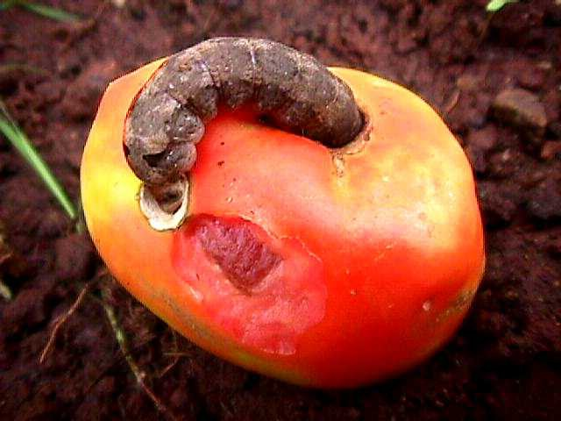
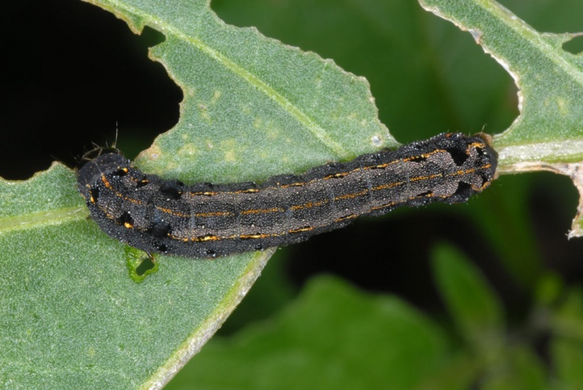
Damage to leaves
Damage to fruit
Ricinus
Tomato
Image credits: Damage to fruit: Creative commons , A. M. Varela, icipe
Damage to leaves: Wolfgang Wagner
Notes:
Most damage occurs from larval feeding. Larvae prefer to feed on young leaves and shoots, but can also feed on stalks, bolls, buds and fruit. Larval gnawing can expose plant tissues making the host much more susceptible to disease. The Egyptian cotton worm can cause skeletonization and intense scaring of plant tissues. Older instars will chew large holes or completely defoliate plants.
On cotton, leaves are heavily attacked and bolls have large holes in them from which yellowish-green to dark-green larval excrement protrudes.
On tobacco, leaves develop irregular, brownish-red patches and the stem base may be gnawed off.
On maize, the stems are often mined and young grains in the ear may be injured.
Information sources: 3, 16

Slide 7
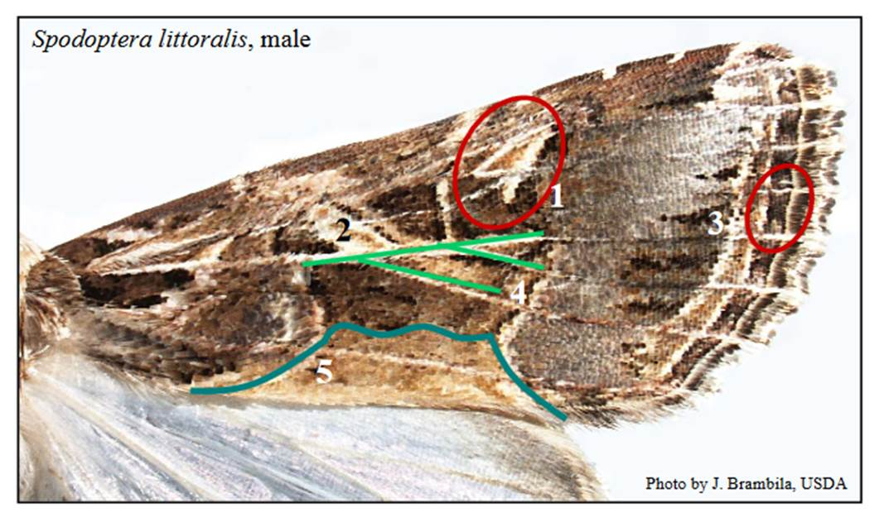
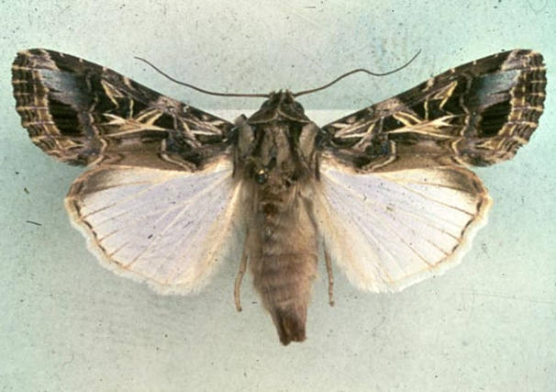
Identification
Adults
  Grey-brown body
  15-20mm (0.6–0.8in) long
Image credits: Left: Julieta Brambilla USDA Right: O. Heikinheimo, Bugwood.org
Notes:
Adult moths are difficult to distinguish visually from related species. The Egyptian cotton worm is a grey-brown moth with specific variegated patterns on the forewings. Hindwings are a pale white color. The body is 15-20mm (0.6–0.8in) long and the wingspan is 30-38mm (1.18 -1.5in).
Information sources: 7

Slide 8
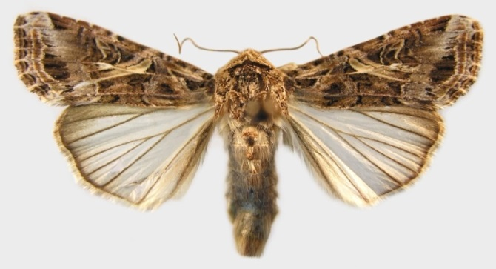
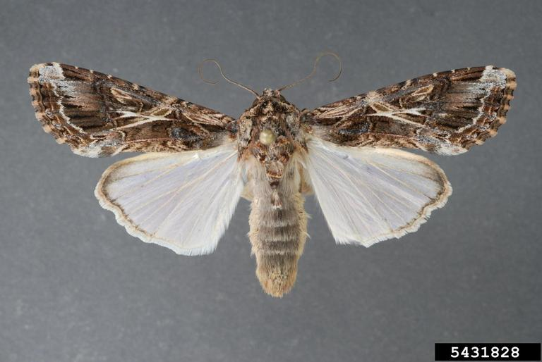
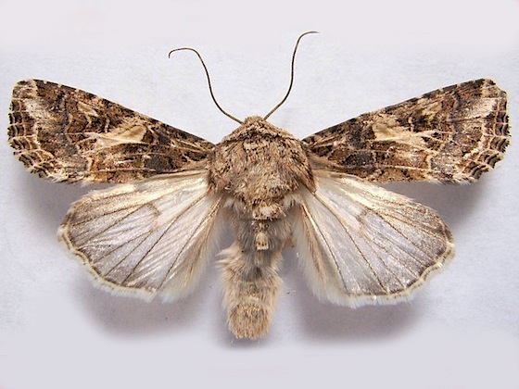
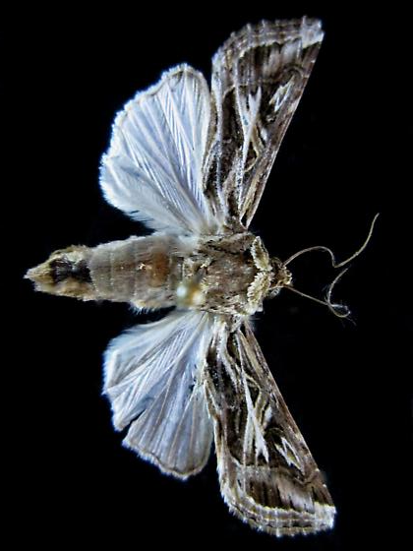
Look Alikes - Adults
Spodoptera ornithogalli
Spodoptera latifascia
Spodoptera praefica
Spodoptera pulchella
Image credit: Spodoptera latifascia Lyle Buss, University of Florida, Bugwood.org
Spodoptera ornithogalli Natasha Wright, Cook's Pest Control, Bugwood.org
Spodoptera praefica: 2012 Jim Moore, bugguide.net
Spodoptera pulchella 2012 Paul Dennehy
Notes:
Many of the species of Spodoptera look very similar so identification is difficult. S. littoralis is often confused with S. litura, but both are not established in the continental United States. Dissection and examination of adult genitalia is the only method for identification. Other lookalikes include S. dolichos, S. latifascia, S. ornithogalli, and S. pulchella.
S. latifascia –In U.S. S. latifascia is distributed in the Southeast
S. ornithogalli – widely distributed across U.S.
S. praefica – Distributed in western North America from Washington south to California and east to Kansas; also Alberta, Canada
References: 1, 12

Slide 9
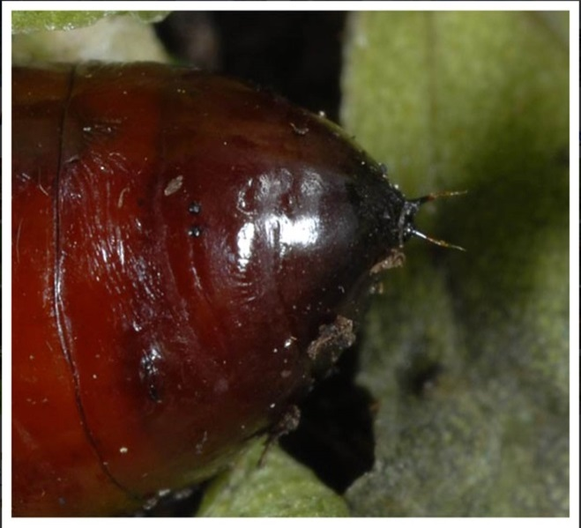
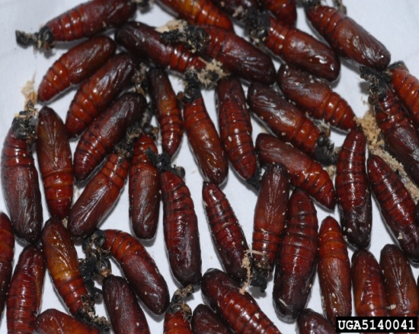
Identification
Pupae
  reddish-brown
  14 to 20 x 5mm (9/16 to 13/16 x 3/16in) in length
  Two small spines on the tip of the abdomen
Image credits:
top image - Esmat M. Hegazi, University of Alexandria, Bugwood.org #5140041
bottom image- Wolfgang Wagner http://www.pyrgus.de/Spodoptera_littoralis_en.html
Notes:
Initially, pupae are green with a reddish color, but quickly turn dark reddish brown. Pupae are cylindrical and 14 to 20 x 5mm (approx. 9/16 to 13/16 x 3/16in). The last segment has two strong spines as indicated by the lower images on the slide.
Information sources: 11, 16

Slide 10
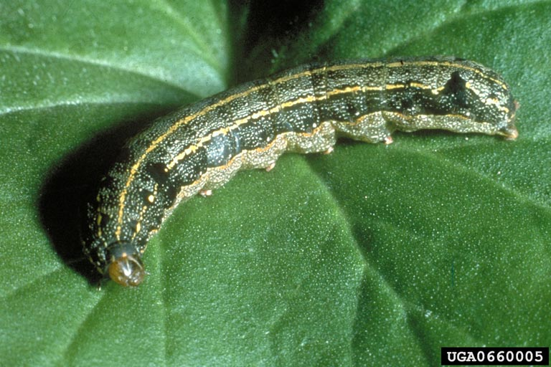
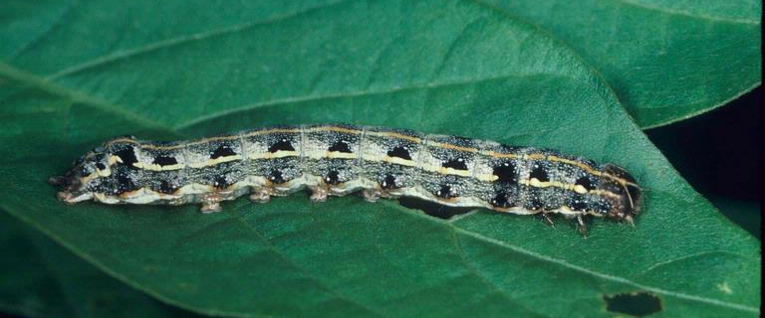
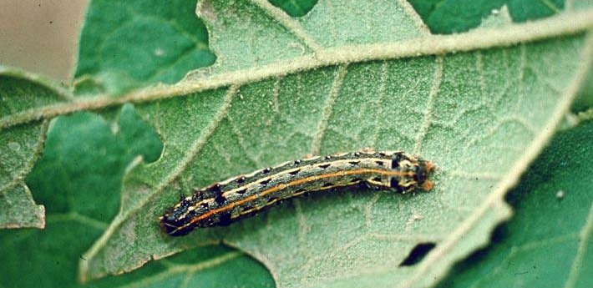
Identification
Larvae
  length of 40-45mm (1.57–1.77in) length
  Hairless
  Blackish-grey to dark-green, becoming reddish-brown or whitish-yellow
  sides of body with alternating dark and light longitudinal bands
  bright-yellow stripe along the length of the dorsal surface
Image credits:
Top – Forstwirtschaft, Bugwood.org, #0660005
Middle image - Merle Shepard, Gerald R.Carner, and P.A.C Ooi. Bugwood.org, #5368053
Bottom - K. Kiritani, Bugwood.org
Notes:
Larvae can grow up to 40-45mm (1.57-1.77in) in length. Younger larvae are blackish-grey to dark green while older larvae become reddish-brown or whitish-yellow. The sides of the body have dark and light bands along its length. On the dorsal side, larvae have two dark semilunar spots on each segment except for the prothorax. Bright yellow stripes also run along the length of the body.
Information sources: 6

Slide 11
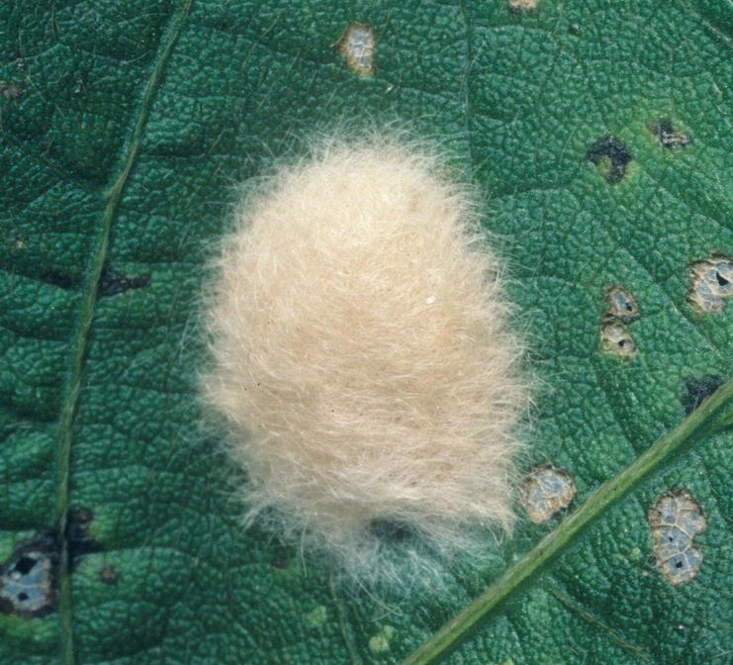
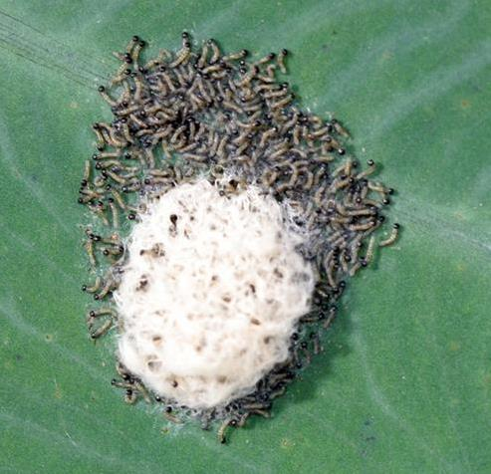
Identification
Eggs
  Spherical, flattened clusters
  0.6mm (< 0.02in) in diameter
  Clusters of 100-300 eggs
  Covered in hairy, pale orange, light yellow or pink scales
Image credits:
upper image- Eggs covered with hairy scales (Merle Shepard, Gerald R.Carner, and P.A.C Ooi, Insects and their Natural Enemies Associated with Vegetables and Soybean in Southeast Asia, Bugwood.org)
bottom image - Emerging larvae (Amy Carmichael, Queensland University of Technology, PaDIL)
Notes:
Eggs are laid in spherical, flattened clusters. The females cover the egg clusters with hair-like scales that can be pale orange, light yellow, or pink. Clusters are roughly 0.4 to 0.7mm (<1/16in) in diameter.
Information sources: 3

Slide 12
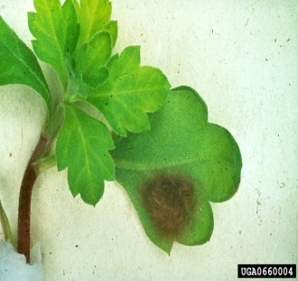
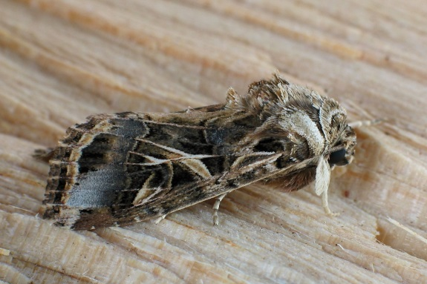
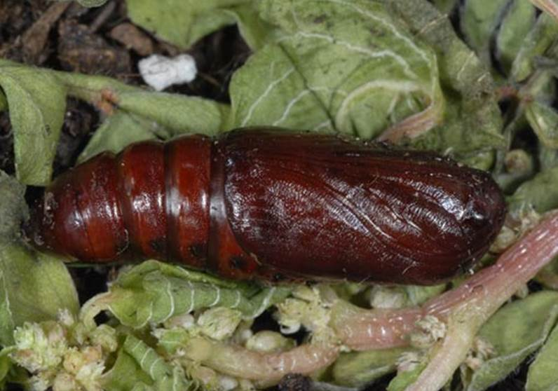
Life cycle
4 days
5 - 10 days
10 - 35 days
8 - 27 days
Image credit: Adult: Bernard Fransen, Bugwood.org #5140026 Egg mass: O. Heikinheimo, Bugwood.org #06600064
Larva Biologische Bundesanstalt für Land- und Forstwirtschaft, Bugwood.org #0660005 Pupa: Wolfgang Wagner http://www.pyrgus.de/Spodoptera_littoralis_en.html
Notes:
Females lay clusters of eggs on the under sides of leaves. The eggs will hatch in around 4 days depending on the temperature. Larval soon begin feeding on plant tissues and causing extensive damage to the host. The Egyptian cotton worm larvae will complete six instars over a three week period in most warmer climates. Cooler regions require additional development time. Larvae will push downward in the soil and pupate where there is solid ground 3 to 5cm (approx. 1 3/16 to 2in) deep. The larvae will form a clay “cell” or cocoon and pupates within 5-6 hours. In the winter, pupae can overwinter in the ground. Adults will emerge at night and live for 5-10 days and typically lay eggs during their first night. In warmer climates, it is estimated that the Egyptian cotton worm completes anywhere between 2 and 9 generations annually.
At temperatures of 18°C (64°F) and 36°C (97°F), eggs can hatch at 2 and 9 days respectively. In the same temperatures, the larval stage lasted on average 10 and 35 days, and the pupal stage required 8 and 27 days, respectively (Ocete Rubio, 1984).
Information sources: 5, 14, 16

Slide 13
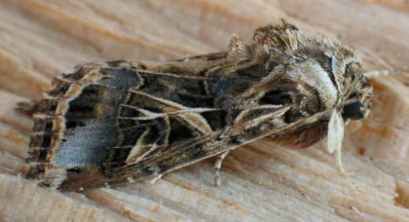
Hibernation and Dispersal
Moths can fly and disperse up to 1.5km to new hosts.
In warm climates, up to 8-9 generations are possible per year.
Overwinters as pupa in
the soil.
Image credits:Bernard Fransen, Bugwood.org
Notes:
The moths can disperse over a long distance (1.5km during a period of 4 hours overnight) in search of new host plants. In warm climates, up to 8-9 generations are possible and the pest can overwinter as pupae in the soil. S. littoralis has been noted outside its normal range in Europe, but this is likely due to movement of plant materials.
Information sources: 3, 4, 17

Slide 14
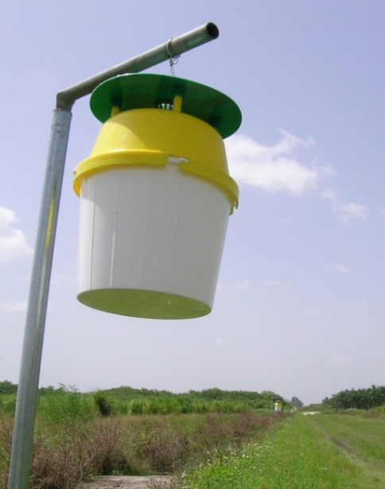
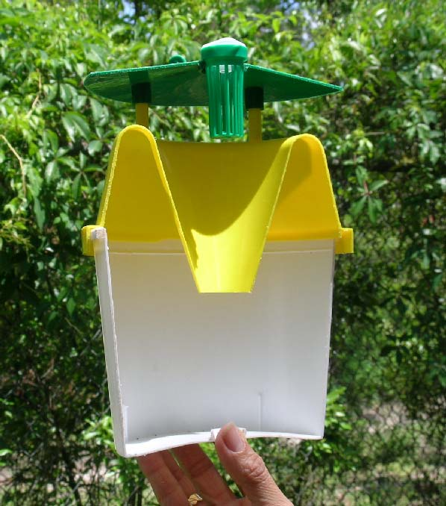
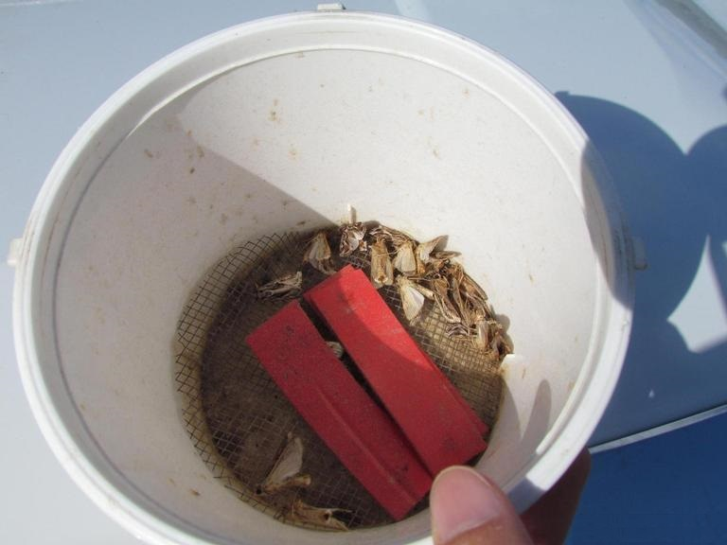
Monitoring
Plastic bucket trap cut in half to show its interior.
Image credit:
Bottom right: Andrew Derksen, USDA-APHIS, Bugwood.org #5440169. Left and top right: J. Brambila (USDA/APHIS/PPQ Eastern Region) and R. Meagher (USDA/ARS/CMAVE)
Notes:
The Cooperative Agricultural Pest Survey (CAPS) approved method is a trap and lure. A plastic bucket trap [unitrap] with dry kill strip is the approved trap. It is reccomended that the lure be changes every 84 days (12 weeks).
Information sources: 1

Slide 15
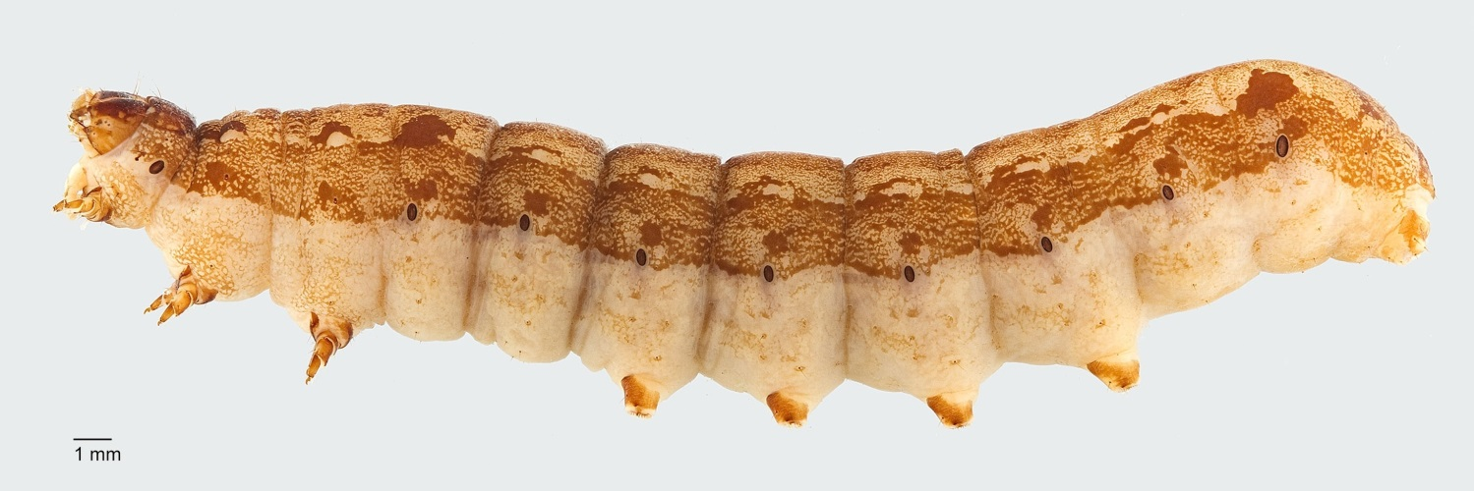
Chemical Control
Many populations of S. littoralis are extremely resistant to pesticides
Insect growth regulators are used against Spodoptera spp.
Image credits: Todd Gilligan, LepIntercept, USDA APHIS ITP, Bugwood.org
Notes:
S. littoralis was previously treated with methyl-parathion in Egypt, but resistance has developed since 1968. Since then, organophosphates, synthetic pyrethroids, and other insecticides have been used but resistances has recently occurred in these as well. Limitation of synthetic pyrethroids to one applications per year on cotton in Egypt and as a result, resistance has significantly slowed.
Chemicals used against Spodoptera spp. also include insect growth regulators. In India, research has begun on various antifeedant compounds or extracts such as need extract and azadirachtin.
Since resistance to pesticides is very common in this pest species, establishment in the U.S. could be devastating and very difficult to control.
Be sure to check with your local county extension agent regarding any restrictions on use of these pesticides as some may require an applicator’s license!
Information sources: 3

Slide 16
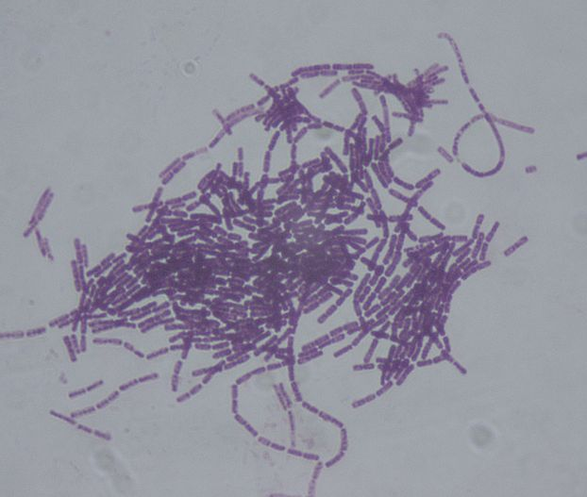
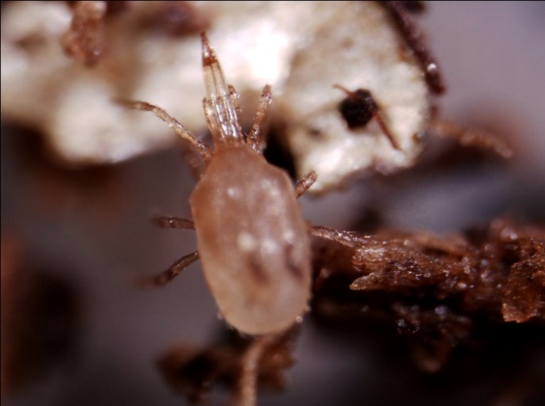
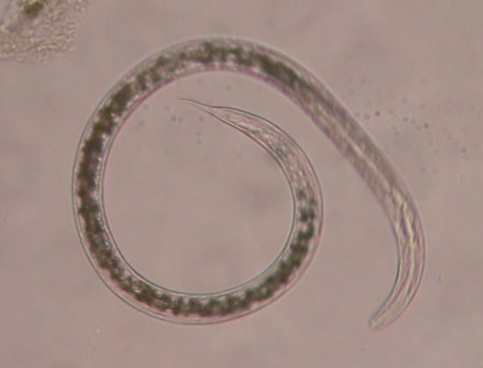
Biological Control
S. littoralis is resistant to many strains of Bacillus thuringiensis.
XenTari® is particularly effective against S. littoralis larvae and is widely used in Spodoptera control.
Image credit:
Bacillus thuringiensis: Dr. Sahay, wikimedia.com creative commons
Nematodes: Tesfamariam Mengistu, Department of Entomology and Nematology, University of Florida
Mites: Lance Osborne, Mid-Florida Research and Education Center, University of Florida
Notes:
Many studies on possible biological control of the two species of Spodoptera have occurred. Parasites (braconids, encyrtids, tachinids, ichneumonids) and predators have shown some success. It has also been noted that nuclear polyhedosis, fungi, and microsporidia have proven effective. Furthermore, parasitic nematodes such as Neoaplectana carpocapsae have been tested but not shown successful results in practice. In the past, Bacillus thuringiensis has been used on Egyptian cotton worm, but resistance to many strains has occurred.
One strain, XenTari® is effective with little resistance thus far against S. littoralis larvae and is widely used in Spodoptera control. This strain of Bacillus thuringiensis aizawai (ABTS-1857) contains two additional toxin proteins that make it more effective on Egyptian cotton worm. As with most caterpillars, earlier larvae are more susceptible to control and as a result, early treatment is the most effective. As a whole, integrated pest management techniques are recommended for control and limitation of resistance.
Information sources: 3, 17

Slide 17
Author and Publication Dates
Jennifer Carr
  Laboratory Manager, Department of Entomology and Nematology, University of Florida
Amanda Hodges, Ph.D.
  Associate Extension Scientist, Department of Entomology and Nematology, University of Florida
Publication date: October 2016

Slide 18
Reviewers
Catherine A. Marzolf
  Assistant State Plant Health Director, USDA APHIS PPQ

Slide 19
Educational Disclaimer and Citation
This presentation can be used for educational purposes for NON-PROFIT workshops, trainings, etc.
Citation:
  Carr, Jennifer and Amanda Hodges. 2016. Egyptian Cottonworm – Spodoptera littoralis. accessed (add the date) – www.protectingusnow.org

Slide 20

Our Partners
United States Department of Agriculture, National Institute of Food and Agriculture (USDA NIFA)
United States Department of Agriculture, Animal and Plant Health Inspection Service, Plant Protection and Quarantine (USDA APHIS PPQ)
Cooperative Agriculture Pest Survey (CAPS) Program
National Plant Board (NPB)
States Department of Agriculture
Extension Disaster Education Network (EDEN)
Center for Invasive Species and Ecosystem Health (Bugwood)
National Plant Diagnostic Network (NPDN)
U.S. Department of Homeland Security (DHS)
U.S. Forest Service (USFS)

Slide 21
References
Brambila, J. 2009. Steps for the dissection of male Spodoptera moths (Lepidoptera: Noctuidae) and notes on distinguishing S. litura and S. littoralis from native Spodoptera species. USDA-APHIS-PPQ. http://caps.ceris.purdue.edu/webfm_send/2150
Brambila, J. Jackson, L. and Meagher, R. Plastic Bucket Trap Protocol. USDA. 2010.
CABI and EPPO, Data Sheets on Quarantine Pests Spodoptera littoralis and Spodoptera litura. Retrieved 7/1/2016 from https://www.eppo.int/QUARANTINE/data_sheets/insects/PRODLI_ds.pdf
Hachler, M. (1986) [Notes on three pests of subtropical ornamental plants captured in western Switzerland]. Mitteilungen der Schweizerischen Entomologischen Gesellschaft 59, 263-266.
Hassan, A. S., M. A. Moussa, and E. A. Nasr. 1960. Behavior of larvae and adults of the cotton leaf worm, Prodenia litura. Bulletin de la Société Entomologique d'Egypte 44:337-343.
Invasive Species Compendium. Spodoptera littoralis datasheet. Accessed 7/6/2016 from http://www.cabi.org/isc/datasheet/51070

Slide 22
References
Julieta Brambila USDA-APHIS-PPQ Identification notes for Spodoptera litura and Spodoptera littoralis (Lepidoptera: Noctuidae) and some native Spodoptera moths http://www.invasive.org/publications/aphis/Handout_Spodoptera_Wings_2013.pdf
Michigan State University’s invasive species factsheet. Egyptian cottonworm Spodoptera littoralis. Accessed 6/27/2017 from http://www.ipm.msu.edu/uploads/files/Forecasting_invasion_risks/egyptianCottonworm.pdf
Ocete Rubio, E. 1984. Study of the biological cycle of Spodoptera-littoralis at different temperatures Lepidoptera Noctuidae. Graellsia 40:195-206.
Pest Tracker. Accessed 7/1/2016 from http://pest.ceris.purdue.edu/map.php?code=ITBCFPA
Pinhey, E. C. G. 1975. Moths of Southern Africa. Descriptions and colour illustrations of 1183 species. Moths of Southern Africa.
Pogue, Michael. USDA Systemic Entomology Lab, Smithsonian Institution. CAPS Lepidoptera Workshop Noctuidae - presentation

Slide 23
References
Salama, H.S.; Dimetry, N.Z.; Salem, S.A. (1970) On the host preference and biology of the cotton leaf worm Spodoptera littoralis. Zeitung für Angewandte Entomologie 67, 261-266.
Salama, H. S. and A. Shoukry. 1972. Flight range of the moth of the cotton leafworm Spodoptera littoralis. Zeitschrift fuer Angewandte Entomologie 71(2):181-184.
Salem, S. and H. S. Salama. 1985. Sex pheromones for mass trapping of Spodoptera littoralis (Boisd.) in Egypt. Journal of Applied Entomology/Zeitschrift fur Angewandte Entomologie 100: 316-319.
Sullivan, M. 2007. CPHST Pest Datasheet for Spodoptera littoralis. USDA-APHIS-PPQ-CPHST. Revised March 2014.
Valent Biosciences Corporation. Spodoptera littoralis. 2014. Accessed 7/6/2016 from http://cropprotection.valentbiosciences.com/valent-biosciences-corporation-biorational-crop-protection/insecticides/pests/spodoptera-littoralis
USDA. 1982. Pests not known to occur in the United States or of limited distribution, No. 25: Egyptian cottonworm., pp. 1-14. APHIS-PPQ, Hyattsville, MD.

