Slide 1
Asian Gypsy Moth Lymantria dispar asiatica

Slide 2
Asian Gypsy Moth
Native pest to Europe and Asia.
Pest of over 500 species of trees and shrubs including oaks.
Lymantria dispar asiatica has been found in North America on several occasions.
Very similar to the European gypsy moth (Lymantria dispar dispar).
Unlike related gypsy moths, the Asian gypsy moth females can fly.
Notes:
The Asian gypsy moth or Lymantria dispar asiatica is a native pest to Europe and Asia. They are a pest of over 500 species of trees and shrubs including oaks. It has been found on several occasions in North America, but successful programs have eradicated local outbreaks. The Asian gypsy moth is very similar in appearance and biology to the European gypsy moth (Lymantria dispar dispar). This pest in particular poses a higher risk than related moths because the females can fly. As a result, the spread of the pest could be much faster than others.
Information sources: 1, 2, 6

Slide 3
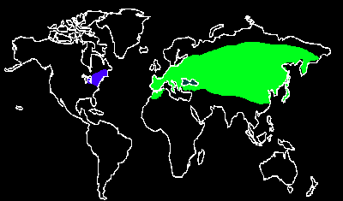
Global Distribution of the Gypsy Moth
Distribution of gypsy moths in North America
Distribution of gypsy moths in the Eastern hemisphere
Image credits: Gypsy Moth Around the World - Sandy Liebhold - http://www.fs.fed.us/ne/morgantown/4557/gmoth/world/
Notes:
The two types of gypsy moth are the European and the Asian gypsy moths. Both are common pests in the East. The European moth is a well established pest in the West while the Asian moth is less common and a serious threat. The map above depicts the global distribution of both the Asian and European gypsy moths. The blue coloration shows the distribution in North America, while the green is the much more widespread distribution in the Eastern hemisphere.
Information sources: 1, 4, 9

Slide 4
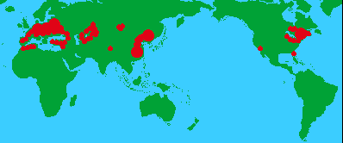
Global Distribution of the Asian Gypsy Moth
Known distribution of the Asian gypsy moth
Image credits: Appendix 1. Asian gypsy moth distribution map - Agriculture Western Australia - http://agspsrv34.agric.wa.gov.au/ento/surveillance/asian%20gypsy%20moth.html#Appendix%201.
Notes:
The map above depicts only the distribution of the Asian gypsy moth throughout the globe. The European gypsy moth has been a pest present in the United States since the late 1800’s, but it was not until recently that the Asian gypsy moth had appeared in the Western hemisphere. In 1991, the Asian gypsy moth was introduced around British Columbia, Canada and quickly spread to other parts of North America. Detection and successful eradication programs have been implemented in several states including California, Oregon, Idaho, Texas and Washington. Currently, incoming cargo from Europe and Asia is inspected thoroughly for Lymantria dispar asiatica before leaving the initial port and again upon its arrival at its Western destination. Due to the wide rant of acceptable hosts in North America, it is a severe risk that this pest could establish in the temperate regions of the United States and spread rapidly destroying native forests.
Information sources: 1, 4, 9

Slide 5
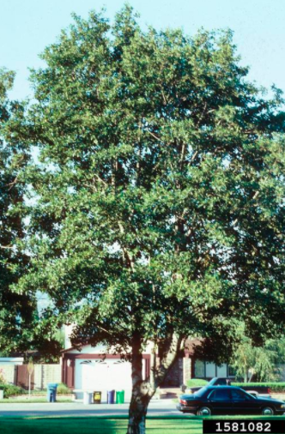
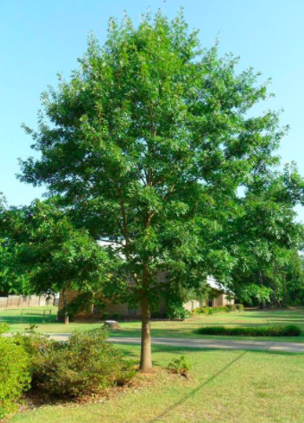
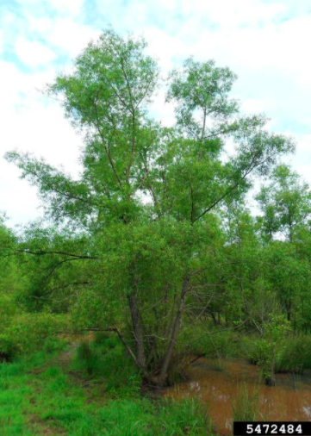
Pest of Deciduous Trees
Image credits: white alder (Alnus rhombifolia) Nutt. - John Ruter, University of Georgia - Bugwood.org, #1581082; pin oak (Quercus palustris) Muenchh. - David Stephens - Bugwood.org, #5443459; black willow (Salix nigra) Marsh. - David Stephens - Bugwood.org, #5472484
Notes:
Lymantria dispar asiatica is a polyphagous pest in deciduous forests. When compared to the European gypsy moth, it has a much wider variety of hosts. The Asian gypsy moth appears to prefer larch, oak, poplar, alder, willow, and some evergreens. Younger larvae prefer oak to all other hosts. Nonetheless, they can also potentially attack other plants as well. When the population levels are high, they are more likely to move to less preferred hosts.
The main hosts include:
Alnus spp. (alder)
Larix spp. (larch)
Larix sibirica (Siberian larch)
Liquidambar spp. (sweetgum)
Malus spp. (apple)
Populus spp. (poplar)
Quercus spp. (oak)
Salix spp. (willow)
Tilia spp. (linden)
Ulmus spp. (elm)
Some other potential hosts include but are not limited to the following:
Abies balsamea (balsam fir)
Acer spp. (maple)
Betula spp. (birch)
Callistemon brachyandrus (prickly bottlebrush)
Carpinus spp. (hornbeam)
Castanea spp. (chestnut)
Castanopsis spp. (chinquapin)
Celtis spp. (hackberry)
Cerasis spp.
Corylus spp. (hazel)
Corymbia maculata (spotted gum)
Cydonia spp. (quince)
Diospyros spp.
D. kaki (persimmon)
Eriobotrya spp. (loquat)
Eucalyptus spp. (gum)
Eurya spp.
Fagus spp. (beech)
Fraxinus spp. (ash)
Hammamelis spp. (witch-hazel)
Juglans spp. (walnut)
Lespedeza spp. (bush clover)
Morus spp. (mulberry)
Picea spp. (spruce)
Pinus spp. (pine)
Prunus spp. (plum)
Pyrus spp. (pear)
Rosa spp. (rose)
Rubus spp. (blackberry)
Shorea robusta (sal tree)
Wisteria spp.
Xylosma spp. (brushholly)
Zelkova spp.
Information sources: 1, 5, 9

Slide 6
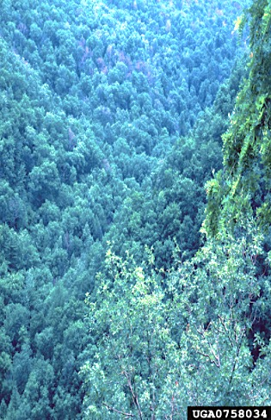
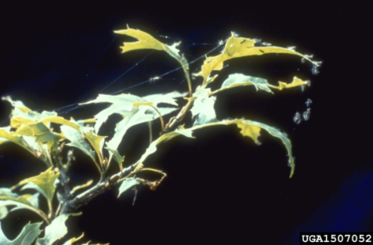
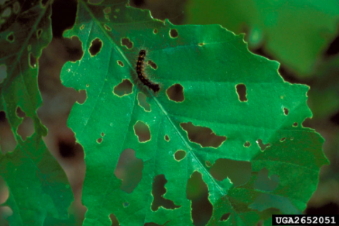
Damage
Damage to leaves
Oak mortality
Image credits: gypsy moth (Lymantria dispar) (Linnaeus) - William M. Ciesla, Forest Health Management International - Bugwood.org, #0758034; gypsy moth (Lymantria dispar) (Linnaeus) - USDA Forest Service - Region 8 - Southern , USDA Forest Service - Bugwood.org, #1507052; gypsy moth (Lymantria dispar) (Linnaeus) - USDA APHIS PPQ , USDA APHIS PPQ - Bugwood.org, #2652051
Notes:
The main damage to host plants is caused by feeding larvae. Larvae can defoliate plants at a very high rate, especially when the population level is high. This defoliation also makes the plant more susceptible to secondary pests or disease. Overall, Asian gypsy moths can partially or completely defoliate forests and in the process, destroy natural landscapes and habitats.
Information Sources: 5

Slide 7
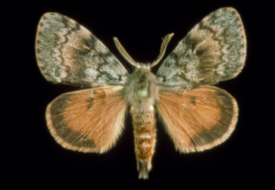
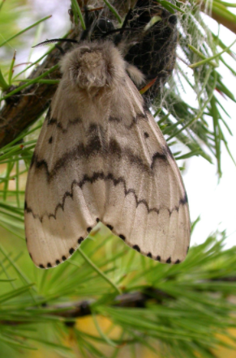
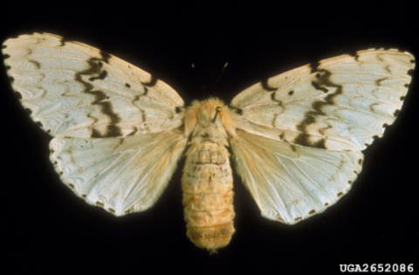
Identification
Adults
Females
8.9cm
White with grey markings
Males
3.8cm
Gray and brown
Image credits: gypsy moth (Lymantria dispar) (Linnaeus) - USDA APHIS PPQ , USDA APHIS PPQ - Bugwood.org, #2652084; gypsy moth (Lymantria dispar) (Linnaeus) - USDA APHIS PPQ , USDA APHIS PPQ - Bugwood.org, #2652086; Asian gypsy moth (Lymantria dispar asiatica) Vnukovskij (Pogue and Schaefer, 2007) - John H. Ghent, USDA Forest Service - Bugwood.org, #1241013
Notes:
Adults, much like the pupae, will display sexual dimorphism. The males are gray and brown with a wingspan of around 3.8cm (1.5in). On the other hand, the females are much larger with a wingspan of up to 8.9cm (3.5in) and are whiter in color with gray markings. The adults are actually diurnal or active during the day unlike most moths. They will mate and both the male and female will die after eggs have been laid.
Information sources: 2, 6

Slide 8
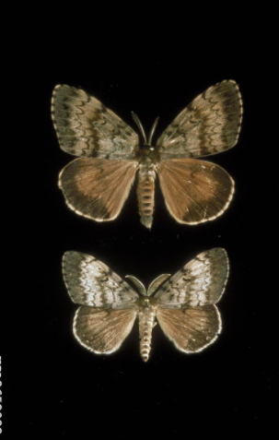
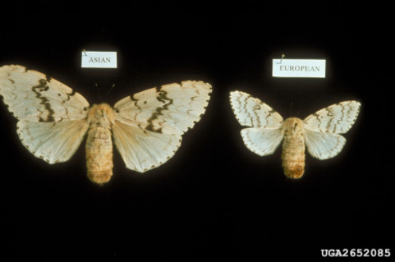
Lookalikes - Adults
Female Asian gypsy moth (left) versus female European gypsy moth (right)
Male Asian gypsy moth (upper) versus female European gypsy moth (lower)
Image credits: gypsy moth (Lymantria dispar) (Linnaeus) - USDA APHIS PPQ , USDA APHIS PPQ - Bugwood.org, #2652083; gypsy moth (Lymantria dispar) (Linnaeus) - USDA APHIS PPQ , USDA APHIS PPQ - Bugwood.org, #2652085
Notes:
The major lookalikes of Lymantria dispar asiatica are other subspecies of gypsy moths. The most common one is the European gypsy moth which is already a pest in Northern America. European gypsy moths have more narrow host range and are also smaller than the average Asian moth. Another major difference is the female Asian gypsy moths can fly unlike their relatives. This is why the Asian gypsy moth is at a high risk for spreading faster and invading new areas.
Information sources: 1

Slide 9
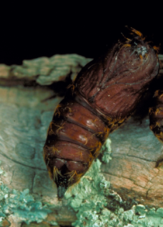
Identification
Pupae
Dark brown
Male: 1.5cm in length
Female: 3cm in length
Image credit: gypsy moth (Lymantria dispar) (Linnaeus) - USDA APHIS PPQ , USDA APHIS PPQ - Bugwood.org, #2652067
Notes:
Larvae will pupate in summer around July and take 7-14 days to become adults In Europe and Asia. The pupae are dark brown and show sexual dimorphism. The male pupae are approximately 1.5cm (0.59in) while the females are about 3cm (1.18in) in length.
Information sources: 2

Slide 10
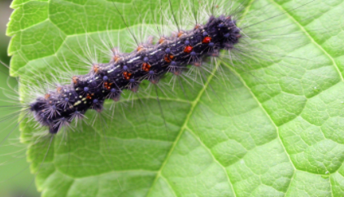
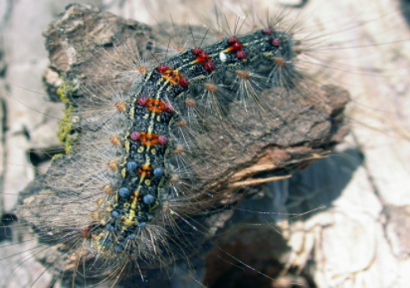
Identification
Larvae
Up to 8.9cm in length
Grey and yellow bodies
Long hairs
Double rows of blue and red warts
Image credits: Asian gypsy moth (Lymantria dispar asiatica) Vnukovskij (Pogue and Schaefer, 2007) - John H. Ghent, USDA Forest Service - Bugwood.org, #1335005; Asian gypsy moth (Lymantria dispar asiatica) Vnukovskij (Pogue and Schaefer, 2007) - John H. Ghent, USDA Forest Service - Bugwood.org, #1335025
Notes:
In spring, larvae will emerge from the eggs and begin feeding. Initially, the larvae are around 0.32cm (1/8in) but grow to lengths between 5.08-8.9cm (2-3.5in). The first instar will be smaller and black with long black hairs. The second instar, slightly larger, is brown with short hairs. The most distinct looking larvae are the fourth to sixth instars. They have light to dark gray bodies with some yellow flecks and long gray or gold hairs. Furthermore, they have double rows of blue and red warts. The typical pattern is five blue rows followed by six red rows but this is not always the case.
Information sources: 1, 2, 6

Slide 11
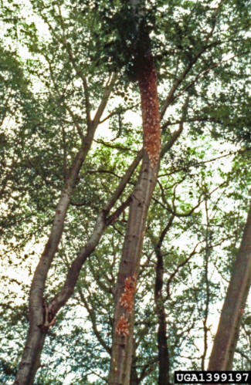
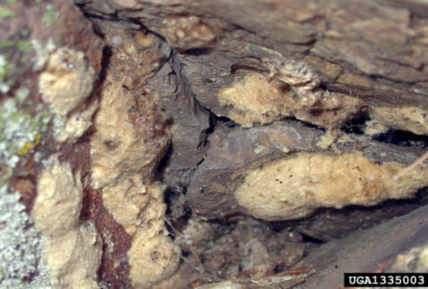
Identification
Eggs
Up to 1200 eggs per egg mass
Buff color
Yellowish fuzz
Average size 3.8cm by 1.905cm
Image credits: Asian gypsy moth (Lymantria dispar asiatica) Vnukovskij (Pogue and Schaefer, 2007) - John H. Ghent, USDA Forest Service -- Bugwood.org, #1335003; Asian gypsy moth (Lymantria dispar asiatica) Vnukovskij (Pogue and Schaefer, 2007) - Manfred Mielke, USDA Forest Service - Bugwood.org, #1399197
Notes:
In July or August, egg masses are usually laid on directly on host trees but they can also be found on stones, walls, logs, furniture and most other outdoor objects. The egg masses are a buff color with yellowish fuzz from the female abdomen. Overtime they will lighten in color due to sun bleaching and weathering. Each egg mass can contain up to 1200 eggs and is on average 3.8cm by 1.905cm (1.5in by 0.75in) in size. Larvae develop in the egg and remain inside throughout the winter.
Information sources: 1, 5, 6

Slide 12
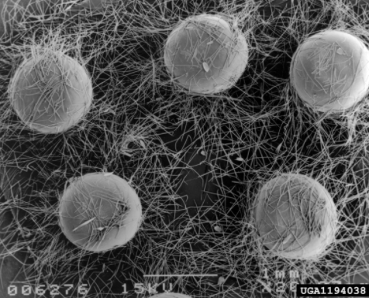
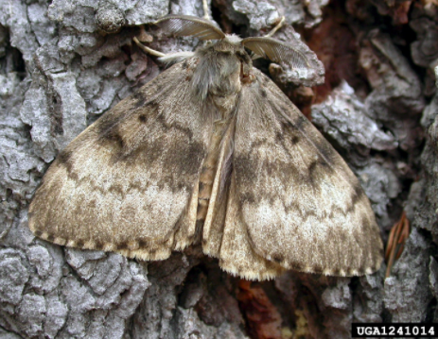
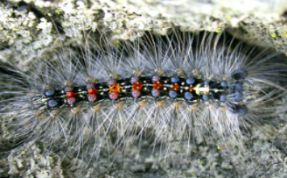
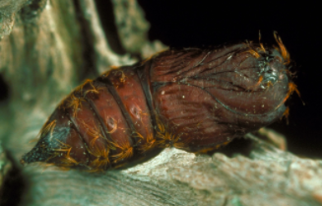
Life cycle
Eggs
August to May
Adult
Late July to August
Larvae
May to early July
Pupae
7-14 days
Image credit: Asian gypsy moth (Lymantria dispar asiatica) Vnukovskij (Pogue and Schaefer, 2007) - DAFF Archive - Bugwood.org, #1194038; Asian gypsy moth (Lymantria dispar asiatica) Vnukovskij (Pogue and Schaefer, 2007) - John H. Ghent, USDA Forest Service - Bugwood.org, #1335026; gypsy moth (Lymantria dispar) (Linnaeus) - USDA APHIS PPQ , USDA APHIS PPQ - Bugwood.org, #2652066; Asian gypsy moth (Lymantria dispar asiatica) Vnukovskij (Pogue and Schaefer, 2007) - John H. Ghent, USDA Forest Service - Bugwood.org, #1241014
Notes:
Lymantria dispar asiatica will complete one generation per year. The damaging population levels will occur about every five to seven years. In late July to August, the adult females lay eggs on a wide variety of surfaces but often the host tree itself. The adults will die shortly after the eggs are laid. The eggs will take about four weeks to develop into larvae but the larvae will remain inside the eggs over the winter. In spring, following a period of warmth, the larvae emerge from the eggs. They begin to feed on host tissues and cause damage to the hosts during this stage. Around early July, pupation will occur. The pupae will develop for about 7-14 days before emerging as adults to mate and start the next generation.
Information sources: 1

Slide 13
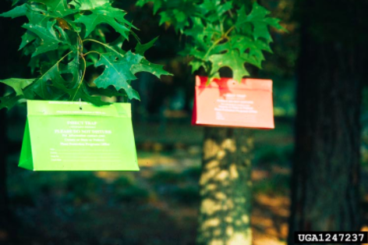
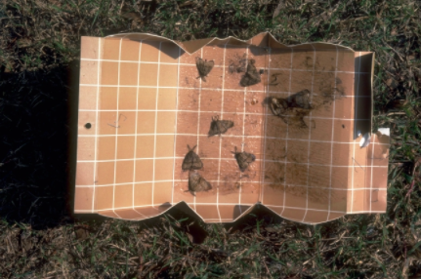
Monitoring
Pheromone traps
cis-7R,8S-epoxy-2-methyloctadecane (aka disparlure)
Image credits: gypsy moth (Lymantria dispar) (Linnaeus) - Terry S. Price, Georgia Forestry Commission - Bugwood.org, #1247237; gypsy moth (Lymantria dispar) (Linnaeus) - William A. Carothers, USDA Forest Service - Bugwood.org, #1515074
Notes:
Pheromone traps can be used to monitor for the Asian gypsy moth. The recommend pheromone to use in delta, milk-carton, or tented traps is cis-7R,8S-epoxy-2-methyloctadecane which is commercially known as disparlure. These traps will attract male Asian gypsy moths This lure will also attract closely related moths including L. umbrosa (Lymantria dispar hokkaidoensis/umbrosa/nesiobia), L. albescens (L. dispar albescens), and L. postalba (L. d. postalba/tsushimensis, L. albescens tsushimensis). This monitoring system is recommended for high risk areas such as ports. Around 25 traps per square mile is suggested for extremely high risk areas and around 16 traps per square mile in areas surrounding the higher risk locations.
Light traps can also be used but they are rather ineffective and nonspecific so they are not recommended.
Information Sources: 5, 8

Slide 14
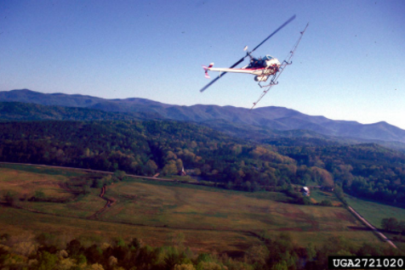
Chemical Control
Aerial chemical spraying
diflubenzuron (Dimilin)
carbaryl (Sevin)
mimic (tebufenozide)
Mating disruption with Disrupt® II
Baculovirus, nuclear polyhedrosis virus (NPV)
Image credits: gypsy moth (Lymantria dispar) (Linnaeus) - G. Keith Douce, University of Georgia - Bugwood.org, #2721020
Notes:
Control methods for the Asian gypsy moth have been extensively researched. In areas of dense populations, aerial spraying is a common eradication technique. The chemicals typically used against Lymantria dispar asiatica are diflubenzuron (Dimilin), carbaryl (Sevin), and mimic (tebufenozide). These chemicals are typically broad spectrum insecticides and can have harmful effects on other insect populations. In recent years, research for a semiochemical control has been mildly successful.
A method more specific to the Asian gypsy moth has been tested and is only available on the market as Disrupt® II plastic laminated flake formulation of sex pheromone disparlure. It is most effective at low populations levels and disrupts the mating of related gypsy moths. Currently research aims at developing a stronger synthetic pheromone to better disrupt the mating systems of the Asian gypsy moth.
Other broad spectrum sprays include Baculovirus). Baculovirus, nuclear polyhedrosis virus (NPV) has proven effective on low population densities of the Asian gypsy moth but as the population increase, it becomes less effective.
Information sources: 3, 10

Slide 15
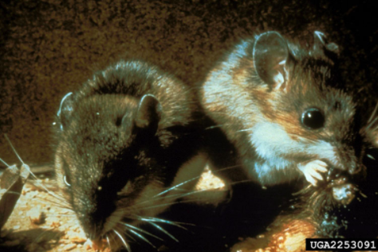
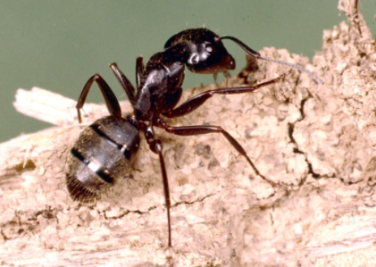
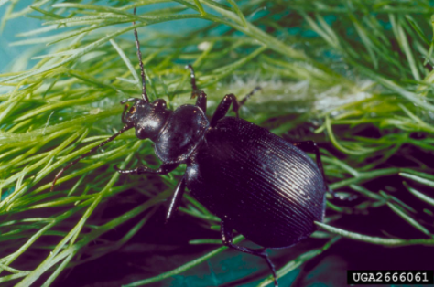
Biological Control
Bacillus thuringiensis (Bt)
Small mammals
Birds
Ground beetles
Ants
Image credits: gypsy moth (Lymantria dispar) (Linnaeus) - Bill Antrobius, USDA Forest Service - Bugwood.org, #2253091; black carpenter ant (Camponotus pennsylvanicus) (De Geer) - Clemson University - USDA Cooperative Extension Slide Series - Bugwood.org, #1435184; forest caterpillar hunter (Calosoma sycophanta) (Linnaeus, 1758) - Debbie Waters, University of Georgia - Bugwood.org, #2666061
Notes:
The most common biological control for the Asian gypsy moth is Bacillus thuringiensis (Bt). The specific variety of Bt that targets all moths and butterflies is Bacillus thuringiensis kurstaki (B.t.k). Bt is a naturally occurring bacteria that interferes with larval stages as they feed. It is sprayed on foliage in spring as the larvae emerge from their eggs.
Small mammals and birds are known to feed on Lymantria dispar asiatica and are particularly effective when the population is at low levels but this would not naturally control an infestation.
Ants and ground beetles are some invertebrate predators of the Asian gypsy moth, but overall they are not as effective in controlling moth populations are vertebrate predators. Ants will attack early larvae and ground beetles typically target late larvae and pupae. This type of predation is most common when moth populations are very high.
Information Sources: 3, 4, 10

Slide 16
Cultural Control
Port inspections
General sanitation
Siviculture
Resistant trees
Image credits: gypsy moth (Lymantria dispar) (Linnaeus) - USDA APHIS PPQ , USDA APHIS PPQ - Bugwood.org, #2652089
Notes:
Cultural control methods include quick a few general techniques. One of the most important is port inspections to present future introductions of the Asian gypsy moth from spreading. Frequently, shipments to North America are checked when they leave their initially port and again upon arrival to their destination. General sanitation is also important to the control of many pests. This includes cleaning areas surrounding hosts and removing heavily infected plants. It is also important to not transport infected plant material including firewood. Siviculture is a specific type of sanitation often applied in pest eradication as a sustainable method of growth and health of forests. Recent research has looked into plant more resistant varieties of trees in order to lower population levels in heavily effected areas throughout Europe and Asia. If the moth were to invade in large numbers in North America, the same techniques could be implemented.
Information Sources: 3, 10

Slide 17
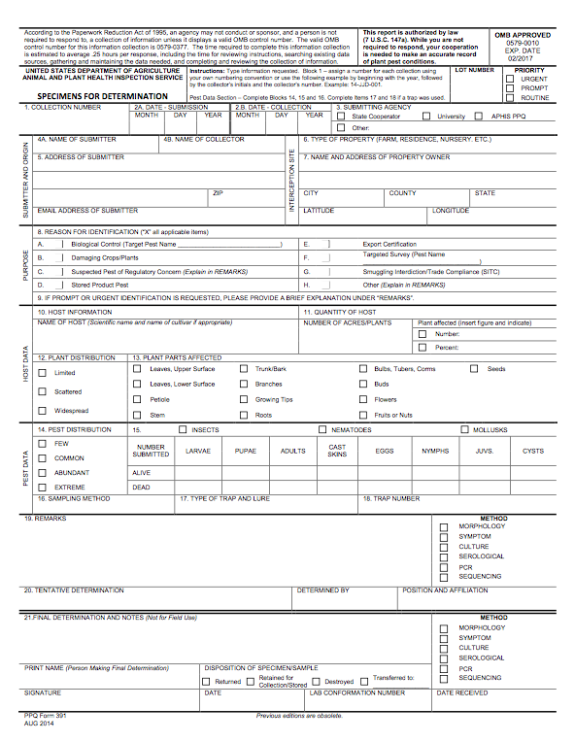
Suspect Sample Submissions
Contact your State Department of Agriculture or University Cooperative Extension laboratory
http://www.npdn.org/home
PPQ form 391, Specimens for Determination
https://www.aphis.usda.gov/library/forms/pdf/PPQ_Form_391.pdf
An example of a PPQ form for sample submissions
Image credits: https://www.aphis.usda.gov/library/forms/pdf/PPQ_Form_391.pdf
Notes:
If a suspect pest has been located in the United States, a sample should be submitted for proper identification. Contact your local diagnostic lab to ship in a sample for identification. Information regarding your local diagnostic lab is available at National Plant Diagnostic Network (NPDN) website. The diagnostic lab information and available contacts are divided by state.
http://www.npdn.org/home
The sample specimen should be submitted along with accompanying documentation using the PPQ form 391.
https://www.aphis.usda.gov/library/forms/pdf/PPQ_Form_391.pdf
Your local diagnostic lab is part of your local cooperative extension service or your state department of agriculture. Your local lab will also have a specific form. All local labs may not be a member of NPDN. However, all labs should report new pest and pathogen detections to local regulatory officials.

Slide 18
Communications
Contact your State Plant Health Director
https://www.aphis.usda.gov/aphis/ourfocus/planthealth/ppq-program-overview/ct_sphd
Contact your State Plant Regulatory Official
http://nationalplantboard.org/membership/
Image credits: http://www.usda.gov/wps/portal/usda/usdahome; http://nationalplantboard.org/
Notes:
Remember that new pest and pathogen records must be reported to your State Plant Health Director (SPHD) and your State Plant Regulatory Official (SPRO). The SPRO is a State Department of Agriculture Employee and the SPHD is a USDA-APHIS-PPQ employee.
The link to your SPRO is on the National Plant Board (NPB) website. It has an interactive map and when you click on your state it will take you to another page with contact information. The NPB is a cooperative organization that includes membership from all State Departments of Agriculture.

Slide 19
Author and Publication Dates
Morgan Pinkerton
Lab Technician, Department of Entomology and Nematology, University of Florida
Amanda Hodges, Ph.D.
Associate Extension Scientist, Department of Entomology and Nematology, University of Florida
Publication date: October 2016

Slide 20
Reviewers
Catherine A. Marzolf
Assistant State Plant Health Director, USDA APHIS PPQ

Slide 21
Educational Disclaimer and Citation
This presentation can be used for educational purposes for NON-PROFIT workshops, trainings, etc.
Citation: Pinkerton, Morgan and Amanda Hodges. 2016. Asian Gypsy Moth. – Lymantria dispar asiatica. Accessed: (add the date)-
www.protectingusnow.org

Slide 22
Our Partners
United States Department of Agriculture, National Institute of Food and Agriculture (USDA NIFA)
United States Department of Agriculture, Animal and Plant Health Inspection Service, Plant Protection and Quarantine (USDA APHIS PPQ)
Cooperative Agriculture Pest Survey (CAPS) Program
National Plant Board (NPB)
States Department of Agriculture
Extension Disaster Education Network (EDEN)
Center for Invasive Species and Ecosystem Health (Bugwood)
National Plant Diagnostic Network (NPDN)
U.S. Department of Homeland Security (DHS)
U.S. Forest Service (USFS)

Slide 23
References
Anonymous. Asian Gypsy Moth Pest Alert. Cooperative Agricultural Pest Survey, NY. Accessed 5/26/2016.
http://www.agriculture.ny.gov/caps/pdf/Asian%20Gypsy%20Moth%20Pest%20Alert.pdf
Anonymous. 2012. Exotic Pest Alert: Asian gypsy moth. NSW Government: Department of Plant Industries. Accessed 6/3/2016.
http://www.dpi.nsw.gov.au/__data/assets/pdf_file/0013/443110/Exotic-Pest-Alert-Asian-gypsy-moth.pdf
ISSG. Invasive Species Management and Control: Gypsy moth (Lymantria dispar). Invasive Species Specialist Group (ISSG). Accessed 6/3/2016.
http://issg.org/database/species/reference_files/lymdis/lymdis_man.pdf
Liebhold, S. 2003. Gypsy Moth In North America. USDA Forest Service Northeastern Research Station. Accessed 6/3/2016.
http://www.fs.fed.us/ne/morgantown/4557/gmoth/

Slide 24
References
Molet, T. 2012. CPHST Pest Datasheet for Lymantria dispar asiatica. USDA-APHIS-PPQ-CPHST. Accessed 5/26/2016.
caps.ceris.purdue.edu/dmm/1886
USDA. 1999. Plant Protection and Quarantine Factsheet: Asian Gypsy Moth. USDA, Animal and Plant Health Inspection Service. Accessed 5/26/2016.
http://www.invasive.org/publications/aphis/fsgma.pdf
USDA. 2010. Gypsy Moth Program Manual. USDA, Animal and Plant Health Inspection Service. Accessed 6/3/2016.
https://www.aphis.usda.gov/import_export/plants/manuals/domestic/downloads/gypsy_moth.pdf
USDA. 2014. USDA-APHIS-PPQ Asian Gypsy Moth Survey and Response Guidelines. USDA. Accessed 6/3/2016.
https://www.aphis.usda.gov/plant_health/plant_pest_info/gypsy_moth/downloads/AGMSurveyResponseGuidelines.pdf

Slide 25
References
USDA. 2016. Plant Protection and Quarantine Factsheet: Asian Gypsy Moth. USDA, Animal and Plant Health Inspection Service. Accessed 6/2/2016.
https://www.aphis.usda.gov/publications/plant_health/content/printable_version/fs_phasiangm.pdf
Whittle, A, S. Lenhart, K.A.J. White. 2008. Optimal Control of Gypsy Moth Populations. Bulletin of Mathematical Biology 70: 398–411. Accessed 6/3/2016.
http://link.springer.com/article/10.1007%2Fs11538-007-9260-7

