Slide 1
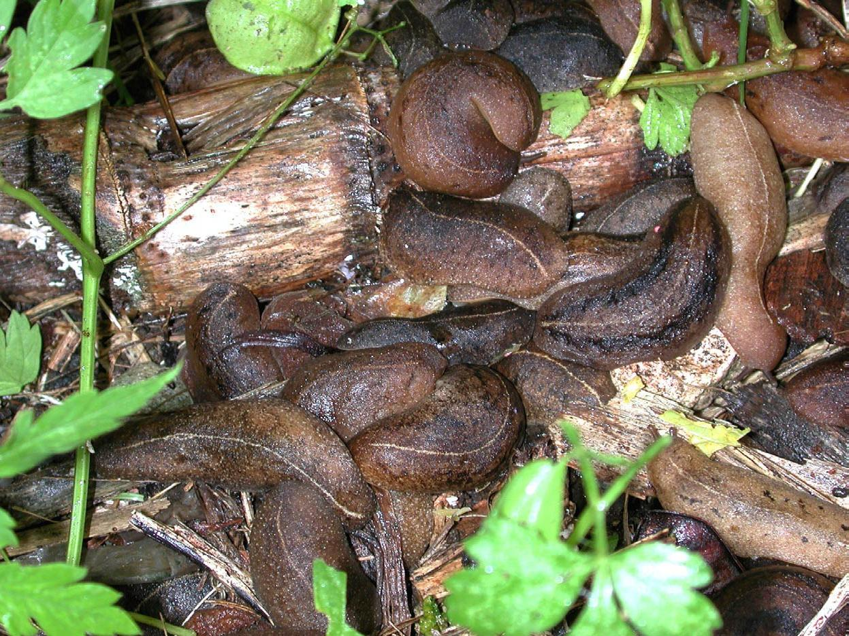
Leatherleaf slugs: A Threat to Florida
Image Credit: David Robinson, Terrestrial Mollusc Tool. USDA-APHIS-PPQ

Slide 2
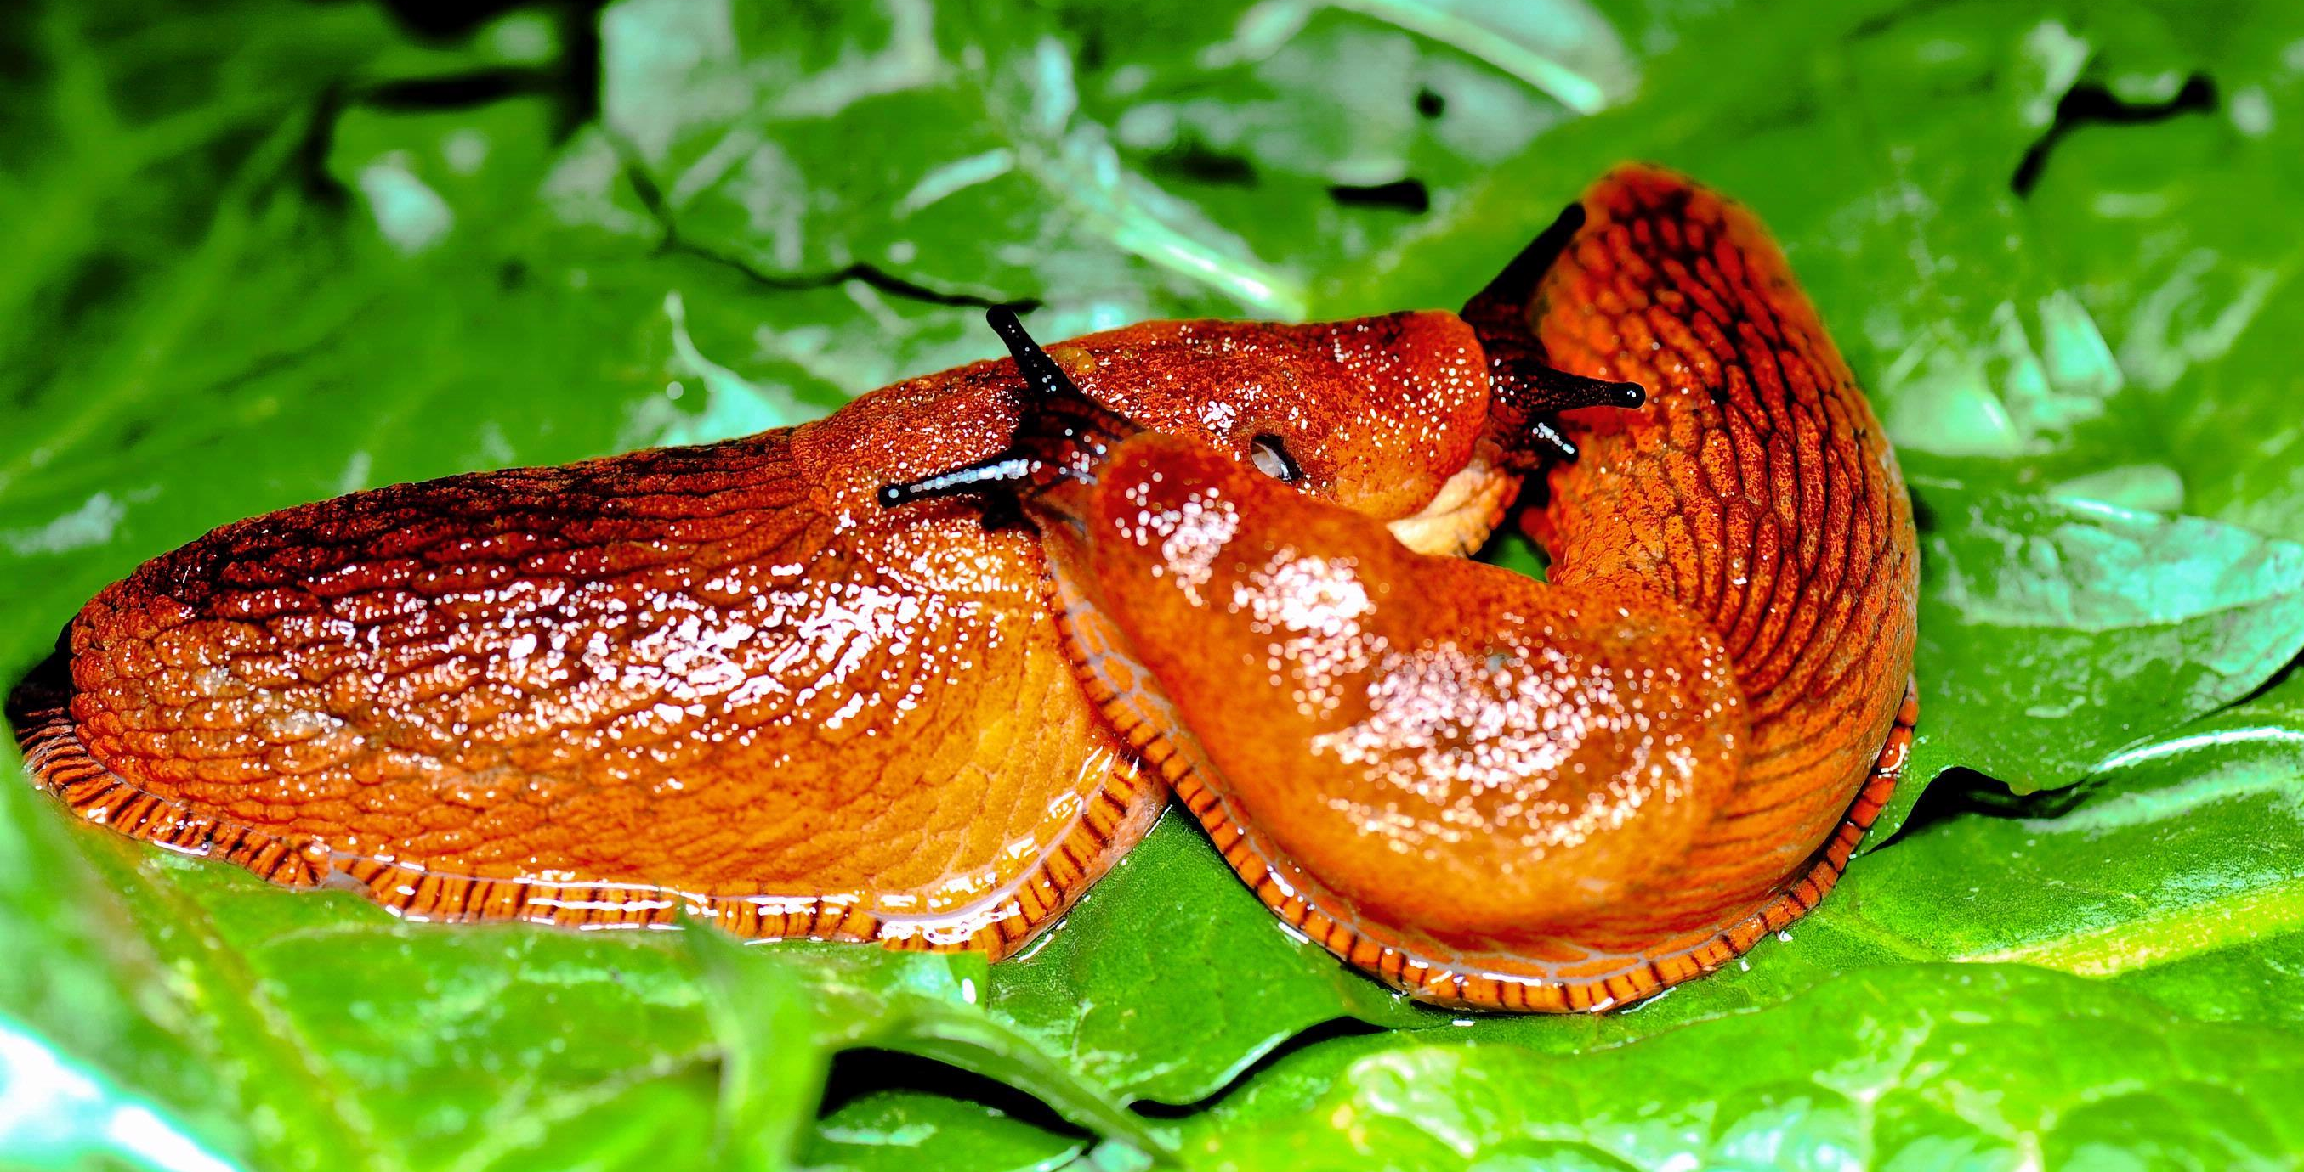
Introduction to Slugs
Image Credit: Bonsak Hammeraas, Bioforsk - Norwegian Institute for Agricultural and Environmental Research, Bugwood.org, #5393372
Notes:
Slugs belong to the phylum Mollusca, which includes organisms such as snails, squids, octopi, and cuttlefish. They are essentially snails without a visible shell. Snails are dependent on calcium-rich environments because they have to build their shell. Because slugs do not have a shell, they are able to exploit a wider range of habitats. In addition, being without a shell can also help with maneuverability and burrowing.
However, because they do not have shells, they are nocturnal and prefer sheltered areas so as to conserve moisture.
They move using a “foot” which secretes mucus to help them move. This mucus dries to become a “slime trail” which is a sign of their presence.
Some slugs are serious garden pests, while others are only occasional pests.
Information sources:
Capinera, J. L., J. White and G. Bernon. 2011. Terrestrial Slugs of Florida (Gastropoda: Stylommatophora). EENY-493 (IN891). Entomology and Nematology. Florida Cooperative Extension Service. University of Florida IFAS. Accessed March 6th, 2014.
http://edis.ifas.ufl.edu/in891
Flint, M.L. 2009. UC Statewide IPM Program, Davis/Entomology, UC Davis; and C. A. Wilen, UC Statewide IPM Program, San Diego Co. Accessed 6/6/2014-
http://www.ipm.ucdavis.edu/PMG/PESTNOTES/pn7427.html

Slide 3
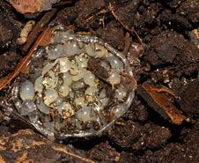
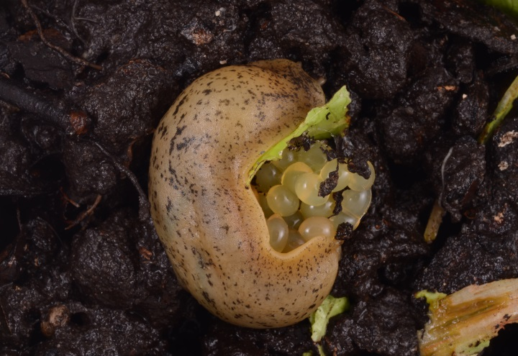
Life cycle of Slugs
Chain of eggs around a clutch
Loose clutch
Image Credit: Lyle Buss, University of Florida
Notes:
Most species of slugs are hermaphroditic (having both functional male and female reproductive structures). This means that some species can inseminate either another mate or even themselves.
It also means that for some species it only takes one to start a population potentially making them very dangerous as an invasive species.
Eggs are ovoid in shape (like a chicken egg). They are translucent white and are usually laid in chains or clusters in moist soil. Incubation period varies from average of 14 to 30 days.
The juveniles look similar to adults, just smaller. Slugs can take several months to several years to mature, but during warmer conditions they develop faster and start to reproduce faster.
Information Sources:
Capinera, J. L., J. White and G. Bernon. 2011. Terrestrial Slugs of Florida (Gastropoda: Stylommatophora). EENY-493 (IN891). Entomology and Nematology. Florida Cooperative Extension Service. University of Florida IFAS. Accessed March 6th, 2014.
http://edis.ifas.ufl.edu/in891
Yates, J.R. III. 1992. Slugs and Snails. Accessed 6/7/2014-
http://www.extento.hawaii.edu/kbase/urban/site/slugs.htm

Slide 4
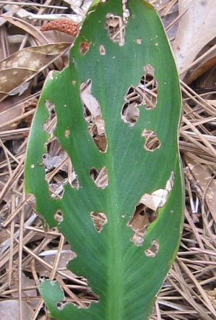
Damage Caused by Slugs
Cause ragged, irregular holes
Can girdle saplings and branches
Can reduce quality and yield of crops
Can transmit nematodes that cause severe health issues in humans
Image Credit: John Capinera, University of Florida
Notes:
Slugs are omnivorous, feeding on live plants and organic materials, decomposing vegetation and even fungi.
They cause damage by feeding on economically important crops lowering the quality and yield.
When they feed on the leaves of live plants, they chew irregular holes using their rasping tongue (and can sometimes remove the whole sections of foliage). They can also remove bark and girdle the branches of young plants.
Slugs can even vector parasitic nematodes like Angiostrongylus spp., which can cause long lasting brain damage or death. The symptoms are those common to meningitis including high fever, headaches, blindness and death. Washing hands after contact with mollusks and before eating should reduce the chance of infection. Washing snail-contaminated produce thoroughly before consumption should further reduce the chance of infection.
In addition to the agricultural threat that might arise, these slugs could feed on rare and endangered native plants. In sufficiently large numbers, these slugs could also alter nutrient cycling in an area. With enough damage, slugs could deter tourism to a region that is known for its plant life and even affect the animals that rely on that plant life.
Information Sources:
Capinera, J. L., J. White and G. Bernon. 2011. Terrestrial Slugs of Florida (Gastropoda: Stylommatophora). EENY-493 (IN891). Entomology and Nematology. Florida Cooperative Extension Service. University of Florida IFAS. Accessed March 6th, 2014.
http://edis.ifas.ufl.edu/in891
Flint, M.L. 2009. UC Statewide IPM Program, Davis/Entomology, UC Davis; and C. A. Wilen, UC Statewide IPM Program, San Diego Co. Accessed 6/6/2014-
http://www.ipm.ucdavis.edu/PMG/PESTNOTES/pn7427.html
McDonnell, R.J., A. Hansen, T.D. Paine, and M.J. Gormally. 2007. A Record of the Invasive Slug Veronicella cubensis (Pfeiffer, 1840) in California. The Veliger 50(2).
Michalak, P.S. and Price, T.P. 2011. New Pest Response Guidelines: Tropical Terrestrial Gastropods. USDA. Accessed 6/6/2014 –
http://phytosanitary.info/sites/phytosanitary.info/files/New_Pest_Response_Guidelines_Tropical_Terrestrial_Gastropods.pdf
Molet, T. 2011. CPHST Pest Datasheet for Veronicellidae spp. USDA-APHIS-PPQ-CPHST. Accessed 6/6/2014 –
https://caps.ceris.purdue.edu/webfm_send/867
Yates, J.R. III. 1992. Slugs and Snails. Accessed 6/7/2014-
http://www.extento.hawaii.edu/kbase/urban/site/slugs.htm

Slide 5
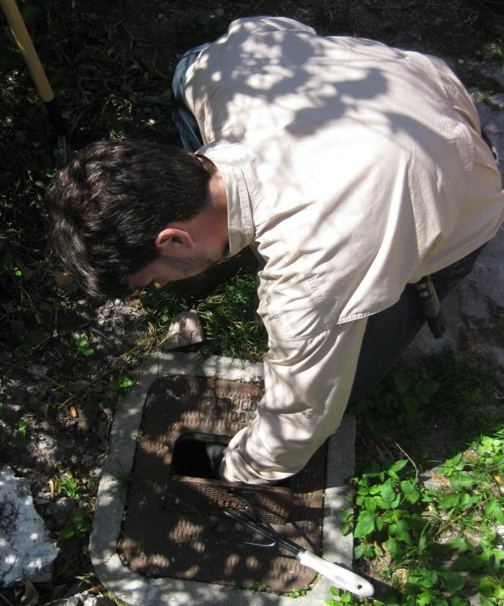
Monitoring for Slugs
Visual inspection is the best method for monitoring for slugs
Traps also work
Platforms
Baited traps
Trap crops
Trash traps
Image Credit: Andrew Derksen, FDACS
Notes:
Visual inspection is the main survey method for slugs. Look for the slime trail on the soil surface and on plants as it is usually a great indicator of the presence of slugs in general. However, these slugs do not produce lots of slime so the trail may be faint. If you are looking for a slime trail, it is more effective to conduct these inspections early morning or late evening, or immediately after rainfall or irrigation.
Trapping is also useful especially when combined with visual inspection. There are many different traps types available (platform traps, trap crop stations, trash traps, etc.) as well as different baits depending on your target species. However, these traps may catch many non-target species as well.
Platform traps provide an artificial refuge for slugs to collect under during the heat of the day. Simply get a square sheet of thick cardboard or wood and place it on the ground. If needed, you can even raise the platform about an inch off the ground.
Baited traps can also be used. Place the bait inside a cup or bowl, and dig a shallow pit in the ground so that the top of the bowl or cup is even with the soil surface. Baits can include beer, bran, a sugar water and yeast mixture, or other food types. A commercially available molluscicide can be paired with baits in traps.
Trap crop stations use a preferred crop planted at a site and monitored on a regular basis for the presence of slugs.
Trash traps use plant residues that are piled in a small hill (30cm X 30cm X 30cm). These hills act as daytime refuges for slugs; however, if left unmonitored, they can become breeding sites instead.
Information sources:
Michalak, P.S. and Price, T.P. 2011. New Pest Response Guidelines: Tropical Terrestrial Gastropods. USDA. Accessed 6/6/2014 –
http://phytosanitary.info/sites/phytosanitary.info/files/New_Pest_Response_Guidelines_Tropical_Terrestrial_Gastropods.pdf
Molet, T. 2011. CPHST Pest Datasheet for Veronicellidae spp. USDA-APHIS-PPQ-CPHST. Accessed 6/6/2014 –
https://caps.ceris.purdue.edu/webfm_send/867

Slide 6
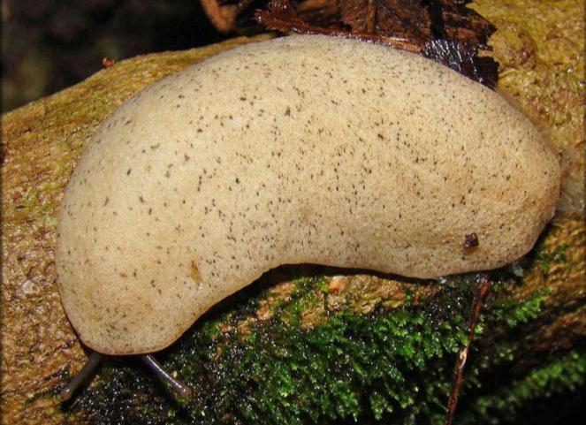
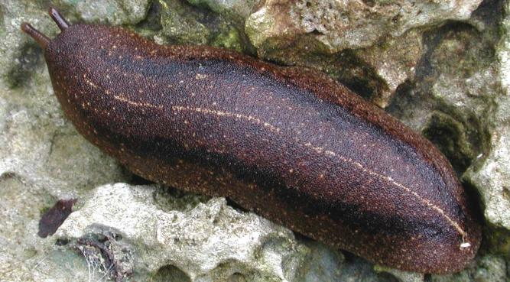
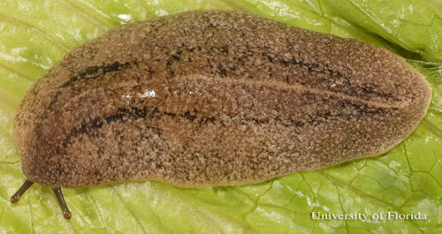
Leatherleaf slugs of concern
Sloan’s slug
Cuban Slug (Veronicella cubensis)
Sloan’s Slug (Veronicella sloanei)
Florida Leatherleaf (Leidyula floridana)
Cuban slug
Florida leatherleaf
Image Credit: Cuban slug - David Robinson, USDA –APHIS-PPQ , Terrestrial Mollusc Tool; Florida leatherleaf - Lyle J. Buss, University of Florida; Sloan’s slug - Robert Pilla, Terrestrial Mollusc Tool
Notes:
There are two slugs on the CAPS Priority List that would be of particular concern to Florida should they become established here: the Cuban slug (Veronicella cubensis) and Sloan’s slug (Veronicella sloanei). These two species are NOT established in Florida as of June 2014.
There is another species of leatherleaf slugs that is already present here in Florida, the Florida leatherleaf (Leidyula floridana), that can be confused with these two. This slug was most probably introduced from Cuba well over a hundred years ago. As it may be confused with the two leatherleaf slug species that are not currently in Florida, we will cover this species in this presentation as well.
All three of these slugs are in the family Veronicellidae which is found in the tropical regions of South America, southern Asia, Africa, Madagascar, and islands of the Indian Ocean. The family contains known pests of ornamental and horticultural crops and gardens.
Veronicellidae are easy to distinguish from other slugs, as they are flattened with a large mantle covering the entire back with no shell. The foot is separated from the body with a groove.
However, the species are difficult to tell apart within the family. They have similar morphologies and each species could have multiple color variations. Sometimes dissection of genitalia is needed for correct identification.
Information Sources:
CAPS. 2013. Priority List. Accessed 6/6/2014 –
https://caps.ceris.purdue.edu/guidelines/2014/apdx_d
Molet, T. 2011. CPHST Pest Datasheet for Veronicellidae spp. USDA-APHIS-PPQ-CPHST.
NAPIS Pest Tracker. Leatherleaf slugs. Accessed 6/6/2014 –
https://pest.ceris.purdue.edu/pest.php?code=IGDQAWA
Michalak, P.S. and Price, T.P. 2011. New Pest Response Guidelines: Tropical Terrestrial Gastropods. USDA. Accessed 6/6/2014 –
http://phytosanitary.info/sites/phytosanitary.info/files/New_Pest_Response_Guidelines_Tropical_Terrestrial_Gastropods.pdf

Slide 7
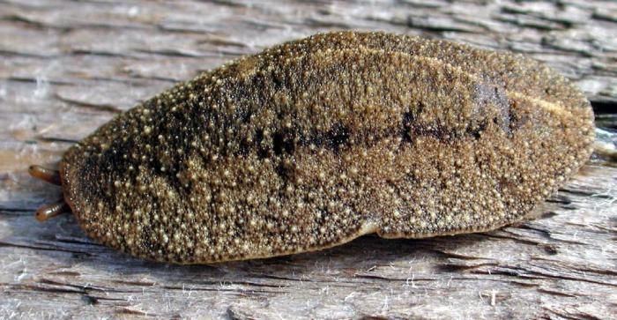
Cuban Slug
Image Credit: David Robinson, Terrestrial Mollusc Tool. USDA-APHIS-PPQ
Notes:
The Cuban slug (Veronicella cubensis) can be of different shades of brown while some could also be albino.
They normally have two dark bands on running along either side of the midline on the dorsal side which can be solid or broken. There may also be a pale line running down the midline of the body.
The body surface itself could be smooth or granular. This slug has distinctive bluish gray eye tentacles and there is a pale brown area around the eyespots.
The adult slug is about 50 to 70 mm long but some could reach up to 120 mm. They produce clutches of varying numbers.
It is nocturnal and prefers moist soil usually found near water bodies. The Cuban slug has been associated with the transmission of parasitic nematodes like Angiostrongylus spp.
Because differentiation between the species in the family usually requires dissection of the genitalia of mature species, it is recommended that all suspected Veronicella species be sent to taxonomic experts for identification through both morphological and molecular methods.
Information Sources:
Capinera, J. L., J. White and G. Bernon. 2011. Terrestrial Slugs of Florida (Gastropoda: Stylommatophora). EENY-493 (IN891). Entomology and Nematology. Florida Cooperative Extension Service. University of Florida IFAS. Accessed March 6th, 2014.
http://edis.ifas.ufl.edu/in891
Michalak, P.S. and Price, T.P. 2011. New Pest Response Guidelines: Tropical Terrestrial Gastropods. USDA. Accessed 6/6/2014 –
http://phytosanitary.info/sites/phytosanitary.info/files/New_Pest_Response_Guidelines_Tropical_Terrestrial_Gastropods.pdf
Molet, T. 2011. CPHST Pest Datasheet for Veronicellidae spp. USDA-APHIS-PPQ-CPHST. Accessed 6/6/2014 –
https://caps.ceris.purdue.edu/webfm_send/867
White-McLean, J.A. 2011. Veronicellidae: Veronicella spp. Terrestrial Mollusc Tool. USDA/APHIS/PPQ Center for Plant Health Science and Technology and the University of Florida. Accessed on 6th March, 2014.
http://idtools.org/id/mollusc/factsheet.php?name=Veronicellidae:%20Veronicella%20spp.

Slide 8
Distribution of Cuban Slug
This pest is found in the Caribbean and the Pacific Islands
It has been intercepted but not considered established in Louisiana and Florida
It was intercepted in Santa Barbara County, California in 2006 and may be established there now
Notes:
The Cuban slug is found in the Caribbean (Antigua, the Bahamas, Barbados, Cuba, Dominica, Dominican Republic, Haiti, Hispaniola, Jamaica, Puerto Rico, St. Croix, St. Kitts and Nevis).
It has also been found in the Pacific Islands (Northern Mariana Islands, Guam, Hawaii, Olosega (Manu’a Islands), Rota, Tutulia (American Somoa), and Pohnpei (Micronesia)).
It has been intercepted BUT IS NOT CONSIDERED ESTBALISHED in Louisiana and Florida. It was found is Santa Barbara County, California in 2006 (where one citation has it as being established there now).
Information Sources:
Capinera, J. L., J. White and G. Bernon. 2011. Terrestrial Slugs of Florida (Gastropoda: Stylommatophora). EENY-493 (IN891). Entomology and Nematology. Florida Cooperative Extension Service. University of Florida IFAS. Accessed March 6th, 2014.
http://edis.ifas.ufl.edu/in891
Michalak, P.S. and Price, T.P. 2011. New Pest Response Guidelines: Tropical Terrestrial Gastropods. USDA. Accessed 6/6/2014 –
http://phytosanitary.info/sites/phytosanitary.info/files/New_Pest_Response_Guidelines_Tropical_Terrestrial_Gastropods.pdf
McDonnell, R.J., T.D. Paine, and M.J. Gormally. 2009. Slugs – A Guide to the Invasive and Native Fauna of California. University of California Division of Agriculture and Natural Resources. Publication 8336.
McDonnell, R.J., A. Hansen, T.D. Paine, and M.J. Gormally. 2007. A Record of the Invasive Slug Veronicella cubensis (Pfeiffer, 1840) in California. The Veliger 50(2).
White-McLean, J.A. 2011. Veronicellidae: Veronicella spp. Terrestrial Mollusc Tool. USDA/APHIS/PPQ Center for Plant Health Science and Technology and the University of Florida. Accessed on 6th March, 2014.
http://idtools.org/id/mollusc/factsheet.php?name=Veronicellidae:%20Veronicella%20spp.

Slide 9
Hosts of Cuban Slug include…
Soursop
Breadfruit
Star fruit
Cabbage
Papaya
Yam
Hibiscus
Lantana
Cassava
Mango
Lettuce
Sweet potato
Taro
Citrus
Coffee
Banana
Notes:
The host range of this pest is extensive.
Annona muricata (sour sop)
Artocarpus altilis (breadfruit)
Averrhoa bilimbi (pickle tree)
Averrhoa carambola (star fruit)
Brassica spp. (cabbage)
Brugmansia spp. (angel trumpet)
Capsicum spp. (pepper)
Carica papaya (papaya)
Cecropia peltata (trumpet-tree)
Citrus spp. (citrus)
Coffea spp. (coffee)
Colocasia spp. (taro)
Crotalaria retusa (rattlebox)
Cucumis spp. L. (Melon)
Cucurbita spp. (pumpkin)
Dioscorea spp. (yam)
Eulophia alta (wild coco)
Eupatorium odoratum (bitterbush)
Euphorbia cyathophora (Mexican fire plant)
Hibiscus spp. (hibiscus)
Ipomoea batatas (sweet potato)
Lactuca spp. (lettuce)
Lantana camara (lantana)
Mangifera indica (mango)
Manihot esculenta (cassava)
Mentha spicata (spearmint)
Miconia spp. (johnnyberry)
Mikania micrantha (bittervine)
Mimosa pudica (action plant)
Morinda citrifolia (noni)
Musa spp. (banana)
Nephrolepis biserrata (giant sword fern)
Nephrolepis multiflora (Asian sword fern)
Ocimum basilicum (basil)
Paspalum spp. (crowngrass)
Passiflora spp. (passionfruit)
Peperomia meriannensis (pot popot)
Philodendron spp. (philodendron)
Piper aduncum (spiked pepper)
Pipturus albidus (mamaki)
Pteridium spp. (brackenfern)
Sida rhombifolia (Cuban-jute)
Solanum melongena (eggplant)
Spermacoce laevis (buttonplant)
Tacca leontopetaloides (Polynesian arrowroot)
Thunbergia spp. (thunbergia)
Trimezia spp. (trimezia)
Urena lobata (aramina)
Veronia spp. such as Veronia cinerea (little ironweed)
Vinca spp. (periwinkle)
Information Sources:
Michalak, P.S. and Price, T.P. 2011. New Pest Response Guidelines: Tropical Terrestrial Gastropods. USDA. Accessed 6/6/2014 –
http://phytosanitary.info/sites/phytosanitary.info/files/New_Pest_Response_Guidelines_Tropical_Terrestrial_Gastropods.pdf
Molet, T. 2011. CPHST Pest Datasheet for Veronicellidae spp. USDA-APHIS-PPQ-CPHST. Accessed 6/6/2014 –
https://caps.ceris.purdue.edu/webfm_send/867
White-McLean, J.A. 2011. Veronicellidae: Veronicella spp. Terrestrial Mollusc Tool. USDA/APHIS/PPQ Center for Plant Health Science and Technology and the University of Florida. Accessed on 6th March, 2014.
http://idtools.org/id/mollusc/factsheet.php?name=Veronicellidae:%20Veronicella%20spp.

Slide 10
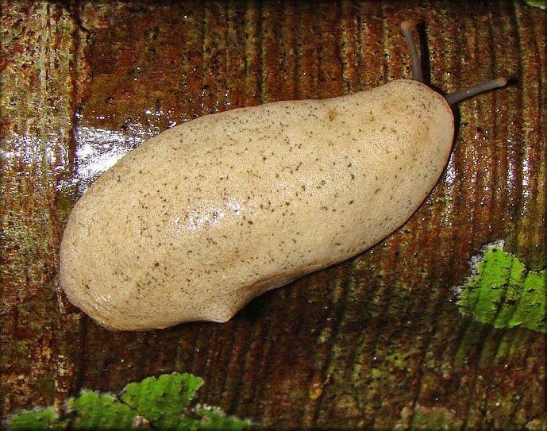
Sloan’s Slug (aka Pancake Slug)
Image Credit: Robert Pilla, Terrestrial Mollusc Tool
Notes:
Sloan’s slug (Veronicella sloanei) is also known as the pancake slug. Adults are about 120 mm long. It usually is pale yellow to white in color but this could vary. They could have black spots that forms faint longitudinal bands on the dorsal side. These bands are better defined in the juveniles. The eyestalks are bluish grey with light brown tip.
Because differentiation between the species in the family usually requires dissection of the genitalia of mature species, it is recommended that all suspected Veronicella species be sent to taxonomic experts for identification through both morphological and molecular methods.
It is also nocturnal and often found mating in pairs or triplets or groups. They produce clutches of varying numbers.
Information Sources:
Capinera, J. L., J. White and G. Bernon. 2011. Terrestrial Slugs of Florida (Gastropoda: Stylommatophora). EENY-493 (IN891). Entomology and Nematology. Florida Cooperative Extension Service. University of Florida IFAS. Accessed March 6th, 2014.
http://edis.ifas.ufl.edu/in891
Michalak, P.S. and Price, T.P. 2011. New Pest Response Guidelines: Tropical Terrestrial Gastropods. USDA. Accessed 6/6/2014 –
http://phytosanitary.info/sites/phytosanitary.info/files/New_Pest_Response_Guidelines_Tropical_Terrestrial_Gastropods.pdf
Molet, T. 2011. CPHST Pest Datasheet for Veronicellidae spp. USDA-APHIS-PPQ-CPHST. Accessed 6/6/2014 –
https://caps.ceris.purdue.edu/webfm_send/867
White-McLean, J.A. 2011. Veronicellidae: Veronicella spp. Terrestrial Mollusc Tool. USDA/APHIS/PPQ Center for Plant Health Science and Technology and the University of Florida. Accessed on 6th March, 2014.
http://idtools.org/id/mollusc/factsheet.php?name=Veronicellidae:%20Veronicella%20spp.

Slide 11
Distribution of Sloan’s Slug
This pest can be found in the Caribbean Islands
It can also be found in some countries in Central and South America
It has been reported in South Florida, BUT is not considered established There
Notes:
Sloan’s slug is found in the Caribbean Islands (Bahamas, Barbados, Bermuda, Cuba, Dominica, Dominican Republic, Grand Cayman, Guadeloupe, Jamaica, St. Lucia and St. Vincent).
It can also be found in Central and South America (Columbia, Honduras, and Nicaragua).
It has been reported in Florida at least one time, though there are no official records of it according to the Florida Department of Agriculture and Consumer Services, Division of Plant Industry. As such, it is not considered to be established here.
Information Sources:
Michalak, P.S. and Price, T.P. 2011. New Pest Response Guidelines: Tropical Terrestrial Gastropods. USDA. Accessed 6/6/2014 –
http://phytosanitary.info/sites/phytosanitary.info/files/New_Pest_Response_Guidelines_Tropical_Terrestrial_Gastropods.pdf
Molet, T. 2011. CPHST Pest Datasheet for Veronicellidae spp. USDA-APHIS-PPQ-CPHST. Accessed 6/6/2014 –
https://caps.ceris.purdue.edu/webfm_send/867
Stocks, Ian. Florida Department of Agriculture and Consumer Services, Division of Plant Industry. Personal Communication.
White-McLean, J.A. 2011. Veronicellidae: Veronicella spp. Terrestrial Mollusc Tool. USDA/APHIS/PPQ Center for Plant Health Science and Technology and the University of Florida. Accessed on 6th March, 2014.
http://idtools.org/id/mollusc/factsheet.php?name=Veronicellidae:%20Veronicella%20spp.

Slide 12
Hosts of Sloan’s Slug include….
Peanut
Papaya
Carrot
Yams
Gardenia
Plantain
Hibiscus
Eggplant
Lettuce
Tomato
Bean
Dasheen
Pepper
Pea
Spinach
Bougainvillea
Notes:
The hosts list of this pest includes the following:
Arachis spp. (peanut)
Bougainvillea spp. (bougainvillea)
Brassica oleracea (broccoli, cabbage, cauliflower)
Carica papaya (papaya)
Citrus spp. (citrus)
Colocasia esculenta (dasheen, eddo)
Datura spp. (Datura)
Daucus carota (carrot)
Dioscorea spp. (yam)
Gardenia spp. (Gardenia)
Hibiscus spp. (hibiscus)
Ipomoea batatas (sweet potato)
Lactuca sativa (lettuce)
Lycopersicon esculentum (tomato)
Musa spp. (banana)
Phaseolus spp. (bean)
Piper spp. (pepper)
Plantago spp. (plantain)
Pisum spp. (pea)
Solanum melongena (eggplant)
Spinacia oleracea (spinach)
Xanthosoma spp. (tannia)
Orchids have also been noted as a host.
Information Sources:
Michalak, P.S. and Price, T.P. 2011. New Pest Response Guidelines: Tropical Terrestrial Gastropods. USDA. Accessed 6/6/2014 –
http://phytosanitary.info/sites/phytosanitary.info/files/New_Pest_Response_Guidelines_Tropical_Terrestrial_Gastropods.pdf
Molet, T. 2011. CPHST Pest Datasheet for Veronicellidae spp. USDA-APHIS-PPQ-CPHST. Accessed 6/6/2014 –
https://caps.ceris.purdue.edu/webfm_send/867
White-McLean, J.A. 2011. Veronicellidae: Veronicella spp. Terrestrial Mollusc Tool. USDA/APHIS/PPQ Center for Plant Health Science and Technology and the University of Florida. Accessed on 6th March, 2014.
http://idtools.org/id/mollusc/factsheet.php?name=Veronicellidae:%20Veronicella%20spp.

Slide 13
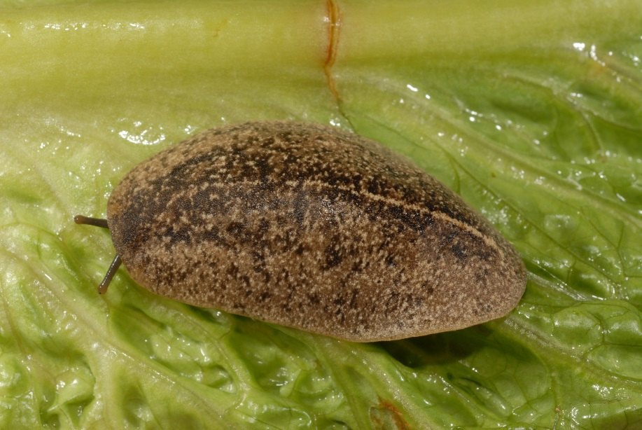
Florida Leatherleaf
Image Credit: Lyle J. Buss, University of Florida
Notes:
The appearance Florida leatherleaf (Leidyula floridana) is highly variable. It can be tan mottled with brown and black spots on the dorsal surface. Sometimes these spots may come together to form two lines extending along the midline. The most consistent character, however, is the whitish line running down the midline. The adults are 120 mm in length.
It is also found in the literature as Veronicella floridana or Vaginulus floridanus , though these are no longer valid scientific names.
This is one of the most common slugs found in Florida.
Because differentiation between the species in the family usually requires dissection of the genitalia of mature species, it is recommended that all suspected Veronicella species be sent to taxonomic experts for identification through both morphological and molecular methods.
This slug is also nocturnal and hides under wood and in crevices and under stones during the day. It is oviparous.
Information Sources:
Baker, H.B. 1925. North American Veronicellidae. Proceedings of the Academy of Natural Sciences of Philadelphia, Vol. 77, pp.157-184
Capinera, J. L., J. White and G. Bernon. 2011. Terrestrial Slugs of Florida (Gastropoda: Stylommatophora). EENY-493 (IN891). Entomology and Nematology. Florida Cooperative Extension Service. University of Florida IFAS. Accessed March 6th, 2014.
http://edis.ifas.ufl.edu/in891
Pilsbry, H.A. 1948. Land Mollusca of North America (North of Mexico). Wickersham Printing Company, Lancaster Pennsylvania.

Slide 14
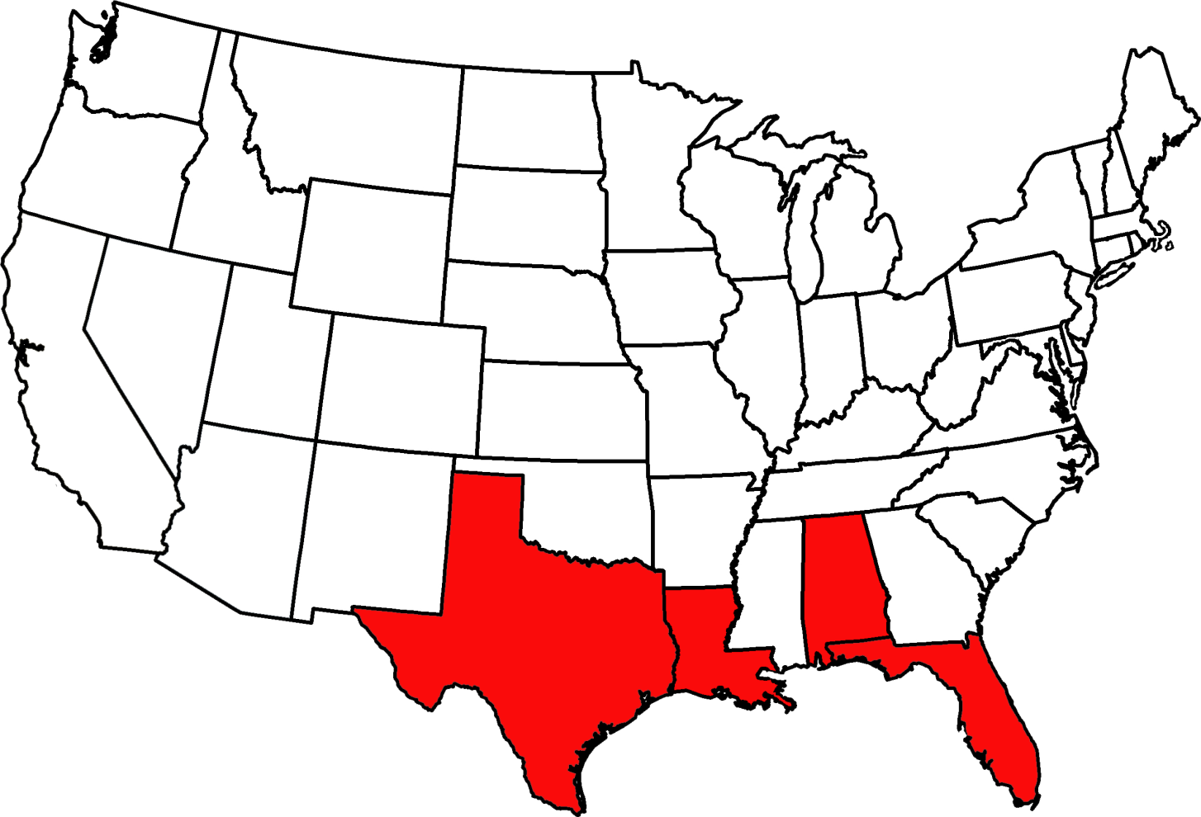
Distribution of Florida Leatherleaf in the U.S.
States where this slug is found
Notes:
This slug is found in Florida, Alabama, Louisiana, and Texas.
It has apparently also been collected from Cuba, the Bahamas, and Jamaica.
Information sources:
Baker, H.B. 1925. North American Veronicellidae. Proceedings of the Academy of Natural Sciences of Philadelphia, Vol. 77, pp.157-184
Capinera, J. L., J. White and G. Bernon. 2011. Terrestrial Slugs of Florida (Gastropoda: Stylommatophora). EENY-493 (IN891). Entomology and Nematology. Florida Cooperative Extension Service. University of Florida IFAS. Accessed March 6th, 2014.
http://edis.ifas.ufl.edu/in891
White-McLean, J.A. 2011. Veronicellidae: Veronicella spp. Terrestrial Mollusc Tool. USDA/APHIS/PPQ Center for Plant Health Science and Technology and the University of Florida. Accessed on 6th March, 2014.
http://idtools.org/id/mollusc/factsheet.php?name=Veronicellidae:%20Veronicella%20spp.

Slide 15
Hosts of Florida Leatherleaf
An exact host list is not known, but it is a pest of pest of potatoes in Cuba and beans, tomatoes, and ornamental plants in some areas.
Not known to cause economic damage in Florida.
Notes:
Though an exact host list has not been established for this species, it has been reported to be a pest of potatoes, beans, tomatoes and ornamental plants. It also feeds on many weed species.
There has been no serious crop damage reported from this species in Florida even though they are known to feed on crop plants and ornamentals.
Information Sources:
Capinera, J. L., J. White and G. Bernon. 2011. Terrestrial Slugs of Florida (Gastropoda: Stylommatophora). EENY-493 (IN891). Entomology and Nematology. Florida Cooperative Extension Service. University of Florida IFAS. Accessed March 6th, 2014.
http://edis.ifas.ufl.edu/in891
Capinera, J. L., Department of Entomology and Nematology, personal communication
White-McLean, J.A. 2011. Veronicellidae: Veronicella spp. Terrestrial Mollusc Tool. USDA/APHIS/PPQ Center for Plant Health Science and Technology and the University of Florida. Accessed on 6th March, 2014.
http://idtools.org/id/mollusc/factsheet.php?name=Veronicellidae:%20Veronicella%20spp.

Slide 16
Authors
Stephanie Stocks, M.S.
Department of Entomology and Nematology, University of Florida.
Shweta Sharma, PhD.
Department of Entomology and Nematology, University of Florida.
Andrew Derksen, M.S.
Pest Survey Specialist, Florida Department of Agriculture and Consumer Services.

Slide 17
Reviewers
John Capinera, Ph.D.
Department of Entomology and Nematology, University of Florida.
Kevin Williams, Ph.D.
Florida Department of Agriculture and Consumer Services, Division of Plant Industry
Paul Skelley, Ph.D.
Florida Department of Agriculture and Consumer Services, Division of Plant Industry

Slide 18
Collaborating Agencies
U.S. Department of Agriculture Animal and Plant Health Inspection Service (USDA-APHIS)
Cooperative Agricultural Pest Survey Program (CAPS)
Florida Department of Agriculture and Consumer Services (FDACS)
National Plant Diagnostic Network (NPDN)
Sentinel Plant Network (SPN)
Protect U.S.
University of Florida Institute of Food and Agricultural Sciences (UF-IFAS)

Slide 19
Educational Disclaimer and Citation
This presentation can be used for educational purposes for NON-PROFIT workshops, trainings, etc.
Citation:
Stocks, S., M.S., Sharma, S., Ph.D., Derksen, A., M.S., 2014. Leatherleaf slugs: A Threat to Florida, June 2014.

Slide 20
References
Baker, H.B. 1925. North American Veronicellidae. Proceedings of the Academy of Natural Sciences of Philadelphia, Vol. 77, pp.157-184
Capinera, J. L., J. White and G. Bernon. 2011. Terrestrial Slugs of Florida (Gastropoda: Stylommatophora). EENY-493 (IN891). Entomology and Nematology. Florida Cooperative Extension Service. University of Florida IFAS. Accessed March 6th, 2014.
http://edis.ifas.ufl.edu/in891
CAPS. 2013. Priority List. Accessed 6/6/2014 –
https://caps.ceris.purdue.edu/guidelines/2014/apdx_d
Flint, M.L. 2009. UC Statewide IPM Program, Davis/Entomology, UC Davis; and C. A. Wilen, UC Statewide IPM Program, San Diego Co. Accessed 6/6/2014-
http://www.ipm.ucdavis.edu/PMG/PESTNOTES/pn7427.html
McDonnell, R.J., A. Hansen, T.D. Paine, and M.J. Gormally. 2007. A Record of the Invasive Slug Veronicella cubensis (Pfeiffer, 1840) in California. The Veliger 50(2).

Slide 21
References
McDonnell, R.J., T.D. Paine, and M.J. Gormally. 2009. Slugs – A Guide to the Invasive and Native Fauna of California. University of California Division of Agriculture and Natural Resources. Publication 8336.
Michalak, P.S. and Price, T.P. 2011. New Pest Response Guidelines: Tropical Terrestrial Gastropods. USDA. Accessed 6/6/2014 –
http://phytosanitary.info/sites/phytosanitary.info/files/New_Pest_Response_Guidelines_Tropical_Terrestrial_Gastropods.pdf
Molet, T. 2011. CPHST Pest Datasheet for Veronicellidae spp. USDA-APHIS-PPQ-CPHST. Accessed 6/6/2014 –
https://caps.ceris.purdue.edu/webfm_send/867
NAPIS Pest Tracker. Leatherleaf slugs. Accessed 6/6/2014 –
https://pest.ceris.purdue.edu/pest.php?code=IGDQAWA
White-McLean, J.A. 2011. Veronicellidae: Veronicella spp. Terrestrial Mollusc Tool. USDA/APHIS/PPQ Center for Plant Health Science and Technology and the University of Florida. Accessed on 6th March, 2014.
http://idtools.org/id/mollusc/factsheet.php?name=Veronicellidae:%

Slide 22
References
Yates. J.R. III. 1992. Slugs and Snails. Accessed 6/6/2014 –
http://www.extento.hawaii.edu/kbase/urban/site/slugs.htm

