Slide 1
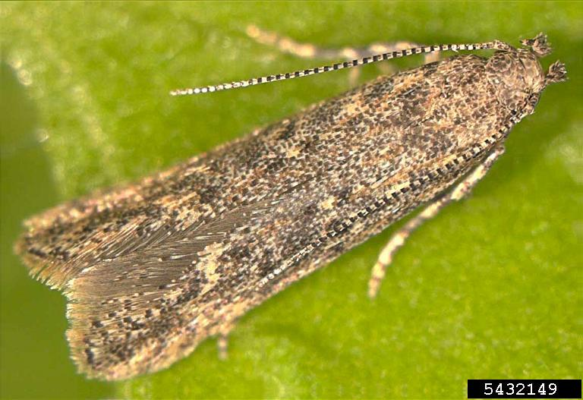
Tuta absoluta
Photo: Marja van der Straten, NVWA Plant Protection Service, www.bugwood.org, #5432149
Notes:
This presentation is about Tuta absoluta, an invasive moth that is native to South America.

Slide 2
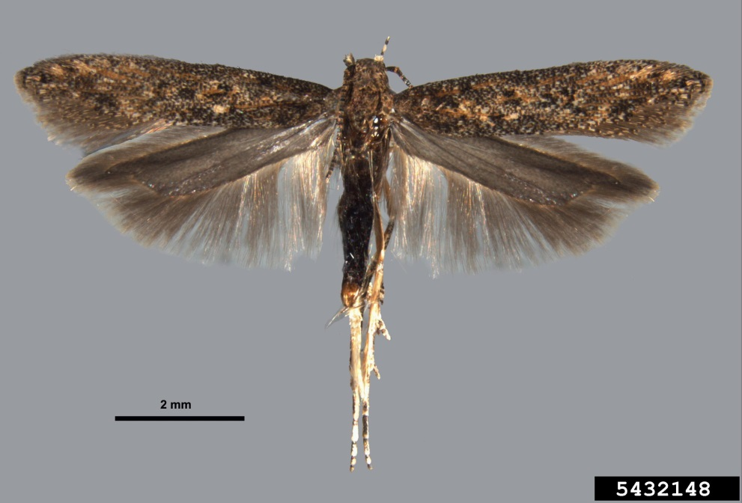
Tuta absoluta
Small moth native to South America
Major pest of tomatoes and other solanaceous plants (nightshades)
Larvae mine inside leaves and also feed inside fruits
Decreases production and fruit quality
Can result in complete plant loss
Photo: Sangmi Lee, Hasbrouck Insect Collection, Arizona State University, www.bugwood.org, #5432148
Notes:
Tuta absoluta is a small moth that is native to South America. It is a major pest of tomatoes and other solanaceous plants (nightshades). Immature moths (i.e., caterpillars or larvae) primarily form mines in the leaves they feed on. They may also feed on and burrow into fruit. Larval feeding results in decreased production and fruit quality. The fruit can become diseased, leading to fruit rot. In some instances, complete plant loss can result.
Tuta absoluta is sometimes referred to as the tomato leafminer, but the common name “tomato leafminer” properly refers to at least three species of flies in the genus Liriomyza. Tuta absoluta does not have a common name at this time.
Information Sources:
Smith, Melissa. 2012. Virginia Tech research program confirms presence of invasive insect in Senegal. Virginia Tech News. Published 28 Sep 2012. Accessed 23 Feb 2013.
http://www.vtnews.vt.edu/articles/2012/09/092812-oired-tuta.html
European and Mediterranean Plant Protection Organization. 2005. Data sheets on quarantine pests: Tuta absoluta. EPPO Bulletin 35, p. 434–435. Accessed 10 Feb 2013, http://www.eppo.int/QUARANTINE/insects/Tuta_absoluta/DS_Tuta_absoluta.pdf

Slide 3
Distribution
Native to South America
Spread to Europe, Central America, Africa, and the Middle East
Currently, it is not known to occur in the U.S.
Notes:
Tuta absoluta is native to South America and occurs throughout the South American continent (Argentina, Bolivia, Brazil, Chile, Colombia, Ecuador, Paraguay, Peru, Uruguay, and Venezuela).
It is widely distributed throughout Europe (Albania, Austria, Bosnia-Hercegovina, Bulgaria, Croatia, Cypress, France, Germany, Greece, Guernsey, Hungary, Italy, Lithuania, Malta, Montenegro, Netherlands, Portugal, Russian Federation, Serbia, Spain, Switzerland, United Kingdom), Central America (Panama), Africa (Algeria, Egypt, Libya, Morocco, Senegal, Sudan, Tunisia), and the Middle East (Bahrain, Iran, Iraq, Israel, Jordan, Kuwait, Lebanon, Saudi Arabia, Syria, Turkey).
Tuta absoluta is currently not known to occur in the United States.
Information Sources:
Bloem, S. and E. Spaltenstein. 2011. New Pest Response Guidelines: Tomato Leafminer (Tuta absoluta). USDA–APHIS–PPQ–EDP Emergency Management, Riverdale, Maryland. Accessed 12/17/2013, http://www.aphis.usda.gov/import_export/plants/manuals/emergency/downloads/Tuta-absoluta.pdf.
CABI Invasive Species Compendium. Tuta absoluta. Accessed 17 December 2013,
http://www.cabi.org/isc/?compid=5&dsid=49260&page=481&site=144#
Smith, Melissa. 2012. Virginia Tech research program confirms presence of invasive insect in Senegal. Virginia Tech News. Published 28 Sep 2012. Accessed 23 Feb 2013.
http://www.vtnews.vt.edu/articles/2012/09/092812-oired-tuta.html

Slide 4
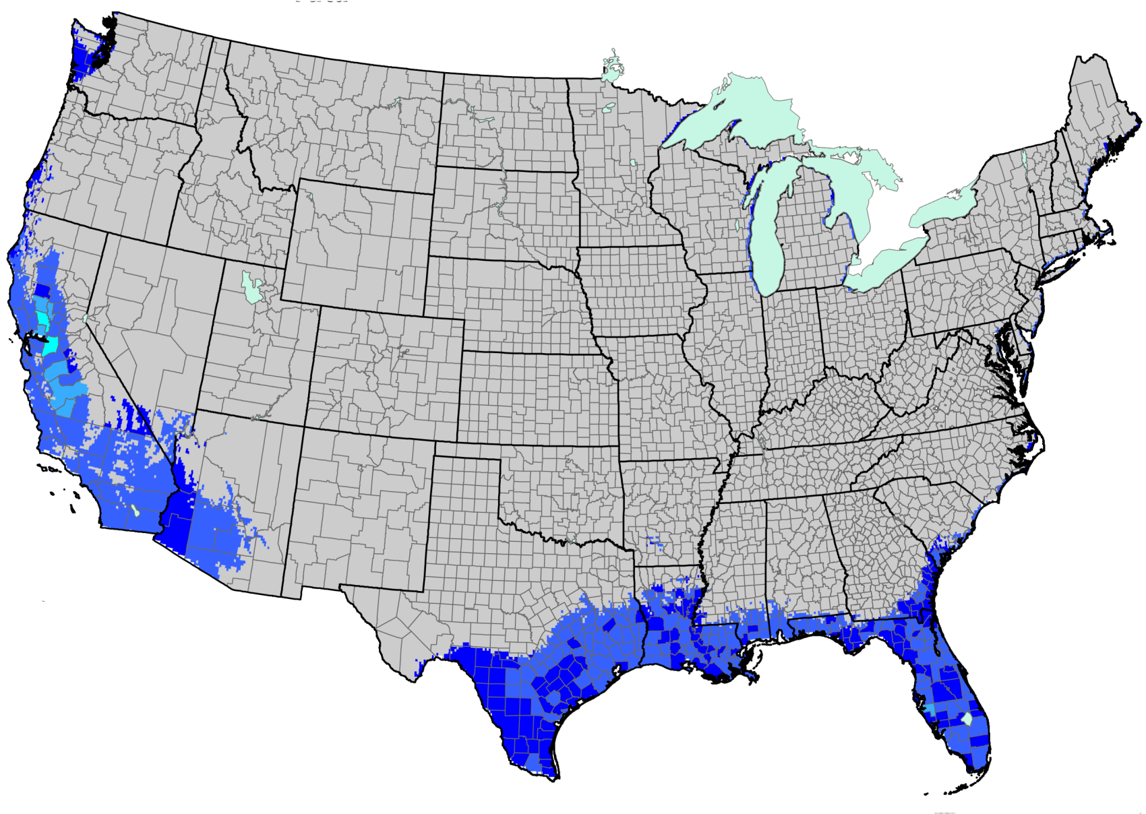
Areas at Risk of Establishment
Risk Potential
High
Low
Map courtesy of http://www.nappfast.org/caps_pests/Caps%20edits%20for%20matrix.htm.
“This Risk map is a combination of the Host and Climate suitability. A Risk map depicts, with relative scale, the potential areas that are unsuitable or highly suitable for growth and establishment.”
Notes:
This map shows the relative risk potential forTuta absoluta establishment for each county in the United States based on the suitability of the climate and the host availability in these regions. If Tuta absoluta is introduced, parts of Washington state, Nevada, and Oregon, as well as much of California and Arizona and the Gulf Coast of the U.S., including the entire state of Florida, are at risk forTuta absoluta establishment.
Information Sources:
Bloem, S. and E. Spaltenstein. 2011. New Pest Response Guidelines: Tomato Leafminer (Tuta absoluta). USDA–APHIS–PPQ–EDP Emergency Management, Riverdale, Maryland. Accessed 12/17/2013, http://www.aphis.usda.gov/import_export/plants/manuals/emergency/downloads/Tuta-absoluta.pdf.

Slide 5
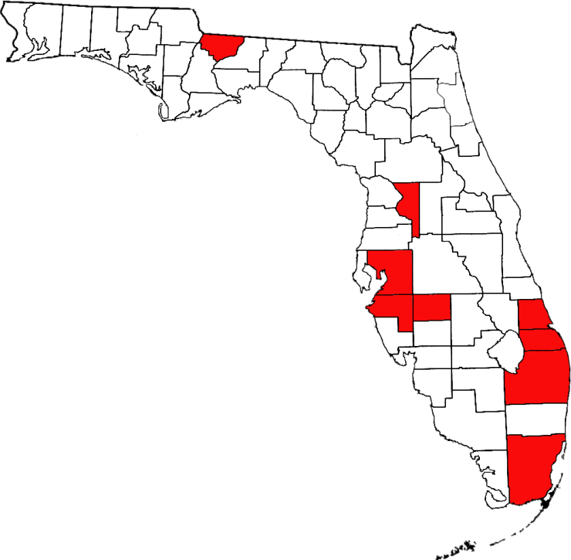
Counties that Grow Tomatoes in Florida
Counties where tomatoes are planted commercially
Map courtesy of Florida Agriculture by Numbers.
Notes:
In Florida in 2012, 30,000 acres of tomatoes were planted, producing 957 million pounds of tomatoes with a value of $267,960,000. Counties that produce a large amount of tomatoes include: Gadsden, Sumter, Hillsborough, Manatee, Hardee, St. Lucie, Lee, Martin, Palm Beach, and Miami-Dade.
Information Sources:
Florida Department of Agriculture and Consumer Services. 2013. Florida Agriculture by the Numbers. Accessed 1/28/2013-
http://freshfromflorida.s3.amazonaws.com/Media%2FFiles%2FMarketing-Development-Files%2FAg_stats_2013_with+covers.pdfP-01304.pdf

Slide 6


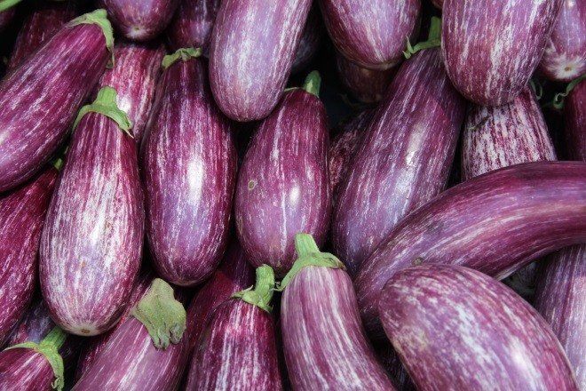
Susceptible Plants
Prefers tomato
Will also feed on other nightshades, such as potatoes, eggplant, and peppers
Other host plants possible but unlikely and incidental
Photos: Wikimedia commons
Notes:
Tuta asbsoluta preferentially feeds on tomato when it is available. It may also feed on other valuable nightshade crops such as potatoes, eggplant, and peppers.
Tuta asbsoluta has been reported on the following host plants but the suitability of these plants as a host is questionable.
Datura quercifolia and Datura ferox (long-spined thorn apple); Datura stramonium (jimson weed, devil’s trumpet); Lycopersicum puberulum; Nicotiana tabacum (tobacco); Physalis angulata; Physalis peruviana (Cape gooseberry); Solanum americanum (American nightshade); Solanum bonariense; Solanum elaeagnifolium; Solanum gracilius; Solanum hirtum; Solanum muricatum (sweet cucumber, pepino); Solanum nigrum (black nightshade); Solanum pseudo-capsicum (Jerusalem cherry); Solanum sisymbriifolium (sticky nightshade, litchi tomato); and Phaseolus vulgaris (common bean).
Information Sources:
Bloem, S. and E. Spaltenstein. 2011. New Pest Response Guidelines: Tomato Leafminer (Tuta absoluta). USDA–APHIS–PPQ–EDP Emergency Management, Riverdale, Maryland. Accessed 12/17/2013, http://www.aphis.usda.gov/import_export/plants/manuals/emergency/downloads/Tuta-absoluta.pdf.
CABI Invasive Species Compendium. Tuta absoluta. Accessed 17 December 2013,
http://www.cabi.org/isc/?compid=5&dsid=49260&page=481&site=144#

Slide 7
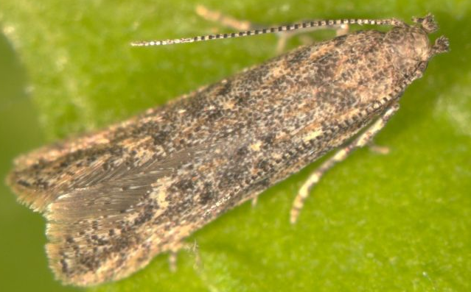
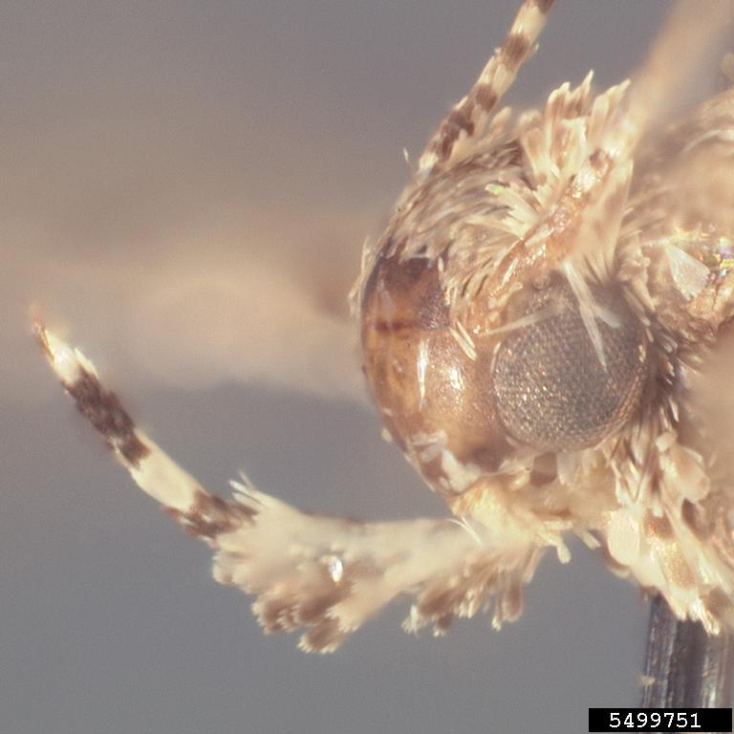
Identification: Adults
Filiform antennae, alternating rings of light and dark scales
Recurved labial palps
Body length up to 10 mm
Light/dark bands on antennae
Recurved (upcurved) labial palps
Photo credit: Marja van der Straten, NVWA Plant Protection Service, www.bugwood.org, #5432149 and James Hayden, FDACS Division of Plant Industry, Bugwood.org, #5499751
Notes:
Adult Tuta absoluta are about 1 cm (10 mm) in length. The male abdomen is usually longer and slimmer than the female. They are mottled grey in color and their antennae are long and filiform with alternating light and dark bands. Labial palps (mouthparts) are also banded with light and dark scales and are recurved (curved upwards). Note that for final identification, an examination of the adult male genitalic structures may be necessary.
Information Sources:
Brambila, J., S. Lee, and S. Passoa. 2010. Tuta absoluta diagnostic aid. Cooperative Agriculture Pest Survey program. Accessed 4 Dec 2013, http://caps.ceris.purdue.edu/screening/tuta_absoluta
Bloem, S. and E. Spaltenstein. 2011. New Pest Response Guidelines: Tomato Leafminer (Tuta absoluta). USDA–APHIS–PPQ–EDP Emergency Management, Riverdale, Maryland. Accessed 12/17/2013, http://www.aphis.usda.gov/import_export/plants/manuals/emergency/downloads/Tuta-absoluta.pdf.
CABI Invasive Species Compendium. Tuta absoluta. Accessed 17 December 2013,
http://www.cabi.org/isc/?compid=5&dsid=49260&page=481&site=144#
European and Mediterranean Plant Protection Organization. 2005. Data sheets on quarantine pests: Tuta absoluta. EPPO Bulletin 35, p. 434–435. Accessed 10 Feb 2013, http://www.eppo.int/QUARANTINE/insects/Tuta_absoluta/DS_Tuta_absoluta.pdf

Slide 8
Identification: Adults
“hair pencils”
Hindwings have apical concave margin and fringed edges
Wing margin
Photo: Sangmi Lee, Hasbrouck Insect Collection, Arizona State University, www.bugwood.org, #5432148
Notes:
Tuta absoluta has dark spots on their narrow forewings. The hindwing posterior margin is fringed with long hairs and looks roughly like a finger pointing outward from the body when the wings are spread. Again, note that for final identification, an examination of the adult male genitalic structures may be necessary.
Information Sources:
Bloem, S. and E. Spaltenstein. 2011. New Pest Response Guidelines: Tomato Leafminer (Tuta absoluta). USDA–APHIS–PPQ–EDP Emergency Management, Riverdale, Maryland. Accessed 12/17/2013, http://www.aphis.usda.gov/import_export/plants/manuals/emergency/downloads/Tuta-absoluta.pdf.
Brambila, J., S. Lee, and S. Passoa. 2010. Tuta absoluta diagnostic aid. Cooperative Agriculture Pest Survey program. Accessed 4 Dec 2013, http://caps.ceris.purdue.edu/screening/tuta_absoluta

Slide 9
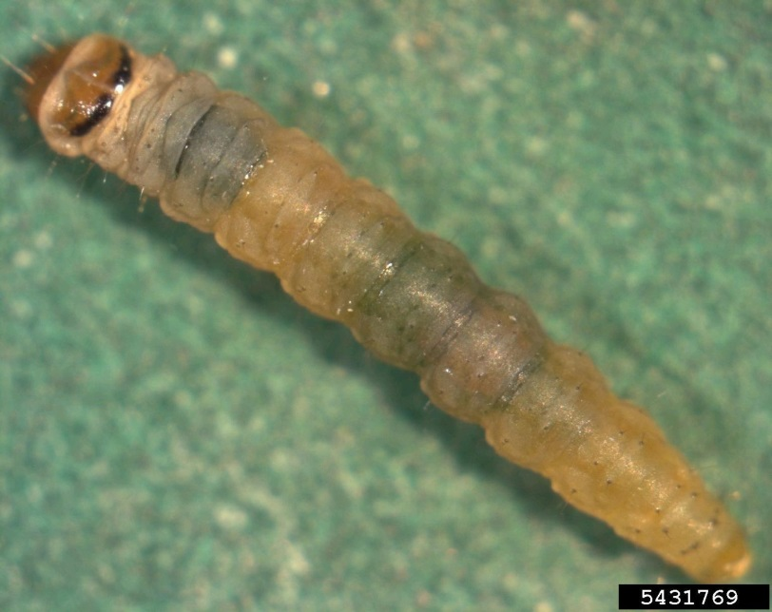
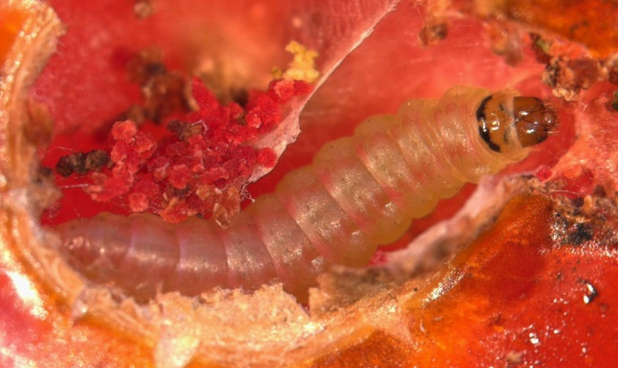
Identification: Larvae and Pupae
“hair pencils”
Photos: (Left) Marja van der Straten, NVWA Plant Protection Service, Bugwood.org, #5431766 and #5431769
Notes:
The eggs are small (0.38 mm in length by 0.21 mm in width), cylindrical, and creamy white to yellow, turning yellow-orange as they progress in development. Just before hatching, they turn almost black. Eggs are usually laid on the underside of leaves.
Tuta absoluta larva is creamy in color with a dark head at hatching. The color changes to green or light pink in later stages. When mature, the larvae average 8 mm in length.
The larvae leave the mines and build silk cocoons in the leaflets or the soil. Pupae are greenish at the beginning, turning dark brown as they mature. The male pupae are smaller (about 4.25 mm) than the female pupae (about 4.7 mm).
Information Sources:
Bloem, S. and E. Spaltenstein. 2011. New Pest Response Guidelines: Tomato Leafminer (Tuta absoluta). USDA–APHIS–PPQ–EDP Emergency Management, Riverdale, Maryland. Accessed 12/17/2013, http://www.aphis.usda.gov/import_export/plants/manuals/emergency/downloads/Tuta-absoluta.pdf.
CABI Invasive Species Compendium. Tuta absoluta. Accessed 17 December 2013,
http://www.cabi.org/isc/?compid=5&dsid=49260&page=481&site=144#
European and Mediterranean Plant Protection Organization. 2005. Data sheets on quarantine pests: Tuta absoluta. EPPO Bulletin 35, p. 434–435. Accessed 10 Feb 2013, http://www.eppo.int/QUARANTINE/insects/Tuta_absoluta/DS_Tuta_absoluta.pdf

Slide 10
Life Cycle
Can complete up to 12 generations per year depending on temperature
The adults mate multiple times
Females can lay up to 260 eggs
Can overwinter in the following stages:
Egg
Pupa
Adult
Notes:
Tuta absoluta completes its life cycle in approximately 29-38 days (28.7 days at 25°C).
As many as 12 generations are possible in a year depending on environmental conditions.
At 27.1°C, eggs hatched in 4 to 6 days, larvae were ready to pupate in 11 to 13 days, and pupae emerged as adults in 5 to 8 days. At lower temperatures, the life cycle took longer to complete.
A female can lay up to 260 eggs in its lifetime (averaging 60 to 120 eggs) and mate multiple times. Larvae undergo four instar stages.
Pupation occurs in the soil, leaf surface, or within mines. The day after adults emerge, the first mating usually occurs. Adults are nocturnal and mate at dawn. Tuta absoluta may overwinter in the egg, pupa, or adult stage.
Information Sources:
European and Mediterranean Plant Protection Organization. 2005. Data sheets on quarantine pests: Tuta absoluta. EPPO Bulletin 35, p. 434–435. Accessed 10 Feb 2013, http://www.eppo.int/QUARANTINE/insects/Tuta_absoluta/DS_Tuta_absoluta.pdf
Bloem, S. and E. Spaltenstein. 2011. New Pest Response Guidelines: Tomato Leafminer (Tuta absoluta). USDA–APHIS–PPQ–EDP Emergency Management, Riverdale, Maryland. Accessed 12/17/2013, http://www.aphis.usda.gov/import_export/plants/manuals/emergency/downloads/Tuta-absoluta.pdf.

Slide 11
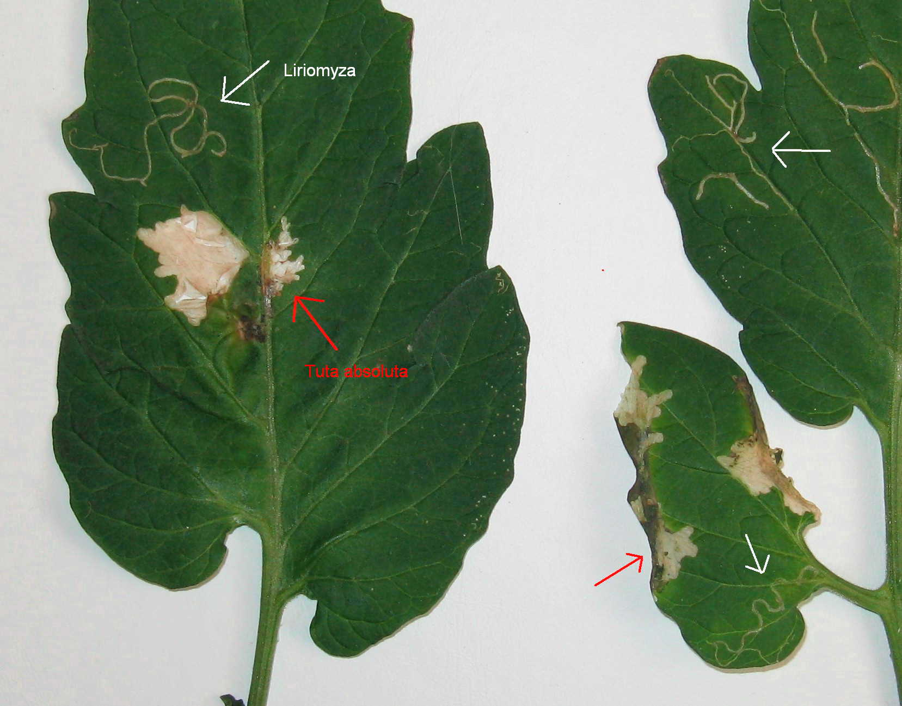
Damage
Larvae cause damage when they tunnel through leaves, shoots, flowers, and fruit
Produce mines and galleries and large amounts of waste as they tunnel through plant tissue
Galleries and pinholes can lead to secondary infections by pathogens
Leafmines of Liriomyza sp. (white arrows) and of Tuta absoluta (red arrows) on tomato leaves
Photo credit: Wietse den Hartog, National Reference Centre, Plant Protection Service Wageningen (NL)
Notes:
Larvae feed on leaves, shoots, flowers, and fruit creating conspicuous mines as they tunnel. Larvae create mines and galleries with large amounts of frass (waste) as they mine the plant tissues. Note the difference between the mines created by Lyriomyza flies (tomato leafminer) and Tuta absoluta in the image.
Feeding on the plant hurts its overall health and can lead to the death of the plant. The leaves can have necrotic areas, be malformed, and rolled or folded in appearance.
Feeding on the stems can cause witches broom, wilting, and dieback. Feeding on the flowers can cause them to drop. Feeding on the fruit causes abnormal shape, premature drop, and reduced size.
It will also feed on harvested plant material.
Galleries and pinholes in fruit made by the feeding larvae create opportunities for secondary infections by pathogens. Damage can be particularly severe in young plants.
Information Sources:
Bloem, S. and E. Spaltenstein. 2011. New Pest Response Guidelines: Tomato Leafminer (Tuta absoluta). USDA–APHIS–PPQ–EDP Emergency Management, Riverdale, Maryland. Accessed 12/17/2013, http://www.aphis.usda.gov/import_export/plants/manuals/emergency/downloads/Tuta-absoluta.pdf.
CABI Invasive Species Compendium. Tuta absoluta. Accessed 17 December 2013,
http://www.cabi.org/isc/?compid=5&dsid=49260&page=481&site=144#
European and Mediterranean Plant Protection Organization. 2005. Data sheets on quarantine pests: Tuta absoluta. EPPO Bulletin 35, p. 434–435. Accessed 10 Feb 2013, http://www.eppo.int/QUARANTINE/insects/Tuta_absoluta/DS_Tuta_absoluta.pdf

Slide 12
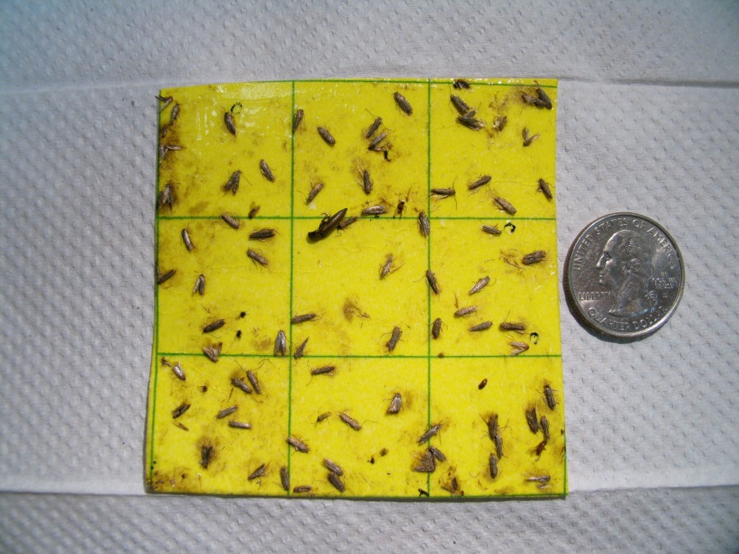
Monitoring and Management
Monitoring:
Scouting
Synthetic pheromones in delta or sticky traps
Cultural management:
rotation with non-solanaceous crops
ploughing for weed control
Sticky board with males attracted to pheromone
adequate fertilization and irrigation to minimize plant stress
destruction of infested plants
removal of plant debris after harvest
Photo credit: Dr. J.E. Hayden, FDACS-DPI
Notes:
To monitor population levels, synthetic pheromones in delta traps or sticky traps can be used in conjunction with scouting. Monitoring helps with proper timing on chemical controls if needed.
Management practices include cultural methods (such as rotation with non-solanaceous crops and destruction of infested plants).
Information Sources:
CABI Invasive Species Compendium. Tuta absoluta. Accessed 17 December 2013,
http://www.cabi.org/isc/?compid=5&dsid=49260&page=481&site=144#
European and Mediterranean Plant Protection Organization. 2005. Data sheets on quarantine pests: Tuta absoluta. EPPO Bulletin 35, p. 434–435. Accessed 10 Feb 2013, http://www.eppo.int/QUARANTINE/insects/Tuta_absoluta/DS_Tuta_absoluta.pdf
Smith, Melissa. 2012. Virginia Tech research program confirms presence of invasive insect in Senegal. Virginia Tech News. Published 28 Sep 2012. Accessed 23 Feb 2013. http://www.vtnews.vt.edu/articles/2012/09/092812-oired-tuta.html

Slide 13
Monitoring and Management
Chemical Management:
insecticides can be effective, but some evidence of resistance
Biological control:
research being done on various parasitoids or predators
Resistant cultivars are also being investigated
Notes:
Chemical management requires several application during the growing season; however, there is some evidence of insecticide resistance.
Research on biological control agents such as parasitoids (e.g. Trichogramma pretiosum) and predators (e.g. Podisus nigrispinus) that can be used against this pest are being researched. Other parasites as well as pathogens have also been recorded as potential biological control agents. Some on the list include:
Agathis fuscipennis (Parasite on the larvae)
Apanteles gelechiidivoris (Parasite on the larvae)
Bacillus thuringiensis (Pathogen)
Bracon lucileae (Parasite on the larvae)
Copidosoma koehleri (Parasite on the eggs)
Nesidiocoris tenuis (Predator)
Parasierola nigrifemur (Parasite on the larvae)
Trichogramma exiguum (Parasite on the eggs)
Entomopathogenic nematodes have also been used.
Resistant cultivars are also being investigated.
Information Sources:
CABI Invasive Species Compendium. Tuta absoluta. Accessed 17 December 2013,
http://www.cabi.org/isc/?compid=5&dsid=49260&page=481&site=144#
European and Mediterranean Plant Protection Organization. 2005. Data sheets on quarantine pests: Tuta absoluta. EPPO Bulletin 35, p. 434–435. Accessed 10 Feb 2013, http://www.eppo.int/QUARANTINE/insects/Tuta_absoluta/DS_Tuta_absoluta.pdf
Smith, Melissa. 2012. Virginia Tech research program confirms presence of invasive insect in Senegal. Virginia Tech News. Published 28 Sep 2012. Accessed 23 Feb 2013. http://www.vtnews.vt.edu/articles/2012/09/092812-oired-tuta.html

Slide 14
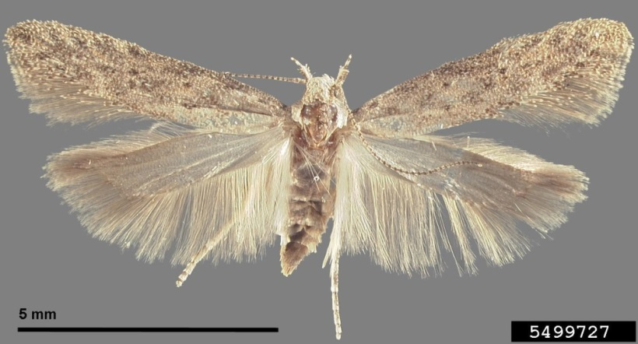
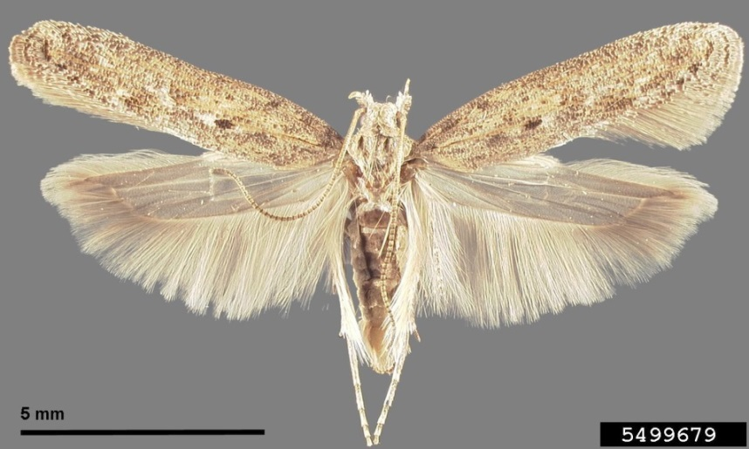
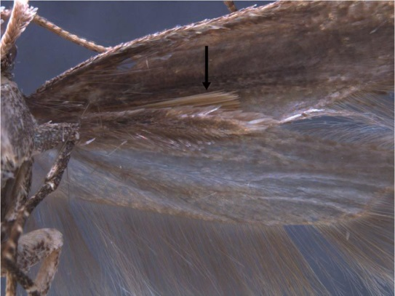
Look-alike Species
Tuta absoluta
tomato pinworm
“hair pencils”
Hair pencil of tomato pinworm
potato tuber moth
Photo: Clockwise upper left to right: Tuta absoluta - Sangmi Lee, Hasbrouck Insect Collection, Arizona State University, www.bugwood.org, #5432148; tomato pinworm - James Hayden, FDACS Division of Plant Industry, www.bugwood.org, #5499727; potato tuber moth - James Hayden, FDACS Division of Plant Industry, Bugwood.org, #5499679; hair pencil - James Hayden, FDACS-DPI
Notes:
Tuta absoluta can easily be confused with the tomato pinworm (Keiferia lycopersicella) and the potato tuber moth (Phthorimaea operculella), two pest species that occur in tomato fields in the United States.
The adult tomato pinworm in particular resembles the adult T. absoluta; both species have light-and-dark banded antennae (yellow arrow). The most noticeable differences are the tomato pinworm has somewhat lighter coloration on the forewings and “hair pencils” (bundles of long stiff setae) along the back edge of the hindwings (blue arrow). Accurate identification of either of these species requires examination of adult male genitalic structures. The tomato pinworm occupies the ecological niche on tomatoes that T. absoluta would occupy if it were present in the United States.
The potato tuber moth also has banded antennae, but the colors are not as contrasting as in T. absoluta and tomato pinworm. A row of three dark spots appear on the forewings (red circle). Similar to the tomato pinworm, the potato tuber moth also has hair pencils along the back edge of the hindwings; however, there are also hair pencils near the apex of the abdomen (purple arrow), which is not found in eitherT. absoluta or tomato pinworm.
Additional information on this pest can be found at - http://www.tutaabsoluta.com/.
Information Sources:
Bloem, S. and E. Spaltenstein. 2011. New Pest Response Guidelines: Tomato Leafminer (Tuta absoluta). USDA–APHIS–PPQ–EDP Emergency Management, Riverdale, Maryland. Accessed 12/17/2013, http://www.aphis.usda.gov/import_export/plants/manuals/emergency/downloads/Tuta-absoluta.pdf.
Brambila, J., S. Lee, and S. Passoa. 2010. Tuta absoluta diagnostic aid. Cooperative Agriculture Pest Survey program. Accessed 4 Dec 2013, http://caps.ceris.purdue.edu/screening/tuta_absoluta
Hayden, J.E., S. Lee, S.C. Passoa, J. Young, J.-F. Landry, V. Nazari, R. Mally, L.A. Somma, and K.M. Ahlmark. 2013. Digital Identification of Microlepidoptera on Solanaceae. USDA-APHIS-PPQ Identification Technology Program (ITP). Fort Collins, CO. Accessed 16 January 2014, http://idtools.org/id/leps/micro/factsheet.php?name=%3Cem%3ETuta+absoluta%3C%2Fem%3E

Slide 15
Authors
Carla Burkle, B.S.
Graduate Research Assistant, Doctor of Plant Medicine program, University of Florida
Smriti Bhotika, Ph.D.
Postdoctoral Associate, Department of Entomology and Nematology, University of Florida

Slide 16
Editors
Stephanie Stocks, M.S.
Assistant-In, Extension Scientist, Department of Entomology and Nematology, University of Florida
Jennifer Hamel, Ph.D.
Postdoctoral Associate, Department of Entomology and Nematology, University of Florida
Matthew D. Smith, Ph.D.
Postdoctoral Associate, Department of Entomology and Nematology, University of Florida

Slide 17
Reviewers
Julieta Brambila, M.S.
USDA, Animal and Plant Health Inspection Service, Plant Protection and Quarantine.
James E. Hayden, Ph.D.
Florida Department of Agriculture and Consumer Services, Division of Plant Industry.
Leroy Whilby, DPM
State Survey Coordinator, Cooperative Agricultural Pest Survey Program

Slide 18
Collaborating Agencies
U.S. Department of Agriculture Animal and Plant Health Inspection Service (USDA-APHIS)
Cooperative Agricultural Pest Survey Program (CAPS)
Florida Department of Agriculture and Consumer Services (FDACS)
National Plant Diagnostic Network (NPDN)
Sentinel Plant Network (SPN)
Protect U.S.
University of Florida Institute of Food and Agricultural Sciences (UF-IFAS)

Slide 19
Educational Disclaimer and Citation
This presentation can be used for educational purposes for NON-PROFIT workshops, trainings, etc.
Citation:
Burkle, C., B.S., Bhotika, S., Ph.D., 2014. Tuta absoluta, June 2014.

Slide 20
References
Bloem, S. and E. Spaltenstein. 2011. New Pest Response Guidelines: Tomato Leafminer (Tuta absoluta). USDA–APHIS–PPQ–EDP Emergency Management, Riverdale, Maryland. Accessed 12/17/2013,
http://www.aphis.usda.gov/import_export/plants/manuals/emergency/downloads/Tuta-absoluta.pdf.
Brambila, J., S. Lee, and S. Passoa. 2010. Tuta absoluta diagnostic aid. Cooperative Agriculture Pest Survey program. Accessed 4 Dec 2013,
http://caps.ceris.purdue.edu/screening/tuta_absoluta
CABI Invasive Species Compendium. Tuta absoluta. Accessed 17 December 2013.
http://www.cabi.org/isc/?compid=5&dsid=49260&page=481&site=144#
European and Mediterranean Plant Protection Organization. 2005. Data sheets on quarantine pests: Tuta absoluta. EPPO Bulletin 35, p. 434–435. Accessed 10 Feb 2013,
http://www.eppo.int/QUARANTINE/insects/Tuta_absoluta/DS_Tuta_absoluta.pdf

Slide 21
References
Florida Department of Agriculture and Consumer Services. 2013. Florida Agriculture by the Numbers. Accessed 1/28/2013-
http://freshfromflorida.s3.amazonaws.com/Media%2FFiles%2FMarketing-Development-Files%2FAg_stats_2013_with+covers.pdfP-01304.pdf
Hayden, J.E., S. Lee, S.C. Passoa, J. Young, J.-F. Landry, V. Nazari, R. Mally, L.A. Somma, and K.M. Ahlmark. 2013. Digital Identification of Microlepidoptera on Solanaceae. USDA-APHIS-PPQ Identification Technology Program (ITP). Fort Collins, CO. Accessed 16 January 2014,
http://idtools.org/id/leps/micro/factsheet.php?name=%3Cem%3ETuta+absoluta%3C%2Fem%3E
Smith, Melissa. 2012. Virginia Tech research program confirms presence of invasive insect in Senegal. Virginia Tech News. Published 28 Sep 2012. Accessed 23 Feb 2013.
http://www.vtnews.vt.edu/articles/2012/09/092812-oired-tuta.html

