Slide 1
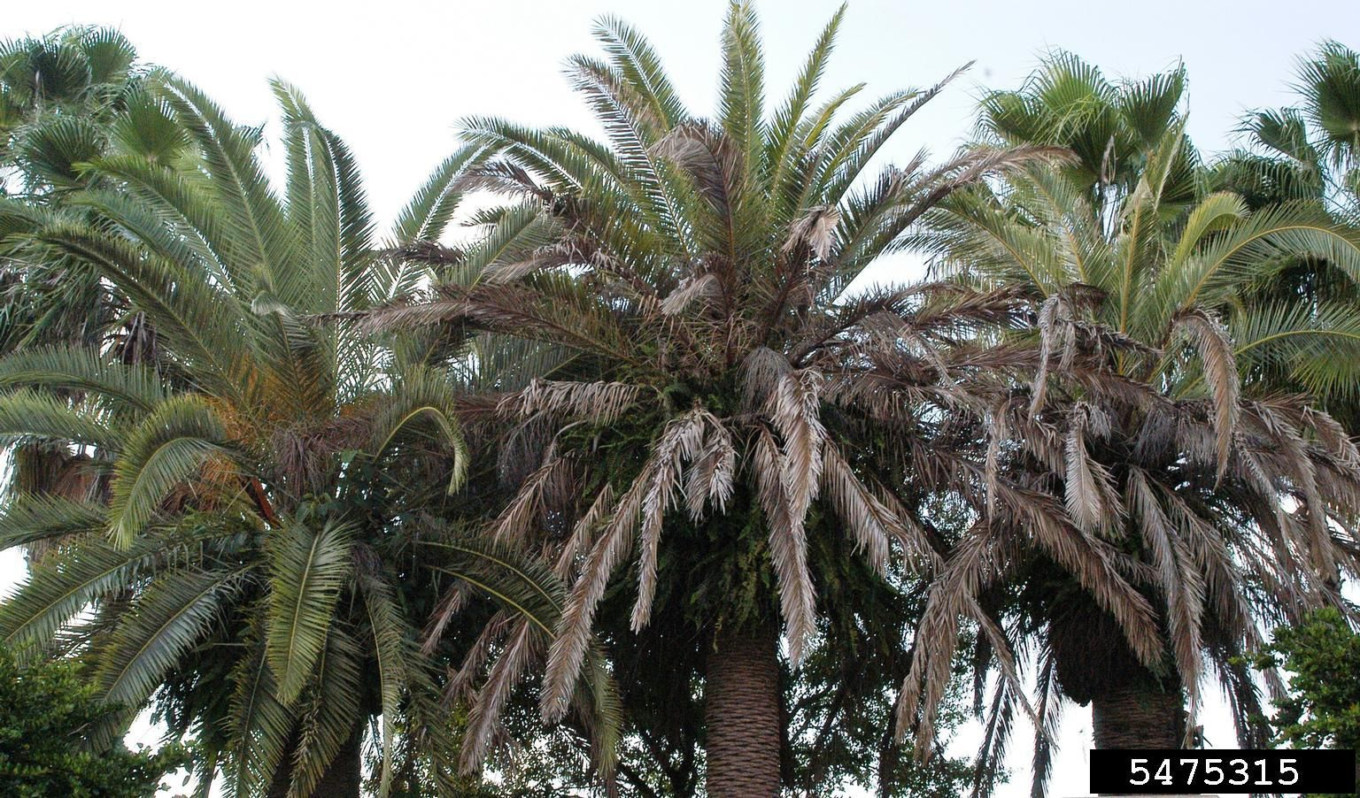
Texas Phoenix Palm Decline: A New Palm Phytoplasma in Florida A new palm phytoplasma in Florida
Photo: Monica Elliott, University of Florida, Bugwood.org, #5475315

Slide 2
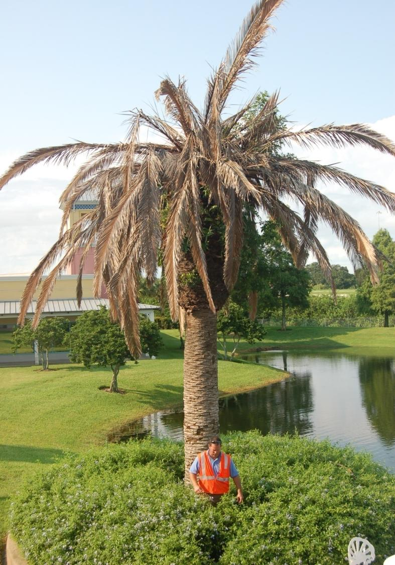
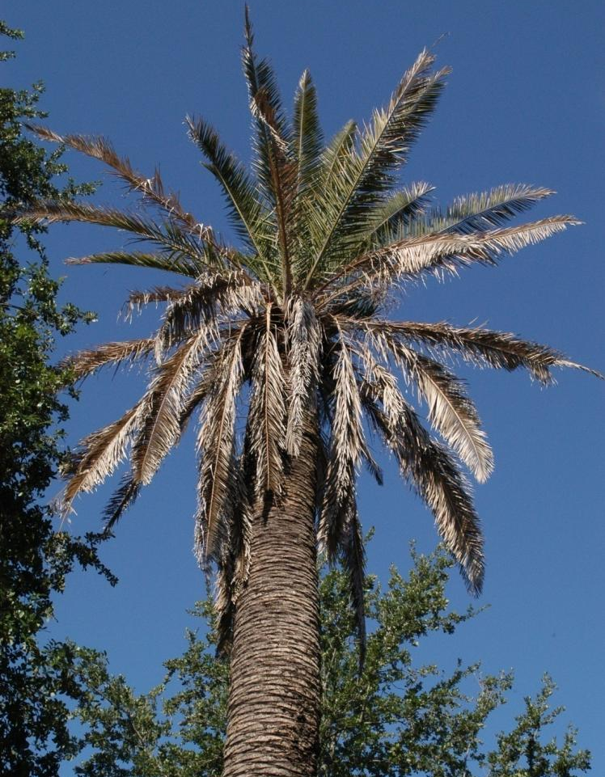
Texas Phoenix Palm Decline (TPPD)
Phoenix sp. decline due to TPPD
Photos: N. Harrison, University of Florida
Notes:
Texas Phoenix Palm Decline (TPPD) is a palm disease caused by a phytoplasma, a specialized unculturable bacterium without a cell wall. TPPD initially was discovered in the southern coastal area of Texas during 2001 on Canary Island date palm (Phoenix canariensis).
TPPD first was identified in the coastal regions of West Central Florida on Phoenix species in 2006. Before the detection of TPPD, the only palm disease in Florida caused by a phytoplasma was lethal yellowing, a systemic palm disease that is transmitted by a common neotropical planthopper (Haplaxius crudus). The symptoms of lethal yellowing are almost identical to TPPD, but the host range and geographical distribution differ. TPPD is closely related to lethal yellowing and the phytoplasma is similar.
Information Sources:
Harrison, N.A., M. Womack, and M.L. Carpio. 2002. Detection and characterization of a lethal yellowing (16SrIV) group phytoplasma in Canary island date palms affected by lethal decline in Texas. Plant Disease 86(6): 676-681.
accessed 12/5/2013 -
http://apsjournals.apsnet.org/doi/abs/10.1094/PDIS.2002.86.6.676
Harrison, N. A., E. E. Helmick, M. L. Elliott. 2008. Lethal yellowing-type diseases of palms associated with phytoplasmas newly identified in Florida, USA. Annals of Applied Biology 153:85-94.
Harrison, N. A., E. E. Helmick, M. L. Elliott. 2009. First report of a phytoplasma-associated lethal decline of Sabal palmetto in Florida, USA. Plant Pathology 58:792.
Harrison, N. and M. Elliott. 2007. Revised 2013. Texas Phoenix Palm Decline. University of Florida, Institute of Food and Agricultural Sciences.
Accessed 10-21-13
http://edis.ifas.ufl.edu/pp163
Halbert. S. 2008. Pest Alert: Texas Phoenix Palm Decline. Florida Department of Agriculture and Consumer Sciences, Division of Plant Industry.
Accessed 11-22-13
http://www.freshfromflorida.com/Divisions-Offices/Plant-Industry/Plant-Industry-Publications/Pest-Alerts/Pest-Alerts-Texas-Phoenix- Palm-Decline
Texas Department of Agriculture. Texas Phoenix Palm Decline.
Accessed 10-21-13
http://www.texasagriculture.gov/RegulatoryPrograms/PlantQuality/PestandDiseaseAlerts/DatePalmLethalDecline.aspx

Slide 3
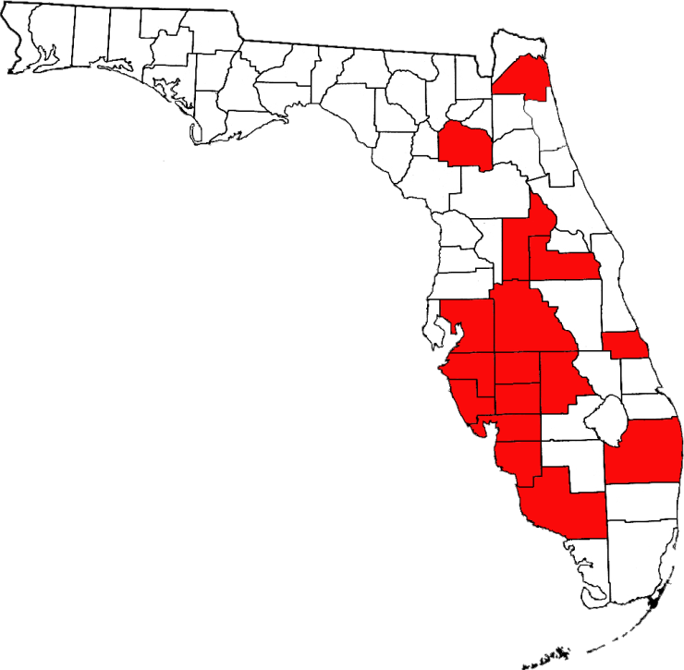
Distribution in Florida
Disease detected
Map courtesy of N. Harrison, University of Florida and FDACS-DPI.
Notes:
TPPD occurs in Texas and Florida. It was first detected in Texas in 2001. While unknown as to how it spread to Florida, it may have spread via infected plant material or an infected vector. TPPD has primarily been observed in west-central Florida while lethal yellowing is primarily distributed in southern Florida.
In Florida, the disease has been detected in landscapes, nurseries and natural areas in the following counties: Alachua, Charlotte, Lee, Palm Beach, Orange, Indian River, DeSoto, Hardee, Highlands, Hillsborough, Manatee, Collier, Polk, Sarasota, Duval, and Lake Counties.
In Texas, the disease has been detected in the following counties: Bexar, Cameron, Hidalgo, Kleberg, Nueces and Willacy.
Information Sources:
Lucid Key. A resource for pests and diseases of cultivated palms, symptoms of diseases and disorders - Texas Phoenix Palm Decline.
Accessed 11-22-13
http://itp.lucidcentral.org/id/palms/symptoms/Texas_Phoenix_Palm_Decline.htm
Harrison, N. and M. Elliott. 2007. Revised 2013. Texas Phoenix Palm Decline. University of Florida, Institute of Food and Agricultural Sciences.
Accessed 10-21-13
http://edis.ifas.ufl.edu/pp163
Halbert, S.E., B. Bextine, S.B. Youngblood, and A.A. Dickens. 2013. Texas phoenix palm decline and potential vectors. APS and MSA joint meeting. 68-S.
Accessed 11-23-13
http://www.apsnet.org/meetings/Documents/2013_Meeting_Abstracts/aps2013abS68.htm
Tim Schubert, FDACS-DPI – personal communication.
Ong, K and S. McBride. 2009. Palm diseases Caused by Phytoplasmas in Texas. AgriLife Extension, Texas A& M system.
Accessed 1-21-14
http://www.npdn.org/webfm_send/1065

Slide 4
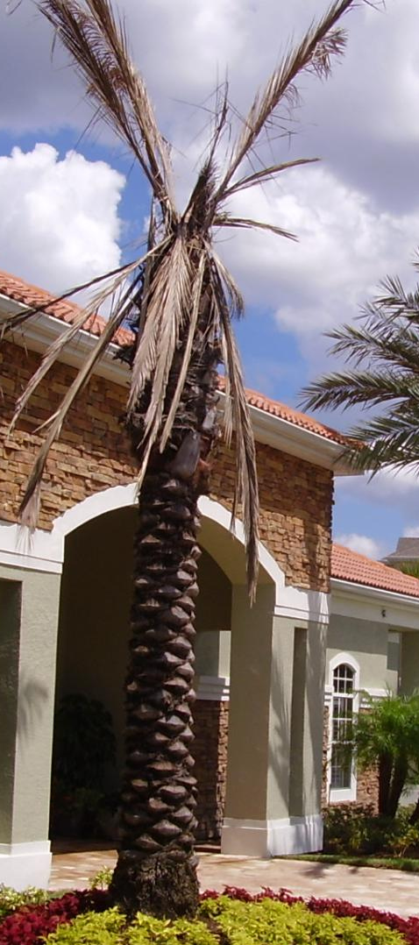
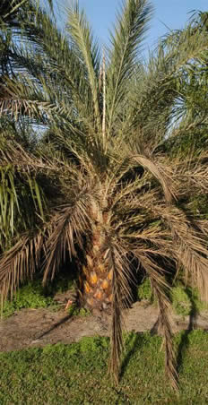
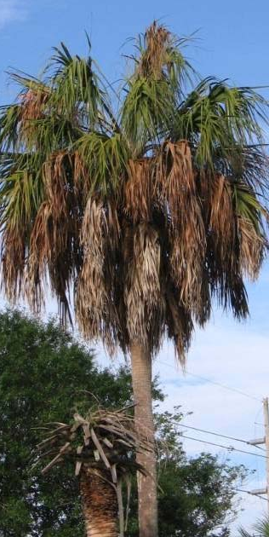
Host Plants
Phoenix canariensis
Phoenix dactylifera
Phoenix sylvestris
Sabal palmetto
Photos: N. Harrison and M. Elliott, University of Florida
Notes:
Texas Phoenix palm decline has been known to affect the following hosts: Canary Island date palm (Phoenix canariensis), edible date palm (P. dactylifera), wild date palm (P. sylvestris), Senegal date palm (P. reclinata), Queen palm (Syagrus romanzoffiana), pygmy date palm (P. roebelenii), Mule palm (X Butiagrus nabonnandii) and Cabbage palms (Sabal palmetto).
Information Sources:
Harrison, N. and M. Elliott. 2007. Revised 2013. Texas Phoenix Palm Decline. University of Florida, Institute of Food and Agricultural Sciences.
Accessed 10-21-13
http://edis.ifas.ufl.edu/pp163
Halbert. S. 2008. Pest Alert: Texas Phoenix Palm Decline. Florida Department of Agriculture and Consumer Sciences, Division of Plant Industry.
Accessed 10-22-13
http://www.freshfromflorida.com/Divisions-Offices/Plant-Industry/Plant-Industry-Publications/Pest-Alerts/Pest-Alerts-Texas-Phoenix-Palm-Decline
Jeyaprakash, A. B. D. Sutton, S. E. Halbert and T. S. Schubert. 2011. High-fidelity PCR facilitates detection and identification of a Texas Phoenix palm phytoplasma strain from pigmy date palm, Phoenix roebelenii in Florida. Plant Disease 95: 1475.
Accessed 7-19-2013
http://www.apsnet.org/publications/plantdisease/2011/November/Pages/95_11_1475.1.aspx
Texas Department of Agriculture. Texas Phoenix Palm Decline.
Accessed 10-21-13
http://www.texasagriculture.gov/RegulatoryPrograms/PlantQuality/PestandDiseaseAlerts/DatePalmLethalDecline.aspx

Slide 5
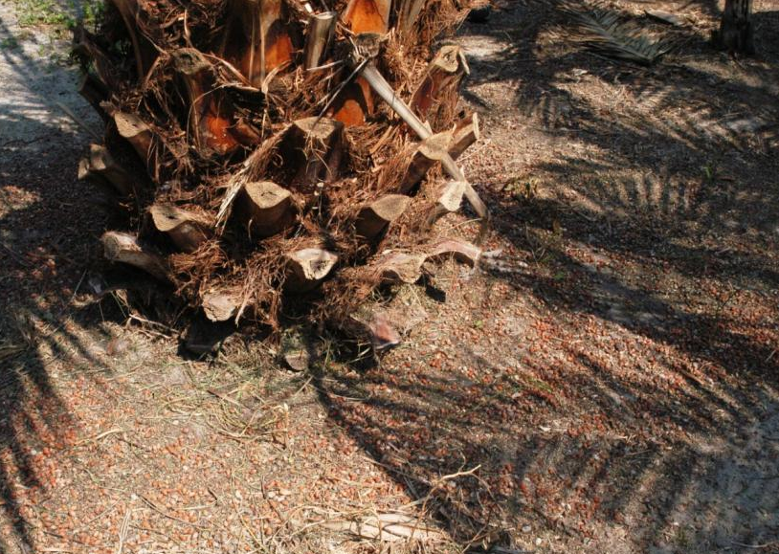
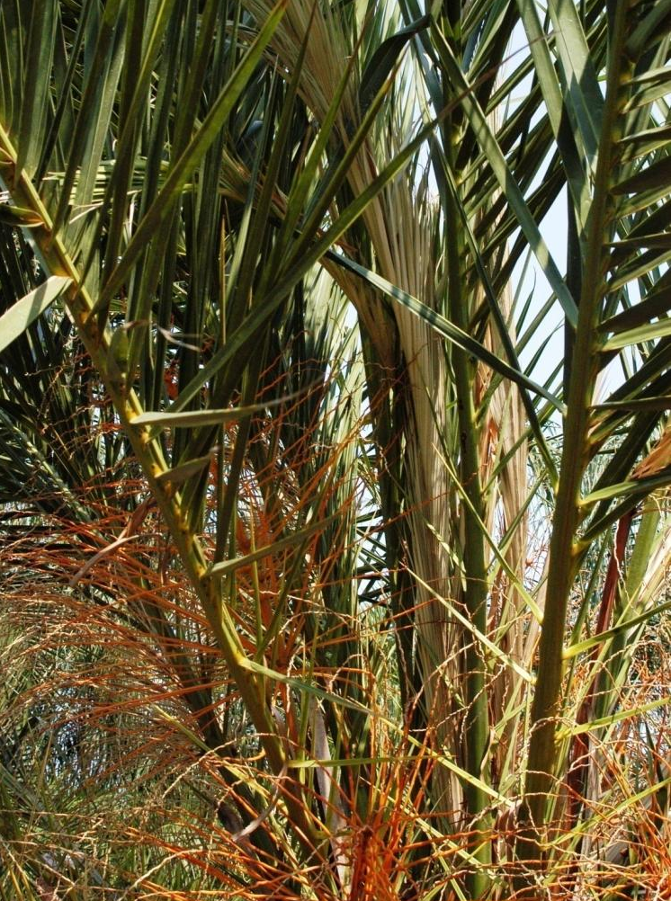
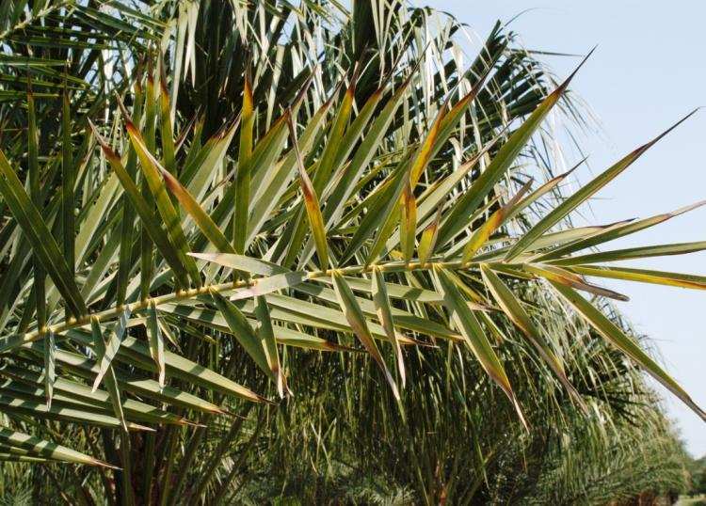
Early Symptoms
Sudden loss of fruit
Dead inflorescence (flowers)
Discoloration of the leaf tips
Symptoms on Phoenix sylvestris
Photos: N. Harrison and M. Elliott, University of Florida
Notes:
The symptoms of TPPD are almost the same as those of lethal yellowing on Phoenix spp.; however, root decay is an additional symptom that has been observed in TPPD.
Early symptoms of TPPD include: a premature drop of most fruits, death of inflorescences, and discoloration of leaf tips.
The premature drop of fruits and inflorescence necrosis will be only observed in mature palms that can produce fruits and be in the fruit producing season.
Discoloration of the foliage begins at the tips of leaves on the oldest, lowermost leaves. The old leaves quickly turn to a reddish-brown, dark brown or gray color. This leaf discoloration can be confused with some other issues such as natural senescence or nutrient deficiency. This symptom may not be obvious when dying and dead leaves are regularly removed in nursery and landscape settings. Consequently, it is important to monitor the trees closely to recognize the onset of leaf discoloration.
Information Sources:
Harrison, N.A., M. Womack, and M.L. Carpio. 2002. Detection and characterization of a lethal yellowing (16SrIV) group phytoplasma in Canary island date palms affected by lethal decline in Texas. Plant Disease 86(6): 676-681.
accessed 12/5/2013 -
http://apsjournals.apsnet.org/doi/abs/10.1094/PDIS.2002.86.6.676
Harrison, N. and M. Elliott. 2007. Revised 2013. Texas Phoenix Palm Decline. University of Florida, Institute of Food and Agricultural Sciences.
Accessed 10-21-13
http://edis.ifas.ufl.edu/pp163
Halbert. S. 2008. Pest Alert: Texas Phoenix Palm Decline. Florida Department of Agriculture and Consumer Sciences, Division of Plant Industry.
Accessed 10-22-13
http://www.freshfromflorida.com/Divisions-Offices/Plant-Industry/Plant-Industry-Publications/Pest-Alerts/Pest-Alerts-Texas-Phoenix- Palm-Decline

Slide 6
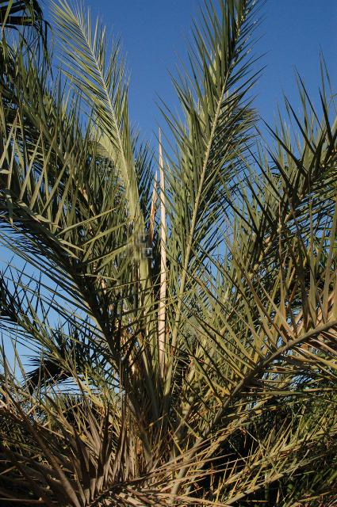
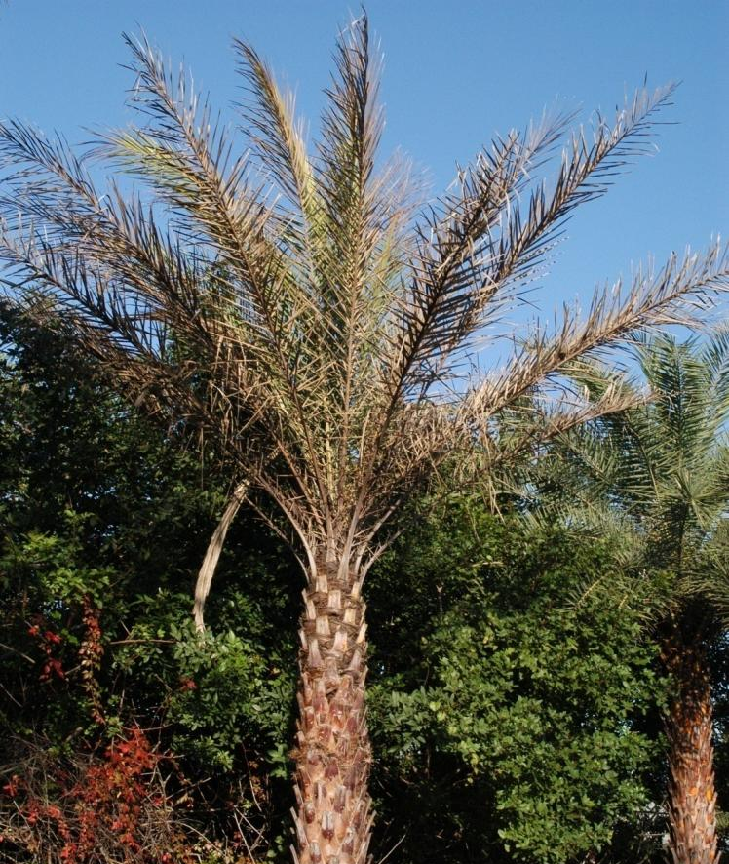
Later Symptoms
Dead spear leaf hanging down from the canopy
Dead spear leaf
Symptoms on Phoenix sylvestris
Photos: N. Harrison and M. Elliott, University of Florida
Notes:
Once the oldest leaves have discolored and become necrotic, the spear leaf will collapse and die. The spear leaf is the vertical and unopened newest leaf of the palm (yellow arrows). The death of the spear leaf occurs in Phoenix palms when less than 1/3 of the leaves have become discolored; in Sabal palm, it occurs when approximately 2/3 of the leaves have become discolored.
Once the spear leaf has died, no new leaves develop and discoloration or necrosis of the remaining leaves will continue from the oldest to the youngest leaves. It is important to make sure the spear leaf itself is in fact dead, as there are many leaves that surround the spear leaf. In addition, please do not confuse the brown sheath for the dead spear leaf (in Canary Island date palms, the spear leaf is often enclosed in a thin, brown sheath that looks like paper).
Information Sources:
Harrison, N. and M. Elliott. 2007. Revised 2013. Texas Phoenix Palm Decline. University of Florida, Institute of Food and Agricultural Sciences.
Accessed 10-21-13
http://edis.ifas.ufl.edu/pp163
Halbert. S. 2008. Pest Alert: Texas Phoenix Palm Decline. Florida Department of Agriculture and Consumer Sciences, Division of Plant Industry.
Accessed 10-22-13
http://www.freshfromflorida.com/Divisions-Offices/Plant-Industry/Plant-Industry-Publications/Pest-Alerts/Pest-Alerts-Texas-Phoenix- Palm-Decline

Slide 7
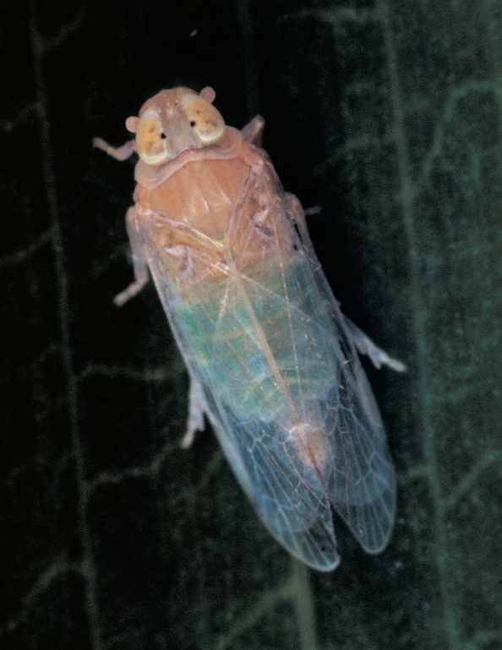
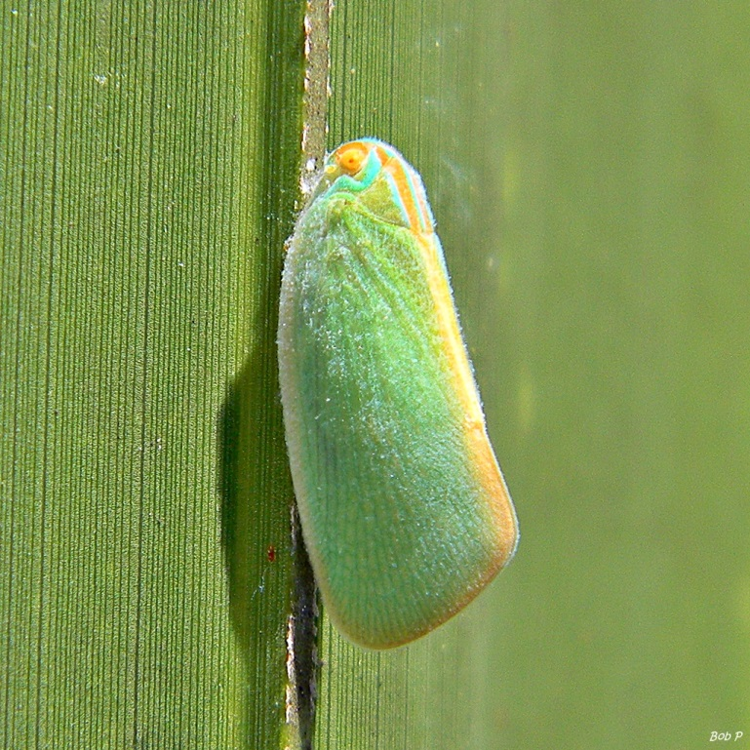
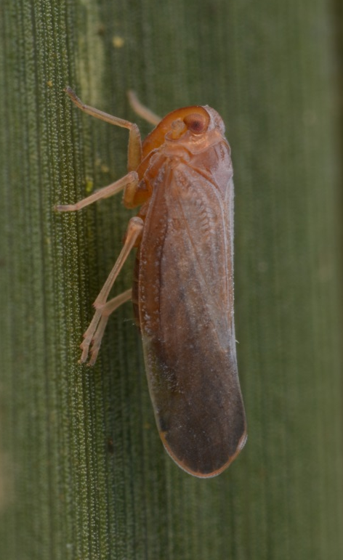
Potential Vectors of TPPD
Omolicna n. sp
Haplaxius crudus
(formerly Myndus crudus)
Ormenaria rufifascia
Photos:
Omolicna species novae – Lyle Buss, Department of Entomology and Nematology, University of Florida
Haplaxius (Myndus) crudus - J.D. de Filippis, University of Florida, www.bugwood.org, #0725076
Ormenaria rufifascia – WikiMedia Commons
Notes:
The phytoplasma that causes TPPD is an unculturable bacterium without a cell wall that is found in the phloem of its host plants. The disease is most likely transmitted by piercing-sucking insect vectors that feed in the phloem tissues.
It is possible that this pathogenic phytoplasma can be transmitted by insect vectors such as planthoppers and treehoppers, however, no specific vector for the TPPD has been identified yet.
There are three potential planthoppers candidates for the vector of TPPD. They are: a derbid that is currently being described (Omolicna n. sp), a cixiid (H. crudus), and a flatid (Ormenaria rufifascia).
Those three planthoppers exist on the palms in Tampa Bay, Florida where TPPD occurs and are being tested for determining the vector.
Information Sources:
Harrison, N. and M. Elliot. 2007. Texas Phoenix Palm Decline. University of Florida, Institute of Food and Agricultural Sciences.
Accessed 10-21-13
http://edis.ifas.ufl.edu/pp163
Halbert. S. 2008. Pest Alert: Texas Phoenix Palm Decline. Florida Department of Agriculture and Consumer Sciences, Division of Plant Industry.
Accessed 10-22-13
http://www.freshfromflorida.com/Divisions-Offices/Plant-Industry/Plant-Industry-Publications/Pest-Alerts/Pest-Alerts-Texas-Phoenix- Palm-Decline
Halbert, S.E., B. Bextine, S.B. Youngblood, and A.A. Dickens. 2013. Texas phoenix palm decline and potential vectors. APS and MSA joint meeting. 68-S.
Accessed 11-23-13
http://www.apsnet.org/meetings/Documents/2013_Meeting_Abstracts/aps2013abS68.htm
Halbert, S.E., Wilson, S.W., Bextine, B., and Youngblood, S.B. 2014. Potential planthopper vectors of palm phytoplasmas in Florida with a description of a new species of the genus Omolicna (Hemiptera: Fulgoroidea). Florida Entomologist (in press).

Slide 8
Monitoring and Management
Monitor for symptoms
Remove the palm after death of the spear leaf
Use antibiotic injections (Oxytetracycline HCl)
Therapeutic when the spear leaf has not died
Preventive for healthy palms in the area
Control of insect vectors is not recommended
Use of host resistance for long-term solution
Diversify the landscape
Notes:
In TPPD active areas, susceptible hosts should be monitored regularly for typical symptoms. Palms with a suspected infection should be quarantined and not moved as movement of infected plant material can spread the disease. Please report suspect infections to your local county agent of your Department of Agriculture. As the diagnosis of this disease must be done in a plant pathology lab, your local county agent or plant inspector can provide instructions on how to obtain a sample and send it to an appropriate laboratory.
Management of TPPD is similar to that of lethal yellowing.
When the spear leaf has died, the palm should be removed to help prevent the spread of the disease to other susceptible palms.
If the spear leaf has not died yet, a therapeutic treatment of oxytetracycline HCl (an antibiotic) can be injected into the trunk. However, injections must continue every three to four months for the life of the palm. You can also use the injections as a preventative treatment to protect palms when TPPD is known to occur in the area. These injections must also continue every three to four months, but should only be administered to susceptible palm species.
Controlling the population of insect vectors is not recommended because the vector is unknown at this time. Use of palm species that are not considered susceptible to TPPD or use of trees other than palms is recommended for the most practical long-term solution.
It should be noted that there are Sabal palms still alive and asymptomatic in the Tampa area after several years of infestation. While more research must be conducted in this area, it is a possibility these palms may carry a natural resistance to the phytoplasma.
Information Sources:
Harrison, N. and M. Elliott. 2007. Revised 2013. Texas Phoenix Palm Decline. University of Florida, Institute of Food and Agricultural Sciences.
Accessed 10-21-13
http://edis.ifas.ufl.edu/pp163
Halbert. S. 2008. Pest Alert: Texas Phoenix Palm Decline. Florida Department of Agriculture and Consumer Sciences, Division of Plant Industry.
Accessed 10-22-13
http://www.freshfromflorida.com/Divisions-Offices/Plant-Industry/Pests-Diseases/Texas-Phoenix-Palm-Decline
Oropeza, C., I. Cordova, M. Narvaez, and N. Harrison. Palm Trunk Sampling for DNA Extraction and Phytoplasma Detection.
http://flrec.ifas.ufl.edu/pdfs/LY-TPPD-Trunk-Sampling.pdf
Texas Department of Agriculture. Texas Phoenix Palm Decline.
Accessed 10-21-13
http://www.texasagriculture.gov/RegulatoryPrograms/PlantQuality/PestandDiseaseAlerts/DatePalmLethalDecline.aspx

Slide 9
Authors
Nigel Harrison, Ph.D.
Associate Professor, Fort Lauderdale Research and Education Center, University of Florida
Keumchul Shin, M.S.
DPM student, Doctor of Plant Medicine Program, University of Florida

Slide 10
Editors
Stephanie Stocks, M.S.
Department of Entomology and Nematology, University of Florida
Matthew D. Smith, Ph.D.
Postdoctoral Associate, Department of Entomology and Nematology, University of Florida

Slide 11
Reviewers
Susan Halbert, Ph.D
Florida Department of Agriculture and Consumer Services, Division of Plant Industry
Andrew Derksen, M.S.
Pest Survey Scientist, Florida Department of Agriculture and Consumer Services, Division of Plant Industry
Smriti Bhotika, Ph.D.
Postdoctoral Associate, Department of Entomology and Nematology, University of Florida
Monica Elliott, Ph.D.
Professor of Plant Pathology, Fort Lauderdale Research and Education Center

Slide 12
Collaborating Agencies
U.S. Department of Agriculture Animal and Plant Health Inspection Service (USDA-APHIS)
Cooperative Agricultural Pest Survey Program (CAPS)
Florida Department of Agriculture and Consumer Services (FDACS), Division of Plant Industry
National Plant Diagnostic Network (NPDN)
Sentinel Plant Network (SPN)
Protect U.S.
University of Florida Institute of Food and Agricultural Sciences (UF-IFAS)

Slide 13
Educational Disclaimer and Citation
This presentation can be used for educational purposes for NON-PROFIT workshops, trainings, etc.
Citation:
Harrison, N., Ph.D., Shin, K., M.S., 2014. Texas Phoenix Palm Decline: A New Palm Phytoplasma in Florida, June 2014.

Slide 14
References
Halbert. S. 2008. Pest Alert: Texas Phoenix Palm Decline. Florida Department of Agriculture and Consumer Sciences, Division of Plant Industry. Accessed 11-22-13
http://www.freshfromflorida.com/Divisions-Offices/Plant-Industry/Plant-Industry-Publications/Pest- Alerts/Pest-Alerts-Texas-Phoenix-Palm-Decline
Halbert, S.E., B. Bextine, S.B. Youngblood, and A.A. Dickens. 2013. Texas phoenix palm decline and potential vectors. APS and MSA joint meeting. 68-S. Accessed 11-23-13
http://www.apsnet.org/meetings/Documents/2013_Meeting_Abstracts/aps2013abS68.htm
Halbert, S.E., Wilson, S.W., Bextine, B., and Youngblood, S.B. 2014. Potential planthopper vectors of palm phytoplasmas in Florida with a description of a new species of the genus Omolicna (Hemiptera: Fulgoroidea). Florida Entomologist (in press).
Harrison, N. A., E. E. Helmick, M. L. Elliott. 2008. Lethal yellowing-type diseases of palms associated with phytoplasmas newly identified in Florida, USA. Annals of Applied Biology 153:85-94.
Harrison, N. A., E. E. Helmick, M. L. Elliott. 2008. Lethal yellowing-type diseases of palms associated with phytoplasmas newly identified in Florida, USA. Annals of Applied Biology 153:85-94.

Slide 15
References
Harrison, N. A., E. E. Helmick, M. L. Elliott. 2009. First report of a phytoplasma-associated lethal decline of Sabal palmetto in Florida, USA. Plant Pathology 58:792.
Harrison, N.A., M. Womack, and M.L. Carpio. 2002. Detection and characterization of a lethal yellowing (16SrIV) group phytoplasma in Canary island date palms affected by lethal decline in Texas. Plant Disease 86(6): 676-681. Accessed 12/5/2013 -
http://apsjournals.apsnet.org/doi/abs/10.1094/PDIS.2002.86.6.676
Harrison, N. and M. Elliott. 2007. Revised 2013. Texas Phoenix Palm Decline. University of Florida, Institute of Food and Agricultural Sciences. Accessed 10-21-13
http://edis.ifas.ufl.edu/pp163
Jeyaprakash, A. B. D. Sutton, S. E. Halbert and T. S. Schubert. 2011. High-fidelity PCR facilitates detection and identification of a Texas Phoenix palm phytoplasma strain from pigmy date palm, Phoenix roebelenii in Florida. Plant Disease 95: 1475. Accessed 7-19-2013
http://www.apsnet.org/publications/plantdisease/2011/November/Pages/ 95_11_1475.1.aspx

Slide 16
References
Lucid Key. A resource for pests and diseases of cultivated palms, symptoms of diseases and disorders - Texas Phoenix Palm Decline. Accessed 11-22-13
http://itp.lucidcentral.org/id/palms/symptoms/Texas_Phoenix_Palm_Decline.htm
Oropeza, C., I. Cordova, M. Narvaez, and N. Harrison. Palm Trunk Sampling for DNA Extraction and Phytoplasma Detection.
http://flrec.ifas.ufl.edu/pdfs/LY-TPPD-Trunk-Sampling.pdf
Ong, K and S. McBride. 2009. Palm diseases Caused by Phytoplasmas in Texas. AgriLife Extension, Texas A& M system. Accessed 1-21-14
http://www.npdn.org/webfm_send/1065
Texas Department of Agriculture. Texas Phoenix Palm Decline. Accessed 10-21-13
http://www.texasagriculture.gov/RegulatoryPrograms/PlantQuality/PestandDiseaseAlerts/DatePalmLethalDecline.aspx

