Slide 1
Florida First
Detector Training:
Sample Submission

Slide 2
Long Term Workshop Evaluation
We would like you to submit 6 to 8 samples to your county agent to help us evaluate this workshop series.
Supplies needed:
  Plastic bags or vials
  Alcohol or another preservative such as 30% antifreeze
  Sample submission form
  Box for mailing
Notes:
For the Collaborative and Enhanced Workshops, we would like participants to submit 6 to 8 samples as a follow-up “evaluation” of this program. The participants were provided with plastic bags, vials, alcohol or another preservative, and at least 4 sample submission forms so that they have the equipment needed to submit a sample. If participants do not have access to alcohol, rubbing alcohol or non-toxic antifreeze (30% antifreeze – 70% water) will also work as a temporary preservative.
We ask that they focus on the invasive species covered; however, if they do not find any of the invasive species discussed in the workshop, we ask that they submit a sample of any organism that they have a question regarding its identity. That way, they at least go through the sample collection and preparation part.

Slide 3
How do you survey for pests?
Use a Systematical approach
  Search every plant the same way.
Document your methods
  e.g. I searched every other plant, every fifth plant, 10 plants on the outer row and 10
Quantify the effort
  e.g. Number of plants searched/number of total plants plants on the innermost row, etc.
Notes:
We ask that when participants look for the invasive species covered in the workshops, that they do so in a systematic way (looking from the base of the plant and going up to the top or looking at the leaves, followed by the stem, etc.) and document the survey method on the sample submission form. We also ask them to report the number of plants that they surveyed and report that on the form as well.

Slide 4
How to Package your Submission
Insects that are difficult to remove from the plant (mites, scales, thrips, etc.)
  Capture multiple life stages on 6 to 8 inches of a plant; wrap the plant material in a paper towel or newspaper and double bag it.
    Plant identification can help with pest identification
  Capture multiple life stages on a smaller piece of plant and put them in a vial along with a preservative.
  Put the vial in a bag and seal it.
  Put both of these bags plus the sample submission form in yet another bag.
  Box your sample and take it to your county agent.
  http://www.youtube.com/watch?v=Ma42lE02pDo
Notes:
There are different methods for submitting a sample for identification.
In this slide, we cover how to submit a sample of an insect (or arthropod) that is difficult to remove from the plant. These types of insects (or arthropods) include mites, thrips, whiteflies, and scales. We ask for 6 to 8 inches of plant material because host plant identification can help with the insect (or arthropod) identification. It also allows us to document hosts in case the host range is incomplete (which often happens with new invasive species). Wrap the plant sample completely in paper towels or newspaper to absorb excess moisture in the plastic bag.
We ask for live samples and well as preserved samples for these groups. The reason we ask for live samples is that depending on the type of insect (or arthropod), identification keys are only known from one life stage (i.e. pupae or adult or larvae). We may need to allow the organism to complete one life stage and move on to the next for identification purposes. Please emphasize the importance of double bagging all live samples!
Place both bags in yet another bag along with the sample submission form.
The video link provided shows how to collect and prepare a sample of insects that are hard to remove from the plant.

Slide 5
How to Package your Submission
Hard bodied insects (beetles, stink bugs, grasshoppers, etc.)
  Capture multiple specimens if possible and put them in a vial along with a preservative.
  Put the vial in a bag and seal it.
  Put this bag plus the sample submission form in yet another bag.
  Box your sample and take it to your county agent.
  http://www.youtube.com/watch?v=DPSOddSQxDE
Notes:
Hard bodied insects such as grasshoppers, beetles, earwigs, stink bugs, etc. are easily removed from the plant for sample submission. In addition, there are many keys for both mature and immature stages of these insects so it is not necessary to submit them live.
Put the specimen in a preservative filled vial and put that in a zippered plastic bag. Then place this bag in yet another bag along with the sample submission form.
The video link provided shows how to collect and prepare a sample of hard bodied insects.

Slide 6
How to Package your Submission
Soft bodied insects (caterpillars, grubs, etc.)
  Capture multiple specimens if possible and put them in boiling water.
    Be sure to get the water boiling first, then add the sample to the boiling water
  Remove the specimens from the water and put them in preservative-filled vial.
  Put the vial in a bag.
  Put this bag plus the sample submission form in yet another bag.
  Box your sample and take it to your county agent.
  http://www.youtube.com/watch?v=2HA06HW4Kc4
Notes:
Soft bodied insects include caterpillars or grubs. In order for these to be identified properly, we ask that they be “fixed” with boiling water first. Because soft bodied insects are usually quite chunky, this “fixing” process prevents the inside of the body from rotting even though the outside of the body is preserved in alcohol. There are several internal structures that are key to identifying these species.
Please emphasize that you do not want the insect in the water when the water is being brought to a boil. Boil the water first, then put the soft bodied insect in the water. Let the water cool, then remove the insect and place it in the preservative filled vial or container. Then place this vial in a zippered bag.
Then place this bag in yet another bag along with the sample submission form.
The video link provided shows how to collect and prepare a sample of soft bodied insects.

Slide 7
How to Package your Submission
Butterflies and moths
  Capture multiple specimens if possible.
  Put some in a preservative-filled vial and put it in a zippered plastic bag.
  Put others in the freezer overnight to submit a dry sample.
    Place a tissue in the vial to prevent damage during transit and place the vial in a zippered plastic bag.
  Put these bags plus the sample submission form in yet another bag.
  Box your sample and take it to your county agent.
Notes:
In order for butterflies and moths to be identified properly, we ask that, when possible, you submit both a dry and wet sample for identification.
Primarily, because many of these moths are identified through their reproductive structures, you can submit your sample in alcohol or another preservative. Place the specimen in its preservative-filled vial in a zippered bag.
Secondarily, because many key identifying characteristics are found on the wings of butterflies and moths and that these wings are covered in scales which come off in alcohol, we also ask that you submit a dry sample if possible. To do this, when you capture the butterfly or moth in a container, place it in the freezer immediately and keep it there overnight. This kills the butterfly or moth and keeps it from fluttering around and losing its scales. When you remove it the next day, place a tissue in the container with the butterfly or moth sample to prevent the specimen from being damaged in transit. Place the dry sample in another zippered bag.
Place both bags in yet another bag along with the sample submission form.

Slide 8
How to Package your Submission
Plant disease sample
  Collect 6 to 8 inches of plant material with symptoms, wrap it in paper towels or newspaper, and bag it.
    Best if you can get the whole plant, but that may not be feasible.
  Collect 6 to 8 inches of plant material without symptoms, wrap it in paper towels or newspaper, and bag it separately.
  Put both these samples plus the sample submission form in yet another bag.
  Box your sample and take it to your county agent.
  http://www.youtube.com/watch?v=JOrNi8HrIpI
Notes:
Some invasive pests that are discussed in these workshops include plant diseases. In order to submit a plant disease sample, there are a few steps to follow.
If you can submit the whole plant, wrap the roots in a separate bag and tape it or seal it off, then wrap the rest of the plant in paper towels or newspaper to absorb excess moisture. Finally, place the entire plant in another plastic bag. If you cannot take the whole plant, diagnosticians will need at least 6 to 8 inches of the plant, wrapped completely in paper towels or newspaper.
Also, if you cannot collect the whole plant, you need to collect a healthy part of the plant as well as the diseased part of the plant. Wrap them separately in paper towels or newspapers and put them in separate bags. Then place both of them in one bag along with the sample submission form.

Slide 9
What if you do not find any pests?
It is okay if you do not find a pest!
  We need to know that you looked.
  Quantify your effort, and tell us the methods you used, too.
Notes:
We need to know about monitoring efforts when it comes to invasive species. If you look for one of these invasive species, but do not find it, that is valuable information. Should there be a positive detection, this information will help state and federal agencies to determine the best management or eradication strategy possible.

Slide 10
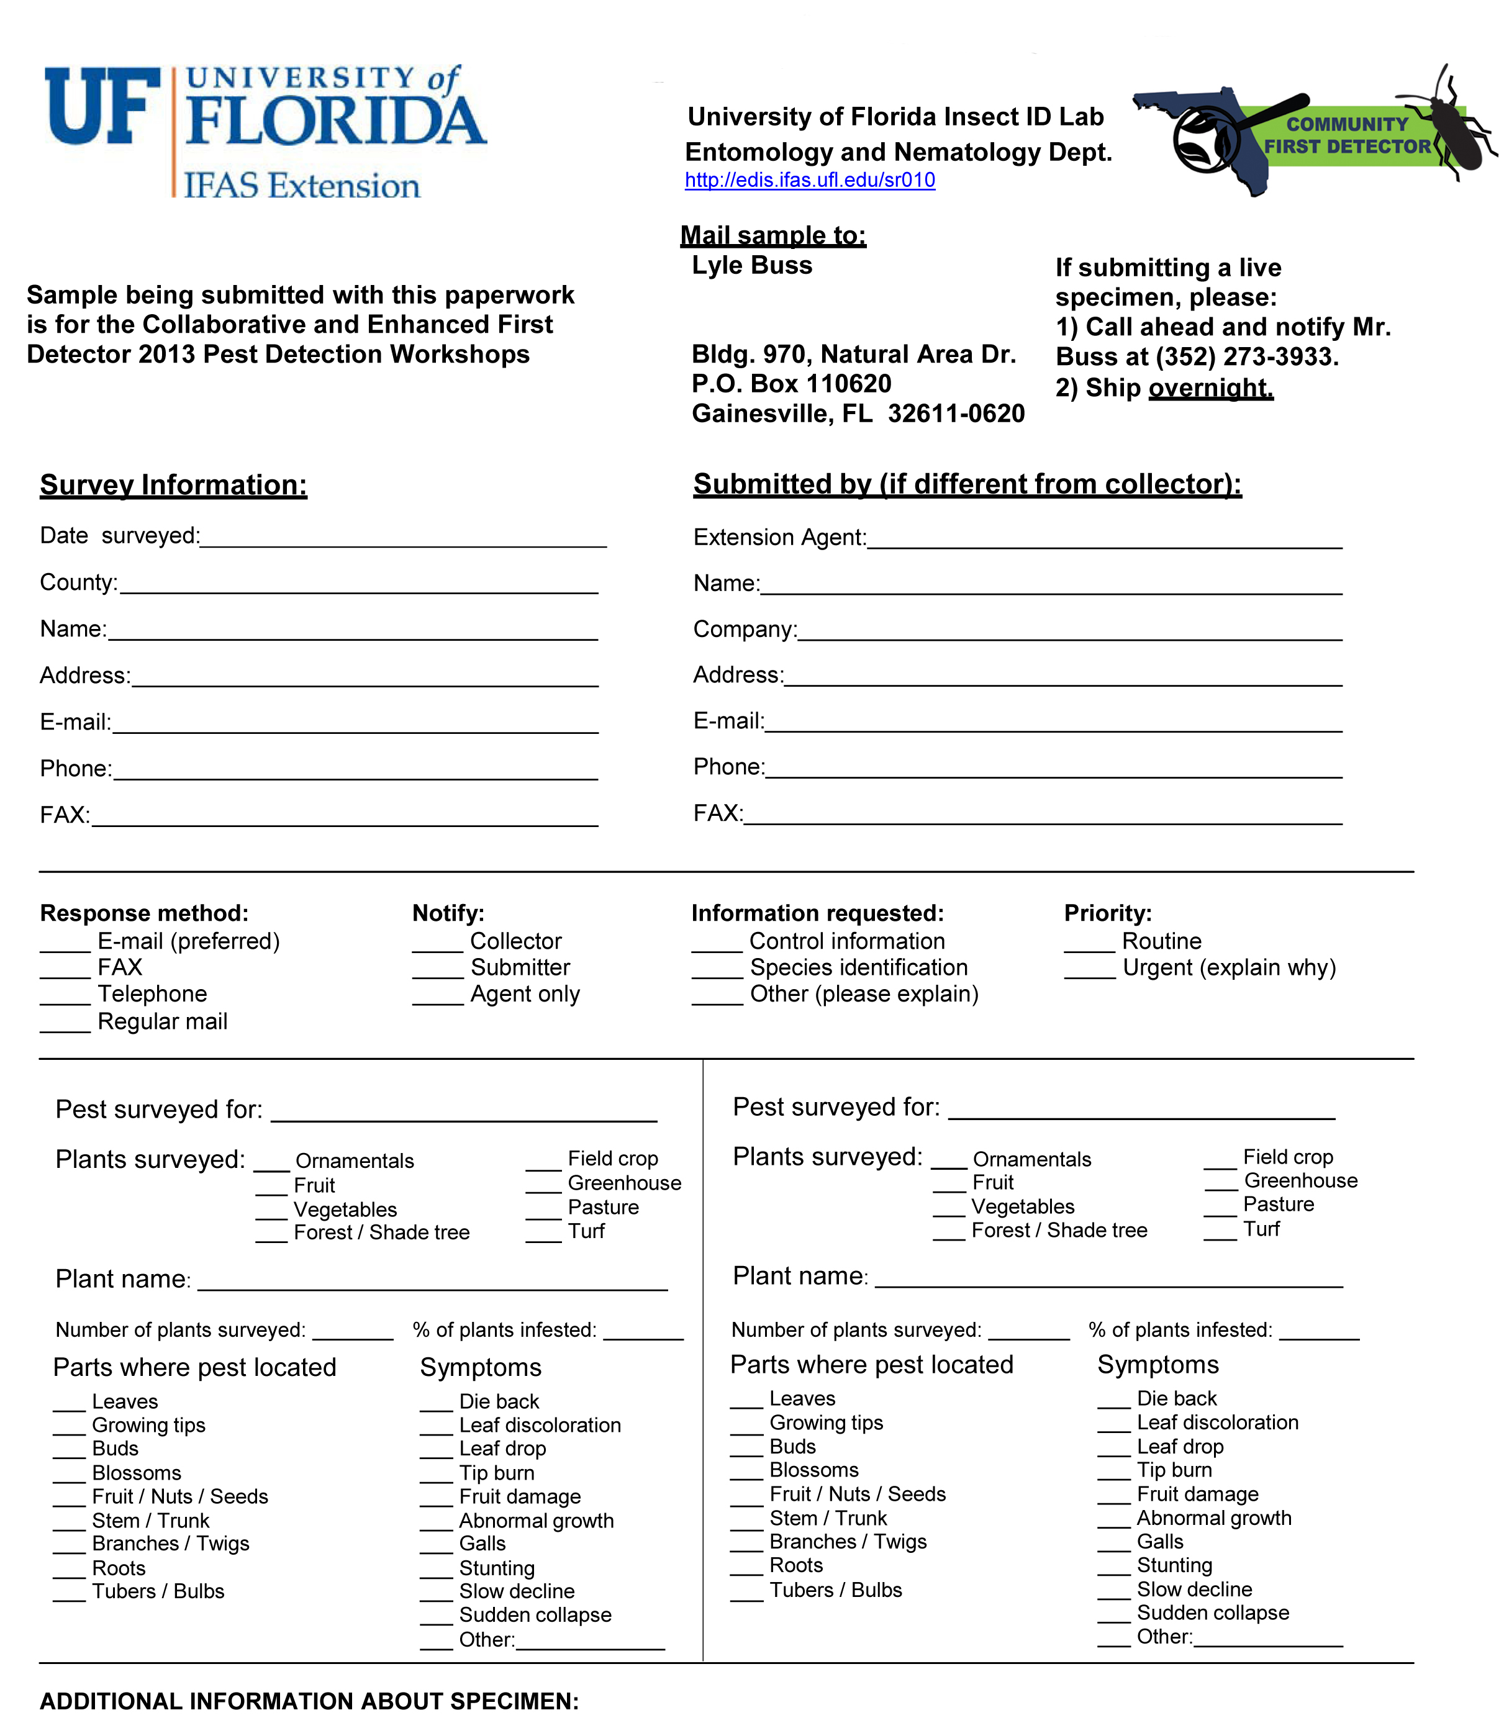
Notes:
This is the sample submission form. We need information on date, county, name of collector/person submitting sample, address, email, phone, and fax (if applicable). The above pest survey form is a modification of the UF/IFAS EDIS sample submission form for the UF Insect Identification Lab. Using the form found on the Florida First Detector website (www.flfirstdetector.org) means that there will be no charge for the sample and it makes it easier to track samples that were submitted as a direct result of these workshops.

Slide 11
Notes:
We will also need information on the pest that was surveyed (one that was covered during your particular workshop). Please note the pest, the plant name, the number of plants surveyed and the percentage of those plants that were infested with the suspect pest.

Slide 12
Notes:
Also note where the pest was located on the plant and what the damage was that you suspect was caused by the pest.

Slide 13
Notes:
If you surveyed the same plant for two different pests that was discussed in your workshop, please fill out this box as well. Again, note the pest, the plant name, the number of plants surveyed and the percentage of those plants that were infested with the suspect pest along with parts of the plant where the pest was found and damage you suspect was caused by the pest.

Slide 14
Bring symptomatic plant tissue or arthropod samples to your local county agent. Please use the sample submission form found at www.flfirstdetector.org.
All samples can then be submitted to:
Lyle Buss
University of Florida Insect ID Lab
970 Natural Area Dive
Gainesville, FL 32611
More information on the lab can be found at:
http://entnemdept.ufl.edu/insectid/index.html
Notes:
Participants should bring samples to their county agent first. The county agent sends it to the appropriate NPDN identifier (in Florida, this is Lyle Buss at UF). This point person will send the sample to the insect identifier or the plant disease clinic. In Florida, if Lyle cannot identify the specimen, he will consult with appropriate taxonomic specialists at Florida Department of Agriculture and Consumer Services, Division of Plant Industry. Plant disease samples will be taken to the UF/IFAS Plant Diagnostic Center.

Slide 15
Sample Submission Exception
Giant African Land Snail
1. Do not collect live suspect samples.
2. Call the FDACS-DPI Hotline-
888-397-1517
Notes:
The Giant African Land Snail is under eradication within the state of Florida. All suspect samples should be reported to the DPI hotline at 888-397-1517. More information is available at: http://www.freshfromflorida.com/pi/gals/
Remember that the UF-IFAS extension clinics are available to you whether or not you have completed a training. Your local county extension office can be found at: http://solutionsforyourlife.ufl.edu/map/index.html The UF Insect Identification Lab web page is available at: http://entnemdept.ifas.ufl.edu/InsectID/index.html
The UF-Plant Disease Clinic web address is available at: http://plantpath.ifas.ufl.edu/clinic/ . Sample processing fees may apply.
The University of Florida Distance Diagnostics and Identification System can be useful for screening pests
http://ddis.ifas.ufl.edu/

Slide 16
Author
Stephanie Stocks, M.S.
Assistant-In, Extension Scientist, Department of Entomology and Nematology, University of Florida

Slide 17
Editors
Amanda Hodges, Ph.D.
Associate Extension Scientist, Department of Entomology and Nematology, University of Florida
Matthew D. Smith, Ph.D.
Postdoctoral Associate, Department of Entomology and Nematology, University of Florida
Keumchul Shin, M.S.
Graduate student, Doctor of Plant medicine program, University of Florid

Slide 18
Reviewers
Andrew Derksen, M.S.
Pest Survey Scientist, Florida Department of Agriculture and Consumer Services, Division of Plant Industry
Jennifer Hamel, Ph.D.
Postdoctoral Associate, Department of Entomology and Nematology, University of Florida
Smriti Bhotika, Ph.D.
Postdoctoral Associate, Department of Entomology and Nematology, University of Florida

Slide 19
Collaborating Agencies
U.S. Department of Agriculture Animal and Plant Health Inspection Service (USDA-APHIS)
Cooperative Agricultural Pest Survey Program (CAPS)
Florida Department of Agriculture and Consumer Services (FDACS)
National Plant Diagnostic Network (NPDN)
Sentinel Plant Network (SPN)
Protect U.S.
University of Florida Institute of Food and Agricultural Sciences (UF-IFAS)

Slide 20
Educational Disclaimer and Citation
This presentation can be used for educational purposes for NON-PROFIT workshops, trainings, etc.
Citation:
  Stocks, S., M.S, 2014. Collaborative and Enhanced First Detector Training: Sample Submission, June 2014.

