Slide 1
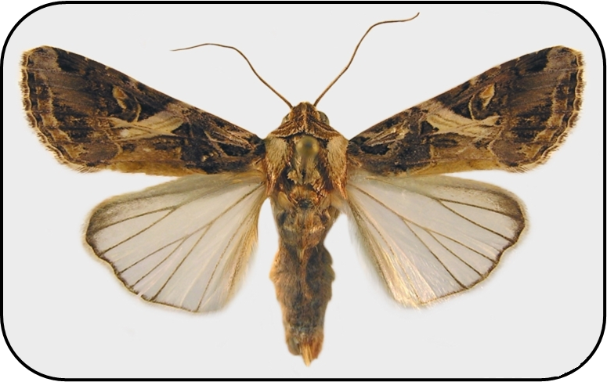
The rice-cotton cutworm Spodoptera litura
Photo: Natasha Wright, Florida Department of Agriculture and Consumer Services, Bugwood.org, #5190079

Slide 2
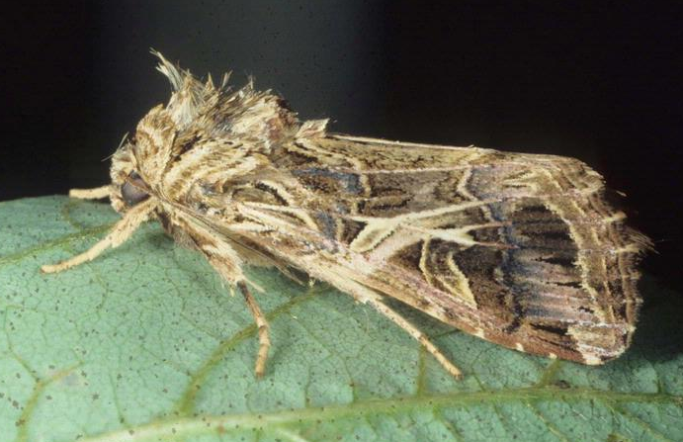
The rice-cotton cutworm
Generalist plant-feeding moth.
Not yet established in the U.S.
Potentially high economic impact.
Also known as: tobacco cutworm, cotton leafworm, cluster caterpillar, oriental leafworm moth and tropical armyworm
Photo: M. Shepard, G. R.Carner, and P.A.C. Ooi, Insects & their Natural Enemies Associated with Vegetables & Soybean in Southeast Asia, Bugwood.org, #5368051
Notes:
The rice-cotton cutworm (Spodoptera litura) is a polyphagous pest of over 100 different host plants.
It has not established in the U.S. (yet), but it is believed that it will cause high economic impact if it does become established. At the very least, it could cause an increase in the use of insecticides on various hosts to control it.
It is also known as cluster caterpillar, common cutworm, cotton leafworm, tobacco cutworm, tobacco caterpillar, oriental leafworm moth, rice cutworm, and tropical armyworm. These common names derive from the different geographical regions in which this pest is found and the host plants on which they are found.
Information sources:
Ellis, S. E. 2004. New Pest Response Guidelines: Spodoptera. USDA/APHIS/PPQ/PDMP. Accessed on 02/27/2014
http://www.phytosanitary.info/sites/phytosanitary.info/files/New_Pest_Response_Guidelines_Spodoptera.pdf
Venette, R. C., Davis, E. E., Zaspel, J., Heisler, Holly, and Larson, M. 2003. Mini risk assessment: rice cutworm, Spodoptera litura Fabricius [Lepidoptera: Noctuidae]. Accessed on: 2/27/2014
http://www.aphis.usda.gov/plant_health/plant_pest_info/pest_detection/downloads/pra/sliturapra.pdf
Weeks, J.A., Hodges, A.C., and N.C. Leppla. 2012. Citrus Pests: Cotton cutworm. Accessed on 02/27/2014
http://idtools.org/id/citrus/pests/factsheet.php?name=Cotton+cutworm

Slide 3
Hosts include:
Citrus
Soybeans
Potatoes
Sweet potatoes
Cauliflower
Strawberry
Sugarcane
Peanuts
Crucifers
Onions
Sugarbeets
Cotton
Apple
Rice
Roses
Tomato
Notes:
This pest is a generalist on over 100 hosts. It can attack all citrus and their hybrids (Citrus spp.) and all crucifers (Brassica spp.).
The host list includes (but is not limited to):
Abelmoschus esculentus (okra)
Allium cepa (onion)
Begonia spp.
Beta vulgaris var. saccharifera (sugarbeet)
Cicer arietinum (chickpea)
Coffea sp. (coffee)
Coriandrum sativum (coriander)
Fabaceae (leguminous plants)
Fragaria ananassa (strawberry)
Glycine max (soybean)
Gossypium spp. (cotton)
Helianthus annuus (sunflower)
Hevea brasiliensis (rubber)
Ipomoea batatas (sweet potato)
Lathyrus odoratus (sweet pea)
Malus domestica (apple)
Manihot esculenta (cassava)
Musa sp. (banana)
Nicotiana tabacum (tobacco)
Oryza sativa (rice)
Phaseolus spp. (beans)
Ricinus communis (castor bean)
Rosa sp. (roses)
Solanum lycopersicum (tomato)
Solanum melongena (aubergine)
Solanum tuberosum (potato)
Sorghum bicolor (sorghum)
Zea mays (maize)
Zinnia elegans (zinnia)
More information on host range could be accessed through following links:
http://www.cabi.org/isc/datasheet/44520 and
http://www.aphis.usda.gov/plant_health/plant_pest_info/pest_detection/downloads/pra/sliturapra.pdf
Information sources:
Ellis, S. E. 2004. New Pest Response Guidelines: Spodoptera. USDA/APHIS/PPQ/PDMP.
http://www.phytosanitary.info/sites/phytosanitary.info/files/New_Pest_Response_Guidelines_Spodoptera.pdf
Weeks, J.A., Hodges, A.C., and N.C. Leppla. 2012. Citrus Pests: Cotton cutworm. Accessed on 02/27/2014
http://idtools.org/id/citrus/pests/factsheet.php?name=Cotton+cutworm

Slide 4
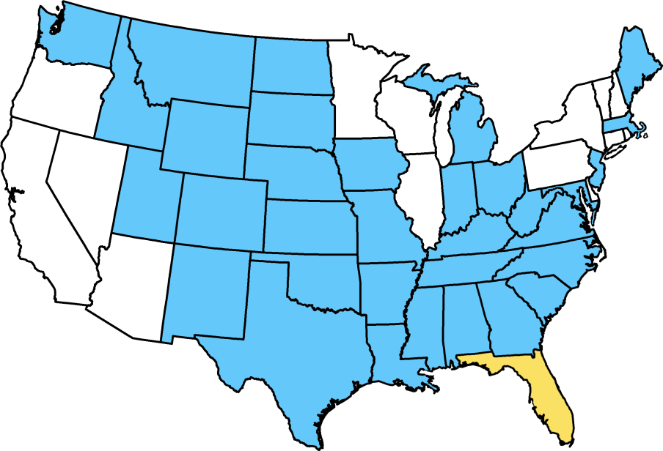
Distribution
No sampling
Intercepted or detected, but not considered established
Map courtesy of Pest Tracker, National Agricultural Pest Information System (NAPIS)
Notes:
This pest is native to Asia and found in Afghanistan, Bangladesh, Brunei, Cambodia, China, Christmas Island, Hong Kong, Indonesia, India, Iran, Japan, Korea Democratic People's Republic (North Korea), Korea Republic (South Korea), Lao, Maldives, Malaysia, Myanmar, Nepal, Oman, Pakistan, Philippines, Singapore, Sri Lanka, Taiwan, Thailand, and Viet Nam.
In the Pacific islands, it is found in American Samoa, Australia, Cocos Islands, Cook Islands, Fiji, French Polynesia, Guam, Kiribati, Marshall Islands, New Caledonia, Niue, Norfolk Island, Northern Mariana Islands, Micronesia, Palau, Papua New Guinea, Samoa, Solomon Islands, Tonga, Tuvalu, Vanuatu, and Wallis and Futuna Islands.
It has also been reported from Russia, Africa (most probably this is Reunion Island as mainland Africa has Spodoptera littoralis), and Hawaii.
It was detected in Florida in 2007 and again in 2014 but when subsequent surveying was carried out around the positive sites, no additional specimens were found.
This pest has been intercepted frequently by quarantine. Between 1985 and 2003, it was intercepted 1,759 times on fruits, vegetables, ornamentals, and other plant material from almost 230 plant taxa. Most of these interceptions were from permitted cargo (live plants and plant products imported into or passing through the U.S. with approved Plant Protection and Quarantine permits).
Information Sources:
Personal Communication with Leroy Whilby, CAPS/FDACS.
NAPIS Pest Tracker – Spodoptera litura.
Accessed 5/1/2014-
http://pest.ceris.purdue.edu/map.php?code=ITBCFMA#
Venette, R.C., E.E. Davis, J. Zaspel, H. Heisler, and M. Larson. 2003. Mini Risk Assessment: Rice cutworm, Spodoptera litura Fabricius (Lepidoptera: Noctuidae). Accessed on 02/27/2014. http://www.aphis.usda.gov/plant_health/plant_pest_info/pest_detection/downloads/pra/sliturapra.pdf

Slide 5
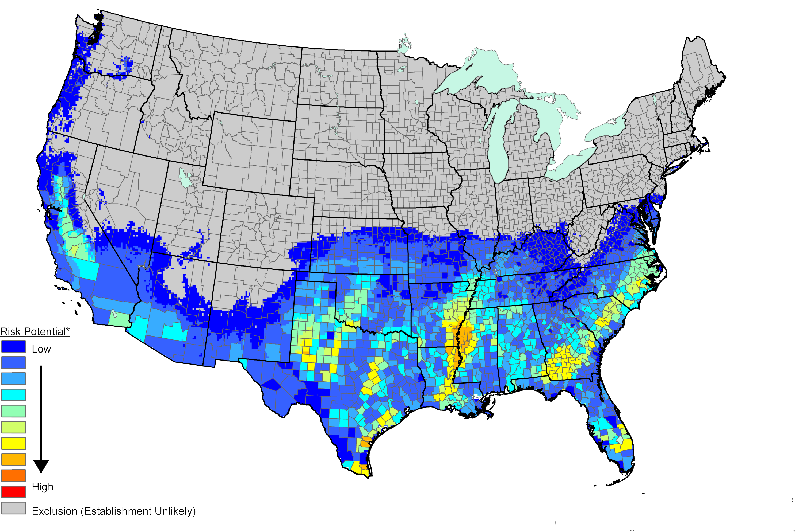
Risk of Establishment
Notes:
Based on the risk map above which includes climate suitability and host availability, this pest could become established in approximately 48% of the U.S.
Florida, Texas, Louisiana, Arkansas, Alabama, Georgia, and South Carolina might be some of the most affected states if this happens.
The eggs and larvae could be present in plant materials and get dispersed through international trade. However, the risk of natural dispersal of this pest is low since the eggs are attached to the lower part of the plants and the larvae hide in soil when they are not feeding. The moths can also fly quite a distance overnight (1.5 km in 4 hours) and wind can further assist their dispersal.
The majority of interceptions are attributed to permit cargo (62%), general cargo (22%) and international airline passengers (16%). General cargo are classified as luggage and inanimate (non-living) imports. Sometimes international airline passengers carry plant products either intentionally or accidentally into the U.S. through their luggage and carry-ons.
Information Sources:
EPPO. Spodoptera littoralis and Spodoptera litura. Data Sheets and Quarantine Pests. Accessed 4/11/2014.
http://www.eppo.int/QUARANTINE/insects/Spodoptera_litura/PRODLI_ds.pdf
Venette, R.C., E.E. Davis, J. Zaspel, H. Heisler, and M. Larson. 2003. Mini Risk Assessment: Rice cutworm, Spodoptera litura Fabricius (Lepidoptera: Noctuidae). Accessed on 02/27/2014. http://www.aphis.usda.gov/plant_health/plant_pest_info/pest_detection/downloads/pra/sliturapra.pdf

Slide 6
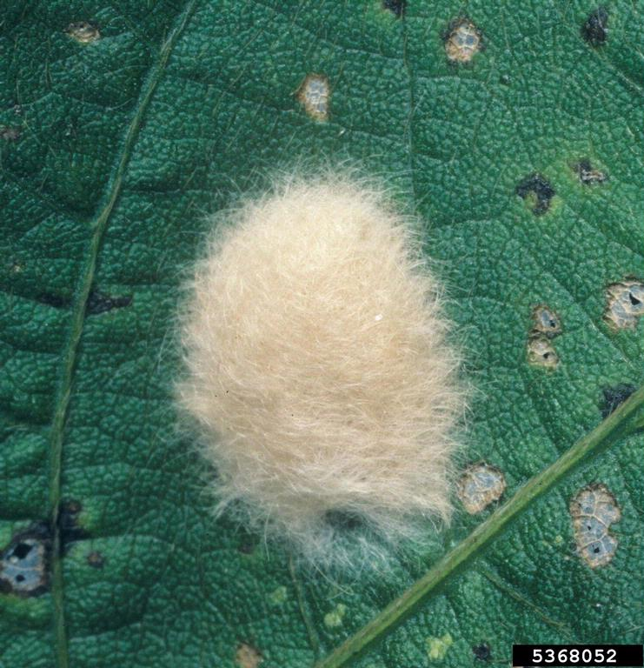
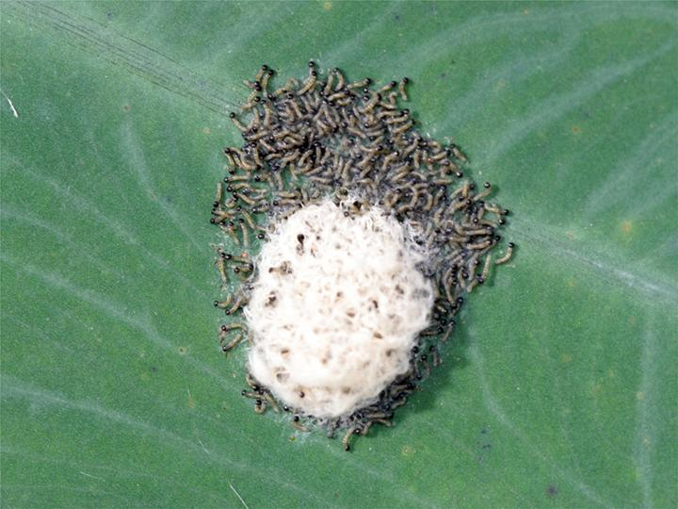
Eggs
Egg mass
Egg mass with early instars emerging
Image Credit: left - Brent Rowell, University of Kentucky, Growers guide to Bt; right - Merle Shepard, Gerald R. Carner, P.A. C. Ooi, Insects and their Natural Enemies Associated with Vegetables and Soybean in Southeast Asia, bugwood.org # 5368052
Notes:
Egg masses are round, placed upright on a flat surface, have a small pore on the top, and are ribbed longitudinally. Scales from the abdomen of the female moths cover the eggs. Each egg mass is about 4 to 7 mm in diameter and orange-brown or pink in color. The batch itself can be made up of 200 to 300 eggs. Eggs are usually laid on the undersides of leaves.
Information sources:
Ellis, S. E. 2004. New Pest Response Guidelines: Spodoptera. USDA/APHIS/PPQ/PDMP. Accessed on 02/27/2014
http://www.phytosanitary.info/sites/phytosanitary.info/files/New_Pest_Response_Guidelines_Spodoptera.pdf
EPPO. Spodoptera littoralis and Spodoptera litura. Data Sheets and Quarantine Pests. Accessed 4/11/2014.
http://www.eppo.int/QUARANTINE/insects/Spodoptera_litura/PRODLI_ds.pdf
Weeks, J.A., Hodges, A.C., and N.C. Leppla. 2012. Citrus Pests: Cotton cutworm. Accessed on 02/27/2014
http://idtools.org/id/citrus/pests/factsheet.php?name=Cotton+cutworm

Slide 7
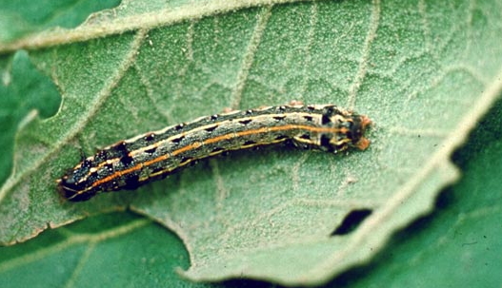
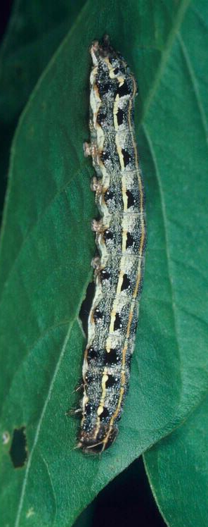
Identification: larvae
Fourth and fifth instar larvae
Photos: K. Kiritani, Bugwood.org, 1949066; Merle Shepard, Gerald R.Carner, and P.A.C Ooi, Insects and their Natural Enemies Associated with Vegetables and Soybean in Southeast Asia, Bugwood.org, #5368053
Notes:
In total there are six larval instars.
Newly emerged larvae are translucent green with a dark underside. Young larvae are smooth-skinned and translucent green, and dark underneath. The third instars have red and yellow longitudinal lines. Fourth and fifth instars have yellow longitudinal lines and black triangular spots on each side of the middle line on top. The last instars are darker brown larvae which have four yellow triangles on the mesothorax. Mature larvae reach 40 to 45mm in length.
It is important to note that many Spodoptera larvae, including our native ones, look similar to each other.
Information Sources:
EPPO. Spodoptera littoralis and Spodoptera litura. Data Sheets and Quarantine Pests. Accessed 4/11/2014.
http://www.eppo.int/QUARANTINE/insects/Spodoptera_litura/PRODLI_ds.pdf
Weeks, J.A., Hodges, A.C., and N.C. Leppla. 2012. Citrus Pests: Cotton cutworm. Accessed on 02/27/2014
http://idtools.org/id/citrus/pests/factsheet.php?name=Cotton+cutworm

Slide 8
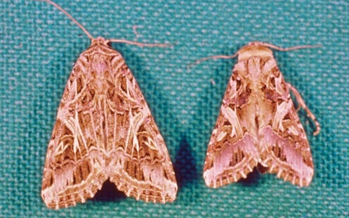
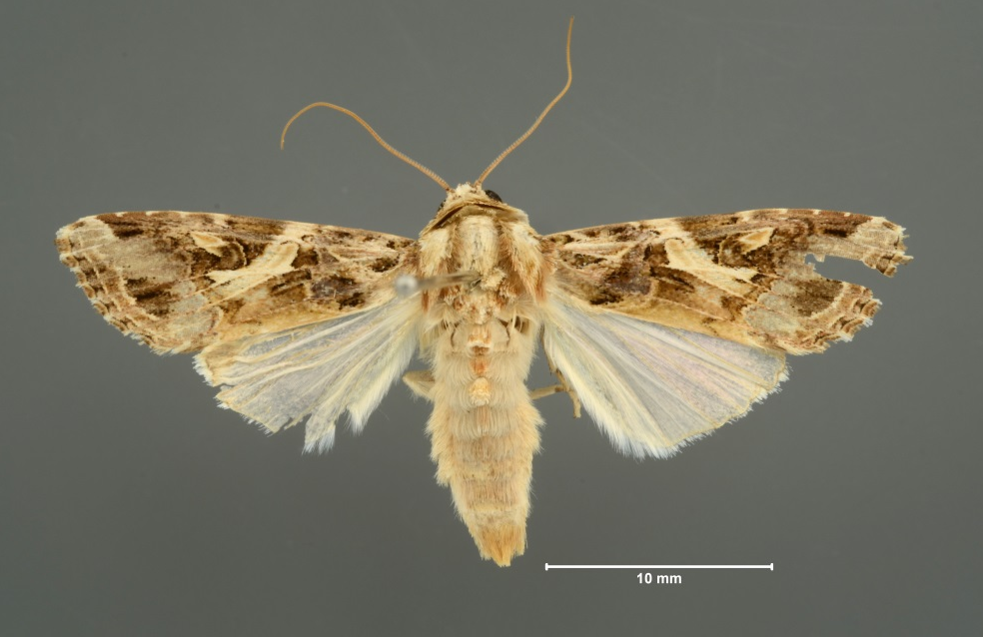
Identification: adults
female (left) and a male (right)
male
Note: Positive identification requires dissection of adult.
Photos: K. Kiritani, Bugwood.org, #1949067; Lyle Buss, Department of Entomology and Nematology, University of Florida
Notes:
Adults are grayish brown in color and 15 to 20 mm in length (from head to tip of the abdomen) with a wingspan of about 30 to 40 mm.
The forewings are grayish brown with cream colored complex markings and with paler lines along the veins. In males, bluish regions are present near the wing tips. The hind wings are cream colored and glossy, sometimes with brown margins and dark veins.
In some specimens, you can see a marking resembling a “4” on the forewings (yellow arrow) though this might not be seen in all specimens, especially if they are damaged. In some cases, the triangle inside the marking that looks like a “4” is filled in with brown coloring and does not look like a “4” anymore (red arrow).
Dissection of genitalia of the adults is required for proper identification to species.
Information sources:
Ellis, S. E. 2004. New Pest Response Guidelines: Spodoptera. USDA/APHIS/PPQ/PDMP.
http://www.phytosanitary.info/sites/phytosanitary.info/files/New_Pest_Response_Guidelines_Spodoptera.pdf
Weeks, J.A., Hodges, A.C., and N.C. Leppla. 2012. Citrus Pests: Cotton cutworm. Accessed on 02/27/2014
http://idtools.org/id/citrus/pests/factsheet.php?name=Cotton+cutworm

Slide 9

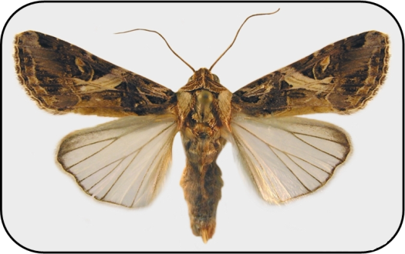

Life cycle
Eggs hatch in 4 to 12 days
After the mature larval stage, pupation takes place. This lasts about 6 to 7 days.
Adults can live for 8 to 10 days
Larvae pass through six instars in about 13 days
Image Credit: young larvae - Brent Rowell, University of Kentucky, Growers guide to Bt; egg mass - Merle Shepard, Gerald R. Carner, P.A. C. Ooi, Insects and their Natural Enemies Associated with Vegetables and Soybean in Southeast Asia, bugwood.org # 5368052 ; mature larva - K. Kiritani, Bugwood.org, 1949066; adult - Natasha Wright, Florida Department of Agriculture and Consumer Services, Bugwood.org, #5190079
Notes:
Eggs are laid two to three days after mating. Adults are active during night and live for about 8 to 10 days.
Females lay batches of up to 300 eggs at night on the underside of the host leaves and six to nine batches of eggs in her life time.
The eggs hatch in about 4 days in warm conditions and 12 days in cooler conditions. The number of eggs laid is adversely affected by higher temperature and lower humidity. For example, about 960 eggs were laid when the temperature was 30°C and 90% relative humidity (RH) and only 145 eggs were laid at 35°C and 30% RH.
Newly emerged larvae are susceptible to sun light. They stay on the lower leaf surface during the day and come out to feed at night. Larvae pass through six instars in about 13 days.
Pupation occurs in the soil inside an excavated cell (about 1 to 2 inches below the surface). The pupae develop in about 6 to 7 days.
Males can mate more than once. They can fly up to 3 miles per night in search of mates. They mate once each night and avoid the females that have already mated. Adults usually emerge between 11 pm and 3 am. Females do not mate for 24 hours after emergence.
The average life span from egg to adult is about 30 days.
Information Sources:
Ellis, S. E. 2004. New Pest Response Guidelines: Spodoptera. USDA/APHIS/PPQ/PDMP. Accessed on 02/27/2014
http://www.phytosanitary.info/sites/phytosanitary.info/files/New_Pest_Response_Guidelines_Spodoptera.pdf
EPPO. Spodoptera littoralis and Spodoptera litura. Data Sheets and Quarantine Pests. Accessed 4/11/2014.
http://www.eppo.int/QUARANTINE/insects/Spodoptera_litura/PRODLI_ds.pdf
Weeks, J.A., Hodges, A.C., and N.C. Leppla. 2012. Citrus Pests: Cotton cutworm. Accessed on 02/27/2014
http://idtools.org/id/citrus/pests/factsheet.php?name=Cotton+cutworm

Slide 10
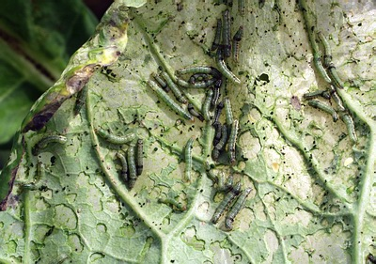
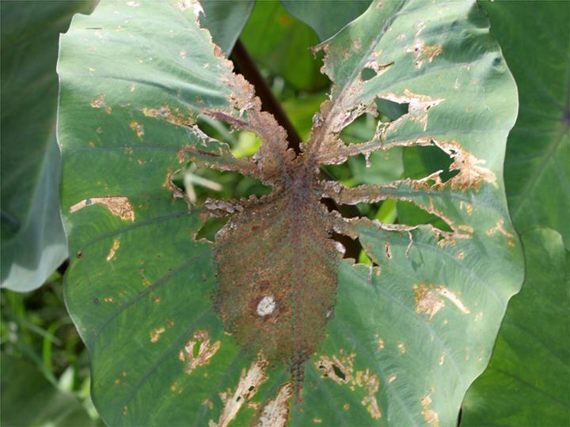
Damage
Larvae skeletonize leaves.
Older larvae eat entire leaves, flowers, and fruits.
Damage on crucifers
Damage to taro
Image Credit: Brent Rowell, University of Kentucky, Growers guide to Bt
Image Credit: Amy Carmichael, Queensland University of Technology, www.padil.gov.au
Notes:
This pest prefers to feed on young leaves. The young caterpillars feed on the leaves, leaving the veins but older instars eat the entire leaf.
The larvae also feed on growing points, flowers and fruits. They might sometime cut young plants at the soil line.
In India, the yield from the crops that were sprayed with pesticides against this pest yielded 42% more than the control group. In another study in India, it was found that 8 larvae per tobacco plant reduced yield by up to 50%.
Information sources:
Ellis, S. E. 2004. New Pest Response Guidelines: Spodoptera. USDA/APHIS/PPQ/PDMP.
http://www.phytosanitary.info/sites/phytosanitary.info/files/New_Pest_Response_Guidelines_Spodoptera.pdf
EPPO. Spodoptera littoralis and Spodoptera litura. Data Sheets and Quarantine Pests. Accessed 4/11/2014.
http://www.eppo.int/QUARANTINE/insects/Spodoptera_litura/PRODLI_ds.pdf
Schreiner, I. 2000. Cluster Caterpillar (Spotoptera litura [Fabricus]). Agricultural Pests of the Pacific. Accessed on 02/26/2014.
http://www.ctahr.hawaii.edu/adap/Publications/ADAP_pubs/2000-3.pdf

Slide 11
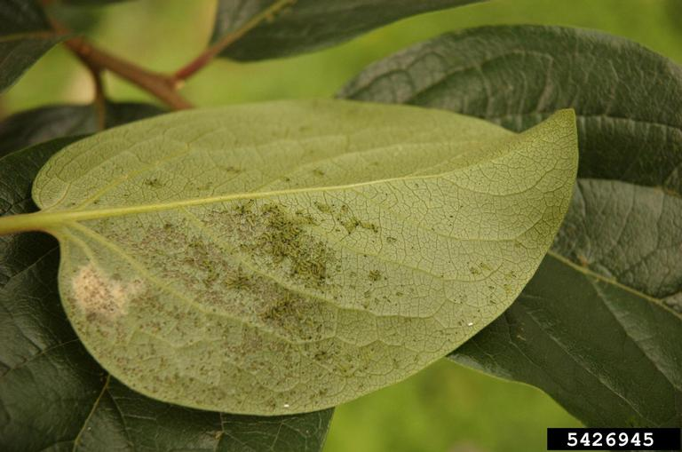
Monitoring
Visual inspection of plants
Especially fuzzy egg masses
Sweep-net sampling
Trapping
Pheromone and light
Soil survey
Early instar larvae on persimmon leaf
Photos: Yuan-Min Shen, Taichung District Agricultural Research and Extension Station, Bugwood.org;
Notes:
There are several methods that could be used for monitoring this pest.
1 - Visual inspections of plants: Since these larvae skeletonize leaves, it’s easy to see the damage. The host plants should be checked for the adults, larvae and especially the fuzzy egg masses on the underside of the leaves.
2 - Sweep-net sampling: This method is useful for collecting larvae. Sweeping at dawn and dusk can produce better results.
3 - Trapping: Sticky wing traps with pheromone lures work very well. Also, a mercury vapor bulb light with transparent trap works for these moths.
4 - Soil survey: If the eggs and larvae are found, a soil survey for pupae could be conducted within a 200 yard radius of the detection site. This requires taking soil samples and washing the samples through a sieve breaking up lumps to see if pupae can be detected.
Information Source:
Ellis, S. E. 2004. New Pest Response Guidelines: Spodoptera. USDA/APHIS/PPQ/PDMP. Accessed on 02/27/2014
http://www.phytosanitary.info/sites/phytosanitary.info/files/New_Pest_Response_Guidelines_Spodoptera.pdf

Slide 12
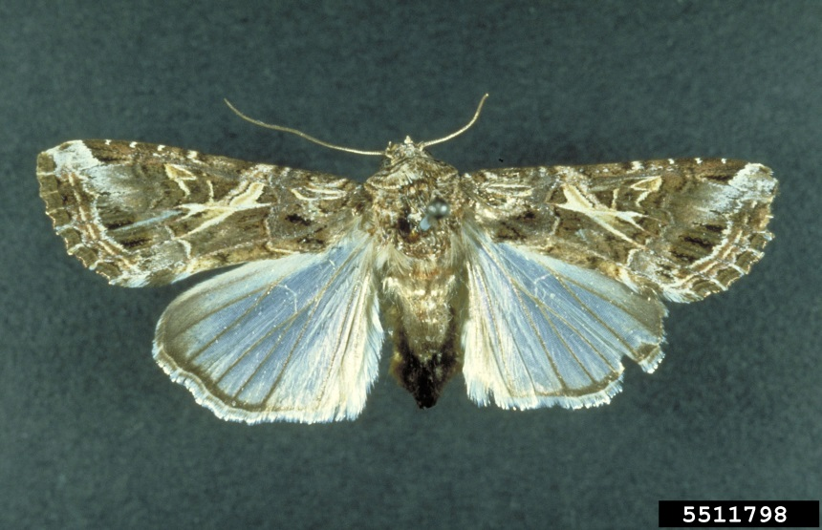
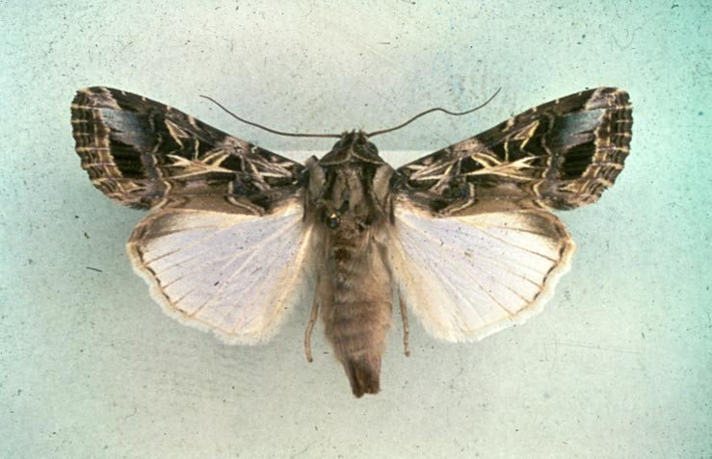
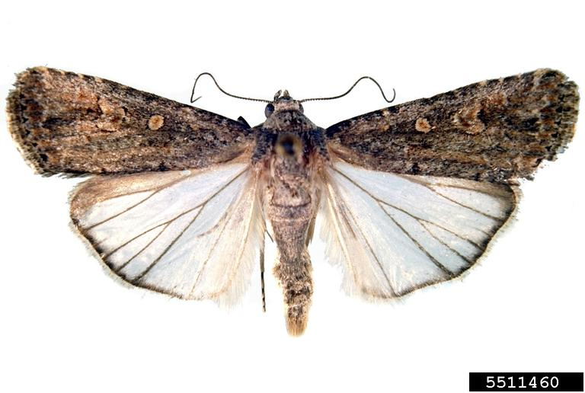
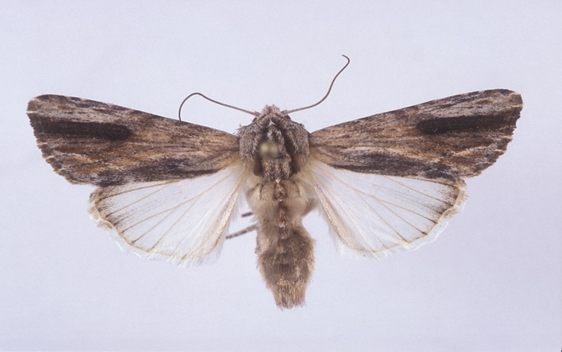
Look-alike Species - Adults
Yellowstriped armyworm
Rice-cotton cutworm
Beet armyworm
Southern armyworm
Image Credit: beet armyworm- Robert J. Bauernfeind, Kansas State University, Bugwood.org, # 5511460; southern armyworm- Lyle Buss, University of Florida; yellowstriped armyworm – John Capinera, University of Florida, Bugwood.org, #5511798; S. littoralis - O. Heikinheimo, Finland, Bugwood.org, #UGA0660006
Notes:
This pest could be confused with some other Spodoptera adult species like beet armyworm (S. exigua), southern armyworm (S. eridania), and yellowstriped armyworm (S. ornithogalli). S. exigua, S. ornithogalli, and S. eridania are all found in Florida.
S. exigua (the beet armyworm) has a wing span of 25 to 30 mm. It also has a light colored kidney bean shaped pattern in their forewings.
S. eridania (the southern armyworm) has a wing span of 33 to 38mm. It could also have a pronounced kidney bean shaped spot near the center of the forewings or have a broad black band that extends from the center of the wing to the margin.
S. ornithogalli (yellowstriped armyworm) has a wing span of 34 to 41mm. I also has a number “4” on the wings like S. littoralis as well as a similar pattern and coloration on the forewings.
To identify them correctly, however, dissection of the genitalia is required.
Information Sources:
CABI/EPPO. Spodoptera littoralis and Spodoptera litura. Data Sheets on Quarantine Pests. Prepared by CABI and EPPO for the EU. Accessed: 13th April, 2007.
Capinera, J. L. 1999. Spodoptera eridania (Stoll). Featured Creature Article. University of Florida. Assessed on 15 April, 2014.
http://entnemdept.ifas.ufl.edu/creatures/veg/leaf/southern_armyworm.htm
Capinera, J. L. 1999. Spodoptera exigua (Hubner). Featured Creature Article. University of Florida. Assessed on 15 April, 2014.
http://entnemdept.ifas.ufl.edu/creatures/veg/leaf/beet_armyworm.htm
Capinera, J. L. 1999. Spodoptera ornithogalli (Guenee). Featured Creature Article. University of Florida. Assessed on 6 June, 2014.
http://entnemdept.ifas.ufl.edu/creatures/veg/leaf/yellowstriped_armyworm.htm
Weeks, J.A., Hodges, A.C., and N.C. Leppla. 2012. Citrus Pests: Cotton cutworm. Accessed on 02/27/2014
http://idtools.org/id/citrus/pests/factsheet.php?name=Cotton+cutworm

Slide 13

Look Alike Species - Adults
Egyptian cotton leafworm
Rice-cotton cutworm
Image Credit: S. litura - Natasha Wright, FDASCS, Bugwood.org, #5190079; S. littoralis - O. Heikinheimo, Finland, Bugwood.org, #UGA0660006
Notes:
This pest could be confused with the Egyptian cotton leafworm (S. littoralis) which has not been found in the U.S.
S. litura somewhat resembles S. littoralis. The hind wings of S. litura are grayish white with gray margins often with dark veins whereas the hind wings of S. littoralis are without the dark veins.
To identify them correctly, however, dissection of the genitalia is required.
Information Sources:
CABI/EPPO. Spodoptera littoralis and Spodoptera litura. Data Sheets on Quarantine Pests. Prepared by CABI and EPPO for the EU. Accessed: 13th April, 2007.
EPPO. Spodoptera littoralis and Spodoptera litura. Data Sheets and Quarantine Pests. Accessed 4/11/2014.
http://www.eppo.int/QUARANTINE/insects/Spodoptera_litura/PRODLI_ds.pdf
Weeks, J.A., Hodges, A.C., and N.C. Leppla. 2012. Citrus Pests: Cotton cutworm. Accessed on 02/27/2014
http://idtools.org/id/citrus/pests/factsheet.php?name=Cotton+cutworm

Slide 14
Authors
Shweta Sharma, Ph.D.
Department of Entomology and Nematology, University of Florida

Slide 15
Editors
Stephanie Stocks, M.S.
Assistant-In, Extension Scientist, Department of Entomology and Nematology, University of Florida

Slide 16
Reviewers
Andrew Derksen, M.S.
Pest Survey Scientist (CAPS), Florida Department of Agriculture and Consumer Services, Division of Plant Industry
Leroy Whilby, DPM
State Survey Coordinator, Cooperative Agricultural Pest Survey Program
Julieta Brambila, M.S.
USDA, Animal and Plant Health Inspection Service, Plant Protection and Quarantine.
James E. Hayden, Ph.D.
Florida Department of Agriculture and Consumer Services, Division of Plant Industry.

Slide 17
Collaborating Agencies
U.S. Department of Agriculture Animal and Plant Health Inspection Service (USDA-APHIS)
Cooperative Agricultural Pest Survey Program (CAPS)
Florida Department of Agriculture and Consumer Services (FDACS)
National Plant Diagnostic Network (NPDN)
Sentinel Plant Network (SPN)
Protect U.S.
University of Florida Institute of Food and Agricultural Sciences (UF-IFAS)

Slide 18
Educational Disclaimer and Citation
This presentation can be used for educational purposes for NON-PROFIT workshops, trainings, etc.
Citation:
Sharma, S., Ph.D., 2014. The rice-cotton cutworm, Spodoptera litura, June 2014.

Slide 19
References
CABI/EPPO. Spodoptera littoralis and Spodoptera litura. Data Sheets on Quarantine Pests. Prepared by CABI and EPPO for the EU. Accessed: 13th April, 2007.
http://www.eppo.org/QUARANTINE/insects/Spodoptera_litura/PRODLI_ds.pdf
Capinera, J. L. 1999. Spodoptera eridania (Stoll). Featured Creature Article. University of Florida. Accessed on 15 April, 2014.
http://entnemdept.ifas.ufl.edu/creatures/veg/leaf/southern_armyworm.htm
Capinera, J. L. 1999. Spodoptera exigua (Hubner). Featured Creature Article. University of Florida. Accessed on 15 April, 2014.
http://entnemdept.ifas.ufl.edu/creatures/veg/leaf/beet_armyworm.htm
Capinera, J. L. 1999. Spodoptera ornithogalli (Guenee). Featured Creature Article. University of Florida. Assessed on 6 June, 2014.
http://entnemdept.ifas.ufl.edu/creatures/veg/leaf/yellowstriped_armyworm.htm
Ellis, S. E. 2004. New Pest Response Guidelines: Spodoptera. USDA/APHIS/PPQ/PDMP. Accessed on 02/27/2014
http://www.phytosanitary.info/sites/phytosanitary.info/files/New_Pest_Response_Guidelines_Spodoptera.pdf

Slide 20
References
EPPO. Data Sheets on Quarantine Pests - Spodoptera littoralis and Spodoptera litura . Accessed 6/8/2014 –
http://www.eppo.int/QUARANTINE/insects/Spodoptera_litura/PRODLI_ds.pdf?utm_source=www.eppo.org&utm_medium=int_redirect
NAPIS Pest Tracker – Spodoptera litura. Accessed 5/1/2014-
http://pest.ceris.purdue.edu/map.php?code=ITBCFMA#
Schreiner, I. 2000. Cluster Caterpillar (Spotoptera litura [Fabricus]). Agricultural Pests of the Pacific. Accessed on 02/26/2014.
http://www.ctahr.hawaii.edu/adap/Publications/ADAP_pubs/2000-3.pdf
Venette, R.C., E.E. Davis, J. Zaspel, H. Heisler, and M. Larson. 2003. Mini Risk Assessment: Rice cutworm, Spodoptera litura Fabricius (Lepidoptera: Noctuidae). Accessed on 02/27/2014.
http://www.aphis.usda.gov/plant_health/plant_pest_info/pest_detection/downloads/pra/sliturapra.pdf
Weeks, J.A., Hodges, A.C., and N.C. Leppla. 2012. Citrus Pests: Cotton cutworm. Accessed on 02/27/2014
http://idtools.org/id/citrus/pests/factsheet.php?name=Cotton+cutworm

