Slide 1
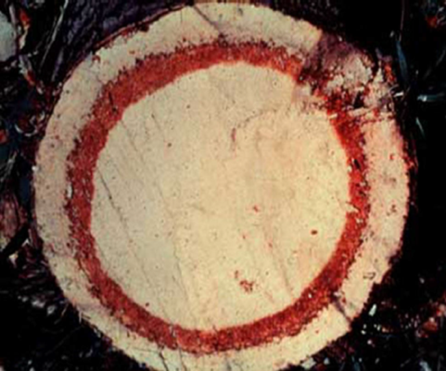
Red Ring Disease of Palms
Photos: Brammer and Crow 2001 (Credit: Society of Nematology slide collection)

Slide 2
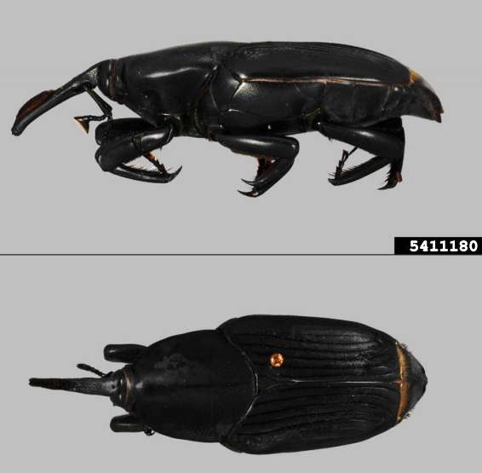
Red Ring Disease of Palms
Caused by red ring nematode
Bursaphelenchus cocophilus
First described on coconut palms in 1905
Vectored by South American palm weevil
Rynchophorus palmarum
Infects and damages mainly coconut and oil palms. May affect other members of Palmae family
Photos: (Top) Brammer and Crow 2001 (Credit: Society of Nematology slide collection), (Bottom) Jennifer C. Giron Duque, University of Puerto Rico, Bugwood.org, # 5411179 and 5411180
Notes:
Red ring disease of coconut palms is caused by the red ring nematode (Bursaphelenchus cocophilus), though this nematode may also be known as the coconut palm nematode.
This disease was first described on coconut palms in 1905 in Trinidad and the association between the disease and the nematode was reported in 1919.
The vector of the nematode is the South American palm weevil (Rhynchophorus palmarum), both adults and larvae.
The nematode parasitizes the weevil which then transmits the nematode as it moves from tree to tree. Though the weevil may visit many different tree species, the nematode only infects members of the Palmae family.
The nematode and South American palm weevil have not yet been observed in Florida.
Information Sources:
Brammer, A.S. and Crow, W.T. 2001. Red Ring Nematode, Bursaphelenchus cocophilus (Cobb) Baujard (Nematoda: Secernentea: Tylenchida: Aphelenchina: Aphelenchoidea: Bursaphelechina) formerly Rhadinaphelenchus cocophilus. University of Florida, IFAS Extension. EENY236.
Accessed 11-27-13
http://edis.ifas.ufl.edu/in392
Griffith, R. 1987. “Red Ring Disease of Coconut Palm”. The American Pathological Society Plant Disease, Volume 71, February, 193-196.
accessed 12/5/2013-
http://www.apsnet.org/publications/plantdisease/backissues/Documents/1987Articles/PlantDisease71n02_193.PDF
Griffith, R., R. M. Giblin-Davis, P. K. Koshy, and V. K. Sosamma. 2005. Nematode parasites of coconut and other palms. M. Luc, R. A. Sikora, and J. Bridges (eds.) In Plant Parasitic Nematodes in Subtropical and Tropical Agriculture. C.A.B. International, Oxon, UK. Pp. 493-527.

Slide 3
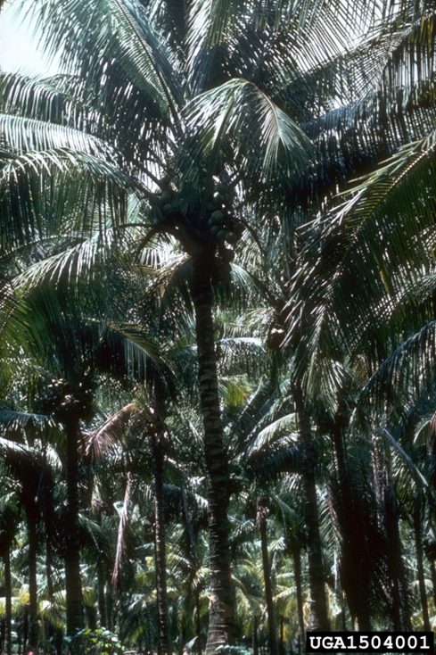
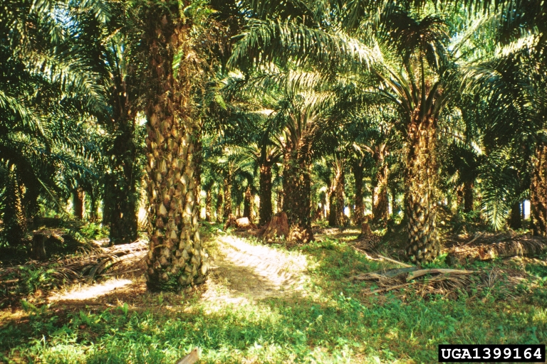
Hosts of the Nematode
Coconut palm (Cocos nucifera)
African oil palm (Elaeis guineensis)
Photos: (left) USDA Forest Service - Region 8 - Southern Archive, USDA Forest Service , Bugwood.org,#1504001 and (Right) Manfred Mielke, USDA Forest Service, bugwood.org, #1399164
Notes:
The host trees susceptible to the red ring nematode are usually found in the family Palmae.
The red ring nematode mainly affects coconut palm (Cocos nucifera) and African oil palm (Elaeis guineensis) which are economically important. Other hosts include Acrocomia intumescens, Cohune nut (Attalea cohune), Bactris gasipaes, Euterpe pacifica, Jessenia polycarpa, Mauritia mexicana, Oenocarpus distichus, Canary Island date (Phoenix canariensis), Cuban royal palm (Roystonea regia) and date palm (Phoenix dactylifera).
Under coercive conditions, the nematode can infect the following palm trees: cabbage palm (Roystonea oleracea), sabal palm (Sabal palmetto), gru-gru palm (Acrocomia aculeata), Ita palm (Mauritia flexuosa), cucurite palm (Maximiliana maripa) and cocorite palm (Mauritia caribea).
Information Sources:
Griffith, R., R. M. Giblin-Davis, P. K. Koshy, and V. K. Sosamma. 2005. Nematode parasites of coconut and other palms. M. Luc, R. A. Sikora, and J. Bridges (eds.) In Plant Parasitic Nematodes in Subtropical and Tropical Agriculture. C.A.B. International, Oxon, UK. Pp. 493-527.
Sullivan, M. 2013. CPHST Pest Datasheet for Bursaphelenchus cocophilus. USDA-APHIS-PPQ-CPHST.
Accessed 12-12-13
http://caps.ceris.purdue.edu/webfm_send/2137

Slide 4
Distribution of the Nematode
Located in the Neotropics
Mexico
Central and South America
Such as Belize, Costa Rica, El Salvador, Guatemala, Brazil, Colombia, and Ecuador
Some Caribbean countries
Grenada, St. Vincent and the Grenadines, and Trinidad and Tobago
Notes:
Red ring nematode is commonly found in areas of North America (Mexico), Central and Southern America, and many Caribbean countries.
Countries in Central America include Belize, Costa Rica, El Salvador, Guatemala, Honduras, Nicaragua and Panama. Countries in South America include Brazil, Colombia, Ecuador, French Guiana, Guyana, Peru, Suriname and Venezuela. Caribbean countries includes Grenada, St. Vincent and the Grenadines, and Trinidad and Tobago. The nematode has been also reported in Mexico in North America.
The red ring nematode has not yet been reported from the continental U.S., Hawaii, Puerto Rico or the Virgin Islands (as of December 2013).
Information Sources:
Brammer, A.S. and Crow, W.T. 2001. Red Ring Nematode, Bursaphelenchus cocophilus (Cobb) Baujard (Nematoda: Secernentea: Tylenchida: Aphelenchina: Aphelenchoidea: Bursaphelechina) formerly Rhadinaphelenchus cocophilus. University of Florida, IFAS Extension. EENY236.
Accessed 11-27-13
http://edis.ifas.ufl.edu/in392
NAPIS Pest Tracker. Bursaphelenchus cocophilus.
Accessed 12/19/2013-
http://pest.ceris.purdue.edu/map.php?code=NEABBBA
Sullivan, M. 2013. CPHST Pest Datasheet for Bursaphelenchus cocophilus. USDA-APHIS-PPQ-CPHST.
Accessed 12-12-13
http://caps.ceris.purdue.edu/webfm_send/2137

Slide 5
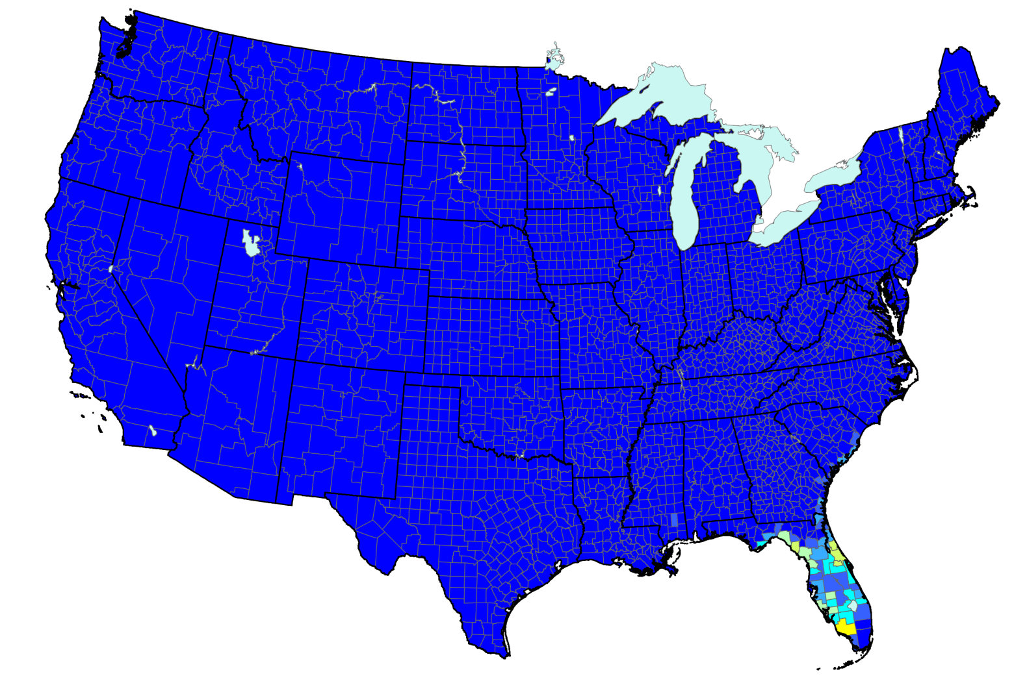
Risk Map for Red Ring Disease
Risk Potential
High
Low
Map courtesy of NAPPFAST.
Notes:
According to the map, Florida is the only state that has a moderate density of the host plants utilized by red ring nematode.
Information source:
NAPPFAST. 2014. “Bursaphelenchus cocophilus, Red Ring Nematode”.
accessed 3/6/2014-
http://www.nappfast.org/caps_pests/maps/2010%20Matrix%20Host%20Map%20PDFs/Bursaphelenchus%20cocophilus%20Host%20Map%20Final.pdf

Slide 6
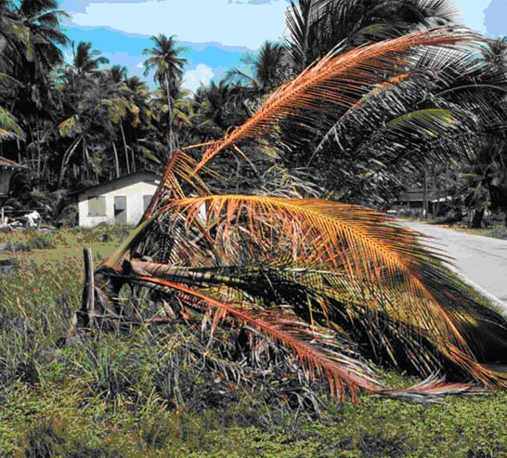
Symptoms of the Disease
Red circular band inside the stem (internal)
Yellow wilting (external)
Photos: (Left) Brammer and Crow 2001 (Credit: Society of Nematology slide collection) and (Right) Robin Giblin-Davis, University of Florida
Notes:
Coconut palms 3 to 10 years-old and African oil palms older than 5 years-old are usually killed within 2 to 4 months after the nematode infection.
The major internal symptom of the red ring disease is a circular band of discoloration on tissue found within roots, stems and petioles. These internal symptoms can be observed two or three weeks after the nematode infection. The telltale discolored ring is usually bright red so this disease is named from this typical symptom.
External symptoms are observed on leaves, showing wilting and turning yellow and brown from the tip of the leaflets to the base of the rachis. Usually, leaf symptoms begin at the oldest and lowest leaves which are close to the infection points and progress to the upper canopy. Several dying or dead leaves are often broken down or remain hanging from the stem. As the discoloration of leaves continues, host trees wilt and die. The external symptoms can be seen around two months after the nematode infection.
Information Sources:
Brammer, A.S. and Crow, W.T. 2001. Red Ring Nematode, Bursaphelenchus cocophilus (Cobb) Baujard (Nematoda: Secernentea: Tylenchida: Aphelenchina: Aphelenchoidea: Bursaphelechina) formerly Rhadinaphelenchus cocophilus. University of Florida, IFAS Extension. EENY236.
Accessed 11-27-13
http://edis.ifas.ufl.edu/in392
Giblin-Davis, R.M., Lehman, R.S., and Inserra, R.N. Bursaphelenchus cococphilus: Red Ring Disease of Coconut.
Accessed 11-27-13
http://nematode.unl.edu/pest1.htm
Griffith, R. 1987. “Red Ring Disease of Coconut Palm”. The American Pathological Society Plant Disease, Volume 71, February, 193-196.
accessed 12/5/2013-
http://www.apsnet.org/publications/plantdisease/backissues/Documents/1987Articles/PlantDisease71n02_193.PDF
Griffith, R., R. M. Giblin-Davis, P. K. Koshy, and V. K. Sosamma. 2005. Nematode parasites of coconut and other palms. M. Luc, R. A. Sikora, and J. Bridges (eds.) In Plant Parasitic Nematodes in Subtropical and Tropical Agriculture. C.A.B. International, Oxon, UK. Pp. 493-527.

Slide 7
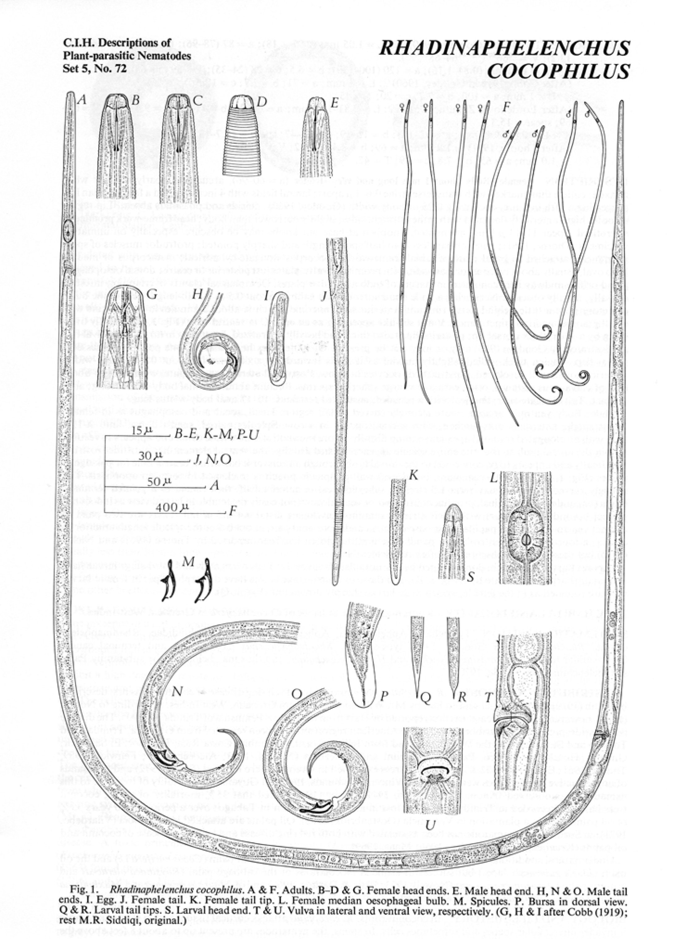
Identification of the Nematode
About 1mm in length
Too tiny to be recognized by naked eyes
Closely related to pine wood nematode
B. xylophilus
Image credit : Brathhwaite, C. W. D. and R. Siddiqi (1975). C. I. H. Descriptions of Plant-parasitic Nematodes Set 5, No. 72. Commonwealth Institute of Helminthology, St. Albans, Hearts, England
Notes:
The red ring nematode is about 1mm in length and too tiny to be recognized by the naked eye. Therefore, it is important to monitor palms for the typical symptoms in the fronds and occurrence of specimens of the weevil vector harboring the nematodes by trapping. Examination of trapped weevil specimens provides the best indication of the presence of the red ring nematode. The nematodes can be extracted from the infected host tissues or soil sample around roots and can be observed under microscopy. However, the extraction of the nematodes from palm host tissue samples is not always successful. The examination of the weevil vector is a more reliable procedure.
Red ring nematode is closely related to another plant parasitic nematode B. xylophilus which causes pine wilt disease. These nematodes both have a stylet, which is a protrusible needle-like feeding structure of the mouth. The stylet is used to pierce the host tissues.
Information Sources:
Brammer, A.S. and Crow, W.T. 2001. Red Ring Nematode, Bursaphelenchus cocophilus (Cobb) Baujard (Nematoda: Secernentea: Tylenchida: Aphelenchina: Aphelenchoidea: Bursaphelechina) formerly Rhadinaphelenchus cocophilus. University of Florida, IFAS Extension. EENY236.
Accessed 11-27-13
http://edis.ifas.ufl.edu/in392
Brathwaite, C. W. D. and M. R. Siddiqi. 1975. Rhadinaphelenchus cocophilus. C.I.H. Description of Plant Parasitic Nematodes, Set 5, No. 72.
Giblin-Davis, R.M., Lehman, R.S., and Inserra, R.N. Bursaphelenchus cococphilus: Red Ring Disease of Coconut.
Accessed 11-27-13
http://nematode.unl.edu/pest1.htm
Griffith, R., R. M. Giblin-Davis, P. K. Koshy, and V. K. Sosamma. 2005. Nematode parasites of coconut and other palms. M. Luc, R. A. Sikora, and J. Bridges (eds.) In Plant Parasitic Nematodes in Subtropical and Tropical Agriculture. C.A.B. International, Oxon, UK. Pp. 493-527.
Sullivan, M. 2013. CPHST Pest Datasheet for Bursaphelenchus cocophilus. USDA-APHIS-PPQ-CPHST.
Accessed 12-12-13
http://caps.ceris.purdue.edu/webfm_send/2137

Slide 8
Vector of the Nematode
Adult of Rhynchophorus palmarum
Photos: Jennifer C. Giron Duque, University of Puerto Rico, Bugwood.org, # 5411179 and 5411180
Notes:
The red ring nematode is vectored to its hosts by the South American palm weevil (Rhynchophorus palmarum). This weevil is also known as giant palm weevil, palm-marrow weevil and American palm weevil.
The eggs laid by this weevil are an elongated ovoid in form and their size is about 2.4 mm long and 0.87 mm wide.
The larva is white and legless with an orange to brown head capsule. At maturity, the larva measures about 5 inches long and 1 inch wide.
The pupal cocoon is tough and fibrous made from the host palm materials. It measures about 3 inches long and a little over an inch wide.
The adult South American palm weevil is deep black in color. Its body surface is also pitted and covered with short hairs. The size is about 1.5 inches in length and a little more than 0.5 inches wide. The males have a “mustache” or a comb of hair located on the rostrum (see red arrow).
Information Sources:
Molet, T. A. L. Roda, L. D. Jackson, and B. Salas. 2011. CPHST Pest Datasheet for Rhynchophorus palmarum. USDA-APHIS-PPQ-CPHST. accessed 11/27/2013
http://www.aphis.usda.gov/plant_health/plant_pest_info/palmweevil/downloads/Rhynchophoruspalmarum_v5.pdf

Slide 9
Distribution of the Vector
Located in the Neotropics
Caribbean
Such as Grenada, Guadeloupe, and Martinique
North America
It has been detected in California and Texas, though it is not established there
Central and South America
Such as Argentina, Bolivia, Brazil, Colombia, Belize, Costa Rica, and El Salvador
Notes:
R. palmarum has been found in North America (Mexico and United States), Caribbean and Central America (Belize, Costa Rica, Cuba, Dominica, El Salvador, Grenada, Guadeloupe, Guatemala, Honduras, Martinique, Nicaragua, Panama, Puerto Rico, St Vincent, and Trinidad and Tobago) and South America (Argentina, Bolivia, Brazil, Colombia, Ecuador, French Guiana, Guyana, Paraguay, Peru, Surinam, Uruguay, and Venezuela).
Most countries where the vector is found overlap with the nematode distribution except for the United States, where the weevil has been detected only in recent years.
The South American palm weevil have recently been found in California in 2011 and Texas in 2012 (though this pest is not established in either of these states).
Should there be an arrival of populations of the South American palm weevil harboring the red ring nematode in the U.S., several areas where host palms are grown could be at risk including Alabama, Arizona, California, Florida, Georgia, Hawaii, Louisiana, Massachusetts, Mississippi, North Carolina, South Carolina and Texas.
Information Sources:
Brammer, A.S. and Crow, W.T. 2001. Red Ring Nematode, Bursaphelenchus cocophilus (Cobb) Baujard (Nematoda: Secernentea: Tylenchida: Aphelenchina: Aphelenchoidea: Bursaphelechina) formerly Rhadinaphelenchus cocophilus. University of Florida, IFAS Extension. EENY236.
Accessed 11-27-13
http://edis.ifas.ufl.edu/in392
Institute for the study of invasive species. Bursaphelenchus cocophilus.
Accessed 11-27-13
http://www.tsusinvasives.org/database/red-ring_nema.html
Molet, T. A. L. Roda, L. D. Jackson, and B. Salas. 2011. CPHST Pest Datasheet for Rhynchophorus palmarum. USDA-APHIS-PPQ-CPHST. accessed 11/27/2013
http://www.aphis.usda.gov/plant_health/plant_pest_info/palmweevil/downloads/Rhynchophoruspalmarum_v5.pdf

Slide 10

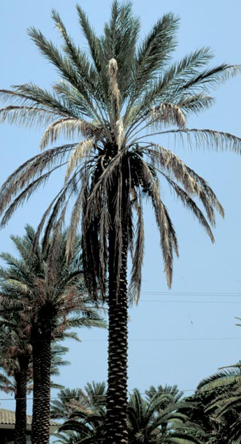
Hosts of the Vector and the Nematode
Coconut palm
African oil palm
Canary Island date palm
Date palm
Photos: left to right - USDA Forest Service - Region 8 - Southern Archive, USDA Forest Service , Bugwood.org, #1504001 and (Right) Manfred Mielke, USDA Forest Service, bugwood.org, #1399164; Joseph M. DiTomaso, University of California - Davis, bugwood.org, #5374214, and F.W. Howard, University of Florida, bugwood.org, #0725064
Notes:
35 plant species in 12 different families are reported as known hosts of the South American palm weevil.
The primary hosts include Cocos nucifera (coconut), Elaeis guineensis (African oil palm), Euterpe edulis (assai palm), Metroxylon sagu (sago palm), Phoenix canariensis (Canary Island date palm), Phoenix dactylifera (date palm), and Saccharum officinarum (sugarcane).
Secondary hosts include Ananas comosus (pineapple), Annona reticulata (custard apple), Artocarpus altilis (Fosberg breadfruit), Carica papaya (papaya), Citrus spp. (citrus), Mangifera indica (mango), Musa spp. (banana), Persea americana (avocado), Psidium guajava (guava), Theobroma cacao (cocoa).
Some host palms of this weevil including Cocos nucifera (coconut palm), Elaeis guineensis (African oil palm), Phoenix canariensis (Canary Island date palm) and Phoenix dactylifera (date palm) are also hosts of the red ring nematode.
Information Sources:
Molet, T. A. L. Roda, L. D. Jackson, and B. Salas. 2011. CPHST Pest Datasheet for Rhynchophorus palmarum. USDA-APHIS-PPQ-CPHST. accessed 11/27/2013
http://www.aphis.usda.gov/plant_health/plant_pest_info/palmweevil/downloads/Rhynchophoruspalmarum_v5.pdf

Slide 11
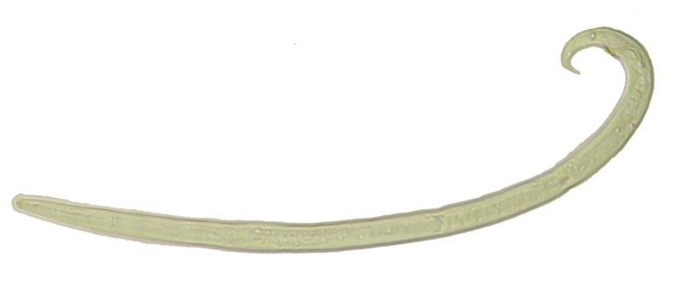
The Life Cycle of the Disease
Insect vector
Healthy palm
Diseased palm
Nematode
Photos: (Top left) Jennifer C. Giron Duque, University of Puerto Rico, Bugwood.org, #5411179; (top right) F.W. Howard, University of Florida, Bugwood.org, #0725064; (lower right); Pest and Diseases Image Library, bugwood.org, #5488453, (Bottom left) Robin Giblin-Davis, University of Florida
Notes:
Adult female palm weevils harboring red ring nematodes parasitize a healthy palm tree. During oviposition, they deposit the juveniles of the red ring nematode, which enter the host tissues through the oviposition wound. The red ring nematodes feed, develop and reproduce in the host tissues, inducing symptoms such as leaf discoloration (yellow and brown or bronze) and a brick to brownish-red ring that is 2 – 6 cm wide and occurs 2 – 6 cm from the stem periphery. The nematodes complete their life cycle in the host tissues within nine or ten days.
Immature red ring nematodes enter into the hatched weevil larvae infesting the host tree and they can persist in the insect even as the insect goes through metamorphosis. The adult weevils leave the host trees carrying the nematode juveniles which are ready to infect other healthy trees.
Information Sources:
Giblin-Davis, R. M. 1990. Red ring nematode and its vectors. Florida Department of Agriculture and Consumer Service, Division of Plant Industry, Nematology Circular No. 181.
Accessed 11-27-13
http://www.freshfromflorida.com/content/download/10970/142111/nem181.pdf
Griffith, R., R. M. Giblin-Davis, P. K. Koshy, and V. K. Sosamma. 2005. Nematode parasites of coconut and other palms. M. Luc, R. A. Sikora, and J. Bridges (eds.) In Plant Parasitic Nematodes in Subtropical and Tropical Agriculture. C.A.B. International, Oxon, UK. Pp. 493-527.

Slide 12
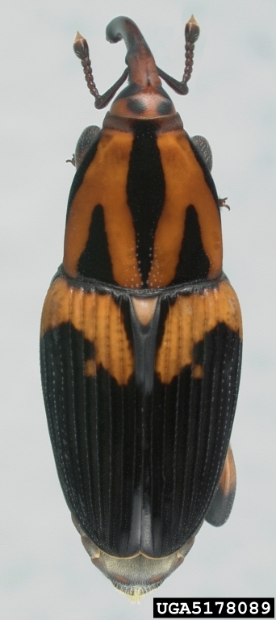
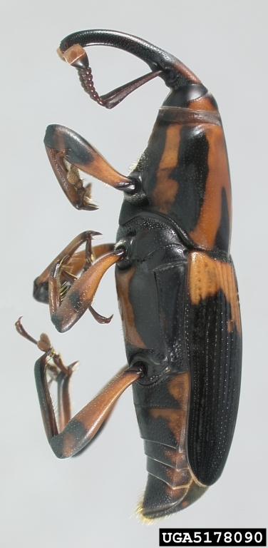
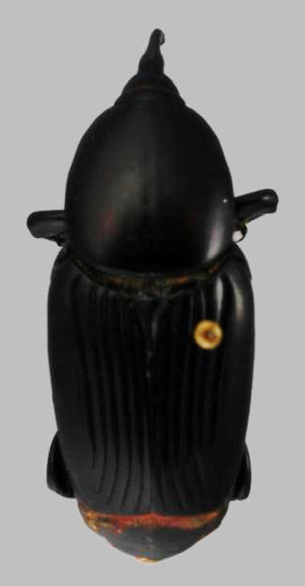
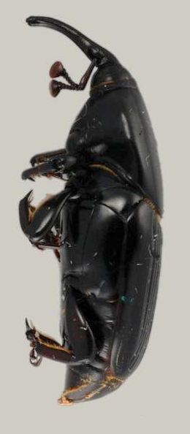
Additional Vectors of the Nematode
Silky cane weevil
(Metamasius hemipterus)
Palmetto weevil
(Rhynchophorus cruentatus)
Photos: left to right - Natasha Wright, Florida Department of Agriculture and Consumer Services, Bugwood.org, # 5178089 and 5178090; Jennifer C. Giron Duque, University of Puerto Rico, bugwood.org, #5411177 and 5411178
Notes:
Although the South American palm weevil is the major vector of the red ring nematode, other potential additional vectors are ants, spiders and other types of weevils.
Two other potential weevil vectors of red ring nematode include the silky cane weevil (Metamasius hemipterus ) and palmetto weevil (Rhynchophorus cruentatus) which are common in Florida.
The silky cane weevil (Metamasius hemipterus) is found throughout the Caribbean Islands and Central and South America. It is also found in Florida, where it is an economically important pest of sugarcane, palms and other tropical plants. Adults range is color from orange to black and has a highly variable pattern. The length of this pest is 9 to 14 mm. Their larvae resemble the South American palm weevil in that they are legless, have a white creamy body, and a hard brown head capsule.
The palmetto weevil (Rhynchophorus cruentatus) is the largest weevil in North America and is also found in Florida. It is considered a minor pest affecting only severely wounded and dying trees but it has been a pest of transplanted, stressed palms including Canary Island (Phoenix canariensis), Bismarck (Bismarckia nobilis ), and Latan (Latania spp.) palms. The adults pf the palmetto palm weevil also vary in color from solid black to almost entirely red. They range in size from 1.9 to 3.0 cm. Their larvae also resemble the South American palm weevil in that they are legless, have a white creamy body, and a hard brown head capsule.
Information Sources:
Brammer, A.S. and Crow, W.T. 2001. Red Ring Nematode, Bursaphelenchus cocophilus (Cobb) Baujard (Nematoda: Secernentea: Tylenchida: Aphelenchina: Aphelenchoidea: Bursaphelechina) formerly Rhadinaphelenchus cocophilus. University of Florida, IFAS Extension. EENY236.
Accessed 11-27-13
http://edis.ifas.ufl.edu/in392
Griffith, R., R. M. Giblin-Davis, P. K. Koshy, and V. K. Sosamma. 2005. Nematode parasites of coconut and other palms. M. Luc, R. A. Sikora, and J. Bridges (eds.) In Plant Parasitic Nematodes in Subtropical and Tropical Agriculture. C.A.B. International, Oxon, UK. Pp. 493-527.
Weissing, T.J. and Glblin-Davis, R.M. 1997. Palmetto weevil, Rhynchophorus cruentatus Fabricius (Insecta: Coleoptera: Curculionidae). University of Florida, IFAS Extension. EENY013.
Accessed 12-12-13
http://edis.ifas.ufl.edu/in139
Weissing, T.J. and Glblin-Davis, R.M. 1998. Silky Cane Weevil, Metamasius hemipterus sericeus (Olivier) (Insecta: Coleoptera: Curculionidae). University of Florida, IFAS Extension. EENY053.
Accessed 12-12-13
http://edis.ifas.ufl.edu/in210

Slide 13
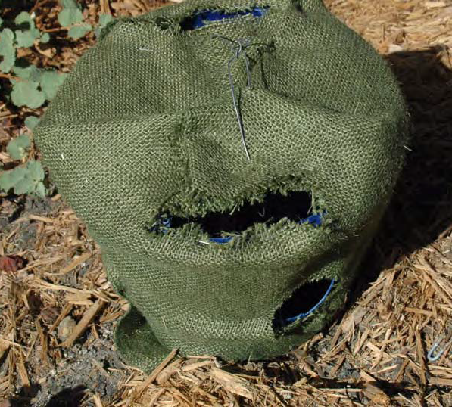
Monitoring and Management
Most effective method is phytosanitation
Enforcement of phytosanitary actions to prevent the import of palms infested with weevil vectors of the red ring nematode
Monitoring programs of the weevil vector (R. palmarum) of the red ring nematode using aggregation pheromone traps
Trap with lure for the insect vector
Photos: Amy Roda, USDA-APHIS
Notes:
Phytosanitation, pest exclusion and monitoring programs are the most appropriate approaches to prevent the arrival and establishment of red ring disease of palms in the U.S.
Monitoring programs include the use of aggregation pheromone traps, which attract the adult weevil vectors (R. palmarum) of the red ring nematodes. Blends of aggregation pheromones (named as methyl-branched secondary alcohols) are commercially available. If R. palmarum specimens are captured, they should be examined for presence of the red ring nematodes. Since the aggregation pheromones traps attract many weevil species, these weevils captured in the traps should be assorted and identified by specialists.
If R. palmarum weevils harboring the red ring nematodes are captured in the traps, susceptible host palms of red ring disease such as coconut palms, in the areas where the captures occurred, should be surveyed and monitored for red ring disease symptoms. If typical disease symptoms are detected, trees should be removed and destroyed.
Confirmation of the disease and the vector should be done by a specialist, so please contact your local county agent if you suspect you have a South American palm weevil infestation.
Information Sources:
Brammer, A.S. and Crow, W.T. 2001. Red Ring Nematode, Bursaphelenchus cocophilus (Cobb) Baujard (Nematoda: Secernentea: Tylenchida: Aphelenchina: Aphelenchoidea: Bursaphelechina) formerly Rhadinaphelenchus cocophilus. University of Florida, IFAS Extension. EENY236.
Accessed 11-27-13
http://edis.ifas.ufl.edu/in392
Giblin-Davis, R.M., Lehman, R.S., and Inserra, R.N. Bursaphelenchus cococphilus: Red Ring Disease of Coconut.
Accessed 11-27-13
http://nematode.unl.edu/pest1.htm
Griffith, R., R. M. Giblin-Davis, P. K. Koshy, and V. K. Sosamma. 2005. Nematode parasites of coconut and other palms. M. Luc, R. A. Sikora, and J. Bridges (eds.) In Plant Parasitic Nematodes in Subtropical and Tropical Agriculture. C.A.B. International, Oxon, UK. Pp. 493-527.
Molet, T. A. L. Roda, L. D. Jackson, and B. Salas. 2011. CPHST Pest Datasheet for Rhynchophorus palmarum. USDA-APHIS-PPQ-CPHST. accessed 11/27/2013
http://www.aphis.usda.gov/plant_health/plant_pest_info/palmweevil/downloads/Rhynchophoruspalmarum_v5.pdf

Slide 14
Authors
Nick Sekora
Scientist I, Syngenta Crop Protection, Pasteuria Bioscience Laboratory; Former Postdoctoral Research Associate, Entomology and Nematology, University of Florida
Keumchul Shin, M.S.
Graduate Research Assistant, Doctor of Plant Medicine Program, University of Florida

Slide 15
Editors
Stephanie Stocks, M.S.
Department of Entomology and Nematology, University of Florida

Slide 16
Reviewers
Robin Giblin-Davis, Ph.D.
Professor of Entomology and Nematology, Fort Lauderdale Research and Education Center
Renato Inserra, Ph.D.
Regulatory Nematologist, Florida Department of Agriculture and Consumer Services
Tesfamariam Mekete Mengistu, Ph.D.
Research Extension Scientist, Department of Entomology and Nematology, University of Florida
Billy Crow, Ph.D.
Landscape Nematologist, Department of Entomology and Nematology, University of Florida

Slide 17
Collaborating Agencies
U.S. Department of Agriculture Animal and Plant Health Inspection Service (USDA-APHIS)
Cooperative Agricultural Pest Survey Program (CAPS)
Florida Department of Agriculture and Consumer Services (FDACS)
National Plant Diagnostic Network (NPDN)
Sentinel Plant Network (SPN)
Protect U.S.
University of Florida Institute of Food and Agricultural Sciences (UF-IFAS)

Slide 18
Educational Disclaimer and Citation
This presentation can be used for educational purposes for NON-PROFIT workshops, trainings, etc.
Citation:
Sekora, N., Shin, K., M.S., 2014. Red Ring Disease of Palms, June 2014.

Slide 19
References
Brammer, A.S. and Crow, W.T. 2001. Red Ring Nematode, Bursaphelenchus cocophilus (Cobb) Baujard (Nematoda: Secernentea: Tylenchida: Aphelenchina: Aphelenchoidea: Bursaphelechina) formerly Rhadinaphelenchus cocophilus. University of Florida, IFAS Extension. EENY236. Accessed 11-27-13
http://edis.ifas.ufl.edu/in392
Giblin-Davis, R. M. 1990. Red ring nematode and its vectors. Florida Department of Agriculture and Consumer Service, Division of Plant Industry, Nematology Circular No. 181. Accessed 11-27-13
http://www.freshfromflorida.com/content/download/10970/142111/nem181.pdf
Giblin-Davis, R.M., Lehman, R.S., and Inserra, R.N. Bursaphelenchus cococphilus: Red Ring Disease of Coconut. Accessed 11-27-13
http://nematode.unl.edu/pest1.htm
Griffith, R. 1987, Red ring disease of coconut palm. Plant Dis. 71: 193-196.
Griffith, R.; Giblin-Davis, R. M.; Koshy, P. K.; Sosamma, V. K. 2005. Nematode parasites of coconut and other palms. In Plant parasitic nematodes in subtropical and tropical agriculture. C.A.B. International, Oxon, UK. Pp. 493-527.

Slide 20
References
Institute for the study of invasive species. Bursaphelenchus cocophilus. Accessed 11-27-13
http://www.tsusinvasives.org/database/red-ring_nema.html
Molet, T. A. L. Roda, L. D. Jackson, and B. Salas. 2011. CPHST Pest Datasheet for Rhynchophorus palmarum. USDA-APHIS-PPQ-CPHST. accessed 11/27/2013
http://www.aphis.usda.gov/plant_health/plant_pest_info/palmweevil/downloads/Rhynchophoruspalmarum_v5.pdf
NAPIS Pest Tracker. Bursaphelenchus cocophilus. Accessed 12/19/2013-
http://pest.ceris.purdue.edu/map.php?code=NEABBBA
NAPPFAST. 2014. “Bursaphelenchus cocophilus, Red Ring Nematode”. accessed 3/6/2014-
http://www.nappfast.org/caps_pests/maps/2010%20Matrix%20Host%20Map%20PDFs/Bursaphelenchus%20cocophilus%20Host%20Map%20Final.pdf
Sullivan, M. 2013. CPHST Pest Datasheet for Bursaphelenchus cocophilus. USDA-APHIS-PPQ-CPHST. Accessed 12-12-13
http://caps.ceris.purdue.edu/webfm_send/2137

Slide 21
References
Weissing, T.J. and Glblin-Davis, R.M. 1997. Palmetto weevil, Rhynchophorus cruentatus Fabricius (Insecta: Coleoptera: Curculionidae). University of Florida, IFAS Extension. EENY013. Accessed 12-12-13
http://edis.ifas.ufl.edu/in139
Weissing, T.J. and Glblin-Davis, R.M. 1998. Silky Cane Weevil, Metamasius hemipterus sericeus (Olivier) (Insecta: Coleoptera: Curculionidae). University of Florida, IFAS Extension. EENY053. Accessed 12-12-13
http://edis.ifas.ufl.edu/in210

