Slide 1
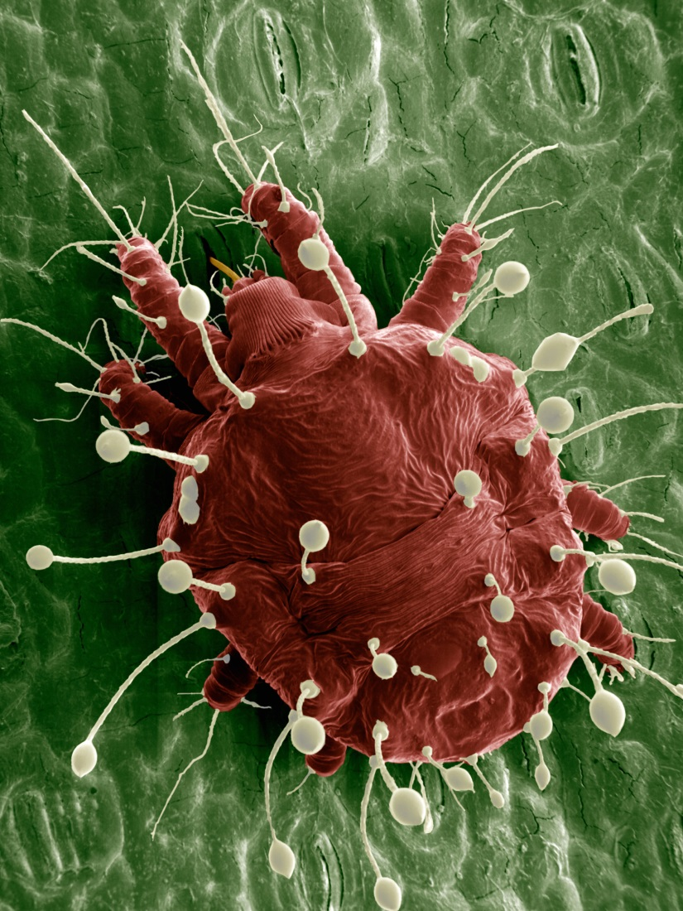
Plant-feeding mite pests
SEM of adult red palm mite, Raoiella indica
Photo credit:
Gary R. Bauchan, USDA-ARS Electron & Confocal Microscopy Unit
Notes:
In this presentation we will discuss the basics of mite biology and anatomy and learn some of the ways mites can damage plants or be beneficial as predators or fungus feeders. We will also introduce you to the citrus Hindu mite, the citrus brown mite, and the red palm mite. The citrus Hindu mite and citrus brown mite are not known to occur in the U.S. whereas the red palm mite is found in South Florida currently. All three are exotic plant feeding mites of economic importance.
This presentation will provide you with introductory information about plant-feeding mite pests with an introduction to three mites of economic concern. It is not intended to be a comprehensive review.

Slide 2
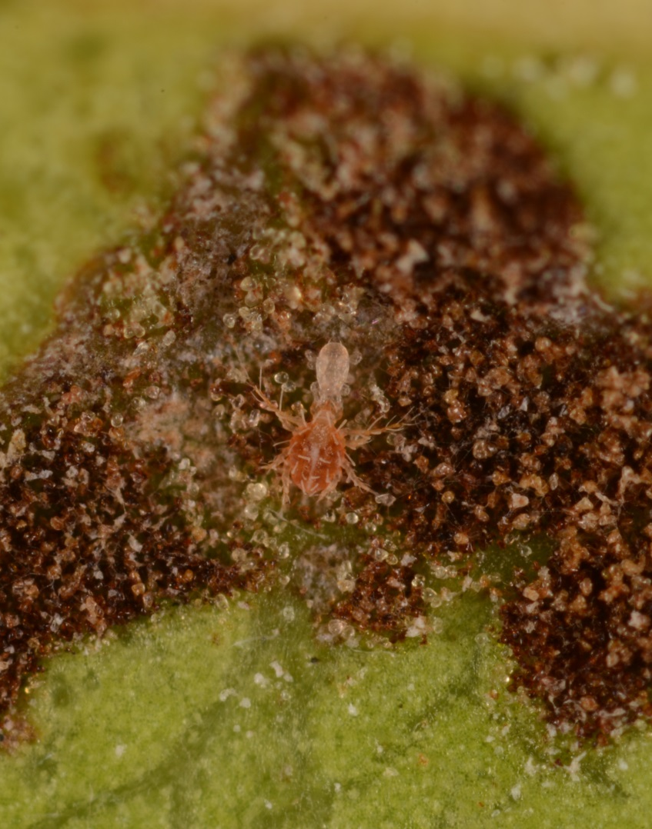
What are mites?
Very small arthropods usually with eight legs
Usually live in very specialized habitats
Live on plants, animals, stored products, soil and water
Some plant-dwelling mites are beneficial, others cause no visible injury to plants, but some are serious plant pests
Predatory Mexecheles aztercorum mite eating a phytoseiid mite nymph
Photo credit:
Lyle Buss, Department of Entomology and Nematology, University of Florida
Notes:
Most mites are very small arthropods that can usually only be seen with a microscope. Mites are arachnids like spiders and scorpions, and usually have eight legs. Larval mites have six legs and mites in the superfamily Eriophyoidea only have four legs. Mites are not insects though they are sometimes mistaken for insects.
Most mites live in the soil, but they also live on animals, plants, stored products such as grain, sugar, or pet food. Plant-dwelling mites aren’t necessarily plant pests. Many plant-dwelling mites are predators of plant pest mites, some may feed on plants but don’t cause noticeable damage, and others can be beneficial by feeding on leaf fungus.
Mites usually have very specialized habitats and are only found in the particular place in which they are adapted to live. For example, an animal pest mite will not live on a plant. Some mites, such as the two-spotted spider mite (Tetranychus urticae), are able to live on many different types of plants whereas others, such as the blueberry bud mite (Acalitus vaccinii), can only live in a certain part of a particular plant.
Some plant-dwelling mites are beneficial because they eat plant feeding mites or help control fungus on leaves. Some of these mites may be used as biocontrol agents.
Mites can be difficult to find on a plant due to their small size and tendency to hide in fairly inaccessible parts of the plant. Correct identification can be difficult because many species look similar. Field identification is difficult because most mites look the same to the naked eye or under a hand-lens.
Having some basic knowledge about mites and how they can affect plants is helpful.
Citations:
Boudreaux, H. B. 1963. Biological aspects of some phytophagous mites. Ann. Rev. Entomol. 8: 137-154.
Fitzgerald, J., N. Pepper, M. Easterbrook, T. Pope, and M. Solomon. 2007. Interactions among phytophagous mites, and introduced and naturally occurring predatory mites, on strawberry in the UK. Exp. Appl. Acarol. 43: 33-47.
Krants, G. W. and E. E. Lindquist. 1979. Evolution of phytophagous mites (Acari). Ann. Rev. Entomol. 24: 121-158.
Romero, G. Q., and W. W. Benson. 2005. Biotic interactions of mites, plants and leaf domatia. Current Opinions in Plant Biology 8: 436-440.
Saito, K. 2010. What are mites?, pp. 1-3. In Y. Saito (ed.), Plant Mites and Sociality: Diversity and Evolution. Springer, New York, NY.
Saito, K. 2010. Plant mites, pp. 5-38. In Y. Saito (ed.), Plant Mites and Sociality: Diversity and Evolution. Springer, New York, NY.
Vásquez, C., J. Morales-Sánchez, F. R. da Silva, and M. F. Sandoval. 2012. Biological studies and pest management of phytophagous mites in South America, pp. 353-376. In S. Soloneski (ed.), Integrated Pest Management and Pest Control – Current and Future Tactics. InTech, Rijeka, Croatia.

Slide 3
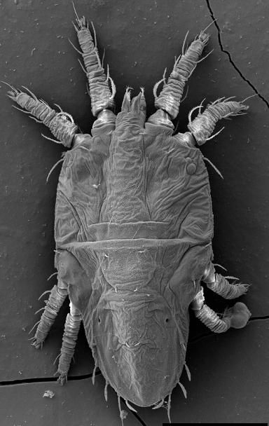
Generalized mite anatomy
Legs (4 pairs)
Pedipalps
Gnathosoma (“head”)
Idiosoma (“body”)
Photo credit: Gary Bauchan, USDA-ARS, bugwood.org, #5504732
Notes:
This scanning electron micrograph (SEM) is of a flat mite, Tenuipalpus pacificus. This species is a pest of orchids in Florida and worldwide.
This image helps illustrate the basic anatomy of most mites. Mites have two body regions: gnathosoma (“head”) and idiosoma (“body”). The gnathosoma or “head” includes specialized feeding mouthparts which includes pedipalps and chelicerae. Chelicerae are used to pierce the plant. Plant-feeding mites cannot “chew” and partially digest their food before ingesting it. The idiosoma or “body” ranges in shape from roundish (most plant mites) to wormlike. Most mites have four pairs of legs (eight in total) attached to the ventral side of the idiosoma, but some groups have two or three pairs of legs. The idiosoma and legs of mites have some various types of setae (“hair”).
Mites in the superfamily Eriophyoidea have four legs, rather than eight, and their body is described as cigar-shaped or wormlike. Eriophyoid mites are smaller than most other mites, and tend to live in hidden places on a plant. Later in the presentation we will mention citrus rust mites and grape erineum mites, both of which are eriophyoid mites.
Citations:
Vásquez, C., J. Morales-Sánchez, F. R. da Silva, and M. F. Sandoval. 2012. Biological studies and pest management of phytophagous mites in South America, pp. 353-376. In S. Soloneski (ed.), Integrated Pest Management and Pest Control – Current and Future Tactics. InTech, Rijeka, Croatia.

Slide 4
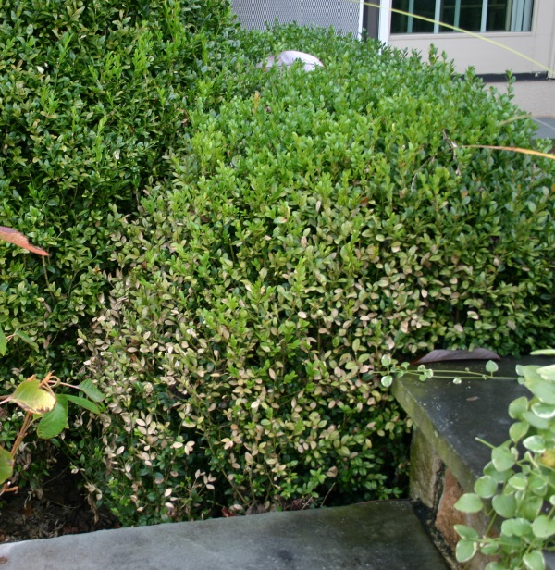
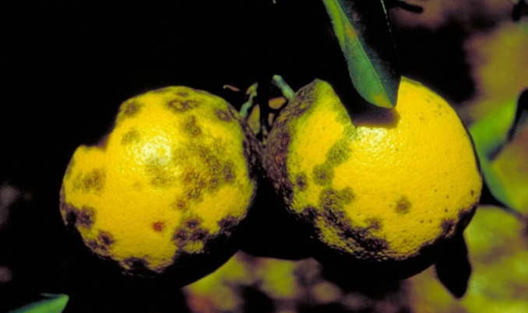
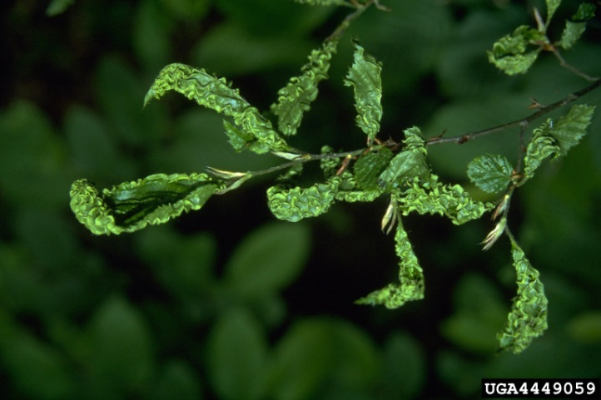
How mites damage plants
Break cuticle with mouthparts or suck out plant juice
Transmit pathogens
Induce malformed plant parts
Shriveled and dead leaves
Citrus leprosis virus damage
Photo credit: shriveled and dead leaves – WikiMedia Commons; malformed leaves - Petr Kapitola, State Phytosanitary Administration, Bugwood.org , #4449059; Citrus leprosis - Carlos Amadeu Leite de Oliveira, Universidade Estadual Paulista, Bugwood.org , #0746010
Malformed leaves
Notes:
Plant-feeding mites can cause injury in several ways. They may injure the plant’s leaf or fruit surface by piercing the plant cells with their chelicerae and sucking out the contents. Many small holes remain on the leaf or fruit surface through which the plant may lose water after the mite has finished feeding. Leaves may become shriveled and die, and fruit may develop unsightly lesions.
In addition, some plant-feeding mites can transmit plant pathogens, though this is uncommon. This means that although the mite’s feeding activity may not cause any noticeable plant injury, the disease that develops after the mite has transmitted the plant pathogen does.
Citrus leprosis virus is an example of a plant pathogen that is spread to citrus by mites in the genus Brevipalpus. The feeding activity does not appear to cause injury to the citrus plants at low population levels. Symptoms of citrus leprosis disease develop at the mite feeding site if the mite transmitted the virus.
Plants may produce galls or other malformed plant parts in response to mite feeding. The mite may shelter within these malformed plant parts to feed and reproduce.
Citations:
Romero, G. Q., and W. W. Benson. 2005. Biotic interactions of mites, plants and leaf domatia. Current Opinions in Plant Biology 8: 436-440.
Vásquez, C., J. Morales-Sánchez, F. R. da Silva, and M. F. Sandoval. 2012. Biological studies and pest management of phytophagous mites in South America, pp. 353-376. In S. Soloneski (ed.), Integrated Pest Management and Pest Control – Current and Future Tactics. InTech, Rijeka, Croatia.

Slide 5
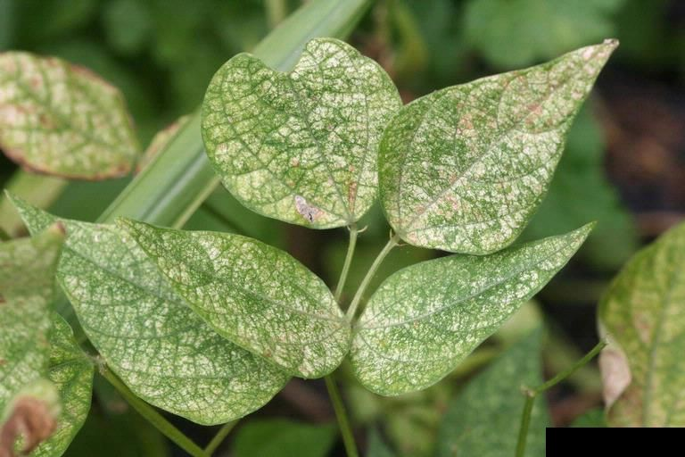
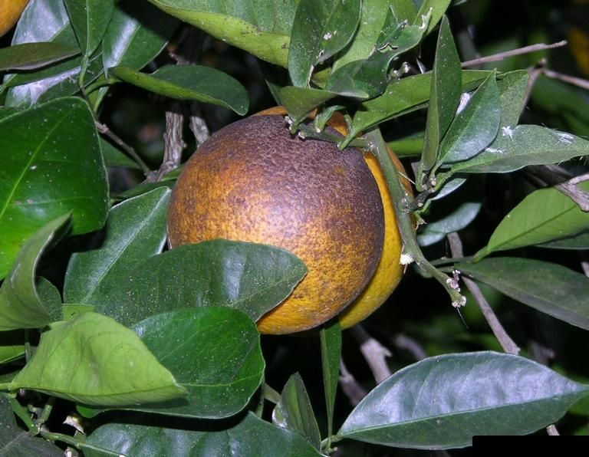
Mite damage to plants
Leaf stippling caused by two-spotted spider mite feeding
Bronzing on citrus rind caused by citrus rust mite feeding
Photo credits: [Left] Whitney Cranshaw, Colorado State University, bugwood.org , #5369738; [Right] Don Ferrin, Louisiana State University Agricultural Center, bugwood.org, #5473733
Notes:
Some mites such as the two-spotted spider mite (Tetranychus urticae) suck cell contents (“plant sap”) from the leaf. This causes a stippled appearance on the leaf where the mite has drained the cell contents in a particular area.
Affected leaves may become shriveled, dry, and fall from the plant as water and nutrients are lost to mite feeding. This can cause the whole plant to decline if the infestation is severe.
Fruit rind is another potential feeding site for mites. For example, the citrus rust mite (Eriophyidae) (Phyllocoptruta oleivora) feeds on the citrus fruit rind and leaves which develop a bronzed appearance in response.
Citations:
Rogers, M. E., P. A. Stansly, C. C. Childers, C. W. McCoy, and H. N. Nigg. (1999). 2012 Florida citrus pest management guide: Rust mites, spider mites, and other phytophagous mites (ENY603). University of Florida Institute of Food and Agricultural Sciences. Retrieved September 4, 2013, from http://edis.ifas.ufl.edu/cg002.

Slide 6
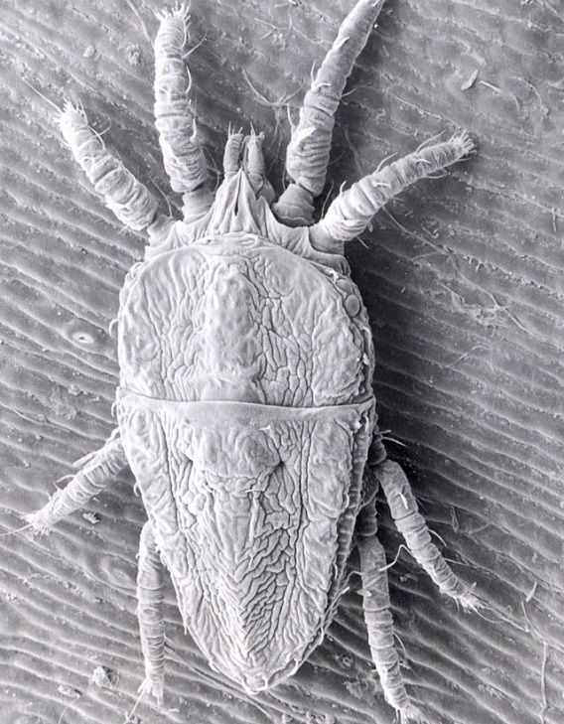
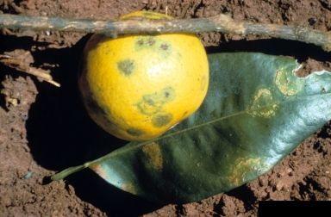
Mite damage to plants
The false spider mite Brevipalpus phoenicis transmits
Citrus leprosis virus, the cause of citrus leprosis disease
Photo credit: [Left] Eric Erbe, USDA Agricultural Research Service, bugwood.org, #1355019; [Right] Florida Division of Plant Industry Archive, Florida Department of Agriculture and Consumer Services, bugwood.org, #5260041
Notes:
The false spider mite (Tenuipalpidae) Brevipalpus phoenicis doesn’t cause obvious feeding damage at low population levels, but it can transmit Citrus leprosis virus to the plant it’s feeding on, which causes citrus leprosis disease. The mite can only transmit Citrus leprosis virus if it has fed on other plant tissue with the virus. Brevipalpus phoenicis and other Brevipalpus species are known to transmit plant viruses to more than 37 ornamental plant species in 18 families in addition to the Citrus leprosis virus.
Citations:
Rogers, M. E., P. A. Stansly, C. C. Childers, C. W. McCoy, and H. N. Nigg. (1999). 2012 Florida citrus pest management guide: Rust mites, spider mites, and other phytophagous mites (ENY603). University of Florida Institute of Food and Agricultural Sciences. Retrieved September 4, 2013, from http://edis.ifas.ufl.edu/cg002.

Slide 7
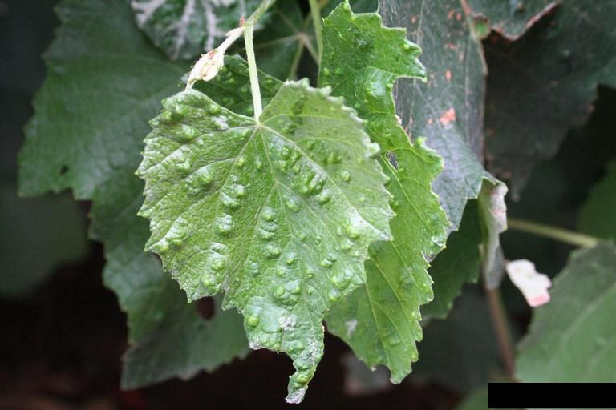
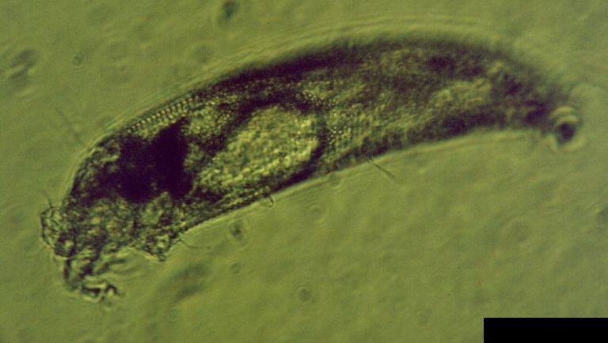
Mite damage to plants
Erineum mites cause grape leaves to make galls
Tiny erineum mites live within these galls
Photo credits: [Left] Lesley Ingram, bugwood.org, #5401675; [Right] Jody Fetzer, Hillwood Estate, Museum & Gardens, bugwood.org , #5026068
Notes:
This grape leaf has developed little galls called erinea in response to feeding by grape erineum mites (Eriophyidae) (Colomerus vitis). These tiny mites shelter within the pockets created by the erinea galls to feed and reproduce. Erinea are one example of the ways mite feeding can cause plants to develop malformed plant parts.
As mentioned previously, the grape erineum mite is an eriophyid mite that has only four legs and the body is tiny and "worm like". Eriophyid mites are very specialized and occur on specific parts of specific plants and cause distinctive damage.
Citations:
University of California Statewide Integrated Pest Management Program. Grape erineum mite-Colomerus vitis. Accessed March 14, 2013 from http://www.ipm.ucdavis.edu/PMG/GARDEN/FRUIT/PESTS/grerineummte.html.

Slide 8
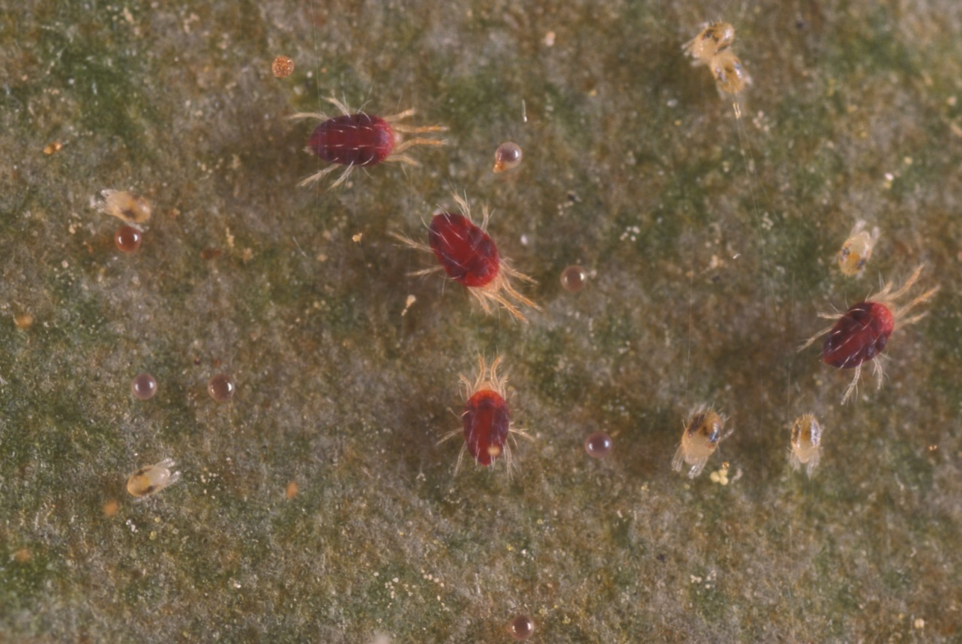
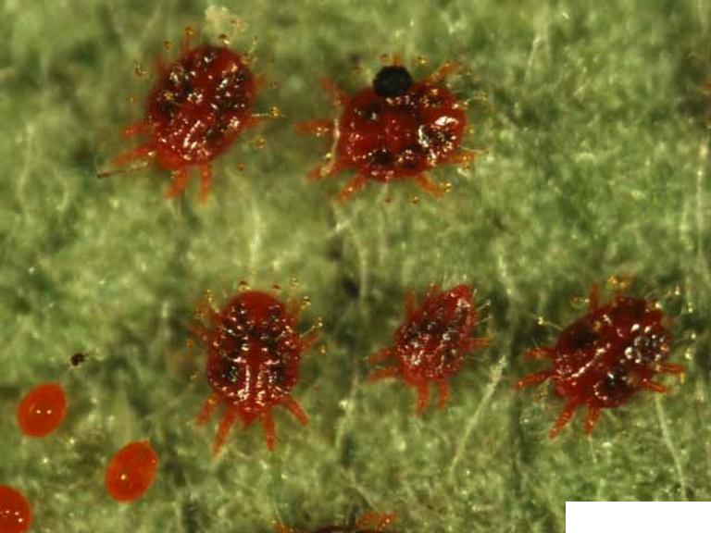
Generalized mite life cycle
Adults
Nymphs
Eggs
Adult
Nymph
Adult male
Adult females
Photo credit: left - Lyle Buss, Department of Entomology and Nematology, University of Florida; right - Jennifer Beard, University of Maryland, bugwood.org, #5503423
Notes:
Most mite species develop according to the following generalized life cycle:
The six-legged larva hatches from the egg and then molts into two or three eight-legged nymph stages before reaching the adult stage.
Depending on the temperature and availability of food, this cycle usually takes from 8 to 14 days for many plant pests.
The mated adult female lays eggs which develop into males and females, with a female-biased sex ratio. Eggs from unmated females develop into males and the unmated female then mates with the males when they mature so she can produce female eggs. This biology makes many plant-feeding mites potential invasive pests.
Adult males are commonly smaller than females and usually necessary to make a species identification.
Citations:
Saito, K. 2010. Plant mites, pp. 5-38. In Y. Saito (ed.), Plant Mites and Sociality: Diversity and Evolution. Springer, New York, NY.

Slide 9
Examples of invasive mite pests
Citrus Hindu mite, Schizotetranychus hindustanicus
Citrus brown mite, Eutetranychus orientalis
Red palm mite, Raoiella indica
Notes:
There are many mite pests in the U.S., some of them native, some were introduced. In addition, there are mite pests in the world that have not reached the U.S.
The citrus Hindu mite (Schizotetranychus hindustanicus), citrus brown mite (Eutetranychus orientalis), and red palm mite (Raoiella indica) are considered invasive species to the U.S. The Cooperative Agricultural Pest Survey (CAPS) Program for Florida has included these mites on their watch list due to the probability of them coming into Florida through commercial plant trade with countries in the Caribbean. Nursery growers who import plants from the Caribbean as part of their business are asked to pay particularly close attention to their imported plants for these mites.
The best way to keep invasive mite pests from becoming established in the U.S. is to find and eradicate them before they become established. You can help with prevention and eradication of invasive mite pests by becoming familiar with mite pests that are considered at risk of introduction or establishment in the U.S.
The citrus Hindu mite and citrus brown mite are not known to occur in the U.S. at this time. The red palm mite is currently found only in South Florida but there is concern that this mite will spread to other areas. We will discuss each mite in more detail in the upcoming slides.

Slide 10
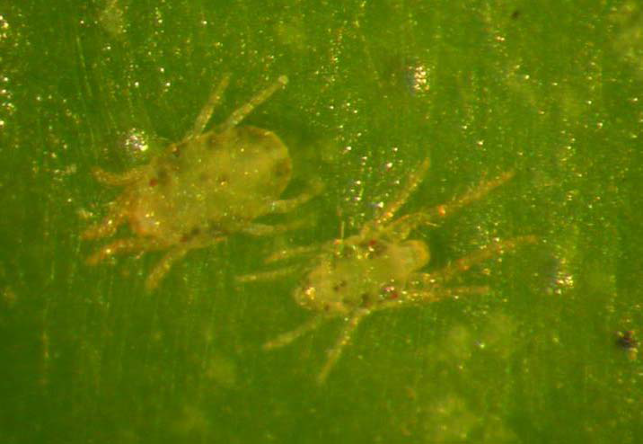
Citrus Hindu mite
Schizotetranychus hindustanicus
Originally from India, has been reported in Venezuela and Brazil
Hosts include citrus, sorghum, coconut and neem
Research on control methods, means of dispersal, and the full host range is ongoing
Female adult
Male adult
Photo credit: Barbara Nienstaedt, Instituto de Zoología Agrícola de la Facultad de Agronomía de la Universidad Central de Venezuela, 2007
Notes:
The citrus Hindu mite, Schizotetranychus hindustanicus, was originally reported from India but was recently discovered in Venezuela, Brazil, and Colombia. Citrus Hindu mite was found on lemons in Brazil but was not found on oranges growing in the same grove.
The adults and immature stages are yellowish or yellowish green in color with dark internal spots on the sides of the body. The female body is oval and somewhat flattened with stubby legs. The male is pear-shaped, paler and smaller than the female. His legs are long (especially the first pair).
The eggs are rather round, though slightly flattened, and clear to light yellow in coloration. Just before hatching, the larvae become yellowish green and have two small red spots (which are the eyes). The larvae are yellowish green after hatching and globular in shape. As they feed, they become darker and more oval in shape.
In laboratory conditions, the life cycle takes 14 to 15 days from egg to adult with females laying eggs (11 to 13) for about 9 days. However, what happens in the field can be dramatically different.
Control methods, means of dispersal, and the full host range are not fully known for this pest. The citrus Hindu mite has been reported to feed on sorghum (Sorghum bicolor), coconut (Cocos nucifera), Acacia spp., Persian lilac (Melia azedarach), and neem (Azadirachta indica) in addition to citrus (key lime, mandarin, sweet orange, Tahiti lime, and lemon). Citrus Hindu mite reared in laboratory conditions on orange, Persian lime, and lemon leaves reportedly completed their life cycle in approximately 30 days. Notably, each female mite laid a very low number of eggs in this study and the authors speculate that citrus Hindu mite may not be an important pest of citrus.
Research into the importance of citrus Hind mite as a pest of citrus, this mite’s full host range, and control methods is ongoing.
Citations:
Arevalo, E., Delgado, L., and Gonzalez, M. 2012. Boletin epidemiologico: Situacion actual de Acaro hindu de los citricos Schizotetranychus hindustanicus (Hirst) (Prostigmata: Tetranychidae) en Colombia. Accessed February 10, 2014 from http://www.ica.gov.co/Areas/Agricola/Servicios/Epidemiologia-Agricola/BOLETINES/Nacionales/2012/B_N_SHINDUSTANICUS_DIC_2012.aspx.
Bolland, H. R., Guitierrez, J. & Flechtmann, C.H.W. (1998) World Catalogue of the Spider Mite Family (Acari: Tetranychidae). Brill, Leiden, Boston,
Köln. 392 pp.
Ferragut, F., Navia, D., and R. Ochoa. 2013. “New mite invasions in citrus in the early years of the 21st Century”. Experimental and Applied Acarology, 59: 145-164.
Marsaro Júnior, A. L., Sato, M.E., de Aguiar, R. M., Vieira, G. B., da Silva Júnior, R. J., and Mineiro, J. L. de C. 2012. Efeito de acaracidas sobre Schizotetranychus hindustanicus (Hirst) (Acari: Tetranychidae) e ácaros predadores em citros no estado de Roraima, Brasil. Arquivos do Instituto Biológico 79: 75-83.
Navia, D., and Marsaro Jr., A. L. 2010. First report of the citrus Hindu mite, Schizotetranychus hindustanicus (Hirst) (Prostigmata: Tetranychidae) in Brazil. Neotrop. Entomol. 39 (1): 140-143.
Nienstaedt, B. and Marcano, R. 2009. Estudio de la biologia del acaro hindu de los citricos Schizotetranychus hindustanicus (Hirst, 1924) (Acari: Tetranychidae), en tres tipos de alimentos. Entomotropica 24: 51-56.

Slide 11
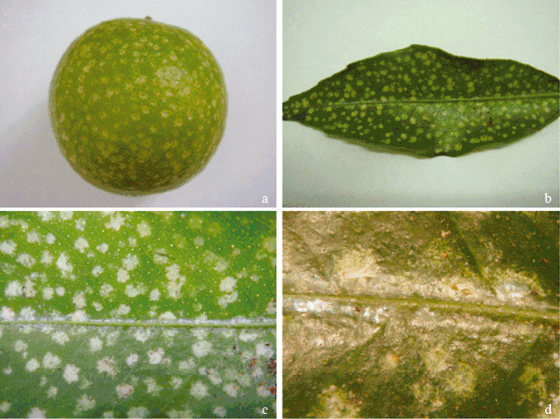
Citrus Hindu mite
Schizotetranychus hindustanicus
Causes silvery uniform splotches and covers underside of leaf with webbing
Colony under nest
Exuvia
Nest entry
Photo credit: (top left) Navia, D., and Marsaro Jr., A. L. 2010. First report of the citrus Hindu mite, Schizotetranychus hindustanicus (Hirst) (Prostigmata: Tetranychidae) in Brazil. Neotrop. Entomol. 39 (1): 140-143. (Bottom right) Barbara Nienstaedt, Instituto de Zoología Agrícola de la Facultad de Agronomía de la Universidad Central de Venezuela.
Notes:
Citrus Hindu mite feeding causes uniform silvery splotches on the fruit and leaves and the underside of the leaves are covered in circular webbing nests (ranging in size from 1 to 3mm) under which the mites live and reproduce. This mite is known as a nest-webbing mite because of this behavior. This behavior also makes it easier to spot when scouting in the field. Unfortunately, it also means that predatory mites have a hard time getting to them.
Fruit injury is expected to reduce fresh market value and leaf injury may reduce the tree’s photosynthetic potential.
The impact of the citrus Hindu mite on citrus cultivation is not clear. Citrus Hindu mite has reportedly caused significant damage in Venezuela, primarily on lemon, though no economic damage data is currently published from any country encountering this pest. Regulatory agencies in Venezuela, Brazil, and Colombia are monitoring for citrus Hindu mite and evaluating the effect of this pest on their citrus industries. Preventing new introductions is always advisable over managing a new pest once it has arrived; therefore it is prudent to be aware of this pest so that you can quickly report any symptoms you suspect could be caused by citrus Hindu mite.
Citations:
Arevalo, E., Delgado, L., and Gonzalez, M. 2012. Boletin epidemiologico: Situacion actual de Acaro hindu de los citricos Schizotetranychus hindustanicus (Hirst) (Prostigmata: Tetranychidae) en Colombia. Accessed February 10, 2014 from http://www.ica.gov.co/Areas/Agricola/Servicios/Epidemiologia-Agricola/BOLETINES/Nacionales/2012/B_N_SHINDUSTANICUS_DIC_2012.aspx.
Ferragut, F., Navia, D., and R. Ochoa. 2013. “New mite invasions in citrus in the early years of the 21st Century”. Experimental and Applied Acarology, 59: 145-164.
Navia, D., and Marsaro Jr., A. L. 2010. First report of the citrus Hindu mite, Schizotetranychus hindustanicus (Hirst) (Prostigmata: Tetranychidae) in Brazil. Neotrop. Entomol. 39 (1): 140-143.

Slide 12
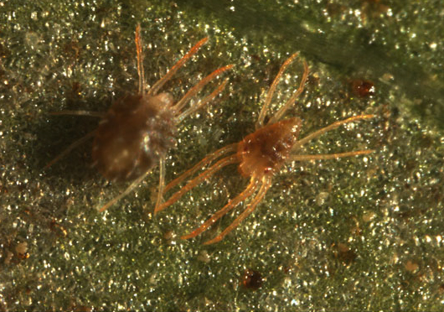
Citrus brown mite
Eutetranychus orientalis
Origin not known but major citrus pest in Africa, Europe, Middle East, Asia, and Australia
Males are triangular and slender, while females are broadly oval
Photo credit: Ferragut et al. “New mite invasions in citrus in the early yearsof the 21st century”, Exp Appl Acarol (2013) 59:145–164
Notes:
Citrus brown mite (Eutetranychus orientalis) is a major pest of citrus and nearly 200 other plants in parts of Africa, southern Europe, the Middle East, Asia, and Australia. Its place of origin is not known. It is also known as the Oriental red mite or ORM.
Like other members of this genus, the females are broadly oval and somewhat flattened. Their coloration ranges from green to orange or brown and with irregular dark green spots found on her back near the margins. Males are slender, triangular in shape, with noticeable long legs (they are very active on) the leaves. Both males and females hold the first two pairs of legs straight out in front of them and the back two pairs straight out. Citrus brown mite can be easily confused with the Texas citrus mite (Eutetranychus banksi), a species widespread in North and South America.
Female citrus brown mites begin to lay eggs when only a few days old with the female living between 1 and 3 weeks. The eggs themselves are flat and disk shaped and pale or a light green in color. They are laid along the main veins of the host plant leaves and hatch I about a week (or less depending on climate). The length of the entire life cycle is around 10-12 days. Under optimal conditions, E. orientalis can produce between 10 and 30 generations in a year.
Citations:
Ferragut, F., Navia, D., and R. Ochoa. 2013. “New mite invasions in citrus in the early years of the 21st Century”. Experimental and Applied Acarology, 59: 145-164.
NAPPO. Eutetranychus orientalis (Klein). Accessed March 14, 2013 from http://www.pestalert.org/viewArchPestAlert.cfm?rid=62
OEPP/EPPO. Eutetranychus orientalis. Accessed March 14, 2013 from http://www.eppo.int/QUARANTINE/insects/Eutetranychus_orientalis/EUTEOR_ds.pdf.

Slide 13
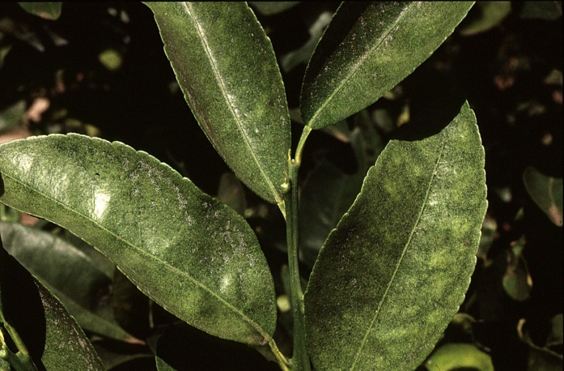
Citrus brown mite
Eutetranychus orientalis
Usually feed on the upperside of the leaf along the midrib then spreading to side veins
At least 216 hosts, with preference to members of Rutaceae and Fabaceae
Hosts include:
  Lemons, mandarins, oranges
  Pears, peaches, olives, and almonds
Citrus brown mite feeding injury on citrus leaves
Photo credit: Queensland Department of Agriculture, Fisheries and Forestry
Notes:
This pest usually feeds on the upper side of the leaf along the midrib and then spreads to the side veins. Their feeding causes the leaves to become yellow, with pale yellow streaks developing along the midrib and veins. Heavy infestations or lesser infestations in dry areas can cause the leaves to drop and eventually defoliate a tree.
There are at least 216 plant species belonging to 66 different plant families that are hosts for this pest; however, they seem to have a preference for Rutaceae and Fabaceae. Citrus hosts includes: lemons (Citrus limon), mandarins (C. reticulata), and oranges (C. sinensis). Other hosts include: almonds (Prunus dulcis), bananas (Musa paradisiaca), cassava (Manihot esculenta), cotton (Gossypium), figs (Ficus carica), guavas (Psidium guajava), mulberries (Morus), olives (Olea europaea), pawpaws (Carica papaya), peaches (Prunus persica), pears (Pyrus spp.), plumeria (Plumeria spp.), quinces (Cydonia oblonga), castor oil plant (Ricinus communis), sunflowers (Helianthus annuus), sweet potatoes (Ipomoea batatas), and watermelons (Citrullus lanatus).
Citrus brown mite, like most spider mites, is spread by wind currents and on infested plant material. In countries where this mite is a problem, acaricides and predatory mites are used to control the citrus brown mite. Even though control measures do exist, mites are in general very difficult to control.
Citations:
Ferragut, F., Navia, D., and R. Ochoa. 2013. “New mite invasions in citrus in the early years of the 21st Century”. Experimental and Applied Acarology, 59: 145-164.
NAPPO. Eutetranychus orientalis (Klein). Accessed March 14, 2013 from http://www.pestalert.org/viewArchPestAlert.cfm?rid=62
OEPP/EPPO. Eutetranychus orientalis. Accessed March 14, 2013 from http://www.eppo.int/QUARANTINE/insects/Eutetranychus_orientalis/EUTEOR_ds.pdf.

Slide 14
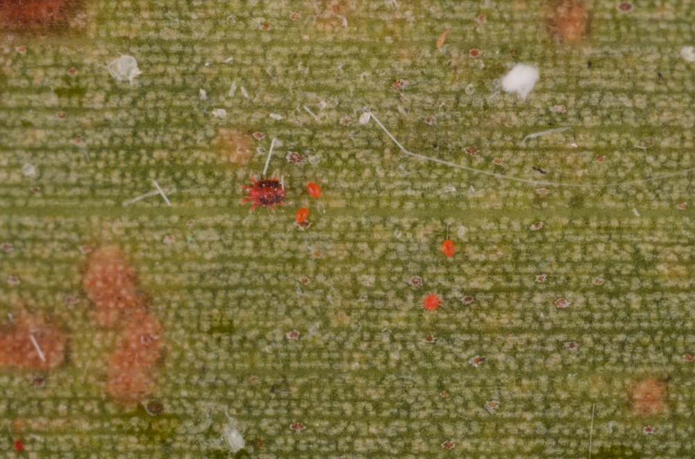
Red palm mite
Raoiella indica
Spread to the Caribbean in 2004 and to Florida in 2007
Feeding on leaves causes severe yellowing, reduced fruit yield
Dispersed by wind or on infested plant material
Pest on palms, especially coconut as well as bananas, plantains, gingers, and heliconias
Adult female
Eggs
Photo credit: Lyle Buss, Department of Entomology and Nematology, University of Florida
Notes:
Red palm mite, Raoiella indica, arrived in the Caribbean probably from Reunion Island around 2004 and has devastated palms throughout the Caribbean, arriving in Florida in 2007.
Red palm mite prefers coconut palms, Cocos nucifera. Red palm mites also feed on banana and plantain, Musa spp., gingers and heliconias. Other hosts in Florida include date palms (Phoenix canariensis and Phoenix dactylifera), fishtail palms (Caryota spp.), Australian arenga palm (Arenga australasica), red cabbage palm (Livistona mariae), Mexican fan palm (Washingtonia robusta), and many other palm species.
The red palm mite is easily spread by wind and on infested plant material and due to the ornamental palm trade, it is highly likely this mite will continue to spread. It has already spread into northeastern South America.
Chemical control is usually not practical for this mite because treating very large palms is expensive and difficult. Chemical control may be necessary in palm nurseries. Predatory mites and other natural enemies can provide some control.
Citations:
CAPS. 2013. Raoiella indica. Accessed 10 December 2013 from http://caps.ceris.purdue.edu/webfm_send/2232.
Hoy, M. A., J. Peña, and R. Nguyen. (2006). Red palm mite, Raoiella indica Hirst (Arachnida: Acari: Tenuipalpidae) (EENY397). Gainesville: University of Florida Institute of Food and Agricultural Sciences. Retrieved September 4, 2013, from http://edis.ifas.ufl.edu/in711.
Kane E. C., R. Ochoa, G. Mathurin, and E. F. Erbe. (2005). Raoiella indica Hirst (Acari: Tenuipalpidae): An island-hopping mite pest in the Caribbean. http://www.sel.barc.usda.gov/acari/PDF/Raoiella%20indica-Kane%20et%20al.pdf (1 March 2013).
Vásquez, C., J. Morales-Sánchez, F. R. da Silva, and M. F. Sandoval. 2012. Biological studies and pest management of phytophagous mites in South America, pp. 353-376. In S. Soloneski (ed.), Integrated Pest Management and Pest Control – Current and Future Tactics. InTech, Rijeka, Croatia.

Slide 15
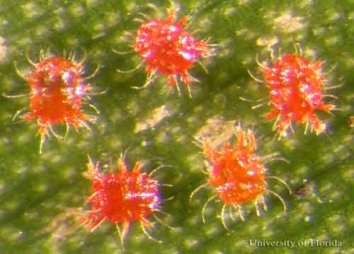
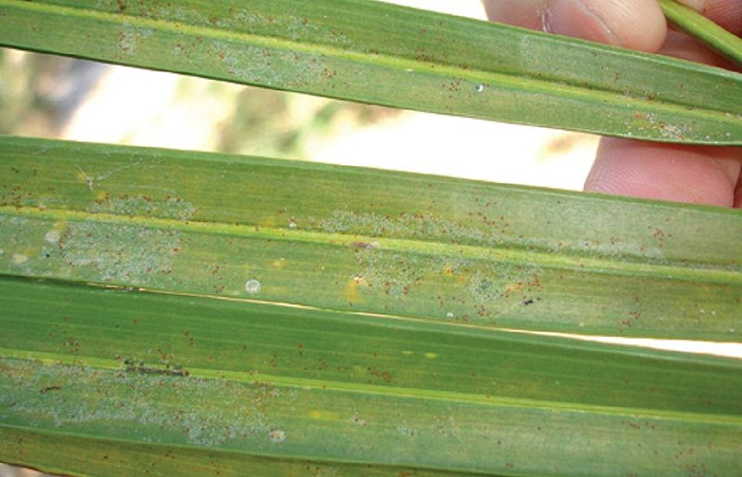
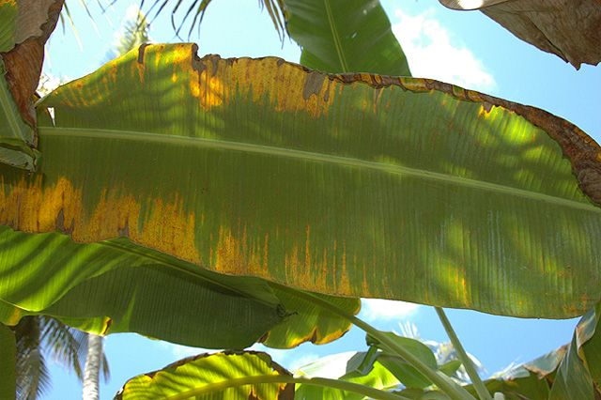
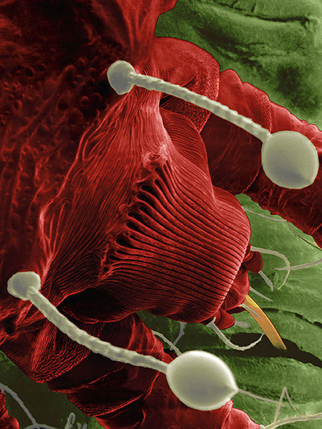
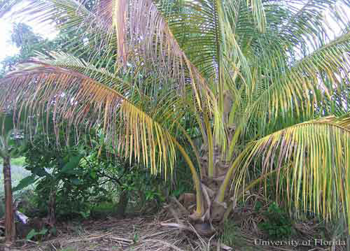
Red palm mite
Raoiella indica
Close-up of adult red palm mites
Early (top) and advanced (bottom) feeding damage on palm
Feeding damage on banana
Photo credit: Close-up of adult red palm mites: Rita Duncan, University of Florida, entnemdept.ufl.edu; SEM of adult feeding: Gary Bauchan, USDA-ARS Electron & Confocal Microscopy Unit; Early feeding damage on palm: Wikimedia Commons; Advanced feeding damage on palm: Jorge Peña, University of Florida, entnemdept.ufl.edu; Feeding damage on banana: Wikimedia Commons.
SEM of adult feeding through stomate
Notes:
This bright red mite is easy to see up close against the green leaf tissue, especially because there can be millions of mites or more on a single coconut palm. Both adult and juvenile mites are a vibrant red color.
The mite feeds through the plant’s stomata, which are small openings in the leaves that allow the plant to photosynthesize. This type of feeding is different from some other plant-feeding mites that feed on the cells on the leaf surface. The red palm mite’s stomatal feeding is thought to interfere with photosynthesis. The mite’s feeding causes severe yellowing of the leaves and reduced fruit production. Yellowed areas progress to brown, dead foliage as the mite continues to feed.
This type of damage can be mistaken for nutritional deficiencies, so it is important to look for the mites themselves.
Citations:
CAPS. 2013. Raoiella indica. Accessed 10 December 2013 from http://caps.ceris.purdue.edu/webfm_send/2232.
Hoy, M. A., J. Peña, and R. Nguyen. (2006). Red palm mite, Raoiella indica Hirst (Arachnida: Acari: Tenuipalpidae) (EENY397). University of Florida Institute of Food and Agricultural Sciences. Retrieved September 4, 2013, from http://edis.ifas.ufl.edu/in711.
Kane E. C., R. Ochoa, G. Mathurin, and E. F. Erbe. (2005). Raoiella indica Hirst (Acari: Tenuipalpidae): An island-hopping mite pest in the Caribbean. http://www.sel.barc.usda.gov/acari/PDF/Raoiella%20indica-Kane%20et%20al.pdf (1 March 2013).
Vásquez, C., J. Morales-Sánchez, F. R. da Silva, and M. F. Sandoval. 2012. Biological studies and pest management of phytophagous mites in South America, pp. 353-376. In S. Soloneski (ed.), Integrated Pest Management and Pest Control – Current and Future Tactics. InTech, Rijeka, Croatia.

Slide 16
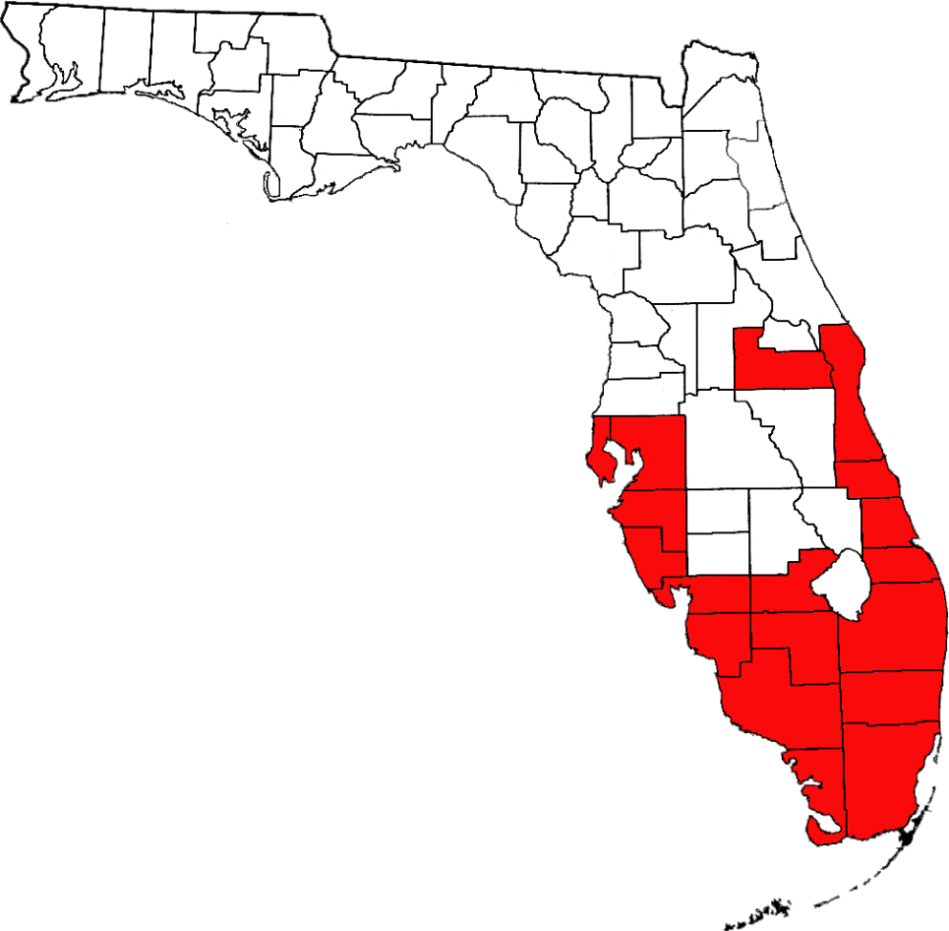
Distribution of red palm mite in Florida
Counties with reports of red palm mite detections
Map based on FDACS DPI records.
Notes:
The Florida Department of Agriculture and Consumer Services, Division of Plant Industry reports that as of 2014 the red palm mite is known from Brevard, Broward, Charlotte, Collier, Glades, Hendry, Hillsborough, Indian River, Lee, Manatee, Martin, Miami-Dade, Monroe, Orange, Palm Beach, Pinellas, Sarasota, and St. Lucie Counties in Florida.
The red palm mite has been detected in Florida on over 30 palm species, banana, gingers and heliconias. Due to the heavy red palm mite infestations, the mites are being found on non-host plants though they cannot reproduce on any dicots and most non-palm monocots.

Slide 17
Authors
Carla J. Burkle
Doctor of Plant Medicine student, Department of Entomology and Nematology, University of Florida

Slide 18
Editor
Stephanie Stocks, M.S.
Assistant –In, Extension Scientist, Department of Entomology and Nematology, University of Florida

Slide 19
Reviewers
Marjorie Hoy, Ph.D.
Eminent Scholar, Department of Entomology and Nematology, University of Florida
Cal Welbourn, Ph.D.
Curator of Acari, Florida Department of Agriculture and Consumer Services, Division of Plant Industry

Slide 20
Translators
Lanette Sobel, Doctor of Plant Medicine student, Department of Entomology and Nematology, University of Florida
  Nienstaedt, B. and Marcano, R. 2009. Estudio de la biologia del acaro hindu de los citricos Schizotetranychus hindustanicus (Hirst, 1924) (Acari: Tetranychidae), en tres tipos de alimentos. Entomotropica 24: 51-56.
Silva Vau, PhD student, Department of Entomology and Nematology, University of Florida
  Marsaro Júnior, A. L., Sato, M.E., de Aguiar, R. M., Vieira, G. B., da Silva Júnior, R. J., and Mineiro, J. L. de C. 2012. Efeito de acaracidas sobre Schizotetranychus hindustanicus (Hirst) (Acari: Tetranychidae) e ácaros predadores em citros no estado de Roraima, Brasil. Arquivos do Instituto Biológico 79: 75-83.

Slide 21
Educational Disclaimer and Citation
This presentation can be used for educational purposes for NON-PROFIT workshops, trainings, etc.
Citation:
  Burkle, C., B.S., 2014. Plant-feeding mite pests, May 2014.

Slide 22
References
Arevalo, E., Delgado, L., and Gonzalez, M. 2012. Boletin epidemiologico: Situacion actual de Acaro hindu de los citricos Schizotetranychus hindustanicus (Hirst) (Prostigmata: Tetranychidae) en Colombia. Accessed February 10, 2014 .
  http://www.ica.gov.co/Areas/Agricola/Servicios/Epidemiologia-Agricola/BOLETINES/Nacionales/2012/B_N_SHINDUSTANICUS_DIC_2012.aspx.
Boudreaux, H. B. 1963. Biological aspects of some phytophagous mites. Ann. Rev. Entomol. 8: 137-154.
Bolland, H. R., Guitierrez, J. & Flechtmann, C.H.W. (1998) World Catalogue of the Spider Mite Family (Acari: Tetranychidae). Brill, Leiden, Boston, Köln. 392 pp.
CAPS. 2013. Raoiella indica. Accessed 10 December 2013
  http://caps.ceris.purdue.edu/webfm_send/2232.
Ferragut, F., Navia, D., and R. Ochoa. 2013. “New mite invasions in citrus in the early years of the 21st Century”. Experimental and Applied Acarology, 59: 145-164.
Fitzgerald, J., N. Pepper, M. Easterbrook, T. Pope, and M. Solomon. 2007. Interactions among phytophagous mites, and introduced and naturally occurring predatory mites, on strawberry in the UK. Exp. Appl. Acarol. 43: 33-47.
Hoy, M. A., J. Peña, and R. Nguyen. 2006. Red palm mite, Raoiella indica Hirst (Arachnida: Acari: Tenuipalpidae) (EENY397). Gainesville: University of Florida Institute of Food and Agricultural Sciences. Retrieved September 4, 2013,
  http://edis.ifas.ufl.edu/in711.

Slide 23
References
Kane E. C., R. Ochoa, G. Mathurin, and E. F. Erbe. (2005). Raoiella indica Hirst (Acari: Tenuipalpidae): An island-hopping mite pest in the Caribbean.
  http://www.sel.barc.usda.gov/acari/PDF/Raoiella%20indica-Kane%20et%20al.pdf (1 March 2013).
  Krants, G. W. and E. E. Lindquist. 1979. Evolution of phytophagous mites (Acari). Ann. Rev. Entomol. 24: 121-158.
  Marsaro Júnior, A. L., Sato, M.E., de Aguiar, R. M., Vieira, G. B., da Silva Júnior, R. J., and Mineiro, J. L. de C. 2012. Efeito de acaracidas sobre Schizotetranychus hindustanicus (Hirst) (Acari: Tetranychidae) e ácaros predadores em citros no estado de Roraima, Brasil. Arquivos do Instituto Biológico 79: 75-83.
Navia, D., and Marsaro Jr., A. L. 2010. First report of the citrus Hindu mite, Schizotetranychus hindustanicus (Hirst) (Prostigmata: Tetranychidae) in Brazil. Neotrop. Entomol. 39 (1): 140-143.
NAPPO. Eutetranychus orientalis (Klein). Accessed March 14, 2013
  http://www.pestalert.org/viewArchPestAlert.cfm?rid=62
Nienstaedt, B. and Marcano, R. 2009. Estudio de la biologia del acaro hindu de los citricos Schizotetranychus hindustanicus (Hirst, 1924) (Acari: Tetranychidae), en tres tipos de alimentos. Entomotropica 24: 51-56.
OEPP/EPPO. Eutetranychus orientalis. Accessed March 14, 2013
  http://www.eppo.int/QUARANTINE/insects/Eutetranychus_orientalis/EUTEOR_ds.pdf.
Romero, G. Q., and W. W. Benson. 2005. Biotic interactions of mites, plants and leaf domatia. Current Opinions in Plant Biology 8: 436-440.

Slide 24
References
Rogers, M. E., P. A. Stansly, C. C. Childers, C. W. McCoy, and H. N. Nigg. (1999). 2012 Florida citrus pest management guide: Rust mites, spider mites, and other phytophagous mites (ENY603). Gainesville: University of Florida Institute of Food and Agricultural Sciences. Retrieved September 4, 2013.
  http://edis.ifas.ufl.edu/cg002.
Saito, K. 2010. What are mites?, pp. 1-3. In Y. Saito (ed.), Plant Mites and Sociality: Diversity and Evolution. Springer, New York, NY.
Saito, K. 2010. Plant mites, pp. 5-38. In Y. Saito (ed.), Plant Mites and Sociality: Diversity and Evolution. Springer, New York, NY.
University of California Statewide Integrated Pest Management Program. Grape erineum mite-Colomerus vitis. Accessed March 14, 2013
  http://www.ipm.ucdavis.edu/PMG/GARDEN/FRUIT/PESTS/grerineummte.html.
Vásquez, C., J. Morales-Sánchez, F. R. da Silva, and M. F. Sandoval. 2012. Biological studies and pest management of phytophagous mites in South America, pp. 353-376. In S. Soloneski (ed.), Integrated Pest Management and Pest Control – Current and Future Tactics. InTech, Rijeka, Croatia.

