Slide 1
Florida First
Detector Training:
Pests and Pathways
Notes:
In this presentation, we will explore how pests are introduced to Florida.

Slide 2
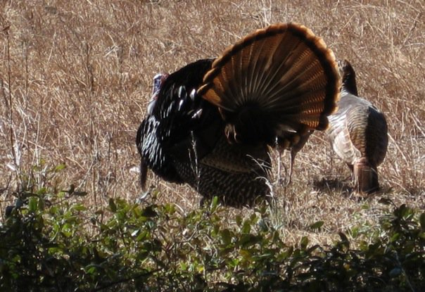
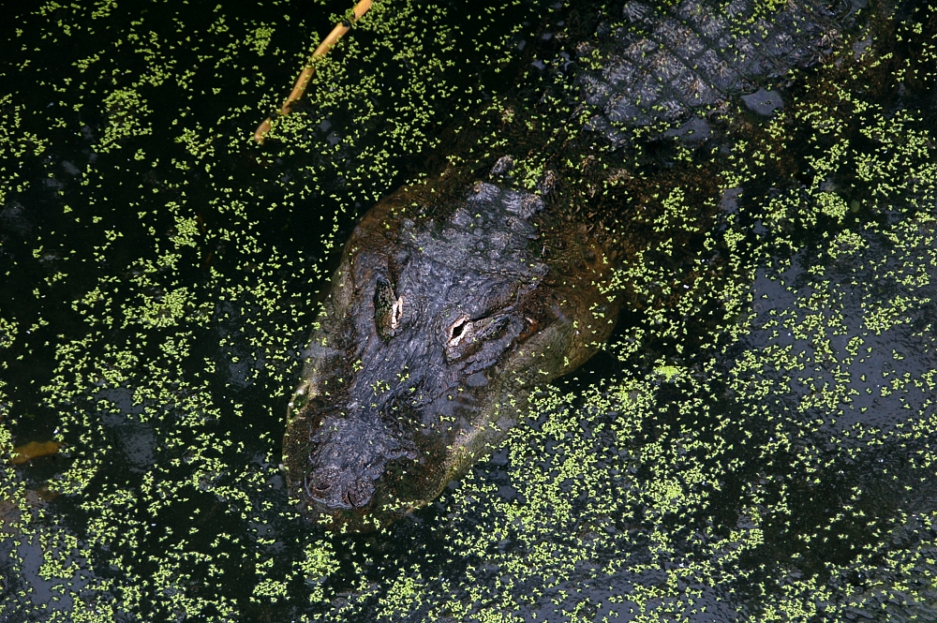
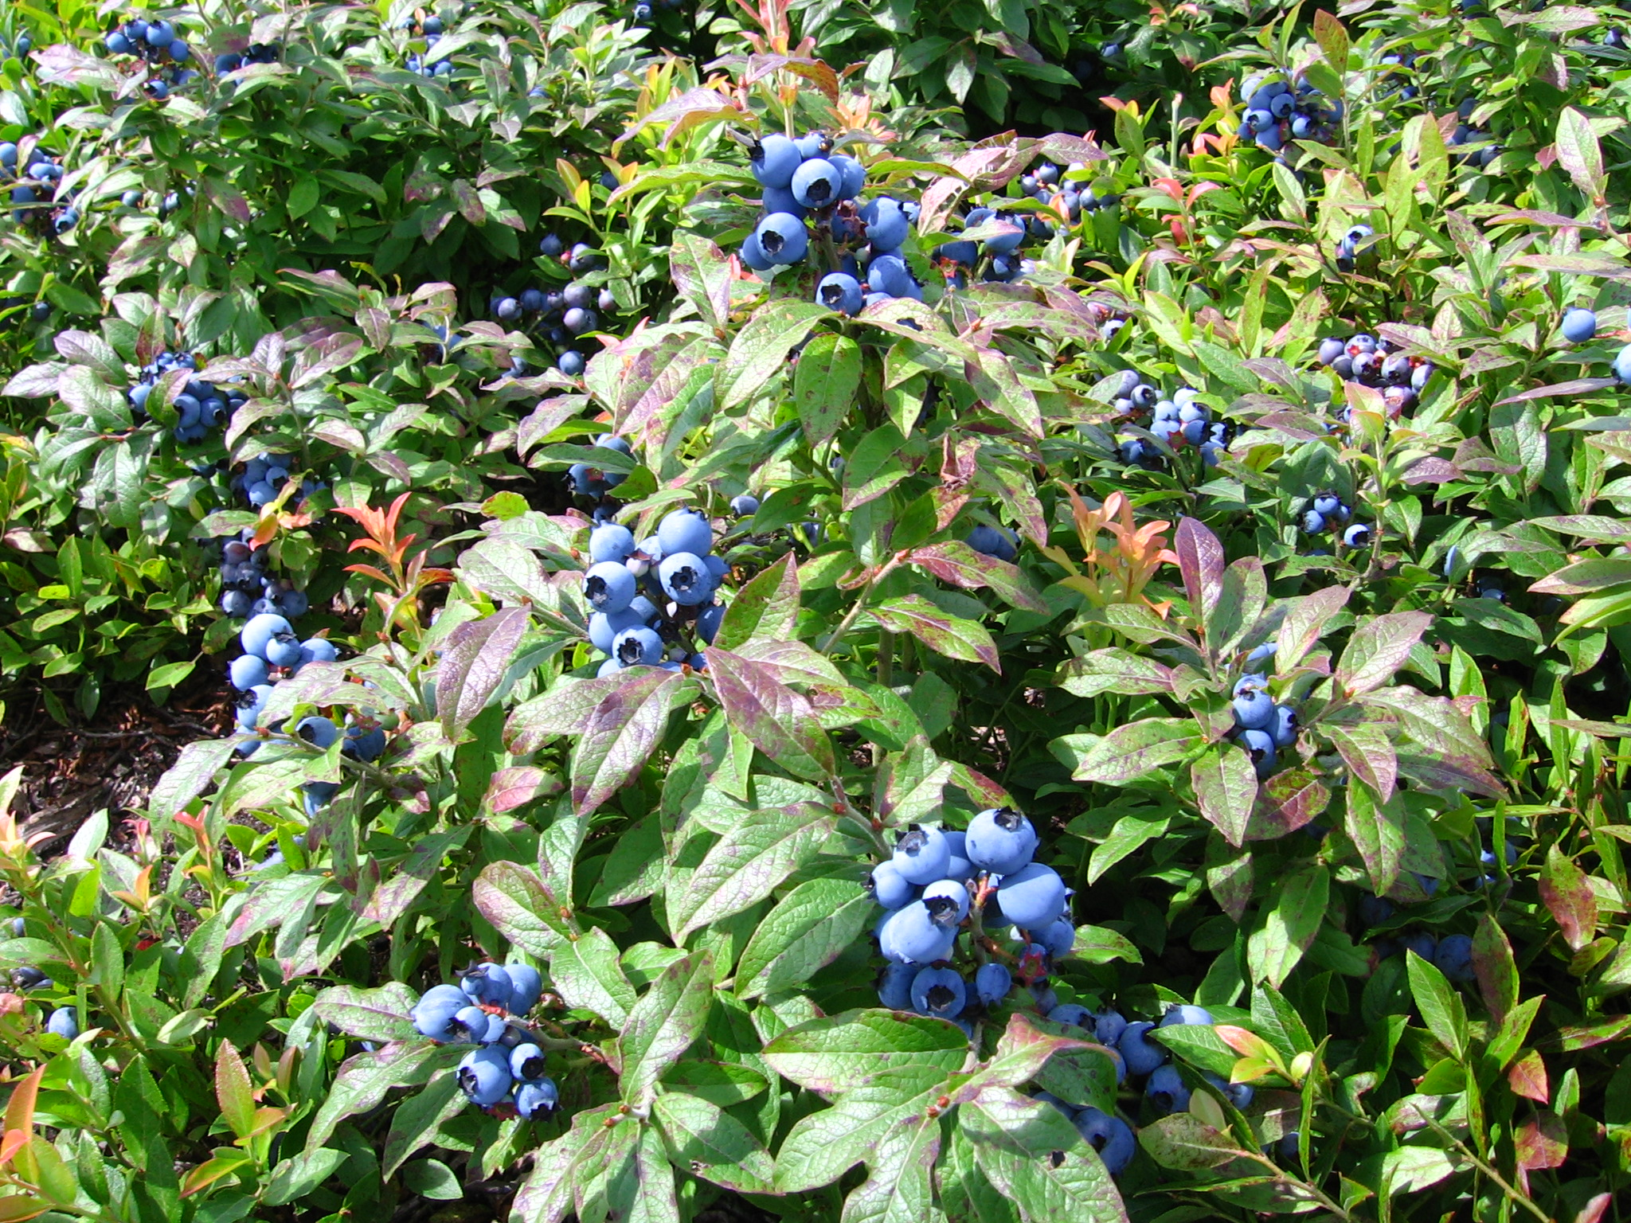
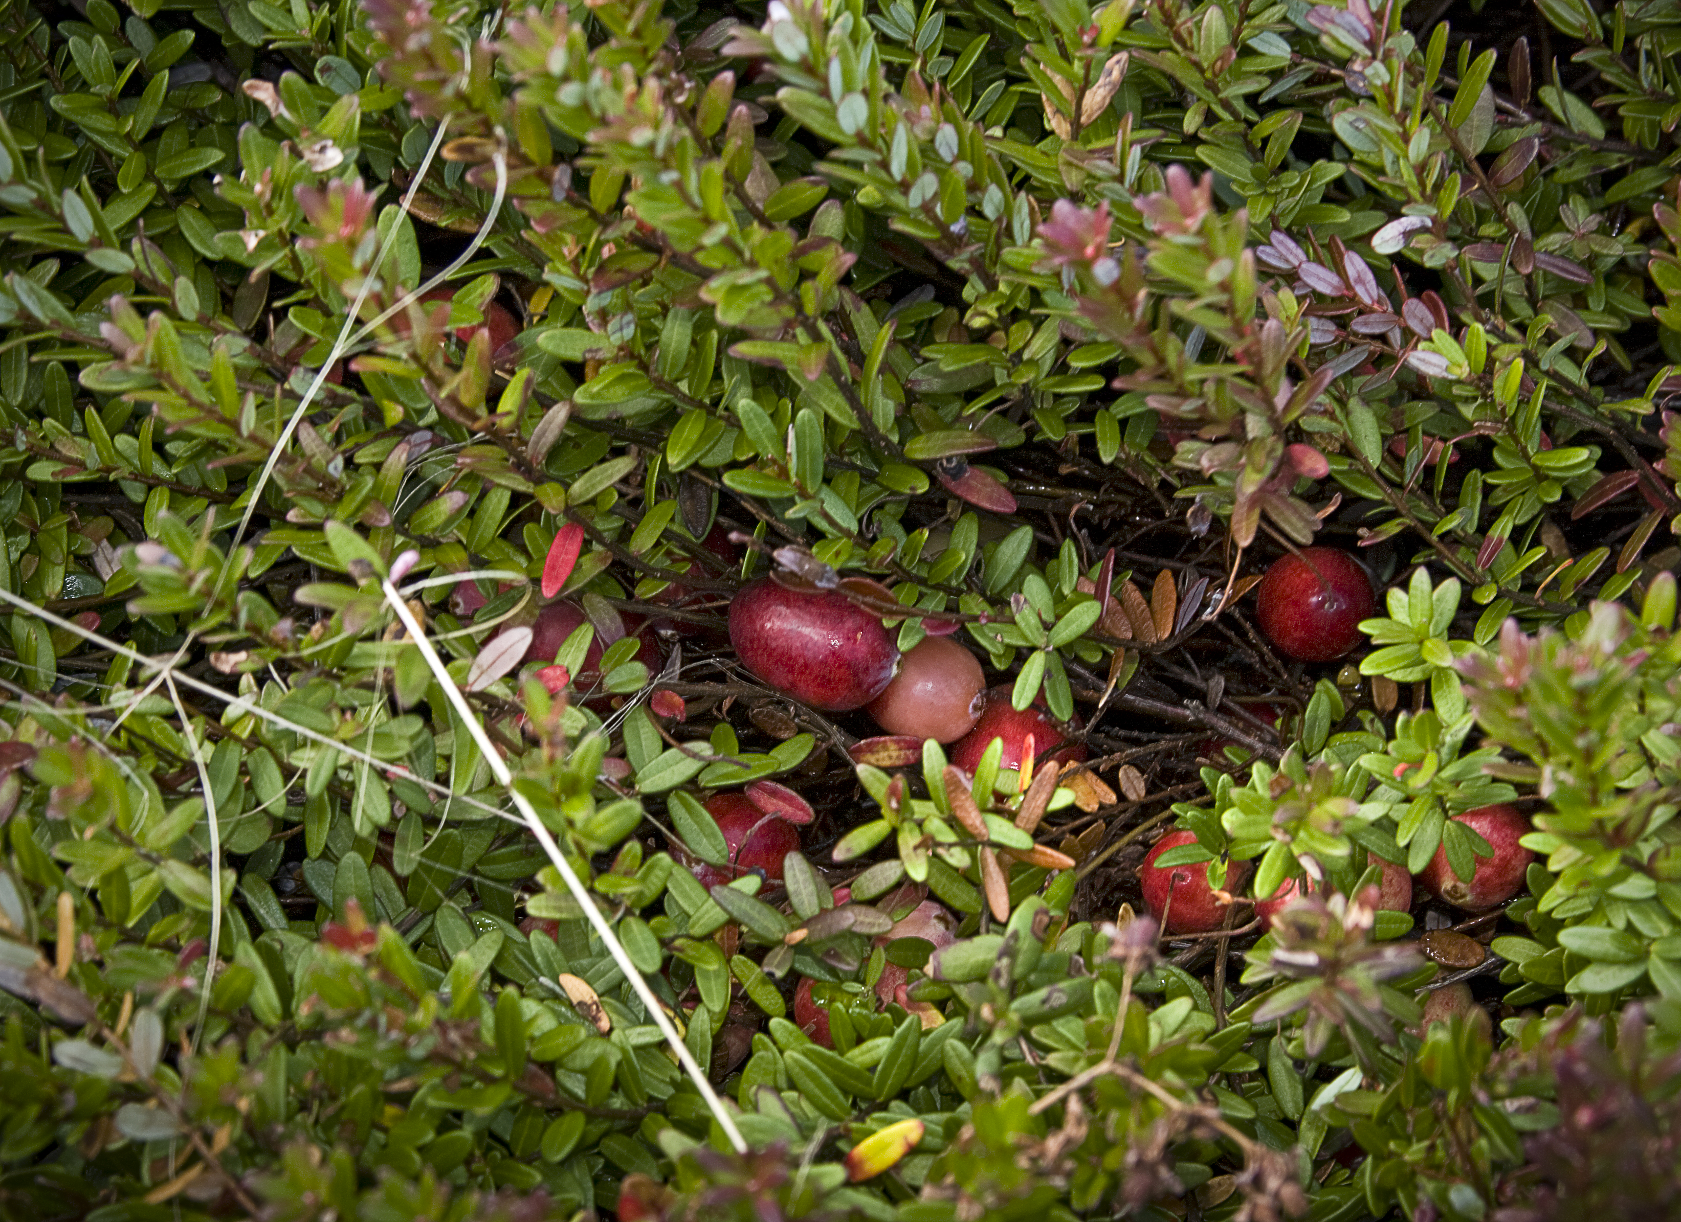
Wild turkey
Alligator
Blueberry
Crabapple
Photo: (Top left) – Jennifer A. Hamel, University of Florida; (All others) – Wikimedia Commons.
Notes:
We will begin by reviewing some of the vocabulary that scientists and decision-makers use when discussing plant pests.
Consider the images on this slide. Would you consider the four species pictured here to be native, introduced, or invasive in the U.S.?
Each of these species (clockwise from top left: wild turkey, alligator, crabapple, and blueberry) are native to the continental U.S.

Slide 3
Native
  Organisms that occur in an ecosystem as a result of only natural processes, with no human intervention.
Blueberry
Wild turkey
Photos: (Left) – Wikimedia Commons; (Right) - Jennifer A. Hamel, University of Florida.
Notes:
Native species are organisms (e.g., plants, animals, fungi) whose presence in an ecosystem is the result of only natural processes and is not the result of human intervention.
Information source:
Hodges, Amanda and Stephanie Stocks. 2010. Overview: Invasive Species that Affect Plants. Updated December 2011.
Accessed June 21, 2013 –
www.protectingusnow.org

Slide 4
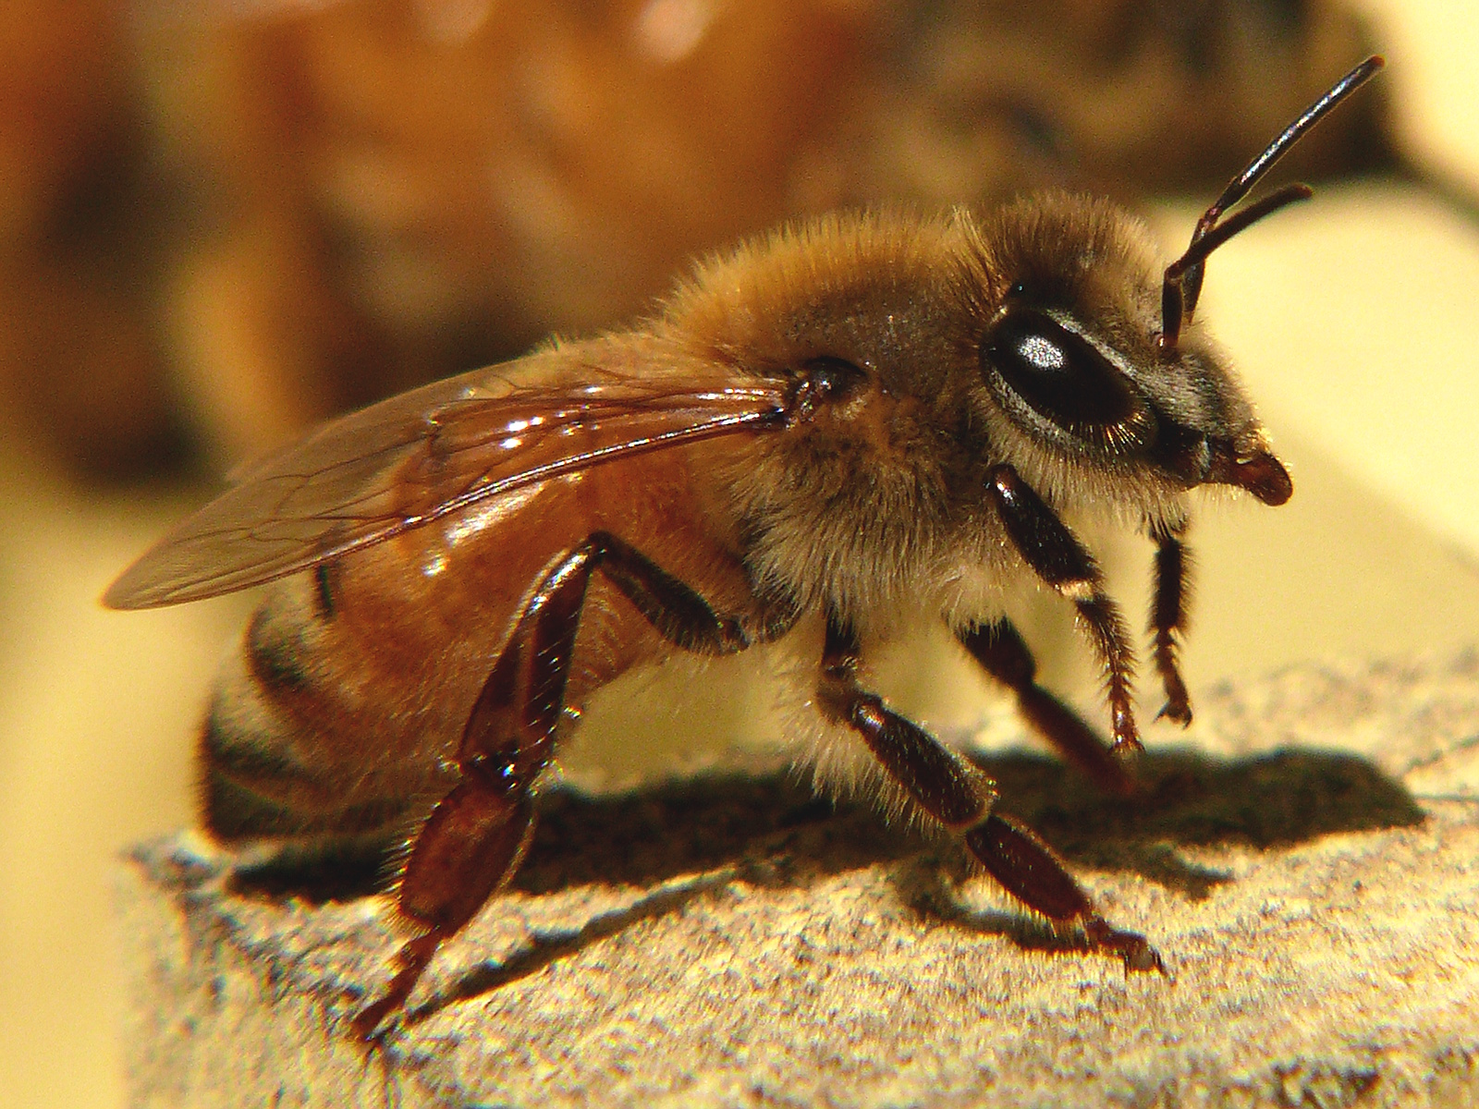
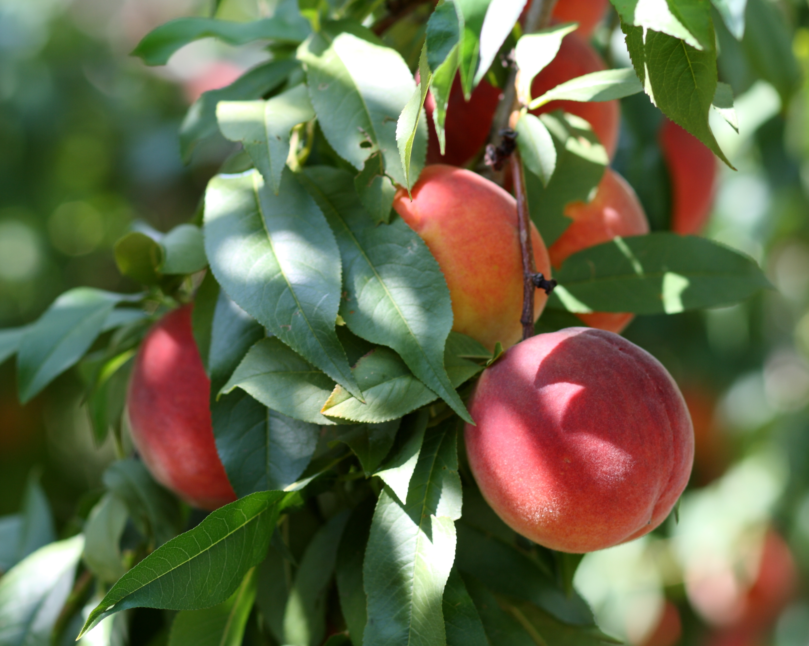
Introduced
  Organisms that are introduced to a new ecosystem where they become established and survive.
  Usually introduced via human intervention
  Can have beneficial or detrimental effects on environment
Honeybee
Peaches
Photos: Wikimedia Commons
Notes:
Introduced species are organisms that originate in one region/ecosystem, but are introduced to another region/ecosystem and become acclimated and “established” in the new region/ecosystem.
This means the organism can survive and reproduce on its own, and maintain a stable population in the new area. Introduced species are often introduced to the new environment by humans. These introductions may be deliberate or accidental.
Introduced species can have either beneficial or detrimental effects on the environment.
Honeybees (from Europe) and peaches (from Asia) are both examples of introduced species that are considered to be beneficial.
Information source:
Hodges, Amanda and Stephanie Stocks. 2010. Overview: Invasive Species that Affect Plants. Updated December 2011.
Accessed June 21, 2013 –
www.protectingusnow.org

Slide 5
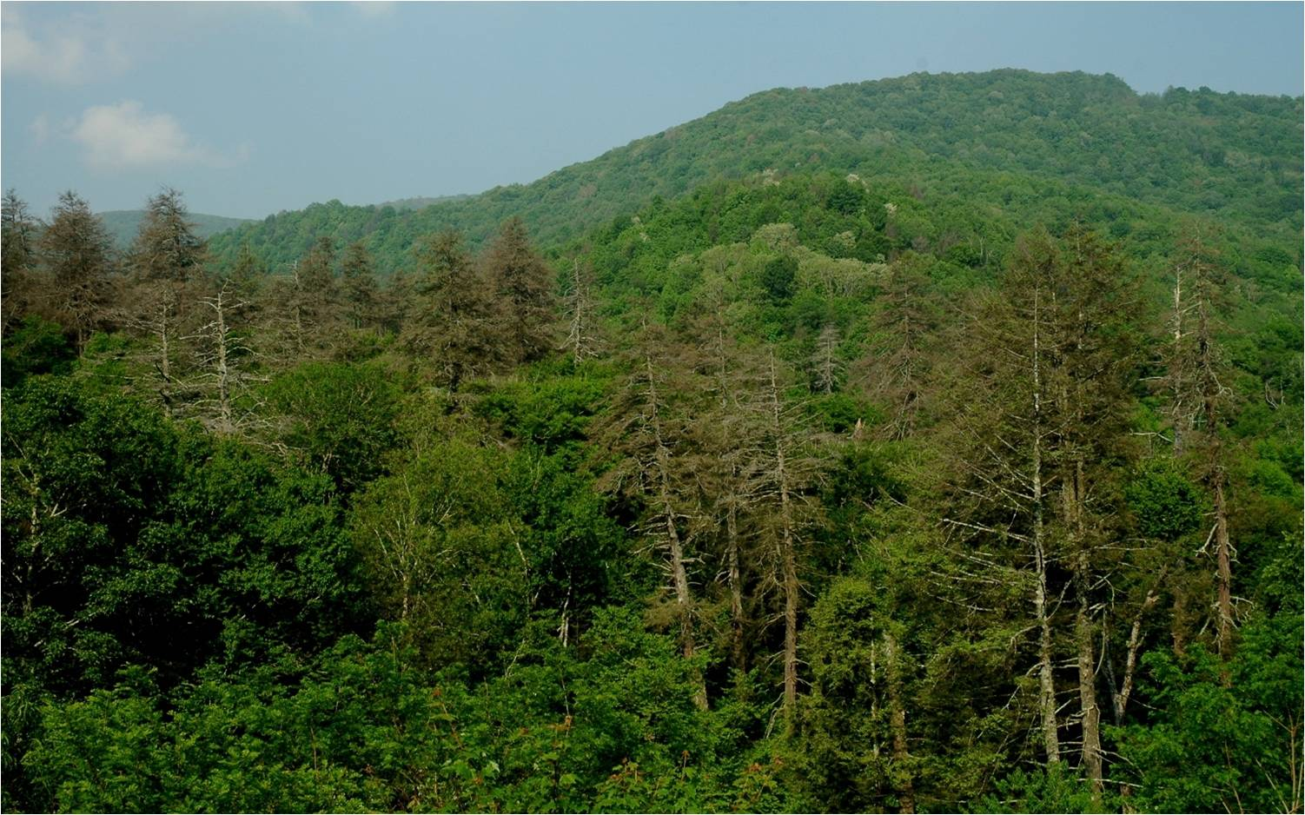
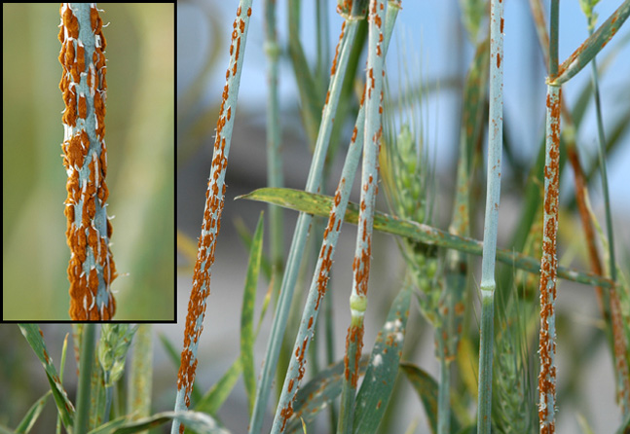
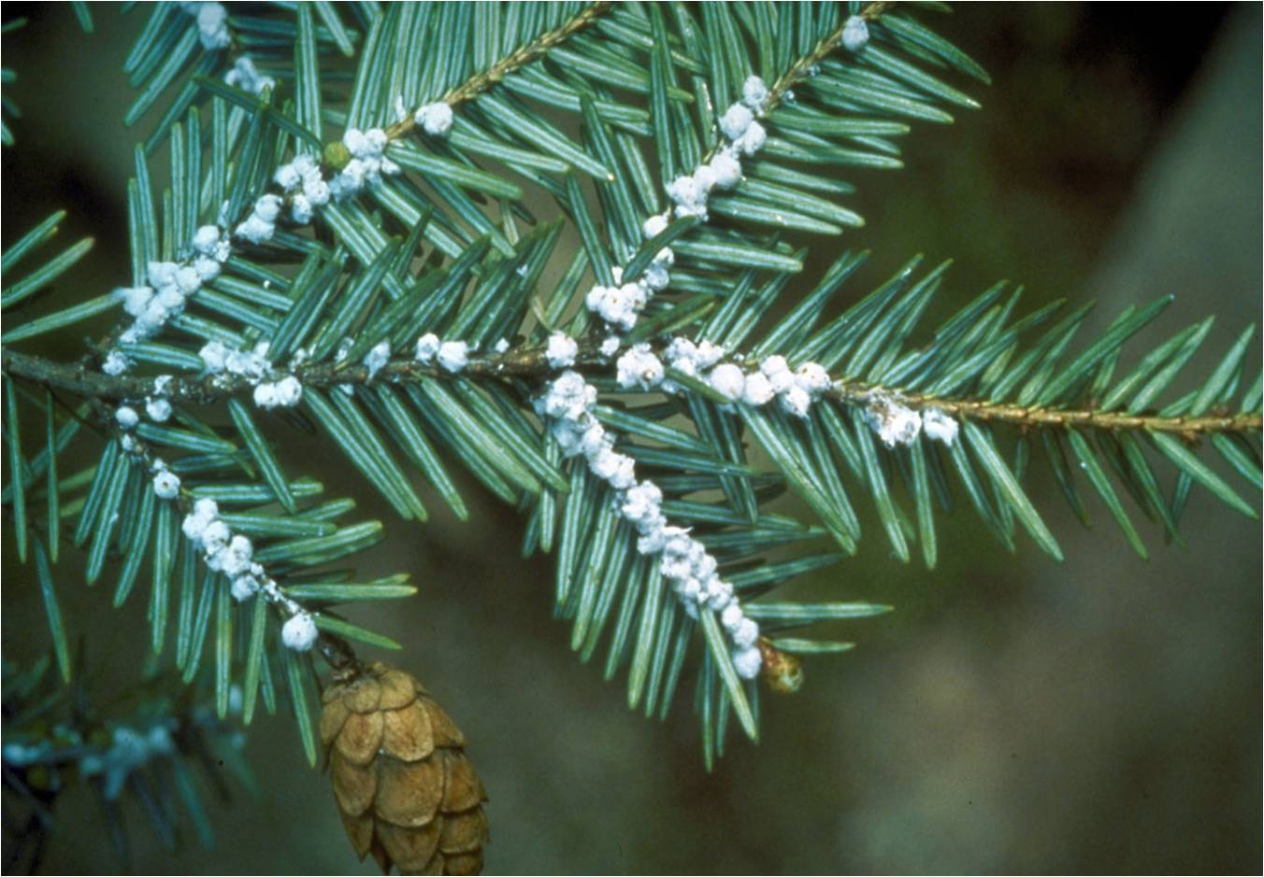
Invasive
  Organisms that are introduced to an ecosystem where they establish and survive, causing harm.
  Usually introduced via human intervention
  Only have detrimental effects (economic, ecological, and/or human health)
Damaged hemlock woolly adelgid trees
Wheat stem rust
Photos: (Left, main) - William M. Ciesla, Forest Health Management International, http://www.invasive.org/ Image No. 2167012; (Left, inset) Connecticut Agricultural Experiment Station, www.bugwood.org, #3225077; (Right) - USDA-ARS Photo, http://www.ars.usda.gov/Main/docs.htm?docid=9910
Notes:
Invasive species are introduced species that have detrimental effects on the environment or human health or crop health.
The National Invasive Species Council defines invasive species as being not native to the ecosystem (i.e. introduced) and whose introduction will likely cause economic harm or harm to human health – detrimental effects.
Invasive species are usually accidentally introduced through shipping of goods or movement of people from country to country, but sometimes they are intentionally introduced.
Can you think of an example of an invasive species? How about one that is or has been intentionally introduced? One current example in Florida is the giant African land snail. These snails were intentionally introduced to South Florida when three giant African land snails were smuggled into south Florida from Hawaii by a Miami, FL, resident in 1966. The giant African snails were eventually released into a garden and they have caused serious detrimental economic, environmental, and human health effects. (For more information on the giant African land snail, please see the scripted presentation on that species.)
Information source:
Hodges, Amanda and Stephanie Stocks. 2010. Overview: Invasive Species that Affect Plants. Updated December 2011.
Accessed June 21, 2013 –
www.protectingusnow.org
USDA, Animal and Plant Health Inspection Service. Plant Health. Giant African Snail.
Accessed December 5, 2013 –
http://www.aphis.usda.gov/plant_health/plant_pest_info/gas/index.shtml

Slide 6
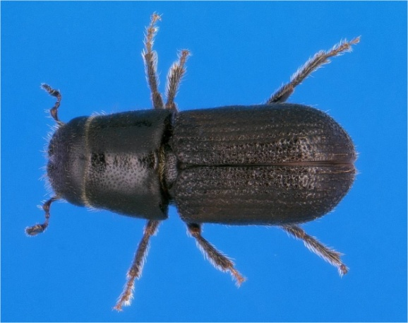
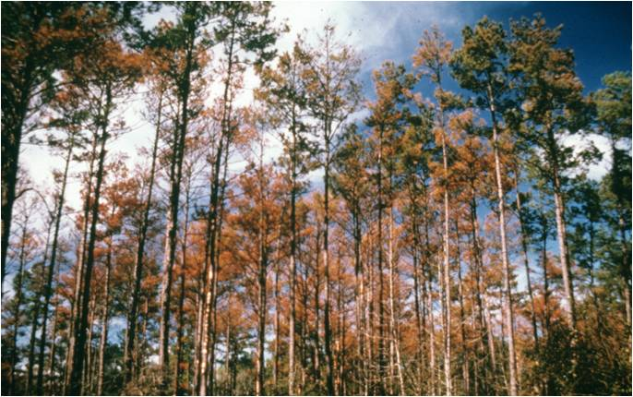
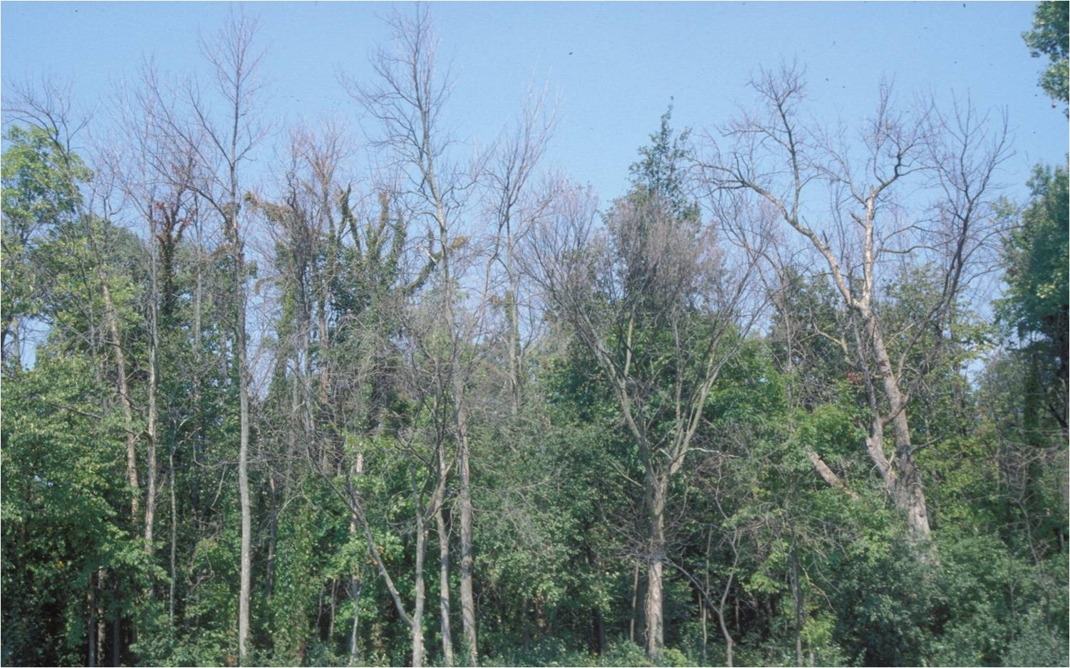
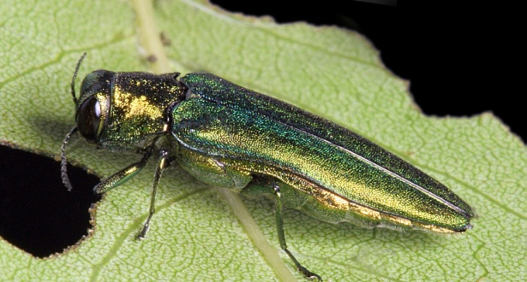
Pest
  Organisms that compete with humans for resources.
  Only have detrimental effects
  Competition includes consuming or damaging food, fiber, other resources that humans value
  Pests can be native, introduced, or invasive
Pine tree damage caused by Southern pine beetle
Ash tree damage caused by Emerald ash borer
Photos: (Left, main) - Ronald F. Billings, Texas Forest Service, www.bugwood.org, #1546017; (Left, inset) - Erich G. Vallery, USDA Forest Service - SRS-4552, www.bugwood.org, #5289035; (Right, main) - Daniel Herms, The Ohio State University, www.bugwood.org, #5171038; (Right, inset) - David Cappaert, Michigan State University, www.bugwood.org, #2106098.
Notes:
Pest species are organisms that compete with humans for resources we value. For example, pests may consume or damage food, fiber or other materials intended for human consumption or use.
Pests can be native to an area or be introduced (and they are called invasive species). For example, The southern pine beetle (Dendroctonus frontalis) is a native species that attacks pine trees. The emerald ash borer (Agrilus planipennis) is an introduced pest (i.e. invasive species) that attacks ash trees.
Information sources:
Hodges, Amanda and Stephanie Stocks. 2010. Overview: Invasive Species that Affect Plants. Updated December 2011.
Accessed June 21, 2013 –
www.protectingusnow.org
Massachusetts Introduced Pests Outreach Project. August 23, 2006. Plum Pox Pest Alert.
Accessed June 21, 2013 –
http://www.massnrc.org/pests

Slide 7
How are new species introduced and why does Florida seem to get so many?
Notes:
We now have good working definitions for native, introduced, and invasive species, and pests. But the big question is how are species introduced to new areas and why does Florida seem to get so many?
This part is meant to be interactive. Please ask the audience to come up with a list of how species can be introduced into a new area. For example, commercial shipping, airplane travel, cars traveling from one area to another, trucks coming into Florida carrying produce or other plant products, people bringing plants or seeds back with them when they travel, people bring fruit and vegetables in from another country, etc. Any one of these can bring in an unwanted pest.
Next, ask the audience to think about why Florida gets so many invasive species. Have them think about why they like living in Florida.
The answers are:
Climate
Florida has tropical, semi-tropical, and temperate regions. That means that they have a climate that is suitable for many different types of organisms, especially invasive ones. In the southern part of Florida, there is no hard freeze. This means that organisms that would normally die off during a hard freeze don’t get that hard freeze and instead continue to live and prosper.
Food availability
We have an extended growing season. This means that there is a continuous food source for agricultural and horticultural pests.
Tourism
In addition, we have a large tourism industry which means we get many visitors from around the world traveling everyday via ships and airplanes. Pests can hitch a ride in airplanes and ships and be in Florida in a short amount of time.
For all of these reasons and more, Florida has been designated a state which is highly impacted by invasive species.
But how do invasive species get here?

Slide 8
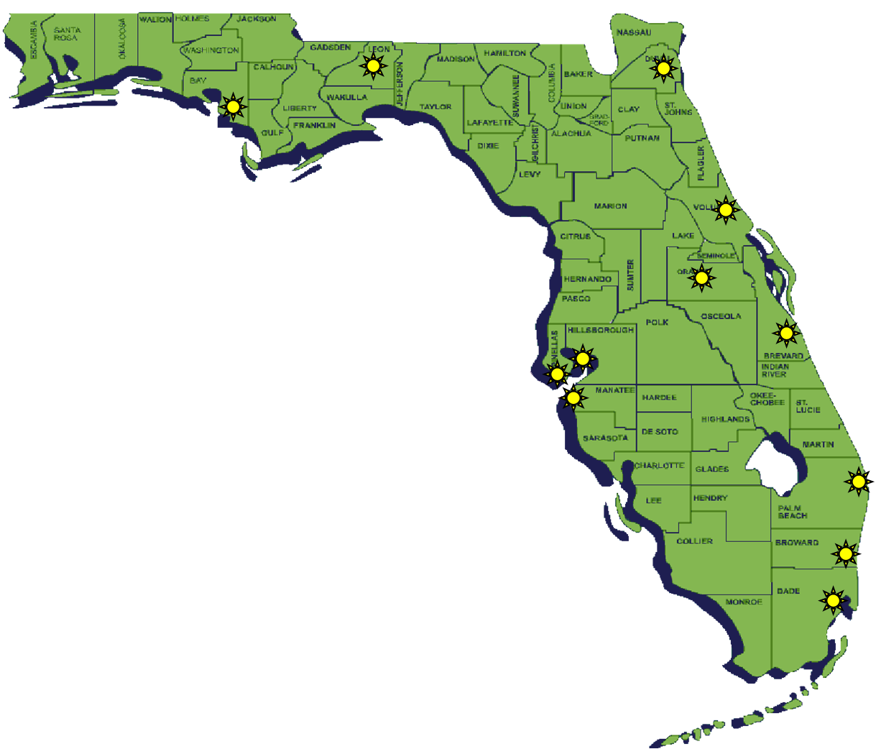
Florida has 12 International Airports
Panama City/Bay County International
Tallahassee International
Jacksonville International
Daytona Beach International
Orlando International
Melbourne International
Palm Beach International
Ft. Lauderdale International
Miami International
Sarasota International
St. Pete/Clearwater International
Tampa International
Map courtesy of: Florida CAPS
Notes:
Florida is especially susceptible to species introductions. Human travel and shipment of goods are the main means by which species are introduced to Florida.
For example, Florida has 12 international airports. At which Florida airport do you think most pest introductions occur?
Map courtesy of Florida Cooperative Agricultural Pest Survey (CAPS) program.

Slide 9
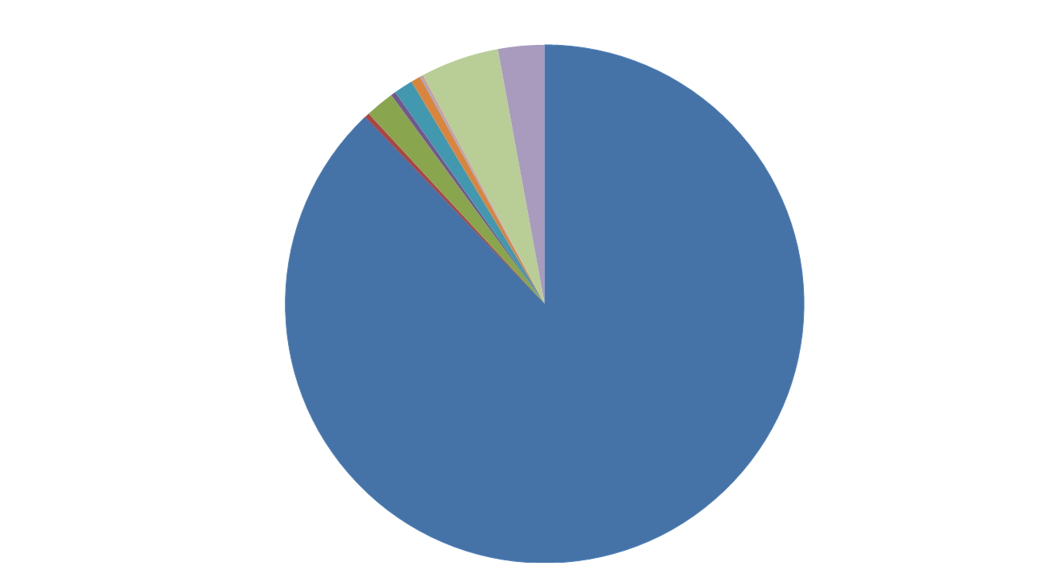
U.S. Flower Imports
US Airports, 2004
ORD
1.2%
BOS
0.6%
DFW
0.1%
IAH
0.1%
JFK
4.9%
ATL
0.3%
LAX
2.9%
All Other Airports
1.8%
SFO
0.3%
MIA
88%
Notes:
The overwhelming majority of US flower imports (88%) enters the U.S. through the Miami International Airport (MIA on the graph). Flower imports are live plant material, on which plant pests can and do hitchhike. This figure shows flower imports from all U.S. airports, not just Florida!
Information source:
US Department of Commerce

Slide 10
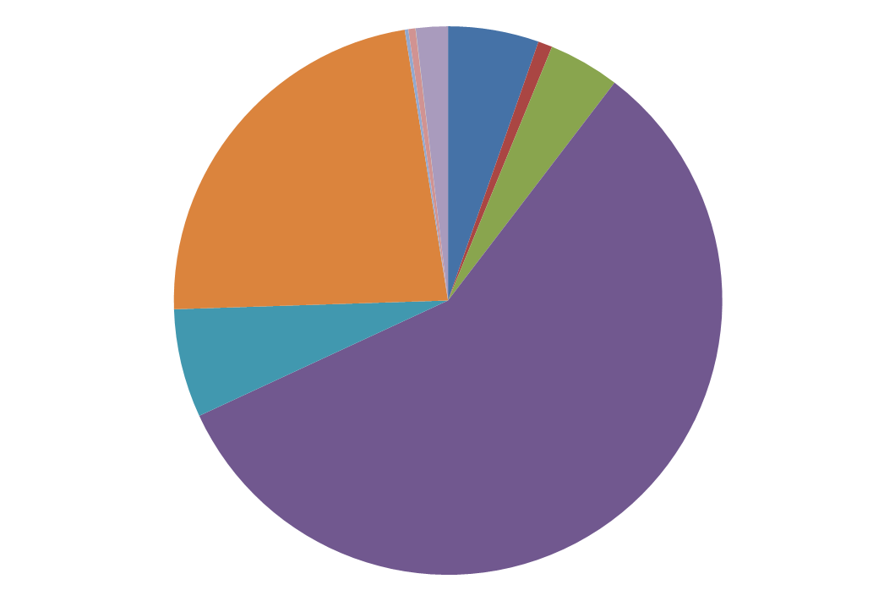
U.S. Fruit and Vegetable Imports
US Airports, 2004
DFW
0.4%
ATL
1.8%
All Other Airports
5.1%
BOS
0.01%
SFO
0.8%
ORD
4.0%
JFK
21.9%
MIA
55%
LAX
6.1%
Notes:
It’s a similar story for fruit and vegetable imports – more plant material on which pests can and do enter Florida. Miami International Airport represents an enormous pathway for plant pest introductions.
Information source:
US Department of Commerce

Slide 11
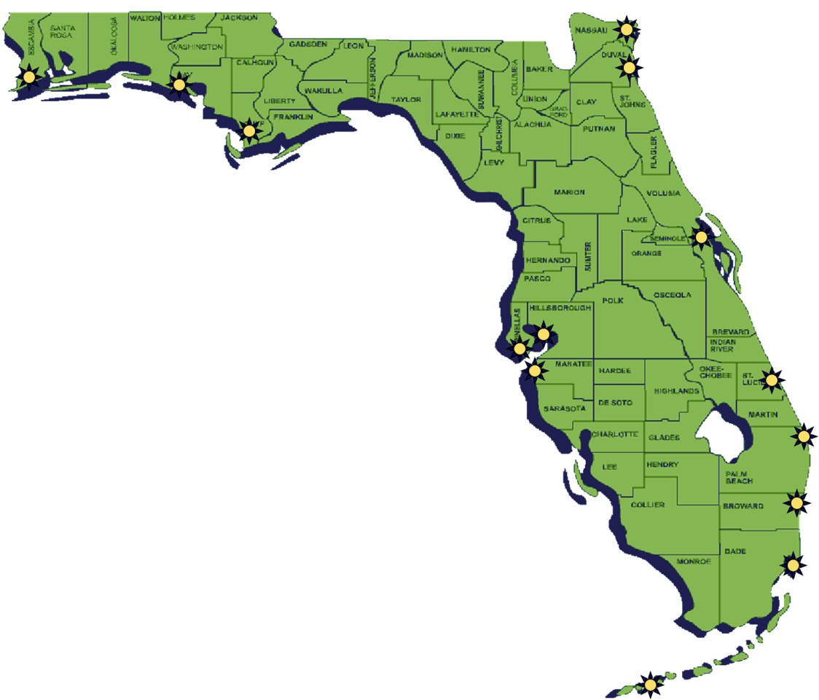
Florida has 14 Deepwater Ports
Port of Pensacola
Port of Panama City
Port of St. Joe
Port of Tampa
Port of St. Petersburg
Port of Manatee
Port of Key West
Port of Miami-Dade
Port of Everglades
Port of Palm Beach
Port of Ft. Pierce
Port Canaveral
Port of Jacksonville
Port Fernandina
Photo: Microsoft Power point clip art, Map courtesy of: Florida CAPS
Notes:
In addition to airports, Florida also has 14 deepwater ports. They play an important role in international trade which causes introduction of exotic species into Florida.
Map courtesy of Florida CAPS program.

Slide 12
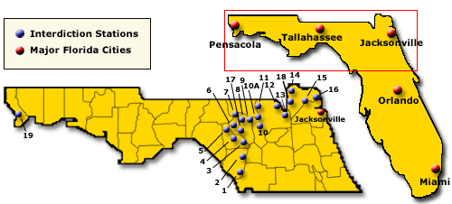
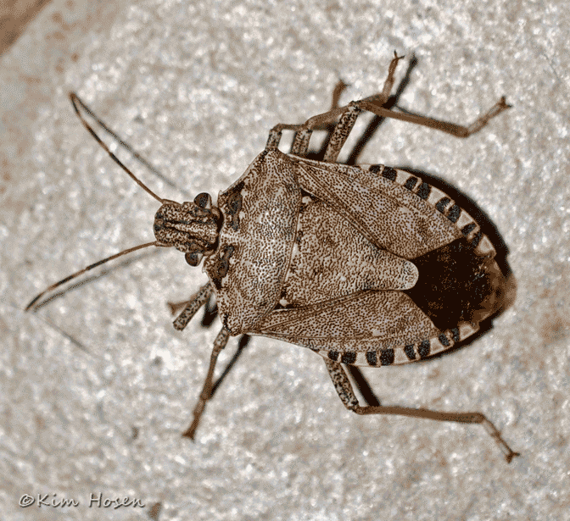
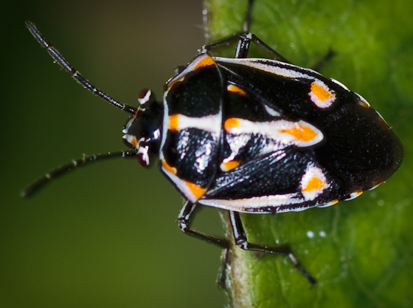
Agricultural Interdiction Stations
Multiple Interceptions: 2011-2013
Brown Marmorated Stink Bug
Bagrada Bug
Map courtesy of: Florida CAPS
Notes:
Invasive pests can also come into Florida through commercial shipments of agricultural, ornamental, or forestry products that originated in a different part of the United States and are brought to Florida on trucks.
21 interceptions for BMSB-2011-2013
13 interceptions for Bagrada Bug 2011-2013
Part of the mission of the Florida Cooperative Agricultural Pest Survey (CAPS) is to inspect agricultural shipments traveling into Florida from other states (e.g. via interstate highway). Although less than 5% of agricultural shipments can be thoroughly inspected, in 2012, CAPS detected brown marmorated stink bug and bagrada bug (both potentially invasive pest species) three times each at interdiction stations.
Information source:
Dyrana Russell. 2012. Agricultural Interdiction Station Inspection. Presented at the 2013 Annual CAPS Conference, Gainesville, FL.
Greg Hodges. 2014. Personal communication.

Slide 13
Why is Florida a likely place for invasive species to establish?
Live plant material is imported through airports, deepwater ports, and interstate travel.
Florida has a large tourism industry.
Florida has prolonged growing seasons and a favorable climate.
Notes:
Time to review: why is Florida a likely place for invasive species to establish?
Live plant material is imported regularly through airports, deepwater ports, and interstate travel.
Florida has a large tourism industry which promotes regular international travel and possible “hitchhikers”
Florida has prolonged growing seasons and a favorable climate for introduced pest populations.
This means that because Florida has a higher chance of getting potentially invasive species and having them survive and thrive in its climate, Florida is disproportionately affected by invasive species.
Clearly, we need your help to keep an eye on things.

Slide 14
Authors
Jennifer Hamel, Ph.D.
Postdoctoral Associate, Department of Entomology and Nematology, University of Florida

Slide 15
Editors
Matthew D. Smith, Ph.D.
Postdoctoral Associate, Department of Entomology and Nematology, University of Florida
Keumchul Shin, M.S.
Graduate Research Assistant, Doctor of Plant Medicine program, University of Florida

Slide 16
Reviewers
Stephanie Stocks, M.S.
Assistant-In, Extension Scientist, Department of Entomology and Nematology, University of Florida
Amanda Hodges, Ph.D.
Associate Extension Scientist, Department of Entomology and Nematology, University of Florida
Smriti Bhotika, Ph.D.
Postdoctoral Associate, Department of Entomology and Nematology, University of Florida

Slide 17
Educational Disclaimer and Citation
This presentation can be used for educational purposes for NON-PROFIT workshops, trainings, etc.
Citation:
  Hamel, J., Ph.D., 2014. Collaborative and Enhanced First Detector Training: Pests and Pathways, June 2014.

Slide 18
Collaborating Agencies
U.S. Department of Agriculture Animal and Plant Health Inspection Service (USDA-APHIS)
Cooperative Agricultural Pest Survey Program (CAPS)
Florida Department of Agriculture and Consumer Services (FDACS)
National Plant Diagnostic Network (NPDN)
Sentinel Plant Network (SPN)
Protect U.S.
University of Florida Institute of Food and Agricultural Sciences (UF-IFAS)

Slide 19
References
  Hodges, Amanda and Stephanie Stocks. 2010. Overview: Invasive Species that Affect Plants. Updated December 2011. Accessed June 21, 2013 –
      www.protectingusnow.org
  Massachusetts Introduced Pests Outreach Project. August 23, 2006. Plum Pox Pest Alert. Accessed June 21, 2013 –
      http://www.massnrc.org/pests
  Dyrana Russell. 2012. Agricultural Interdiction Station Inspection. Presented at the 2013 Annual CAPS Conference, Gainesville, FL.
  US Department of Commerce
  Florida CAPS program
  USDA, Animal and Plant Health Inspection Service. Plant Health. Giant African Snail. Accessed December 5, 2013 – http://www.aphis.usda.gov/plant_health/plant_pest_info/gas/index.shtml

