Slide 1
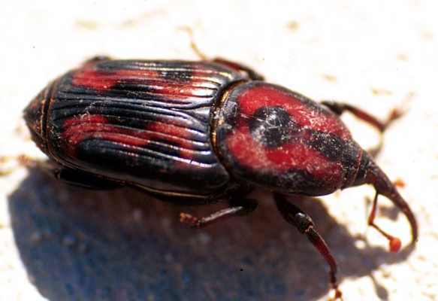
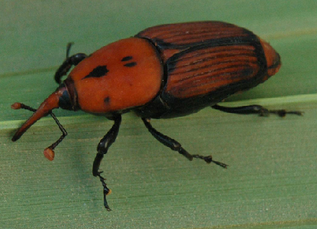
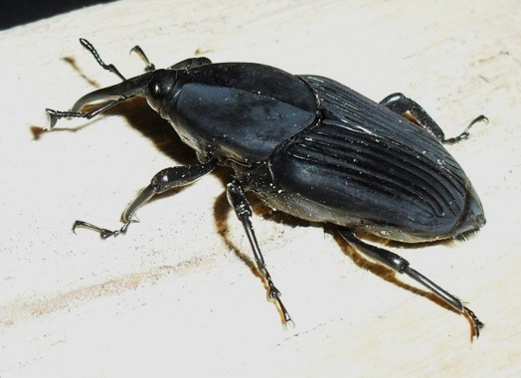
Palm Weevils
Palmetto weevil
(Rhynchophorus cruentatus)
Red Palm Weevil
(Rhynchophorus ferrugineus)
South American Palm Weevil
(Rhynchophorus palmarum)
Photos: (Left) - Jim Occi, BugPics, Bugwood.org, #2512047; (Center) - Amy Roda, USDA-APHIS; (Right) - F. J. Rodriguez, Wikimedia Commons
Notes:
This presentation discusses three giant palm weevil species of the genus Rhynchophorus. Palmetto weevil (Rhynchophorus cruentatus), red palm weevil (Rhynchophorus ferrugineus), and South American palm weevil (Rhynchophorus palmarum) are all important pests of palm.
Weevils are in the beetle order (Coleoptera) and represent a large, important and diverse group of insects. Weevils have mandibles at the end of their rostrum (a long, snout-like projection at the anterior of the head). For those species that are considered economic pests, the most damage is caused by larvae that feed inconspicuously inside the host plant.
Information sources:
Weissling, T. J. and R. M. Giblin-Davis. 1997. Revised 2013. “Palmetto weevil, Rhynchophorus cruentatus Fabricius (Insecta: Coleoptera: Curculionidae).” University of Florida, Entomology and Nematology Department, IFAS. Accessed 2-6-14 –
https://edis.ifas.ufl.edu/pdffiles/IN/IN13900.pdf

Slide 2
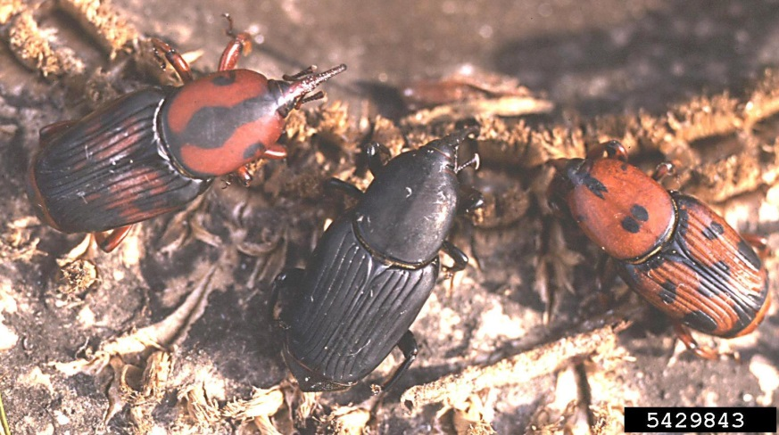
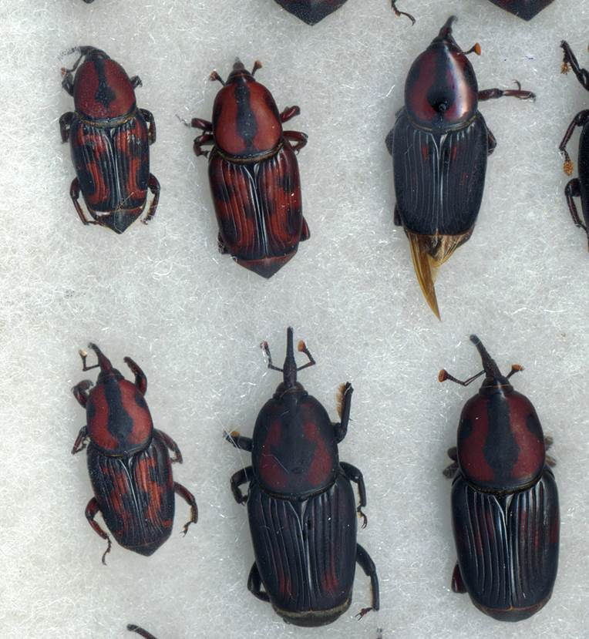
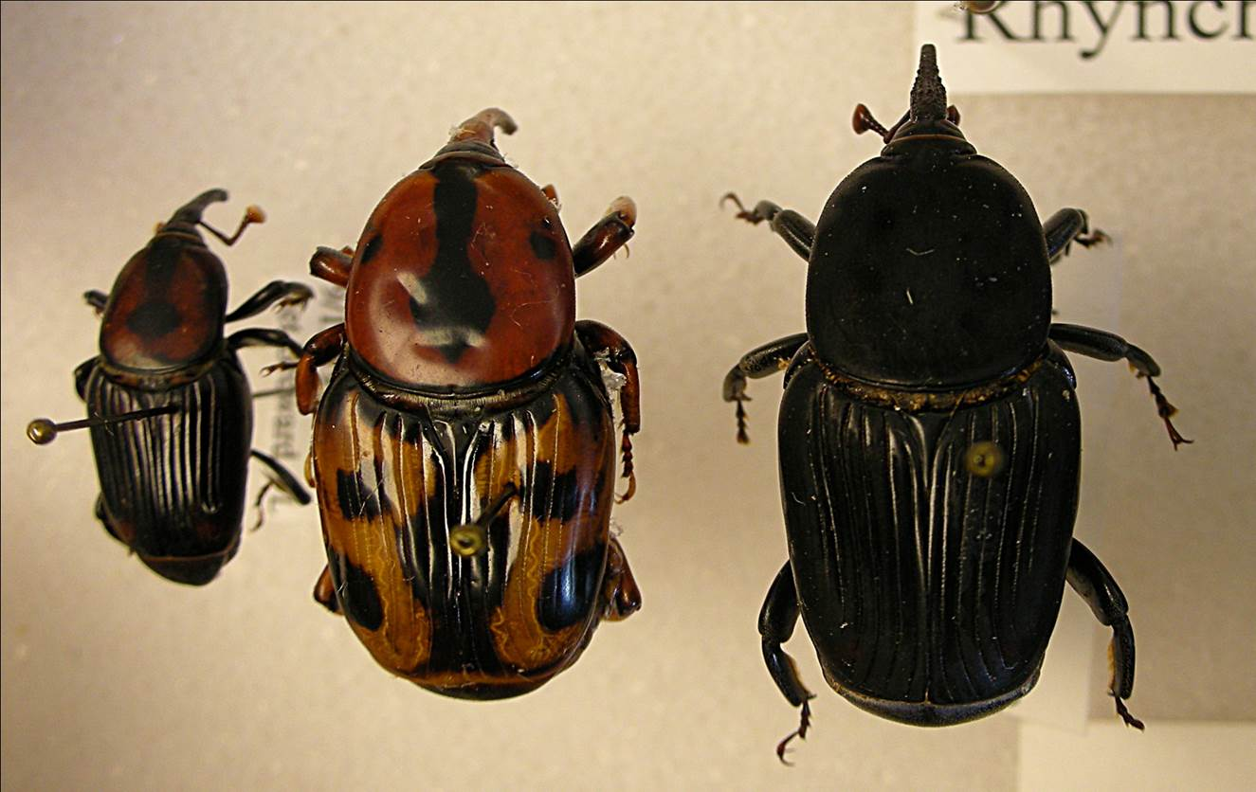
Palmetto Weevil
Rhynchophorus cruentatus
Photo: Top left: Doug Caldwell, Univ. Florida, Bugwood.org, #5429843; Right and Bottom Left: Robin M. Giblin-Davis, University of Florida
Notes:
The palmetto weevil, Rhynchophorus cruentatus, is native to Florida and the southeastern United States. The adult weevils can vary greatly in coloration from nearly solid black to almost solid red with a variable black pattern. It also varies in size from 1.9 to 3 cm and is the largest weevil in North America.
Information sources:
Thomas, M. C. 2010. Pest alert: Giant palm weevils of the genus Rhynchophorus (Coleoptera: Curculionidae) and their threat to Florida palms. FDACS DPI.
Accessed 2/9/2014 –
http://www.freshfromflorida.com/pi/pest-alerts/pdf/giantpalmweevils.pdf

Slide 3
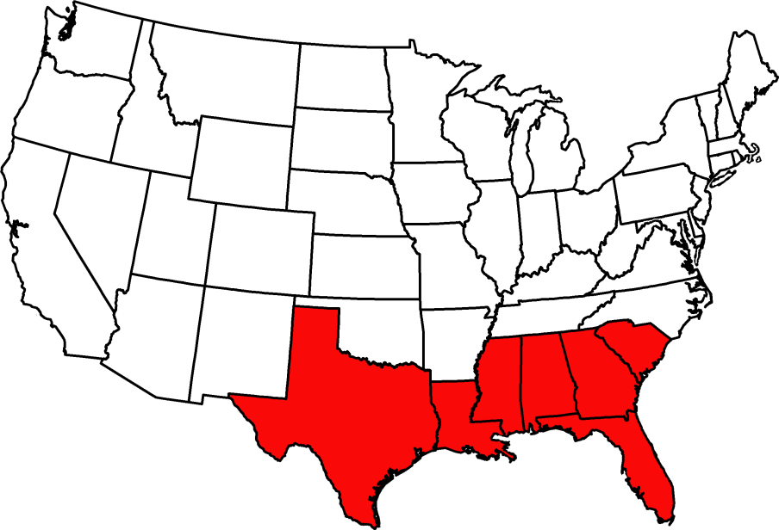
Palmetto Weevil Distribution
States where palmetto weevil is found
Notes:
Palmetto weevil is found in the coastal plain of the southeastern United States from South Carolina to southern Texas. In Florida, it occurs throughout the state.
It is also found in the Bahamas.
Information sources:
Thomas, M. C. 2010. Pest alert: Giant palm weevils of the genus Rhynchophorus (Coleoptera: Curculionidae) and their threat to Florida palms. FDACS DPI.
Accessed 2/9/2014-
http://www.freshfromflorida.com/pi/pest-alerts/pdf/giantpalmweevils.pdf
Thomas, M. C. 2011. “Giant palm weevils: Headed our way?”. FDACS DPI - Florida State Collection of Arthropods.
Accessed 2/9/2014-
http://entnemdept.ufl.edu/hodges/Florida2011/Thomas.pdf

Slide 4
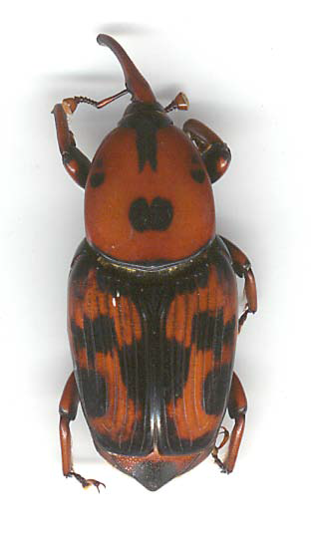
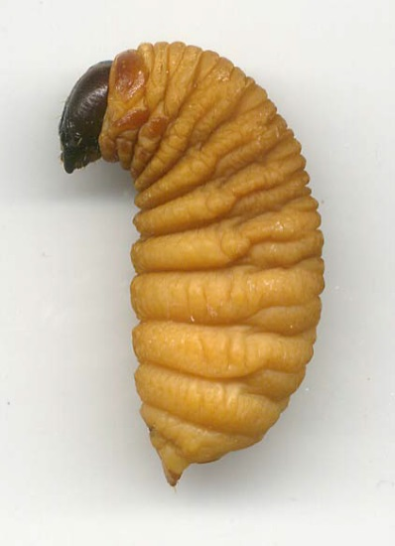
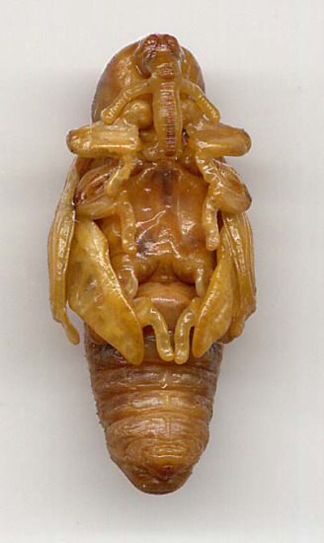
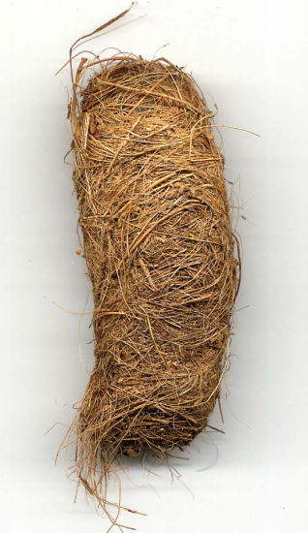
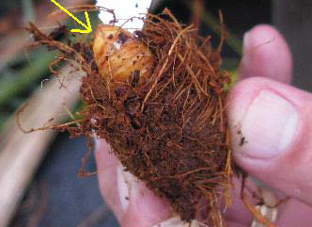
Palmetto Weevil Life Cycle
Adult
Larva
Eggs
Pupa
Pupal cocoon
Pupa in cocoon
Photos: Robin M. Giblin-Davis , University of Florida
Notes:
Volatile odors called “palm esters” are released by stressed, wounded or dying trees. Palmetto weevils are able to detect these odors and are attracted to the trees. Once Rhynchophorus cruentatus has found such a host, it will then release aggregation hormones that attract even more palmetto weevils. When a population of weevils has massed on the tree, mating and egg laying take place.
Eggs: Under laboratory conditions, females lay an average of 207 eggs over the course of their lives. Eggs are laid in wounds or the bottom of leaves in host plants. After about 3 days, eggs hatch and begin to feed.
Larvae: Larvae are creamy yellowish in color and can be quite large, weighing close to 6 grams. The prominent head capsule is hard and dark brown with large mandibles. Larvae are voracious feeders and prefer the soft tissue surrounding the apical meristem. When mature, larvae migrate to the edge of stems and petioles where cocoons are prepared from palm fibers.
Pupae: Palmetto weevils first enter a prepupal stage then a pupal stage. The pupal stage lasts several weeks.
Adults: Once the adult molts, it may immediately leave the cocoon or stay within the cocoon for several days to weeks before emerging. Adults are active fliers and can vary greatly in coloration from nearly solid black to almost solid red with a variable black pattern. They vary in size from 1.9 to 3 cm. Lifespan of is about 84 days, but in laboratory conditions adults have lived up to 26 weeks under adequate moisture conditions.
Information sources:
Bertone, C., P. S. Michalak, and A. Roda. 2010. New pest response guidelines: Red palm weevil, Rhychophorus ferrugineus. USDA APHIS.
Accessed 2/9/2014-
http://www.aphis.usda.gov/import_export/plants/manuals/emergency/downloads/nprg-redpalmweevil.pdf
Nisson, N., D. Hodel, and M. S. Hoddle. “Red palm weevil”. Center for Invasive Species Research – University of California, Riverside.
Accessed 2/9/2014-
http://cisr.ucr.edu/red_palm_weevil.html
Weissling, T. J. and R. M. Giblin-Davis. 1997. Revised 2013. “Palmetto weevil, Rhynchophorus cruentatus Fabricius (Insecta: Coleoptera: Curculionidae).” University of Florida, Entomology and Nematology Department, IFAS. Accessed 2-6-14 –
https://edis.ifas.ufl.edu/pdffiles/IN/IN13900.pdf

Slide 5
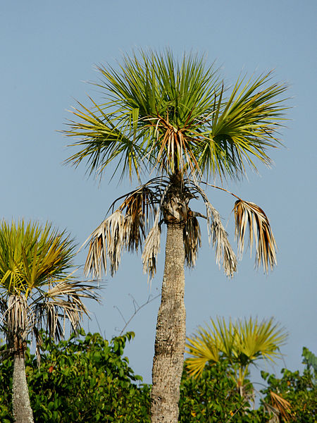
Palmetto Weevil Susceptible Plants
Native host plant:
Sabal palms
Saw palmetto
Florida thatch palm
Royal palms
Other host plants:
Canary Island date palms
Bismarck palms
Fan palms
Date palms
Coconut palm
Latania palms
Fishtail palms
Sabal palmetto
Photo: Wikimedia Commons, © Hans Hillewaert / CC-BY-SA-3.0
Notes:
The native host plant of palmetto weevil is sabal palm (Sabal palmetto). This pest’s host range is restricted to wounded or dying sabal palm, or newly planted landscape palms that are stressed.
Since the late 1990’s, however, it has caused damage to apparently healthy Canary Island date palms (Phoenix canariensis), latania (Latania sp.), and bismark (Bismarckia nobilis) palms. At times, it has even achieved severe pest status on Canary Island date palm (Phoenix canariensis) in Florida nurseries.
Other host plants of palmetto weevil include: Fan palms (Washingtonia sp. and Pritchardia sp.), Saw palmetto (Serrenoa repens), Date palm (Phoenix dactylifera), Royal palms (Roystonea sp.), Coconut palm (Cocos nucifera), Fishtail palms (Caryota sp.), and Florida thatch palm (Thrinax radiata).
Information sources:
Thomas, M. C. 2010. Pest alert: Giant palm weevils of the genus Rhynchophorus (Coleoptera: Curculionidae) and their threat to Florida palms. FDACS DPI.
Accessed 2/9/2014-
http://www.freshfromflorida.com/pi/pest-alerts/pdf/giantpalmweevils.pdf
Weissling, T. J. and R. M. Giblin-Davis. 1997. Revised 2013. “Palmetto weevil, Rhynchophorus cruentatus Fabricius (Insecta: Coleoptera: Curculionidae).” University of Florida, Entomology and Nematology Department, IFAS. Accessed 2-6-14 –
https://edis.ifas.ufl.edu/pdffiles/IN/IN13900.pdf
Thomas, M. C and L. Whilby. 2011. “Giant palm weevils: Headed our way?”. FDACS DPI - Florida State Collection of Arthropods.
Accessed 2/9/2014-
http://entnemdept.ufl.edu/hodges/Florida2011/Thomas.pdf

Slide 6
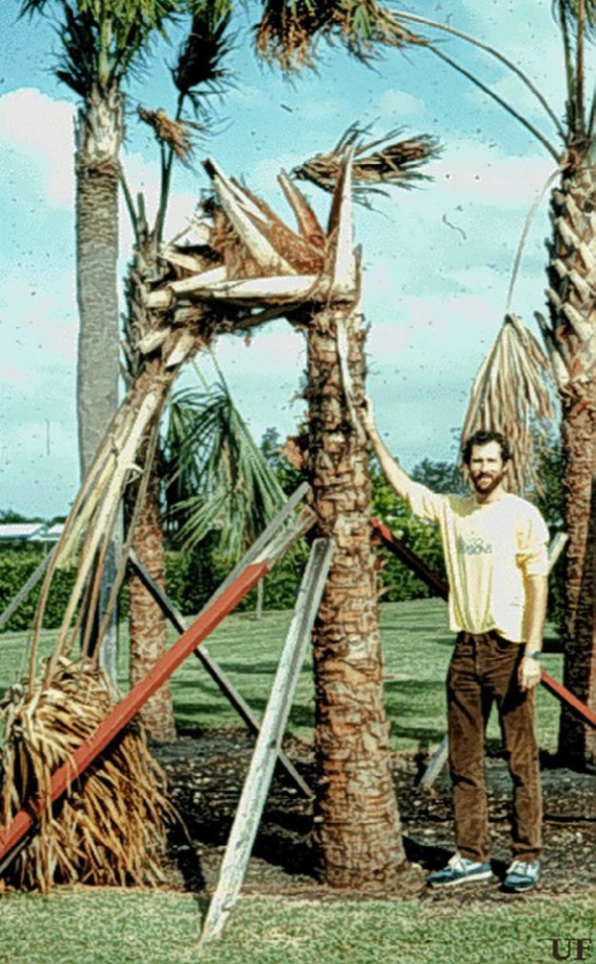
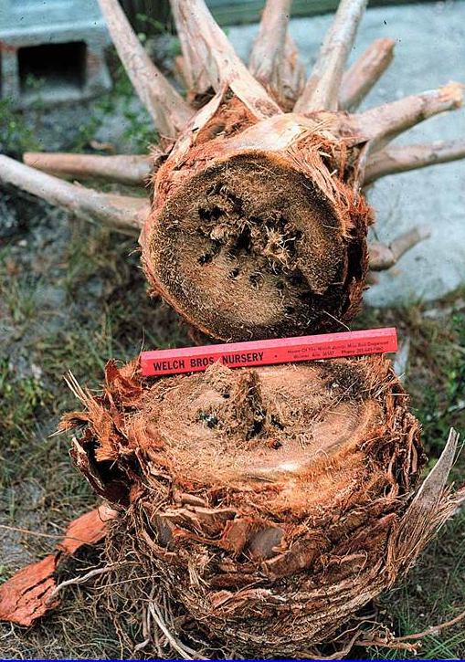
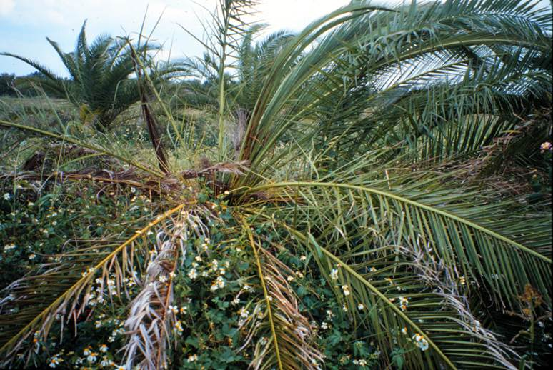
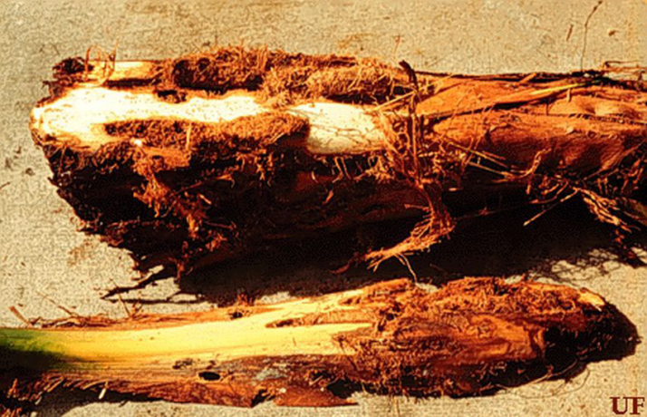
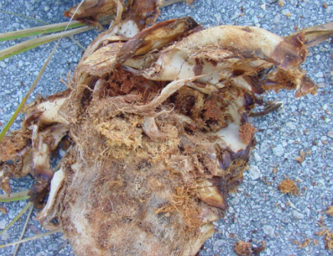
Palmetto Weevil Damage
From left to right, clockwise: “Popped neck” condition (sabal palm), larval damage in stem (sabal palm), larval damage of petioles and stem (Phoenix canariensis), larval damage (Canary Island date palm), damage to older Washingtonia
Photos: Robin M. Giblin-Davis , University of Florida
Notes:
Most damage is caused by larvae feeding on palm tissue. Larvae feed inconspicuously inside the host palm, thus early detection is very difficult.
Symptoms can vary, but generally include irreversible decline of younger leaves. Palm species with upright leaves, such as Canary Island date palms, show early symptoms in older leaves which first droop then collapse. Damage can be so severe that a condition called “popped neck” may occur where the top of the palm falls over as the integrity of the crown is compromised.
When the dead crown and stem eventually collapse, fronds are completely necrotic and a large amount of weevil frass is evident. If the crown is pulled apart, cocoons, larvae and even adults may be found.
Information sources:
Weissling, T. J. and R. M. Giblin-Davis. 1997. Revised 2013. “Palmetto weevil, Rhynchophorus cruentatus Fabricius (Insecta: Coleoptera: Curculionidae).” University of Florida, Entomology and Nematology Department, IFAS. Accessed 2-6-14 –
https://edis.ifas.ufl.edu/pdffiles/IN/IN13900.pdf
Giblin-Davis, R. M. “Biology and management of palm weevils.” University of Florida/IFAS, Fort Lauderdale Research and Education Center .
Accessed 2-6-2014 –
http://cisr.ucr.edu/pdf/giblin-davis,robin-biology_and_management_of_palm_weevils.pdf

Slide 7
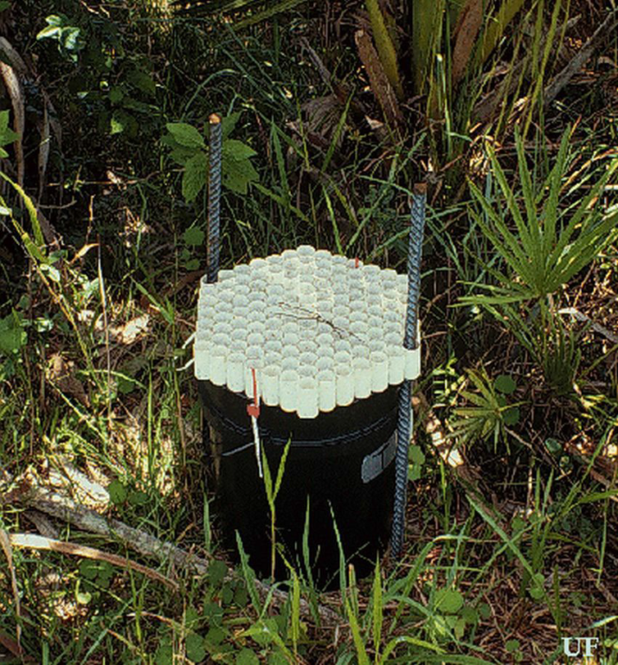
Palmetto Weevil Monitoring & Management
Bucket traps for monitoring
Prevention is key
Promote plant health
Avoid pruning/wounding
Plant non-susceptible species
Once infestation is detected, little can be done to save the tree
Palmetto weevil bucket trap
Photos: Robin M. Giblin-Davis , University of Florida
Notes:
Bucket traps with freshly cut palm tissue and/or commercially available pheromones can be used to monitor for various palm weevil species, including the palmetto weevil. The traps are most effective for capturing Rhynchophorus cruentatus adults if bait tissue is harvested within the previous 72 hours.
Cultural practices provide the best management options. Firstly, palms should be properly fertilized and irrigated to promote plant health and vigor. Secondly, pruning or wounding of trees should be avoided. Canary Island date palms, which are not adapted to South Florida, should not be planted. Otherwise, these palms should be carefully cared for to ensure their health.
Since larvae feed inconspicuously inside the host palm, early detection before there is lethal damage to the crown is difficult. By the time an infestation is detected, there is little that can be done to save the tree. Recently transplanted palms can be prophylactically treated with insecticides, but costs may be prohibitive. Systematic neonicitinoid insecticides can be used for curative and preventative treatments, but persistence and vigilance are necessary.
The recommended course of action is to cut down and destroy infested palms before adults emerge, thus reducing the possibility of spreading the infestation to adjacent trees.
Information sources:
Weissling, T. J. and R. M. Giblin-Davis. 1997. Revised 2013. “Palmetto weevil, Rhynchophorus cruentatus Fabricius (Insecta: Coleoptera: Curculionidae).” University of Florida, Entomology and Nematology Department, IFAS. Accessed 2-6-14 –
https://edis.ifas.ufl.edu/pdffiles/IN/IN13900.pdf
Weissling, T. J., R. M. Giblin-Davis, Scheffrahn, R. H., Mendoza, N. M. 1992. “Trap for Capturing and Retaining Rhynchophorus cruentatus (Coleoptera: Churculionidae) Adults Using Sabal Palmetto as Bait.” Florida Entomologist. 75: 212 – 221.
Accessed 2-7-2014 –
http://ufdcimages.uflib.ufl.edu/UF/00/09/88/13/00061/SN00154040_0075_00027.pdf

Slide 8
Red Palm Weevil
Native to southeast Asia and Pacific Islands
Most damaging pest of palms in the world!
$203 million U.S. palm industry at risk
Rhynchophorus ferrugineus
Photo: Amy Roda, USDA-APHIS
Notes:
Some consider the red palm weevil to be the most damaging insect pest of palms in the world.
From an economic standpoint, the nursery production of palm trees in Florida has an estimated value of $127 million, and $203 million throughout the United States. If the red palm weevil were detected in Florida, this could effect the production and trade of palm trees.
The red palm weevil may also effect other species of palm and outcompete native palm weevils, such as the palmetto weevil (Rhynchophorus cruentatus). Palm trees in the landscapes of major cities, residences, or local parks may also be at risk – who would want to see droopy palm trees along the coastal waters of Florida?
From an environmental perspective, the red palm weevil could heavily affect the threatened or endangered species of palms in Florida such as Sabal miamiensis if the insect were to use these palms as hosts. It should be noted that it is currently unknown whether S. miamiensis would be a suitable host of the red palm weevil.
The red palm weevil was recently detected for the first time in the western hemisphere in 2009 in the Caribbean Islands of Aruba and Curaçao.
Information sources:
Bertone, C., P. S. Michalak, and A. Roda. 2010. New pest response guidelines: Red palm weevil, Rhychophorus ferrugineus. USDA APHIS PPQ.
Accessed 2/9/2014-
http://www.aphis.usda.gov/import_export/plants/manuals/emergency/downloads/nprg-redpalmweevil.pdf
Nisson, N., D. Hodel, and M. S. Hoddle. “Red palm weevil”. Center for Invasive Species Research – University of California, Riverside.
Accessed 2/9/2014-
http://cisr.ucr.edu/red_palm_weevil.html
Zona, S. 1985. “A new species of Sabal (Palmae) from Florida.” Brittonia. 37: 366-368. Accessed 2-16-14 –
http://www.jstor.org/stable/2806549
Personal communication, Amy Roda.

Slide 9
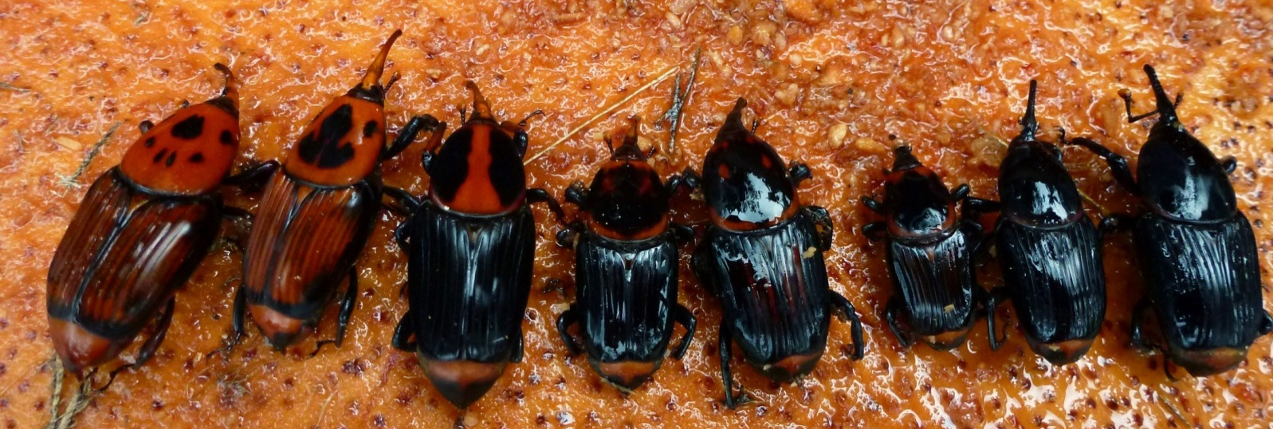
Red Palm Weevil Identification
Photos: Center for Invasive Species Research, University of California, Riverside
Notes:
The red palm weevil is predominately reddish-brown in the most typical form. However, coloration is not the most reliable method of identification since the red palm weevil has multiple color morphs ranging from almost entirely red with black markings to almost entirely black with red markings. Accurate identification can only be made using molecular data.
Information sources:
Hallett, R. H., B. J. Crespi, and J. H. Borden. 2004. Synonymy of Rhynchophorus ferrugineus (Olivier), 1790 and R. vulneratus (Panzer), 1798 (Coleoptera, Curculionidae, Rhynchophorinae). Journal of Natural History. 38: 2863-2882.
Nisson, N., D. Hodel, and M. S. Hoddle. “Red palm weevil”. Center for Invasive Species Research – University of California, Riverside.
Accessed 2/9/2014-
http://cisr.ucr.edu/red_palm_weevil.html

Slide 10
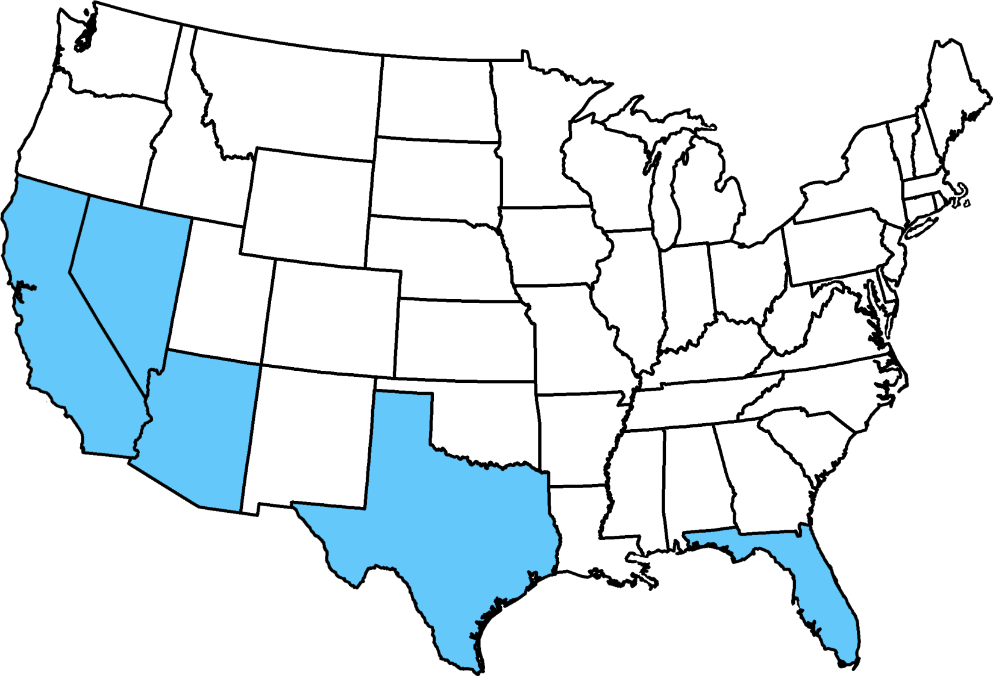
Red Palm Weevil Distribution
No sampling
Sampled but not found
Map courtesy of Pest Tracker, National Agricultural Pest Information System (NAPIS) and Amy Roda
Notes:
The red palm weevil is native to southeast Asia and Pacific Islands. Its current range includes parts of Asia, the Middle East, Africa, Europe, Oceania, and the Caribbean.
It is most commonly believed that the spread of this species and other species of giant palm weevils is due to international trade of infested palm plants or the use of untreated coconut coir as packing material. Since the palm weevils would be introduced to new areas along with their food source, the likelihood of establishment is high.
Distribution by region:
Asia: Bangladesh, Cambodia, China (Guangdong, Taiwan), India, Indonesia, Japan, Laos, Malaysia (Sabah, Sarawak), Myanmar, Pakistan, Philippines, Singapore, Sri Lanka, Thailand, and Vietnam.
Middle East: Bahrain, Georgia, Syria, Iran, Iraq, Israel, Jordan, Kuwait, Oman, Palestine, Qatar, Saudi Arabia, and the United Arab Emirates.
Africa: Algeria, Egypt, Libya, Madagascar, Malta, and Morocco.
Europe: Cyprus, France, Greece, Italy, Spain, Portugal, and Turkey.
Oceania: Australia, Papua New Guinea, Samoa, and the Solomon Islands.
The Caribbean: Aruba, Curacao
In 2010, it was reported that the first detection of the red palm weevil was detected in Laguna Beach, California. However, in 2013, it was found to not be Rhynchophorus ferrugineus, but a genetically distinct species. Researchers are currently debating whether or not to resurrect this species under the name R. vulneratus (Panzer).
Information sources:
National Agricultural Pest Information System (NAPIS). Purdue University. "Survey Status of Red Palm Weevil - Rhynchophorus ferrugineus (All years)." Published: 12/17/2013. http://pest.ceris.purdue.edu/map.php?code=INASMKA&year=alltime. Accessed: 12/19/2013.
Nisson, N., D. Hodel, and M. S. Hoddle. “Red palm weevil”. Center for Invasive Species Research – University of California, Riverside.
Accessed 2/9/2014-
http://cisr.ucr.edu/red_palm_weevil.html
Personal communication, (Andrew Derksen).
Rugman-Jones, P. F., C. Hoddle, M. Hoddle, R. Stouthamer. 2013. “The lesser of two weevils: molecular-genetics of pest
palm weevil populations confirm Rhynchophorus vulneratus (Panzer 1798) as a valid species distinct from R. ferrugineus (Olivier 1790), and reveal the global
extent of both.” PLoS ONE. 8: 1- 15.
Thomas, M. C. 2010. Pest alert: Giant palm weevils of the genus Rhynchophorus (Coleoptera: Curculionidae) and their threat to Florida palms. FDACS DPI.
Accessed 2/9/2014-
http://www.freshfromflorida.com/pi/pest-alerts/pdf/giantpalmweevils.pdf
Thomas, M. C and L. Whilby. 2011. “Giant palm weevils: Headed our way?”. FDACS DPI - Florida State Collection of Arthropods.
Accessed 2/9/2014-
http://entnemdept.ufl.edu/hodges/Florida2011/Thomas.pdf

Slide 11
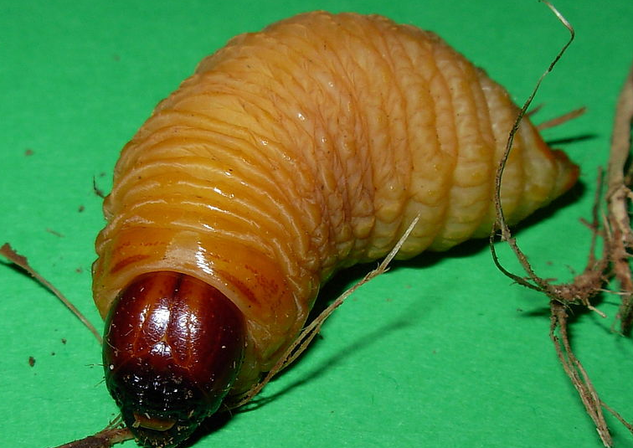
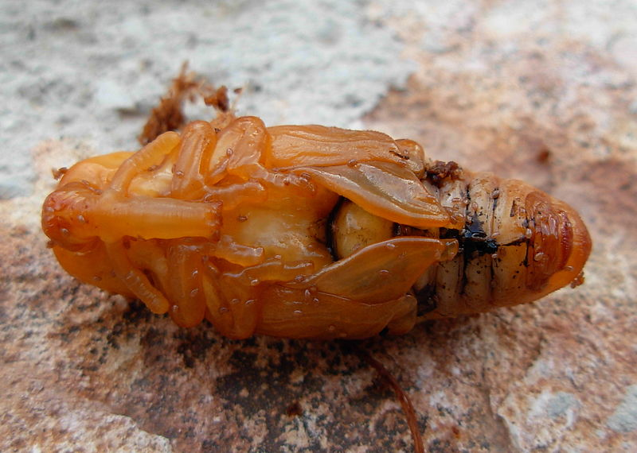
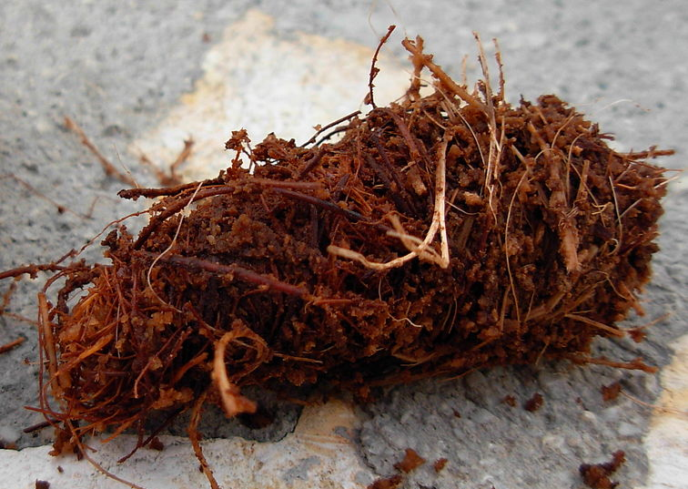
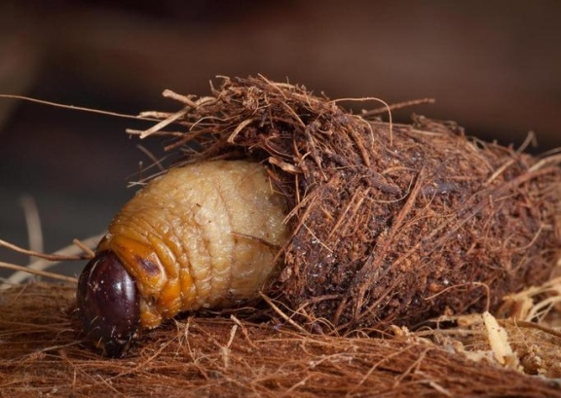
Red Palm Weevil Life Cycle
Adult
Larva
Eggs
Pupa
Pupal cocoon
Larva in cocoon
Photos: (Top left) Amy Roda, USDA APHIS; (Bottom right) - Mike Lewis, Center for Invasive Species Research, Bugwood.org #5430201; (Others) - Luigi Barraco, Wikimedia Commons
Notes:
The life cycle description provided here is for red palm weevils.
Eggs: The adult female penetrates plant tissue using her long, slender snout (rostrum) and deposits several eggs before cementing the hole closed. Each females lays an average of 250 eggs. The light yellow eggs are about 2.5 mm long. The eggs hatch in about 1 – 6 days.
Larvae: Larvae have soft, yellow grub-like bodies with hard, reddish-brown head capsules and grow up to 2 in long. The larvae feed on surrounding plant tissue, boring their way to the center of the tree. The larvae will continue to feed and tunnel through the plant for about two months. Before reaching the pupa stage, the larvae will create a cocoon out of dead plant tissue and coarse palm fibers in the trunk of the tree.
Pupae: Pupation in the cocoons requires an average of three weeks before pupae molt into adults.
Adults: Once the adult molts, it remains in the cocoon for several days until it reaches sexual maturity. Then the adult emerges and, within one week, begins mating and laying eggs. Adults are predominately active during the day and can fly long distances of more than 900 m (0.56 mi). The average adult is reddish-brown color and 35 x 12 mm (1.4 x 0.5 in) in size. The lifespan of an adult is ~2 – 3 months.
Information sources:
Bertone, C., P. S. Michalak, and A. Roda. 2010. New pest response guidelines: Red palm weevil, Rhychophorus ferrugineus. USDA APHIS.
Accessed 2/9/2014-
http://www.aphis.usda.gov/import_export/plants/manuals/emergency/downloads/nprg-redpalmweevil.pdf
Nisson, N., D. Hodel, and M. S. Hoddle. “Red palm weevil”. Center for Invasive Species Research – University of California, Riverside.
Accessed 2/9/2014-
http://cisr.ucr.edu/red_palm_weevil.html

Slide 12
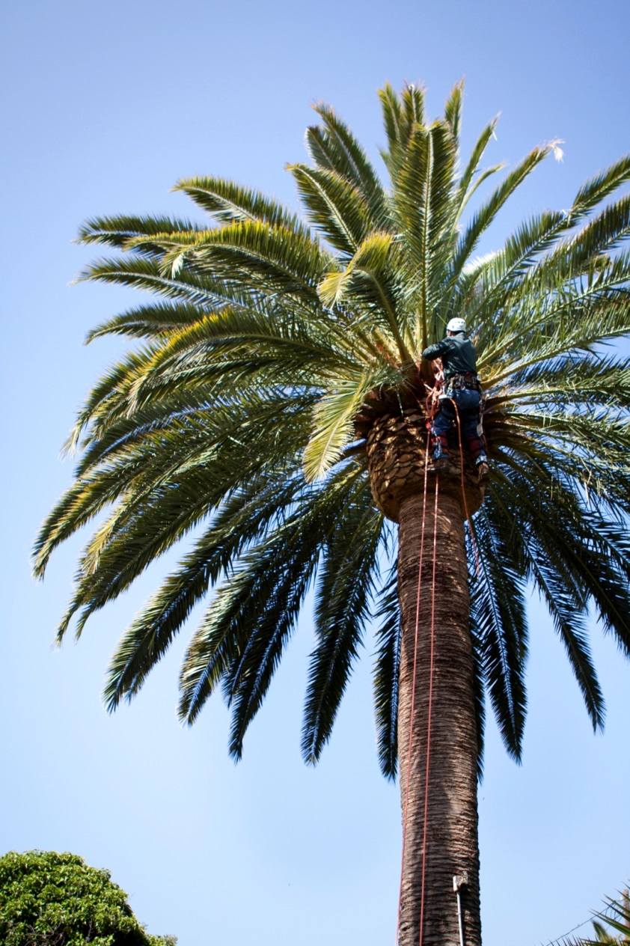
Red Palm Weevil Susceptible Plants
Some of the hosts found in Florida include:
African oil palm
Canary Island date palms
Chinese fan palm
Coconut
Cuban royal palm
Fishtail palm
Sago palm
Queen palm
Washington palms
Photo: Center for Invasive Species Research, University of California, Riverside
Notes:
Primary hosts of the red palm weevil include:
African oil palm (Elaeis guineensis)
betelnut palm (Areca catechu)
Canary Island date palm (Phoenix canariensis)
Chinese fan palm (Livistona chinensis)
Chinese windmill palm (Trachycarpus fortunei)
coconut (Cocos nucifera)
Cuban royal palm (Roystonea regia)
date palm (Phoenix dactylifera)
east Indian date palm (Phoenix sylvestris)
fishtail palm (Caryota cumingii)
gebang palm (Corypha utan)
mountain fishtail palm (Caryota maxima)
nibung palm (Oneosperma tigillarium)
palasan (Calamus merrillii)
pygmy date palm (Sabal blackburniana (=umbraculifera))
queen palm (Arecastrum romanzoffianum)
ribbon fan palm (Livistona decipiens)
sago palm (Metroxylon sagu)
sugar palm (Arenga pinnata)
thorny palm (Oneosperma horrida)
toddy palm (Borassus flabellifer)
Washington palms (Washingtonia sp.)
Sugarcane (Saccharum officinarum) is a secondary host.
The image shows an infested Canary Island date palm.
Of the above mentioned hosts, Phoenix and Elaeis are the most economically important species.
Information sources:
Bertone, C., P. S. Michalak, and A. Roda. 2010. New pest response guidelines: Red palm weevil, Rhychophorus ferrugineus. USDA APHIS.
Accessed 2/9/2014-
http://www.aphis.usda.gov/import_export/plants/manuals/emergency/downloads/nprg-redpalmweevil.pdf
Personal communication, Andrew Derksen.

Slide 13
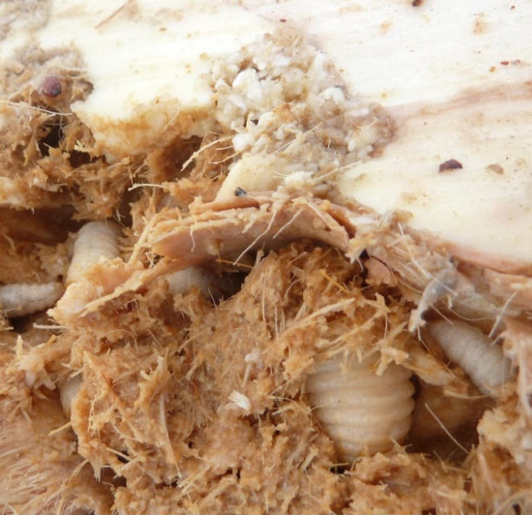
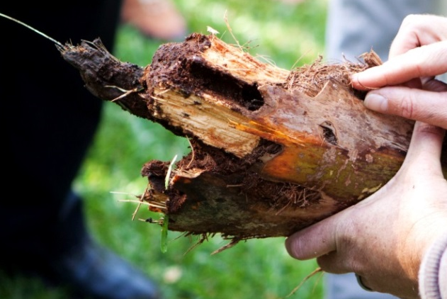
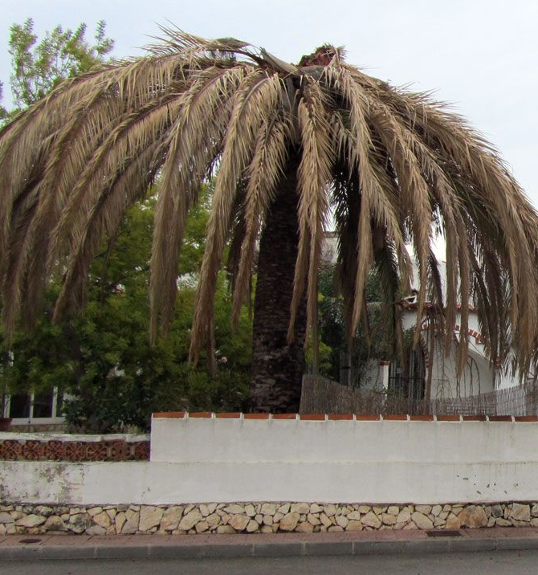
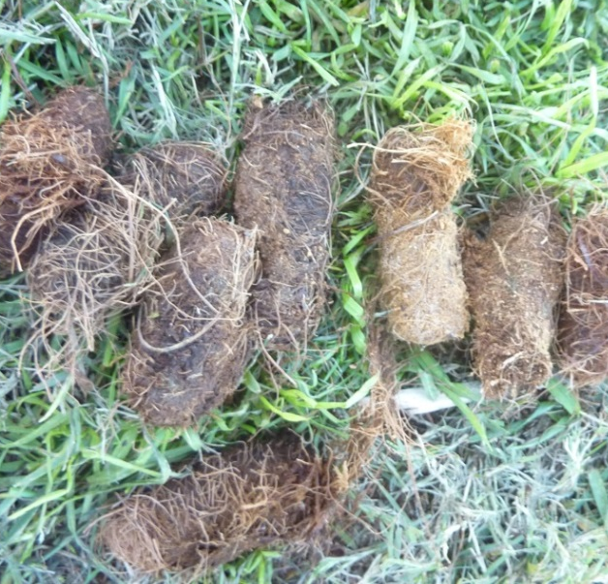
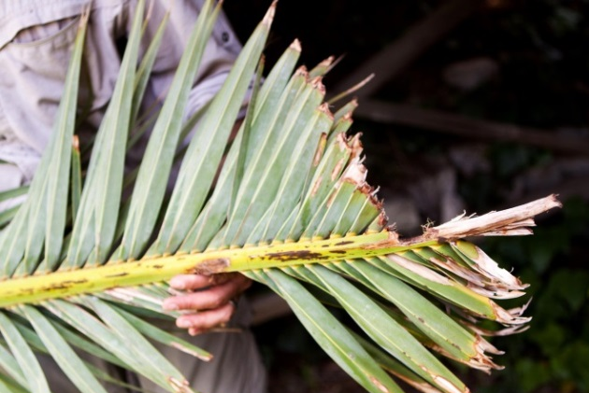
Red Palm Weevil Damage
Photos: (Top left) - Christina Hoddle, University of California - Riverside, Bugwood.org #5432623; (Middle) – Katja Schulz; Others) - Center for Invasive Species Research, University of California, Riverside
Notes:
Since most of the red palm weevil’s life cycle occurs in the palm’s internal tissues, early infestations of red palm weevil are difficult to detect. If it is possible to view the crown of the palm, look for larval mines and frass around the central growing point (apical meristem) or points of injury. The older leaves may also begin to droop.
Later stages of infestation are more noticeable. The newer leaves will not grow as large as older leaves and will start to yellow. The crown of dead or dying trees will become distorted and droop downward. Also, look for empty pupal cases and dead adults at the base of the tree.
Symptoms of red palm weevil:
Presence of tunnels on the base or crown of tree.
“Gnawing" sounds caused by larvae feeding inside.
Frass or plant fluids oozing near external tunnel entrances.
Highly distinctive "fermented" odor.
Empty pupal cases and dead adult in and around heavily infested palms.
Breaking of the trunk, or toppling of the palm crown.
Information sources:
Bertone, C., P. S. Michalak, and A. Roda. 2010. New pest response guidelines: Red palm weevil, Rhychophorus ferrugineus. USDA APHIS.
Accessed 2/9/2014-
http://www.aphis.usda.gov/import_export/plants/manuals/emergency/downloads/nprg-redpalmweevil.pdf
Nisson, N., D. Hodel, and M. S. Hoddle. “Red palm weevil”. Center for Invasive Species Research – University of California, Riverside.
Accessed 2/9/2014-
http://cisr.ucr.edu/red_palm_weevil.html

Slide 14
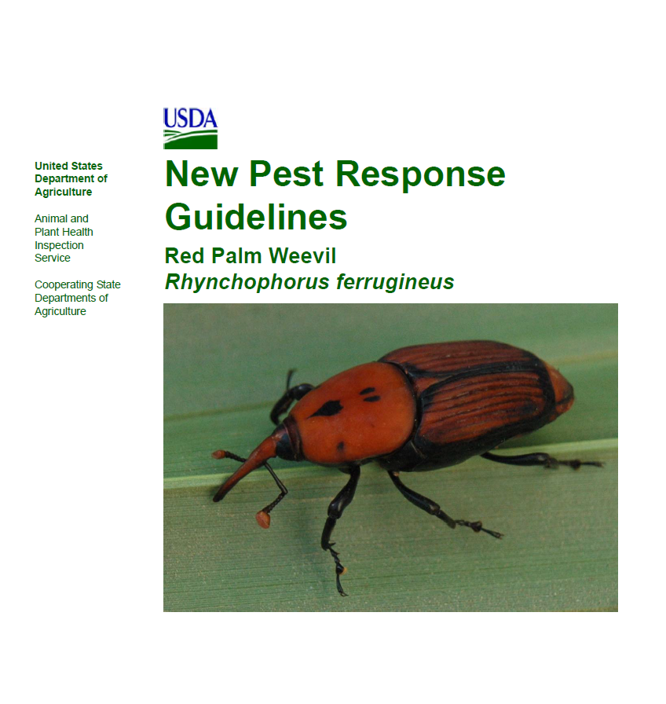
Red Palm Weevil Monitoring & Management
Control methods
Systemic insecticides (i.e. trunk injections, soil applications, etc.)
Mass trapping with aggregation pheromones
Chipping and burning infested material
Refer to New Pest Response Guidelines: Red Palm Weevil (USDA PPQ)
Notes:
The monitoring and management description provided here is for red palm weevils.
There are a few methods used to control or suppress populations of red palm weevil. Insecticides in the form of dusts, liquid sprays, trunk injections, or soil applications are the most commonly used and can be very effective. To reduce population densities without the use of chemicals, mass trapping has been used. The trapping consists of a combination of aggregation pheromones, fermented food bait, and ethyl acetate in bucket traps. At this time, there are no effective methods of biological control for this species.
Information sources:
Nisson, N., D. Hodel, and M. S. Hoddle. “Red palm weevil”. Center for Invasive Species Research – University of California, Riverside.
Accessed 2/9/2014-
http://cisr.ucr.edu/red_palm_weevil.html

Slide 15
South American Palm Weevil
Native to Mexico, Central and South America
Vector of Red Ring Nematode, Bursaphelenchus cocophius
Rhynchophorus palmarum
Photo: F. J. Rodriguez, Wikimedia Commons
Notes:
The South American palm weevil, Rhynchophorus palmarum, is also an invasive pest of palms and can be found in Mexico, Central America, and South America.
Rhynchophorus palmarum can vector a nematode, Bursaphelenchus cocophius, that causes red-ring disease in coconut.
Information sources:
Thomas, M. C. 2010. Pest alert: Giant palm weevils of the genus Rhynchophorus (Coleoptera: Curculionidae) and their threat to Florida palms. FDACS DPI.
Accessed 2/9/2014-
http://www.freshfromflorida.com/pi/pest-alerts/pdf/giantpalmweevils.pdf

Slide 16
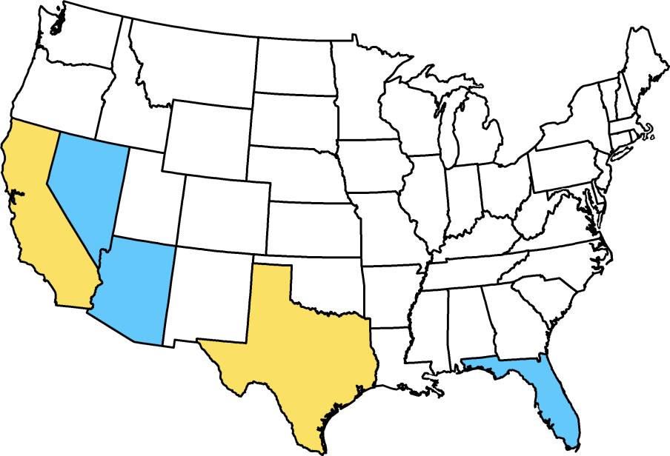
South American Palm Weevil Distribution
No sampling
Sampled but not found
Intercepted or detected, but not established
Map courtesy of Pest Tracker, National Agricultural Pest Information System (NAPIS)
Notes:
South American palm weevil is found in the tropical Americas, and the Caribbean. It has also been detected in parts of the United States (California and Texas).
Rhynchophorus palmarum has been recorded from Argentina, Belize, Bolivia, Brazil, Colombia, Costa Rica, Cuba, Dominica, Ecuador, El Salvador, French Guiana, Grenada, Guadeloupe, Guatemala, Guyana, Honduras, Martinique, Mexico, Nicaragua, Panama, Paraguay, Peru, Puerto Rico, St. Vincent, Surinam, Trinidad and Tobago, Uruguay and Venezuela.
The South American palm weevil has been intercepted or detected, but is not established in California and Texas. It is considered to be a threat to palms in Florida.
Information sources:
National Agricultural Pest Information System (NAPIS). Purdue University. "Survey Status of South American Palm Weevil - Rhynchophorus palmarum (All years)." Published: 12/17/2013. http://pest.ceris.purdue.edu/map.php?code=INASHTA&year=alltime. Accessed: 12/19/2013.
Thomas, M. C. 2010. Pest alert: Giant palm weevils of the genus Rhynchophorus (Coleoptera: Curculionidae) and their threat to Florida palms. FDACS DPI.
Accessed 2/9/2014-
http://www.freshfromflorida.com/pi/pest-alerts/pdf/giantpalmweevils.pdf
Thomas, M. C and L. Whilby. 2011. “Giant palm weevils: Headed our way?”. FDACS DPI - Florida State Collection of Arthropods.
Accessed 2/9/2014-
http://entnemdept.ufl.edu/hodges/Florida2011/Thomas.pdf

Slide 17
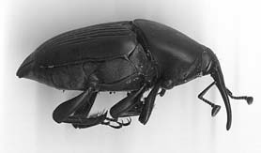
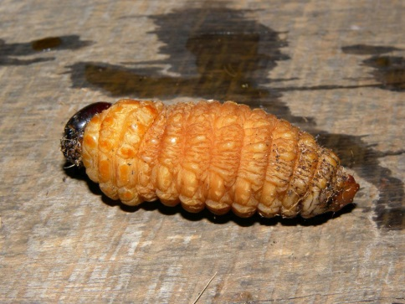
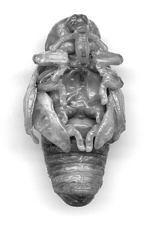
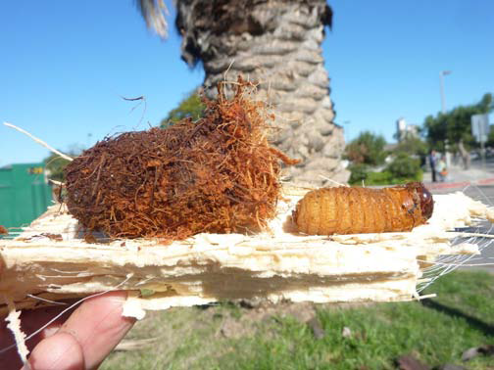
South American Palm Weevil Life Cycle
Adult
Larva
Eggs
Pupa
Pupal cocoon and prepupa
Photos: Adult - Robin M. Giblin-Davis , University of Florida ; Larva - Reinaldo Aguilar; Pupal cocoon and prepupa - Center for Invasive Species Research, University of California, Riverside; Pupa - Robin M. Giblin-Davis , University of Florida
Notes:
The life cycle of South American palm weevils is similar to other palm weevils but there are differences.
Eggs: The adult female penetrates plant tissue using her long, slender snout (rostrum) and deposits a single egg before cementing the hole closed. Females have been documented to lay up to 718 eggs in a lifetime. The pearly white eggs are about 2.4 mm long and 0.9 mm wide and hatch in about 3 – 5 days.
Larvae: Larvae go through 6 – 10 larval molts, with 9 molts being most common. Larvae are creamy white, legless and caterpillar-like and can grow up to 5 in long and 1 in wide. A deep orange-brown head houses stout mandibles. Larvae are voracious feeders, feeding on live vegetative and rotting tissue and preferring the softer tissue of the host plant. The larvae will continue to feed and tunnel through the plant for about two months. Once mature, the cuticle darkens to a reddish-brown with a dark brown head. Before reaching the pupa stage, the larvae will create a cocoon out of tough, fibrous palm fibers.
Pupae: Pupae spend 4 -17 days in a prepupal stage and 8-23 days in a true pupal stage.
Adults: Once the adult molts, it remains in the cocoon for 4 -11 days. Then the adult emerges and, within 12 – 24 hours, begins feeding and mating indiscriminately. Oviposition occurs 2 – 9 days after first mating. Adults are strong fliers which are predominately active during the morning and late afternoon. Adults fly an average of 20 feet per second and can travel distances up to 1600 m (1 mile) in 24 hours. The average adult is a deep black color and 33 x 15 mm (1.3 x 0.6 in) in size. The lifespan of an adult averages 40 – 45 days.
Information sources:
EPPO. 2005. Data sheets on quarantine pests: Rhynchophorus palmarum. OEPP/EPPO Bulletin. 35: 468 – 471.
Accessed 2-7-14 –
http://www.eppo.int/QUARANTINE/insects/Rhynchophorus_palmarum/DS_Rhynchophorus_palmarum.pdf
Hagley, E. A. C. 1965. “On the Life History and Habits of the Palm Weevil, Rhynchophorus palmarium.” Annals of the Entomological Society of America. 58: 22-28.
Molet, T. A. L. Roda, L. D. Jackson, and B. Salas. 2011. CPHST Pest Datasheet for Rhynchophorus palmarum. USDA-APHIS-PPQ-CPHST.
Accessed 2-7-14 –
http://www.aphis.usda.gov/plant_health/plant_pest_info/palmweevil/downloads/Rhynchophoruspalmarum_v5.pdf

Slide 18
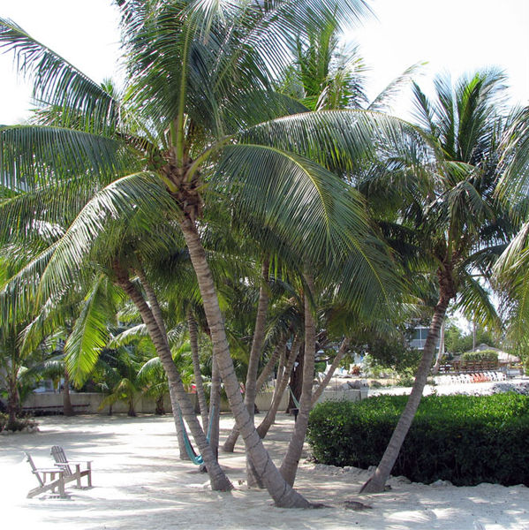
South American Palm Weevil Susceptible Plants
Primary hosts include:
Coconut palm
African oil palm
Sago palm
Canary Island date palm
Date palm
Sugar cane
Juçara palm
Coconut palm
Photo: Wikimedia Commons, Dominika Durtan
Notes:
Primary host plants of South American palm weevil are: Coconut palm (Cocos nucifera), African oil palm (Elaeis guineensis), Juçara palm (Euterpe edulis), Sago palm (Metroxylon sagu), Canary Island date palm (Phoenix canariensis), Date palm (Phoenix dactylifera), and sugarcane (Saccharum officinarum).
Secondary hosts include: Ananas comosus (pineapple), Annona reticulata (custard apple), Artocarpus altilis (Fosberg breadfruit), Carica papaya (papaya), Citrus spp. (citrus), Mangifera indica (mango), Musa spp. (banana), Persea americana (avocado), Psidium guajava (guava), Theobroma cacao (cocoa). Rhynchophorus palmarum is not known to be an economically important pest of secondary hosts.
Adults can also feed on numerous plant species including:
Acrocomia aculeata (gru gru palm), Ananas sativa (pineapple), Anona reticulata (sugar apple), Anona muricata (soursop), Bactris major (black Roseau palm), Bambusa sp. (bamboo), Beta vulgaris (beet), Brassica rapa (turnip), Carica papaya (paw paw), Chrysalidocarpus lutescens (bamboo palm), Citrullus vulgaris (watermelon), Citrus aurantium (orange), Colocasia sp. (dasheen), Cucumis sativus (cucumber) , Cucurbita pepo (pumpkin), Daucus carota (carrot), Desmoncus major (picmoc palm), Dioscorca sp. (yam), Euterpe broadwayana (manac palm), Mangifera indica (mango), Manicaria saccifera (timite palm), Maximiliana caribaea (cocorite palm), Musa sapientum (banana), Oreodoxa oleracea (cabbage palm), Persea gratissima (avocado pear), Psidium guyava (guava), Sabal sp. (carat palm), Solanum lycopersicum (tomato), Solanum melongena (egg plant), Spondias cytherea (golden apple), and Xanthosoma sp. (tannia).
Information sources:
Molet, T. A. L. Roda, L. D. Jackson, and B. Salas. 2011. CPHST Pest Datasheet for Rhynchophorus palmarum. USDA-APHIS-PPQ-CPHST.
Accessed 2/9/2014-
http://www.aphis.usda.gov/plant_health/plant_pest_info/palmweevil/downloads/Rhynchophoruspalmarum_v5.pdf
Thomas, M. C. 2010. Pest alert: Giant palm weevils of the genus Rhynchophorus (Coleoptera: Curculionidae) and their threat to Florida palms. FDACS DPI.
Accessed 2/9/2014-
http://www.freshfromflorida.com/pi/pest-alerts/pdf/giantpalmweevils.pdf
Thomas, M. C and L. Whilby. 2011. “Giant palm weevils: Headed our way?”. FDACS DPI - Florida State Collection of Arthropods.
Accessed 2/9/2014-
http://entnemdept.ufl.edu/hodges/Florida2011/Thomas.pdf

Slide 19
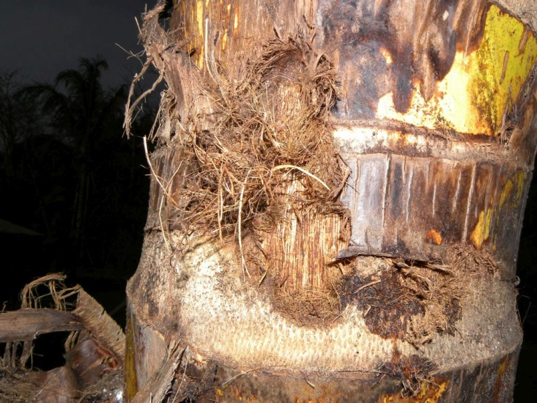
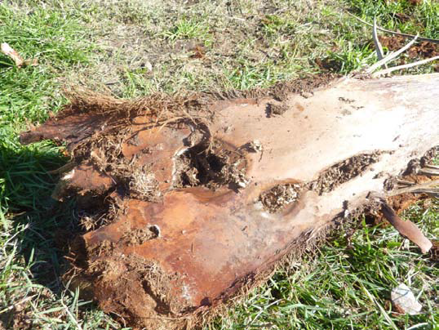
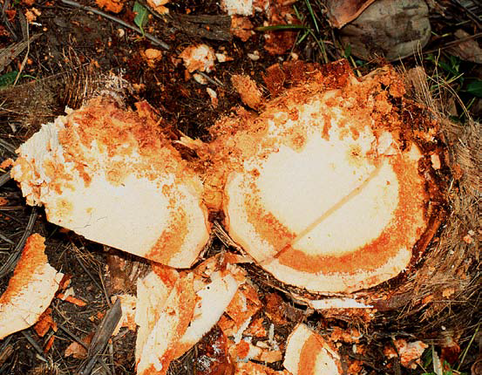
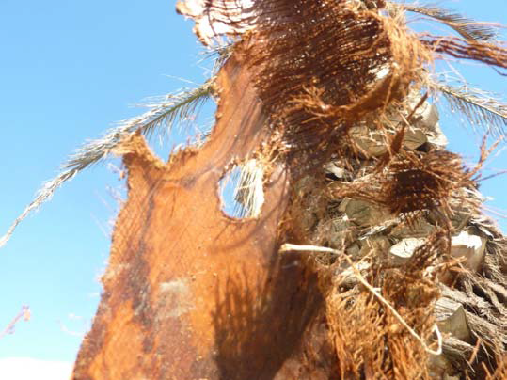
South American Palm Weevil Damage
Palm trunk damaged by R. palmarum in Costa Rica
Palm frond damage caused by larval tunneling of R. palmarum
Red ring disease showing the characteristic “red ring” in a coconut palm
Photos: (Top left) - Reinaldo Aguilar, www.osaresearch.org; (Others) - Center for Invasive Species Research, University of California, Riverside; Pupa - Robin M. Giblin-Davis , University of Florida
Notes:
Symptoms involve progressive yellowing of leaves, necrotic flowers and the death of emerging leaves. Leaves dry out from the crown down, with the apical meristem drooping and eventually dying. Most of the damage is caused by older larval instars which can excavate tunnels up to 40 cm in length and 3 cm wide in 24 to 36 hours. Larval galleries are clearly evident in leaves and stems of heavily infested hosts. The internal tissue of a 3 to 5 year old palm can be completely destroyed by larvae in just 5 to 6 weeks. It has been reported that just 30 larvae are sufficient to kill an adult coconut palm.
Pupae and older instars are often found in the petiole bases of the crown where they are well concealed.
Infested trees emit a characteristic odor which is foul and strong.
Symptoms of the lethal red ring disease of palms may also be evident as Rhynchophorus palmarum vectors the nematode Bursaphelenchus cocophilus which transmits the disease. A characteristic “red ring” is evident when the interior of the tree stem is exposed. Other symptoms vary depending on host species but can include yellowing of older leaves followed by younger leaves, premature nut fall and withering of inflorescences. Trees infected with red ring disease typically die 2 - 4 months after first showing symptoms. Red ring disease causes serious damage to over 17 species of palms, but is especially important to coconut and oil palms in the Neotropics where it is causes up to 10 – 15% of the annual losses of these two species.
Information sources:
EPPO. 2005. Data sheets on quarantine pests: Rhynchophorus palmarum. OEPP/EPPO Bulletin. 35: 468 – 471.
Accessed 2-7-14 –
http://www.eppo.int/QUARANTINE/insects/Rhynchophorus_palmarum/DS_Rhynchophorus_palmarum.pdf
Giblin-Davis, R. M., P. S. Lehman, and R. N. Inserra. Fact sheet: Bursaphelenchus cocophilus, Red Ring Disease of Coconut. Society of Nematologists. A
ccessed 2-7-14 –
http://nematode.unl.edu/pest1.htm

Slide 20
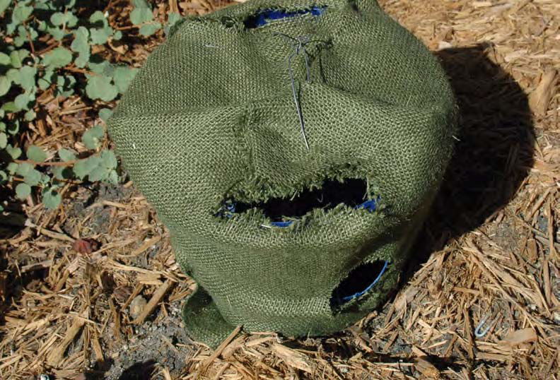
South American Palm Weevil Monitoring & Management
Monitoring by:
Pheromone traps
Visual inspection
Management by:
Pheromone traps
Phytosanitation
Management of red ring disease by control of R. palmarum populations
Homemade weevil trap
Photos: Amy Roda, USDA-APHIS
Notes:
Since Rhynchophorus palmarum are well concealed within the tissues of the host, infestations can only be detected once the palm begins to die, by using pheromone traps to detect adults or via visual surveys to detect larval populations before adults emerge.
Visual inspections are typically conducted once signs of infestation are evident for suspect trees. Palm fronds are removed from the base with a pole cutter and the petiole is inspected for tunneling, larvae, pupae or adults. Splitting the base of the palm frond with a hatchet can be helpful.
Another method for visual inspection is to cut a “window” by cutting multiple fronds from the crown to the beginning of the trunk. This method may be able to detect larval and pupal stages before adults emerge but will affect the appearance of the palm and should only be used with highly suspect trees.
These techniques can be used to monitor other palm weevil species as well.
Traps can be homemade using a 5-gallon bucket or bought. A lure with aggregation pheromones, ethyl acetate (the chemical emitted by stressed trees) and a sweet food bait such as sugarcane are used. A 1:1 solution of propylene glycol and water are poured over the bait to cover 75% of the food bait. This mixture retains the captured weevils in the trap as well as extends the life of the food bait. It is also acceptable to used the same trap to lure the red palm weevil. In such a case, a pheromone lure specific to the red palm weevil should also be used.
Various variations of traps and lures also exist.
Traps are used not only to monitor but also to control R. palmarum populations. Most often, however, infested trees are destroyed to reduce infestation levels. Chemical control has not been successful and is not recommended. Research is currently being conducted on the use of natural enemies such as Paratheresia menezesi (Diptera: Tachinidae), mites (Hypoaspis sp. and Tetrapolypus rhynchophori) and the entomopathogenic fungi Beauveria bassiana to control populations but more work needs to be done in this area.
Currently the only method of managing red ring disease is to control the vector R. palmarum as efficient control of the nematode vector does not exist.
Information sources:
EPPO. 2005. Data sheets on quarantine pests: Rhynchophorus palmarum. OEPP/EPPO Bulletin. 35: 468 – 471.
Accessed 2-7-14 –
http://www.eppo.int/QUARANTINE/insects/Rhynchophorus_palmarum/DS_Rhynchophorus_palmarum.pdf
Molet, T. A. L. Roda, L. D. Jackson, and B. Salas. 2011. CPHST Pest Datasheet for Rhynchophorus palmarum. USDA-APHIS-PPQ-CPHST.
Accessed 2/9/2014-
http://www.aphis.usda.gov/plant_health/plant_pest_info/palmweevil/downloads/Rhynchophoruspalmarum_v5.pdf
Miguens F. C., J. A. S. Magalhães, L. M. Amorim, V. R. Goebel, N. L. Coustour, M. Lummerzheim, J. I. L. Moura and R. M. Costa. Mass Trapping and Biological Control of Rhynchophorus palmarum L.: A hypothesis based on morphological evidences. Projeto Entomologistas do Brasil.
Accessed 2-7-14 –
http://www.periodico.ebras.bio.br/ojs/index.php/ebras/article/viewFile/85/124

Slide 21
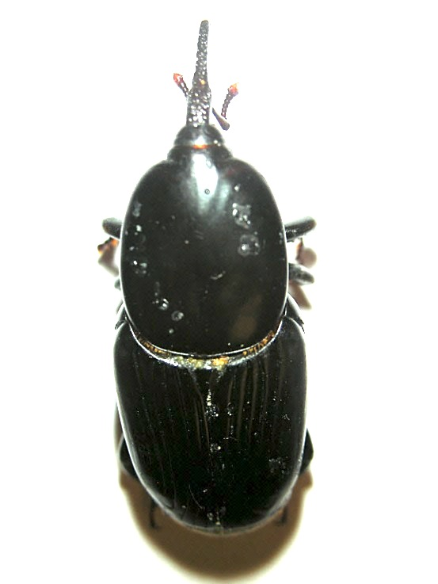
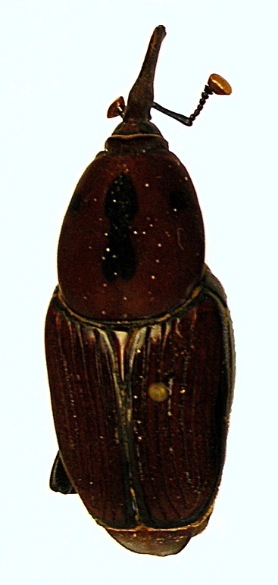
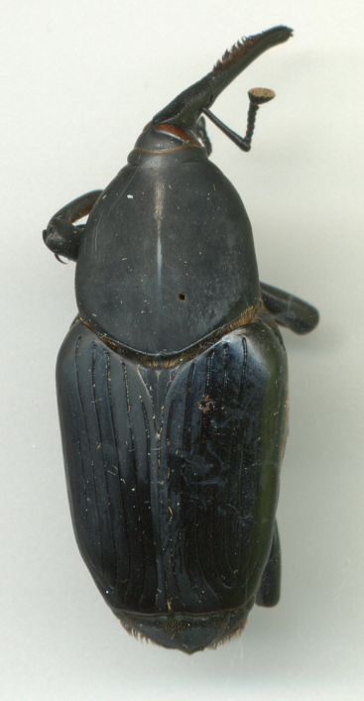
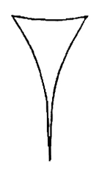
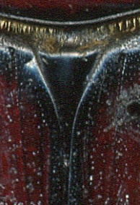
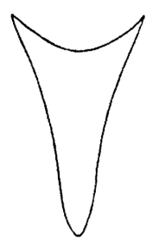
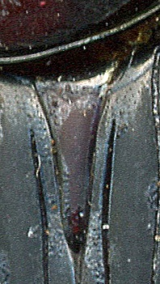

Palmetto weevil
Rhynchophorus cruentatus
Red palm weevil
Rhynchophorus ferrugineus
South American palm weevil
Rhynchophorus palmarum
♂
♂
♂
Pronotum: anterior with broad shoulders (red arrow); posterior edge flat (yellow arrow)
Pronotum: anterior with tapered shoulders (red arrow); posterior edge flat (yellow arrow)
Pronotum: anterior with tapered shoulders (red arrow); posterior edge lobed (yellow arrow)
Dorsal view: Scutellum of both sexes (blue arrows)
Tapers acutely
Tapers broadly
Tapers broadly
Photos: 2012, Robin Giblin-Davis, University of Florida
Notes:
The best way to distinguish these three species of giant palm weevils is to look at the shape of the pronotum. First, look at the posterior end (back edge) of the pronotum. The palmetto weevil (top left photo) and the red palm weevil (top center photo) both have flat/evenly curved back ends of the pronotum, whereas the South American palm weevil (top right photo) has a rounded/lobed posterior end.
Then, look at the anterior end of the pronotum (front). As you follow the pronotum of the palmetto weevil (top left photo) from the front to the back, it looks like this weevil has broad “shoulders”. However, if you view the pronotum of the red palm weevil and the South American palm weevil (top center and right photo), you can see that there are no “shoulders” (it slopes down).
In addition, the scutellum of palmetto weevil (bottom left photo) tapers acutely, whereas it tapers broadly on red palm weevil (bottom center photo) and South American palm weevil (bottom right photo).
Information sources:
Giblin-Davis, R. M. and A. L. Roda. 2013. Real time internet invasive pest identification training: a case study with Rhynchophorus weevils. Florida Entomologist. 96: 741-745.
Thomas, M. C. 2010. Pest alert: Giant palm weevils of the genus Rhynchophorus (Coleoptera: Curculionidae) and their threat to Florida palms. FDACS DPI.
Accessed 2/9/2014-
http://www.freshfromflorida.com/pi/pest-alerts/pdf/giantpalmweevils.pdf

Slide 22









Lateral view of male head: Rostrum (blue arrows) & Mandible (yellow arrows)
Palmetto weevil
Red palm weevil
South American palm weevil
Rostrum:
no setae
Rostrum:
with setae
Rostrum:
with setae
4
Mandible unidentate
Mandible tridentate
Mandible bidentate
Ventral view of head, both sexes: Submentum (red arrows)
Straight subgenal sutures
Concave subgenal sutures
Narrow suture and sculpturing between antennal scrobes
Photos: 2012, Robin Giblin-Davis, University of Florida
Notes:
In addition, the rostrum of male palmetto weevils does not have setae (top left photo), whereas setae are present on the rostrum of red palm weevil (top center photo) and South American palm weevil (top right photo). These setae makes it look like the males of the red palm weevil and the South American palm weevil have mustaches.
The mandible of males is unidentate (single toothed) in palmetto weevils (top left photo), tridentate (triple toothed) in red palm weevil (top center photo), and bidentate (double toothed) in South American palm weevil (top right photo).
The submentum (of both sexes) also varies among the three species as follows:
Palmetto weevils have straight subgenal sutures (bottom left photo)
Red palm weevils have concave subgenal sutures (bottom center photo)
South American palm weevils have a narrow suture and sculpturing between antennal scrobes.
Information sources:
Giblin-Davis, R. M. and A. L. Roda. 2013. Real time internet invasive pest identification training: a case study with Rhynchophorus weevils. Florida Entomologist. 96: 741-745.

Slide 23
Authors
Ashley Poplin, M.S.
Graduate Student, Department of Entomology and Nematology, University of Florida
Amy Roda, Ph.D.
Entomologist, USDA–APHIS–PPQ–CPHST
Smriti Bhotika, Ph.D.
Postdoctoral Associate, Department of Entomology and Nematology, University of Florida
Lanette Sobel, B.S.
Doctor of Plant Medicine Student, University of Florida

Slide 24
Editors
Stephanie Stocks, M.S.
Assistant-In, Extension Scientist, Department of Entomology and Nematology, University of Florida
Matthew D. Smith, Ph.D.
Postdoctoral Associate, Department of Entomology and Nematology, University of Florida

Slide 25
Reviewers
Robin M. Giblin-Davis, Ph.D.
Professor and Acting Center Co-Director, Fort Lauderdale Research and Education Center, UF-IFAS
Katherine Okins, M.S.
Identifier - Coleoptera, Florida Department of Agriculture and Consumer Services, Division of Plant industry, Cooperative Agricultural Pest Survey
Andrew Derksen, M.S.
Pest Survey Scientist, Florida Department of Agriculture and Consumer Services, Division of Plant Industry
Paul Skelley, Ph.D.
Florida Department of Agriculture and Consumer Services, Division of Plant industry

Slide 26
Collaborating Agencies
U.S. Department of Agriculture Animal and Plant Health Inspection Service (USDA-APHIS)
Cooperative Agricultural Pest Survey Program (CAPS)
Florida Department of Agriculture and Consumer Services (FDACS)
National Plant Diagnostic Network (NPDN)
Sentinel Plant Network (SPN)
Protect U.S.
University of Florida Institute of Food and Agricultural Sciences (UF-IFAS)

Slide 27
Educational Disclaimer and Citation
This presentation can be used for educational purposes for NON-PROFIT workshops, trainings, etc.
Citation:
Poplin, A., M.S., Roda, A., Ph.D., Bhotika, S., Ph.D., Sobel, L., B.S., 2014. Palm Weevils, May 2014.

Slide 28
References
Bertone, C., P. S. Michalak, and A. Roda. 2010. New pest response guidelines: Red palm weevil, Rhynchophorus ferrugineus. USDA APHIS PPQ. http://www.aphis.usda.gov/import_export/plants/manuals/emergency/downloads/nprg-redpalmweevil.pdf
EPPO. 2005. Data sheets on quarantine pests: Rhynchophorus palmarum.
OEPP/EPPO Bulletin. 35: 468 – 471. Accessed 2-7-14 –
http://www.eppo.int/QUARANTINE/insects/Rhynchophorus_palmarum/DS_Rhynchophorus_palmarum.pdf
Giblin-Davis, R. M. and A. L. Roda. 2013. Real time internet invasive pest identification
training: a case study with Rhynchophorus weevils. Florida Entomologist. 96: 741-745.
Giblin-Davis, R. M., P. S. Lehman, and R. N. Inserra. Fact sheet: Bursaphelenchus
cocophilus, Red Ring Disease of Coconut. Society of Nematologists. Accessed 2-7-14 –
http://nematode.unl.edu/pest1.htm

Slide 29
References
Giblin-Davis, R. M. “Biology and management of palm weevils.” University of
Florida/IFAS, Fort Lauderdale Research and Education Center. Accessed 2-6-2014-
http://cisr.ucr.edu/pdf/giblin-davis,robin-biology_and_management_of_palm_weevils.pdf
Hagley, E. A. C. 1965. “On the Life History and Habits of the Palm Weevil,
Rhynchophorus palmarium.” Annals of the Entomological Society of America. 58: 22-28.
Hallett, R. H., B. J. Crespi, and J. H. Borden. 2004. Synonymy of Rhynchophorus ferrugineus (Olivier), 1790 and R. vulneratus (Panzer), 1798 (Coleoptera, Curculionidae, Rhynchophorinae). Journal of Natural History. 38: 2863-2882.
Miguens F. C., J. A. S. Magalhães, L. M. Amorim, V. R. Goebel, N. L. Coustour, M.
Lummerzheim, J. I. L. Moura and R. M. Costa. Mass Trapping and Biological Control of Rhynchophorus palmarum L.: A hypothesis based on morphological evidences. Projeto Entomologistas do Brasil. Accessed 2-7-14 –
http://www.periodico.ebras.bio.br/ojs/index.php/ebras/article/viewFile/85/124

Slide 30
References
Molet, T. A. L. Roda, L. D. Jackson, and B. Salas. 2011. CPHST Pest Datasheet for
Rhynchophorus palmarum. USDA-APHIS-PPQ-CPHST. Accessed 2-7-14 –
http://www.aphis.usda.gov/plant_health/plant_pest_info/palmweevil/downloads/Rhynchophoruspalmarum_v5.pdf
National Agricultural Pest Information System (NAPIS). Purdue University. "Survey Status of Red Palm Weevil - Rhynchophorus ferrugineus (All years)." Published: 12/17/2013. http://pest.ceris.purdue.edu/map.php?code=INASMKA&year=alltime. Accessed: 12/19/2013.
National Agricultural Pest Information System (NAPIS). Purdue University. "Survey Status of South American Palm Weevil - Rhynchophorus palmarum (All years)." Published: 12/17/2013. http://pest.ceris.purdue.edu/map.php?code=INASHTA&year=alltime. Accessed: 12/19/2013.

Slide 31
References
Nisson, N., D. Hodel, and M. S. Hoddle. “Red palm weevil”. Center for Invasive Species Research – University of California, Riverside. http://cisr.ucr.edu/red_palm_weevil.html
Red Palm Weevil Research Chair. 2013. “Host range”. CLEVA, TeachArabia.
Rugman-Jones, P. F., C. Hoddle, M. Hoddle, R. Stouthamer. 2013. “The lesser of two
weevils: molecular-genetics of pest palm weevil populations confirm Rhynchophorus vulneratus (Panzer 1798) as a valid species distinct from R. ferrugineus (Olivier 1790), and reveal the global extent of both.” PLoS ONE. 8: 1- 15.
Thomas, M. C. 2010. Pest alert: Giant palm weevils of the genus Rhynchophorus (Coleoptera: Curculionidae) and their threat to Florida palms. FDACS DPI. http://www.freshfromflorida.com/pi/pest-alerts/pdf/giantpalmweevils.pdf

Slide 32
References
Thomas, M. C and L. Whilby. 2011. “Giant palm weevils: Headed our way?”. FDACS DPI
- Florida State Collection of Arthropods. http://entnemdept.ufl.edu/hodges/Florida2011/Thomas.pdf
Weissling, T. J. and R. M. Giblin-Davis. 1997. Revised 2013. “Palmetto weevil,
Rhynchophorus cruentatus Fabricius (Insecta: Coleoptera: Curculionidae).” University of Florida, Entomology and Nematology Department, IFAS. Accessed 2-6-14 –
https://edis.ifas.ufl.edu/pdffiles/IN/IN13900.pdf
Weissling, T. J., R. M. Giblin-Davis, Scheffrahn, R. H., Mendoza, N. M. 1992. “Trap for
Capturing and Retaining Rhynchophorus cruentatus (Coleoptera: Churculionidae) Adults Using Sabal Palmetto as Bait.” Florida Entomologist. 75: 212 – 221. Accessed 2-7-2014 –
http://ufdcimages.uflib.ufl.edu/UF/00/09/88/13/00061/SN00154040_0075_00027.pdf

Slide 33
References
Zona, S. 1985. “A new species of Sabal (Palmae) from Florida.” Brittonia. 37: 366-368.
Accessed 2-16-14 –
http://www.jstor.org/stable/2806549

