Slide 1
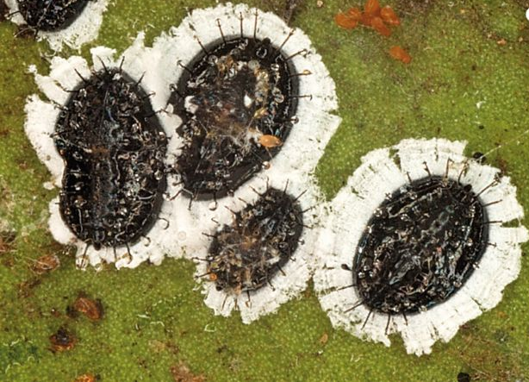
Orange Spiny Whitefly Aleurocanthus spiniferus
Image Credit: Francesco Porcelli, DiBCA sez Entomologia e Zoologia , University of Bari, EPPO website - http://photos.eppo.org/index.php/image/2602-alecsn-08

Slide 2
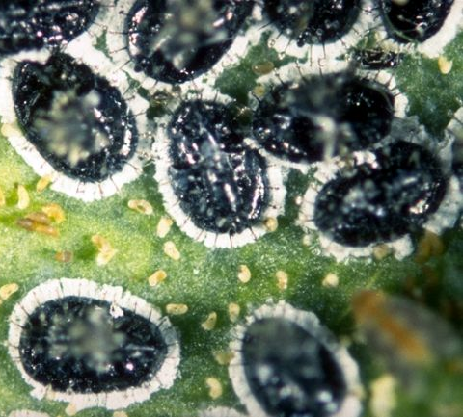
Orange Spiny Whitefly
Orange spiny whitefly (OSW) is native to tropical Asia
It can be found in countries around the world
It is a major pest of citrus, but has many other hosts
Image Credit: M.A. van den Berg, Institute for Tropical and Subtropical Crops, Bugwood.org # UGA1263006
Notes:
Orange spiny whitefly (OSW), Aleurocanthus spiniferus, is native to tropical Asia. It was originally reported in 1903 from Java on Citrus sp. and Rosa sp. It is a major pest of citrus (though it has many other hosts) and causes the weakening of plants and loss of vigor due to its feeding and the development of sooty mold an its waste product (honeydew).
Heavy infestations can lead to tree death.
Information sources:
Evans, G. A. and A.B. Hamon. 2014. Aleurocanthus spiniferus. Whitefly Catalog. USDA APHIS PPQ. Accessed 6/10/2014
http://www.fsca-dpi.org/homoptera_hemiptera/whitefly/whitefly_catalog.htm
Gyeltshen, J., A. Hodges and G. Hodges. 2005. Orange spiny whitefly, Aleurocanthus spiniferus (Quaintance) (Insecta: Hemiptera: Aleurodidae). EENY-341. Gainesville: University of Florida, Institute of Food and Agriculture Sciences. Accessed January 27, 2014
http://edis.ifas.ufl.edu/pdffiles/IN/IN61800.pdf
Muniappan, R., M. Purea, F. Sengebau, and G.V.P. Reddy. 2006. Orange spiny whitefly, Aleurocanthus spiniferus (Quaintance) (Homoptera: Aleyrodidae), and its parasitoids in the Republic of Palau. Hawaiian Entomological Society, 38:21–25. accessed 7/17/2014 –
https://scholarspace.manoa.hawaii.edu/bitstream/handle/10125/119/2_muniappan.pdf?sequence=1
Van den Berg, M.A., G. Hoppner, and J. Greenland. 2000. An economic study of the biological control of the spiny blackfly, Aleurocanthus spiniferus (Hemiptera: Aleyrodidae), in a citrus orchard in Swaziland. Biocontrol Science and Technology, 10(1): 27–32. accessed 7/17/2014-
http://www.tandfonline.com/doi/pdf/10.1080/09583150029350
USDA. 1974. New United States records-orange spiny whitefly Aleurocanthus spiniferus (Quaintance)-Hawaii. Cooperative-Economic-Insect-Report 24: 30, 585.

Slide 3
Distribution
OSW has spread throughout Asia, Africa, Australia and the Pacific Region
OSW has also been found in the Caribbean Islands and in Europe
It was first discovered in the U.S. in Hawaii in 1974, though there are no records that OSW has been introduced into the continental U.S.
Notes:
This pest has spread throughout Asia, Africa, Australia, and the Pacific region.
In the Asia, this pest has been found in: Bangladesh, Bhutan, Brunei Darussalam, Cambodia, China, Hong Kong, India, Japan, Korea Democratic People's Republic, Korea Republic, Lao, Macau, Malaysia, Myanmar, Pakistan, Philippines, Sri Lanka, Taiwan, Thailand, and Viet Nam.
In Africa, this pest has been found in: Kenya, Mauritius, Nigeria, South Africa, Swaziland, Tanzania, and Uganda.
It has also been reported from the Pacific region: Guam, Micronesia, Northern Mariana Islands, Sumatra, Andaman Islands, Nicobar Islands, Java, Caroline Islands, New Caledonia, Palau, and Papua New Guinea.
There is a record of it being found in Southern Italy (2008) as well as Greece and Iran (though it has also been intercepted at U.S. ports in shipments the originated from Syria).
There are also reports from the Caribbean (Jamaica) though it has also been intercepted at U.S. ports in shipments originating from Haiti and Dominican Republic.
It has been reported from Hawaii in 1974 (on rose foliage, naval oranges, lime, tangerine and pear) but so far, there are no records of it being introduced into the continental U.S.
Some initial reports of orange spiny whitefly being present in South America were later identified as another similar species.
Information Sources:
Cioffi, M., D. Cornara, I. Corrado, M.G.M. Jansen, and F. Porcelli. 2013. The status of Aleurocanthus spiniferus from its unwanted introduction in Italy to date. Bulletin of Insectology 66 (2): 273-281. accessed 7/17/2014 –
http://www.bulletinofinsectology.org/pdfarticles/vol66-2013-273-281cioffi.pdf
EPPO/CABI 1997. Aleurocanthus spiniferus. Data Sheets on Quarantine Pests. In Quarantine Pests for Europe, 2nd ed., CAB International, Wallingford: 21-24.
https://www.eppo.int/QUARANTINE/insects/Aleurocanthus_spiniferus/ALECSN_ds.pdf
Evans, G. A. and A.B. Hamon. 2014. Aleurocanthus spiniferus. Whitefly Catalog. USDA APHIS PPQ. Accessed 6/10/2014
http://www.fsca-dpi.org/homoptera_hemiptera/whitefly/whitefly_catalog.htm
Gyeltshen, J., A. Hodges and G. Hodges. 2005. Orange spiny whitefly, Aleurocanthus spiniferus (Quaintance) (Insecta: Hemiptera: Aleurodidae). EENY-341. Gainesville: University of Florida, Institute of Food and Agriculture Sciences. Accessed January 27, 2014
http://edis.ifas.ufl.edu/pdffiles/IN/IN61800.pdf
Muniappan, R., M. Purea, F. Sengebau, and G.V.P. Reddy. 2006. Orange spiny whitefly, Aleurocanthus spiniferus (Quaintance) (Homoptera: Aleyrodidae), and its parasitoids in the Republic of Palau. Hawaiian Entomological Society, 38:21–25. accessed 7/17/2014 –
https://scholarspace.manoa.hawaii.edu/bitstream/handle/10125/119/2_muniappan.pdf?sequence=1
Paulson, G.S. and B.R. Kumashiro. 1985. Hawaiian Aleyrodidae. Proceedings of the Hawaiian Entomological Society, 25:102–124. accessed 6/5/2014 –
http://hdl.handle.net/10125/11179
Porcelli, F. 2008. First record of Aleurocanthus spiniferus (Homoptera: Aleyrodidae) in Apulia, Southern Italy. EPPO. Accessed 6/5/2014 –
http://www.eppo.int/QUARANTINE/special_topics/aleurocanthus_spiniferus_IT/first_record.htm
Van den Berg, M.A., G. Hoppner, and J. Greenland. 2000. An economic study of the biological control of the spiny blackfly, Aleurocanthus spiniferus (Hemiptera: Aleyrodidae), in a citrus orchard in Swaziland. Biocontrol Science and Technology, 10(1): 27–32. accessed 7/17/2014-
http://www.tandfonline.com/doi/pdf/10.1080/09583150029350
USDA. 1974. New United States records - orange spiny whitefly Aleurocanthus spiniferus (Quaintance) - Hawaii. Cooperative-Economic-Insect-Report 24: 30, 585.

Slide 4
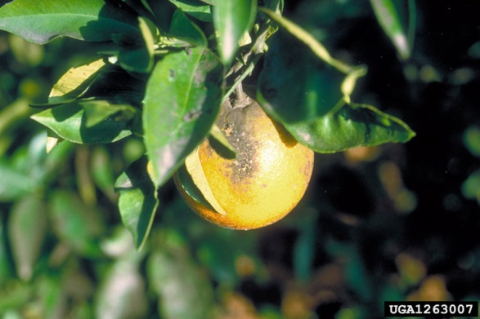
Hosts
Citrus is an economically important host of this pest
It also attacks many other hosts such as:
roses, grapes, peaches, guavas, apricots, pears and persimmons
Many plants found in the natural landscape as well as ornamental cultivars
Sooty mold on citrus caused by this pest
Image credit: M.A. van den Berg, Institute for Tropical and Subtropical Crops, Bugwood.org # UGA1263007
Notes:
Citrus is the major host of economic importance but orange spiny whitefly also attacks roses (Rosa spp.), grapes (Vitis vinifera), peaches (Prunus persica), guavas (Psidium guajava), pears (Pyrus communis, P. pyraster, P. pyrifolia, and P. serotina) and persimmon (Diospyros kaki). OSW is most frequently found on the leaves but also can be found on branches and fruits.
A complete host list is found below:
Annona muricata
Annona reticulata
Annona squamosa
Rollinia deliciosa
English ivy (Hedera helix)
Fatsia sp.
Synedrella nodiflora
Maranthes corymbosa
Macaranga tanarius
Carob tree (Ceratonia siliqua)
Entada phaseoloides
Camphor tree (Cinnamomum camphora)
Phoebe formosana
Bay laurel (Laurus nobilis)
Gossypium sp.
Malva sp.
Urena lobata
White mulberry (Morus alba)
Wax apple (Syzygium samarangenese)
Piper kadsura
Pomegranate (Punica granatum)
Apricot (Prunus armeniaca)
Mussaenda pubescens
Flindersia sp.
Meliosma rigida
Beach tamarind (Cupaniopsis anacardiodes)
Scaly ash (Ganophyllum falcatum)
Camellia (Camellia sinensis)
Aphananthe philippinensis
Parthenocissus tricuspidata
Frangipani (Plumeria rubra)
Coconut palm (Cocos nucifera)
Formosan Alder (Alnus formosana)
Erycibe acutifoliae
Japanese persimmon (Diospyros kaki)
Malaysian Persimmon (Diospyros maritima)
Sloanea dasycarpa
Rhododendron ellipticum
Cassava (Manihot esculenta)
Chinese tallow tree (Sapium sebiferum)
Bauhinia championii
Bauhinia blinii
Cassia tree (Cassia siamea)
Chinese long bean (Vigna sesquipedalis)
Casearia aculeata
Myroxylon japonicum
Scolopia oldhamii
Chinese sweet gum (Liquidambar formosana)
Akebia labata
Akebia longeracemosa
Avocado (Persea americana)
Persea zuihoensis
Barringtonia acutangula
Kenaf (Hibiscus cannabinus)
Rose mallow (Hibiscus rosa-sinensis)
Sea hibiscus (Hibiscus tilaceus)
Toona australis
Ficus capensis
Cluster fig tree (Ficus racemosa)
Common fig (Ficus carica)
Streblus sp.
Maesa perlaria
Szyzgium samarangense
Kadsura piper
Loquat (Eriobotrya japonica)
Black Cerry (Prunus serotina)
Rose (Rosa indica)
Chinese hibiscus (Rosa sinensis)
Gardenia (Gardenia jasminoides)
Mussaenda pubescens
Bitter orange (Citrus bigaradia and Citrus aurantium)
Lemon (Citrus limon)
Orange (Citrus sinensis)
shiny-leaf prickly-ash (Zanthoxylum nitidaum)
Meliosma rigida
Willow (Salix sp.)
Boehmeria densiglomerata
Common grape (Vitis vinifera)
In addition, this pest has been intercepted at U.S. on:
Curry tree (Bergera koenigii (Murraya koenigii))
Camellia (Camellia sp.)
Mandarin orange (Citrus reticulata)
Parthenium sp.
Piper sp.
Pyracantha sp.
Information Source:
Cioffi, M., D. Cornara, I. Corrado, M.G.M. Jansen, and F. Porcelli. 2013. The status of Aleurocanthus spiniferus from its unwanted introduction in Italy to date. Bulletin of Insectology 66 (2): 273-281. accessed 7/17/2014 –
http://www.bulletinofinsectology.org/pdfarticles/vol66-2013-273-281cioffi.pdf
EPPO/CABI 1997. Aleurocanthus spiniferus. Data Sheets on Quarantine Pests. In Quarantine Pests for Europe, 2nd ed., CAB International, Wallingford: 21-24.
https://www.eppo.int/QUARANTINE/insects/Aleurocanthus_spiniferus/ALECSN_ds.pdf
EPPO. 2002. Aleurocanthus spiniferus. EPPO Standards - Diagnostic protocols for regulated pests. OEPP/EPPO Bulletin 32:255-259. Accessed on January 7, 2014.
http://www.eppo.int/QUARANTINE/insects/Aleurocanthus_spiniferus/ALECSN_protocol.pdf
Evans, G. A. and A.B. Hamon. 2014. Aleurocanthus spiniferus. Whitefly Catalog. USDA APHIS PPQ. Accessed 6/10/2014
http://www.fsca-dpi.org/homoptera_hemiptera/whitefly/whitefly_catalog.htm
Gyeltshen, J., A. Hodges and G. Hodges. 2005. Orange spiny whitefly, Aleurocanthus spiniferus (Quaintance) (Insecta: Hemiptera: Aleurodidae). EENY-341. Gainesville: University of Florida, Institute of Food and Agriculture Sciences. Accessed January 27, 2014
http://edis.ifas.ufl.edu/pdffiles/IN/IN61800.pdf

Slide 5
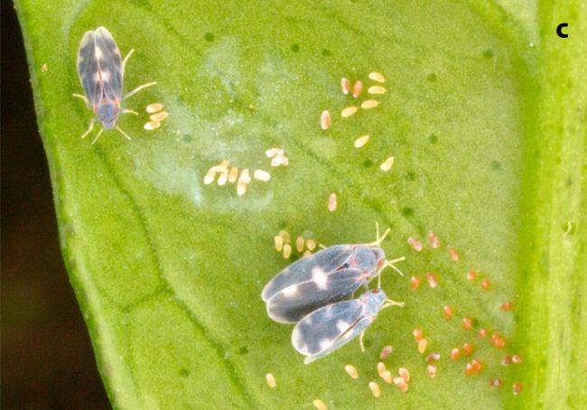
Identification: eggs
Eggs and adults of orange spiny whitefly
Image Credit: Francesco Porcelli, DiBCA sez Entomologia e Zoologia , University of Bari, EPPO website - http://photos.eppo.org/index.php/image/2602-alecsn-06
Notes:
The eggs are tiny (0.2×0.1 mm), elongated and kidney shaped. They are laid on a stalk that holds the eggs in an upright position on the leaf. The eggs are yellow in color at first and later turn brown. Eggs are indicated by the red arrow.
Information Source:
EPPO/CABI 1997. Aleurocanthus spiniferus. Data Sheets on Quarantine Pests. In Quarantine Pests for Europe, 2nd ed., CAB International, Wallingford: 21-24.
https://www.eppo.int/QUARANTINE/insects/Aleurocanthus_spiniferus/ALECSN_ds.pdf
Gyeltshen, J., A. Hodges and G. Hodges. 2005. Orange spiny whitefly, Aleurocanthus spiniferus (Quaintance) (Insecta: Hemiptera: Aleurodidae). EENY-341. Gainesville: University of Florida, Institute of Food and Agriculture Sciences. Accessed January 27, 2014
http://edis.ifas.ufl.edu/pdffiles/IN/IN61800.pdf
Paulson, G.S. and B.R. Kumashiro. 1985. Hawaiian Aleyrodidae. Proceedings of the Hawaiian Entomological Society, 25:102–124. Accessed 6/5/2014 –
http://hdl.handle.net/10125/11179
Quaintance, A.L. 1903. New Oriental Aleurodidae. The Canadian Entomologist, 35(3): 61–64.

Slide 6
Identification: Immatures
Image Credit: Francesco Porcelli, DiBCA sez Entomologia e Zoologia , University of Bari, EPPO website - http://photos.eppo.org/index.php/image/2602-alecsn-08
Notes:
OSW has four nymphal instars. The first instar nymphs are called crawlers. They are dusky in color, have six legs, and are very small (0.3 x 0.15 mm). They also have 2 long and several short spiny filaments.
The second instar measures 0.4 X 0.3mm and has no legs. Once it has settled to feed, it will not move again. The color of the second instar is dark-brown to pale black with yellow markings and spiny filaments that radiate out from the body. The third instar measures 0.74 to 0.87 mm and also has no legs. It is more oval in shape and black in color with a green spot on the abdomen. The spiny filaments are still obvious.
All stages are more or less elliptical in shape with a wide fringe of white wax along the margins. The thick, heavy spines referred to above are located on the dorsum (there 14 in total by the third instar – see red arrows).
The fourth instar is called the puparium. The last larval instar molts into an adult within the 4th instar nymphal skin. The pupae are shiny black in color and convex with a white fringe around the margin and dark spines along the submargin. They measure approximately 1.33 to 1.88 X 1.0 to 1.23mm and are elliptical in shape, with females being slightly larger than males.
The exuviae, which are molted skins of earlier instars, remain on the leaves and can be seen when scouting for this pest.
Identification of this species needs to be confirmed by a taxonomic expert which can only occur in the pupal stage.
Information Source:
EPPO/CABI 1997. Aleurocanthus spiniferus. Data Sheets on Quarantine Pests. In Quarantine Pests for Europe, 2nd ed., CAB International, Wallingford: 21-24.
https://www.eppo.int/QUARANTINE/insects/Aleurocanthus_spiniferus/ALECSN_ds.pdf
Gyeltshen, J., A. Hodges and G. Hodges. 2005. Orange spiny whitefly, Aleurocanthus spiniferus (Quaintance) (Insecta: Hemiptera: Aleurodidae). EENY-341. Gainesville: University of Florida, Institute of Food and Agriculture Sciences. Accessed January 27, 2014
http://edis.ifas.ufl.edu/pdffiles/IN/IN61800.pdf
Paulson, G.S. and B.R. Kumashiro. 1985. Hawaiian Aleyrodidae. Proceedings of the Hawaiian Entomological Society, Vol. 25, pp. 102–124. accessed 6/5/2014 –
http://hdl.handle.net/10125/11179
Quaintance, A.L. 1903. New Oriental Aleurodidae. The Canadian Entomologist, 35(3): 61–64.

Slide 7
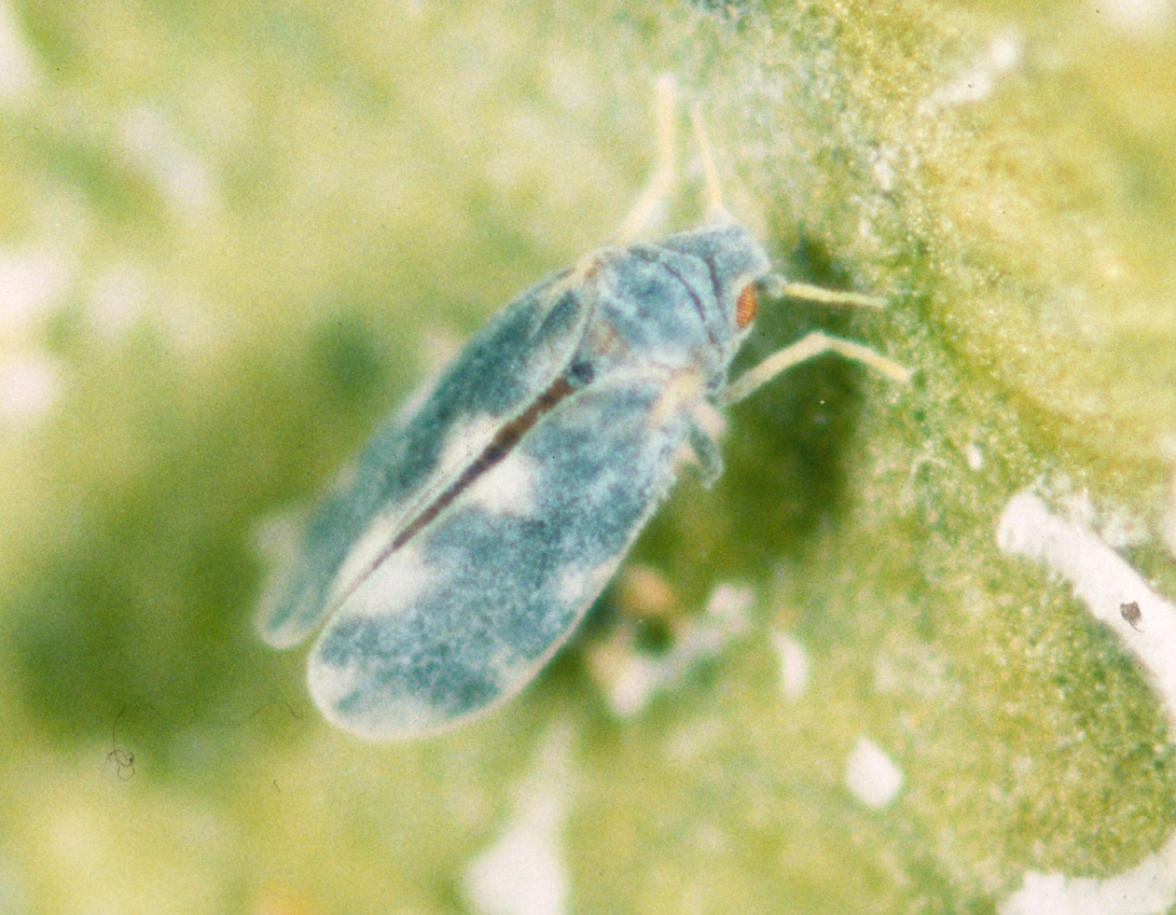
Identification: Adults
Image Credit: M.A. van den Berg, Institute for Tropical and Subtropical Crops, Bugwood.org #0177075
Notes:
Adults range in size from 2 to 3mm in length, with females being larger than males. Both are metallic bluish-grey in color with reddish brown eyes. There are light spots on the wings. The wings also have a light dusting of wax on them.
The abdomen is red to orange and the legs and antennae are white with light yellow markings.
If the leaves are disturbed the adults fly actively.
Information Source:
EPPO/CABI 1997. Aleurocanthus spiniferus. Data Sheets on Quarantine Pests. In Quarantine Pests for Europe, 2nd ed., CAB International, Wallingford: 21-24.
https://www.eppo.int/QUARANTINE/insects/Aleurocanthus_spiniferus/ALECSN_ds.pdf
EPPO. 2002. Aleurocanthus spiniferus. EPPO Standards - Diagnostic protocols for regulated pests. OEPP/EPPO Bulletin 32:255-259. Accessed on January 7, 2014.
http://www.eppo.int/QUARANTINE/insects/Aleurocanthus_spiniferus/ALECSN_protocol.pdf
Gyeltshen, J., A. Hodges and G. Hodges. 2005. Orange spiny whitefly, Aleurocanthus spiniferus (Quaintance) (Insecta: Hemiptera: Aleurodidae). EENY-341. Gainesville: University of Florida, Institute of Food and Agriculture Sciences. Accessed January 27, 2014
http://edis.ifas.ufl.edu/pdffiles/IN/IN61800.pdf
Paulson, G.S. and B.R. Kumashiro. 1985. Hawaiian Aleyrodidae. Proceedings of the Hawaiian Entomological Society, 25: 102–124. accessed 6/5/2014 –
http://hdl.handle.net/10125/11179

Slide 8
Life Cycle
Prefer mild temperatures and high humidity
It generally takes 2 to 4 months to reach adulthood
There can be 3 to 6 generations per year depending on environmental temperatures
When plant material is disturbed, adults are very noticable
Overwintering occurs in the nymphal stage
Notes:
In tropical regions, all stages of the OSW may be found throughout the year. They prefer mild temperature (20 to 30 °C) with high relative humidity (70 to 80%). They do not mate in cool temperatures and do not survive in temperatures above 43°C.
During her lifetime, each adult female may lay 35 to 100 eggs laid in batches of 35 to 50 eggs. Development time is greatly influenced by environmental temperature, but typically, the egg hatches in 4 to 12 days (though this can take up to 22 days).
The crawlers (first instar) emerge and disperse. Once they find a suitable spot, they will insert the sucking mouthparts into the leaf and suck sap from the phloem for the next two instars. The first instar takes 7 to 11 days to complete.
The second instar lasts 5 to 7 days while the third instar lasts 7 to 130 days. The fourth instar, in which the nymph turns into an adult, lasts 7 to 34 days.
Though there can be wide variability in the length of the instars (particularly the third and fourth instars), it generally it takes up 2 to 4 months to reach adulthood.
There can be three to six overlapping generations per year.
Overwintering has been observed in this pest. It occurs in the nymphal stage.
Information Source:
Chien, C.C. and S.C. Chiu. 1986. Biology of the citrus spiny blackfly Aleurocanthus spiniferus. Journal of Agricultural Research of China (abstract only). 35(2):222–229.
EPPO/CABI 1997. Aleurocanthus spiniferus. Data Sheets on Quarantine Pests. In Quarantine Pests for Europe, 2nd ed., CAB International, Wallingford: 21-24.
https://www.eppo.int/QUARANTINE/insects/Aleurocanthus_spiniferus/ALECSN_ds.pdf
Gyeltshen, J., A. Hodges and G. Hodges. 2005. Orange spiny whitefly, Aleurocanthus spiniferus (Quaintance) (Insecta: Hemiptera: Aleurodidae). EENY-341. Gainesville: University of Florida, Institute of Food and Agriculture Sciences. Accessed January 27, 2014
http://edis.ifas.ufl.edu/pdffiles/IN/IN61800.pdf

Slide 9
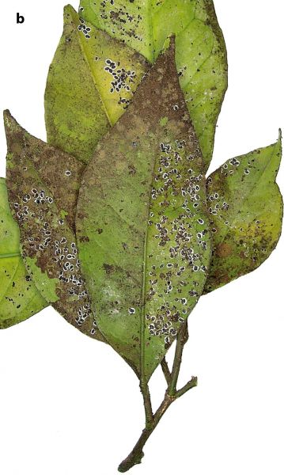
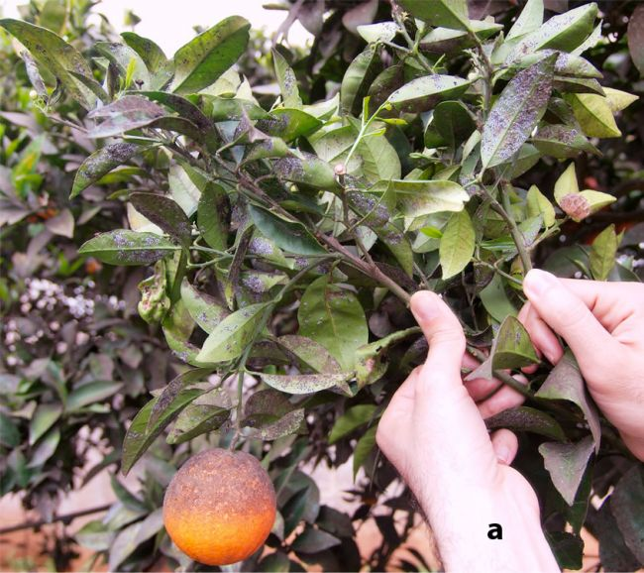
Damage
Image Credit: Francesco Porcelli, University of Bari, EPPO website - http://photos.eppo.org/index.php/image/2604-alecsn-05 and http://photos.eppo.org/index.php/image/2601-alecsn-07
Notes:
Hundreds of immatures can be found on the underside of the leaves (though they can also get on branches as well as fruit) with sooty mold found on the tops of the leaves. Because this pest tends to infests the lower half of a tree, it is best to focus scouting efforts there.
This pest sucks the sap from the host plant and this feeding causes the tree to become stressed and weakened, which in turn reduces vigor. Foliage may drop and fruit set may be reduced. Heavy infestations can even result in the death of the tree.
The sugary, liquid waste produced by these pests is called honeydew and large amounts of honeydew causes sooty molds to grow. The presence of sooty mold reduces the plant’s ability to photosynthesize. Heavily infested plants looks dark, almost black due to the sooty mold.
Information Source:
Cioffi, M., D. Cornara, I. Corrado, M.G.M. Jansen, and F. Porcelli. 2013. The status of Aleurocanthus spiniferus from its unwanted introduction in Italy to date. Bulletin of Insectology 66 (2): 273-281. accessed 7/17/2014 –
http://www.bulletinofinsectology.org/pdfarticles/vol66-2013-273-281cioffi.pdf
EPPO/CABI 1997. Aleurocanthus spiniferus. Data Sheets on Quarantine Pests. In Quarantine Pests for Europe, 2nd ed., CAB International, Wallingford: 21-24.
https://www.eppo.int/QUARANTINE/insects/Aleurocanthus_spiniferus/ALECSN_ds.pdf
EPPO. 2002. Aleurocanthus spiniferus. EPPO Standards - Diagnostic protocols for regulated pests. OEPP/EPPO Bulletin 32:255-259. Accessed on January 7, 2014.
http://www.eppo.int/QUARANTINE/insects/Aleurocanthus_spiniferus/ALECSN_protocol.pdf
Gyeltshen, J., A. Hodges and G. Hodges. 2005. Orange spiny whitefly, Aleurocanthus spiniferus (Quaintance) (Insecta: Hemiptera: Aleurodidae). EENY-341. Gainesville: University of Florida, Institute of Food and Agriculture Sciences. Accessed January 27, 2014
http://edis.ifas.ufl.edu/pdffiles/IN/IN61800.pdf
Muniappan, R., M. Purea, F. Sengebau, and G.V.P. Reddy. 2006. Orange spiny whitefly, Aleurocanthus spiniferus (Quaintance) (Homoptera: Aleyrodidae), and its parasitoids in the Republic of Palau. Hawaiian Entomological Society, 38:21–25. accessed 7/17/2014 –
https://scholarspace.manoa.hawaii.edu/bitstream/handle/10125/119/2_muniappan.pdf?sequence=1
Van den Berg, M.A., G. Hoppner, and J. Greenland. 2000. An economic study of the biological control of the spiny blackfly, Aleurocanthus spiniferus (Hemiptera: Aleyrodidae), in a citrus orchard in Swaziland. Biocontrol Science and Technology, 10(1): 27–32. accessed 7/17/2014-
http://www.tandfonline.com/doi/pdf/10.1080/09583150029350

Slide 10
Management
Some important bio-control agents:
Encarsia smithi
Amitus hesperidum
Cryptognatha sp.
Petroleum oils can be effective
Chemical control is not effective
If you think you have detected this pest, please contact your local county agent.
Notes:
Biological control is very important in the control of OSW.
In 1925, Japanese scientists introduced the parasitoids Encarsia smithi (reported then as Prospaltella smithi) and the lady beetle Cryptognatha sp. (Coleoptera: Coccinellidae) from China. They were successful in controlling OSW by killing 74% of the population.
Similarly in Guam, Encarsia smithi (Hymeoptera: Aphelinidae) and Amitus hesperidium (Hymenoptera: Platygastridae) killed 80 to 95% of OSW.
Encarsia smithi parasitized 72.9% of OSW in studies conducted in Southern Africa. In a study conducted in South Africa, during the 1996/1997 and 1997/1998 growing seasons, E. smithi did such a good job of controlling populations of OSW that chemical control was not needed.
In addition, Encarsia aseta (Hymeoptera: Aphelinidae) was reported as a fairly effective biocontrol agent of OSW in Palau when in sufficient numbers (with parasitism rates up to 42%).
In Hawaii, natural enemies of OSW include E. smithi, E. variegata (Hymeoptera: Aphelinidae), and a Coccinellidae Serangium maculigerum.
Encarsia opulenta (Hymeoptera: Aphelinidae) and Amitus hesperidum are reported as established in Florida and have good control of citrus blackfly (Aleurocanthus woglumi) populations. However, in 1998, it was found that what was being referred to as E. opulenta was actually a new species that was later described as Encarsia perplexa. This species may help control OSW if it were introduced into Florida.
Additional parasitoids of OSW reported in the literature include: Ablerus connectans (Hymenoptera: Aphelinidae), Encarsia divergens, Encarsia ishii, Encarsia merceti modesta, Encarsia nipponica, Eretmocerus serius (Hymenoptera: Aphelinidae), and Eretmocerus silvestrii.
A predaceous drosophila (Acletoxenus sp.) was reported to feed on OSW in Taiwain citrus orchards. In addition, entomogenous fungi (Aschersonia spp. and Aegerita webberi) were reported to infect OSW in the wet season.
Petroleum oil sprays in low concentration (0.25 to 0.5%) may be effective against OSW.
Like many other whitefly species, chemical control hasn’t been effective against OSW.
Because this pest is not found in the United States, if you think you have detected this pest, please contact your local county agent.
Information Sources:
Chien, C.C. and S.C. Chiu. 1986. Biology of the citrus spiny blackfly Aleurocanthus spiniferus. Journal of Agricultural Research of China (abstract only). 35(2):222–229.
Cioffi, M., D. Cornara, I. Corrado, M.G.M. Jansen, and F. Porcelli. 2013. The status of Aleurocanthus spiniferus from its unwanted introduction in Italy to date. Bulletin of Insectology 66 (2): 273-281. accessed 7/17/2014 –
http://www.bulletinofinsectology.org/pdfarticles/vol66-2013-273-281cioffi.pdf
EPPO/CABI 1997. Aleurocanthus spiniferus. Data Sheets on Quarantine Pests. In Quarantine Pests for Europe, 2nd ed., CAB International, Wallingford: 21-24.
https://www.eppo.int/QUARANTINE/insects/Aleurocanthus_spiniferus/ALECSN_ds.pdf
Gyeltshen, J., A. Hodges and G. Hodges. 2005. Orange spiny whitefly, Aleurocanthus spiniferus (Quaintance) (Insecta: Hemiptera: Aleurodidae). EENY-341. Gainesville: University of Florida, Institute of Food and Agriculture Sciences. Accessed January 27, 2014
http://edis.ifas.ufl.edu/pdffiles/IN/IN61800.pdf
Muniappan, R., M. Purea, F. Sengebau, and G.V.P. Reddy. 2006. Orange spiny whitefly, Aleurocanthus spiniferus (Quaintance) (Homoptera: Aleyrodidae), and its parasitoids in the Republic of Palau. Hawaiian Entomological Society, 38:21–25. accessed 7/17/2014 –
https://scholarspace.manoa.hawaii.edu/bitstream/handle/10125/119/2_muniappan.pdf?sequence=1
Nakao, H.K. and G.Y. Funasaki. 1976. Introductions for biological control in Hawaii 1974. Proceedings of the Hawaiian Entomological Society, 22: 329–331.
Paulson, G.S. and B.R. Kumashiro. 1985. Hawaiian Aleyrodidae. Proceedings of the Hawaiian Entomological Society, 25: 102–124. accessed 6/5/2014 –
http://hdl.handle.net/10125/11179
Van den Berg, M.A., G. Hoppner, and J. Greenland. 2000. An economic study of the biological control of the spiny blackfly, Aleurocanthus spiniferus (Hemiptera: Aleyrodidae), in a citrus orchard in Swaziland. Biocontrol Science and Technology, 10(1): 27–32. accessed 7/17/2014-
http://www.tandfonline.com/doi/pdf/10.1080/09583150029350

Slide 11
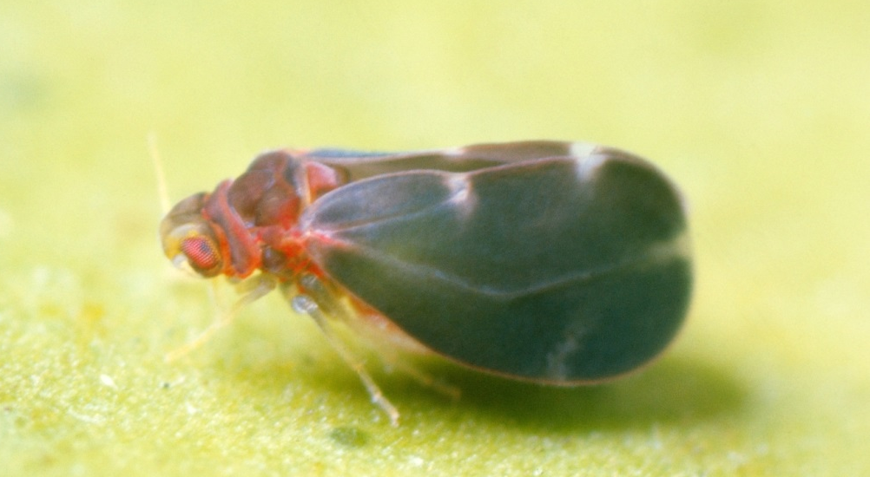

Look-alike species
Citrus Blackfly (Aleurocanthus woglumi )
Citrus blackfly
Orange spiny whitefly
Image credit: citrus blackfly - Florida Division of Plant Industry Archive, Florida Department of Agriculture and Consumer Services, Bugwood.org, #5194004; orange spiny whitefly - M.A. van den Berg, Institute for Tropical and Subtropical Crops, Bugwood.org #0177075
Notes:
The adult orange spiny whitefly and citrus blackfly are both slate blue in color, but in both species the color can vary from lighter to darker blue. They are similar in sizes and have light markings on the wings. As a result, at present, the adults of these two species can not be distinguished; however a detailed comparison of their morphological characteristics may lead to our ability to distinguish them based on the adult stage in the future. For now, it requires the pupal stage to achieve a species determination.
Information Sources:
EPPO/CABI 1997. Aleurocanthus spiniferus. Data Sheets on Quarantine Pests. In Quarantine Pests for Europe, 2nd ed., CAB International, Wallingford: 21-24.
https://www.eppo.int/QUARANTINE/insects/Aleurocanthus_spiniferus/ALECSN_ds.pdf
Gyeltshen, J., A. Hodges and G. Hodges. 2005. Orange spiny whitefly, Aleurocanthus spiniferus (Quaintance) (Insecta: Hemiptera: Aleurodidae). EENY-341. Gainesville: University of Florida, Institute of Food and Agriculture Sciences. Accessed January 27, 2014
http://edis.ifas.ufl.edu/pdffiles/IN/IN61800.pdf

Slide 12
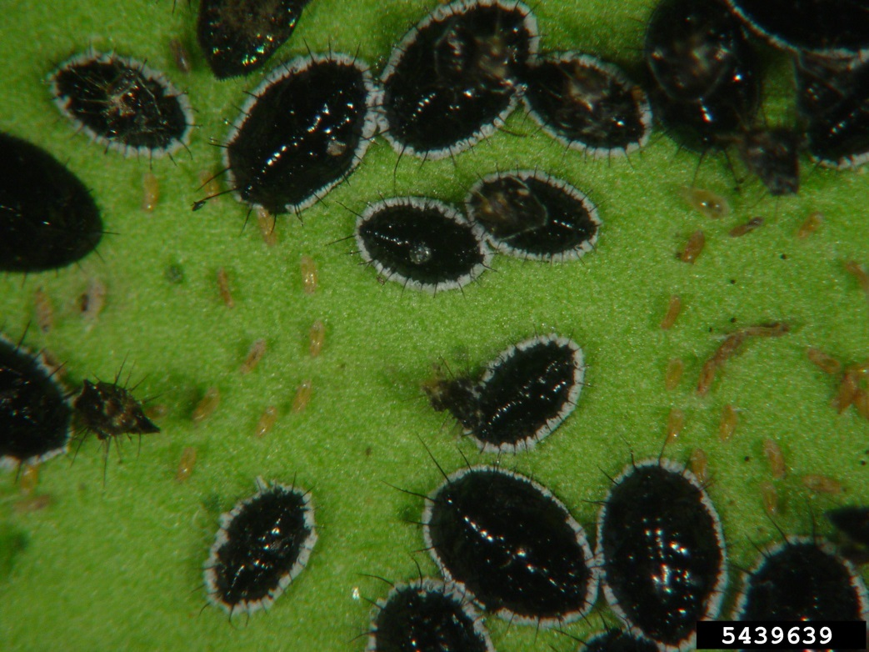
Look-alike species
Citrus Blackfly (Aleurocanthus woglumi )
Citrus blackfly
Orange spiny whitefly
Image credit: citrus blackfly - Chazz Hesselein, Alabama Cooperative Extension System, bugwood.org #5439639; orange spiny whitefly - Francesco Porcelli, DiBCA sez Entomologia e Zoologia , University of Bari, EPPO website - http://photos.eppo.org/index.php/image/2602-alecsn-08
Notes:
The nymphal and pupal stages are also very similar. However, the white waxy fringe of OSW is twice as wide as that of citrus blackfly.
Citrus blackfly is established in Florida and has been since 1962.
Information Sources:
EPPO/CABI 1997. Aleurocanthus spiniferus. Data Sheets on Quarantine Pests. In Quarantine Pests for Europe, 2nd ed., CAB International, Wallingford: 21-24.
https://www.eppo.int/QUARANTINE/insects/Aleurocanthus_spiniferus/ALECSN_ds.pdf
Gyeltshen, J., A. Hodges and G. Hodges. 2005. Orange spiny whitefly, Aleurocanthus spiniferus (Quaintance) (Insecta: Hemiptera: Aleurodidae). EENY-341. Gainesville: University of Florida, Institute of Food and Agriculture Sciences. Accessed January 27, 2014
http://edis.ifas.ufl.edu/pdffiles/IN/IN61800.pdf

Slide 13
Authors
Stephanie Stocks, M.S.
Assistant-In, Extension Scientist, Department of Entomology and Nematology, University of Florida
Shweta Sharma, PhD.
Department of Entomology and Nematology, University of Florida

Slide 14
Reviewers
Ian Stocks, Ph.D.
Entomologist, Division of Plant Industry, Florida Department of Agriculture and Consumer Services
Greg Evans, Ph.D.
United States Department of Agriculture, Animal and Plant Health Inspection Service, Plant Protection and Quarantine
Amanda Hodges, Ph.D.
Associate Extension Scientist, Director, Doctor of Plant Medicine, Department of Entomology and Nematology, University of Florida

Slide 15
Collaborating Agencies
U.S. Department of Agriculture Animal and Plant Health Inspection Service (USDA-APHIS)
Cooperative Agricultural Pest Survey Program (CAPS)
Florida Department of Agriculture and Consumer Services (FDACS)
National Plant Diagnostic Network (NPDN)
Sentinel Plant Network (SPN)
Protect U.S.
University of Florida Institute of Food and Agricultural Sciences (UF-IFAS)

Slide 16
Educational Disclaimer and Citation
This presentation can be used for educational purposes for NON-PROFIT workshops, trainings, etc.
Citation:
Stocks, S., M.S., Sharma, S., Ph.D., 2014. Orange Spiny Whitefly, Aleurocanthus spiniferus, December 2014.

Slide 17
References
Chien, C.C. and S.C. Chiu. 1986. Biology of the citrus spiny blackfly Aleurocanthus spiniferus. Journal of Agricultural Research of China (abstract only). 35(2):222–229.
Cioffi, M., D. Cornara, I. Corrado, M.G.M. Jansen, and F. Porcelli. 2013. The status of Aleurocanthus spiniferus from its unwanted introduction in Italy to date. Bulletin of Insectology 66 (2): 273-281. accessed 7/17/2014 –
http://www.bulletinofinsectology.org/pdfarticles/vol66-2013-273-281cioffi.pdf
EPPO/CABI 1997. Aleurocanthus spiniferus. Data Sheets on Quarantine Pests. In Quarantine Pests for Europe, 2nd ed., CAB International, Wallingford: 21-24.
https://www.eppo.int/QUARANTINE/insects/Aleurocanthus_spiniferus/ALECSN_ds.pdf
EPPO. 2002. Aleurocanthus spiniferus. EPPO Standards - Diagnostic protocols for regulated pests. OEPP/EPPO Bulletin 32:255-259. Accessed on January 7, 2014.
http://www.eppo.int/QUARANTINE/insects/Aleurocanthus_spiniferus/ALECSN_protocol.pdf
Evans, G. A. and A.B. Hamon. 2014. Aleurocanthus spiniferus. Whitefly Catalog. USDA APHIS PPQ. Accessed 6/10/2014
http://www.fsca-dpi.org/homoptera_hemiptera/whitefly/whitefly_catalog.htm

Slide 18
References
Gyeltshen, J., A. Hodges and G. Hodges. 2005. Orange spiny whitefly, Aleurocanthus spiniferus (Quaintance) (Insecta: Hemiptera: Aleurodidae). EENY-341. Gainesville: University of Florida, Institute of Food and Agriculture Sciences. Accessed January 27, 2014
http://edis.ifas.ufl.edu/pdffiles/IN/IN61800.pdf
Muniappan, R., M. Purea, F. Sengebau, and G.V.P. Reddy. 2006. Orange spiny whitefly, Aleurocanthus spiniferus (Quaintance) (Homoptera: Aleyrodidae), and its parasitoids in the Republic of Palau. Hawaiian Entomological Society, 38:21–25. accessed 7/17/2014 –
https://scholarspace.manoa.hawaii.edu/bitstream/handle/10125/119/2_muniappan.pdf?sequence=1
Nakao, H.K. and G.Y. Funasaki. 1976. Introductions for biological control in Hawaii 1974. Proc. Hawaii. Entomol. Soc. 22: 329-331.
Paulson, G.S. and B.R. Kumashiro. 1985. Hawaiian Aleyrodidae. Proceedings of the Hawaiian Entomological Society, Vol. 25, pp. 102-124. accessed 6/5/2014 –
http://hdl.handle.net/10125/11179

Slide 19
References
Porcelli, F. 2008. First record of Aleurocanthus spiniferus (Homoptera: Aleyrodidae) in Apulia, Southern Italy. EPPO. Accessed 6/5/2014 –
http://www.eppo.int/QUARANTINE/special_topics/aleurocanthus_spiniferus_IT/first_record.htm
Quaintance, A.L. 1903. New Oriental Aleurodidae. The Canadian Entomologist , Volume 35, Issue 03, pp 61-64.
Van den Berg, M.A., G. Hoppner, and J. Greenland. 2000. An economic study of the biological control of the spiny blackfly, Aleurocanthus spiniferus (Hemiptera: Aleyrodidae), in a citrus orchard in Swaziland. Biocontrol Science and Technology, 10(1): 27–32. accessed 7/17/2014-
http://www.tandfonline.com/doi/pdf/10.1080/09583150029350
USDA. 1974. New United States records - orange spiny whitefly Aleurocanthus spiniferus (Quaintance) - Hawaii. Cooperative-Economic-Insect-Report 24: 30, 585.

