Slide 1
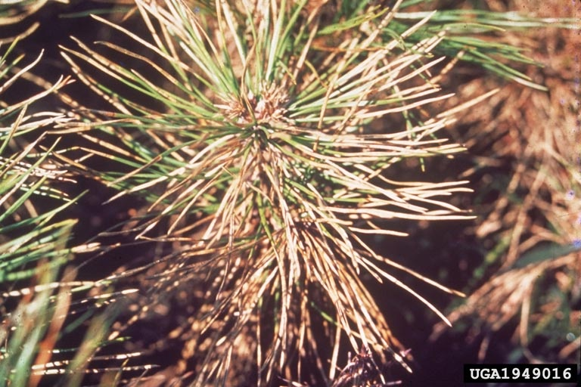
Needle Blight
Mycosphaerella gibsonii
Photo: H. Hashimoto, Bugwood.org # 1949016
Notes:
This presentation is about Needle Blight of pine trees, a disease caused by a fungus.

Slide 2
Needle Blight
Fungal pathogen
First recorded in Japan in 1913
Serious disease of exotic and native trees in Pinus spp.
Mostly affects seedlings and saplings
Needle blight symptoms on Pinus thunbergii.
Under epidemic conditions, may cause 100% infection rates and 50-80% death rates
Disease severity influenced by:
Species infected, age of tree infected, environmental conditions
Photo: H. Hashimoto, Bugwood.org # 1949016
Notes:
Needle blight of pine, also known as brown needle blight, brown needle disease, Cercospora blight of pine, and Cercospora needle blight, is a disease caused by a fungal pathogen (Mycosphaerella gibsonii).
It was first recorded in Japan in 1913, then it spread to other countries in Asia (Bangladesh, China, Hong Kong, India, Korea Democratic People's Republic, Korea Republic, Malaysia, Nepal, Philippines, Sri Lanka, Taiwan, Thailand, Viet Nam), Africa (Kenya, Madagascar, Malawi, South Africa, Swaziland, Tanzania, Zambia,
Zimbabwe), Central America and Caribbean (Jamaica, Nicaragua), and Papua New Guinea.
It is thought to be originally from eastern Asia and Central America.
Information sources:
CAPS Report. 2010. Mycosphaerella gibsonii.
Accessed 12/06/2013 -
http://caps.ceris.purdue.edu/webfm_send/586
Diekmann, M., J.R. Sutherland, D.C. Nowell, F.J. Morales and G. Allard, editors. 2002. FAO/IPGRI Technical Guidelines for the Safe Movement of Germplasm. No. 21. Pinus spp. Food and Agriculture Organization of the United Nations, Rome/International Plant Genetic Resources Institute, Rome.
Accessed 12/06/2013 –
http://www.bioversityinternational.org/uploads/tx_news/Pinus_spp._828.pdf
EPPO Data Sheets on Quarantine Pests. Mycosphaerella gibsonii. CABI and EPPO European and Mediterranean Plant Protection Organization.
Accessed 12/06/2013 –
http://www.eppo.int/QUARANTINE/fungi/Mycosphaerella_gibsonii/CERSPD_ds.pdf

Slide 3
Host Plants
Numerous species of Pinus trees including:
Rocky Mountain bristle cone pine
shortleaf pine
lodgepole pine
slash pine
ponderosa pine
white pine
loblolly pine
Under laboratory conditions, other conifers are susceptible
Resistance to the disease reported in a few Pinus spp.
Notes:
This fungus affects many species, both native and exotic, in the genus Pinus.
In some countries, resistance to the disease has been reported in a few Pinus spp.:
In India - P. kesiya (Khasi pine), P. clausa (sand pine), and P. elliottii (slash pine).
In Japan - P. rigida (pitch pine), P.taeda (loblolly pine), P. caribaea (Caribbean pine), P. griffithi (Himalayan pine), P. torreyana (Torrey pine), and P. patula (patula pine).
Host species of needle blight:
Major Hosts - Pinus aristata (Rocky Mountain bristle cone pine), Pinus armandii (Chinese white pine), Pinus attenuata (knobcone pine), Pinus ayacahuite (Mexican white pine), Pinus canariensis (Canary Island pine), Pinus caribaea (Caribbean pine), Pinus cembra (swiss or arolla pine), Pinus clausa (Alabama pine), Pinus contorta (lodgepole pine), Pinus densiflora (Japanese red pine), Pinus echinata (shortleaf pine), Pinus eliottii (slash pine), Pinus flexilis (limber pine), Pinus greggii (Gregg’s pine), Pinus halepensis (aleppo pine), Pinus hartwegii (Hartweg pine), Pinus jeffreyi (Jeffrey pine), Pinus kesiya (Khasi pine), Pinus kesiya var. langbianensis, Pinus lambertiana (sugar pine), Pinus luchuensis (luchu pine), Pinus massoniana (masson pine), Pinus mugo (Montana pine), Pinus muricata (bishop pine), Pinus murrayana (Sierra lodgepole pine), Pinus nigra (Austrian pine), Pinus oocarpa (Nicaraguan pitch pine), Pinus parviflora (Japanese white pine), Pinus patula (Mexican weeping pine), Pinus pinaster (maritime, cluster pine), Pinus pinea (stone pine), Pinus ponderosa (ponderosa pine), Pinus pseudostrobus (smoothback Mexican pine), Pinus radiata (radiata pine), Pinus resinosa (red pine), Pinus rigida (pitch pine), Pinus roxburghii (chir pine), Pinus strobus (white pine), Pinus sylvestris (Scots pine), Pinus taeda (loblolly pine), Pinus taiwanensis (Taiwan red pine), Pinus thunbergii (black pine), and Pinus wallichiana (Bhutan, blue pine).
Minor hosts include – Pinus griffithii (Himalayan pine), Pinus merkusii (merkus pine), and Pinus tabulaeformis (=tabuliformis) (Chinese red pine).
Under laboratory conditions, other conifers seem to be susceptible as well:
Veitch’s fir (Abies veitchii)
Sakhalin fir (A. sachalinensis)
Himalayan cedar (Cedrus deodara)
Glehn’s spruce (Picea glehnii)
Jezo spruce (P. jezoensis)
Douglas fir (Pseudotsuga menziesii)
Japanese larch (Larix leptolepis)
Information sources:
CAPS Report. 2010. Mycosphaerella gibsonii.
Accessed 12/06/2013 -
http://caps.ceris.purdue.edu/webfm_send/586
Diekmann, M., J.R. Sutherland, D.C. Nowell, F.J. Morales and G. Allard, editors. 2002. FAO/IPGRI Technical Guidelines for the Safe Movement of Germplasm. No. 21. Pinus spp. Food and Agriculture Organization of the United Nations, Rome/International Plant Genetic Resources Institute, Rome.
Accessed 12/06/2013 –
http://www.bioversityinternational.org/uploads/tx_news/Pinus_spp._828.pdf

Slide 4
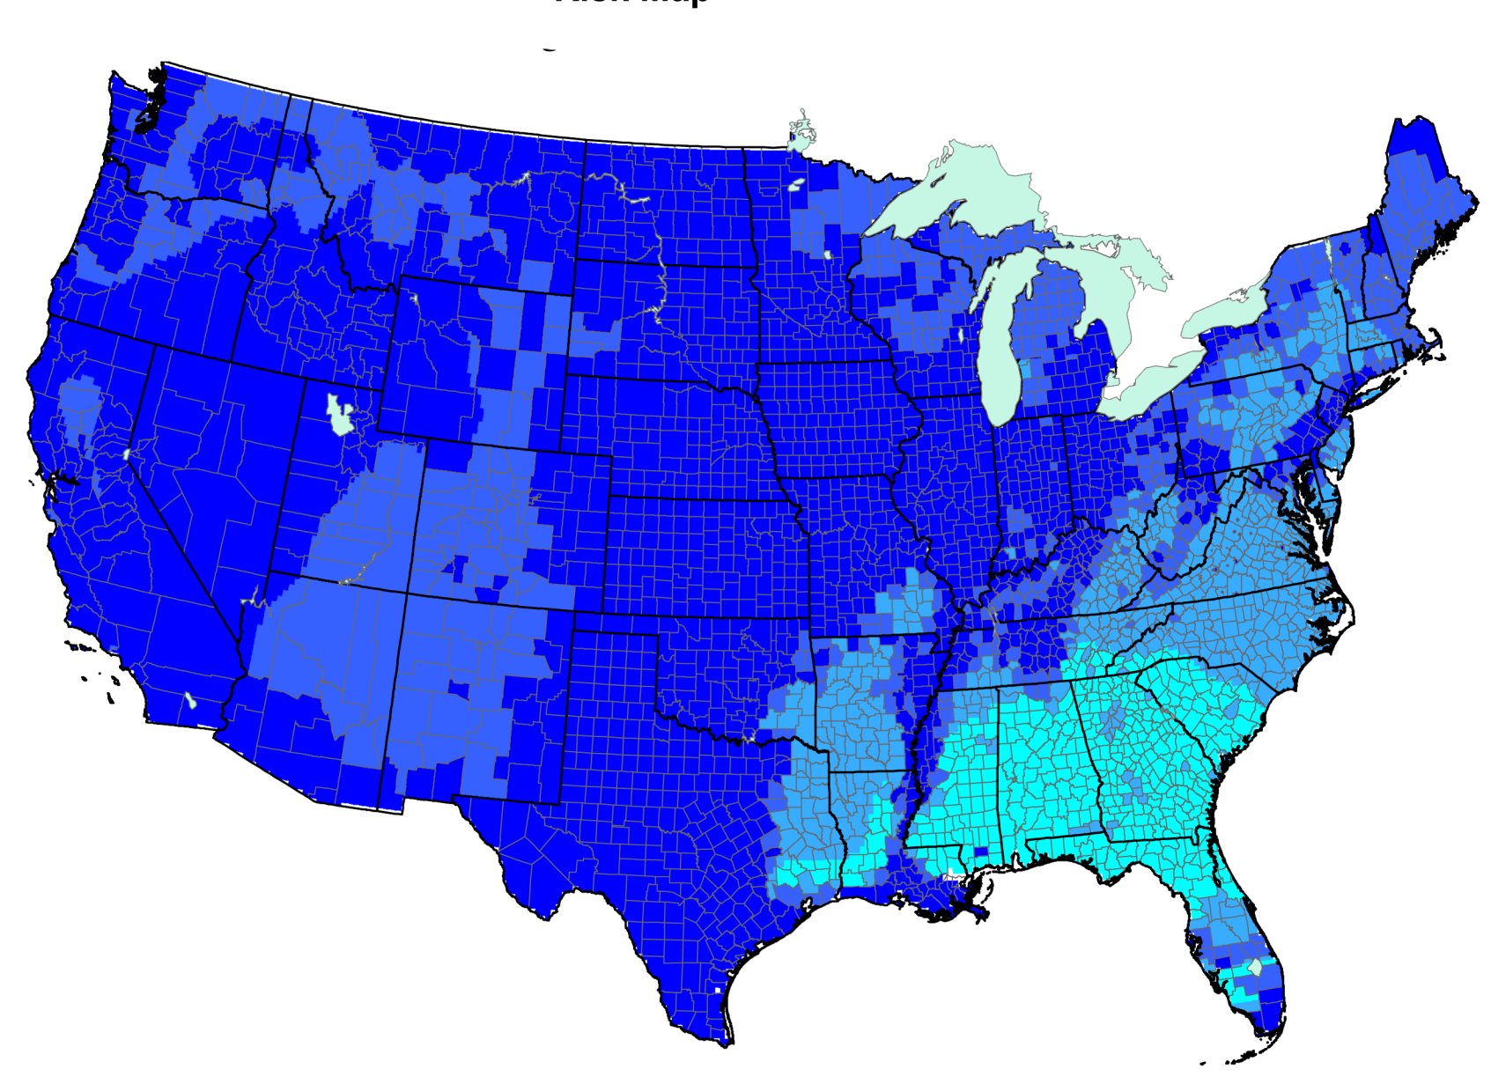
Potential Distribution Risk Map (2011)
Risk Potential
High
Low
Map courtesy of www.nappfast.org – accessed 11/12/2013
Notes:
M. gibsonii is not present in the U.S., yet states with moderate risk for the establishment of the pathogen include parts of Texas, Louisiana, Alabama, Mississippi, Georgia, Florida, Tennessee, North Carolina, and South Carolina. Please note that there is a low risk of establishment in most of the continental U.S.
Information sources:
CAPS Report. 2010. Mycosphaerella gibsonii.
Accessed 12/06/2013 -
http://caps.ceris.purdue.edu/webfm_send/586

Slide 5
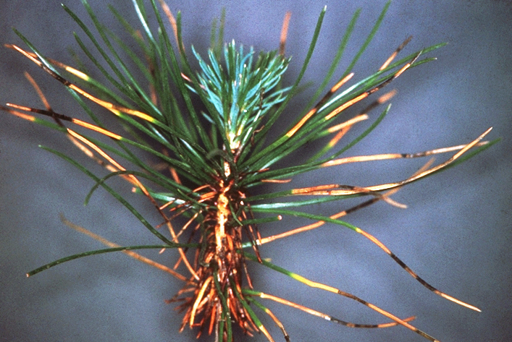
Disease Symptoms
Appear within 2 to 5 weeks of infection on lower needles
Lesions that are 5–10 mm long
initially light, yellow-green bands; fade to gray-brown
no reddish tint
Dark fruiting bodies on lesions.
Host loses leaves, has stunted growth, and may die
Lesions on infected Pinus thunbergii needles.
Photo: European and Mediterranean Plant Protection Organization, eppo.int
Notes:
Symptoms usually appear within 2 to 5 weeks of plants being infected with lesions forming on infected needles. Symptoms are first observed on lower needles of 1 to 2 year old infected trees and slowly progress upwards and to branch tips. The lesions are 5-10 mm long, and start out as light, yellow-green bands and eventually fade to yellow, then gray-brown in color. The diseased needles are not associated with a reddish tint that is characteristic of other diseases.
Additionally, dark colored spots form on the lesions that appear as dirty areas; these are actually the fruiting bodies. Under humid conditions, dark olive tufts of conidia may be seen.
Over time, the host plant will lose leaves, have stunted growth, and may die.
The pathogen primarily affects seedlings and saplings, but mature trees can also be infected. Under epidemic conditions, needle blight may cause 100% infection rates and 50-80% death rates. The severity of the disease is influenced by the species that is infected, the age of the tree when infected, and the environmental conditions under which the trees are grown.
Information sources:
CAPS Report. 2010. Mycosphaerella gibsonii.
Accessed 12/06/2013 -
http://caps.ceris.purdue.edu/webfm_send/586
Diekmann, M., J.R. Sutherland, D.C. Nowell, F.J. Morales and G. Allard, editors. 2002. FAO/IPGRI Technical Guidelines for the Safe Movement of Germplasm. No. 21. Pinus spp. Food and Agriculture Organization of the United Nations, Rome/International Plant Genetic Resources Institute, Rome.
Accessed 12/06/2013 –
http://www.bioversityinternational.org/uploads/tx_news/Pinus_spp._828.pdf

Slide 6
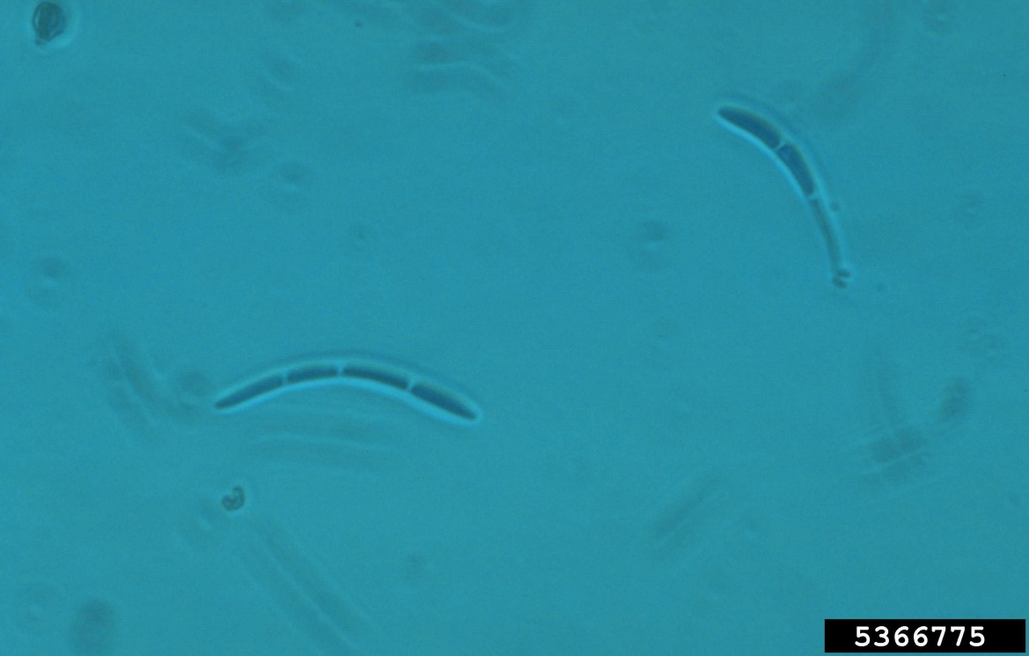
Identification
Fungal species can be distinguished by examining conidia - asexual non-motile spores of a fungus.
Conidia of Mycosphaerella sp.
Photo: William Jacobi, Colorado State University, Bugwood.org, #5366775
Notes:
Conidia are asexual non-motile spores of a fungus. Conidia can be used to distinguish fungal species through microscopic examination using the color, shape, and size.
Information sources:
CAPS Report. 2010. Mycosphaerella gibsonii.
Accessed 12/06/2013 -
http://caps.ceris.purdue.edu/webfm_send/586

Slide 7
Spread and Transmission
Pathogen spreads on infected nursery stock
Hyphae can overwinter in affected needles or as a latent infection on healthy-looking needles
Spores dispersed by rain splash or overhead irrigation
2 to 3 days of moist, humid conditions required for fungal dispersal and infection
Notes:
The needle blight pathogen may be spread through the movement of infected nursery stock from one location to another.
Hyphae are long, branching filamentous structures of a fungus that are the main mode of vegetative growth and can overwinter in affected needles. Latent infections may also occur in which healthy-looking needles were infected late in the year (symptoms are usually observed the following spring).
The spread of spores (conidia) that cause the disease may occur either through rain splash or overhead irrigation. Dispersal of the pathogen and subsequent infection in susceptible pine plants usually takes 2-3 days of moist conditions.
Information sources:
CAPS Report. 2010. Mycosphaerella gibsonii.
Accessed 12/06/2013 -
http://caps.ceris.purdue.edu/webfm_send/586
Diekmann, M., J.R. Sutherland, D.C. Nowell, F.J. Morales and G. Allard, editors. 2002. FAO/IPGRI Technical Guidelines for the Safe Movement of Germplasm. No. 21. Pinus spp. Food and Agriculture Organization of the United Nations, Rome/International Plant Genetic Resources Institute, Rome.
Accessed 12/06/2013 –
http://www.bioversityinternational.org/uploads/tx_news/Pinus_spp._828.pdf

Slide 8
Monitoring and Management
Monitoring
conduct a survey for visual symptoms and collect blighted needles
Chemical control
in nurseries, use maneb (or mancozeb) or copper-based fungicides
Cultural control
all diseased seedlings should be removed and burned early in the season
Notes:
To monitor for needle blight, conduct a survey for visual symptoms and collect symptomatic (blighted) needles.
Chemical control in nurseries can be achieved using maneb (or mancozeb) or copper-based fungicides applied to the current year's and 1-year-old seedlings at 2-weekly intervals during the growing season. It is important to note that maneb (or mancozeb) are contact fungicides and it is very important to get good spray coverage when applying.
All diseased seedlings should be removed and burned early in the season when an infection occurs.
Information sources:
CAPS Report. 2010. Mycosphaerella gibsonii.
Accessed 12/06/2013 -
http://caps.ceris.purdue.edu/webfm_send/586
EPPO Data Sheets on Quarantine Pests. Mycosphaerella gibsonii. CABI and EPPO European and Mediterranean Plant Protection Organization.
Accessed 12/06/2013 –
http://www.eppo.int/QUARANTINE/fungi/Mycosphaerella_gibsonii/CERSPD_ds.pdf

Slide 9
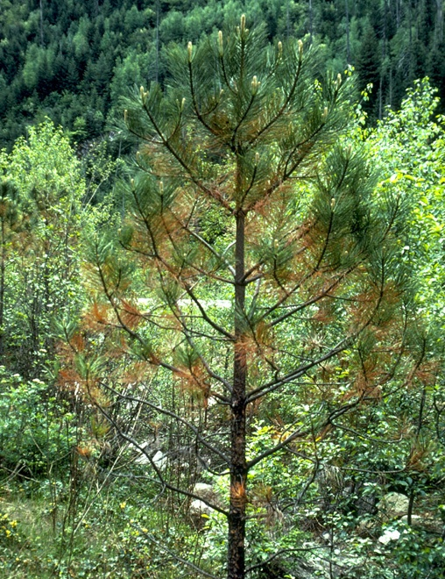
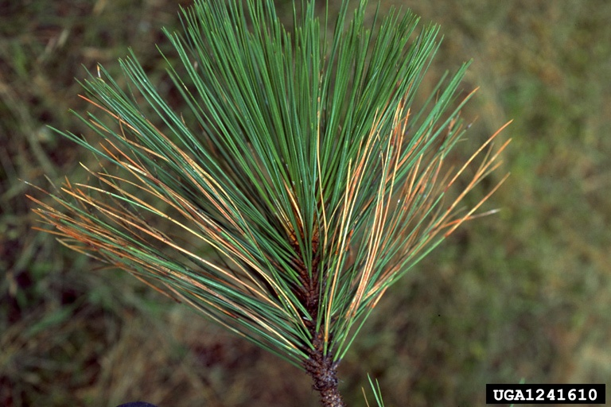
Look-alike Species Dothistroma blight (Mycosphaerella pini)
Note – Needles infected by M. gibsonii do not have a reddish tint as with other pine diseases.
M. pini symptoms on Pinus ponderosa.
Photos: (Left) Robert L. James, USDA Forest Service, Bugwood.org #1241609; (Right) Susan K. Hagle, USDA Forest Service, Bugwood.org #1241610
Notes:
Needle blight may be confused with Dothistroma blight (Mycosphaerella pini). However, needles infected by M. gibsonii do not have a reddish tint as is characteristic of other diseases. The pathogen may be identified by examination of the conidia.
Information sources:
CAPS Report. 2010. Mycosphaerella gibsonii.
Accessed 12/06/2013 -
http://caps.ceris.purdue.edu/webfm_send/586

Slide 10
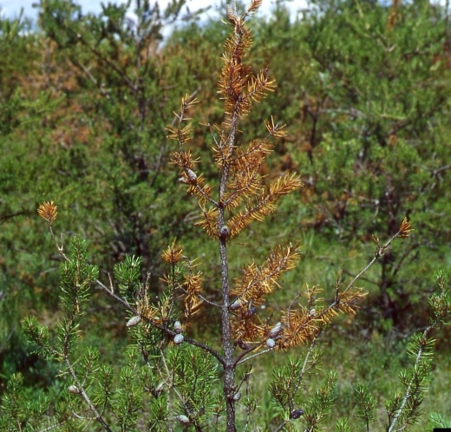
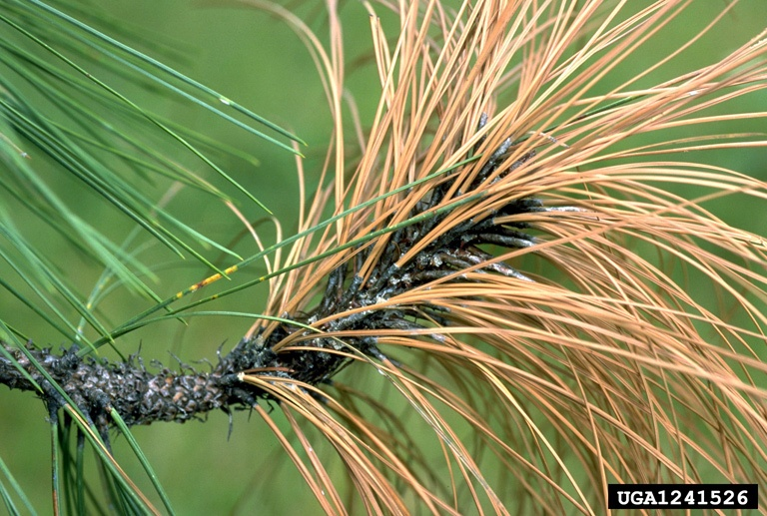
Look-alike Species Diplodia blight (Sphaeropsis sapinea)
Note - Needles infected by M. gibsonii do not have a reddish tint as with other pine diseases.
S. sapinea symptoms on Pinus ponderosa.
Photos: (Left) Joseph O’Brien, USDA Forest Service, Bugwood.org #5029014; (Right) Susan K. Hagle, USDA Forest Service, Bugwood.org #1241526
Notes:
Needle blight symptoms may also be masked by or confused with Diplodia blight (Sphaeropsis sapinea). Again, when compared with other pine diseases, needles infected by M. gibsonii do not have a reddish tint. The pathogen may be identified by examination of the conidia.
Information sources:
CAPS Report. 2010. Mycosphaerella gibsonii.
Accessed 12/06/2013 -
http://caps.ceris.purdue.edu/webfm_send/586

Slide 11
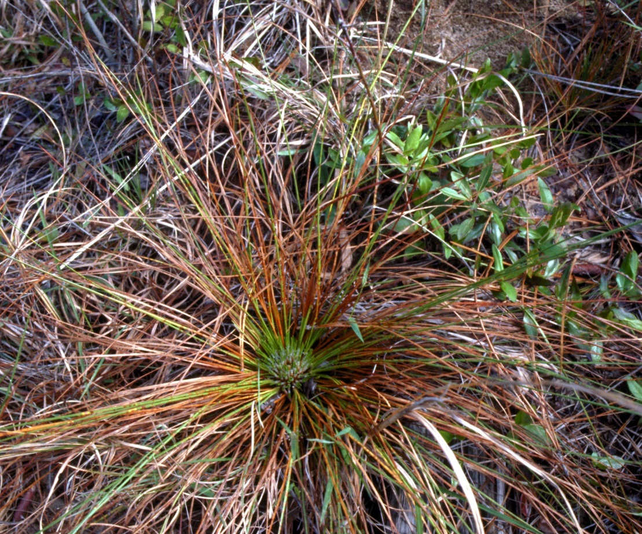
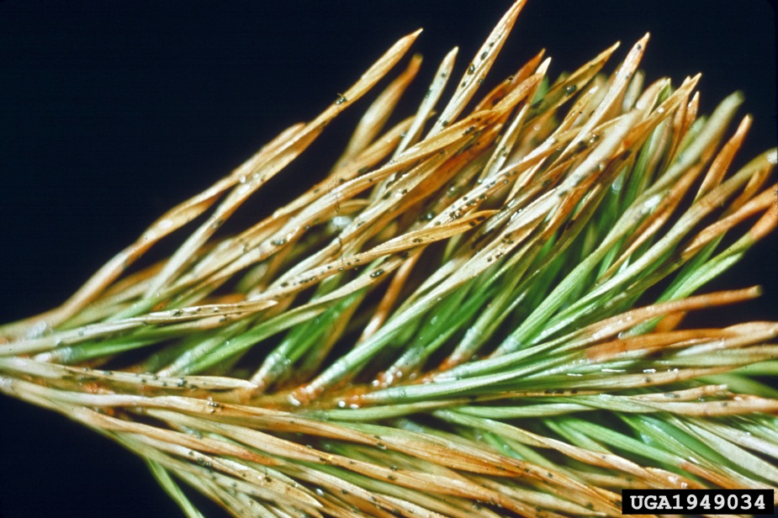
Look-alike Species Brown Spot Needle Blight (Mycosphaerella dearnsesii)
M. dearnssii symptoms on Pinus sylvestris L.(Scots pine)
M. dearnssii symptoms on Pinus palustris (longleaf pine)
Photos: (Left) - David J. Moorhead, University of Georgia, Bugwood.org, #0908075; (Right) - Darroll D. Skilling, USDA Forest Service, Bugwood.org , #1949034
Notes:
Needle blight symptoms may also be masked by or confused with brown spot needle blight (Mycosphaerella dearnessii). Symptoms of M. dearnssii appear first on older needles and have yellow, resin-soaked spots approximately 3 mm in diameter. As symptoms progress, the lesions turn dark brown in the center with a yellow-orange border. Branch dieback and tree death may occur over several years. The pathogen may be identified by examination of the conidia.
Note that M. dearnessii may also be known by as Scirrhia acicola.
Information sources:
EPPO Data Sheets on Quarantine Pests. Mycosphaerella dearnsii and Mycosphaerella pini. CABI and EPPO European and Mediterranean Plant Protection Organization.
Accessed 1/22/2014 – http://www.eppo.int/QUARANTINE/fungi/Mycosphaerella_dearnessii/SCIRSP_ds.pdf

Slide 12
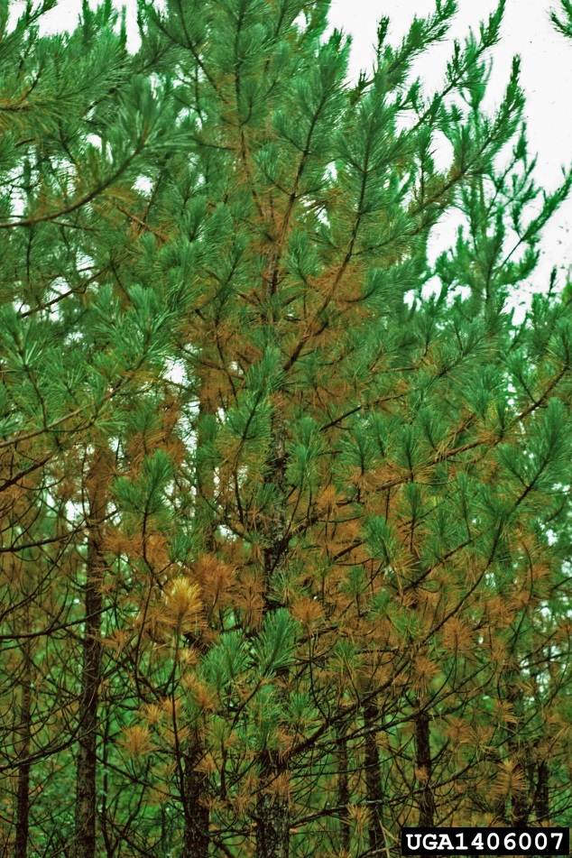
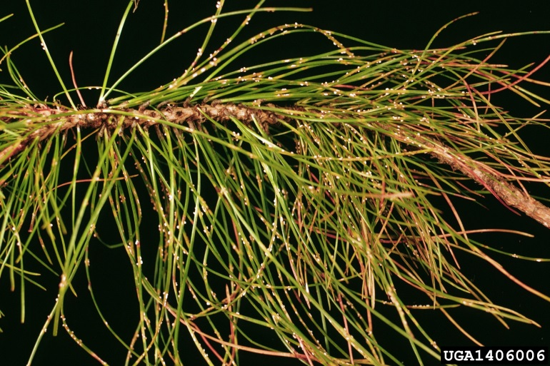
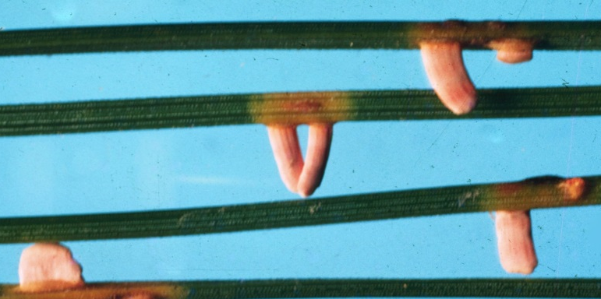
Look-alike Species Pine Needle Rust (Coleosporium asterum)
C. Asterum symptoms on Pinus resinosa (red pine)
Above: C. Asterum symptoms on red pine. Below: fruiting bodies (aecia) on pine host
Photos: (Left) USDA Forest Service - North Central Research Station Archive, USDA Forest Service, Bugwood.org , #1406007; (Right top) Susan K. Hagle, USDA Forest Service, Bugwood.org #1241526; (Right bottom) - USDA Forest Service - North Central Research Station Archive, USDA Forest Service, Bugwood.org , #1406003
Notes:
Needle blight symptoms may also be masked by or confused with pine needle rust (Coleosporium asterum). This disease does not normally cause severe damage to trees and the fungus needs an alternate host (goldenrod or aster) to complete its life cycle. Infected pines will often have white-orange blisters on the needles, which are the fruiting bodies of the fungus. The pathogen may be identified by examination of the conidia.
Information sources:
USDA Forest Service. Pine Needle Rust. Accessed 1/22/2014 –
http://www.na.fs.fed.us/spfo/pubs/misc/red%20pine%20pocket%20guide/pnr4.htm

Slide 13
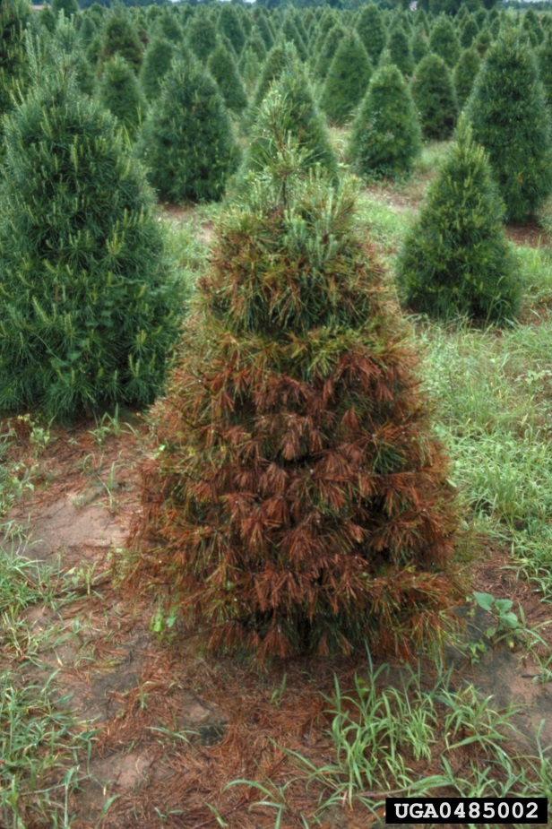
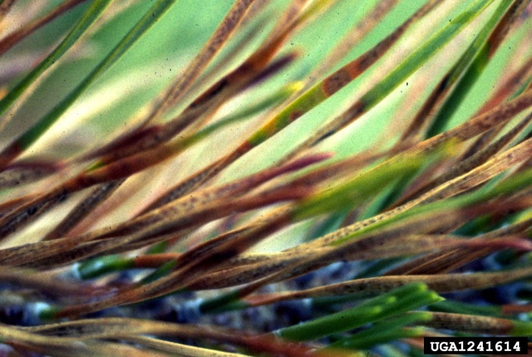
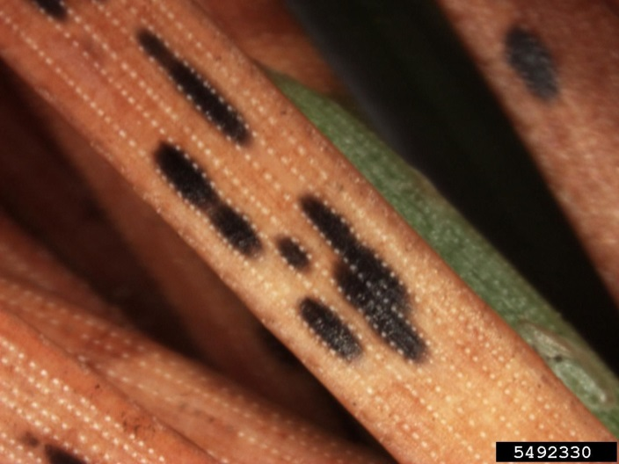
Look-alike Species Needle Cast (Ploioderma and Lophodermium spp.)
Lodgepole pine needle cast symptoms (above); Immature fruiting bodies of Ploioderma spp. on Pinas nigra Arnold (below)
Ploioderma needle cast symptoms on Pinus virginiana (Virginia pine)
Photos: (Left) – David J. Moorhead, University of Georgia, Bugwood.org, #0485002; (Top Right) – USDA Forest Service Archive, USDA Forest Service, Bugwood.org, #1241614;
(Bottom right) - Sandra Jensen, Cornell University, Bugwood.org, #5492330
Notes:
Needle blight symptoms may also be masked by or confused with pine needle cast, a group of diseases caused by fungi of several genera, including Ploioderma and Lophodermium spp. Symptoms first appear on the lower branches and progressively move upwards. The fungi cause spotting or banding of the needles resulting in brown or reddish-brown needles which eventually die and are shed. The tree’s vigor can be severely reduced, but in otherwise healthy trees the effects are often negligible. In rare cases, however, continued infection may lead to plant death. The pathogen may be identified by examination of the conidia.
Information sources:
Barnard, E. 1985. Republished 2008. Forest and Shade Tree Pests: Needle Casts of Pines. Florida Forest Service, Florida Department of Agriculture and Consumer Services. Accessed 1/23/2014 –
http://www.freshfromflorida.com/content/download/4612/29442/Needle%20Cast%20of%20Pines.pdf
University of Illinois Extension. 1999. Report on Plant Disease: Needle Blights and Needle Casts of Pines. University of Illinois at Urbana-Champaign, Department of Crop Sciences. Accessed 1/22/2014 –
http://web.aces.uiuc.edu/vista/pdf_pubs/624.PDF

Slide 14
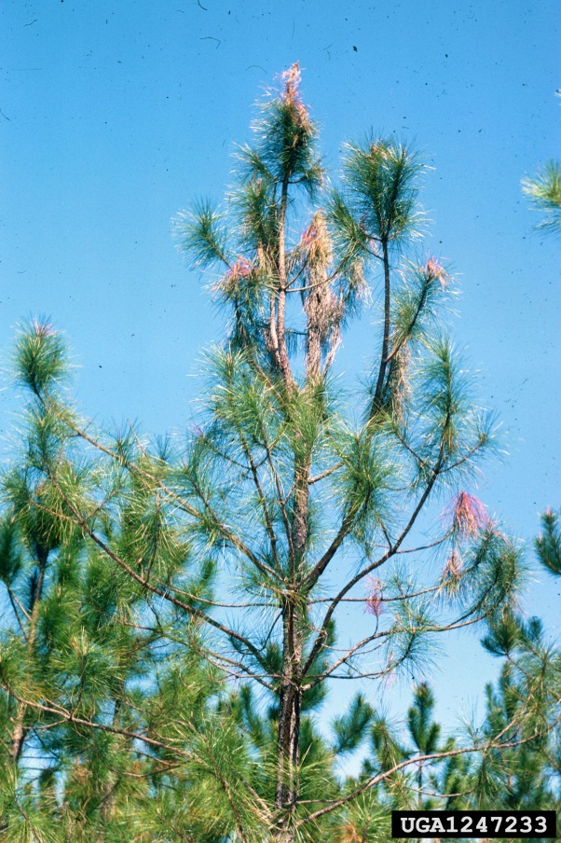
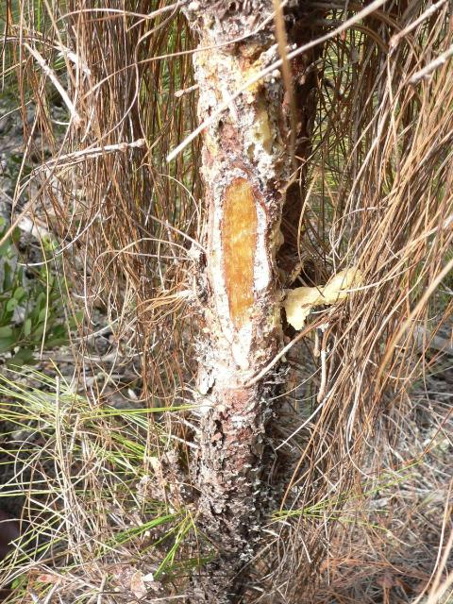
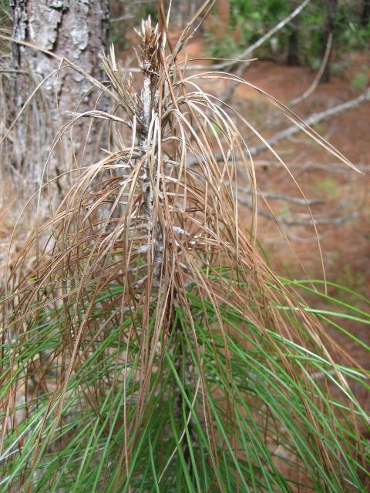
Look-alike Species Pitch Canker Disease (Fusarium circinatum)
Pitch canker symptoms on Pinus elliottii Englem (slash pine)
Longleaf pine with pitch canker, note resin soaked wood & resin on stem
Slash pines showing resin on outside of stem
Photos: (Left) – Terry S. Price, Georgia Forestry Commission, Bugwood.org, #1247233; (Middle) – Jason Smith, University of Florida; (Right) – Tyler Dreaden, University of Florida
Notes:
Needle blight symptoms may also be masked by or confused with pitch canker disease of pines (Fusarium circinatum). The presence of “flagging”, the dieback of lateral or terminal shoots, is a characteristic symptom of pitch canker disease in mature trees. Needles become impregnated with resin and will turn reddish-brown, then brown to grey and typically die in a few months due the girdling of the stem by the fungus. This fungus also causes resin soaked, bleeding cankers on the stems and shoots which is a key distinguishing feature from needle blight. Cankers which encircle the stem of the tree are lethal. The pathogen may be identified by examination of the conidia.
Information sources:
Dreaden, T., J. Smith. 2010. Reviewed 2013. Pitch Canker Disease of Pines. University of Florida, IFAS, Florida Cooperative Extension Service. Accessed 1/23/14 –
https://edis.ifas.ufl.edu/fr298#FIGURE 2

Slide 15
Authors
Annika Minott
Graduate Research Assistant, Doctor of Plant Medicine Program, University of Florida
Smriti Bhotika, Ph.D.
Postdoctoral Associate, Department of Entomology and Nematology, University of Florida

Slide 16
Editors
Stephanie Stocks, M.S.
Assistant-In, Extension Scientist, Department of Entomology and Nematology, University of Florida
Matthew D. Smith, Ph.D.
Postdoctoral Associate, Department of Entomology and Nematology, University of Florida

Slide 17
Reviewers
Jeff Eickwort, B.S.
Forest Biologist, Florida Department of Agriculture and Consumer Services, Florida Forest Service
Jason Smith, Ph.D.
School of Forest Resources and Conservation, University of Florida
Aaron Palmateer, Ph.D.
Associate Professor, Tropical Research and Education Center

Slide 18
Collaborating Agencies
U.S. Department of Agriculture Animal and Plant Health Inspection Service (USDA-APHIS)
Cooperative Agricultural Pest Survey Program (CAPS)
Florida Department of Agriculture and Consumer Services (FDACS)
National Plant Diagnostic Network (NPDN)
Sentinel Plant Network (SPN)
Protect U.S.
University of Florida Institute of Food and Agricultural Sciences (UF-IFAS)

Slide 19
Educational Disclaimer and Citation
This presentation can be used for educational purposes for NON-PROFIT workshops, trainings, etc.
Citation:
Minott A., Bhotika, S., Ph.D., 2014. Needle Blight, Mycosphaerella gibsonii, June 2014.

Slide 20
References
Barnard, E. 1985. Republished 2008. Forest and Shade Tree Pests: Needle Casts of Pines. Florida Forest Service, Florida Department of Agriculture and Consumer Services. Accessed 1/23/2014 –
http://www.freshfromflorida.com/content/download/4612/29442/Needle%20Cast%20of%20Pines.pdf
CAPS Report. 2010. Mycosphaerella gibsonii. Accessed 12/06/2013 -
http://caps.ceris.purdue.edu/webfm_send/586
Diekmann, M., J.R. Sutherland, D.C. Nowell, F.J. Morales, and G. Allard, editors. 2002. FAO/IPGRI Technical Guidelines for the Safe Movement of Germplasm. No. 21. Pinus spp. Food and Agriculture Organization of the United Nations, Rome/International Plant Genetic Resources Institute, Rome. Accessed 12/06/2013
http://www.bioversityinternational.org/uploads/tx_news/Pinus_spp._828.pdf
Dreaden, T., J. Smith. 2010. Reviewed 2013. Pitch Canker Disease of Pines. University of Florida, IFAS, Florida Cooperative Extension Service. Accessed 1/23/14
https://edis.ifas.ufl.edu/fr298#FIGURE 2

Slide 21
References
EPPO Data Sheets on Quarantine Pests. Mycosphaerella gibsonii. CABI and EPPO European and Mediterranean Plant Protection Organization. Accessed 12/06/2013
http://www.eppo.int/QUARANTINE/fungi/Mycosphaerella_gibsonii/CERSPD_ds.pdf
EPPO Data Sheets on Quarantine Pests. Mycosphaerella dearnsii and Mycosphaerella pini. CABI and EPPO European and Mediterranean Plant Protection Organization. Accessed 1/22/2014 –
http://www.eppo.int/QUARANTINE/fungi/Mycosphaerella_dearnessii/SCIRSP_ds.pdf
University of Illinois Extension. 1999. Report on Plant Disease: Needle Blights and
Needle Casts of Pines. University of Illinois at Urbana-Champaign, Department of Crop Sciences. Accessed 1/22/2014 –
http://web.aces.uiuc.edu/vista/pdf_pubs/624.PDF
USDA Forest Service. Pine Needle Rust. Accessed 1/22/2014 –
http://www.na.fs.fed.us/spfo/pubs/misc/red%20pine%20pocket%20guide/pnr4.htm

