Slide 1
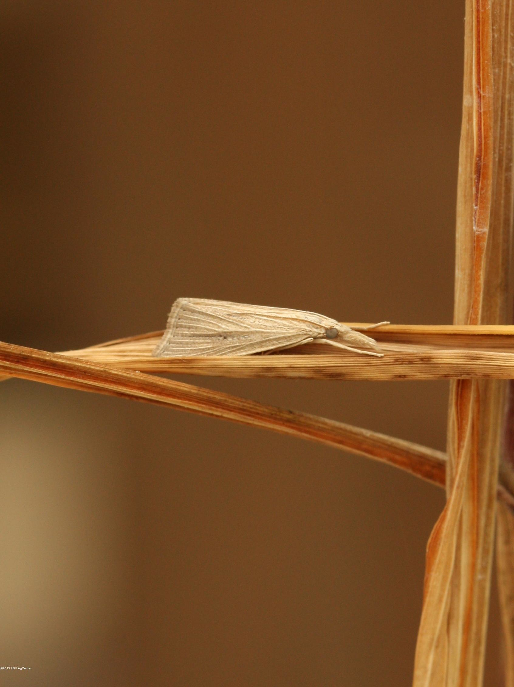
Mexican Rice Borer Eoreuma loftini
Photo: Anna Meszaros, ©2013, Louisiana State University AgCenter
Notes:
This presentation is about a crambid moth called the Mexican rice borer, Eoreuma loftini . While the distribution is presently limited in the United States, this species has the potential to become a major pest for Florida.

Slide 2
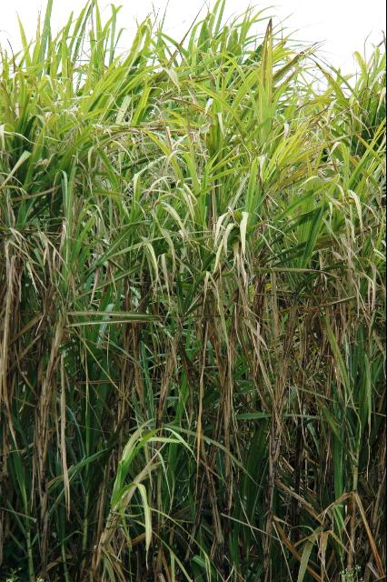
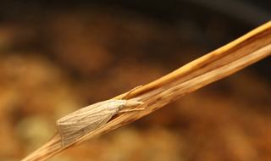
Mexican Rice Borer
Stem-boring moth
Major pest of sugarcane, rice, and other grass crops
Not yet established in Florida, but detected in Levy Co.
Photos: Anna Meszaros, Louisiana State University AgCenter; Josh Wickham, University of Florida Institute of Food and Agricultural Science
Notes:
The Mexican Rice Borer (MRB) is a significant pest of sugarcane, rice, and other grass crops in Mexico. Over the last several decades, this species has been spreading throughout Texas and Louisiana. The first Florida state record for the species occurred in Levy County on 23 March 2012, when a single specimen was caught at a mercury vapor light during a general survey. This male was identified as a MRB on 14 July. The extent of the population is not currently known. However, the collection of two additional males at pheromone traps in March 2013 (in the same county) suggests that this species may be established in parts of Florida.
Information sources:
Hummel, N.A., T. Hardy, T.E. Reagan, D. Pollet, C. Carlton, M.J. Stout, J.M. Beuzelin, W. Akbar, and W.H. White. 2010. Monitoring and First Discovery of the Mexican Rice Borer Eoreuma loftini (Lepidoptera: Crambidae) in Louisiana. Florida Entomologist. 93:123-124.
Hayden, James E. Mexican Rice Borer, Eoreuma loftini (Dyar) (Lepidoptera: Crambidae: Crambinae) in Florida. 2012. Florida Department of Agriculture and Consumer Services, Division of Plant Industry Pest Alert. DACS-P-01827.

Slide 3
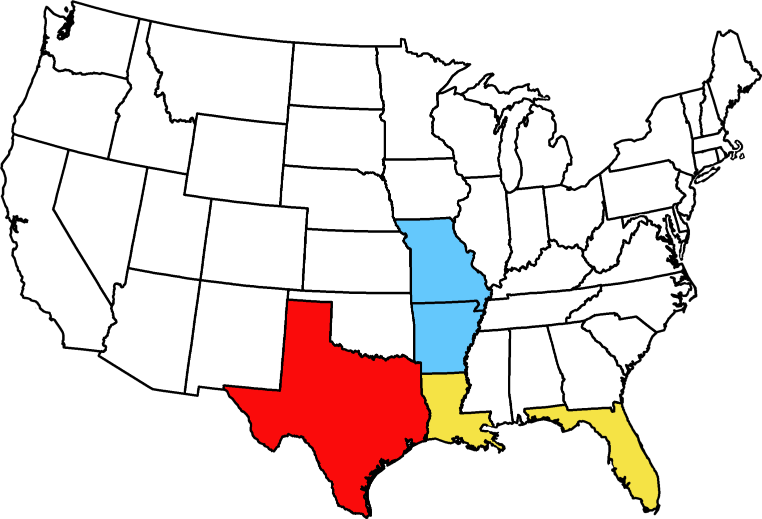
Distribution
No sampling
Sampled but not found
Intercepted or detected, but not established
Established by survey or consensus
Map courtesy of Pest Tracker, National Agricultural Pest Information System (NAPIS)
Notes:
These mainly subtropical moths are native to Mexico, and were historically found in southwestern deserts of the U.S. such as the Imperial Valley in California and the Sonoran Desert in Arizona. This species was first detected in the Lower Rio Grande Valley of Texas in 1959. By the late 1980’s it displaced the sugarcane borer, Diatraea saccharalis, as the dominant pest of sugarcane in the Lower Valley, but had also spread northeast far into the rice producing areas of the Texas gulf coast. From 1980 to 2004, the average rate of spread in Texas was 23.2 km/yr. The range expansion of MRBs continued into southwestern Louisiana by late 2008, and a larval infestation was detected in Louisiana sugarcane for the first time this spring (2013). As mentioned earlier, they now have been found in Florida as well.
Information sources:
Reay-Jones, F.P.F. 2005. Integrated Pest Management of the Mexican rice borer in Louisiana and Texas sugarcane and rice. Ph.D. Dissertation. Louisiana State University, Baton Rouge.
Hummel, N.A., T. Hardy, T.E. Reagan, D. Pollet, C. Carlton, M.J. Stout, J.M. Beuzelin, W. Akbar, and W.H. White. 2010. Monitoring and First Discovery of the Mexican Rice Borer Eoreuma loftini (Lepidoptera: Crambidae) in Louisiana. Florida Entomologist. 93:123-124.
Meaux, J. Louisiana Sugarcane: Mexican Rice Borer Infestation Confirmed. AgFax.Com. http://agfax.com/2013/04/08/louisiana-sugarcane-mexican-rice-borer-infestation-confirmed/#sthash.PborlY8r.dpuf. Accessed 13 June 2013.

Slide 4
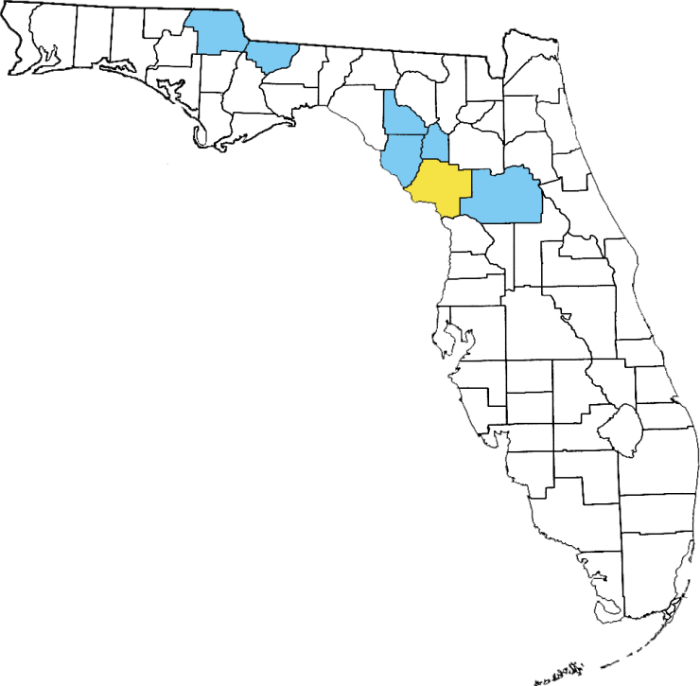
Florida Detections
No sampling
Sampled but not found
Found
Map courtesy of FL CAPS
Notes:
The first Florida state record for the species occurred in Levy County on 23 March 2012, when a single specimen was caught at a mercury vapor light during a general survey. This male was identified as a MRB on 14 July. The extent of the population is not currently known. However, the collection of two additional males at pheromone traps in March 2013 (in the same county) suggests this species may be established in Florida.
Currently, CAPS is surveying for MRB using bucket traps in Marion, Dixie, Gilchrest, Jackson, Gadsden, and Lafayette counties.
Information Sources:
Hayden, James E. Mexican Rice Borer, Eoreuma loftini (Dyar) (Lepidoptera: Crambidae: Crambinae) in Florida. 2012. Florida Department of Agriculture and Consumer Services, Division of Plant Industry Pest Alert. DACS-P-01827.

Slide 5
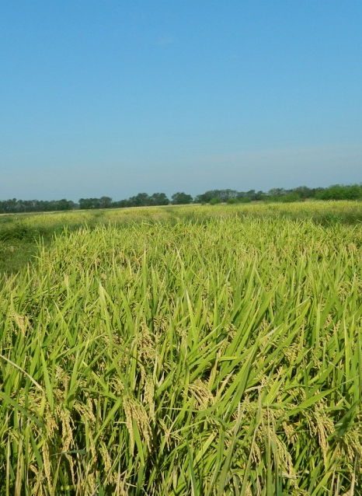
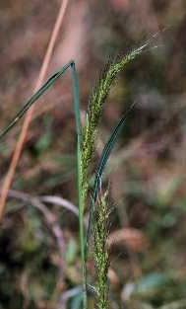
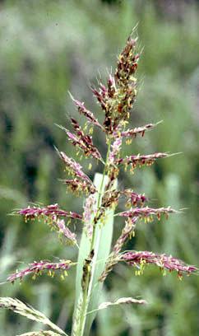
Susceptible Plants
Rice
Sugarcane
Barnyardgrass
Johnsongrass
Photos (from left to right): Fuger Dou, Department of Soil and Crop Science, Texas A&M University; Larry Allain, U.S. Geological Survey; George Yatskievych, Missouri Botanical Garden;
Josh Wickham, University of Florida Institute of Food and Agricultural Science
Notes:
Crops and ornamental plants such as sugarcane, rice, maize, millet sorghum, and lemongrass are susceptible hosts for the MRB. Possible wild hosts in Florida include many other large grasses such as barnyardgrass (Echinochloa crus-galli), Johnsongrass (Sorghum halepense), sudangrass (Sorghum bicolor drummondi), and Vasey’s grass (Paspalum urvillei).
CAPS is also interested in the MRB because of potential damage to perennial grasses, such as switch-grass, that are grown for biofuel production. This new industry is growing in Florida, and thus the MRB could pose a further economic threat to our state.
Information sources:
Holguin, C. M. 2010. Insect diversity and pest status on switchgrass grown for biofuel in South Carolina. M.Sc. Thesis. Clemson University: South Carolina, USA.
Hummel, N.A., T. Hardy, T.E. Reagan, D. Pollet, C. Carlton, M.J. Stout, J.M. Beuzelin, W. Akbar, and W.H. White. 2010. Monitoring and First Discovery of the Mexican Rice Borer Eoreuma loftini (Lepidoptera: Crambidae) in Louisiana. Florida Entomologist. 93:123-124.
Solis, M.A. 2006. Update: “Key to selected Pyraloidea (Lepidoptera) larvae intercepted at U.S. ports of entry: revision of Pyraloidea in ‘keys to some frequently intercepted lepidopterous larvae’ by Weisman 1986”. USDA Systematic Entomology Laboratory. Paper 1.

Slide 6
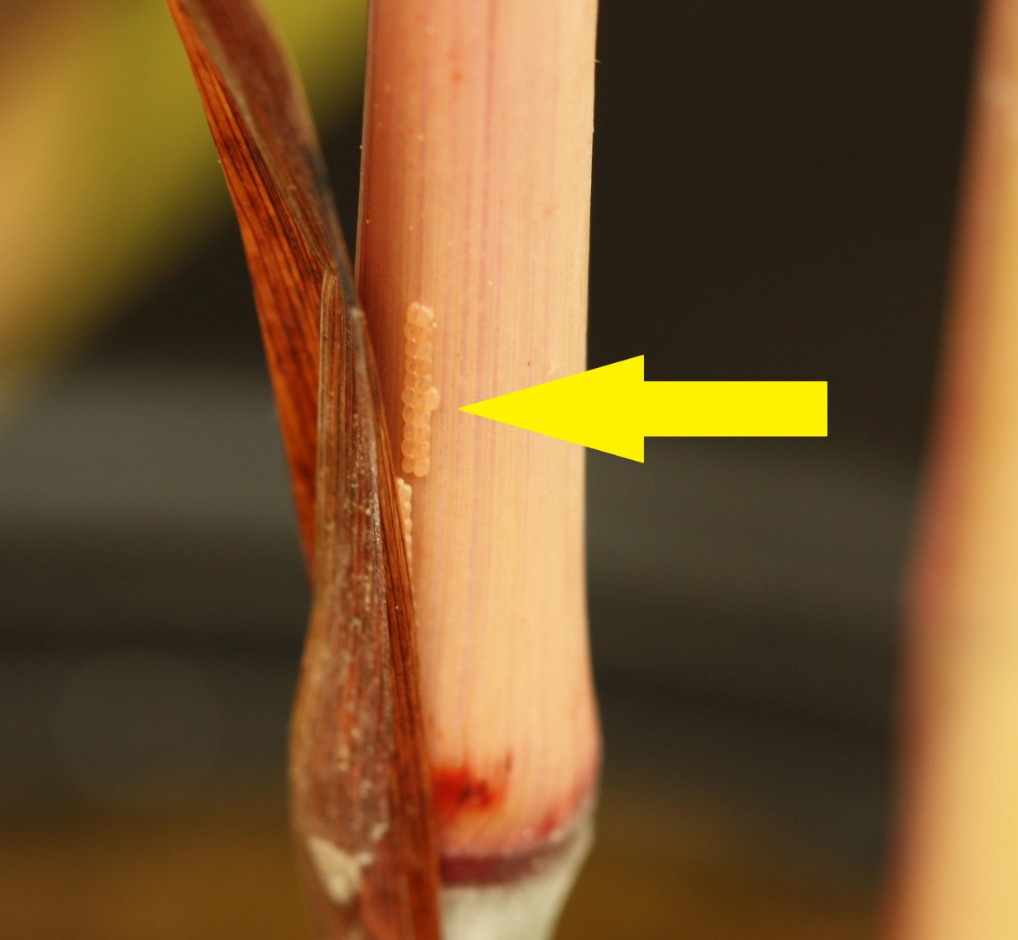
Identification: Eggs
Photo: Julien Beuzelin, ©2013, Louisiana State University AgCenter
Notes:
Eggs are yellowish and creamy in color, and spherical and sub-globular in shape. They are laid in groups of 5 to 100 in crevices of the dried shoots or dead leaves near the base of them stem. This is unlike most cane borers that lay eggs on higher, fresher leaves.
Information sources:
Hayden, James E. Mexican Rice Borer, Eoreuma loftini (Dyar) (Lepidoptera: Crambidae: Crambinae) in Florida. 2012. Florida Department of Agriculture and Consumer Services, Division of Plant Industry Pest Alert. DACS-P-01827.
Hummel, N.A., T.E. Reagan, D. Pollet, W. Akbar, J. Beuzelin, C. Carlton, J. Saichuk, T. Hardy and M. Way. 2008. Mexican Rice Borer, Eoreuma loftini (Dyar). LSU AgCenter Pub. 3098.

Slide 7
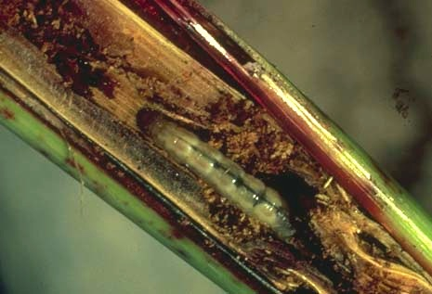
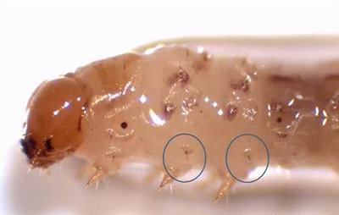
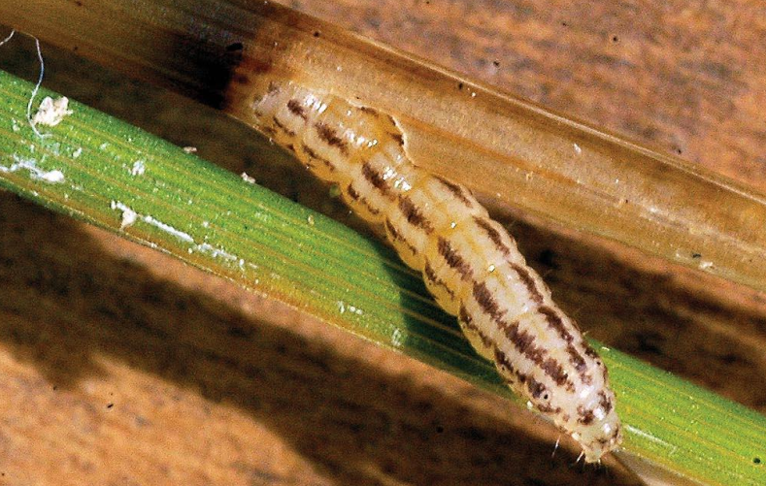
Identification: Larvae
Larva in a stem
Laval head capsule and thorax
Larva boring into a stem
Photos: (Top Row) - courtesy of insects.tamu.edu; Anna Meszaros, ©2013, Louisiana State University AgCenter. (Bottom) - T. Eugene Reagan, Louisiana State University AgCenter.
Notes:
Full-grown larvae are almost 2.5 cm (1 inch) in length. They are whitish in color with a tan head capsule and two pairs of broken pink to purple longitudinal stripes, but no mid-dorsal stripe (no stripe down the middle of the back).
On the second and third segments of the larval thorax right above the legs, the Mexican rice borer has only one seta (hair) in the pink pigmented area (see blue circles), while the rice stalk borer has two. Also, in general, the Mexican rice borer has light-colored hairs and head capsule while the rice stalk borer has dark hairs and head capsule (see slide 15).
Information sources:
Hayden, James E. Mexican Rice Borer, Eoreuma loftini (Dyar) (Lepidoptera: Crambidae: Crambinae) in Florida. 2012. Florida Department of Agriculture and Consumer Services, Division of Plant Industry Pest Alert. DACS-P-01827.
Solis, M.A. 2006. Update: “Key to selected Pyraloidea (Lepidoptera) larvae intercepted at U.S. ports of entry: revision of Pyraloidea in ‘keys to some frequently intercepted lepidopterous larvae’ by Weisman 1986”. USDA Systematic Entomology Laboratory. Paper 1.
Hayden, Jim. FDACS DPI. Personal communication.

Slide 8
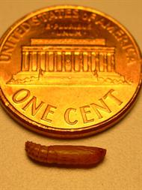
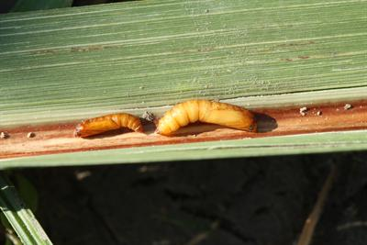
Identification: Pupae
Mexican rice borer
Sugarcane borer
Photos: Anna Meszaros, ©2013, Louisiana State University AgCenter.
Notes:
The pupa is brown and nondescript and is found within a thin cocoon inside the tunnel near the emergence hole. Sugarcane borer pupae are larger and lighter in color. Stripes can sometimes be visible on the back of MRB pupae.
Information sources:
Hayden, James E. Mexican Rice Borer, Eoreuma loftini (Dyar) (Lepidoptera: Crambidae: Crambinae) in Florida. 2012. Florida Department of Agriculture and Consumer Services, Division of Plant Industry Pest Alert. DACS-P-01827.
Solis, M.A. 2006. Update: “Key to selected Pyraloidea (Lepidoptera) larvae intercepted at U.S. ports of entry: revision of Pyraloidea in ‘keys to some frequently intercepted lepidopterous larvae’ by Weisman 1986”. USDA Systematic Entomology Laboratory. Paper 1.

Slide 9
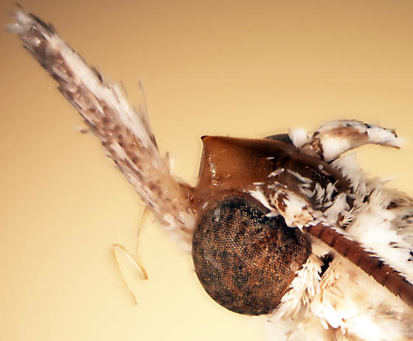
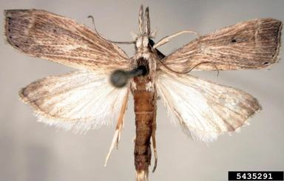

Identification: Adults
Mouthparts
Patterns on the forewings
Closed wings
Photos: (Left & Top Right) - Kira Metz, USDA, APHIS, Plant Protection and Quarantine; (Bottom Right) - Anna Meszaros, ©2013, Louisiana State University AgCenter
Notes:
Adult Mexican rice borers are 1.2 cm (0.5 inch) long, light tan in color with nearly no pattern, and delta-shaped wings like a triangle when their wings are closed. There is a small black dot in the center of MRB forewings (black arrows) as well as two faint, blackish longitudinal streaks (red arrows).
MRB mouthparts are long, extending fairly far in front of the head. The forehead is slightly conical (green arrow), but that is visible under magnification only. Positive identification requires dissection by experts as many related grass borers share some of these characters.
Information sources:
Hayden, James E. Mexican Rice Borer, Eoreuma loftini (Dyar) (Lepidoptera: Crambidae: Crambinae) in Florida. 2012. Florida Department of Agriculture and Consumer Services, Division of Plant Industry Pest Alert. DACS-P-01827.

Slide 10

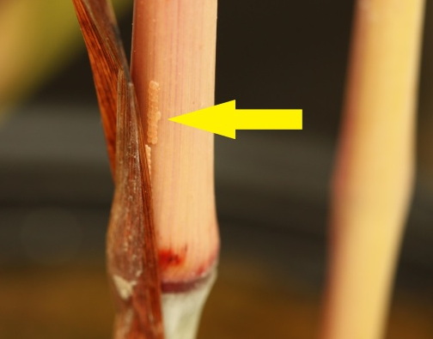
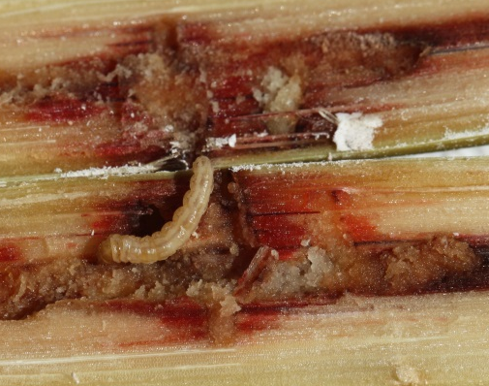
Life Cycle
Adult
Egg stage (5-14 days)
Pupal stage (7-21 days)
Laval stage (21-78 days)
Photos: Anna Meszaros, JulienBeuzelin, Natalie Hummel, and Johnny Saichuk; ©2013, Louisiana State University AgCenter, Josh Wickham, University of Florida Institute of Food and Agricultural Science
Notes:
Across their range, MRBs breed continuously, so any life stage can occur at any time of year. Their total generation time varies with temperature and ranges from 45 days in warmer temperatures to three months in cooler temperatures.
Two days after emergence, most adult females begin to lay their eggs in cracks on plant surfaces and in dry leaf folds near the lower part of the plant. Eggs can be found between the stalk and leaf sheath (yellow arrow) in the laboratory or greenhouse but it is nearly impossible to observe the eggs in the field.
Eggs hatch after 5-14 days and then move inside fresh leaf sheaths to feed on plant tissue. After approximately one week of feeding, larvae tunnel into the internodes of the plant stem. As they bore these tunnels, they pack them with frass to block out predators and parasites. Total larval duration takes 21-78 days. The pupal stage takes place in the tunnels packed with frass and lasts 7-21 days.
Information sources:
Reay-Jones, F.P.F. 2005. Integrated Pest Management of the Mexican rice borer in Louisiana and Texas sugarcane and rice. Ph.D. Dissertation. Louisiana State University, Baton Rouge.
Hayden, James E. Mexican Rice Borer, Eoreuma loftini (Dyar) (Lepidoptera: Crambidae: Crambinae) in Florida. 2012. Florida Department of Agriculture and Consumer Services, Division of Plant Industry Pest Alert. DACS-P-01827.

Slide 11
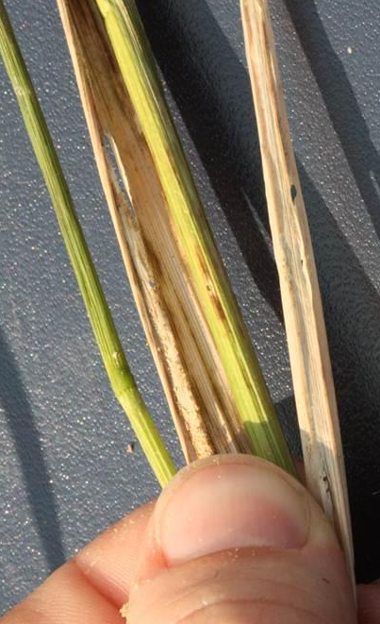
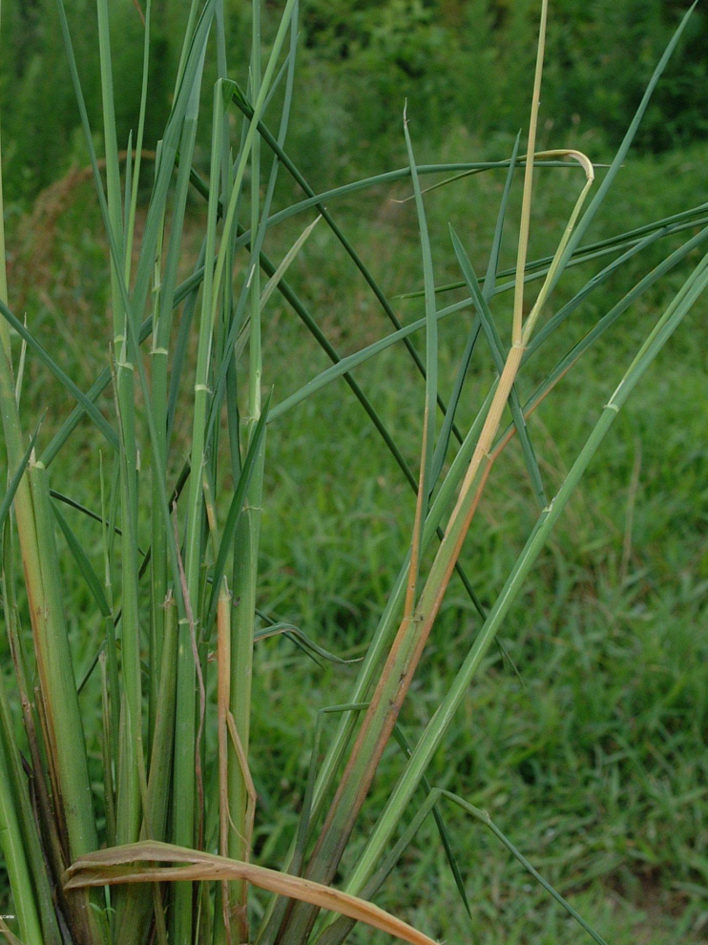
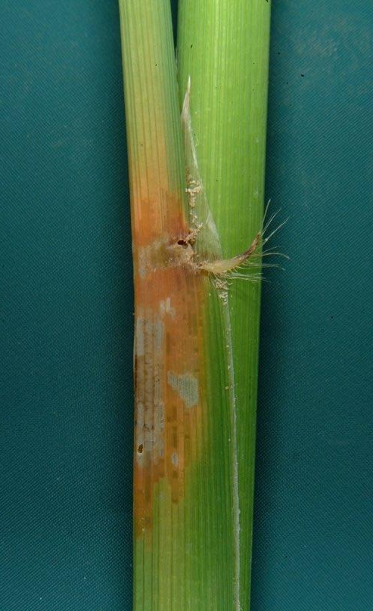
Damage
Orange coloration and Withering
Deadheart
Photos: (Left to Right) - Johnny Saichuk; Anna Meszaros; Bruce Schultz. ©2013, Louisiana State University AgCenter
Notes:
Larval feeding causes a variety of plant damage. Early signs of injury include orange discoloration (white arrow) and lesions on the leaf sheath; in rice and sugarcane, a condition known as “deadheart” can result from the withering and death of the youngest leaves.
At this stage, damage from different species of stalk borers looks the same, but tunnels from Mexican rice borer larvae are packed with frass, whereas tunnels from sugarcane borers are not. The tunnels packed with frass are easy to identify in sugarcane, but may be difficult to see in rice and weedy grasses.
Information sources:
Hayden, James E. Mexican Rice Borer, Eoreuma loftini (Dyar) (Lepidoptera: Crambidae: Crambinae) in Florida. 2012. Florida Department of Agriculture and Consumer Services, Division of Plant Industry Pest Alert. DACS-P-01827.
Hummel, N.A., T.E. Reagan, D. Pollet, W. Akbar, J. Beuzelin, C. Carlton, J. Saichuk, T. Hardy and M. Way. 2008. Mexican Rice Borer, Eoreuma loftini (Dyar). LSU AgCenter Pub. 3098.

Slide 12
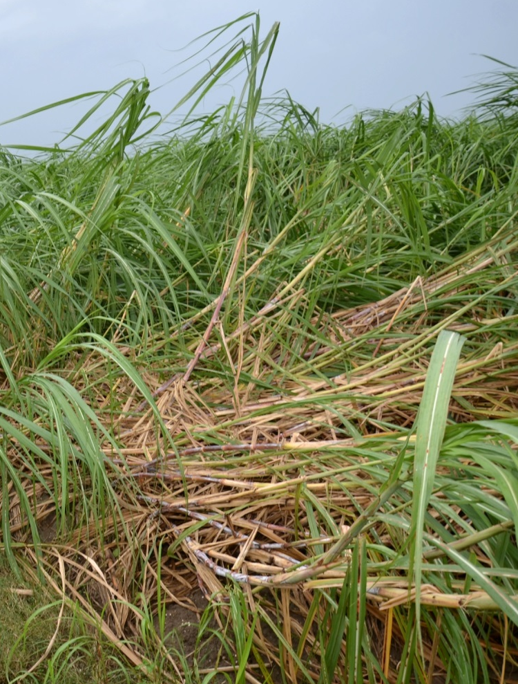
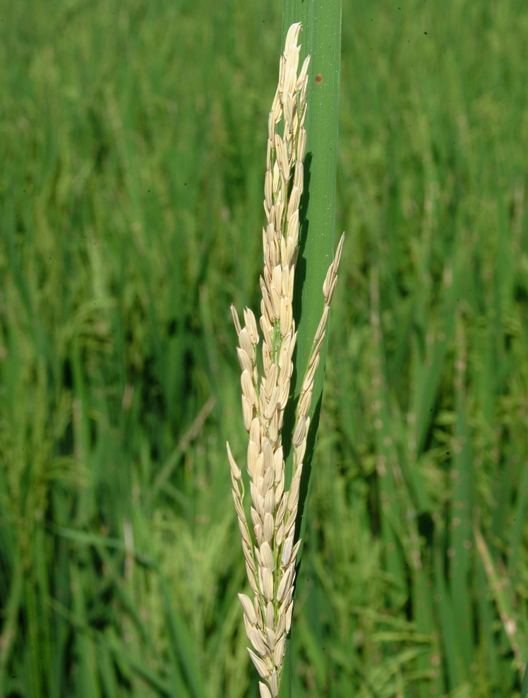
Damage
Lodging of stalks in sugarcane
Whitehead condition in rice
Photos: Johnny Saichuk, ©2013, Louisiana State University AgCenter
Notes:
Feeding larvae often tunnel transversely across the stem. This weakens the stem and makes a plant more susceptible to lodging (or falling over) prior to harvest. In rice, feeding during the development of the panicle causes partial or total plant sterility. This condition is called “whitehead” and is characterized by empty, white panicles that are light and stand upright due to the seed loss.
Damage to sugarcane can cause a decrease in sugar production and stunting and lodging of stalks. Heavy infestations can be severe enough to make harvesting fields unfeasible.
Information sources:
Hayden, James E. Mexican Rice Borer, Eoreuma loftini (Dyar) (Lepidoptera: Crambidae: Crambinae) in Florida. 2012. Florida Department of Agriculture and Consumer Services, Division of Plant Industry Pest Alert. DACS-P-01827.
Hummel, N.A., T.E. Reagan, D. Pollet, W. Akbar, J. Beuzelin, C. Carlton, J. Saichuk, T. Hardy and M. Way. 2008. Mexican Rice Borer, Eoreuma loftini (Dyar). LSU AgCenter Pub. 3098.

Slide 13
Monitoring
Surveying should begin:
When internodes are visible in most plants (sugarcane)
Green ring stage (rice)
Look for orange lesions caused by larval feeding
Peel off the leaf sheath to detect larva or frass
Frass = MRB
Check the edges of fields or clusters of plants.
Check individual plants in a systematic way (e.g., every 5th plant, or every 10th plant).
Notes:
In rice, scouting should begin at green ring stage (internode elongation) and intensify at the early boot stage (panicle development).
In sugarcane, scouting should begin when internodes are visible in most plants and continue on a regular basis. Look at the leaf sheath for orange lesions caused by larval feeding.
To confirm Mexican rice borer injury, peel off the leaf sheath to detect larva or frass (frass = MRB).
Edges of fields can act as pest reservoirs, especially if you are spraying / using chemical control. Check those edges for damage. Check individual plants for damage.
Pheromone traps can help to monitor for Mexican rice borer adults in rice and sugarcane. Scouting should begin when 20 moths are collected in a trap during a one-week period.
Information sources:
Reay-Jones, F.P.F. 2005. Integrated Pest Management of the Mexican rice borer in Louisiana and Texas sugarcane and rice. Ph.D. Dissertation. Louisiana State University, Baton Rouge.
Hummel, N.A., T.E. Reagan, D. Pollet, W. Akbar, J. Beuzelin, C. Carlton, J. Saichuk, T. Hardy and M. Way. 2008. Mexican Rice Borer, Eoreuma loftini (Dyar). LSU AgCenter Pub. 3098.
LSU AgCenter, Mexican rice borer fact sheet. http://www.lsuagcenter.com/en/crops_livestock/crops/rice/insects/presentations/6-mexican-rice-borer.htm Accessed 10 June 2013.

Slide 14
Management
Plant resistant varieties
Apply narrow-range minimum-risk insecticides
Minimize plant stress
Plant early
Process cane at closest mill to minimize spread
Notes:
Drought stressed sugarcane has been found to be more attractive for oviposition, therefore minimizing plant stress through manipulation of irrigation and fertilization practices is recommended. As of 2012, no resistant cultivars of rice are available, but seed treatments are available in some regions. Some varieties of sugarcane are more resistant than others and are recommended. According to a recent study, although NCo 310 has been regarded as the most susceptible commercial cultivar, HoCP 91-555, LCP 85-384, and HoCP 96-540 appear to be even more susceptible.
Insecticide control is more effective on rice than sugarcane. Apply insecticides to coincide with larval emergence so larvae are killed before they enter the rice stems. Once larvae enter the stems, foliar insecticides are not effective.
Destroy crop residues after harvest to reduce overwintering borer population. Plant early, especially in areas with a history of borer infestations. Early planting allows the crops to mature before the beginning of moth migration from other crops and non-crop hosts.
Information sources:
Reay-Jones, F.P.F. 2005. Integrated Pest Management of the Mexican rice borer in Louisiana and Texas sugarcane and rice. Ph.D. Dissertation. Louisiana State University, Baton Rouge.
Hummel, N.A., T.E. Reagan, D. Pollet, W. Akbar, J. Beuzelin, C. Carlton, J. Saichuk, T. Hardy and M. Way. 2008. Mexican Rice Borer, Eoreuma loftini (Dyar). LSU AgCenter Pub. 3098.
LSU AgCenter, Mexican rice borer fact sheet. http://www.lsuagcenter.com/en/crops_livestock/crops/rice/insects/presentations/6-mexican-rice-borer.htm. Accessed 10 June 2013.

Slide 15
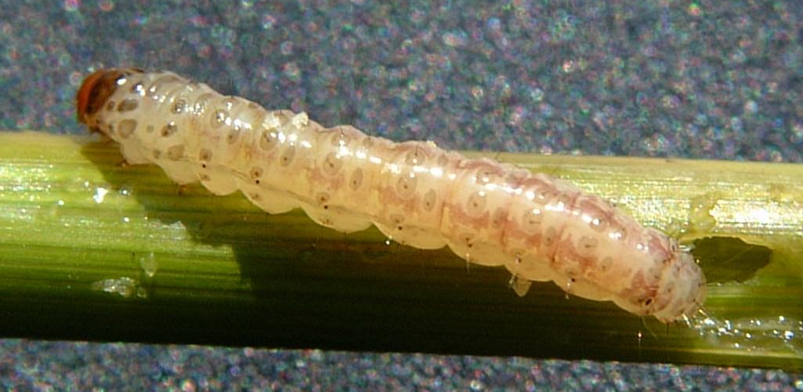
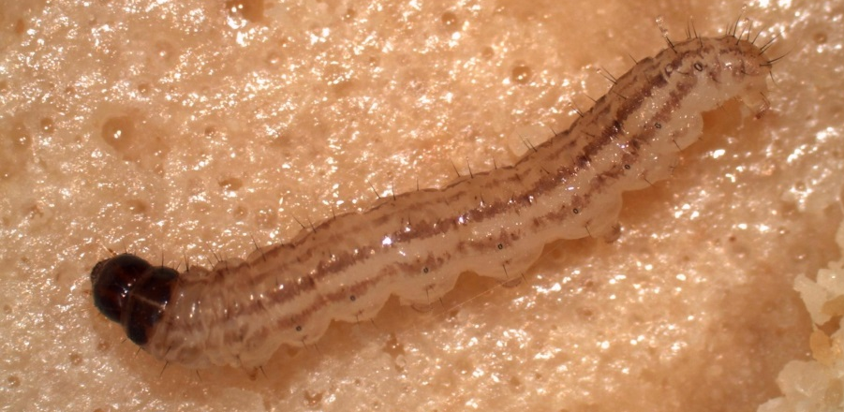
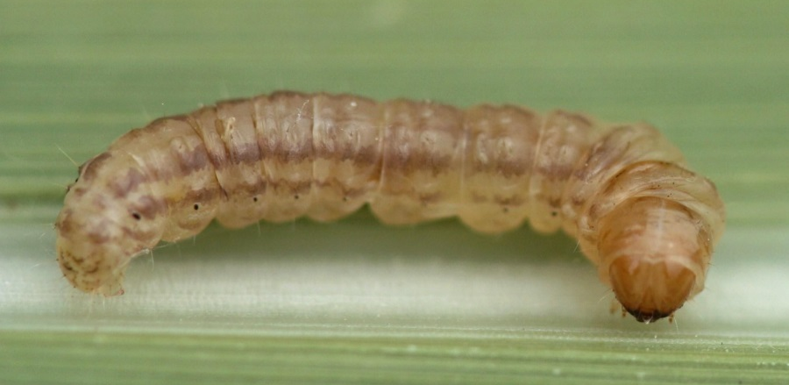
Look-alike Species
Sugarcane borer (Diatraea saccharalis)
Rice stalk borer (Chilo plejadellus)
Mexican Rice Borer (Eoreuma loftini)
Photos: (Top Left) - - Johnny Saichuk, ©2013, Louisiana State University AgCenter; (Top Right & Bottom) - Anna Meszaros, ©2013, Louisiana State University AgCenter
Notes:
Mexican rice borer – “Larvae are honey-colored with two pairs of stripes running the length of body”
Rice stalk borer – “Larvae have two pairs of stripes running the length of the body and a black head capsule.” They also are not found infesting sugarcane.
Sugarcane borer – “Larvae are pale yellow-white in the summer, with a series of brown spots visible on the back. Overwintering larva are a deeper yellow and lack of the brown spots.”
Information sources:
LSU AgCenter. Accessed 15 July 2013.
http://www.lsuagcenter.com/en/crops_livestock/crops/rice/Insects/photos/

Slide 16
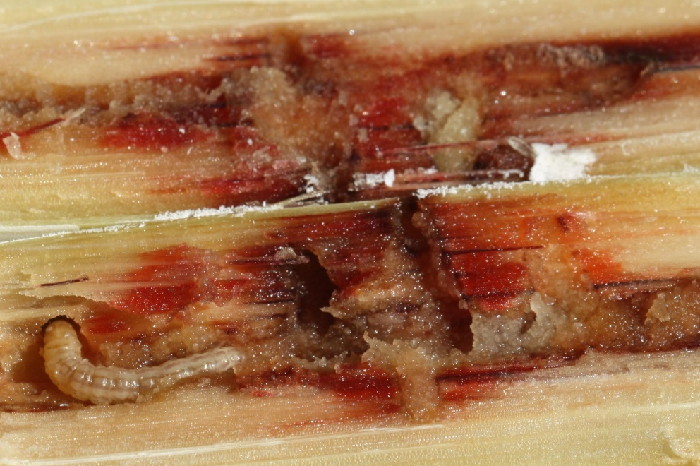
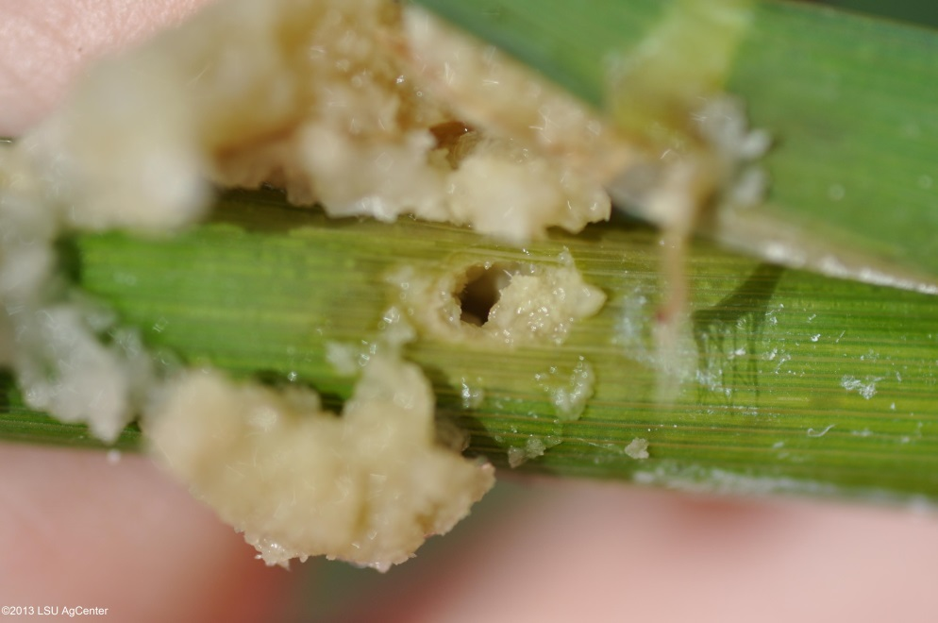
Look-alike Species
Mexican Rice Borer (Eoreuma loftini)
Sugarcane borer (Diatraea saccharalis)
Frass packed tunnels
Frass build up outside exit hole
Photos: - Anna Meszaros; Natalie Hummel - ©2013, Louisiana State University AgCenter
Notes:
Tunnels from Mexican rice borer larvae are packed with frass, as you can see on the left; whereas tunnels from sugarcane borers are not, frass builds up outside exit hole as seen on the right.
Information sources:
LSU AgCenter. Accessed 15 July 2013.
http://www.lsuagcenter.com/en/crops_livestock/crops/rice/Insects/photos/

Slide 17
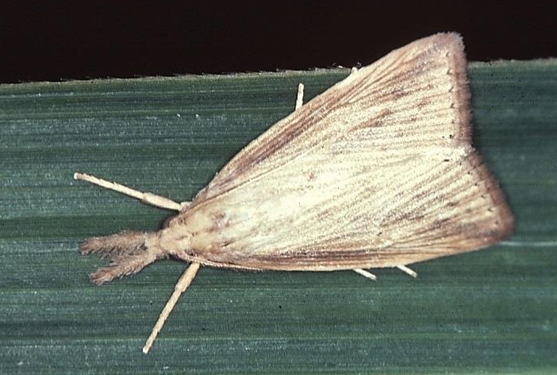
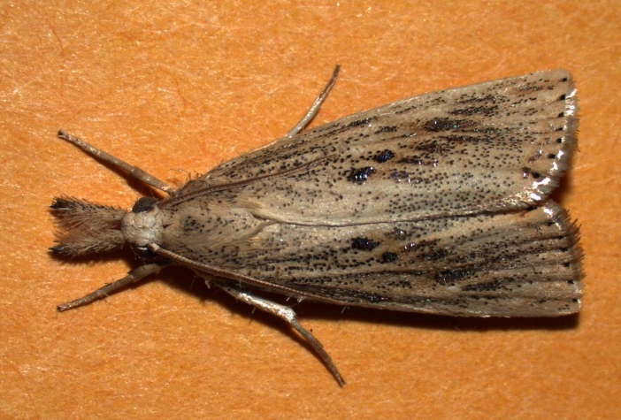
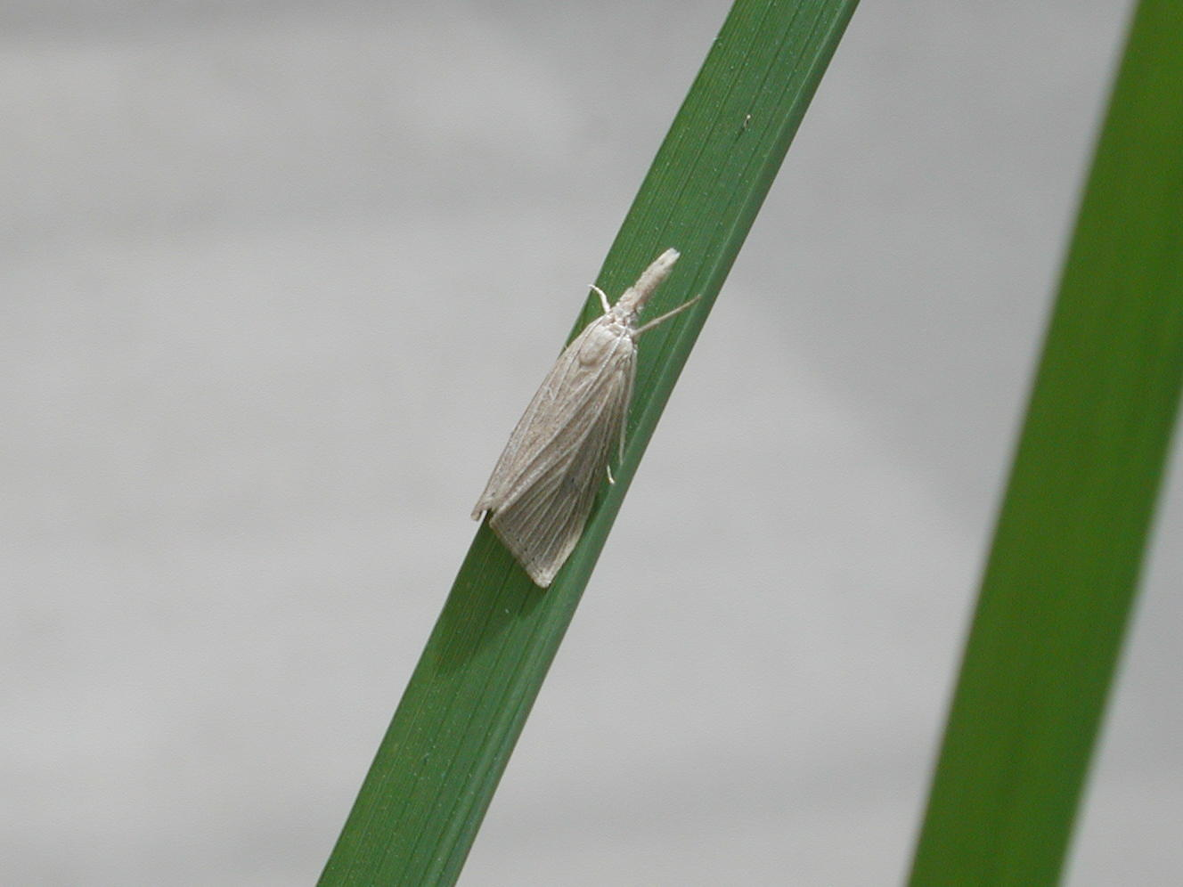
Look-alike Species
Sugarcane borer (Diatraea saccharalis)
Rice stalk borer (Chilo plejadellus)
Mexican Rice Borer (Eoreuma loftini)
Photos: (Top Left) - William White, Bugwood.org # UGA1324047; (Top Right) - Anna Meszaros, ©2013, Louisiana State University AgCenter; (Bottom) - Francis Reay-Jones, Clemson University.
Notes:
Sugarcane borer - Adults are “larger, straw-colored moths about ¾ inch long with a series of black dots arranged in an inverted V shape pattern on the front wings (red arrows).”
Rice Stalk Borer: “Adult moths have pale white wings tinged on the edges with metallic gold (black arrow) (1 inch long).”
Mexican rice borer - Adults are “light tan moths with delta-shaped wings like a triangle when their wings are closed”
Information sources:
LSU AgCenter. Accessed 15 July 2013.
http://www.lsuagcenter.com/en/crops_livestock/crops/rice/Insects/photos/
LSU AgCenter. Rice stalk borer. Accessed 20 November 2013.
http://www.lsuagcenter.com/en/crops_livestock/crops/rice/Insects/presentations/7+Rice+Stalk+Borer.htm

Slide 18
Authors
Jennifer Hamel, Ph.D.
Postdoctoral Associate, Department of Entomology and Nematology, University of Florida

Slide 19
Editors
Matthew D. Smith, Ph.D.
Postdoctoral Associate, Department of Entomology and Nematology, University of Florida
Stephanie Stocks, M.S.
Assistant-In, Extension Scientist, Department of Entomology and Nematology, University of Florida
Amanda Hodges, Ph.D.
Associate Extension Scientist, Department of Entomology and Nematology, University of Florida
Keumchul Shin, M.S.
Graduate student, Doctor of Plant medicine program, University of Florida

Slide 20
Reviewers
Julieta Brambila, M.S.
USDA, Animal and Plant Health Inspection Service, Plant Protection and Quarantine
James E. Hayden, Ph.D.
Florida Department of Agriculture and Consumer Services, Division of Plant Industry
Francis P.F. Reay-Jones, Ph.D.
Associate Professor, Entomology, School of Agricultural, Forest, and Environmental Sciences, Clemson University
Julien Beuzelin, Ph.D.
Assistant Research and Extension Entomologist, Dean Lee Research Station, Louisiana State University AgCenter

Slide 21
Collaborating Agencies
U.S. Department of Agriculture Animal and Plant Health Inspection Service (USDA-APHIS)
Cooperative Agricultural Pest Survey Program (CAPS)
Florida Department of Agriculture and Consumer Services (FDACS)
National Plant Diagnostic Network (NPDN)
Sentinel Plant Network (SPN)
Protect U.S.
University of Florida Institute of Food and Agricultural Sciences (UF-IFAS)

Slide 22
Educational Disclaimer and Citation
This presentation can be used for educational purposes for NON-PROFIT workshops, trainings, etc.
Citation:
Hamel, J., Ph.D., 2014. Mexican Rice Borer Eoreuma loftini, June 2014.

Slide 23
References
Hayden, James E. Mexican Rice Borer, Eoreuma loftini (Dyar) (Lepidoptera: Crambidae: Crambinae) in Florida. 2012. Florida Department of Agriculture and Consumer Services, Division of Plant Industry Pest Alert. DACS-P-01827.
Holguin, C. M. 2010. Insect diversity and pest status on switchgrass grown for biofuel in South Carolina. M.Sc. Thesis. Clemson University: South Carolina, USA.
Hummel, N.A., T. Hardy, T.E. Reagan, D. Pollet, C. Carlton, M.J. Stout, J.M. Beuzelin, W. Akbar, and W.H. White. 2010. Monitoring and First Discovery of the Mexican Rice Borer Eoreuma loftini (Lepidoptera: Crambidae) in Louisiana. Florida Entomologist. 93:123-124.
Hummel, N.A., T.E. Reagan, D. Pollet, W. Akbar, J. Beuzelin, C. Carlton, J. Saichuk, T. Hardy and M. Way. 2008. Mexican Rice Borer, Eoreuma loftini (Dyar). LSU AgCenter Pub. 3098.
LSU AgCenter, Mexican rice borer fact sheet. http://www.lsuagcenter.com/en/crops_livestock/crops/rice/insects/presentations/6-mexican-rice-borer.htm. Accessed 10 June 2013.
LSU AgCenter. Rice stalk borer. http://www.lsuagcenter.com/en/crops_livestock/crops/rice/Insects/presentations/7+Rice+Stalk+Borer.htm Accessed 20 November 2013

Slide 24
References
LSU AgCenter: http://www.lsuagcenter.com/en/crops_livestock/crops/rice/Insects/photos. Accessed 15 July 2013.
Meaux, J. Louisiana Sugarcane: Mexican Rice Borer Infestation Confirmed. AgFax.Com. http://agfax.com/2013/04/08/louisiana-sugarcane-mexican-rice-borer-infestation-confirmed/#sthash.PborlY8r.dpuf. Accessed 13 June 2013.
National Agricultural Pest Information System (NAPIS). Purdue University. "Survey Status of Mexican Rice Borer - Eoreuma loftini (All years).” http://pest.ceris.purdue.edu/map.php?code=ITBMFLA&year=alltime. Accessed: 06/11/2013.
Reay-Jones, F.P.F. 2005. Integrated Pest Management of the Mexican rice borer in Louisiana and Texas sugarcane and rice. Ph.D. Dissertation. Louisiana State University, Baton Rouge.
Solis, M.A. 2006. Update: “Key to selected Pyraloidea (Lepidoptera) larvae intercepted at u. s. ports of entry: revision of Pyraloidea in ‘keys to some frequently intercepted lepidopterous larvae’ by Weisman 1986”. USDA Systematic Entomology Laboratory. Paper 1.

