Slide 1
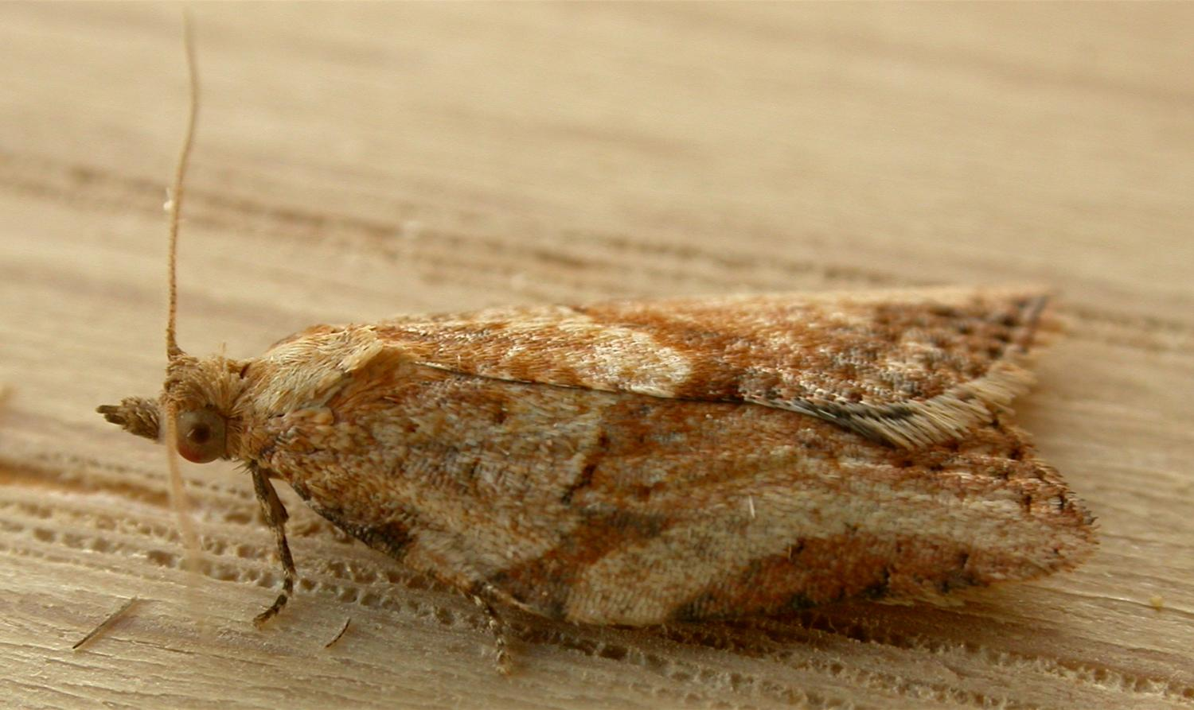
Light Brown Apple Moth Epiphyas postvittana
Photo: Donald Hobern, 2008 wikimedia commons
Notes:
This presentation is about the Light Brown Apple Moth, an invasive pest posing an economic and environmental threat to Florida.

Slide 2
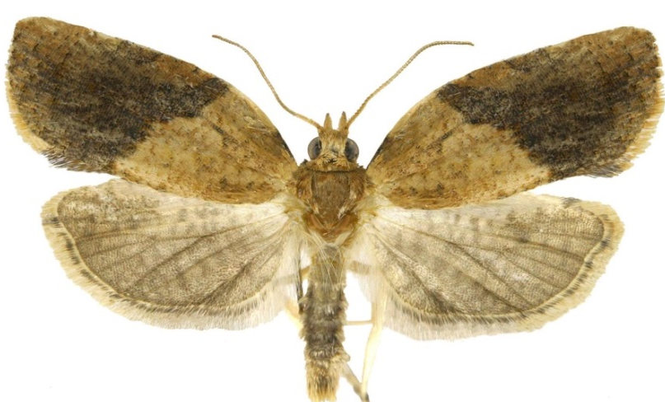
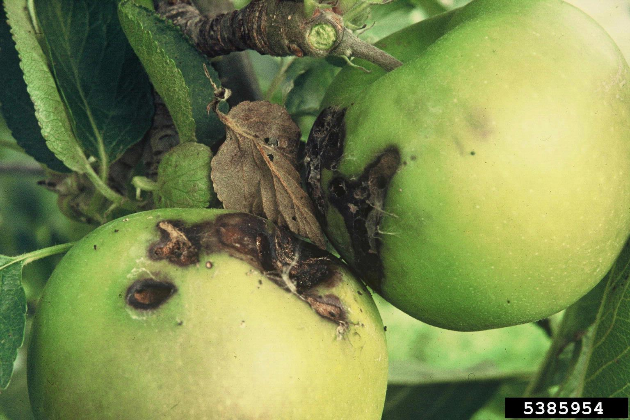
Light Brown Apple Moth
Native to Australia
First U.S. detection was in CA in 2006
Pest of ornamental plants, crops, and plantation trees.
Damage on apples
Photos: (Top) - Todd Gilligan, CSU, Bugwood.org #5482456; (Bottom) - Department of Primary Industries and Water, Tasmania Archive, Bugwood.org #5385954
Notes:
Light Brown Apple Moth (LBAM) is native to Australia, but has long been established in New Zealand, New Caledonia, Hawaii, and the United Kingdom. They have been present in California since 2006.
This species is an economic pest of fruit and ornamental crops, and of managed forests. The population and range size of LBAM continues to expand, and Florida growers are concerned about the potential for this pest to become established here in the state.
Information sources:
Brown, J. W. 2007. Discovery of light brown apple moth in North America. Torts 8: 2.
Plant Epidemiology and Risk Analysis Laboratory, Center for Plant Health Science and Technology. 2009. APHIS Draft Response to Petitions for the Reclassification of Light Brown Apple Moth [Epiphyas postvittana (Walker)] as a Non-Quarantine Pest. United States Department of Agriculture Animal and Plant Health Inspection Service Plant Protection and Quarantine.

Slide 3
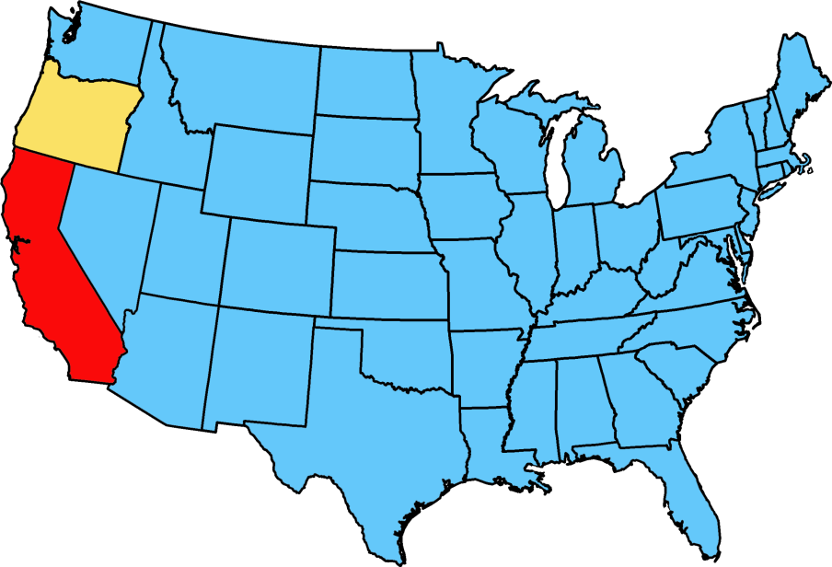
Distribution
Sampled but not found
Intercepted or detected, but not considered established
Considered established by USDA APHIS in parts of the state
Map courtesy of Pest Tracker, National Agricultural Pest Information System (NAPIS)
Notes:
They were originally a pest of apples in Australia, and moved around the world with the global commodities trade on plants, such as apples, stone fruit, and cut flowers.
The first detection of LBAMs in the continental United States was in Alameda County, California (near Berkley) in 2006, although the specimens were not determined to species until 2007. Presently, 25 of California’s 58 counties are under some form of quarantine or observation for LBAM.
Florida growers are concerned that the moth will hitchhike on lettuce, cut flowers, or strawberries imported from California.
[Found in: New Zealand, 1891; Hawaii, 1896; England, 1936; New Caledonia, 1968; France, 2004; California, 2007]
Information sources:
Espinosa, A. and A. C. Hodges. 2009. Epiphyas postvittana. Bugwood Wiki. Accessed 28 July 2013.
Plant Epidemiology and Risk Analysis Laboratory, Center for Plant Health Science and Technology. 2009. APHIS Draft Response to Petitions for the Reclassification of Light Brown Apple Moth [Epiphyas postvittana (Walker)] as a Non-Quarantine Pest. United States Department of Agriculture Animal and Plant Health Inspection Service Plant Protection and Quarantine.

Slide 4
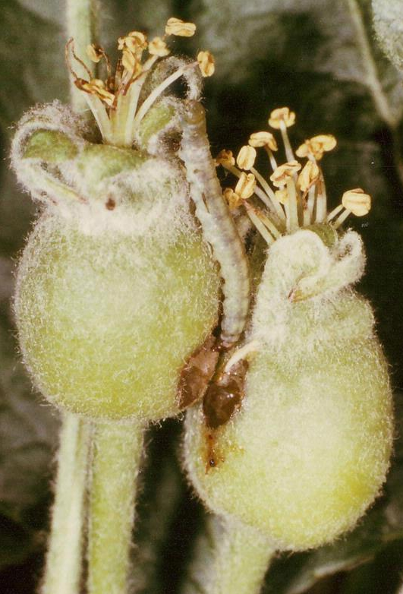
Host Plants
Generalist
Serious pest of stone and pome fruits
Adds 1.3% to management costs
Untreated, can result in 70% crop loss
Florida hosts can include:
Ornamental: cassia, cypress, geranium, passionflower, pine, rose
Agricultural: avocado, blueberry, cabbage, carrot, citrus, broccoli, cucumber, loquat, mango, strawberry
Endangered native species
Larva on young apples
Photos: Department of Primary Industries and Water,
Tasmania Archive, Bugwood.org #5385957
Notes:
LBAMs are extremely polyphagous herbivores, feeding on well over 2,000 species of plants in 121 separate families. They appear to prefer herbaceous plants to woody perennials, but will utilize whatever hosts are available. In particular, they are a serious pest of stone and pome fruit in Australia and New Zealand.
In addition to economically important crops and nursery stock, this moth also jeopardizes over 70 species, subspecies, or varieties of native plants that are in danger of extinction.
Florida hosts include: Cassia, Cypress, Geranium, Passionflower, Pine, Rose, Avocado, Blueberry, Cabbage, Carrots, Citrus, Broccoli, Cucumber, Loquat, Mango, and Strawberry.
For a full list – http://www.cdfa.ca.gov/plant/factsheets/LBAM_HostList.pdf
Information sources:
Anonymous. 2008. “LBAM Host List”. California Department of Food and Agriculture. Sacramento, CA.
Plant Epidemiology and Risk Analysis Laboratory, Center for Plant Health Science and Technology. 2009. APHIS Draft Response to Petitions for the Reclassification of Light Brown Apple Moth [Epiphyas postvittana (Walker)] as a Non-Quarantine Pest. United States Department of Agriculture Animal and Plant Health Inspection Service Plant Protection and Quarantine.

Slide 5
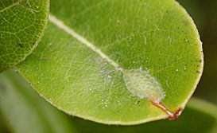
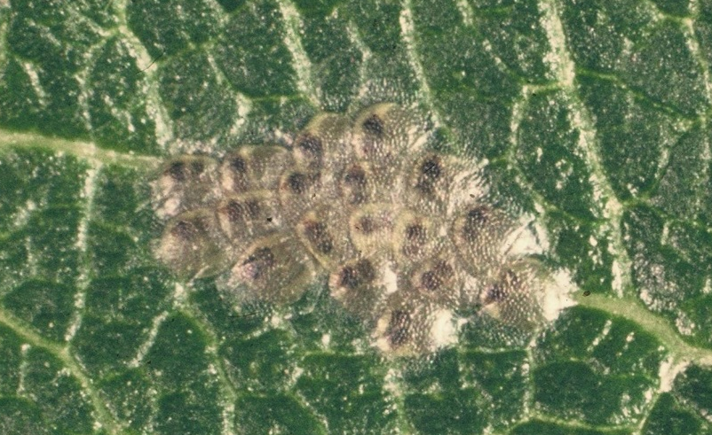
Identification: Eggs
Egg mass on a leaf
20 - 50 laid on upper surface of leaf or fruit
0.84 - 0.95 mm long
Pale white to green
Black or brown when parasitized
Parasitized egg mass
Photos: Top – Todd Gilligan, CSU Bugwood.org #5495358; Department of Primary Industries and Water, Tasmania Archive, Bugwood.org #5385952
Notes:
Each egg is approximately 0.04 inches (0.84 to 0.95 mm) long. They are white to light green in color and appear flat with a pebbled-like surface. They are laid in small overlapping rafts of twenty to fifty eggs at a time. As eggs mature they turn paler yellow-green. They will also turn black or brown when parasitized.
Information sources:
Lewis, C. and A. C. Hodges. 2013. Light Brown Apple Moth. UF & FDACS/DPI. Featured Creatures # EENY-469
Espinosa, A. and A. C. Hodges. 2009. Epiphyas postvittana. Bugwood Wiki. Accessed 28 July 2013.

Slide 6
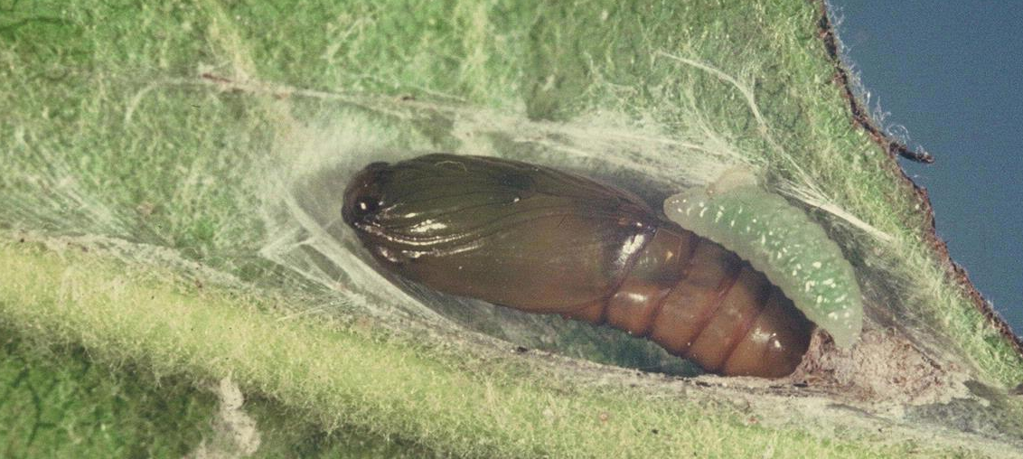
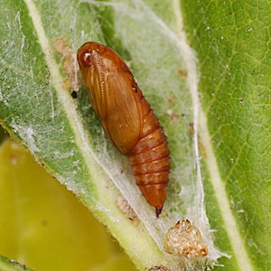
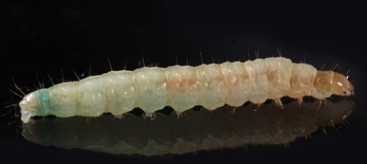
Identification: Larvae & Pupae
Positive ID with molecular methods only
Pupa
Pupa
larva
Photos:
(Top Left) Department of Primary Industries and Water, Tasmania Archive, Bugwood.org #5385959; (Bottom Left) - Wikimedia Commons; (Right) - Todd Gilligan, CSU, Bugwood.org #5495362
Notes:
Leafroller moths are very difficult t tell apart, as many of them have the same general appearance. Newly hatched larvae are pale green in color and 2 mm in length. As they mature their color deepens and their length increases up to 20 mm.
First instar larvae are about 1.5-2 mm long and have dark brown heads. The other instars have a light brown head and a greenish-brown region behind the head with no markings.
Mature larvae are 10 to 18 mm in length with a green body and a darker green central stripe and two side stripes. The body hairs are whitish. They pupate in a thin-walled silken cocoon webbed between two leaves. The pupa measures between 10 and 15 mm in length and will turn from green to brown as it matures.
Information sources:
Espinosa, A. and A. C. Hodges. 2009. Epiphyas postvittana. Bugwood Wiki. Accessed 28 July 2013.

Slide 7
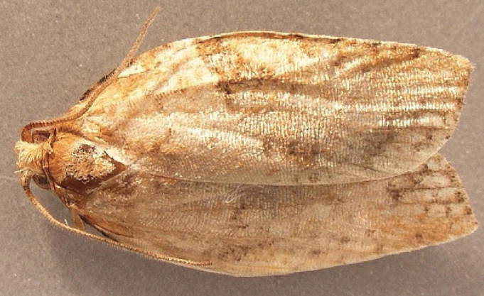
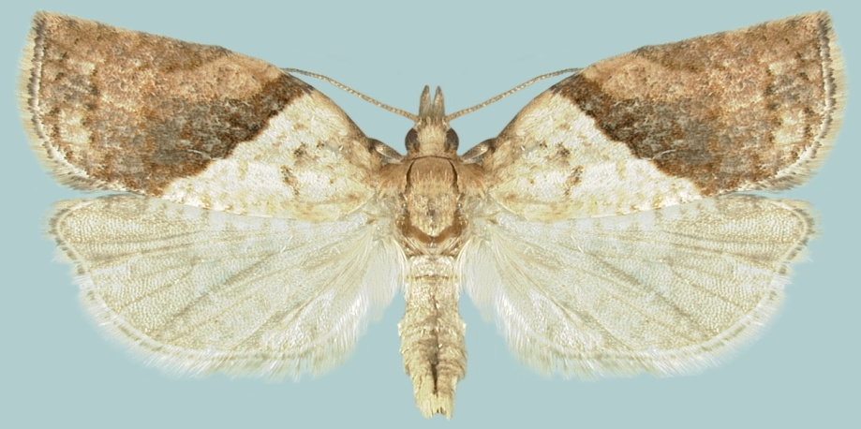
Identification: Adults
About 1cm in length
Broad, brown, overlapping wings
Thin antennae
If microscope available
Forward-facing palps
Proboscis free of scales
Female
Photos: Top - Julieta Brambila, USDA 2011; Bottom - Natasha Wright, FDACS 2008
Notes:
Adult’s are approximately 0.4 inches (1 cm) long, with a wingspan between 0.6 and 1.3 cm, females being slightly larger than males.
They have a yellowish-brown to dark brown body color with overlapping brown forewings of varying shades and mottled pale brown-gray hind wings. Additionally, light brown apple moths are sexually dimorphic, and the females are differentiated by a dark mark located on the hind margin of each forewing.
The adult moths have whip-like antennae, forward-facing palpi, and no scales on the proboscis.
Information sources:
Danthanarayana, W. 1975. The Bionomics, distribution and host range of the light brown apple moth, Epiphyas Postvittana (Walk.) (Tortricidae). Australian Journal of Zoology 23: 419-437.
Espinosa, A. and A. C. Hodges. 2009. Epiphyas postvittana. Bugwood Wiki. Accessed 28 July 2013.
Lewis, C. and A. C. Hodges. 2013. Light Brown Apple Moth. UF & FDACS/DPI. Featured Creatures # EENY-469.

Slide 8
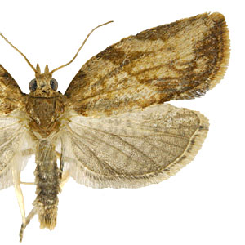
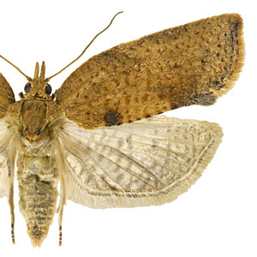
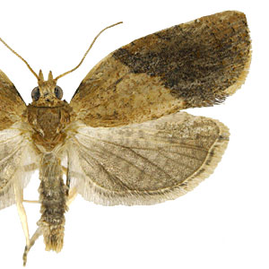
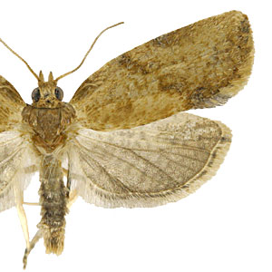
Identification: Adults
ID requires expert species level confirmation by dissection of genitalia or molecular methods
Highly variable forewing coloration & pattern
NOT a reliable diagnostic tool.
Photos: Todd Gilligan, CSU, Bugwood.org #5482458
Notes:
Identification of light brown apple moths requires expert confirmation as they may exhibit color variation and be difficult to distinguish from other small brown moths. As seen in these images, the brown shade and pattern of the forewings is highly variable, and cannot be used as a diagnostic character.
Adults can only be reliably identified using genital dissection or molecular methods. Tools for diagnosing the light brown apple moth and related western U.S. leafrollers are available at http://keys.lucidcentral.org/keys/v3/LBAM/lucid.html.
If you see a moth that meets the description, please contact your local NPDN diagnostic lab or state department of agriculture, especially if you are experiencing unusual pest outbreaks and notice moths or larvae similar to LBAM.
Information sources:
Espinosa, A. and A. C. Hodges. 2009. Epiphyas postvittana. Bugwood Wiki. Accessed 28 July 2013.
Lewis, C. and A. C. Hodges. 2013. Light Brown Apple Moth. UF & FDACS/DPI. Featured Creatures # EENY-469.

Slide 9
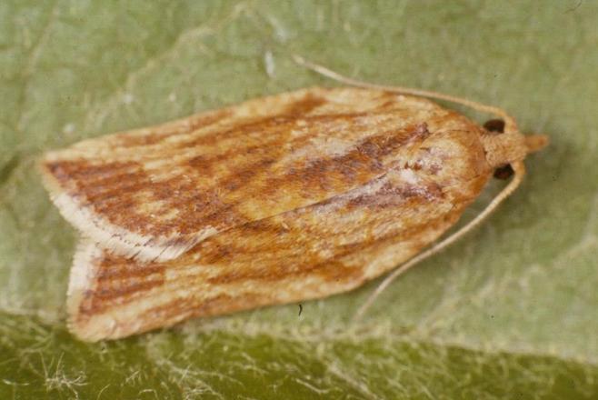
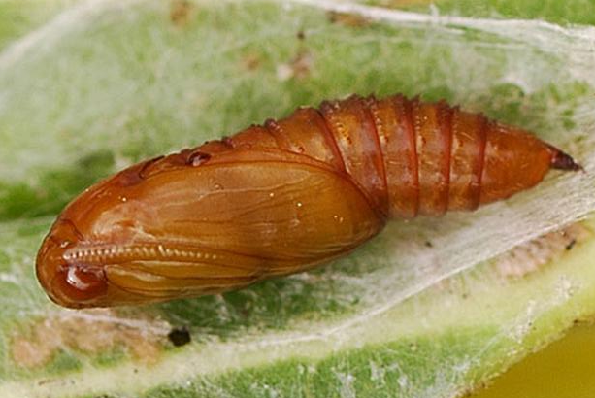

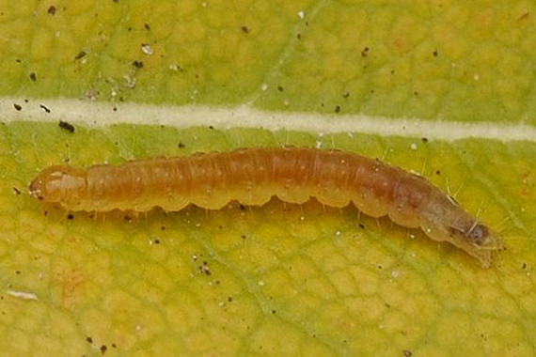
Life cycle
Females lay eggs in 6-10 d
Pupation lasts 10 d
Eggs hatch in 8-9 d
Larval stage ≈ 25 d
Photos:
Department of Primary Industries and Water, Tasmania Archive, Bugwood.org #5385950 (adult); #5385952 (eggs); Todd Gilligan, CSU, Bugwood.org #5495359 (larvae); #5495362 (pupae)
Notes:
In warmer climates, there can be four or five overlapping generations per year; whereas in colder climates they may be limited to two generations per year.
Egg masses are laid on the leaves, young stems, or fruit of plants, and contain 2 to 170 slightly overlapping eggs. Eggs hatch after 5 to 30 days depending on temperature. LBAM has 5 to 6 larval instars, which can take from three to five weeks to grow through. Cold temperatures slow larval development and overwintering occurs between the 2nd and 4th larval instars.
Larvae pupate in a thin-walled silken cocoon webbed between two leaves. The pupal stage will last between 3 and 8 weeks.
Females mate and begin to lay eggs 6 to 10 days after emerging from her cocoon, and will continue for about 21 days. A female usually lays around 300 eggs in a lifetime, but is capable of producing up to 1,500 eggs.
The life span of an adult LBAM is 2 to 3 weeks, depending on temperature and host plant availability. Major flight periods occur during September-October, December-January, February-March, and April-May. First Detectors might see the moth flying at these times.
Information sources:
Lewis, C. and A. C. Hodges. 2013. Light Brown Apple Moth. UF & FDACS/DPI. Featured Creatures # EENY-469
Espinosa, A. and A. C. Hodges. 2009. Epiphyas postvittana. Bugwood Wiki. Accessed 28 July 2013.

Slide 10
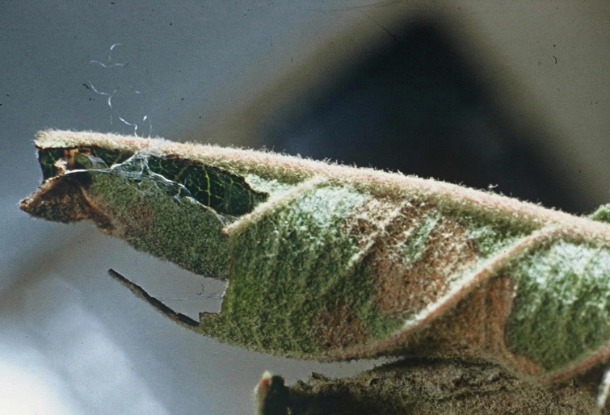
Damage
Leaf-roller moth (construct tent)
Feed on underside of leaves
Scar exterior surface of fruit
Older larvae burrow into fruit
Photos: Department of Primary Industries and Water, Tasmania Archive, Bugwood.org #5385955; #5385954
Notes:
As “leafroller” moths, the larvae will web leaves together to hide from predators, and then feed safely inside these tents. The "leaf rolls", or nests, that larvae construct damages leaves and fruit surfaces. Additional damage is caused directly by feeding on buds and leaves and when older larvae tunnel into the flesh of the fruit. This deforms the host plant, reduces growth rate, and renders fruit unmarketable.
A USDA quantitative analysis estimated that in high risk areas, light brown apple moths could cause over $118 million in damages, due to direct effects on apple, grape, orange, and pear crops of the country, and also through widespread international and domestic trade restrictions.
Information sources:
Lewis, C. and A. C. Hodges. 2013. Light Brown Apple Moth. UF & FDACS/DPI, Featured Creatures # EENY-469.
Irvin N. 2009. Light Brown Apple Moth. Center for Invasive Species Research. Accessed 28 July 2013.
USDA-APHIS-PPQ. 2009. Economic Analysis: Risk to U.S. Apple, Grape, Orange and Pear Production from the Light Brown Apple Moth, Epiphyas postvittana (Walker). Animal and Plant Health Inspection Service. Accessed 28 July 2013.

Slide 11
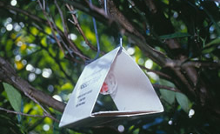
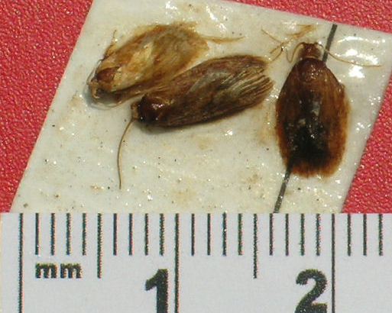
Monitoring
Pheromone trap
Scouting
Look for leafrollers
The USDA eradication program
Traps baited with LBAM lure
Sterile males
Quarantines
Ground based & Aerial treatments
Biocontrols
Photos: Julieta Brambila, USDA 2011
Notes:
Millions of dollars have already been spent to prevent the spread of this pest. The USDA initiated an eradication program in 2007 and it is anticipated to continue until 2015.
The program emphasizes:
(1) rigorous moth trapping and detection program throughout California and other at risk states, including the southeastern U.S.
(2) releasing sterile male LBAMs through the use of the sterile insect technique
(3) applying ground-based treatments to control infestations around leading edges and in densely-affected areas (i.e. commercial nurseries) to reduce artificial/mechanical spread
(4) rigorous enforcement of quarantines,
(5) use of aerial treatments in unoccupied areas only when necessary.
Some alternative methods that have also been proposed include the use of pheromone traps and biological controls, such as Trichogramma platerni and Trichogramma pretiosa wasps.
Information sources:
Irvin N. 2009. Light Brown Apple Moth. Center for Invasive Species Research. Accessed 28 July 2013.
Jones, D. 2009. Vigilance urged after moth find. San Jose Mercury News - Central Coast. Accessed 23 April 2013.

Slide 12
Author
Andrew Derksen, M.S.
Pest Survey Scientist/Biological Scientist II, Florida Department of Agriculture and Consumer Services, Division of Plant Industry

Slide 13
Editors
Matthew D. Smith, Ph.D.
Postdoctoral Associate, Department of Entomology and Nematology, University of Florida
Stephanie Stocks, M.S.
Assistant-In, Extension Scientist, Department of Entomology and Nematology, University of Florida
Keumchul Shin, M.S.
Graduate Research Assistant, Doctor of Plant Medicine program, University of Florida

Slide 14
Reviewers
Peter T. Oboyski, Ph.D.
Essig Museum of Entomology, University of California, Berkeley
Jim Hayden, Ph.D.
Florida Department of Agriculture and Consumer Services, Division of Plant Industry
Jerry Powell, Ph.D.
Director Emeritus, Essig Museum of Entomology, University of California, Berkeley

Slide 15
Educational Disclaimer and Citation
This presentation can be used for educational purposes for NON-PROFIT workshops, trainings, etc.
Citation:
Derksen, A., M.S., 2014. Light Brown Apple Moth, Epiphyas postvittana, June 2014.

Slide 16
References
Anonymous. 2008. “LBAM Host List”. California Department of Food and Agriculture. Sacramento, CA.
Brown, J. W. 2007. Discovery of light brown apple moth in North America. Torts 8: 2.
Danthanarayana, W. 1975. The Bionomics, distribution and host range of the light brown apple moth, Epiphyas Postvittana (Walk.) (Tortricidae). Australian Journal of Zoology 23: 419-437.
Espinosa, A. and A. C. Hodges. 2009. Epiphyas postvittana. Bugwood Wiki. Accessed 28 July 2013.
Gilligan, TM and ME Epstein. 2009. “LBAM ID, Tools for diagnosing light brown apple moth and related western U. S. leafrollers (Tortricidae: Archipini)”. Colorado State Univeristy, California Department of Food and Agriculture, and Center for Plant Health Science and Technology, USDA, APHIS, PPQ.
Irvin N. 2009. Light Brown Apple Moth. Center for Invasive Species Research. Accessed 28 July 2013.
Jones, D. 2009. Vigilance urged after moth find. San Jose Mercury News - Central Coast. Accessed 23 April 2013.

Slide 17
References
Lewis, C. and A. C. Hodges. 2013. Light Brown Apple Moth. UF & FDACS/DPI. Featured Creatures # EENY-469
National Agricultural Pest Information System (NAPIS). Purdue University. "Survey Status of Light Brown Apple Moth - Epiphyas postvittana (All years)." Published: 08/06/2013. http://pest.ceris.purdue.edu/map.php?code=ITBUBPA&year=alltime. Accessed: 08/06/2013.
Plant Epidemiology and Risk Analysis Laboratory, Center for Plant Health Science and Technology. 2009. APHIS Draft Response to Petitions for the Reclassification of Light Brown Apple Moth [Epiphyas postvittana (Walker)] as a Non-Quarantine Pest. United States Department of Agriculture Animal and Plant Health Inspection Service Plant Protection and Quarantine.
Suckling, DM and EG Brockerhoff. 2010. “Invasion biology, ecology, and management of the light brown apple moth (Tortricidae)”. Annual Reviews of Entomology. 55:285–306.
USDA-APHIS-PPQ. 2009. Economic Analysis: Risk to U.S. Apple, Grape, Orange and Pear Production from the Light Brown Apple Moth, Epiphyas postvittana (Walker). Animal and Plant Health Inspection Service. Accessed 28 July 2013.
USDA. 2008. “Treatment program for light brown apple moth in California. Environmental Assessment, February 2008.” 46 pp.

