Slide 1
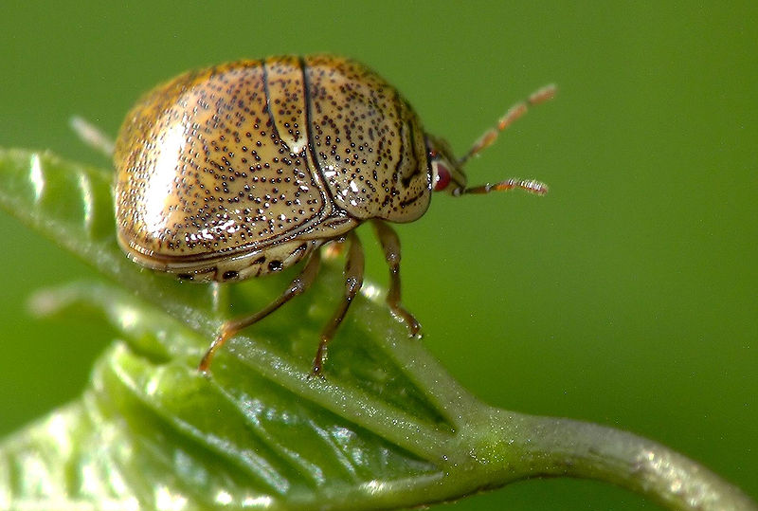
Kudzu Bug
Megacopta cribraria
Photo: ©2007 Charles Lam, Wikimedia commons
Notes:
This presentation is about a relatively new pest, the kudzu bug, also referred to as the bean plataspid, lablab bug, or globular stink bug.

Slide 2
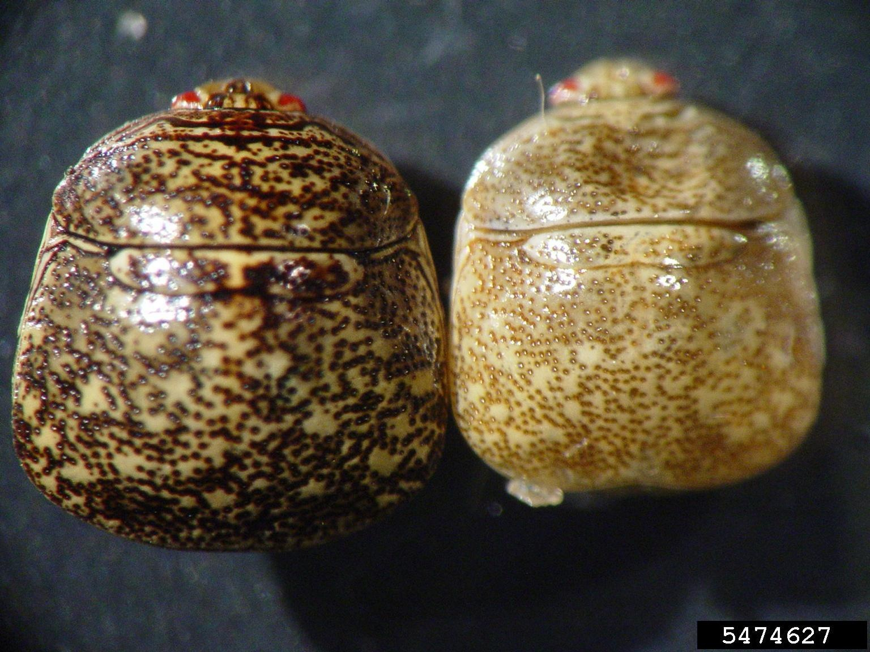
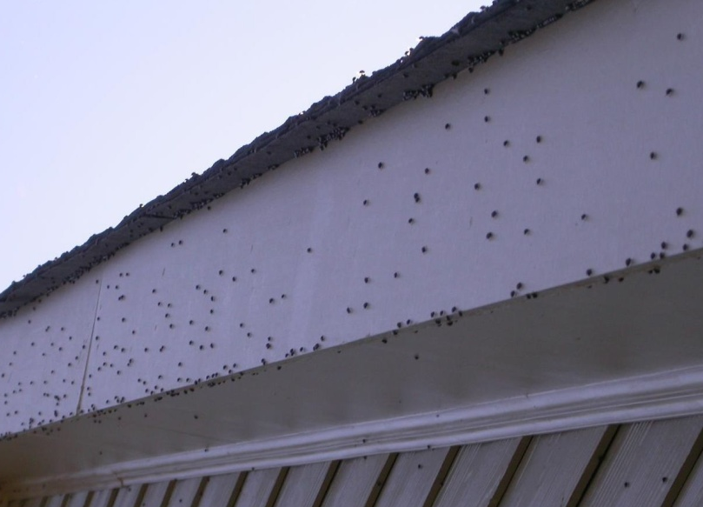
Kudzu Bug
First species of Plataspidae family in Western Hemisphere!
2009: First detection in U.S. (Georgia)
Agricultural pest to legumes
Nuisance pest to homeowners
Photos:
(Top) - Michasia Harris, University of Georgia, Bugwood.org #5474627; (Bottom) - Daniel R. Suiter, University of Georgia, Bugwood.org # 5407722
Notes:
The kudzu bug is native to Asia and Australia, and was first reported in the United States in October 2009. This detection marks the first time a species of the family Plataspidae was found in the Western Hemisphere. The kudzu bug is an agricultural pest of legumes in the U.S., and can be also a nuisance pest for homeowners.
Information sources:
Eger, Jr. J.E., L. M. Ames, D. R. Suiter, T. M. Jenkins, D. A. Rider, and S. E. Halbert. 2010. Occurrence of the Old World bug Megacopta cribraria (Fabricius) (Heteroptera: Plataspidae) in Georgia: a serious home invader and potential legume pest. Insecta Mundi. 0121:1-11.
Accessed 7/26/2013-
http://www.ces.ncsu.edu/depts/ent/notes/Urban/Egeretal2010.pdf
Poplin, A. and A. C. Hodges. 2012. Bean Plataspid: Megacopta cribraria (Fabricius) (Insecta: Hemiptera: Heteroptera: Plataspidae). UF & FDACS/DPI. Featured Creatures #EENY-257
Accessed 7/26/2013-
http://edis.ifas.ufl.edu/in939

Slide 3
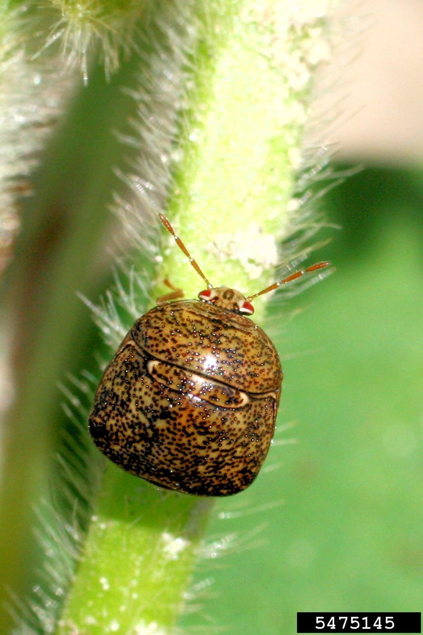
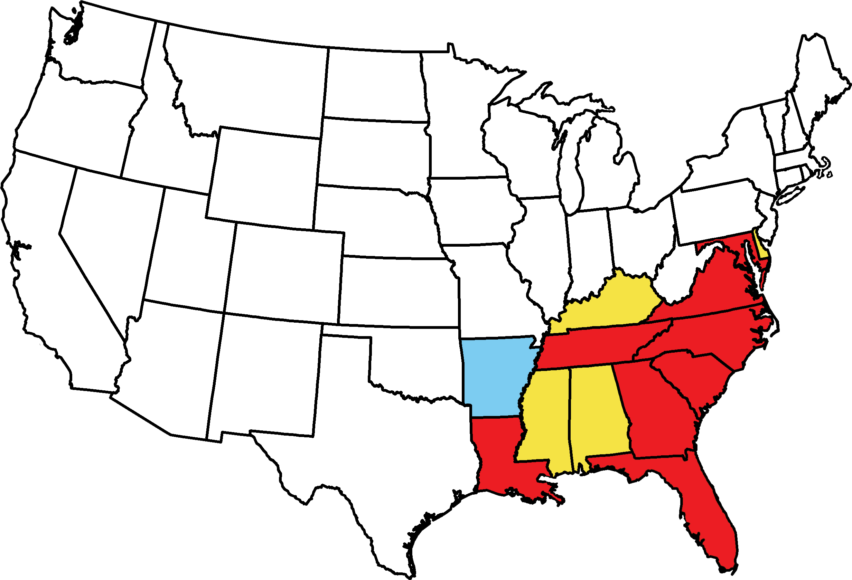
Kudzu Bug Distribution
No sampling
Sampled but not found
Intercepted or detected, but not established
Established by survey or consensus
Map courtesy of Pest Tracker, National Agricultural Pest Information System (NAPIS), and The University of Georgia - Center for Invasive Species and Ecosystem Health, eddmaps.org
Photo: Russ Ottens, University of Georgia, Bugwood.org #5475145
Notes:
The kudzu bug is native to Australia and Asia (specifically: China, India, Indonesia, Japan, Korea, Macao, Malaysia, Myanmar, New Caledonia, Pakistan, Sri Lanka, Taiwan, Thailand, and Vietnam).
In the U.S., the kudzu bug was first identified by morphological and molecular diagnoses in Georgia, during October 2009. Since becoming established in the United States, the kudzu bug has been reported in Maryland, Florida, Louisiana, Virginia, Tennessee, North Carolina, South Carolina and Georgia.
The kudzu bug has been intercepted or detected, but not established in Alabama, Delaware, Mississippi and Kentucky.
DNA analysis from the kudzu bugs found in the United States confirmed that all specimens from the United States came from a single female lineage originating in Japan. This means that kudzu bugs in the U.S. came from the same mother, and this pest was introduced from a single occurrence; which could have been from the immigration of a gravid female or from a single egg mass that was transported from Japan to the United States.
Information sources:
Eger, Jr. J.E., L. M. Ames, D. R. Suiter, T. M. Jenkins, D. A. Rider, and S. E. Halbert. 2010. Occurrence of the Old World bug Megacopta cribraria (Fabricius) (Heteroptera: Plataspidae) in Georgia: a serious home invader and potential legume pest. Insecta Mundi. 0121:1-11.
Accessed 7/26/2013-
http://edis.ifas.ufl.edu/in939
Jenkins T. M. and T. D. Eaton. 2011. Population genetic baseline of the first plataspid stink bug symbiosis (Hemiptera: Heteroptera: Plataspidae) reported in North America. Insects. 2: 264-272.
Accessed 7/26/2013-
http://www.mdpi.com/2075-4450/2/3/264

Slide 4
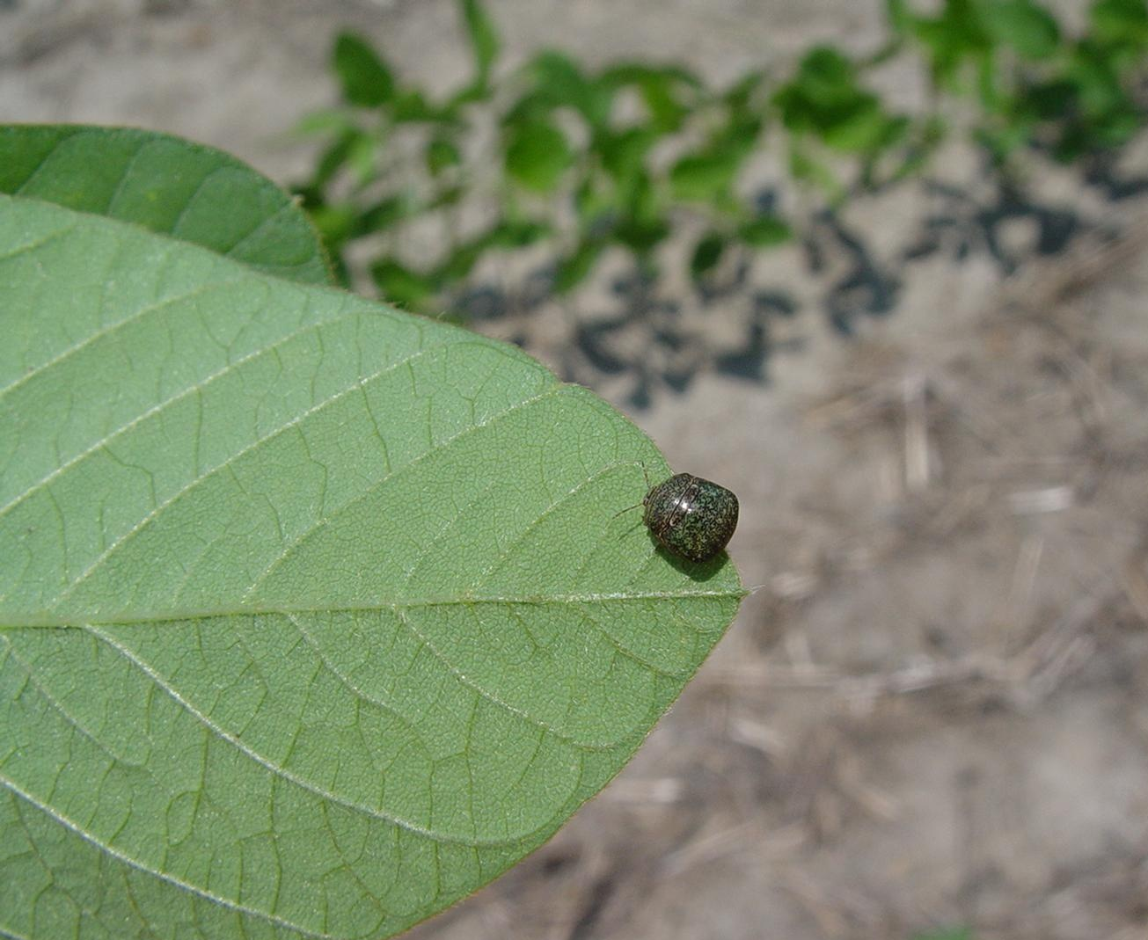
Susceptible Plants
In the United States:
Kudzu
Soybean and other legumes
Corn
Sweet potato
Wisteria
Wheat
In native regions:
NOT an agricultural pest
Kudzu bug on soybean
Photo: Michasia Harris, University of Georgia, Bugwood.org #5473918
Notes:
In the United States, legumes are the primary hosts of kudzu bugs. They feed mainly on soybean (Glycine max), kudzu (Pueraria montana var. lobata), and lablab bean (Lablab purpureus). Both nymphs and adults feed on the leaves, stem, flower, and pod of the host plant. In its native region, it also feeds on the legumes.
Interestingly, in parts of their native range, kudzu bugs are not known to be an agricultural pest, however, a close relative of the Kudzu bug is a pest of soybean there (e.g. mainland Japan).
Hosts of members of the Megacopta genus include:
agathi (Sesbania grandiflora), azuki bean (Vigna angularis), bean (Phaseolus spp.), broad bean (Vicia faba), Chinese milk vetch (Astragalus sinicus), Chinese privet (Ligustrum sinense), citrus (Citrus spp.), cluster bean (Cyamopsis tetragonoloba), cotton (Gossypium hirsutum), deutzia (Deutzia crenata), firecracker plant (Crossandra infundibuliformis), horsenettle (Solanum carolinense), Indian beech tree (Pongamia pinnata), indigo (Indigofera sp.), jute (Corchorus capsularis), kidney bean (Phaseolus vulgaris), lespedeza (Lespedexa cyrtobotra), lima bean (Phaseolus lunatus), mung bean (Phaseolus radiates), pigeon pea (Cajanus indicus), potato (Solanum tuberosum), rice (Oryza sativa), sugarcane (Saccharum officinarum), sweet potato (Ipomoea batatas), urd-bean (Vigna mungo), velvet bean (Mucuna pruriens), vetch (Vicia angustifolia), wheat (Triticum aestivum), white mulberry (Morus alba), and Wisteria (Wisteria brachybotrys).
Information sources:
Eger, Jr. J.E., L. M. Ames, D. R. Suiter, T. M. Jenkins, D. A. Rider, and S. E. Halbert. 2010. Occurrence of the Old World bug Megacopta cribraria (Fabricius) (Heteroptera: Plataspidae) in Georgia: a serious home invader and potential legume pest. Insecta Mundi. 0121:1-11.
Accessed 7/26/2013-
http://www.ces.ncsu.edu/depts/ent/notes/Urban/Egeretal2010.pdf
Jenkins T. M. and T. D. Eaton. 2011. Population genetic baseline of the first plataspid stink bug symbiosis (Hemiptera: Heteroptera: Plataspidae) reported in North America. Insects. 2: 264-272.
Accessed 7/26/2013-
http://www.mdpi.com/2075-4450/2/3/264
Poplin, A. and A. C. Hodges. 2012. Bean Plataspid: Megacopta cribraria (Fabricius) (Insecta: Hemiptera: Heteroptera: Plataspidae). UF & FDACS/DPI. Featured Creatures #EENY-257
Accessed 7/26/2013-
http://edis.ifas.ufl.edu/in939

Slide 5
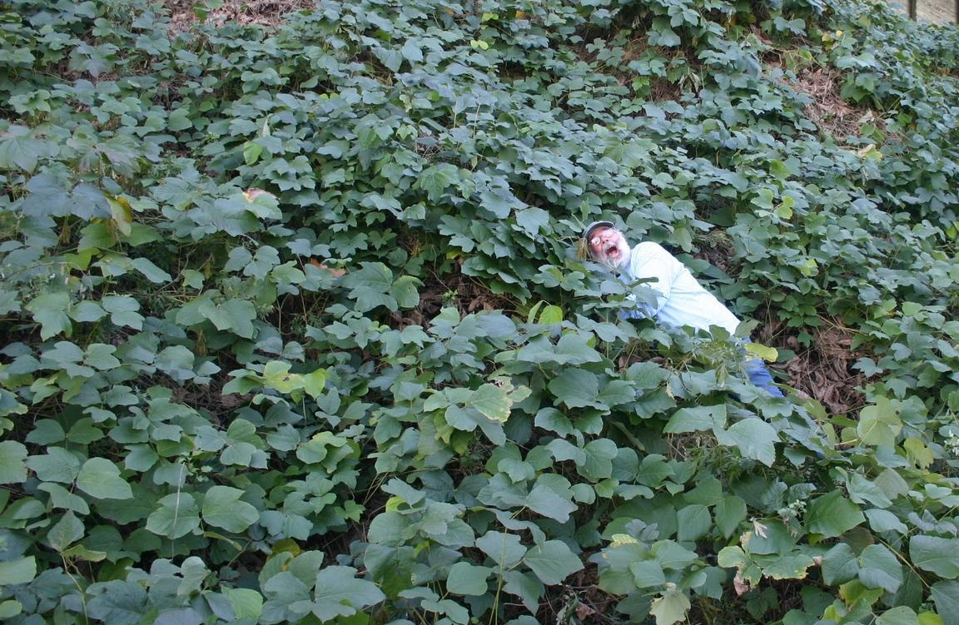
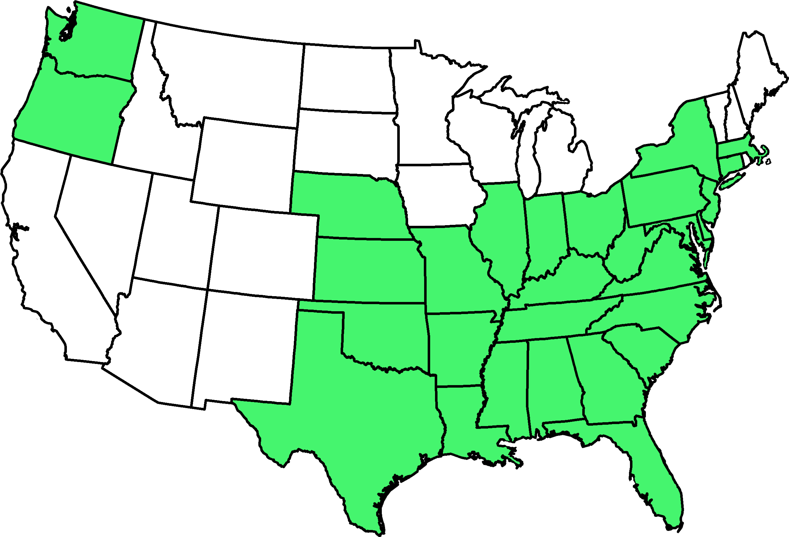
Kudzu
“The vine that ate the South”
Kudzu vine
Distribution of Kudzu
Photo: Leslie J. Mehrhoff, University of Connecticut, Bugwood.org #5483399; Map courtesy of USDA database, National Agricultural Pest Information System (NAPIS)
Notes:
Kudzu, also called Japanese arrowroot, is a plant in the pea family Fabaceae.
This climbing, coiling, and trailing vine is native to southern Japan and southeast China. Kudzu was introduced to the U.S. in 1876, and was used for many purposes including animal feed, processing of soaps and lotions, and for compost. However, kudzu was recognized in the 1950’s as an invasive species. It is a noxious weed that climbs over plants and grows very rapidly; this overgrowth subsequently kills trees or shrubs due to heavy shading. Kudzu is known as the vine that ate the South spreading at the rate of 150,000 acres (61,000 ha) annually it now occupies 7 million acres of land in the U.S.
Given that kudzu is a major host of the kudzu bug, it’s not surprising that this pest is now spreading throughout the U.S.
Information sources:
Collins, J. 2003. If You Can't Beat Kudzu, Join It. Off the Wall. Duke Energy Employee Advocate..
Accessed 19 July 2013.
http://www.dukeemployees.com/offthewall2.shtml
Everest, J. W., J. H. Miller, D. M. Ball, M. Patterson. 1999. Kudzu in Alabama History, Uses, and Control. Alabama A&M and Auburn Universities, Alabama Cooperative Extension System ANR-65.
Accessed 7/26/2013-
http://www.treesearch.fs.fed.us/pubs/2341
Stewart, D. 2000 (October). Kudzu: Love It or Run. Smithsonian Magazine.
Accessed 7/26/2013-
http://www.smithsonianmag.com/science-nature/kudzu-abstract.html
USDA PLANTS profile . Kudzu.
Accessed 11/3/2013.
http://plants.usda.gov/core/profile?symbol=pumo
USDA GRIN Taxonomy.
Accessed 19 July 2013.
http://www.ars-grin.gov/cgi-bin/npgs/html/taxon.pl?314966
USDA/Agricultural Research Service. 2009. "Controlling Kudzu With Naturally Occurring Fungus." ScienceDaily.
Accessed 19 July 2013.
http://www.sciencedaily.com/releases/2009/07/090719185107.htm

Slide 6
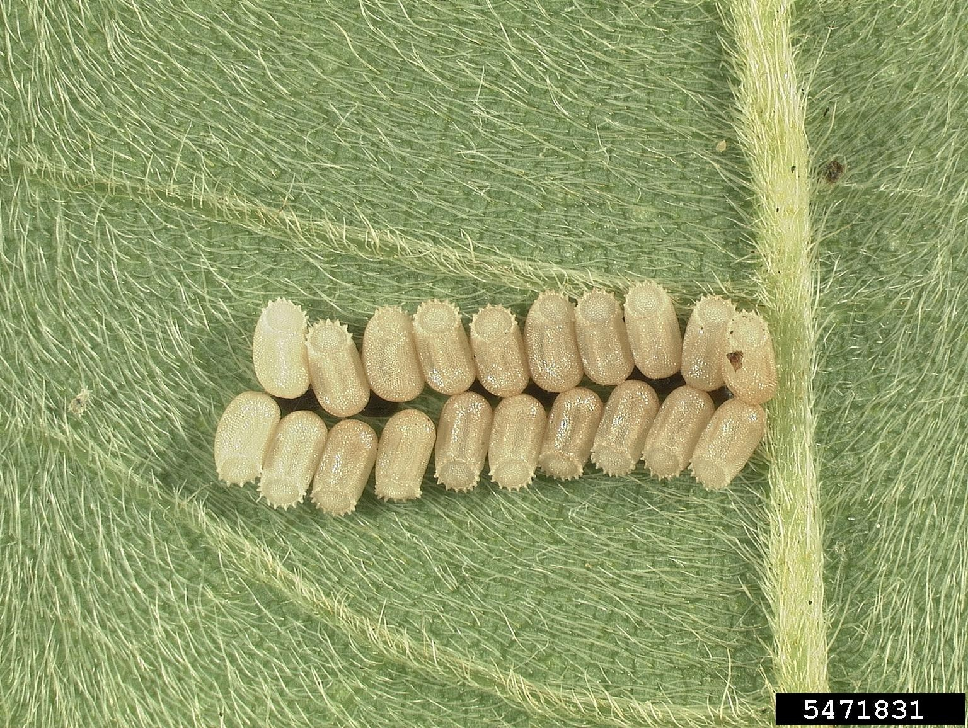
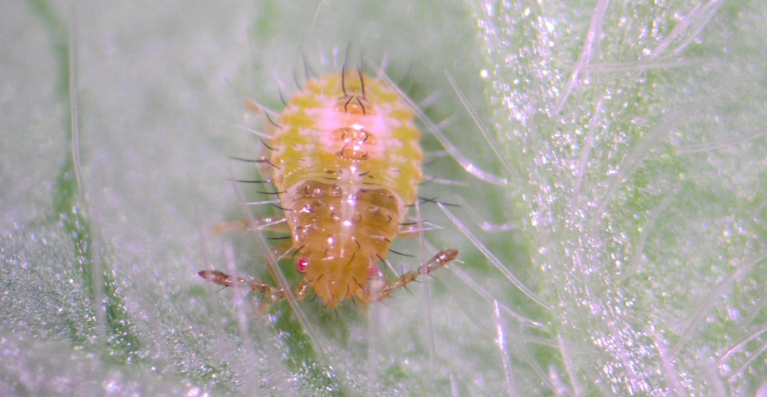
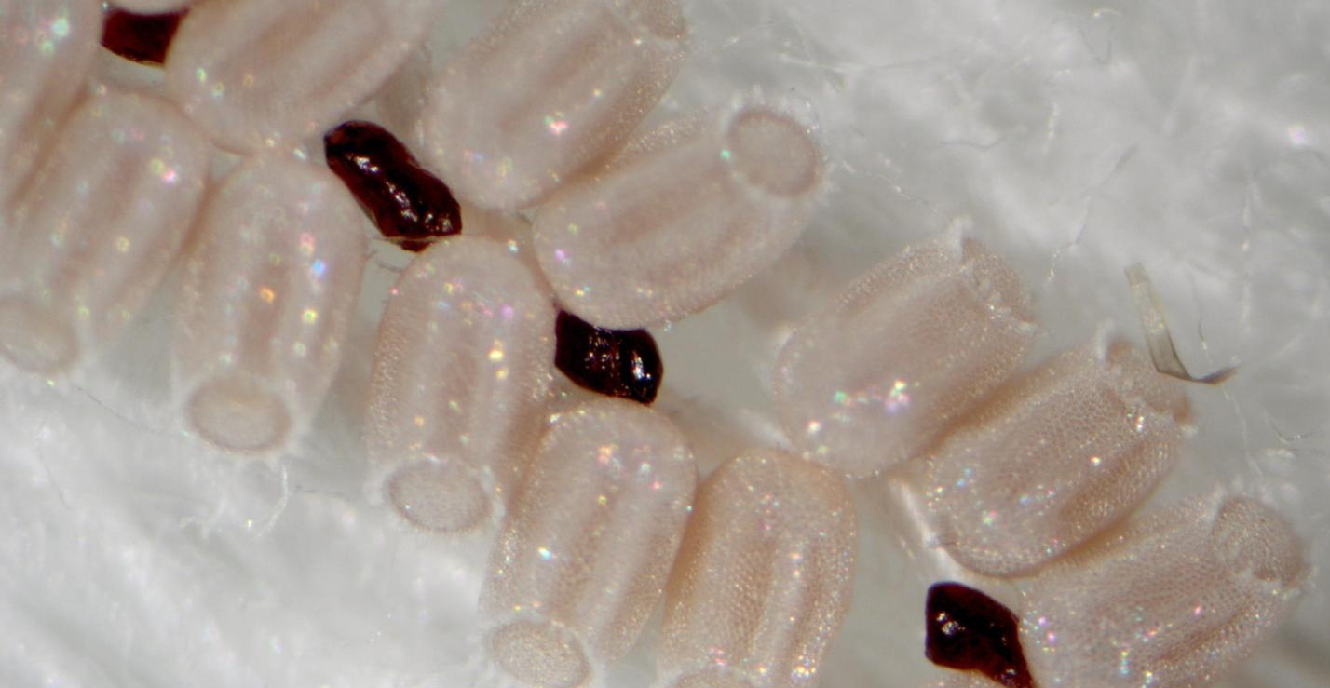
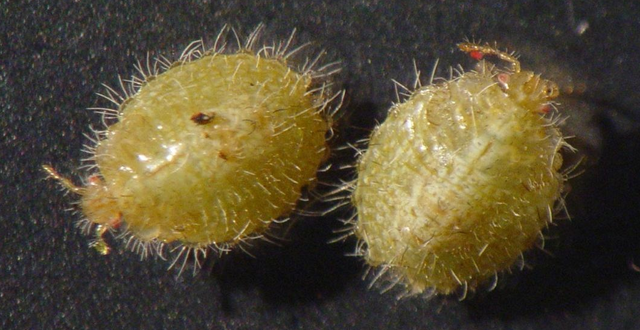
Identification
Eggs
Nymphs
Symbiont capsules in egg mass
Hairy appearance of nymphs
Photos: (Top) - Joe Eger, Dow AgroSciences, Bugwood.org #5471831; Yasmin Cardoza, North Carolina State University, Bugwood.org #5472919
(Bottom) - Yasmin Cardoza, North Carolina State University, Bugwood.org #5472911; Michasia Harris, University of Georgia, Bugwood.org #5474632
Notes:
Each egg mass contains 26 to 274 eggs. The eggs are pale salmon in color with medially spaced dark bands running in a horizontal direction. They are elongate and have a truncated ring of rugged projections at one end.
Females also deposit small brownish capsules on the underside of the egg mass (yellow arrow). These structures are symbiont capsules containing symbiotic bacteria that are ingested by newborn nymphs to aid in nutritional development and digestion of cellulose. This bacteria appears to allow young to survive on soybeans and other host plants such as peas, beans, and peanuts.
Kudzu bugs have five nymphal instars that each develop in two to 56 days. Nymphs tend to have a hairy appearance and vary in color but are typically pale orange, olive green, or light brown.
Information sources:
Poplin, A. and A. C. Hodges. 2012. Bean Plataspid: Megacopta cribraria (Fabricius) (Insecta: Hemiptera: Heteroptera: Plataspidae). UF & FDACS/DPI. Featured Creatures #EENY-257
Accessed 7/26/2013-
http://edis.ifas.ufl.edu/in939
University of Georgia. Kudzu bug.
Accessed 7/26/2013-
www.kudzubug.org

Slide 7
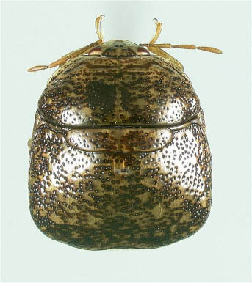
Identification - Adult
Small, 3.5 – 6 mm (0.14 – 0.24 in) long
  Pseudosuture
  Enlarged scutellum
  Truncated posterior end
Photo: Lilyconnor, wiki.bugwood.org.
Notes:
Adult kudzu bugs are quite small, ranging in size from 3.5 to 6 mm long (0.14 – 0.24 inches).
The dorsal (back) side varies in color, but is typically light brown to olive green in color and a mottled appearance due to dark punctations (depressions) that cover their exoskeleton.
Diagnostic characters of the kudzu bug include:
1- the elliptical plate at the center of the back, called a pseudosuture (yellow arrow)
2- the scutellum (posterior plate on the dorsal side of the thorax) is enlarged and covers the forewings and abdomen (red arrow)
3- the posterior end of the scutellum, which is truncated, or flattened (black arrow)
Information sources:
Poplin, A. and A. C. Hodges. 2012. Bean Plataspid: Megacopta cribraria (Fabricius) (Insecta: Hemiptera: Heteroptera: Plataspidae). UF & FDACS/DPI. Featured Creatures #EENY-257
Accessed 7/26/2013-
http://edis.ifas.ufl.edu/in939

Slide 8
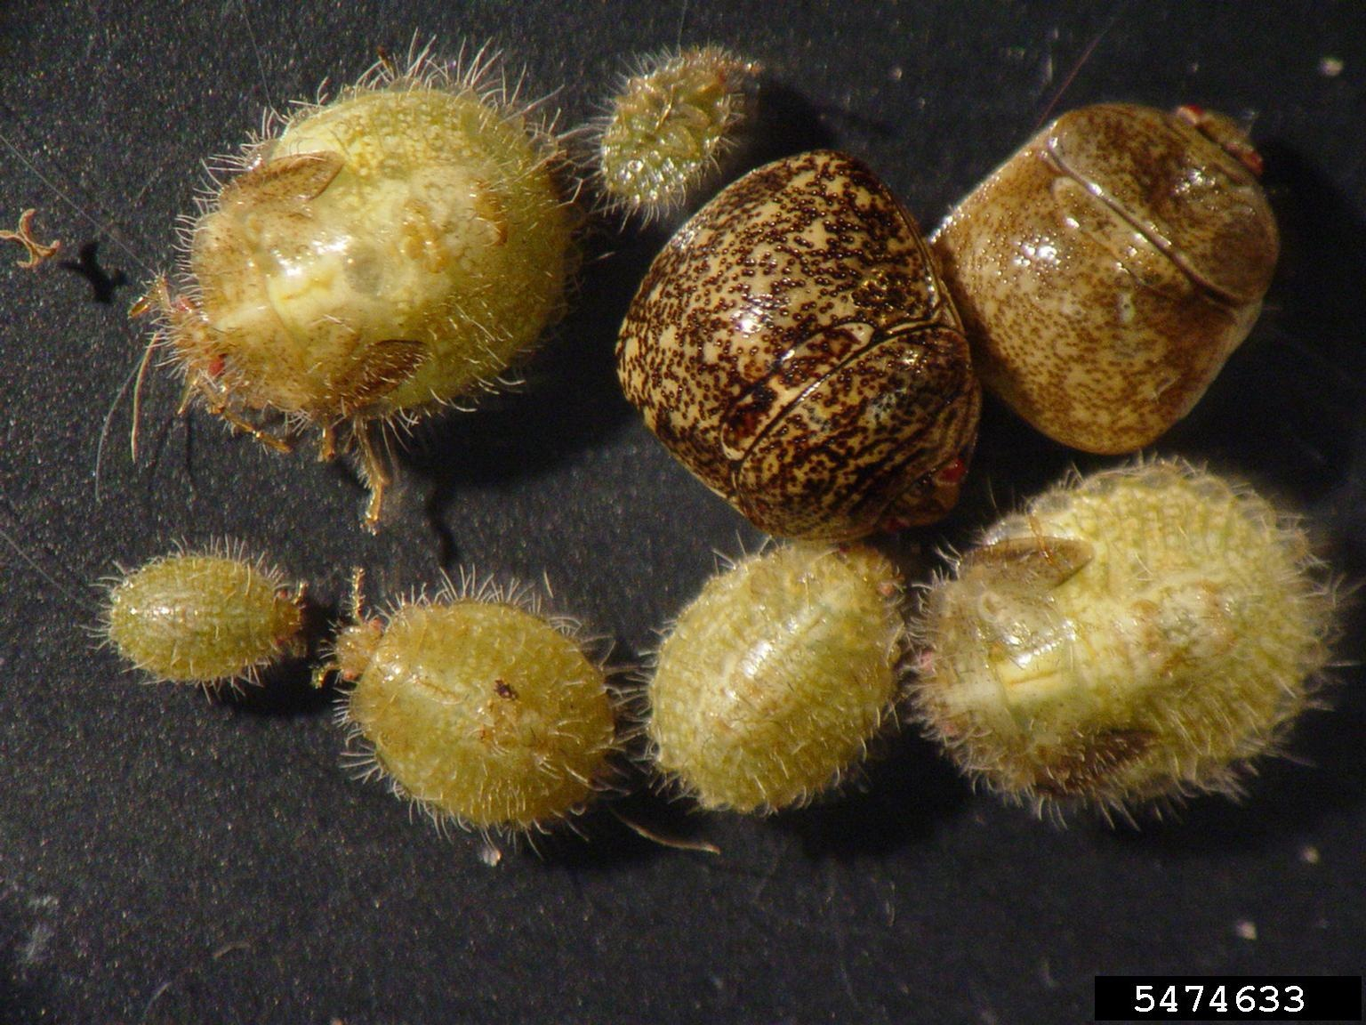
Life Cycle
Development from egg to adult takes 6-8 weeks
Egg mass
Nymphs and adults
Photos: Joe Eger, Dow AgroSciences, Bugwood.org #5471831; Michasia Harris, University of Georgia, Bugwood.org #5474633
Notes:
Kudzu bugs overwinter as adults in plant debris and behind tree bark near kudzu patches and soybean fields. They will also overwinter in building and housing structures, where they can be nuisance pests.
As temperatures increase in the spring, kudzu bugs move into kudzu or wisteria where they mate, lay eggs, and develop through 5 nymphal stages. In Georgia, the kudzu bug can complete development from egg to adult in 6-8 weeks. In June and July, adults produced in this new generation move to soybean plants, and during these months can become a nuisance to soybean growers, organic farmers, and home gardeners.
Beginning in mid-October and lasting until late November or early December, a second peak of nuisance activity occurs when kudzu bugs migrate back to overwintering sites.
Information sources:
Poplin, A. and A. C. Hodges. 2012. Bean Plataspid: Megacopta cribraria (Fabricius) (Insecta: Hemiptera: Heteroptera: Plataspidae). UF & FDACS/DPI. Featured Creatures #EENY-257
Accessed 7/26/2013-
http://edis.ifas.ufl.edu/in939
University of Georgia. Kudzu bug.
Accessed 7/26/2013-
www.kudzubug.org

Slide 9
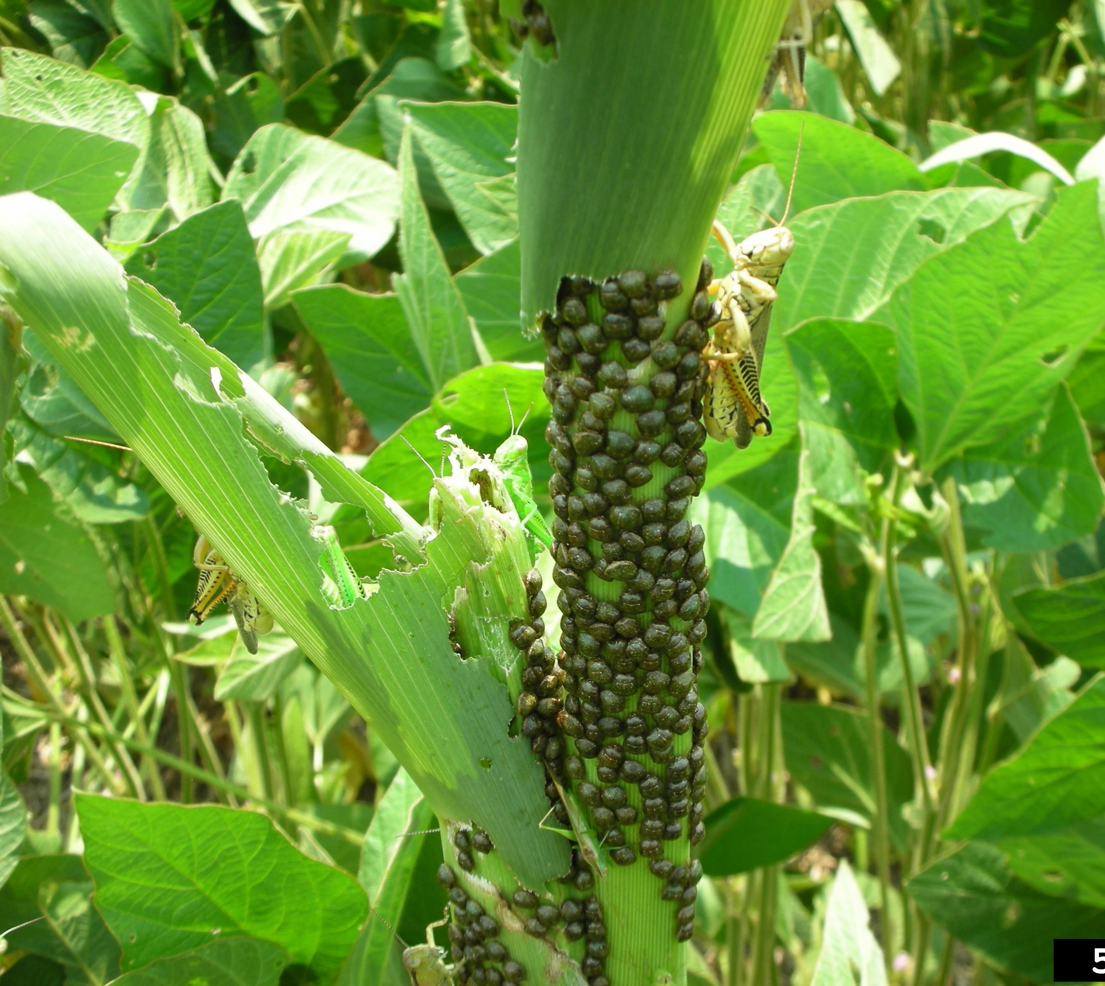
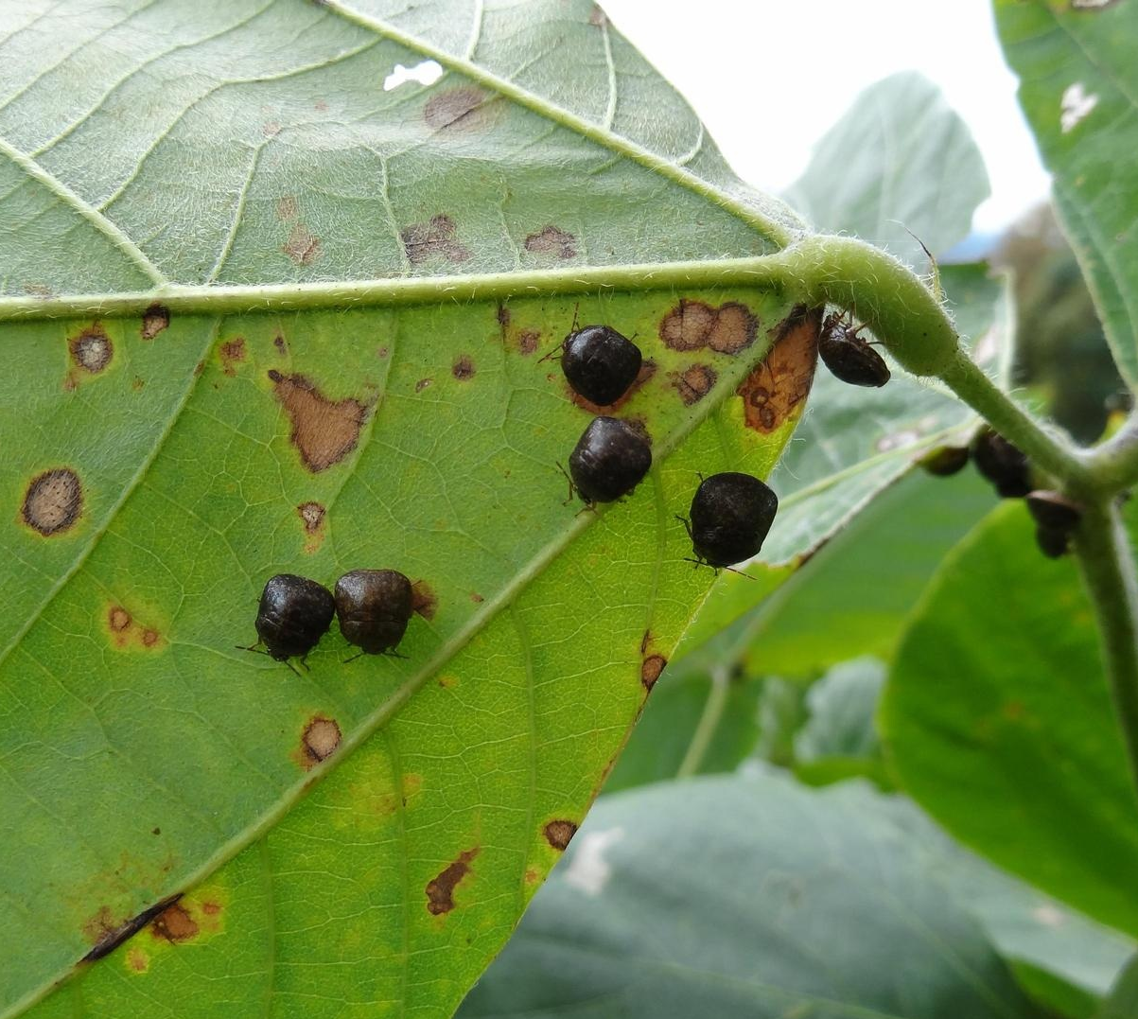
Damage
Kudzu bugs on corn
Kudzu bugs on kudzu
Kudzu bugs use piercing-sucking mouthparts to
tap into the veins of plants and extract phloem
Photos: Jeremy Greene, Clemson University, Bugwood.org #5426340; Joseph LaForest, University of Georgia, Bugwood.org # 5461420
Notes:
In 2011, Georgia reported yield losses of nearly 50% on untreated beans. Like other hemipterans, kudzu bugs use their piercing-sucking mouthparts to tap into the veins of plants to extract the phloem. The subsequent injury to plants results from nutrient and water loss, rather than from a direct feeding of plant tissue. Adults and older nymphs feed on the stems of soybeans, while smaller nymphs have been observed feeding on leaf veins.
Information sources:
Poplin, A. and A. C. Hodges. 2012. Bean Plataspid: Megacopta cribraria (Fabricius) (Insecta: Hemiptera: Heteroptera: Plataspidae). UF & FDACS/DPI. Featured Creatures #EENY-257
Accessed 7/26/2013-
http://edis.ifas.ufl.edu/in939
University of Georgia. Kudzu bug.
Accessed 7/26/2013-
www.kudzubug.org

Slide 10
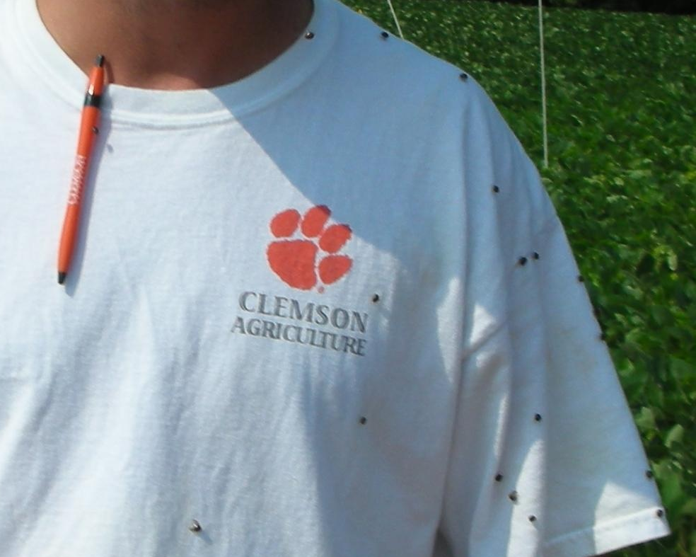
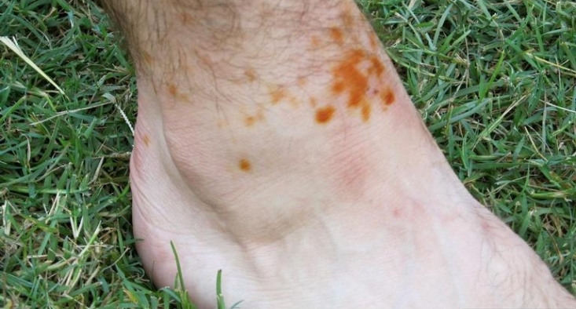
Nuisance Pest
Overwinters on houses, buildings, and vehicles
Attracted to white and yellow surfaces
Emits a pungent odor when disturbed
  Staining and skin irritation
Photos:
Jeremy Greene, Clemson University, Bugwood.org #5426287;
Michael Toews, University of Georgia, Bugwood.org #5455581
Notes:
Kudzu bugs can also be a nuisance pest to home owners. These bugs are attracted to light colored surfaces, such as white and yellow houses, buildings, and vehicles. During colder months, overwintering adults form large aggregations numbering in the hundreds, an overwhelming number of bugs for homeowners to control. Disturbance resulting from the attempted removal of aggregations can cause these bugs to excrete a pungent odor as a defensive mechanism. The excreted chemicals stain surfaces and can cause skin irritation.
Information sources:
Horn, S. and J. L. Hanula. 2011. Influence of trap color on collection of the recently-introduced bean plataspid, Megacopta cribraria (Hemiptera: Plataspidae). Journal of Entomological Science. 46: 85-87.
accessed 7/26/2013-
http://www.srs.fs.usda.gov/pubs/37792
Poplin, A. and A. C. Hodges. 2012. Bean Plataspid: Megacopta cribraria (Fabricius) (Insecta: Hemiptera: Heteroptera: Plataspidae). UF & FDACS/DPI. Featured Creatures #EENY-257
Accessed 7/26/2013-
http://edis.ifas.ufl.edu/in939

Slide 11
Management
Outside control methods:
Insecticides for temporary relief
Biological control (in progress)
Inside control methods:
Properly seal all windows, doors, and small cracks.
Replace damaged window screens.
Close off all other areas (such as vents) with wire mesh or screening.
Kudzu bug on soybean
Photo: Russ Ottens, University of Georgia, Bugwood.org #5475145
Notes:
Light colored (i.e. white or yellow) monitoring traps attract adults and may be a good tool to survey for kudzu bugs. Hand-picking and sweep netting are also good methods for surveying. As populations can be extremely high (especially on field edges), a threshold of one immature kudzu bug per sweep is recommended to initiate a properly timed insecticide application.
Homeowners should ensure screening is placed over possible entry points of insects and that windows and doors are tightly sealed.
For more information about proper pest treatment methods and surveying in your area, contact your local county Cooperative Extension Service (CES) agent.
Information sources:
Horn, S. and J. L. Hanula. 2011. Influence of trap color on collection of the recently-introduced bean plataspid, Megacopta cribraria (Hemiptera: Plataspidae). Journal of Entomological Science. 46: 85-87.
accessed 7/26/2013-
http://www.srs.fs.usda.gov/pubs/37792
Poplin, A. and A. C. Hodges. 2012. Bean Plataspid: Megacopta cribraria (Fabricius) (Insecta: Hemiptera: Heteroptera: Plataspidae). UF & FDACS/DPI. Featured Creatures #EENY-257
Accessed 7/26/2013-
http://edis.ifas.ufl.edu/in939
University of Georgia. Kudzu bug.
Accessed 7/26/2013-
www.kudzubug.org

Slide 12
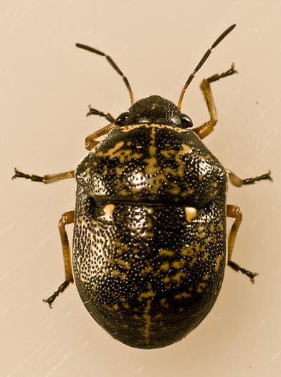
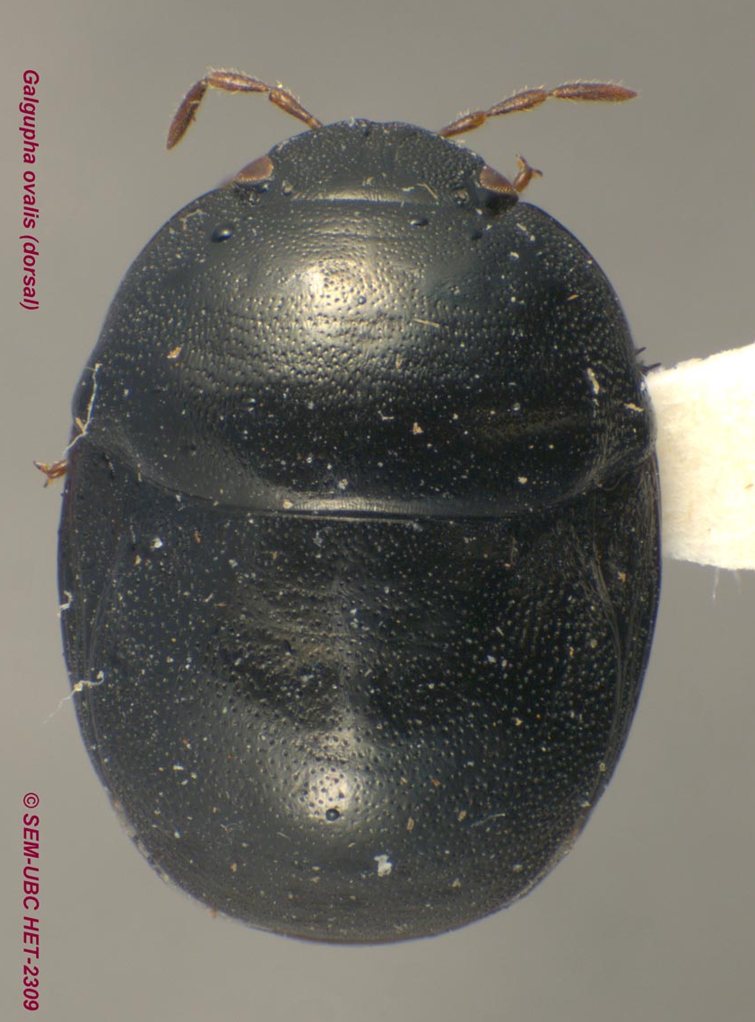
Look-alikes
Kudzu bug
Megacopta cribraria
Shield-backed bug
Orsilochides guttata
Thyreocorid
Galgupha ovalis
Photos: Lilyconnor, wiki.bugwood.org; bugguide.net; Don Griffiths, Spencer Entomological Collection, Beaty Biodiversity Museum, UBC
Notes:
The kudzu bug may be confused with species in the families Scuttelleridae (such as the shield-backed bug - Orsilochides guttata) and Thyreocoridae (black bugs - Galgupha ovalis). True bugs in these families have enlarged scutella like the kudzu bug. However, the scutella of the species in these families tend to have a rounded posterior end whereas it is truncated in the kudzu bug.
Information sources:
Biehler, J.A. and J.E. Mcpherson. 1982. Life history and laboratory rearing of Galgupha ovalis (Hemiptera: Corimelaenidae), with Descriptions of Immature stages. Annals of the entomological society of America. Vol. 75 (4): 465- 470.
Eaton, E.R. and K. Kaufman. 2007. Kaufman Field Guide to Insects of North America. Houghton Mifflin Company, New York.
Accessed 11/6/2013
http://books.google.com/books?id=aWVi0IF_jcQC&pg=PA127&dq=Orsilochides+guttata&hl=en&sa=X&ei=aqF6Uv6hFMOrkQfRz4DQCw&ved=0CDEQ6AEwAA#v=onepage&q=Orsilochides%20guttata&f=false
Poplin, A. and A. C. Hodges. 2012. Bean Plataspid: Megacopta cribraria (Fabricius) (Insecta: Hemiptera: Heteroptera: Plataspidae). UF & FDACS/DPI. Featured Creatures #EENY-257
Accessed 7/26/2013-
http://edis.ifas.ufl.edu/in939

Slide 13
Authors
Ashley V. Poplin, M.S.
Department of Entomology and Nematology, University of Florida
Matthew D. Smith, Ph.D.
Postdoctoral Associate, Department of Entomology and Nematology, University of Florida
Amanda Hodges, Ph.D.
Associate Extension Scientist, Department of Entomology and Nematology, University of Florida

Slide 14
Editors
Stephanie Stocks, M.S.
Assistant-In, Extension Scientist, Department of Entomology and Nematology, University of Florida
Keumchul Shin, M.S.
Graduate student, Doctor of Plant medicine program, University of Florida

Slide 15
Reviewers
Brad Danner, B.S.
Pest Survey Specialist, Cooperative Agricultural Pest Survey Program
Andrew Derksen, M.S.
Pest Survey Scientist, Florida Department of Agriculture and Consumer Services, Division of Plant Industry
Smriti Bhotika, Ph.D.
Postdoctoral Associate, Department of Entomology and Nematology, University of Florida

Slide 16
Collaborating Agencies
U.S. Department of Agriculture Animal and Plant Health Inspection Service (USDA-APHIS)
Cooperative Agricultural Pest Survey Program (CAPS)
Florida Department of Agriculture and Consumer Services (FDACS)
National Plant Diagnostic Network (NPDN)
Sentinel Plant Network (SPN)
Protect U.S.
University of Florida Institute of Food and Agricultural Sciences (UF-IFAS)

Slide 17
Educational Disclaimer and Citation
This presentation can be used for educational purposes for NON-PROFIT workshops, trainings, etc.
Citation:
  Poplin, A., M.S., Smith, M., Ph.D., Hodges, A., Ph.D., 2014. Kudzu Bug, Megacopta cribraria, June 2014.

Slide 18
References
Biehler, J.A. and J.E. Mcpherson. 1982. Life history and laboratory rearing of Galgupha ovalis (Hemiptera: Corimelaenidae), with Descriptions of Immature stages. Annals of the entomological society of America. Vol. 75 (4): 465- 470.
Collins, J. 2003. If You Can't Beat Kudzu, Join It. Off the Wall. Duke Energy Employee Advocate. Accessed 19 July 2013.
  http://www.dukeemployees.com/offthewall2.shtml
Eaton, E.R. and K. Kaufman. 2007. Kaufman Field Guide to Insects of North America. Houghton Mifflin Company, New York. Accessed 11/6/2013
  http://books.google.com/books?id=aWVi0IF_jcQC&pg=PA127&dq=Orsilochides+guttata&hl=en&sa=X&ei=aqF6Uv6hFMOrkQfRz4DQCw&ved=0CDEQ6AEwAA#v=onepage&q=Orsilochides%20guttata&f=false
Eger, Jr. J.E., L. M. Ames, D. R. Suiter, T. M. Jenkins, D. A. Rider, and S. E. Halbert. 2010. Occurrence of the Old World bug Megacopta cribraria (Fabricius) (Heteroptera: Plataspidae) in Georgia: a serious home invader and potential legume pest. Insecta Mundi. 0121:1-11. Accessed 7/26/2013-
  http://www.ces.ncsu.edu/depts/ent/notes/Urban/Egeretal2010.pdf

Slide 19
References
Everest, J. W., J. H. Miller, D. M. Ball, M. Patterson. 1999. Kudzu in Alabama History, Uses, and Control. Alabama A&M and Auburn Universities, Alabama Cooperative Extension System ANR-65. Accessed 7/26/2013-
  http://www.treesearch.fs.fed.us/pubs/2341
Horn, S. and J. L. Hanula. 2011. Influence of trap color on collection of the recently-introduced bean plataspid, Megacopta cribraria (Hemiptera: Plataspidae). Journal of Entomological Science. 46: 85-87. accessed 7/26/2013-
  http://www.srs.fs.usda.gov/pubs/37792
Jenkins T. M. and T. D. Eaton. 2011. Population genetic baseline of the first plataspid stink bug symbiosis (Hemiptera: Heteroptera: Plataspidae) reported in North America. Insects. 2: 264-272. Accessed 7/26/2013-
  http://www.mdpi.com/2075-4450/2/3/264
Poplin, A. and A. C. Hodges. 2012. Bean Plataspid: Megacopta cribraria (Fabricius) (Insecta: Hemiptera: Heteroptera: Plataspidae). UF & FDACS/DPI. Featured Creatures #EENY-257. Accessed 7/26/2013-
  http://edis.ifas.ufl.edu/in939

Slide 20
References
Stewart, D. 2000 (October). Kudzu: Love It or Run. Smithsonian Magazine. Accessed 7/26/2013-
  http://www.smithsonianmag.com/science-nature/kudzu-abstract.html
University of Georgia. Kudzu bug. Accessed 7/26/2013-
  www.kudzubug.org
USDA PLANTS profile. Kudzu. Accessed 19 July 2013.
  http://plants.usda.gov/core/profile?symbol=pumo
USDA GRIN Taxonomy. Accessed 19 July 2013.
  http://www.ars-grin.gov/cgi-bin/npgs/html/taxon.pl?314966
USDA/Agricultural Research Service. 2009. "Controlling Kudzu With Naturally Occurring Fungus." ScienceDaily. Accessed 19 July 2013.
  http://www.sciencedaily.com/releases/2009/07/090719185107.htm

