Slide 1
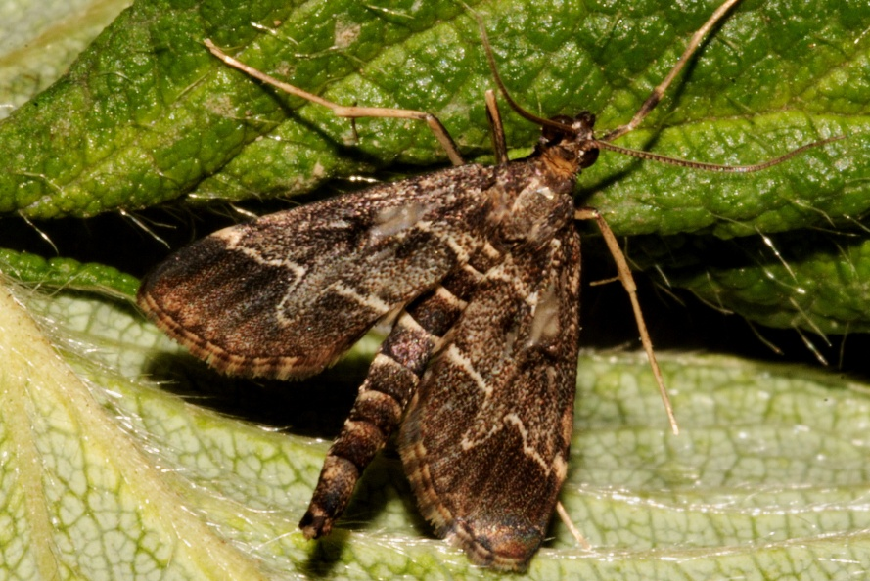
A New Emerging Pest in Florida:
European Pepper Moth
(Duponchelia fovealis)
Photo: Carmelo Peter Bonsignore, Università degli Studi Mediterranei di Reggio Calabria
Notes:
This presentation is about the moth Duponchelia fovealis (Lepidoptera: Crambidae); also known as the ‘southern European marshland pyralid’ (even though it has been moved from the family Pyralidae), or the ‘European pepper moth’ (not to be confused with the ‘European peppered moth’).
(This presentation has been modified from a presentation that the authors created for Protect U.S. (www.protectingusnow.org).

Slide 2
European Pepper Moth
Native to the coastal wetlands of the Mediterranean.
A.k.a. “Southern European marshland pyralid” and “European Pepper Moth”.
Is known as a greenhouse pest in Northern Europe.
May become a pest outside of a greenhouse setting if the climate is right.
Notes:
European Pepper Moths are native to the coastal wetlands of southern Europe, the eastern Mediterranean, and northern Africa. They were first reported outside of this range in 1984 when they were found in Finland. Since then, they have been detected in other parts of Africa and the Middle East, northwest India, Europe, Canada, and the United States.
European Pepper Moths have become notable greenhouse pests in northern Europe and Canada for the cut flower, vegetable, and aquatic plant industries. In addition to causing damage in this expanded range, they have also become pests of commercially grown Lisianthus and strawberries in their native Italy.
Based on the climate of their native habitat, European Pepper Moths may become established in U.S. states along the west coast and in the southeast. In fact, most of these states have already reported detections of this moth.
In the U.S., researchers are currently monitoring these moths to determine their distribution; to track whether or not populations are becoming established; and to investigate potential damage to the greenhouse industry and to commercial crops grown outdoors or in shade houses.
Information sources:
Ahern, Robert. 2010. Amended NPAG Report. Duponchelia fovealis Zeller: Lepidoptera/Pyralidae.
Accessed 4/29/2011 -
http://entnemdept.ufl.edu/pestalert/Duponchelia_fovealis_NPAG_ET_Report_20100917.pdf
Anonymous. 2005a. Risk management Decision Document for Duponchelia fovealis in Canada. Canadian Food Inspection Agency.
Accessed 4/29/2011 -
http://entnemdept.ufl.edu/pestalert/duponchelia_fovealis_risk_management.pdf
Anonymous. 2005b. Plant Pest Information: Duponchelia fovealis Zeller. Canadian Food Inspection Agency.
Accessed 4/29/2011 –
http://entnemdept.ufl.edu/pestalert/Duponchelia_fovealis_Canada.pdf
Bethke, James and Brian Vander Mey. 2010. Pest Alert: Duponchelia fovealis. University of California Cooperative Extension, San Diego.
Accessed 4/29/2011 –
http://ucanr.org/sites/cetest/files/55177.pdf
Billen W, 1994. On the harmfulness of Duponchelia fovealis (Zeller, 1847) in Germany (Lepidoptera, Pyralidae). Nota Lepidopterol, 16: 3-4, p. 212.
Bonsignore, Carmelo Peter and Vincenzo Vacante. 2010. “Duponchelia fovealis (Zeller). A New Emergency for Strawberries?”. Protezione delle colture, pp. 40-43.
Brambila, Julieta and Ian Stocks. 2010. The European Pepper Moth, Duponchelia fovealis Zeller (Lepidoptera: Crambidae), a Mediterranean Pest Moth Discovered in Central Florida.
Accessed 4/29/2011 –
http://www.freshfromflorida.com/pi/pest_alerts/pdf/duponchelia_fovealis.pdf
CABI International. 2010. “Selected Sections for: Duponchelia fovealis (Southern European Marshland Pyralid)”. Crop Protection Compendium.
Derksen, A., and L. Whilby. 2011. “Update on Florida CAPS trapping activities for Duponchelia fovealis Zeller, September 2010 to May 2011”, CAPS Report.
accessed 8/15/2011 –
http://entomology.ifas.ufl.edu/stocks/DFOV_update%201_v5%2008-19-11.pdf
Faquaet, Marcel. 2000. “Duponchelia fovealis, een nieuwe soort voor de Belgische fauna (Lepidoptera: Pyralidae)”. Phegea 28:1.
Guda, C. D. , A. Capizzi, and P. Trematerra. 1988. “Damages on Eustoma grandiflorum (Raf.) Shinn. Caused by Duponchelia fovealis (Zeller)”. Annali dell’Istituto Sperimentale per la Floricultura. Vol. 19, pp. 3-11.
Hoffman, Kevin. 2010. CDFA Detection Advisory for a Cramid moth: Duponchelia fovealis (Zeller) (Pyraloidea: Crambidae). Reference PDR: 1511851.
Accessed 4/29/2011 –
http://www.kernag.com/dept/news/2010/2010-san-diego-duponchelia-fovealis-07-16-2010.pdf
MacLeod, A. 1996. Summary Pest Risk Assessment: Duponchelia fovealis. DEFRA (Department for Environment, Food, and Rural Affairs), Central Science Laboratory, Sand Hutton, York, United Kingdom.
NAPPO – Phytosanitary alert system. 2010.
http://www.pestalert.org/oprDetail.cfm?oprID=466&keyword=Duponchelia%20fovealis

Slide 3
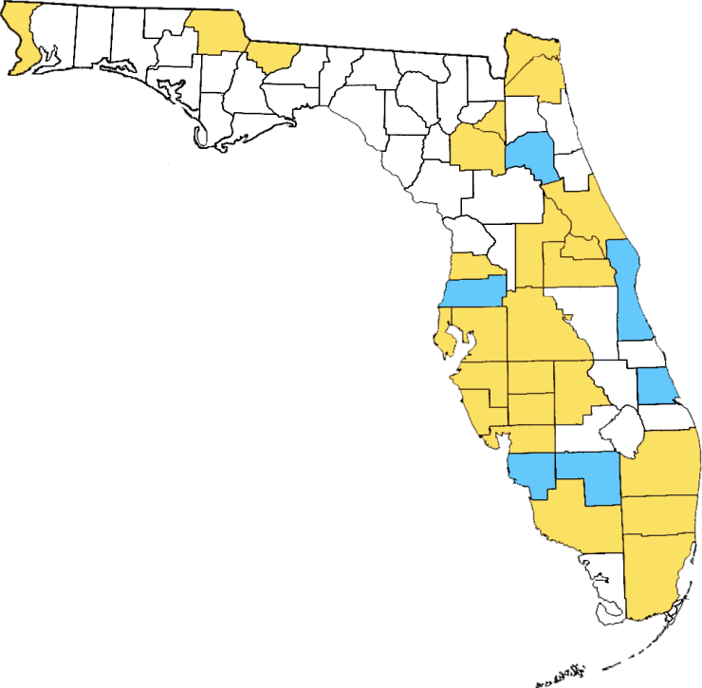
Known Distribution in Florida
No sampling
Sampled but not found
Intercepted or detected, but not considered established
Map based on CAPS Survey September 2010 to May 2011, research conducted by S. Stocks, and NAPIS Pest Tracker.
Notes:
European Pepper Moths were first detected in the United States in 2004 in San Diego County (on begonias). As of September 2011, they have spread to at least seventeen other California counties. Furthermore, they have been detected in Alabama, Arizona, Colorado, Florida, Georgia, Mississippi, New York, North Carolina, Oklahoma, Oregon, South Carolina, Tennessee, Texas, and Washington.
A Cooperative Agriculture Pest Survey (or ‘CAPS’) program survey was conducted from September 2010 to May 2011 to determine the status of European Pepper Moths in Florida. The CAPS survey sampled 26 counties by using 88 delta traps baited with the species-specific pheromone . Adults (but not immature animals) were detected in 21 of the 26 counties sampled (shown in red). These were: Alachua, Bradford, Desoto, Duval, Charlotte, Collier, Escambia, Hardee, Hernando, Highlands, Hillsborough, Manatee, Miami-Dade, Nassau, Palm Beach, Pinellas, Polk, Orange, Sarasota, Seminole, and Volusia counties. Counties that were sampled but had no detections included: Brevard, Broward, Hendry, Putnam, and St. Lucie.
In addition, the S. Stocks has added two counties to the map: Gadsden and Broward. NAPIS Pest Tracker reports Lake and Jackson Counties as positive for detections or interceptions as well.
The official FDACS-DPI response to this pest is that although Duponchelia fovealis has been intercepted at several locations throughout Florida in CAPS traps, they have not been detected in the landscape and are therefore considered a pest of limited distribution within the nursery trade. As a result, when it is detected in nurseries, it is considered a pest of quarantine significance.
Information sources:
Derksen, A., and L. Whilby. 2011. “Update on Florida CAPS trapping activities for Duponchelia fovealis Zeller, September 2010 to May 2011”, CAPS Report.
accessed 8/15/2011 –
http://entomology.ifas.ufl.edu/stocks/DFOV_update%201_v5%2008-19-11.pdf

Slide 4
Susceptible Plants
Ornamental hosts include:
    Begonia
    Daisies
    Poinsettia
    Lisianthus
    Common purslane
    Creeping buttercup
    Cyclamen
    Impatiens
    Kalanchoe
    Coral bells
Agricultural hosts include:
beet
pepper
fig
basil
pomegranate
blackberry
Tomato
Cucumbers
Squash
Strawberries
There are several aquatic plants hosts as well.
Notes:
The European pepper moth has been listed as a pest on a variety of plants ranging from aquatic plants to crop plants to plants grown in the nursery and floriculture trade.
Complete host lists are found below.
Aquatic plants (species):
Alternanthera splendida
Alternanthera rosaefolia
Bacopa lanigera
Echinodorus tropica
Echinodorus parviflorus
Hygrophila rubella
Ludwigia glandulosa
Ludwigia perennis
Nesaea pedicellata
Rotala macranda
Rotala wallichii
Aquatic plant (genera):
Aponogeton and Cryptocoryne
Agricultural plants:
Apium graveolens (celery)
Beta vulgaris (beets)
Capsicum annuum (pepper)
Cucumis sativus (cucumbers)
Cucurbita moschata (squash)
Fragaria ananassa (strawberries)
Lactuca sativa (lettuce)
Ocimum basilicum (basil)
Origanum majorana (majorum)
Plantago lanceolata (plantain)
Punica granatum (pomegranate)
Rubus fruticosus (blackberry)
Solanum lycopersicum (tomatoes)
Thymus vulgaris (thyme)
Zea mays (corn)
Ornamental plants (species):
Begonia tuberosa
Begonia elatior
Bellis perennis (English daisy)
Chenopodium album (lamb’s quarters)
Convolvulus arvensis (bindweed)
Cuphea hyssopifolia (false heather)
Euphorbia pulcherrima (poinsettia)
Eustoma grandiflorum (Lisianthus)
Ficus triangularis (fig)
Hyeronima alchorneoides (a tropical tree of South American origin so it is probably a transplanted landscape tree)
Malva sylvestris (mallow)
Mentha pulegium (penny royal)
Oxalis acetosella (common wood sorrel)
Portulaca oleracea (common purslane)
Ranunculus repens (creeping buttercup)
Ornamental plant (genera):
Amaranthus
Anemone
Annona
Anthurium
Bouvardia
Calathea
Chrysanthemum
Cineraria
Codiaeum
Coleus
Cyclamen
Gerbera (African daisies)
Heuchera (coral bells)
Impatiens
Kalanchoe
Limonium (sea lavender)
Lysimachia
Ophiopogon (mondo grass though there are also aquatic versions of this plant)
Pelargonium (geranium)
Paeonia
Phalaenopsis (orchids)
Rhododendron (azalea)
Rosa (roses)
Rumex
Sambucus (elderberry)
Sarracenia
Senecio
Tanacetum
Ulmus (elm)
Based on what is currently known about this species, it appears to be a threat to cultivated crops. In fact, its natural habitat is wetlands, so ornamental aquatic plants (especially if grown in a greenhouse setting) seem to be particularly susceptible.
However, it is prudent to remember that not much is known about its ecology in its native habitat (including what plants its feeds on in the wetlands); therefore, there is potential for it becoming an environmental threat in wetland areas where it is introduced. This can be especially tricky in states where plants grown for the aquarium industry (considered aquatic weeds) have become established in the natural landscape.
Virtually all of the plants listed above either are or can be grown in Florida, many of them commercially and most of them can be maintained in a homeowner’s yard. Florida’s crop plants that are probably the most at risk from this pest include: green peppers (which generated $198,553,000 in sales in 2009), cucumbers (which generated $101,550,000 in sales in 2009), squash (which generated $51,480,000 in sales in 2009), tomatoes (which generated $520,205,000 in sales in 2009), strawberries (which generated $313,632,000 in sales in 2009), and corn which generated ($227,154,000 in sales in 2009).
Information sources:
Ahern, Robert. 2010. Amended NPAG Report. Duponchelia fovealis Zeller: Lepidoptera/Pyralidae.
Accessed 4/29/2011 -
http://entnemdept.ufl.edu/pestalert/Duponchelia_fovealis_NPAG_ET_Report_20100917.pdf
Anonymous. 2005a. Risk management Decision Document for Duponchelia fovealis in Canada. Canadian Food Inspection Agency.
Accessed 4/29/2011 -
http://entnemdept.ufl.edu/pestalert/duponchelia_fovealis_risk_management.pdf
Bethke, James and Brian Vander Mey. 2010. Pest Alert: Duponchelia fovealis. University of California Cooperative Extension, San Diego.
Accessed 4/29/2011 –
http://ucanr.org/sites/cetest/files/55177.pdf
Billen W, 1994. On the harmfulness of Duponchelia fovealis (Zeller, 1847) in Germany (Lepidoptera, Pyralidae). Nota Lepidopterol, 16: 3-4, p. 212.
Bonsignore, Carmelo Peter and Vincenzo Vacante. 2010. “Duponchelia fovealis (Zeller). A New Emergency for Strawberries?”. Protezione delle colture, pp. 40-43.
Brambila, Julieta and Ian Stocks. 2010. The European Pepper Moth, Duponchelia fovealis Zeller (Lepidoptera: Crambidae), a Mediterranean Pest Moth Discovered in Central Florida.
Accessed 4/29/2011 -
http://www.freshfromflorida.com/pi/pest_alerts/pdf/duponchelia_fovealis.pdf
CABI International. 2010. “Selected Sections for: Duponchelia fovealis (Southern European Marshland Pyralid)”. Crop Protection Compendium.
Clark, J. S. 2000. Duponchelia fovealis (Zell.) arriving on imported plant material. Atropos 10:20–21.
DeVenter, Peter van. 2009. “Water trap best for catching Duponchelia”. Fruit & Veg Tech 9.1.
Accessed 4/29/2011 -
http://documents.plant.wur.nl/wurglas/C_bestwatertrap.pdf
Guda, C. D. , A. Capizzi, and P. Trematerra. 1988. “Damages on Eustoma grandiflorum (Raf.) Shinn. Caused by Duponchelia fovealis (Zeller)”. Annali dell’Istituto Sperimentale per la Floricultura. Vol. 19, pp. 3-11.
Hoffman, Kevin. 2010. CDFA Detection Advisory for a Cramid moth: Duponchelia fovealis (Zeller) (Pyraloidea: Crambidae). Reference PDR: 1511851.
Accessed 4/29/2011 –
http://www.kernag.com/dept/news/2010/2010-san-diego-duponchelia-fovealis-07-16-2010.pdf.
MacLeod, A. 1996. Summary Pest Risk Assessment: Duponchelia fovealis. DEFRA (Department for Environment, Food, and Rural Affairs), Central Science Laboratory, Sand Hutton, York, United Kingdom.
Marek J. and E. Bártová. 1998. Duponchelia fovealis Zeller, 1847, a new pest of glasshouse plants in the Czech Republic. Plant Protection Science, 34(4):151-152.
Romeijn, G. 1996. “Een nieuwe plaag in de kas”, Vakblad voor de Bloemisterij, volume 47, pp. 46-47.
Unknown. 2006a. “Duponchelia alla ribalta”, Colture Protette, No. 3, page 14.
Monetary data obtained from USDA ERS for the state of Florida.

Slide 5
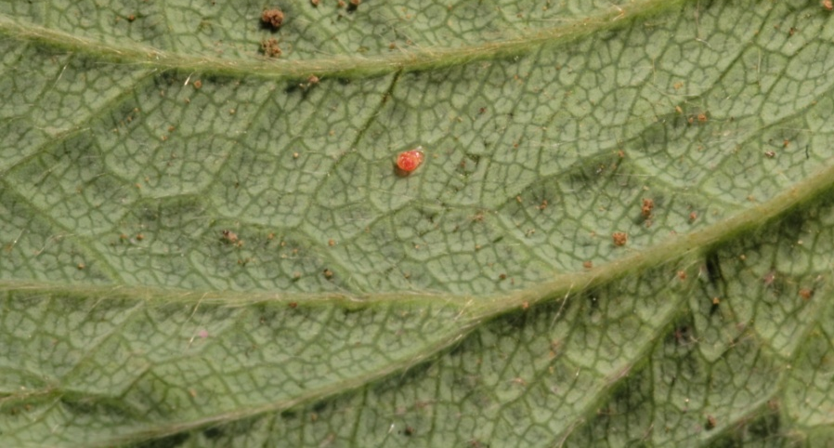
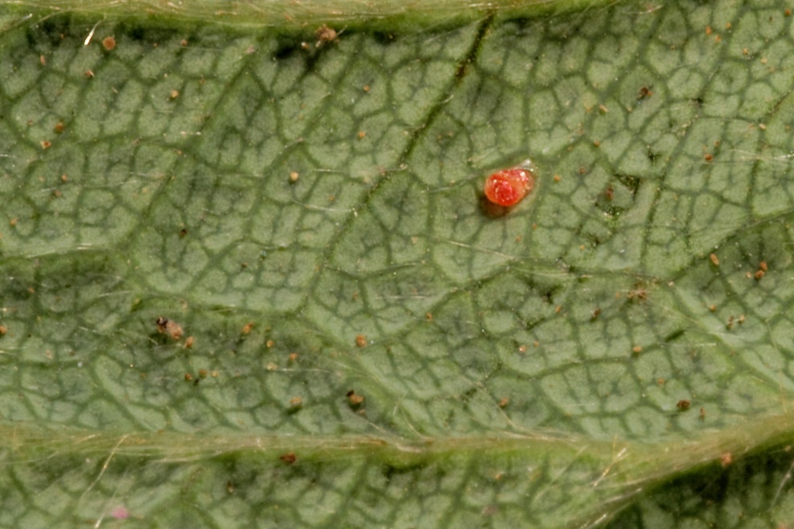
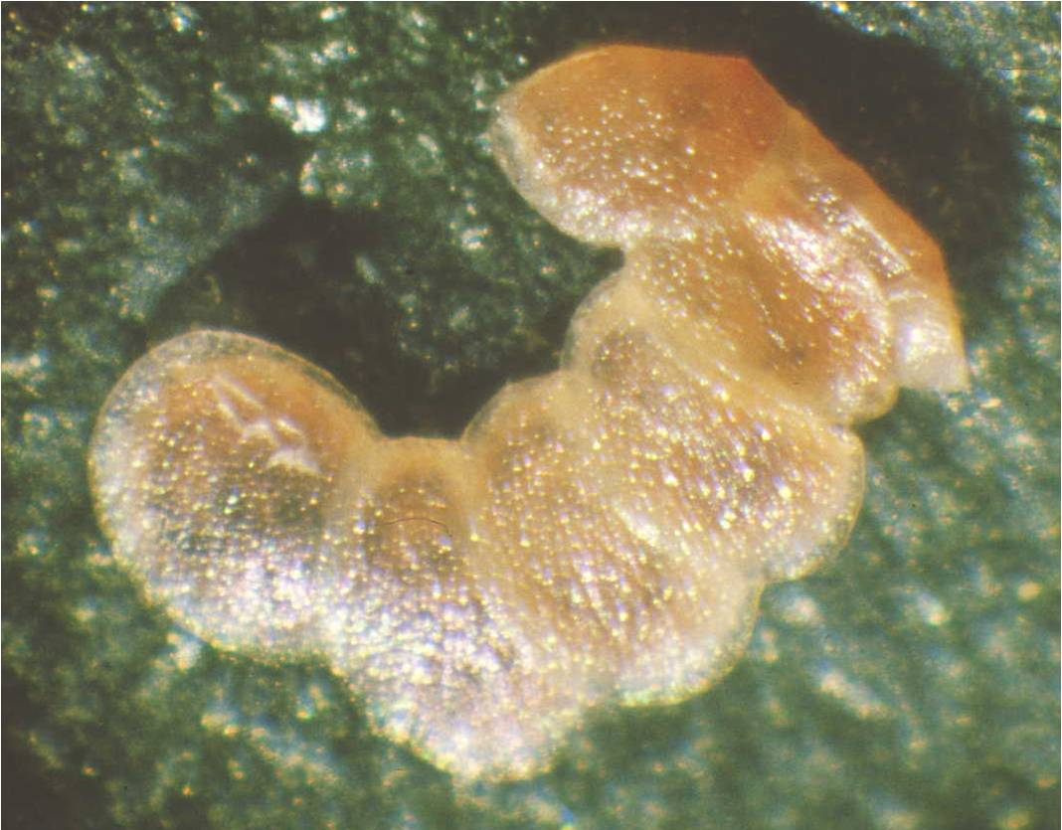
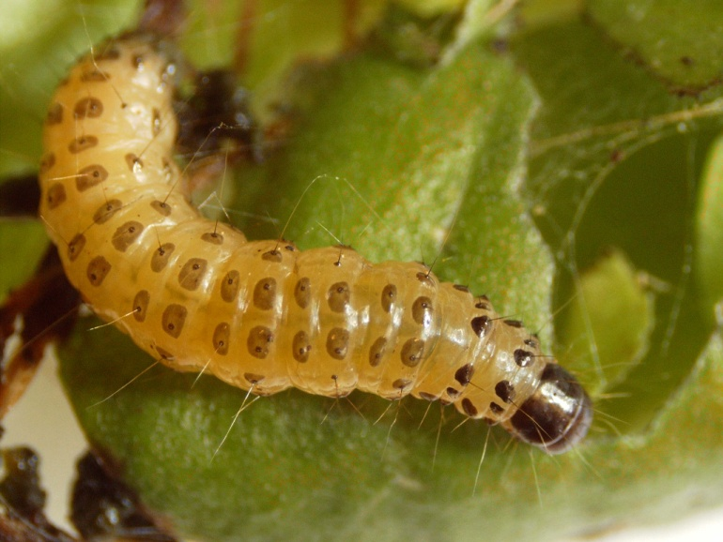
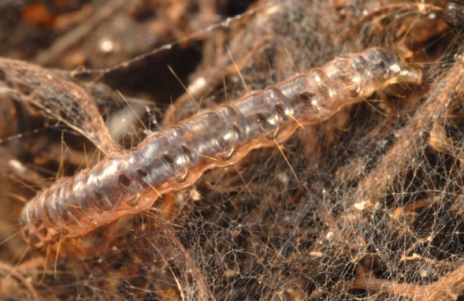
Identification
Eggs
Laid singly or in groups of 3-10.
Mostly found on undersides of leaves
  can also be found on the upper side of the leaves, on the stems, at the base of the plant, in the upper soil layer.
Larvae
Turn creamy white or light brown with spots as they mature.
  Depending on diet
20-30mm long when fully developed.
Color of larvae feeding on live plant material
Photos:
Eggs - Carmelo Peter Bonsignore, Università degli Studi Mediterranei di Reggio Calabria and Pasquale Trematerra, University of Molise, Italy.
Larvae - Henk Stigter, Plant Protection Service, National Reference Centre, The Netherlands, Marja van der Straten, Plant Protection Service, Wageningen, Netherlands, and Lyle Buss, Department of Entomology and Nematology, University of Florida
Color of larvae feeding on detritus
Notes:
The eggs measure 0.5 X 0.7mm (0.02 X 0.03inches) and are whitish green or straw colored when laid. Eggs turn pink then red as the embryo develops, finally turning brown prior to hatching. They are laid singly or in masses of 3-10 (overlapping each other) mostly on the undersides of leaves (close to the veins). However, they can also be found on the upper surface of the leaf, on the stalks, at the base of the plant, in the upper soil layer, and possibly on the fruit.
Upon hatching, the larvae measure 1.5mm (0.06in) in length and have a shiny dark head and a salmon pink body with a line of separated brown to gray spots extending across and around each segment. These spots are uniform in color from top to bottom (i.e. the spots do not fade in color as they approach the ventral side of the caterpillar).
On some segments, there are 2 transverse rows of these spots though the second row of spots will not extend around the segment; they stop on the sides of the caterpillar.
If you look at these spots with a hand lens, you will see at least one short, stout hair emerging from each of them (yellow arrow). There is also a hard dorsal plate (or sclerotized region) located on the segment just behind the head. This plate is the same color as the head capsule (red arrow).
As the larvae grow, their background color changes to a creamy white or light brown or dirty white color. The color also apparently varies depending on what the caterpillar is feeding upon. In cases where the larvae are feeding on detritus, the background color of the larvae can appear quite dark making the spots hard to see.
Prior to pupation, the larvae can reach 17-30mm (0.7 to 1.25in) long and become pearly in appearance (they also seem to loose their spots).
Information sources:
Anonymous. 2005a. Risk management Decision Document for Duponchelia fovealis in Canada. Canadian Food Inspection Agency.
Accessed 4/29/2011 -
http://entnemdept.ufl.edu/pestalert/duponchelia_fovealis_risk_management.pdf
Anonymous. 2005b. Plant Pest Information: Duponchelia fovealis Zeller. Canadian Food Inspection Agency.
Accessed 4/29/2011 –
http://entnemdept.ufl.edu/pestalert/Duponchelia_fovealis_Canada.pdf
Bethke, James and Brian Vander Mey. 2010. Pest Alert: Duponchelia fovealis. University of California Cooperative Extension, San Diego.
Accessed 4/29/2011 –
http://ucanr.org/sites/cetest/files/55177.pdf
Billen W, 1994. On the harmfulness of Duponchelia fovealis (Zeller, 1847) in Germany (Lepidoptera, Pyralidae). Nota Lepidopterol, 16: 3-4, p. 212.
Bonsignore, Carmelo Peter and Vincenzo Vacante. 2010. “Duponchelia fovealis (Zeller). A New Emergency for Strawberries?”. Protezione delle colture, pp. 40-43.
Brambila, Julieta and Ian Stocks. 2010. The European Pepper Moth, Duponchelia fovealis Zeller (Lepidoptera: Crambidae), a Mediterranean Pest Moth Discovered in Central Florida.
Accessed 4/29/2011 -
http://www.freshfromflorida.com/pi/pest_alerts/pdf/duponchelia_fovealis.pdf
CABI International. 2010. “Selected Sections for: Duponchelia fovealis (Southern European Marshland Pyralid)”. Crop Protection Compendium.
Guda, C. D. , A. Capizzi, and P. Trematerra. 1988. “Damages on Eustoma grandiflorum (Raf.) Shinn. Caused by Duponchelia fovealis (Zeller)”. Annali dell’Istituto Sperimentale per la Floricultura. Vol. 19, pp. 3-11.
Hoffman, Kevin. 2010. CDFA Detection Advisory for a Cramid moth: Duponchelia fovealis (Zeller) (Pyraloidea: Crambidae). Reference PDR: 1511851.
Accessed 4/29/2011 –
http://www.kernag.com/dept/news/2010/2010-san-diego-duponchelia-fovealis-07-16-2010.pdf.
Jackel, Barbara, Birgit Kummer, and Monika Kurhais. 1996. “Biological Control of Duponchelia fovealis Zeller (Lepidoptera, Pyralidae)”. Mitteilungen aus der Biologishen fur Land und Forstwirtschaft. Vol. 321. p. 483.
Marek J. and E. Bártová. 1998. Duponchelia fovealis Zeller, 1847, a new pest of glasshouse plants in the Czech Republic. Plant Protection Science, 34(4):151-152.
Trematerra, P. 1990. “Morphological aspects of Duponchelia fovealis Zeller (Lepidoptera: Pyralidae)”. Redia, vol. 73, issue 1, pp. 41-52.

Slide 6
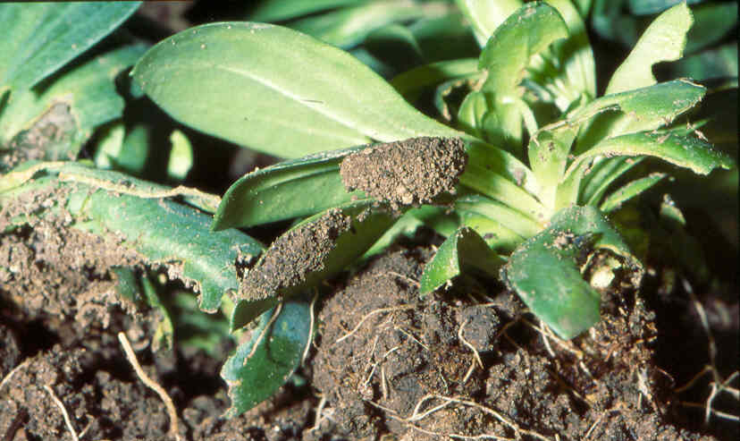
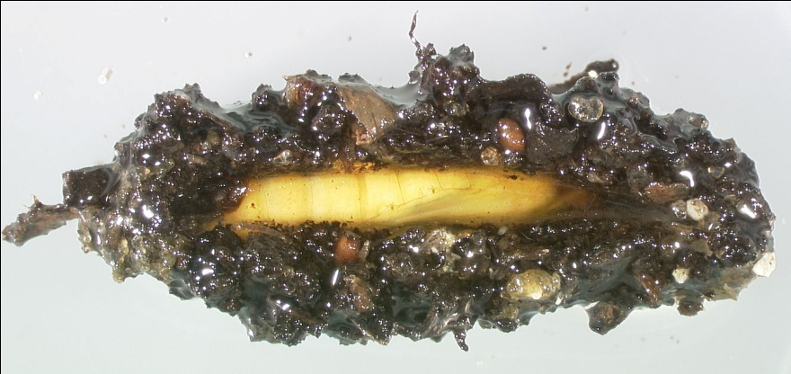
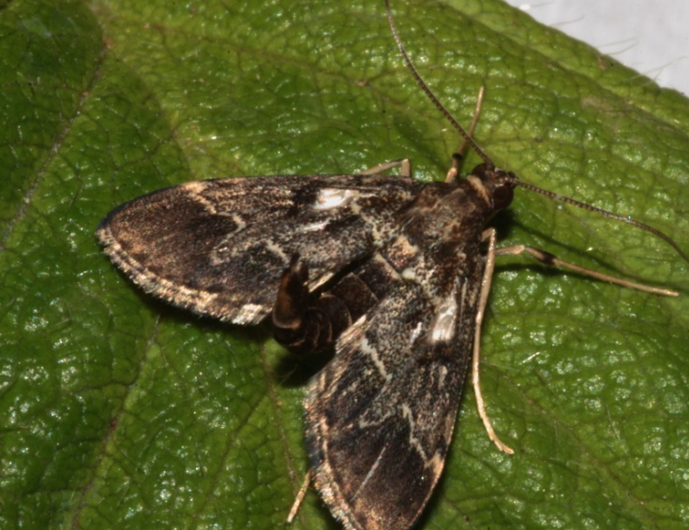
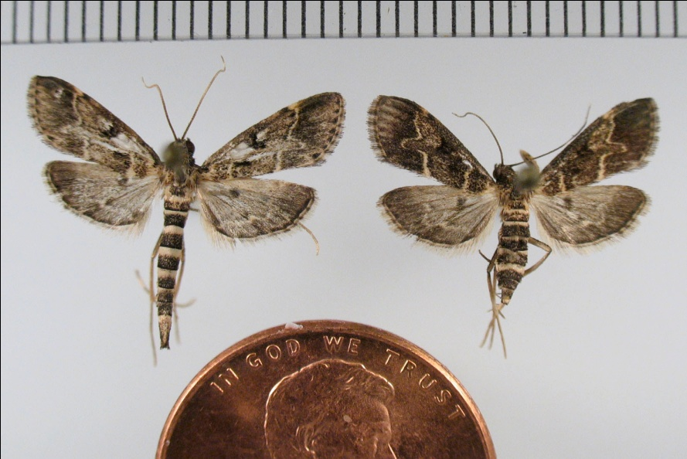
Identification
Pupae
9-12mm long made of webbing with soil and frass in it.
Found on undersides of leaves, at the edge of the pot, or in the upper soil layer.
Adults
19-21mm across
Striped abdomen
Dark wings
“The finger”
male
male
female
Photos:
Pupa - Henk Stigter, Plant Protection Service, National Reference Centre, Netherlands and James Hayden, Florida Department of Agriculture and Consumer Services, Division of Plant Industry
Adult - James Hayden, Florida Department of Agriculture and Consumer Services, Division of Plant Industry and Carmelo Peter Bonsignore, Università degli Studi Mediterranei di Reggio Calabria
Notes:
Pupation occurs in a 15 to 19mm (0.6 to 0.75in) cocoon made of webbing, frass, and soil particles (yellow arrows). The pupae itself measures 9 to 12mm long (0.35 to 0.5in) and is yellow brown in color, becoming darker as the adult gets closer to emergence.
Adults have a wingspan of 19 to 21mm (0.75 to 0.83in). The forewings are gray-brown in color with 2 yellowish white transverse lines (white arrows). The outermost of these lines has a pronounced “finger” which points towards the edge of the wing (red arrow). When at rest, the wings are held out from body forming a triangle. The wing fringe alternates between cream-colored and dark bands (orange arrow).
The head, antennae, and body are olive brown; and the legs are pale brown. The abdomen has cream-colored rings encircling it (purple arrows). The abdomen is usually held curved upwards (almost 90 degrees from horizontal – blue arrow).
Males can be identified by their a longer, slimmer abdomen compared to females. In fact, the abdomen of the male is unusually long for most moths as it extends beyond the wings. The males also have a cream colored, somewhat triangular shaped spot located along the innermost line of the forewing. In some cases, this area looks like a clear area in the wing (fovea). This area may be seen when the males are at rest, though the use of a hand lens is likely needed. Yet, if the male specimen has lost many of its scales, this area may not be visible at all. Additionally, the finger projection on the outermost line also may be difficult to see if the specimen has lost many wing scales.
Several articles note that adults fly low and fast with their abdomen curved upwards, giving the species a unique flight pattern that is rather quick and irregular. In addition, adults can move in swarms with heavy infestations.
Information sources:
Anonymous. 2005b. Plant Pest Information: Duponchelia fovealis Zeller. Canadian Food Inspection Agency.
Accessed 4/29/2011 –
http://entnemdept.ufl.edu/pestalert/Duponchelia_fovealis_Canada.pdf
Bethke, James and Brian Vander Mey. 2010. Pest Alert: Duponchelia fovealis. University of California Cooperative Extension, San Diego.
Accessed 4/29/2011 –
http://ucanr.org/sites/cetest/files/55177.pdf
Bonsignore, Carmelo Peter and Vincenzo Vacante. 2010. “Duponchelia fovealis (Zeller). A New Emergency for Strawberries?”. Protezione delle colture, pp. 40-43.
Brambila, Julieta and Ian Stocks. 2010. The European Pepper Moth, Duponchelia fovealis Zeller (Lepidoptera: Crambidae), a Mediterranean Pest Moth Discovered in Central Florida.
Accessed 4/29/2011 -
http://www.freshfromflorida.com/pi/pest_alerts/pdf/duponchelia_fovealis.pdf
CABI International. 2010. “Selected Sections for: Duponchelia fovealis (Southern European Marshland Pyralid)”. Crop Protection Compendium.
Guda, C. D. , A. Capizzi, and P. Trematerra. 1988. “Damages on Eustoma grandiflorum (Raf.) Shinn. Caused by Duponchelia fovealis (Zeller)”. Annali dell’Istituto Sperimentale per la Floricultura. Vol. 19, pp. 3-11.
Hoffman, Kevin. 2010. CDFA Detection Advisory for a Cramid moth: Duponchelia fovealis (Zeller) (Pyraloidea: Crambidae). Reference PDR: 1511851.
Accessed 4/29/2011 –
http://www.kernag.com/dept/news/2010/2010-san-diego-duponchelia-fovealis-07-16-2010.pdf
Pijnakker, Juliette. 2001. “Duponchelia fovealis, le lépidoptère redouté des plantes en pot aux Pays-Bas”, Revue Horticole, volume 429, pp. 51-53.
Trematerra, P. 1990. “Morphological aspects of Duponchelia fovealis Zeller (Lepidoptera: Pyralidae)”. Redia, vol. 73, issue 1, pp. 41-52.
Unknown. 2006a. “Duponchelia alla ribalta”, Colture Protette, No. 3, page 14.

Slide 7
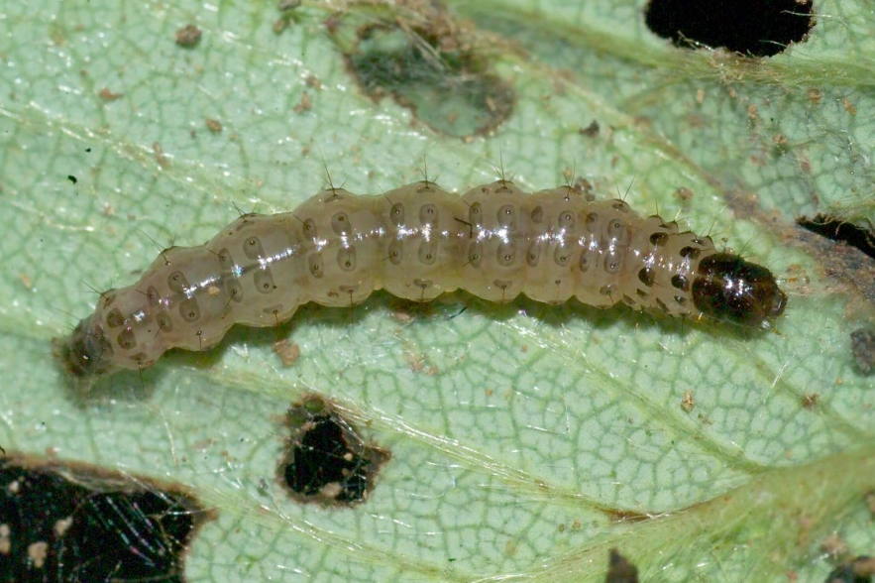
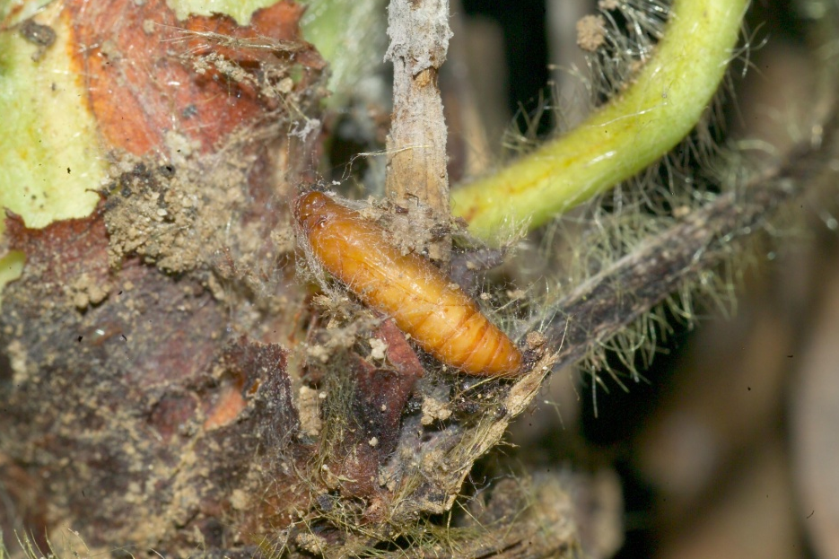
Life Cycle
Egg stage
( 4-9 days)
Adult
(1-2 weeks)
Laval stage
(3-4 weeks)
Photos: Carmelo Peter Bonsignore, Università degli Studi Mediterranei di Reggio Calabria
Pupal stage
(1-2 weeks)
Notes:
Like most insects, developmental time for European Pepper Moths varies according to temperature. In a 68˚F (or 20˚C) greenhouse, total development time is 6-8 weeks. Development takes 4-9 days for eggs; 3-4 weeks for larvae; and 1-2 weeks for pupation; adults then live for another 1-2 weeks.
The adults quickly mate and females lay eggs within 24 hours after emergence. Each females is capable of laying 200 eggs during her lifetime. In a greenhouse setting, 8 to 9 generations per year have been recorded. In the warm climates of California and the southeastern United States, the potential for multiple brood production and a shortened life cycle is quite high.
Information sources:
Ahern, Robert. 2010. Amended NPAG Report. Duponchelia fovealis Zeller: Lepidoptera/Pyralidae.
Accessed 4/29/2011 -
http://entnemdept.ufl.edu/pestalert/Duponchelia_fovealis_NPAG_ET_Report_20100917.pdf
Anonymous. 2005a. Risk management Decision Document for Duponchelia fovealis in Canada. Canadian Food Inspection Agency.
Accessed 4/29/2011 -
http://entnemdept.ufl.edu/pestalert/duponchelia_fovealis_risk_management.pdf
Anonymous. 2005b. Plant Pest Information: Duponchelia fovealis Zeller. Canadian Food Inspection Agency.
Accessed 4/29/2011 –
http://entnemdept.ufl.edu/pestalert/Duponchelia_fovealis_Canada.pdf
Bethke, James and Brian Vander Mey. 2010. Pest Alert: Duponchelia fovealis. University of California Cooperative Extension, San Diego.
Accessed 4/29/2011 –
http://ucanr.org/sites/cetest/files/55177.pdf
Bonsignore, Carmelo Peter and Vincenzo Vacante. 2010. “Duponchelia fovealis (Zeller). A New Emergency for Strawberries?”. Protezione delle colture, pp. 40-43.
Brambila, Julieta and Ian Stocks. 2010. The European Pepper Moth, Duponchelia fovealis Zeller (Lepidoptera: Crambidae), a Mediterranean Pest Moth Discovered in Central Florida.
Accessed 4/29/2011 -
http://www.freshfromflorida.com/pi/pest_alerts/pdf/duponchelia_fovealis.pdf
CABI International. 2010. “Selected Sections for: Duponchelia fovealis (Southern European Marshland Pyralid)”. Crop Protection Compendium.
Hoffman, Kevin. 2010. CDFA Detection Advisory for a Cramid moth: Duponchelia fovealis (Zeller) (Pyraloidea: Crambidae). Reference PDR: 1511851.
Accessed 4/29/2011 –
http://www.kernag.com/dept/news/2010/2010-san-diego-duponchelia-fovealis-07-16-2010.pdf
Jackel, Barbara, Birgit Kummer, and Monika Kurhais. 1996. “Biological Control of Duponchelia fovealis Zeller (Lepidoptera, Pyralidae)”. Mitteilungen aus der Biologishen fur Land und Forstwirtschaft. Vol. 321. p. 483.
Pijnakker, Juliette. 2001. “Duponchelia fovealis, le lépidoptère redouté des plantes en pot aux Pays-Bas”, Revue Horticole, volume 429, pp. 51-53.
Romeijn, G. 1996. “Een nieuwe plaag in de kas”, Vakblad voor de Bloemisterij, volume 47, pp. 46-47.
Unknown. 2006a. “Duponchelia alla ribalta”, Colture Protette, No. 3, page 14.

Slide 8
Hibernation and Dispersal
Is not cold tolerant.
Hibernation reportings are unknown
In colder climates: it is primarily a pest of greenhouses.
In warmer climates: it is usually found in the field
Dispersal:
  Movement of plant material spreads this pest
  They are also reportedly good fliers
Notes:
European pepper moths do not seem to be cold tolerant. In northern climates, it is mainly a pest of greenhouses (though it may be found outside during warm summer months, dying off when it becomes cold). In warmer, humid climates, it may be possible to find the species outside in the landscape for a longer time.
Hibernation and diapause reports seem to be incomplete. No reports of hibernation or diapause has been noted in greenhouses. In addition, reports from the Canary Islands suggest that this moth produces broods continuously. However, both the greenhouses and these islands have a fairly constant climate year round which means that hibernation or diapause may not be necessary.
On the other hand, it has been noted that the moth can overwinter in the pupal stage. This overwintering in the pupal stage supports notations in the literature describing the presence of adults in parts of its native range from April to May and then again from August to October producing at least 2 broods a year.
It may be that in areas with less extreme winter temperatures, this moth could hibernate in a pupal stage. This could have a large affect on the level of pest this species could become in the United States.
Adults are good fliers and can disperse up to of 100m (or 0.062 miles). They can also be dispersed through propagative and non-propagative material such as fruit, herbs, fresh vegetable products, and cut flowers due to the fact that they can bore into stems and fruit and are well hidden among the soil, leaves, and containers.
Information sources:
Ahern, Robert. 2010. Amended NPAG Report. Duponchelia fovealis Zeller: Lepidoptera/Pyralidae.
Accessed 4/29/2011 -
http://entnemdept.ufl.edu/pestalert/Duponchelia_fovealis_NPAG_ET_Report_20100917.pdf
Anonymous. 2005a. Risk management Decision Document for Duponchelia fovealis in Canada. Canadian Food Inspection Agency.
Accessed 4/29/2011 -
http://entnemdept.ufl.edu/pestalert/duponchelia_fovealis_risk_management.pdf
Anonymous. 2005b. Plant Pest Information: Duponchelia fovealis Zeller. Canadian Food Inspection Agency.
Accessed 4/29/2011 –
http://entnemdept.ufl.edu/pestalert/Duponchelia_fovealis_Canada.pdf
Brambila, Julieta and Ian Stocks. 2010. The European Pepper Moth, Duponchelia fovealis Zeller (Lepidoptera: Crambidae), a Mediterranean Pest Moth Discovered in Central Florida.
Accessed 4/29/2011 -
http://www.freshfromflorida.com/pi/pest_alerts/pdf/duponchelia_fovealis.pdf
CABI International. 2010. “Selected Sections for: Duponchelia fovealis (Southern European Marshland Pyralid)”. Crop Protection Compendium.
Derksen, A., and L. Whilby. 2011. “Update on Florida CAPS trapping activities for Duponchelia fovealis Zeller, September 2010 to May 2011”, CAPS Report.
accessed 8/15/2011 –
http://entomology.ifas.ufl.edu/stocks/DFOV_update%201_v5%2008-19-11.pdf
Faquaet, Marcel. 2000. “Duponchelia fovealis, een nieuwe soort voor de Belgische fauna (Lepidoptera: Pyralidae)”. Phegea 28:1.
Guda, C. D. , A. Capizzi, and P. Trematerra. 1988. “Damages on Eustoma grandiflorum (Raf.) Shinn. Caused by Duponchelia fovealis (Zeller)”. Annali dell’Istituto Sperimentale per la Floricultura. Vol. 19, pp. 3-11.
Hale, W.G. and J.P. Margham. 1991. The Harper Collins Dictionary of Biology. Harper Perennial, New York.
Hoffman, Kevin. 2010. CDFA Detection Advisory for a Cramid moth: Duponchelia fovealis (Zeller) (Pyraloidea: Crambidae). Reference PDR: 1511851.
Accessed 4/29/2011 –
http://www.kernag.com/dept/news/2010/2010-san-diego-duponchelia-fovealis-07-16-2010.pdf.
Marek J. and E. Bártová. 1998. Duponchelia fovealis Zeller, 1847, a new pest of glasshouse plants in the Czech Republic. Plant Protection Science, 34(4):151-152.
Unknown. 2006a. “Duponchelia alla ribalta”, Colture Protette, No. 3, page 14.
Unknown. 2006b. “Duponchelia: capitolo secondo”, Colture Protette, No. 4, page 24.

Slide 9
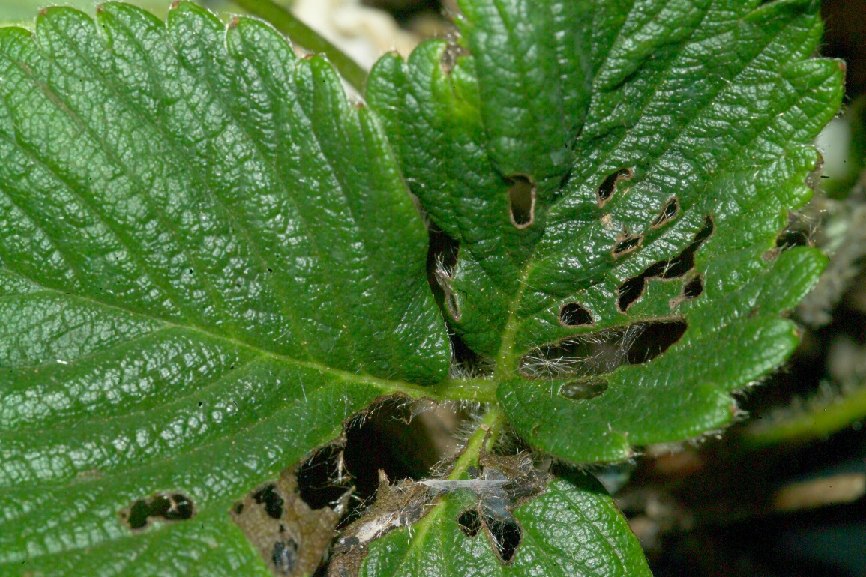
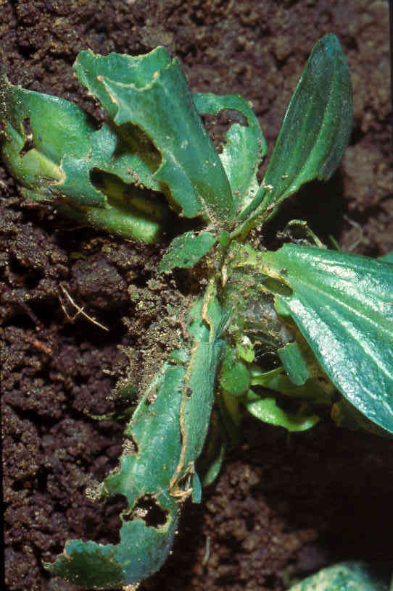
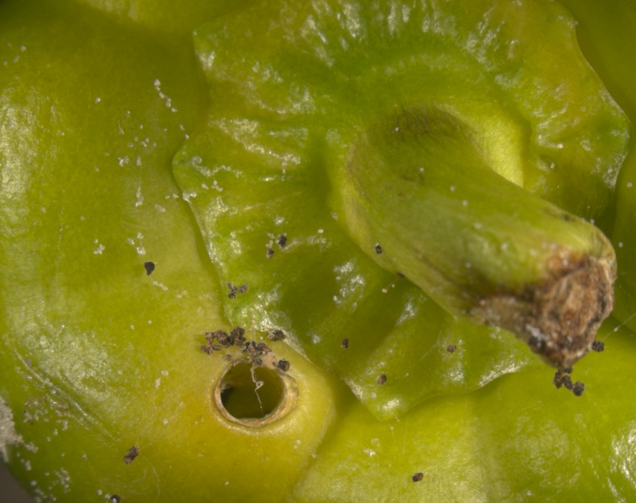
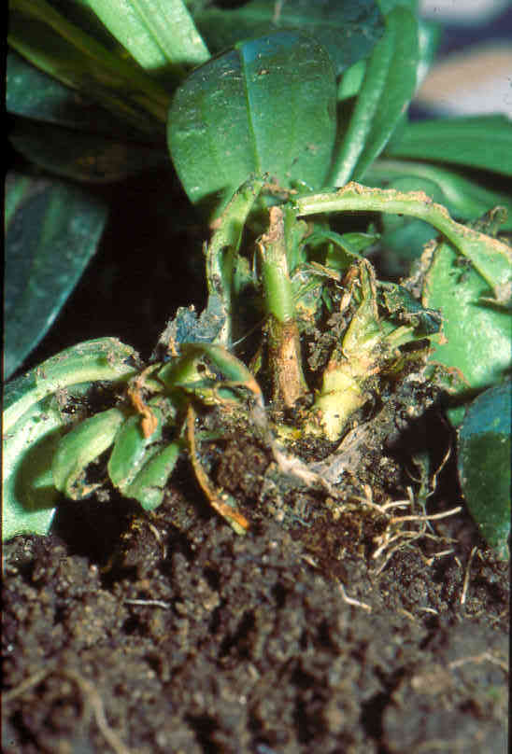
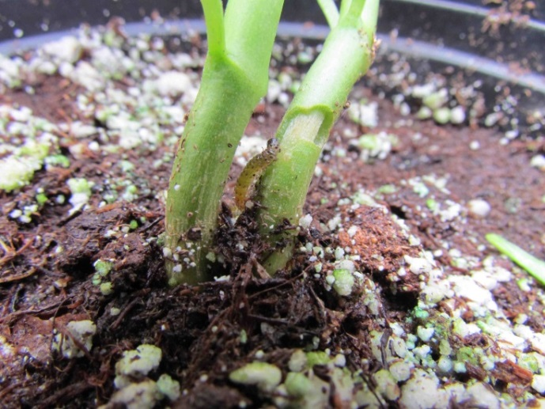
Damage to leaves
Damage to fruit
Strawberry
Eustoma
Pepper
 Damage to stems
Image credits:
Strawberry - Carmelo Peter Bonsignore, Università degli Studi Mediterranei di Reggio Calabria;
Pepper fruit - Marja van der Straten, Plant Protection Service, Wageningen, The Netherlands;
Stem damage - Bryan Vander Mey, Department of Entomology, University of California, Riverside;
Both Eustoma images - Henk Stigter, Plant Protection Service, National Reference Centre, The Netherlands
Stem collapse in Eustoma
Note the larva girdling the stem
Notes:
Feeding larvae of this moth inflicts damage to roots, leaves, flowers, buds, and fruit.
On leaves, this damage appears first as rounded or crescent-shaped bites on the outside of the leaves, but eventually the whole leaf is eaten. Leaves at the base of the plant are usually attacked, but leaves higher in the canopy can also be impacted if the plants are placed very close together.
Late instar larvae even burrow into soft woody or herbaceous plant stems causing additional damage such as withered or dried crowns and stem collapse.
In potted plants where the soil is not packed hard around the roots, larvae can be found below the soil line sometimes feeding on roots. They also feed on decaying plant debris and rich potting medium.
Sometimes this moth eats so aggressively that only the naked caules (stem or stalk of the plant) are left. Other times, external damage can only be detected when there are heavy infestations due to larvae boring into the stems. The leaves can appear to develop normally, thus leaving growers unaware of the pest presence until the damage is already done. The stems will collapse suddenly without the darkening of the stem associated with fungal diseases.
Information sources:
Ahern, Robert. 2010. Amended NPAG Report. Duponchelia fovealis Zeller: Lepidoptera/Pyralidae.
Accessed 4/29/2011 -
http://entnemdept.ufl.edu/pestalert/Duponchelia_fovealis_NPAG_ET_Report_20100917.pdf
Anonymous. 2005a. Risk management Decision Document for Duponchelia fovealis in Canada. Canadian Food Inspection Agency.
Accessed 4/29/2011 -
http://entnemdept.ufl.edu/pestalert/duponchelia_fovealis_risk_management.pdf
Anonymous. 2005b. Plant Pest Information: Duponchelia fovealis Zeller. Canadian Food Inspection Agency.
Accessed 4/29/2011 –
http://entnemdept.ufl.edu/pestalert/Duponchelia_fovealis_Canada.pdf
Bethke, James and Brian Vander Mey. 2010. Pest Alert: Duponchelia fovealis. University of California Cooperative Extension, San Diego.
Accessed 4/29/2011 –
http://ucanr.org/sites/cetest/files/55177.pdf
Billen W, 1994. On the harmfulness of Duponchelia fovealis (Zeller, 1847) in Germany (Lepidoptera, Pyralidae). Nota Lepidopterol, 16: 3-4, p. 212.
Bonsignore, Carmelo Peter and Vincenzo Vacante. 2010. “Duponchelia fovealis (Zeller). A New Emergency for Strawberries?”. Protezione delle colture, pp. 40-43.
Brambila, Julieta and Ian Stocks. 2010. The European Pepper Moth, Duponchelia fovealis Zeller (Lepidoptera: Crambidae), a Mediterranean Pest Moth Discovered in Central Florida.
Accessed 4/29/2011 -
http://www.freshfromflorida.com/pi/pest_alerts/pdf/duponchelia_fovealis.pdf
CABI International. 2010. “Selected Sections for: Duponchelia fovealis (Southern European Marshland Pyralid)”. Crop Protection Compendium.
Guda, C. D. , A. Capizzi, and P. Trematerra. 1988. “Damages on Eustoma grandiflorum (Raf.) Shinn. Caused by Duponchelia fovealis (Zeller)”. Annali dell’Istituto Sperimentale per la Floricultura. Vol. 19, pp. 3-11.
Hoffman, Kevin. 2010. CDFA Detection Advisory for a Cramid moth: Duponchelia fovealis (Zeller) (Pyraloidea: Crambidae). Reference PDR: 1511851.
Accessed 4/29/2011 –
http://www.kernag.com/dept/news/2010/2010-san-diego-duponchelia-fovealis-07-16-2010.pdf.
Marek J. and E. Bártová. 1998. Duponchelia fovealis Zeller, 1847, a new pest of glasshouse plants in the Czech Republic. Plant Protection Science, 34(4):151-152.
MacLeod, A. 1996. Summary Pest Risk Assessment: Duponchelia fovealis. DEFRA (Department for Environment, Food, and Rural Affairs), Central Science Laboratory, Sand Hutton, York, United Kingdom.
Messelink, G. and W. Van Wensveen. 2003. “Biocontrol of Duponchelia fovealis (Lepidoptera: Pyralidae) with Soil-Dwelling Predators in Potted Plants”. Communications in Agriculture and Applied Biological Sciences, Ghent University, 68(4a), pp. 159-165.
Murphy, Graeme. 2005. Duponchelia fovealis - pronouncing it is just the start of the battle
Pijnakker, Juliette. 2001. “Duponchelia fovealis, le lépidoptère redouté des plantes en pot aux Pays-Bas”, Revue Horticole, volume 429, pp. 51-53.
Romeijn, G. 1996. “Een nieuwe plaag in de kas”, Vakblad voor de Bloemisterij, volume 47, pp. 46-47.
Unknown. 2006a. “Duponchelia alla ribalta”, Colture Protette, No. 3, page 14.

Slide 10
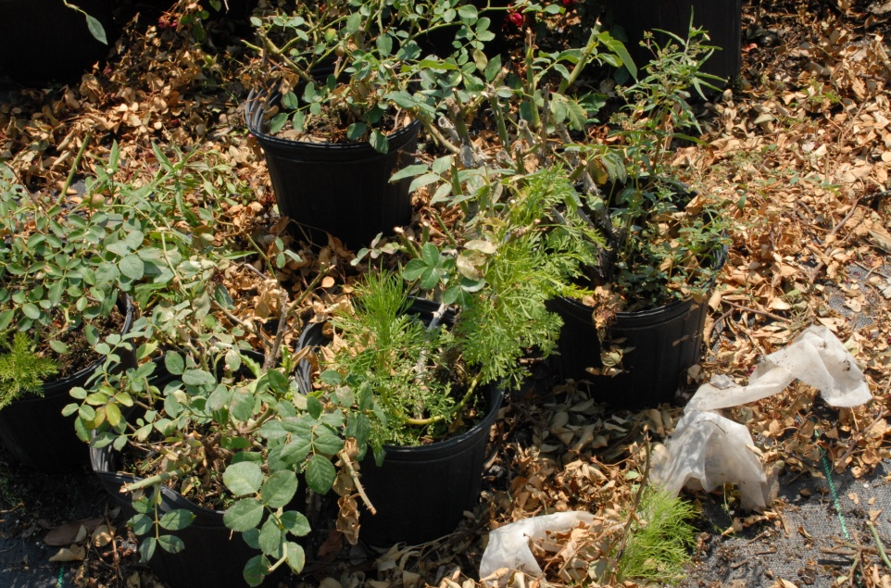
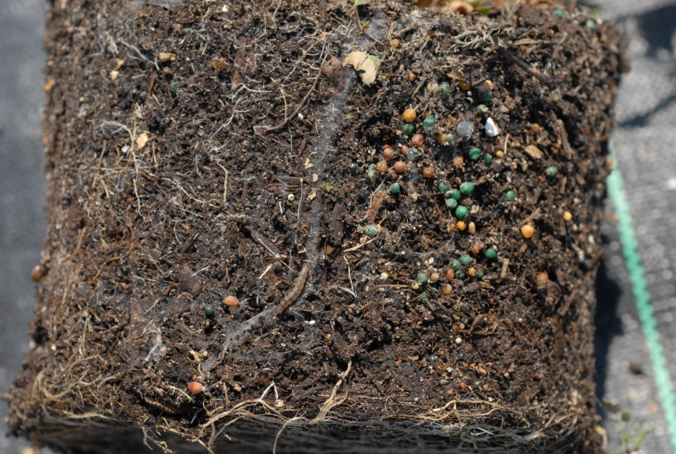
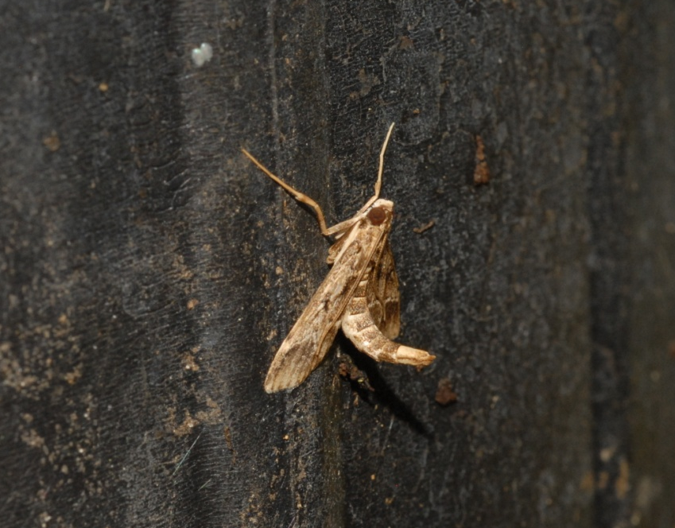
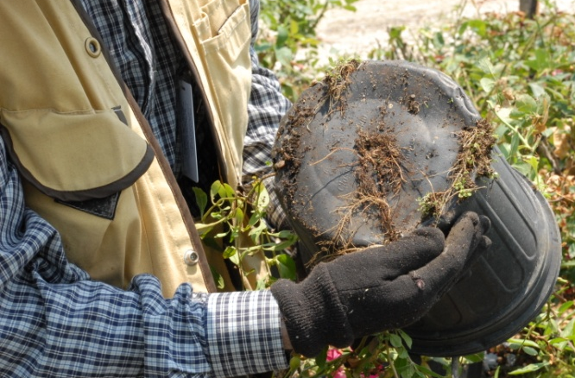
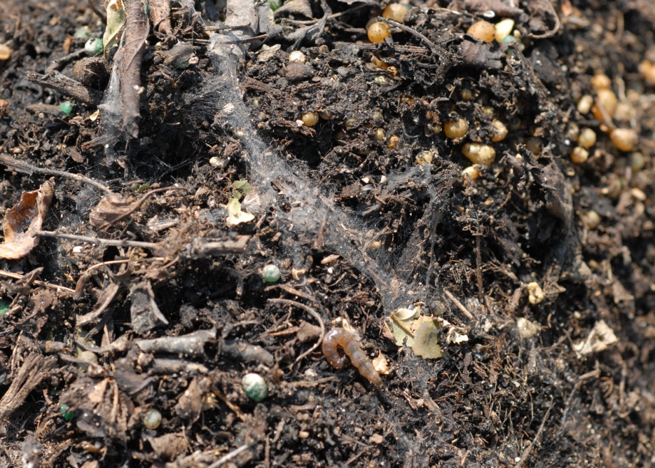
Monitoring and Inspection
Check pots next to detritus
Plant pulled out of the container
Check the bottom edge of the container.
Look for webbing on the soil surface
adult
Photos: Lyle Buss, Department of Entomology and Nematology, University of Florida
Notes:
Monitoring for European pepper moths is necessary for controlling populations of this pest. Inspection for this pest is often driven by the presence of damage observed on plants and by observing adult moths in a crop via pheromone traps or through direct observation. A pheromone that is quite specific for this moth is available commercially. The moths like to have a large, flat landing surface so pheromone baited delta traps and water traps are recommended (though water traps are better used in a greenhouse setting).
The eggs of this pest are quite small and hard to scout. Detection of eggs is difficult and requires a certain level of expertise and cost that is not always possible.
Caterpillars are easier to find on the plant. Look for signs of this caterpillars such as webbing and leaves spun together to form tunnels (particularly at interface of leaves and soil), frass along with feeding damage, leaf wilting, and stem collapse (from larval tunneling).
In containerized plants, be sure to look around the base of pots and in detritus next to the pots for larvae. In addition, be sure to pull the plant out of the container. The authors and colleagues have found that even without evidence of webbing above the soil surface, silk tunnels and caterpillars can be found at the interface between the soil and the sides of the container. Cocoons have been found along the bottom edges of the container next to detritus, but can also be found on low-lying leaves.
In addition, be sure to look at wet areas of nurseries where the irrigation is running too much and the interface between the soil and the leaves and in detritus found around the crop.
Also look for the presence of the adults. Adults are nocturnal and like sheltered areas (such as under vegetation) or on the outside of the containers (especially when these containers are grouped together forming a larger sheltered area). When the adults are disturbed, their flight is short and irregular or they can drop to the ground below.
Management suggestions are from greenhouses in Northern Europe and may no be applicable to a field setting. Removal of detritus may aid in cultural control. For more information, please refer to the Protect U.S> presentation (www.protectingusnow.org).
Information sources:
Ahern, Robert. 2010. Amended NPAG Report. Duponchelia fovealis Zeller: Lepidoptera/Pyralidae.
Accessed 4/29/2011 -
http://entnemdept.ufl.edu/pestalert/Duponchelia_fovealis_NPAG_ET_Report_20100917.pdf
Anonymous. 2005b. Plant Pest Information: Duponchelia fovealis Zeller. Canadian Food Inspection Agency.
Accessed 4/29/2011 –
http://entnemdept.ufl.edu/pestalert/Duponchelia_fovealis_Canada.pdf
Bonsignore, Carmelo Peter and Vincenzo Vacante. 2010. “Duponchelia fovealis (Zeller). A New Emergency for Strawberries?”. Protezione delle colture, pp. 40-43.
Brambila, Julieta and Ian Stocks. 2010. The European Pepper Moth, Duponchelia fovealis Zeller (Lepidoptera: Crambidae), a Mediterranean Pest Moth Discovered in Central Florida.
Accessed 4/29/2011 –
http://www.freshfromflorida.com/pi/pest_alerts/pdf/duponchelia_fovealis.pdf
DeVenter, Peter van. 2009. “Water trap best for catching Duponchelia”. Fruit & Veg Tech 9.1.
Accessed 4/29/2011 -
http://documents.plant.wur.nl/wurglas/C_bestwatertrap.pdf.
Guda, C. D. , A. Capizzi, and P. Trematerra. 1988. “Damages on Eustoma grandiflorum (Raf.) Shinn. Caused by Duponchelia fovealis (Zeller)”. Annali dell’Istituto Sperimentale per la Floricultura. Vol. 19, pp. 3-11.
Romeijn, G. 1996. “Een nieuwe plaag in de kas”, Vakblad voor de Bloemisterij, volume 47, pp. 46-47.

Slide 11
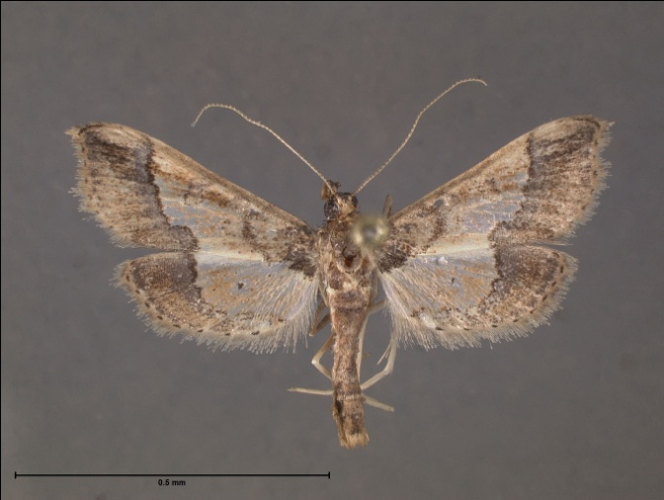
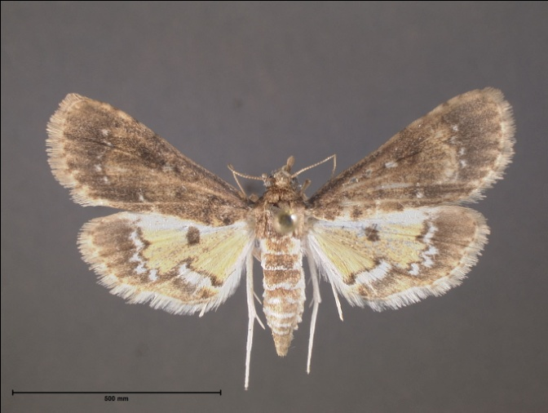
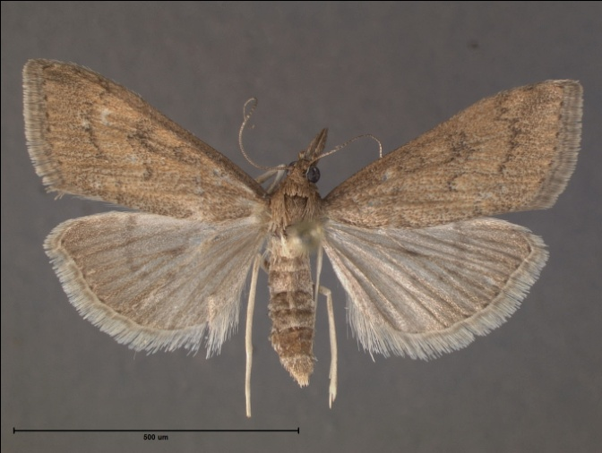
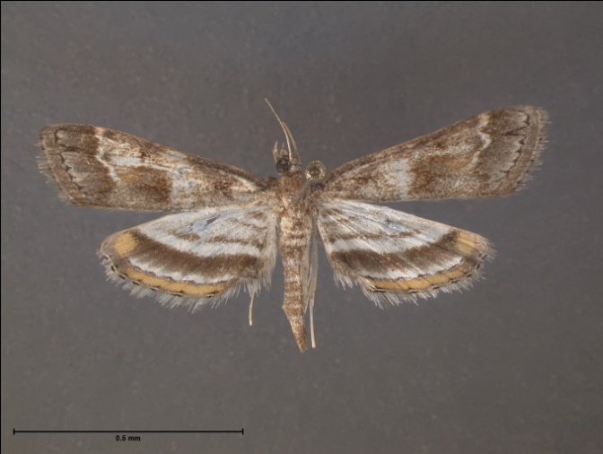
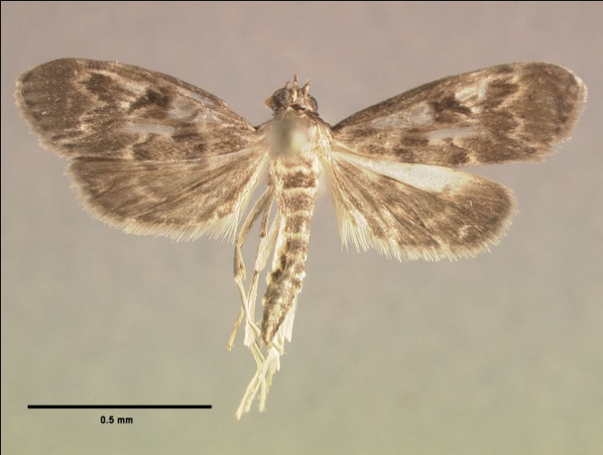
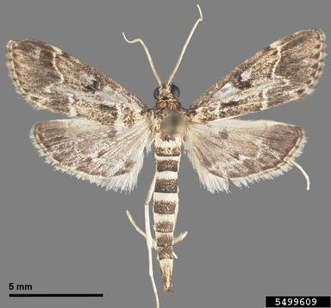
Florida Look Alikes - Adults
Hydriris ornatalis
Niphograpta albiguttalis
Udea rubigalis
Parapoynx obscuralis
Penestola bufalis
Duponchelia fovealis
Image credit:
James Hayden, Florida Department of Agriculture and Consumer Services, Division of Plant Industry and Thomson Paris, graduate student, Department of Entomology and Nematology, University of Florida; EPM - Kurt Ahlmark, FDACS Division of Plant Industry, Bugwood.org - #5499609
Notes:
These moths are similar in appearance to adult Duponchelia fovealis and are fairly common (though if you use a pheromone lure to capture the adults, you should pretty much get only D.fovealis).
They include:
Hydriris ornatalis – the ornate hydriris moth is the same size as the European pepper moth, but it does not have a striped abdomen, light colored lines on a dark forewing, or the “finger”.
Niphograpta albiguttalis – the water hyacinth moth is also the same size as the European pepper moth and it does have a striped abdomen and a single light colored line on the forewings, but it does not have the “finger”.
Udea rubigalis - the celery leaftier moth is the same size as the European pepper moth and it has a striped abdomen, but it has dark lines on the forewing, not light ones and no finger.
Parapoynx obscuralis – the obscure pondweed moth is the same size as the European pepper moth, has a light colored line on the forewing, a slightly striped abdomen, but no “finger”.
Penestola bufalis – the black penestola moth is the same size as the European pepper moth, has a striped abdomen, but has two “fingers” that are not as pronounced.

Slide 12
Authors
Stephanie Stocks, M.S.
Assistant-In, Extension Scientist, Department of Entomology and Nematology, University of Florida
Amanda Hodges, Ph.D.
Associate Extension Scientist, Department of Entomology and Nematology, University of Florida

Slide 13
Editors
Matthew D. Smith, Ph.D.
Postdoctoral Associate, Department of Entomology and Nematology, University of Florida
Keumchul Shin, M.S.
Graduate student, Doctor of Plant medicine program, University of Florida

Slide 14
Reviewers
Douglas A. Restom Gaskill, M.S.
United States Department of Agriculture, Animal and Plant Health Inspection Service, Plant Health, Plant Protection and Quarantine, Cooperative Agricultural Pest Survey
Jim Hayden, Ph.D.
Florida Department of Agriculture and Consumer Services, Division of Plant Industry
Jason Dombroskie, Ph.D.
Senior Extension Associate, Department of Entomology, Cornell University
Notes:
Jim Hayden and colleagues have written a nice Lucid key for microlepidoptera that includes information on European Pepper Moth.
Hayden, J. E., S. Lee, S. C. Passoa, J. Young, J.-F. Landry, V. Nazari, R. Mally, L. A. Somma, and K. M. Ahlmark. 2013. Digital Identification of Microlepidoptera on Solanaceae. USDA-APHIS-PPQ Identification Technology Program (ITP). Fort Collins, CO. http://idtools.org/id/leps/micro/
Fact sheet: http://idtools.org/id/leps/micro/factsheet.php?name=%3Cem%3EDuponchelia+fovealis%3C%2Fem%3E

Slide 15
Collaborating Agencies
U.S. Department of Agriculture Animal and Plant Health Inspection Service (USDA-APHIS)
Cooperative Agricultural Pest Survey Program (CAPS)
Florida Department of Agriculture and Consumer Services (FDACS)
National Plant Diagnostic Network (NPDN)
Sentinel Plant Network (SPN)
Protect U.S.
University of Florida Institute of Food and Agricultural Sciences (UF-IFAS)

Slide 16
Educational Disclaimer and Citation
This presentation can be used for educational purposes for NON-PROFIT workshops, trainings, etc.
Citation:
  Stocks, S., M.S., Hodges, A., Ph.D., 2014. A New Emerging Pest in Florida: European Pepper Moth (Duponchelia fovealis) March 2014.

Slide 17
References
Ahern, R. 2010. Amended NPAG Report. Duponchelia fovealis Zeller: Lepidoptera/Pyralidae. Accessed 4/29/2011 -
  http://entnemdept.ufl.edu/pestalert/Duponchelia_fovealis_NPAG_ET_Report_20100917.pdf
Anonymous. 2005a. Risk management Decision Document for Duponchelia fovealis in Canada. Canadian Food Inspection Agency. Accessed 4/29/2011
  http://entnemdept.ufl.edu/pestalert/duponchelia_fovealis_risk_management.pdf
Anonymous. 2005b. Plant Pest Information: Duponchelia fovealis Zeller. Canadian Food Inspection Agency. Accessed 4/29/2011 -
  http://entnemdept.ufl.edu/pestalert/Duponchelia_fovealis_Canada.pdf
Bethke, J. and B. Vander Mey. Pest Alert: Duponchelia fovealis. University of California Cooperative Extension, San Diego. Accessed 4/29/2011
  http://ucanr.org/sites/cetest/files/55177.pdf
Billen W. 1994. On the harmfulness of Duponchelia fovealis (Zeller, 1847) in Germany (Lepidoptera, Pyralidae). Nota Lepidopterol, 16: 3-4, p. 212.
Bonsignore, C. P. and V. Vacante. 2010. “Duponchelia fovealis (Zeller). A New Emergency for Strawberries?”. Protezione delle colture, pp. 40-43.

Slide 18
References
Brambila, J. and I. Stocks. 2010. The European Pepper Moth, Duponchelia fovealis Zeller (Lepidoptera: Crambidae), a Mediterranean Pest Moth Discovered in Central Florida. Accessed 4/29/2011 –
  http://www.freshfromflorida.com/pi/pest_alerts/pdf/duponchelia_fovealis.pdf
CABI International. 2010. “Selected Sections for: Duponchelia fovealis (Southern European Marshland Pyralid)”. Crop Protection Compendium.
Clark, J. S. 2000. Duponchelia fovealis (Zell.) arriving on imported plant material. Atropos 10:20–21.
Derksen, A., and L. Whilby. 2011. “Update on Florida CAPS trapping activities for Duponchelia fovealis Zeller, September 2010 to May 2011”, CAPS Report.
  http://entomology.ifas.ufl.edu/stocks/DFOV_update%201_v5%2008-19-11.pdf
DeVenter, P. van. 2009. “Water trap best for catching Duponchelia”. Fruit & Veg Tech 9.1. Accessed 4/29/2011 -
  http://documents.plant.wur.nl/wurglas/C_bestwatertrap.pdf

Slide 19
References
Faquaet, M. 2000. “Duponchelia fovealis, een nieuwe soort voor de Belgische fauna (Lepidoptera: Pyralidae)”. Phegea 28:1.
Guda, C. D. , A. Capizzi, and P. Trematerra. 1988. “Damages on Eustoma grandiflorum (Raf.) Shinn. caused by Duponchelia fovealis (Zeller)”. Annali dell’Istituto Sperimentale per la Floricultura. Vol. 19, pp. 3-11.
Hale, W.G. and J.P. Margham. 1991. The Harper Collins Dictionary of Biology. Harper Perennial, New York.
Hoffman, Kevin. 2010. CDFA Detection Advisory for a Cramid moth: Duponchelia fovealis (Zeller) (Pyraloidea: Crambidae). Reference PDR: 1511851. Accessed 4/29/2011
  http://www.kernag.com/dept/news/2010/2010-san-diego-duponchelia-fovealis-07-16-2010.pdf
Jackel, B., B. Kummer, and M. Kurhais. 1996. “Biological Control of Duponchelia fovealis Zeller (Lepidoptera, Pyralidae)”. Mitteilungen aus der Biologishen fur Land und Forstwirtschaft. Vol. 321. p. 483.

Slide 20
References
MacLeod, A. 1996. Summary Pest Risk Assessment: Duponchelia fovealis. DEFRA (Department for Environment, Food, and Rural Affairs), Central Science Laboratory, Sand Hutton, York, United Kingdom.
Marek J. and E. Bártová. 1998. Duponchelia fovealis Zeller, 1847, a new pest of glasshouse plants in the Czech Republic. Plant Protection Science, 34(4):151-152.
Messelink, G. and W. Van Wensveen. 2003. “Biocontrol of Duponchelia fovealis (Lepidoptera: Pyralidae) with Soil-Dwelling Predators in Potted Plants”. Communications in Agriculture and Applied Biological Sciences, Ghent University, 68(4a), pp. 159-165., pp. 159-165.
Murphy, G. 2005. Duponchelia fovealis - pronouncing it is just the start of the battle.
NAPPO – Phytosanitary alert system. 2010.
  http://www.pestalert.org/oprDetail.cfm?oprID=466&keyword=Duponchelia%20fovealis

Slide 21
References
Pijnakker, J. 2001. “Duponchelia fovealis, le lépidoptère redouté des plantes en pot aux Pays-Bas”, Revue Horticole, volume 429, pp. 51-53.
Romeijn, G. 1996. “Een nieuwe plaag in de kas”, Vakblad voor de Bloemisterij, volume 47, pp. 46-47.
Trematerra, P. 1990. “Morphological aspects of Duponchelia fovealis Zeller (Lepidoptera: Pyralidae)”. Redia, vol. 73, issue 1, pp. 41-52.
Unknown. 2006a. “Duponchelia alla ribalta”, Colture Protette, No. 3, page 14.
Unknown. 2006b. “Duponchelia: capitolo secondo”, Colture Protette, No. 4, page 24.

