Slide 1
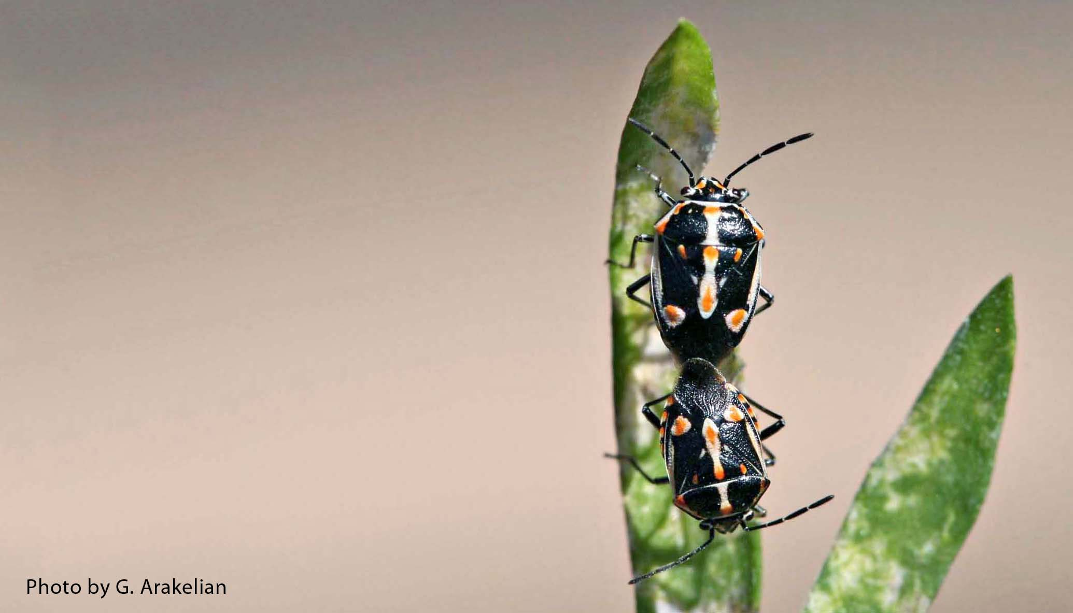
Bagrada Bug
(Bagrada hilaris)
Photo: Gevork Arakelian, LA County entomologist, bugwood.org #5493926
Notes:
The Bagrada bug is native to Africa and has caused damage to crops since it was first detected in California in 2008.

Slide 2
Bagrada Bug
Female and male Bagrada bugs
Stink bug
Native to Africa
First detected in the US
Los Angeles County, CA 2008
Also called painted bug, painted stink bug, African stink bug
Photo: Gevork Arakelian, LA County entomologist, bugwood.org #5493926
Notes:
The Bagrada bug, Bagrada hilaris, is also called the painted bug, painted stink bug, or African stink bug. It is a type of hemipteran or “True Bug”. It has a distinctive shield-shaped body. Bagrada bugs are called “stink bugs” because of an unpleasant odor they give off when disturbed.
The Bagrada bug is native to Africa, but has been found in southern Asia and southern Europe also. In the U.S., Bagrada bugs were first detected in California in 2008.
Information sources:
Arakelian, Gevork. 2008. Bagrada Bug (Bagrada hilaris). Los Angeles County Agricultural Commissioner/Weights and Measures Department, CA. Accessed April 2013
http://www.cdfa.ca.gov/plant/PPD/PDF/Bagrada_hilaris.pdf
Arakelian, Gevork. “Bagrada bug, Bagrada hilaris”. Center for Invasive Species Research – University of California, Riverside. Accessed April 2013
http://cisr.ucr.edu/bagrada_bug.html
Halbert, Susan E. and Joseph E. Eger. 2010. Bagrada bug (Bagrada hilaris) (Hemiptera: Pentatomidae): an exotic pest of Cruciferae established in the western USA. Accessed April 2013
http://edocs.dlis.state.fl.us.lp.hscl.ufl.edu/fldocs/doacs/dpi/pestalert/01750.pdf
Palumbo, John C. 2010. The Bagrada bug, a New Invasive pest of cole crops in Arizona. University of Arizona, Yuma, AZ. Accessed April 2013
http://ag.arizona.edu/crops/vegetables/advisories/docs/Bagrad_bug_2010_Palumbo.pdf
Palumbo, John C. and Eric T. Natwick. 2010. The Bagrada bug (Hemiptera: Pentatomidae): A new invasive pest of cole crops in Arizona and California. Plant Health Progress. Accessed April 2013
http://www.plantmanagementnetwork.org/sub/php/brief/2010/bagrada/
Reed, Darcy. 2012. Bagrada bug: biology, host range and effects on cole crops. Center for Invasive Species Research – University of California, Riverside. Accessed April 2013
http://cisr.ucr.edu/pdf/capca-bagrada-darcy-reed-sept-19-2012.pdf

Slide 3
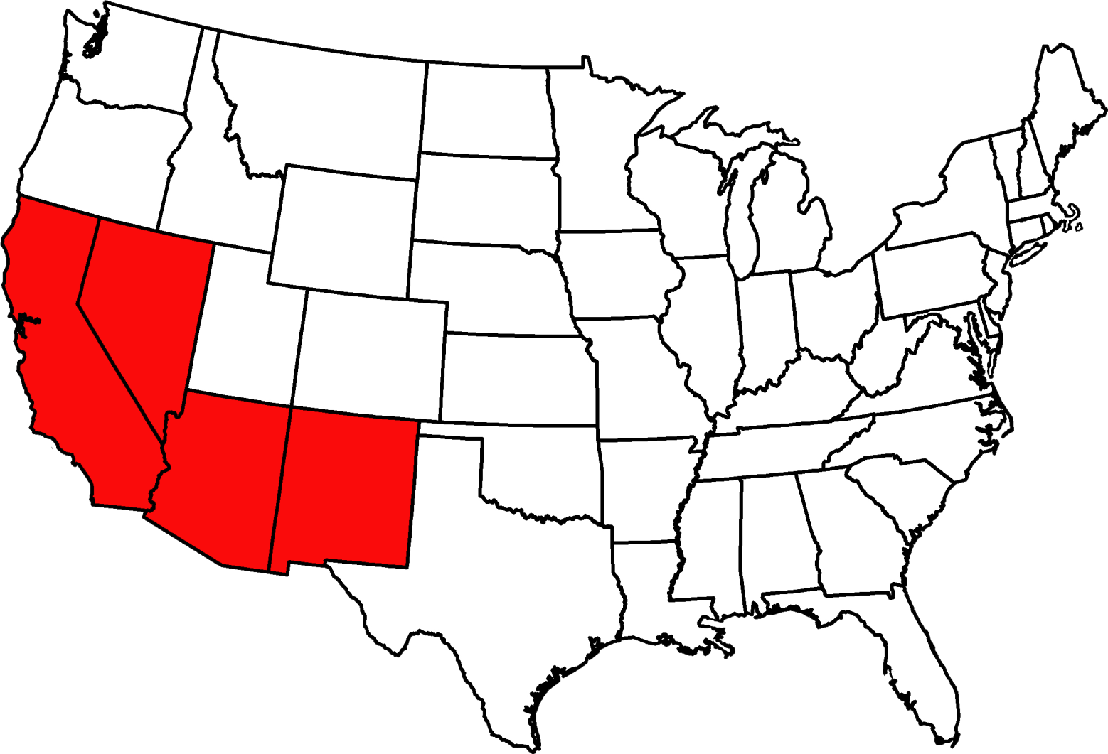
Distribution
No sampling
Es
t
a
blished by sur
v
e
y
or c
o
nsensus
Map based on: http://www.ncipmc.org/alerts/bagradabug.pdf.
Notes:
Bagrada bugs were first detected in the U.S. in Los Angeles County in June 2008. They are now found throughout southern California and southern Arizona as well as parts of Nevada and New Mexico. They are expected to permanently establish in California and Arizona due to favorable weather conditions and abundant food sources throughout the year. In Florida, Bagrada bugs have been intercepted at FDACS interdiction stations, but none have been found established in the state.
Information sources:
Arakelian, Gevork. 2008. Bagrada Bug (Bagrada hilaris). Los Angeles County Agricultural Commissioner/Weights and Measures Department, CA. Accessed April 2013
http://www.cdfa.ca.gov/plant/PPD/PDF/Bagrada_hilaris.pdf
Arakelian, Gevork. “Bagrada bug, Bagrada hilaris”. Center for Invasive Species Research – University of California, Riverside. Accessed April 2013
http://cisr.ucr.edu/bagrada_bug.html
Halbert, Susan E. and Joseph E. Eger. 2010. Bagrada bug (Bagrada hilaris) (Hemiptera: Pentatomidae): an exotic pest of Cruciferae established in the western USA. Accessed April 2013
http://edocs.dlis.state.fl.us.lp.hscl.ufl.edu/fldocs/doacs/dpi/pestalert/01750.pdf
Palumbo, John C. 2010. The Bagrada bug, a New Invasive pest of cole crops in Arizona. University of Arizona, Yuma, AZ. Accessed April 2013
http://ag.arizona.edu/crops/vegetables/advisories/docs/Bagrad_bug_2010_Palumbo.pdf
Palumbo, John C. and Eric T. Natwick. 2010. The Bagrada bug (Hemiptera: Pentatomidae): A new invasive pest of cole crops in Arizona and California. Plant Health Progress. Accessed April 2013
http://www.plantmanagementnetwork.org/sub/php/brief/2010/bagrada/
Reed, Darcy. 2012. Bagrada bug: biology, host range and effects on cole crops. Center for Invasive Species Research – University of California, Riverside. Accessed April 2013
http://cisr.ucr.edu/pdf/capca-bagrada-darcy-reed-sept-19-2012.pdf

Slide 4
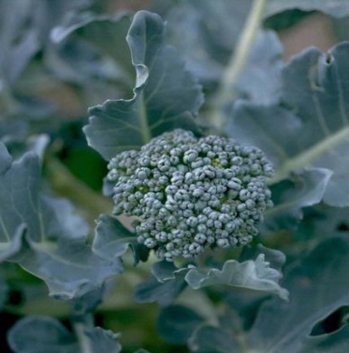
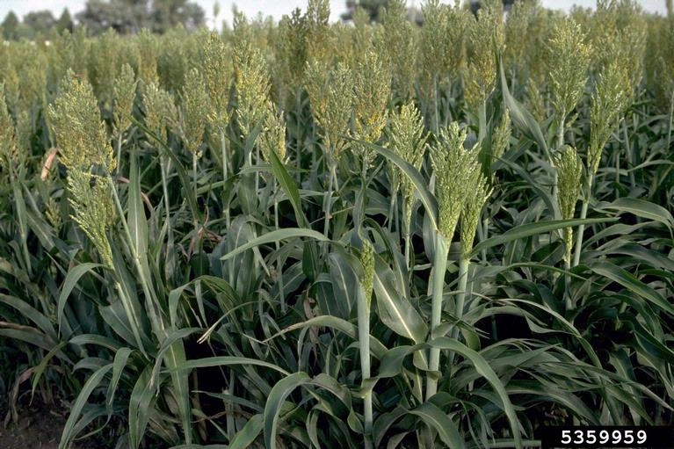
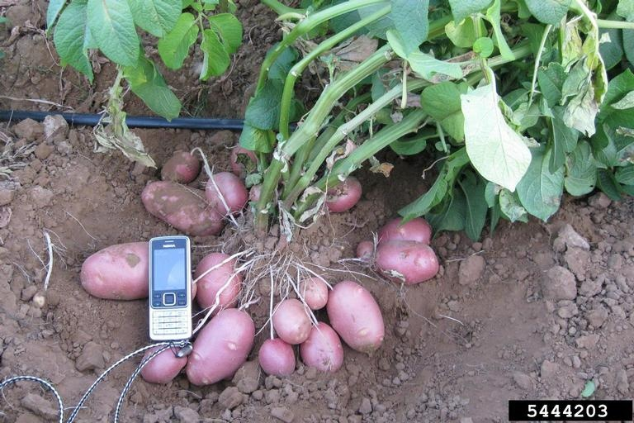
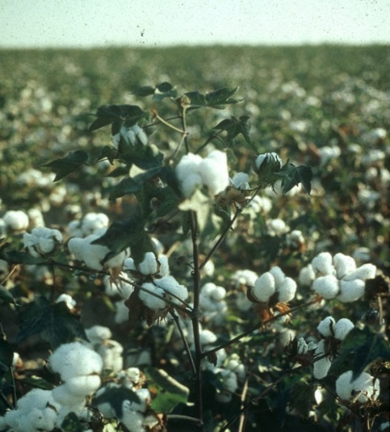
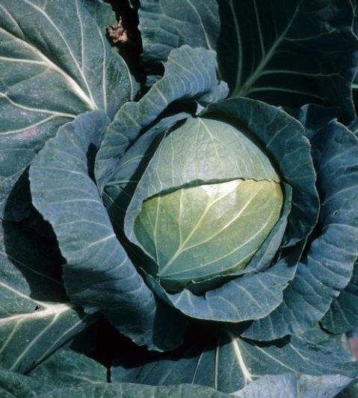
Susceptible Plants
Broccoli
Sorghum
Potato
Cotton
Cabbage
Photo: (Top row) - Howard F. Schwartz, Colorado State University, www.Bugwood.org # 5363676; # 5359959. (Bottom Row) - USDA APHIS PPQ Archive, USDA APHIS PPQ, www.Bugwood.org #UGA1148076; Gerald Holmes, Valent USA Corporation, www.Bugwood.org # 1573271. (Far Right) - Nikolai Sokolov, www.Bugwood.org # 5444203
Notes:
While not all stink bugs are bad, many are plant pests. They have long straw-like mouthparts that they use to pierce plant leaves and stems and suck out the plant’s juice. Their feeding behavior can cause the plant to wilt and have shriveled, damaged leaves. Bagrada bugs especially prefer the seedlings of crucifers such as cabbage, broccoli, and kale.
They will eat many non-cruciferous plants too such as, potatoes, corn, papaya, sorghum, cotton, and some legumes. Bagrada bugs will also eat weeds such as wild mustard, allowing them to reproduce when commercial crops are not being grown.
Information sources:
Arakelian, Gevork. 2008. Bagrada Bug (Bagrada hilaris). Los Angeles County Agricultural Commissioner/Weights and Measures Department, CA. Accessed April 2013
http://www.cdfa.ca.gov/plant/PPD/PDF/Bagrada_hilaris.pdf
Arakelian, Gevork. “Bagrada bug, Bagrada hilaris”. Center for Invasive Species Research – University of California, Riverside. Accessed April 2013
http://cisr.ucr.edu/bagrada_bug.html
Halbert, Susan E. and Joseph E. Eger. 2010. Bagrada bug (Bagrada hilaris) (Hemiptera: Pentatomidae): an exotic pest of Cruciferae established in the western USA. Accessed April 2013
http://edocs.dlis.state.fl.us.lp.hscl.ufl.edu/fldocs/doacs/dpi/pestalert/01750.pdf
Palumbo, John C. 2010. The Bagrada bug, a New Invasive pest of cole crops in Arizona. University of Arizona, Yuma, AZ. Accessed April 2013
http://ag.arizona.edu/crops/vegetables/advisories/docs/Bagrad_bug_2010_Palumbo.pdf
Palumbo, John C. and Eric T. Natwick. 2010. The Bagrada bug (Hemiptera: Pentatomidae): A new invasive pest of cole crops in Arizona and California. Plant Health Progress. Accessed April 2013
http://www.plantmanagementnetwork.org/sub/php/brief/2010/bagrada/
Reed, Darcy. 2012. Bagrada bug: biology, host range and effects on cole crops. Center for Invasive Species Research – University of California, Riverside. Accessed April 2013
http://cisr.ucr.edu/pdf/capca-bagrada-darcy-reed-sept-19-2012.pdf

Slide 5
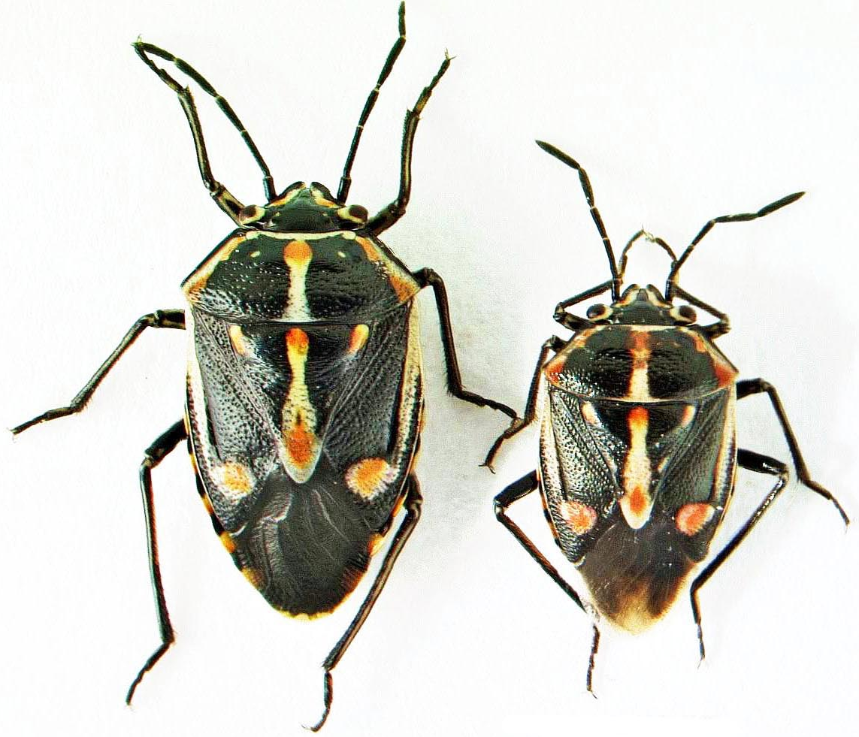
Identification: Adult
Female
Male
Photo: Gevork Arakelian, LA County entomologist, bugwood.org #5493925
Notes:
Adult Bagrada bugs range in size from 5 to 7 mm (0.2 – 0.3 inches) with the typical shield-shaped body see in all stink bugs. They are mostly black with some orange and white accents. Adult females and males look alike with the exception that males are noticeably smaller than females. Male-female pairs are usually seen coupled together mating.
Information sources:
Arakelian, Gevork. 2008. Bagrada Bug (Bagrada hilaris). Los Angeles County Agricultural Commissioner/Weights and Measures Department, CA. Accessed April 2013
http://www.cdfa.ca.gov/plant/PPD/PDF/Bagrada_hilaris.pdf
Arakelian, Gevork. “Bagrada bug, Bagrada hilaris”. Center for Invasive Species Research – University of California, Riverside. Accessed April 2013
http://cisr.ucr.edu/bagrada_bug.html
Halbert, Susan E. and Joseph E. Eger. 2010. Bagrada bug (Bagrada hilaris) (Hemiptera: Pentatomidae): an exotic pest of Cruciferae established in the western USA. Accessed April 2013
http://edocs.dlis.state.fl.us.lp.hscl.ufl.edu/fldocs/doacs/dpi/pestalert/01750.pdf
Reed, Darcy. 2012. Bagrada bug: biology, host range and effects on cole crops. Center for Invasive Species Research – University of California, Riverside. Accessed April 2013
http://cisr.ucr.edu/pdf/capca-bagrada-darcy-reed-sept-19-2012.pdf

Slide 6
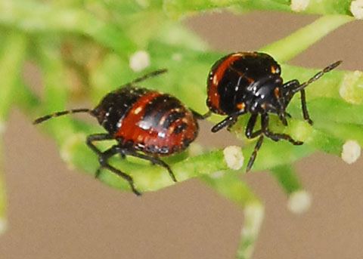
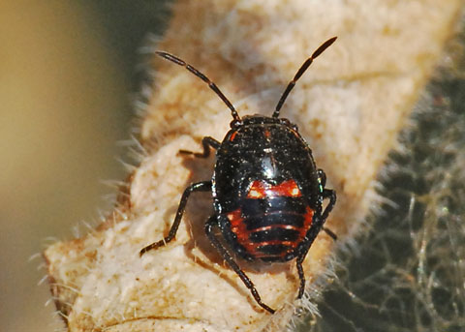
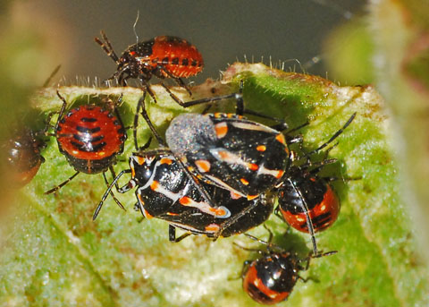
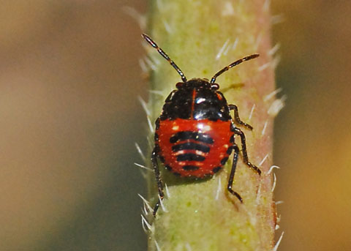
Identification: Nymphs
Nymphs
Nymph
Adults and nymphs
Nymph
Photos: Ron Hemberger, Irvine, Orange Co., Calif. All rights reserved.
Notes:
Bagrada bugs congregate in large numbers and all life stages can be found together on the same plant.
Newly hatched Bagrada bug nymphs are bright red. The nymphs will molt four times before reaching the adult stage. The redder immature Bagrada bugs are younger than the nymphs that have more black coloring. Their exoskeleton progressively becomes more black with each molt.
Information sources:
Arakelian, Gevork. 2008. Bagrada Bug (Bagrada hilaris). Los Angeles County Agricultural Commissioner/Weights and Measures Department, CA. Accessed April 2013
http://www.cdfa.ca.gov/plant/PPD/PDF/Bagrada_hilaris.pdf
Arakelian, Gevork. “Bagrada bug, Bagrada hilaris”. Center for Invasive Species Research – University of California, Riverside. Accessed April 2013
http://cisr.ucr.edu/bagrada_bug.html
Halbert, Susan E. and Joseph E. Eger. 2010. Bagrada bug (Bagrada hilaris) (Hemiptera: Pentatomidae): an exotic pest of Cruciferae established in the western USA. Accessed April 2013
http://edocs.dlis.state.fl.us.lp.hscl.ufl.edu/fldocs/doacs/dpi/pestalert/01750.pdf
Reed, Darcy. 2012. Bagrada bug: biology, host range and effects on cole crops. Center for Invasive Species Research – University of California, Riverside. Accessed April 2013
http://cisr.ucr.edu/pdf/capca-bagrada-darcy-reed-sept-19-2012.pdf

Slide 7
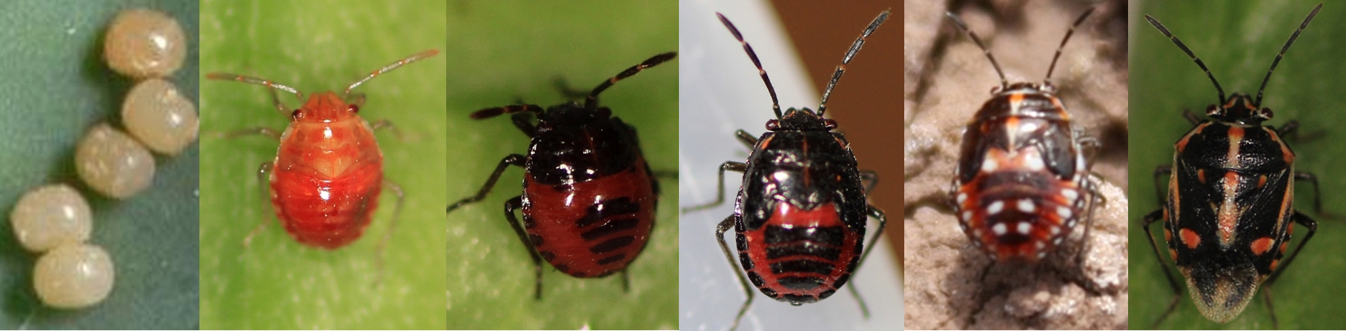
Life Cycle
Overwinter as adults
Females lay eggs in soil or on host plants
Incomplete metamorphosis
Nymphs molt 4 times
Eggs
4 nymphal stages from early to late instars
Adult
Photos: (Eggs and the last instar) - Eric Natwick, Cooperative Extension Imperial County; (others) - Surendra Dara, UC Cooperative Extension
Notes:
Bagrada bugs overwinter as adults and can produce three to four generations in a year. Females lay eggs in the soil beneath host plants (or sometimes on the host plant).
After hatching, the immature Bagrada bug will molt four times before reaching the adult stage.
Bagrada bugs congregate in large numbers and all life stages can be found together on the same plant, as opposed to some insects that use different plants as food sources for immature and adult stages.
Hemipterans are hemimetabolous insects, meaning that they do not undergo metamorphosis between a larval phase and an adult. Instead, their young are called nymphs, and resemble the adults to a large degree, the final transformation involving little more than the development of functional wings (if they are present at all) and sexual organs.
Information sources:
Arakelian, Gevork. 2008. Bagrada Bug (Bagrada hilaris). Los Angeles County Agricultural Commissioner/Weights and Measures Department, CA. Accessed April 2013
http://www.cdfa.ca.gov/plant/PPD/PDF/Bagrada_hilaris.pdf
Arakelian, Gevork. “Bagrada bug, Bagrada hilaris”. Center for Invasive Species Research – University of California, Riverside. Accessed April 2013
http://cisr.ucr.edu/bagrada_bug.html
Halbert, Susan E. and Joseph E. Eger. 2010. Bagrada bug (Bagrada hilaris) (Hemiptera: Pentatomidae): an exotic pest of Cruciferae established in the western USA. Accessed April 2013
http://edocs.dlis.state.fl.us.lp.hscl.ufl.edu/fldocs/doacs/dpi/pestalert/01750.pdf
Palumbo, John C. 2010. The Bagrada bug, a New Invasive pest of cole crops in Arizona. University of Arizona, Yuma, AZ. Accessed April 2013
http://ag.arizona.edu/crops/vegetables/advisories/docs/Bagrad_bug_2010_Palumbo.pdf
Palumbo, John C. and Eric T. Natwick. 2010. The Bagrada bug (Hemiptera: Pentatomidae): A new invasive pest of cole crops in Arizona and California. Plant Health Progress. Accessed April 2013
http://www.plantmanagementnetwork.org/sub/php/brief/2010/bagrada/
Reed, Darcy. 2012. Bagrada bug: biology, host range and effects on cole crops. Center for Invasive Species Research – University of California, Riverside. Accessed April 2013
http://cisr.ucr.edu/pdf/capca-bagrada-darcy-reed-sept-19-2012.pdf

Slide 8
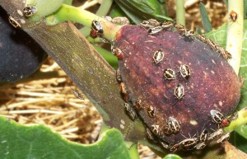
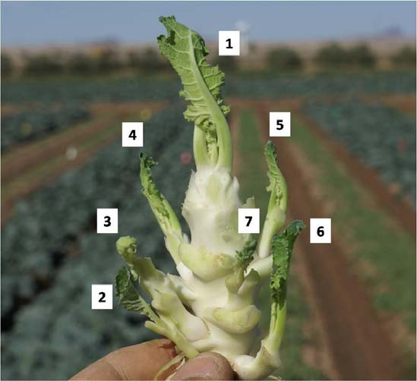
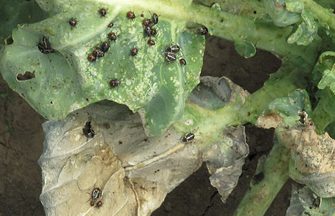
Damage
Bagrada bugs feeding on a fig
Damage to broccoli
Photos: (Left) - John Palumbo, Univ. of Arizona; (Top) - Judi V. Cugat; (Bottom) - Wikimedia Commons.
Bagrada bugs feeding on a collard greens
Notes:
Bagrada bug feeding can cause young plants to dry out and die from wilting. Plants have a growing point at the vertical tip called an apical meristem. This meristem allows the plants to grow vertically and if it is damaged or removed the plant will put out side shoots. Bagrada bug feeding can kill the plant’s apical meristem and the plant responds to this by producing numerous side shoots. In crucifers this leads to an unmarketable product since several small, underdeveloped heads are produced instead of one mature head (left image).
On the picture on the lower right you can see whitish spots on the leaf edges; these are damage caused by feeding Bagrada bug sucking out the plant’s juices, which causes this bleached out, shriveled appearance.
On the picture on the left you can see a broccoli plant whose apical meristem was destroyed by feeding. The plant has put out several smaller side shoots (numbers 1-7), none of which will properly mature into a marketable product.
Bagrada bugs can cause severe feeding damage due to their high numbers and preference for young, vulnerable plants. They can be especially problematic on organic farms since synthetic insecticides aren’t used.
Information sources:
Arakelian, Gevork. 2008. Bagrada Bug (Bagrada hilaris). Los Angeles County Agricultural Commissioner/Weights and Measures Department, CA. Accessed April 2013
http://www.cdfa.ca.gov/plant/PPD/PDF/Bagrada_hilaris.pdf
Arakelian, Gevork. “Bagrada bug, Bagrada hilaris”. Center for Invasive Species Research – University of California, Riverside. Accessed April 2013
http://cisr.ucr.edu/bagrada_bug.html
Halbert, Susan E. and Joseph E. Eger. 2010. Bagrada bug (Bagrada hilaris) (Hemiptera: Pentatomidae): an exotic pest of Cruciferae established in the western USA. Accessed April 2013
http://edocs.dlis.state.fl.us.lp.hscl.ufl.edu/fldocs/doacs/dpi/pestalert/01750.pdf
Palumbo, John C. 2010. The Bagrada bug, a New Invasive pest of cole crops in Arizona. University of Arizona, Yuma, AZ. Accessed April 2013
http://ag.arizona.edu/crops/vegetables/advisories/docs/Bagrad_bug_2010_Palumbo.pdf
Palumbo, John C. and Eric T. Natwick. 2010. The Bagrada bug (Hemiptera: Pentatomidae): A new invasive pest of cole crops in Arizona and California. Plant Health Progress. Accessed April 2013
http://www.plantmanagementnetwork.org/sub/php/brief/2010/bagrada/
Reed, Darcy. 2012. Bagrada bug: biology, host range and effects on cole crops. Center for Invasive Species Research – University of California, Riverside. Accessed April 2013
http://cisr.ucr.edu/pdf/capca-bagrada-darcy-reed-sept-19-2012.pdf

Slide 9
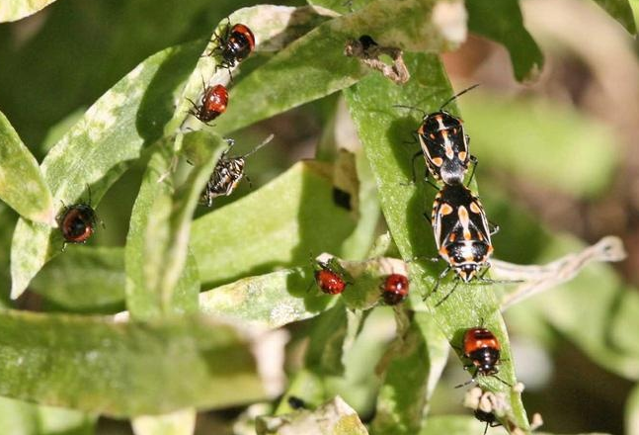
Management
Adults and nymphs on Alyssum plants
Weed management
Soil cultivation
Remove crop residues
Hand removal
Pyrethroid, neonicotinoids, organophosphate insecticides
Pyrethrins and azadirachtin for organic growers
Gevork Arakelian, LA County entomologist, bugwood.org #5493927
Notes:
Soil tillage is a possible strategy to reduce Bagrada bug numbers since their eggs are reportedly damaged when the soil they are laid in is disturbed. Eggs laid on the soil surface beneath host plants are easily damaged by cultivation so lightly turning the soil under host plants once a week is recommended.
Weeds may be an important part of the Bagrada bug problem. Many weeds serve as a food source which allows the Bagrada bug to live and reproduce even if there is no food crop, allowing them to then move into a newly planted crop and cause damage. Managing weeds, especially brassicaceous weeds such as wild mustard, can discourage Bagrada bug populations.
Bagrada bugs are reported to be a problem particularly in organic farms where their immature stages may be confused with beneficial lady bugs, and where weedy hedgerows are often allowed to grow to attract beneficial insects. Bagrada bugs may take advantage of this food source and reach high numbers.
Removing crop residues from the field deprives Bagrada bugs of a food source and helps reduce local populations.
In early infestations hand removal can reduce damage and population size, though this is only feasible for small plots.
If you want to use insecticides, be sure to check with your local county extension agent regarding any restrictions on use of these pesticides as some may require an applicator’s license! In addition, growers need to confirm registration of the use of these products for their specific crop of concern in their specific state. Remember that the use of neonicotinoids can be extremely toxic to bees and other beneficial insects and should not be used if any flowering plants (including weeds) are present.
Information sources:
Palumbo, John C. 2010. The Bagrada bug, a New Invasive pest of cole crops in Arizona. University of Arizona, Yuma, AZ. Accessed April 2013
http://ag.arizona.edu/crops/vegetables/advisories/docs/Bagrad_bug_2010_Palumbo.pdf
Palumbo, John C. and Eric T. Natwick. 2010. The Bagrada bug (Hemiptera: Pentatomidae): A new invasive pest of cole crops in Arizona and California. Plant Health Progress. Accessed April 2013
http://www.plantmanagementnetwork.org/sub/php/brief/2010/bagrada/
Reed, Darcy. 2012. Bagrada bug: biology, host range and effects on cole crops. Center for Invasive Species Research – University of California, Riverside. Accessed April 2013
http://cisr.ucr.edu/pdf/capca-bagrada-darcy-reed-sept-19-2012.pdf

Slide 10
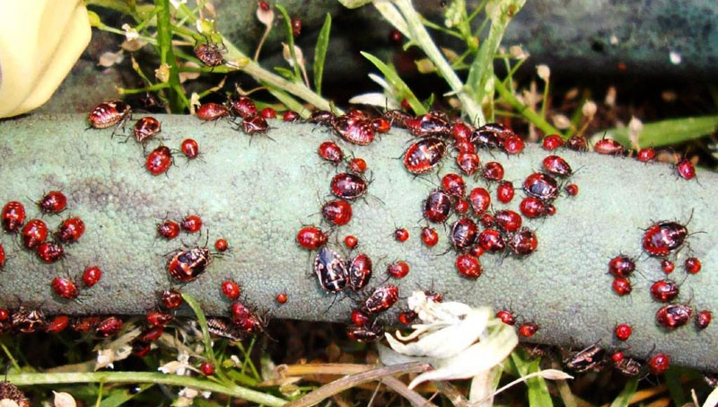
Look-alike Species
Adult and nymphal stage Bagrada bugs in San Pedro, CA
Photo: Delbert Crawford
Notes:
What do these look like to you? Bagrada bugs can be confused with lady beetles in their immature form and harlequin bugs in their adult form. Immature Bagrada bugs are bright red with some black markings, similar to lady beetles, and their markings incorporate more black coloration with each molt.
Information sources:
Arakelian, Gevork. 2008. Bagrada Bug (Bagrada hilaris). Los Angeles County Agricultural Commissioner/Weights and Measures Department, CA. Accessed April 2013
http://www.cdfa.ca.gov/plant/PPD/PDF/Bagrada_hilaris.pdf
Arakelian, Gevork. “Bagrada bug, Bagrada hilaris”. Center for Invasive Species Research – University of California, Riverside. Accessed April 2013
http://cisr.ucr.edu/bagrada_bug.html
Halbert, Susan E. and Joseph E. Eger. 2010. Bagrada bug (Bagrada hilaris) (Hemiptera: Pentatomidae): an exotic pest of Cruciferae established in the western USA. Accessed April 2013
http://edocs.dlis.state.fl.us.lp.hscl.ufl.edu/fldocs/doacs/dpi/pestalert/01750.pdf
Palumbo, John C. 2010. The Bagrada bug, a New Invasive pest of cole crops in Arizona. University of Arizona, Yuma, AZ. Accessed April 2013
http://ag.arizona.edu/crops/vegetables/advisories/docs/Bagrad_bug_2010_Palumbo.pdf
Palumbo, John C. and Eric T. Natwick. 2010. The Bagrada bug (Hemiptera: Pentatomidae): A new invasive pest of cole crops in Arizona and California. Plant Health Progress. Accessed April 2013
http://www.plantmanagementnetwork.org/sub/php/brief/2010/bagrada/
Reed, Darcy. 2012. Bagrada bug: biology, host range and effects on cole crops. Center for Invasive Species Research – University of California, Riverside. Accessed April 2013
http://cisr.ucr.edu/pdf/capca-bagrada-darcy-reed-sept-19-2012.pdf

Slide 11
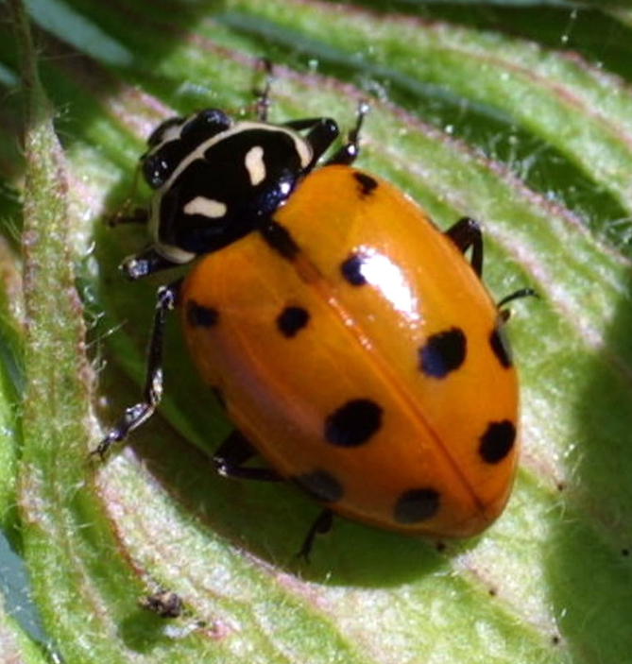
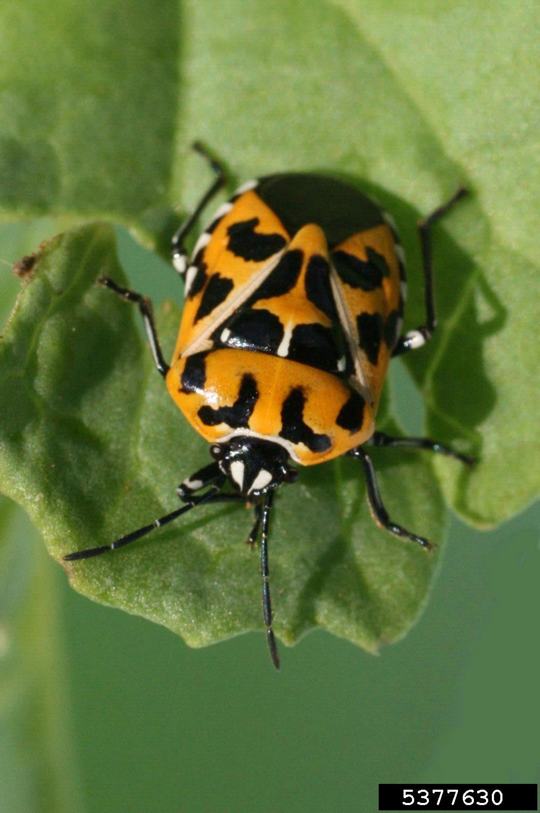
Look-alikes
Bagrada Bug
Ladybird Beetle
Harlequin Bug
Photos: (Left) - Gevork Arakelian, LA County entomologist, bugwood.org #5493926; (Middle and Right) Russ Ottens, University of Georgia, www.bugwood.org, #1242018; #5377630
Notes:
Observe the differences between an adult Bagrada bug and an adult harlequin bug. They both have black, orange and white markings and the same shield-shape.
However, the harlequin bug has more orange markings while the Bagrada bug is mostly black. Bagrada bug and harlequin bug both feed on cruciferous crops but the harlequin bug is present in Florida while the Bagrada bug is not currently. Harlequin bugs are also much larger than Bagrada bugs. An adult harlequin bug is about 6 to 8 times the size of an adult Bagrada bug.
Lady beetles have similar black, white, and orange-red markings but lack the prominent shoulders that Bagrada and harlequin bug have. Lady beetles also do not have a scutellum, which is the triangle-shaped structure between the wings that Bagrada and harlequin bug both have. Lady beetles are generally considered beneficial in agricultural settings because they feed on plant pests such as aphids.
Information sources:
Arakelian, Gevork. 2008. Bagrada Bug (Bagrada hilaris). Los Angeles County Agricultural Commissioner/Weights and Measures Department, CA. Accessed April 2013
http://www.cdfa.ca.gov/plant/PPD/PDF/Bagrada_hilaris.pdf
Arakelian, Gevork. “Bagrada bug, Bagrada hilaris”. Center for Invasive Species Research – University of California, Riverside. Accessed April 2013
http://cisr.ucr.edu/bagrada_bug.html
Halbert, Susan E. and Joseph E. Eger. 2010. Bagrada bug (Bagrada hilaris) (Hemiptera: Pentatomidae): an exotic pest of Cruciferae established in the western USA. Accessed April 2013
http://edocs.dlis.state.fl.us.lp.hscl.ufl.edu/fldocs/doacs/dpi/pestalert/01750.pdf
Palumbo, John C. 2010. The Bagrada bug, a New Invasive pest of cole crops in Arizona. University of Arizona, Yuma, AZ. Accessed April 2013
http://ag.arizona.edu/crops/vegetables/advisories/docs/Bagrad_bug_2010_Palumbo.pdf
Palumbo, John C. and Eric T. Natwick. 2010. The Bagrada bug (Hemiptera: Pentatomidae): A new invasive pest of cole crops in Arizona and California. Plant Health Progress. Accessed April 2013
http://www.plantmanagementnetwork.org/sub/php/brief/2010/bagrada/
Reed, Darcy. 2012. Bagrada bug: biology, host range and effects on cole crops. Center for Invasive Species Research – University of California, Riverside. Accessed April 2013
http://cisr.ucr.edu/pdf/capca-bagrada-darcy-reed-sept-19-2012.pdf

Slide 12
Authors
Richard Hoenisch, M.S.
Department of Plant Pathology, University of California at Davis
Carla J. Burkle, B.S.
Department of Entomology and Nematology, University of Florida
Amanda C. Hodges, Ph.D.
Associate Extension Scientist, Department of Entomology and Nematology, University of Florida

Slide 13
Editors
Matthew D. Smith, Ph.D.
Postdoctoral Associate, Department of Entomology and Nematology, University of Florida
Stephanie Stocks, M.S.
Assistant-In, Extension Scientist, Department of Entomology and Nematology, University of Florida
Keumchul Shin, M.S.
Graduate student, Doctor of Plant medicine program, University of Florida

Slide 14
Reviewers
Andrew Derksen, M.S.
Pest Survey Scientist/Biological Scientist II, Florida Department of Agriculture and Consumer Services, Division of Plant Industry
Susan Webb, Ph.D.
Associate Professor, Department of Entomology and Nematology, University of Florida
Hugh Smith, Ph.D.
Assistant Professor, Gulf Coast Research and Education Center, University of Florida

Slide 15
Collaborating Agencies
U.S. Department of Agriculture Animal and Plant Health Inspection Service (USDA-APHIS)
Cooperative Agricultural Pest Survey Program (CAPS)
Florida Department of Agriculture and Consumer Services (FDACS)
National Plant Diagnostic Network (NPDN)
Sentinel Plant Network (SPN)
Protect U.S.
University of Florida Institute of Food and Agricultural Sciences (UF-IFAS)

Slide 16
Educational Disclaimer and Citation
This presentation can be used for educational purposes for NON-PROFIT workshops, trainings, etc.
Citation:
Hoenisch, R., M.S., Burkle, C., B.S., Hodges, A., Ph.D., 2014. Bagrada Bug (Bagrada hilaris), June 2014

Slide 17
References
Arakelian, G. 2008. Bagrada Bug (Bagrada hilaris). Los Angeles County Agricultural Commissioner/Weights and Measures Department, CA. Accessed April 2013
http://www.cdfa.ca.gov/plant/PPD/PDF/Bagrada_hilaris.pdf.
Arakelian, G. “Bagrada bug, Bagrada hilaris”. Center for Invasive Species Research – University of California, Riverside. Accessed April 2013
http://cisr.ucr.edu/bagrada_bug.html
Halbert, S. E. and J. E. Eger. 2010. Bagrada bug (Bagrada hilaris) (Hemiptera: Pentatomidae): an exotic pest of Cruciferae established in the western USA. Accessed April 2013
http://edocs.dlis.state.fl.us.lp.hscl.ufl.edu/fldocs/doacs/dpi/pestalert/01750.pdf
Palumbo, J. C. 2010. The Bagrada bug, a New Invasive pest of cole crops in Arizona. University of Arizona, Yuma, AZ. Accessed April 2013
http://ag.arizona.edu/crops/vegetables/advisories/docs/Bagrad_bug_2010_Palumbo.pdf.
Palumbo, J.C. and E.T. Natwick. 2010. The Bagrada bug (Hemiptera: Pentatomidae): A new invasive pest of cole crops in Arizona and California. Plant Health Progress. Accessed April 2013
http://www.plantmanagementnetwork.org/sub/php/brief/2010/bagrada/
Reed, D. 2012. Bagrada bug: biology, host range and effects on cole crops. Center for Invasive Species Research – University of California, Riverside. Accessed April 2013
http://cisr.ucr.edu/pdf/capca-bagrada-darcy-reed-sept-19-2012.pdf

