Slide 1
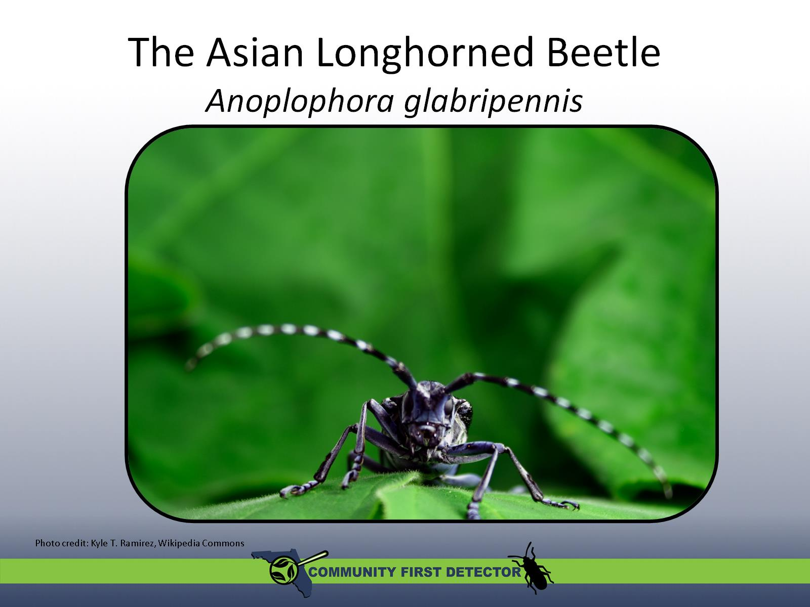
The Asian Longhorned Beetle Anoplophora glabripennis

Slide 2
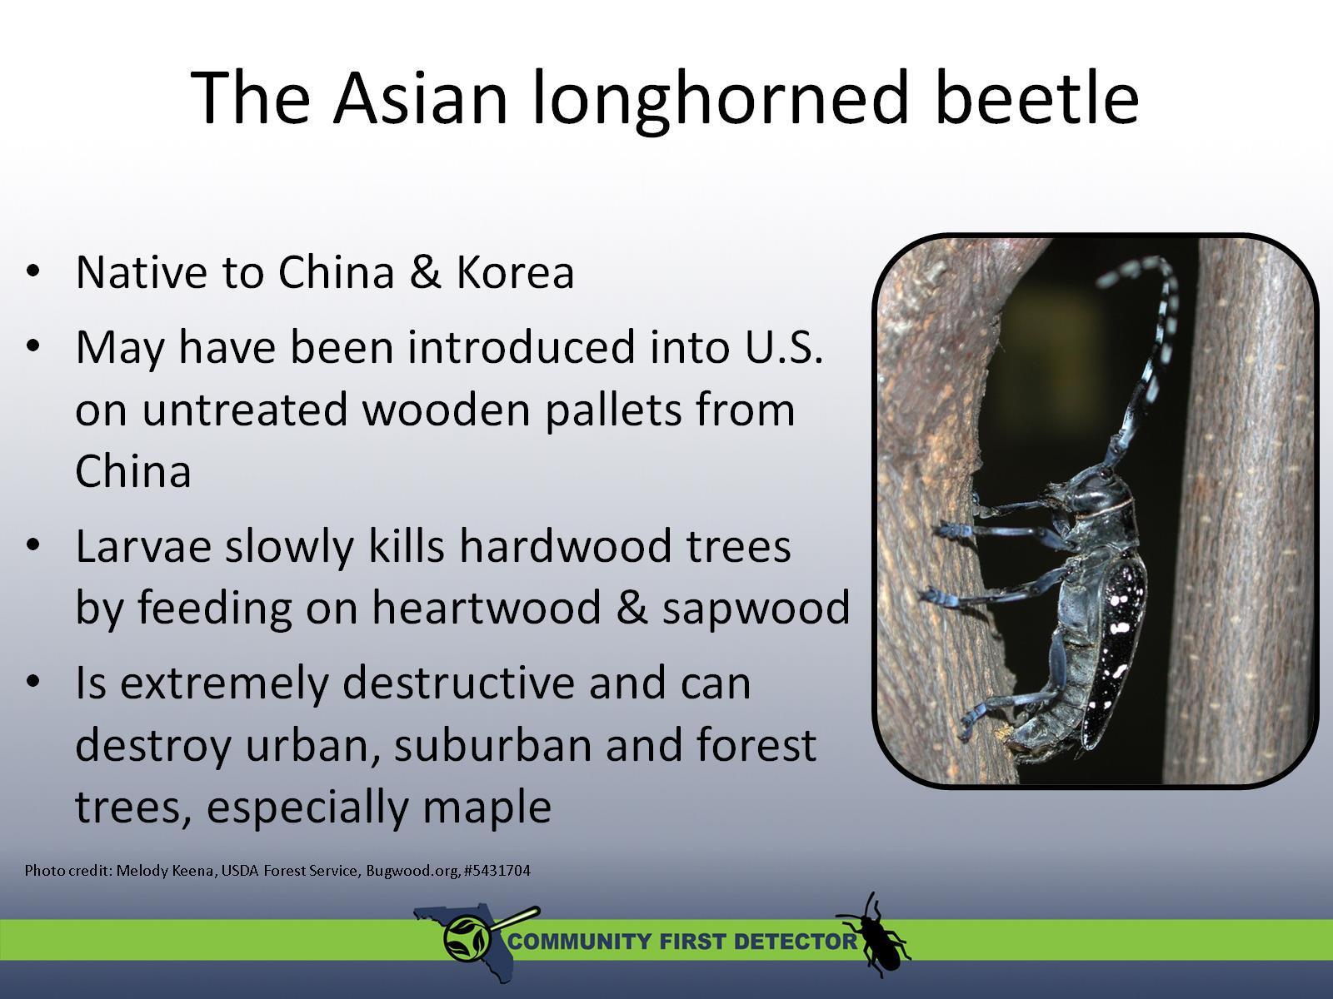
The Asian longhorned beetle

Slide 3
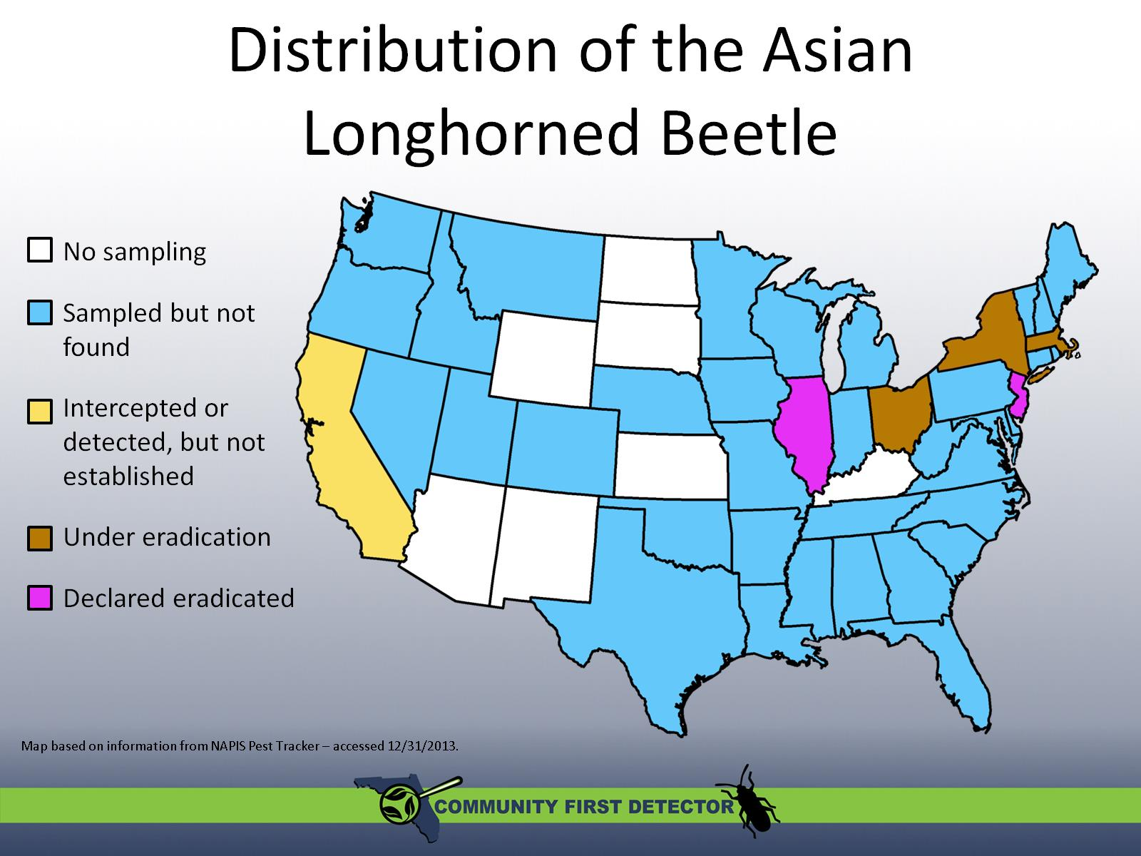
Distribution of the Asian Longhorned Beetle

Slide 4
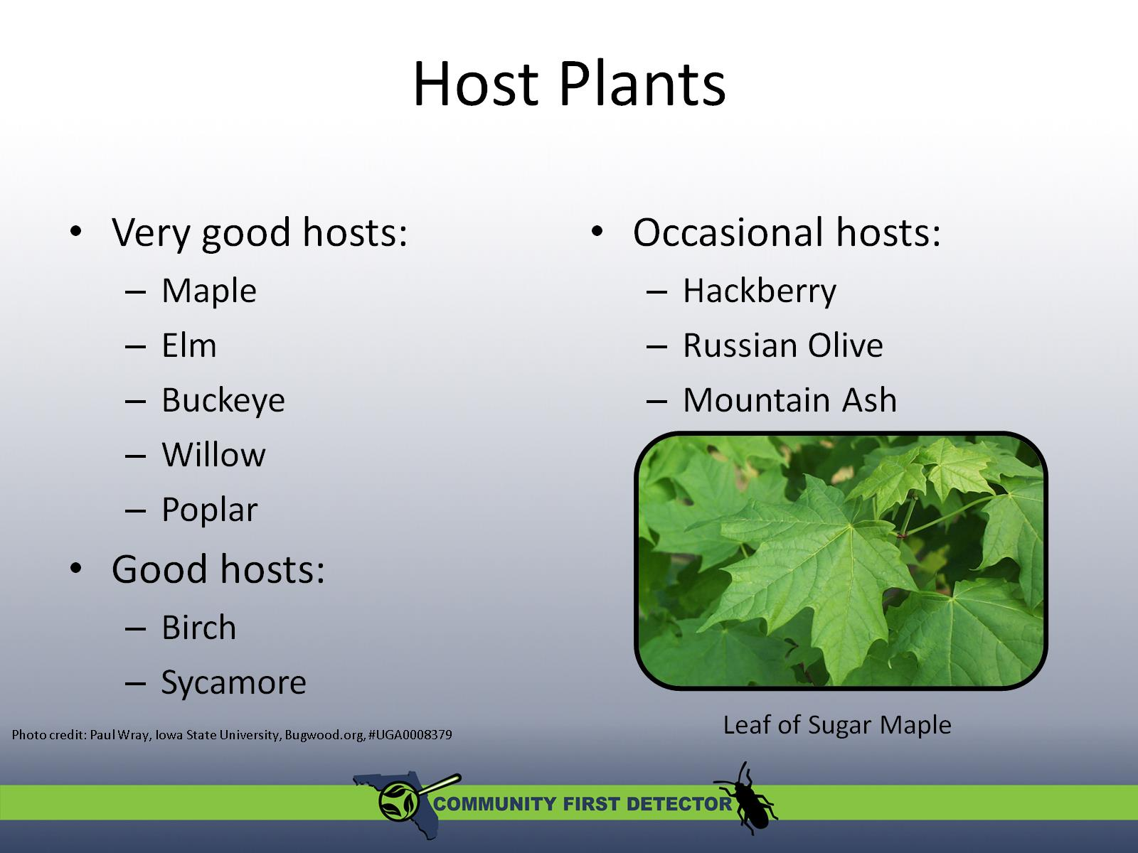
Host Plants

Slide 5
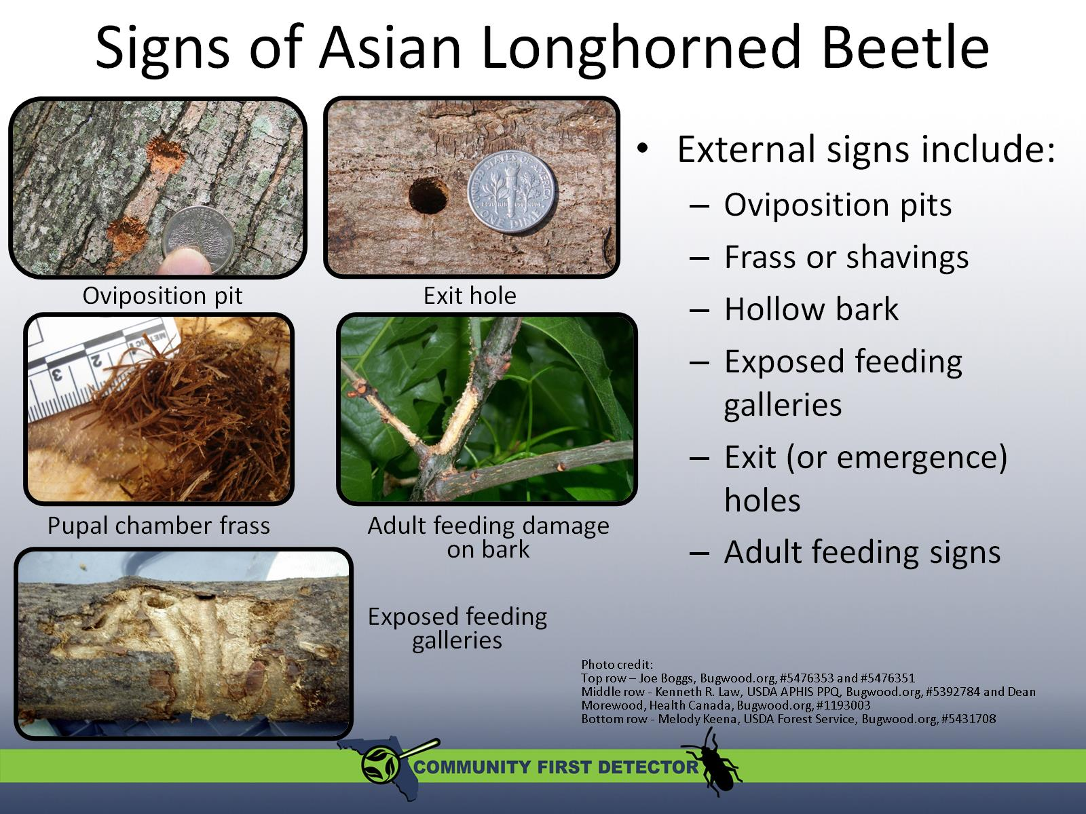
Signs of Asian Longhorned Beetle

Slide 6
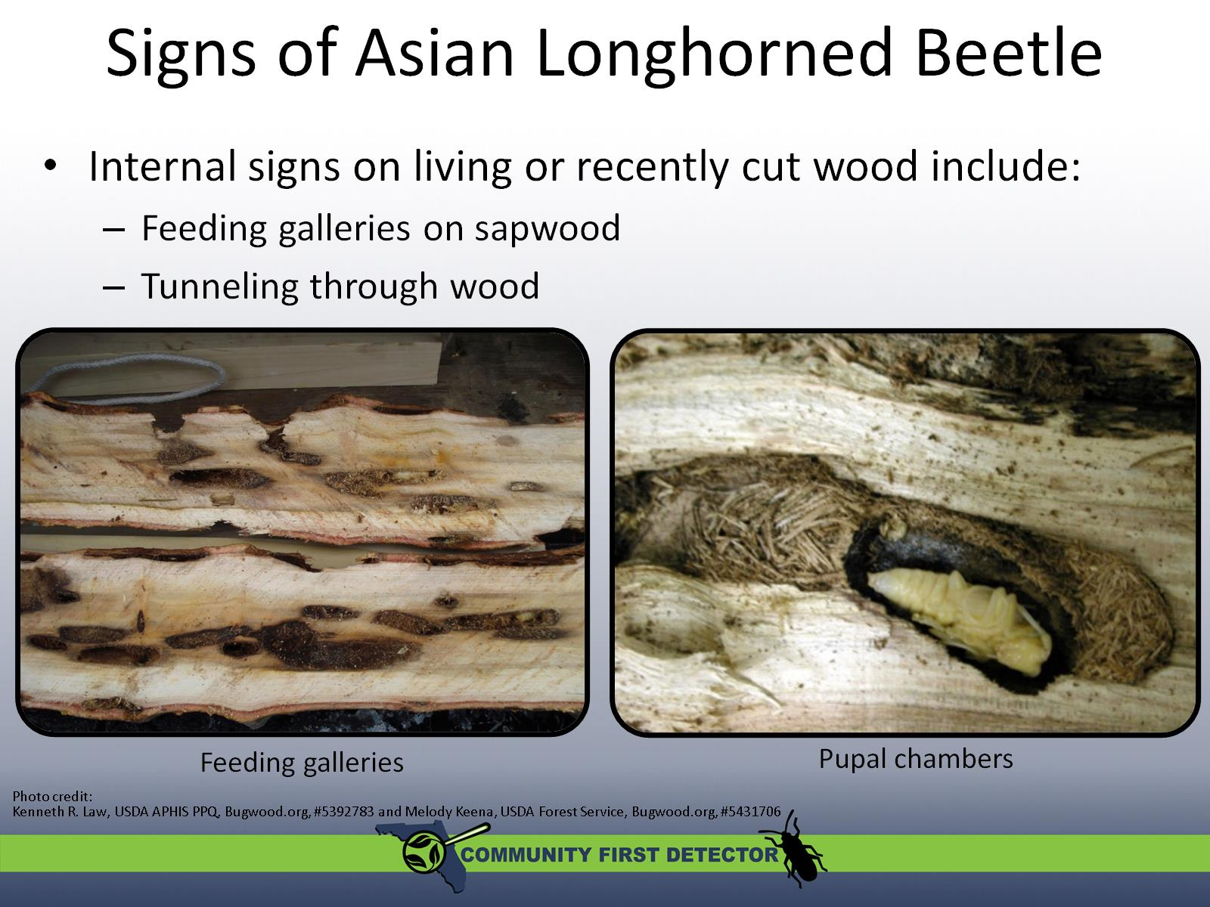
Signs of Asian Longhorned Beetle

Slide 7
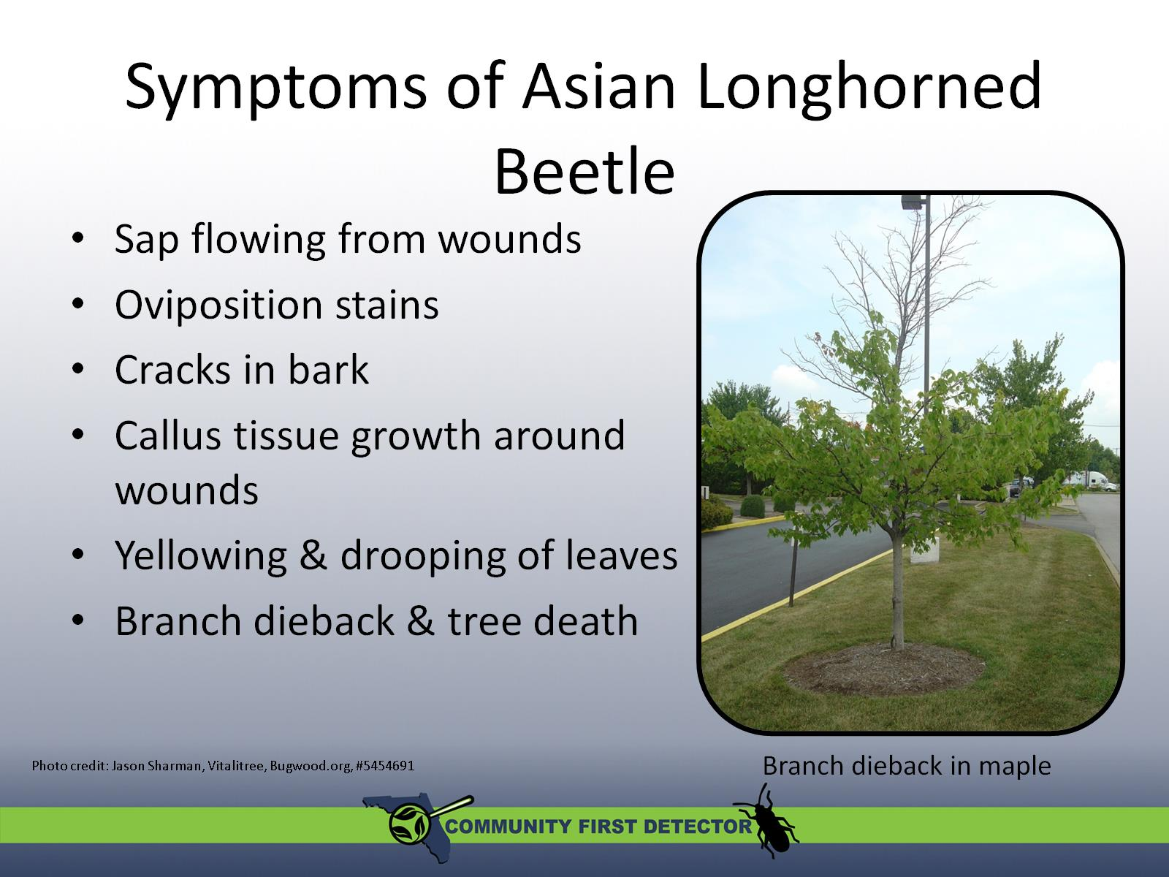
Symptoms of Asian Longhorned Beetle

Slide 8
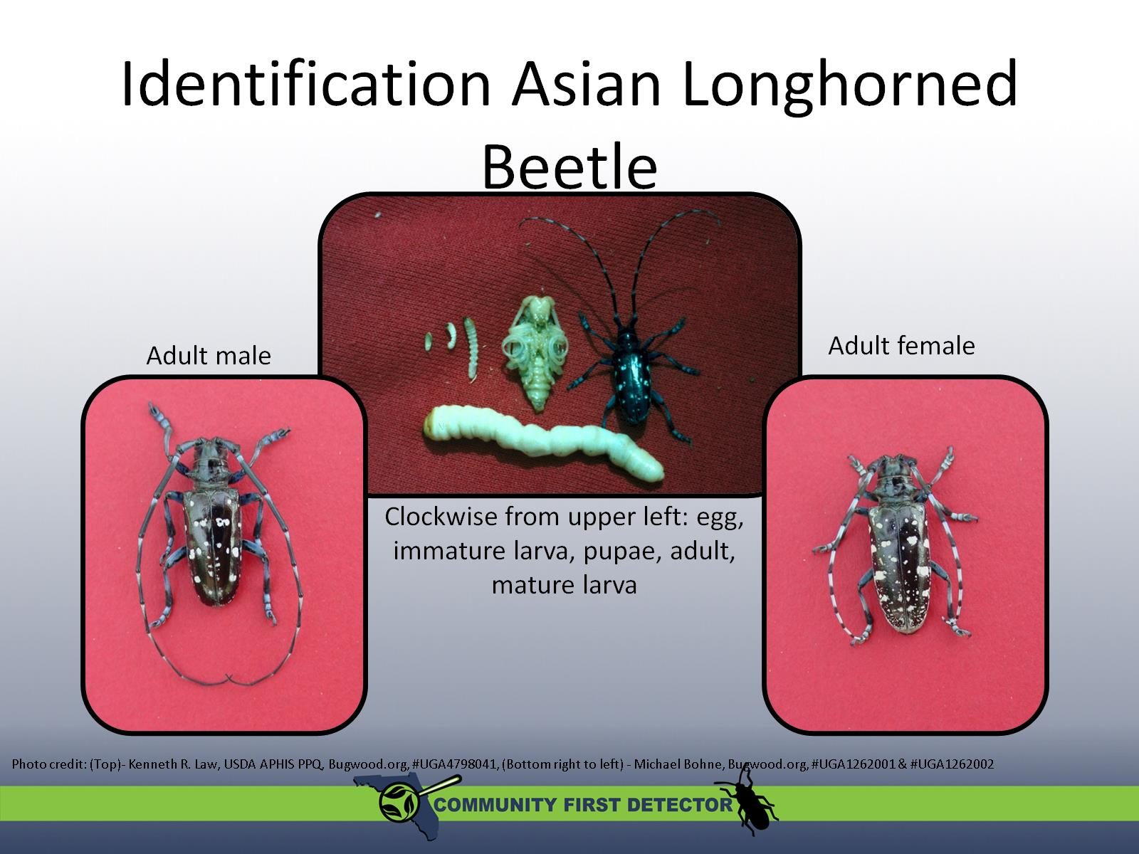
Identification Asian Longhorned Beetle

Slide 9
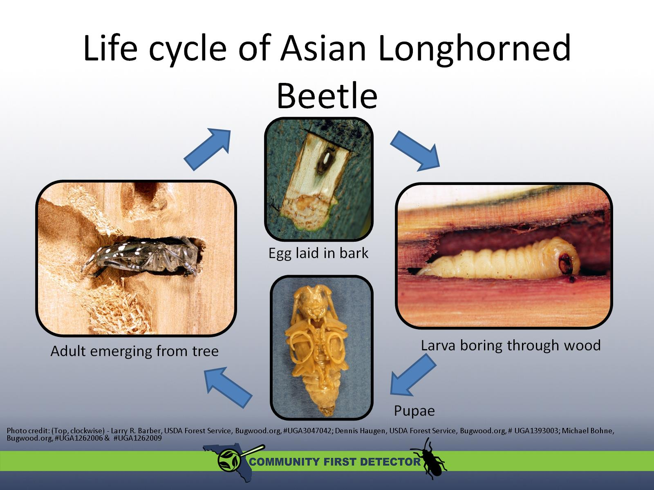
Life cycle of Asian Longhorned Beetle

Slide 10
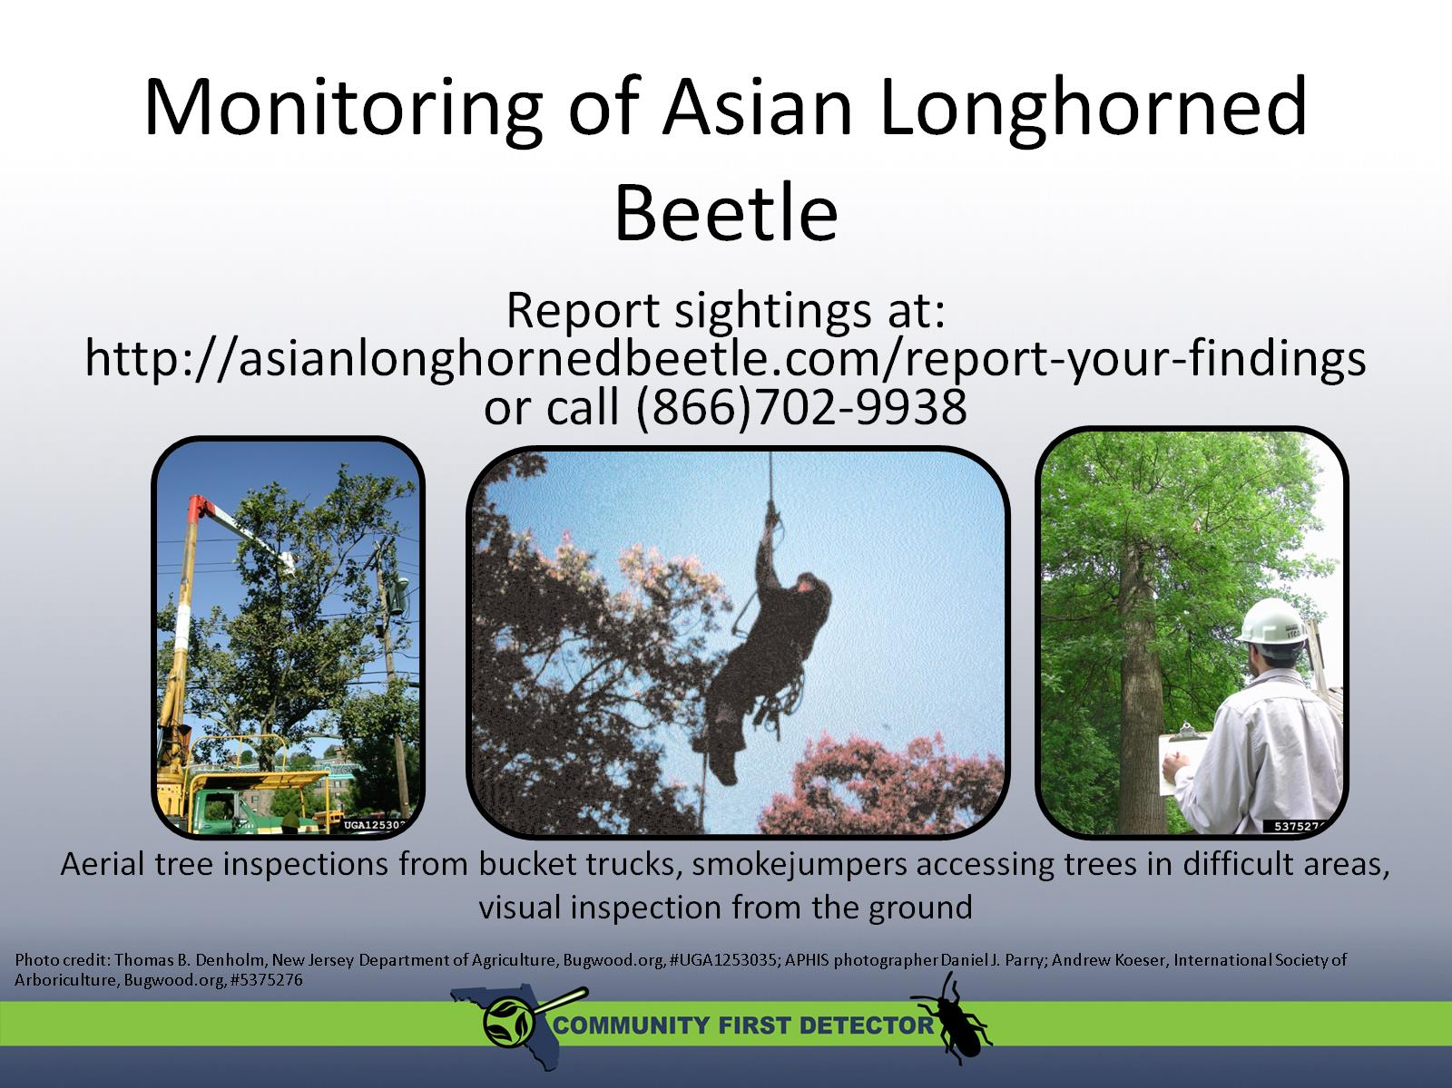
Monitoring of Asian Longhorned Beetle

Slide 11
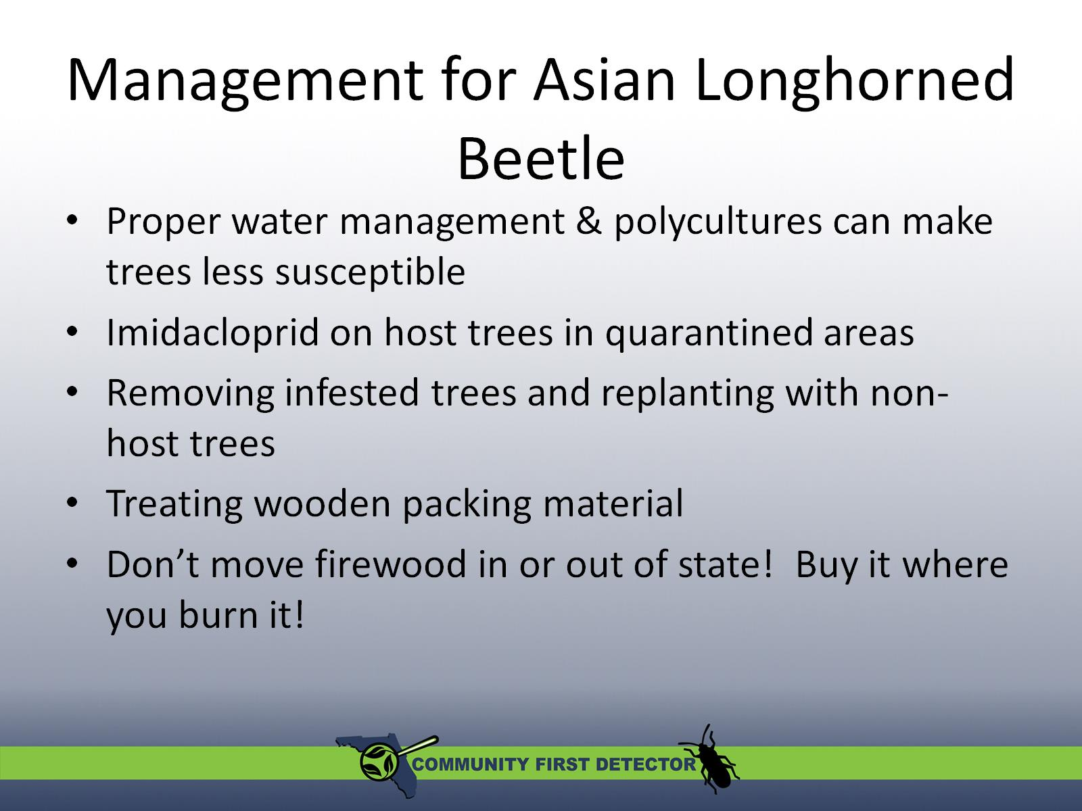
Management for Asian Longhorned Beetle

Slide 12
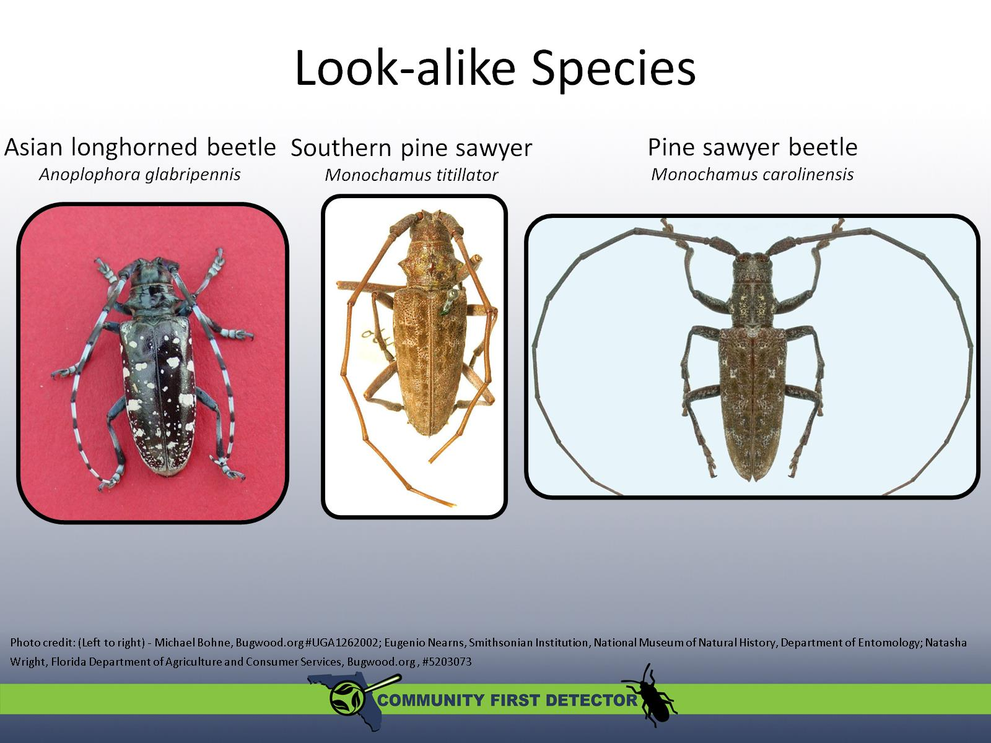
Look-alike Species

Slide 13
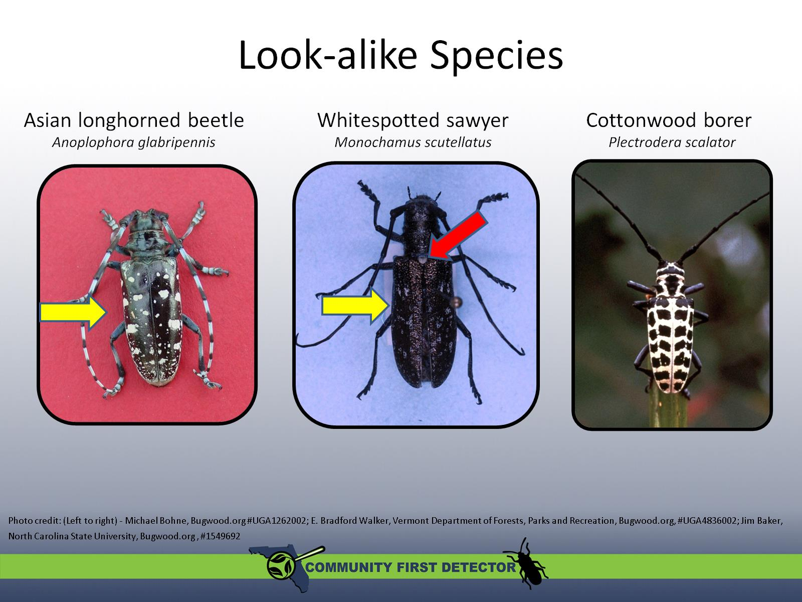
Look-alike Species

Slide 14
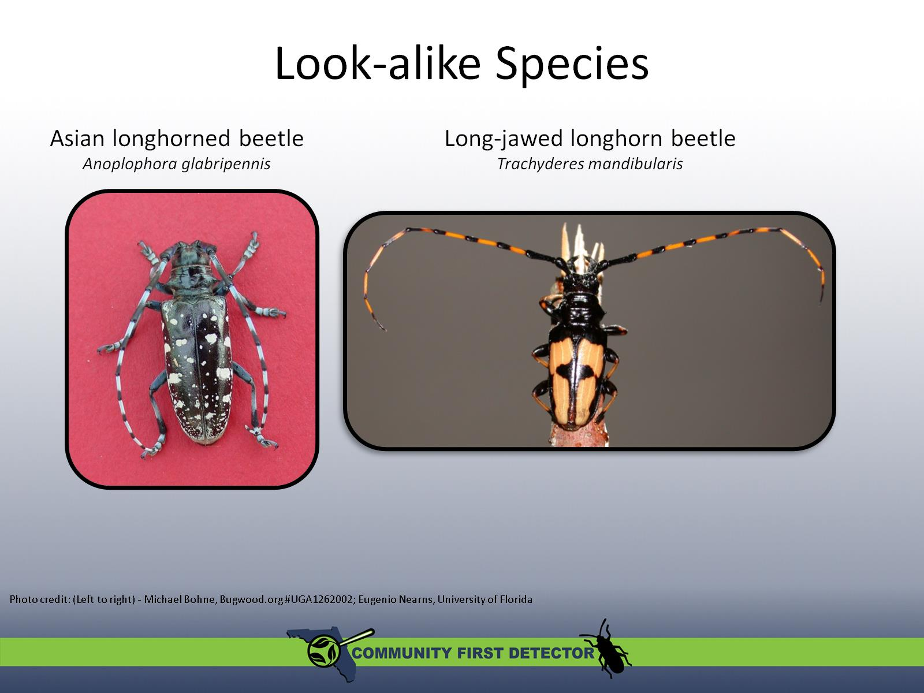
Look-alike Species

Slide 15
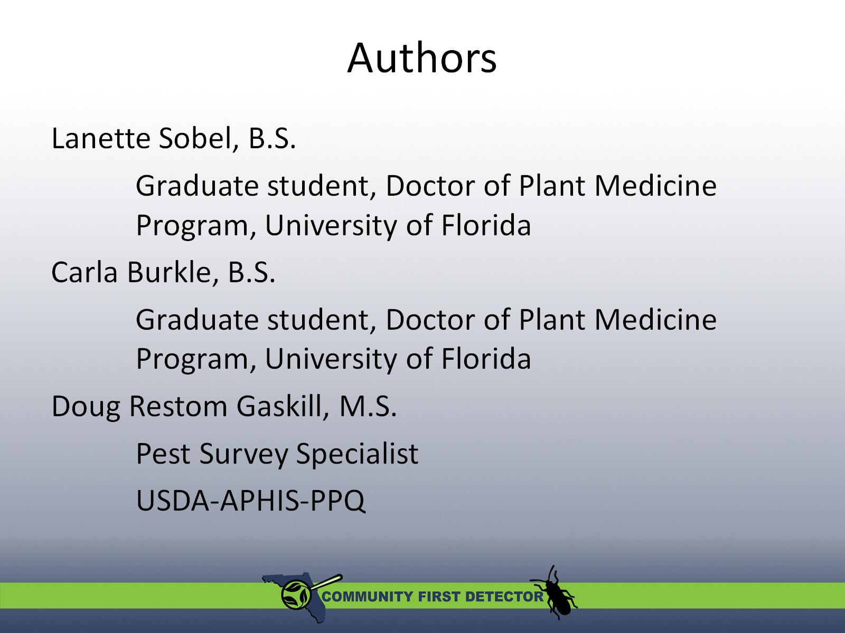
Authors

Slide 16
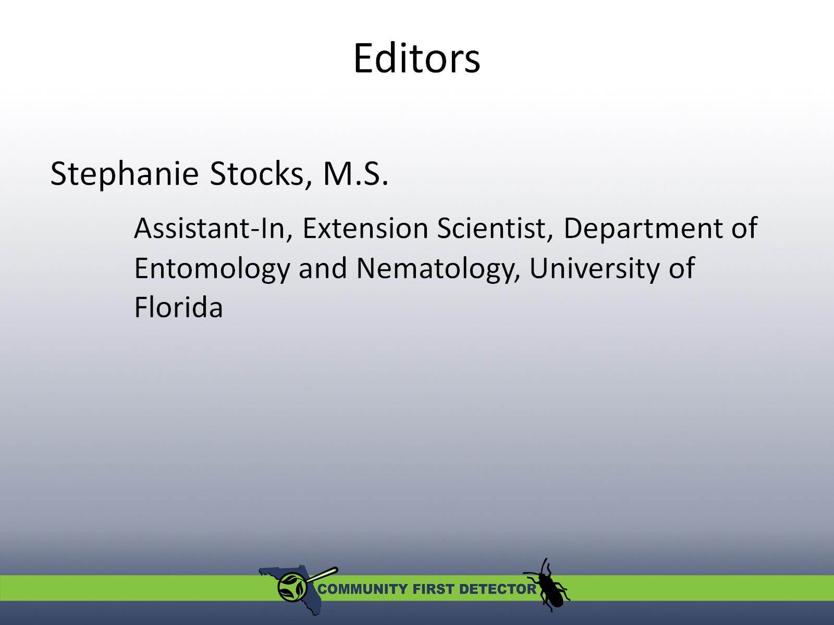
Editors

Slide 17
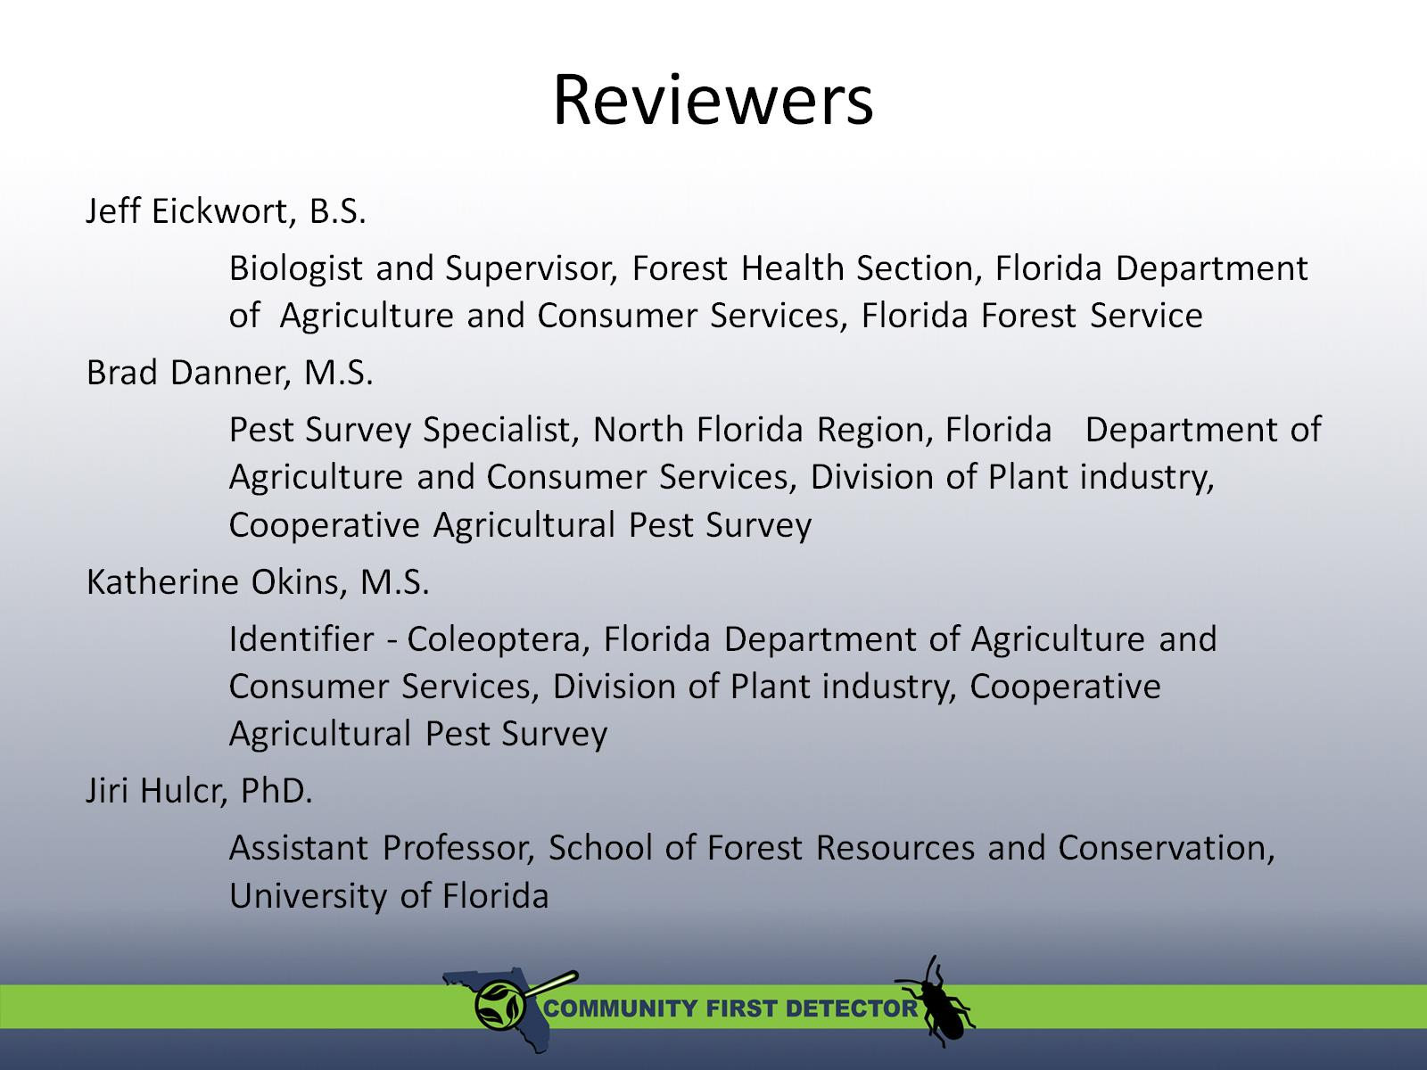
Reviewers

Slide 18
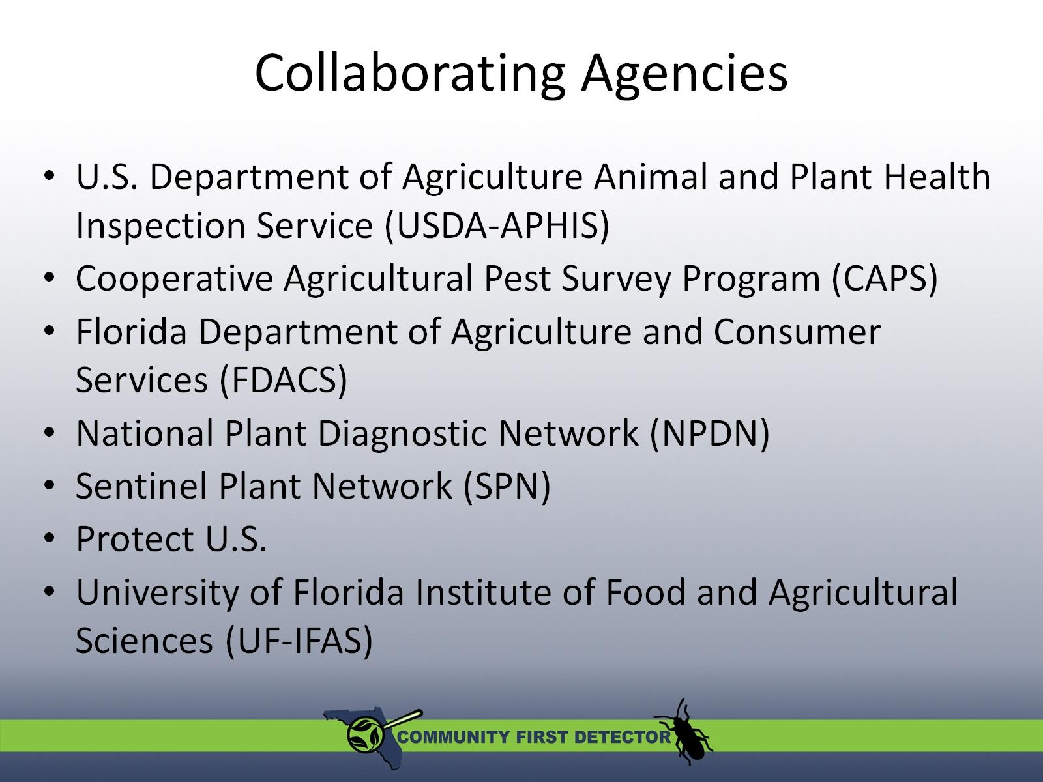
Collaborating Agencies

Slide 19
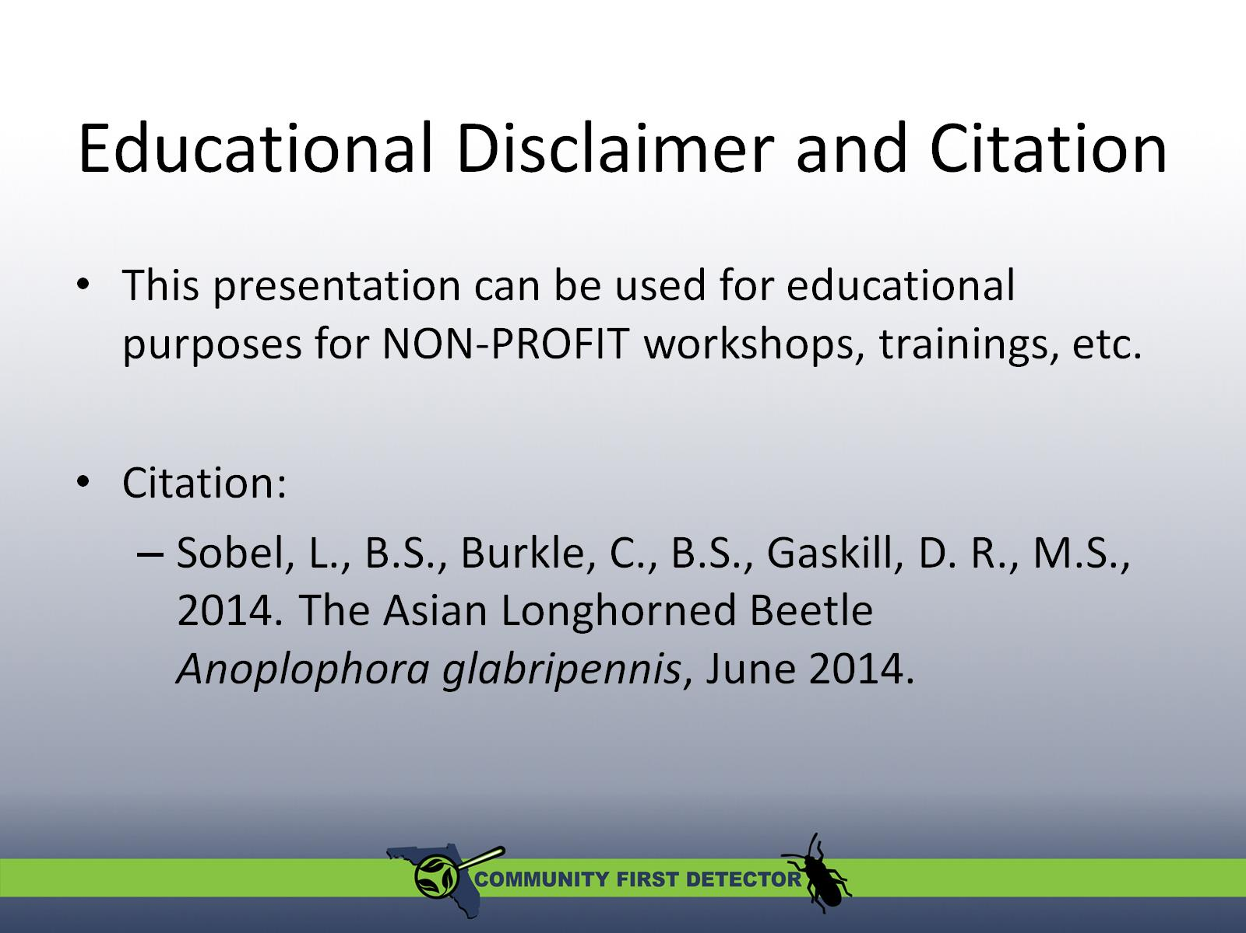

Slide 20
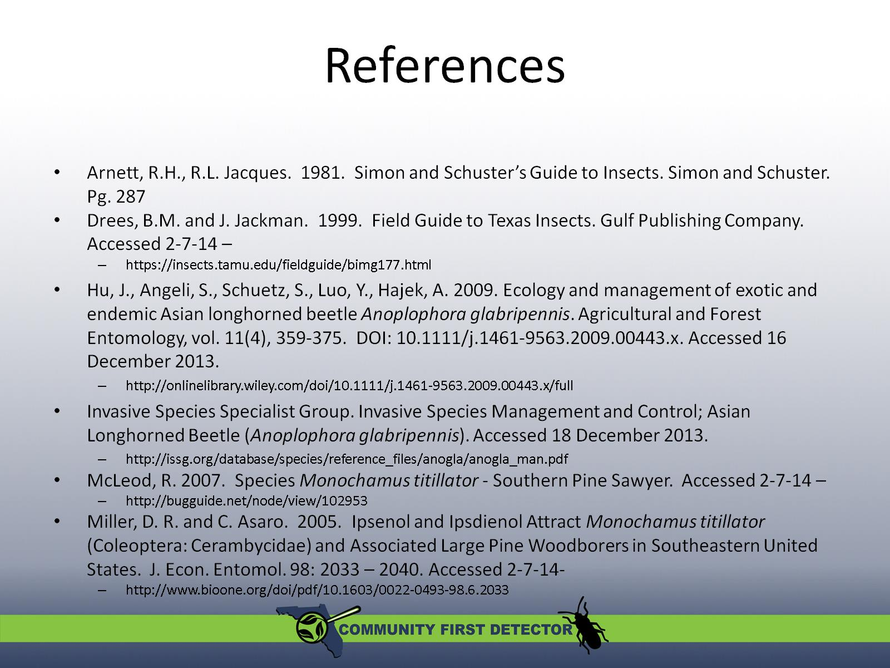
References

Slide 21
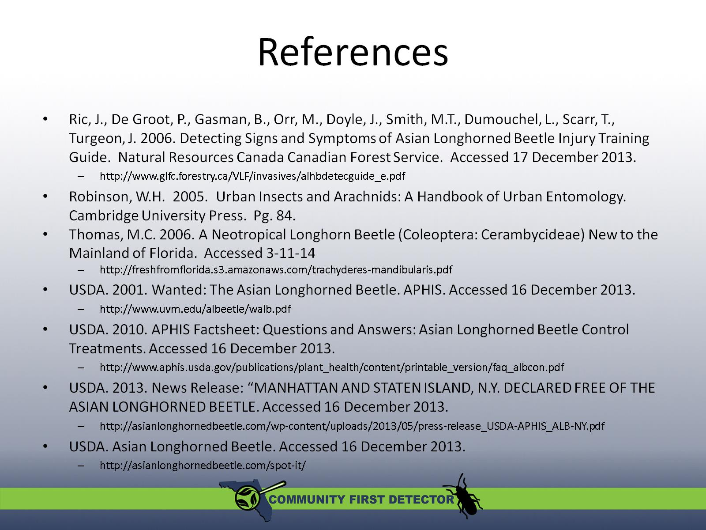
References

