Slide 1
Florida First
Detector Training:
Partner Agencies and
Their Roles

Slide 2
Combatting Invasive Species Requires a Collaborative effort
The following agencies and organizations have come together to create the materials used in the Collaborative and Enhanced First Detector Training Workshops in Florida.
The following slides talks about them and the role they play in detecting, eradicating, monitoring, and managing invasive species.
Notes:
Many agencies, both federal and state, as well as various public organizations have come together to create the materials used for the Collaborative and Enhanced First Detector Training Workshops in Florida. This presentation is designed to introduce the audience to the different agencies and organizations, what they do, and what roles they play in monitoring and managing invasive species that come into the United States.

Slide 3
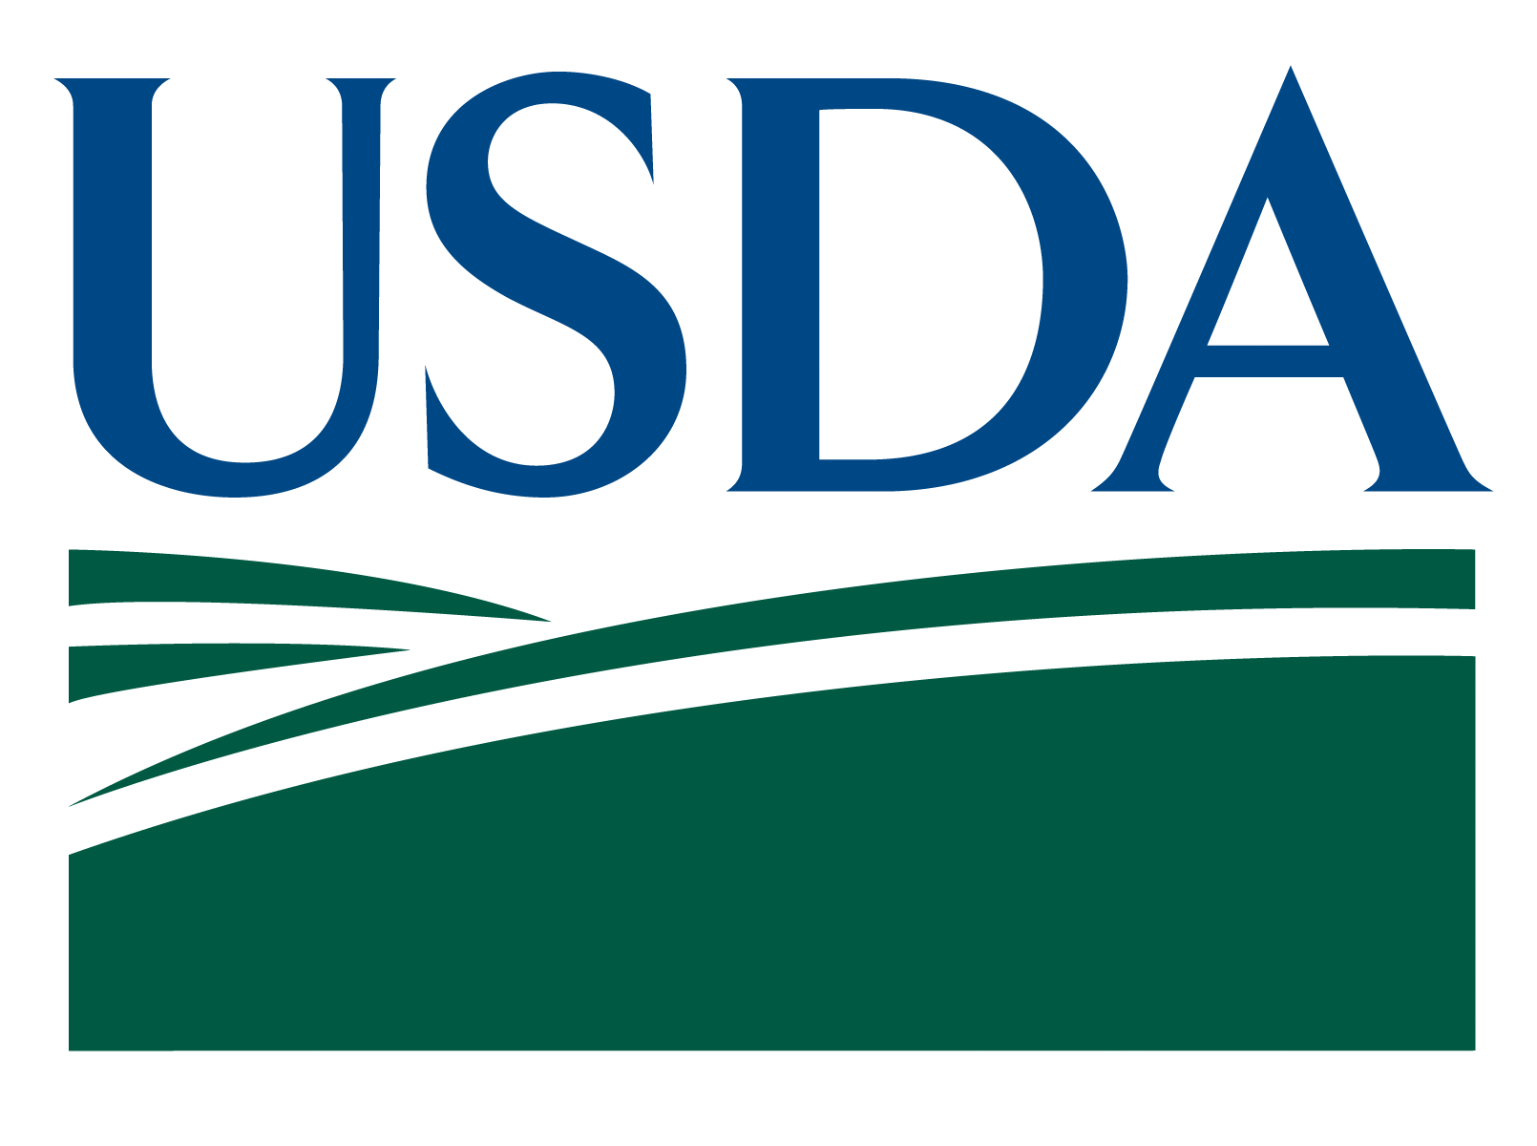
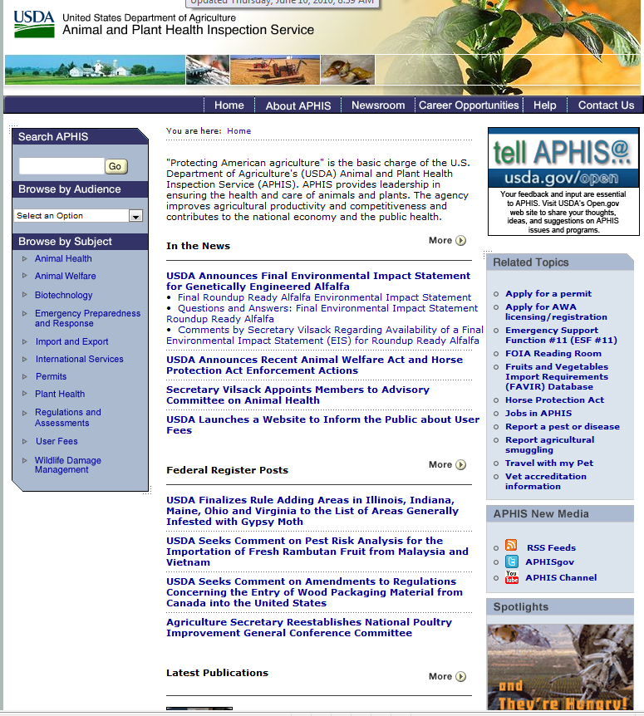
United States Dept. of Agriculture Animal and Plant Health Inspection Service Plant Protection and Quarantine (USDA-APHIS-PPQ)
Mandates of USDA-APHIS:
protecting and promoting U.S. agricultural health
regulating genetically engineered organisms
administering the Animal Welfare Act
carrying out wildlife damage management activities
Notes:
The United States Department of Agriculture has many agencies and offices that it manages. Many of those agencies and offices play important roles in various invasive species efforts. Its mandates are listed on the slide.
From the APHIS website: “Protecting American agriculture is the basic charge of the U.S. Department of Agriculture's (USDA) Animal and Plant Health Inspection Service (APHIS). APHIS provides leadership in ensuring the health and care of animals and plants. The agency improves agricultural productivity and competitiveness and contributes to the national economy and the public health.”
USDA-APHIS has a branch called Plant Protection and Quarantine (USDA-APHIS-PPQ) that focuses on safeguarding “agriculture and natural resources from the risks associated with the entry, establishment, or spread of animal and plant pests and noxious weeds to ensure an abundant, high-quality, and varied food supply”. - http://www.aphis.usda.gov/plant_health/index.shtml
While Department of Home Security – Customs and Border Protection can inspect almost everything that comes into the United States, USDA-APHIS-PPQ retains the responsibility of inspecting all plants that are used for planting or propagation. They are the National Plant Protection Organization (NPPO) for the U.S. and are responsible for federal quarantines, regulations, and international trade issues. They have a state plant health director (SPHD) in every state who works closely with their state counterpart within the state department of agriculture (referred to as the state plant regulatory official or SPRO) in pest response, pest detection, etc.
The USDA-APHIS-PPQ also has plant pest identifiers operating through the National Identification Services branch of PPQ (USDA-APHIS-PPQ-NIS) -http://www.aphis.usda.gov/plant_health/identification/index.shtml. Should a pest that is unknown to the area be detected, these identifiers can put a name to the specimen (if it has one – not all arthropods have a name or have ever been described at all as they are new to science).

Slide 4
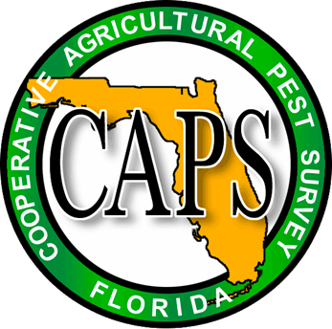
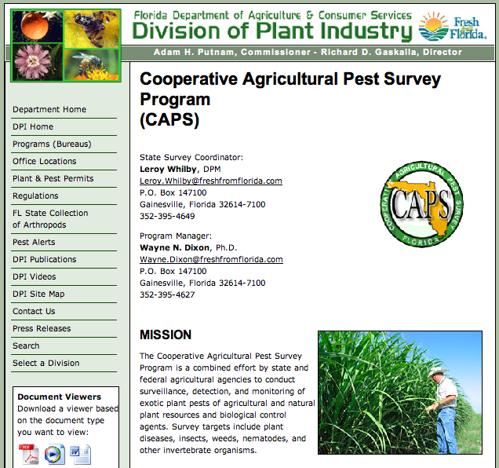
Cooperative Agricultural Pest Survey (CAPS)
Combined effort by Federal and State agricultural organizations
Early detection of pests and diseases of regulatory concern
Improve the quality and availability of pest information
Notes:
The Cooperative Agricultural Pest Survey Program (CAPS Program) is coordinated by USDA-APHIS and serves as a second line of defense against entry of harmful plant pests and weeds through surveys targeted at specific known pests. The CAPS program surveys for exotic species that may have arrived into the U.S. (maybe through imported commodities) but have not yet been reported or detected. USDA funding is provided through cooperative agreements between state departments of agriculture and land grant universities for these surveys to be conducted.
Local offices of the CAPS Program may engage in public outreach as well.
CAPS survey targets can include plant diseases, insects, weeds, nematodes, and other invertebrate organisms.

Slide 5
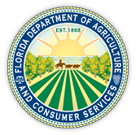
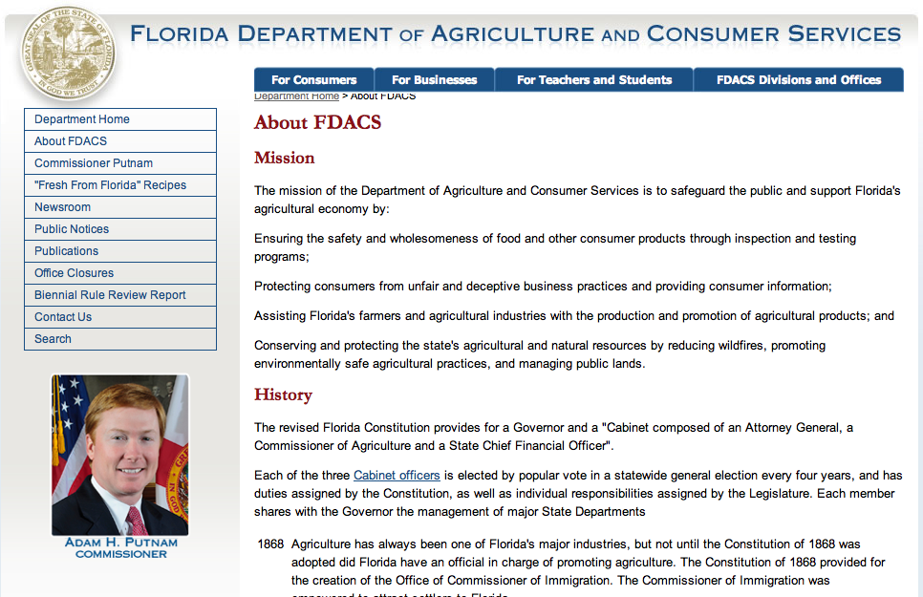
Florida Department of Agriculture and Consumer Services: Division of Plant Industry (FDACS-DPI)
Implements laws, regulations, and programs related to plants and plant pests for the state of Florida
Registration of nurseries, brokers, stock dealers
Inspection of commercial greenhouses and nurseries
Identification, monitoring, and eradication of exotic pests and diseases
Notes:
Each state has a department of agriculture that works with the United States Department of Agriculture to protect the state’s agricultural and natural resources.
The Division of Plant Industry is a regulatory agency of the Florida Department of Agriculture and Consumer Services (FDCAS-DPI). DPI works to detect, intercept and control plant and honey bee pests that threaten Florida’s native and commercially grown plants and agricultural resources. In doing so, they also help protect those sectors of Florida’s economy that rely on nurseries, honey, and agriculture.
Within the Division of Plant Industry, there are insect and plant taxonomic specialists (Bureau of Entomology, Nematology & Plant Pathology (and Botany)) that help identify unknown plant pests that inspectors (Bureau of Plant & Apiary Inspection) and state CAPS personnel encounter. There is also a Citrus Budwood Registration Bureau, Methods Development & Biological Control Bureau, and a Bureau of Pest Eradication & Control. All these Bureaus work together to protect Florida from invasive species (among other things).

Slide 6
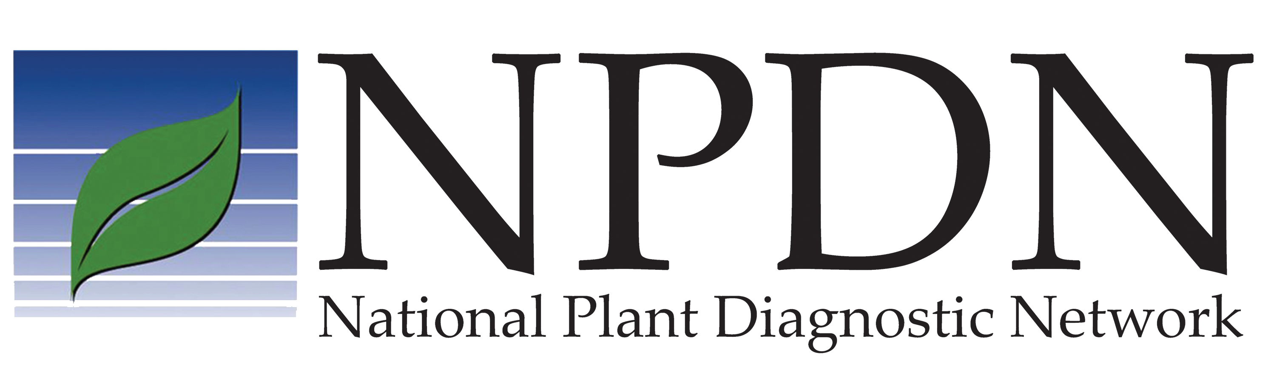
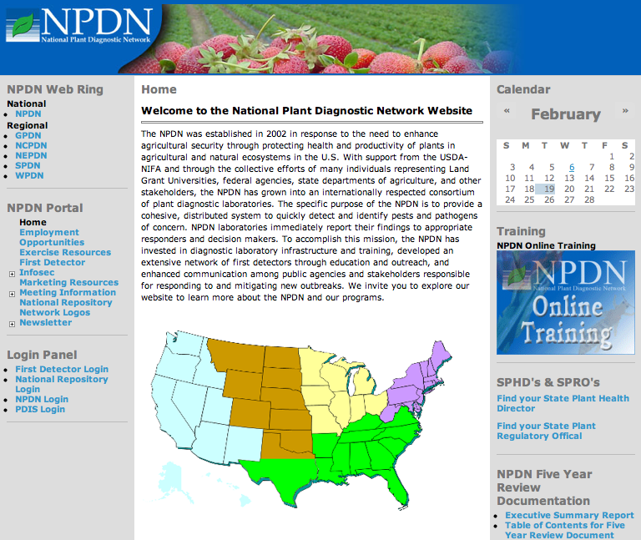
National Plant Diagnostic
Network (NPDN)
National network of plant diagnostic laboratories that work to identify pests and pathogens of concern and reports findings to appropriate responders and decision makers.
Supports diagnostic laboratories in all 50 states, Puerto Rico and the U.S. Virgin islands
Reports findings to appropriate responders and decision makers
Trains First Detectors
Notes:
The National Plant Diagnostic Network (NPDN) has diagnostic labs in every state (http://www.npdn.org/). Most of the NPDN members are land grant university diagnostic labs associated with cooperative extension, but state department of agriculture labs may be NPDN labs in some cases.
All NPDN labs accept physical samples of pests and pathogens for identification. In addition, many of the NPDN labs are able to accept digital samples through local digital diagnosis systems. If they identify a suspect pest of regulatory concern, NPDN labs have been trained to communicate and work with national identification specialists as well as state specialists to disseminate that information. This way, appropriate action to eradicate or control the plant pest can be taken.
The NPDN also has opportunities for traditional, face-to-face training and e-learning online training regarding plant pest issues (www.firstdetector.org). The more people there are making observations and being vigilant about potentially invasive pests in their gardens, or fields, or where they like to hike, the quicker the appropriate agencies can respond to a pest before it spreads. Those that take this training are referred to as First Detectors. This training is specialized for those in and associated with the plant industry, though any interested person can access their online training modules and attend a training session.

Slide 7
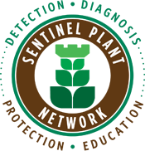
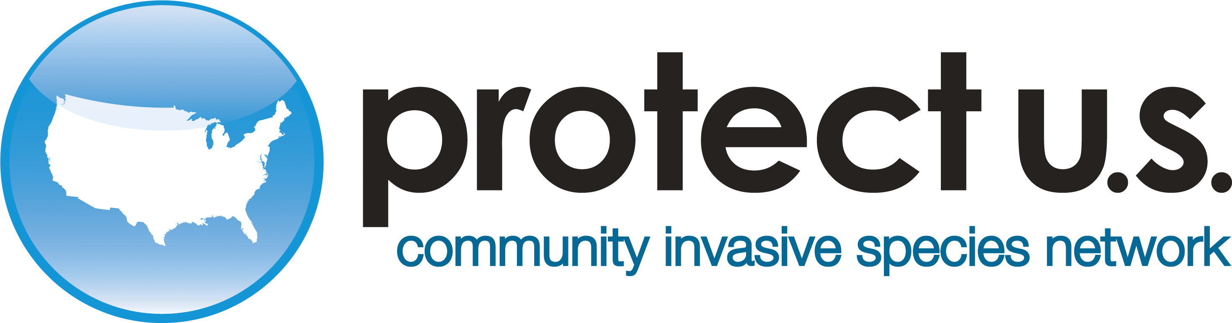
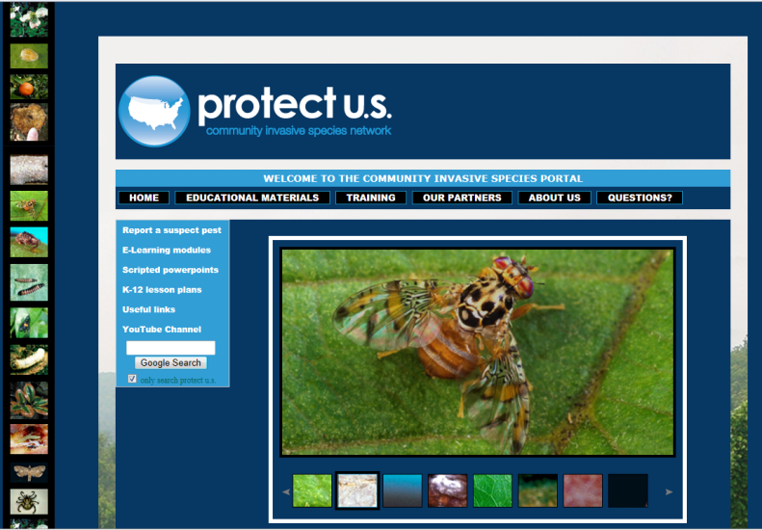
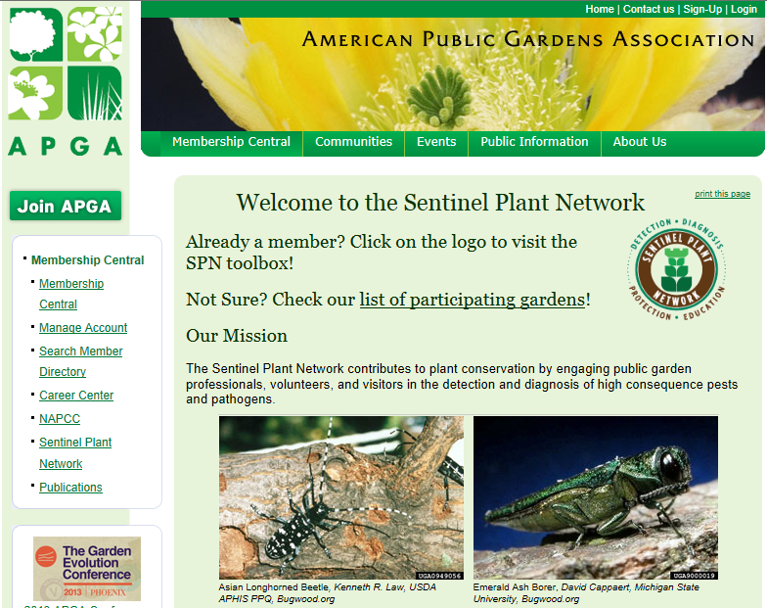
Partner programs to the National Plant Diagnostic Network that work to educate specific audiences on invasive species of concern that affect plants.
Notes:
Protect U.S. and the Sentinel Plant Network are partner programs with the National Plant Diagnostic Network.
Protect U.S. is involved with invasive species education for small farm producers, homeowner, and K-12. They provide online training for clientele and scripted presentations for educators on the latest invasive species issues. They also developed lesson plans for teachers (correlated with the National Science Education Standards) that focus on invasive species education.
Sentinel Plant Network (SPN) was developed as a First Detector program specifically designed for botanical gardens. They provide workshops, online training, and access to NPDN labs for plant pest identification. This also helps in the fight against invasive species.

Slide 8
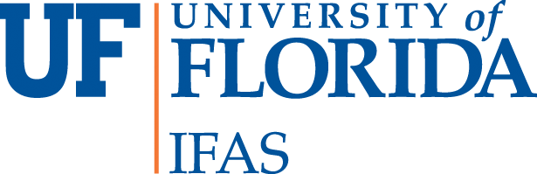
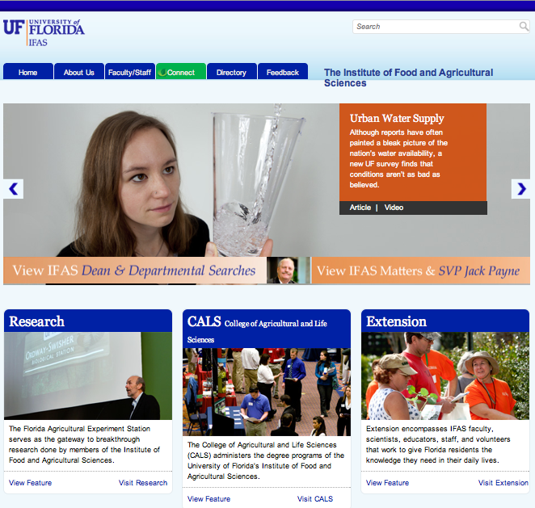
Land-grant University
A U.S. college or university entitled to support from the
federal government under the provisions of the Morrill Acts.
Provides agricultural and technical education
Conducts agricultural research
Disseminates findings
Brings the results of agricultural research to the end users
Notes:
Through research, Land Grant Universities help fill the gap that occurs between the detection of new invasive species and action that should be taken to effectively manage or eradicate invasive pests. They also work with the ornamental and agricultural industries in areas such as developing Integrated Pest Management Programs for specific plants or crops, developing disease and pest resistant cultivars, and basic research on the effects that invasive species have on a state’s natural, ornamental and agricultural landscapes.

Slide 9
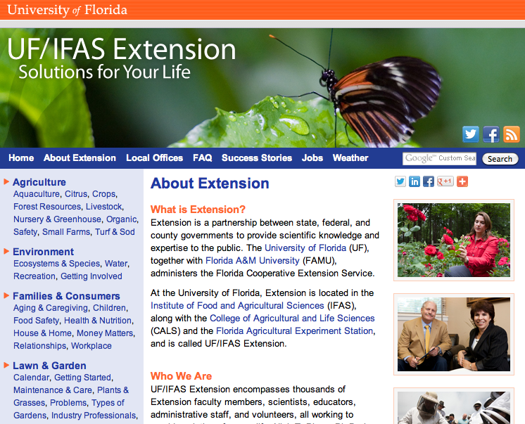
Cooperative Extension
State, federal, and county partnership to provide science knowledge and expertise to the public
Master Gardener Program
Distance Diagnostic & Identification System (DDIS)
Many, many other programs
Notes:
Cooperative extension (as part of the Land Grant University system) converts the information provided by the state and federal agencies agencies and discovered by the researchers into educational material that can be delivered to the public through local county extension offices.
Audiences for this material include homeowners, Master Gardeners and Master Naturalists as well as small farm producers and industry.
Extension faculty and agents also work with local First Detectors to help identify local plant pests and help submit suspect samples to the appropriate places (such as the state NPDN labs).
A list of extension offices can be found here - http://www.csrees.usda.gov/Extension/.

Slide 10
What happens after a suspect is detected and confirmed a pest?
Notes:
Once a suspect species is detected, it is identified (involving the local NPDN lab, USDA-APHIS-PPQ, and state agricultural agency).
If it is, indeed, an introduced species, it is determined if it is a pest for which CAPS is actively monitoring, a organism that is a known pest in another country, and what is known about it in general.
If it is a invasive pest, then it is determined if the population is small enough to be eradicated (this is done by USDA-APHIS-PPQ and the state agricultural agency). If not, it is determined how best to manage it (this is done by USDA-APHIS-PPQ, state agricultural agency, and land grant researchers).
Information on the pest is then sent out around the country (through the NPDN) and locally (through Cooperative Extension) to help monitor for the spread of this invasive species or to identify additional populations.
Researchers at land grant universities continue to investigate the invasive pest and help determine the impact it will have in the state in terms of impact to the natural ecosystem, the agricultural ecosystem, and any economic impact.
This is how all these agencies work together to mitigate the effects of invasive species.

Slide 11
Authors
Stephanie Stocks, M.S.
Assistant-In, Extension Scientist, Department of Entomology and Nematology, University of Florida
Amanda Hodges, Ph.D.
Associate Extension Scientist, Department of Entomology and Nematology, University of Florida
Jennifer Hamel, Ph.D.
Postdoctoral Associate, Department of Entomology and Nematology, University of Florida

Slide 12
Editors
Matthew D. Smith, Ph.D.
Postdoctoral Associate, Department of Entomology and Nematology, University of Florida
Keumchul Shin, M.S.
Graduate student, Doctor of Plant medicine program, University of Florida

Slide 13
Reviewers
Leroy Whilby, DPM
State Survey Coordinator, Cooperative Agricultural Pest Survey Program
Smriti Bhotika, Ph.D.
Postdoctoral Associate, Department of Entomology and Nematology, University of Florida

Slide 14
Collaborating Agencies
U.S. Department of Agriculture Animal and Plant Health Inspection Service (USDA-APHIS)
Cooperative Agricultural Pest Survey Program (CAPS)
Florida Department of Agriculture and Consumer Services (FDACS)
National Plant Diagnostic Network (NPDN)
Sentinel Plant Network (SPN)
Protect U.S.
University of Florida Institute of Food and Agricultural Sciences (UF-IFAS)

Slide 15
Educational Disclaimer and Citation
This presentation can be used for educational purposes for NON-PROFIT workshops, trainings, etc.
Citation:
Stocks, S. M.S., Hodges, A., Ph.D., Hamel, J., Ph.D., 2014. Florida First Detector Training: Partner Agencies and Their Roles, June 2014.

