Slide 1
Common and Invasive Pests of Stonefruits:
Peaches and Nectarines-
Bacteria, Viruses, and Nematodes

Slide 2
Background
Tree in leaf
Tree in bloom
Flower
Nectarine fruit
Peach fruit
Young fruit
Image citations: peach tree in leaf - Howard F. Schwartz, Colorado State University, www.bugwood.org, #5359260; tree in bloom - Charles Drake, Virginia Polytechnic Institute and State University, www.bugwood.org, #5335075; flower - H.J. Larsen, ww.bugwood.org, #5365442; nectarine fruit - Howard F. Schwartz, Colorado State University, www.bugwood.org, #5359261; peach fruit - Carroll E. Younce, USDA Agricultural Research Service, www.bugwood.org, #1304024; young fruit - University of Georgia Plant Pathology Archive, University of Georgia, www.bugwood.org, 1492186
Notes:
Peaches (Prunus persica) belong in the Rose family. They originated in China and have been reported in history at least as far back as 3000 years ago. It was introduced into the United States multiple times by Spanish, French, and English settlers.
It is typically a temperate cultivar. Though it is sensitive to really low temperatures, it won’t set fruit unless it experiences a certain number of hours of winter temperatures. Varieties of peaches have been developed over the years, however, to expand its production into tropical and subtropical regions by trying to reduce the number of hours of cold required to set fruit.
It typically grows best in fertile, deep, and naturally well-drained soils with good ventilation and a soil pH of about 6.5.
Nectarines are a variety of peaches that are essentially hairless. They have been reported as far back as 2000 years ago, though the first official recorded case of a nectarine on a peach tree was in 1741.
The total commercial production of peaches in 2010 was 2.3 billion pounds worth almost $615 million. The total production of nectarines in 2010 was 466 million pounds worth a little more than $129 million.
In 2010, California led the states in peach production followed by South Carolina then Georgia and New Jersey. Only 15 states have no record of commercial peach production for 2010: Arizona, Florida, Hawaii, Indiana, Iowa, Kansas, Maine, Minnesota, Mississippi, Montana, New Hampshire, New Mexico, Rhode Island, Vermont, and Wisconsin. In 2010, nectarines were commercially produced in only 2 states: California (by far the largest) and Washington.
Of course, these numbers do not include peach and nectarine trees located in homeowners yards.
Information sources:
Ogawa, J.M., editor. 1995. Compendium of Stone Fruit Diseases. American Phytopathological Society Press, St. Paul, Minnesota.
USDA-ERS. Spreadsheet A-5, A-8, and A-18.
accessed 12/30/2011 –
http://usda.mannlib.cornell.edu/MannUsda/viewDocumentInfo.do?documentID=1377

Slide 3
Bacterial Diseases
Bacterial spot
Bacterial canker
Peach X disease
European stone fruit yellows
Notes:
Bacterial spot is more common and severe in areas of light, sandy soils and moist, warm environments (such as the southern coastal states). It has not been reported in the Pacific coast region of the United States.
Bacterial canker is especially prevalent in cool, wet environments (such as the northwest and parts of the northeast), but it is also part of the peach tree short life complex in the southeastern U.S.
Peach X disease is found mainly the northeastern U.S.
European stone fruit yellows is quickly becoming a disease of concern in Europe, though it has not been found yet in the United States.

Slide 4
Bacterial Diseases
Bacterial spot is caused by Xanthomonas arboricola pv. pruni.
Also known as:
bacteriosis, bacterial leaf spot, bacterial shot hole, bacterial crack, and black spot
Notes:
Bacterial spot is caused by Xanthomonas arboricola pv. pruni. Strains of X. arboricola pv. pruni exhibit different virulence among Prunus spp., but cause significant economic losses on peaches and nectarines. This disease is also known as bacteriosis, bacterial leaf spot, bacterial shot hole, bacterial crack, and black spot.
The bacteria is found in most countries where peaches are grown, but is more common and severe in areas of light, sandy soils and moist, warm environments. It has not been reported in the Pacific coast region of the United States.
This bacteria was previously known as Xanthomonas campestris pv. pruni.
This bacteria should be cultured in order to properly identify the species as it is not prudent to diagnose the species solely by symptoms and appearance of infected tissue. Bacterial streaming should be seen in the lesions under a microscope (100-200X) when a drop of water is added to it.
Information sources:
Boudon. S., C. Manceau, and J.L. Notteghem. 2005. Structure and origin of Xanthomonas arboricola pv. pruni populations causing bacterial spot of stone fruit trees in Western Europe. Phytopathology, vol. 95, no. 9, pp. 1081-1088.
Horton, D. and D. Johnson, editors. 2011. Southeastern Peach Growers' Handbook. University of Georgia Extension and Outreach.
accessed 12/15/2011 –
http://www.ent.uga.edu/peach/peachhbk/toc.htm
Layne, D.R., and D. Bassi, editors. 2008. The Peach: Botany, Production, and Uses. CABI, Cambridge, Massachusetts.
Ogawa, J.M., editor. 1995. Compendium of Stone Fruit Diseases. American Phytopathological Society Press, St. Paul, Minnesota.

Slide 5
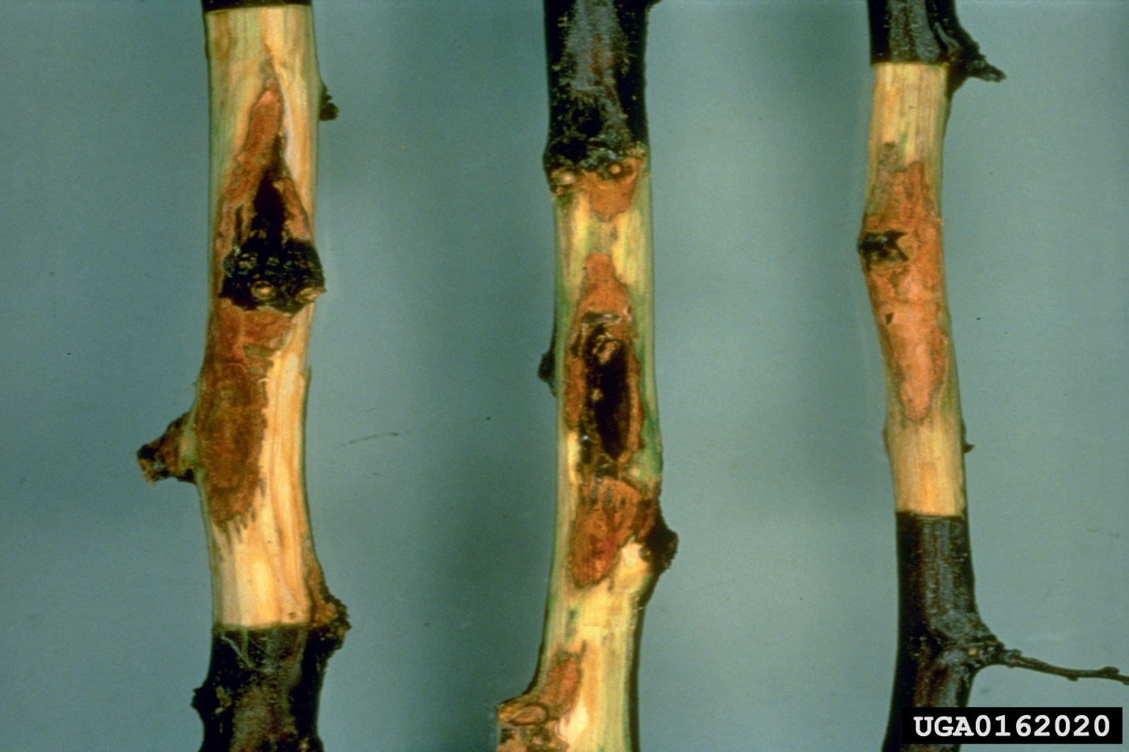
Bacterial Diseases
Bacterial spot symptoms on stems
Image citations:
U. Mazzucchi, Università di Bologna, www.bugwood.org, #0162020
Notes:
Stem –
There are three types of cankers that result from bacterial spot.
Spring cankers are first visible near bloom time and develop on the previous season’s twig growth, usually centered on the leaf scar infection from the previous autumn. These look like slightly raised, blister areas that can extend several centimeters along the twig. Leaf and flower buds will fail to open.
Cankers that occur on the current season’s twig growth is referred to as summer cankers. These cankers appear on new green shoots and can be seen in late spring or early summer.
Black tip canker occurs in late winter (before leaf emergence) and is restricted to the terminal bud region of last year’s growth (the previous autumn – just like spring cankers). The terminal bud will fail to open, and a dark cankered area appears which can extend several centimeters down from the dead bud. It has a greasy, black, wet appearance. If you remove the outer bark, you will see brownish water-soaked bark below, but this will not extend into the wood (whereas bacterial canker will).
The image above is of bacterial spot on a plum tree.
Information sources:
Horton, D. and D. Johnson, editors. 2011. Southeastern Peach Growers' Handbook. University of Georgia Extension and Outreach.
accessed 12/15/2011 –
http://www.ent.uga.edu/peach/peachhbk/toc.htm
Layne, D.R., and D. Bassi, editors. 2008. The Peach: Botany, Production, and Uses. CABI, Cambridge, Massachusetts.
Ogawa, J.M., editor. 1995. Compendium of Stone Fruit Diseases. American Phytopathological Society Press, St. Paul, Minnesota.

Slide 6
Bacterial Diseases
Bacterial spot symptoms on leaves and fruit
Image of fruit damage
Image citations:
Top left - University of Georgia Plant Pathology Archive, University of Georgia, www.bugwood.org, #1492099
Bottom left - U. Mazzucchi, Università di Bologna, www.bugwood.org, #0162026
Right - Clemson University - USDA Cooperative Extension Slide Series, www.bugwood.org, #1436079
Notes:
Leaf –
Lesions and chlorosis are usually the first and most obvious symptoms seen. The lesions start as grey areas, angular in shape, and 1-3mm in width (they seldom exceed 5mm). These lesions are often located along the midrib, at the leaf tip, or along the leaf margin (or a combination of these places). The lesion centers will later enlarge, become dark red, purple, black, or brown and necrotic. These lesions may be surrounded by grey to yellowish tissue, and if the lesions fall off, the leaves look like they have a hole shot through them. With many lesions, however, the leaves may then become chlorotic and fall off the tree. Leaf symptoms are first visible 5 to 14 days after infection. Multiple years of severe premature defoliation will result in fewer fruit buds and fruit crops as well as weaken the tree overall. Foliar lesions can also occur due to pesticide injury. However, these lesions will be circular and not water soaked in appearance.
Fruit –
Lesions on the fruit begin 3-5 weeks after petal fall and first appear small, brown, angular in shape, and water-soaked (this can be mistaken for insect damage). Gum may be secreted from these lesions during periods of high humidity. These lesions can then progress into deep, cavernous holes. Lesions that occur from later infections though (after pit hardening) tend to be not as cavernous and more confined to the fruit surface. Peach scab lesions look similar in appearance except that they are darker in color, circular, and restricted to the surface of the skin.
Information sources:
Horton, D. and D. Johnson, editors. 2011. Southeastern Peach Growers' Handbook. University of Georgia Extension and Outreach.
accessed 12/15/2011 –
http://www.ent.uga.edu/peach/peachhbk/toc.htm
Layne, D.R., and D. Bassi, editors. 2008. The Peach: Botany, Production, and Uses. CABI, Cambridge, Massachusetts.
Ogawa, J.M., editor. 1995. Compendium of Stone Fruit Diseases. American Phytopathological Society Press, St. Paul, Minnesota.

Slide 7
Bacterial Diseases
Managing bacterial spot: Cultural control
Do not plant susceptible cultivars
Such as O’Henry and Ryan Sun
Apply the correct amount of fertilizer
Split applications of fertilizer can also help.
Planting ground cover and windbreaks in areas with sandy soils
Plant cultivars that are resistant to bacterial spot
Be aware that these resistant cultivars may not have the characteristics that are most sought after
Notes:
The bacteria overwinters in association with buds, leaf scars, and protected areas on the surface of the woody tree and inoculum can be transferred by rain and wind and even pruning shears. Severe infections (both leaf and fruit) can occur during extended periods of rainfall; few infections occur in hot, dry conditions. Once this disease is established, it is very difficult to control. Do not plant susceptible cultivars in adjacent blocks and try to avoid excessive growth due to over fertilizing. However, make sure your trees are not weak either due to poor nutrition. Both of these factors increase the chance of bacterial spot development.
In addition, because bacterial spot occurs more frequently in areas of sandy soil, it may be that wind blown sand is causing injury to the tree, thus making it very easy for bacterial spot to establish. Planting ground covers and windbreaks to blunt the wind (while still allowing for circulation) may help alleviate this. Split applications of fertilizer also helps
O’Henry and Ryan Sun seem to be highly susceptible to bacterial spot. However, some peach cultivars show resistance to bacterial spot, though the fruit may not have the most desirable characteristics. These resistant cultivars include: Biscoe, Bounty, Candor, Clayton, Derby, Dixired, Harrow Diamond, Jerseydawn, Newhaven, Redstar, Salem, Sentinel, and Sweet haven. Low-chill peach cultivars that are resistant to bacterial spot include Flordastar, Flordacrest, Sunblaze, Suncoast, Sunhome, Sunraycer, and FlordaMex 1.
Nectarines that show resistance include Carolina Red, Le Grand, Nectared 3, Nectared 6, Royalkist, and Sweet Melody. Jade is moderately resistant to bacterial spot.
Information sources:
D.K. Books. 2011. Great Fruit and Vegetable Guide. New York.
Horton, D. and D. Johnson, editors. 2011. Southeastern Peach Growers' Handbook. University of Georgia Extension and Outreach.
accessed 12/15/2011 –
http://www.ent.uga.edu/peach/peachhbk/toc.htm
Layne, D.R., and D. Bassi, editors. 2008. The Peach: Botany, Production, and Uses. CABI, Cambridge, Massachusetts.
Ogawa, J.M., editor. 1995. Compendium of Stone Fruit Diseases. American Phytopathological Society Press, St. Paul, Minnesota.
Schnabel, G. personal communication.

Slide 8
Bacterial Diseases
Managing bacterial spot: Chemical control*
Use copper in dormant and early season (before shuck split)
At bloom and thereafter:
Use oxytetracycline, dodine combined with captan, and chemicals that contain zinc (such as ziram and zinc sulfate)
Add oxytet to copper if disease pressure is high.
*Be sure to check with your local county agent to find out which chemicals are certified for use in your state, on what crop it is allowed to be used, if it is allowed to be used post-harvest or pre-harvest, and if it should be applied by a licensed applicator.
Notes:
Chemical control can depend on timing the applications (which relies on the frequency of precipitation) and will be prophylactic in nature. Once the symptoms are observed, it is very difficult to control.
Application of fixed copper in autumn near leaf drop and/or in the early season (before shuck split) may reduce overwintering inoculum. Because peaches and nectarines are sensitive to copper, it is usually only used in dormant and early seasons.
Application of chemicals at bloom and for several weeks thereafter may reduce the number of fruit with bacterial spot symptoms at harvest. Other chemicals suggested in the literature include: oxytetracycline, dodine combined with captan, and those that contain zinc such as ziram and zinc sulfate. Copper applications at reduced rates during the growing season are more effective than captan and dodine. You can also add oxytet to copper if disease pressure is high.
However, be sure to check with your local county agent to find out which chemicals are certified for use in your state, on what crop it is allowed to be used, if it is allowed to be used post-harvest or pre-harvest, and if it should be applied by a licensed applicator.
Information sources:
Anonymous. 2010. 2011 North Carolina Agricultural Chemicals Manual. North Carolina Cooperative Extension Service.
accessed 12/15/2011 –
http://ipm.ncsu.edu/agchem/agchem.html
Horton, D. and D. Johnson, editors. 2011. Southeastern Peach Growers' Handbook. University of Georgia Extension and Outreach.
accessed 12/15/2011 –
http://www.ent.uga.edu/peach/peachhbk/toc.htm
Layne, D.R., and D. Bassi, editors. 2008. The Peach: Botany, Production, and Uses. CABI, Cambridge, Massachusetts.
Ogawa, J.M., editor. 1995. Compendium of Stone Fruit Diseases. American Phytopathological Society Press, St. Paul, Minnesota.
Schnabel, G. personal communication.

Slide 9
Bacterial Diseases
Bacterial canker is caused by Pseudomonas syringae pv. syringae and P. syringae pv. morsprunorum.
P. syringae pv. syringae affects peaches and nectarines, as well as other commercially grown stonefruits.
Also known as bacterial gummosis, sour sap, blossom blast, dieback, spur blight or twig blight.
Prevalent in cool wet environments
northwestern and northeastern United States
part of the peach tree short life complex in the southeastern U.S.
Notes:
Bacterial canker is caused by Pseudomonas syringae pv. syringae and P. syringae pv. morsprunorum.
P. syringae pv. syringae can cause cankers on many commercially grown species of Prunus, whereas P. syringae pv. morsprunorum infects predominantly cherry (both sweet and sour) and plum. A third strain P. syringae pv. persicae affects peach in France and nectarines in New Zealand.
This disease is also known as bacterial gummosis, sour sap, blossom blast, dieback, spur blight or twig blight.
The disease is especially prevalent in cool, wet environments (such as the northwest and parts of the northeast) and several predisposing elements (especially stress to the plant due to abiotic factors) favors development and expression of the disease. It is also part of the peach tree short life complex in the southeastern U.S.
This disease varies in its severity ranging from slight affects to rapid death of the tree. It does seem that younger trees are more susceptible than older trees.
This bacteria should be cultured in order to properly identify the species as it is not prudent to diagnose the species solely by symptoms and appearance of infected tissue.
Information sources:
Horton, D. and D. Johnson, editors. 2011. Southeastern Peach Growers' Handbook. University of Georgia Extension and Outreach.
accessed 12/15/2011 –
http://www.ent.uga.edu/peach/peachhbk/toc.htm
Layne, D.R., and D. Bassi, editors. 2008. The Peach: Botany, Production, and Uses. CABI, Cambridge, Massachusetts.
Ogawa, J.M., editor. 1995. Compendium of Stone Fruit Diseases. American Phytopathological Society Press, St. Paul, Minnesota.

Slide 10
Bacterial Diseases
Bacterial canker symptoms stems
Image citations:
Left - University of Georgia Plant Pathology Archive, University of Georgia, www.bugwood.org, #1492089
Right - University of Georgia Plant Pathology Archive, University of Georgia, www.bugwood.org, #1492081
Notes:
Stem –
Upon emergence from dormancy, fruit and leaf buds may fail to open, be delayed in opening, or will open, stop growing, wilt, and dieback. This is usually the first symptom of this disease that is noticed.
An elliptical canker may form at the base of the killed buds, in pruning wounds, and at the base of infected spurs. This canker spreads upwards and is usually formed in late winter and early spring. Gum can seep from these cankers (especially early in the growing season). If the stem or branch is girdled by the canker, it will die within weeks.
If you remove the outer bark, you will see red-brown water soaked streaks in the wood which may extend only an inch or so or may encompass an entire branch as well as extend into the trunk. Water soaked areas may also develop in the bark.
There is a sour sap odor that is associated with this diseased tissue that is quite noticeable. Younger trees (in their second to sixth growing season) are more prone to bacterial canker than older trees. Leaf and fruit symptoms are rare on peach and are not used as part of the symptoms description .
Injury from freezing temperatures looks similar to bacterial canker, except that injury from freezing causes the bark to separate from the underlying tissue whereas in bacterial canker, it remains attached.
Given all of this, however, on some hosts cankers may not appear. Collapse and tree death can occur within two months of infection, though in some instances the tree will recover and put out new growth.
Information sources:
Horton, D. and D. Johnson, editors. 2011. Southeastern Peach Growers' Handbook. University of Georgia Extension and Outreach.
accessed 12/15/2011 –
http://www.ent.uga.edu/peach/peachhbk/toc.htm
Layne, D.R., and D. Bassi, editors. 2008. The Peach: Botany, Production, and Uses. CABI, Cambridge, Massachusetts.
Ogawa, J.M., editor. 1995. Compendium of Stone Fruit Diseases. American Phytopathological Society Press, St. Paul, Minnesota.

Slide 11
Bacterial Diseases
Managing bacterial canker: Cultural control
Reducing stress to the tree helps to reduce the chances of infection
Select an appropriate site for planting
Select proper rootstock and cultivars for the area in which the plant in grown
Reduce nematode induced stress by fumigating the soil
If possible
Protect the tree from freezing
Don’t prune until late winter
Notes:
Pseudomonas syringae can exist in dormant leaf and flower buds. These are often killed, but some infected buds can open in spring, then die back in summer. The bacteria can also live on the surface of the leaves of weeds found around the peach and nectarines trees. This serves as a source of inoculum for further infection. Rain splash and wind may serve as avenues for disease spread.
It is thought that infections of the woody part of the tree (trunks and branches) occur in the fall with symptoms seen the following spring. Canker expansion can slow in the winter months, then resume in the spring.
Rootstock can be symptomless, which aids in disease spread as well.
Cultural practices seem to be the best way to prevent bacterial canker from occurring. And as chances of infection from this pathogen increase with increased stress on the trees, reducing stress is key. This includes things like selecting an appropriate site for planting, selecting proper rootstock and cultivars for the growing region, reduction of nematode induced stress by fumigating the soil, protection from freezing, and not pruning until late winter.
Redstar (peach) and Fantasia (nectarine) have been reported to have resistance to bacterial canker.
Information sources:
D.K. Books. 2011. Great Fruit and Vegetable Guide. New York.
Horton, D. and D. Johnson, editors. 2011. Southeastern Peach Growers' Handbook. University of Georgia Extension and Outreach.
accessed 12/15/2011 –
http://www.ent.uga.edu/peach/peachhbk/toc.htm
Layne, D.R., and D. Bassi, editors. 2008. The Peach: Botany, Production, and Uses. CABI, Cambridge, Massachusetts.
Ogawa, J.M., editor. 1995. Compendium of Stone Fruit Diseases. American Phytopathological Society Press, St. Paul, Minnesota.

Slide 12
Bacterial Diseases
Managing bacterial canker: Chemical control*
Based on copper sprays applied before flowering
Remember that peaches and nectarines are very sensitive to copper.
Cultural control seems to be better than chemical control for this disease.
*Be sure to check with your local county agent to find out which chemicals are certified for use in your state, on what crop it is allowed to be used, if it is allowed to be used post-harvest or pre-harvest, and if it should be applied by a licensed applicator.
Notes:
Chemical control is based on copper sprays applied before flowering. However, it is important to remember that peaches and nectarines are very sensitive to copper.
However, be sure to check with your local county agent to find out which chemicals are certified for use in your state, on what crop it is allowed to be used, if it is allowed to be used post-harvest or pre-harvest, and if it should be applied by a licensed applicator.
Cultural control seems to be better than chemical control for this disease.
Information sources:
Horton, D. and D. Johnson, editors. 2011. Southeastern Peach Growers' Handbook. University of Georgia Extension and Outreach.
accessed 12/15/2011 –
http://www.ent.uga.edu/peach/peachhbk/toc.htm
Ogawa, J.M., editor. 1995. Compendium of Stone Fruit Diseases. American Phytopathological Society Press, St. Paul, Minnesota.

Slide 13
Bacterial Diseases
Peach X disease is caused by a mycoplasma-like organism (MLO) living in the phloem cells of plants.
It has not been reported outside of North America
found mainly the northeastern U.S.
Now referred to as X-disease
Notes:
Peach X Disease is caused by a mycoplasma-like organism living in the phloem cells of plants. It has not been reported outside of North America and is found mainly the northeastern U.S. It affects peaches, cherries, plum, almonds, apricots and wild Prunus spp. (which serve as important reservoirs for the disease).
This disease is diagnosed using DNA hybridization analysis and serological methodology. Diagnosis should not be made based on symptoms alone.
X-disease occurs in a number of different hosts and is caused by (associated with) a phytoplasma Ca Phytoplasma pruni (16srIII group). It is now referred to as X disease.
Scientists used to distinguish between 2 forms of the disease, Western-X and Eastern-X, but antibodies created to the eastern disease react against western sources.
Information sources:
Jiang, Y.P.; Chen, T.A.; Chiykowski, L.N.; Sinha, R.C. (1989) Production of monoclonal antibodies to peach eastern X-disease agent and their use in disease detection. Canadian Journal of Plant Pathology 11, 325-331.
Layne, D.R., and D. Bassi, editors. 2008. The Peach: Botany, Production, and Uses. CABI, Cambridge, Massachusetts.
Ogawa, J.M., editor. 1995. Compendium of Stone Fruit Diseases. American Phytopathological Society Press, St. Paul, Minnesota.

Slide 14
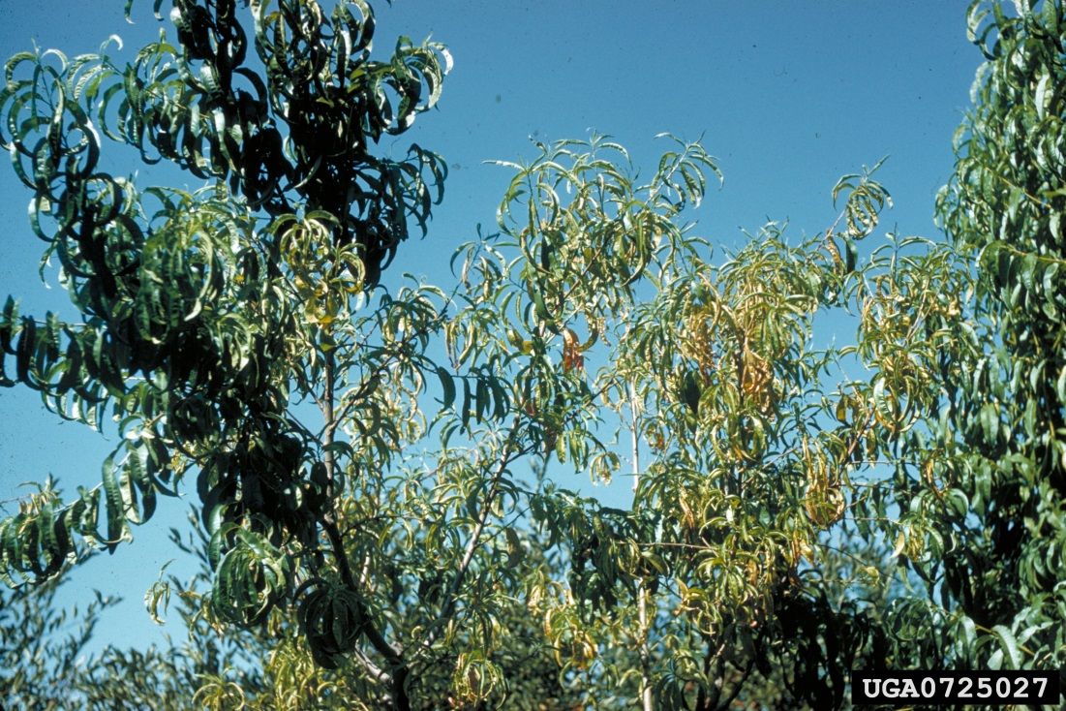
Bacterial Diseases
Peach X symptoms on leaves and stem
Image citations:
Left - F. Dosba, INRA, Bordeaux, www.bugwood.org, #0725208; right - R. Bernhard, INRA, Bordeaux, www.bugwood.org, #0725027
Notes:
Stem –
Symptoms first appear on the infected scaffold. Because the phytoplasma takes 2 years to colonize a mature tree, disease symptoms are irregular (especially in the early stages). Branches are more sensitive to freezing and young trees can die within 3 years after infection. Mature trees usually die after 5 years.
Leaf –
Leaves appear normal until mid-summer when yellow (chlorotic) or necrotic spots that are irregularly distributed can be seen on the leaves of the infected tree. These spots become more numerous over the course of the season. The lesion centers may fall off resulting in a shot-hole like appearance. Leaves are also rolled and pale green in color making the tree look like it has reduced vigor. As the season continues, the leaves appear tattered. The leaves can also fall off the tree at the base of the shoot causing terminal rosetting.
Fruit –
Fruit size and yield are greatly reduced with fruit that develops taking several more days to ripen. The fruit will also lack flavor.
Information sources:
Layne, D.R., and D. Bassi, editors. 2008. The Peach: Botany, Production, and Uses. CABI, Cambridge, Massachusetts.
Ogawa, J.M., editor. 1995. Compendium of Stone Fruit Diseases. American Phytopathological Society Press, St. Paul, Minnesota.

Slide 15
Bacterial Diseases
Managing peach X disease: Cultural control
Managing the vectors
Manage for Colladonus montanus, C. geminates, Fieberiella florii in the western states
Manage for Paraphlepsius irroratus in the eastern and northcentral U.S.
Manage overwintering hosts of these vectors
Removal of dicot weeds and not planting sugarbeets near peach and nectarine trees for Colladonus montanus
Removal of bitter cherry and chokecherry from around orchards for Fieberiella florii
Removal of monocots for Paraphlepsius irroratus
Notes:
The greatest potential for infection occurs in late spring and summer. Transmission of the disease occurs by grafting to several Prunus spp., dodder, periwinkle and other herbaceous plants such as celery, carrot, parsley, tobacco, and tomato.
The primary dissemination of the disease, however, is by leafhoppers, particularly Colladonus montanus, C. geminates, Fieberiella florii, and Paraphlepsius irroratus, as well as some Osbornellus species.
Colladonus montanus, C. geminates, Fieberiella florii seem to be the most important vectors of this disease in the western states, whereas Paraphlepsius irroratus is important in the eastern and northcentral U.S.
The ability for Colladonus montanus to vector the disease increases in orchard areas where sugarbeet or dicot weeds are present. The insect overwinters in sugarbeets and multiplies in the dicot weeds. As the summer progresses and the sugarbeets are harvested and the weeds die off due to summer heat, the insects move to cherry and peach trees. Removal of the dicot weeds can cut down on the insect population as will not planting sugarbeets near the orchard.
In the eastern U.S., the presence of bitter cherry (Prunus emarginata) and chokecherry (P. virginiana) around orchards serve as disease reservoirs from which the cherry leafhopper (F. florii) can then vector. Removal of these plants from within 200m of the orchard decreases the chances of the orchard getting the disease. In addition, the insect reproduces on orchard trees, but also on ornamentals such as privet and boxwood. Removal of these ornamentals can help cut down the insect population.
In areas where P. irroratus is found, the presence of monocots around the orchard increase the chances of this vector spreading the disease since they spend the day in the monocots, then move to peach or other woody hosts at night. Removal of the monocots can cut down on the insect population.
Diseased peach trees should be removed and destroyed as soon as detected. Removal of overwintering material that are used by these vectors surrounding the orchard is an important step in accomplishing this. In addition, removal of plant species that may serve as potential reservoirs will help.
Information sources:
Layne, D.R., and D. Bassi, editors. 2008. The Peach: Botany, Production, and Uses. CABI, Cambridge, Massachusetts.
Ogawa, J.M., editor. 1995. Compendium of Stone Fruit Diseases. American Phytopathological Society Press, St. Paul, Minnesota.

Slide 16
Bacterial Diseases
Managing peach X disease: Chemical control*
Oxytetracycline which can be injected into the trunk or scaffold
Repeated annually only delays the decline of the tree health
Can be cost prohibitive
Only cost effective for unique tree specimens
Controlling the vector populations through insecticides can also help
*Be sure to check with your local county agent to find out which chemicals are certified for use in your state, on what crop it is allowed to be used, if it is allowed to be used post-harvest or pre-harvest, and if it should be applied by a licensed applicator.
Notes:
This disease seems to be sensitive to oxytetracycline which can be injected into the trunk or scaffold. These treatments need to be repeated annually and tree decline will happen anyway (though it will be more gradual). Cost of these treatments may be cost prohibitive and should be used with unique tree specimens. In addition, oxytetracycline causes remission of symptoms but does not eliminate the bacterium, thus propagation from a tree in which symptoms are in remission has a high probability of transmitting the bacterium to any progeny and is not advisable.
Chemical control of the vectors will also help control this disease.
Reduction of spread will occur by elimination of infected trees but “complete control” would require elimination of the many alternate hosts that might harbor X-disease. Rosette disease of peach typically occurs around the edge of an orchard. Even though leafhoppers are strong fliers they do no move the disease very far into the orchard and trees displaying symptoms typically do not emerge from dormancy at the start of the next growing season.
However, be sure to check with your local county agent to find out which chemicals are certified for use in your state, on what crop it is allowed to be used, if it is allowed to be used post-harvest or pre-harvest, and if it should be applied by a licensed applicator
Information sources:
Ogawa, J.M., editor. 1995. Compendium of Stone Fruit Diseases. American Phytopathological Society Press, St. Paul, Minnesota.
Scott, Simon. Personal communication.

Slide 17
Bacterial Diseases
European stone fruit yellows is caused by Candidatus Phytoplasma prunorum
vectored by the psyllid Cacopsylla pruni
It has not been reported in North America
Notes:
European stone fruit yellows (ESFY) is caused by Candidatus Phytoplasma prunorum (the candidatus part means that it has not be cultured in a lab) and vectored by Cacopsylla pruni, a psyllid that is widespread in Europe.
This disease affects several members of the genus Prunus, with some wild members of the genus being highly tolerant of the disease.
It was detected in Europe at the beginning of the 20th century, but has increased its prevalence in Europe in recent decades, becoming especially problematic to apricots, peaches, and Japanese plums grown in countries bordering the Mediterranean Sea. Recent experiments show a wide range of susceptibility among members of the genus Prunus with cherry trees being highly resistant and Japanese plums being very susceptible.
The disease has also been referred to as apricot chlorotic leaf roll, plum leptonecrosis, peach yellows, and peach decline. The vector is known as jumping plant louse and plum psyllid.
CAPS is surveying for this disease in the U.S. This disease cannot be diagnosed by symptoms alone, it must be identified by a lab. It will then be reported to the appropriate authorities as this disease does not occur in the U.S.
Information sources:
Carraro, L. and R. Osler. 2003. European Stone Fruit Yellows: A destructive disease in the Mediterranean basin. Part of Virus and virus-like diseases of stone fruits, with particular reference to the Mediterranean region. Edited by Myrta A. (ed.), Di Terlizzi B. (ed.), Savino V. (ed.) and published by CIHEAM.
accessed 1/25/2012 –
http://ressources.ciheam.org/om/pdf/b45/03001782.pdf
Cieslinska, M. 2011. “European stone fruit yellows disease and its causal agent Candidatus Phytoplasma prunorum”. Journal of Plant Protection Research, vol. 51, no. 4, pp. 441-447.
accessed 1/25/2012 –
http://www.plantprotection.pl/PDF/51(4)/JPPR_51(4)_21_Cieslinska.pdf
Thebaud, G., N. Sauvion, J. Chadoeuf, A. Dufils, and G. Labonne. 2006. “Identifying risk factors for European Stonefruit Yellows from a Survey”. Phytopathology, vol. 96, no. 8, pp. 890-899.
accessed 1/25/2012 –
http://apsjournals.apsnet.org/doi/pdf/10.1094/PHYTO-96-0890
USDA-APHIS. 2011. European Stone Fruit Yellows, Candidatus Phytoplasma prunorum.
accessed 1/25/2012 –
http://caps.ceris.purdue.edu/webfm_send/1077

Slide 18
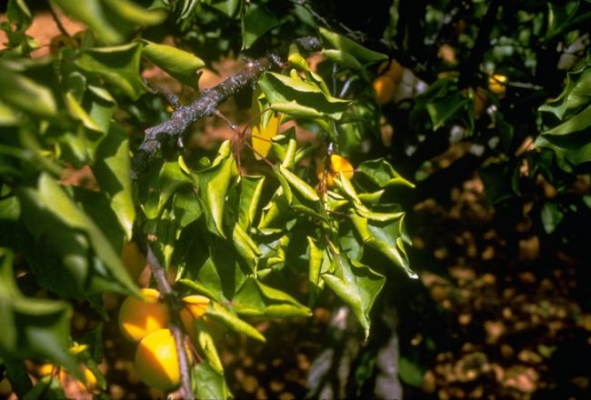
Bacterial Diseases
European stone fruit yellows symptoms on leaves
Image citations:
EPPO - http://photos.eppo.org/index.php/image/829-phyp16-01
Notes:
The symptoms of this disease can vary it their severity.
Stem –
Infected shoots are generally shorter and bear small, deformed leaves. These leaves can drop prematurely and the shoot can die back. In winter temperatures (below -5˚C), infected trees show browning of the middle layer of the bark. In summer, the bark appears dried out.
Flowers –
This disease can cause the tree to produce tiny flowers.
Leaf –
The leaves begin to roll lengthwise, turn yellow (chlorosis), then turn red during over the summer months. The leaves also have abnormal thickening of the midribs and primary veins and may be deformed. The leaf symptoms should be clearly visible in the fall. These leaves also tend to be brittle and will fall of the tree early in the fall.
Fruit –
The tree produces lower yields and the fruit itself develops poorly and may fall prematurely.
The disease can also cause the tree to come out of dormancy too early in the season producing new growth. This increases the chances of frost damage to the tree. It can also cause the decline and eventual death of the tree (usually within 12-24 months of infection).
The image above is of leaf curl on an apricot.
Information sources:
Carraro, L. and R. Osler. 2003. European Stone Fruit Yellows: A destructive disease in the Mediterranean basin. Part of Virus and virus-like diseases of stone fruits, with particular reference to the Mediterranean region. Edited by Myrta A. (ed.), Di Terlizzi B. (ed.), Savino V. (ed.) and published by CIHEAM.
accessed 1/25/2012 –
http://ressources.ciheam.org/om/pdf/b45/03001782.pdf
Cieslinska, M. 2011. “European stone fruit yellows disease and its causal agent Candidatus Phytoplasma prunorum”. Journal of Plant Protection Research, vol. 51, no. 4, pp. 441-447.
accessed 1/25/2012 –
http://www.plantprotection.pl/PDF/51(4)/JPPR_51(4)_21_Cieslinska.pdf
EPPO. Apricot chlorotic leafroll phytoplasma. Data sheets on quarantine Pests.
accessed 1/25/2012 –
http://www.eppo.org/QUARANTINE/bacteria/European_stone_fruit/PHYPPR_ds.pdf
USDA APHIS. 2011. European Stone Fruit Yellows, Candidatus Phytoplasma prunorum.
accessed 1/25/2012 –
http://caps.ceris.purdue.edu/webfm_send/1077

Slide 19
Bacterial Diseases
Managing European stone fruit yellows: Cultural control
Managing the vector of the disease - Cacopsylla pruni
In Europe it has only one generation per year, but that may change if it comes into the U.S.
Managing the winter host of the vector
Using clean budwood
Removal of wild Prunus species which may be reservoirs for this disease is also recommended
Quarantine area established and destruction of infected trees
Notes:
This disease is not curable, so control is based on prevention. Managing the vector will definitely help to control this disease. It has only one generation in Europe which makes it easier to focus chemical control methods for the vector. However, if it becomes established in the U.S., the number of generations it has in a year may change. In addition, because the vector overwinters in conifers in Europe, removal of overwintering hosts of the vector may be prudent.
Using clean budwood is a must. Because this disease can exist in wild species of Prunus, removal of these potential reservoirs from around the orchard will also help. Researchers are looking to see if other plants can also be hosts for this disease.
Research is also underway on resistant cultivars.
Establishment of a quarantine zone and destruction of infected trees (along with some surrounding trees) will probably be what the authorities will require if this disease is detected in the U.S.
Information sources:
Carraro, L. and R. Osler. 2003. European Stone Fruit Yellows: A destructive disease in the Mediterranean basin. Part of Virus and virus-like diseases of stone fruits, with particular reference to the Mediterranean region. Edited by Myrta A. (ed.), Di Terlizzi B. (ed.), Savino V. (ed.) and published by CIHEAM.
accessed 1/25/2012 –
http://ressources.ciheam.org/om/pdf/b45/03001782.pdf
Cieslinska, M. 2011. “European stone fruit yellows disease and its causal agent Candidatus Phytoplasma prunorum”. Journal of Plant Protection Research, vol. 51, no. 4, pp. 441-447.
accessed 1/25/2012 –
http://www.plantprotection.pl/PDF/51(4)/JPPR_51(4)_21_Cieslinska.pdf
EPPO. Apricot chlorotic leafroll phytoplasma. Data sheets on quarantine Pests.
accessed 1/25/2012 –
http://www.eppo.org/QUARANTINE/bacteria/European_stone_fruit/PHYPPR_ds.pdf

Slide 20
Viral Diseases
Plum pox is a potyvirus.
The disease it causes is referred to as Sharka.
Invasive disease
Was detected in Pennsylvania in 1999, declared eradicated in 2009.
Detected in Michigan in 2006, declared eradicated in 2006.
Detected in New York in 2006, under eradication.
Notes:
Plum pox virus (PPV) is a member of the viral genus Potyvirus, in the family Potyviradae. The disease it causes is known as sharka. It can devastate apricots, peaches, nectarines, and plums by reducing fruit quality, causing fruit to drop prematurely, and causing premature death of the tree. Cherries and almonds may be infected occasionally. It also infects wild or ornamental species of Prunus spp. such as sand cherry, Nanking cherry, flowering almond, and buckthorn. It seems to affect early ripening varieties more than later-maturing varieties. Asymptomatic infections can also occur.
There are 2 main groups or types of PPV, Dideron (D) and Marcus (M) (with 4 more minor types also being identified – EA, C, W, and PPV-Rec). The D-strain is less severe, not seed transmitted, and spreads more slowly due to it being spread less efficiently by aphids. It is spread mainly through grafting material. The M-strain is more severe and is spread quite efficiently by aphids. Both strains are present in Europe, while only the D-strain was found in the U.S.
PPV was found in Adams County Pennsylvania in 1999, but due to efforts of the Pennsylvania Department of Agriculture, USDA/APHIS, USDA/ARS, Penn State University, and local growers, it was declared eradicated by the Secretary of Agriculture in October 2009.
In 2006, PPV was detected in Michigan in a single plum tree located at a Michigan State University facility (Benton Harbor, Michigan). The infected tree was destroyed and, through trace-forward and trace-back investigations, no additional trees in Michigan were found to be infected with PPV. Plum pox is considered eradicated in Michigan.
PPV was also detected in New York State in 2006 and is currently under eradication in cooperation with the New York Department of Agriculture and USDA APHIS. State and Federal quarantine regulations have been imposed to prevent the spread of PPV from impacted areas in New York State. AS of now, PPV has been detected in Niagara, Orleans, and Wayne counties.
Diagnosis of the disease must be done in a lab.
Information sources:
Gildow, F.E., J. Halbrendt, J. Harper, L. Kime, W. Kleiner, G. Krawczyk, and J.W. Travis. 2007. Recovery Plan for Plum Pox Virus (Sharka) of Stone Fruits.
accessed 12/22/2011 –
http://www.ars.usda.gov/SP2UserFiles/Place/00000000/opmp/Plum%20Pox%20PPV%2070222.pdf
Layne, D.R., and D. Bassi, editors. 2008. The Peach: Botany, Production, and Uses. CABI, Cambridge, Massachusetts.
Ogawa, J.M., editor. 1995. Compendium of Stone Fruit Diseases. American Phytopathological Society Press, St. Paul, Minnesota.
NAPPO Phytosanitary Alert System. 2009. Pennsylvania declared free of Plum pox virus (PPV) – Removal of Federal quarantine.
Accessed 12/22/2011-
http://www.pestalert.org/oprDetail.cfm?oprID=404&keyword=ppv
USDA APHIS. 2012. Plum Pox.
accessed 7/6/2013
http://www.aphis.usda.gov/plant_health/plant_pest_info/plum_pox/background.shtml

Slide 21
Viral Diseases
Plum pox symptoms on leaves and fruit
Image citations:
Left - Biologische Bundesanstalt für Land- und Forstwirtschaft Archive, Biologische Bundesanstalt für Land- und Forstwirtschaft, www.bugwood.org, #0660084
Right - European and Mediterranean Plant Protection Organization Archive, www.bugwood.org, #0660072
Notes:
Flowers –
Symptoms do not normally appear until three years after infection takes place. Even then, there can be asymptomatic infections.
The first symptom that may be observed however occurs on blossoms. Discoloration of the petals of the peach tree in the form of darker pink stripes are caused by this virus in some peach varieties. However, if bloom time is short, you may miss it.
Leaf –
Symptoms on leaves can vary and include mild, light green discoloration, chlorotic spots, bands or rings, vein clearing or yellowing, and leaf deformation (twisting and distortion). Symptoms usually appear on the first leaves to develop on infected shoots in the spring (look for symptoms on the lower part of the shoot).
Fruit –
Symptoms on fruits manifest as chlorotic spots or underpigmented yellow rings or line patterns, deformity (or at least irregularity) in shape, and small, brown, or necrotic areas. These symptoms can become less pronounced as the fruit matures. Inside the fruit, the flesh becomes brown and quality is reduced (fruit is low in sugar and tasteless). The fruit may even drop prematurely from the tree. The circular pattern may be seen on the stone.
Information sources:
Gildow, F.E., J. Halbrendt, J. Harper, L. Kime, W. Kleiner, G. Krawczyk, and J.W. Travis. 2007. Recovery Plan for Plum Pox Virus (Sharka) of Stone Fruits.
accessed 12/22/2011 –
http://www.ars.usda.gov/SP2UserFiles/Place/00000000/opmp/Plum%20Pox%20PPV%2070222.pdf
Layne, D.R., and D. Bassi, editors. 2008. The Peach: Botany, Production, and Uses. CABI, Cambridge, Massachusetts.
Ogawa, J.M., editor. 1995. Compendium of Stone Fruit Diseases. American Phytopathological Society Press, St. Paul, Minnesota.

Slide 22
Viral Diseases
Managing plum pox virus
Prophylactic measures such as quarantine measures, eradication programs, and using certified virus tested planting material
Varieties bred for resistance are currently being looked at
When detected, the trees will be quarantined and destroyed
With a three year moratorium after the last positive sample on replanting
Notes:
Movement of infected plant propagation material is the most important means of spreading the D-strain of this disease across long distances in the U.S. Aphids can also transmit the disease, though this spread is not persistent as there are non-aphid transmissible isolates out there. In addition, aphids do not necessarily reside or develop on the fruit tree crop. As a result, control of aphid populations through aphicides doesn't’t efficiently protect the orchard from PPV. Grafting also transmits the disease.
The M group tends to be spread more easily by aphids to peach trees than the D group. M group also causes faster epidemics and more severe symptoms in peach than D group. D group also tends to spread naturally in apricot and plum orchards but do not tend to spread from these hosts to peach. This is not a “hard and fast rule” as individual isolates within the groups may react differently under different epidemiological conditions. It is interesting to note that experimental host plants such as service tree and garden pea can be mechanically infected with the disease for experimental purposes.
Prophylactic measures such as quarantine measures, eradication programs, and using certified virus tested planting material seems to be the only option to combat this disease. Efforts at breeding varieties for resistance are currently underway.
Because there is no cure for this disease, growers need to be vigilant about possible PPV symptoms and report them right away to their county extension agent. Those trees that do test positive, as well as the other trees on the orchard block, must be quarantined and destroyed (burned). A three year moratorium after the last positive sample on replanting is also in effect.
Information sources:
Gildow, F.E., J. Halbrendt, J. Harper, L. Kime, W. Kleiner, G. Krawczyk, and J.W. Travis. 2007. Recovery Plan for Plum Pox Virus (Sharka) of Stone Fruits.
accessed 12/22/2011 –
http://www.ars.usda.gov/SP2UserFiles/Place/00000000/opmp/Plum%20Pox%20PPV%2070222.pdf
Layne, D.R., and D. Bassi, editors. 2008. The Peach: Botany, Production, and Uses. CABI, Cambridge, Massachusetts.
Ogawa, J.M., editor. 1995. Compendium of Stone Fruit Diseases. American Phytopathological Society Press, St. Paul, Minnesota.

Slide 23
Nematode Pests
Root knot nematode
Root lesion nematode
Notes:
Root knot nematodes are widespread throughout the United States, however, different species of root knot nematodes are found in different regions and cause problems with peaches and nectarines.
Root lesion nematodes also have different species that are problematic in different areas of the united States, though they seem to be more problematic in sandy loam areas.

Slide 24
Nematode Pests
The fruit of peaches and nectarines can be affected directly by the root-knot nematode.
Meloidogyne arenaria, M. incognita, and M. javanica are the main ones
Prevalent in areas with sandy soils
Image citations:
Tesfamariam Mengistu, Department of Entomology and Nematology, University of Florida
Notes:
The fruit of peaches and nectarines can be affected directly by nematodes such as the root-knot nematode. The three main species of concern are Meloidogyne arenaria, M. incognita, and M. javanica. Meloidogyne hapla is another root-knot nematode that can be a significant pest of stonefruits in cooler climates. In addition, there has been reported a new species of root-knot nematode (M. floridensis) which has the common name of peach root-knot nematode. It is found in Florida, though the exact distribution of this species has not been determined.
Root-knot nematodes are found in temperate, tropical, and equatorial regions and cause many rootstock diseases. They are dispersed in rooted cuttings and seedlings that are sold and shipped in the plant trade. They are endoparasites that have a wide host range (they can even develop on weed species found on the orchard floor). The three main species discussed here reproduce by parthenogenesis and are especially troublesome in areas with sandy soils.
These nematodes have also been implicated in peach disease complexes in association with bacteria and fungi.
Information sources:
Layne, D.R., and D. Bassi, editors. 2008. The Peach: Botany, Production, and Uses. CABI, Cambridge, Massachusetts.
Ogawa, J.M., editor. 1995. Compendium of Stone Fruit Diseases. American Phytopathological Society Press, St. Paul, Minnesota.

Slide 25
Nematode Pests
Description of root-knot nematode
Adult female
eggs
Adult female and eggs that have been removed from the root
Adult females
Image citations:
Tesfamariam Mengistu, Department of Entomology and Nematology, University of Florida
Notes:
Nematodes are non-segmented roundworms with bilateral symmetry and no appendages. They are microscopic and threadlike in shape (for the most part).
Eggs are laid in gelatinous egg masses (consisting of between 200 to 1000 eggs) in the soil or on plant residues. The mobile juveniles hatch from the egg and penetrate the tip of the root where they migrate between the plant cells within root tissues. They begin feeding in areas that will become vascular tissue (the areas that transport nutrients, water, and food to all parts of the plant). Mature females become very rotund (filled with reproductive tissue), while males do not. The typical life cycle lasts 4 weeks, but can be longer if the temperature and host environment are not favorable for development. The eggs can survive for several years in the egg masses in temperate regions.
Information sources:
Horton, D. and D. Johnson, editors. 2011. Southeastern Peach Growers' Handbook. University of Georgia Extension and Outreach.
accessed 12/15/2011 –
http://www.ent.uga.edu/peach/peachhbk/toc.htm
Layne, D.R., and D. Bassi, editors. 2008. The Peach: Botany, Production, and Uses. CABI, Cambridge, Massachusetts.
Ogawa, J.M., editor. 1995. Compendium of Stone Fruit Diseases. American Phytopathological Society Press, St. Paul, Minnesota.

Slide 26
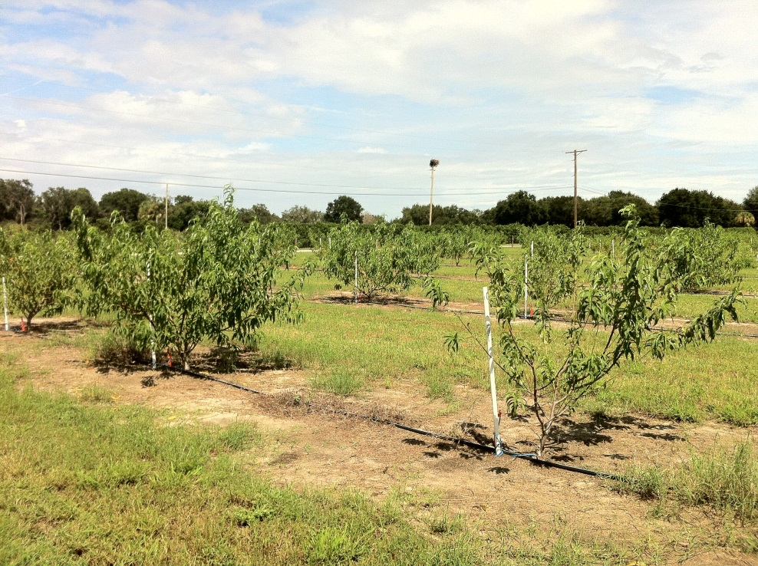
Nematode Pests
Root-knot nematode damage on leaves and roots
Image citations:
Left – Mercy Olmstead, Department of Plant Pathology, University of Florida
Right – Tesfamariam Mengistu, Department of Entomology and Nematology, University of Florida
Notes:
Leaves –
Above ground symptoms can vary. Usually, the overall vigor of the tree is reduced (because the nutrient uptake by the nematodes suppresses plant development) and leaves fall off the tree which further reduces yield. The growth of the tree above ground is usually also stunted. Those trees planted in sandy soil have greater symptom expression, especially during times of drought.
Roots –
The root symptoms occur even in the absence of above ground symptoms. These nematodes cause galls to grow on the root and stunts the growth of young peach trees by interrupting nutrient and water uptake. This also reduces the root biomass. Young trees without much root development are very susceptible to tree death.
Information sources:
Horton, D. and D. Johnson, editors. 2011. Southeastern Peach Growers' Handbook. University of Georgia Extension and Outreach.
accessed 12/15/2011 –
http://www.ent.uga.edu/peach/peachhbk/toc.htm
Layne, D.R., and D. Bassi, editors. 2008. The Peach: Botany, Production, and Uses. CABI, Cambridge, Massachusetts.
Ogawa, J.M., editor. 1995. Compendium of Stone Fruit Diseases. American Phytopathological Society Press, St. Paul, Minnesota.

Slide 27
Nematode Pests
Managing root-knot nematode: Cultural and Chemical control*
Cultural
To reduce nematode levels before planting
leave the orchard fallow or plant a non-host species (such as cereal grains)
Plant desirable cultivars on resistant rootstock
Control weedy species that may be hosts
Chemical
Metam sodium and 1,3 dichloropropene have been recommended prior to planting
Fumigation may or may not be an option
*Be sure to check with your local county agent to find out which chemicals are certified for use in your state, on what crop it is allowed to be used, if it is allowed to be used post-harvest or pre-harvest, and if it should be applied by a licensed applicator.
Notes:
These species cannot be identified based on the galling symptoms that they produce. They must be identified using morphological, morphometrical, and electrophoresis techniques.
There are several options available to manage nematode populations in your orchard. Prior to planting, it is best to leave the orchard fallow or plant a non-host species (such as cereal grains) so that the nematode populations fall to nondetectable levels. Controlling weedy species in your orchard that might be a host for these nematodes is also recommended.
The only other alternative is to use resistant rootstock created using peach germplasm such as Nemaguard, Bokhara, Okinawa, Shalil, S-37, Higama, Nemared, Guardian, Hansen 2168, Hansen 536, and Floraguard. However, these rootstocks that are resistant to root-knot nematodes may be susceptible to other nematodes such as ring nematodes.
You may be able to fumigate the orchard before planting (easier) or use non-fumigant nematicides after planting, but these chemicals are being phased out in favor of non-chemical controls. Metam sodium and 1,3 dichloropropene have been recommended prior to planting while sodium tetrathiocarbonate has been recommended after planting.
Be sure to check with your local county agent to find out which chemicals are certified for use in your state, on what crop it is allowed to be used, if it is allowed to be used post-harvest or pre-harvest, and if it should be applied by a licensed applicator. Also, be sure to follow application directions and to alternate the modes of action of any chemical treatments to reduce the potential for the development of pesticide resistant organisms.
Information sources:
Horton, D. and D. Johnson, editors. 2011. Southeastern Peach Growers' Handbook. University of Georgia Extension and Outreach.
accessed 12/15/2011 –
http://www.ent.uga.edu/peach/peachhbk/toc.htm
Layne, D.R., and D. Bassi, editors. 2008. The Peach: Botany, Production, and Uses. CABI, Cambridge, Massachusetts.
Ogawa, J.M., editor. 1995. Compendium of Stone Fruit Diseases. American Phytopathological Society Press, St. Paul, Minnesota.
Westerdahl, B.B., M.V. McKenry, and R.A. Duncan. 2010. Peach - Nematodes. UC IPM Online.
accessed 12/29/2011.
http://www.ipm.ucdavis.edu/PMG/r602200111.html

Slide 28
Nematode Pests
The fruit of peaches and nectarines can be affected directly by the root-lesion nematode.
Pratylenchus vulnus found in warmer climates
P. penetrans found in cooler climates and higher elevations
Cause more damage in sandy loam areas
Image citations:
Tesfamariam Mengistu, Department of Entomology and Nematology, University of Florida
Notes:
The fruit of peaches and nectarines can be affected directly by nematodes such as the root-lesion nematode (Pratylenchus vulnus and P. penetrans). Pratylenchus vulnus is typically found in warmer climates while P. penetrans is found in cooler climates and higher elevations. Both cause more damage in sandy loam areas.
They are migratory endoparasites that cause damage from movement inside and around plant cells. They can also exit and re-enter the root repeatedly.
There are over 80 hosts for P. vulnus and over 350 hosts for P. penetrans. Most of these hosts are woody perennials.
Information sources:
Layne, D.R., and D. Bassi, editors. 2008. The Peach: Botany, Production, and Uses. CABI, Cambridge, Massachusetts.
Ogawa, J.M., editor. 1995. Compendium of Stone Fruit Diseases. American Phytopathological Society Press, St. Paul, Minnesota.

Slide 29
Nematode Pests
Description of root-lesion nematode
Image citations:
Tesfamariam Mengistu, Department of Entomology and Nematology, University of Florida
Notes:
Nematodes are non-segmented roundworms with bilateral symmetry and no appendages. They are microscopic and threadlike in shape (for the most part).
These nematodes reproduce sexually. Adult females lay eggs singly (not in masses) over the course of 35 days within individual living root cells. Once the egg hatches, the juveniles emerge and begin feeding. Their life spans ranges from 30 to 86 days depending on the temperature.
Again, dispersal of these nematodes relies mainly on the plant trade, but can also result during the transportation of machinery which has contaminated soil on it.
Information sources:
Horton, D. and D. Johnson, editors. 2011. Southeastern Peach Growers' Handbook. University of Georgia Extension and Outreach.
accessed 12/15/2011 –
http://www.ent.uga.edu/peach/peachhbk/toc.htm
Layne, D.R., and D. Bassi, editors. 2008. The Peach: Botany, Production, and Uses. CABI, Cambridge, Massachusetts.
Ogawa, J.M., editor. 1995. Compendium of Stone Fruit Diseases. American Phytopathological Society Press, St. Paul, Minnesota.

Slide 30
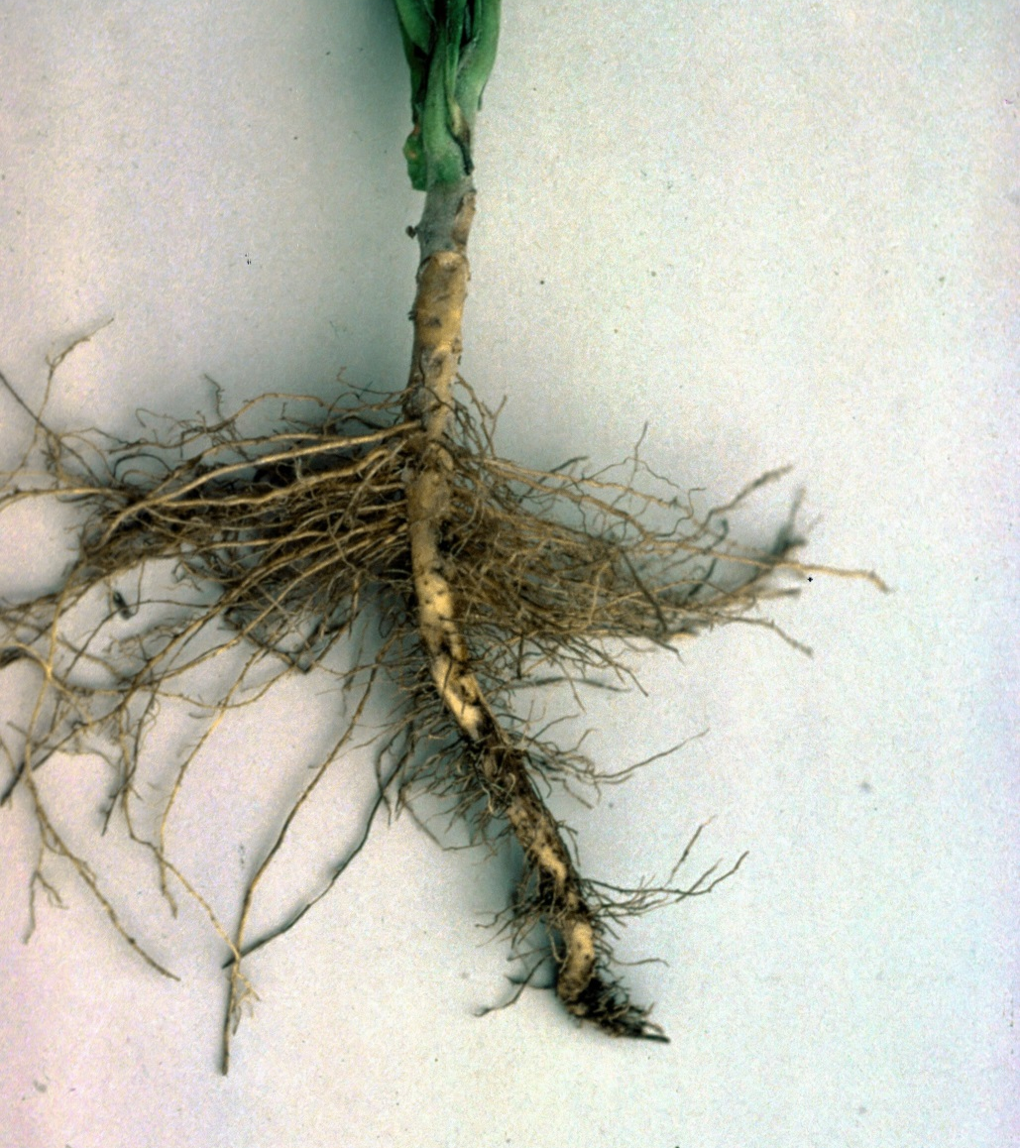
Nematode Pests
Root-lesion nematode damage to roots
Image citations:
R.J. Reynolds Tobacco Company Slide Set, R.J. Reynolds Tobacco Company, www.bugwood.org, #1402035
Notes:
Stem –
Above ground symptoms look like nutrient deficiency that includes reduced shoot growth and overall reduced tree vigor which leads to reduced fruit size.
Root –
The nematodes reduce the number of feeder roots, darkens the roots, and causes necrotic lesions on the roots. This can ultimately result in the death of the root. The symptoms are more common in younger trees than older ones.
The image above is of root lesion damage to tobacco.
Information sources:
Horton, D. and D. Johnson, editors. 2011. Southeastern Peach Growers' Handbook. University of Georgia Extension and Outreach.
accessed 12/15/2011 –
http://www.ent.uga.edu/peach/peachhbk/toc.htm
Layne, D.R., and D. Bassi, editors. 2008. The Peach: Botany, Production, and Uses. CABI, Cambridge, Massachusetts.
Ogawa, J.M., editor. 1995. Compendium of Stone Fruit Diseases. American Phytopathological Society Press, St. Paul, Minnesota.

Slide 31
Nematode Pests
Managing root-lesion nematode: cultural and chemical control*
Cultural
To reduce nematode levels before planting
leave the orchard fallow or plant a non-host species (such as cereal grains)
Plant resistant cultivars
Control weedy species that may be hosts
Chemical
Metam sodium and 1,3 dichloropropene have been recommended prior to planting
Fumigation may or may not be an option
*Be sure to check with your local county agent to find out which chemicals are certified for use in your state, on what crop it is allowed to be used, if it is allowed to be used post-harvest or pre-harvest, and if it should be applied by a licensed applicator.
Notes:
These species cannot be identified based on the galling symptoms that they produce. They must be identified using morphological, morphometrical, and electrophoresis techniques.
There are several options available to manage nematode populations in your orchard. Prior to planting, it is best to leave the orchard fallow or plant a non-host species so that the nematode populations fall to nondetectable levels. Controlling weedy species in your orchard that might be a host for these nematodes is also recommended.
Development of resistant rootstock has not been successful, but tolerant rootstock includes Rutgers Red Leaf, Tzim Pee Tao, Bailey, BY520-8, Higama, and Guardian.
Fumigation before planting and nematicide application after planting provide goods control of these nematodes, however these chemicals are being phased out in favor of non-chemical controls. Metam sodium and 1,3 dichloropropene have been recommended prior to planting while sodium tetrathiocarbonate has been recommended after planting.
Be sure to check with your local county agent to find out which chemicals are certified for use in your state, on what crop it is allowed to be used, if it is allowed to be used post-harvest or pre-harvest, and if it should be applied by a licensed applicator. Also, be sure to follow application directions and to alternate the modes of action of any chemical treatments to reduce the potential for the development of pesticide resistant organisms.
Information sources:
Horton, D. and D. Johnson, editors. 2011. Southeastern Peach Growers' Handbook. University of Georgia Extension and Outreach.
accessed 12/15/2011 –
http://www.ent.uga.edu/peach/peachhbk/toc.htm
Layne, D.R., and D. Bassi, editors. 2008. The Peach: Botany, Production, and Uses. CABI, Cambridge, Massachusetts.
Ogawa, J.M., editor. 1995. Compendium of Stone Fruit Diseases. American Phytopathological Society Press, St. Paul, Minnesota.
Westerdahl, B.B., M.V. McKenry, and R.A. Duncan. 2010. Peach - Nematodes. UC IPM Online.
accessed 12/29/2011.
http://www.ipm.ucdavis.edu/PMG/r602200111.html

Slide 32
Comparing root galls and mycorrhizae
Root galls
Mycorrhizae
Image citations:
Tesfamariam Mengistu, Department of Entomology and Nematology, University of Florida
Notes:
Root galls and mycorrhizae look similar, but there are some important characteristics that should be noted. Mycorrhizae are located on the outside of the root and they can be removed fairly easily. Root galls are swellings within the root tissue and cannot be stripped away from the root itself. Mycorrhizae are good for the plant, root-knot nematodes and root lesion nematodes are not.
Information sources:
Tesfamariam Mengistu, Department of Entomology and Nematology, University of Florida

Slide 33
Questions?
For more information, check out www.protectingusnow.org
You can also contact:
Amanda Hodges, University of Florida, achodges@ufl.edu
Stephanie D. Stocks, University of Florida, sstocks@ufl.edu

Slide 34
Author Credits and Date of Publication
Stephanie Stocks, M.S., Assistant –In, Extension Scientist, Department of Entomology and Nematology, University of Florida
Mercy Olmstead, Ph.D., Assistant Professor, Horticultural Sciences Department, University of Florida
Guido Schnabel, Ph.D., Professor & Plant Pathologist, School of Agricultural, Forest & Environmental Sciences, Clemson University
Scott Simon, Ph.D., Professor of Plant Pathology, Entomology, Soils and Plant Sciences, Clemson University
July 2013

Slide 35
Reviewers Credits
Amanda Hodges, Ph.D., Associate Extension Scientist, Department of Entomology and Nematology, University of Florida
Stephen Mclean, DPM, Department of Entomology and Nematology, University of Florida
Tesfamariam Mekete Mengistu, Ph.D., Entomology and Nematology Department, University of Florida.

Slide 36
Educational Disclaimer and Citation
This presentation can be used for educational purposes for NON-PROFIT workshops, trainings, etc.
Citation:
Stocks, S., M. Olmstead, G. Schnabel, and S. Simon. 2013. Common and Exotic Diseases and Pests of Stonefruits: Peaches and Nectarines – Bacteria, Viruses, and Nematodes. accessed (add the date) – www.protectingusnow.org.

Slide 37
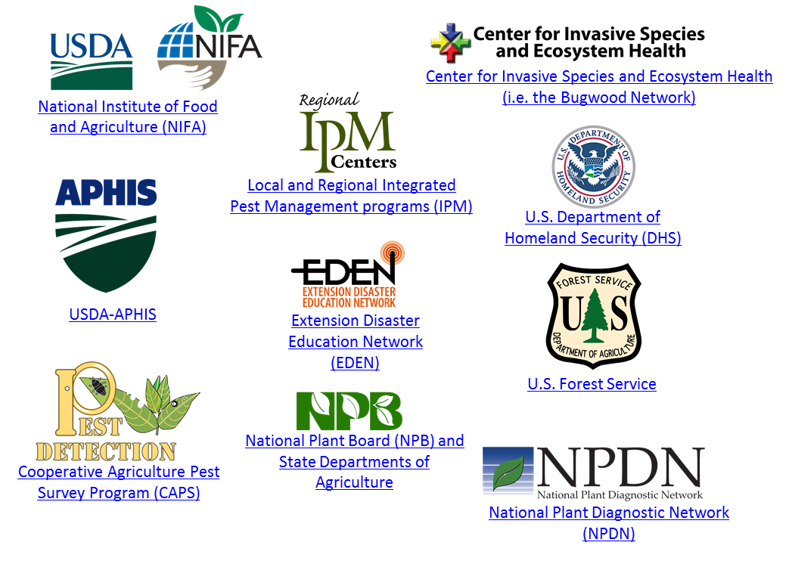
Our Partners
Much of the authorship of e-learning content has occurred through partnerships. Some of our partnering organizations have included:

Slide 38
References
Anonymous. 2010. 2011 North Carolina Agricultural Chemicals Manual. North Carolina Cooperative Extension Service. accessed 12/15/2011 –
http://ipm.ncsu.edu/agchem/agchem.html
Boudon. S., C. Manceau, and J.L. Notteghem. 2005. Structure and origin of Xanthomonas arboricola pv. pruni populations causing bacterial spot of stone fruit trees in Western Europe. Phytopathology, vol. 95, no. 9, pp. 1081-1088.
Carraro, L. and R. Osler. 2003. European Stone Fruit Yellows: A destructive disease in the Mediterranean basin. Part of Virus and virus-like diseases of stone fruits, with particular reference to the Mediterranean region. Edited by Myrta A. (ed.), Di Terlizzi B. (ed.), Savino V. (ed.) and published by CIHEAM. accessed 1/25/2012 –
http://ressources.ciheam.org/om/pdf/b45/03001782.pdf
Cieslinska, M. 2011. “European stone fruit yellows disease and its causal agent Candidatus Phytoplasma prunorum”. Journal of Plant Protection Research, vol. 51, no. 4, pp. 441-447. accessed 1/25/2012 –
http://www.plantprotection.pl/PDF/51(4)/JPPR_51(4)_21_Cieslinska.pdf
D.K. Books. 2011. Great Fruit and Vegetable Guide. New York.

Slide 39
References
EPPO. Apricot chlorotic leafroll phytoplasma. Data sheets on quarantine Pests. accessed 1/25/2012 –
http://www.eppo.org/QUARANTINE/bacteria/European_stone_fruit/PHYPPR_ds.pdf
Gildow, F.E., J. Halbrendt, J. Harper, L. Kime, W. Kleiner, G. Krawczyk, and J.W. Travis. 2007. Recovery Plan for Plum Pox Virus (Sharka) of Stone Fruits. accessed 12/22/2011 –
http://www.ars.usda.gov/SP2UserFiles/Place/00000000/opmp/Plum%20Pox%20PPV%2070222.pdf
Horton, D. and D. Johnson, editors. 2011. Southeastern Peach Growers' Handbook. University of Georgia Extension and Outreach. accessed 12/15/2011 –
http://www.ent.uga.edu/peach/peachhbk/toc.htm
Jiang, Y.P.; Chen, T.A.; Chiykowski, L.N.; Sinha, R.C. (1989) Production of monoclonal antibodies to peach eastern X-disease agent and their use in disease detection. Canadian Journal of Plant Pathology 11, 325-331.
Layne, D.R., and D. Bassi, editors. 2008. The Peach: Botany, Production, and Uses. CABI, Cambridge, Massachusetts.

Slide 40
References
NAPPO Phytosanitary Alert System. 2009. Pennsylvania declared free of Plum pox virus (PPV) – Removal of Federal quarantine. Accessed 12/22/2011-
http://www.pestalert.org/oprDetail.cfm?oprID=404&keyword=ppv
Ogawa, J.M., editor. 1995. Compendium of Stone Fruit Diseases. American Phytopathological Society Press, St. Paul, Minnesota.
Thebaud, G., N. Sauvion, J. Chadoeuf, A. Dufils, and G. Labonne. 2006. “Identifying risk factors for European Stonefruit Yellows from a Survey”. Phytopathology, vol. 96, no. 8, pp. 890-899. accessed 1/25/2012 –
http://apsjournals.apsnet.org/doi/pdf/10.1094/PHYTO-96-0890
USDA-APHIS. 2011. European Stone Fruit Yellows, Candidatus Phytoplasma prunorum. accessed 1/25/2012 –
http://caps.ceris.purdue.edu/webfm_send/1077
USDA APHIS. 2012. Plum Pox. accessed 7/6/2013
http://www.aphis.usda.gov/plant_health/plant_pest_info/plum_pox/background.shtml

Slide 41
References
USDA-ERS. Spreadsheet A-5, A-8, and A-18. accessed 12/30/2011 –
http://usda.mannlib.cornell.edu/MannUsda/viewDocumentInfo.do?documentID=1377
Westerdahl, B.B., M.V. McKenry, and R.A. Duncan. 2010. Peach - Nematodes. UC IPM Online. accessed 12/29/2011.
http://www.ipm.ucdavis.edu/PMG/r602200111.html

