Slide 1
Thousand Cankers Disease

Slide 2
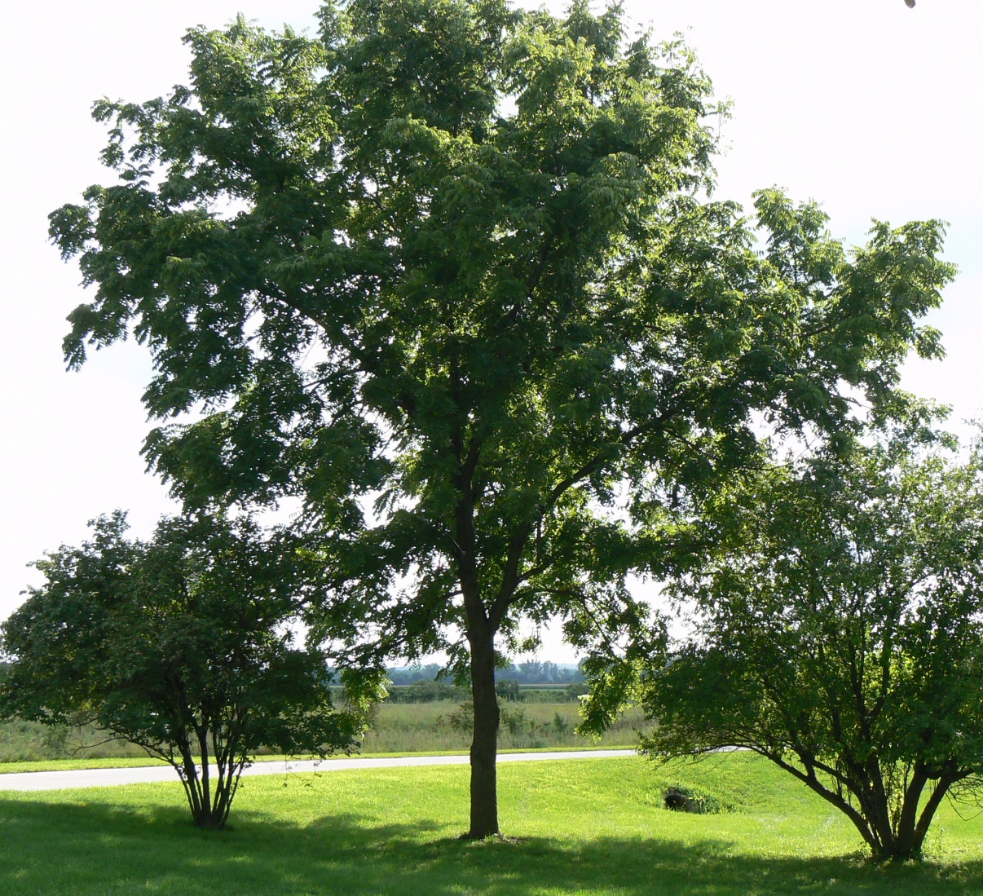
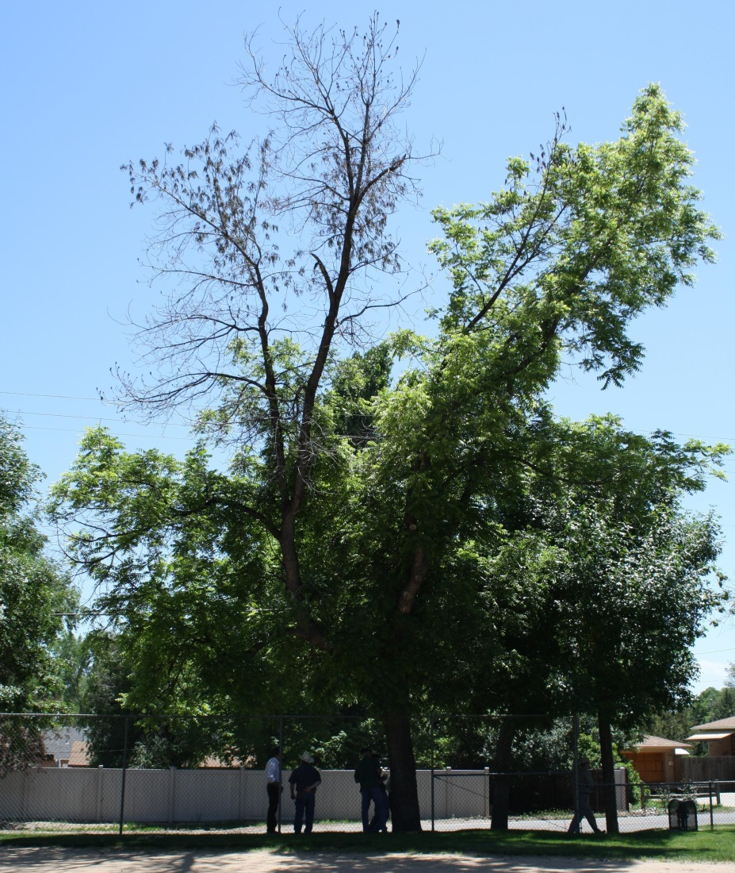
Introduction
Healthy Tree (left) and declining tree (right)
Image credits:
Healthy tree – wikimedia commons; Dying tree - Karen Snover-Clift, Cornell University, ww.bugwood.org, #5458329;
Notes:
There are fifteen species of walnut that are found in the United States, some of which are native, while others are imports that have been planted for ornamental or commercial purposes. Among them is the black walnut tree (Juglans nigra). Black walnut is native to the eastern United States where they typically occur in small clusters or as scattered individuals in mixed hardwood stands where they are an important component of riparian communities. The tree is also a common urban tree in older neighborhoods.
The nuts of black walnut trees are important sources of food for wildlife. The distinctive flavor of their nuts also means that they are sought-after as a specialty ingredient in ice cream and baked goods. These trees are also commercially important as timber products used in cabinetry, gunstocks, and other wood products. The extremely hard shells of the nuts are sold as an abrasive with many industrial applications.
Black walnuts, while found in the Eastern United States, has also been widely planted in the western United States, mostly as an ornamental, but also for timber and nut production.
As early as 2001, people began to see a decline in the health (that led to the eventual death) of those black walnut trees planted in the western United States. This decline in tree health was first attributed to drought conditions (especially with the drought of 2000-2003). However, trees that received irrigation during this drought were also declining in health. Later, when levels of rainfall returned to normal in 2004, black walnut trees continued to die and an alternative explanation was sought.
References:
Reid, W., M. Coggeshall, H. E. Garrett, J. Van Sambeek. 2009. Growing black walnut for nut production. University of Missouri, Center for Agroforestry, Technology Transfer and Outreach Unit.
accessed 3/25/2013 –
http://extension.missouri.edu/explorepdf/agguides/agroforestry/af1011.pdf
Shifley, S. R. 2004. The black walnut resource in the United States. Proceedings of the 6th Walnut Council research symposium, July 25-28, 2004; Lafayette, IN. Pp. 168-176.
accessed 3/25/2013 –
http://nrs.fs.fed.us/pubs/gtr/gtr_nc243/gtr_nc243_168.pdf
Tisserat, N., W. Cranshaw, D. Leatherman, C. Utley, and K. Alexander. 2009. Black walnut mortality in Colorado caused by the walnut twig beetle and thousand cankers disease. Online. Plant Health Progress doi:10.1094/PHP-2009-0811-01-RS.
accessed 3/25/2013 –
http://www.plantmanagementnetwork.org/pub/php/research/2009/walnut/
USDA Plant Database. 2013. Juglans.
accessed 3/31/2013 –
http://plants.usda.gov/java/profile?symbol=JUGLA

Slide 3
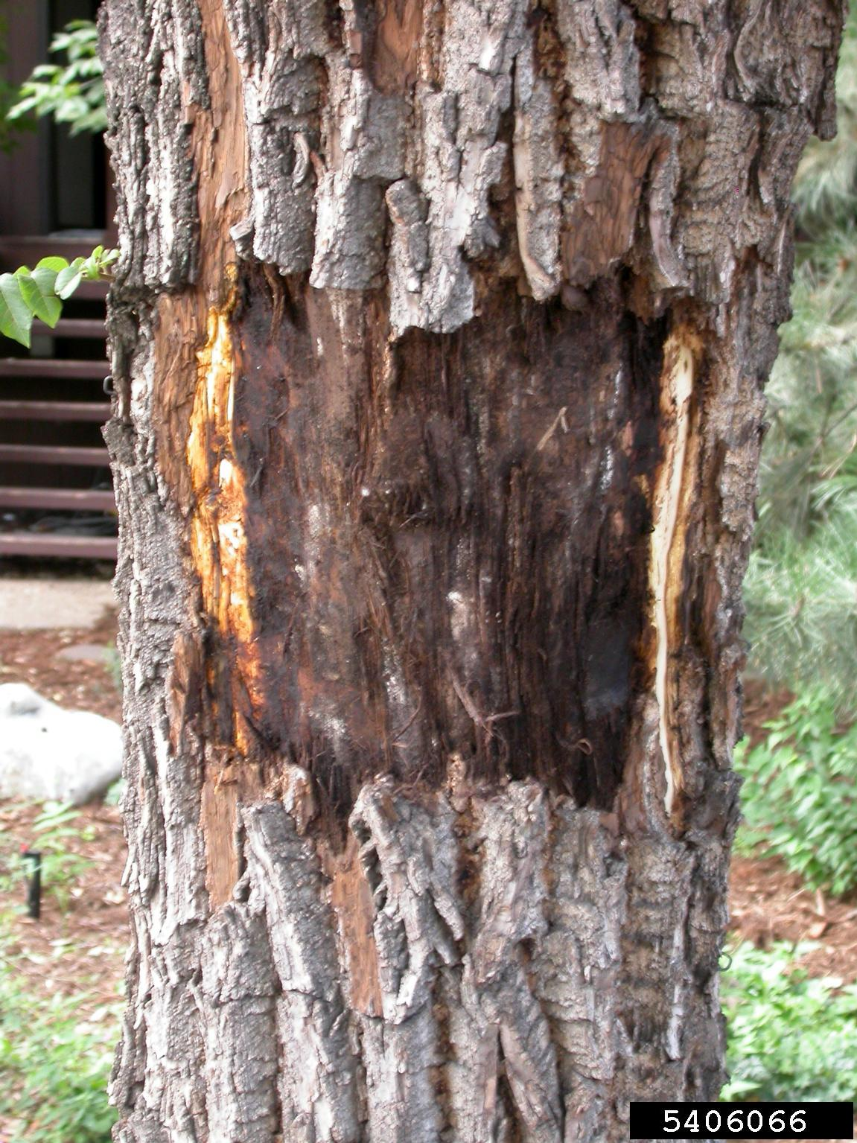
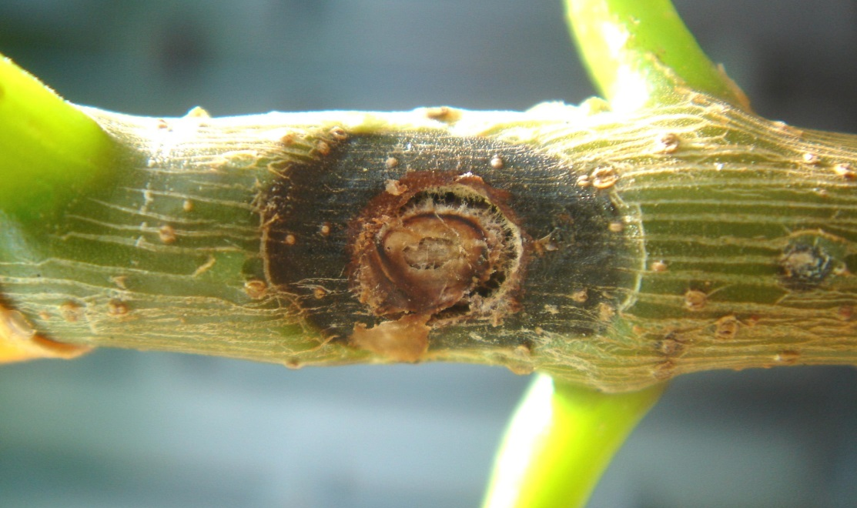
Thousand Cankers Disease (TCD)
Cankers caused by thousand cankers disease
Image credits:
Right - Curtis Utley, CSUE, www.bugwood.org, #5406077 and left - Whitney Cranshaw, Colorado State University, www.bugwood.org, #5406066
Notes:
Upon further examination, it turns out that the decline and death of the black walnut trees is actually caused by a previously unknown fungus (since described as Geosmithia morbida ). The disease caused by this fungus is named after the symptoms it creates (shown above) – thousand cankers disease (TCD).
This fungus was first described after it had been isolated from dying and diseased trees. Presumably, the fungus itself is native to the western United States, but remained undiscovered until it began to cause tree death in black walnuts (a recently introduced species).
The virulence of this fungus in black walnut trees in western states has serious implications for black walnut trees in their native range in the eastern U.S. as well as other walnut species (especially the non-native ones) that are grown throughout the U.S. (such as English walnuts - Juglans regia). These trees are grown commercially in some areas in the U.S.
In this presentation, we will discuss the biology, the current status, economic ramifications, and efforts to control the spread of the disease in the U.S. By the end of the presentation, we hope you recognize the potential importance of this insect-pathogen complex, how to identify it, and who to contact with that information.
References:
Kolarik, M., E. Freeland, C. Utley, and N. Tisserat. 2011. Geosmithia morbida sp. nov., a new phytopathogenic species living in symbiosis with the walnut twig beetle (Pityophthorus juglandis) on Juglans in USA. Mycologia 103(2); 325-332.
accessed 3/25/2013 –
http://www.mycologia.org/content/103/2/325.full
Seybold, S., D. Haugen, and A. Graves. 2010. Pest alert: Thousand cankers disease. United States Department of Agriculture, Forest Service, Northeastern Area State and Private Forestry.
accessed 3/25/2013 –
http://na.fs.fed.us/pubs/palerts/cankers_disease/thousand_cankers_disease_screen_res.pdf
Tisserat, N., W. Cranshaw, D. Leatherman, C. Utley, and K. Alexander. 2009. Black walnut mortality in Colorado caused by the walnut twig beetle and thousand cankers disease. Online. Plant Health Progress doi:10.1094/PHP-2009-0811-01-RS.
accessed 3/25/2013 –
http://www.plantmanagementnetwork.org/pub/php/research/2009/walnut/

Slide 4
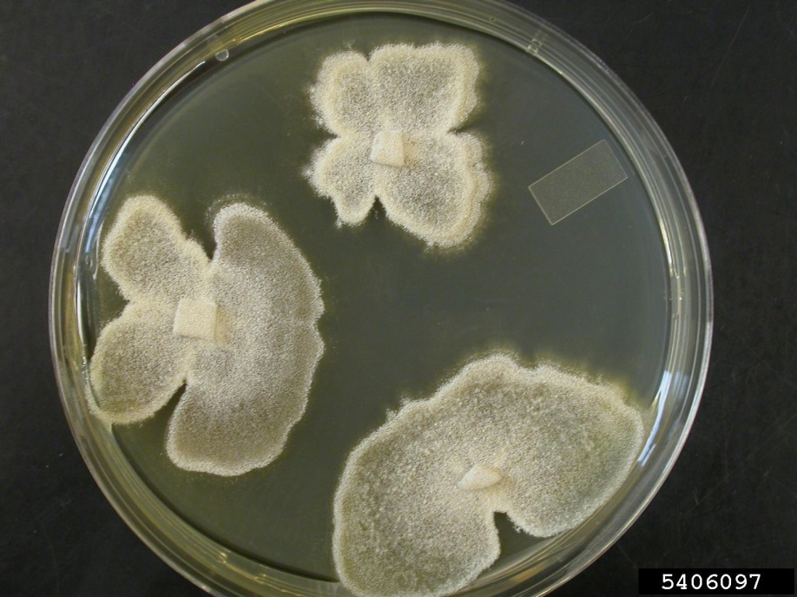
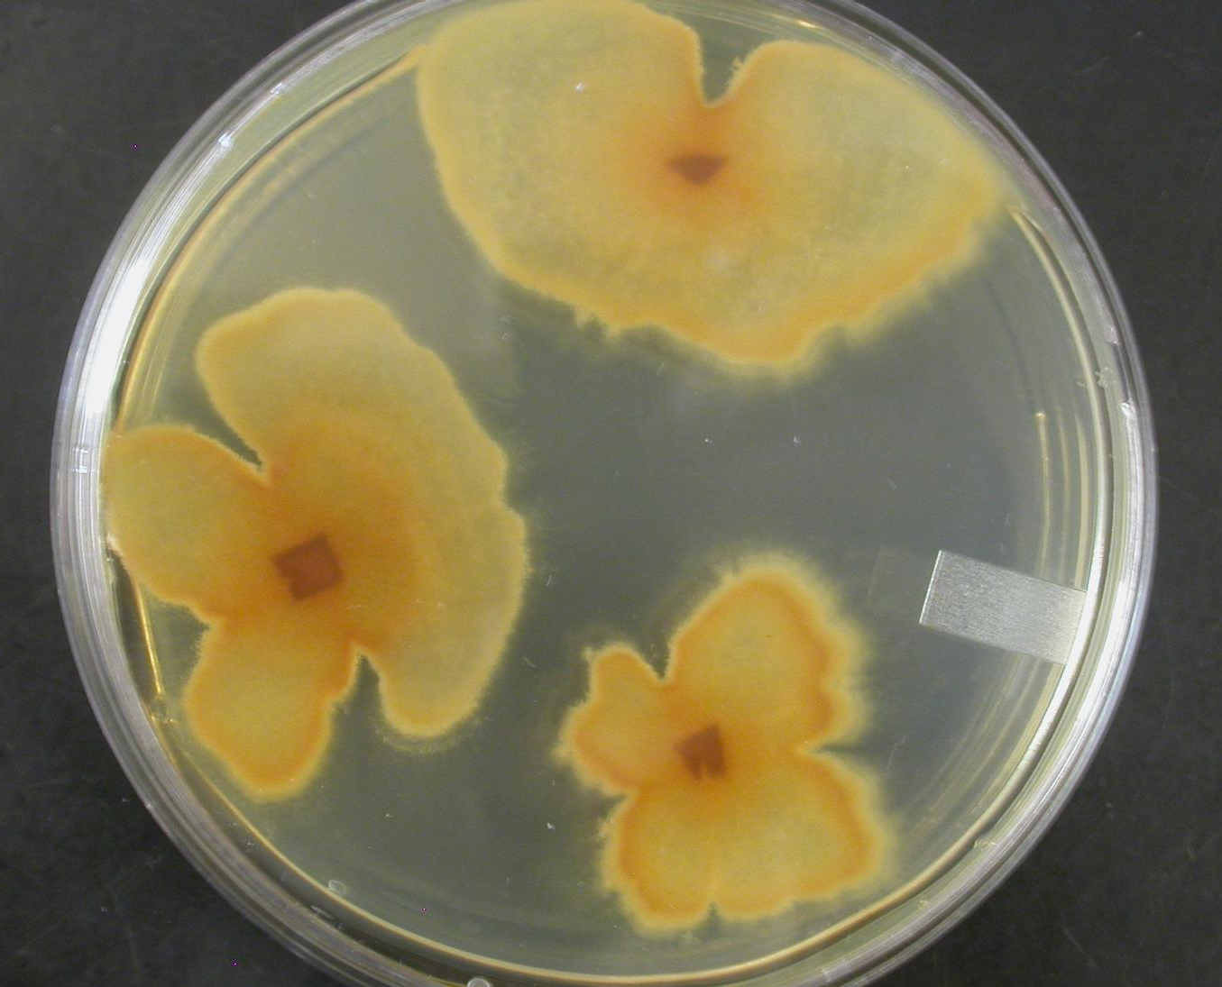
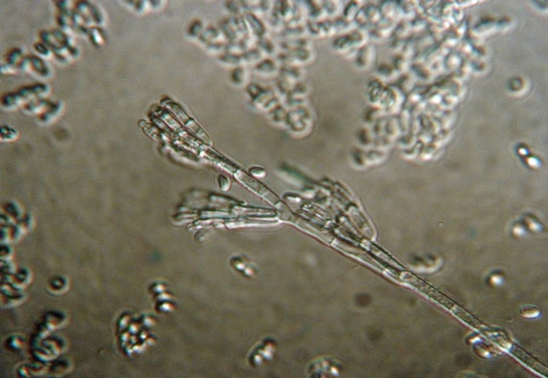
The fungal pathogen
Fungus in culture – dorsal view (top left) .
Fungus in culture – ventral view (right).
Conidiophores (bottom left).
Image credits:
Fungus in culture - Ned Tisserat, Colorado State University, www.bugwood.org, #5406098 and #54060997; asexual spores - Alan Windham, University of Tennessee.
Notes:
Geosmithia is a genus of fungi comprised of 22 known species and approximately 20 more unpublished species. Although most species of Geosmithia are associated with beetles that feed on phloem, Geosmithia morbida is the first description of a fungus in this genus that is a phytopathogen and directly harmful to the host plant.
This fungus eventually kills the eastern black walnut trees it infects. As an obligate parasite, they require a vector, the walnut twig beetle, to infect the host plant to complete the life cycle. To date, Geosmithia morbida has been cultured only from walnut twig beetles or cankers on walnut trees. Thus, it is believed that the fungus is specialist on walnuts.
Reference:
Freeland, Emily. 2012. Intraspecific variability of Geosmithia morbida the causal agent of thousand cankers disease, and effects of temperature, isolate and host family (Juglans nigra) on canker development. Masters Thesis.
accessed 3/26/2013 –
http://digitool.library.colostate.edu///exlibris/dtl/d3_1/apache_media/L2V4bGlicmlzL2R0bC9kM18xL2FwYWNoZV9tZWRpYS8xNjQwNzM=.pdf
Kolarik, M., E. Freeland, C. Utley, and N. Tisserat. 2011. Geosmithia morbida sp. nov., a new phytopathogenic species living in symbiosis with the walnut twig beetle (Pityophthorus juglandis) on Juglans in USA. Mycologia 103(2); 325-332.
accessed 3/25/2013 –
http://www.mycologia.org/content/103/2/325.full

Slide 5
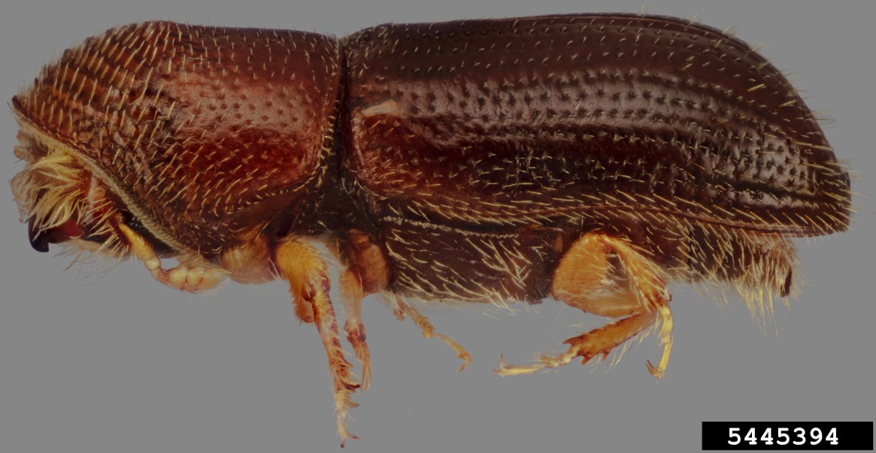
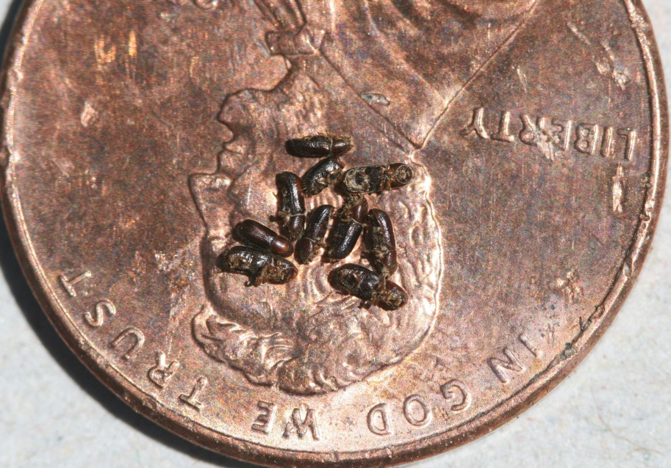
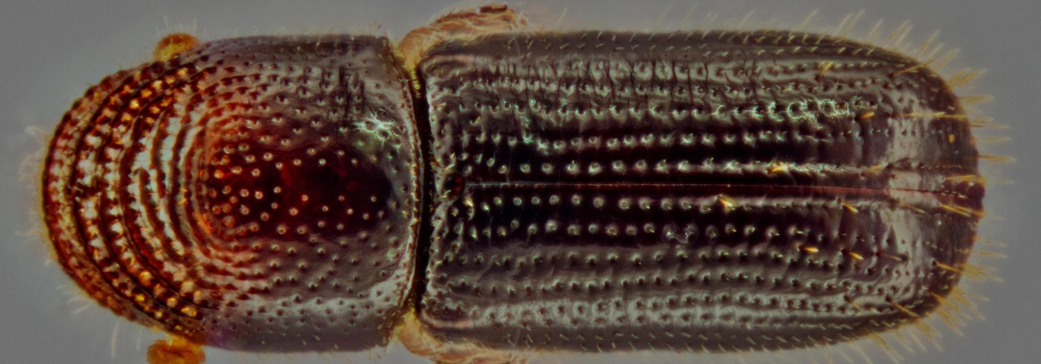
The vector of TCD
Walnut twig beetle (left) and twig beetle size (right)
Image credits:
Side view of beetle - Steven Valley, Oregon Department of Agriculture, www.bugwood.org, #5445394; dorsal view of beetle - Steven Valley, Oregon Department of Agriculture, www.bugwood.org, #5482202; beetles on penny - Whitney Cranshaw, Colorado State University, www.bugwood.org, #5445294
Notes:
The vector of this fungus is the tiny, walnut twig beetle (Pityophthorus juglandis) which is native to the Southwestern U.S. (originally found in Arizona, New Mexico, and California) and Northern Mexico.
It is a small reddish-brown bark beetle with yellowish legs that measures 1.5 to 1.9mm in length.
While this beetle appears to be the only vector noted to date, researchers are looking into the possibility that other potential vectors of this fungal pathogen exist as other beetles have been collected from infected trees along with this beetle species. Examples are Xyleborinus saxesenii (an ambrosia beetle from Asia), Pityophthorus lautus (a native bark beetle), and Xylosandrus germanus (an ambrosia beetle from Asia).
References:
Newton, L. and G. Fowler. 2009. Pathway Assessment: Geosmithia sp. and Pityophthorus juglandis Blackman movement from the western into the eastern United States.
accessed 3/25/2013 –
http://oregonstate.edu/dept/nurspest/APHIS%20CPHST%20Geosmithia_PATHWAY_Rev1_10-19-2009%20(2).pdf
Seybold, S., D. Haugen, and A. Graves. 2010. Pest alert: Thousand cankers disease. United States Department of Agriculture, Forest Service, Northeastern Area State and Private Forestry.
accessed 3/25/2013 –
http://na.fs.fed.us/pubs/palerts/cankers_disease/thousand_cankers_disease_screen_res.pdf
Tisserat, N., W. Cranshaw, D. Leatherman, C. Utley, and K. Alexander. 2009. Black walnut mortality in Colorado caused by the walnut twig beetle and thousand cankers disease. Online. Plant Health Progress doi:10.1094/PHP-2009-0811-01-RS.
accessed 3/25/2013 –
http://www.plantmanagementnetwork.org/pub/php/research/2009/walnut/

Slide 6
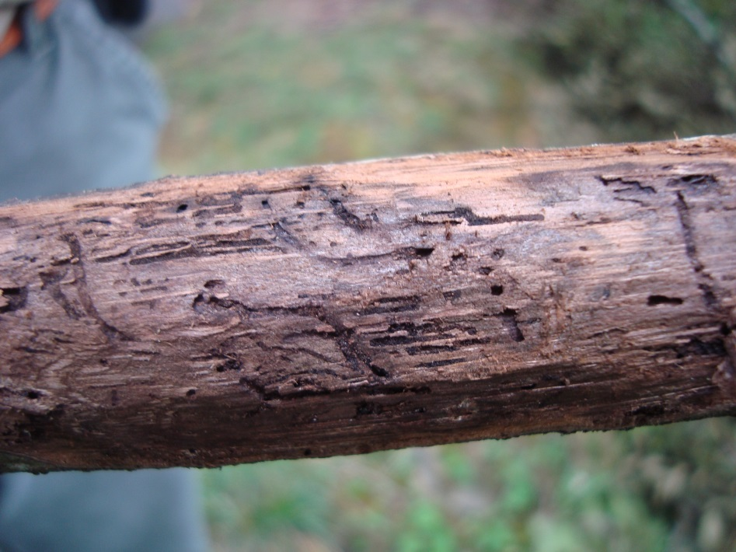
Life History of Walnut Twig Beetle and the Spread of TCD
Adult beetles colonize branches in mid-spring, introducing fungus.
The length of time it takes for larval beetle development to complete and for adults to disperse to infect other trees depends on the temperature.
8 weeks in Colorado, 5 weeks in Tennessee
Multiple generations occur from spring through late summer.
Late summer generations emerge as adults which then overwinter under bark.
Adult female galleries go across the grain
Larval galleries go with the grain
Image credits:
Paris Lambdin, University of Tennessee.
Notes:
Adult beetles overwinter on walnut trees under the bark of the trunk. The adults disperse in April or May to mate and infest branches of other trees. Females tunnel producing galleries in the bark of limbs (over 2cm in circumference) and the trunk where she lays her eggs. These galleries go across the grain of the wood.
The maturation from egg to adult varies depending on environmental temperature with development being 8 weeks in Colorado, but 5-6 weeks in Tennessee. Therefore, there may be two or three lifecycles before the adults overwinter in the late fall (adults are present from April to October in Colorado). In areas where the winter is mild, however, the larval stage will overwinter as well as the adult stage.
After the eggs hatch, the larvae produce galleries that go with the grain of the wood (perpendicular to the adult galleries). Beetle adults and larvae feed on the phloem. Newly-emerged adult beetles may disperse to new trees (or may reinfest the same tree), taking spores of the fungus with them.
References:
Freeland, Emily. 2012. Intraspecific variability of Geosmithia morbida the causal agent of thousand cankers disease, and effects of temperature, isolate and host family (Juglans nigra) on canker development. Masters Thesis.
accessed 3/26/2013 –
http://digitool.library.colostate.edu///exlibris/dtl/d3_1/apache_media/L2V4bGlicmlzL2R0bC9kM18xL2FwYWNoZV9tZWRpYS8xNjQwNzM=.pdf
Newton, L. and G. Fowler. 2009. Pathway Assessment: Geosmithia sp. and Pityophthorus juglandis Blackman movement from the western into the eastern United States.
accessed 3/25/2013 –
http://oregonstate.edu/dept/nurspest/APHIS%20CPHST%20Geosmithia_PATHWAY_Rev1_10-19-2009%20(2).pdf
Peachy, Emily. 2012. Studies On The Walnut Twig Beetle (WTB), Pityophthorus juglandis, in Relation to its Association With Geosmithia morbida, its Survival in Felled Logs, and its Sensitivity to Temperature Extremes. Masters Thesis.
Accessed 3/26/2013 –
http://digitool.library.colostate.edu///exlibris/dtl/d3_1/apache_media/L2V4bGlicmlzL2R0bC9kM18xL2FwYWNoZV9tZWRpYS8xOTIwMzA=.pdf
Seybold, S., D. Haugen, and A. Graves. 2010. Pest alert: Thousand cankers disease. United States Department of Agriculture, Forest Service, Northeastern Area State and Private Forestry.
accessed 3/25/2013 –
http://na.fs.fed.us/pubs/palerts/cankers_disease/thousand_cankers_disease_screen_res.pdf
Tisserat, N., W. Cranshaw, D. Leatherman, C. Utley, and K. Alexander. 2009. Black walnut mortality in Colorado caused by the walnut twig beetle and thousand cankers disease. Online. Plant Health Progress doi:10.1094/PHP-2009-0811-01-RS.
accessed 3/25/2013 –
http://www.plantmanagementnetwork.org/pub/php/research/2009/walnut/
Windham, Mark. Personal communication.

Slide 7
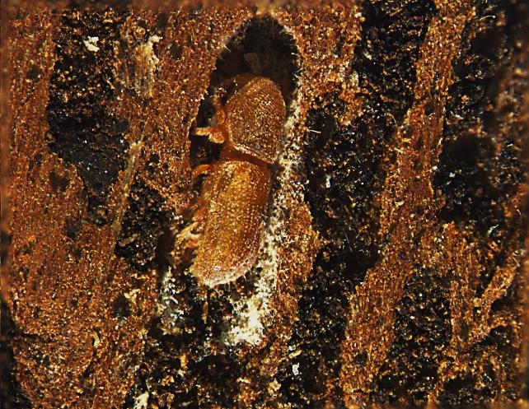
Life History of Walnut Twig Beetle and the Spread of TCD
Fungus lining the galleries made by the beetle.
Image credits:
Paris Lambdin, University of Tennessee.
Notes:
Walnut twig beetles apparently carry spores of the fungus Geosmithia morbida with them as they burrow into the bark of an otherwise healthy walnut tree. The relationship between the beetle and the fungal spores is not entirely clear. The fungus is often seen lining the galleries made by the twig beetle and coating the pupae. In recent research in the West, walnut twig beetle larvae seem to have a preference for walnut tissue infected with the fungal hyphae.
Whatever the relationship, the fungal spores enter the phloem and, as the fungus spreads, the tree forms cankers in response to the infection. Once the fungus has infected a tree, it continues to create cankers, eventually resulting in branch dieback and the death of the tree.
Aside from dispersal of adult walnut twig beetles, the spread of TCD is assisted by human activities. Transport of logs (especially as firewood or for use in woodworking activities) with live beetles drastically increases the dispersal abilities of the beetle and is likely responsible for introducing TCD to the east coast including Tennessee, North Carolina, Pennsylvania, and Virginia.
References:
Freeland, Emily. 2012. Intraspecific variability of Geosmithia morbida the causal agent of thousand cankers disease, and effects of temperature, isolate and host family (Juglans nigra) on canker development. Masters Thesis.
accessed 3/26/2013 –
http://digitool.library.colostate.edu///exlibris/dtl/d3_1/apache_media/L2V4bGlicmlzL2R0bC9kM18xL2FwYWNoZV9tZWRpYS8xNjQwNzM=.pdf
Newton, L. and G. Fowler. 2009. Pathway Assessment: Geosmithia sp. and Pityophthorus juglandis Blackman movement from the western into the eastern United States.
accessed 3/25/2013 –
http://oregonstate.edu/dept/nurspest/APHIS%20CPHST%20Geosmithia_PATHWAY_Rev1_10-19-2009%20(2).pdf
Peachy, Emily. 2012. Studies On The Walnut Twig Beetle (WTB), Pityophthorus juglandis, in Relation to its Association With Geosmithia morbida, its Survival in Felled Logs, and its Sensitivity to Temperature Extremes. Masters Thesis.
Accessed 3/26/2013 –
http://digitool.library.colostate.edu///exlibris/dtl/d3_1/apache_media/L2V4bGlicmlzL2R0bC9kM18xL2FwYWNoZV9tZWRpYS8xOTIwMzA=.pdf
Seybold, S., D. Haugen, and A. Graves. 2010. Pest alert: Thousand cankers disease. United States Department of Agriculture, Forest Service, Northeastern Area State and Private Forestry.
accessed 3/25/2013 –
http://na.fs.fed.us/pubs/palerts/cankers_disease/thousand_cankers_disease_screen_res.pdf
Tisserat, N., W. Cranshaw, D. Leatherman, C. Utley, and K. Alexander. 2009. Black walnut mortality in Colorado caused by the walnut twig beetle and thousand cankers disease. Online. Plant Health Progress doi:10.1094/PHP-2009-0811-01-RS.
accessed 3/25/2013 –
http://www.plantmanagementnetwork.org/pub/php/research/2009/walnut/
Windham, Mark. Personal communication.

Slide 8
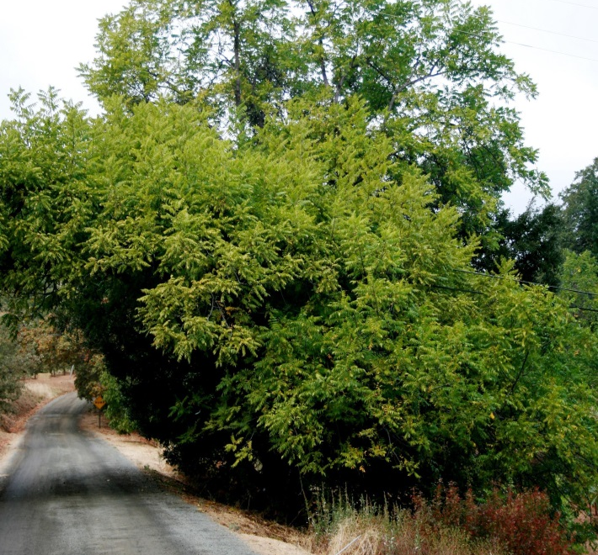
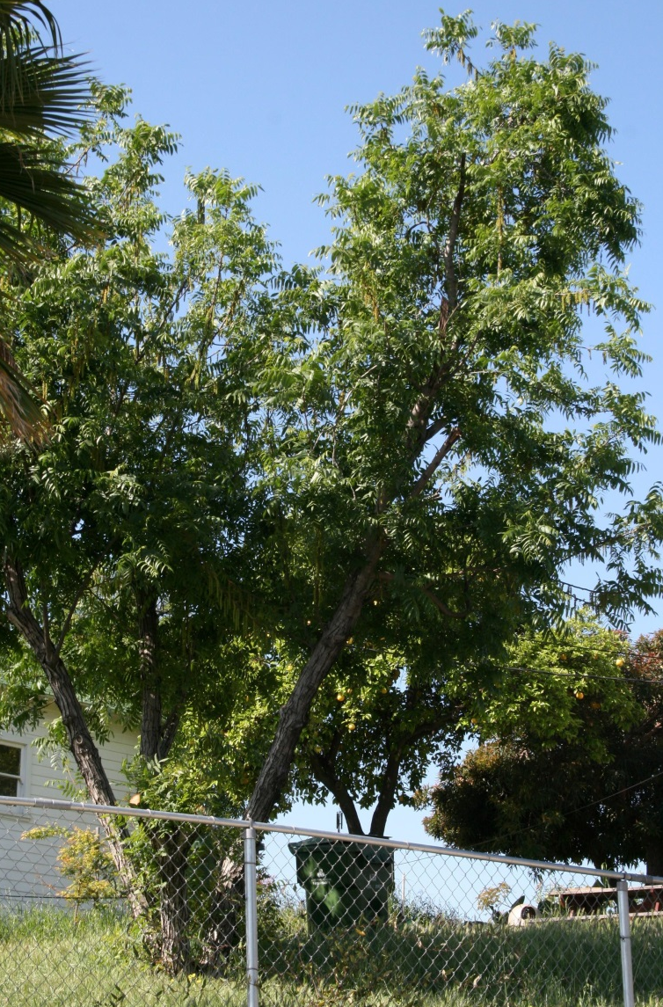
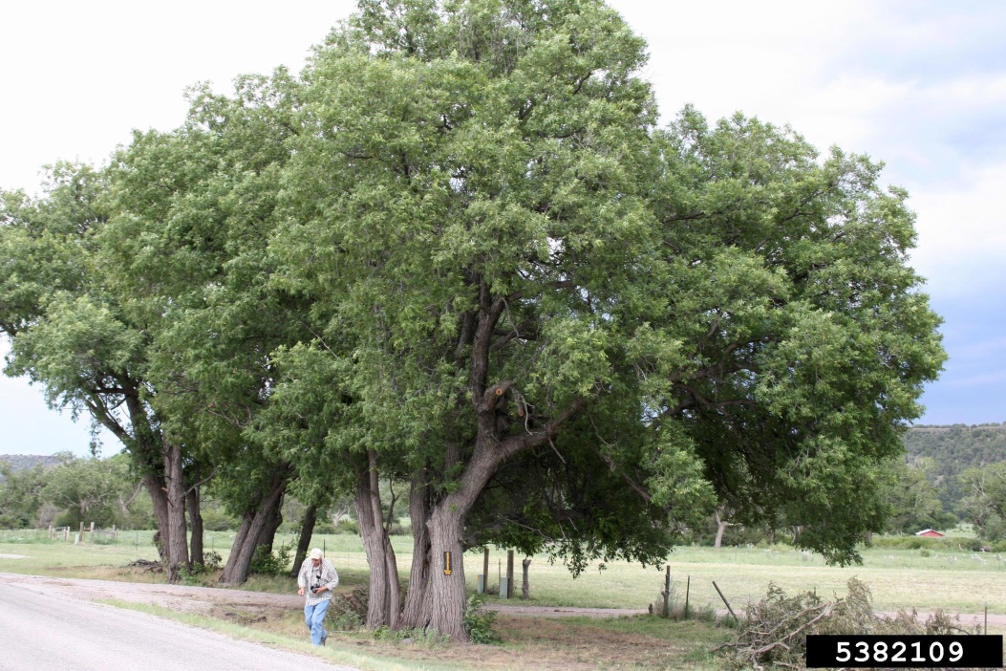
Other Hosts
Hinds walnut (top right)
Arizona walnut (bottom right)
California walnut (pictured above)
Image credits:
Whitney Cranshaw, Colorado State University, www.bugwood.org, #5382109 , #5488801, and #5422222
Notes:
As mentioned before, there are fifteen species of walnut found in the U.S. The Arizona walnut (Juglans major) is thought to be the original host plant of the walnut twig beetle. On Arizona walnut, the beetles attack small twigs and branches, but are not known to cause tree mortality on their own.
In addition, Arizona walnut appears to be highly resistant to the fungus that causes TCD. Damage by the beetles and inoculation with the fungus results in some cankers, but does not result in the death of the tree.
Other walnut hosts that appear to be susceptible to the fungus besides black walnut include: California walnut (J. californica), Hinds walnut (J. hindsii), and little walnut (J. microcarpa). The distributions of all these walnut species overlap the distribution of the walnut twig beetle (i.e. the western U.S.).
English walnut (J. regia) is an economically important commercially grown crop in California that appears to be susceptible to this fungus. Another non-native susceptible host seems to be Manshurian walnut (J. mandshurica).
References
Newton, L. P., G. Fowler, A. D. Neeley, R. A. Schall, and Y. Tacheuchi. 2009. Pathway Assessment: Geosmithia sp. and Pityophthorus juglandis Blackman movement from the western into the eastern United States. U. S. Dept. of Agriculture, Animal and Plant Health Inspection Service.
accessed 3/25/2013 –
http://oregonstate.edu/dept/nurspest/APHIS%20CPHST%20Geosmithia_PATHWAY_Rev1_10-19-2009%20(2).pdf
Pavek, Diane S. 1993. Juglans major. In: Fire Effects Information System, [Online]. U.S. Department of Agriculture, Forest Service, Rocky Mountain Research Station, Fire Sciences Laboratory (Producer).
Accessed 3/26/2013 –
http://www.fs.fed.us/database/feis/plants/tree/jugmaj/all.html
Peachy, Emily. 2012. Studies On The Walnut Twig Beetle (WTB), Pityophthorus juglandis, in Relation to its Association With Geosmithia morbida, its Survival in Felled Logs, and its Sensitivity to Temperature Extremes. Masters Thesis.
Accessed 3/26/2013 –
http://digitool.library.colostate.edu///exlibris/dtl/d3_1/apache_media/L2V4bGlicmlzL2R0bC9kM18xL2FwYWNoZV9tZWRpYS8xOTIwMzA=.pdf
Seybold, S., D. Haugen, and A. Graves. 2010. Pest alert: Thousand cankers disease. United States Department of Agriculture, Forest Service, Northeastern Area State and Private Forestry.
accessed 3/25/2013 –
http://na.fs.fed.us/pubs/palerts/cankers_disease/thousand_cankers_disease_screen_res.pdf

Slide 9
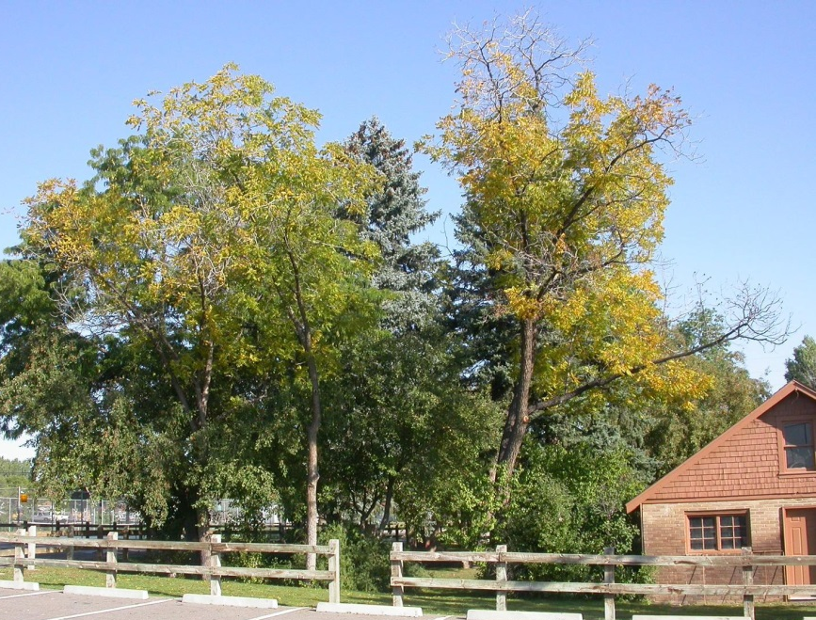
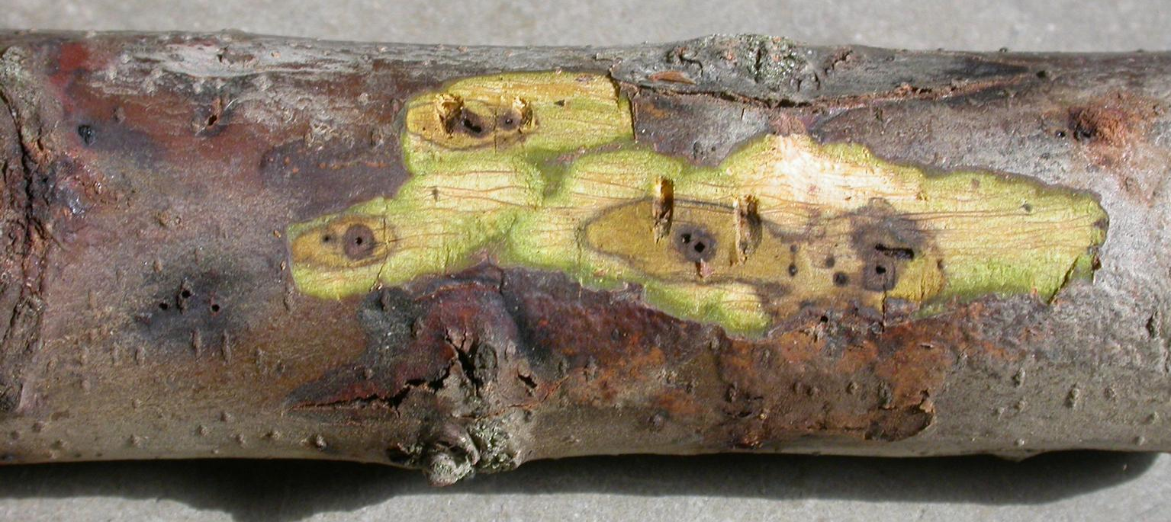
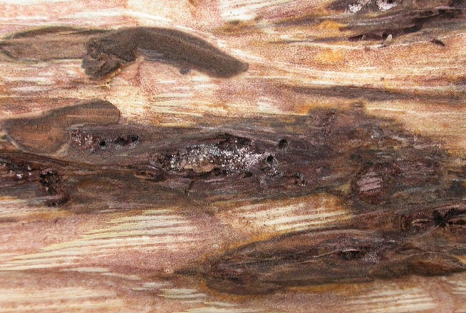
Symptoms of TCD
Small circular to oblong cankers found after bark is removed
Trees with yellowing and thinning of the foliage
Image credits:
Trees with yellowing fringe: Whitney Cranshaw, Colorado State University, www.bugwood.org, #5406054 and Ned Tisserat, Colorado State University, www.bugwood.org, #5406085; cankers - Ned Tisserat, Colorado State University, www.bugwood.org, #5406091 and #5406089
Notes:
Once the fungus is vectored to a tree by the beetle, the fungus damages the phloem tissue and disrupts nutrient transport to the branches.
Early symptoms of TCD include yellowing and thinning of the foliage which progresses to brown wilted foliage (orange arrows). However, these symptoms have not been seen in eastern outbreaks.
This disease also causes two different canker types to form on the tree. Early on, you can see small, circular to oblong cankers (yellow arrows) developing around the walnut twig beetle galleries on twigs, branches and the trunk. However, you must remove the thin layer of outer bark to see these cankers. On the bark surface, you may see an amber stain around the entrance to the beetle hole (though keep in mind – these are really small beetles and the holes are subsequently very small as well). You may also see bark cracks forming in smaller twigs around the entrance holes, but for the most part, branches with many beetle galleries and cankers (seen when you peel back the bark) may not show any outward appearance of this disease in the early stages.
In thicker branches and the trunk, the cankers are restricted to the phloem, but as the disease progresses, the cankers expand into the cambium and cause a darkening of the tissue (usually only seen after extensive infestation) which is indicated by the red arrow. The amount of cankers formed is numerous and eventually these cankers coalesce to girdle twigs and branches leading to dieback and eventual death of the tree.
References:
Newton, L. and G. Fowler. 2009. Pathway Assessment: Geosmithia sp. and Pityophthorus juglandis Blackman movement from the western into the eastern United States.
accessed 3/25/2013 –
http://oregonstate.edu/dept/nurspest/APHIS%20CPHST%20Geosmithia_PATHWAY_Rev1_10-19-2009%20(2).pdf
Seybold, S., D. Haugen, and A. Graves. 2010. Pest alert: Thousand cankers disease. United States Department of Agriculture, Forest Service, Northeastern Area State and Private Forestry.
accessed 3/25/2013 –
http://na.fs.fed.us/pubs/palerts/cankers_disease/thousand_cankers_disease_screen_res.pdf
Tisserat, N., W. Cranshaw, D. Leatherman, C. Utley, and K. Alexander. 2009. Black walnut mortality in Colorado caused by the walnut twig beetle and thousand cankers disease. Online. Plant Health Progress doi:10.1094/PHP-2009-0811-01-RS.
accessed 3/25/2013 –
http://www.plantmanagementnetwork.org/pub/php/research/2009/walnut/
Windham, Mark. Personal communication.

Slide 10
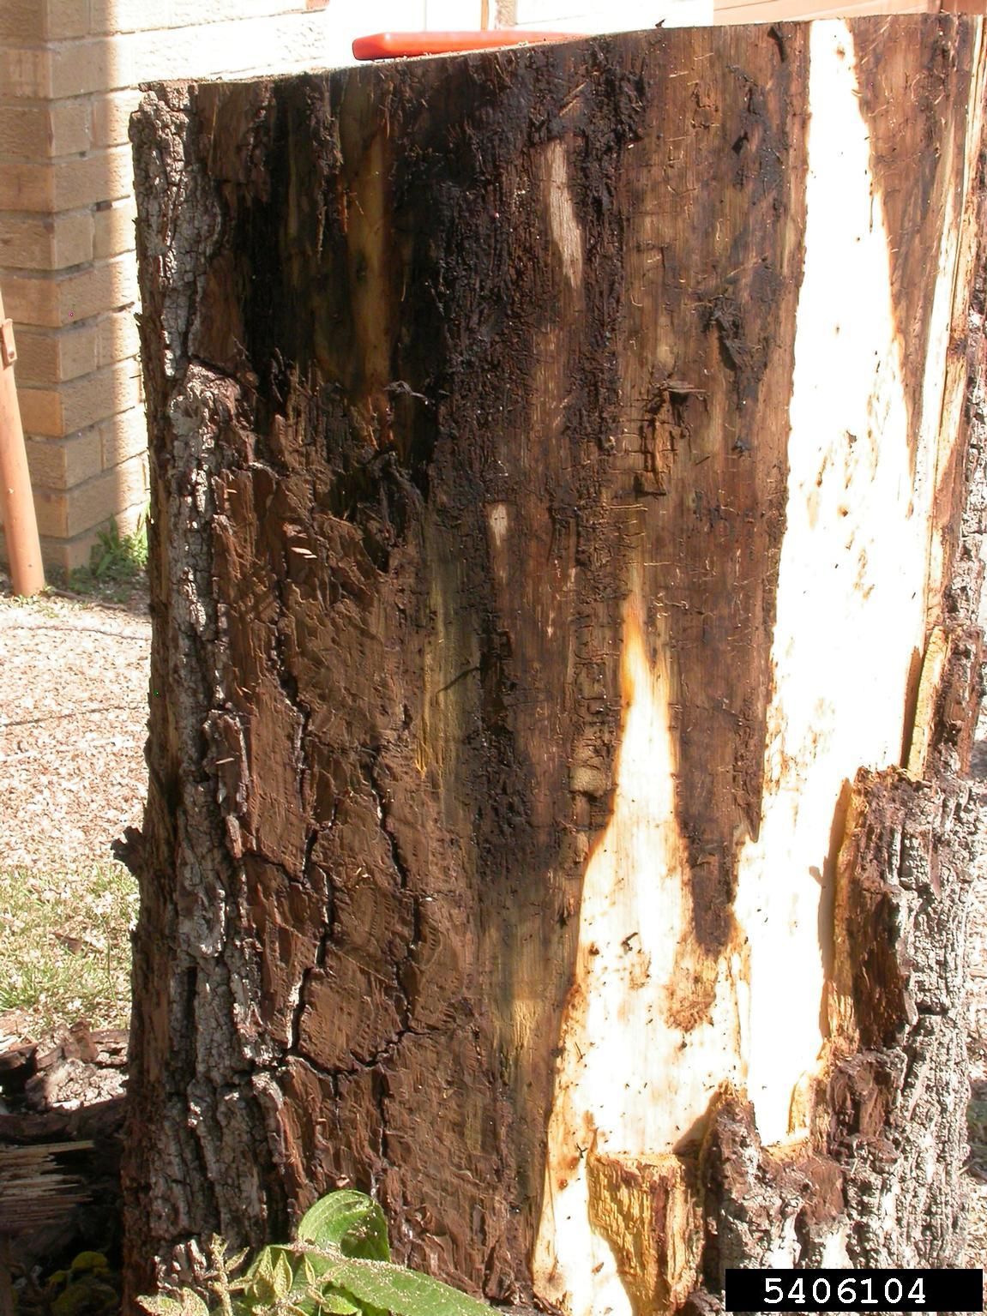
Symptoms of TCD
Image credits:
Right - Curtis Utley, CSUE, www.bugwood.org, #5406077 and left - Ned Tisserat, Colorado State University, www.bugwood.org, #5406104
Notes:
The second canker type to be seen is much, much larger than the first (can be more than 2m in length) resulting from coalescing cankers and is usually found on the trunks. You may also see a dark brown stain on the surface of the bark or even cracks in the bark where these cankers have formed. However, you must remove the bark to see the cankers themselves, even though they are so large. The inner bark and cambium will be water soaked and dark brown to black in color (yellow arrow).
It is not known how long it takes for the fungus to kill the tree from the time of initial infection. However, death of the tree typically occurs within two to three years of visible symptoms in the crown.
References:
Newton, L. and G. Fowler. 2009. Pathway Assessment: Geosmithia sp. and Pityophthorus juglandis Blackman movement from the western into the eastern United States.
accessed 3/25/2013 –
http://oregonstate.edu/dept/nurspest/APHIS%20CPHST%20Geosmithia_PATHWAY_Rev1_10-19-2009%20(2).pdf
Peachy, Emily. 2012. Studies On The Walnut Twig Beetle (WTB), Pityophthorus juglandis, in Relation to its Association With Geosmithia morbida, its Survival in Felled Logs, and its Sensitivity to Temperature Extremes. Masters Thesis.
Accessed 3/26/2013 –
http://digitool.library.colostate.edu///exlibris/dtl/d3_1/apache_media/L2V4bGlicmlzL2R0bC9kM18xL2FwYWNoZV9tZWRpYS8xOTIwMzA=.pdf
Seybold, S., D. Haugen, and A. Graves. 2010. Pest alert: Thousand cankers disease. United States Department of Agriculture, Forest Service, Northeastern Area State and Private Forestry.
accessed 3/25/2013 –
http://na.fs.fed.us/pubs/palerts/cankers_disease/thousand_cankers_disease_screen_res.pdf
Tisserat, N., W. Cranshaw, D. Leatherman, C. Utley, and K. Alexander. 2009. Black walnut mortality in Colorado caused by the walnut twig beetle and thousand cankers disease. Online. Plant Health Progress doi:10.1094/PHP-2009-0811-01-RS.
accessed 3/25/2013 –
http://www.plantmanagementnetwork.org/pub/php/research/2009/walnut/

Slide 11
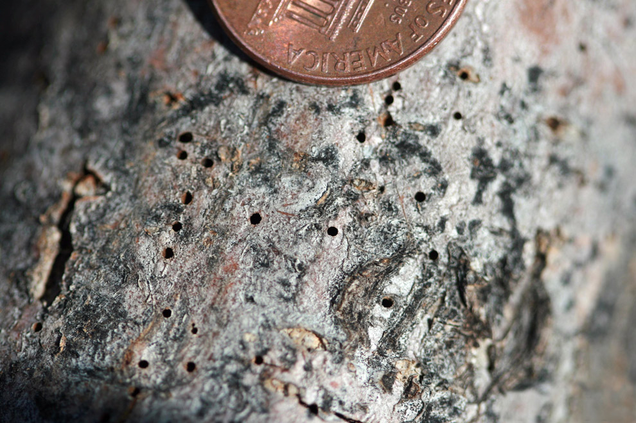
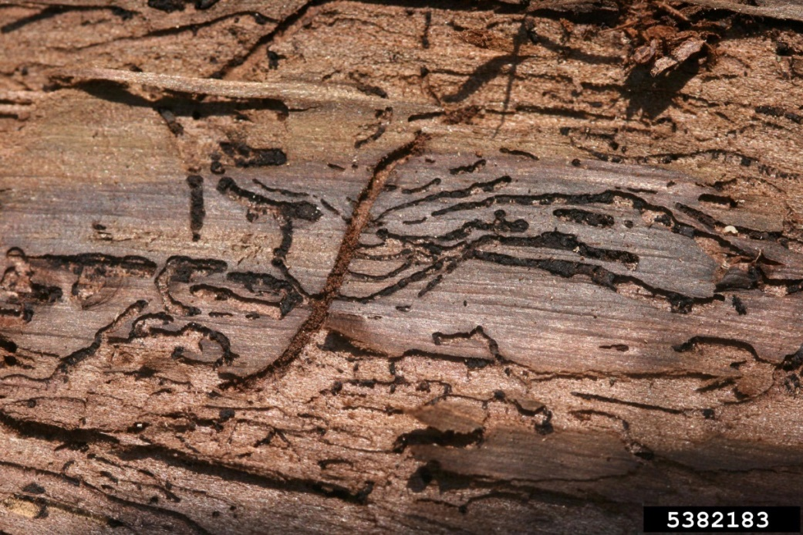
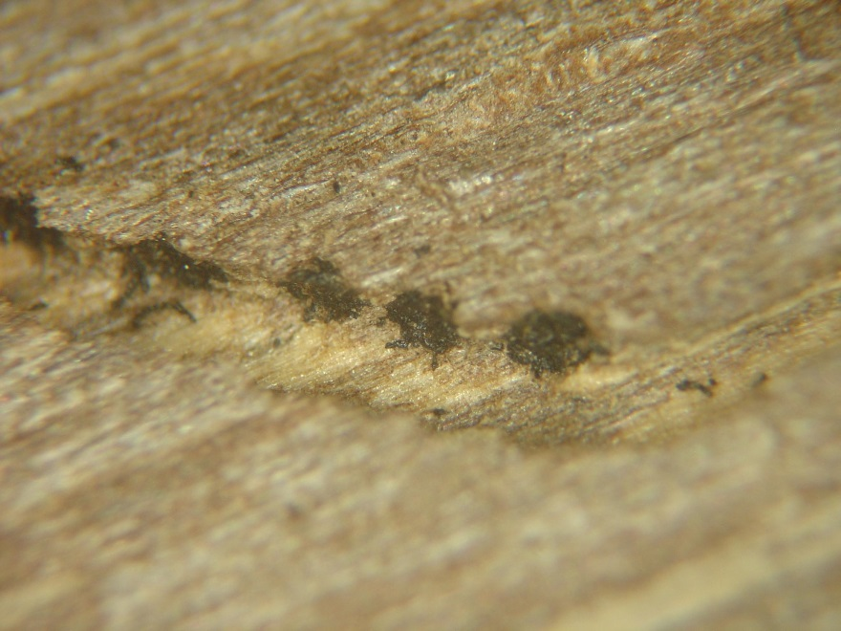
Signs of the beetle
Image credits:
Holes left by beetles - Whitney Cranshaw, Colorado State University, www.bugwood.org, #5406073; walnut twig beetle galleries - Whitney Cranshaw, Colorado State University, www.bugwood.org, #5382183; frass caps – Katheryne Nix, Entomology and Plant Pathology Department, University of Tennessee
Notes:
Signs that the walnut twig beetle may be infesting the tree include entrance and exit holes of the adults and galleries produced by adults and larvae. The large gallery near the center of the image that runs against the grain is the adult egg laying gallery while the smaller more numerous galleries running perpendicular to it and with the grain are the larval galleries.
In addition, you may see frass caps if you slice through the outer bark. These frass caps denote where a female has deposited her eggs.
References:
Seybold, S., D. Haugen, and A. Graves. 2010. Pest alert: Thousand cankers disease. United States Department of Agriculture, Forest Service, Northeastern Area State and Private Forestry.
accessed 3/25/2013 –
http://na.fs.fed.us/pubs/palerts/cankers_disease/thousand_cankers_disease_screen_res.pdf
Tisserat, N., W. Cranshaw, D. Leatherman, C. Utley, and K. Alexander. 2009. Black walnut mortality in Colorado caused by the walnut twig beetle and thousand cankers disease. Online. Plant Health Progress doi:10.1094/PHP-2009-0811-01-RS.
accessed 3/25/2013 –
http://www.plantmanagementnetwork.org/pub/php/research/2009/walnut/

Slide 12
Distribution of TCD
Red indicates TCD being established in parts of the state
Yellow indicates where TCD has been found, but is not considered established
Blue indicates places where people have surveyed for TCD, but not found it
Map based on pest tracker information accessed on March 27, 2013 and the revised pest alert on thousand cankers disease.
Notes:
According to the Pest Alert on Thousand Cankers (updated in February 2013), Washington, Oregon, California, Idaho, Nevada, Utah, Arizona, New Mexico, Colorado, Tennessee, North Carolina, Virginia, and Pennsylvania have detected TCD. It is not noted if all these states are now considered as having TCD established within its borders or not.
NAPIS Pest Tracker reports that the states in blue have been surveyed for this disease but it has not been found. Pennsylvania has reported this disease, but they have not declared it as being established yet.
The walnut twig beetle has been detected in Ohio but TCD has not been found yet.
References:
Seybold, S., D. Haugen, and A. Graves. 2010 (revised February 2013). Pest alert: Thousand cankers disease. United States Department of Agriculture, Forest Service, Northeastern Area State and Private Forestry.
accessed 3/25/2013 –
http://na.fs.fed.us/pubs/palerts/cankers_disease/thousand_cankers_disease_screen_res.pdf
Tisserat, N., W. Cranshaw, D. Leatherman, C. Utley, and K. Alexander. 2009. Black walnut mortality in Colorado caused by the walnut twig beetle and thousand cankers disease. Online. Plant Health Progress doi:10.1094/PHP-2009-0811-01-RS.
accessed 3/25/2013 –
http://www.plantmanagementnetwork.org/pub/php/research/2009/walnut/

Slide 13
If TCD is a native disease, why has it become an issue recently?
Association between the beetle and the fungus may be a recent development
The twig beetle has expanded its host preference with the introduction of other walnut species within its range
Expansion of the range of the walnut twig beetle into the eastern U.S.
What could be the impact?
Notes:
Researchers are still addressing this question.
It may be that although the beetle and the fungus are native to the U.S., the association between them may actually be recent. In other words, the beetle may not have always been a vector of this fungus and this may just be a recent development.
In addition, with the planting of the eastern walnut (Juglans nigra) as well as other non-native walnuts into the range of the walnut twig beetle, the beetle has been able to utilize these new tree species as a host. However, these new tree species do not have the resistance to the fungal pathogen that a native walnut such as Arizona walnut has.
Eastern black walnut trees appear to be highly susceptible to this disease unlike their relative, the Arizona walnut, which shows substantial resistance.
Lastly, the expansion of the range of the walnut twig beetle from the southwestern U.S. into California and the Pacific Northwest and the eastern U.S. means that trees that would not normally have to contend with a beetle infestation are now exposed to it. The effect this additional stressor can have on the tree can be catastrophic.
References:
Seybold, S., D. Haugen, and A. Graves. 2010. Pest alert: Thousand cankers disease. United States Department of Agriculture, Forest Service, Northeastern Area State and Private Forestry.
accessed 3/25/2013 –
http://na.fs.fed.us/pubs/palerts/cankers_disease/thousand_cankers_disease_screen_res.pdf
Tisserat, N., W. Cranshaw, D. Leatherman, C. Utley, and K. Alexander. 2009. Black walnut mortality in Colorado caused by the walnut twig beetle and thousand cankers disease. Online. Plant Health Progress doi:10.1094/PHP-2009-0811-01-RS.
accessed 3/25/2013 –
http://www.plantmanagementnetwork.org/pub/php/research/2009/walnut/

Slide 14
Distribution of TCD and black walnut
Green indicates the current range of Black Walnut in the U.S.
Blue indicates those states that lie within the current range of black walnut and where TCD has either become established or has been found.
Map based on pest tracker information, revised national pest alert on thousand cankers disease, and USDA Plant Database accessed on May 27, 2013.
Notes:
There are 6 states that either reported that TCD is established or TCD has been found there that are also found within the current range of black walnut trees in the U.S.: Utah, Colorado, Tennessee, Virginia, North Carolina, and Pennsylvania.
References:
Seybold, S., D. Haugen, and A. Graves. 2010. Pest alert: Thousand cankers disease. United States Department of Agriculture, Forest Service, Northeastern Area State and Private Forestry.
accessed 3/25/2013 –
http://na.fs.fed.us/pubs/palerts/cankers_disease/thousand_cankers_disease_screen_res.pdf
Tisserat, N., W. Cranshaw, D. Leatherman, C. Utley, and K. Alexander. 2009. Black walnut mortality in Colorado caused by the walnut twig beetle and thousand cankers disease. Online. Plant Health Progress doi:10.1094/PHP-2009-0811-01-RS.
accessed 3/25/2013 –
http://www.plantmanagementnetwork.org/pub/php/research/2009/walnut/

Slide 15
How is TCD spreading?
Commercial trade
Infected and infested timber that is harvested and sent to an area that does not have TCD is a key pathway
Raw lumber, sawlogs, burls, stumps used for furniture making, cabinetry, gun stocks, bowls, etc.
Travel
People traveling from one campground to another have a tendency to bring firewood from one area to another
DO NOT MOVE FIREWOOD!
Notes:
As earlier mentioned, black walnut is used in many different ways and for many different purposes; therefore commercial trade and movement of black walnut within and between states is quite common. Because these are small boring beetles and the damage really cannot be seen unless the bark is pulled away, an infestation may go unnoticed if the purchaser or seller does not know what the signs of an infestation are.
In addition, the movement of infected firewood from one area to another is quite common especially when people go camping (i.e. natural areas, state parks, national parks).
References:
Newton, L. and G. Fowler. 2009. Pathway Assessment: Geosmithia sp. and Pityophthorus juglandis Blackman movement from the western into the eastern United States.
accessed 3/25/2013 –
http://oregonstate.edu/dept/nurspest/APHIS%20CPHST%20Geosmithia_PATHWAY_Rev1_10-19-2009%20(2).pdf

Slide 16
Important economic consequences
Walnut harvest is a high-dollar industry in some states.
407 million pounds of walnuts were produced in the U.S. in 2011/2012
Up to 70% of all walnuts produced in the U.S. are exported
California alone has 280,000 acres of walnut trees planted (2011/2012)
English walnut grown in California was valued at over $1.3 billion in 2010.
Missouri estimates that over $35 million could be lost annually in nut harvest due to TCD
Notes:
Black walnut is valued for its nuts which are commercially harvested. The species most commonly used in commercial orchards is English walnut – J. regia. In California, English walnut grown for nut harvest was worth over $1.3 billion in 2010 and the total acres of walnut production was 280,000 (this represents the bulk of the walnut harvest in the U.S.).
In addition, up to 70% of all walnuts grown commercially in the U.S. are exported. Should countries decide to stop the import of walnuts, the economic impact could be devastating.
References:
Perez, A. and K. Plattner. 2012. Fruit and tree nuts outlook. United States Department of Agriculture, Economic Research Service. FTS-352.
accessed 3/27/ 2013 -
http://www.ers.usda.gov/media/826893/fts352.pdf
Treiman, T. and J. Tuttle. 2009. Thousand Cankers Disease of Black Walnut: How Much Will It Hurt Missouri’s Pocketbook? Missouri Department of Conservation. Notes for Forest Managers, Report #16.
accessed 3/27/ 2013 –
http://mdc.mo.gov/sites/default/files/resources/2010/10/21128.pdf
USDA. 2013. Noncitrus Fruit and Nuts Preliminary Summary.
accessed 3/28/2013 –
http://usda01.library.cornell.edu/usda/current/NoncFruiNu/NoncFruiNu-01-25-2013.pdf

Slide 17
Important economic consequences
Timber harvest for walnut wood products is a high-dollar industry in some states.
Georgia, Kentucky, Michigan, Ohio, Mississippi, North Carolina, New York, and Tennessee provide the bulk of the walnut timber harvest in the U.S.
Prices run from $300 to $2000 per thousand board feet for sawtimber
Missouri estimates that over $36 million could be lost annually in wood product losses due to TCD
Notes:
Black walnut is one of the most high-valued hardwood species. According to a stumpage price report from New York (2012), depending on the quality of the wood, black walnut timbers can sell for $300 to $2000 per thousand board feet for sawtimber. Georgia, Kentucky, Michigan, Mississippi, North Carolina, New York, Ohio, and Tennessee are the biggest providers of walnut for timber harvest. If this disease becomes established in those states, the economic impact would be far reaching.
References:
New York State Department of Environmental Conservation, Division of Lands and Forests. 2012. Stumpage Price Report, Winter 2012. #80.
accessed 3/28/2013 –
http://www.dec.ny.gov/docs/lands_forests_pdf/spr2012winter.pdf
Treiman, T. and J. Tuttle. 2009. Thousand Cankers Disease of Black Walnut: How Much Will It Hurt Missouri’s Pocketbook? Missouri Department of Conservation. Notes for Forest Managers, Report #16.
accessed 3/27/ 2013 –
http://mdc.mo.gov/sites/default/files/resources/2010/10/21128.pdf

Slide 18
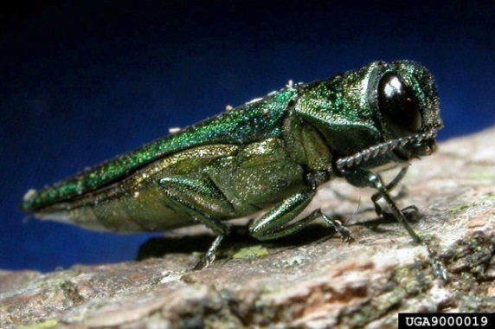
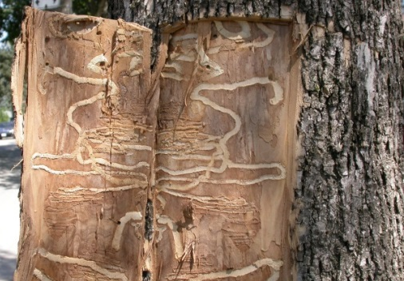
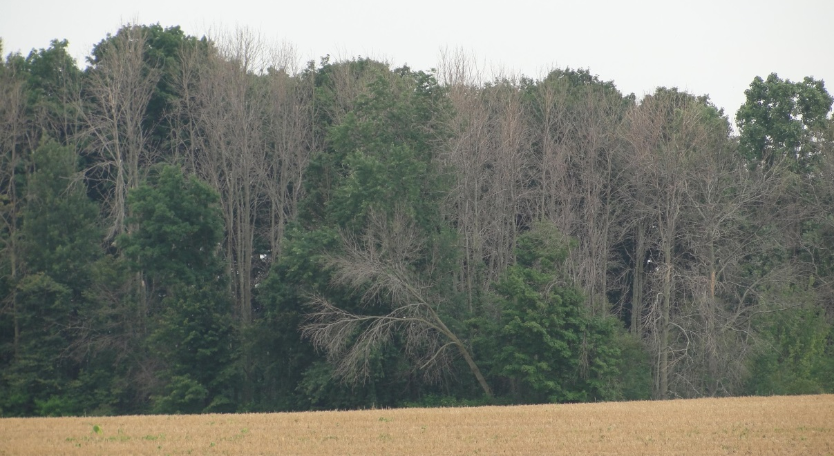
Important ecological consequences
30 states with naturally-occurring black walnut trees.
99% of black walnut trees occur in natural stands.
Potential for ecological disaster in eastern states as seen with pests like the emerald ash borer and diseases such as chestnut blight and Dutch elm disease..
Emerald ash borer and its effects on ash trees
Image credits:
Beetle - David Cappaert, Michigan State University, www.bugwood.org, #9000019; damage - Leah Bauer, USDA Forest Service Northern Research Station, www.bugwood.org, #5449384; galleries - Edward Czerwinski, Ontario Ministry of Natural Resources, www.bugwood.org, #1439009
Notes:
For the most part, TCD has affected mostly black walnut trees that have been planted outside their native range in western states. However, the movement of infected materials in the form of firewood, wood chips, or raw wood to be used to craft furniture as well as the natural dispersal of the beetles presents a serious threat to black walnut in its native range.
Black walnut is an integral part of mixed-hardwood, riparian communities in predominantly in the eastern United States. Based on the pattern of infection in the west, if TCD establishes in eastern forests, it could lead to an uncontrolled outbreak and ecological disaster similar to that of the emerald ash borer and diseases such as chestnut blight and Dutch elm disease.
References:
USDA NRCS – Plant Fact Sheet. Black Walnut. 2002.
Accessed 6/2/2013 –
http://plants.usda.gov/factsheet/pdf/fs_juni.pdf

Slide 19
Management of TCD
Not preventable, beetles can attack and infect healthy trees.
Must limit movement of the beetle
Inspect dying walnuts and report suspected TCD to county agent or state forester.
Do not transport dead/dying wood off-site.
Prompt and proper disposal of infected wood by burying or burning.
Do not transport walnut for firewood.
Notes:
Research for treatment of TCD (culturally, biologically, and chemically) is ongoing so recommendations are limited.
Because the walnut twig beetle can attack and infect healthy trees and it brings the pathogenic fungus with it when it does, TCD is only preventable by keeping the beetles from infecting new trees in the first place. To do this, we have to limit the movement of the walnut twig beetles (and the fungus it vectors) as well as limit the transport of potentially infected materials into new areas.
This is best accomplished by reporting dying walnut trees so they may be inspected for the beetle and the fungus prior to removal. Infected wood should be buried or burned to prevent the dispersal of beetles that are capable of completing their lifecycle in downed logs. In recent research, logs have been found to be suitable in perpetuating the life cycle of the walnut twig beetle for 2 to 3 years after being cut or downed.
In addition, the transport of walnut for firewood must be stopped. There are several educational messages aimed for campers that explain why the movement of firewood can lead to the transport of invasive species from one area to another. Public education is key is help stop this pathway of spread.
References:
Cranshaw, W. 2009. Thousand Cankers Disease Management in Urban Forestry. Draft.
accessed 3/31/2013 –
http://www.coloradotrees.org/News/Thousand%20Cankers%20Disease%209-09.pdf
Freeland, Emily. 2012. Intraspecific variability of Geosmithia morbida the causal agent of thousand cankers disease, and effects of temperature, isolate and host family (Juglans nigra) on canker development. Masters Thesis.
accessed 3/26/2013 –
http://digitool.library.colostate.edu///exlibris/dtl/d3_1/apache_media/L2V4bGlicmlzL2R0bC9kM18xL2FwYWNoZV9tZWRpYS8xNjQwNzM=.pdf
Peachy, Emily. 2012. Studies On The Walnut Twig Beetle (WTB), Pityophthorus juglandis, in Relation to its Association With Geosmithia morbida, its Survival in Felled Logs, and its Sensitivity to Temperature Extremes. Masters Thesis.
Accessed 3/26/2013 –
http://digitool.library.colostate.edu///exlibris/dtl/d3_1/apache_media/L2V4bGlicmlzL2R0bC9kM18xL2FwYWNoZV9tZWRpYS8xOTIwMzA=.pdf
United States Department of Agriculture Forest Service and Plant Protection and Quarantine. 2012. Thousand Cankers Disease Survey Guidelines for 2012.
accessed 6/2/2013 –
http://caps.ceris.purdue.edu/webfm_send/1730

Slide 20
What to do if you suspect TCD
Collect a sample and submit it for verification
Collect a branch 2 to 4 inches in diameter and 6 to 12 inches long showing the diseased wood
Wrap the sample in paper towels or newspaper
Double bag your sample in zippered plastic bags
Fill out a sample submission form for your state NPDN diagnostic lab and tape it to the bag
www.npdn.org
Mail the sample to your lab or give it to your local county agent for them to mail it in
Don’t delay! A good sample is essential for diagnosis
Video on submitting plant samples
Notes:
In areas where TCD is not known to have been detected, it is important to report suspected infestation of TCD to your local county agent.
You can also submit a sample for diagnosis to your local NPDN lab.
Collecting and submitting dead plant samples is not helpful, therefore, submitting healthy and diseased samples from the same plant is useful in diagnosing TCD. Be sure to double bag your sample(s) and fill out the appropriate form for your state lab. You can mail it directly to the lab or have your local county agent do it for you. Either way, your local county agent should be notified of your concern. Since time is of the essence and fresh samples provide better diagnostics, samples should be overnighted to the lab. If the samples cannot be mailed immediately, be sure to double bag them and store them temporarily in a refrigerator. Samples left out in the hot sun degrade quickly and makes the diagnosis more difficult.
The video link on the slide provides more information on how to prepare the sample.
References:
Seybold, S., D. Haugen, and A. Graves. 2010. Pest alert: Thousand cankers disease. United States Department of Agriculture, Forest Service, Northeastern Area State and Private Forestry.
accessed 3/25/2013 –
http://na.fs.fed.us/pubs/palerts/cankers_disease/thousand_cankers_disease_screen_res.pdf
United States Department of Agriculture Forest Service and Plant Protection and Quarantine. 2012. Thousand Cankers Disease Survey Guidelines for 2012.
accessed 6/2/2013 –
http://caps.ceris.purdue.edu/webfm_send/1730

Slide 21
Be sure to recognize the symptoms
Small circular to oblong cankers found after bark is removed
Trees with yellowing and thinning of the foliage
Image credits:
Trees with yellowing fringe: Whitney Cranshaw, Colorado State University, www.bugwood.org, #5406054; cankers - Ned Tisserat, Colorado State University, www.bugwood.org, #5406091 and #5406089
Notes:
Remember, symptoms of TCD include:
yellowing of foliage and branch dieback
cankers that develop underneath the bark (these cannot be seen unless the outer bark is removed)
TCD is outwardly undetectable until there are multiple cankers under the bark that girdle branches and cause crown flagging or branch dieback. At that point, it is typically 2-3 years before the tree dies.
It is important to recognize the symptoms of TCD and alert the proper authorities so trees can be removed and disposed of properly to help mitigate the spread of the disease.

Slide 22
Questions?
For more information, check out www.protectingusnow.org
You can also contact:
Amanda Hodges, Ph.D., Associate Extension Scientist, Department of Entomology and Nematology, University of Florida, achodges@ufl.edu
Stephanie D. Stocks, M.S., Assistant-In Extension Scientist, Department of Entomology and Nematology, University of Florida, sstocks@ufl.edu

Slide 23
Author and Publication Dates
Jennifer Weeks, Ph.D., Department of Entomology and Nematology, University of Florida
Stephanie Stocks, M.S., Department of Entomology and Nematology, University of Florida
Mark Windham, Ph.D., Department of Entomology and Plant Pathology, University of Tennessee, Knoxville
Paris Lambdin, Ph.D., Department of Entomology and Plant Pathology, University of Tennessee, Knoxville
Frank Hale, Ph.D., Department of Entomology and Plant Pathology, University of Tennessee Extension, Nashville
Alan Windham, Ph.D., Department of Entomology and Plant Pathology, University of Tennessee Soil, Plant and Pest Center, Nashville
Published : June 2013

Slide 24
Reviewers
Amanda Hodges, Ph.D., Associate Extension Scientist, Department of Entomology and Nematology, University of Florida
Stephen McLean, Ph.D., Department of Entomology and Nematology, University of Florida

Slide 25
Educational Disclaimer and Citation
This presentation can be used for educational purposes for NON-PROFIT workshops, trainings, etc.
Citation:
Weeks, J.A., S. Stocks, M. Windham, P. Lambdin, and F. Hale. 2013. Thousand Cankers Disease. Accessed (add the date) - www.protectingusnow.org

Slide 26
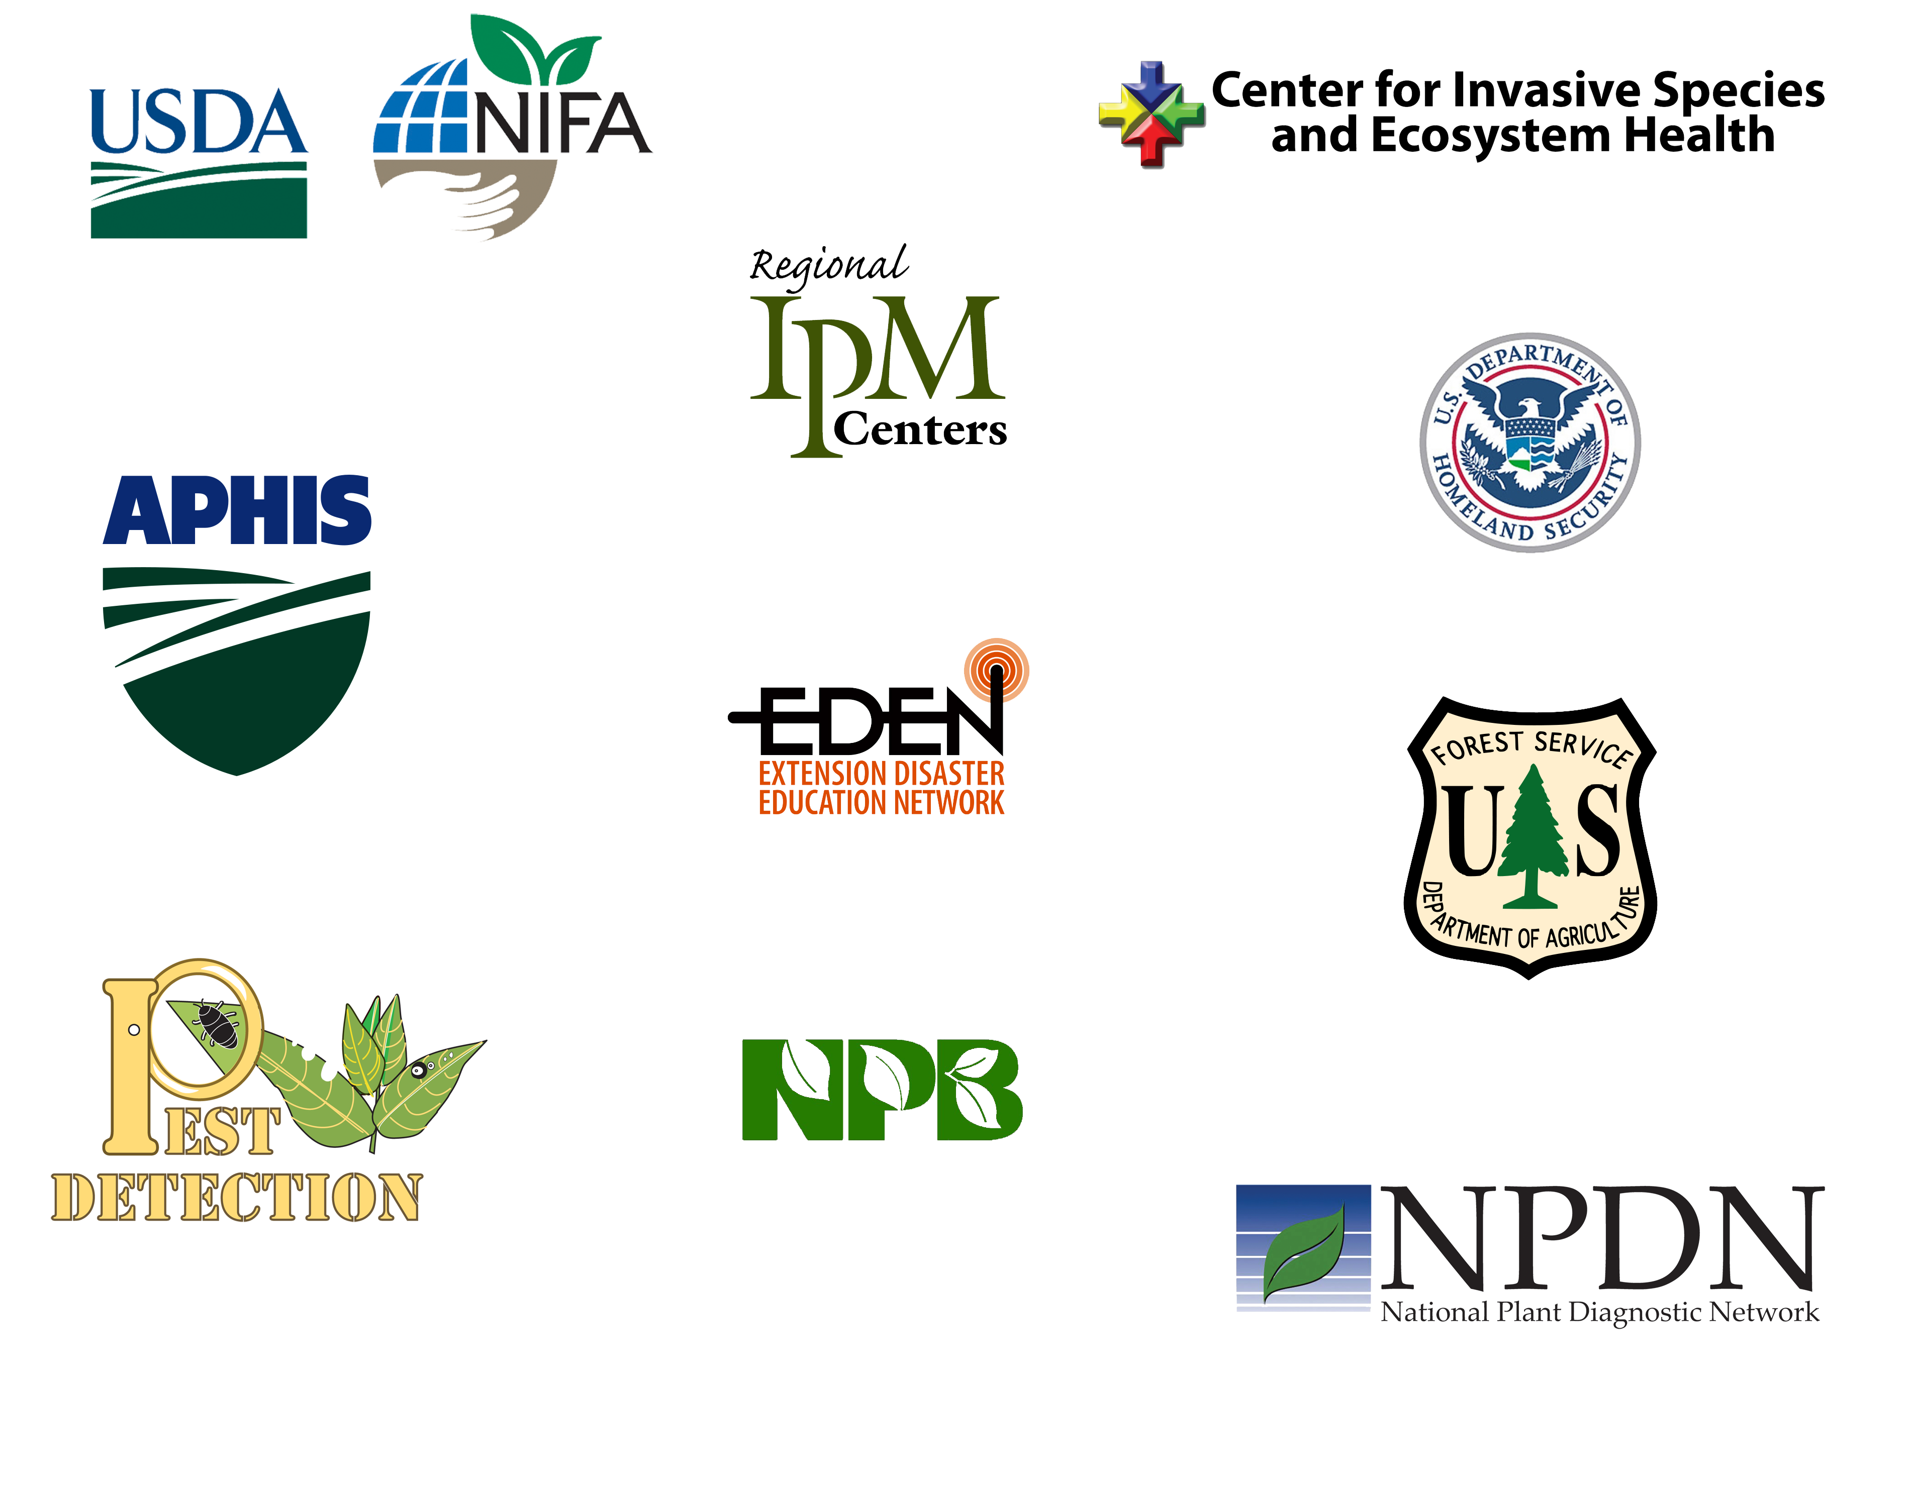
Our Partners
Much of the authorship of e-learning content has occurred through partnerships. Some of our partnering organizations have included:
Center for Invasive Species and Ecosystem Health
(i.e. the Bugwood Network)
National Institute of Food and Agriculture (NIFA)
Local and Regional Integrated
Pest Management programs (IPM)
U.S. Department of Homeland Security (DHS)
USDA-APHIS
Extension Disaster Education Network (EDEN)
U.S. Forest Service
National Plant Board (NPB) and
State Departments of Agriculture
Cooperative Agriculture Pest Survey Program (CAPS)
National Plant Diagnostic Network (NPDN)

Slide 27
References
Cranshaw, W. 2009. Thousand Cankers Disease Management in Urban Forestry. Draft. accessed 3/31/2013.
http://www.coloradotrees.org/News/Thousand%20Cankers%20Disease%209-09.pdf
Freeland, Emily. 2012. Intraspecific variability of Geosmithia morbida the causal agent of thousand cankers disease, and effects of temperature, isolate and host family (Juglans nigra) on canker development. Masters Thesis. accessed 3/26/2013.
http://digitool.library.colostate.edu///exlibris/dtl/d3_1/apache_media/L2V4bGlicmlzL2R0bC9kM18xL2FwYWNoZV9tZWRpYS8xNjQwNzM=.pdf
Kolarik, M., E. Freeland, C. Utley, and N. Tisserat. 2011. Geosmithia morbida sp. nov., a new phytopathogenic species living in symbiosis with the walnut twig beetle (Pityophthorus juglandis) on Juglans in USA. Mycologia 103(2), 325-332. accessed 3/25/2013.
http://www.mycologia.org/content/103/2/325.full
Newton, L. and G. Fowler. 2009. Pathway Assessment: Geosmithia sp. and Pityophthorus juglandis Blackman movement from the western into the eastern United States. accessed 3/25/2013.
http://oregonstate.edu/dept/nurspest/APHIS%20CPHST%20Geosmithia_PATHWAY_Rev1_10-19-2009%20(2).pdf

Slide 28
References
New York State Department of Environmental Conservation, Division of Lands and Forests. 2012. Stumpage Price Report, Winter 2012. #80. accessed 3/28/2013.
http://www.dec.ny.gov/docs/lands_forests_pdf/spr2012winter.pdf
Pavek, Diane S. 1993. Juglans major. In: Fire Effects Information System, [Online]. U.S. Department of Agriculture, Forest Service, Rocky Mountain Research Station, Fire Sciences Laboratory (Producer). accessed 3/26/2013.
http://www.fs.fed.us/database/feis/plants/tree/jugmaj/all.html
Peachy, Emily. 2012. Studies On The Walnut Twig Beetle (WTB), Pityophthorus juglandis, in Relation to its Association With Geosmithia morbida, its Survival in Felled Logs, and its Sensitivity to Temperature Extremes. Masters Thesis. accessed 3/26/2013.
http://digitool.library.colostate.edu///exlibris/dtl/d3_1/apache_media/L2V4bGlicmlzL2R0bC9kM18xL2FwYWNoZV9tZWRpYS8xOTIwMzA=.pdf
Perez, A. and K. Plattner. 2012. Fruit and tree nuts outlook. United States Department of Agriculture, Economic Research Service. FTS-352. accessed 3/27/ 2013.
http://www.ers.usda.gov/media/826893/fts352.pdf

Slide 29
References
Reid, W., M. Coggeshall, H. E. Garrett, J. Van Sambeek. 2009. Growing black walnut for nut production. University of Missouri, Center for Agroforestry, Technology Transfer and Outreach Unit. accessed 3/25/2013.
http://extension.missouri.edu/explorepdf/agguides/agroforestry/af1011.pdf
Seybold, S., D. Haugen, and A. Graves. 2010. Pest alert: Thousand cankers disease. United States Department of Agriculture, Forest Service, Northeastern Area State and Private Forestry. accessed 3/25/2013.
http://na.fs.fed.us/pubs/palerts/cankers_disease/thousand_cankers_disease_screen_res.pdf
Shifley, S. R. 2004. The black walnut resource in the United States. Proceedings of the 6th Walnut Council research symposium, July 25-28, 2004; Lafayette, IN. Pp. 168-176. accessed 3/25/2013.
http://nrs.fs.fed.us/pubs/gtr/gtr_nc243/gtr_nc243_168.pdf
Tisserat, N., W. Cranshaw, D. Leatherman, C. Utley, and K. Alexander. 2009. Black walnut mortality in Colorado caused by the walnut twig beetle and thousand cankers disease. Online. Plant Health Progress doi:10.1094/PHP-2009-0811-01-RS. accessed 3/25/2013.
http://www.plantmanagementnetwork.org/pub/php/research/2009/walnut/

Slide 30
References
Treiman, T. and J. Tuttle. 2009. Thousand Cankers Disease of Black Walnut: How Much Will It Hurt Missouri’s Pocketbook? Missouri Department of Conservation. Notes for Forest Managers, Report #16. accessed 3/27/ 2013.
http://mdc.mo.gov/sites/default/files/resources/2010/10/21128.pdf
United States Department of Agriculture Forest Service and Plant Protection and Quarantine. 2012. Thousand Cankers Disease Survey Guidelines for 2012. accessed 6/2/2013 –
http://caps.ceris.purdue.edu/webfm_send/1730
USDA NRCS – Plant Fact Sheet. Black Walnut. 2002. Accessed 6/2/2013 –
http://plants.usda.gov/factsheet/pdf/fs_juni.pdf
USDA Plant Database. 2013. Juglans. accessed 3/31/2013.
http://plants.usda.gov/java/profile?symbol=JUGLA
USDA. 2013. Noncitrus Fruit and Nuts Preliminary Summary. accessed 3/28/2013.
http://usda01.library.cornell.edu/usda/current/NoncFruiNu/NoncFruiNu-01-25-2013.pdf

