Slide 1
Rosy Moth Lymantria mathura

Slide 2
Rosy Moth
Other common names: rosy gypsy moth, russian gypsy moth, sal defoliator, pink gypsy moth
Major defoliator of deciduous forests, especially oak, in Asia
Outbreaks are often followed by wood borer pest problems
Considered a high risk for invasion in North America
Notes:
Information sources: 1, 4, 5

Slide 3
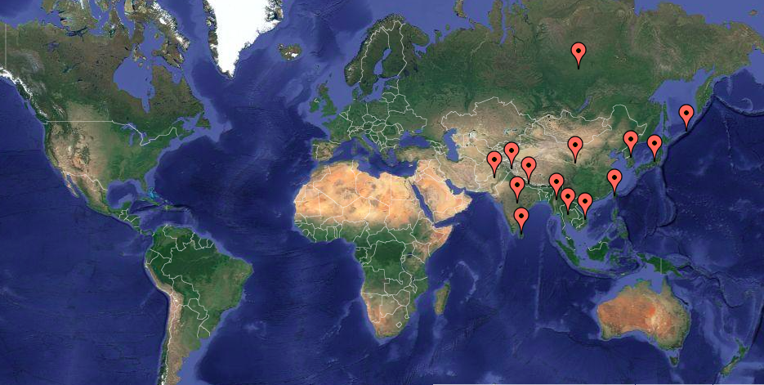
Global Distribution
Image credits: map created with easymapmakers.com, Background image: NASA, Terrametrics 2016
Notes:
The rosy moth is currently present throughout many countries in Asia including Bangladesh, China, India, Japan, Kashmir, Korea, Kurile Islands, Myanmar, Nepal, Pakistan, Russia, Sri Lanka, Taiwan, Thailand, and Vietnam. So far, it has been isolated to the Eastern hemisphere, but there is a risk that is will become a pest present in other parts of the world including the United States.
Information sources: 4

Slide 4
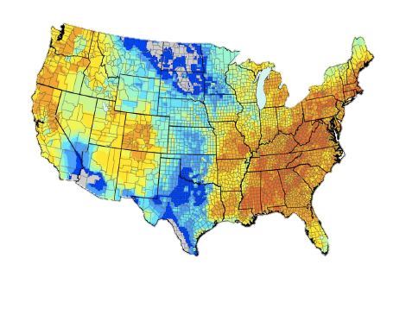
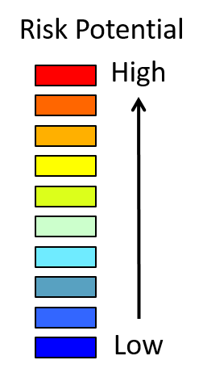
Risk Assessment in the United States
Risk Map for Lymantria Mathura, Rosy moth
Image credits: USDA-APHIS-PPQ-CPHST
Notes:
Although the rosy moth has not yet been intercepted in the United States, it is at risk due to its climate and vegetation. The rosy moth is attracted to temperate to warm climates and variable rainfall making much of the United States a suitable climate. The Eastern and Western states are at a high risk for the establishment of the rosy moth as indicated by the orange and yellow on the map. The states with blue coloration indicate a lower level of risk. It is predicted that the major ports could be the port of entry if the pest was ever to make it into the United States. This is because adult rosy moths will lay eggs on foreign cargo that later gets ships to U.S. ports.
Information sources: 4

Slide 5
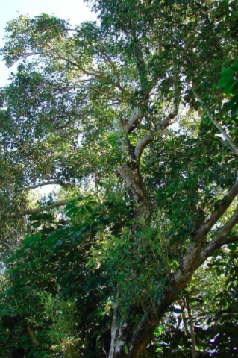
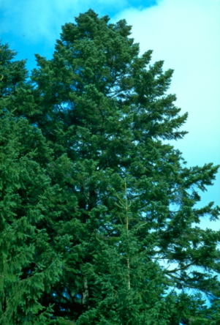
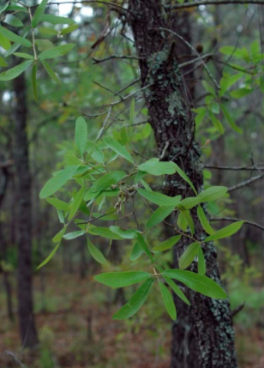
Pest of forests and fruit trees
Image credits: bluejack oak (Quercus incana) Bartr, Chris Evans, University of Illinois -Bugwood.org, #1378026; Java plum (Syzygium cumini) (L.) Skeels - Forest and Kim Starr, Starr Environmental - Bugwood.org, #5420643; fir (Abies spp.) P. Mill. - Petr Kapitola, Central Institute for Supervising and Testing in Agriculture -Bugwood.org, #4544003
Notes:
In eastern Asia, the rosy moth is a major pest of deciduous forests and fruit trees. The have several preferential hosts that include two species of oak but have been noted on several other oak species. It feeds on more that 45 genera of hosts and causes extreme damage during outbreaks in Asia including countries like India.
Key Hosts:
Quercus leucotrichophora (=Q. incana*) (Himalayan oak),
Q. serrata (Konara oak),
Shorea robusta* (sal tree),
Syzygium cumini* (Java plum),
Terminalia arjuna (arjuna),
T. myriocarpa (East Indian almond)
Other Hosts:
Abelicea spp.,
Abies spp. (fir),
Abies nephrolepis (Manchurian fir),
Acrocarpus spp.,
Acrocarpus fraxinifolius* (pink cedar),
Alnus pp. (alder),
Alstonia spp. (alstonia),
Alstonia scholaris (blackboard tree),
Anogeissus spp. (anogeissus),
Anogeissus lalifolia (dhaoda),
Ammora spp.,
Aphanamixis polystachya (rayana),
Artocarpus lacucha (monkey-jack tree),
Betula spp. (birch),
Butea spp. (butea),
Butea monosperma (Bengal kino),
Carya sp. (hickory),
Castanea spp. (chestnut),
Castanea mollissima (Chinese hairy chestnut),
Castanea sativa (European chestnut),
Cedrela spp. (cedrela),
Cleyera spp. (cleyera),
Dimocarpus longan (longan),
Duabanga spp.,
Duabanga grandiflora (duabanga),
Elaeodendron spp. (Ceylon tea),
Elaeodendron glaucum (Ceylon tea),
Eugenia spp.(stopper),
Fagus spp. (beech),
Fagus grandifolia (American beech)**,
Fagus sylvatica (European beech)**,
Ficus benghalensis (Indian banyan),
Fraxinus spp. (ash),
Grewia sapinda,
Haldina cordifolia (haldu),
Hippophae rhamnoides (seaberry),
Juglans spp. (walnut),
Jugans mandshurica (Manchurian walnut),
Larix spp. (larch),
Liquidambar formosana (Formosan sweetgum),
Litchi spp. (lychee),
Litchi chinensis (lychee),
Mallotus philipinensis (kamala),
Malus spp. (apple),
Malus mandshurica (Manchurian crabapple),
Malus prunifolia (Chinese apple),
Mangifera spp. (mango), M. indica (mango),
Mellotus spp.,
Melia spp. (melia),
Melia azedarach (china berry tree),
Millettia pinnata (pongame oil tree),
Morus alba (white mulberry),
Neolamarckia cadamba (kadam),
Pinus spp. (pine),
Pinus koraiensis (Korean pine)**,
Pongamia spp.,
Populus spp. (cottonwood),
Prunus spp. (plum),
Prunus cerasoides (wild Himalayan cherry),
Pseudotsuga menziesii (Douglas fir),
Pterygota alata (Buddha’s coconut),
Pyrus spp. (pear),
Quercus spp. (oak),
Quercus alba (white oak),
Quercus acuta (Japanese evergreen oak),
Quercus dentata (Daimyo oak),
Quercus glauca (ring-cup oak),
Quercus mongolica (Mongolian oak),
Quercus prinus (chestnut oak,
Quercus variabilis (Chinese cork oak),
Rhus spp. (sumac),
Rosa rugosa (rugosa rose),
Salix spp. (willow),
Salix fragilis (crack willow),
Shorea spp. (shorea),
Syzygium spp. (syzygium),
Terminalia spp. (tropical almond),
Terminalia belerica (beleric),
Terminalia elliptica (asna),
Tilia mandshurica (Manchurian linden),
Terminalia pyrifolia,
Toona ciliata (Australian red-cedar),
Toxicodendron succedaneum (Japanese waxtree),
Ulmus spp. (elm),
Ulmus davidiana (Japanese elm),
Zelkova spp. (zelkova),
Zelkova serrata (=Z. acuminata) (Japanese zelkova)
Information sources: 1

Slide 6
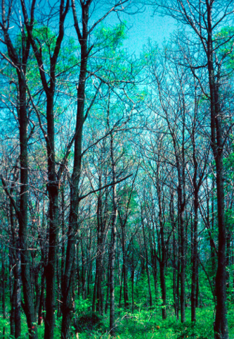
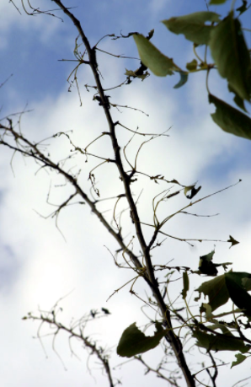
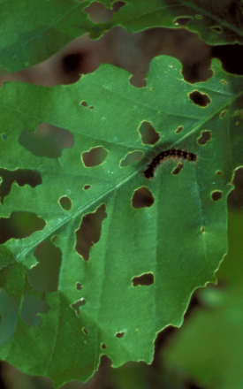
Damage
Image credits: gypsy moth (Lymantria dispar) (Linnaeus) - William M. Ciesla, Forest Health Management International - Bugwood.org, #0758032; gypsy moth (Lymantria dispar) (Linnaeus) - USDA APHIS PPQ , USDA APHIS PPQ - Bugwood.org, #2652051; gypsy moth (Lymantria dispar) (Linnaeus) - Landesforstpräsidium Sachsen - Bugwood.org, #1259095
Notes:
The rosy moth larvae cause damage to the leaves of trees. They are defoliators that consume whole leaves and vein as well as flowers and young shoots. This leads to the decline of many hosts, a reduction of production in fruit bearing trees and when populations are high, tree death.
Information Sources: 1, 4

Slide 7
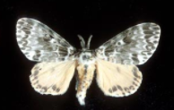
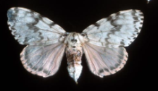
Identification
Adults
Males
Wingspan 3.5-5cm
Brown forewings
Yellow hindwings
Yellow and gray thorax
Dark colored pattern
Females
Wingspan 7.5-9.5cm
White forewings
Pink hindwings
Pink, white and gray thorax
Dark colored pattern
Male
Female
Image credits: rosy gypsy moth (Lymantria mathura) Moore - USDA APHIS PPQ , USDA APHIS PPQ - Bugwood.org, #1267107; rosy gypsy moth (Lymantria mathura) Moore - USDA APHIS PPQ , USDA APHIS PPQ - Bugwood.org, #1267106
Notes:
Rosy moth adults display sexual dimorphism in size and color as adults. The females are larger with a wingspan of 7.5-9.5cm whereas the males have a wingspan of 3.5-5cm. The males have brown forewings and yellow hindwings. The females, on the other hand, have white forewings and pink hindwings. The males have a thorax that is yellow with gray markings while the females have a body that is pink and white with gray markings. Both male and female have darker gray markings on the wings and strongly pectinate antennae. Although the adult stage is the easiest to identify as Lymantria mathura, a dissection of the genitalia is required to identify the pest.
Information sources: 1, 3, 4

Slide 8
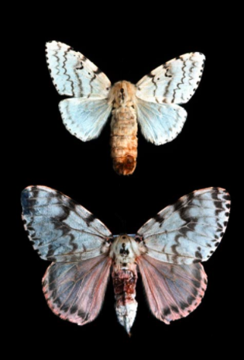
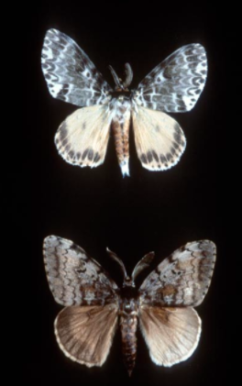
Lookalikes - Adults
Females: Lymantria dispar (above), Lymantria mathura (below)
Males: Lymantria dispar (above), Lymantria mathura (below)
Image credits: rosy gypsy moth (Lymantria mathura) Moore - USDA APHIS PPQ , USDA APHIS PPQ - Bugwood.org, #1267107; rosy gypsy moth (Lymantria mathura) Moore - USDA APHIS PPQ , USDA APHIS PPQ - Bugwood.org, #1267106
Notes:
The rosy moth looks similar to some of the other lymantrids but is easy to identify based on its color. The most similar is Lymantria dispar (gypsy moth). The picture on the left shows females of Lymantria dispar above and the rosy moth below. The rosy moth females have a distinct pink coloration. The photograph of the right shows the males of the two species; Lymantria dispar above and the rosy moth below. The male of the rosy moth has brown hindwings and forewings rather than yellow and white. The gypsy moth (Lymantria dispar) is known to occur in the United States unlike the rosy moth.
Information sources: 1, 4

Slide 9
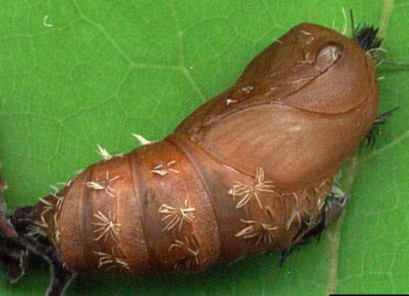
Identification
Pupae
Females
Light brown
3.3cm in length
0.03oz
White hair tufts
Males
Dark brown
2cm in length
0.005oz
White hair tufts
Image credits: rosy gypsy moth (Lymantria mathura) Moore - David Mohn, Critters Page (Creatures Great and Small) - Bugwood.org, #1277085
Notes:
The pupae are light to dark brown and between 2 and 3.6cm long with white colored hair tufts. There is sexual dimorphism seen in the pupae. The female is often lighter in color and larger than the male. The males are on average 2cm and the females pupae are 3.3cm. The female pupae typically weighs around 0.03oz while the male is only 0.005oz. The pupae are easily confused with other species including the gypsy moth (Lymantria dispar).
Information sources: 1, 3, 5

Slide 10
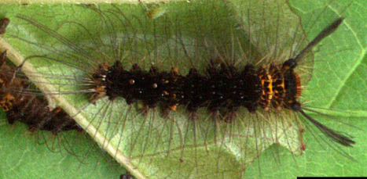
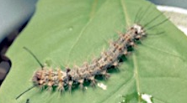
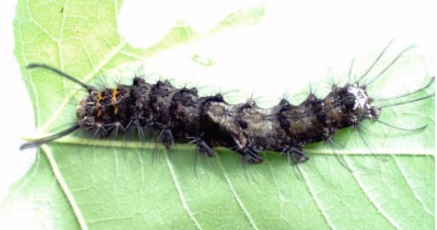
Identification
Larvae
Grey, light brown, or blackish-brown
3.4mm to 6cm long
Posterior and anterior hair pencils
Brown or white hair tufts
Transverse yellow and brown streaks on thorax
Black or white abdominal warts
Image credits: rosy gypsy moth (Lymantria mathura) Moore - David Mohn, Critters Page (Creatures Great and Small) - Bugwood.org, #1277071; rosy gypsy moth (Lymantria mathura) Moore - David Mohn, Critters Page (Creatures Great and Small) - Bugwood.org, #1277080; rosy gypsy moth (Lymantria mathura) Moore - USDA APHIS PPQ , USDA APHIS PPQ - Bugwood.org, 1267113
Notes:
There are three main color forms of larvae; grey, light brown, and blackish-brown. Initially, the larvae are about 3.4mm long when they first hatch and grow up to 4 to 6cm before pupating. The female larvae are typically much larger than the male larvae. On average, the full grown male larva is 4.2cm and the full grown female larva is 6cm. Later instar larvae are not often confused with other lymantrids. They have one pair of anterior and two pairs of posterior hair pencils. They have transverse yellow and brown streaks on the thorax and black or white abdominal warts. Additionally, the larvae have tufts of brown or white hair depending on the color form on their backs. There may also be white or gray spots along the larvae’s backs.
Information sources: 1, 3, 4

Slide 11
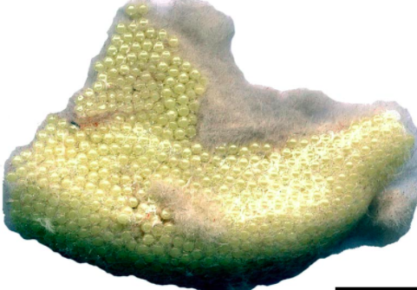
Identification
Eggs
50 to 1,200 eggs per egg mass
Pale yellow
Fluffy
Irregular edges
Ovoid egg shape
Image credits: rosy gypsy moth (Lymantria mathura) Moore - David Mohn, Critters Page (Creatures Great and Small) - Bugwood.org, #1277064
Notes:
The eggs are laid in pale yellow, fluffy patches with irregular edges that are between 0.5 x 1cm and 6 x 15cm in length. The fluffy appearance comes from silken hairs shed by the female upon laying the eggs. The yellow color will darken as the eggs get closer to hatching. The masses are flat and laid overlapping in 2-4 layers of eggs which individually have an ovoid shape. Each mass contains between 50-1,200 eggs and can be found directly on the bark. These egg masses are visible on the bark of host trees between ground level to 18m.
Information sources: 1, 4

Slide 12
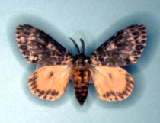
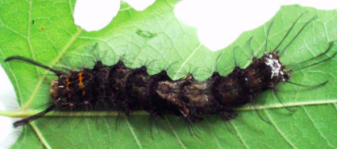
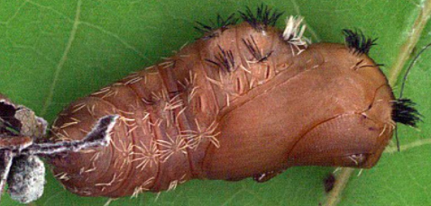
Life cycle
Eggs
Adult
Larvae
Pupae
Image credits: rosy gypsy moth (Lymantria mathura) Moore - David Mohn, Critters Page (Creatures Great and Small) - Bugwood.org, #1277064; rosy gypsy moth (Lymantria mathura) Moore - USDA APHIS PPQ , USDA APHIS PPQ - Bugwood.org, #1267105; rosy gypsy moth (Lymantria mathura) Moore - David Mohn, Critters Page (Creatures Great and Small) - Bugwood.org, #1277081; rosy gypsy moth (Lymantria mathura) Moore - David Mohn, Critters Page (Creatures Great and Small) - Bugwood.org, #1277084
Notes:
The rosy moth is bivoltine meaning it completes two generations every year. The first generation starts when adults will lay eggs in mid-april and mid-june. These eggs will hatch in 3-4 weeks and larvae will begin feeding on host tissues. Then, the larvae will pupate in late July or early October. It is not know how long pupation occurs in the first generation but adults will emerge and lay the next generation of eggs in early September to mid-October. These eggs will develop in 6 weeks but overwinter until February and early April depending on temperature. They require warmer weather to hatch. Larvae will then feed and eventually pupate. In the second generation pupation will last for 10-11 days and adults will emerge to restart the cycle.
Information sources: 3, 4

Slide 13
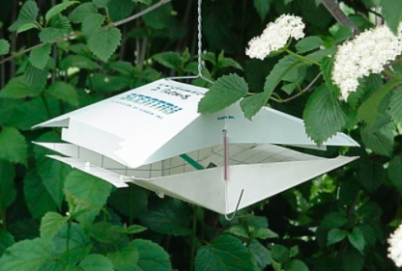
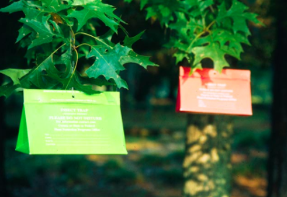
Monitoring
Wing trap
“Lymantria mathura Lure”
Paper or plastic
Delta sticky traps
Image credits: viburnum borer (Synanthedon viburni) Engelhardt - David Parsons, University of Wisconsin - Bugwood.org, #2131007; gypsy moth (Lymantria dispar) (Linnaeus) - Terry S. Price, Georgia Forestry Commission - Bugwood.org, #1247237
Notes:
Wing traps are CAPS-approved to monitor for the rosy moth. Paper or plastic wing traps can be used and the lure is sold commercially as “Lymantria mathura lure”. Other literature cites cis-7,8-epoxy-2-methyloctadecane and 2-methyl-Z7-octadecene as being an effective lure for males. Furthermore, (9R,10S)-cis-9,10-epoxy-Z3,Z6- nonadecadiene and (9S,10R)-cis-9,10-epoxy-Z3,Z6- nonadecadiene mixtures have shown success in trapping in a 1:4 ratio. Traps should be placed 20m or 65ft apart near host trees. It is recommended that trapping for different species should not occur in the same area.
Delta traps have also shown success in monitoring for the rosy moth. These traps are typically hung 1.5-2m or 5-6.5ft above the ground. They are also places about 20-25m or 65.6-82ft apart in areas where the rosy moth are known to be present. Standard gypsy moth detection practices can be applied in the United States where the pest is not yet known to occur.
These two monitoring methods are also known to attract other moths. Epirrhoe sperryi and Prochoerodes transversata have shown up in traps for the rosy moth but the rosy moths are easily identified visually in comparison.
Information Sources: 4

Slide 14
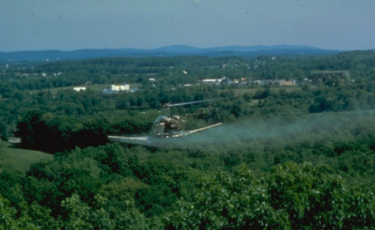
Chemical Control
Diflubenzuron
Bacillus thuringiensis (Bt)
Broad spectrum insecticides
Image credits: gypsy moth (Lymantria dispar) (Linnaeus) - USDA Forest Service - Region 8 - Southern , USDA Forest Service - Bugwood.org, #1507054
Notes:
Chemical control for the rosy moth is the same as most gypsy moths (Lymantria dispar). Chemical control is only recommended in areas with high population levels since broad spectrum insecticides are commonly used. One chemical, Diflubensuron, has proven to be effective in killing gypsy moths, but literature has not confirmed its specific effects on the rosy moth. Although many sources mention the use of chemical controls for the rosy moth, very few actually include the chemical used. Another approach is Bacillus thuringiensis which is a bacterium that kills moth larvae. The downside of its use is that it will also kill other moth and butterfly species. As a whole, chemical control is not the best method of control and biological and cultural control should be attempted first.
Information sources: 2

Slide 15
Biological Control
Beauveria
Brachymeria lasus
Carcelia excavata
Carcelia gnava
Compsilura concinnata
Cotesia melanoscela
Cytoplasmic polyhedrosis virus (CPV)
Entomophaga aulicae
Hexamermis sp.
Nucleopolyhedrosis virus
Winthemia sumatrana
Notes:
There are several biological controls that have been identified for the rosy moth. There are some parasitoids and pathogens related to the control of Rosy moth. In Korea, Cotesia melanoscela and Brachymeria lasus are noted to parasitize the rosy moth larvae and less frequently, pupae. Japan has reported Carcelia excavata and Hexamermis sp. as other possible parasitoids. Moreover, several other parasitoids and two pathogens have shown success as a biological control in Korea including the following:
Beauveria
Brachymeria lasus
Carcelia excavata
Carcelia gnava
Compsilura concinnata
Cotesia melanoscela
Cytoplasmic polyhedrosis virus (CPV)
Entomophaga aulicae
Hexamermis sp.
Nucleopolyhedrosis virus
Winthemia sumatrana
Information Sources: 1

Slide 16
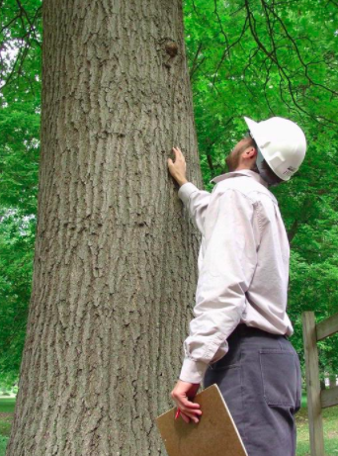
Cultural Control
Reduced lighting near ports
Inspection of cargo
Heat treat infested wood
Visual inspections of hosts
Image credits: visual tree inspection - Andrew Koeser, International Society of Arboriculture - Bugwood.org, #5375278
Notes:
In general, the spread of this pest often occurs through the movement of cargo between infested and non-infested areas. Reduced lighting near ports where the rosy moth is present can help prevent the spread of the pest as the moths are attached to the light and can lay eggs on cargo. Furthermore, inspection of all goods transported from countries with the rosy moth is extremely important. It is recommended that both the sending and receiving ports inspect shipments for the rosy moth. Any wood that is transported from an infested area should be heat treated prior to shipment. Visual inspections of the hosts are also important in the United States for early detection.
Information Sources: 1, 5

Slide 17
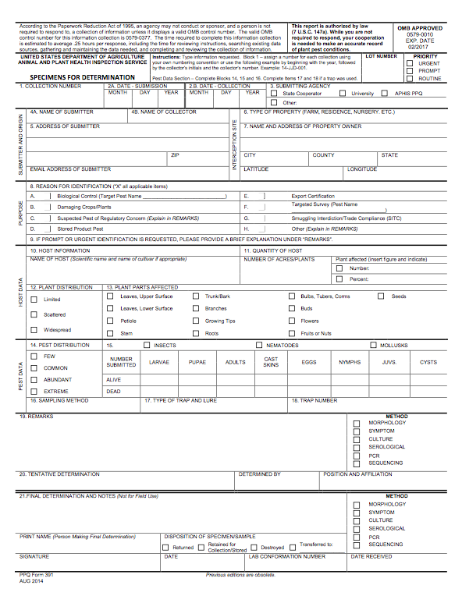
Suspect Sample Submissions
Contact your State Department of Agriculture or University Cooperative Extension laboratory
http://www.npdn.org/home
PPQ form 391, Specimens for Determination
https://www.aphis.usda.gov/library/forms/pdf/PPQ_Form_391.pdf
An example of a PPQ form for sample submissions
Image credits: https://www.aphis.usda.gov/library/forms/pdf/PPQ_Form_391.pdf
Notes:
If a suspect pest has been located in the United States, a sample should be submitted for proper identification. Contact your local diagnostic lab to ship in a sample for identification. Information regarding your local diagnostic lab is available at National Plant Diagnostic Network (NPDN) website. The diagnostic lab information and available contacts are divided by state.
http://www.npdn.org/home
The sample specimen should be submitted along with accompanying documentation using the PPQ form 391.
https://www.aphis.usda.gov/library/forms/pdf/PPQ_Form_391.pdf
Your local diagnostic lab is part of your local cooperative extension service or your state department of agriculture. Your local lab will also have a specific form. All local labs may not be a member of NPDN. However, all labs should report new pest and pathogen detections to local regulatory officials.

Slide 18
Communications
Contact your State Plant Health Director
https://www.aphis.usda.gov/aphis/ourfocus/planthealth/ppq-program-overview/ct_sphd
Contact your State Plant Regulatory Official
http://nationalplantboard.org/membership/
Image credits: http://www.usda.gov/wps/portal/usda/usdahome; http://nationalplantboard.org/
Notes:
Remember that new pest and pathogen records must be reported to your State Plant Health Director (SPHD) and your State Plant Regulatory Official (SPRO). The SPRO is a State Department of Agriculture Employee and the SPHD is a USDA-APHIS-PPQ employee.
The link to your SPRO is on the National Plant Board (NPB) website. It has an interactive map and when you click on your state it will take you to another page with contact information. The NPB is a cooperative organization that includes membership from all State Departments of Agriculture.

Slide 19
Author and Publication Dates
Morgan Pinkerton
Lab Technician, Department of Entomology and Nematology, University of Florida
Amanda Hodges, Ph.D.
Associate Extension Scientist, Department of Entomology and Nematology, University of Florida
Publication date: October 2016

Slide 20
Reviewers
Catherine A. Marzolf
Assistant State Plant Health Director, USDA APHIS PPQ

Slide 21
Educational Disclaimer and Citation
This presentation can be used for educational purposes for NON-PROFIT workshops, trainings, etc.
Citation: Pinkerton, Morgan and Amanda Hodges. 2016. Rosy moth – Lymantria dispar
Accessed (add the date)
www.protectingusnow.org

Slide 22
Our Partners
United States Department of Agriculture, National Institute of Food and Agriculture (USDA NIFA)
United States Department of Agriculture, Animal and Plant Health Inspection Service, Plant Protection and Quarantine (USDA APHIS PPQ)
Cooperative Agriculture Pest Survey (CAPS) Program
National Plant Board (NPB)
States Department of Agriculture
Extension Disaster Education Network (EDEN)
Center for Invasive Species and Ecosystem Health (Bugwood)
National Plant Diagnostic Network (NPDN)
U.S. Department of Homeland Security (DHS)
U.S. Forest Service (USFS)

Slide 23
References
Anonymous. 2015. Lymantria mathura (pink gypsy moth). Invasive Species Compendium. Accessed 6/6/2016.
http://www.cabi.org/isc/datasheet/31809
Anonymous. Least Toxic Control of Gypsy Moths. Beyond Pesticides.
https://www.beyondpesticides.org/assets/media/documents/alternatives/factsheets/Gypsy%20Moth%20Control.pdf
Davis, E.E., S. French, and R.C. Venette. 2005. Mini Risk Assessment: Pink Gypsy Moth, Lymatria mathura Moore [Lepidoptera: Lymantriidae]. CAPS. Accessed 6/13/2016.
https://extension.entm.purdue.edu/CAPS/pdf/datasheets/RussianGypsyMoth.pdf
Molet, T. 2012. CPHST Pest Datasheet for Lymantria mathura . USDA-APHIS-PPQ-CPHST. Accessed 6/6/2016.
download.ceris.purdue.edu/file/1844

Slide 24
References
OEPP/EPPO. 2005. Data sheets on quarantine pests: Lymantria mathura. European and Mediterranean Plant Protection Organization. Bulletin OEPP/EPPO Bulletin 35: 464–467. Accessed 6/10/16.
https://www.eppo.int/QUARANTINE/data_sheets/insects/DS_Lymantria_mathura.pdf

