Slide 1
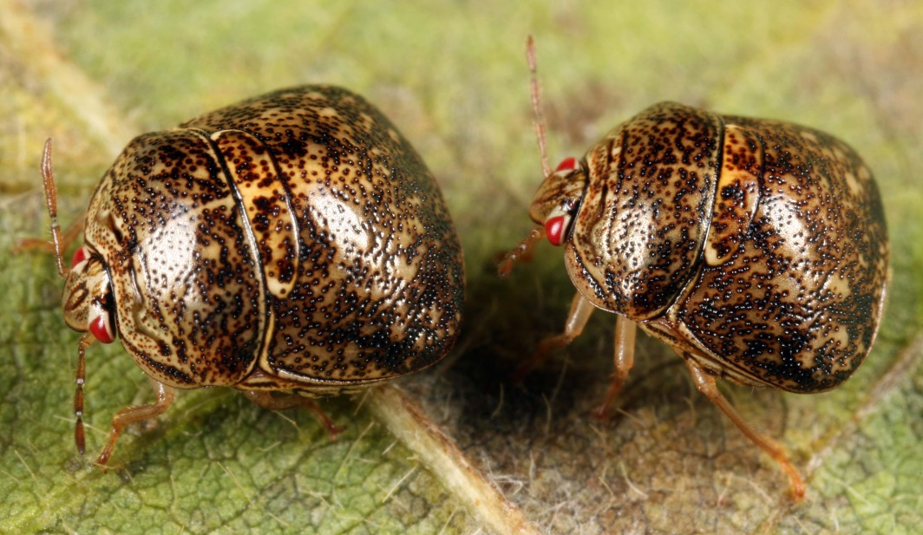
Megacopta cribraria (Heteroptera: Plataspidae) the “Kudzu Bug”
Image credit:
Marlin Rice, DuPont Pioneer, used with permission of the author
Notes:
Good day friends, my name is [Name] from [Organization] and today we will be learning about a relatively new invasive insect pest to the U.S.
The kudzu bug is a malodorous insect pest that can occur in extremely large numbers. Its range is rapidly expanding from the southeastern U.S. across the mid-south and up the Atlantic seaboard. It is well known to anyone who lives in its new home range due to its conspicuous presence as both an urban nuisance and destructive pest of soybean.
Kudzu bug is unique in that it is the only representative from this taxonomic family in the western hemisphere. One of the unusual attributes of the species is that it emits a very pungent odor that is evident anywhere aggregations occur. Many entomologists report they can smell kudzu bugs before making visual confirmation. Also, unlike other stink bugs, its scutellum or shield covers the entire abdomen.

Slide 2
“Kudzu Bug”
Native to southeastern Asian countries including China, India and Japan
First detection in the western hemisphere occurred October 2009 from the metropolitan Atlanta area
aka M. punctatissima, bean plataspid, lablab bug, or globular stink bug
Does not have an officially accepted common name in the U.S., but “kudzu bug” is pending
Notes:
Megacopta cribraria (Heteroptera: Plataspidae), is a native insect to Asia (Australia, China, India, Indonesia, Japan, Korea, Malaysia, Myanmar, New Caledonia, Pakistan, Sri Lanka, Taiwan, Thailand, and Vietnam).
In October 2009, large aggregations of the insect were discovered on the exterior of light colored houses in nine northeast Georgia Counties located in the Atlanta, Georgia metro area. North American taxonomists quickly realized they were dealing with a foreign introduction and classified the insect as a member of the Plataspidae, an insect family completely unknown in the new world. Interestingly, the entire U.S. population is thought to have originated from a single introduction.
The taxonomy and naming of the insect initially proved to be difficult as there were many scientific names in the literature that seemed to described the same species. For example, the insect was described as Cimex cribraria from Indian in 1798, Tetyra cribraria in 1803, Thyreocoris cribrarius in 1835, Coptosoma cribrarius in 1843, Coptosoma xanthochlora in 1867. In Japan the insect was known as Megacopta punctatissima.
Analyses of these specimens as far back as 1934 showed no morphological differences between species described as Megacopta punctatissima and a separate species known as Megacopta cribraria. In addition to revisiting these comparisons from a morphological context, modern phylogenetic studies do not support separate species in each country. Most taxonomists are coalescing around a single scientific name, Megacopta cribraria .
Similarly, many different common names and English translations of common names have been used worldwide. In the U.S., official common names are sanctioned by the Entomological Society of America. There is presently no established common name for this insect as there has never been a successful proposal submitted to the ESA Common Names committee. Since the ambiguity of the proper scientific name is abating, taxonomic experts and researchers in the southeastern U.S. are in agreement that there is an abundant validation/history of "kudzu bug" to support a proposal recognizing this name as the accepted common name.
Admittedly, these processes are slow and deliberate, but that is good from the standpoint of not mucking up a complex situation that has a history dating back several hundred years. By their nature and training, research scientists tend to be deliberate with their decision making as their contributions to the scientific literature will likely outlive their own careers!
Information sources:
Dai, J.-x., and Z.-m. Zheng. 2004. Discussion on the phylogenetic relationships of partial pentatomidae insects based on sequences of cytochrome b gene. Zoological Research 25: 397-402.
Dai, J.-X., and Z.-M. Zheng. 2005a. Phylogenetic relationships of eleven species of Pentatominae based on sequences of cytochrome b gene. Chinese Bulletin of Entomology 42: 395-399.
Dai, J.-X., and Z.-M. Zheng. 2005b. Phylogenetic relationships of eleven species of Pentatominae based on sequences of cytochrome b gene. Kunchong Zhishi 42: 395-399.
Eger, J. E., Jr., L. M. Ames, D. R. Suiter, T. M. Jenkins, D. A. Rider, and S. E. Halbert. 2010. Occurrence of the Old World bug Megacopta cribraria (Fabricius) (Heteroptera: Plataspidae) in Georgia: a serious home invader and potential legume pest. Insecta Mundi 0121: 1-11.
Gardner, W. A., H. B. Peeler, J. LaForest, P. M. Roberts, A. N. Sparks, Jr., J. K. Greene, D. Reisig, D. R. Suiter, J. S. Bacheler, K. Kidd, C. H. Ray, X. P. Hu, R. C. Kemerait, E. A. Scocco, J. E. Eger, Jr., J. R. Ruberson, E. J. Sikora, D. A. Herbert, Jr., C. Campana, S. Halbert, S. D. Stewart, G. D. Buntin, M. D. Toews, and C. T. Bargeron. 2013b. Confirmed distribution and occurrence of Megacopta cribraria (F.) (Hemiptera: Heteroptera: Plataspidae) in the southeastern United States. Journal of Entomological Science 48: 118-127.
Hosokawa, T., N. Nikoh, and T. Fukatsu. 2014. Fine-scale geographical origin of an insect pest invading North America. Plos One 9.
Hsiao, T. y., L. y. Zheng, S. z. Ren, and et al. 1977. A handbook for the determination of the Chinese Hemiptera-Heteroptera. Volume 1.
Jenkins, T. M., T. D. Eaton, D. R. Suiter, J. E. Eger, Jr., L. M. Ames, and G. D. Buntin. 2010. Preliminary genetic analysis of a recently-discovered invasive true bug (Hemiptera: Heteroptera: Plataspidae) and its bacterial endosymbiont in Georgia, USA. Journal of Entomological Science 45: 62-63.
Ruberson, J. R., K. Takasu, G. D. Buntin, J. E. Eger, Jr., W. A. Gardner, J. K. Greene, T. M. Jenkins, W. A. Jones, D. M. Olson, P. M. Roberts, D. R. Suiter, and M. D. Toews. 2013. From Asian curiosity to eruptive American pest: Megacopta cribraria (Hemiptera: Plataspidae) and prospects for its biological control. Applied Entomology and Zoology 48: 3-13.
Suiter, D.R., J.E. Eger, Jr., W.A. Gardner, R.C. Kemerait, J.N. All, P.M. Roberts, J.K. Greene, L.M. Ames, G.D. Buntin, T.M. Jenkins and G.K. Douce. 2010. Discovery and distribution of Megacopta cribraria (Hemiptera: Heteroptera: Plataspidae) in Northeast Georgia. Journal of Integrated Pest Management. 1: 1-4.
Suiter, D. R., L. M. Ames, J. E. Eger, Jr., and W. A. Gardner. 2010. Megacopta cribraria as a nuisance pest. UGA-CAES Extension Circular No. 991. University of Georgia, Athens.

Slide 3
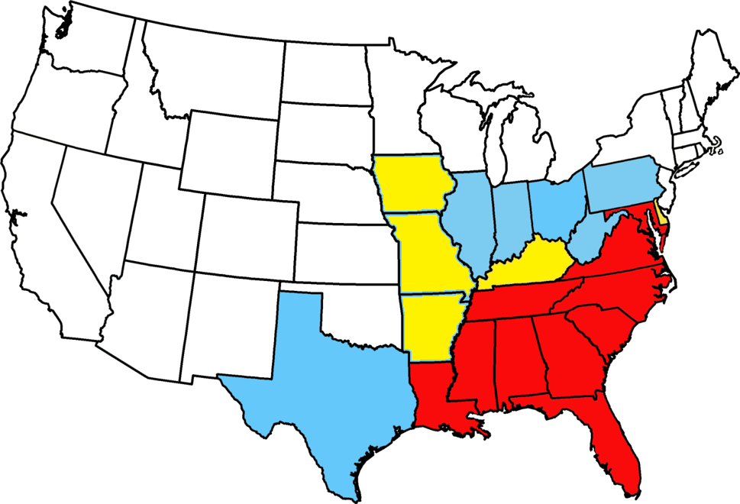
“Kudzu Bug” Distribution and Spread as of September 2014
No sampling
Sampled but not found
Intercepted or detected, but not considered established
Considered established by survey or consensus
Map courtesy of Pest Tracker, National Agricultural Pest Information System (NAPIS), and kudzubug.org– Accessed 9/11/2014 and http://www.kudzubug.org/distribution_map.cfm and SPROs and researchers from various states
Notes:
Since its initial discovery in northeastern Georgia in 2009, credible surveys through June 2014 confirm this new invasive species in numerous southeastern U.S. counties located in at least twelve U.S. states and the District of Columbia including: Alabama, Delaware, Florida, Georgia, Kentucky, Louisiana, Maryland, Mississippi, North Carolina, South Carolina, Tennessee, and Virginia. The species crossed the Mississippi River in 2013. Range expansion appears to be facilitated by an abundance of kudzu in the landscape, a plant that covers approximately 2.8 M ha in the southern and southeastern U.S.
Kudzu bug is a strong flier, but it is also an excellent hitchhiker. Researchers commonly report finding bugs in their vehicles and on their clothing after making field visits to infested areas. Experts believe that such rapid range expansion has no doubt been assisted by motorists travelling around the country with hidden bugs hitching a ride inside or under passenger cars and trucks.
Next time you smell something unpleasant in the office, don’t be so quick to assume the guy in adjacent cubicle forgot to put on deodorant; perhaps he is unsuspectingly harboring dispersing kudzu bugs!
Information sources:
Eger, J. E., Jr., L. M. Ames, D. R. Suiter, T. M. Jenkins, D. A. Rider, and S. E. Halbert. 2010. Occurrence of the old world bug Megacopta cribraria (Fabricius) (Heteroptera: Plataspidae) in Georgia: a serious home invader and potential legume pest. Insecta Mundi 0121: 1-11.
Gardner, W. A., J. L. Blount, J. R. Golec, W. A. Jones, X. P. Hu, E. J. Talamas, R. M. Evans, X. Dong, C. H. Ray, Jr., G. D. Buntin, N. M. Gerardo, and J. Couret. 2013a. Discovery of Paratelenomus saccharalis (Dodd) (Hymenoptera: Platygastridae), an egg parasitoid of Megacopta cribraria F. (Hemiptera: Plataspidae) in its expanded North American range. Journal of Entomological Science 48: 355-359.
Gardner, W. A., H. B. Peeler, J. LaForest, P. M. Roberts, A. N. Sparks, Jr., J. K. Greene, D. Reisig, D. R. Suiter, J. S. Bacheler, K. Kidd, C. H. Ray, X. P. Hu, R. C. Kemerait, E. A. Scocco, J. E. Eger, Jr., J. R. Ruberson, E. J. Sikora, D. A. Herbert, Jr., C. Campana, S. Halbert, S. D. Stewart, G. D. Buntin, M. D. Toews, and C. T. Bargeron. 2013b. Confirmed distribution and occurrence of Megacopta cribraria (F.) (Hemiptera: Heteroptera: Plataspidae) in the southeastern United States. Journal of Entomological Science 48: 118-127.
Ruberson, J. R., K. Takasu, G. D. Buntin, J. E. Eger, Jr., W. A. Gardner, J. K. Greene, T. M. Jenkins, W. A. Jones, D. M. Olson, P. M. Roberts, D. R. Suiter, and M. D. Toews. 2013. From Asian curiosity to eruptive American pest: Megacopta cribraria (Hemiptera: Plataspidae) and prospects for its biological control. Applied Entomology and Zoology 48: 3-13.
Suiter, D.R., J.E. Eger, Jr., W.A. Gardner, R.C. Kemerait, J.N. All, P.M. Roberts, J.K. Greene, L.M. Ames, G.D. Buntin, T.M. Jenkins and G.K. Douce. 2010. Discovery and distribution of Megacopta cribraria (Hemiptera: Heteroptera: Plataspidae) in Northeast Georgia. Journal of Integrated Pest Management. 1: 1-4.
Suiter, D. R., L. M. Ames, J. E. Eger, Jr., and W. A. Gardner. 2010. Megacopta cribraria as a nuisance pest. UGA-CAES Extension Circular No. 991. University of Georgia, Athens.
Zhang, Y., J. L. Hanula, and S. Horn. 2012. The biology and preliminary host range of Megacopta cribraria (Heteroptera: Plataspidae) and its impact on kudzu growth. Environmental Entomology 41: 40-50.
Map verification through the SPRO of states with interceptions or sampled but not found:
Pennsylvania - Sven-Erik Spichiger, Entomology Program Manager, Pennsylvania Department of Agriculture, Bureau of Plant Industry
Indiana- Larry W. Bledsoe, State Survey Coordinator, Indiana Cooperative Ag Pest Survey, Dept. of Entomology, Purdue University
Missouri – Wayne Baily, University of Missouri
West Virginia – Eric Ewing, Director Plant Industries Division, WV Department of Agriculture
Illinois - Kelly Estes, State Survey Coordinator, Illinois Cooperative Agricultural Pest Survey, Illinois Natural History Survey
Kentucky - Douglas W. Johnson, Extension Entomologist, University of Kentucky
Delaware - Faith B. Kuehn, Environmental Program Administrator, Delaware Department of Agriculture
Mississippi - John Campbell, State Entomologist, Bureau of Plant Industry, Mississippi Department of Agriculture and Commerce
Texas - Awinash Bhatkar, SPRO & Coordinator for Biosecurity & Agriculture Resource Management, Texas Department of Agriculture
Ohio – Andrew Michel, Assistant Professor of Entomology, Ohio State University
Alabama – John Crayton, Alabama Dept. of Agriculture & Industries

Slide 4
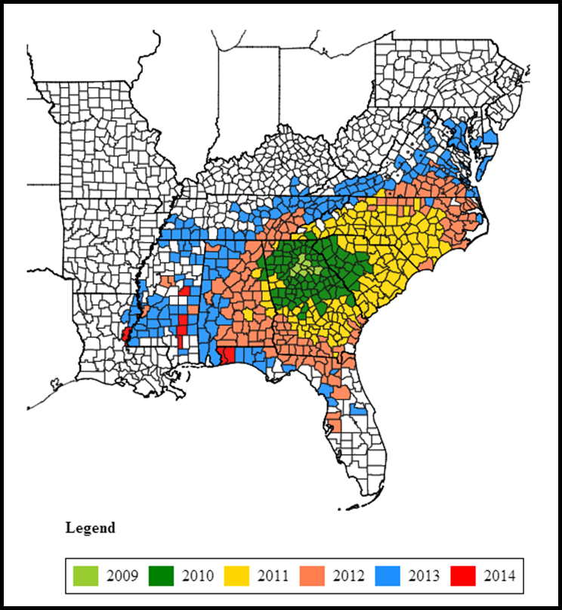
Potential for spread in the U.S.
The recent rate and distribution of kudzu bug population expansion suggests that a major proportion of the soybean growing areas in the U.S. are likely to see kudzu bugs in the future
Map courtesy of http://www.kudzubug.org/distribution_map.cfm - accessed 6/19/2014
Notes:
The recent rate and distribution of kudzu bug population expansion suggests that a major proportion of the soybean growing areas in the U.S. are likely to see kudzu bugs in the future.
NOTE TO SPEAKER: Be sure to check that you are using the most updated county map. Click here to access it - http://www.kudzubug.org/distribution_map.cfm.
Information sources:
Eger, J. E., Jr., L. M. Ames, D. R. Suiter, T. M. Jenkins, D. A. Rider, and S. E. Halbert. 2010. Occurrence of the old world bug Megacopta cribraria (Fabricius) (Heteroptera: Plataspidae) in Georgia: a serious home invader and potential legume pest. Insecta Mundi 0121: 1-11.
Gardner, W. A., J. L. Blount, J. R. Golec, W. A. Jones, X. P. Hu, E. J. Talamas, R. M. Evans, X. Dong, C. H. Ray, Jr., G. D. Buntin, N. M. Gerardo, and J. Couret. 2013a. Discovery of Paratelenomus saccharalis (Dodd) (Hymenoptera: Platygastridae), an egg parasitoid of Megacopta cribraria F. (Hemiptera: Plataspidae) in its expanded North American range. Journal of Entomological Science 48: 355-359.
Gardner, W. A., H. B. Peeler, J. LaForest, P. M. Roberts, A. N. Sparks, Jr., J. K. Greene, D. Reisig, D. R. Suiter, J. S. Bacheler, K. Kidd, C. H. Ray, X. P. Hu, R. C. Kemerait, E. A. Scocco, J. E. Eger, Jr., J. R. Ruberson, E. J. Sikora, D. A. Herbert, Jr., C. Campana, S. Halbert, S. D. Stewart, G. D. Buntin, M. D. Toews, and C. T. Bargeron. 2013b. Confirmed distribution and occurrence of Megacopta cribraria (F.) (Hemiptera: Heteroptera: Plataspidae) in the southeastern United States. Journal of Entomological Science 48: 118-127.
Ruberson, J. R., K. Takasu, G. D. Buntin, J. E. Eger, Jr., W. A. Gardner, J. K. Greene, T. M. Jenkins, W. A. Jones, D. M. Olson, P. M. Roberts, D. R. Suiter, and M. D. Toews. 2013. From Asian curiosity to eruptive American pest: Megacopta cribraria (Hemiptera: Plataspidae) and prospects for its biological control. Applied Entomology and Zoology 48: 3-13.
Suiter, D.R., J.E. Eger, Jr., W.A. Gardner, R.C. Kemerait, J.N. All, P.M. Roberts, J.K. Greene, L.M. Ames, G.D. Buntin, T.M. Jenkins and G.K. Douce. 2010. Discovery and distribution of Megacopta cribraria (Hemiptera: Heteroptera: Plataspidae) in Northeast Georgia. Journal of Integrated Pest Management. 1: 1-4.
Suiter, D. R., L. M. Ames, J. E. Eger, Jr., and W. A. Gardner. 2010. Megacopta cribraria as a nuisance pest. UGA-CAES Extension Circular No. 991. University of Georgia, Athens.
Zhang, Y., J. L. Hanula, and S. Horn. 2012. The biology and preliminary host range of Megacopta cribraria (Heteroptera: Plataspidae) and its impact on kudzu growth. Environmental Entomology 41: 40-50.

Slide 5
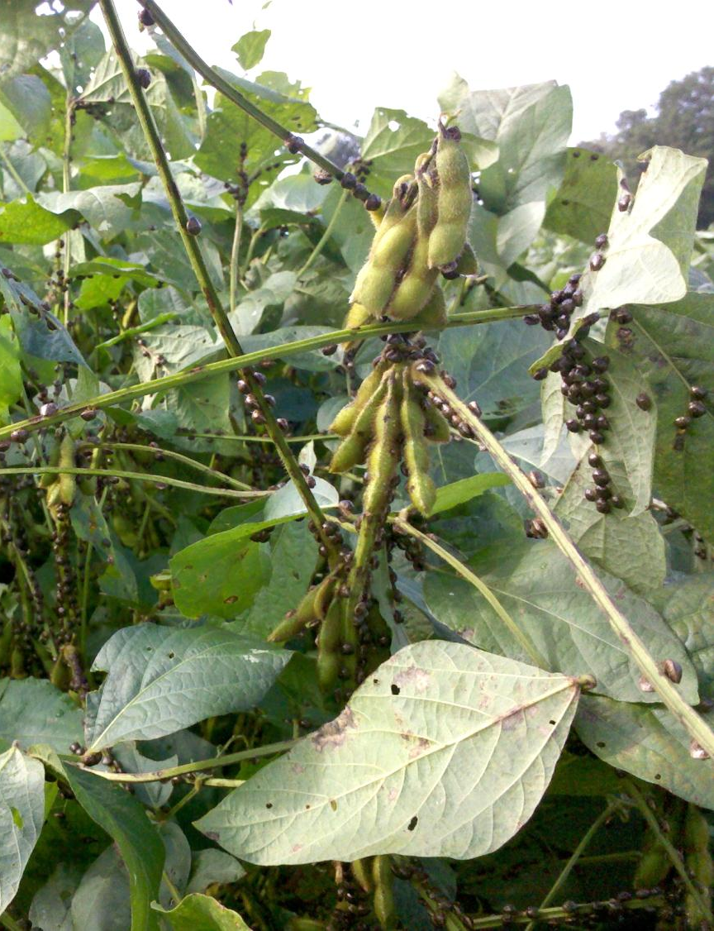
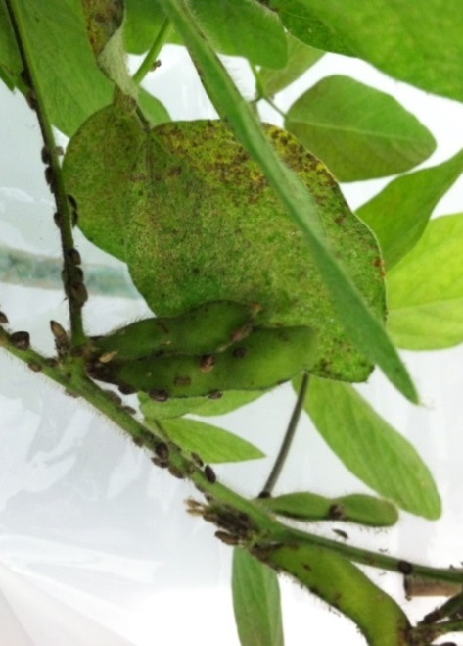
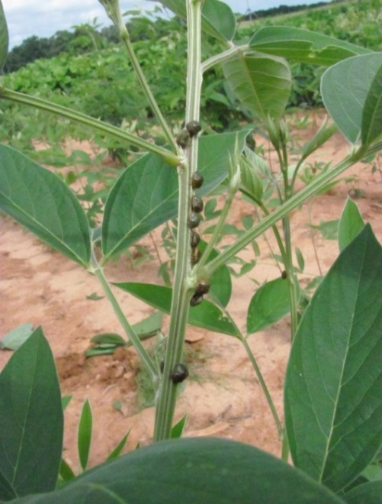
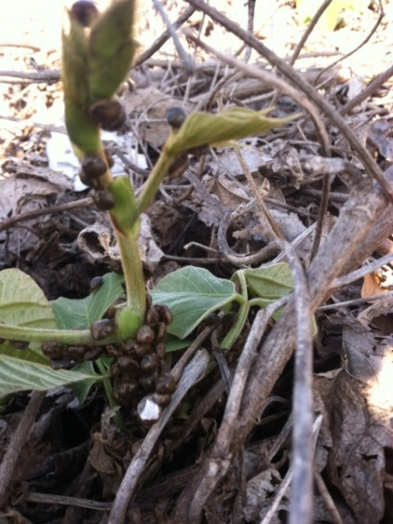
Known Reproductive Hosts in the Western Hemisphere
Kudzu
Soybean
Edamame
Pigeon Pea
Image credits:
Kudzu-Phillip Roberts, University of Georgia
Soybean-Phillip Roberts, University of Georgia
Edamame-Michael Toews, University of Georgia
Pigeon Pea-Joni Blount, University of Georgia
Notes:
Reproductive hosts, those plants that support development from egg to adult, are very limited in North America. Kudzu (Pueria montana var. lobata) and soybean (Glycine max) are by far the most important hosts, but research shows that edamame (edible soybean) and pigeon pea (Cajanus cajan) will also support kudzu bugs. Anecdotal observations suggest that wisteria (Wisteria spp.) and lablab (Lablab purpureus) may also support limited population development. Although a heavy infestation can significantly decrease kudzu growth rates, it will not kill this invasive plant species, known as “the vine that ate the south.”
Hosts that were tested but did not support development of our biotype of immature kudzu bugs in the U.S. included:
Pinto bean (Phaseolus vulgaris)
Winter pea (Pisum sativum)
Chick pea (Cicer arietinum)
Fava bean (Vicia faba)
Snap bean (Phaseolus vulgaris)
Lima bean (Plaseolus lunatus) [reproduction seen in a different test on lima bean variety Ford Hooks 242]
Black-eyed pea/cowpea (Vigna sinensis)
Lablab bean (Lablab purpureus)
Mung bean (Phaseolus radiatus)
Azuki (red) bean (Vigna angularis)
Peanut (Arachis hypogaea)
Tropical kudzu (Pueria phaseoloides)
Hog peanut (Amphicarpaea bracteata)
Information sources:
Gardner, W. A., J. L. Blount, J. R. Golec, W. A. Jones, X. P. Hu, E. J. Talamas, R. M. Evans, X. Dong, C. H. Ray, Jr., G. D. Buntin, N. M. Gerardo, and J. Couret. 2013a. Discovery of Paratelenomus saccharalis (Dodd) (Hymenoptera: Platygastridae), an egg parasitoid of Megacopta cribraria F. (Hemiptera: Plataspidae) in its expanded North American range. Journal of Entomological Science 48: 355-359.
Gardner, W. A., H. B. Peeler, J. LaForest, P. M. Roberts, A. N. Sparks, Jr., J. K. Greene, D. Reisig, D. R. Suiter, J. S. Bacheler, K. Kidd, C. H. Ray, X. P. Hu, R. C. Kemerait, E. A. Scocco, J. E. Eger, Jr., J. R. Ruberson, E. J. Sikora, D. A. Herbert, Jr., C. Campana, S. Halbert, S. D. Stewart, G. D. Buntin, M. D. Toews, and C. T. Bargeron. 2013b. Confirmed distribution and occurrence of Megacopta cribraria (F.) (Hemiptera: Heteroptera: Plataspidae) in the southeastern United States. Journal of Entomological Science 48: 118-127.
Medal, J., S. Halbert, and A. S. Cruz. 2013a. The bean Plataspid, Megacopta cribraria (Hemiptera: Plataspidae), a new invader in Florida. Florida Entomologist 96: 258-260.
Medal, J., S. Halbert, T. Smith, and A. S. Cruz. 2013b. Suitability of selected plants to the bean plataspid, Megacopta cribraria (Hemiptera: Plataspidae) in no-choice tests. Florida Entomologist 96: 631-633.
Ruberson, J. R., K. Takasu, G. D. Buntin, J. E. Eger, Jr., W. A. Gardner, J. K. Greene, T. M. Jenkins, W. A. Jones, D. M. Olson, P. M. Roberts, D. R. Suiter, and M. D. Toews. 2013. From Asian curiosity to eruptive American pest: Megacopta cribraria (Hemiptera: Plataspidae) and prospects for its biological control. Applied Entomology and Zoology 48: 3-13.
Srinivasaperumal, S., P. Samuthiravelu, and J. Muthukrishnan. 1992. Host plant preference and life table of Megacopta cribraria (Fab.) (Hemiptera: Plataspidae). Proceedings of the Indian National Science Academy Part B Biological Sciences 58: 333-340.
Zhang, Y., J. L. Hanula, and S. Horn. 2012. The biology and preliminary host range of Megacopta cribraria (Heteroptera: Plataspidae) and its impact on kudzu growth. Environmental Entomology 41: 40-50.

Slide 6
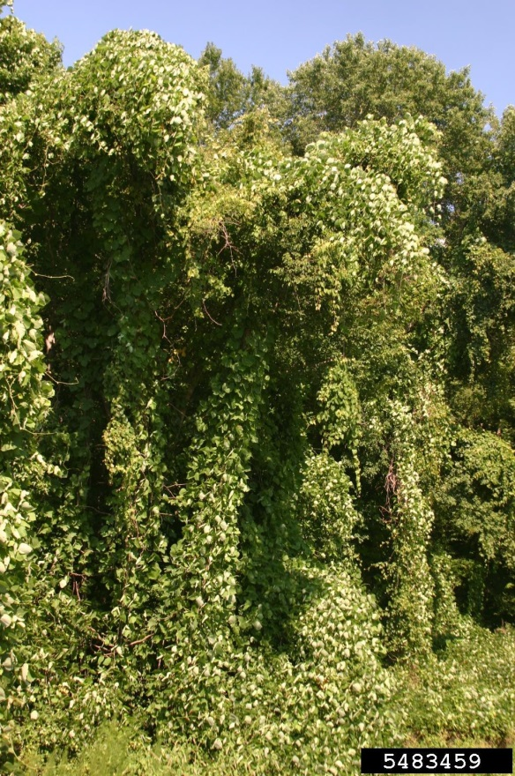
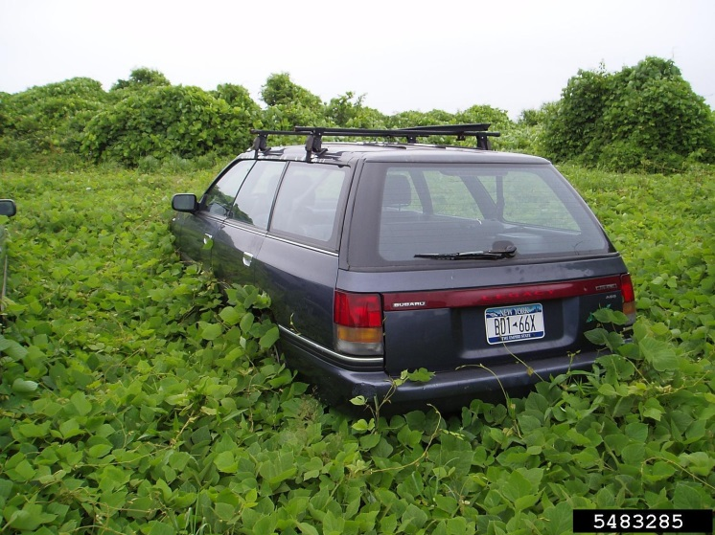
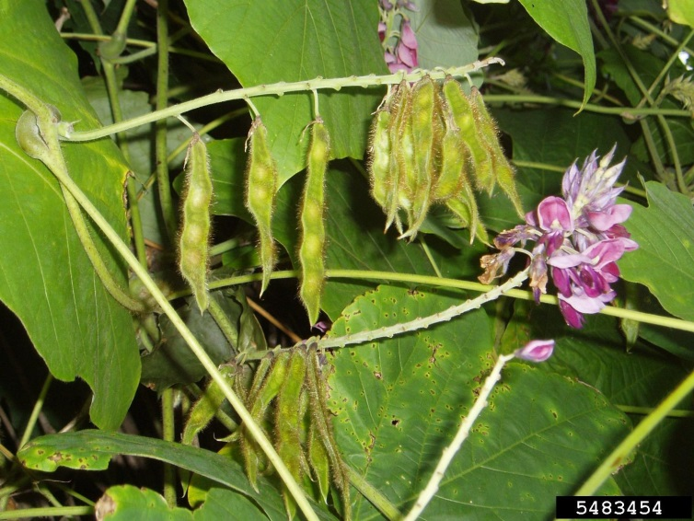
Kudzu “the vine that ate the south”
Introduced for forage then erosion control
Covers millions of acres in the south
An invasive weed
Perennial vine in the legume family
Image credits:
Left - Leslie J. Mehrhoff, University of Connecticut, Bugwood.org, #5483285; middle – Leslie J. Mehrhoff, University of Connecticut, Bugwood.org, #5483454; right- Leslie J. Mehrhoff, University of Connecticut, Bugwood.org, #5483459
Notes:
Kudzu (Pueraria lobata) can be found from New York, across to Nebraska, down to Texas and across to Florida. It can also be found in Washington and Oregon. It is an invasive plant from Asia that was introduced in 1986 at the Philadelphia Centennial Exposition. It was sold as livestock forage and then used to control agricultural erosion by the Soil Conservation Service (then known as the Soil Erosion Service). It was listed as a weed in 1970.
It is called the “vine that ate the south” because it can grow 60 feet in a year and specializes in disturbed areas with a mild winter and a hot summer and plenty of rainfall. It covers millions of acres of southern landscape.
Information Sources:
Ombrello, T. Plant of the Week – Kudzu. accessed 9/11/2014
http://faculty.ucc.edu/biology-ombrello/POW/kudzu.htm
Southeast Exotic Pest Plant Council Invasive Plant Manual. Kudzu. Southeast Exotic Pest Plant Council. Accessed 9/11/20104
http://www.se-eppc.org/manual/kudzu.html
USDA Plants Database. Pueraria lobata. Accessed 9/11/2014
http://plants.usda.gov/core/profile?symbol=PUMOL

Slide 7
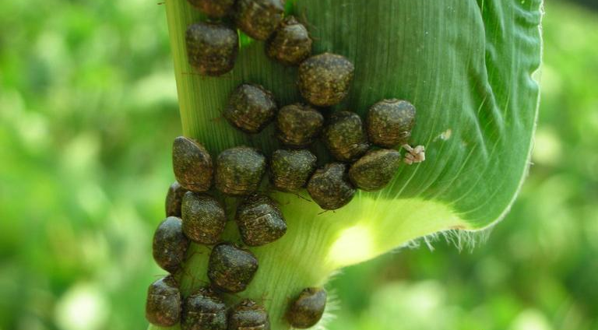
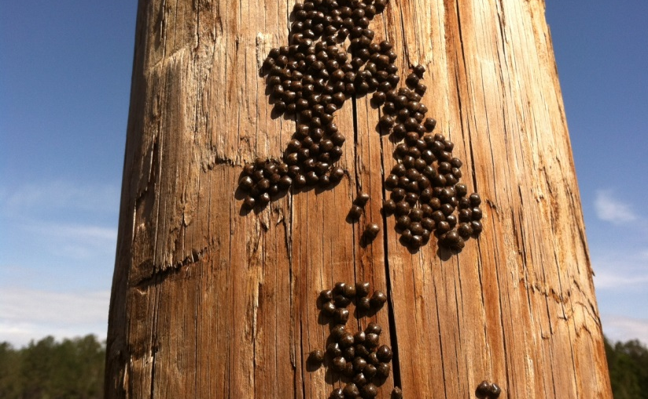
Non-Reproductive Hosts or “Resting Places” Include Just About Everywhere!
Bug presence alone does not indicate damage or feeding
Bugs are commonly observed on landscape plants, wooden poles, wheat, corn, cotton, pecans, peanut, figs, wisteria, snap beans, and many others
Image credits:
Top- Jeremy Greene, Clemson University, Bugwood.org, #5426337
Bottom-Phillip Roberts, University of Georgia
Notes:
The list of cultivated crop species, landscape plants, weedy plants, structures, vehicles, and inanimate (non-living) objects where kudzu bugs have been observed resting is endless. These aggregations are generally the result of dispersing kudzu bug populations in the early spring and fall.
Although these infestations can be unpleasant, it is important to remind urban and rural stakeholders that just because they see a kudzu bug aggregation does not indicate that the bugs are feeding and causing economic damage to the host.
Kudzu bugs have been observed aggregating on commercial buildings, homes, white cars, white tee-shirts and even blond hair.
Information sources:
Medal, J., S. Halbert, and A. S. Cruz. 2013a. The bean Plataspid, Megacopta cribraria (Hemiptera: Plataspidae), a new invader in Florida. Florida Entomologist 96: 258-260.
Medal, J., S. Halbert, T. Smith, and A. S. Cruz. 2013b. Suitability of selected plants to the bean plataspid, Megacopta cribraria (Hemiptera: Plataspidae) in no-choice tests. Florida Entomologist 96: 631-633.
Ruberson, J. R., K. Takasu, G. D. Buntin, J. E. Eger, Jr., W. A. Gardner, J. K. Greene, T. M. Jenkins, W. A. Jones, D. M. Olson, P. M. Roberts, D. R. Suiter, and M. D. Toews. 2013. From Asian curiosity to eruptive American pest: Megacopta cribraria (Hemiptera: Plataspidae) and prospects for its biological control. Applied Entomology and Zoology 48: 3-13.
Srinivasaperumal, S., P. Samuthiravelu, and J. Muthukrishnan. 1992. Host plant preference and life table of Megacopta cribraria (Fab.) (Hemiptera: Plataspidae). Proceedings of the Indian National Science Academy Part B Biological Sciences 58: 333-340.

Slide 8
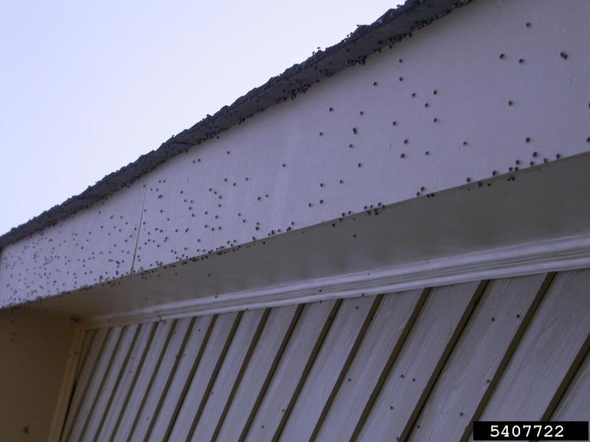
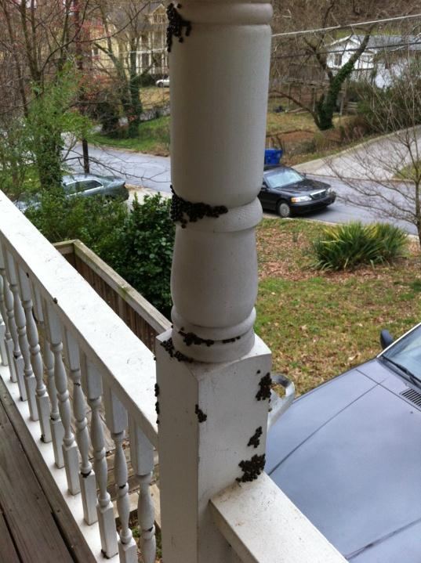
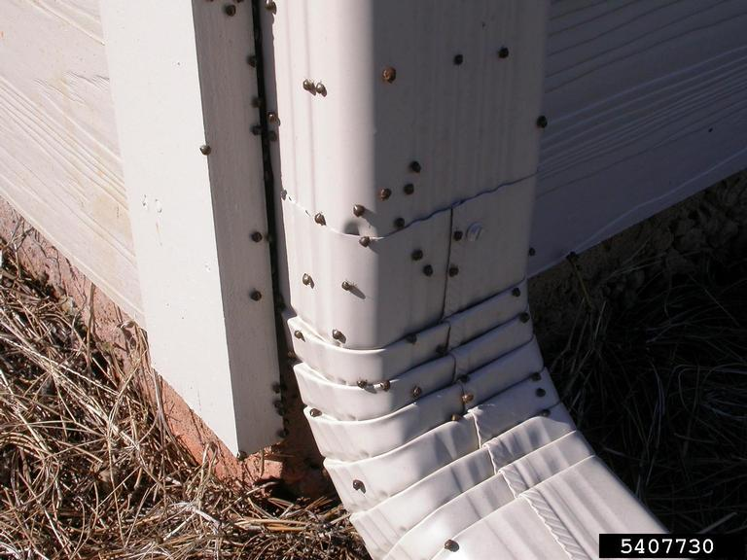
Urban Nuisance
Image credits (all images):
Dan Suiter, University of Georgia, (Bugwood.org, # 5407722 & 5407730)
Notes:
Kudzu bugs were first noticed by homeowners due to large aggregations on the outside of the structures. Managing these very large populations presents difficult challenges. Pest Management Professionals and exterminators have found that although individuals are easy to kill using certain insecticides, spraying is unlikely to provide lasting suppression because the residual activity of insecticides is short and the number of insects that are contacted with the spray is miniscule relative to the population present in a given area. Given a few days, the insects will likely move on to another site.
The exceptions to this rule are structures and plants located adjacent to known reproductive hosts. For example, non-host crops like cotton growing adjacent to soybean will always harbor a few kudzu bugs near the edges. Similarly, homeowners with kudzu on their property should consider removing kudzu to alleviate repeated infestations. Kudzu thrives on disturbed soils such as right of way, ditches, easements, railroad tracks, and transit corridors.
Information sources:
Seiter, N. J., E. P. Benson, F. P. F. Reay-Jones, J. K. Greene, and P. A. Zungoli. 2013c. Residual efficacy of insecticides applied to exterior building material surfaces for control of nuisance infestations of Megacopta cribraria (Hemiptera: Plataspidae). Journal of Economic Entomology 106: 2448-2456.
Suiter, D. R., L. M. Ames, J. E. Eger, Jr., and W. A. Gardner. 2010. Megacopta cribraria as a nuisance pest. UGA-CAES Extension Circular No. 991. University of Georgia, Athens.

Slide 9
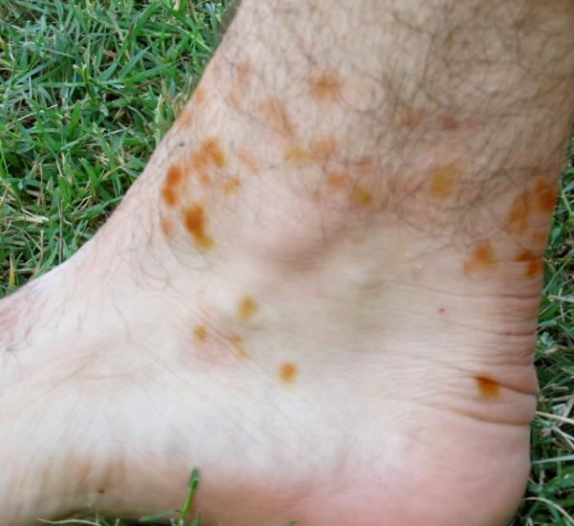
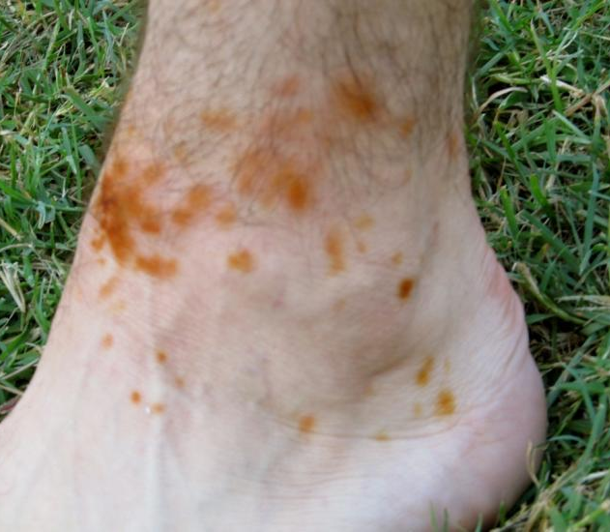
Human Health Concern?
Images taken 2 h after sampling in heavily infested soybean plots. “Kudzu bug” nymphs dropped between boots and socks and were squished by walking. The resulting rash was itchy and lasted about 7 d.
Image credits:
Michael Toews, University of Georgia
Notes:
Kudzu bugs cannot bite humans or any other animal and therefore cannot transmit any diseases. Kudzu bug mouthparts are very small and only good for piercing green plant tissues.
The images on this slide were taken of a University of Georgia research scientist who scouted his soybean plots while wearing shorts during the summer of 2011. Before you dismiss the guy as deserving of a painful and unpleasant experience for wearing shorts in the field, keep in mind that working outdoors in July and August in south Georgia is fairly unpleasant by itself!
While walking though each plot, a few kudzu bugs dropped into his boots and got squished between the boots and socks with every step. After an hour or so, he noticed a distinct burning sensation on his feet. Based on the pictures, you will note that the haemolymph from the squashed bugs caused an acute reaction on human skin. The scientist reported that the resulting rash was very itchy and lasted about a week.
Other researchers have reported similar symptoms after accidentally smashing kudzu bugs on their arms and necks.
Information sources:
Ruberson, J. R., K. Takasu, G. D. Buntin, J. E. Eger, Jr., W. A. Gardner, J. K. Greene, T. M. Jenkins, W. A. Jones, D. M. Olson, P. M. Roberts, D. R. Suiter, and M. D. Toews. 2013. From Asian curiosity to eruptive American pest: Megacopta cribraria (Hemiptera: Plataspidae) and prospects for its biological control. Applied Entomology and Zoology 48: 3-13.

Slide 10
International Trade Implications
In Spring 2012, containerized cargo from the southeastern U.S. was banned at Honduran ports over “kudzu bug” presence
Honduras also reported that 3 live bugs were collected on commercial passenger jets originating from Atlanta, Georgia
Image credits:
Top- Manfred Mielke, U.S.DA Forest Service, Bugwood.org, # 1399194
Bottom-Public domain, all-free-download.com
Notes:
Since kudzu bug is obviously a serious invasive insect that caught the U.S. by surprise, other countries in the western hemisphere do not want it to establish in their countries.
In February 2012, Honduran officials discovered dead kudzu bugs in a shipping container from Georgia. This led the country to step up inspections of cargo from Georgia, South Carolina, North Carolina, Tennessee and Alabama. At one point, more than 4,000 containers from these states where being held up by Honduran ports!
We’ve already established that kudzu bugs are very good hitchhikers on motor vehicles. To add to the complexity, Guatemala and Honduran government officials intercepted live kudzu bugs in the passenger area and baggage compartments of several passenger flights originating from Atlanta.
In response, USDA Animal and Plant Health Inspection Service worked with airport authorities to develop protocols to mitigate these risks.
Information sources:
Dowdy, Sharon. 2012. Latin Americans turn to UGA researchers for kudzu bug knowledge. Georgia FACES, University of Georgia, College of Agriculture and Environmental Sciences. Accessed 6/16/2014 –
http://www.caes.uga.edu/applications/gafaces/?public=viewStory&pk_id=4377
National Cotton Council. 2013. Inspections for Megacopta cribraria (kudzu bug). Accessed 6/16/2014 –
http://www.cotton.org/tech/flow/kudzu-bug-remediation.cfm

Slide 11
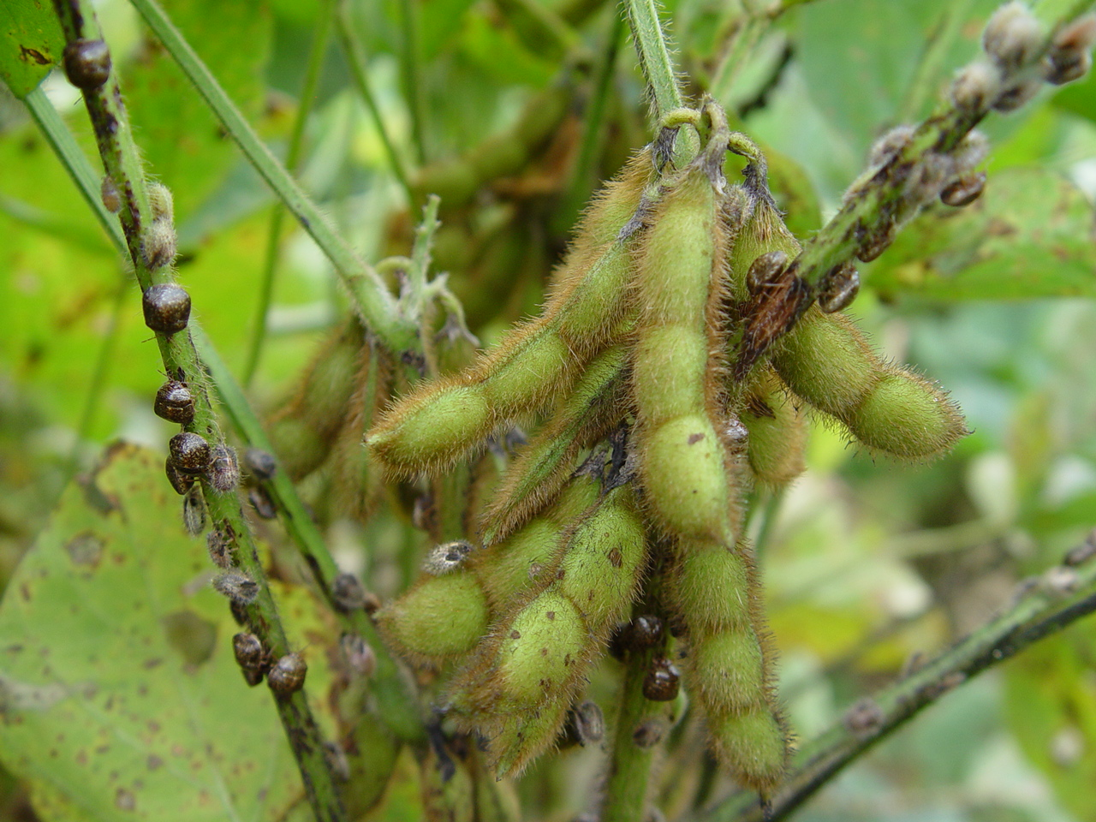
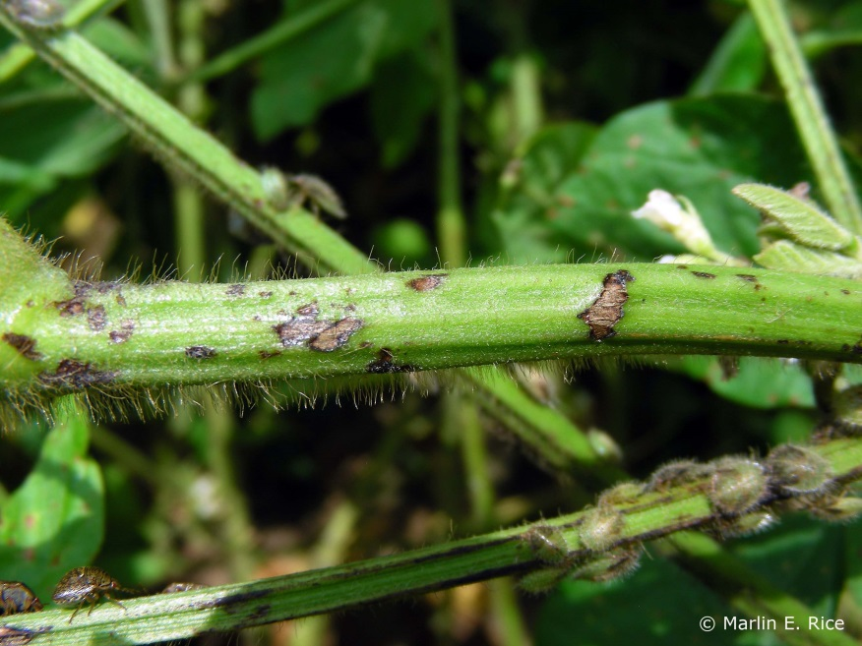
Feeding
“Kudzu bugs” have piercing-sucking mouthparts and feed on stems and petioles
Damaged stems exhibit purple lesions and often develop sooty mold
“Kudzu bugs” do not feed on pods like our native and other exotic stink bugs
Image credits:
Top-Phillip Roberts, University of Georgia
Bottom-Marlin Rice, DuPont Pioneer, used with permission of the author
Notes:
We’ve established that this is a serious insect pest for a variety of reasons. Let’s spend some time learning about this insect’s biology, identification and pest management.
Like other true bugs, stink bugs possess piercing sucking mouthparts that enable them to pierce plant stems and feed on plant sap nutrients intended for supporting growth and reproduction by the plant itself. When a kudzu bug, or a whole bunch of kudzu bugs, feed on a developing soybean plant, they shunt a fair amount of the nutrients out of the plant making it unavailable for plant growth.
Infested plants are characterized by dark colored purplish lesions on the stems and petioles. Similar to aphid honeydew, the excess liquid in the diet is passed through the insect and eventually excreted out of the insect and onto the plant exterior where it creates a favorable habitat for secondary plant pathogens like “sooty mold.”
Unlike stink bugs that prefer to feed on developing seeds, kudzu bugs do not feed on soybean pods or seeds.
Information sources:
Kikuchi, A. and H. Kobayashi. 2010. Effect of injury by adult Megacopta punctatissima (Montandon) (Hemiptera: Plataspidae) on the growth of soybean during the vegetative stage of growth. Japanese Journal of Applied Entomology and Zoology. 54:37–43 (In Japanese with English summary).
Ruberson, J. R., K. Takasu, G. D. Buntin, J. E. Eger, Jr., W. A. Gardner, J. K. Greene, T. M. Jenkins, W. A. Jones, D. M. Olson, P. M. Roberts, D. R. Suiter, and M. D. Toews. 2013. From Asian curiosity to eruptive American pest: Megacopta cribraria (Hemiptera: Plataspidae) and prospects for its biological control. Applied Entomology and Zoology 48: 3-13.
Zhang, Y., J. L. Hanula, and S. Horn. 2012. The biology and preliminary host range of Megacopta cribraria (Heteroptera: Plataspidae) and its impact on kudzu growth. Environmental Entomology 41: 40-50.

Slide 12
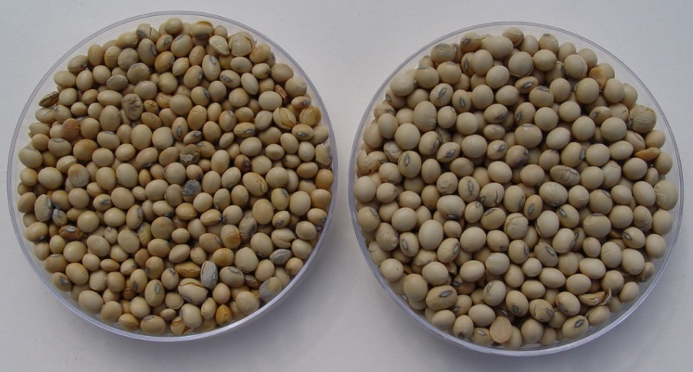
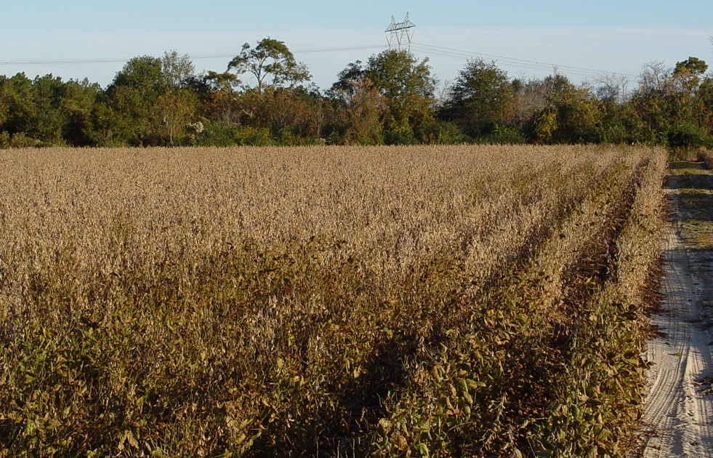
Soybean Damage
“Kudzu bugs” are a stress inducing pest
Pods may not fill and the beans are much smaller
Soybean yield losses average 20%, but can reach 60%
“Greening” or plants that do not senesce for timely harvest are common
Unprotected
Protected
Image credits (all images):
Phillip Roberts, University of Georgia
Notes:
Even though kudzu bugs don’t feed directly on the developing soybean pods or seeds, soybean yields are seriously effected by infestations.
By shunting water and nutrients out of the plant, kudzu bugs induce additional environmental stresses on the developing pods that result in unfilled pods, fewer beans per pod, and much smaller beans. Research studies from Georgia and South Carolina show that kudzu bug infestations average a 20% yield loss, but that number may exceed 50% under severe infestations.
In the top photograph, directly compare the beans on the right from a plot appropriately protected using insecticides with the beans on the left from an untreated plot. In addition to producing fewer beans, some of the beans are so small they will get sifted out of the combine with the plant debris during mechanical harvest.
Another symptom of kudzu bug infestation is “greening” or plants that do not senesce to facilitate mechanical harvest. This can be a very frustrating phenomenon for growers who are patiently waiting to harvest the cash crop with wet weather and fall storms in the forecast.
Information sources:
Kikuchi, A. and H. Kobayashi. 2010. Effect of injury by adult Megacopta punctatissima (Montandon) (Hemiptera: Plataspidae) on the growth of soybean during the vegetative stage of growth. Japanese Journal of Applied Entomology and Zoology. 54:37–43 (In Japanese with English summary).
Ruberson, J. R., K. Takasu, G. D. Buntin, J. E. Eger, Jr., W. A. Gardner, J. K. Greene, T. M. Jenkins, W. A. Jones, D. M. Olson, P. M. Roberts, D. R. Suiter, and M. D. Toews. 2013. From Asian curiosity to eruptive American pest: Megacopta cribraria (Hemiptera: Plataspidae) and prospects for its biological control. Applied Entomology and Zoology 48: 3-13.
Seiter, N. J., J. K. Greene, and F. P. F. Reay-Jones. 2013a. Reduction of soybean yield components by Megacopta cribraria (Hemiptera: Plataspidae). Journal of Economic Entomology 106: 1676-1683.

Slide 13
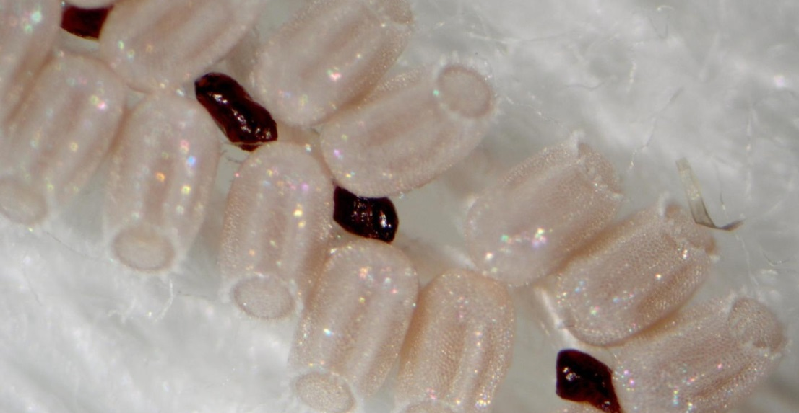
Identification
Image credits:
Top- Joe Eger, Dow AgroSciences, Bugwood.org, # 5471829
Bottom- Yasmin Cardoza, North Carolina State University, Bugwood.org #5472911
Notes:
Eggs are barrel shaped and measure 0.8 to 0.9 mm long by 0.5 mm wide. They are white immediately after oviposition, but change to a pale salmon color with dark bands horizontal with the length of the egg. They are laid in two parallel rows and always have a ring of spines around the end where the first instar will crawl out when the egg hatches (yellow arrow).
Adult females deposit small brownish particles on the underside of their egg mass (blue arrows). These unique structures are symbiont capsules which contain specific symbiotic bacteria. Newly emerged nymphs ingest the symbiont capsules thereby facilitating the transfer of the gut symbiont from adult females to their progeny. The symbiont will enable the individual to feed on a much wider diet than would be possible otherwise.
Information sources:
Brown, A. M. V., L. Y. Huynh, C. M. Bolender, K. G. Nelson, and J. P. McCutcheon. 2014. Population genomics of a symbiont in the early stages of a pest invasion. Molecular Ecology 23: 1516-1530.
Hosokawa, T., Y. Kikuchi, M. Shimada, and T. Fukatsu. 2007. Obligate symbiont involved in pest status of host insect. Proceedings of the Royal Society B-Biological Sciences 274: 1979-1984.
Jenkins, T. M., and T. D. Eaton. 2011. Population genetic baseline of the first plataspid stink bug symbiosis (Hemiptera: Heteroptera: Plataspidae) reported in North America. Insects 2: 264-272.
Jenkins, T. M., T. D. Eaton, D. R. Suiter, J. E. Eger, Jr., L. M. Ames, and G. D. Buntin. 2010. Preliminary genetic analysis of a recently-discovered invasive true bug (Hemiptera: Heteroptera: Plataspidae) and its bacterial endosymbiont in Georgia, USA. Journal of Entomological Science 45: 62-63.
National Center for Biotechnology Information. 2013. Ishikawaella symbiont of Megacopta cribraria overview. European Nucleotide Archive.
Ren, S. 1984. Studies on the fine structure of eggshells and the biology of Megacopta cribraria from China Hemiptera Plataspidae. Entomotaxonomia. 6: 327-332.

Slide 14
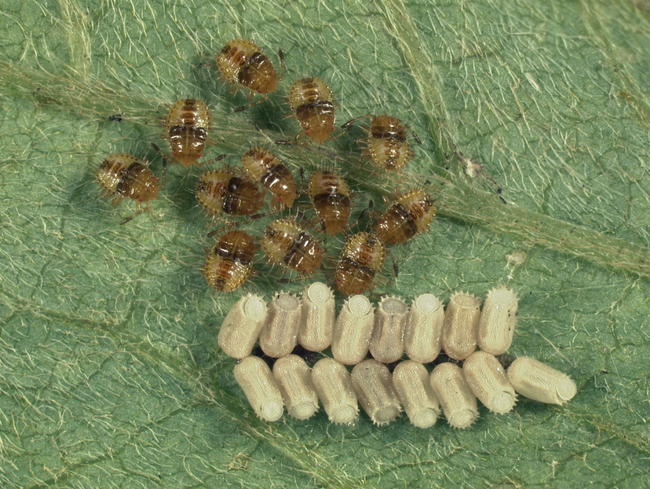
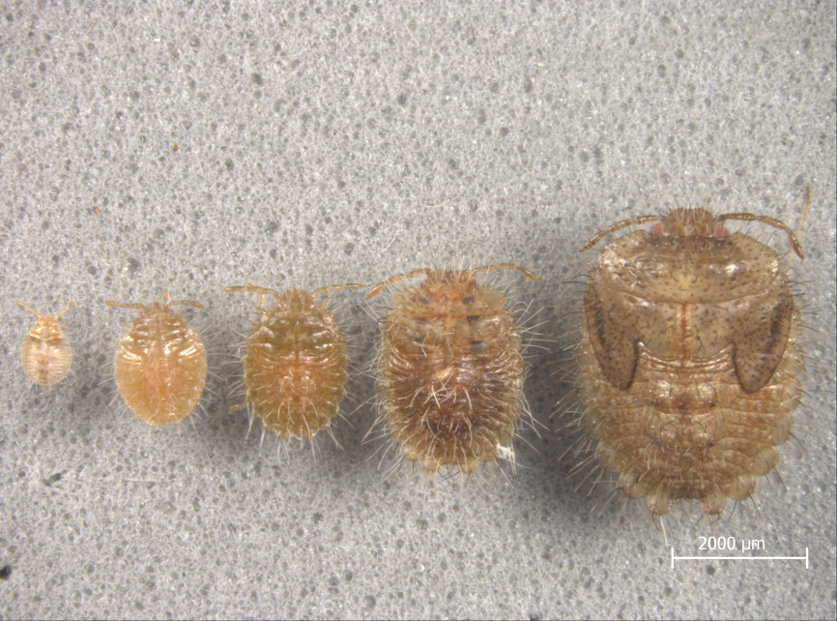
Identification
First instars remain close to egg cases
External wing buds develop on late instars
Image credits:
Top-Joe Eger, Dow AgroSciences
Bottom-Phillip Roberts, University of Georgia, Bugwood.org
Notes:
Nymphs start out yellow and darken in color as they mature; bodies are pubescent and long white hairs are very evident. Differences between instars can often be seen in altered body proportions, colors, patterns, or changes in the number of body segments. Later instars range from green to brown and move about plant. Similar to adults, nymphs are gregarious and likely develop on the same host where they hatched as first instars.
Information sources:
Kudzu Bug Website. Identification. The University of Georgia - Center for Invasive Species and Ecosystem Health. Accessed 6/16/2014 –
http://www.kudzubug.org/identification.html

Slide 15
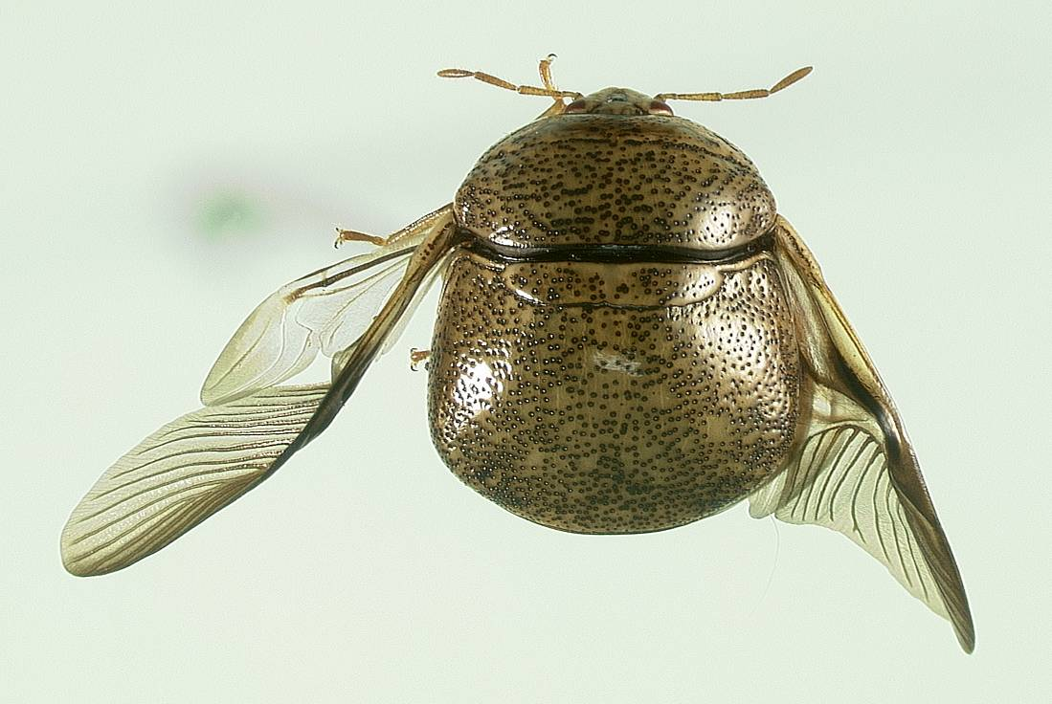
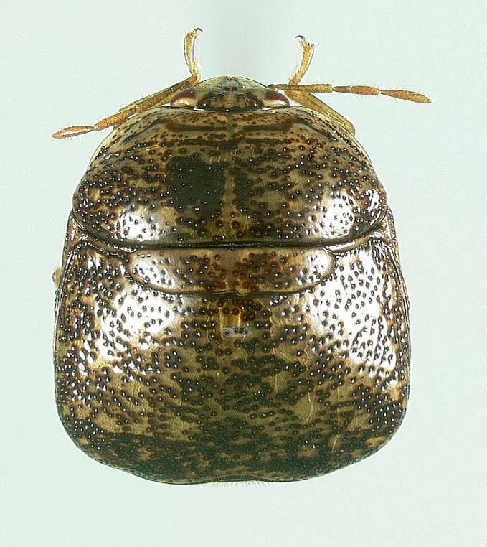
Identification
Female
Male
Pseudosuture
Scutellum
Truncated end
The scutellum or “shield” over the wings covers the entire abdomen
http://www.kudzubug.org/identification.html
Image credits (all images):
Marlin Rice, DuPont Pioneer, used with permission of the author
Notes:
Kudzu bugs are a member of the Plataspidae; they are known as one of the more distinctive shield bugs because of the large scutellum (a hardened extension of the thorax over the abdomen).
Adults are 3.5 to 6 mm long, oblong, and olive-green colored with brown speckles. They produce an offensive odor when disturbed.
In the United States, characteristics that separate the kudzu bug from other stink bugs include: a round body shape as opposed to triangular to semi-elliptical body shape, distinctive head shape, and a scutellum that is much wider than it is long. The scutellum covers the entire abdomen and a false scutellum is readily apparent at the anterior region of the abdomen which is easily confused with being a true scutellum, but it actually an important taxonomic feature of this insect. There appears to be a seam (pseudosuture – red arrows) running across the front end of the center scutellum. The tarsi are 2-segmented.
A comparison among commonly confused stink bugs and the kudzu bug is available at http://www.kudzubug.org/identification.html
Information sources:
Eger, J. E., Jr., L. M. Ames, D. R. Suiter, T. M. Jenkins, D. A. Rider, and S. E. Halbert. 2010. Occurrence of the old world bug Megacopta cribraria (Fabricius) (Heteroptera: Plataspidae) in Georgia: a serious home invader and potential legume pest. Insecta Mundi 0121: 1-11.
Kudzu Bug Website. Identification. The University of Georgia - Center for Invasive Species and Ecosystem Health. Accessed 6/16/2014 –
http://www.kudzubug.org/identification.html

Slide 16
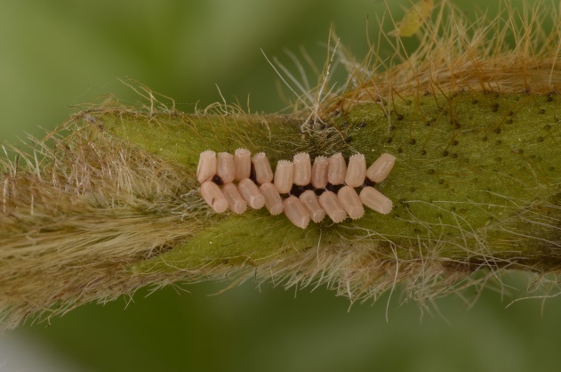
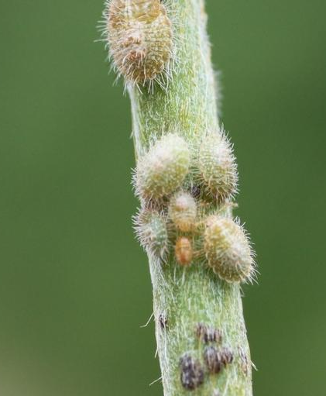
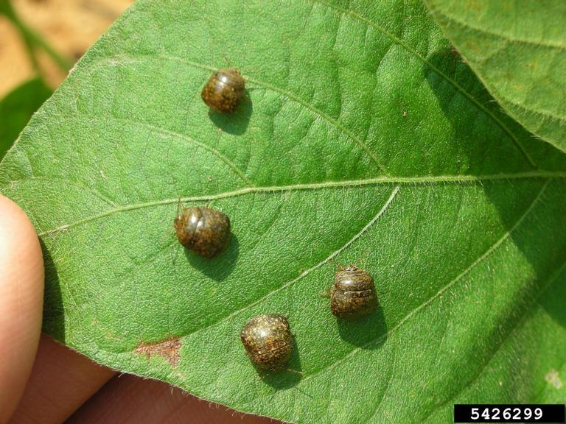
Life Cycle
Eggs
“Kudzu bugs” have incomplete (or simple) metamorphosis
Life stages include egg, nymph (5 instars) and adult
Nymphs appear similar to adults, but they are hairy and do not have wings
There are 2 generations per year (spring and summer)
Nymphs
Adults
Image credits:
Top- Lyle Buss, University of Florida
Middle- John Ruberson, University of Georgia
Bottom-Jeremy Greene, Clemson University, Bugwood.org, # 5426299
Notes:
All heteropterans (true bugs) undergo incomplete metamorphosis. The immature stages are termed nymphs (there are 5 instars) and have a similar diet to the adults. Instars 1 through 5 look like the adults, but are hairy and do not have wings. The fifth instar will have wing pads though.
In Asia, there are up to three generations per year. U.S. scientists believe there are only two generations in the western hemisphere.
The kudzu life cycle (time from egg to adult) is dependent on ambient temperature. The spring generation (April-May) takes about 8 weeks since spring conditions frequently include cool nights and lower daytime highs.
The summer generation (June-July) will complete development in about 6 weeks due to more favorable conditions.
At 28°C or 82°F on soybeans, eggs hatch in about 8 days, each nymphal instar takes 7 to 8 days to develop, and adults live about 7 days.
Information sources:
Del Pozo-Valdivia, A.I. and D.D. Reisig. 2013. First-Generation Megacopta cribraria (Hemiptera: Plataspidae) Can Develop on Soybeans. Journal of Economic Entomology, vol. 106, no. 2: 533-535.
Ren, S. 1984. Studies on the fine structure of eggshells and the biology of Megacopta cribraria from China Hemiptera Plataspidae. Entomotaxonomia 6: 327-332.
Ruberson, J. R., K. Takasu, G. D. Buntin, J. E. Eger, Jr., W. A. Gardner, J. K. Greene, T. M. Jenkins, W. A. Jones, D. M. Olson, P. M. Roberts, D. R. Suiter, and M. D. Toews. 2013. From Asian curiosity to eruptive American pest: Megacopta cribraria (Hemiptera: Plataspidae) and prospects for its biological control. Applied Entomology and Zoology 48: 3-13.
Zhang, Y., J. L. Hanula, and S. Horn. 2012. The biology and preliminary host range of Megacopta cribraria (Heteroptera: Plataspidae) and its impact on kudzu growth. Environmental Entomology 41: 40-50.

Slide 17
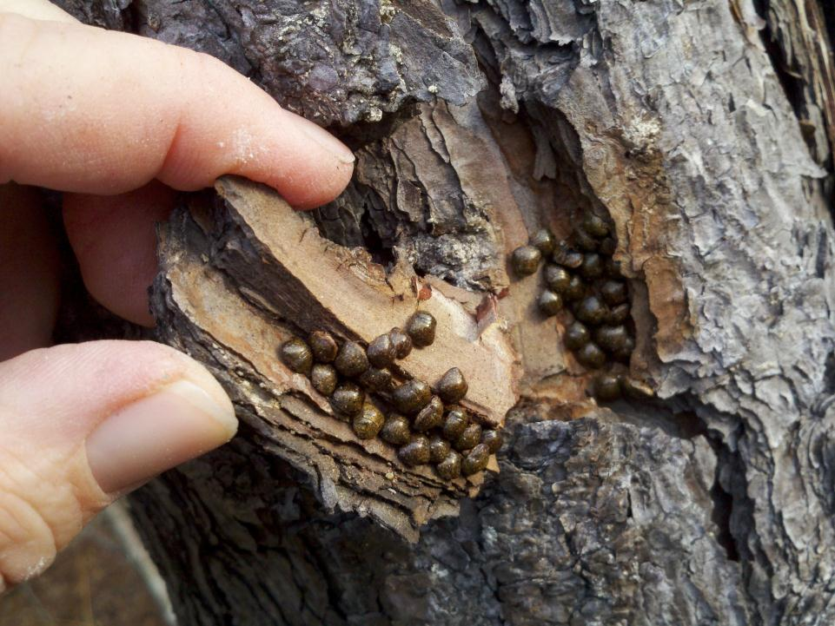
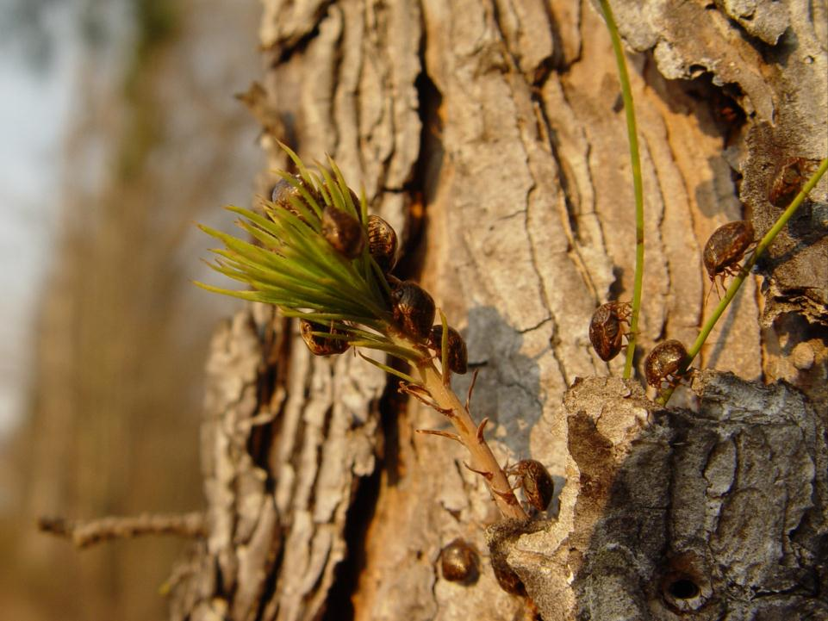
Hibernation and Dispersal
Hibernation
Overwinter as adults under tree bark and in leaf litter
Bugs can be seen on tree bark on warm days during the winter
Dispersal
Kudzu bugs disperse to kudzu in early spring and vegetative soybean when available
January
Late February
Image credits (all images):
Phillip Roberts, University of Georgia, Bugwood.org
Notes:
Hibernation and reproductive diapause occurs in the fall and winter. Kudzu bugs hibernate as adults.
Fall dispersal of the second generation adults correlates with numerous urban complaints. Bug populations are dispersing from senescing hosts and therefore searching for shelter to survive the upcoming winter. In addition to tree bark (primarily pine trees), kudzu bug overwinters in secluded crevices associated with domestic structures. To eliminate large populations from overwintering in structures such as homes, owners should ensure that soffit, ridge, and gable vents are properly screened. Specialized caulking that makes a hardened seal can also be use to close gaps where utilities enter the house.
In the early spring, overwintering kudzu bugs may be evident sunning themselves at the overwintering site on sunny days. It is not known if these individuals actually leave the tree or just crawl out far enough to absorb sunlight. With warm March days, the adults initiate an active dispersal phase as the bugs are searching for new hosts. This dispersal phase also triggers many urban complaints and observations of bugs aggregating on non-reproductive hosts.
Information sources:
Del Pozo-Valdivia, A. I., and D. D. Reisig. 2013. First-generation Megacopta cribraria (Hemiptera: Plataspidae) can develop on soybeans. Journal of Economic Entomology 106: 533-535.

Slide 18
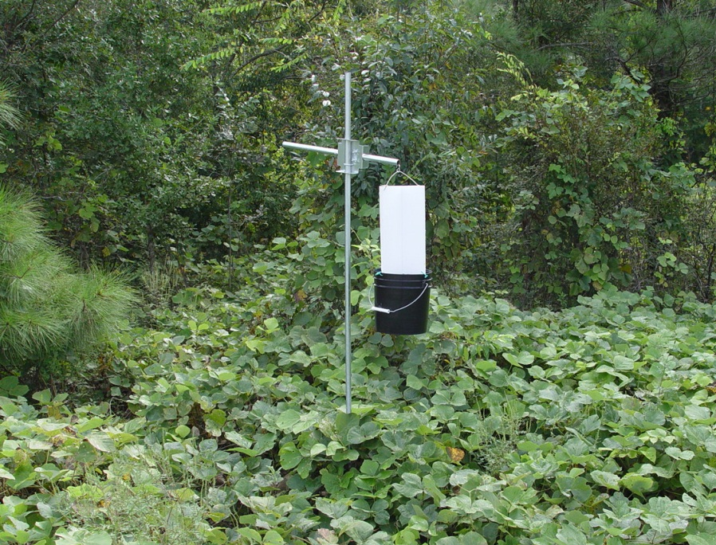
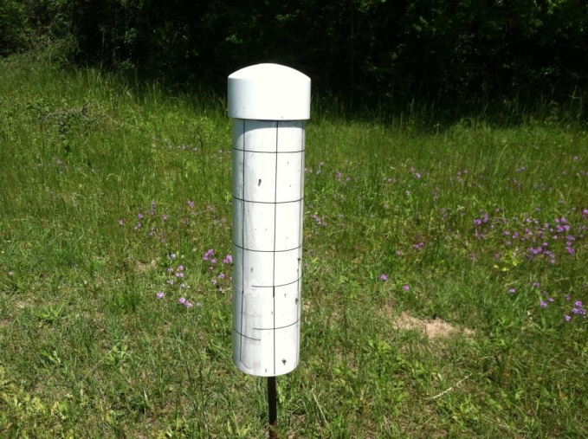
Monitoring with Traps
Kudzu bugs are attracted to virtually any upright light colored surface
Inexpensive traps can be fashioned with flight intercept veins above soapy water or using sticky paper
There are no commercially available pheromone lures
Image credits (all images):
Michael Toews, University of Georgia
Notes:
The active dispersal phase is a boon for detection and monitoring with traps. Kudzu bugs are attracted to any type of upright light colored trap, primarily white and yellow. Although there are no commercially available pheromones for monitoring purposes, inexpensive traps can be fabricated using corrugated cardboard cross veins mounted on top of a bucket containing soapy water, or sticky paper (also known as stable fly paper) on any shape or surface.
Studies are currently being conducted to assess flight distance and frequency as a function of developmental diet, age, sex, and mating status.
Information sources:
Horn, S., and J. L. Hanula. 2011. Influence of trap color on collection of the recently-introduced bean plataspid, Megacopta cribraria (Hemiptera: Plataspidae). Journal of Entomological Science 46: 85-87.

Slide 19
Monitoring in Soybean
1.
2.
3.
4.
Video credit:
Michael Toews, University of Georgia, http://www.kudzubug.org/video.html
Notes:
The preferred method for rapidly assessing presence of kudzu bugs in commercial soybean is 10 single row sweeps with a sweep net.
If you do not have access to the internet, the images above walk you through sweep net sampling in a soybean field. As you can see, there is an empty net in image 1. Then, after 10 sweeps (image 2), the researcher shows the sheer number of kudzu bugs caught (images 3 and 4). These images were taken in Dr. Towes (rhymes with Dave’s) soybean research plots located in Burke County, Georgia
Note to Speaker: There is a video that can be played here if you have internet connection. It is found at http://www.kudzubug.org/video.html in the upper left of the screen and named Sweep netting for Kudzu bug and measuring the catch.
If you use the video, be sure and note that the sweep net is completely empty at the beginning of the clip. When he begins walking back toward the photographer, note the sheer number of kudzu bugs that are crawling on his shirt and hat. You will also notice a fair number of bugs flying out of the net as he begins to sift through some of the soybean leaves. Despite only sampling a single kudzu bug the previous year, these plots were so heavily infested that the researchers estimated kudzu bug counts by volume in a plastic cup.
Information sources:
Greene, J.K., P.M. Roberts, W.A. Gardner, F. Reay-Jones, N. Seiter. 2012. Kudzu Bug Identification and Control in Soybeans, accessed 6/16/2014 -
http://digital.turn-page.com/i/87846

Slide 20
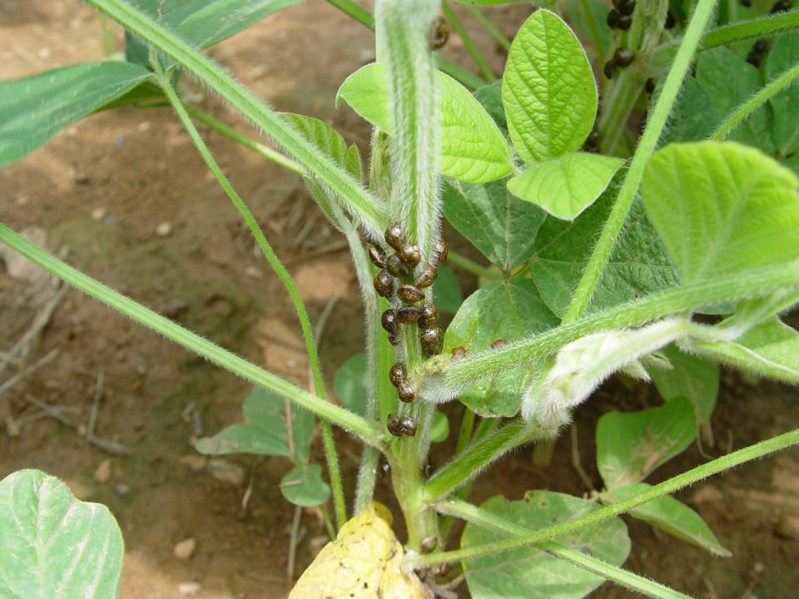
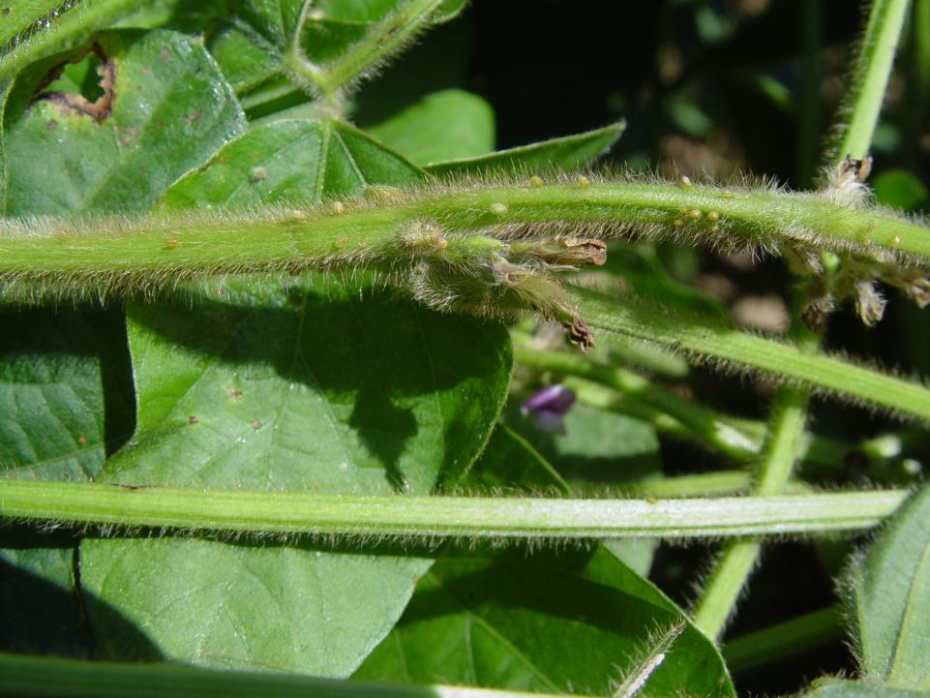
Visual Inspection in Soybean
Adults are gregarious and easy to see
Small nymphs can be more difficult, but are evident when closely examining stems
Image credits (all images)
Phillip Roberts, University of Georgia
Notes:
Because kudzu bugs are frequently present in large numbers, visual inspection of soybean plants may be sufficient for making treatment decisions. Spread the canopy and look at the stems toward the base of the plant for evidence of kudzu bug aggregations. It is important to differentiate the presence of immature kudzu bugs as opposed to adults only. Immatures are much harder to see due to their lack of movement, small size and better camouflage.
Information sources:
Greene, J.K., P.M. Roberts, W.A. Gardner, F. Reay-Jones, N. Seiter. 2012. Kudzu Bug Identification and Control in Soybeans, accessed 6/16/2014 -
http://digital.turn-page.com/i/87846

Slide 21
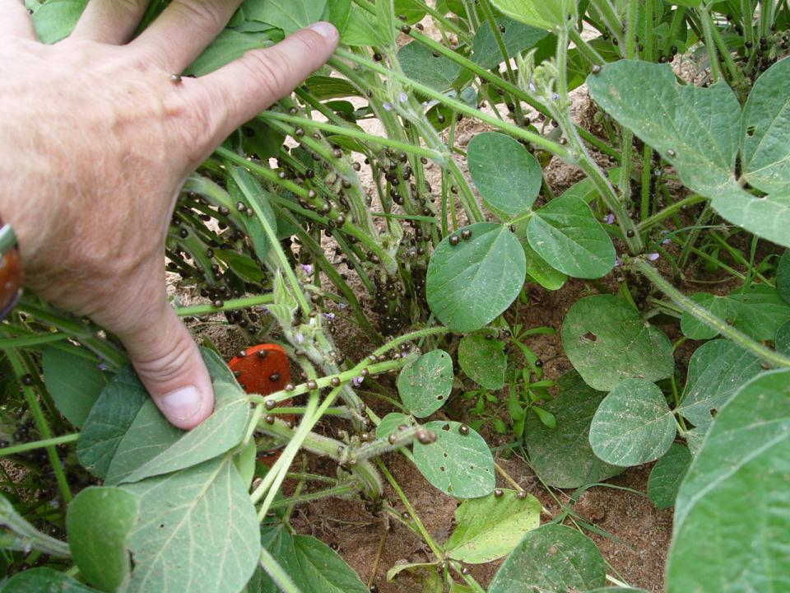
Treatment Thresholds in Soybean
Spraying adults on vegetative soybean is unlikely to boost yield as immediate re-infestation is common
Data suggest that growers wait until immatures are present or beans reach the R3 to R4 developmental stage
Image credits:
Phillip Roberts, University of Georgia
Notes:
Treatment thresholds are being vigorously researched to assist growers with making economically wise treatment decisions. Research data and grower experience suggests that spraying adults on vegetative stage soybean will not provide lasting protection and will not preserve yield. Nevertheless, it can be difficult to convince growers not to spray when large numbers of kudzu bugs are present.
Current research results support two types of thresholds. For growers who scout their fields each week, treatment is advised when adults are present and a minimum density of 1 nymph per sweep (example: 10 nymphs in a 10 sweep sample). For growers who do not scout weekly, spraying is advised when the crop reaches the R4 developmental state (generally mid-July). By waiting until mid-July, the kudzu bug dispersal phase has ended and a single spray will provide adequate suppression for the remainder of the season.
Information sources:
Greene, J.K., P.M. Roberts, W.A. Gardner, F. Reay-Jones, N. Seiter. 2012. Kudzu Bug Identification and Control in Soybeans, accessed 6/16/2014 -
http://digital.turn-page.com/i/87846
Horton, D. editor. 2014. 2014 Georgia Pest Management Handbook - Commercial Edition. University of Georgia. Special Bulletin 28. accessed 6/16/2014-
http://www.ent.uga.edu/pmh/

Slide 22
Chemical Control in Soybean
PEST | INSECTICIDE | FORMULATION PER ACRE | LBS. ACTIVE PER ACRE
Kudzu Bug | acephate | 0.75-1.0 lb | 0.73-0.97
 | bifenthrin | 5.12-6.4 ozs 6.4 ozs | 0.08-0.1 0.1
 | clothianadin | 3-4 ozs | 0.05-0.67
 | gamma-cyhalothrin | 1.28-1.54 ozs | 0.0125-0.015
 | lambda-cyhalothrin | 1.92 ozs | 0.03
 | zeta-cypermethrin | 4 ozs | 0.025
*some premixes also have 2(ee) label
Recommendation credits: Phillip Roberts, Michael Toews and David Buntin, University of Georgia-2014 Pest Management Handbook
Notes:
Kudzu bugs are easy to kill with readily available broad spectrum insecticides. The most efficacious compounds are pyrethroids (i.e. bifenthrin), organophosphates (i.e. acephate) or carbamates (i.e. carbaryl). Insect growth regulators (i.e. diflubenzuron), lepidopteran specific materials (spinosad, flubendiamide, indoxacarb), and diamide class chemistries do not provide adequate control. Premix insecticides that include a pyrethroid or organophosphate will likely provide good to excellent control.
Keep in mind that insecticide labels may be state specific, so stakeholders should contact their local Extension office for appropriate recommendations in your area.
Trials in Georgia and North Carolina have not uncovered any organic labelled insecticides that provide satisfactory control in multiple trials. These trials are ongoing; please contact your county Extension office for the most recent research findings.
Information sources:
Horton, D. editor. 2014. 2014 Georgia Pest Management Handbook - Commercial Edition. University of Georgia. Special Bulletin 28. accessed 6/16/2014-
http://www.ent.uga.edu/pmh/

Slide 23
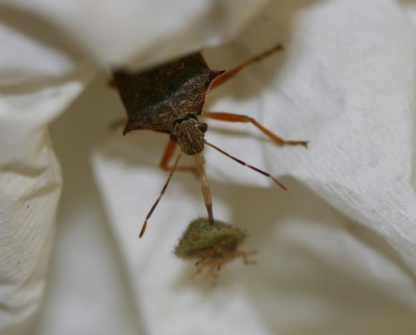
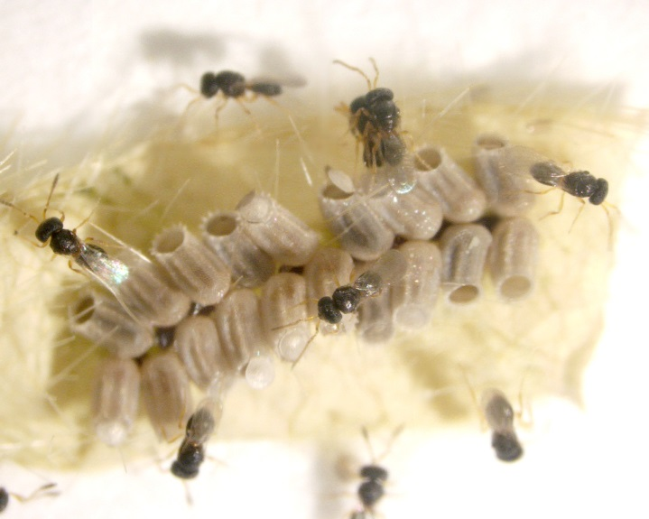
Biological Control
An entomopathogenic fungus may exert some control
Other parasitoids and predators observed include:
Tachinid flies
Egg specialist, Paratelenomus saccharalis
Generalist predators
Image credit:
Top-Michael Toews, University of Georgia
Bottom-Wayne Gardner, University of Georgia
Notes:
Ironically, M. cribraria is only an occasional pest in Asia, likely the result of effective natural enemies including egg parasitoids. Until summer 2013, there were only isolated accounts of any North American biological control agents (pathogens, predators, or parasitoids) attacking kudzu bugs.
Research conducted at the USDA-ARS National Biological Control Laboratory in Stoneville, Mississippi, conﬁrmed that M. cribraria eggs were not attacked by 11 species of native egg parasitoids (8 from Pentatomidae and 1 each from Coreidae, Reduviidae, and Rhopalidae) plus 4 species of exotic egg parasitoids that were being assessed for control of the brown marmorated stink bug.
Isolated kudzu bug specimens from both Georgia and South Carolina showed evidence of Beauveria bassiana infestation in 2010.
A single tachinid fly, Phasia robertsonii, was observed emerging from an adult kudzu bug in Georgia in April 2012. Likewise, in early 2013, research scientists at Auburn University observed a second tachinid fly, Strongygaster triangulifer, parasitizing kudzu bug adults.
Several generalist predators, such as the spined soldier bug and the Florida stink bug, are known to feed on kudzu bugs, but they appear unable to exert any population control as the rate of prey consumption is very low. Molecular gut content analyses confirm feeding on kudzu bugs by the following species:
big-eyed bugs (Geocoris punctipes and Geocoris uliginosus)
minute pirate bug (Orius insidiosus)
spined soldier bug (Podisus maculiventris)
convergent lady beetle (Hippodamia convergens)
ana ssassin bug (Zelus renardii)
spiders (Oxyopes spp., Salticus spp., and Peucetia viridans)
red imported fire ant (Solenopsis invicta)
Information sources:
Gardner, W. A., J. L. Blount, J. R. Golec, W. A. Jones, X. P. Hu, E. J. Talamas, R. M. Evans, X. Dong, C. H. Ray, Jr., G. D. Buntin, N. M. Gerardo, and J. Couret. 2013a. Discovery of Paratelenomus saccharalis (Dodd) (Hymenoptera: Platygastridae), an egg parasitoid of Megacopta cribraria F. (Hemiptera: Plataspidae) in its expanded North American range. Journal of Entomological Science 48: 355-359.
Greenstone, M. H., P. G. Tillman, and J.S. Hu. 2014. Predation of the newly invasive pest Megacopta cribraria (Hemiptera: Plataspidae) in soybean habitats adjacent to cotton by a complex of predators. Journal of Economic Entomology, 107: 947-954.
Golec, J. R., X. P. Hu, C. Ray, and N. E. Woodley. 2013. Strongygaster triangulifera (Diptera: Tachinidae) as a parasitoid of Adults of the invasive Megacopta cribraria (Heteroptera: Plataspidae) in Alabama. Journal of Entomological Science 48: 352-354.
Ruberson, J. R., K. Takasu, G. D. Buntin, J. E. Eger, Jr., W. A. Gardner, J. K. Greene, T. M. Jenkins, W. A. Jones, D. M. Olson, P. M. Roberts, D. R. Suiter, and M. D. Toews. 2013. From Asian curiosity to eruptive American pest: Megacopta cribraria (Hemiptera: Plataspidae) and prospects for its biological control. Applied Entomology and Zoology 48: 3-13.
Takasu, K., Y. Hirose. 1986. Kudzu-vine community as a breeding site of Ooencyrtus nezarae Ishii (Hymenoptera: Encyrtidae), an egg parasitoid of bugs attached soybean. Japanese Journal of Applied Entomology and Zoology, 30:302-304.
Zhang, Y.-T., X.-G. Du, M. Dong, and W. Shao. 2003. A preliminary investigation of egg parasitoids of Megacopta cribraria in soybean fields. Entomological Knowledge 40: 443-445.

Slide 24
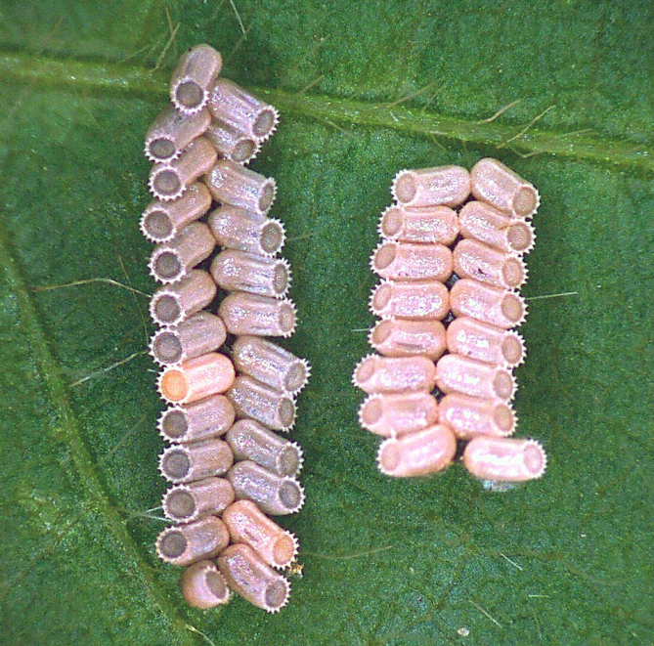
Biological Control
Parasitized eggs
Non-parasitized eggs
Eggs parasitized by P. saccharalis appear abnormally dark-colored
Parasitism rates range from 55 to 95%, most commonly >75%
Image credit:
J. Golec, Auburn University
Notes:
In May 2013, kudzu bug egg masses collected off kudzu near Atlanta, Georgia were found to have been parasitized by an egg parasitoid. In June, the same parasitoid was picked up from kudzu bug eggs near the Auburn University campus in Alabama. This parasitoid was identified as Paratelenomus saccharalis, a species that exerts 43 to 100% control over kudzu bug in Japan.
Further investigation of the P. saccharalis populations in Georgia and Alabama showed that they were exerting many times more control on kudzu bugs than any previously known North American parasitoid species.
By late summer 2013, wasp populations were detected in southern Georgia. Genetic analyses showed the North American strain was an identical match to the strain found in Japan and was distinct from the strain being maintained under quarantine at a USDA ARS Research Facility in Mississippi to support a USDA permit for importation and release against kudzu bug in the U.S.
Kudzu bug eggs that have been parasitized by this species appear much darker in color than non-parasitized eggs. P. saccharalis has been conﬁrmed parasitizing M. cribraria eggs in 17 additional counties in Georgia, 8 additional counties in Alabama, and 1 county in Mississippi. Researchers expect that P. saccharalis populations will rapidly expand as they fill an ecological niche unfilled by any other species at this time.
This species is widely distributed in the Eastern hemisphere and has a very high host specificity to four species in the family Plataspidae. The appearance of the parasitized eggs, percent parasitism, and timing of parasitism are very similar to observations of P. saccharalis in its native range.
Information sources:
Gardner, W. A., J. L. Blount, J. R. Golec, W. A. Jones, X. P. Hu, E. J. Talamas, R. M. Evans, X. Dong, C. H. Ray, Jr., G. D. Buntin, N. M. Gerardo, and J. Couret. 2013a. Discovery of Paratelenomus saccharalis (Dodd) (Hymenoptera: Platygastridae), an egg parasitoid of Megacopta cribraria F. (Hemiptera: Plataspidae) in its expanded North American range. Journal of Entomological Science 48: 355-359.
Takasu, K., Y. Hirose. 1986. Kudzu-vine community as a breeding site of Ooencyrtus nezarae Ishii (Hymenoptera: Encyrtidae), an egg parasitoid of bugs attached soybean. Japanese Journal of Applied Entomology and Zoology, 30:302-304.

Slide 25
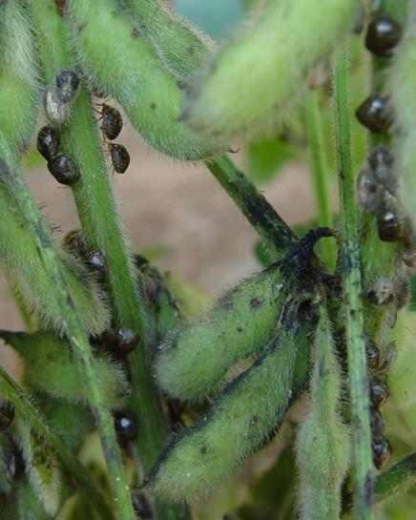
Cultural Control
Soybean planted in April and May experienced many more bugs and egg masses compared to June and July planting dates
Infestations are typically greater on field edges
Image credits:
Phillip Roberts, University of Georgia
Notes:
To date, there is very limited data available on host plant resistance within specific crop species. However, earlier soybean planting dates are highly correlated with population development and kudzu bug oviposition rates.
For example, soybean planted in April experienced nearly two times more egg masses at the same growth stage (R2) as May planted soybeans. Similarly, June planted soybeans experienced less than half the number of eggs observed in the May planted beans. Finally, there were very few egg masses detected in July planted soybeans.
Limited data from Clemson University suggests that kudzu bug populations may be heavier on the edges of fields than in the center. It is important that growers scout the entire field to avoid treating the entire field when only a small portion is heavily infested. This observation may suggest that field edge targeted insecticide applications could be appropriate for this pest.
Information sources:
Seiter, N. J., F. P. F. Reay-Jones, and J. K. Greene. 2013b. Within-field spatial distribution of Megacopta cribraria (Hemiptera: Plataspidae) in soybean (Fabales: Fabaceae). Environmental Entomology 42: 1363-1374.

Slide 26
Author and Publication Dates
Michael Toews, Ph.D. Associate Professor, University of Georgia
Phillip Roberts, Ph.D. Professor, University of Georgia
Wayne Gardner, Ph.D. Professor, University of Georgia
David Riley, Ph.D. Professor, University of Georgia
Published June 2014

Slide 27
Reviewers
Jeremy Greene, Ph.D.
Professor, Clemson University
Joni Blount, Graduate Research Associate University of Georgia
Edited by Stephanie Stocks, M.S., Entomology and Nematology Department, University of Florida

Slide 28
Educational Disclaimer and Citation
This presentation can be used for educational purposes for NON-PROFIT workshops, trainings, etc.
Citation:
Toews, M., P. Roberts, W. Gardner, and D. Riley. 2014. Megacopta cribraria (Heteroptera: Plataspidae) the “kudzu bug.” June 2014. accessed (add the date) – www.potectingusnow.org

Slide 29
Our Partners
United States Department of Agriculture, National Institute of Food and Agriculture (USDA NIFA)
United States Department of Agriculture, Animal and Plant Health Inspection Service, Plant Protection and Quarantine (USDA APHIS PPQ)
Cooperative Agriculture Pest Survey (CAPS) Program
National Plant Board (NPB)
States Department of Agriculture
Extension Disaster Education Network (EDEN)
Center for Invasive Species and Ecosystem Health (Bugwood)
National Plant Diagnostic Network (NPDN)
U.S. Department of Homeland Security (DHS)
U.S. Forest Service (USFS)

Slide 30
References
Brown, A. M. V., L. Y. Huynh, C. M. Bolender, K. G. Nelson, and J. P. McCutcheon. 2014. Population genomics of a symbiont in the early stages of a pest invasion. Molecular Ecology 23: 1516-1530.
Dai, J.-x., and Z.-m. Zheng. 2004. Discussion on the phylogenetic relationships of partial pentatomidae insects based on sequences of cytochrome b gene. Zoological Research 25: 397-402.
Dai, J.-X., and Z.-M. Zheng. 2005a. Phylogenetic relationships of eleven species of Pentatominae based on sequences of cytochrome b gene. Chinese Bulletin of Entomology 42: 395-399.
Dai, J.-X., and Z.-M. Zheng. 2005b. Phylogenetic relationships of eleven species of Pentatominae based on sequences of cytochrome b gene. Kunchong Zhishi 42: 395-399.
Del Pozo-Valdivia, A. I., and D. D. Reisig. 2013. First-generation Megacopta cribraria (Hemiptera: Plataspidae) can develop on soybeans. Journal of Economic Entomology 106: 533-535.

Slide 31
References
Dowdy, Sharon. 2012. Latin Americans turn to UGA researchers for kudzu bug knowledge. Georgia FACES, University of Georgia, College of Agriculture and Environmental Sciences. Accessed 6/16/2014 –
http://www.caes.uga.edu/applications/gafaces/?public=viewStory&pk_id=4377
Eger, J. E., Jr., L. M. Ames, D. R. Suiter, T. M. Jenkins, D. A. Rider, and S. E. Halbert. 2010. Occurrence of the Old World bug Megacopta cribraria (Fabricius) (Heteroptera: Plataspidae) in Georgia: a serious home invader and potential legume pest. Insecta Mundi 0121: 1-11.
Gardner, W. A., J. L. Blount, J. R. Golec, W. A. Jones, X. P. Hu, E. J. Talamas, R. M. Evans, X. Dong, C. H. Ray, Jr., G. D. Buntin, N. M. Gerardo, and J. Couret. 2013a. Discovery of Paratelenomus saccharalis (Dodd) (Hymenoptera: Platygastridae), an egg parasitoid of Megacopta cribraria F. (Hemiptera: Plataspidae) in its expanded North American range. Journal of Entomological Science 48: 355-359.

Slide 32
References
Gardner, W. A., H. B. Peeler, J. LaForest, P. M. Roberts, A. N. Sparks, Jr., J. K. Greene, D. Reisig, D. R. Suiter, J. S. Bacheler, K. Kidd, C. H. Ray, X. P. Hu, R. C. Kemerait, E. A. Scocco, J. E. Eger, Jr., J. R. Ruberson, E. J. Sikora, D. A. Herbert, Jr., C. Campana, S. Halbert, S. D. Stewart, G. D. Buntin, M. D. Toews, and C. T. Bargeron. 2013b. Confirmed distribution and occurrence of Megacopta cribraria (F.) (Hemiptera: Heteroptera: Plataspidae) in the southeastern United States. Journal of Entomological Science 48: 118-127.
Greene, J.K., P.M. Roberts, W.A. Gardner, F. Reay-Jones, N. Seiter. 2012. Kudzu Bug Identification and Control in Soybeans, accessed 6/16/2014 -
http://digital.turn-page.com/i/87846
Greenstone, M. H., P. G. Tillman, and J.S. Hu. 2014. Predation of the newly invasive pest Megacopta cribraria (Hemiptera: Plataspidae) in soybean habitats adjacent to cotton by a complex of predators. Journal of Economic Entomology, 107: 947-954.

Slide 33
References
Golec, J. R., X. P. Hu, C. Ray, and N. E. Woodley. 2013. Strongygaster triangulifera (Diptera: Tachinidae) as a parasitoid of Adults of the invasive Megacopta cribraria (Heteroptera: Plataspidae) in Alabama. Journal of Entomological Science 48: 352-354.
Horn, S., and J. L. Hanula. 2011. Influence of trap color on collection of the recently-introduced bean plataspid, Megacopta cribraria (Hemiptera: Plataspidae). Journal of Entomological Science 46: 85-87.
Horton, D. editor. 2014. 2014 Georgia Pest Management Handbook - Commercial Edition. University of Georgia. Special Bulletin 28. accessed 6/16/2014-
http://www.ent.uga.edu/pmh/
Hosokawa, T., Y. Kikuchi, M. Shimada, and T. Fukatsu. 2007. Obligate symbiont involved in pest status of host insect. Proceedings of the Royal Society B-Biological Sciences 274: 1979-1984.
Hosokawa, T., N. Nikoh, and T. Fukatsu. 2014. Fine-scale geographical origin of an insect pest invading North America. Plos One 9.

Slide 34
References
Hsiao, T. y., L. y. Zheng, S. z. Ren, and et al. 1977. A handbook for the determination of the Chinese Hemiptera-Heteroptera. Volume 1.
Jenkins, T. M., T. D. Eaton, D. R. Suiter, J. E. Eger, Jr., L. M. Ames, and G. D. Buntin. 2010. Preliminary genetic analysis of a recently-discovered invasive true bug (Hemiptera: Heteroptera: Plataspidae) and its bacterial endosymbiont in Georgia, USA. Journal of Entomological Science 45: 62-63.
Jenkins, T. M., and T. D. Eaton. 2011. Population genetic baseline of the first plataspid stink bug symbiosis (Hemiptera: Heteroptera: Plataspidae) reported in North America. Insects 2: 264-272.
Kikuchi, A. and H. Kobayashi. 2010. Effect of injury by adult Megacopta punctatissima (Montandon) (Hemiptera: Plataspidae) on the growth of soybean during the vegetative stage of growth. Japanese Journal of Applied Entomology and Zoology. 54:37–43 (In Japanese with English summary).
Kudzu Bug Website. Identification. The University of Georgia - Center for Invasive Species and Ecosystem Health. Accessed 6/16/2014 –
http://www.kudzubug.org/identification.html

Slide 35
References
Medal, J., S. Halbert, and A. S. Cruz. 2013a. The bean Plataspid, Megacopta cribraria (Hemiptera: Plataspidae), a new invader in Florida. Florida Entomologist 96: 258-260.
Medal, J., S. Halbert, T. Smith, and A. S. Cruz. 2013b. Suitability of selected plants to the bean plataspid, Megacopta cribraria (Hemiptera: Plataspidae) in no-choice tests. Florida Entomologist 96: 631-633.
National Center for Biotechnology Information. 2013. Ishikawaella symbiont of Megacopta cribraria overview. European Nucleotide Archive.
National Cotton Council. 2013. Inspections for Megacopta cribraria (kudzu bug). Accessed 6/16/2014 –
http://www.cotton.org/tech/flow/kudzu-bug-remediation.cfm
Ombrello, T. Plant of the Week – Kudzu. Accessed 9/11/2014
http://faculty.ucc.edu/biology-ombrello/POW/kudzu.htm
Ren, S. 1984. Studies on the fine structure of eggshells and the biology of Megacopta cribraria from China Hemiptera Plataspidae. Entomotaxonomia 6: 327-332.

Slide 36
References
Ruberson, J. R., K. Takasu, G. D. Buntin, J. E. Eger, Jr., W. A. Gardner, J. K. Greene, T. M. Jenkins, W. A. Jones, D. M. Olson, P. M. Roberts, D. R. Suiter, and M. D. Toews. 2013. From Asian curiosity to eruptive American pest: Megacopta cribraria (Hemiptera: Plataspidae) and prospects for its biological control. Applied Entomology and Zoology 48: 3-13.
Seiter, N. J., J. K. Greene, and F. P. F. Reay-Jones. 2013a. Reduction of soybean yield components by Megacopta cribraria (Hemiptera: Plataspidae). Journal of Economic Entomology 106: 1676-1683.
Seiter, N. J., F. P. F. Reay-Jones, and J. K. Greene. 2013b. Within-field spatial distribution of Megacopta cribraria (Hemiptera: Plataspidae) in soybean (Fabales: Fabaceae). Environmental Entomology 42: 1363-1374.
Seiter, N. J., E. P. Benson, F. P. F. Reay-Jones, J. K. Greene, and P. A. Zungoli. 2013c. Residual efficacy of insecticides applied to exterior building material surfaces for control of nuisance infestations of Megacopta cribraria (Hemiptera: Plataspidae). Journal of Economic Entomology 106: 2448-2456.

Slide 37
References
Southeast Exotic Pest Plant Council Invasive Plant Manual. Kudzu. Southeast Exotic Pest Plant Council. Accessed 9/11/20104
http://www.se-eppc.org/manual/kudzu.html
Srinivasaperumal, S., P. Samuthiravelu, and J. Muthukrishnan. 1992. Host plant preference and life table of Megacopta cribraria (Fab.) (Hemiptera: Plataspidae). Proceedings of the Indian National Science Academy Part B Biological Sciences 58: 333-340.
Suiter, D.R., J.E. Eger, Jr., W.A. Gardner, R.C. Kemerait, J.N. All, P.M. Roberts, J.K. Greene, L.M. Ames, G.D. Buntin, T.M. Jenkins and G.K. Douce. 2010. Discovery and distribution of Megacopta cribraria (Hemiptera: Heteroptera: Plataspidae) in Northeast Georgia. Journal of Integrated Pest Management. 1: 1-4.
Suiter, D. R., L. M. Ames, J. E. Eger, Jr., and W. A. Gardner. 2010. Megacopta cribraria as a nuisance pest. UGA-CAES Extension Circular No. 991. University of Georgia, Athens.

Slide 38
References
Takasu, K., Y. Hirose. 1986. Kudzu-vine community as a breeding site of Ooencyrtus nezarae Ishii (Hymenoptera: Encyrtidae), an egg parasitoid of bugs attached soybean. Japanese Journal of Applied Entomology and Zoology, 30:302-304.
USDA Plants Database. Pueraria lobata. Accessed 9/11/2014
http://plants.usda.gov/core/profile?symbol=PUMOL
Zhang, Y., J. L. Hanula, and S. Horn. 2012. The biology and preliminary host range of Megacopta cribraria (Heteroptera: Plataspidae) and its impact on kudzu growth. Environmental Entomology 41: 40-50.

