Slide 1
Japanese Oak Wilt Raffaelea quercivora

Slide 2
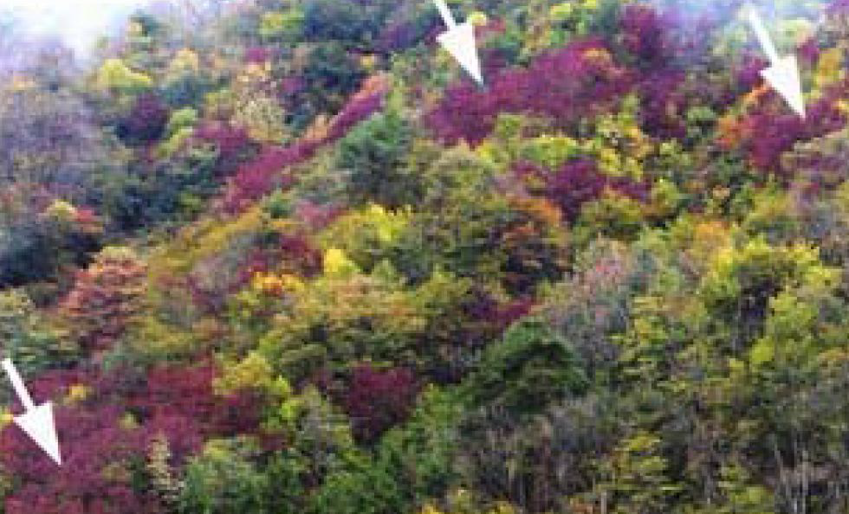
Japanese Oak Wilt (JOW)
Symbiotic ambrosia fungus (Ophiostomataceae)
Vector: Oak Ambrosia Beetle (OAB), Platypus quecivorus
2002: Beetle-vector complex discovered
Image credits: https://www.aphis.usda.gov/import_export/plants/manuals/emergency/downloads/nprg-r_quercivora.pdf
Notes:
Japanese Oak Wilt (Raffaelea quercivora) is a symbiotic ambrosia fungus belonging to the fungal phylum Ascomycota and Family Ophiostomataceae (17). Japanese Oak Wilt has a mutually symbiotic relationship with the Oak Ambrosia Beetle (Platypus quercivorus) and the fungus has not been known to occur naturally without this beetle vector (9,22).
Although Japanese Oak wilt was first observed in 1950 in Japan’s Miyazaki prefecture, this pathogen was not discovered with its vector until 2002 in Honshu, Japan (19). The infected trees were the Konata Oak (Quercus serrata ) and the Mongolian Oak (Q. mongolica) (13, 22). This was the first report of an ambrosia beetle-fungus complex killing healthy trees (8).
The white arrows in the photo on the right illustrate examples of oak trees infected by Japanese Oak Wilt (22).

Slide 3
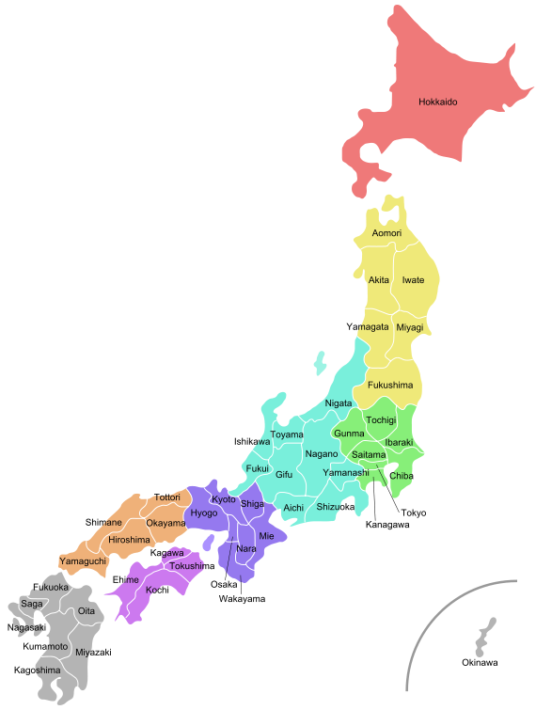
Distribution of JOW
Vector-limited distribution
Occurs in temperate to broadleaf mixed forests
Currently isolated to Japan
Image credits: Tokyoship - Own work, Public Domain, https://commons.wikimedia.org/w/index.php?curid=15683093
Notes:
Currently, Japanese Oak Wilt can be found in temperate broadleaf and mixed forests in Japan (6). Since Japanese Oak Wilt is dependent on the Oak Ambrosia Beetle for natural dispersion the pathogen’s distribution is very limited. Thus far, the disease is not known to occur outside of Japan (22). However, as of 2012, Japanese Oak Wilt has been documented in 31 out of 47 Japanese prefectures (16). Some scientists in Japan proposed climate change and warmer temperatures as major contributing factors of disease success and rapid expansion northward and to higher altitudes since the 1980s(22).

Slide 4
Reported Host Range of JOW
Successfully re-isolated from inoculated and symptomatic or dead seedlings of:
Konara Oak, Quercus serrata
Mongolian Oak, Q. mongolica
Northern Red Oak, Q. rubra
Pin Oak, Q. palustris
Scarlet Oak, Q. coccinea
Potentially susceptible hosts include:
Japanese Chinquapin, Castanopsis sieboldii
Ring-Cup Oak, Q. glauca
Notes:
The pathogenicity of Japanese Oak Wilt was originally thought to be limited to white oaks until its host range was studied via seedling inoculation and re-isolation of the pathogen from symptomatic or dead specimens (2, 22). The following species are reported hosts (22):
Konara Oak, Quercus serrata Murray
Mongolian Oak, Q. mongolica Fisch. ex Ledeb.
Northern Red Oak, Q. rubra L.
Pin Oak, Q. palustris Münchh.
Scarlet Oak, Q. coccinea Münchh.
The Japanese Chinquapin, Castanopsis sieboldii (Makino) Hatus., and Ring-Cup Oak, Q. glauca Thunb., are considered to be susceptible hosts of Japanese Oak Wilt (22).

Slide 5
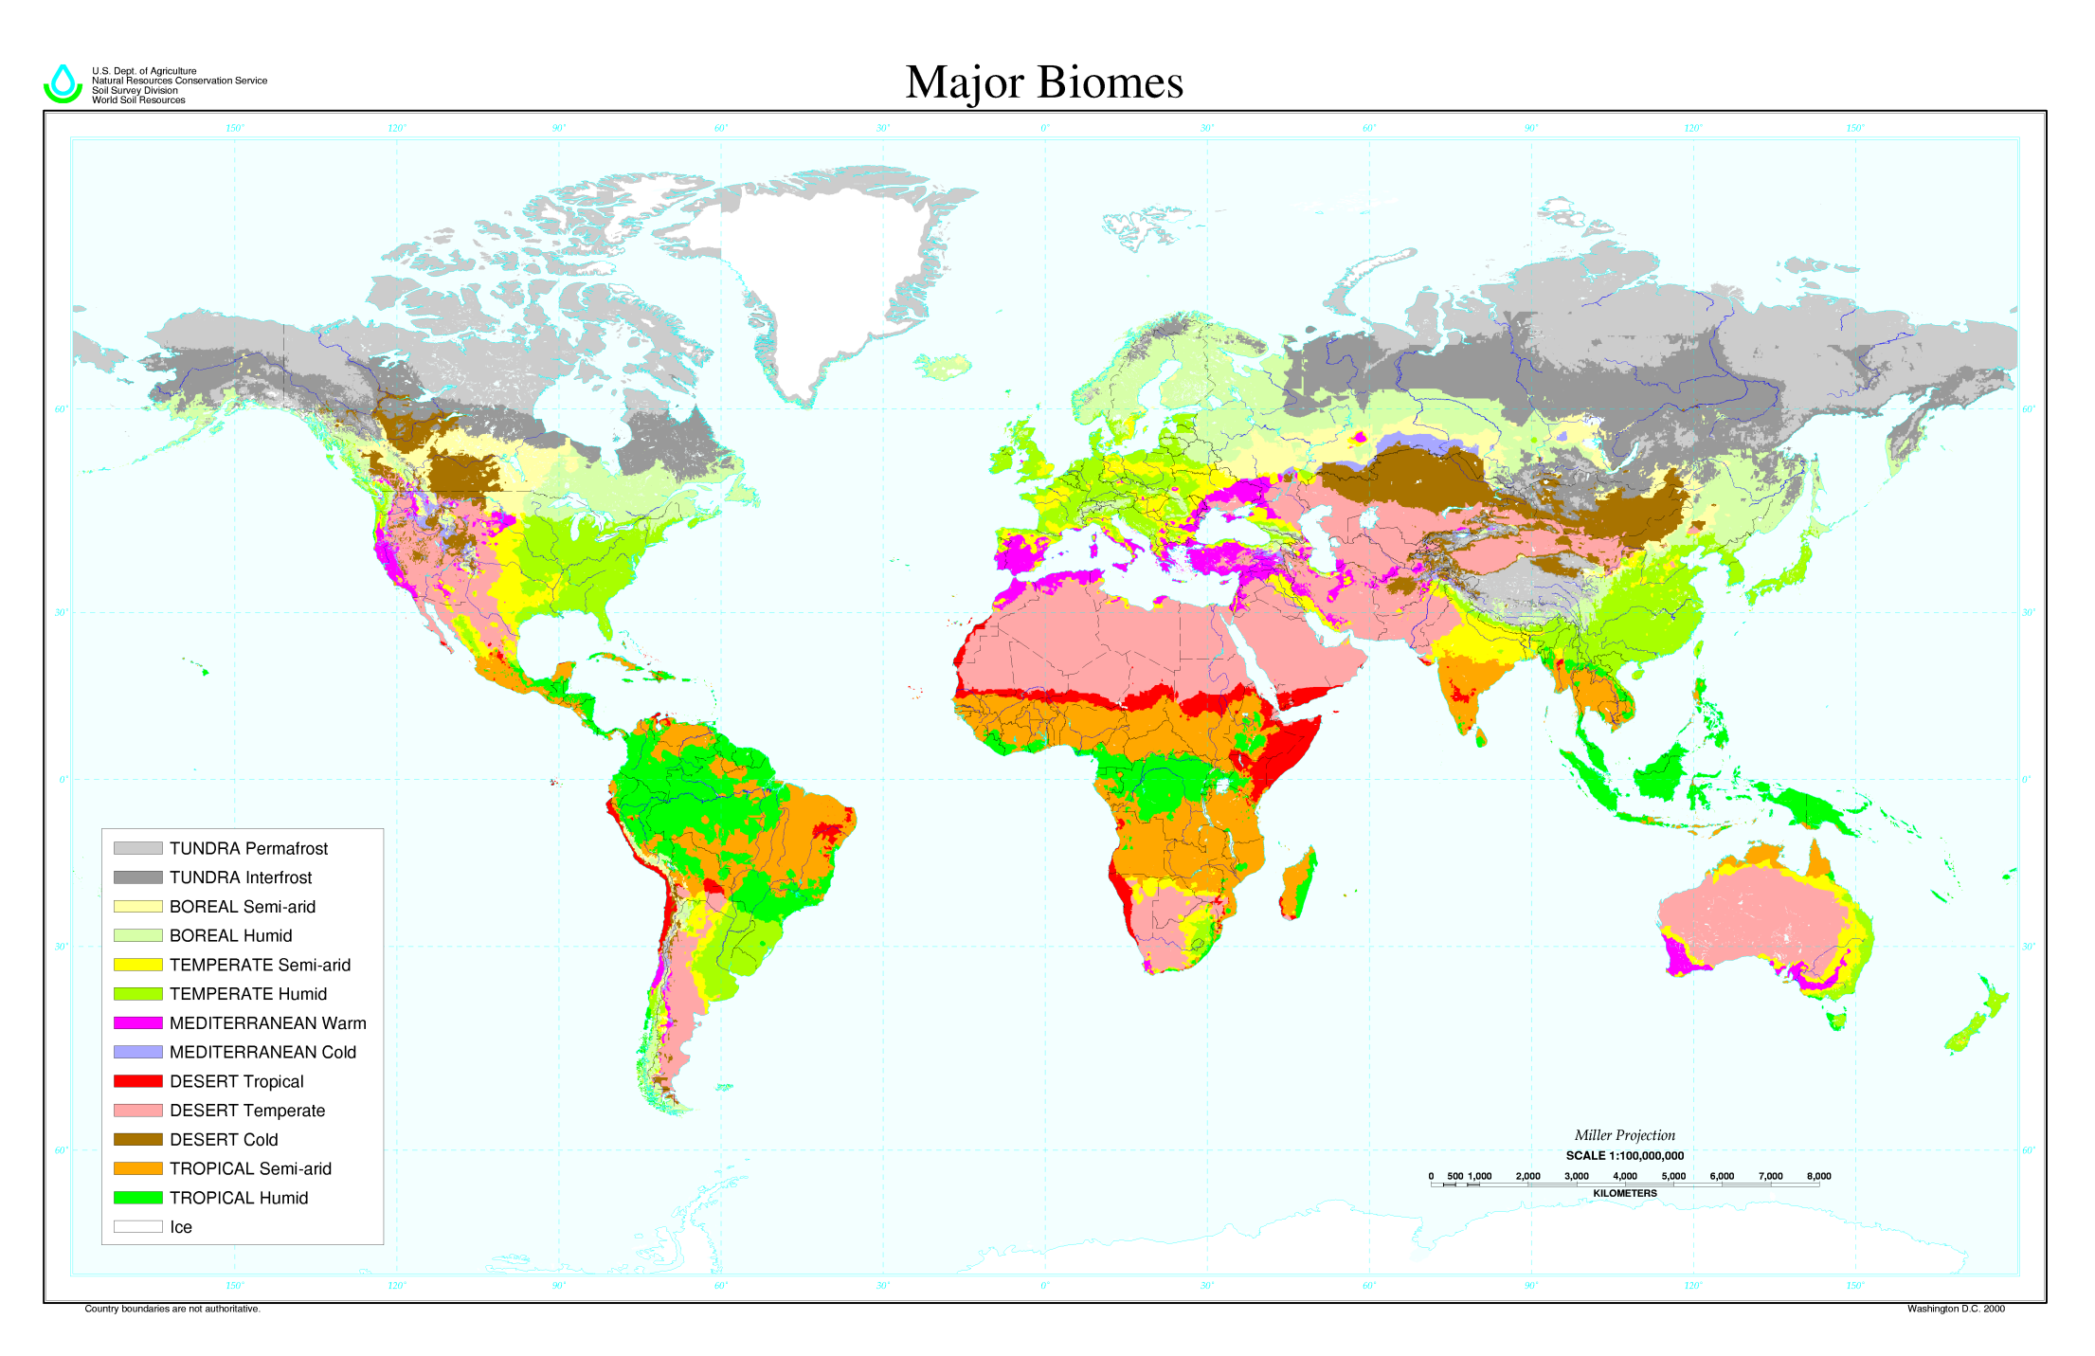
Potential Distribution of JOW
Image credits: Soil climate map, USDA-NRCS, Soil Science Division, World Soil Resources, Washington D.C., http://www.nrcs.usda.gov/wps/portal/nrcs/detail/soils/use/?cid=nrcs142p2_054002
Notes:
As aforementioned, Japanese Oak Wilt distribution is currently restricted to Japan (22). However, the potential additional parts of the world to which Japanese Oak Wilt and its vector (Oak Ambrosia Beetle) may be introduced is cause for regulatory concern.
The Oak Ambrosia Beetle is found in Japan, Bengal (India), Java (Indonesia), Papua New Guinea, and Taiwan (22). Despite this, the beetle’s plant-pathogenic symbiont does not have the appropriate conditions to thrive in these additional locations. Many aspects of this particular beetle-fungus complex remain obscure (2). Scientists believe Japanese Oak Wilt may eventually broaden its distribution as the beetles populations expand to new territories.
At present, the Oak Ambrosia Beetle’s true host range is limited to the family Fagaceae (2). This family contains beeches, oaks, and their relatives. Oaks belong to the genus Quercus, a very common group of trees found naturally (and ornamentally) throughout every state in the US. In fact, Quercus spp. rank among the top 10 most common hardwood trees found in the eastern US, comprising nearly 31% of all hardwood production (20). Oak trees are part of a lucrative forestry industry.
The biome map presented here indicates where suitable temperate forests for the pathogen and its vector exist. Note that the same light green colored biome present in Japan and East Asia is also located in the eastern half of the United States. If the Oak Ambrosia Beetle was introduced to the US through ornamental shipments or other means, the disease could also be unintentionally introduced, devastating landscapes and oak forests, along with the economic value of timber in its wake (2).

Slide 6
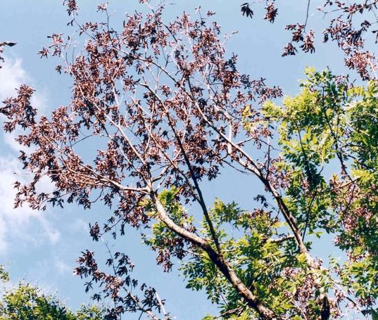
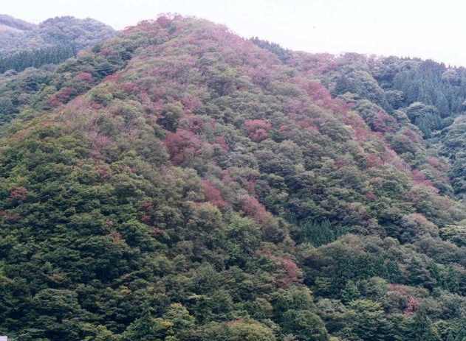
Damage
Image credits: Photos by Troy Kimoto, Canadian Food Inspection Agency, Bugwood.org IDs-5518023 & 5518022
Notes:
Overall wilt symptoms can be seen from a great distance dotting a landscape with dead, reddish-brown crowns (22). The signs and symptoms of Japanese Oak Wilt are more distinct up close.

Slide 7
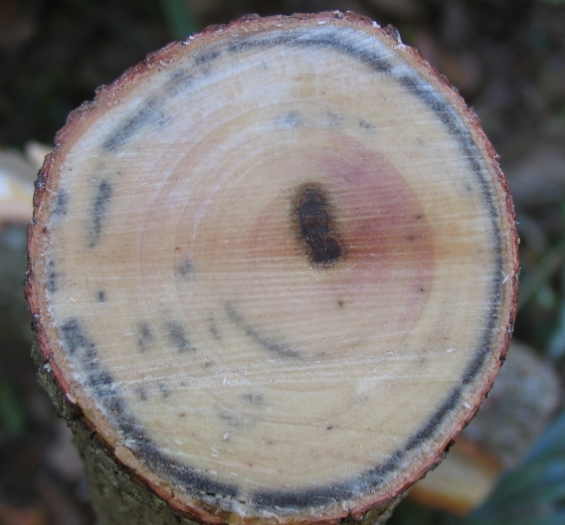
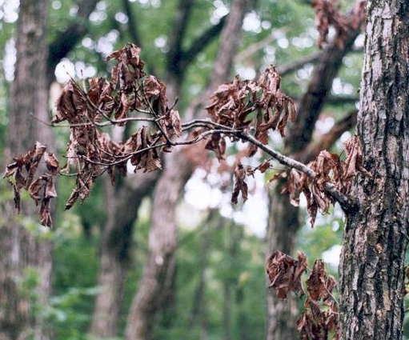
Signs & Symptoms of JOW
Typical wilt symptoms are visible 2-3 months post infection and tree death occurs within 1st season or next spring
Image credits: Wilted leaves by Troy Kimoto, Canadian Food Inspection Agency, Bugwood.org ID-5518022; Fungus-stained cross-section example of Laurel Wilt by Albert (Bud) Mayfield, USDA Forest Service, Bugwood.org ID-UGA5005056
Notes:
Japanese Oak Wilt can be characterized by typical vascular wilt symptoms in oak trees. The image on the left shows are leaves will appear curled and brittle, changing from the vibrant and healthy green to a rusty brown color (22). When the wood is observed in cross-section, the xylem tissue will be noticeable darkened and necrotic (14). Fungal hyphae will be present in Oak Ambrosia Beetle galleries throughout the heart- and sapwood (1, 2, 6). The image on the right is an example of Laurel Wilt (Raffaelea lauricola), a beetle/fungus complex that causes similar necrotic symptoms in redbay and other Lauraceae members.
Initial wilt symptoms are visible within 2 to 3 months after infection or infestation with the beetles (22). Tree death usually occurs within the 1st season or subsequent spring (2, 12, 13). The symptoms are more pronounced and more rapidly lead to tree death in those that have a very high population of Oak Ambrosia Beetles (11).

Slide 8
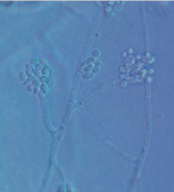
Fungal Morphology
Colonies: pale/brown olive, < 80mm diameter
Hyphae: hyaline, septate, smooth, branched
Conidiophores produced in sporodochia or separately
Conidia: short, slimy, club-shaped
Genus Raffaelea lacks a known sexual stage
Image credits: Conidia and conidiophores on PDA by Kubono and Ito 2002
Notes:
Japanese Oak Wilt can be cultured on PDA within 5 days at temperature range of 20-25C° (13). The colonies can reach an 80 mm diameter and have an irregular margin that is white and viscous (13). Initially the colonies are a drab olive color, but after 2 weeks they darken and emit an alcohol odor (13).
Aerial mycelia are pilose (soft hairy appearance) and comprised of hyphae bundles (13). Hyphae are hyaline, septate, smooth, and branched (13).
Conidiophores can be formed in sporodochia or may be produced separately (13). Multiple sporodochia cluster to create a mucus-laden mound (22). Straight conidiophores are either branched or simple. Similar to hyphae, they are hyaline, septate, and smooth (13, 18).
Conidia are short, slimy, and club-shaped (13, 18). They develop acropetally, such that the youngest conidia are at the apex of the conidiophore and the oldest are at the base (4, 13, 18). No guttules, or lipid storing oil droplets, are present (4, 13, 18) Unlike the hyphae and conidiophores, conidia are aseptate (13, 18). However, they are also hyaline, smooth, straight, and oblong (13, 18). Overall shape can be described as obovoid (the base is narrow and the apex broadly rounded) or pyriform/pear-shaped (4, 13, 18). Numerous sprout cells form from conidia and asexually generate additional hyphae (13, 18).
So far, no sexual stage has been found in any Raffaelea species (2).

Slide 9
Disease Cycle
Image credits: Adult Oak Ambrosia Beetle by Joseph Benzel, Screening Aids, USDA APHIS ITP, Bugwood.org ID-5541203; Bore holes and wilted leaves by Troy Kimoto, Canadian Food Inspection Agency, Bugwood.org IDs-5518018 & 5518022; Platypus spp. galleries by William Fountain, University of Kentucky, Bugwood.org ID-5388182
Notes:
The disease cycle of Japanese Oak Wilt is dependent on the life cycle of its vector the Oak Ambrosia Beetle.
Adult beetles carry conidia and bore into the wood (heart- and sapwood) of a suitable host tree (10). Adult females lay eggs in galleries where they also deposit fungal conidia. The condia then germinate directly or produce sprout cells which generate fungal hyphae (13). The hyphae develop in the beetle galleries and may form bundle and sporodochia (2). In turn, sporodochia (and some hyphae) form conidiophores which produce conidia (2). Oak Ambrosia Beetle larvae and adults feed on the fungus growing in the galleries (22). The combination of infection and feeding triggers the production of tyloses, a plant defensive response involving the enlargement of parenchyma cells to block the spread of pathogens in the xylem (23). Larvae pupate and the newly emerged adults acquire the fungus in their mycangia before leaving the tree and dispersing to a new host (10).

Slide 10
Monitoring
Scout for signs of OAB
Take note of any level of infestation, i.e. frass and boring holes
Detection, Delimiting, and Monitoring Surveys conducted as needed by plant regulatory officials
Above: Whitish frass on leaves next to an OAB-infested tree
Below: Entrance hole of OAB
Image credits: Frass and entrance hole by Troy Kimoto, Canadian Food Inspection Agency, Bugwood.org IDs-5518015 & 5518016
Notes:
Routine inspections for signs of beetle infestations is an important tool for monitoring the spread of both the vector and the disease. Take note of any boring dust and frass on foliage surrounding oak trees and fallen logs (2). Entry and exit holes in the bark may be indicative of beetles developing within the oak tree (2). Look for any evidence of decline, dieback, or foliar wilt symptoms as this may be a sign of plant stress or possible infection (22).
Overall, scouting for Japanese Oak Wilt is primarily conducted by plant regulatory officials via detection, delimiting, and monitoring surveys (22). Detection Surveys are used to determine whether or not Japanese Oak Wilt is present in an area in which it was previously not known to occur. Detection Surveys may be broad in scope and consider multiple pests/pathogens or they may be more restricted to a smaller area where a pest has potential to occur (22). However, it is important to note that a negative Detection Survey does not necessarily guarantee the absence of a pest or disease.
If a new detection is confirmed in the US, or if a detection in a new area where the pest was not previously found is confirmed, regulatory officials will form a Technical Working Group (TWG) to outline the procedure for conducting a Delimiting Survey (22). Delimiting Surveys define the extent, geographic range, and possible rate of spread of the newly detected disease (22).
After regulatory officials determine any necessary and appropriate control options, implementation follows. Monitoring Surveys are used to measure the effectiveness of control efforts (22).

Slide 11
Chemical Control
No known treatment exists
Inject preventative fungicide into healthy trees
Benomyl (cancelled by EPA) and triforine
Potential use of metam-ammonium injections to reduce mortality
Insecticidal control of OAB
Trunk sprays, adhesives, and plastic wraps
If formulation not labeled for necessary use,
Emergency Exemption under FIFRA Section 18
Notes:
At the moment, no known cure for Japanese Oak Wilt exists once an infection has occurred(2). However, preventative fungicide injections with benomyl (since canceled by the EPA) or triforine are used in Japan (7, 22). These compounds are injected into healthy tree trunks (22).
Additionally, research aimed at reducing the mortality of infected trees is underway. Scientists observed control of the beetle vector as a result of host stem injections with metam-ammonium (22). Control of the beetle vector is a primary focus of managing this disease. Insecticidal trunk sprays, adhesive applications, and plastic wrapping trunks are other techniques used to deter beetle boring (7).
In the event that a proposed compound is an approved effective control method at time of pest detection but is not yet labeled for the specific use site or target host, a quarantine exemption request may be submitted to the EPA under FIFRA Section 18. For additional information regarding this procedure visit: https://www.epa.gov/pesticide-registration/pesticide-emergency-exemptions#info (22).

Slide 12
Cultural Control & Sanitation
Maintain healthy oaks to deter beetle attacks*
Fumigate infected material with N-methyl-N-(m-tolyl)dithiocarbamic acid sodium salt during fall and winter
Remains to be chipped and burned
Clear cutting as a preventative
*OAB still attacks healthy trees, but stressed trees may be more susceptible.*
Notes:
Maintaining the health and vigor of oak trees may deter beetle infestations. Oak Ambrosia Beetle can still attack healthy trees, however, stressed trees may be more susceptible.
Sanitation is a key component of any disease management program. In the fall and winter, logs infected with Japanese Oak Wilt are fumigated with N-methyl-N-(m-tolyl)dithiocarbamic acid sodium salt (19). Clear cutting can also help prevent disease proliferation and spread (7).
It is important to remember state specific pesticide and control regulations do exist. Specific management strategies for newly invasive pests and diseases will be determined by regulatory officials.

Slide 13
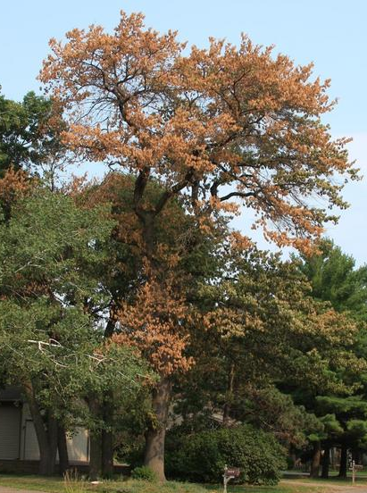
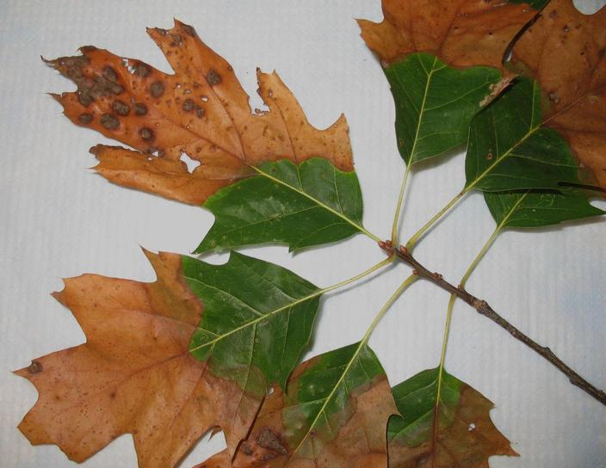
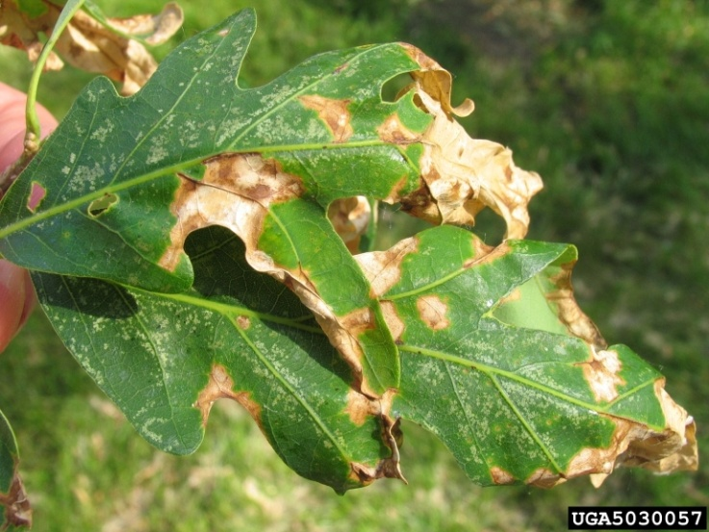
Lookalikes
Bacterial Leaf Scorch
Xylella fastidiosa
Oak Anthracnose
Apiognomonia
errabunda
Oak Wilt
Ceratocystis fagacearum
Image credits: Oak Wilt by Steven Katovich, USDA Forest Service, Bugwood.org ID-5506095; Oak Anthracnose by Joseph OBrien, USDA Forest Service, Bugwood.org ID-UGA5030057; Bacterial Leaf Scorch by Nancy Gregory, University of Delaware, Bugwood.org ID-5427648
Notes:
Oaks are susceptible to a few other diseases which may resemble Japanese Oak Wilt.
Oak Wilt (Ceratocystis fagacearum) usually infects red oaks, but white oaks may also be affected (21). Wilt symptoms and brown, curled foliage are common in the spring and early summer (5, 21)Tree death is more immediate in red versus white oaks, occurring in 1-2 months and over several years, respectively (5, 21).
Oak Anthracnose (Apiognomonia errabunda) rarely causes tree death, but affects several species of oak. Typical symptoms include dieback, premature leaf drop and distortion, as well as discoloration (22).
Bacterial Leaf Scorch (Xyllela fastidiosa) symptoms appear on leaf margins at first during mid to late summer (3, 22). Leaf curl and premature drop may lead to dieback and overall decline over several years (3, 22).

Slide 14
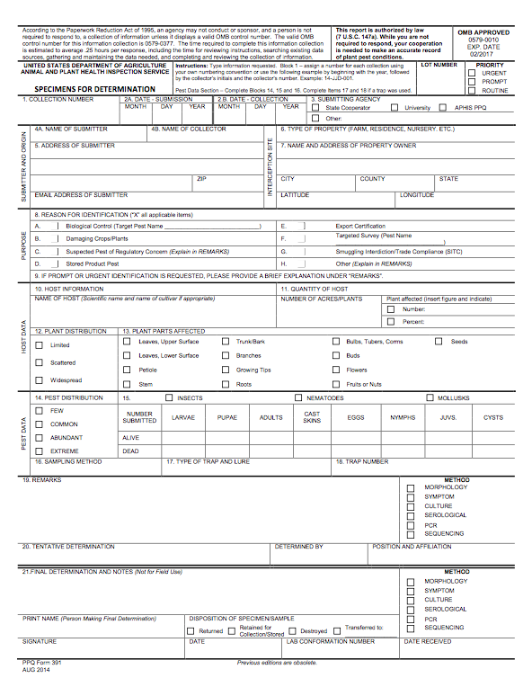
Suspect Sample Submissions
Contact your State Department of Agriculture or University Cooperative Extension laboratory
http://www.npdn.org/home
PPQ form 391, Specimens for Determination
https://www.aphis.usda.gov/library/forms/pdf/PPQ_Form_391.pdf
An example of a PPQ form for sample submissions
Image credits: https://www.aphis.usda.gov/library/forms/pdf/PPQ_Form_391.pdf
Notes:
If a suspect pest has been located in the United States, a sample should be submitted for proper identification. Contact your local diagnostic lab to ship in a sample for identification. Information regarding your local diagnostic lab is available at National Plant Diagnostic Network (NPDN) website. The diagnostic lab information and available contacts are divided by state.
http://www.npdn.org/home
The sample specimen should be submitted along with accompanying documentation using the PPQ form 391.
https://www.aphis.usda.gov/library/forms/pdf/PPQ_Form_391.pdf
Your local diagnostic lab is part of your local cooperative extension service or your state department of agriculture. Your local lab will also have a specific form. All local labs may not be a member of NPDN. However, all labs should report new pest and pathogen detections to local regulatory officials.

Slide 15
Communications
Contact your State Plant Health Director
https://www.aphis.usda.gov/aphis/ourfocus/planthealth/ppq-program-overview/ct_sphd
Contact your State Plant Regulatory Official
http://nationalplantboard.org/membership/
Image credits: http://www.usda.gov/wps/portal/usda/usdahome; http://nationalplantboard.org/
Notes:
Remember that new pest and pathogen records must be reported to your State Plant Health Director (SPHD) and your State Plant Regulatory Official (SPRO). The SPRO is a State Department of Agriculture Employee and the SPHD is a USDA-APHIS-PPQ employee.
The link to your SPRO is on the National Plant Board (NPB) website. It has an interactive map and when you click on your state it will take you to another page with contact information. The NPB is a cooperative organization that includes membership from all State Departments of Agriculture.

Slide 16
Author and Publication Dates
Nicole Casuso
Graduate Assistant, DPM Student, Department of Entomology and Nematology, University of Florida, Gainesville
Eric LeVeen, DPM
State Survey Coordinator, FDACS-DPI CAPS, Gainesville
Amanda Hodges, Ph.D.
Associate Extension Scientist, Department of Entomology and Nematology, University of Florida, Gainesville
Publication date: October 2016

Slide 17
Reviewers
Catherine A. Marzolf
Assistant State Plant Health Director, USDA APHIS PPQ

Slide 18
Educational Disclaimer and Citation
This presentation can be used for educational purposes for NON-PROFIT workshops, trainings, etc.
Citation: Casuso, Nicole; Eric LeVeen, Amanda Hodges. 2016. Japanese oak wilt – Raffaelea quercivora.
Accessed (add a date)
www.protectingusnow.org

Slide 19
Our Partners
United States Department of Agriculture, National Institute of Food and Agriculture (USDA NIFA)
United States Department of Agriculture, Animal and Plant Health Inspection Service, Plant Protection and Quarantine (USDA APHIS PPQ)
Cooperative Agriculture Pest Survey (CAPS) Program
National Plant Board (NPB)
States Department of Agriculture
Extension Disaster Education Network (EDEN)
Center for Invasive Species and Ecosystem Health (Bugwood)
National Plant Diagnostic Network (NPDN)
U.S. Department of Homeland Security (DHS)
U.S. Forest Service (USFS)

Slide 20
References
Batra, L. R. 1967. Ambrosia fungi: a taxonomic revision, and nutritional studies of some species. Mycologia 59(6):976-1017. Accessed 6/15/16
http://www.jstor.org/stable/pdf/3757271.pdf?_=1466533422819
Davis. E., S. French, and R. C. Venette. 2005. Mini Risk Assessment: Ambrosia beetle: Platypus quercivorus Murayama [Coleoptera: Platypodidae]. University of Minnesota and USDA Forest Service. Accessed 6/15/16.
https://extension.entm.purdue.edu/CAPS/pdf/datasheets/OakAmbrosiaBeetle.pdf
Davis, E. E., R. C. Venette, and E. M. Albrecht. 2010h. Oak commodity based survey. USDA-APHIS-PPQ-CPHST-CAPS. 1-298 pp. Accessed 6/15/16.
http://download.ceris.purdue.edu/file/604
D'Arcy, C. J. , D. M. Eastburn, and G. L. Schumann. 2001. Illustrated Glossary of Plant Pathology. The Plant Health Instructor. Accessed 6/15/16
http://www.apsnet.org/edcenter/illglossary/Pages/default.aspx

Slide 21
References
EPPO. 2011. Data sheets on quarantine pests: Ceratocystis fagacearum and its vectors. Accessed 6/15/16.
https://www.eppo.int/QUARANTINE/data_sheets/fungi/CERAFA_ds.pdf
ESRI. 2005. World wildlife fund terrestrial ecoregions. Published by ESRI 2005, dataset adapted by USDA-APHIS-PPQ-S&T-CPHST-PERAL, 2011.
IUFRO. 2012. Japanese oak wilt and its control. Alien invasive species and international trade, 3rd meeting of International Union of Forest Research Organizations Working Unit (IUFRO) 7.03.12, June 10-16, 2012, Tokyo, Japan.
Kamata, N., K. Esaki, K. Kato, H. Oana, Y. Igeta, and R. Komura. 2007. Japanese oak wilt as a newly emerged forest pest in Japan: Why does a symbiotic ambrosia fungus kill host trees? USDA-APHIS-PPQ. 1-3 pp. Accessed 6/15/16.
http://www.nrs.fs.fed.us/pubs/gtr/gtr_nrs-p-10/gtr_nrs-p-10_001.pdf?

Slide 22
References
Kato, K., H. Oana, N. Kakiuchi, M. Mikage, N. Kamata, and K. Esaki. 2003. Induced response of oak trees to Raffaelea quercivora as a possible defense against Japanese oak wilt caused by the ambrosia fungus carried by an ambrosia beetle [Abstract]. Proccedings: IUFRO Kanazawa 2003 "Forest Insect Population Dynamics and Host Influences":137. Accessed 6/15/16.
http://www.uf.a.u-tokyo.ac.jp/~kamatan/symp/iufro2003kanazawa/ proceedings/15_1300_Kamata_ABS.pdf
Kinuura, H. 2002. Relative dominance of the mold fungus, Raffaelea sp., in the mycangium and proventriculus in relation to adult stages of the oak platypodid beetle, Platypus quercivorus (Coleoptera: Platypodidae). Journal of Forestry Research 7(1):7-12. Accessed 6/15/16.
http://link.springer.com/article/10.1007%2FBF02762592

Slide 23
References
Kinuura, H., and M. Kobayashi. 2006. Death of Quercus crispula by inoculation with adult Platypus quercivorus (Coleoptera: Platypodidae). Applied Entomology and Zoology 41(1):123-128. Accessed 6/15/16.
http://ci.nii.ac.jp/els/110004656433.pdf?id=ART0007381465&type=pdf&lang=en&host=cinii&order_no=&ppv_type=0&lang_sw=&no=1466534450&cp=
Kobayashi, M., and A. Ueda. 2003. Observation of mass attack and artificial reproduction in Platypus quercivorus (Murayama) (Coleoptera: Platypodidae). Japanese Journal of Applied Entomology and Zoology 47(2):53-60. Accessed 6/15/16.
https://www.jstage.jst.go.jp/article/jjaez/47/2/47_2_53/_pdf
Kubono, T., and S.-I. Ito. 2002. Raffaelea quercivora sp. nov. associated with mass mortality of Japanese oak, and the ambrosia beetle (Platypus quercivorus). Mycoscience 43(3):255-260. Accessed 6/15/16
http://link.springer.com/article/10.1007%2Fs102670200037#page-1

Slide 24
References
Kuroda, K., Y. Kanbara, T. Inoue, and A. Ogawa. 2006. Magnetic resonance micro-imaging of xylem sap distribution and necrotic lesions in tree stems. IAWA Journal 27(1):3-17. Accessed 6/15/16.
http://www2.kobe-u.ac.jp/~kurodak/MRI2006.pdf
Kuroda K, K. Osumi, and H. Oku. 2011. Reestablishing the health of secondary forests “Satoyama” endangered by Japanese oak wilt: A preliminary report. JAERD. 4(9), pp 192-198. Accessed 6/15/16.
http://www.academicjournals.org/journal/JAERD/article-full-text-pdf/59052AE3635
Matsuda, Y., M. Torii, T. Yamada, and S. Ito. 2012. Lessons from fungal inoculation experiments: How oak trees wilt and die by the infection of Japanese oak wilt pathogen? International Symposium on Oak Forest Preservation, Korea Forest Research Institute, Seoul, Korea. pp 1-10.
http://www.bio.mie-u.ac.jp/junkan/busshitsu/lab2/Abstract_matsuda0731_ final.pdf

Slide 25
References
Mycobank. 2016. Accessed 6/15/16.
http://www.mycobank.org/
Seo, M. Y., Y. Matsuda, C. Nakashima, and S. Ito. 2012. Taxonomic reevaluation of Raffaelea quercivora isolates collected from mass mortality of oak trees in Japan. Mycoscience 53(3):211-219. Accessed. 6/15/16
http://link.springer.com/article/10.1007%2Fs10267-011-0154-z#page-1
Shiono, Y., M. Hagam, H. Koyama, T. Murayama, and T. Koseki. 2013. Antifungal activity of a polyacetylene against the fungal pathogen of Japanese oak from the liquid culture of the edible mushroom, Hypsizygus marmoreus. Zeitschrift für Naturforschung B 68(3):293-300. Accessed 6/15/16
http://www.degruyter.com/dg/viewarticle.fullcontentlink:pdfeventlink/$002fj$002fznb.2013.68.issue-3$002fznb.2013-2289$002fznb.2013-2289.pdf?t:ac=j $002fznb.2013.68.issue-3$002fznb.2013-2289$002fznb.2013-2289.xml
Smith, W. B., P. D. Miles, C. H. Perry, and S. A. Pugh. 2009. Forest Resources of the United States, 2007 (GTR-WO-78), Washington, DC. 1-336 pp. Accessed 6/15/16.
http://www.fs.fed.us/nrs/pubs/gtr/gtr_wo78.pdf

Slide 26
References
USDA Forest Service. 2011. Oak Wilt: Red oaks die quickly; white oaks may recover. 1-3 pp. Accessed 6/15/16.
http://www.fs.usda.gov/Internet/FSE_DOCUMENTS/stelprdb5347329.pdf
USDA-APHIS-PPQ. 2015. New Pest Response Guidelines: Raffaelea quercivora Kubono & Shin. Ito Japanese Oak Wilt. Accessed 6/15/16.
https://www.aphis.usda.gov/import_export/plants/manuals/emergency/downloads/nprg-r_quercivora.pdf
Yamada, T., Y. Ichihara, and K. Hori. 2003. Defense responses of oak trees against the fungus Raffaelea quercivora vectored by the ambrosia beetle Platypus quercivorus. pp. 132-135 in Proceedings: IUFRO Kanazawa 2003 "Forest Insect Population Dynamics and Host Influences". Accessed 6/15/16.
http://www.uf.a.u-tokyo.ac.jp/~kamatan/symp/iufro2003kanazawa/ proceedings/P30_Yamada.pdf

