Slide 1
Species that Cause Change in the Environment: Beneficial vs. Harmful
Notes:
National Science Education Life Science Standards:
Grades K-4:
All organisms cause changes in the environment where they live. Some of these changes are detrimental to the organism or other organisms, whereas others are beneficial.
Sunshine state standards covered:
SC.4.L.17.4 - Recognize ways plants and animals, including humans, can impact the environment.
The focus of this presentation is how some species (native and introduced) are beneficial to the environment, while others (native and introduced) are actually detrimental (harmful) to the environment.
The text provided at the bottom of the slide is meant to aid the presenter. It is not meant to be read verbatim. Please feel free to go into more detail or less detail as needed.

Slide 2
Questions to be answered
What are some native species that are beneficial to the environment?
What are some introduced species that are beneficial to the environment?
What are some native species that are harmful to the environment?
What are some introduced species that are harmful to the environment?

Slide 3
Vocabulary
Species
Native species
Introduced species
Invasive species
Pests
Biological control agents
Predators
Parasitoids
Organic matter
Notes:
Before we explore the concept of invasive species, we need to define a few terms.
Species are groups of organisms (such as plants or animals) that resemble one another closely and can potentially reproduce with each other and, in doing so, produce offspring that are also able to reproduce. This definition works for most animals, but not for other groups of organisms such as most bacteria, many fungi, and some plants. Those organisms, and many others, reproduce asexually and do not require another member of their species to reproduce. It also does not apply to extinct organisms such as dinosaurs because we cannot definitively say they reproduced using sexual means only. Species may not be able to reproduce with each other due to a variety of reason such as: physical barriers (mountains, oceans, rivers), not being reproductive at the same time (one reproduces in spring while the other reproduces in fall), or having reproductive parts that are incompatible with each other. Hybridization between species does occur in nature, however, successful hybridization results in offspring that can also reproduce. Some species that hybridize in “un-natural” settings such as zoos and farms may produce offspring that are unable to reproduce. Examples of these hybridizations are mules (parents are a donkey and a horse), ligers, and tiglons (parents are tigers and lions).
Native species are a group of organisms (such as a plants or animals) whose presence in a given area is the result of only natural processes with no human intervention. Native species normally live and thrive in their particular ecosystem. They can be considered either beneficial or harmful to their environment. Examples of native species to the U.S. include crabapple, wild turkey, and pumpkin.
Introduced species (a non-native or exotic species) are a group of organisms (such as a plants or animals) that originate in a different region but have been brought to a new environment or habitat and can survive in this new environment. Introduced species can be considered either beneficial or harmful to their new environment. These species can be introduced either on purpose (such as by man) or by accident (such as by a hurricane or by man). Examples of introduced species to the U.S. include white potatoes (South America), peaches (China), and zebra mussels (Eastern Europe and Western Asia). We would consider potatoes and peaches to be beneficial introductions because we use them as food (they were introduced on purpose), but we would consider zebra mussels to be a harmful introduction because they have a negative impact on our native freshwater species (they were introduced by accident).
Invasive species are defined by the National Invasive Species Council as any species that is not native to that area (an introduced species) and whose introduction does or is likely to cause economic harm (such as to the environment or to food crops) or harm to human health. The definition of invasive species also includes any parts from which the species can reproduce. For example, some amphibians and insects hatch from eggs, plants may grow from seeds, and bacteria and fungi may reproduce from spores. Some species can also reproduce from parts of their body. For example, some plants can develop from roots, leaves, or stem cuttings. Invasive species are usually accidentally introduced through shipping of goods from country to country or the movement of people from country to country, but sometimes they can be intentionally introduced. You have probably seen some invasive species, but may not have known they were considered invasive.
Pests are species (any organism) that competes with humans by consuming or damaging food, fiber or other materials intended for human consumption or use. A pest can be native to an area or country (such as the Mountain Pine Beetle, Dendroctonus ponderosae) or introduced (such as Cogon grass, Imperata cylindrica).
Biological control agents are a method of pest control using predators or parasitoids to control the pest population. Biological control agents can provide long term control of a pest without having to use chemicals. These are also known as biocontrol agents.
Predators are animals that live by eating other organisms.
Parasitoids are animals that usually lay their eggs in or on a host. These eggs then hatch and usually the young parasitoid continues to live off the host, absorbing its food, until it eventually kills the host.
Organic matter is that part of the soil that is made up of organisms that were once alive.
Information sources:
Allaby, M., editor. 1998. Concise Oxford Dictionary of Ecology.
Hale, W. G. and J.P. Margham. 1991. The Harper Collins Dictionary of Biology. Harper Perennial, New York.
National Invasive Species Council
accessed June 4, 2012 –
http://www.invasivespecies.gov/
USDA Natural Resources Conservation Service. 1996. Soil Quality Indicators: Organic Matter.
accessed June 28, 2012 –
http://soils.usda.gov/sqi/publications/files/sq_fou_1.pdf

Slide 4
Native species that are beneficial
Fungi on a dead log
Sycamore leaf and fruit
Photo Credits:
Sycamore leaf and fruit - Richard Old, XID Services, Inc., www.bugwood.org, #5242024 and #5242022
Fungi - William Jacobi, Colorado State University, www.bugwood.org, #5366947
Notes:
Trees such as the sycamore tree (Platanus occidentalis) are native to the United States and are beneficial to the environment. Trees produce oxygen that other organisms use, they provide shelter for other organisms (including ourselves), they provide shade and help moderate summer temperatures, and when their leaves fall, they provide nutrients to the soil (which have to be released by our next example of a native species that is beneficial to the environment). The sycamore is a flowering tree that averages 131 to 170 feet (40 to 50m) in height and has smooth, white bark in the upper branches with darker bark at the base. It has very large leaves (4 to 9 inches or 10 to 22cm wide) that somewhat resemble the shape of a maple leaf. Its fruits are known as gumballs in some areas of the country.
While the term fungi usually makes us think of bad things like bread mold, many species of fungi breakdown dead organic matter (particularly plants) which is their food source. Fungi are able to break down the material in a plant that allows it grow tall (this material is called lignin). This breakdown is important because it releases the nutrients back into the soil for other organisms such as plants to use again. Without this fungi, all the nutrients that a new plant would need to grow would never return to the soil when the original plant dies. Some fungi is also eaten by wildlife which adds another benefit to the environment. The fungi featured here is a polypore fungi that breaks down dead logs.
Discussion questions:
What are the basic needs of animals and how many of those basic needs are provided by plants?
Without fungi, what do you think the world would smell like? Would we even be around? Why or why not?
How are trees and fungi beneficial to the environment?
Information sources:
Cafferty, S., editor. 2005. Firefly Encyclopedia of Trees. Firefly Books, New York.
Campbell, N.A. 1990. Biology. Benjamin/Cummings Publishing Company, New York.

Slide 5
Native species that are beneficial
Buckeye butterfly
Blue orchard bee
Photo Credits:
Buckeye - William M. Ciesla, Forest Health Management International, www.bugwood.org, #5347009
BOB - Scott Bauer, USDA Agricultural Research Service, www.bugwood.org, #1323039
Notes:
Many species of insects are beneficial to the environment because they pollinate plants.
Butterflies are effective pollinators of flowering plants, including ones that are growing in your backyard. While the adults will visit any blooming flower in search of nectar, they are very specific regarding their choice of host plant on which they lay their eggs. The common buckeye (Junonia coenia) is an example of a common native butterfly. It has a wingspan of 1.75 to 2.75 inches (45 to 70mm). The upper surface of the forewing has a broad white band that encircles a large eyespot (the black dot with the yellow ring). It also has also has 2 orange bars on it. The hindwing also has two large eyespots on it.
Blue orchard bee (Osmia lignaria) is also known as BOB. This is a native bee species that pollinates many native plants as well as many species of crop plants (including apples, raspberries, blackberries, plums, cranberries, and strawberries). The bee is a solitary species that is dark metallic blue-green in color. It averages 0.5 inch (11 to 14mm) in length and is hairy. If you have a garden, you can build BOB houses for this bee to help ensure the pollination of your plants.
Discussion questions:
Besides using insects, in what other ways can plants be pollinated?
Why is plant pollination so important? How is it beneficial to the environment?
Information sources:
British Columbia Ministry of Agriculture. “Blue Orchard Bee”
accessed June 6, 2012 –
http://www.agf.gov.bc.ca/apiculture/factsheets/506_osmia.htm
Greer, L. 1999. “Alternative Pollinators: Native Bees”.
accessed June 6, 2012 –
http://www.jswcd.org/Files/ATTRA%20native%20pollinators.pdf
University of Florida Featured Creatures. “Common Buckeye”.
accessed June 6, 2012 –
http://entnemdept.ufl.edu/creatures/bfly/common_buckeye.htm
USDA-Natural Resources Conservation Services. “Native Pollinators”.
accessed June 6, 2012 –
http://plants.usda.gov/pollinators/Native_Pollinators.pdf

Slide 6
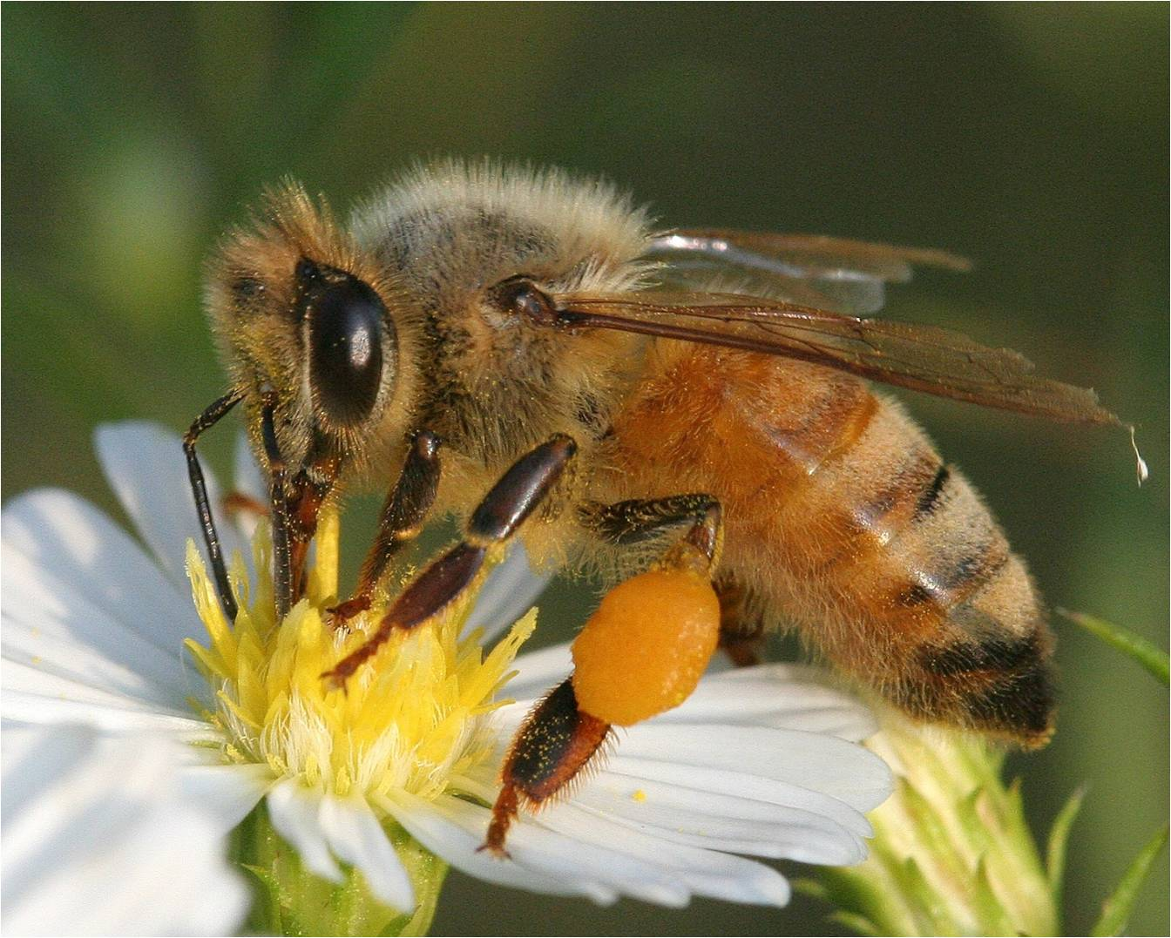
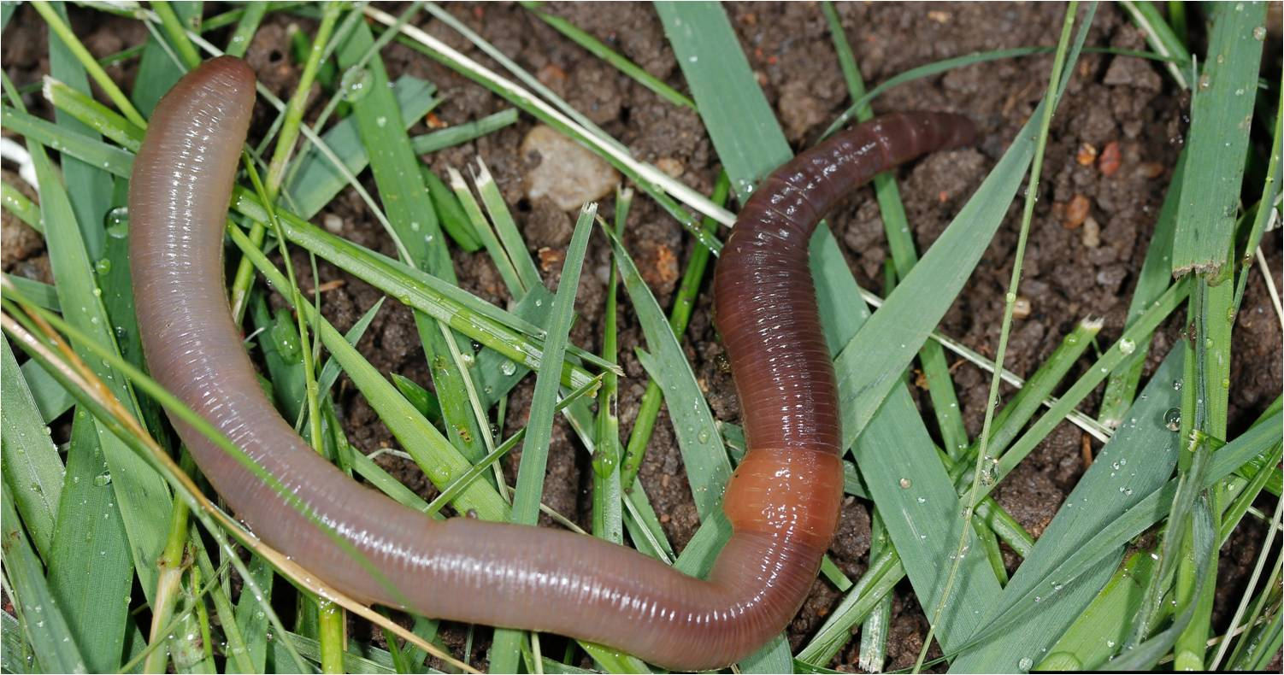
Introduced species that are beneficial
Night crawler
European honeybee
Photo Credits:
Earthworm - Joseph Berger, www.bugwood.org, #5439087
Honeybee- David Cappaert, Michigan State University, www.bugwood.org, #2116051
Notes:
As discussed before, some plants and animals have been introduced into an area. These introductions can be on purpose or by accident. In addition, the introductions can be harmful or beneficial. Let’s take a look at some examples of introductions that are beneficial to the environment.
Examples of species that have been introduced to the U.S. and are beneficial to the environment include earthworms and honey bees.
The earthworm known as a night crawler (Lumbricus terrestris) is actually introduced from Europe. It was introduced for and has spread widely because of its use as bait for fishing. It is reddish-pink in color and ranges in length from 4 to 10 inches (10 to 25cm). It consumes leaf litter, breaking it down and aiding in nutrient recycling for the plants in the environment. It also aerates the soil, keeping it from compacting around plant roots.
Honeybees (Apis mellifera) were brought to the United States from Europe in 1622. They are fantastic pollinators of many food crops and other plants (both native and introduced). They also produce honey and wax. They are 0.5 inch (12mm) long and hairy with a constricted waist and 3 or 5 dark brown bands on its abdomen. They have 2 pair of wings and pollen baskets on their hind legs.
Discussion Questions:
What could happen to the environment if there were no earthworms?
What could happen to the environment if there were no honeybees?
Why are these considered beneficial to the environment?
Information sources:
Global Invasive Species Database. “Lumbricus terrestris”.
accessed June 6, 2012 –
http://www.issg.org/database/species/ecology.asp?si=1555&fr=1&sts=&lang=EN
Kellar, B. “Honeybees across America”
accessed June 5, 2012 –
http://www.orsba.org/htdocs/download/Honey%20Bees%20Across%20America.html
University of Rhode Island Landscape Horticulture Program. “Honeybees”.
accessed June 6, 2012 –
http://www.uri.edu/ce/factsheets/sheets/honeybee.html

Slide 7
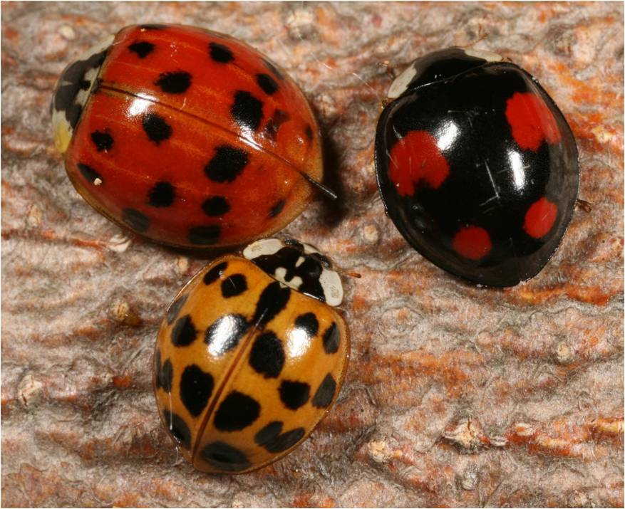
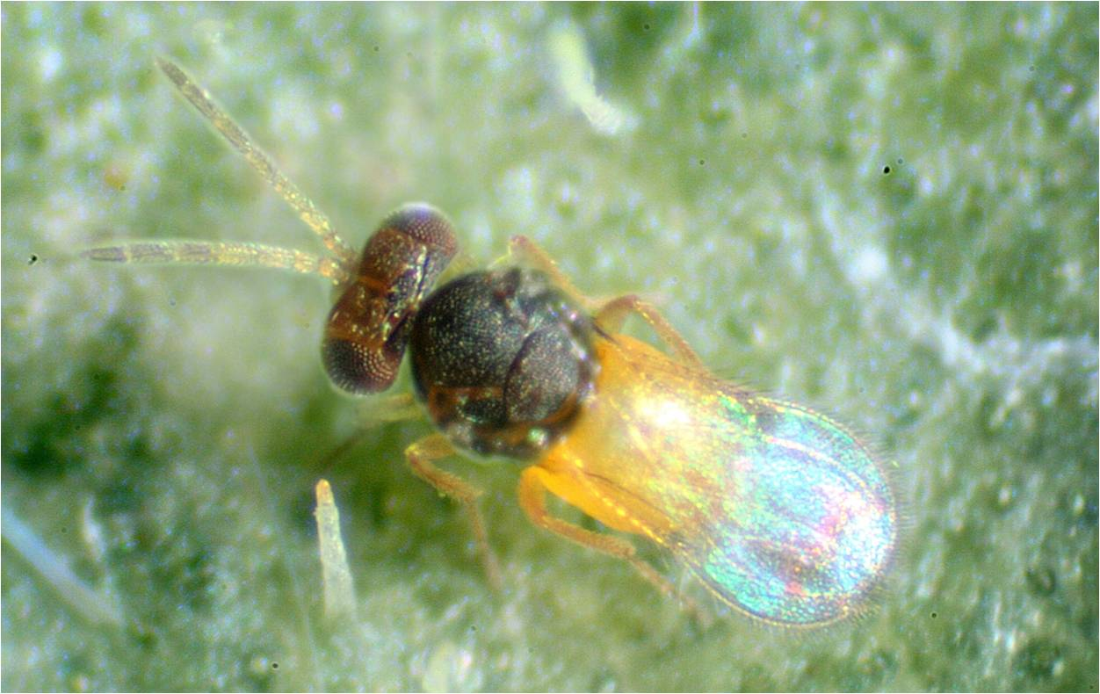
Introduced species that are beneficial
Asian ladybird beetle
Parasitoid wasp
Photo Credits:
Ladybird beetles - Gyorgy Csoka, Hungary Forest Research Institute, www.bugwood.org, #5410810
Bald eagle - David Cappaert, Michigan State University, www.bugwood.org, #2133029
Notes:
Other examples of species that have been introduced to the U.S. and are beneficial to the environment include species of ladybugs and tiny parasitoid wasps. We introduce these insects because they are predators or parasitoids of species that might be harmful to the environment. We would rather use these predators and parasitoids than use chemicals (or at least not as many chemicals) that could further harm the environment. Insects (or other organisms) that are used to control pests are called biological control agents.
Though there are many species of native ladybugs in Florida, several additional species have been introduced over the years. Ladybird beetles in general are valued because they are predators feeding on insect pests that either eat or transmit diseases to our food crops (such as citrus, tomatoes, melons, and beans) and other plants (such as maples, walnuts, roses, and hydrangeas). Ladybird beetles that have been introduced are usually brought in to feed on invasive species that have come into the country. For example, the Asian ladybird beetle (Harmonia axyridis) eats the Asian citrus psyllid that attacks citrus plants. The beetle measures about ¼ inch (5 to 8mm) long and is oval in shape. They have a high degree of variation in their color patterns which range from pale yellow-orange to almost black, with no spots or many black spots. These are the ladybird beetles that try to overwinter in your house (which can end up being a nuisance to you).
There have also been introductions of several parasitoid wasps to help control invasive species populations. These wasps are tiny (less than 0.5 inch or 1mm long) and cannot sting you. They will, however, lay their eggs on or in pests such as invasive species that attack food crops and other plants. For example, many species of Encarsia have been brought in to control invasive species that attack plants such as ficus, citrus, and mango.
Discussion Questions:
What would your life be like if these ladybugs were not introduced to the environment? (HINT: what do they help do?)
What would your life be like if these parasitic wasps were not introduced? (HINT: what do they help do?)
Why are these considered beneficial to the environment?
Information sources:
Florida Whitefly scripted presentation – Invasive Whitefly pests of Florida
accessed June 6, 2012 –
http://www.flwhitefly.org
Protect U.S. scripted presentation - Citrus Greening and the Asian Citrus Psyllid
accessed June 5, 2012 –
http://www.protectingusnow.org
University of Missouri Extension – “Aphids, Scales and Mites On Home Garden and Landscape Plants”.
accessed June 6, 2012 –
http://extension.missouri.edu/p/g7274

Slide 8
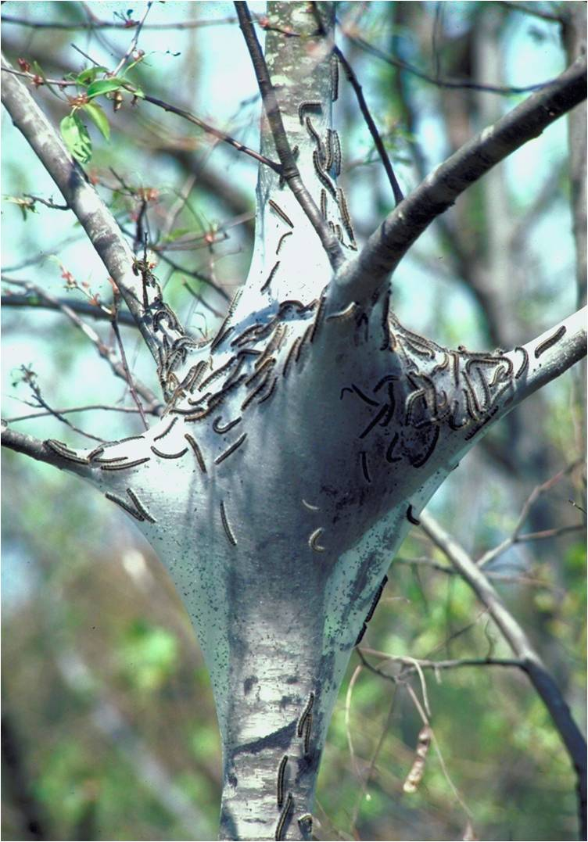
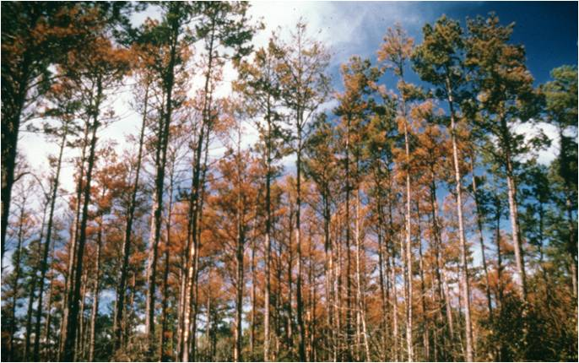
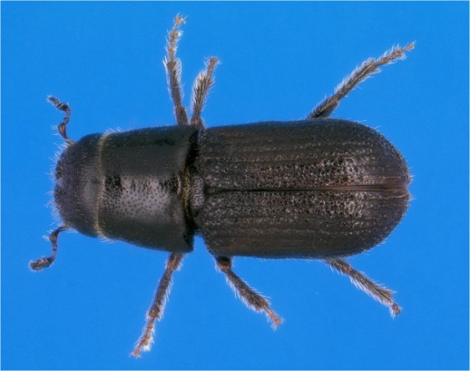
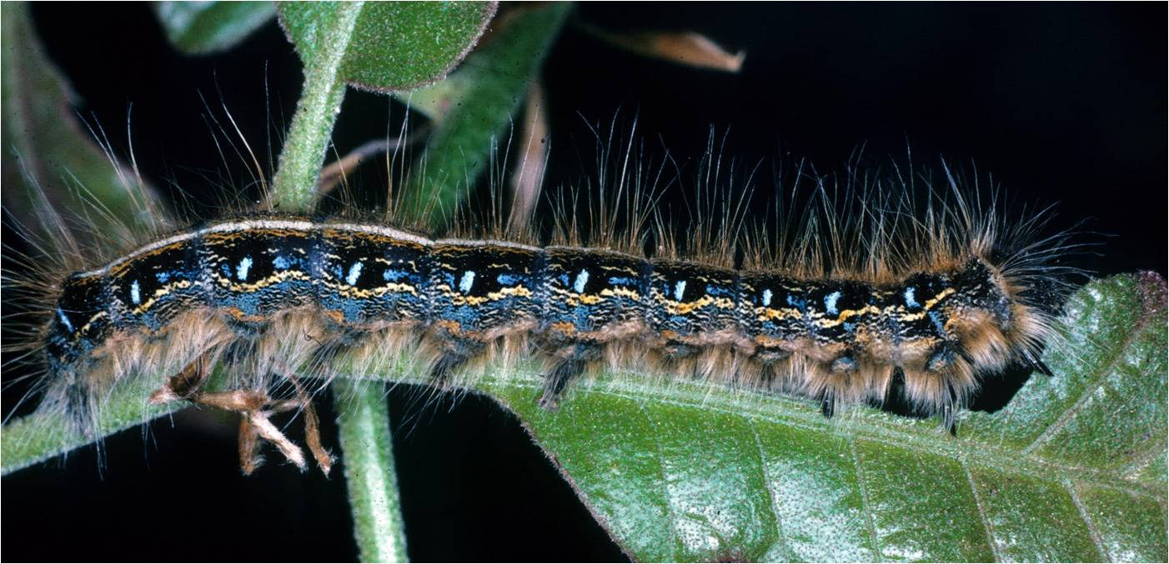
Native species that are harmful
Damage caused by southern pine beetles
Eastern tent caterpillars in their tent
Eastern tent caterpillar
Southern pine beetle
Photo Credits:
Tent caterpillars - Lacy L. Hyche, Auburn University, www.bugwood.org, #1540417 and Robert L. Anderson, USDA Forest Service, www.bugwood.org, #0590064
Southern pine beetle - Ronald F. Billings, Texas Forest Service, www.bugwood.org, #1546017 and Erich G. Vallery, USDA Forest Service - SRS-4552, , www.bugwood.org, #5289035
Notes:
There are some species that are native to an area, but are harmful to the environment under certain situations or conditions.
Eastern tent caterpillars and the southern pine beetle are both examples of native species that can be harmful to the environment.
Eastern tent caterpillars (Malacosoma americanum) are a common pest of eastern forests where they feed on trees such as apple, cherry, pecan, beech, willow, and hawthorn. They construct a “tent” of silk in the forks of a tree where many hundreds will live. They emerge at night to feed. They can be so numerous that they eat all the leaves off the tree. Although tent caterpillars don’t typically kill the tree directly, they can weaken the tree significantly and make it susceptible to disease. They reach 2 inches (5cm) long and are dark in color with light brown hair. They also have a white stripe down the middle of its back (which may also be flanked by a thin yellow stripe) with a row of pale blue, oval spots on either side.
Southern pine beetles (Dendroctonus frontalis) live just under the bark of pines trees feeding in the vascular tissue of the tree (destroying the parts of the tree that deliver food from the leaves to the roots) essentially starving the tree to death. They also carry a fungus with them that grows in the part of the tree that carries water from the roots to the leaves, effectively preventing the movement of the water. Once these beetles enter the tree, there is no way to save it. The adult southern pine beetle is small, about 1/8 of an inch (2 to 4mm) long. It is black in color with short legs.
Discussion Questions:
What do you think has happened to the animals that depend on these trees for food and shelter?
Why are these species considered harmful to the environment?
Information sources:
University of Florida – Featured Creatures. “Southern Pine Beetle”.
accessed June 7, 2012 –
http://entnemdept.ufl.edu/creatures/trees/southern_pine_beetle.htm
USDA Forest Service. “ The Eastern Tent Caterpillar”.
accessed June 7, 2012 –
http://na.fs.fed.us/spfo/pubs/pest_al/etc/etc.htm
Wagner, D.A. 2005. Caterpillars of Eastern North America. Princeton University Press, Princeton.

Slide 9
Introduced species that are harmful
Damage caused by emerald ash borer
Emerald ash borer adult and larva
Galleries left by the larva
Photo Credit:
Damaged ash trees: Daniel Herms, The Ohio State University, www.bugwood.org, #5171038
Beetle: David Cappaert, Michigan State University, www.bugwood.org, #2106098
Larvae: David Cappaert, Michigan State University, www.bugwood.org, # 1460071
Tunnels: Art Wagner, USDA APHIS PPQ, www.bugwood.org, #5147090
Notes:
Remember that introductions that are likely to cause economic harm (such as to the environment or to food crops) or harm to human health are considered invasive species. Let’s take a look at some introductions that are detrimental to the environment (invasive species).
The emerald ash borer (Agrilus planipennis) is a beetle that is native to Asia. It was first detected in Michigan in the summer of 2002 and has since spread to at least 19 other states (Connecticut, Illinois, Indiana, Iowa, Kansas, Kentucky, Massachusetts, Maryland, Minnesota, Missouri, New Hampshire, New York, North Carolina, Ohio, Pennsylvania, Tennessee, Virginia, West Virginia, and Wisconsin). It is thought that they came in by accident on wood packing material made from ash trees in its native range.
The adults average 0.5 inch (1.25cm) long and are metallic green in color. The larvae reach about 1.5 inches (4cm) long, are creamy white, and are somewhat flattened. There segments look like a series of nested bells.
The adults feed on the leaves of the ash trees (Fraxinus spp.) that grow here with very little damage to the tree itself. However, its larvae burrow into the vascular tissues of the tree essentially starving the tree to death within a few years. The image above shows typical damage seen after an emerald ash borer infestation. Millions of ash trees have already been killed and millions more will die because of this invasive insect.
Discussion questions:
What do you think has happened to the animals that depend on these trees for food and shelter?
Why is this species harmful to the environment?
There are four species of ash trees that live in Florida: white ash (Fraxinus americana), Carolina ash (Fraxinus caroliniana), green ash (Fraxinus pennsylvanica), and pumpkin ash (Fraxinus profunda). If this species came down to Florida, what do you think might happen to these trees? What do you think might happen to the animals that depend on these trees for food and shelter?
How do you think this invasive insect might get to Florida? (HINT: because these are wood boring insects, the transport of wood such as firewood and products made form wood such as barrels and planters aids in its spread. In other words, humans transport this pest without realizing it.)
Information sources:
Emerald ash borer website.
accessed June 5, 2012 –
http://www.emeraldashborer.info/
Florida Department of Agriculture and Consumer Service, Division of Forestry. 1999. Forest Trees of Florida. Published in house.
NPDN First Detector Modules - Introduction to the Emerald Ash Borer and Identification and Hosts
accessed June 5, 2012 –
http://www.firstdetector.org
USDA Natural Resources Conservation Service – Plant Database. “Fraxinus”.
accessed June 6, 2012 –
http://plants.usda.gov/
USDA Pest Alert. “Emerald Ash Borer”.
accessed June 5, 2012 –
http://www.na.fs.fed.us/spfo/pubs/pest_al/eab/eab04.htm

Slide 10
Introduced species that are harmful
Destruction of trees infested by Asian longhorned beetle
Asian longhorned beetle adult and larva
Larva inside the wood
Photo Credit:
Chipping trees: Larry R. Barber, USDA Forest Service, www.bugwood.org, #3047034
Beetle: Michael Bohne, www.bugwood.org, #1262001
Larvae: Thomas B. Denholm, New Jersey Department of Agriculture, www.bugwood.org, #1253027
Tunnels: Steven Katovich, USDA Forest Service, www.bugwood.org, #1398111
Notes:
Another example of an invasive species is the Asian long horned beetle (Anoplophora glabripennis). This species is also a native of China and was first detected in New York in 1996. It then spread to areas in Illinois, New Jersey, Massachusetts, and Ohio. It also probably came in accidently on wood packing material. Because there are isolated detections of this pest, an eradication effort is underway. As of September 1, 2013, this pest has been eradicated from Illinois and New Jersey, but populations remain in Ohio, New York, and Massachusetts (NAPPO September 2013).
The adults range between 1 to 1.5 inches (25 and 35mm) in length with long antennae that is 2.5 times the length of the body in males, and 1.3 times the length of the body in females. They are black with white spots. The larvae average 2 inches (50mm) long, are creamy white in color, and quite round in profile.
The larvae of this beetle tunnel into the tree where they feed in the vascular tissues of the tree causing the tree to die. They prefer maple (Acer spp.), but will also attack birches (Betula spp.), buckeye (Aesculus spp.), elms (Ulmus spp.), and willows (Salix spp.).
Currently, authorities are working on eradicating this insect where it is found by removing all trees that are infested. So far, thousands of trees have been cut down and either chipped or burned.
Discussion Questions:
What do you think has happened to the animals that depend on these trees for food and shelter?
Why is this species harmful to the environment?
There are 6 species of maple, one species of birch, 6 species of elm, and 6 species of willow found in Florida. If this species came down to Florida, what do you think might happen to these trees? What do you think might happen to the animals that depend on these trees for food and shelter?
How do you think this invasive insect might get to Florida? (HINT: these are also wood boring insects.)
Information sources:
Asian Longhorned Beetle website –
accessed June 5, 2012 –
http://www.uvm.edu/albeetle/management/treeremoval.html
EPPO Data Sheets on Quarantine Pests. “Anoplophora glabripennis”.
accessed June 6, 2012 –
http://www.eppo.int/QUARANTINE/insects/Anoplophora_glabripennis/ANOLGL_ds.pdf
USDA Natural Resources Conservation Service – Plant Database. “Acer”, “Betula”, “Aesculus”, “Ulmus”, “Salix “.
accessed June 6, 2012 –
http://plants.usda.gov/
USDA Pest Alert. “Asian Longhorned beetle”.
accessed June 5, 2012 –
http://www.na.fs.fed.us/pubs/palerts/alb/alb_pa.pdf

Slide 11
Introduced species that are harmful
Brown marmorated stink bug adult
Brown marmorated stink bug on fruit
Piercing, sucking mouthpart
Photo credit:
adult: Susan Ellis, www.bugwood.org, #5369380 and #5443477
On fruit: Gary Bernon, USDA APHIS, www.bugwood.org, #1113016
Notes:
The brown marmorated stink bug (Halyomorpha halys) is an invasive species that was first detected in Allentown, Pennsylvania in 2001. It is native to Asia where it is a known pest of many species including apple, cherry, fig, peaches, and pears as well as many ornamental plants. No one is quite sure how this insect arrived in the United States.
This insect averages 0.5 inches (12 to 17mm) long and has alternating light and dark bands on the antennae and along the outer edge of the body. It has a long piercing, sucking mouthpart (indicated by the yellow arrow). It uses its mouthpart to suck plant juices which leads to plant injury and decline, making the plant vulnerable to plant diseases. When it feeds on fruit in particular, it causes such damage that the fruit cannot be harvested for consumption.
It has the potential to become a major pest throughout the United States. It has already caused problems with apple and peach production in 2010 in the Northeastern U.S. The distribution of the brown marmorated stink bug in the U.S. continues to spread, but it is not yet considered established in every state. Your local Cooperative Extension service would have more information in regards to this pest’s establishment.
It also has a tendency to overwinter in your home which makes it a nuisance. It is called a stink bug because of the scent that it produces - it stinks.
Discussion Questions:
How do you think this insect might have arrived in the United States?
Why is this species harmful to the environment?
How do you think this insect might be moving from one area to another? (HINT: think about what it eats – how do those plants get moved from one place to another?)
How might this insect impact your life? (HINT: think about what it eats and what you eat.)
Information sources:
Penn State Entomology. “Brown Marmorated Stink Bug”.
accessed June 6, 2012 –
http://ento.psu.edu/extension/factsheets/brown-marmorated-stink-bug
University of Florida Featured creatures – “Brown Marmorated Stink Bug”.
Accessed June 6, 2012 –
http://entnemdept.ufl.edu/creatures/veg/bean/brown_marmorated_stink_bug.htm
USDA News and Events. “Combating the Brown Marmorated Stink Bug: A New Threat for Agriculture,
a Nuisance for Homeowners”
accessed June 5, 2012 –
http://www.ars.usda.gov/is/AR/archive/jul09/bug0709.htm

Slide 12
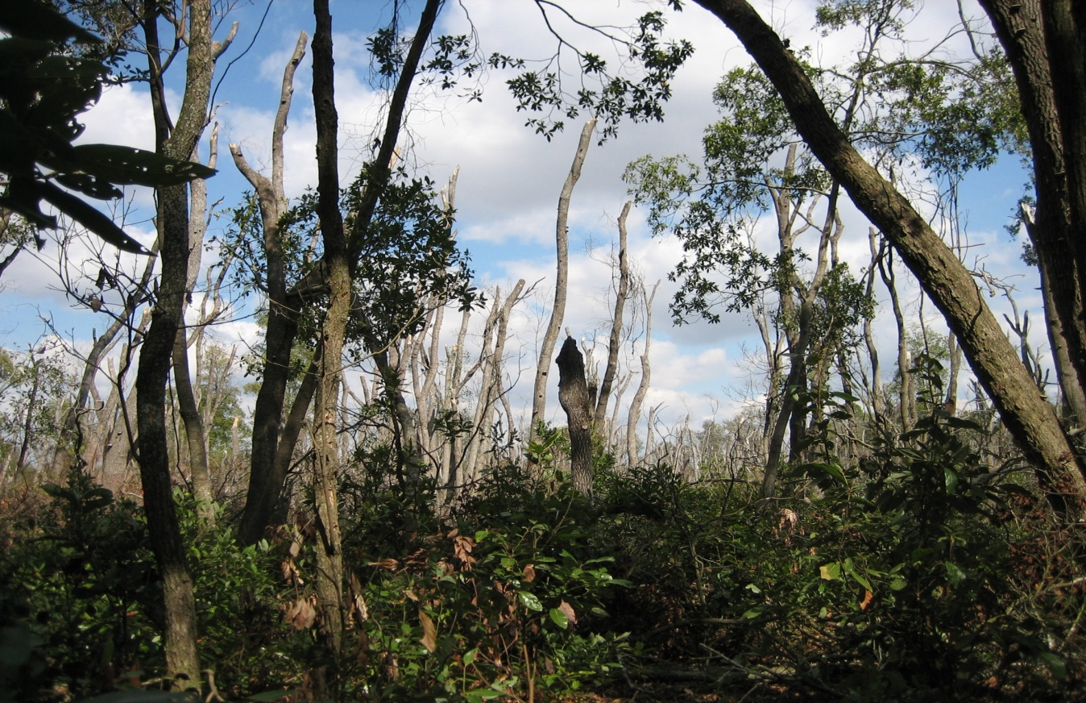
Introduced species that are harmful
Damage caused by laurel wilt disease
Redbay ambrosia beetle adult
Photo credits:
Damage: CL Harmon, University of Florida
Adult and tunneling: Lyle Buss, University of Florida
Notes:
Laurel wilt is a plant disease that is caused by a fungus (Raffaelea lauricola). It is spread by an invasive beetle from Asia called the redbay ambrosia beetle (Xyleborus glabratus). The beetle (and therefore the fungus that causes the disease) came into the U.S. most likely on wood packing material.
The adult of this beetle is tiny (averaging just 1/32inch or 2mm in length) and brown. You will probably never see this beetle, just the damage that it causes.
This disease attacks mostly redbay trees found in the southeastern United States. These trees produce fruit that is a very important source of food for wildlife in the winter. This disease also kills sassafras, swamp bay, pondspice, pondberry, camphor, and avocado.
The adults tunnel into the tree, bringing with it the fungus which it grows in the tree for food. This fungus then spreads throughout the tree and kills it. It was first detected in Georgia and has since spread to Florida, North Carolina, South Carolina, and Mississippi. Once infected, a stand of mature redbays can be completely killed in 3 to 5 years.
There is currently no cure for the disease.
Discussion Questions:
Redbay trees are found throughout the southeastern United States. What do you think might happen to the animals that depend on these trees for food and shelter?
How might this disease impact your life? (HINT: think about what trees it affects and what you eat that might come from those trees.)
Why is this species harmful to the environment?
Information from:
Alabama Forestry Commission. “Laurel Wilt Disease”.
accessed June 5, 2012 –
http://www.forestry.alabama.gov/LaurelWilt.aspx?bv=3
Florida Department of Agriculture and Consumer Services – Florida Forest Service. 2008.
accessed 6/14/2012 –
http://www.floridaforestservice.com/publications/fh_pdfs/Laurel_Wilt.pdf
Fraedrich, S.W., T.C. Harrington, R.J. Rabaglia, M.D. Ulyshen, A.E. Mayfield, III, J.L. Hanula, J.M. Eickwort, and D. R. Miller. 2008. “A Fungal Symbiont of the Redbay Ambrosia Beetle Causes a Lethal Wilt in Redbay and Other Lauraceae in the Southeastern United States”. Plant Disease, Volume 92, No. 2.
Protect U.S. e-learning module – Laurel wilt and the Redbay Ambrosia Beetle
accessed June 5, 2012 –
www.protectingusnow.org

Slide 13
Summary
There are many native species that are beneficial to the environment.
trees, fungi, and pollinators
There are many introduced species that are beneficial to the environment.
Honeybees, night crawlers, Asian ladybird beetles, and parasitoid wasps
There are many native species that are harmful to the environment.
Eastern tent caterpillars and southern pine beetle
There are many introduced species that are harmful to the environment.
Asian longhorned beetle, emerald ash borer, brown marmorated stink bug, and laurel wilt

Slide 14
Activity #1
Research Project (follow along in your handout).
You will provide an example of:
A native species that is beneficial to the environment
An introduced species that is beneficial to the environment
A native species that is harmful to the environment
An introduced species that is harmful to the environment

Slide 15
Activity #1
Answer the following questions for each of your examples:
What does it look like?
Is it from the U.S. and if so where is it found?
Did it come from another country and if so which country?
If it came from another country, where can we find it in the United States?
Why is it beneficial or harmful to the environment? Be specific in your explanation.
Write a report on what you found
Include title page and works cited.

Slide 16
Activity #2
Beneficial and Harmful Species Workbook
Go through the workbook and complete the exercises to further explore species that are beneficial to the environment and species that are harmful to the environment.

Slide 17
Activity #3
Computer Lab
Answer the questions in the handout on beneficial and harmful species as you complete the online exercises.
Turn in the handout to your teacher when you are done with it.

Slide 18
References
Alabama Forestry Commission. “Laurel Wilt Disease”. accessed June 5, 2012 –
http://www.forestry.alabama.gov/LaurelWilt.aspx?bv=3
Allaby, M., editor. 1998. Concise Oxford Dictionary of Ecology.
Asian Longhorned Beetle website – accessed June 5, 2012 –
http://www.uvm.edu/albeetle/management/treeremoval.html
British Columbia Ministry of Agriculture. “Blue Orchard Bee”. accessed June 6, 2012 –
http://www.agf.gov.bc.ca/apiculture/factsheets/506_osmia.htm
Cafferty, S., editor. 2005. Firefly Encyclopedia of Trees. Firefly Books, New York.
Campbell, N.A. 1990. Biology. Benjamin/Cummings Publishing Company, New York.
Emerald ash borer website. accessed June 5, 2012 –
http://www.emeraldashborer.info/

Slide 19
References
EPPO Data Sheets on Quarantine Pests. “Anoplophora glabripennis”. accessed June 6, 2012 –
http://www.eppo.int/QUARANTINE/insects/Anoplophora_glabripennis/ANOLGL_ds.pdf
Florida Department of Agriculture and Consumer Service, Division of Forestry. 1999. Forest Trees of Florida. Published in house.
Florida Forest Service. accessed June 5, 2012 –
http://www.floridaforestservice.com/publications/fh_pdfs/Laurel_Wilt.pdf
Florida Whitefly scripted presentation – Invasive Whitefly pests of Florida. accessed June 6, 2012 –
http://www.flwhitefly.org
Fraedrich, S.W., T.C. Harrington, R.J. Rabaglia, M.D. Ulyshen, A.E. Mayfield, III, J.L. Hanula, J.M. Eickwort, and D. R. Miller. 2008. “A Fungal Symbiont of the Redbay Ambrosia Beetle Causes a Lethal Wilt in Redbay and Other Lauraceae in the Southeastern United States”. Plant Disease, Volume 92, No. 2.

Slide 20
References
Global Invasive Species Database. “Lumbricus terrestris”. accessed June 6, 2012 –
http://www.issg.org/database/species/ecology.asp?si=1555&fr=1&sts=&lang=EN
Greer, L. 1999. “Alternative Pollinators: Native Bees”. accessed June 6, 2012 –
http://www.jswcd.org/Files/ATTRA%20native%20pollinators.pdf
Hale, W. G. and J.P. Margham. 1991. The Harper Collins Dictionary of Biology. Harper Perennial, New York.
Kellar, B. “Honeybees across America”. accessed June 5, 2012 –
http://www.orsba.org/htdocs/download/Honey%20Bees%20Across%20America.html
National Invasive Species Council. accessed June 4, 2012 –
http://www.invasivespecies.gov/

Slide 21
References
NPDN First Detector Modules - Introduction to the Emerald Ash Borer and Identification and Hosts. accessed June 5, 2012 –
http://www.firstdetector.org
Penn State Entomology. “Brown Marmorated Stink Bug”. accessed June 6, 2012 –
http://ento.psu.edu/extension/factsheets/brown-marmorated-stink-bug
Protect U.S. scripted presentation - Citrus Greening and the Asian Citrus Psyllid. accessed June 5, 2012 –
http://www.protectingusnow.org
Protect U.S. e-learning module – Laurel wilt and the Redbay Ambrosia Beetle. accessed June 5, 2012 –
www.protectingusnow.org
University of Florida Featured creatures – “Brown Marmorated Stink Bug”. accessed June 6, 2012 –
http://entnemdept.ufl.edu/creatures/veg/bean/brown_marmorated_stink_bug.htm

Slide 22
References
University of Florida Featured Creatures. “Common Buckeye”. accessed June 6, 2012 –
http://entnemdept.ufl.edu/creatures/bfly/common_buckeye.htm
University of Florida – Featured Creatures. “Southern Pine Beetle”. accessed June 7, 2012 –
http://entnemdept.ufl.edu/creatures/trees/southern_pine_beetle.htm
University of Missouri Extension – “Aphids, Scales and Mites On Home Garden and Landscape Plants”. accessed June 6, 2012 –
http://extension.missouri.edu/p/g7274
University of Rhode Island Landscape Horticulture Program. “Honeybees”. accessed June 6, 2012 –
http://www.uri.edu/ce/factsheets/sheets/honeybee.html
USDA Forest Service. “ The Eastern Tent Caterpillar”. accessed June 7, 2012 –
http://na.fs.fed.us/spfo/pubs/pest_al/etc/etc.htm

Slide 23
References
USDA Natural Resources Conservation Service. “Native Pollinators”. accessed June 6, 2012 –
http://plants.usda.gov/pollinators/Native_Pollinators.pdf
USDA Natural Resources Conservation Service – Plant Database. “Acer”, “Betula”, “Aesculus”, “Ulmus”, “Salix “. accessed June 6, 2012 –
http://plants.usda.gov/
USDA Natural Resources Conservation Service – Plant Database. “Fraxinus”. accessed June 6, 2012 –
http://plants.usda.gov/
USDA Natural Resources Conservation Service. 1996. Soil Quality Indicators: Organic Matter. accessed June 28, 2012 –
http://soils.usda.gov/sqi/publications/files/sq_fou_1.pdf

Slide 24
References
USDA News and Events. “Combating the Brown Marmorated Stink Bug: A New Threat for Agriculture, a Nuisance for Homeowners”. accessed June 5, 2012 –
http://www.ars.usda.gov/is/AR/archive/jul09/bug0709.htm
USDA Pest Alert. “Asian Longhorned beetle”. accessed June 5, 2012 –
http://www.na.fs.fed.us/pubs/palerts/alb/alb_pa.pdf
USDA Pest Alert. “Emerald Ash Borer”. accessed June 5, 2012 –
http://www.na.fs.fed.us/spfo/pubs/pest_al/eab/eab04.htm
Wagner, D.A. 2005. Caterpillars of Eastern North America. Princeton University Press, Princeton.

Slide 25
Author Credits and Date of Publication
Stephanie D. Stocks, Protect U.S. Coordinator, University of Florida
June 2012

Slide 26
Reviewers Credits
Amanda Hodges, PhD, Department of Entomology and Nematology, University of Florida
Dana Mitchell, 4th grade teacher, Newberry Elementary School , Newberry Florida
Jennifer Weeks, PhD, Department of Entomology and Nematology, University of Florida

