Slide 1

Site Preparation and
Planting Dates & Schemes
Bob Hochmuth
Multi County Extension Agent
North Florida REC – Suwannee Valley

Slide 2
Site Selection Factors
Well drained soil
Likelihood of flooding
Away from drain fields
Perennial weeds
Nematode history
Cold air pockets
Alternative systems – no soil

Slide 3
Soil Tests
Texture
pH
Levels of macro nutrients
Levels of micro nutrients
Organic matter
Recommendations based on crop needs

Slide 4
Fertilizer Basics
Soil Test
Lime
Macro & Micro Nutrients
Nitrogen and Potassium Very Important
20-30% N & K plus P and Micros in Bed
Sidedress Remaining N & K
Organic Sources

Slide 5
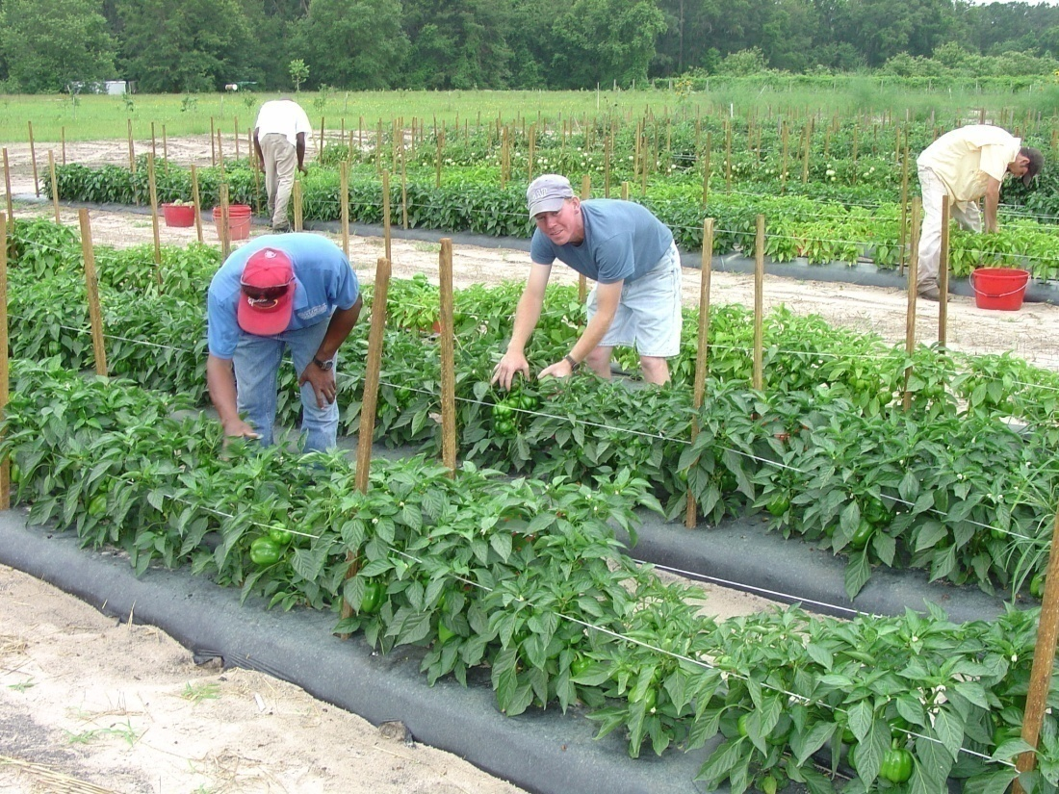
Seasonal Limitations
Spring & Fall – Traditional
Winter – Surprisingly Good
Summer - Tough

Slide 6
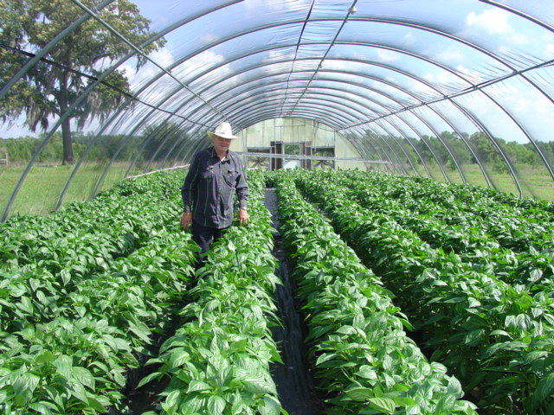
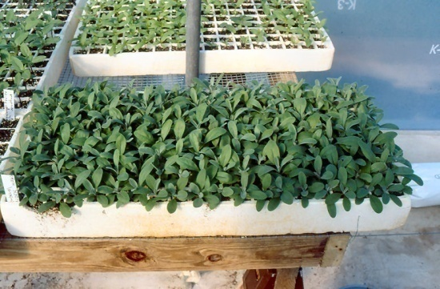
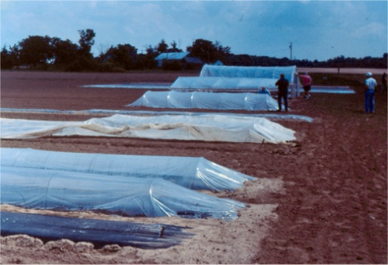
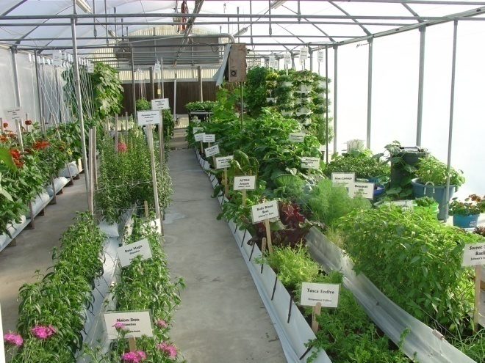
Strategies to Extend Seasons
Diversity of Crops & Varieties
Mulches
Transplants
Frost Protection
  Covers
  Tunnels
Shade Areas
Greenhouses

Slide 7
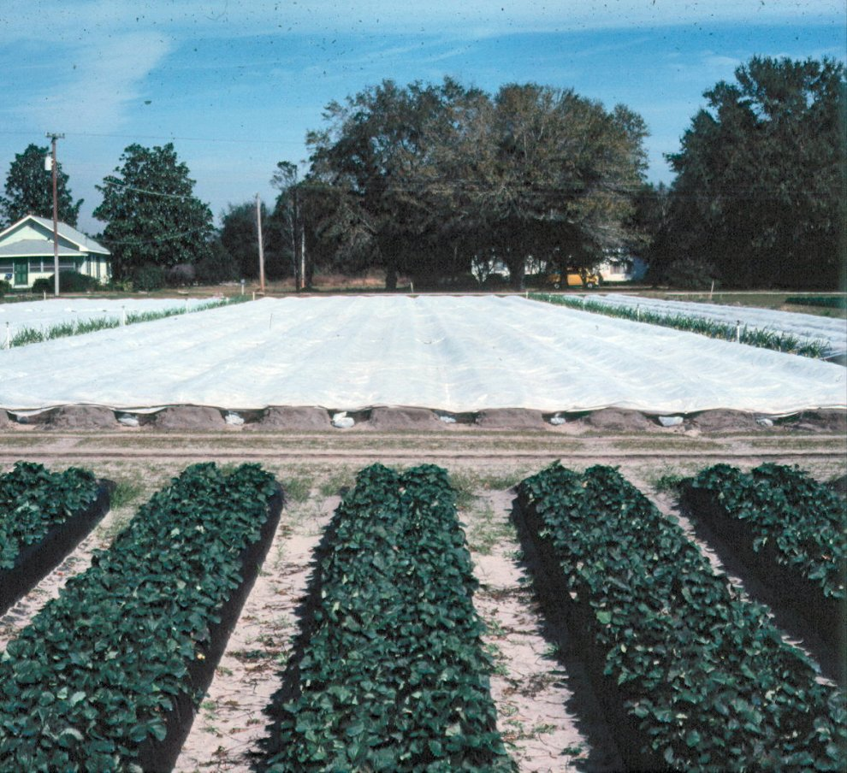
Role of Technology in Vegetable Production in the Field
Irrigation – Drip System
Plastic Mulch
Double Cropping
Fertigation
Row Covers

Slide 8
Cool Season Crops
Cool Season is Great Time for Production
Examples
  Cole Crops: Cabbage, Broccoli, Cauliflower, Brussels Sprouts, Collards
  Oriental Vegetables: Chinese Cabbage, Bok Choi, Oriental Radish
  Radish, Turnips, Beets
  Onions, Chives
  Leafy Greens & Herbs: Lettuces, Arugula, Cilantro, Kale, Dill, Thyme
  Peas (English), Sugar Snap Peas
  Strawberry

Slide 9
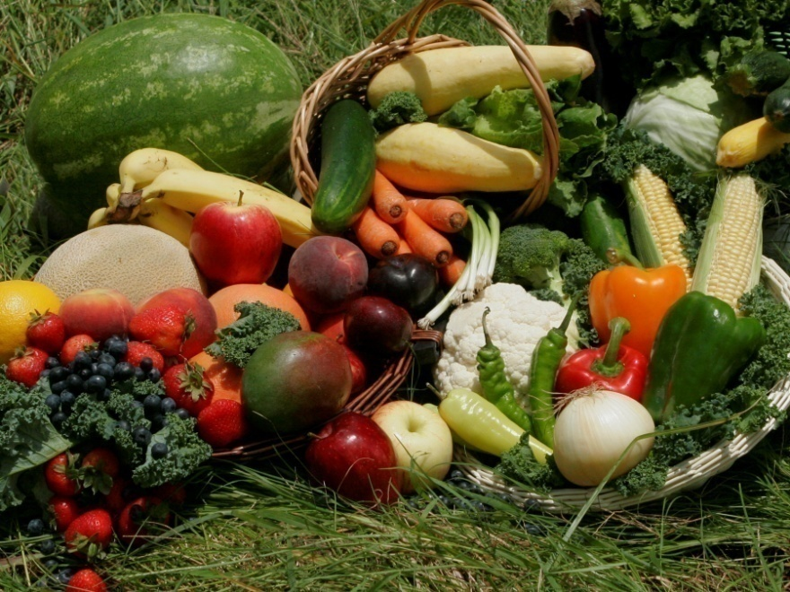
Warm Season Crops
Early
  Potato
Middle
  Pepper
  Tomato
  Sweet Corn
  Eggplant
  Cucumber
  Cantaloupe
  Watermelon
Late
  Okra
  Sweet Potato
  Hot Peppers
  Southern Peas

Slide 10
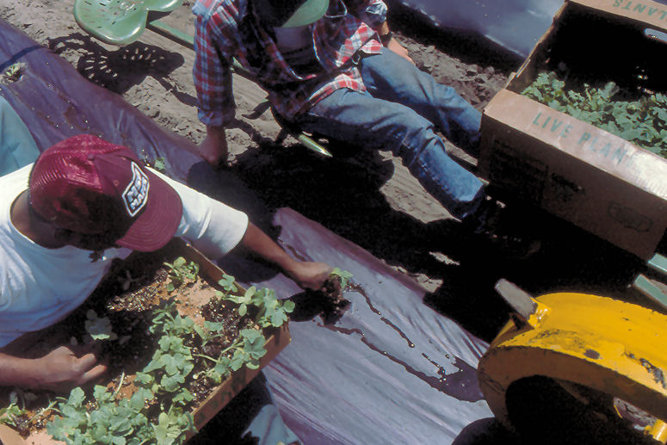
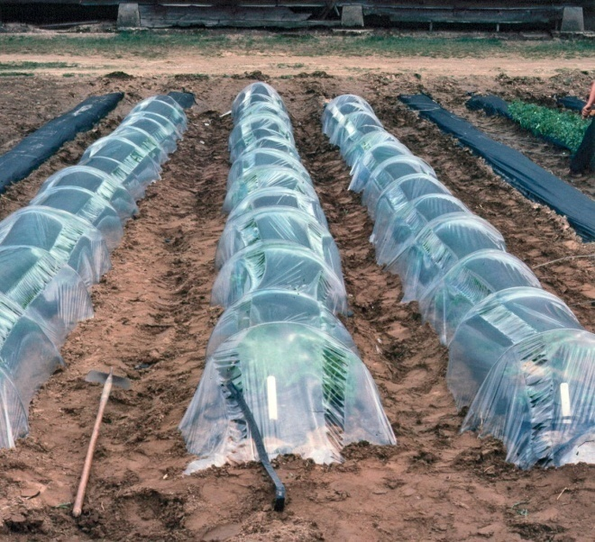
Factors to Consider
Seed vs. Transplants
Mulch vs. No Mulch
Row Covers vs. No Row Covers
Geographic Micro Climate

Slide 11
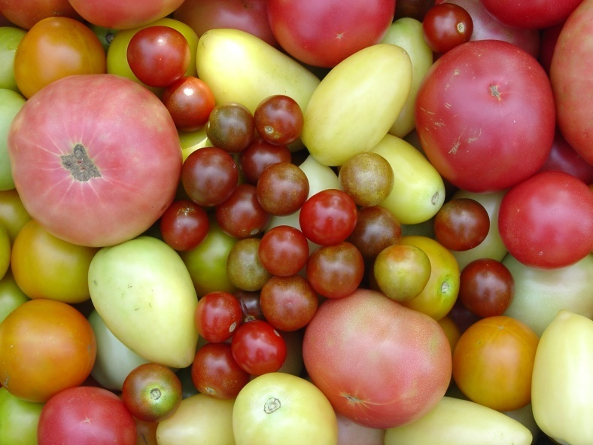
Variety Selection
Resistance
Tolerance
Susceptible
Key to Success
Especially Important in Organics
Viruses – only option most of the time

Slide 12
Disease Resistance Codes
Example – Tomato
  F = Fusarium wilt
  F2 = Fusarium wilt, Races 1 & 2
  V = Verticillium wilt
  N = Nematode
  SRKN = Southern Root Knot Nematode
  TMV – Tobacco Mosaic Virus
  TSWV = Tomato Spotted Wilt Virus
  BW = Bacterial wilt
  and more……..

Slide 13
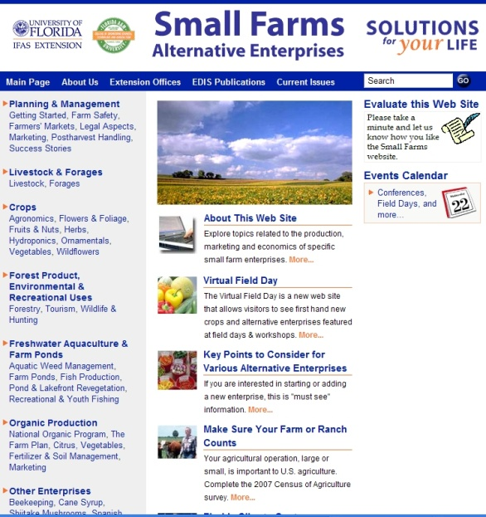
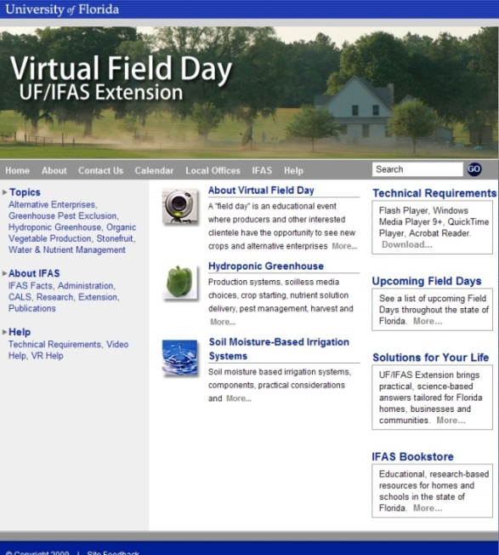
Thank You
For more information visit
the Small Farms web at http://smallfarms.ifas.ufl.edu
Take a virtual field day tour by visiting the Virtual Field Day web at http://vfd.ifas.ufl.edu
This presentation brought to you by the
Small Farms/Alternative Enterprises Focus Team.

