Slide 1
Selecting Field & Greenhouse Vegetable Crops for Small Farmers
Bob Hochmuth
Multi County Extension Agent
North Florida REC – Suwannee Valley
Notes:
Factors to consider when selecting crops.

Slide 2
Develop a Plan to Identify Crops and Production Systems to Meet Seasonal Opportunities
Notes:
Have a plan!
Combination of crops and systems to meet needs.

Slide 3
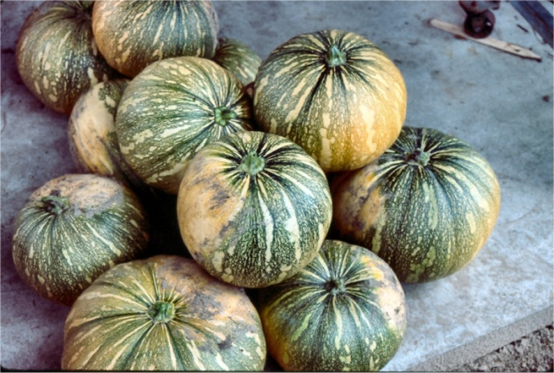
Variety Selection
Disease Tolerance
Adapted to Region
Market Acceptance
Earliness
Yield
Quality
Notes:
Variety selection may be the difference in success and failure.

Slide 4
Fall & Winter Crops
Cool Season is Great Time for Production
Examples:
Cole Crops: Cabbage, Broccoli, Cauliflower, Brussels Sprouts, Collards
Oriental Vegetables: Chinese Cabbage, Bok Choi, Oriental Radish
Radish, Turnips, Beets
Onions, Chives
Leafy Greens & Herbs: Lettuces, Arugula, Cilantro, Kale, Dill, Thyme
Strawberry
Notes:
Cool season can be fantastic.
Fewer pests may need frost protection.

Slide 5
Cool Season Crops
Notes:
Several crops grown for farmers market sales greens, cole crops, onions, etc.

Slide 6
Specialty Greens & Herbs
Notes:
Winter production on mulch, notice wire hoops ready for frost now covers.

Slide 7
Broccoli
Notes:
Some popular crops.
Broccoli excellent fall crop.

Slide 8
Standard Radish
Notes:
Fast crop, new colors, shapes and flavors.

Slide 9
Ethnic Vegetables
Notes:
Large ethnic populations in Florida with special crop demands.
Know your market populations.

Slide 10
Sweet Onion
Notes:
Very popular winter and early spring crop.
Can also store well into summer.

Slide 11
Colored Carrots
Notes:
Many new specialty carrots.
Very cold hardy.

Slide 12
Snow Peas
Snow Peas
‘Oregon Sugarpod II’
‘Melting Sugar’
‘Snowflake’
(no trellising)
Snap Peas
‘Sugar Snap’
‘Sugar Pop’
‘Sugar Daddy’
Notes:
Under utilized vegetable.

Slide 13
Warm Season Specialty Crop Options
Notes:
“warm” season planted March or after in north Florida.

Slide 14
Calabaza Choose the variety ‘LaEstrella’
Available from Rupp Seed Co
Notes:
Also called Tropical Pumpkin, Cuban Pumpkin.
Easy to grow, more tolerant to diseases.

Slide 15
Specialty Peppers Grown in the Field
Colored Pepper
Red: ‘X3R Wizard’, ‘Brigadier’
Orange: ‘Valencia’, ‘Queen’
Yellow: ‘Lafayette’, ‘Early Sunsation’
Specialty Hot Pepper
Jalapeno
Cubanelle
Pablano Stuffing
Banana
Notes:
Huge range of peppers available, colors, hot, sweet.

Slide 16
Specialty Color Potatoes
Notes:
Unique colors of potatoes, reds, yellows, purples, blue, etc.

Slide 17
Okra
Red types such as
‘Red Velvet’
‘Burgundy’
‘Red Okra’
Notes:
Specialty okra varieties (red).

Slide 18
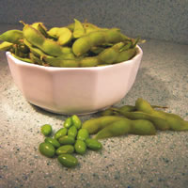
Beans
Unusual varieties are:
‘Royal Burgundy’
‘Gold Mine’
Edamame (soybean)
Notes:
Unusual bean types
Various colors
Edamame – edible soybean

Slide 19
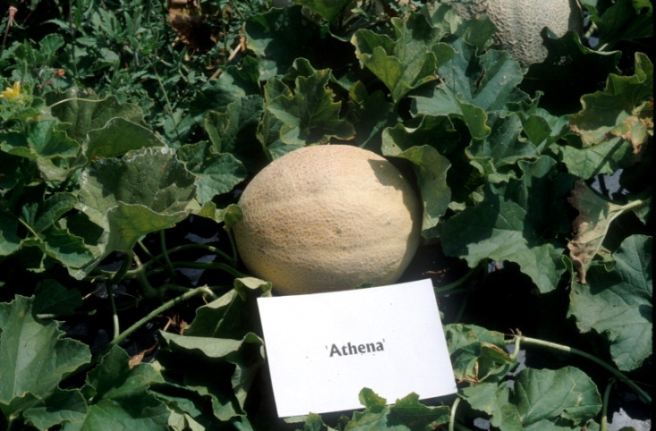
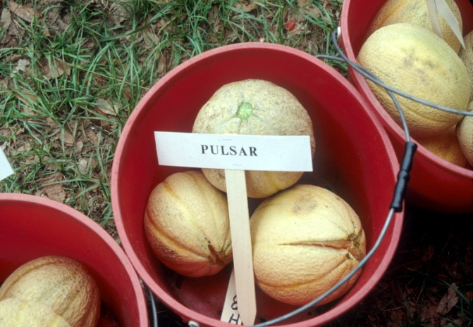
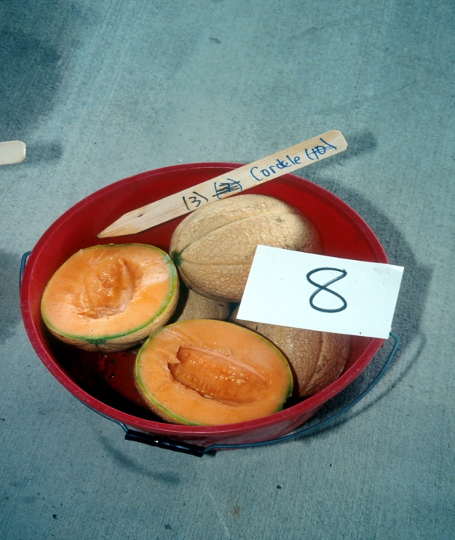
Traditional Cantaloupe Varieties
Notes:
Traditional orange-fleshed cantaloupe.
Athena – best commercial variety (2008).

Slide 20
Specialty Cantaloupe and Other Melon Varieties
Notes:
Can also find several combinations: looks like honeydew, but orange inside; looks like cantaloupe, but green fleshed.

Slide 21
Heirloom Tomatoes
Notes:
High demand for heirlooms, literally 100 or more available.
Can be hard to grow, lack of disease resistance, may crack easily.
Carefully select for your need.

Slide 22
Grape Tomatoes
Notes:
Many varieties available
High labor to harvest
Excellent popularity and flavor.

Slide 23
Florida Hydroponics
Notes:
Greenhouses and other protected culture methods can be used to grow many vegetables, herbs and cutflowers.

Slide 24
Tomato
Primary Crops
Cluster tomato shown grown in perlite bags
Cluster Tomato
Vine ripened
Aroma of stems and calyx
Notes:
Was #1 greenhouse crop in Florida in early 1990s.

Slide 25
Floating Lettuce and Greens Under Shade for Farmers Market Sales
Notes:
Live lettuce grown in floating hydroponic systems.
Good EDIS document available (http://edis.ifas.ufl.edu/HS184) and video on Virtual Field Day website (http://vfd.ifas.ufl.edu)

Slide 26
Hydroponic Cut Flowers for Local Sales
Notes:
Specialty cut flowers can be good crop for Local sales.

Slide 27
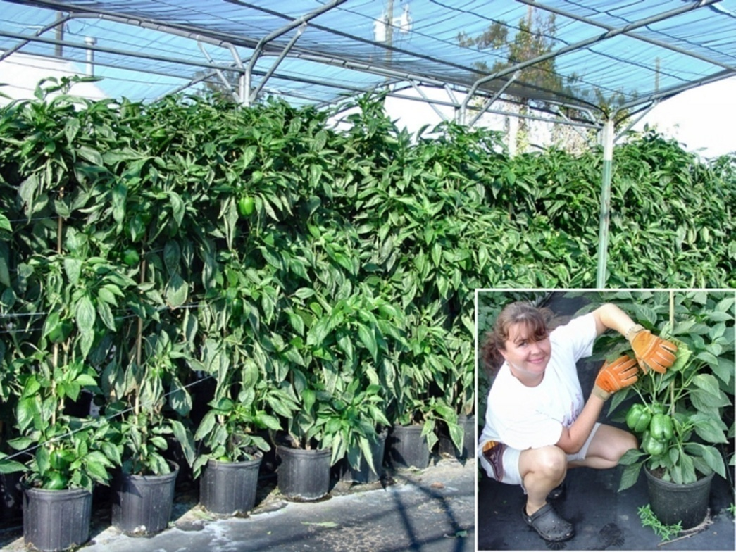
Hydroponic Peppers in a Shade House for Summer Production
Notes:
Shade structures can be used very well in Florida to extend into summer months.

Slide 28
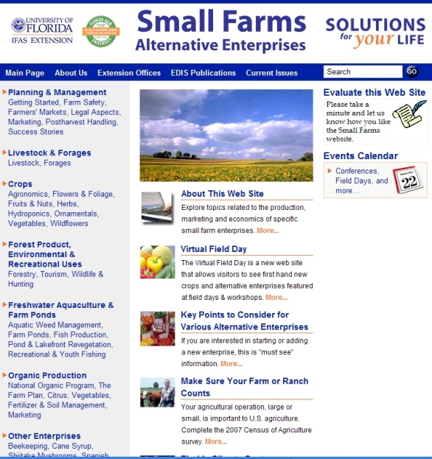
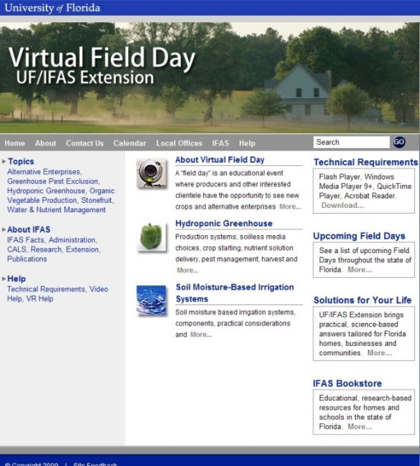
Thank You
For more information visit
the Small Farms web at http://smallfarms.ifas.ufl.edu
Take a virtual field day tour by visiting the Virtual Field Day web at http://vfd.ifas.ufl.edu
This presentation brought to you by the
Small Farms/Alternative Enterprises Focus Team.

