Slide 1
5 Steps to a Healthy Soil
Bob Hochmuth- NFREC-SV
Danielle Treadwell- Horticultural Science
Brad Burbaugh – Duval County
Steve Gaul – Nassau County
Notes:
Building a healthy soil is essential to organic systems.

Slide 2
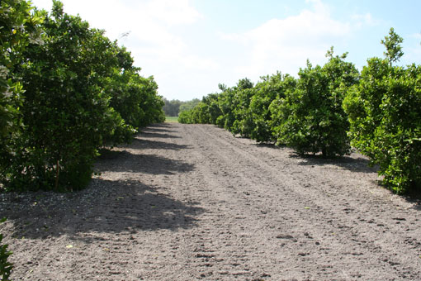
Objectives
Define a healthy soil
Identify 5 simple things you can do to encourage a healthy soil
Inspire all of you to adopt at least one of these practices

Slide 3
What is a Healthy Soil?
Soil quality generally means the soil’s physical, chemical and biological condition are in good condition for it’s intended use.
Farmers typically define soil health to mean …
Notes:
There is no consensus on the definitions of “Soil quality” and “soil health”.
These terms are often used interchangably.
There is no single test for soil quality – because there are many factors that affect soil quality!

Slide 4
Soil Health Defined
…a soil that can:
Accept, retain, and release nutrients
Accept, retain, and release water
Promote and sustain root growth
Maintain suitable habitat for soil organisms
Respond to management
Resist degradation
From: Soil Ecology and Management, SAFS, MSU. www.safs.msu.edu/soilecology/soilbiology.htm
Notes:
How can you tell if soils has “good health”.
SAFS = Sustainable Agriculture Farming Systems Project. (A long term sustainable ag project for research and education).
MSU = Michigan State University

Slide 5
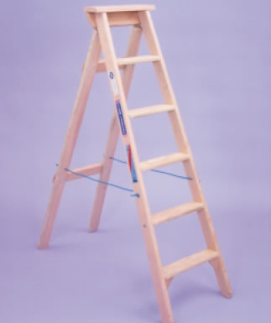
So how do we get a healthy soil?
The 5 Steps

Slide 6
Step 1: Avoid Risks
Notes:
Plan to avoid things that can harm soil health

Slide 7
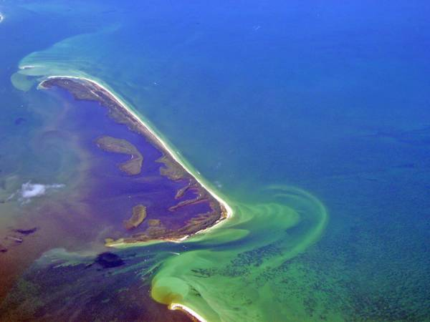
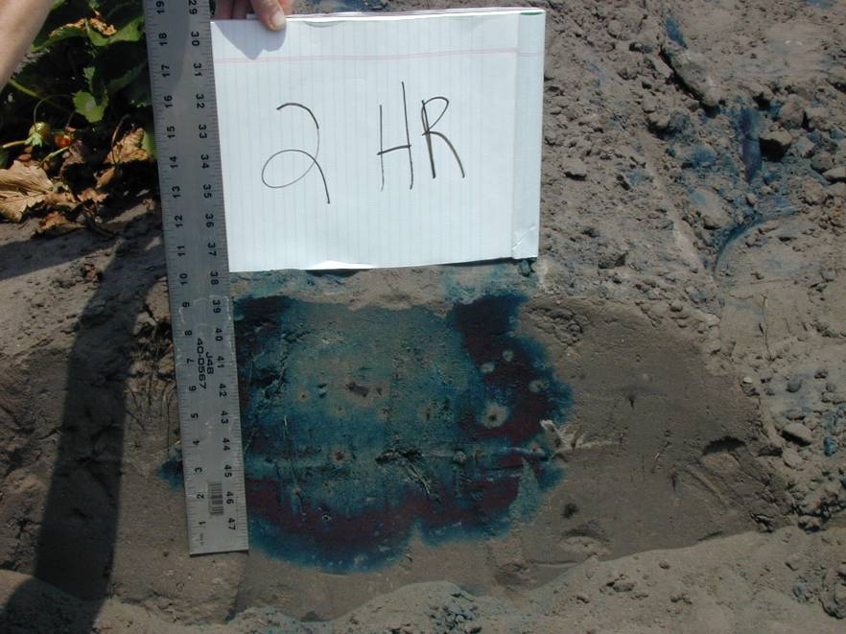
Avoid excessive inputs: fertilizers, water, pesticides
Excess nitrogen leads to utrophication (algal growth fueled by nutrients).
Dye shows movement of water and fertilizer after 2 hours of irrigation. Tape has 4 inch emitter spacing and a flow rate of 32 gal/100 ft/hr.
Notes:
There is now a dead zone the size of Rhode Island off the gulf of mexico where nothing grows. No fish, no primary food chain organisms. This is the result of excess fertilizer running down the Mississippi River from the corn belt. In some parts of Iowa, thye continue to issue “blue baby” warnings when the nitrate content of well water gets too high. Babies that ingest high nitrate water die from brain damage (the cells are starved for O2 and they turn blue). This usually happens in the spring, when the rains come and percolate the nutrients back into the groundwater. Blah blah blah just burns me up man. Darn corn. A perfectly good plant too.

Slide 8
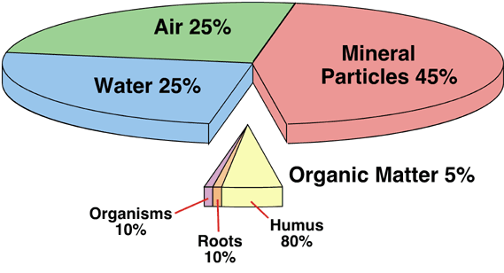
Step 2: Increase Organic Matter
M. Pidwirny, Univ. BC

Slide 9
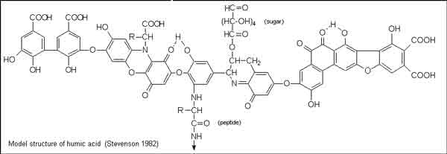
Soil Organic Matter - Situation
Organic matter =
the living + the dead + the very dead.
Soil tests can measure total carbon and OM.
In FL, soil organic matter for most sands is around 1 to 2%.
The VERY dead
Notes:
Living = living organisms, including plant roots
Dead = recently terminated plants, turned into the soil and actively decomposing
Very Dead = the organic matter that has become an integral part of the soil and is very long lasting. **This is the really good stuff that help turn your soil to black!
Total carbon can be requested on a soil test, and so can %OM

Slide 10
Soil Organic Matter - Situation
Fine sands accept and retain water poorly.
Field capacity (water retention) is about 6% and the wilting point (point where roots can no longer extract water) is 3%.
Organisms need moisture to decompose plant material and recycle nutrients.
Soil microbial metabolism is FAST in subtropical climate rapid decomposition
Notes:
Why is organic matter so difficult to build in Florida.
Compare water holding capacity (amount of water by volume that can be retained by adhesive and cohesive forces between particles) of a clay soil at 45%!

Slide 11
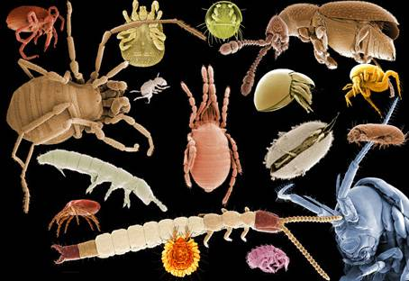
Soil Organic Matter - Situation
Organic matter:
stores water
extends residual activity of pesticides
stores nutrients
improves soil structure
serves as a source of carbon (energy) for soil micro-organisms.
www.fao.org
Notes:
Organic matter is important because it provides many benefits

Slide 12
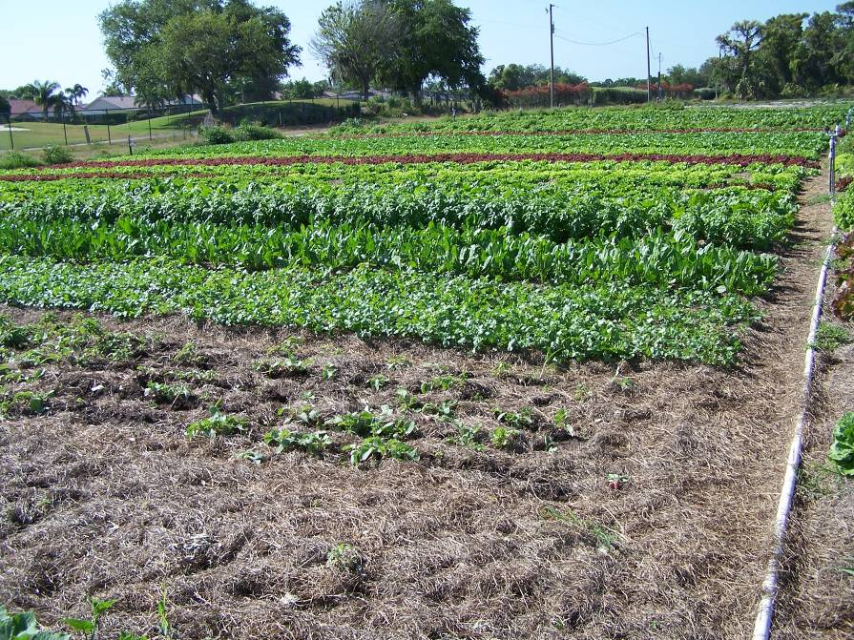
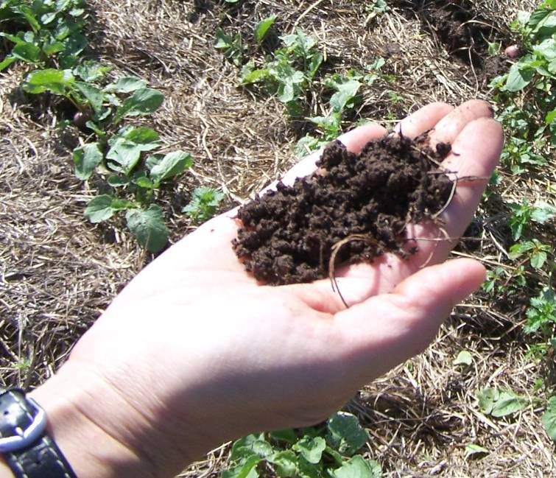
Result of Organic Matter Addition
The soil organic matter on this farm is ~7% after 8 years of adding plant residues like the bahia hay you see here. The OM was 1.5% to start.
Notes:
Organic matter can be increased in Florida.
This Bill Pischer’s farm in Sarasota County - it is organic.

Slide 13
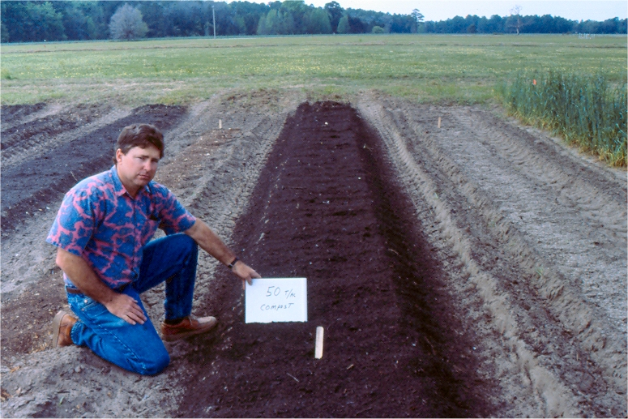
Soil Organic Matter – Recommended Practices
Apply compost or other plant & animal-based soil amendments
Grow annual cover crops between cash crops. To increase SOM, try sorghum/sudangrass planted with cowpea or pigeon pea.
Use plant-based mulches
Reduce cultivation and soil disturbance
Notes:
How can you increase organic matter?

Slide 14
Notes:
Apply inputs at proper rates, especially manures, so to not over fertilize

Slide 15
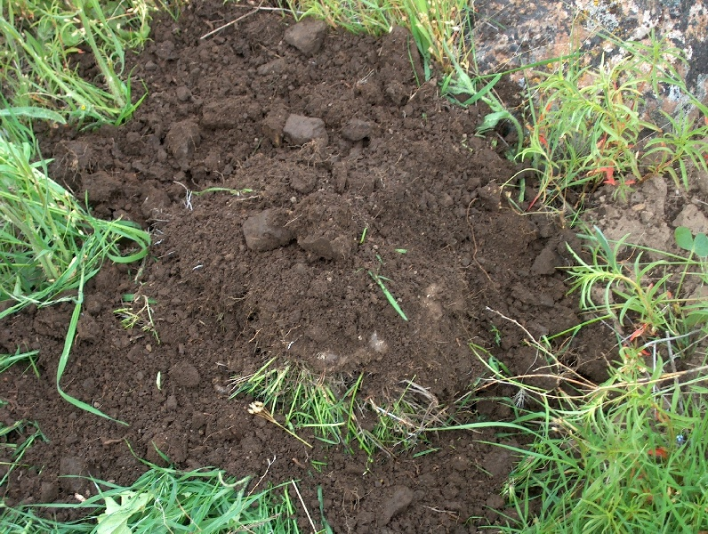
Nitrogen Fixers and Lifters
N
Legumes
FIX NITROGEN
Released to next crop
Non-Legumes
SCAVENGE NITROGEN
Hold until required
N
N
N
N
N
N
N
N
N
Notes:
Nitrogen – important for crop yield
Water soluble
Prone to leaching
Needs recycling (lifters) and fixing
Fleshy annuals release N quickly
Wood

Slide 16
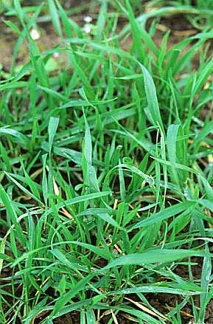
Nitrogen Lifters
Grown to retrieve available nutrients still in the soil following a harvested crop
Prevents nutrient leaching
Species differ (most grass or grain)
Can lift 90% of N
Examples
Rye ----------------------------------------------→
Wheat
Ryegrass
Sorghum-Sudan
Millet
Notes:
Traits and examples of “lifters”

Slide 17
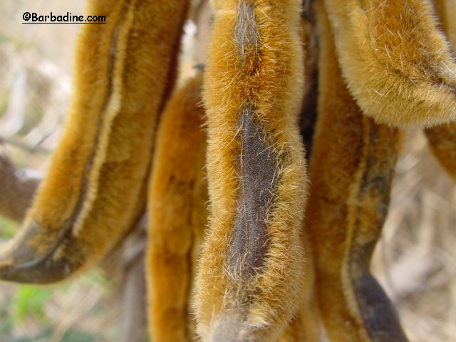
Nitrogen Fixers
Help maintain soil organic matter and add nitrogen to the system
Incorporated into soil or killed on the surface before they are mature
LEGUMES
Examples
White or Red Clover
Southern Peas
Velvet Bean --------------------→
Notes:
Traits and examples of “fixers”
Most cover crop residues are usually low in lingin content and high in nitrogen, they decompose rapidly in the soil.

Slide 18
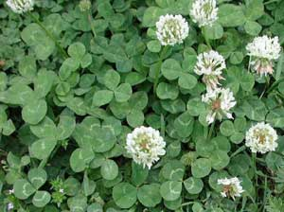
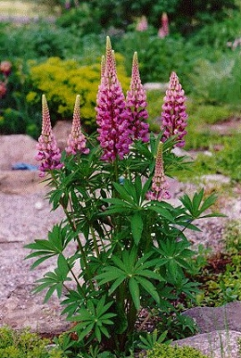
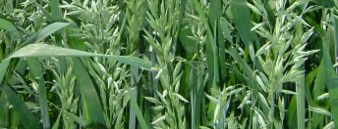
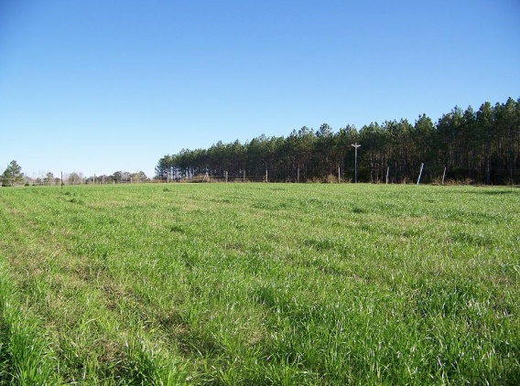
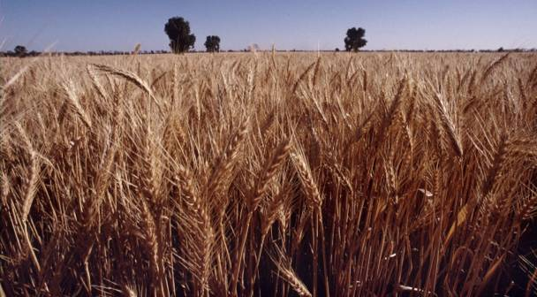
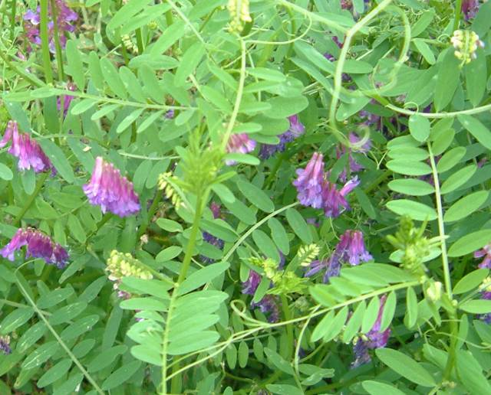
Cool Season Cover Crops
WHITE CLOVER*
LUPINE*
OATS
RYE
WHEAT
HAIRY VETCH*
Notes:
Cover crops for the cool season

Slide 19
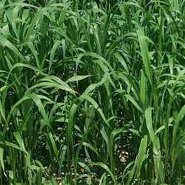
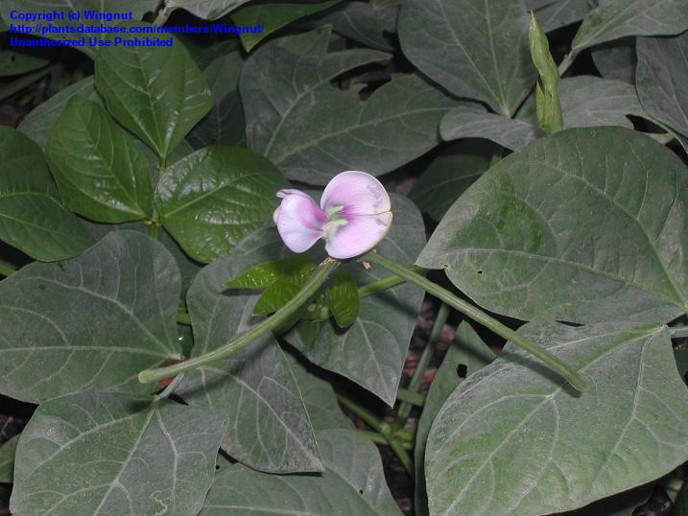
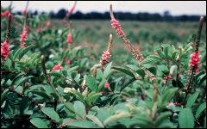
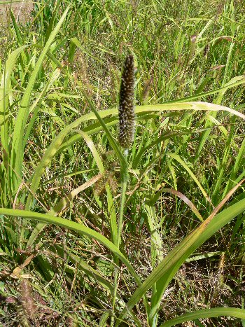
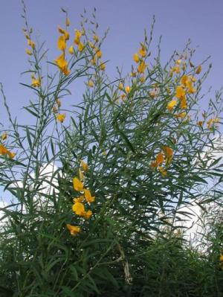
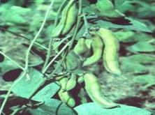
Warm Season Cover Crops
SORGHUM/SUDAN
SOUTHERN PEA*
HAIRY INDIGO*
PEARL MILLET
SUNNHEMP*
VELVET BEAN*
Notes:
Cover crops for the warm season

Slide 20
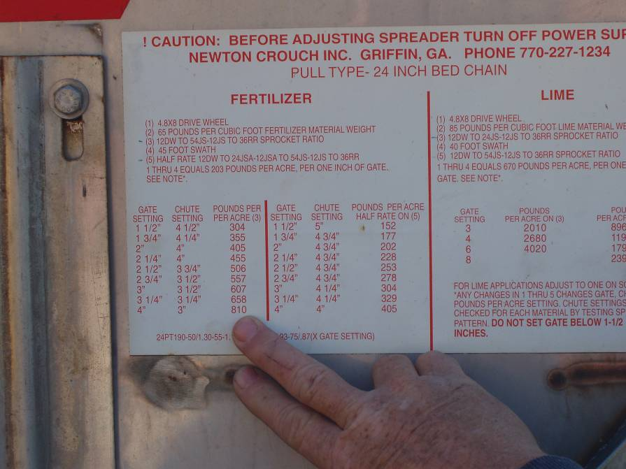
Step 3: Apply the Correct Fertility
Notes:
Base applications and rates of fertilizer and lime on a soil test

Slide 21
Apply the Correct Fertility - Situation
Nutrient imbalances interfere with crop development and reduce soil organism efficiency
cause plant stress
may result in reactive measures by the farmer
poses risk to water quality
excess N facilitates rapid decomposition of plant residues
Notes:
Need proper fertilizer program to maximize crop health

Slide 22
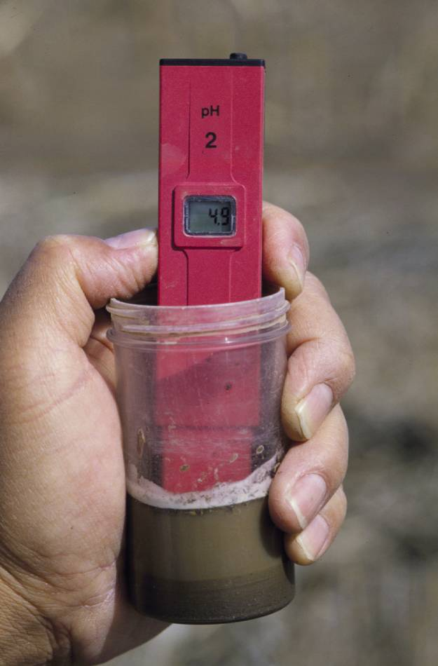
Apply the Correct Fertility - Goal
For vegetable crops, maintain a soil pH of 5.5 – 6.5.
Increase fertilizer use efficiency
Increase water use efficiency
Notes:
If pH is too high, select crops tolerant to high pH (legumes), use acidifying fertilizers, add small small small amounts of elemental sulfur, ect.

Slide 23
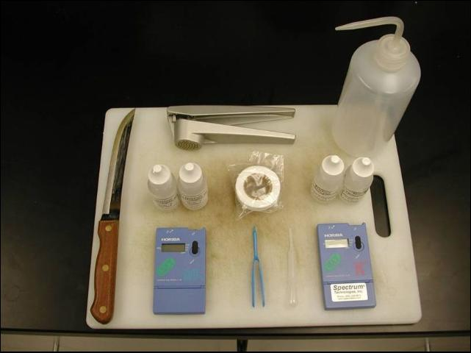
Apply the Correct Fertility – Recommended Practices
Monitor Crop Nutrients
Estimate crop nutrient removals to keep a rough estimate of what needs replacement during the year.
Use laboratory tissue analysis and petiole sap analysis in season.
Use catch crops to recycle nutrients
Notes:
Ways to make adjustments in your fertilizer program

Slide 24
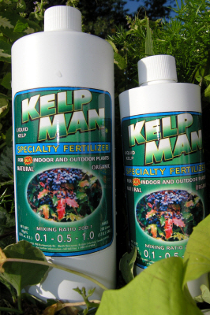
Apply the Correct Fertility – Recommended Practices
Use a combination of fast and slow release nutrients.
FAST (release <1-4 wks):
Soluble synthetic fertilizer
Blood meal
Soybean meal
Fish emulsion
Kelp
Succulent legumes soil incorporated
Notes:
Different sources of nutrients will vary in the rate of release of the nutrients. Know your fertilizer characteristics.
Blood meal is dried, powdered blood used as a high-nitrogen fertilizer. It is one of the highest non-synthetic sources of nitrogen and if over-applied it can burn plants with excessive ammonia. Blood meal is completely soluble and can be mixed with water to be used as a liquid fertilizer. It usually comes from cattle as a slaughterhouse by-product. It may also be spread on gardens to deter animals such as rabbits, or as a compost activator.
Blood meal, bone meal, and other animal by-products are permitted in certified organic production as soil amendments, though they cannot be fed to organic livestock. In the United States, fear of BSE (mad cow disease) and the related Creutzfeldt-Jakob disease prompted Demeter International, which certifies biodynamic farms, to fully prohibit use of bone meal and blood meal, since these could be routes of infection for BSE.
Blood meal is different from bone meal in that blood meal contains a much higher amount of nitrogen, while bone meal contains phosphorus.
Nitrogen is more typically missing from soils than the other elements provided by most fertilizers (phosphorus and potassium). Plants grown in soil lacking proper amounts of nitrogen will yellow from the leaves down due to nitrogen deficiency. Applying blood meal will help plants become green again.

Slide 25
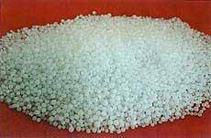
Apply the Correct Fertility – Recommended Practices
SLOW (controlled) release: nutrients are made available over time in quasi-regular amounts. “Release” is mediated by physical and biological means.
Urea, polymer coated fertilizers
Properly prepared compost
Legume cover crops soil incorporated
Uncomposted plant material
Prilled Urea 46% N
Notes:
Nutrients that are slower to release or actually controlled in their release rate.
“Release” is mediated by microorganisms (as the case for urea, compost) or by physical and mechanical means (disintegration of plastic coatings, prills)
Properly prepared compost (no visible particles, cool, sweet smell)
Legume cover crops soil incorporated < 2 weeks before crop.
Uncomposted plant material (wood chips, leaves, yard waste) will contribute to total SOM but additional N must be supplied.

Slide 26
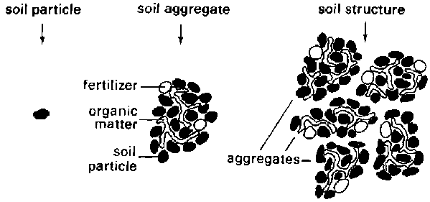
Step 4: Improve Soil Structure
www.fao.org
Notes:
Soil structure refers to the grouping of soil particles (sand, silt, clay, organic matter and fertilizers) into porous compounds. These are called aggregates. Soil structure also refers to the arrangement of these aggregates separated by pores and cracks

Slide 27
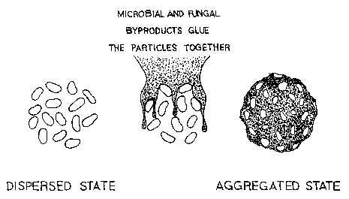
Improve Soil Structure - Goal
Goal:
Increase aggregation
Reduce compaction
Notes:
The two main goals in improving soil structure

Slide 28
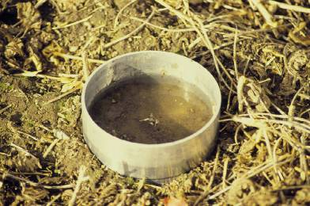
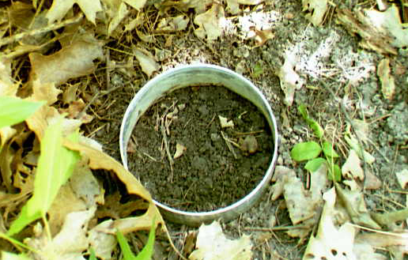
Improved Soil Structure Improves Water Infiltration
0.1 in/min
5 in/min
35%
Water Stable Aggregates
88%
Water Stable Aggregates
Joel Gruver, NIU
Notes:
Soil aggregates or structure affect the infiltration rate. Generally, a soil with a higher percentage of water-stable aggregates will have a higher infiltration rate. This is a comparison of infiltration on the same soil type under different land uses.

Slide 29
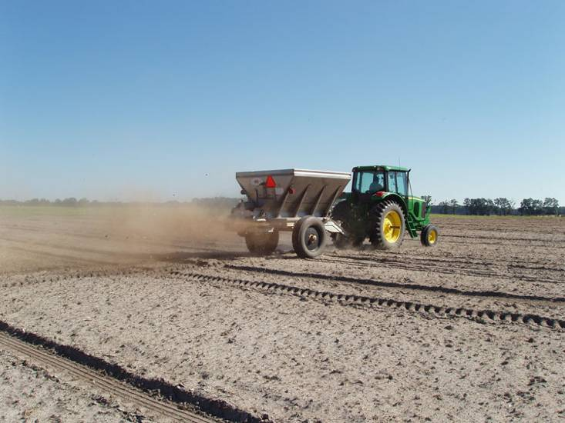
Improve Soil Structure – Recommended Practice
Use the most lightweight equipment possible for the job.
Vary tillage depths to avoid developing a hardpan.
Add organic matter.
Poultry litter application in Citra, FL
Notes:
Ways to keep good structure

Slide 30
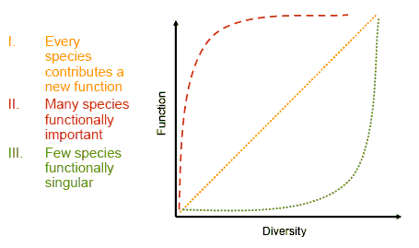
Step 5: Keep the Soil Alive
www.scotland.gov.uk
Notes:
The more species, the better.

Slide 31
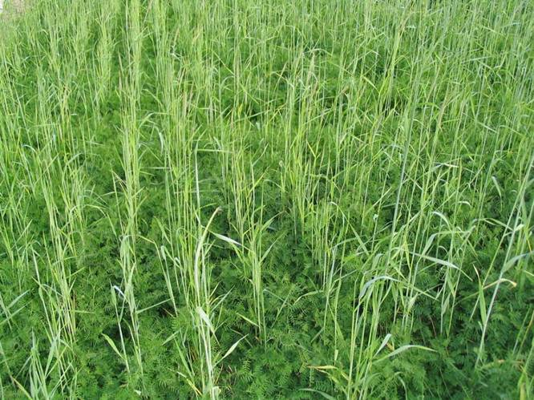
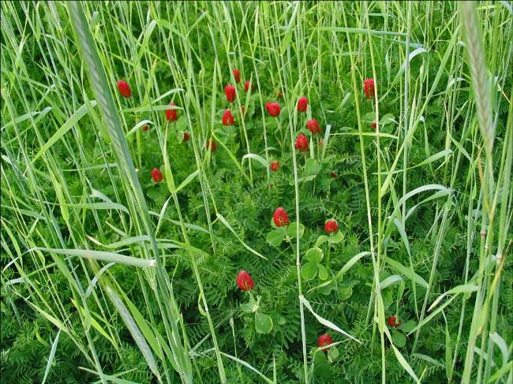
Keep the Soil Alive - Situation
Fungi, bacteria and other micro-organisms make nutrients available for plants and recycle dead plant material.
70% rye, 30% hairy vetch
Rye, crimson, hairy vetch
Notes:
Micro-organisms do the “good work” in the soil.

Slide 32
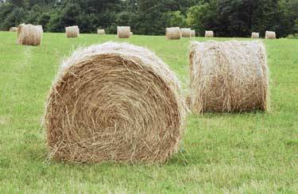
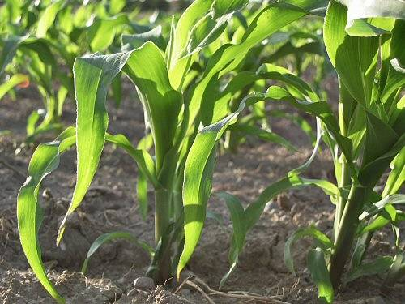
Keep the Soil Alive
Soil benefits with the addition of carbon:
Crop rotations that included at least 3 years of forages increased soil carbon and were more profitable for the grower compared to continuous corn (Karlen et al. 2006).
Notes:
Soils need a good carbon source for long term health

Slide 33
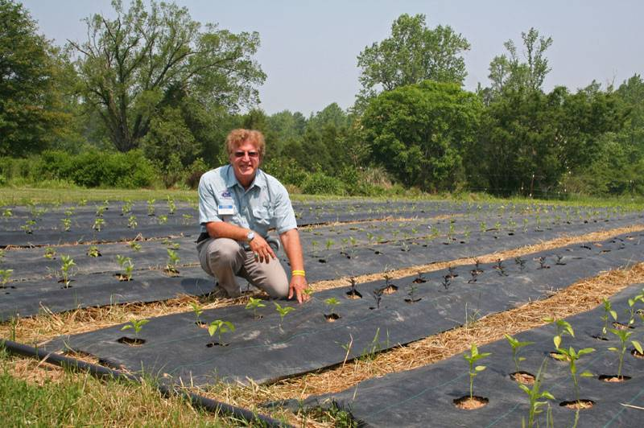
Keep the Soil Alive – Recommended Practices
Maintain a diversity of vegetation
Keep soil covered with plant material
Minimize cultivation and compaction
Add organic matter (are you beginning to see a trend here?)
R. Kluson, Sarasota County Agent at Alex Hitt’s farm in NC. No-till pepper.
Notes:
Key practices to keep the soil alive and build a health soil.

Slide 34
Additional Resources
UF-IFAS Extension Soil Testing Laboratory
http://soilslab.ifas.ufl.edu/
USDA NRCS Web Soil Survey
http://websoilsurvey.nrcs.usda.gov/app/
ATTRA’s Sustainable Soil Management
http://attra.ncat.org/attra-pub/PDF/soilmgmt.pdf
SARE: Building Soils for Better Crops
http://www.sare.org/publications/bsbc/bsbc.pdf

Slide 35
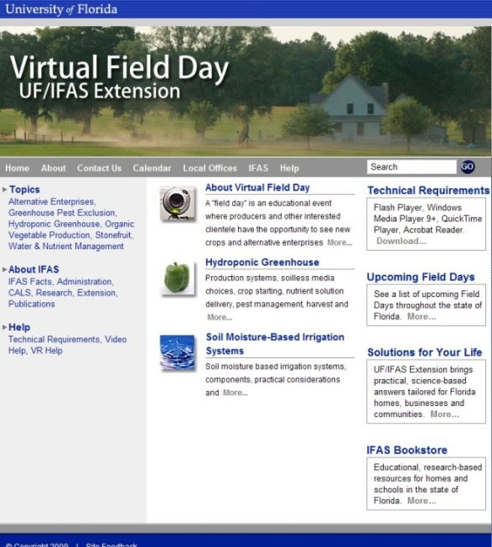
Thank You
For more information visit the Small Farms web at http://smallfarms.ifas.ufl.edu
Take a virtual field day tour by visiting the Virtual Field Day web at http://vfd.ifas.ufl.edu
This presentation brought to you by the
Small Farms/Alternative Enterprises Focus Team.

