Slide 1
Irrigation System Components
Michael D. Dukes, Ph.D., P.E.
Agricultural & Biological Engineering
Institute of Food and Agricultural Sciences (IFAS)‏
Landscape Fundamentals IST
Wimauma, FL Feb 10, 2009
Notes:
1
Build Green & Profit
1

Slide 2
Name Three Irrigation System Components

Slide 3
Basic Anatomy…
Notes:
Basic anatomy is similar to body parts: Brain is the controller; heart is the valve; fingers/ toes are the sprinklers.

Slide 4
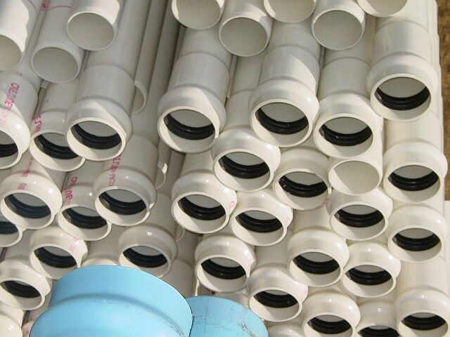
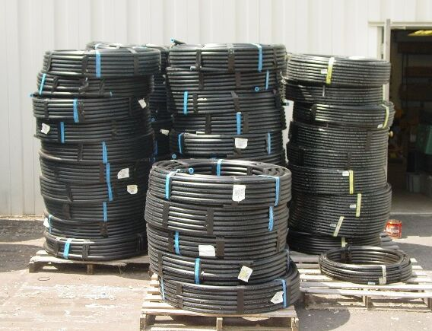
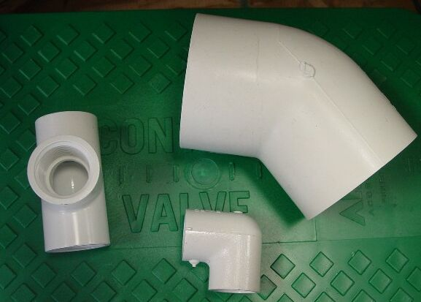
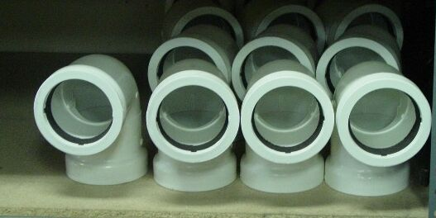
Irrigation Pipe
Photo Credit: IAEF.org

Slide 5
Metered System… Backflow Device
Check Local Codes!!
Reduced Pressure
Double Check
Pressure Vacuum Breaker
Atmospheric Vacuum Breaker
Notes:
Back flow devices are required on all metered systems in the USA. Check with your local codes; it differs even within states. The four basic devices are (in order of significance and safety):

Slide 6
Backflow…
Backflow occurs when imbalance of hydraulic forces in system cause contaminated water to be forced or drawn into a supplying water system.

Slide 7
Backflow…
Backpressure occurs when a pressure higher than the supply pressure is generated w/in the pipe system due to elevation differences, a pump, or any other pressure-regulating devices.

Slide 8
Backflow…
Backsiphonage occurs when atmospheric pressure siphons water back through a cross connection into a supplying water system in which a below-atmospheric pressure exists.

Slide 9
Metered System… Backflow Device…

Slide 10
Metered System… Backflow Device…

Slide 11
Metered System… Backflow Device…

Slide 12
Metered System… Backflow Device…

Slide 13
The Heart….
Notes:
The main line delivers water to the valves…”The Heart” of the system.

Slide 14
Electric Valves
Plastic
Brass
Normally Open
Normally Closed
Notes:
There are a number of different types of valves…

Slide 15
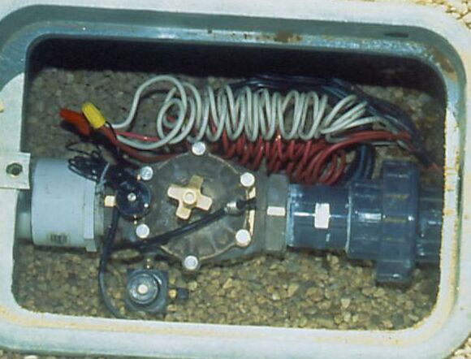
All Irrigation Systems… Electric Valves
Photo Credit: IAEF.org
Notes:
Good installation techniques are paramount. Single manifold versus….

Slide 16
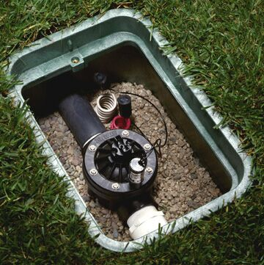
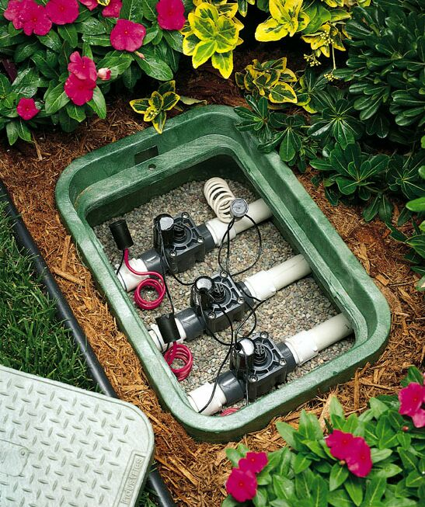
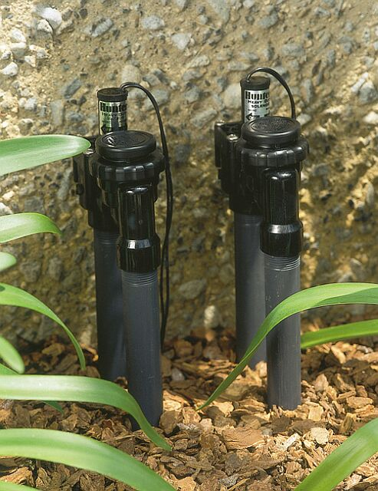
Electric Valves: Installation
Photo Credit: IAEF.org

Slide 17
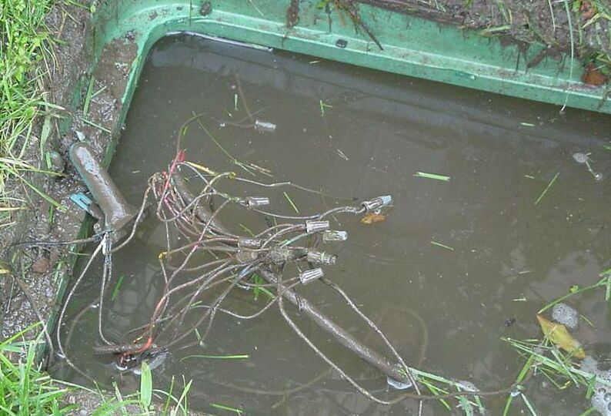
Use Water Proof Connectors!
Photo Credit: IAEF.org

Slide 18
Electric Valves: How do they work?
How a valve works…
Photo Credit: IAEF.org
Notes:
Explain how a valve works.

Slide 19
The Brain….

Slide 20
Controllers…Residential
Photo Credit: IAEF.org

Slide 21
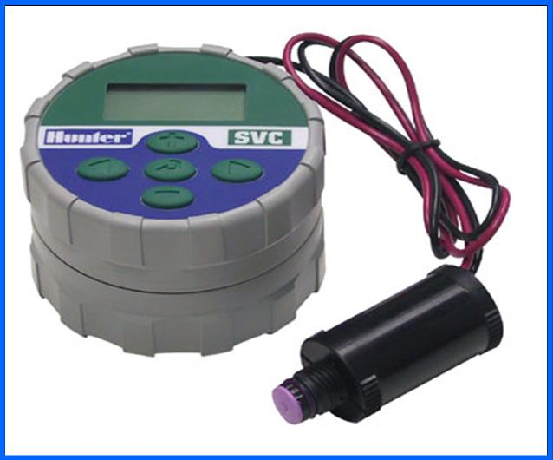
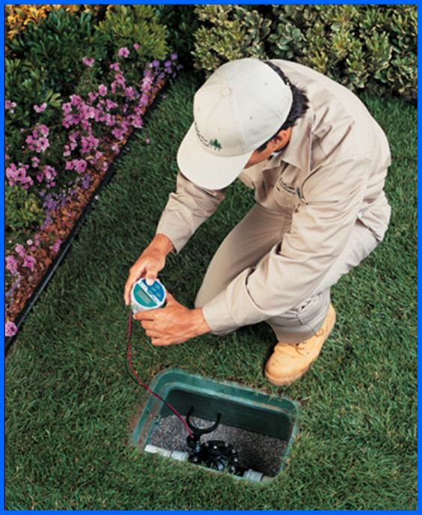
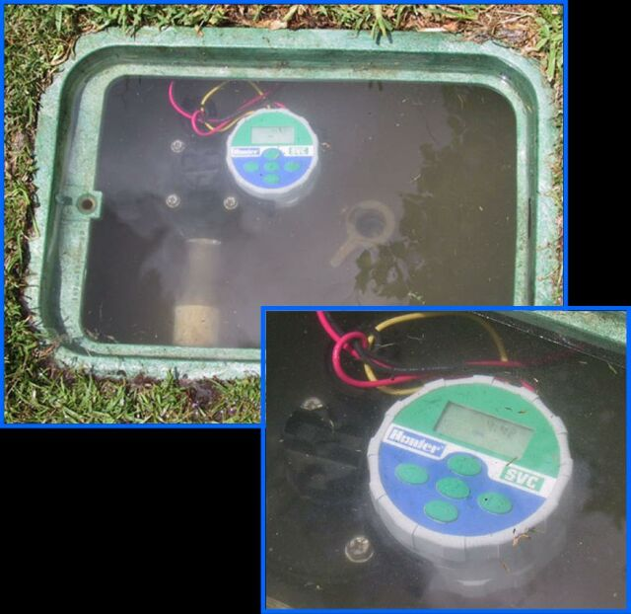
Controllers: Misc. features
Battery operated
Photo Credit: IAEF.org

Slide 22
Controllers: Misc. features
Remote control
Photo Credit: IAEF.org

Slide 23
The Arms, Legs, Fingers & Toes
Notes:
Finally we get to the arms, legs, fingers and toes!

Slide 24
Sprinklers
Rotors
Impacts
Sprays
Notes:
There different types of “sprinklers” used in our irrigation systems.

Slide 25
Sprinklers… Gear driven rotors
Gear Driven rotor….
Photo Credit: IAEF.org
Notes:
Closed case rotor.

Slide 26
Sprinklers… Impact
Impact….
Notes:
Open case rotor….

Slide 27
Sprinklers… Pop up Impacts
Photo Credit: IAEF.org
Notes:
Open case rotor…

Slide 28
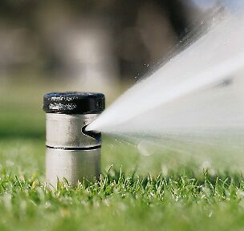
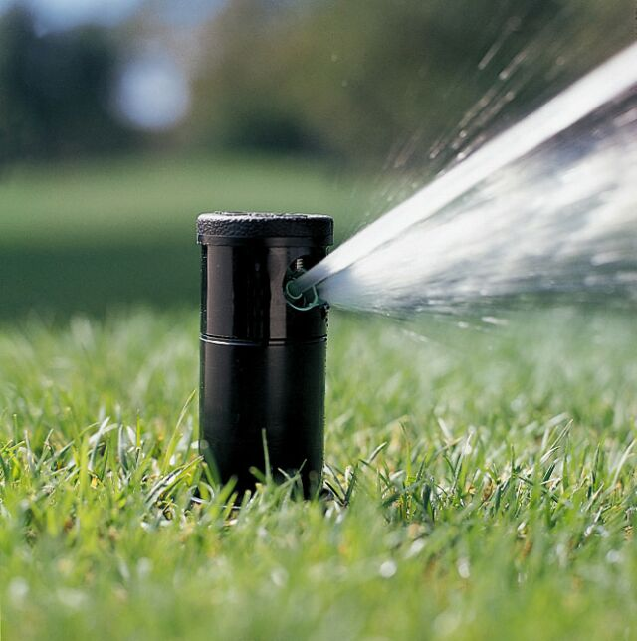
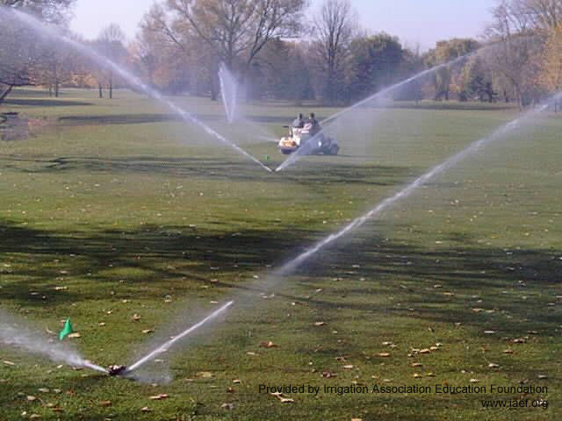
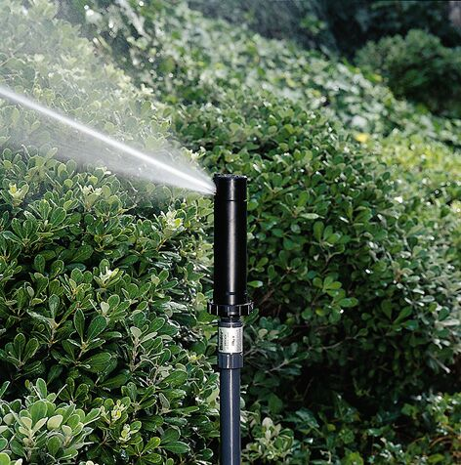
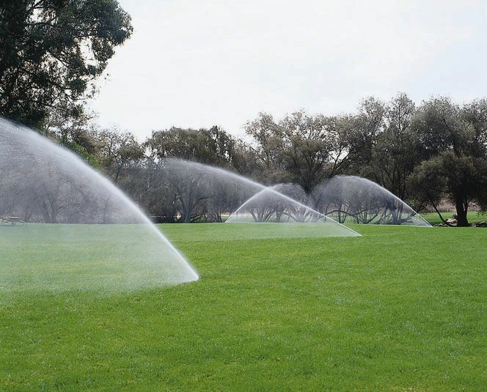
Sprinklers… Many types of rotors
Stainless…
Plastic…
Opposing nozzles…
Large turf…
Shrub…
Photo Credit: IAEF.org
Notes:
Different features to look for when selecting rotors.

Slide 29
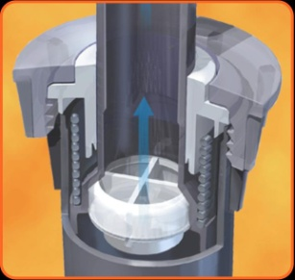
Rotors: Features
Adjustable arcs…
Low head drainage…
25° - 13 ° trajectory nozzles…
Drain check valves….
Color-coded nozzles…
Photo Credit: IAEF.org
Notes:
More features.

Slide 30
Sprinklers… Sprays or spray heads
Photo Credit: IAEF.org
Notes:
Sprays are small area sprinklers with high precip rates.

Slide 31
Sprinklers… Sprays
Various pop-up heights (models)
Wide nozzle selections
High precipitation rates (high flow, small spacing)
“Sprayers”, Micro, Bubblers…
Misc. features

Slide 32
Sprays: Models
12” high-pop…
4” pop-up…
Photo Credit: IAEF.org
All sizes…

Slide 33
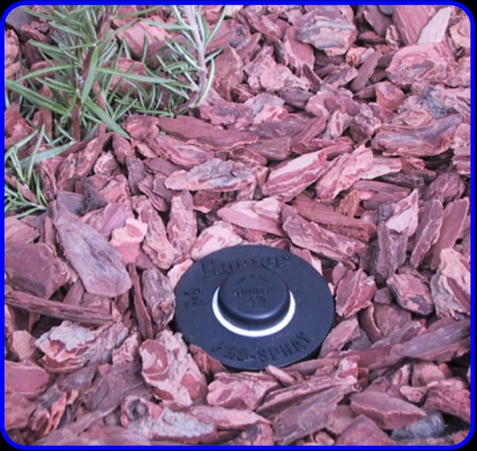
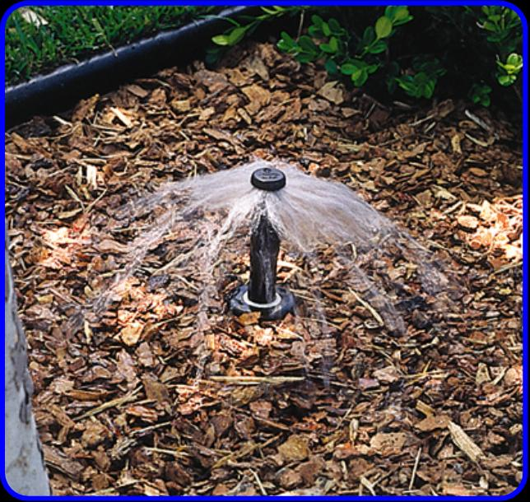
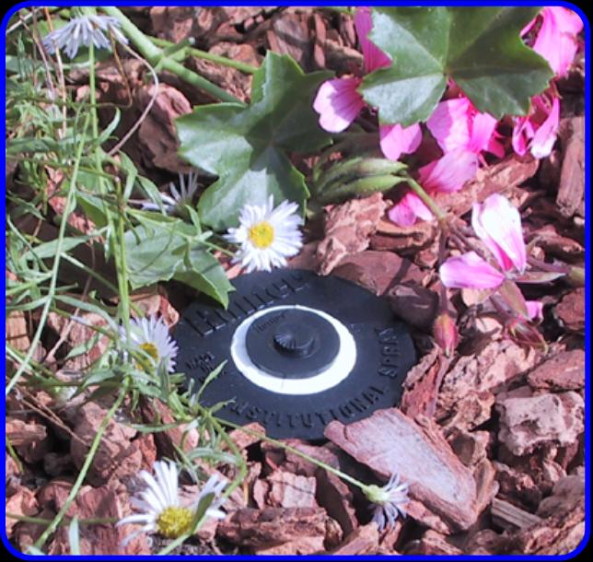
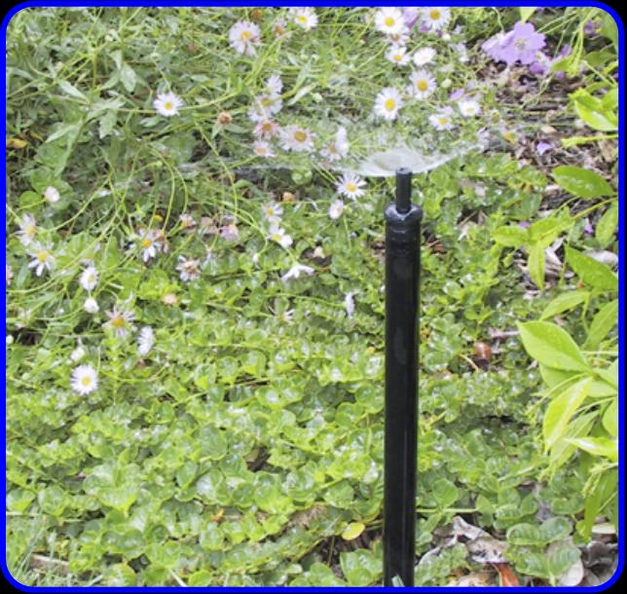
Sprays: Nozzle Selection
Bubblers…
Micro sprays…
Photo Credit: IAEF.org

Slide 34
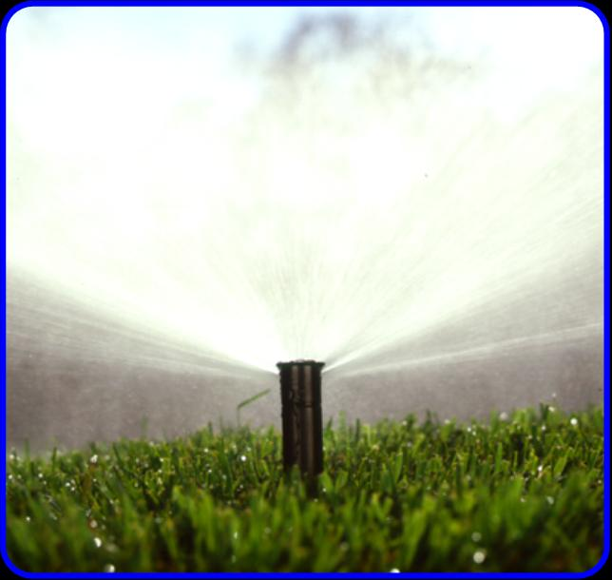
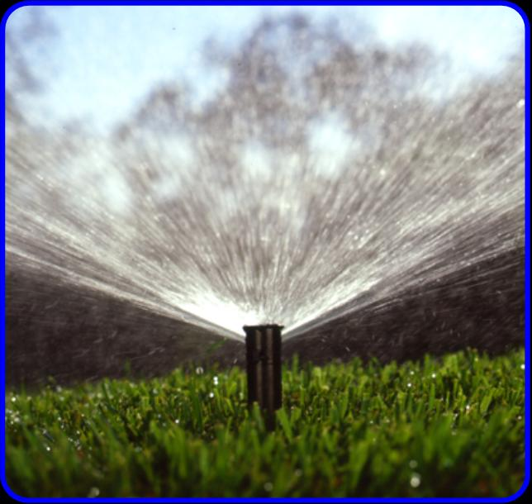
Sprays: Special Features
High pressure…no regulation
High pressure…internal regulation
Photo Credit: IAEF.org

Slide 35
Microirrigation
Definition:
“The frequent application of small quantities of water on or below the soil surface as drops, tiny streams or miniature spray through emitters or applicators placed along a water delivery line. Microirrigation encompasses a number of methods or concepts; such as bubbler, drip, trickle, mist or spray and subsurface irrigation.”
ASABE Standard EP405.1 Jan01, Design and installation of microirrigation systems

Slide 36
Microirrigation Emitters
Bubbler, flowrate < 60 gal/hr
Drip and trickle, flowrate < 2 gal/hr or 1 gal/hr/ft of tubing
Spray (microspray), flowrate < 45 gal/hr

Slide 37
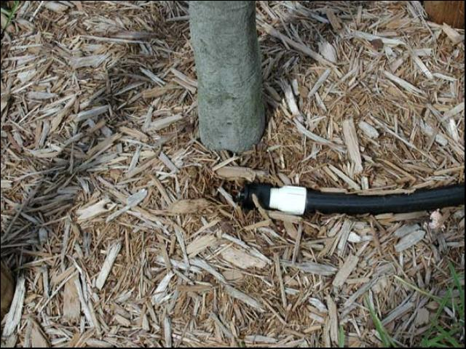
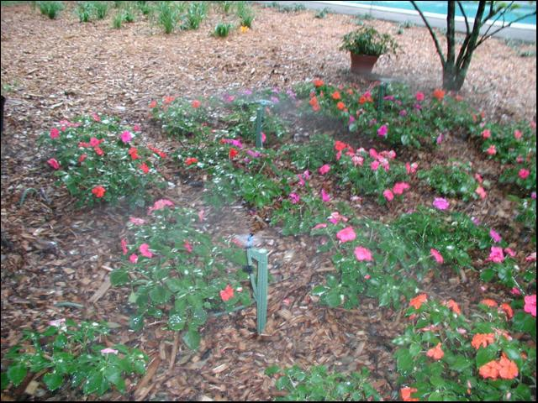
Microirrigation Emitters
Bubbler, typically used on trees and large shrubs
Photo Credit: Michael D. Dukes
Microsprays in a flower bed

Slide 38
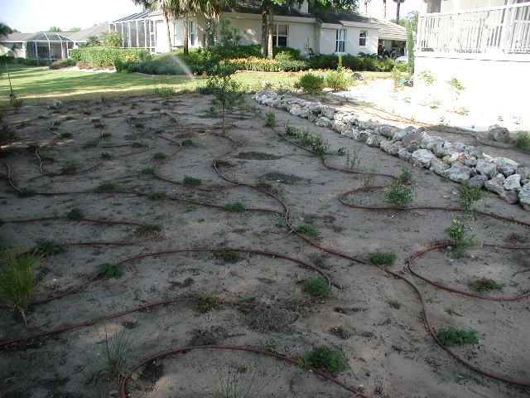
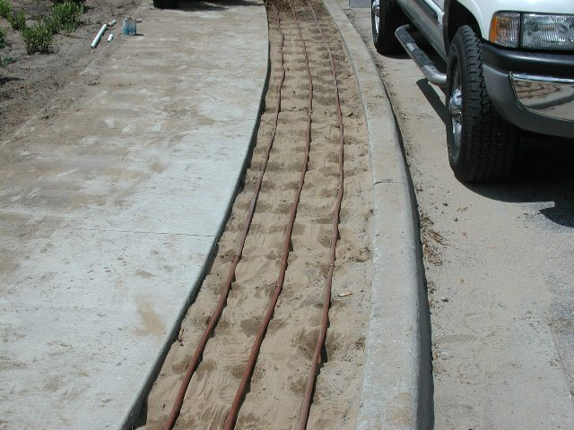
Microirrigation Emitters
Drip tubing in a planting bed before mulch
Photo Credit: Michael D. Dukes
Drip tubing wetting pattern

Slide 39
Questions and Comments
Photos and content courtesy of: irrigation Association Education Foundation, IAEF.org

