Slide 1
Physical Activity and Older Adults

Slide 2
Overview
What is physical activity?
Why is physical activity important?
Barriers to physical activity
Overcoming barriers
What types of activities you should do?

Slide 3
Overview
How often should you be physically active?
Getting started
Sticking with it
How much is too much?
Additional tips

Slide 4
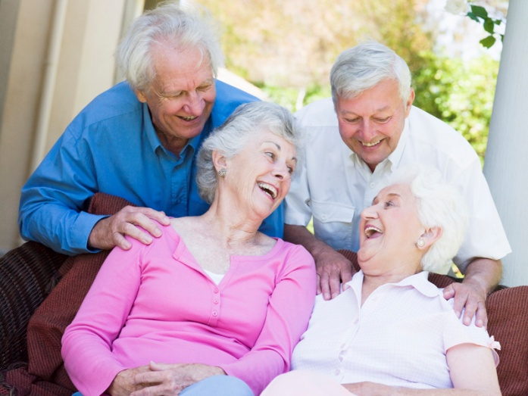
The Older Population
38.9 million adults 65+ in the U.S.
By 2030, 20% of U.S. population will be older than 65 years.

Slide 5
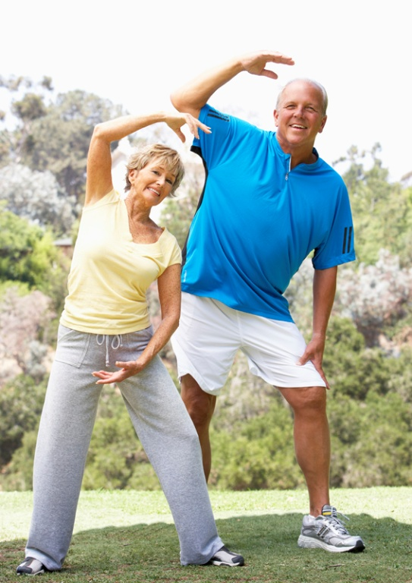
What is Physical Activity?
Movements of the body that use energy.
Physical Activity vs. Exercise

Slide 6
Percent of Inactive Adults by Race and Ethnicity
28-34% of adults 65-74 years of age are inactive
54% of Hispanic or Latino
52% of Black or African American
46% of American Indian/Alaska Native
42% of Asian or Pacific Islander
38% of White

Slide 7
Why is Physical Activity Important for Older Adults?
Improves physical, mental, and social functioning.
Improves energy level.
Decreases stress.
Weight management.
Increases strength, flexibility, and balance.
Delays or prevents the onset of some diseases.

Slide 8
You’re Never too Old
http://nihseniorhealth.gov/exerciseforolderadults/benefitsofexercise/video/e3a_na.html?intro=yes

Slide 9
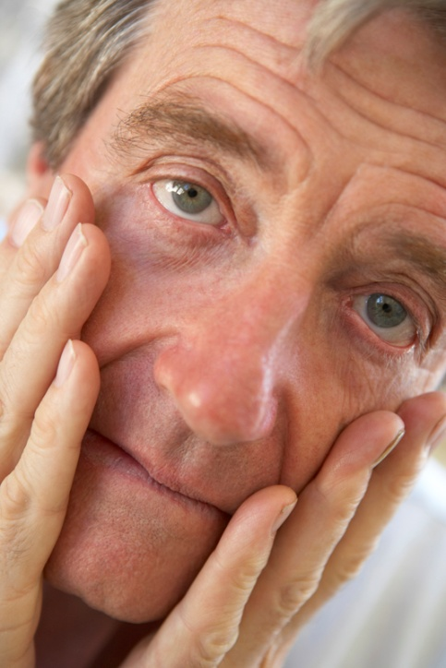
Barriers to Physical Activity
Don’t have time
Too boring
Don’t like to exercise alone
Don’t like to exercise in a group
Bad knees

Slide 10
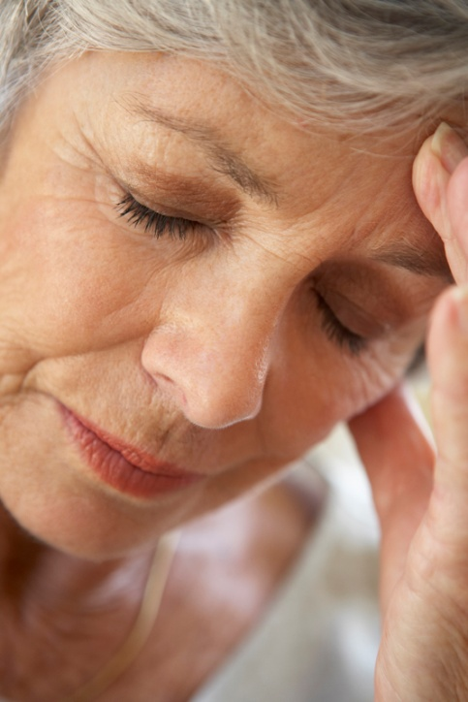
Barriers to Physical Activity
Bad balance
Too hot outside
Can’t afford to join a fitness center
Don’t own the right clothes
Fear of making a health condition worse

Slide 11
Overcoming Barriers
Do as much as you can.
Choose activities you enjoy.
Join an exercise group.
Get friends and/or family involved.
Choose something you can do on your own.
If you have bad knees or poor balance, try low impact activities like swimming or chair dancing.

Slide 12
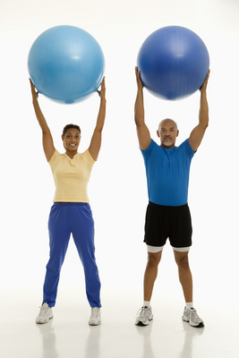
Overcoming Barriers
Too hot? Walk at the mall or try an exercise video at home.
Find activities that don’t require a fitness center.
Wear clothes that feel comfortable.
Talk with your doctor and plan a program suitable for your needs.

Slide 13
Getting Started
Consult your physician.
Establish a goal.
Find an activity or activities that you enjoy.
Wear comfortable clothing and shoes.
Start slowly.

Slide 14
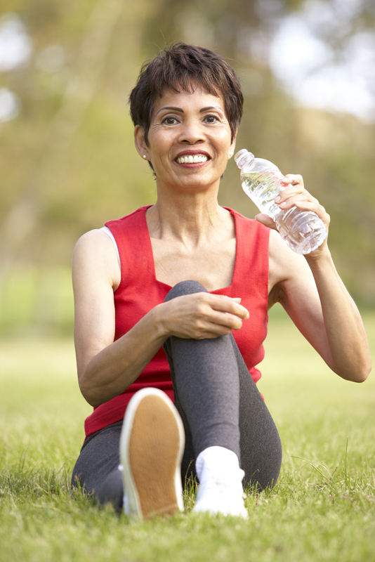
Getting Started
Drink water before, during, and after your workout.
Warm up before the activity.
Aim for 30 minutes.
Cool down afterwards.
Start a fitness log to track your progress.

Slide 15
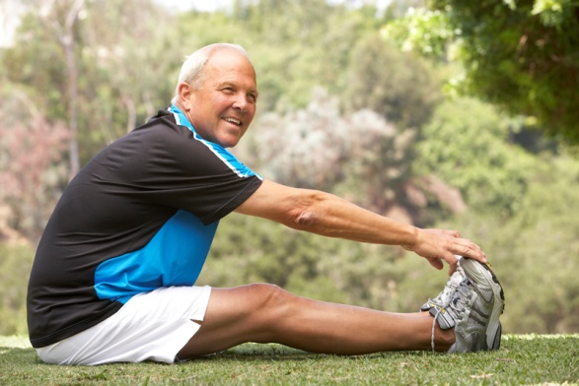
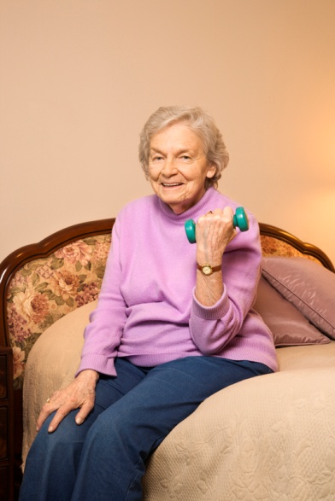
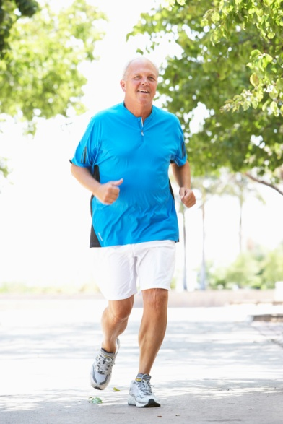
What Types of Activities Should You Do?
Aerobic
Muscle-strengthening
Balance and flexibility

Slide 16
Aerobic Activities
Aerobic exercise classes
Biking
Dancing
Yard work
Gardening
Mowing the lawn
Raking
Swimming
Water aerobics
Tennis
Walking
Jogging
Housework
Vacuuming
Washing floors

Slide 17
Muscle Strengthening Activities
Exercises using resistance bands, weight machines, or handheld weights
Washing windows or floors
Callisthenic exercises
Yard work/gardening
Lifting
Digging
Carrying

Slide 18
Balance and Flexibility Activities
Balance
Walking backwards
Walking sideways
Heel walking
Toe walking
Standing from a sitting position
Flexibility
Stretching for the major muscle groups
Hamstrings
Quadriceps
Triceps
Chest
Back

Slide 19
Balance and Flexibility Examples
National Institute on Aging
http://www.nia.nih.gov/HealthInformation/Publications/ExerciseGuide/04d_balance.htm
http://www.nia.nih.gov/HealthInformation/Publications/ExerciseGuide/04e_flexibility.htm

Slide 20
How Much Physical Activity Do You Need?
Inactive older adults
Start slowly and gradually progress.
Aim for 150 minutes/week of moderate-intensity physical activity.
Include 2 to 3 nonconsecutive days of muscle-strengthening activities.

Slide 21
How Much Physical Activity Do You Need?
Active older adults
Gain additional health benefits by increasing moderate-intensity aerobic activity to 300 or more minutes a week.
Include 2-3 days a week of muscle-strengthening activities

Slide 22
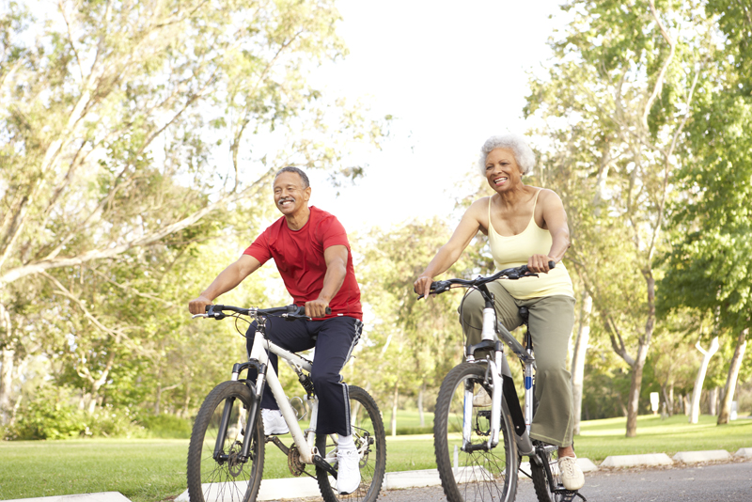
Moderate-Intensity Activities
Effort level: Medium - 5 or 6 on a scale of 0-10
Noticeable increases in breathing and heart rate
Examples:
Walking briskly (3 mph or faster)
Water aerobics
Biking (slower than 10 mph)
Tennis (doubles)
Ballroom dancing
General gardening

Slide 23
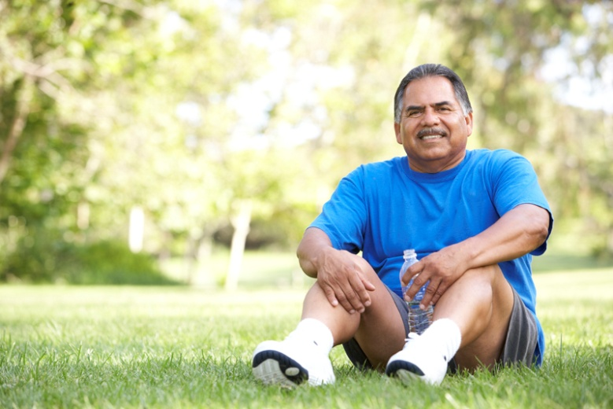
How Much is Too Much?
Listen to your body
Early warning signs of “too much”
Chest pain
Dizziness
Severe muscle soreness

Slide 24
Sticking With It
Use a support system.
Find a variety of activities suitable for you.
Incorporate activities into your daily routine.
If you need to stop for a while, start again slowly.

Slide 25
Additional Tips
Don’t compare yourself to others!
Think about the following:
Do you like to exercise alone or with others?
Do you prefer exercising inside or outside?
What time of day is best for you?
What inspires you?
Who will support your efforts?

Slide 26
QUESTIONS?

Slide 27
References
American Heart Association. How Can Physical Activity Become a Way of Life? http://www.americanheart.org/downloadable/heart/1196270360905Activity_wayoflife.pdf
American Society on Aging Live Well, Live Long: Steps to Better Health Series, 2005. Available at: http://www.asaging.org/cdc/module6/home.cfm. Accessed : September 15, 2010.
Brach JS, Kriska AM, Glynn NW, and Newman AB. Physical activity and the older adult: measurement, benefits, and risks. Current Cardiovascular Risk Reports. 2008;2:305-310.
Brawley LR, Rejeski WJ, and King AC. Promoting physical activity for older adults, the challenges for changing behvior. American Journal of Preventive Medicine. 2003;25(3sii):172-183
Hillan J. Healthy Living: Beating Barriers to Physical Activity. FCS8818. http://edis.ifas.ufl.edu/fy883
Hillan J and Kendall A. Living Actively for Good Health: Older Adults. FCS8753. http://edis.ifas.ufl.edu/fy554
Elsway B and Higgins KE. Physical activity guidelines for older adults. American Family Physician. 2010;81(1):55-59.

Slide 28
References
U.S. Department of Health and Human Services. Administration on Aging. Aging statistics. Available at: http://www.aoa.gov/aoaroot/aging_statistics/index.aspx. Accessed: June 23, 2010.
U.S. Department of Health and Human Services. Administration on Aging. A Profile of Older Americans 2009. Available at: http://www.aoa.gov/AoARoot/Aging_Statistics/Profile/2009/docs/2009profile_508.pdf. Accessed June 23, 2010.
U.S. Department of Health and Human Services, Centers for Disease Control and Prevention , National Center for Chronic Disease Prevention and Health Promotion , and President's Council on Physical Fitness and Sports. A Report of the Surgeon General: Physical Activity and Health Older Adults. Available at: http://www.cdc.gov/nccdphp/sgr/contents.htm. Accessed October 7, 2010.
U.S. National Institutes of Health National Institute on Aging. Exercise & Physical Activity: Your Everyday Guide from the National Institute on Aging. Available at: http://www.nia.nih.gov/HealthInformation/Publications/ExerciseGuide/. Accessed June 15, 2010.
U.S. Department of Health & Human Services, Healthy People 2010. Available at Healthy People on the World Wide Web: www.healthypeople.gov/.

Slide 29
Prepared by: Emily Minton, B.S., ENAFS Program Coordinator, Department of Family, Youth and Community Sciences, IFAS, University of Florida 2010

