Slide 1
Feeding Your Preschooler

Slide 2
Let’s look at preschoolers
Each child is unique, but most preschoolers are similar in these ways:
Growing more slowly than before
Can handle small objects
Generally are pleasant
Learning to share
Enjoy helping with household chores

Slide 3
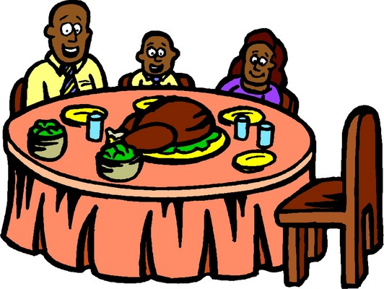
Preschoolers’ food preferences
May be affected by early exposure as infants
Influenced by culture
Increase with repeated exposure
Family influence
Limited by food neophobia

Slide 4
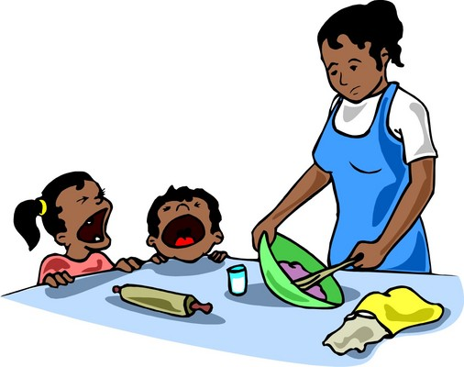
What do preschoolers eat?
Two year olds:
may not accept many foods:
finicky eaters
“food jags”
hold food in mouth and refuse to swallow

Slide 5
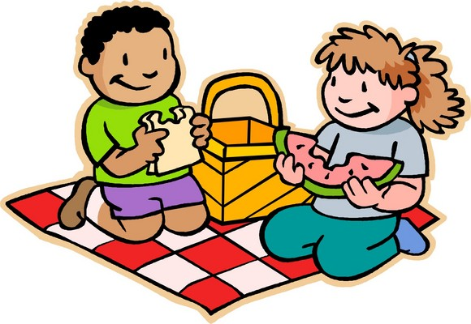
What do preschoolers eat?
Three year olds:
often eat most foods
don’t like strong-tasting vegetables
may dawdle over food if not hungry

Slide 6
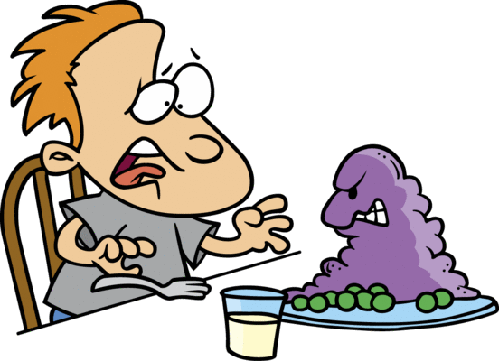
What do preschoolers eat?
Four year olds:
have strong food likes and dislikes
can become emotional around food

Slide 7
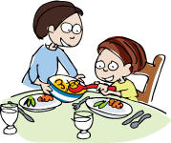
What do preschoolers eat?
Five year olds:
know which foods they like to eat
prefer mainly raw vegetables
may take on food preferences of family members

Slide 8
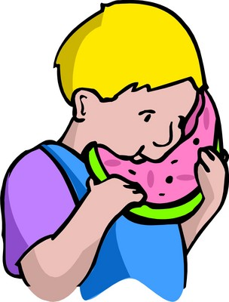
Common parent concerns
My child is a picky eater
My child won’t try new foods
My child hates vegetables

Slide 9
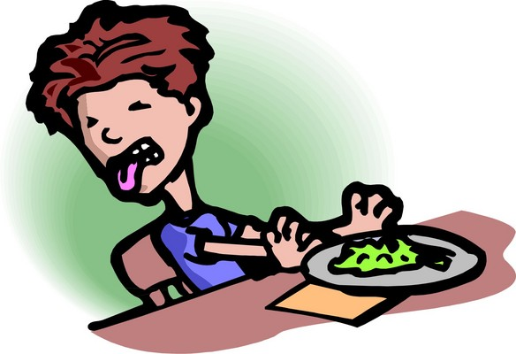
Do you have a picky eater?
Refuses to eat at meal time
Eats very small amounts
Eats very slowly
Accepts a limited number of foods
Avoids foods from one or more of the food groups

Slide 10
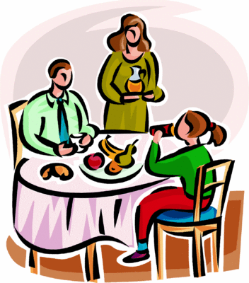
Dealing with your picky eater
Be a great role model!
Eat meals with your child.
Eat slowly and enjoy your own food.
Make mealtime a pleasant time.
Eat a variety of healthful foods.

Slide 11
Is your child afraid to try new foods?
Family Album podcast: Children’s fear of new foods …

Slide 12
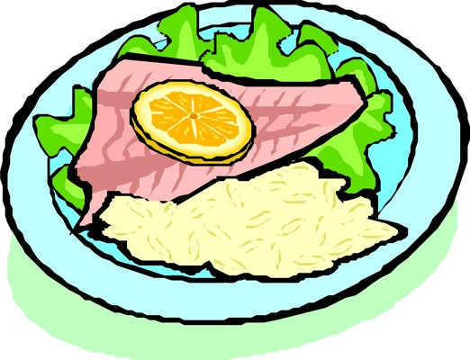
Dealing with food neophobia
Introduce new foods without fanfare
Don’t force, beg, or bribe
Eat the food without commenting
Serve the food once in a while over time
See what happens

Slide 13
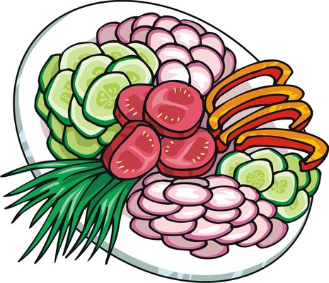
Preschoolers and vegetables
Strong-tasting veggies are not favorites
Incorporate puree into casseroles
Try cold blanched broccoli (“trees”) with dip
Offer a variety of vegetables
Older children may prefer raw veggies

Slide 14
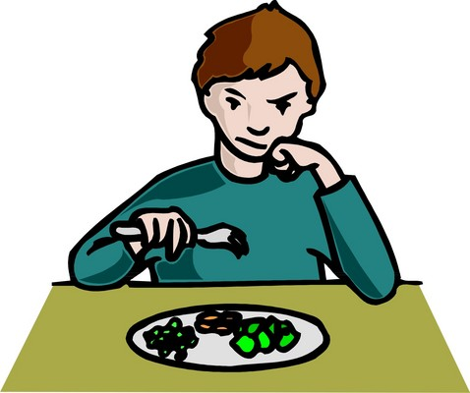
Preschoolers and vegetables
Model eating a variety of cooked and raw vegetables
Let children touch, smell, and taste (not necessarily swallow …) vegetables
Do not force a preschooler to “eat your veggies”
Never use bribes

Slide 15
Role modeling
They learn from watching you.
Eat fruits and veggies and your kids will too.

Slide 16
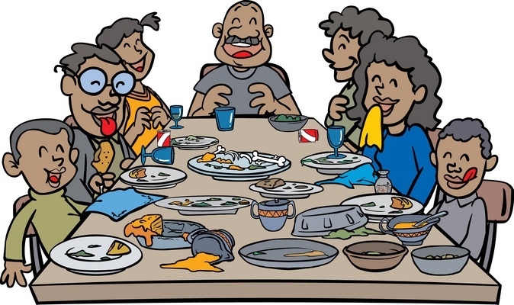
Cooking and Eating Together
Cook together.
Eat together.
Talk together.
Make mealtime a family time.

Slide 17
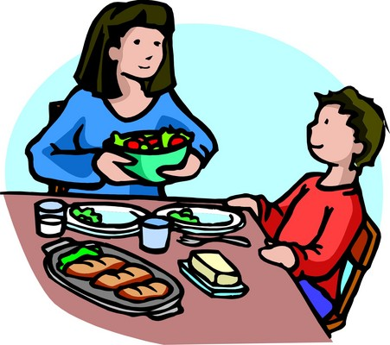
Division of responsibility
Parents decide what to serve and how
Parents set meal and snack times
Do NOT allow panhandling between meals and snacks
Do NOT “short order cook”
Do NOT try to control how much your child eats

Slide 18
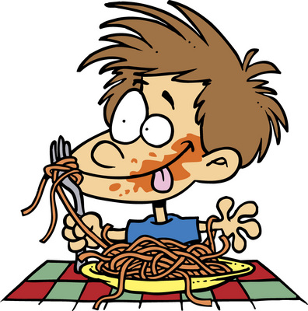
Division of Responsibility
Let them learn by serving themselves.
Let your kids serve themselves at dinner.
Teach them to take small amounts at first.
Tell them they can get more if they’re still hungry.

Slide 19
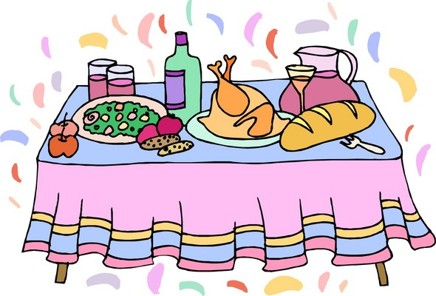
Division of Responsibility
Sometimes new foods take time.
Kids don’t always take to new foods right away.
Offer new fruits and veggies many times.
Give them a taste at first and be patient with them.

Slide 20
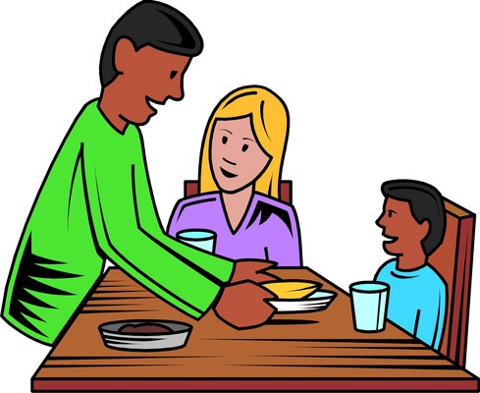
Division of Responsibility
Patience works better than pressure
Offer your children new foods.
Then, let them choose how much to eat.
Kids are more likely to enjoy a food when eating it is their own choice.
It also helps them learn to be independent.

Slide 21
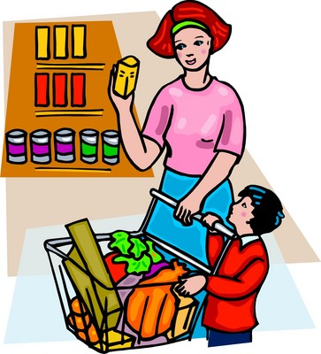
Getting your child involved
Ideas for meals
Food shopping (not when hungry or tired!)
Food preparation
Setting the table
Cleaning up

Slide 22
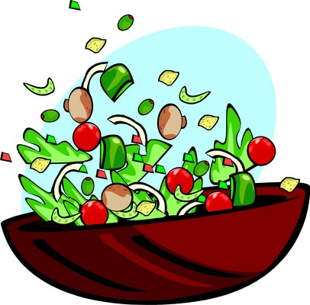
Food handling skills
Two year olds can:
scrub
tear
break
snap
dip

Slide 23
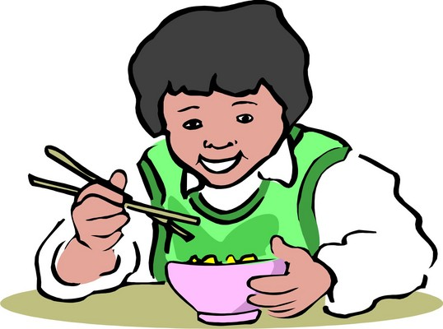
Food handling skills
Three year olds can:
pour milk or juice
serve portions from a serving dish, with help
wrap, mix, spread, and shake foods/drinks
feed him/herself especially if hungry

Slide 24
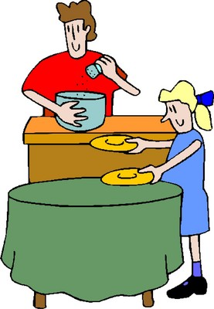
Food handling skills
Four year olds can:
wipe, wash, set table
pour premeasured ingredients
peel, spread, cut, roll and mash foods
crack eggs

Slide 25
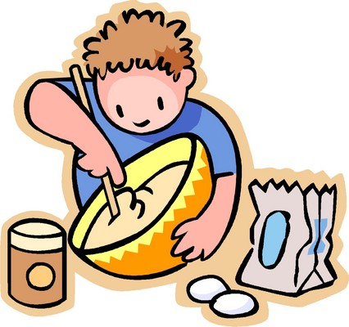
Food handling skills
Five year olds can:
make simple breakfast/lunch
measure, cut, grind and grate foods

Slide 26
Resource for parents

Slide 27
Make meals and memories together. It’s a lesson they’ll use for life.

Slide 28
Prepared by: Linda B. Bobroff, Ph.D., RD Professor and Extension Nutrition Specialist and Karla P. Shelnutt, Ph.D., RD Assistant Professor and Extension Nutrition Specialist Department of Family, Youth and Community Sciences University of Florida February 2009
28

