Slide 1



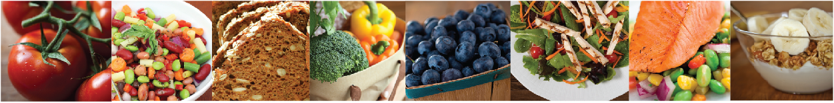

Notes:
Presenter: Please add your name and affiliation in the text box.

Slide 2
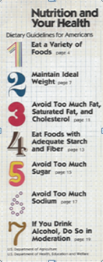
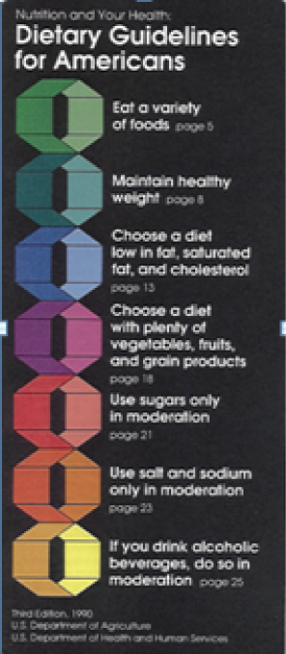


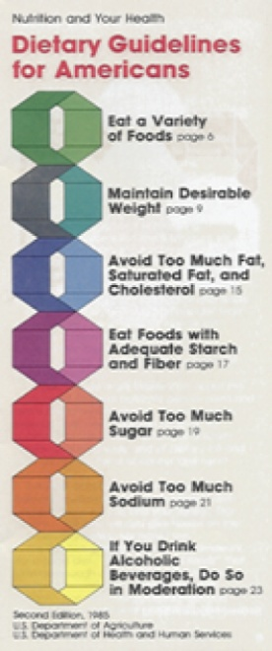
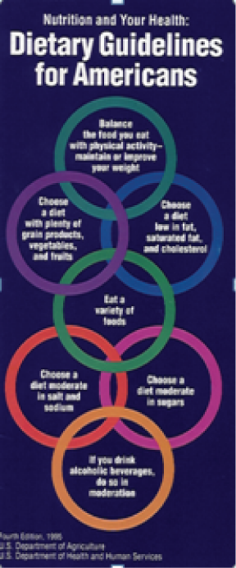

Dietary Guidelines for Americans
History 1980 – 2010
2000
2010
1980
1990
1985
1995
2005

Slide 3
The DGA 2010 are intended for:
Healthy Americans ages two years and older
Americans ages two years and older at increased risk of chronic disease
Both A and B

Slide 4
The DGA 2010 are intended for:
Healthy Americans ages two years and older
Americans ages two years and older at increased risk of chronic disease
Both A and B

Slide 5


Epidemic of overweight and obesity
_{64% of women}
_{72% of men}
Today 33% of adults are obese, compared with 15% in the 1970s.

Slide 6
Poor diet and physical inactivity are associated with which diseases?
Cardiovascular disease
Hypertension
Type 2 diabetes
Osteoporosis
Some types of cancer
All of the above
A, B, C, D only

Slide 7
Poor diet and physical inactivity are associated with which diseases?
Cardiovascular disease
Hypertension
Type 2 diabetes
Osteoporosis
Some types of cancer
All of the above
A, B, C, D only

Slide 8
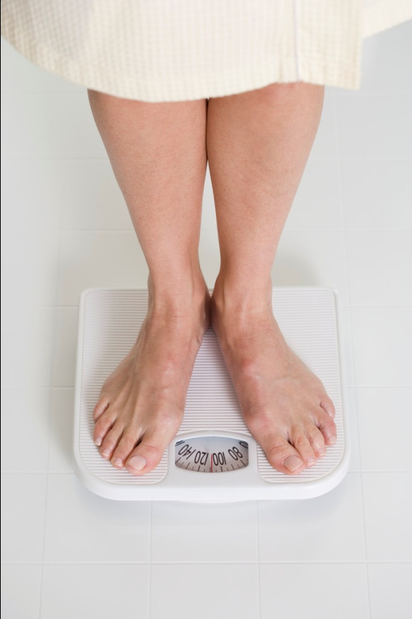
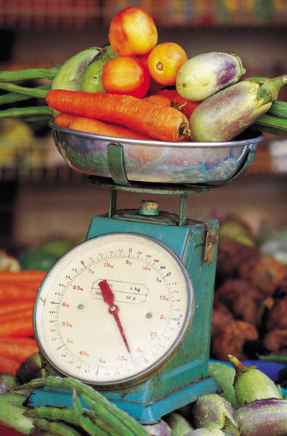

Physical activity and diet are important regardless of weight!

Slide 11

The DGA 2010 can help people meet these food and nutrient goals and limits

Slide 12

DGA 2010 also focus on:
Helping food insecure households have nutritious meals on a budget.
Encouraging healthy eating and activity patterns in children.
Accommodating food preferences, cultural traditions, and customs of our diverse population.

Slide 13
Balancing Calories to Manage Weight
Calorie balance over time is key

Slide 14
The BEST way to assess if you’re eating the right number of calories is:
Check calorie tables in DGA 2010; select level based on age, gender, height, weight, and physical activity.
Monitor body weight; adjust calorie intake and participate in physical activity based on weight changes over time.

Slide 15
The BEST way to assess if you’re eating the right number of calories is:
Check calorie tables in DGA 2010; select level based on age, gender, height, weight, & physical activity
Monitor body weight; adjust calorie intake & participation in physical activity based on weight changes over time

Slide 16
Key Recommendations
Prevent or reduce overweight and obesity through improved eating and physical activity behaviors.
Control calorie intake to manage body weight.
Increase physical activity and reduce time spent in sedentary behaviors.
Maintain calorie balance during each stage of life.

Slide 17

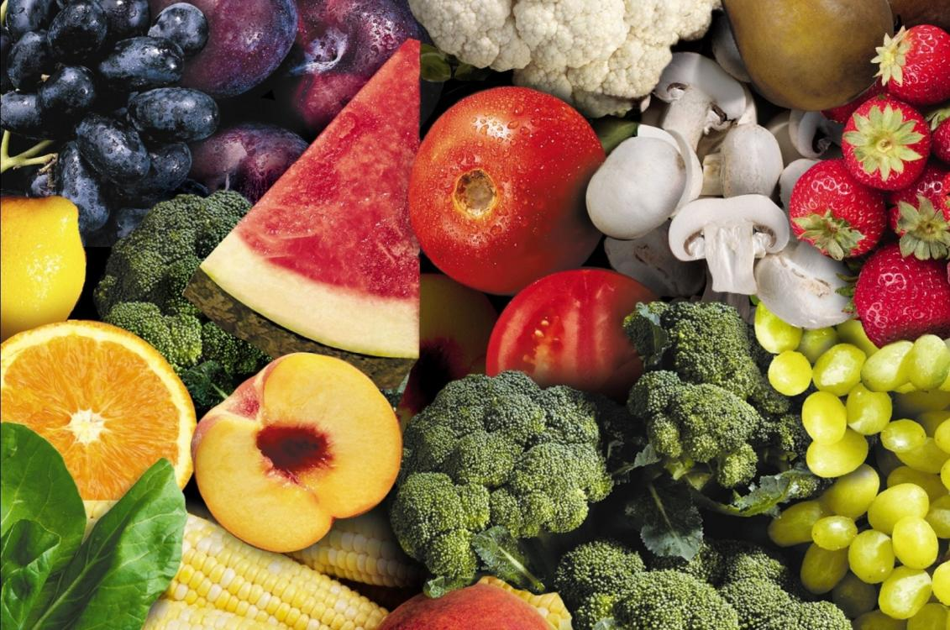
Individual Foods and Beverages and Body Weight
Increase intake of whole grains, vegetables, and fruits.
Reduce intake of sugar-sweetened beverages.
Monitor intake of 100% fruit juice for children and adolescents, especially those who are overweight or obese.
Monitor calorie intake from alcoholic beverages for adults.

Slide 18

“You better cut the pizza in
four pieces, because I’m not hungry enough to eat six.”
~Yogi Berra

Slide 19
How much WEEKLY physical activity should adults (age 18 and over) do for substantial health benefits?
2 hours and 30 minutes of moderate-intensive activity (i.e., 30 minutes, 5 times/week)
1 hour and 15 minutes of vigorous-intensity activity (i.e., 15 minutes, 5 times/week)
Either A or B

Slide 20
How much WEEKLY physical activity should adults (age 18 and over) do for substantial health benefits?
2 hours and 30 minutes of moderate-intensive activity (i.e., 30 minutes, 5 times/week)
1 hour and 15 minutes of vigorous-intensity activity (i.e., 15 minutes, 5 times/week)
Either A or B

Slide 21


Moderate aerobic activity increases breathing and heart rate somewhat.
Vigorous aerobic activity greatly increases heart rate and breathing.

Slide 22

Recommended Behaviors
Focus on total calories consumed.
Monitor your food intake.
When eating out, choose smaller portions or lower-calorie options.
Prepare, serve, and consume small portions.
Eat a nutrient-dense breakfast.
Limit screen time.

Slide 23
Food and Food Components to Reduce
Which foods should you have less of in your diet?

Slide 24
The DGA 2010 recommend we eat LESS:
Sodium
Solid fats
Added sugars
Refined grains
All of the above

Slide 25
The DGA 2010 recommend we eat LESS:
Sodium
Solid fats
Added sugars
Refined grains
All of the above

Slide 26
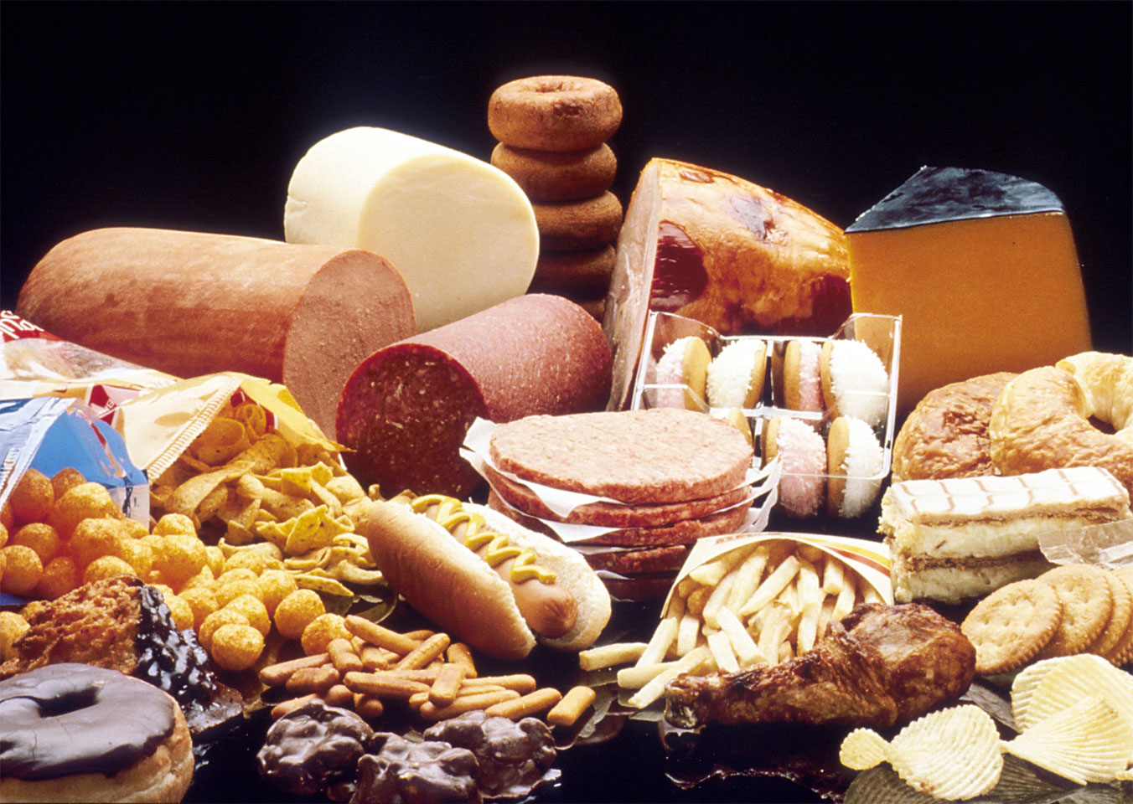
Limit foods
high in sodium, SoFAS, and refined grains
Photo courtesy of National Cancer Institute

Slide 27
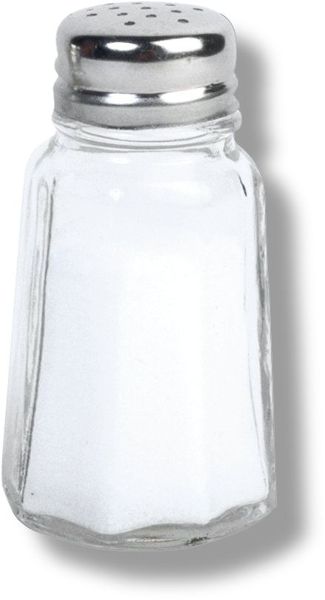
_{Reducing sodium}

Slide 29
6. Approximately how much of our sodium comes from processed foods?
45%
55%
65%
75%

Slide 30
6. Approximately how much of our sodium comes from processed foods?
45%
55%
65%
75%

Slide 31
7. DGA 2010 recommend people ages two and older reduce daily sodium intake to less than:
2,300 mg or 1,500 mg, depending on age/other individual characteristics
2,300 mg or 3,000 mg, depending on age/other individual characteristics

Slide 32
7. DGA 2010 recommend people ages two and older reduce daily sodium intake to less than:
2,300 mg or 1,500 mg, depending on age/other individual characteristics
2,300 mg or 3,000 mg, depending on age/other individual characteristics

Slide 33

Groups who should consume 1,500 mg of sodium or less
African Americans ages 2+
Adults ages 51+
People ages 2+
with high blood pressure, diabetes, or chronic kidney disease

Slide 34
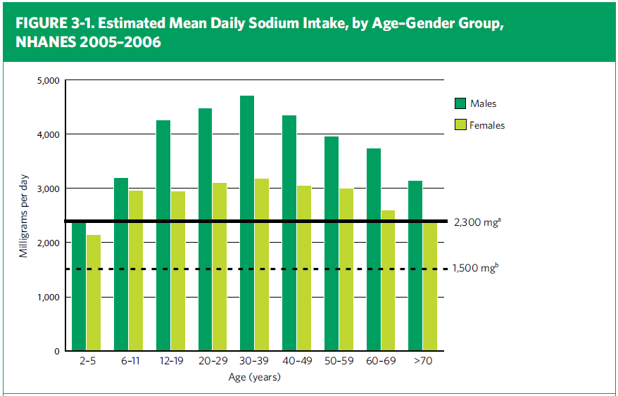

Slide 35

Easy ways to reduce sodium
Check labels.
Avoid adding salt to foods.
Eat fresh foods, frozen veggies without sauces.
Use fewer processed foods.
Request that salt be left off when eating out.
Use other seasonings for flavor.

Slide 36
8. What is the average proportion of calories Americans consume daily from solid fats and added sugars?
20%
25%
30%
35%
40%

Slide 37
8. What is the average proportion of calories Americans consume daily from solid fats and added sugars?
20%
25%
30%
35%
40%

Slide 38
SoFAS provide few nutrients
Current SoFAS: | Most people should limit SoFAS to:
35% of calories | 5 to 15% of calories
800 calories | 100 to 300 calories
Based on a 2,000 calorie diet

Slide 39

Reducing solid fats

Slide 41
9. Regarding fats, which is more important in influencing risk of cardiovascular disease?
The type of fatty acids consumed
The total amount of fat in the diet
They are equally important

Slide 42
9. Regarding fats, which is more important in influencing risk of cardiovascular disease?
The type of fatty acids consumed
The total amount of fat in the diet
They are equally important

Slide 43

Fish are an exception to animal fats being high in saturated fats
Photo courtesy of National Oceanic and Atmospheric Administration
These salmon would be stiff as a board and couldn’t swim if high in saturated fats!

Slide 44
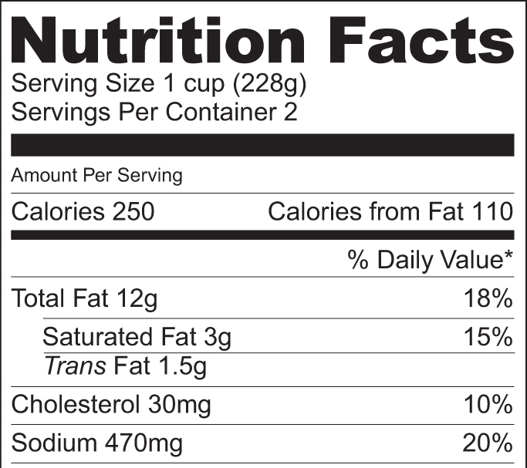
Use nutrition labels to keep trans fat as low as possible

Slide 45

Reducing added sugars

Slide 47

Drink fewer sugar-sweetened beverages
Substitute water and other
beverages with few or no calories

Slide 48

Select fruit for dessert

Slide 49
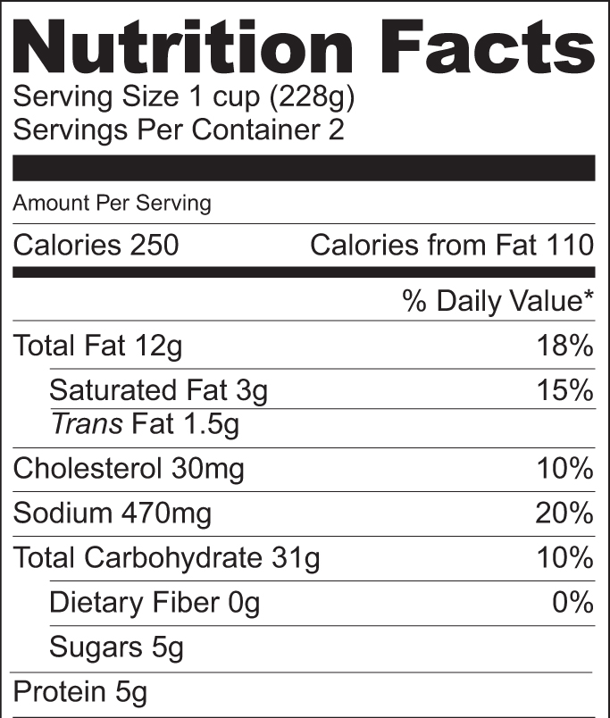
Nutrition Facts Label doesn’t separate “added” & “naturally occurring” sugars
“Added” sugars are sugars and syrups added to foods or beverages during preparation or processing
1 teaspoon sugar = about 4g

Slide 50

Reducing refined grains

Slide 51
…includes pizza, grain-based desserts, tortillas, burritos, tacos, pasta and pasta dishes, rice and rice mixed dishes

Slide 52
Foods and Nutrients to Increase
Foods that are important to include more of in your diet

Slide 53
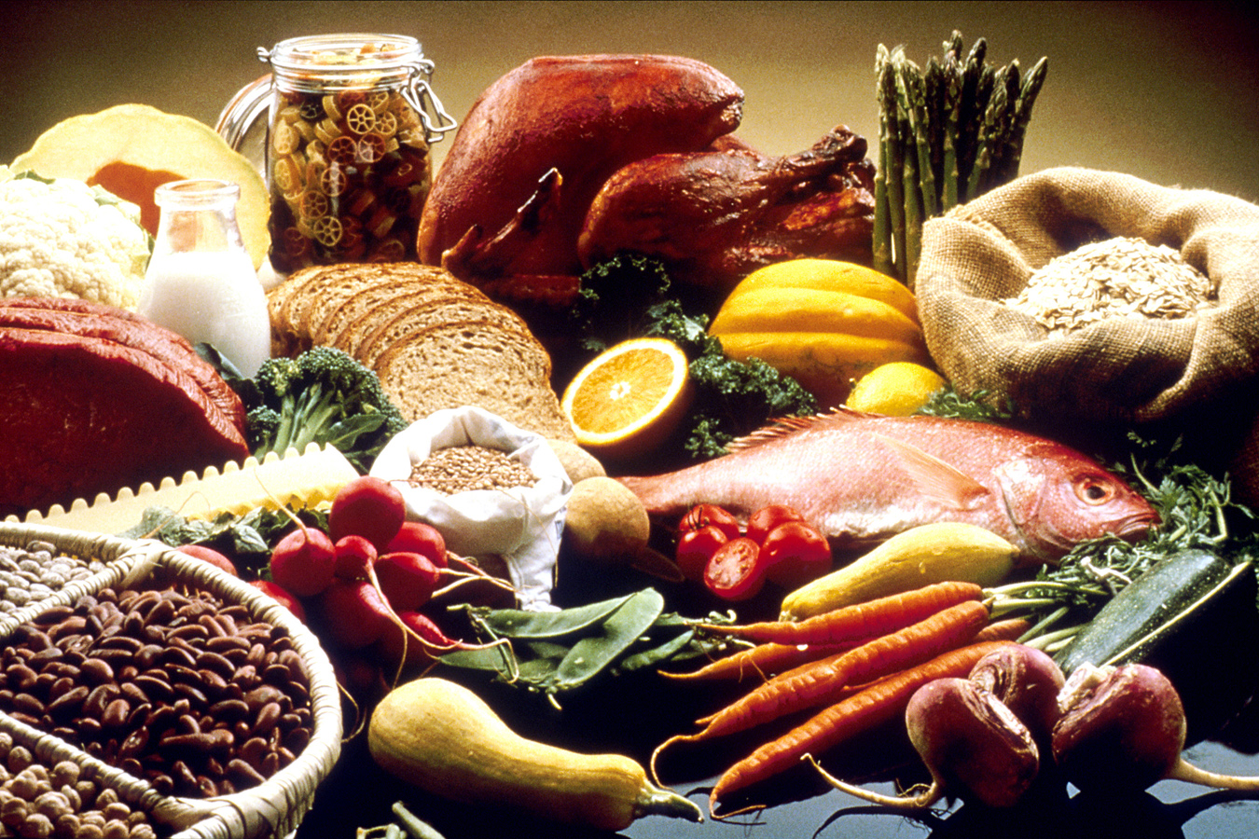
Eat
more
nutrient-
dense
foods
Photo courtesy of National Cancer Institute

Slide 54
10. Based on the DGA 2010, which foods should Americans INCREASE?
Whole grains
Vegetables
Fruits
Dairy
Seafood
Oils
All of them should be increased

Slide 55
10. Based on the DGA 2010, which foods should Americans INCREASE?
Whole grains
Vegetables
Fruits
Dairy
Seafood
Oils
All of them should be increased

Slide 56
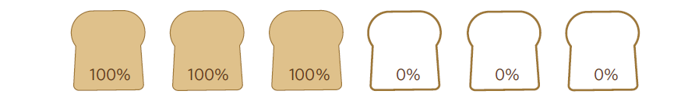
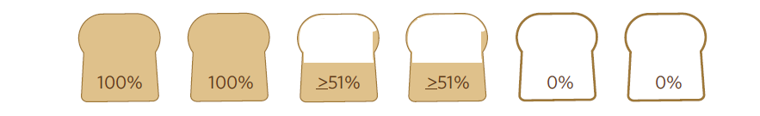
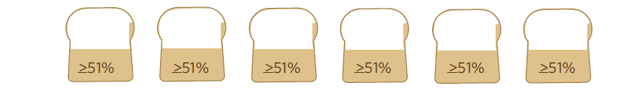
3 ways to eat half whole grains
(1) 3 oz. of 100% whole grains and 3 oz. of refined-grain products
(2) 2 oz. of 100% whole grains, 2 oz. of partly whole-grain products, and 2 oz. of refined grain products
(3) 6 oz. of partly whole-grain products

Slide 57



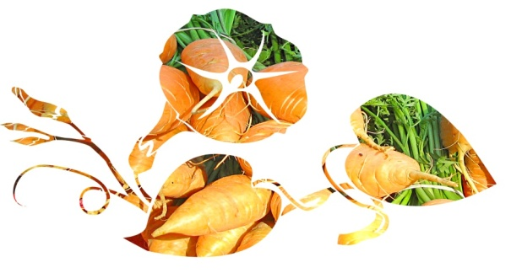

Pick a variety of vegetables from each
of the DGA 2010 vegetable subgroups
Red & orange
Beans & peas
(legumes)
Starchy
Dark-green
Other
57

Slide 58
Eat seafood in place of some meat and poultry.
Women who are pregnant or breast-feeding should consume 8-12 ounces of seafood per week from a variety of seafood types.

Slide 59
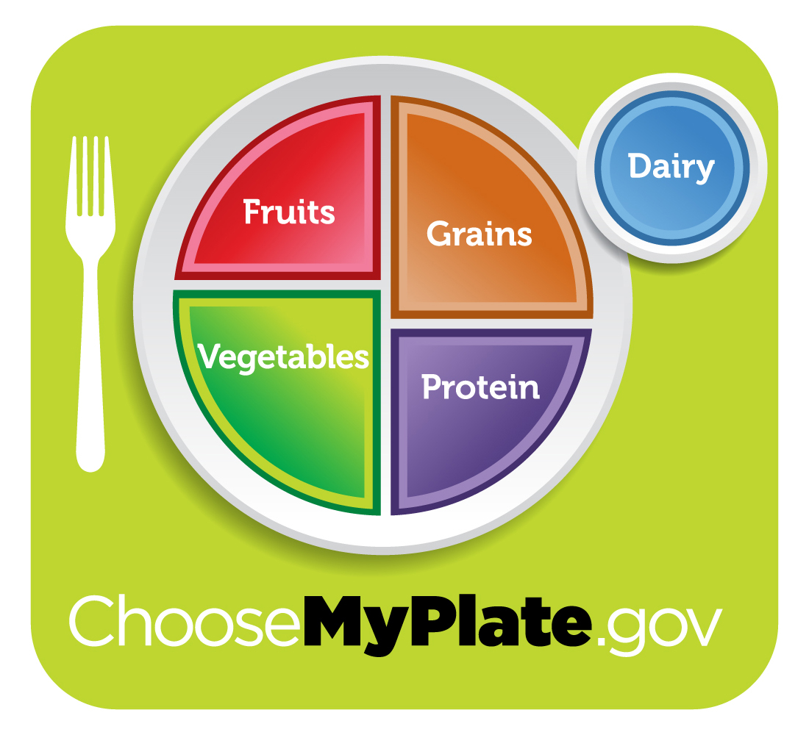

Slide 60
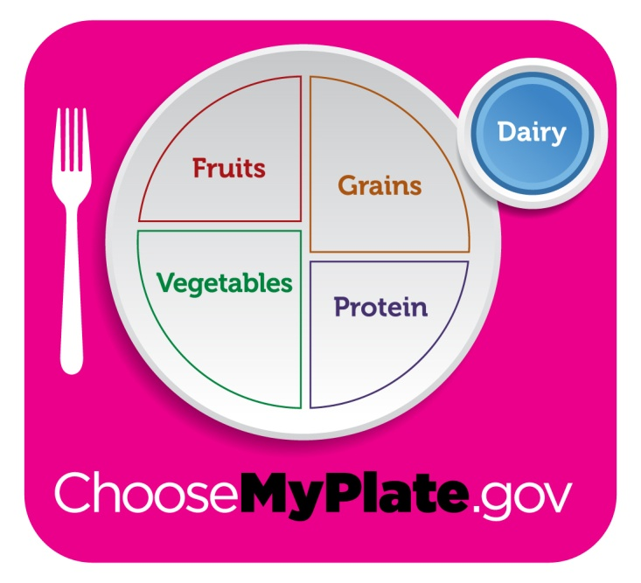
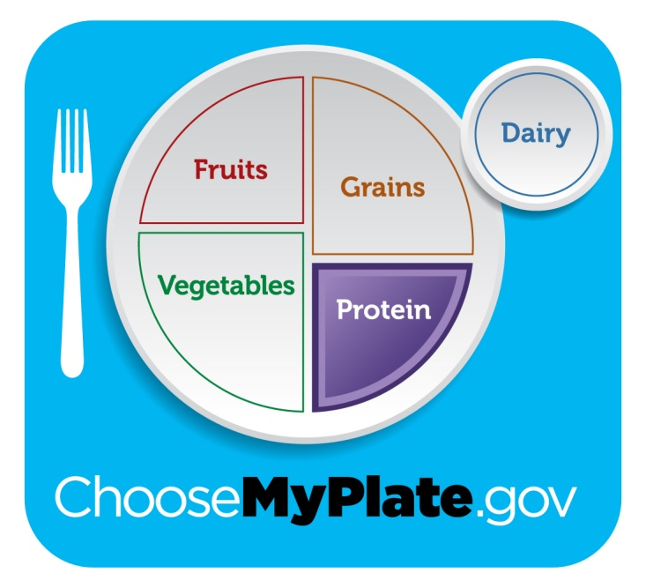
Milk group is now the Dairy group.
Fortified soy beverages are included.
Meat & Beans group is now called Protein Foods

Slide 61
Take Home Messages

Slide 62
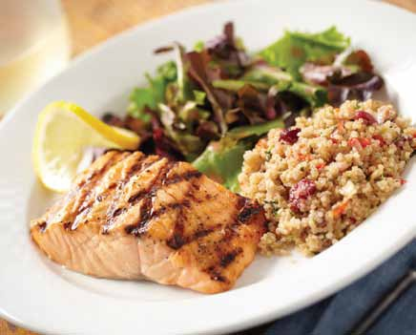
Balancing Calories
Enjoy your food, but eat less.
Avoid oversized portions.

Slide 63
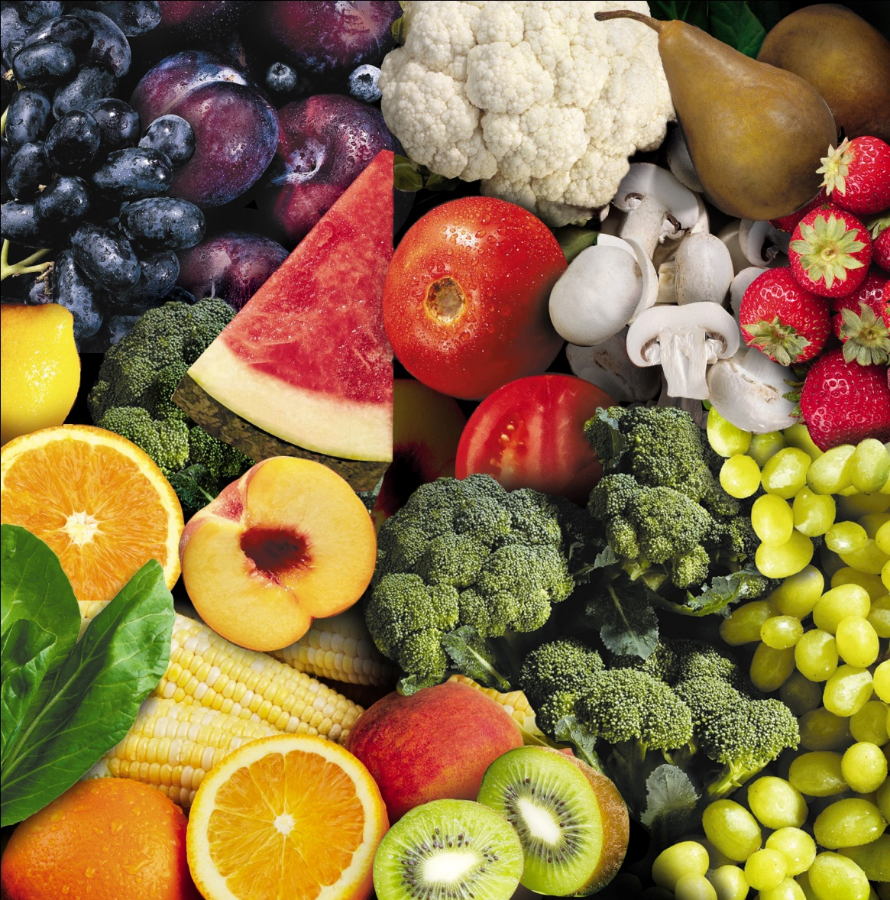
Foods to Increase
Make half your plate
fruits and vegetables.

Slide 64
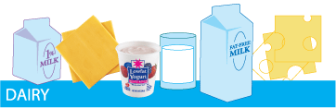
Foods to Increase
Switch to fat-free or low-fat (1%) milk.

Slide 65
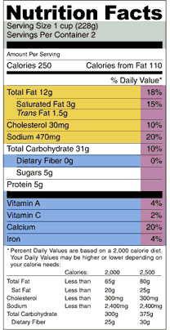
Foods to Reduce
Compare sodium in foods like soup, bread, and frozen meals – and choose the foods with lower numbers.

Slide 66

Foods to Reduce
Drink water instead of
sugary drinks.

Slide 67
What will you change this week?
Decide what you will change.
Write it down.
Tell someone.
Try it out.
Adjust if necessary.
Keep track of your success.
Reward yourself.

Slide 68

Questions?
“The greatest
wealth is
health.”
~Virgil

Slide 69

Selected slides were compiled and adapted from:
USDA Center for Nutrition Policy and Promotion
and
University of Nebraska – Lancaster County Extension
by
Linda B. Bobroff, Ph.D., RD, LD/N
Professor, Dept. of Family, Youth & Community Sciences
University of Florida
2011

