Slide 1
An Overview of UF-IFAS Programs for Small and Mid-Sized Farms
Danielle Treadwell
Associate Professor and State Extension Specialist, Organic Vegetable Production
Horticultural Sciences
ddtreadw@ufl.edu
Bob Hochmuth
Multicounty Extension Agent, Vegetable Production, Suwannee Valley Agricultural Extension Demonstration Unit
Live Oak, FL
bobhoch@ufl.edu

Slide 2
What is Extension?
Extension is a partnership between state, federal, and county governments to provide scientific knowledge and expertise to the public. The University of Florida (UF), together with Florida A&M University (FAMU), administers the Florida Cooperative Extension Service.
Extension BRINGS THE UNIVERSITY TO THE PEOPLE

Slide 3
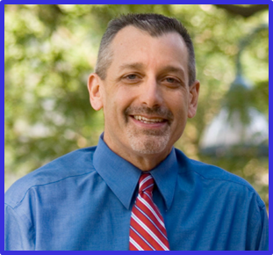
UF/IFAS Extension Administration Office
UF/IFAS Extension encompasses thousands of Extension faculty members, scientists, educators, administrative staff, and volunteers, all working to provide solutions for your life.
Nick Place, Ph.D., is the director of UF/IFAS Extension.

Slide 4
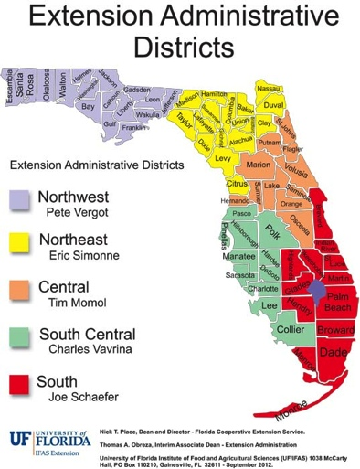

Slide 5
University of Florida
UF is now ranked 14th in the nation for the quality, impact and recognition of its teaching, research and extension programs.
57,000 students are currently enrolled
UF is a Land Grant, a Sea Grant, and a Space Grant University
U.S. land grants celebrate 150 years of extension programming via the Smith Lever Act of 1914.

Slide 6
What Types of Programs Does Extension Offer?
Socioeconomic System Programs
Demography
Culture
Markets
Regulation
Natural System Programs
Climate
Resources
Biological Factors
Farming System Programs
Energy/Materials
Info/Technology

Slide 7
How Does Extension Work?
Florida citizens contact their county office and ask for help. Faculty, staff and volunteers work collaboratively to help find solutions.
UF & FAMU provides evidenced-based, non-biased information in a variety of ways.
Programs are funded locally via the county budget, through the state budget (by way of UF) by competitive grants, or by gifts.

Slide 8
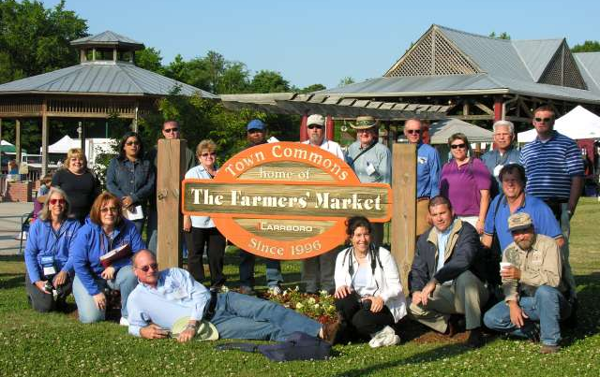
Be Aware of Your Local Extension Programs
Stay connected to your local Extension faculty
Diverse offerings of educational outreach
Newsletters/mailing lists
Web sites
Calendar of
events

Slide 9
Who are these Florida Small Farm folks anyway?
Over 90% of Florida’s 47,463 farms are “small farms”
Florida, only eastern state not consistently losing farm numbers
USDA definition, $250,000 gross receipts
Primary income - Part-Time
Lifestyle - Retirement
15% of agricultural receipts from small farms
89% (2007) $100,000 or less
2002-2007, 8% more farms in Florida, all small farms

Slide 10
What Specific Programs are Offered for Small and/or Beginning Farms?
Business and Financial Planning (Annie’s Project, Enterprise Budgets)
Community Supported Agriculture (CSA)
Farmers’ Markets (Market Rules, Insurance)
Regulatory Compliance (Building Your Farm’s Food Safety Plan; Direct Marketing/Cottage Food)
Production (Irrigation School, IPM, Variety Trial Results, Postharvest Handling, Organic)
Marketing (FL Market Maker/Florida Food Connect, Farmer’s Market Manager Training, Social Media)

Slide 11
What Specific Programs are Offered for Small and/or Beginning Farms?
Distribution (Various Food Systems Programs)
Livestock and Forages (Large and Small)
Crops (Agronomics, Flowers & Foliage, Fruits & Nuts, Herbs, Hydroponics, Aquaponics, Vegetables, etc.)
Forest Products (Forestry, Tourism, Wildlife & Hunting)
Freshwater Aquaculture & Farm Ponds (Weed Management, Fish Production, Pond & Lakefront Revegetation, etc.)
Alternative Enterprises (Beekeeping, Cane Syrup, Mushrooms, Renewable Energy, Worms, etc.)

Slide 12
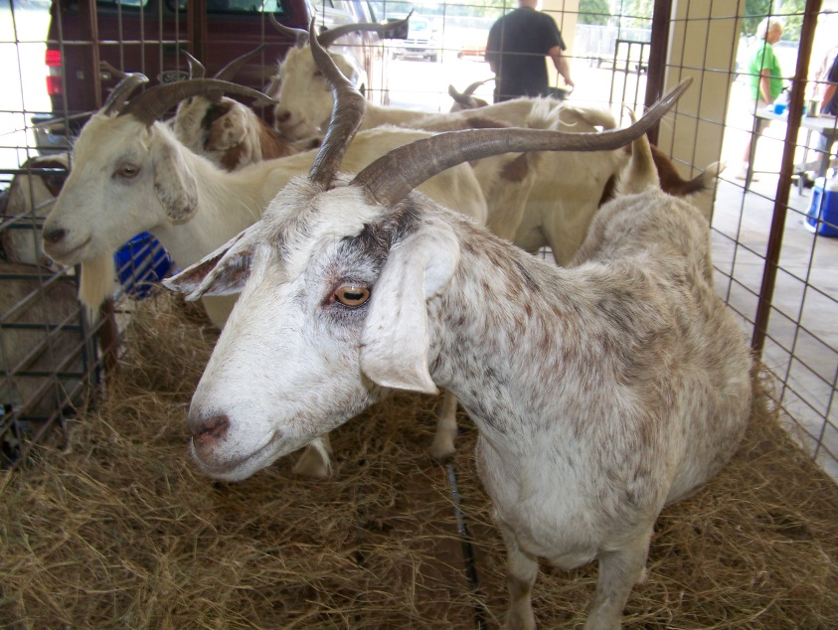
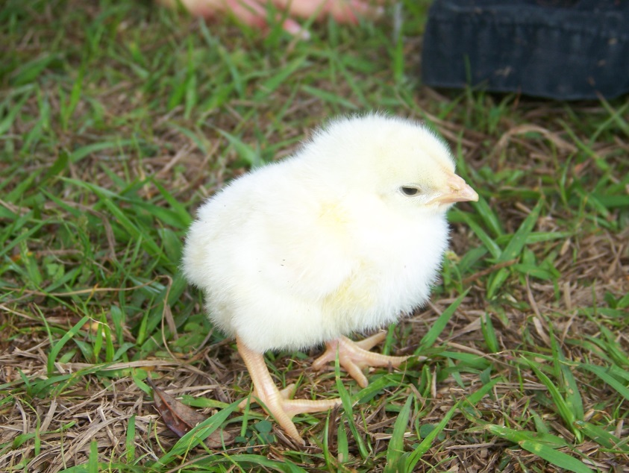
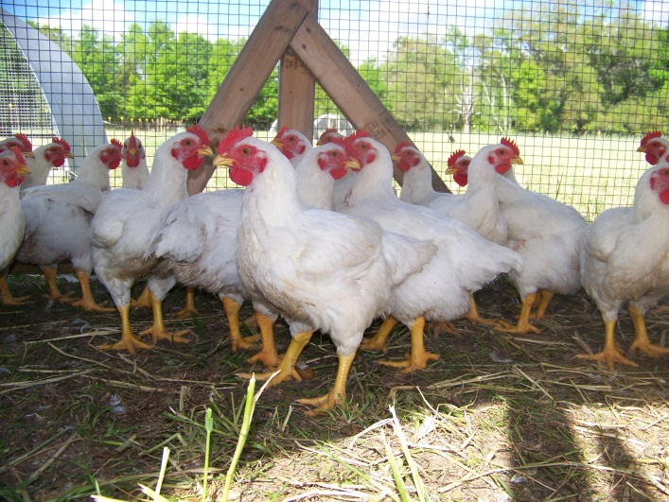
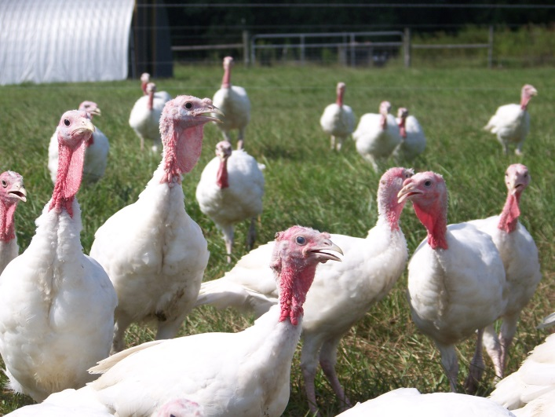
Livestock

Slide 13
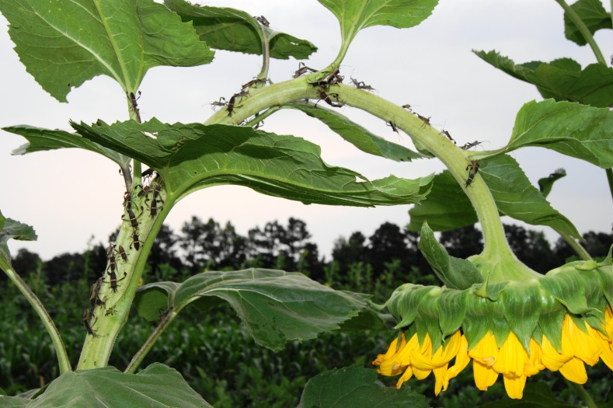
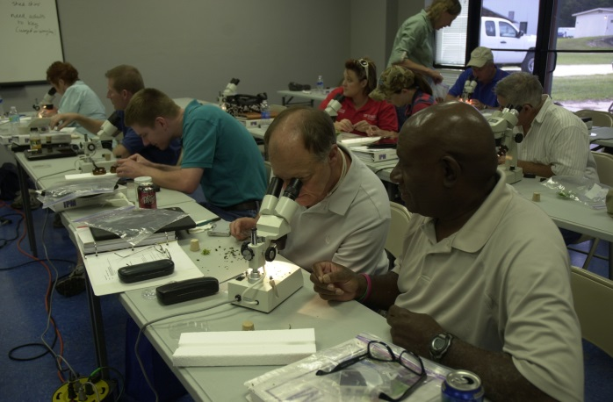
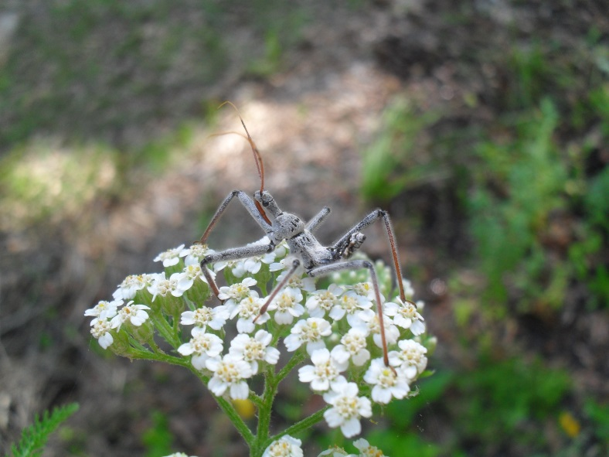
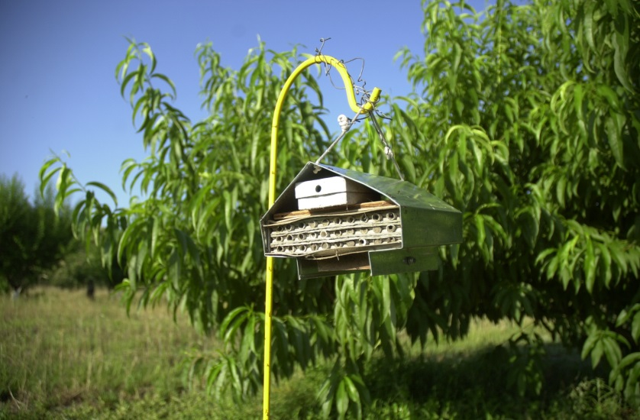
Integrated Pest Management (IPM)

Slide 14
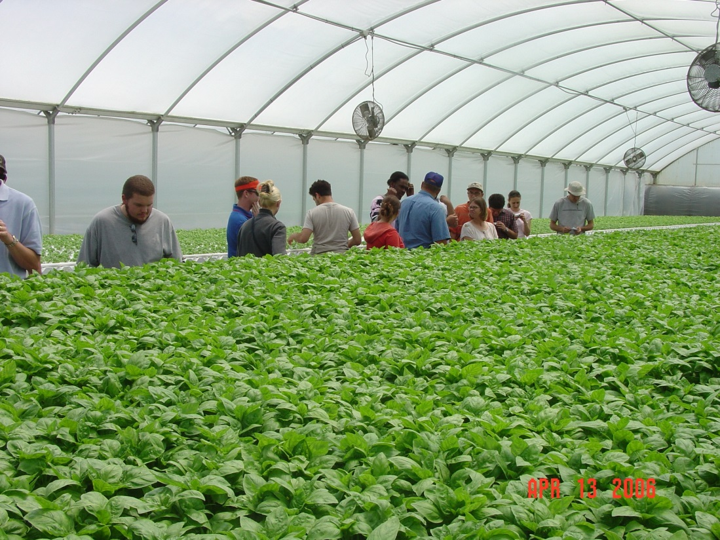
Regional UF/IFAS & FAMU Efforts
Regional SF&AE Conferences State Conference
Several locations
Small farms working groups
Relatively new
Northeast
Southwest
Indian River

Slide 15
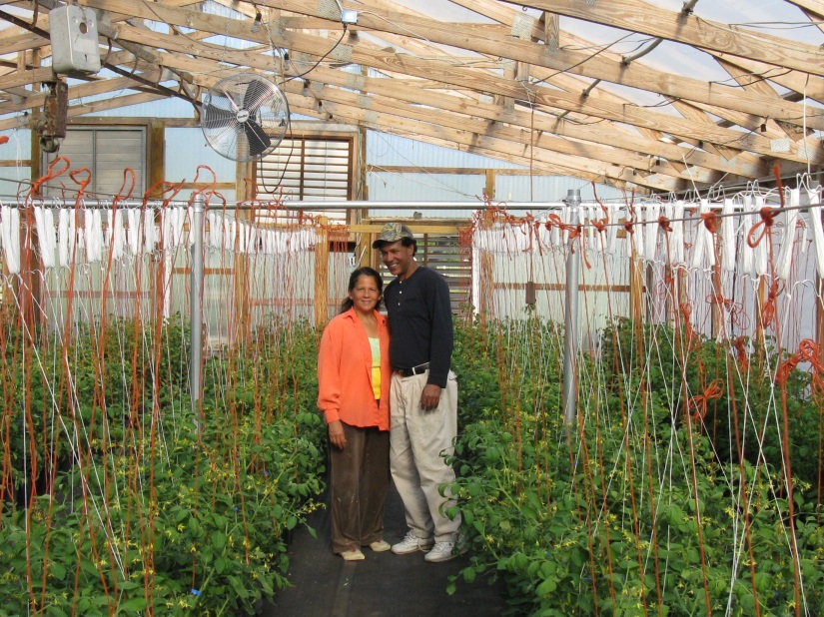
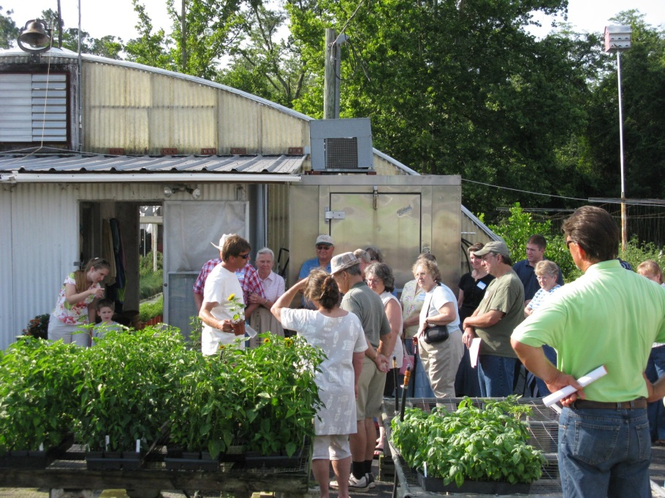
Networking with Other Small Farmers is Very Popular

Slide 16
Regional Small Farms and Alternative Enterprises Conferences
Wide variety of formats, audience sizes, and topics determined by local planning committees.
Typically over 2,000 participants annually
Calendar of conferences and events posted on Small Farms web site
http://smallfarms.ifas.ufl.edu/events_calendar.html

Slide 17
Florida Small Farms and Alternative Enterprises Conference
Started in 2009
Five years of successful conferences
Held in Kissimmee—Osceola Heritage Park
700+ attendees annually
Farm Tours (Livestock, Horticulture, Aquaculture)
Concurrent educational sessions
Air-conditioned livestock arena
Large industry trade show/exhibits
Educational posters
Meals feature Florida small farm products prepared by Chefs
Saturday Evening Networking Social

Slide 18
Web-Based Information
UF/IFAS and FAMU Small Farms and Alternative Enterprises Web Site
Virtual Field Day site
http:// smallfarms.ifas.ufl.edu
2 million hits annually
Front page featuring important news and events
17 topic teams
Calendar of events
Featured farmers
Links-EDIS documents, Virtual Field Days
http://vfd.ifas.ufl.edu
Short video modules
Often “How To” videos
Very popular for new and prospective growers
Topics
Hydroponics
Drip irrigation
Organic production
Fruit crops IPM
Pastured poultry

Slide 19
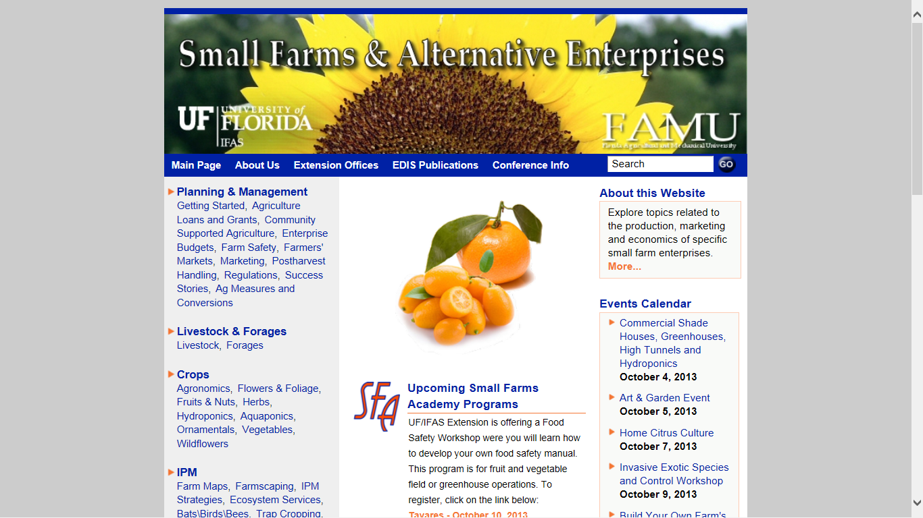

Slide 20
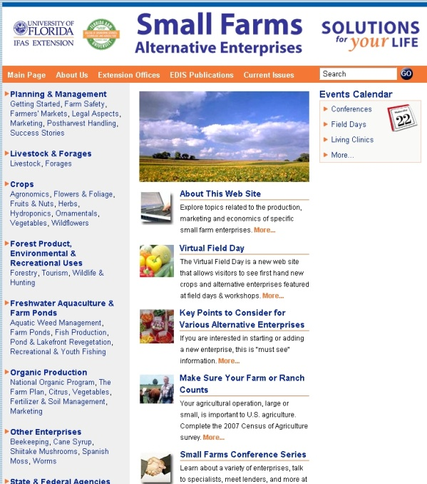
Solutions on the Web from UF/IFAS and FAMU Extension

Slide 21
Video Modules on Virtual Field Day
http://vfd.ifas.ufl.edu

Slide 23
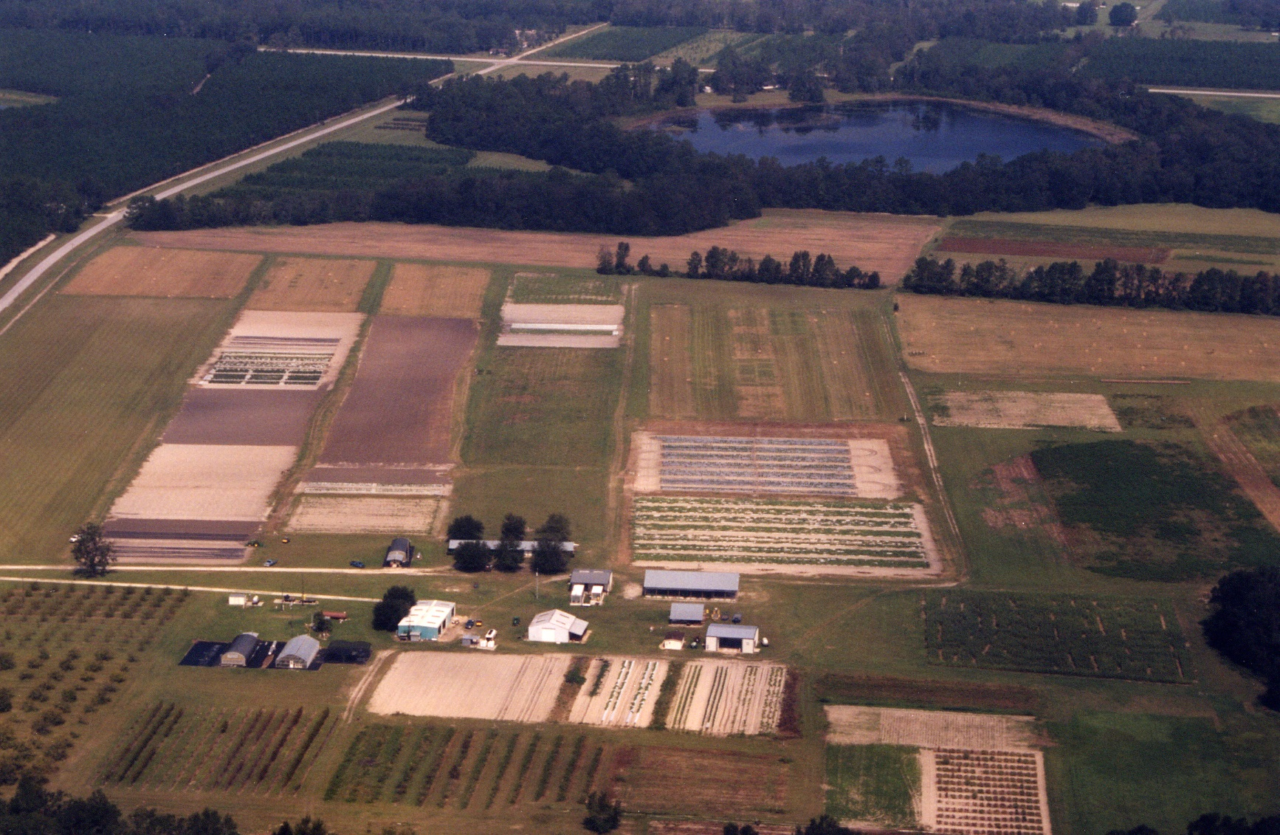

Slide 24
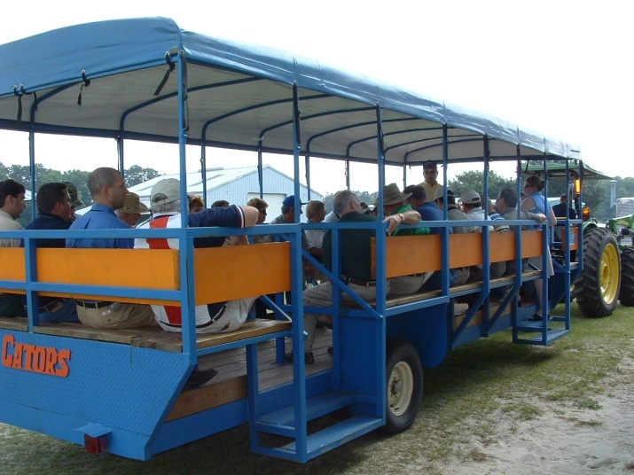
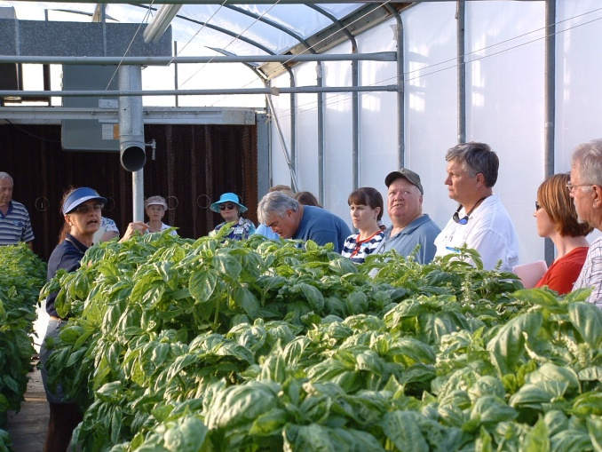
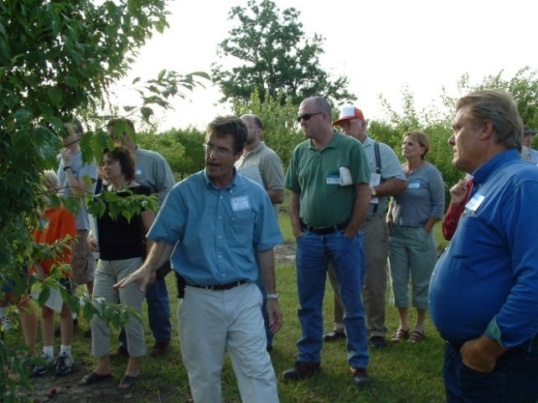
Lots of New Interest in Alternative Enterprise Field Days & Workshops

Slide 25
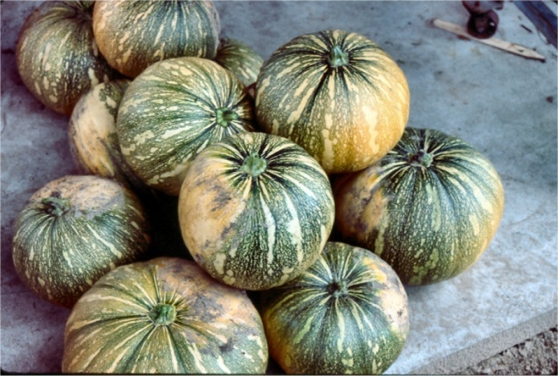
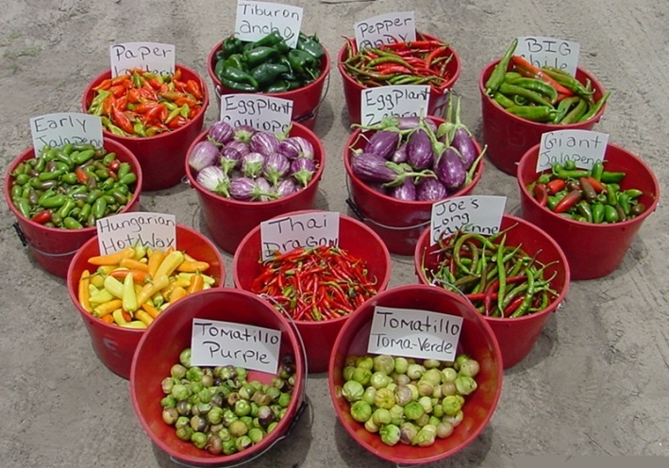
More Interest in Specialty Field Vegetable Trials- Hard to Find
Specialty Peppers
Specialty Lettuce
Calabaza
Specialty Eggplant
Specialty Watermelons

Slide 26
“Separating Yourself from the Pack” Specialty Crops
Sweet Corn
bi-color
supersweet
Tomato
grape
plum
heirloom
Cantaloupe
green fleshed
Watermelon
seedless
palm sized
ice box
Squash
calabaza
spaghetti
yellow zucchini
miniature
squash blossoms
Greens
mixed greens
specialty mixes
summer greens
Peppers
colored bells (red, yellow, orange)
cubanelle
hot peppers
jalapeno
cayenne
poblano, anchos
southwestern chile

Slide 27
Specialty Vegetables, Strawberries & Herbs

Slide 28
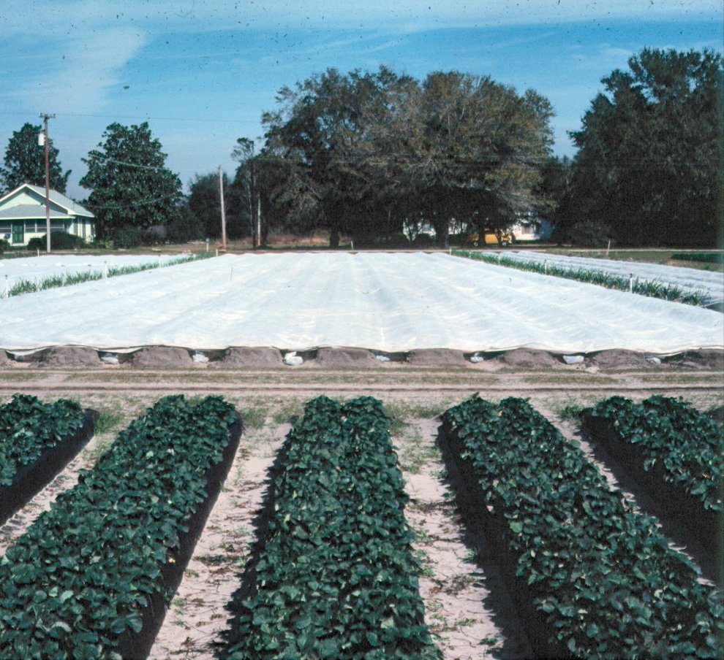
Role of Technology Very Important in Vegetable Production

Slide 29
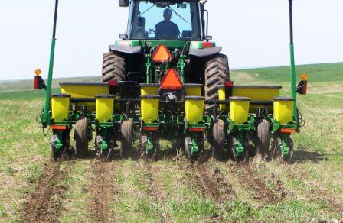
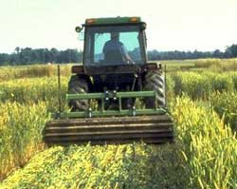
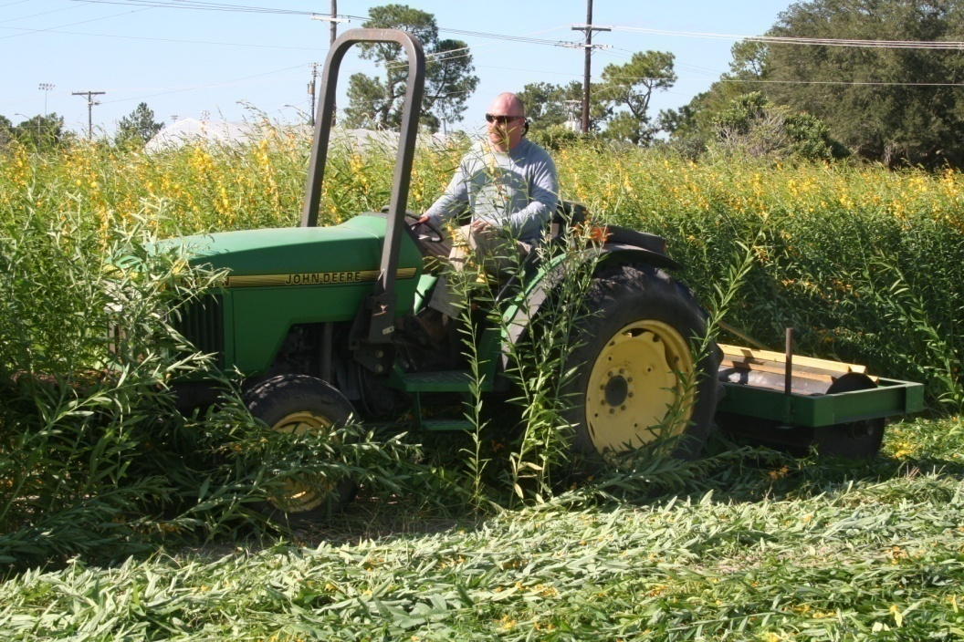
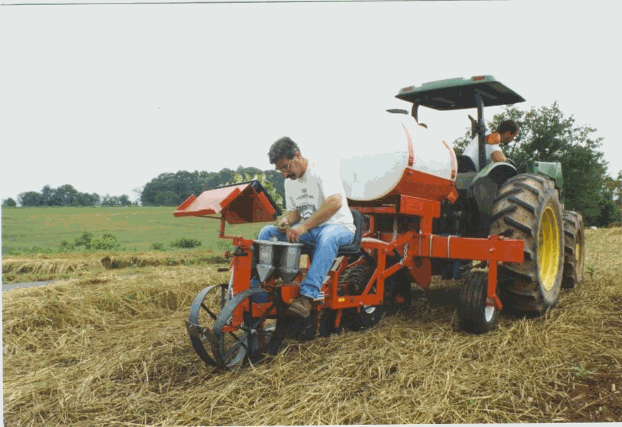
Conservation Tillage

Slide 30
Examples of Technologies and Materials
Plastic Mulch And Drip Irrigation
Irrigation For Freeze Protection
Frost Covers, Row Covers
Low Tunnels
High Tunnels, Walk-in Tunnels, Hoop Houses
Temporary Covers and Microjets
Shade Culture
Screening for Pest Exclusion
Greenhouses (heating, cooling, shading, etc)

Slide 31
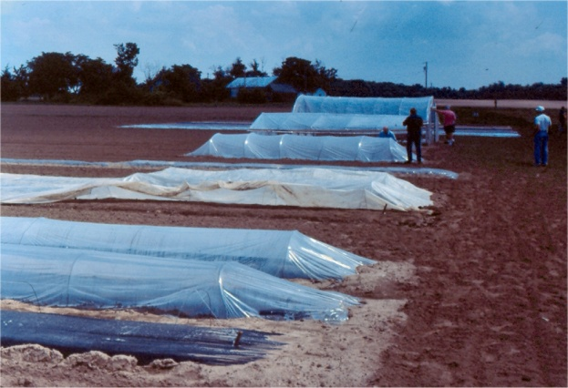
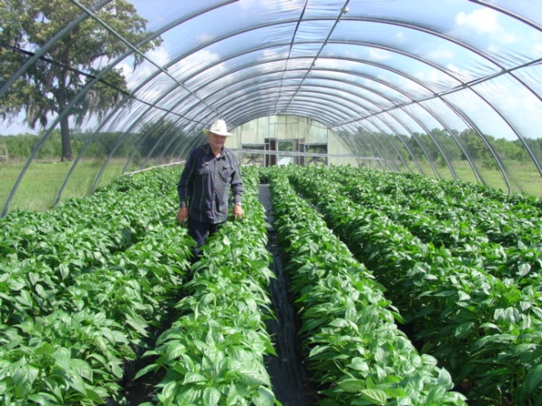
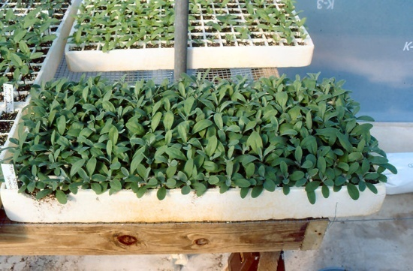
Season Extension
Frost Protection
Row Tunnels
Shade Area
Walk-in Tunnels
Crop & Variety Selection
Transplants

Slide 32
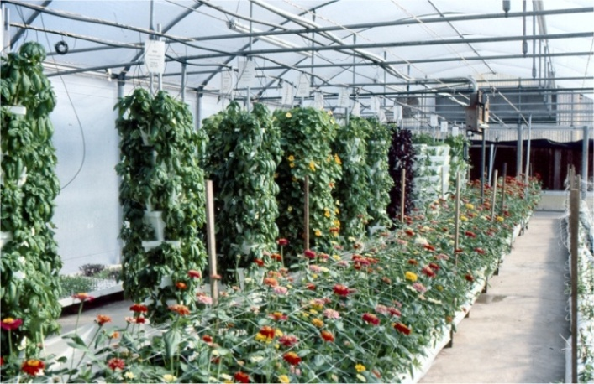
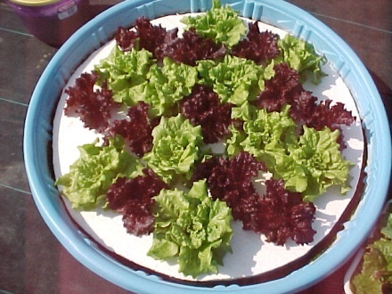
Florida Hydroponic Production Systems and Media
Perlite (layflat bags, Bato buckets, pots)
Rockwool
Composted Pine Bark
Nursery Mixes
Coconut Coir
Floating Systems
Nutrient Film Technique

Slide 33
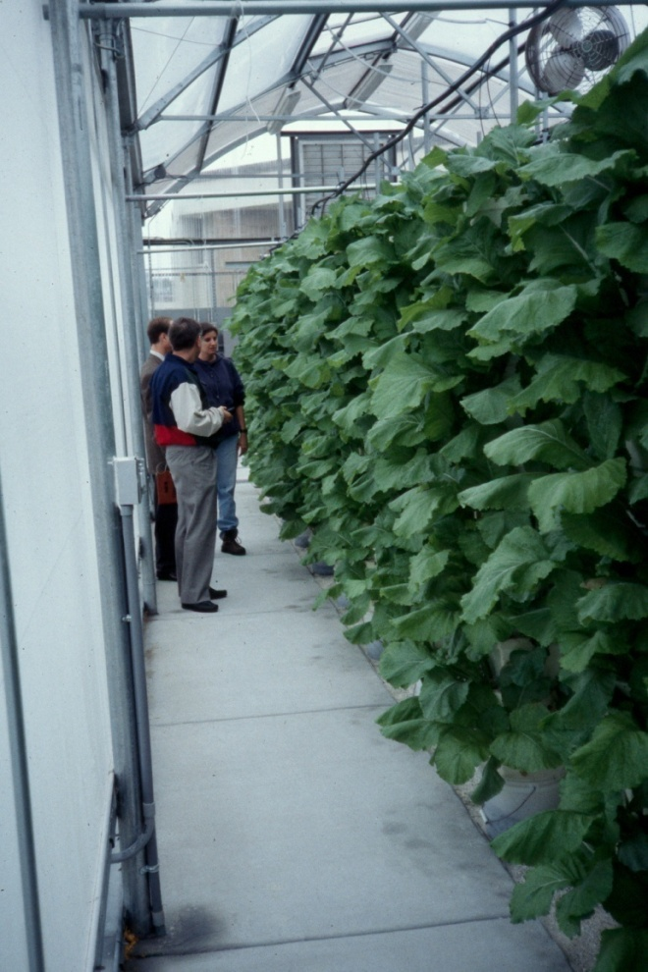
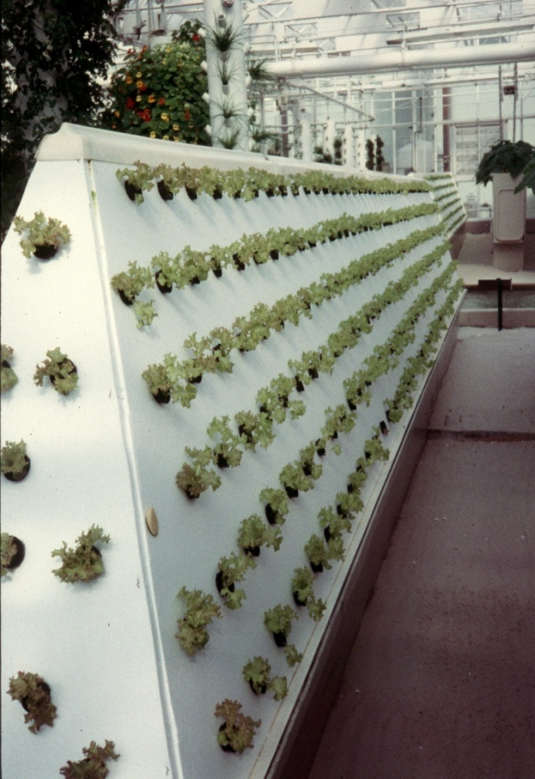
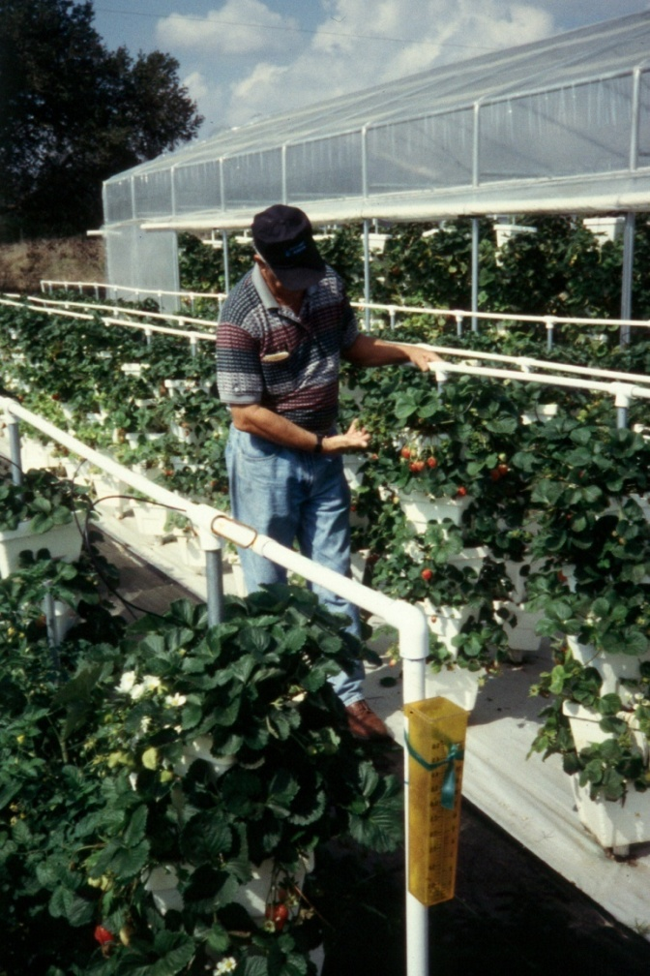
Vertical Systems

Slide 34
Organic Systems
USDA Certified Organic systems are located across the state; typically farmers market products directly to consumers, but some large farms such as Lady Moon Farms ship throughout the SE US.
Production recommendations are located on the Small Farms and Alternative Enterprises website as well as on the Virtual Field Day website.

Slide 35
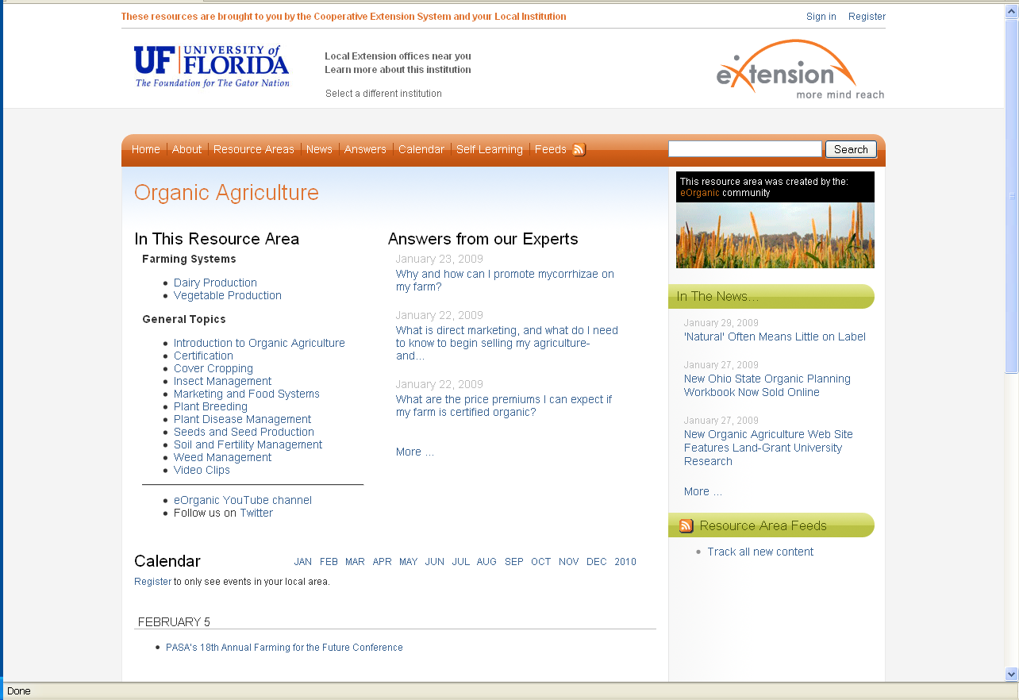
Organic Agriculture on eXtension

Slide 36
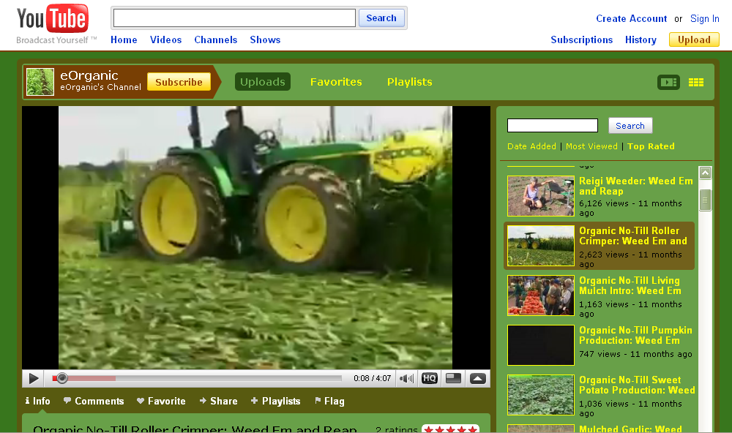
eOrganic’s You Tube Channel

Slide 37
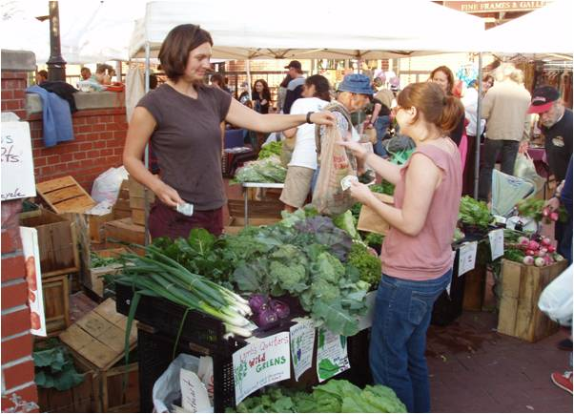
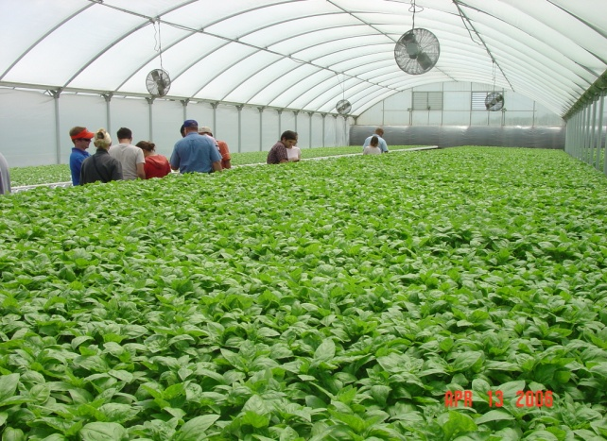
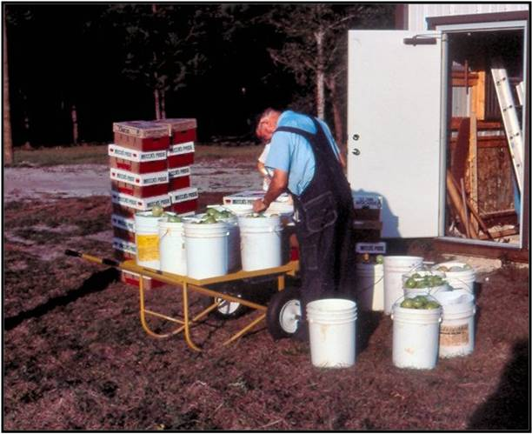
Food Safety Background
Florida growers (small, medium, or large) had an increased awareness of the need for food safety plans
Recent food borne outbreaks increased pressure from buyers to implement food safety plans
Florida has a large number of fruit and vegetable farms (44,000 small farms in FL)
Largest farms were early adopters of programs on their own. Small and medium sized farms do not have the resources and requested help from Extension

Slide 38
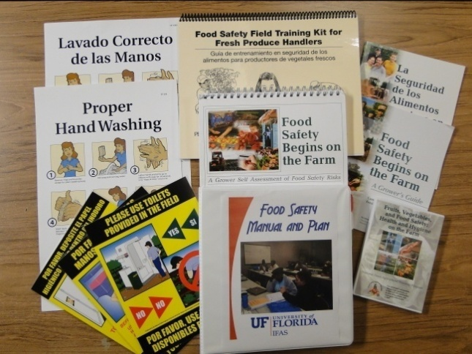
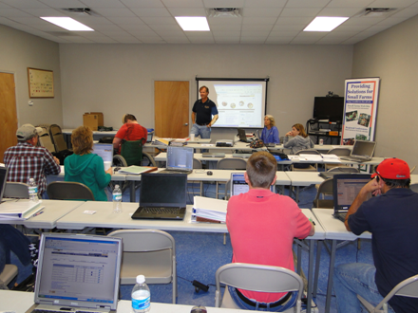
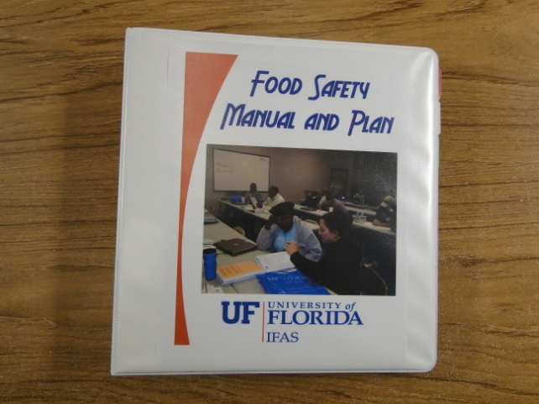
Program Objectives
Develop a training program for small and medium sized farms to be able to develop food safety plans and manuals for their own farm.
Implement an in-service training program for Extension Agents that would result in a statewide Extension Small Farms Food Safety Implementation Team.

Slide 39
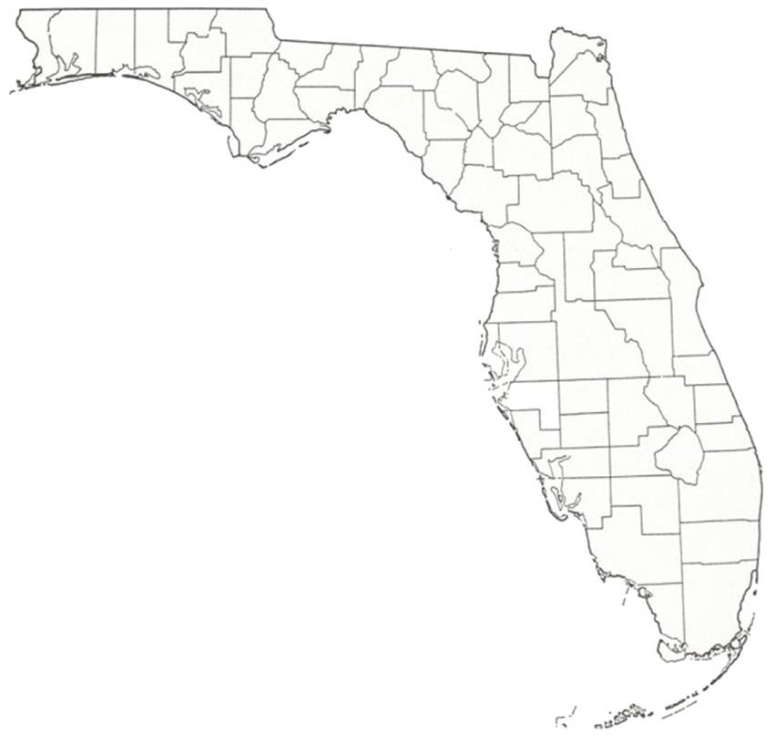
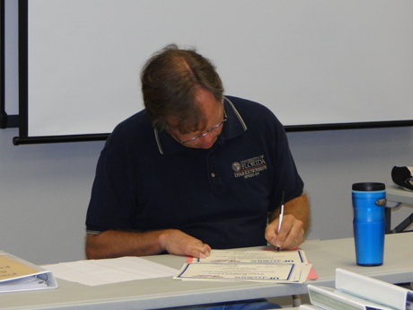
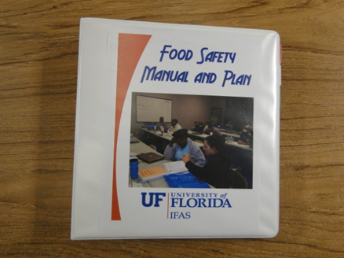
Program Activities
Strategize a program plan
Secure grant funding for educational materials, training and 10 lap top computers
Develop partnerships with FL Extension Specialists (Drs. Schneider, Treadwell, Galindo)
Develop curriculum and learn to use web tool (Primuslabs.com)
Offer “Build Your Own Food Safety Manual” workshops

Slide 40
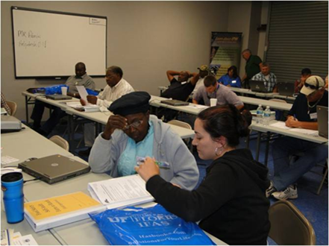
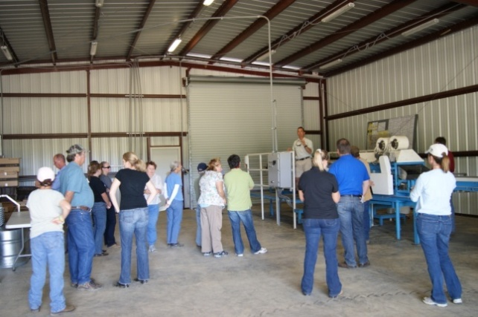
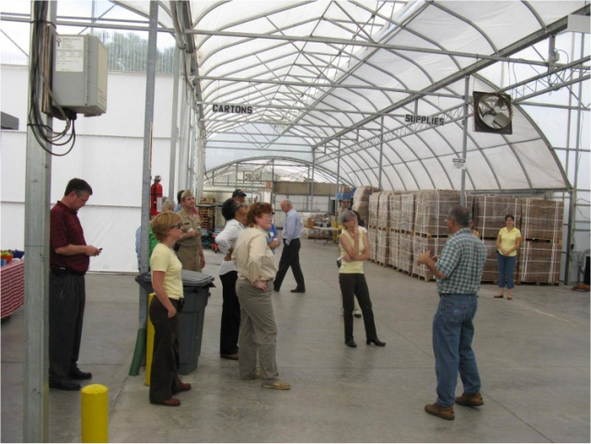
Program Activities
4. Develop the Extension Small Farm Food Safety Implementation Team
5. Offer Food Safety Farmer Field Day, “Taking the Mystery Out of a Food Safety Audit”
6. Affiliated activities
Host FDA Tours
Host USDA/FDA Food Safety Listening Sessions

Slide 41
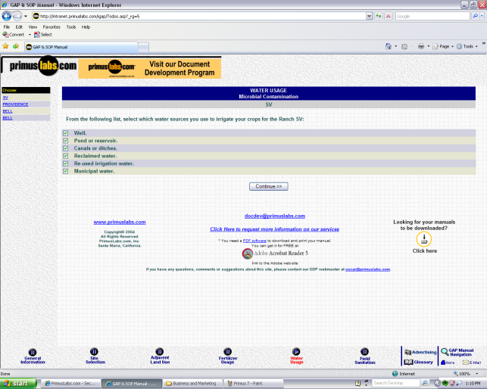
Teaching Methods

Slide 42
Evaluation Methods
State Extension Specialist for Program Evaluation, supported as part of grant to develop evaluation methods
Evaluation tool developed for on-line completion
Content questions for evaluation tools provided by Extension Agents
Used to measure knowledge gained, plans to adopt practices, and perceptions of training

Slide 43
Results
Implementation Team has offered 20 workshops at 10 locations.
Locations
Live Oak (6)
Jay (4)
Kissimmee (2)
Bushnell (2)
Marianna
Madison
Bartow
Starke
Gainesville
St. Augustine

Slide 44
Results
185 producers and packers participated
Supporting materials provided from grant funds, total value: $27,750
CORE Pesticide CEUs were provided in main trainings, also food safety topics (CEUs) are now routine in grower meetings
19 Extension agents participated in IST workshop to form Extension food safety implementation team, 12 offered trainings in their counties in first year
Increased level of competence of Florida County Extension Faculty

Slide 45
Impacts
Based on evaluations, farmers valued the food safety trainings offered, viewed food safety plans as very important, and plan to implement a program on their farm.
92 farmers planned to have a third party, customer, or regulatory audit conducted.

Slide 46
Florida Farm to School
Department of Education to FDACS
Partnership with UF/IFAS – Statewide Team and District Coordinators
GOAL: UF-IFAS will work in partnership with FDACS to engage farmers, state and federal agencies, land grant institutions, school food authorities, and families through facilitated discussion, training and technical support leading to a successful Florida Farm to School Program.

Slide 47
Florida Farm to School Scope of Work

Slide 48
UF/IFAS Farm to School Team
The Team: Danielle Treadwell, Karla Shelnutt, Lauren Headrick, Anna Prizzia, Sebastian Galindo, Glenn Israel, Tiffany Freer, Adam Watson and Chef David Bearl
Northeast, Duval:
Maxine Floyd
Northwest, Escambia: Christina Walmer
Central District, Flagler:
Amy Warwick
South Central, Sarasota:
Zach Glorioso
South, Broward:
Beth Alexis

Slide 49
UF-IFAS Suwannee Valley Agricultural Extension Center
7580 County Road 136, Live Oak, FL 32060
Visit the Florida Small Farms Website at http://smallfarms.ifas.ufl.edu

