Slide 1
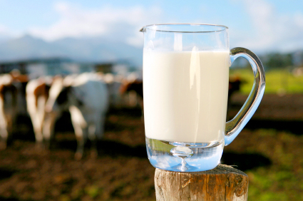
Milk and Milk Substitutes

Slide 2
Health Benefits
Bone Health
Milk contains: calcium, phosphorous, magnesium and protein all essential for healthy bone growth, development and maintenance
Type 2 Diabetes
Research suggests that regular consumption of low fat dairy products (including milk) may help to reduce the risk of type 2 diabetes.

Slide 3
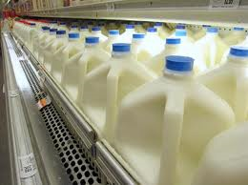
Fat Content of Milk
Weight Maintenance
By choosing low-fat or skim milk, you can receive the nutritional benefits of milk without the excess calories and saturated fat.

Slide 4
Fat Content of Milk
Cow’s Milk | Fat (g / 8 oz glass)
Whole milk | 8
Reduced-fat (2%) milk | 5
Low-fat (1%) milk | 2.5
Skim Milk | 0

Slide 5
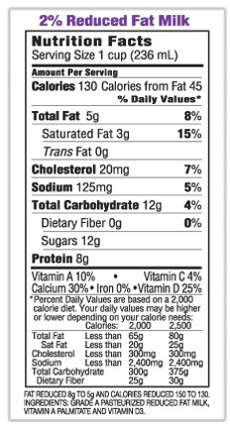
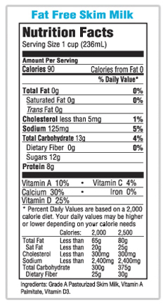
Cow’s Milk
Notes:
Note: that the nutrient content really only differs for the fat. Other nutrients remain similar.

Slide 6
Health Benefits
Hydration
Provides a source of water and essential nutrients
Rehydrates the body
Dental Health
Casein - protein in milk
Casein forms a film on the
enamel surface which prevents
loss of calcium and phosphate

Slide 7
Health Benefits
Cardiovascular Health
Dairy and milk intake may reduce the risks of cardiovascular disease
Blood Pressure
Consuming low-fat dairy
(3 servings/day), with fruit and vegetables
(5 servings/day) as part of a low sodium
diet may reduce high blood pressure (DASH Diet)
Thought to be due to milk’s calcium and potassium content

Slide 8
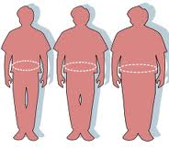
Health Benefits
Obesity
Individuals that regularly consume milk and dairy are less likely to be obese
Cancer
Milk may provide a protective effect on risk of colorectal and breast cancer with increased intakes

Slide 9
Cows Milk- Cancer
Cows milk contains conjugated linoleic acid (CLA)
CLA has anti-carcinogenic properties and provides cancer protection in animal models
Range of CLA levels from 2.4 to 18 mg CLA/g of milk fat – the wide variation in cows’ CLA levels are partly the result of differences in diet and grazing practices

Slide 10
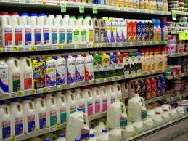
Cow’s Milk
There's a variety of milk products in the market.
Some types of milk meet your needs better than others based on specific health conditions or preferences.

Slide 11
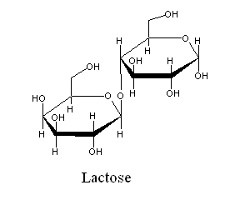
Lactose-free milk
Some people lack the enzyme needed to digest the milk sugar, lactose. These people may have unpleasant digestive symptoms after drinking milk that may include:
Abdominal cramping
Abdominal bloating
Gas
Diarrhea
Nausea

Slide 12
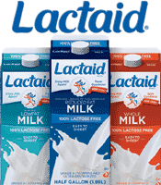
Lactose-Free Milk
Lactase enzymes may be added to regular milk to make it easy to digest
Some brands, such as Lactaid®, offer milk products with this enzyme added
lactose is broken down into smaller sugars so the milk may taste sweeter

Slide 13
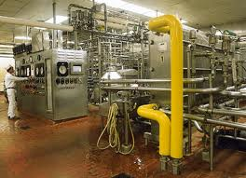
Raw Milk
Raw milk is milk that has not been pasteurized
Pasteurization is a heating procedure used to kill harmful bacteria in dairy products

Slide 14
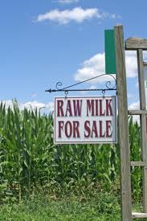
Raw Milk
Both raw and pasteurized milk have the same nutritional value, but the bacteria in raw milk may cause a variety of foodborne illnesses.
Listeria monocytogenes
Salmonella enterica
Yersinia enterocolitica
Campylobacter jejuni
Staphyloccus aureus
Escherichia coli 0157:H7

Slide 15
Raw Milk
Between 1998 and 2008, the Centers for Disease Control and Prevention (CDC) reported raw milk was the cause of:
1,614 illnesses
187 hospitalizations
2 deaths
(U.S. Food and Drug Administration [FDA], 2011)

Slide 16
Raw Milk
The sale of raw milk is currently legal in 29 states
Florida only permits the sale of pasteurized milk for human consumption
However if labeled accordingly, raw milk can be sold as animal feed (Florida Legislature, 2011).

Slide 17
Organic Milk
Milk may be labeled as organic if the animal is:
not treated with hormones or medications
is fed only organic feed
and is allowed enough grazing time
If milk is produced according to standards set by the
USDA National Organic Program, it will carry the
Seal.

Slide 18
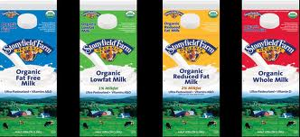
Organic Milk
Same nutrient content as non-organic milk
Production must comply with the same safety standards
No known health benefits of drinking organic milk over non-organic milk
Cost comparison?

Slide 19
Goat’s Milk
Used as an alternative to cow's milk in many countries
Was once thought that goat's milk may be beneficial for people with an allergy to cow's milk
contains different proteins than cow's milk
Studies have found that goat's milk is also highly allergenic
is not a good substitute for most people with a known allergy to cow's milk

Slide 20
Goat’s Milk
Nutrient content slightly different than cow’s milk
More easily digested?
Fat molecules are smaller – research is needed
Goat's milk contains the sugar lactose
may cause digestive upset in people with lactose intolerance.

Slide 21
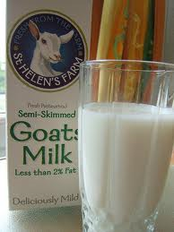
Goat’s Milk
Higher fat content
Goat’s milk has 10 g of fat per cup vs Cow’s milk (whole) 8 g of fat per cup

Slide 22
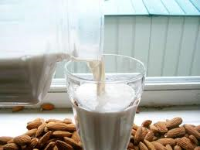
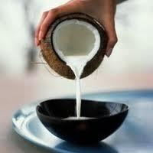
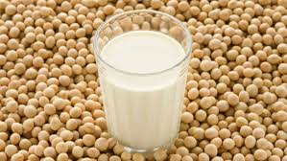
Plant-Based Milks
Soy Milk
Rice Milk
Almond Milk
Coconut Milk

Slide 23
Soy Milk
Made from soybeans
It may be a healthy alternative to cow's milk for many people
Contains about the same amount of protein as cow's milk, but the protein quality is a bit lower than that of cow's milk
Safe for many people with an allergy to cow's milk because it lacks the protein casein etc.

Slide 24
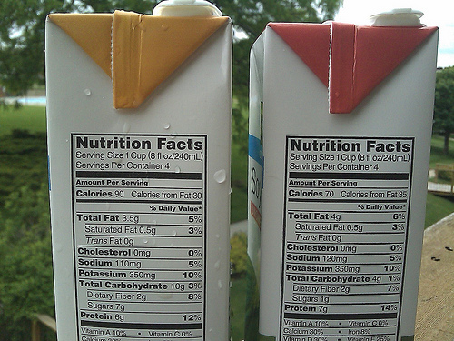
Soy Milk
Soy protein may help decrease blood cholesterol and reduce your risk for heart disease
Soy milk
No cholesterol
Low in saturated fat
No lactose

Slide 25
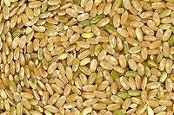
Rice Milk
Made from rice grains
Appropriate for people with lactose intolerance or a cow’s milk allergy
Very different nutrient content
Only 2.5 g of fat per cup
Low protein content - while normal cow's milk has 8 g of protein per cup, rice milk has less than 1 g per cup

Slide 26
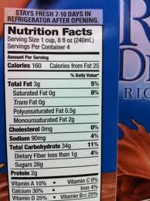
Rice Milk
Label shown in picture is
chocolate rice milk
Original flavor has 120 calories

Slide 27
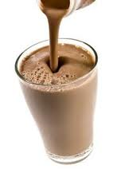
Almond Milk
Contains no: dairy, cholesterol, saturated fat or lactose
Low in calories = low in almonds
45% DV of calcium compared to cow’s milk at 30% DV for calcium
Comes in variety of flavors including: Vanilla, chocolate, unsweetened

Slide 28
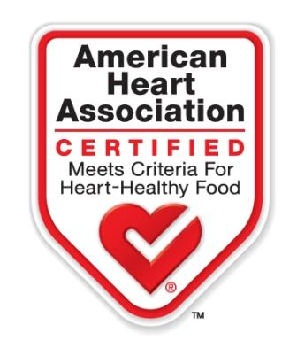
Health Benefits - Almonds
Cholesterol free
Low in saturated fat
Excellent source of vitamin E, magnesium, manganese
Good source of fiber, copper, phosphorus, and riboflavin

Slide 29
Health Benefits - Almonds
Adding almonds in combination with the American Diabetes Association-recommended diet may help improve insulin sensitivity in individuals with pre-diabetes
In 2003 the FDA released a health claim that states: Scientific evidence suggests, but does not prove, that eating 1.5 ounces per day of most nuts, such as almonds, as part of a diet low in saturated fat and cholesterol may reduce the risk of heart disease.

Slide 30
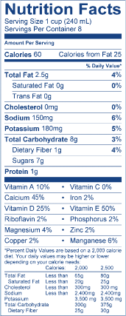
Almond Milk
Almond Milk
Notes:
Note that Almond milk is also very low in protein. Note also that if it is low in calories it must be low in almonds as almonds are energy dense.

Slide 31
Coconut Milk
1 cup = 445 kcal/cup if made from coconut meat and water!
May help raise HDL cholesterol
High in medium chain fats (60%)
Reduced fat versions are available

Slide 32
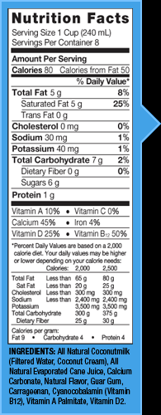
Coconut Milk
Reduced fat coconut
milk

Slide 33
Price Comparisons
All prices are based on a half gallon
Cows Milk = $2.49
Lactaid = $4.09
Silk Almond Milk = $2.50
Rice Dream = $2.29
Silk Soy Milk = $2.50
Notes:
Presenters – Please revise this slide to reflect your local, current prices.

Slide 34
References and Resources
Dahl WJ, Foster L. 2011. Shopping for health: milk. FSHN11-09. 3 pgs. http://edis.ifas.ufl.edu/pdffiles/FS/FS17000.pdf Spanish: http://edis.ifas.ufl.edu/pdffiles/FS/FS20000.pdf
http://ndb.nal.usda.gov/ndb/foods/list

Slide 35
Credits
This presentation adapted for XXXXX county and presented by:
Xxxxxxxx
Xxxxxxxx County Cooperative Extension Office
Xxxxxxxx phone number/address/email
This presentation prepared by:
Wendy J. Dahl PhD RD
Assistant Professor, FSHN
Extension Specialist
University of Florida
wdahl@ufl.edu

